Slide 1
HFCC-A RF systems plan
FERMILAB-SLIDES-25-0302-TD
November 12, 2025
Sergey Belomestnykh
SRF Frontiers Workshop
JLab, Nov 12-14,2025

Slide 2
Outline
Introduction: HFCC
HFCC-A L2 RF systems
SRF at FCC-ee and ongoing R&D
Concluding remarks

Slide 3
Introduction

Slide 4
About HFCC
In the 2023 report, the P5 panel recommended (Recommendation 2) engaging in feasibility and design studies of an offshore Higgs factory. It was stated that “The current designs of FCC-ee and ILC meet our scientific requirements.”
The HFCC, originally named the Higgs Factory Coordination Consortium, was created by DOE and NSF in 2024 to provide strategic direction and leadership for the U.S. community to engage, shape, and thereby advance the development of the Physics, Experiments, and Detectors (PED) and the Accelerator (A) program for a potential future Higgs Factory; and to ensure cooperation with our partners in the international program. https://higgsfactory.slac.stanford.edu/about
In September 2025, the HFCC was renamed to the Higgs Factory Circulator Collider to explicitly support the FCC-ee; NSF pulled out from HFCC. The charge for the HFCC remains the same:
Physics and technical feasibility studies, including any associated design and R&D efforts, to advance detector concepts and accelerator designs for a future e+/e- Higgs factory;
Prioritization and stewardship of the national R&D efforts;
Development of the pre-project R&D scope that will be required to initiate a project;
Conceptualization of the software and computing for the experiments and accelerator;
Develop various funding models that will be required to support the R&D efforts;
Ensure collaborations by the U.S. with our partners are cost-effectively carried out to advance the future Higgs factory initiatives.

Slide 5
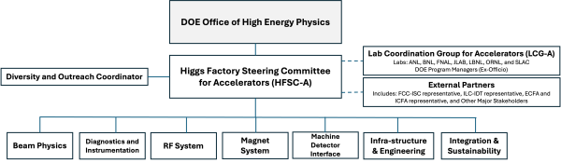
HFCC-A
The HFCC-A is led by a steering committee HFSC-A:
Tor Raubenheimer
Stephen Gourlay
Matthias Liepe
Jean-Luc Vay
LCG-A is created for engagement and coordination with the DOE national labs.
U.S.-CERN FCC Coordination Committee is an interface group to address R&D, priorities, and direction between the U.S. and CERN FCC management.
The HFCC-A includes seven L2 topical areas per the organization chart.
Each topical area has two L2 organizers.
L2 Topic Coordinators
Beam Physics | Ji Qiang (LBNL) | Vadim Sajaev (ANL)
Diagnostics and Instrumentation | Sasha Aleksandrov (ORNL) | Michiko Minty (BNL)
RF Systems | Sergey Belomestnykh (FNAL) | TBD
Magnet Systems | Giorgio Ambrosio (FNAL) | Gianluca Sabbi (LBNL)
Machine Detector Interface (MDI) | Andrei Seryi (JLAB) | Spencer Gessner (SLAC)
Infrastructure & Engineering | Damien Dockery (FNAL) | Vasiliy Morozov (ORNL)
Integration & Sustainability | Roger Ruber (JLAB) | Mei Bei (SLAC)

Slide 6
L2 goals and tasks
Guidelines for the L2 Accelerator groups
Identify potential areas where US can make significant and leading contributions.
Expand on previous US achievements utilizing our expertise & capabilities.
Collect input from community and encourage proposal submissions.
Consider interplay with HFSC-PED and identify joint projects which benefit HFSC-A and HFSC-PED.
Work with international project management teams to ensure the U.S. input is relevant and desired. For the FCC-ee, this includes the leaders of the FCC Feasibility Study and the Topical Groups.
Tasks for the L2 Accelerator groups
Select a set of R&D topics that will contribute to the Higgs Factory designs while augmenting core capabilities in the US and, ideally, will lead to a significant role in a future construction project.
Communicate with the broader accelerator community to encourage the development of proposals from US participants for collaboration on the FCC-ee, LCF, or ILC within the L2 subject area; since September 2025, the focus will be toward FCC-ee although topics with broad applicability are still of interest.
Help develop criteria for proposal reviews and assist in the review process.
Track progress and spending of the accepted proposals within the L2 subject area.
Participate in the annual collaboration meetings and program progress reviews.
Arrange an annual in-person meeting and quarterly virtual meetings focused on the specific L2 topics which might be combined with other L2's working on overlapping topics.

Slide 7
HFCC-A L2 RF systems
1

Slide 8
L2 RF systems proposals
In Spring’2025 we solicited R&D proposals with the following guidelines:
R&D topics should be relevant to an off-shore Higgs Factory that could morph into a significant contribution from the US to such a project. For example: the 800 MHz CM for FCC-ee or 1.3 GHz SRF for ILC.
US National efforts should follow DOE programmatic priorities and guidance and be aligned with international initiatives and efforts.
Proposals should identify partner efforts including (but not limited to) HEP GARD, the FCC Feasibility Study, ICFA, the IDT, ECFA and other major stakeholders.
We received 13 proposals aiming at FCC-ee and ILC with budget requests ranging from $50k to $1.3M.
There were proposals on developing 800 MHz SRF for FCC-ee, energy efficient high-power RF sources, crab cavities and high-gradient SRF for ILC, ferroelectric fast reactive tuners, distributed-coupling short-pulse S-band accelerating structure, and high temperature SRF for input couplers.
The proposals were ranked and submitted to HFSC-A for further considerations.

Slide 9
Current funding
After September 2025 refocusing on FCC-ee, ILC-related proposals were dropped from consideration.
Further, DOE/HEP can provide only $500k of initial funding for HFCC-A.
It is difficult to see a program that can engage with the FCC pre-TDR phase using only $500k. Hopefully, more funds will be available for the next cycle.
Only one RF systems proposal is funded: Developing 800 MHz SRF cavities and cryomodues for FCC-ee. The lead labs are FNAL ($250k) for design of cavities and cryomodules and Cornell ($30k) for 800 MHz SRF cavity R&D. It is assumed that other sources of funding (e.g., GARD) can be synergistically used for cavity R&D.
The funding allocation will allow the design of the 800 MHz 6-cell cavity so CERN can begin purchase of the cavities and will allow the launch of some of the highly ranked MDI and beam dynamics activities.
The major prototypes that are planned for FCC-ee as part of the TDR include systems that are replicated many times or those that have significant technical risk. Specifically, SRF cavities and CM at 400 and 800 MHz, the highly efficient 400 MHz RF power source.

Slide 10
SRF at FCC-ee and ongoing R&D
2

Slide 11
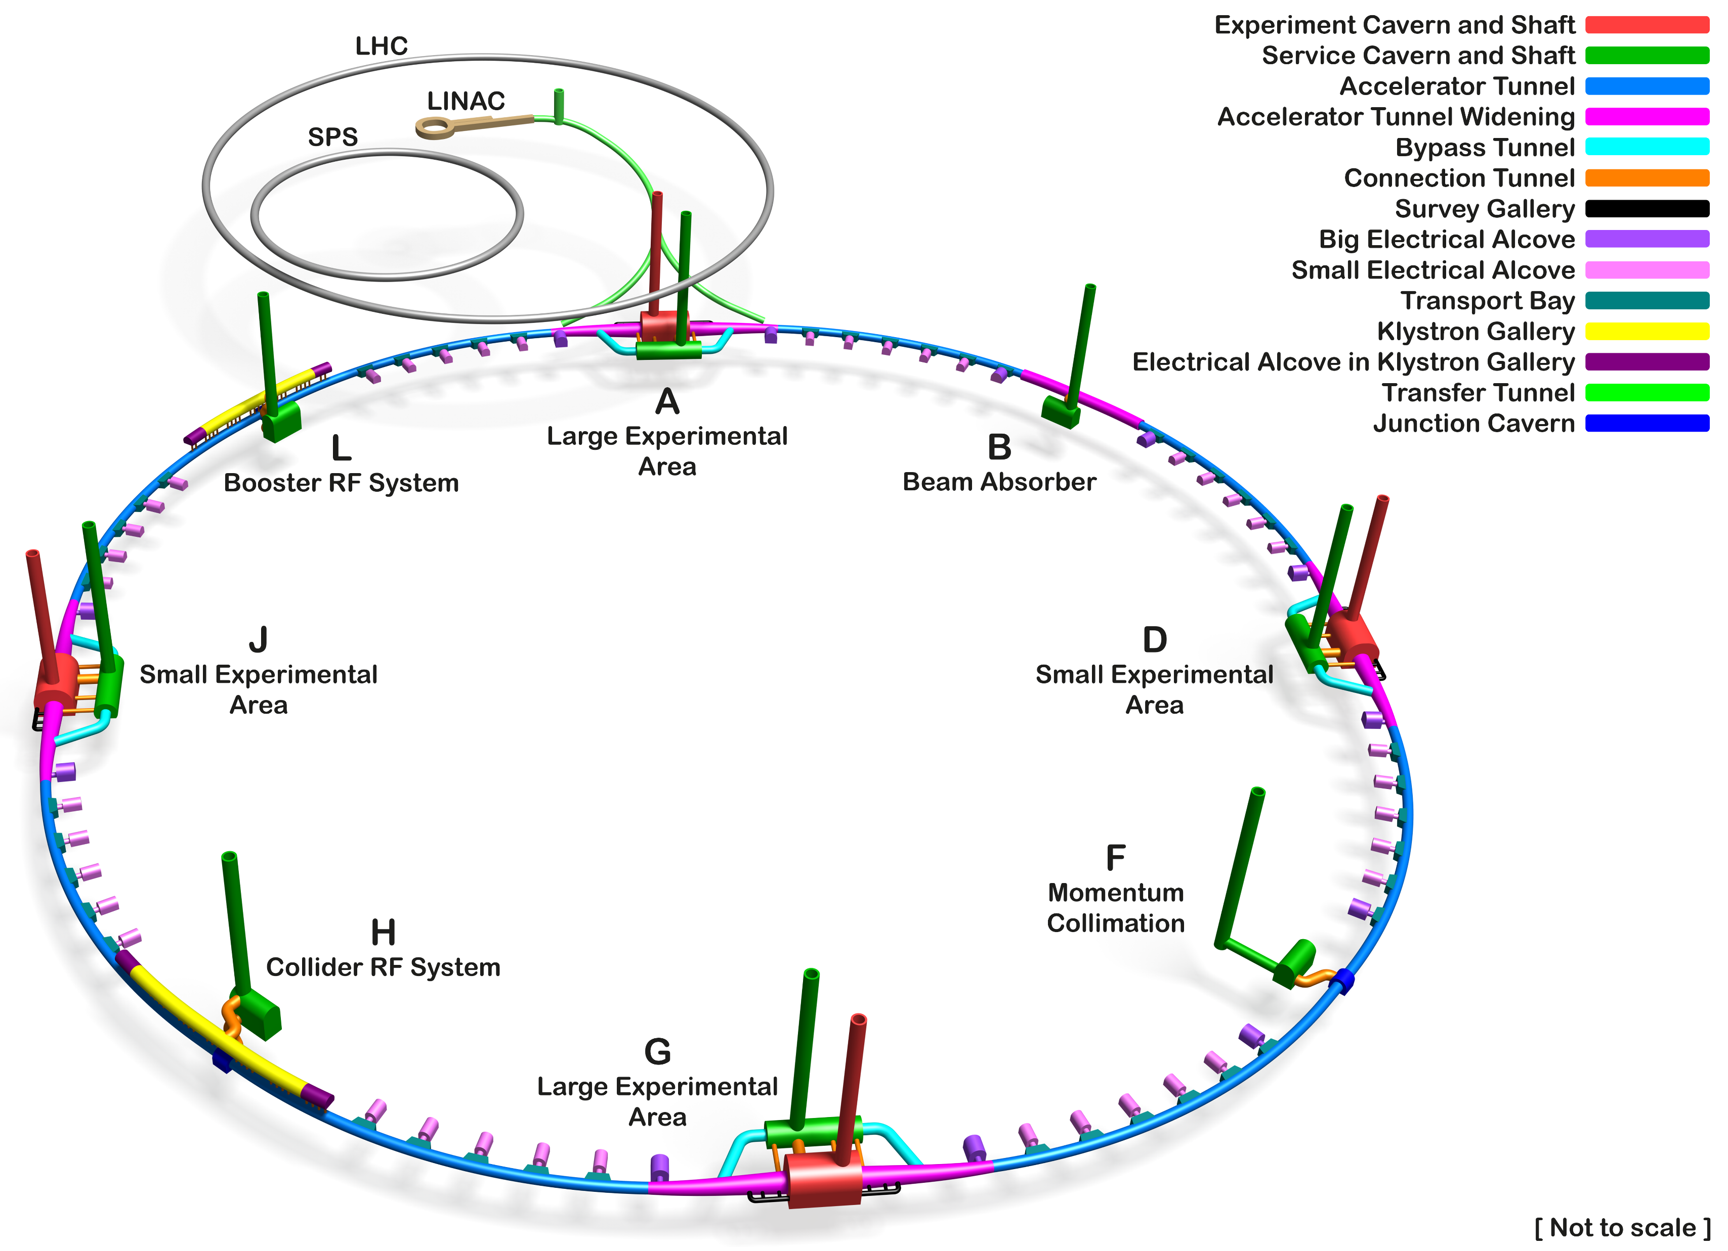
Location of SRF systems in FCC-ee tunnel
Booster
800 MHz cavities
Collider
400 & 800 MHz cavities
Courtesy A. Navascues Cornago (CERN)

Slide 12
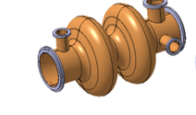
Baseline parameters
The same 2-cell Nb/Cu cavities and CM for Z, W, ZH. All installed at the very beginning.
400 MHz 2-cell cavity for all working points (Pt H, 66 CMs)
800 MHz 6-cell cavity (Pt H, 102 CMs)
The same CM design
800 MHz 6 cell cavity (Pt L, 112 CMs)
Courtesy CERN RF team

Slide 13
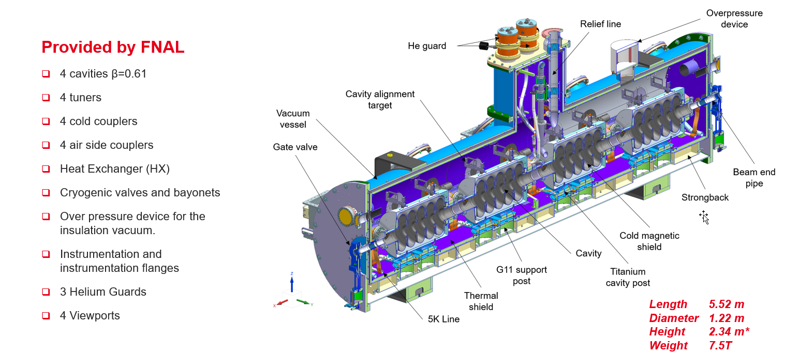
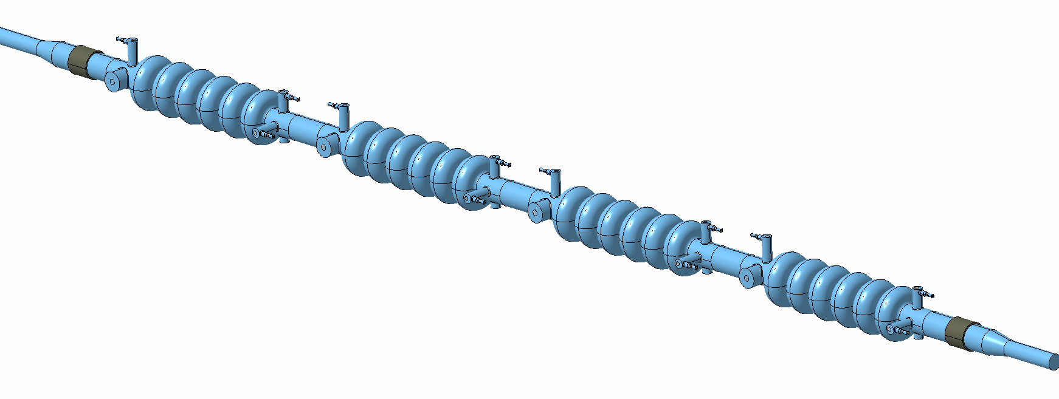
800 MHz CM design
Inspired by the PIP-II cryomodule design concept, collaboration with CERN
PIP-II LB650 cryomodule
Four 6-cell elliptical cavities (new RF design by CERN)
Baseline: bulk Nb, electropolished, N-doped or mid-T baked
Mechanical design of the dressed cavity in progress at Fermilab
FPC: new CERN design
HOM couplers: LHC/crab design or a modification
Strongback support and insertion scheme similar to PIP-II
Some open questions: pressure vessel code compliance, fast cooldown, tuner design around HOM coupler ports …
Courtesy D. Passarelli (Fermilab)

Slide 14
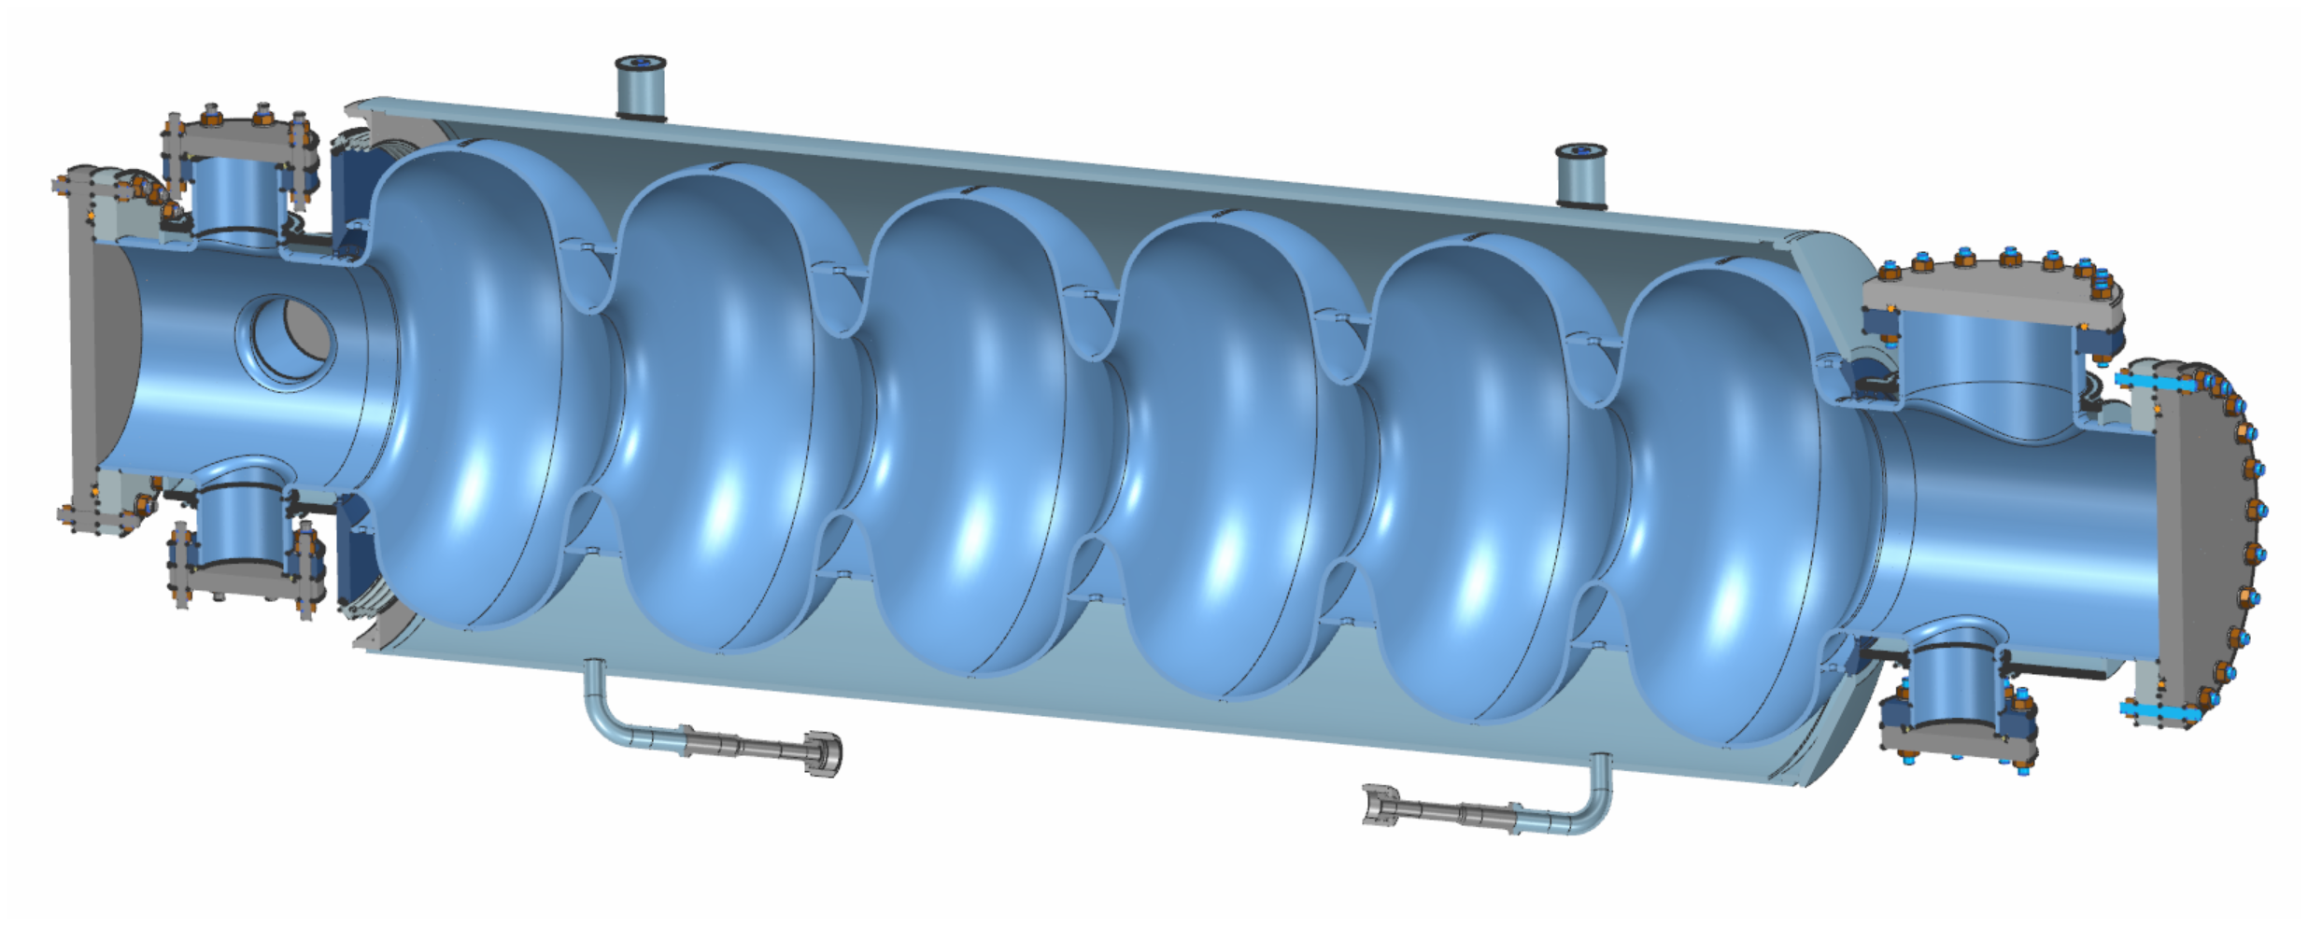
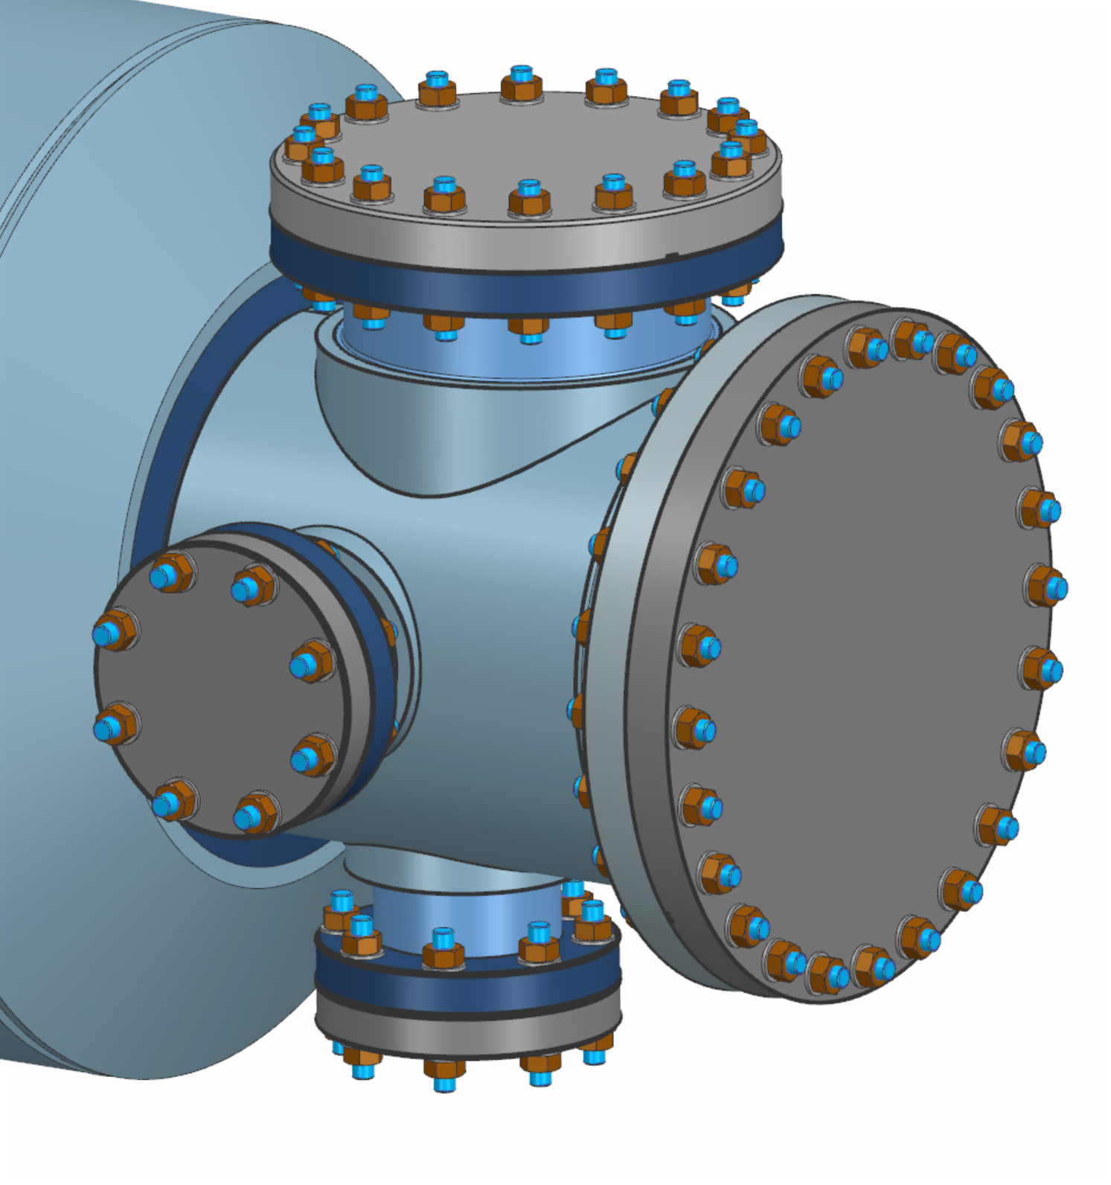
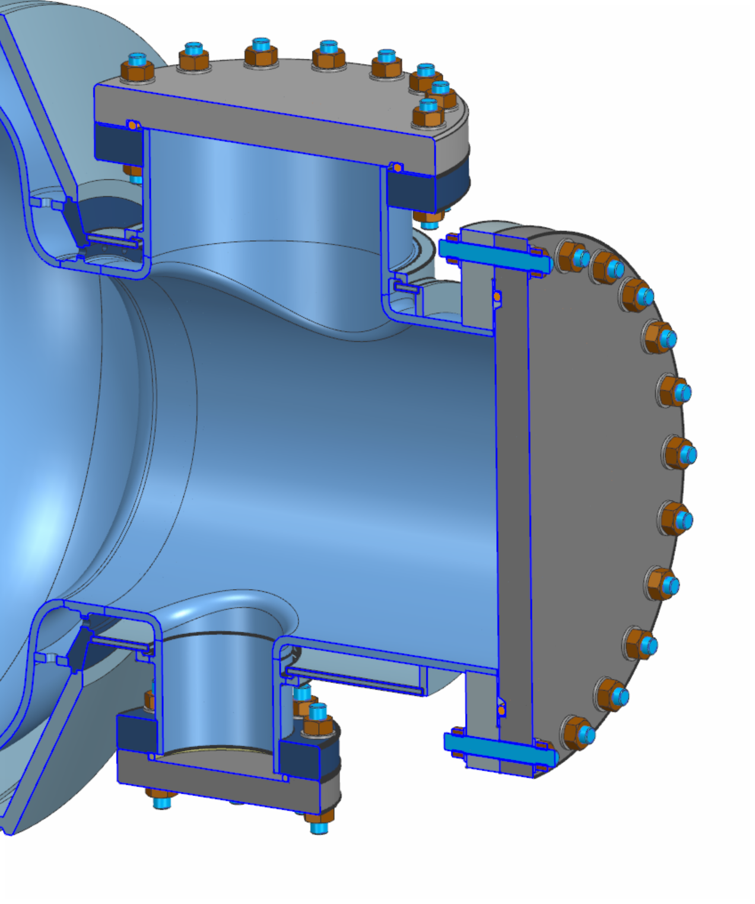
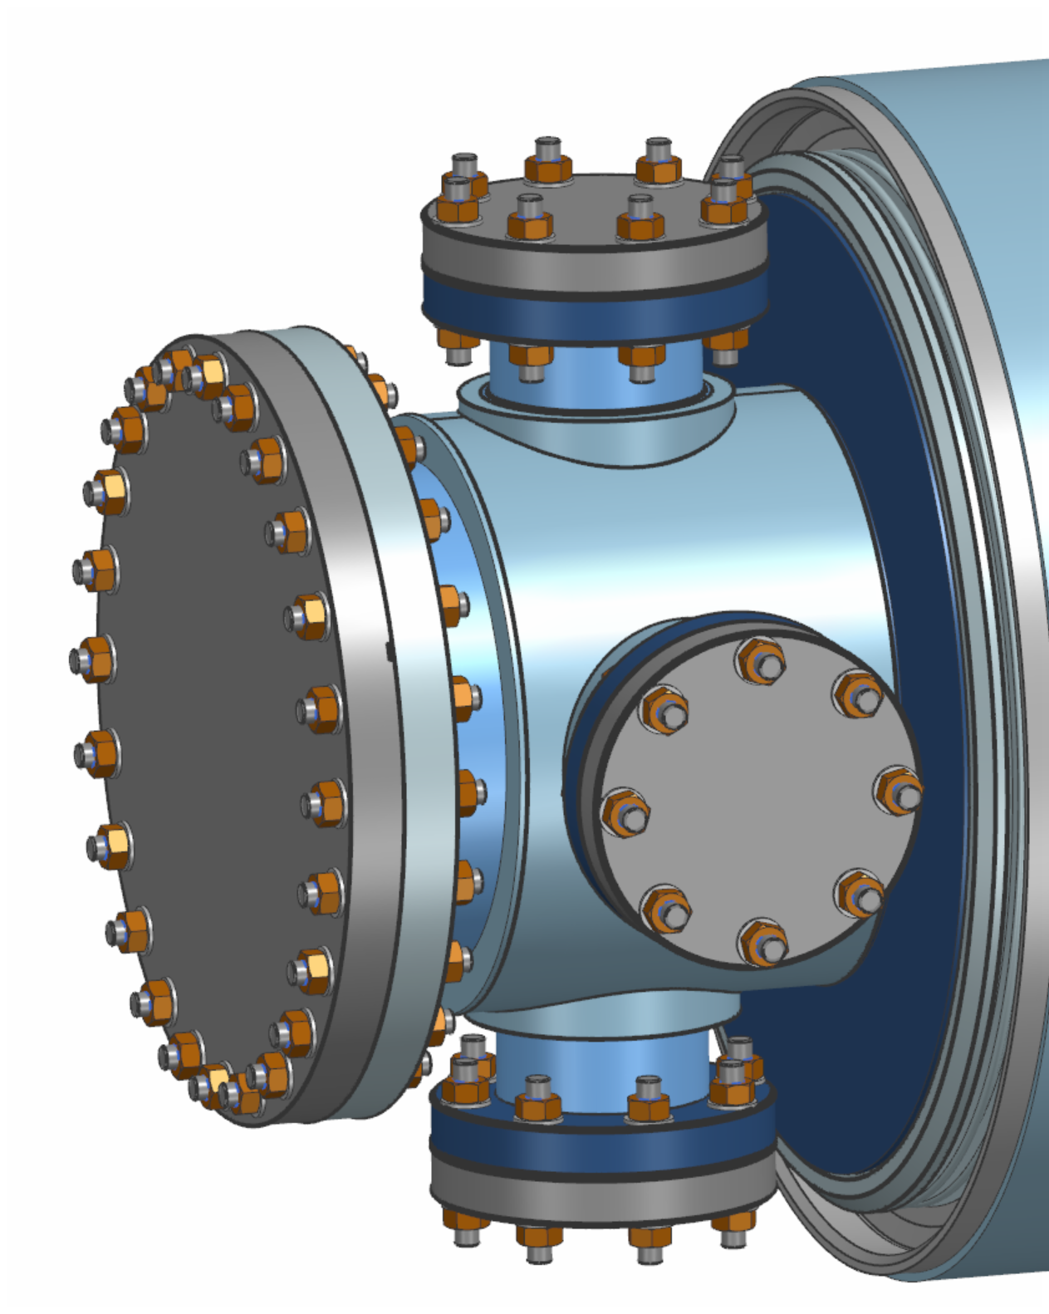
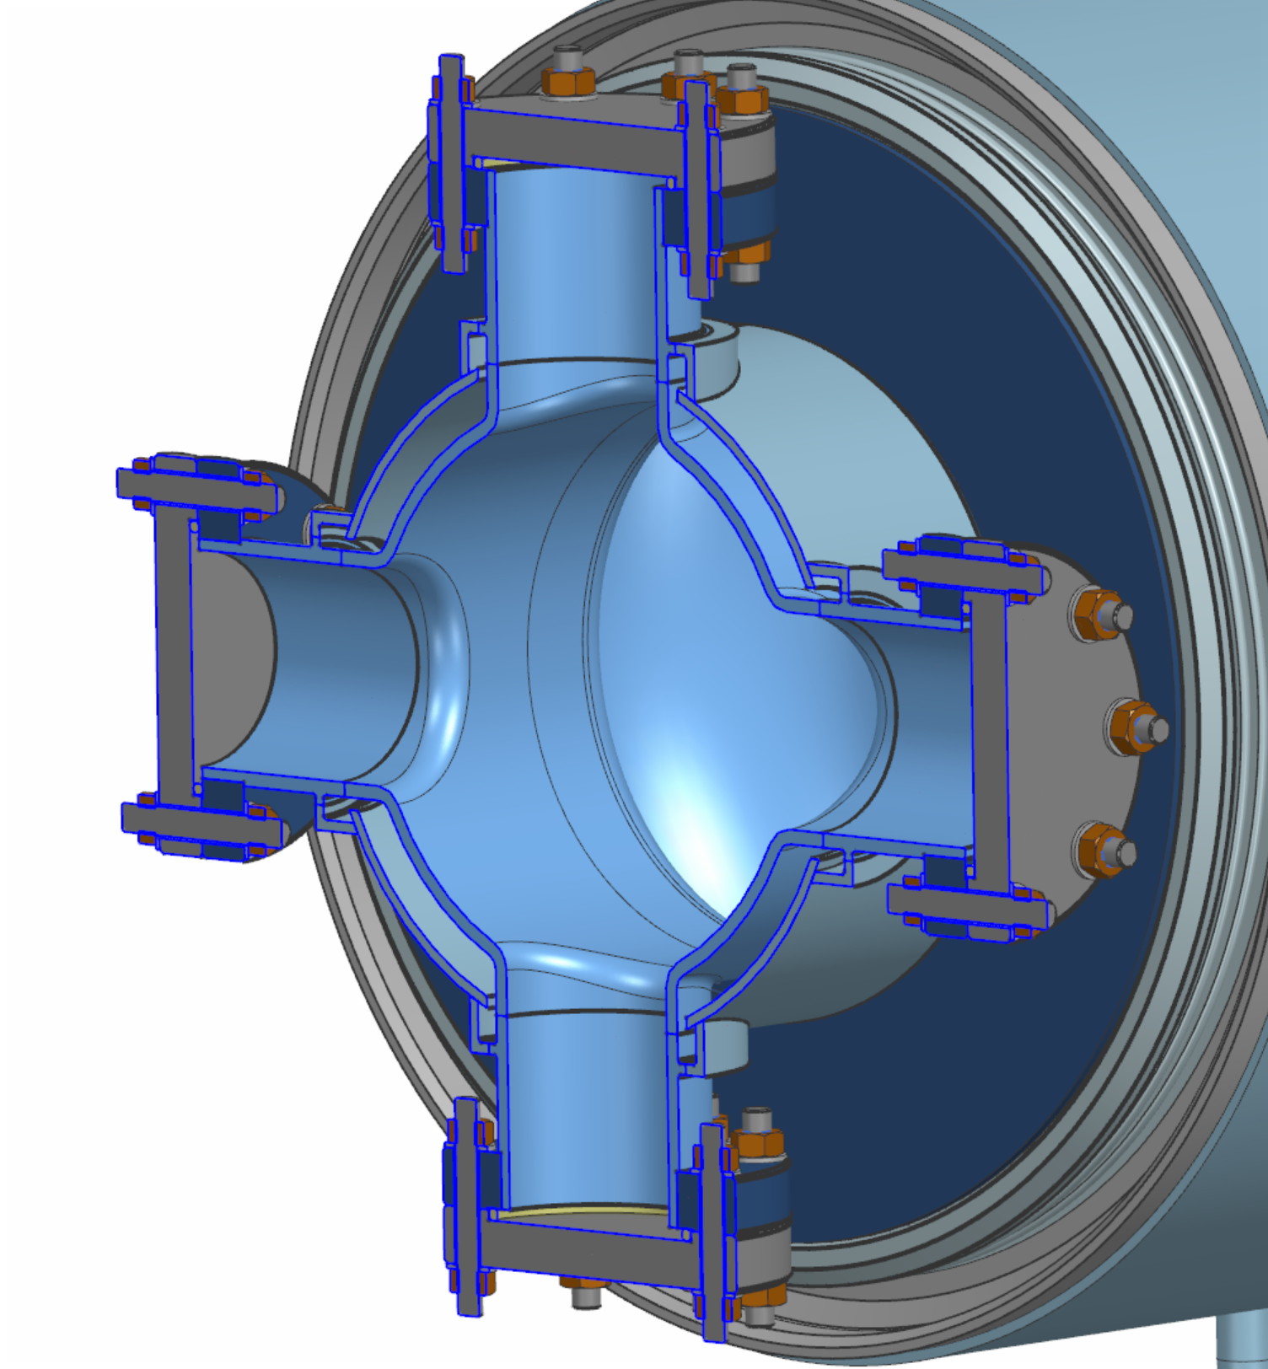
Dressed 6-cell cavity design
Initial design proposed by CERN
Fermilab is contributing based on experience with PIP-II and LCLS-II
Progress on conceptual mechanical designs
Complex higher order mode (HOM) port design
Single cavity design for booster and collider
Potential need for active cooling on the HOM ports, studies ongoing
Tuner design to be based on modified PIP-II double-lever design; leveraging FNAL experience with manufacturing/QA testing these in production quantities
Detailed weld map, fabrication plans to be optimized
Courtesy M. Parise (Fermilab)

Slide 15
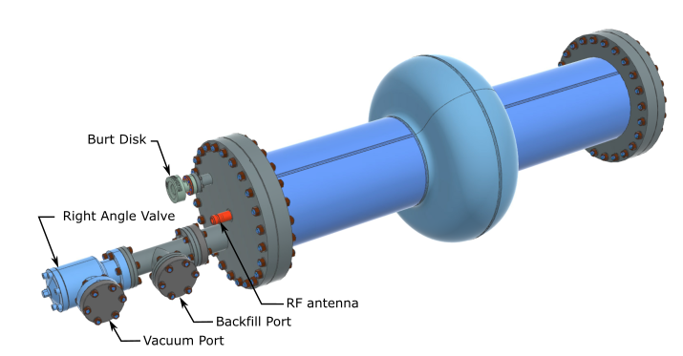
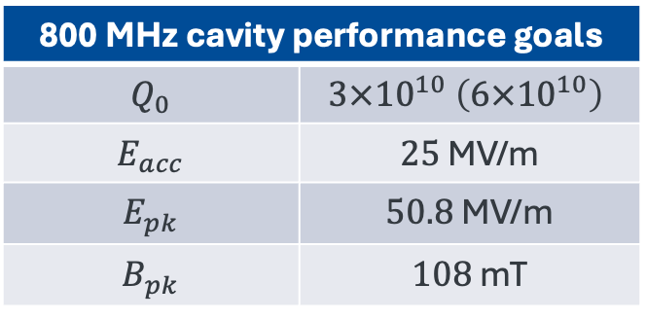
Single-cell cavity and surface processing R&D
For FCC SRF cavity surface processing R&D we designed a single-cell 800 MHz cavity
FNAL mechanical design based on CERN RF design (end cells)
Compatible with high temperature; Nb₃Sn cavity R&D
Nb procurement exercise
CERN is fabricating 10 cavitied in-house, will distribute them between FNAL, Cornell, and IJClab for bulk surface processing, surface treatment development, and RF testing
800 MHz cavity performance goals
$$Q_{0}$$ | $$3×{10}^{10} \left(6×{10}^{10}\right)$$
$$E_{acc}$$ | $25$ MV/m
$$E_{pk}$$ | $50.8$ MV/m
$$B_{pk}$$ | $108$ mT

Slide 16
Concluding remarks

Slide 17
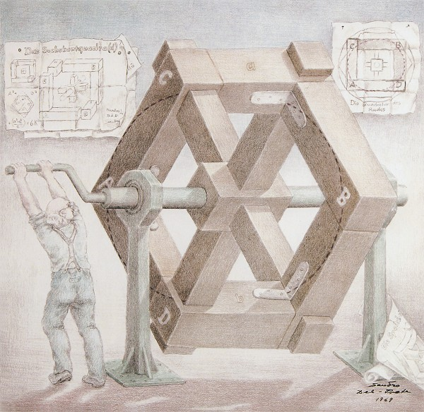
Concluding remarks
SRF will have a big role in the FCC-ee.
Efficiency, reliability, and maintainability of the large systems are the main drivers.
HFCC-A RF systems received its initial funding to continue R&D on developing 800 MHz SRF cavities and cryomodules for FCC-ee in collaboration with CERN.
To stay relevant, the goal is to design, build, and test a prototype cryomodule by the end of TDR Phase (~2031).
As (hopefully) available budget grows, other important RF R&D topics will be included, e.g., efficient RF power sources, Nb/Cu ...
SRF system design is a work of art, science, and engineering calling for imagination, calculation, symmetry …
This manuscript has been authored by FermiForward Discovery Group, LLC under Contract No. 89243024CSC000002 with the U.S. Department of Energy, Office of Science, Office of High Energy Physics.

Slide 18
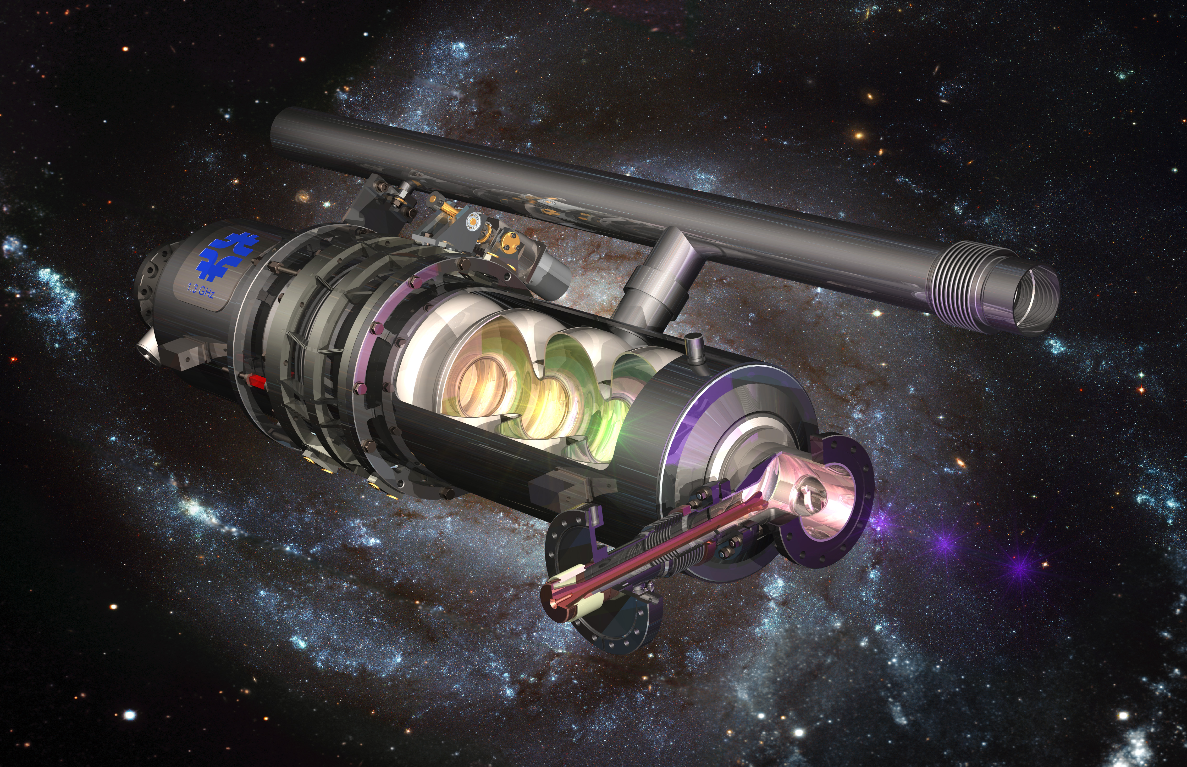
Thank you!

