Slide 1
Euclid’s Capabilities and Interests in Applications of SRF Accelerators
Chunguang Jing
Euclid Techlabs
11/13/2025
SRF Frontiers Workshop, Jlab

Slide 2
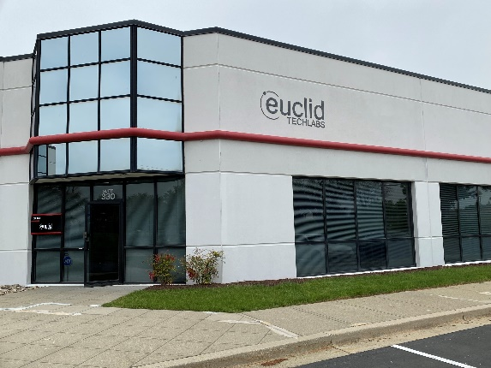
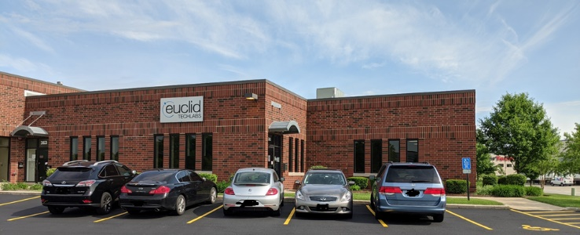
Company Profile
Expertise in electron accelerators, NC and SRF
EM, thermal, beam, fabrication, and tuning, and testing
Acc.
EUCLID EAST • DC HQ and Material Lab
6.4k sqf
World 1st RF-based solution for ultrafast TEM/SEM, enabling observing 100pm spatial,100meV energy and ps temporal resolution
E.M.
EUCLID WEST • Chicago Central Shops and Test Labs
12k sqf
BST-M for ns phase tuner and MgO conductive ceramic for RF window
Dislocation free diamond for Xray optics
Mat.

Slide 3
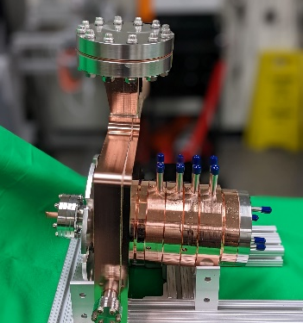
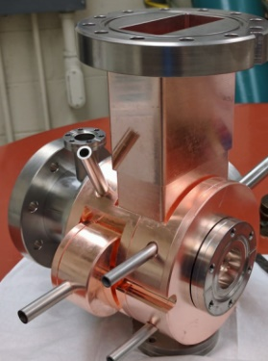
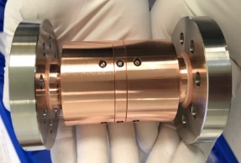
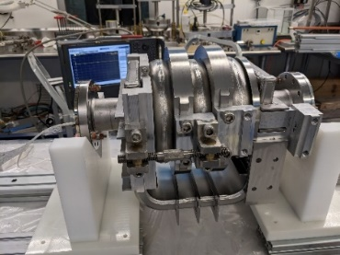
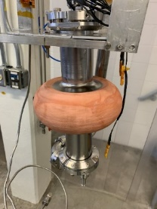
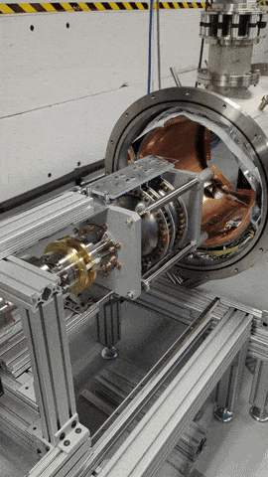
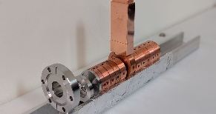
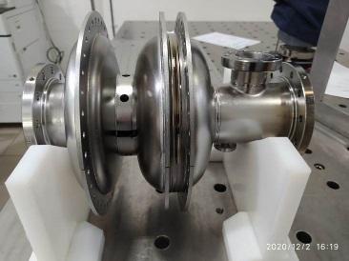
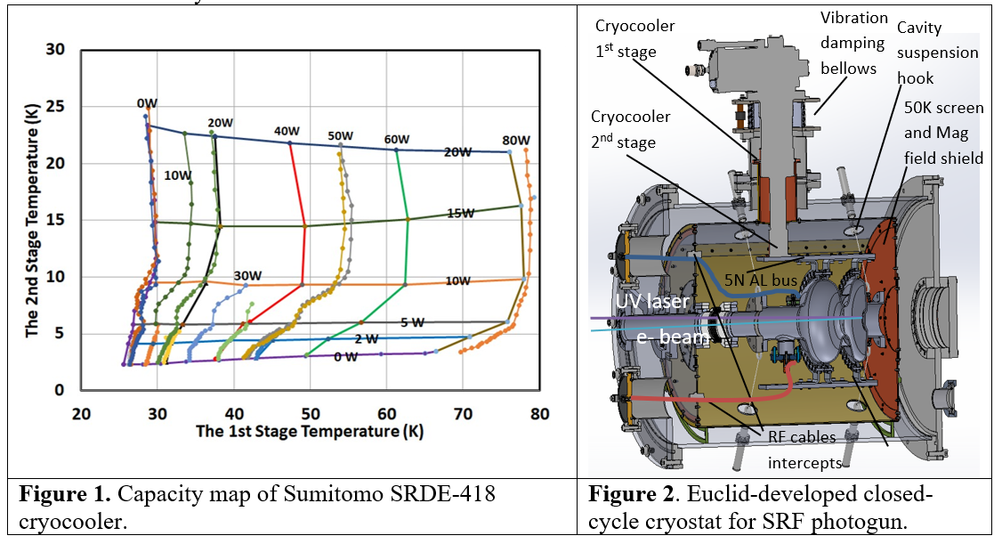
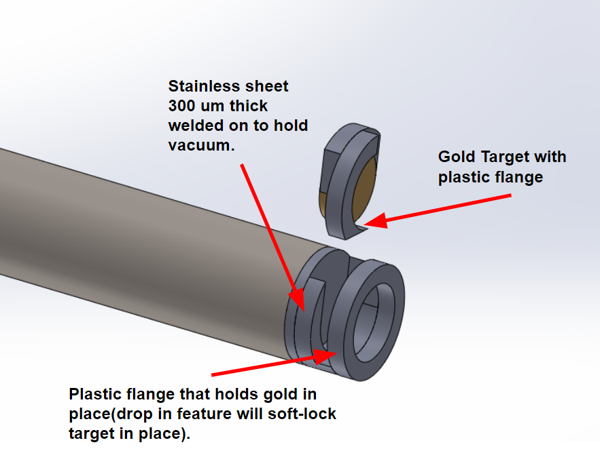
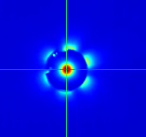
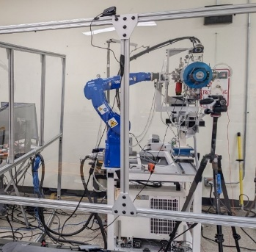
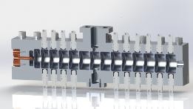
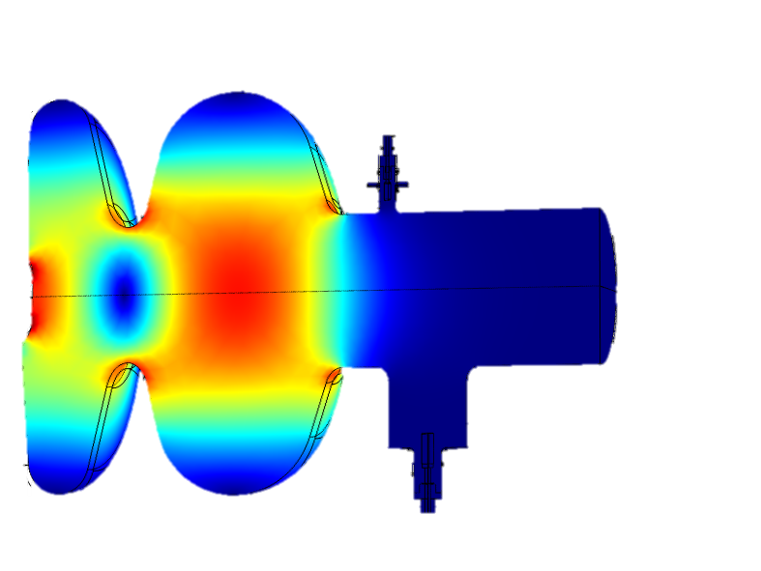
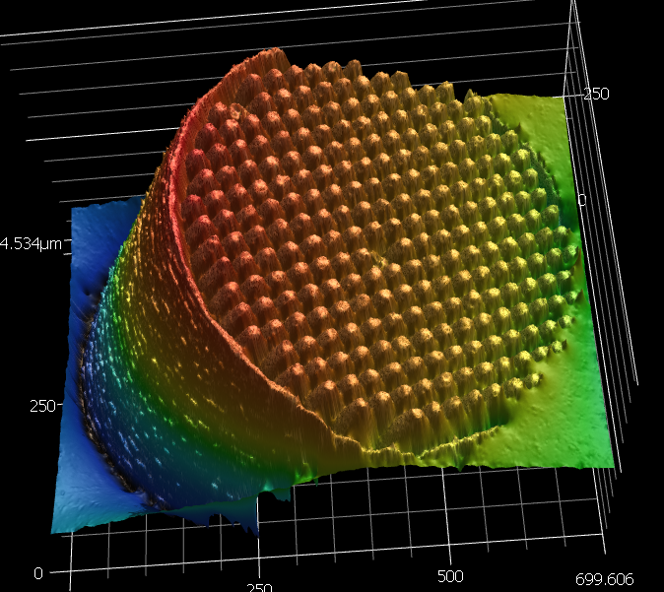
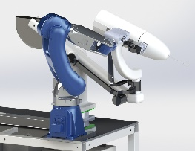
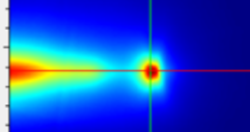
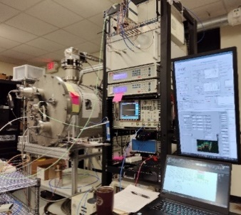
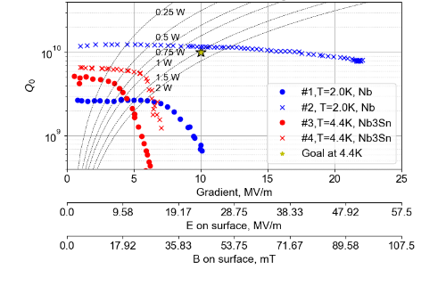
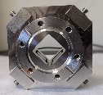
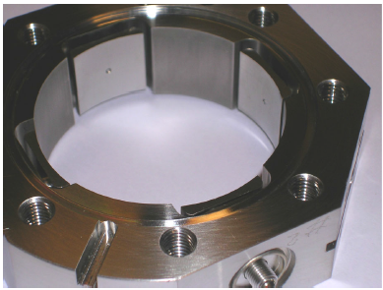
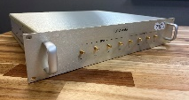
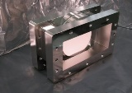
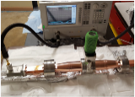
Accelerator Products Snapshot
Normal Conducting
Super Conducting
Thermionic RF photogun
X-band HG
Coldspay Cu for SRF-CC
kHz S-band photogun
X-band 4MeV
TW SRF-3cell
Conduction cooled SRF photogun
MeV HDR EB Prototype
X-band RF valve
L-band RF window
In-flange BPM and electronics

Slide 4

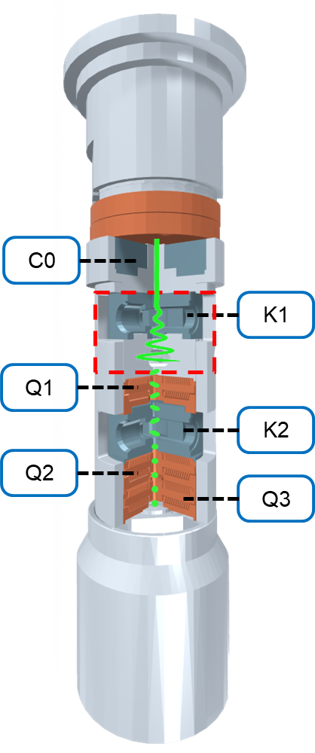
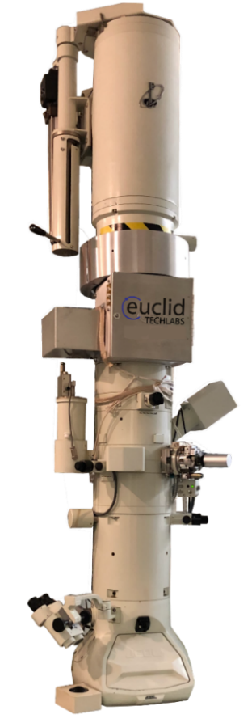
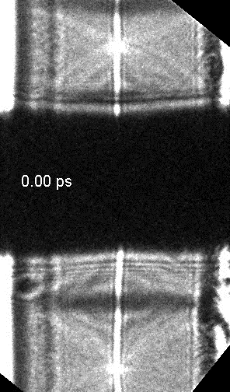
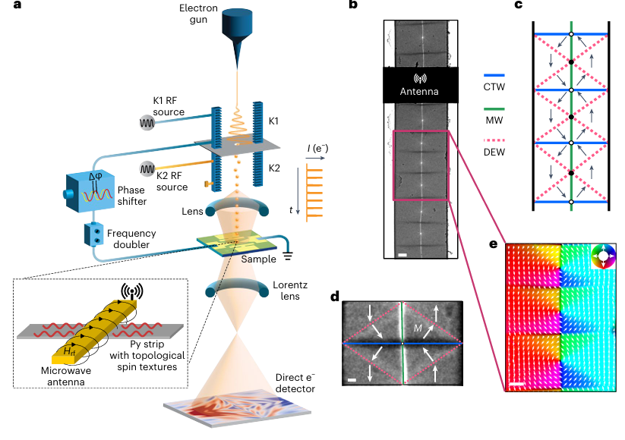
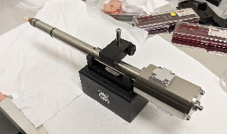
Euclid’s UFPTM imaging Spin-Wave Generation
Liu, C., et al., Nat. Mater. (2025)

Slide 5
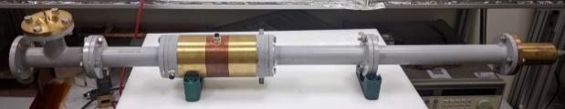
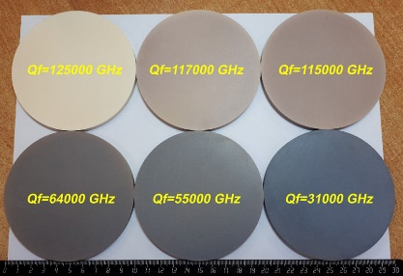
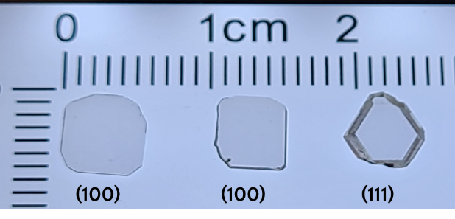
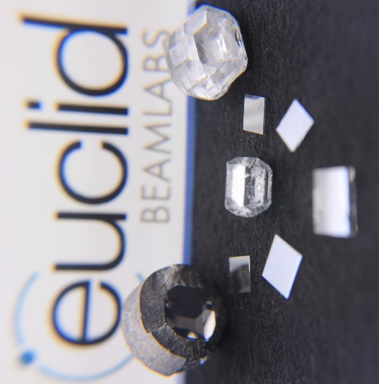
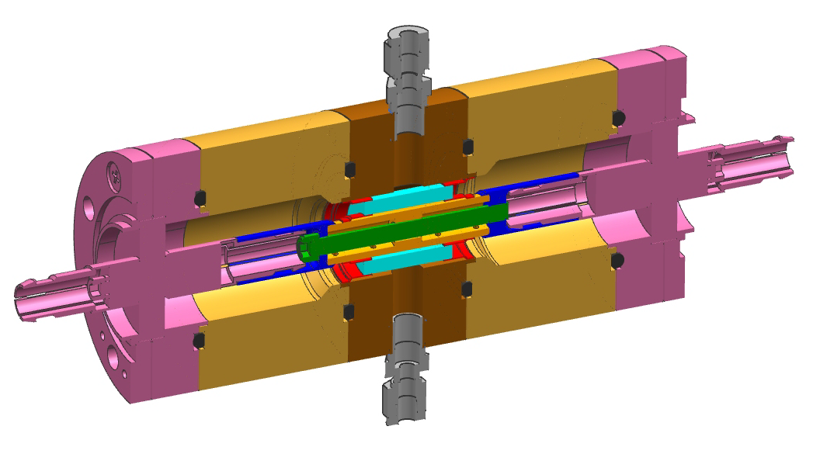
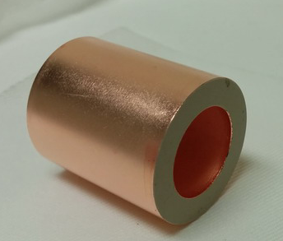
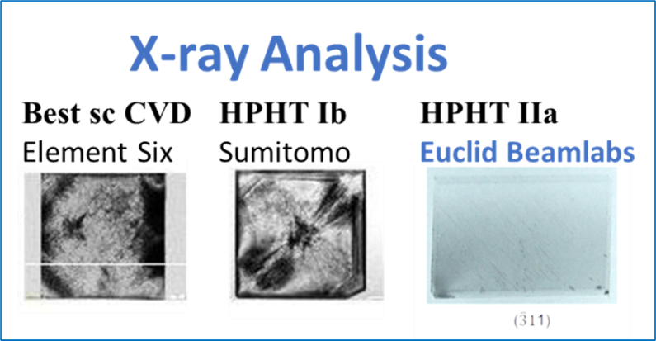

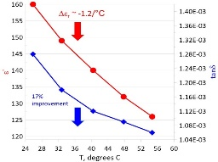
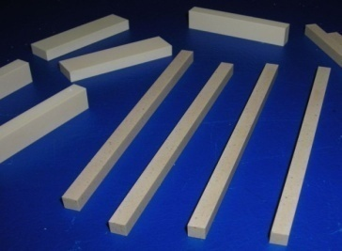
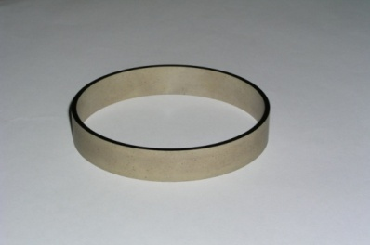
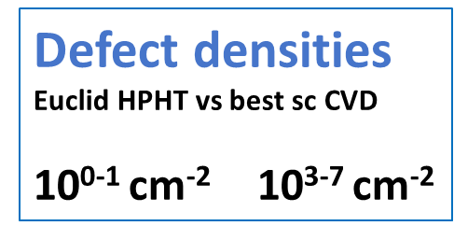
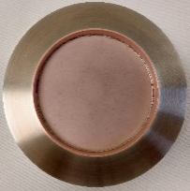
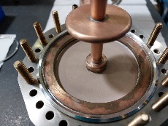
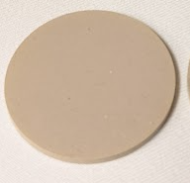
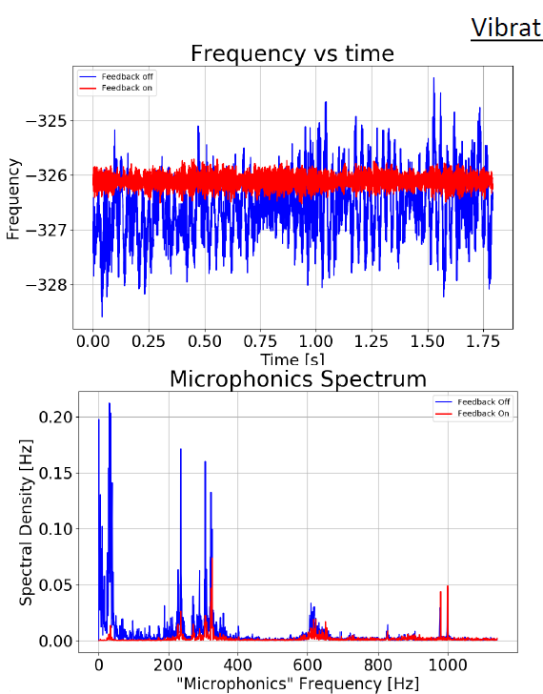
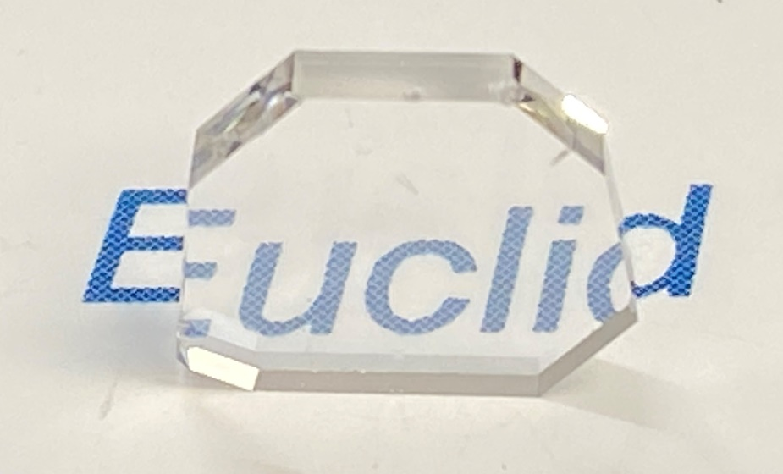
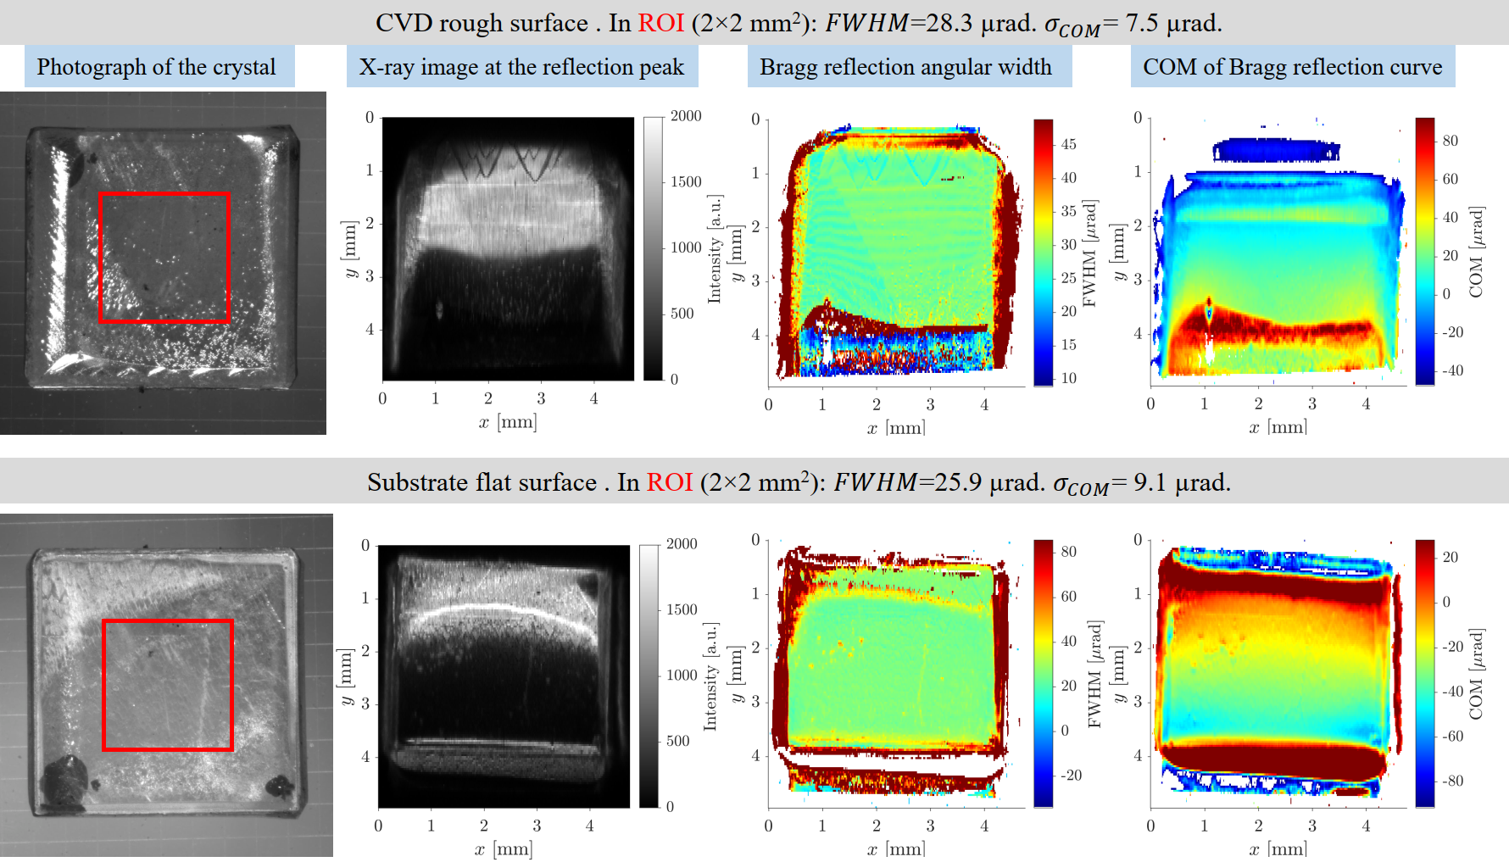
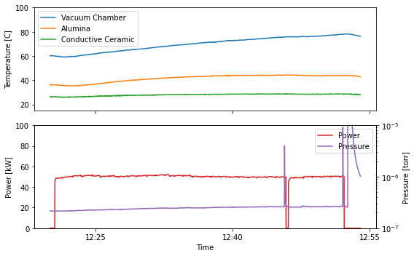
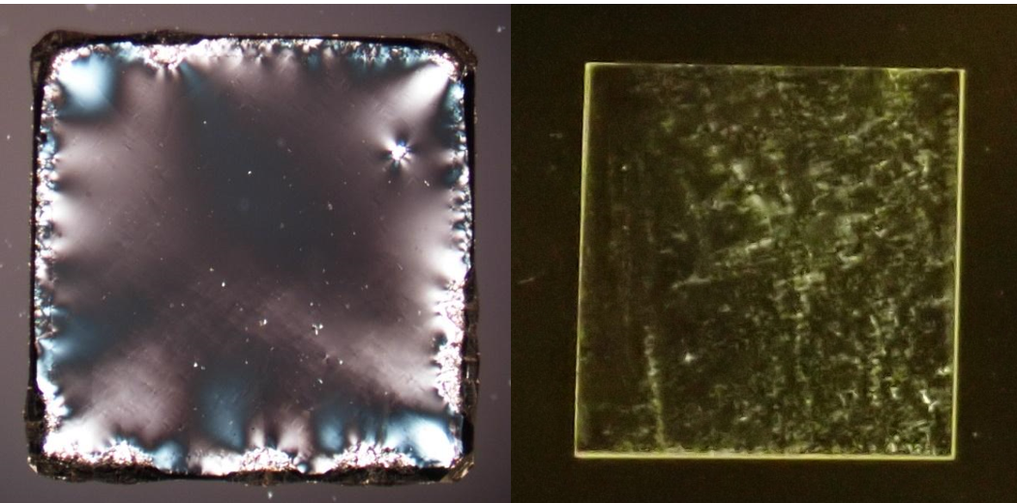


Euclid’s Innovative Materials
Ferroelectric materials
Conductive Ceramics
HPHT and CVD Diamonds
Loss tan
5x10^-6 – 2x10^-5
at 650 MHz
conductivity
(10^-13 -10^-9) S/m
Diamond

Slide 6



























Global Customer Base

Slide 7










In-house Capabilities: EM, Thermal, Beam, MP, Dose, Mechanic, etc
Euclid’ has a team of accelerator researchers who have deep knowledge in NC/SRF and novel accelerators. Euclid holds licenses of variety of accelerator simulation tools to facilitate any RF accelerator design work: CST, HFSS, Comsol, Opera, Astra, Geant4, and Mechanic design tool: Solidworks.
EM
Thermal
Mechanic
Magnetic
Engineering
Beam
Multipactor
Radiation

Slide 8











In-house Capabilities: Fabrication and Bench Measurements
Currently, Euclid’s strategy of accelerator fabrication is the turn-key solution: the in-house design, fabrication, and measurement, excluding the brazing at the partner shop.
High precision turning/milling
MBE system for Cs₃Sb/Cs₂Te
fs laser microfabriction
CVD Reactor
HPHT Reactor
Furnace
RF Bench test
3D magnetic field mapping
Sub-nm vibration meas.
Cleanroom assembling
DC/RF sputtering

Slide 9



In-house Capabilities: Beamlines
30kV gridded CW RF gun
200keV DC Beam
MeV e-beam Test Cage

Slide 10




Nb3Sn SRF: high average beam power for industrial applications
Main Features:
Compact (<3.5m at 10MeV e-beam exit)
Full system driven by SSPA
NC injector +Nb3Sn SRF
Status:
SRF linac cryomodule at Engineering Design (Euclid)
NC injector entering the fabrication stage (Euclid)
RF gun (ordered)

Slide 11


Nb3Sn SRF: high-quality CW beam for UED(M) application
Gun parameters
Parameter | Value
Application | UED | UEM
Beam energy | 1.655MeV | 1.655MeV
Charge | 5fC | 0.5pC
Laser pulse length, rms | 6.4fs | 6.4fs
Laser spot size | 36um | 180um
Beam bunch length, rms | 167fs | 741fs
Beam emittance | 6.6nm | 39nm
Energy spread (relative) | 1.3e-5 | 6.4e-5
Frequency, | 1.3 GHz
Length | 1.45cell (166.54mm)
Q0 at 4°K (Rs = 20 nΩ ) | 1.16×10¹⁰
R/Q | 176.9 Ω
Geometry factor | 232 Ω
Wall Power dissipation | 0.9 W
E on axis | 20 MV/m
E max | 23.5 MV/m
B max | 43.3 mT
E acc | 10 MV/m

Slide 12
Summary
Euclid Techlabs is a U.S.-based firm specializing in electron devices and advanced materials. After 20+ years serving the particle accelerator R&D market, we now ship a much wider-ranging product portfolio around the globe, from semiconductor photocathodes and superconducting photoinjectors, to ultrafast electron microscopy, to domestically-grown technical diamonds, ferroelectric fast tuners to arc-free high power microwave windows using our proprietary ceramic technologies.
As pioneers in advanced electron device engineering, we excel in tackling complex design challenges. Our agile, milestone-driven project management approach ensures optimal resource allocation and timely delivery. We collaborate with leading accelerator laboratories across the United States, the Department of Defense, CERN, and numerous global institutions. Our innovative solutions have garnered a diverse clientele spanning North America, Europe, and Asia.

