Slide 1

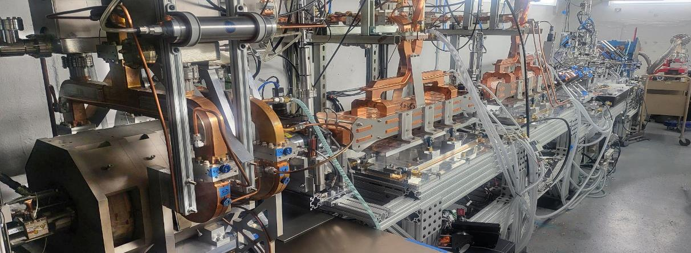
General Capabilities Overview
Ronald Agustsson, RadiaBeam Technologies
SRF Frontiers Workshop @ TJNAF
November 13, 2025

Slide 2
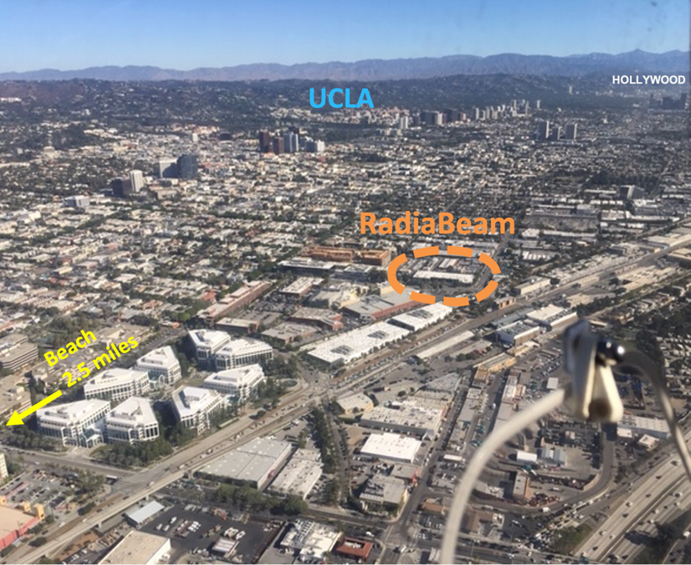
About RadiaBeam
founded in 2004 (UCLA spin off), ~ 50 FTE, > 30,000 ft² facility
Accelerator R&D, design, engineering, manufacturing and testing all under one roof
Products: accelerator components (RF structures, magnets, diagnostics), medical/industrial accelerator systems, in-house testing services

Slide 3
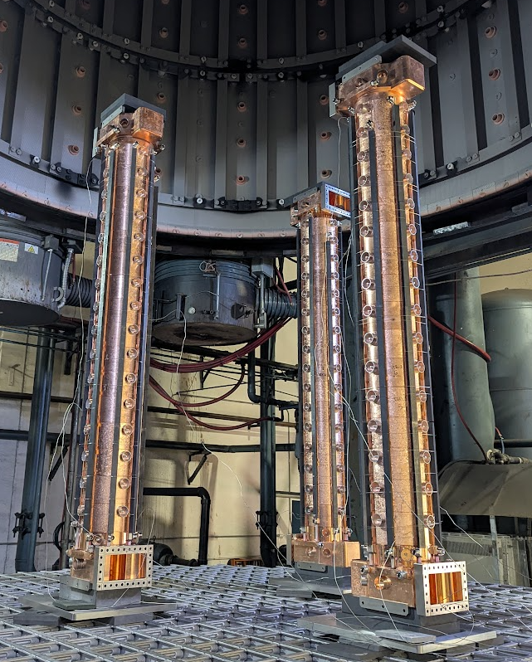
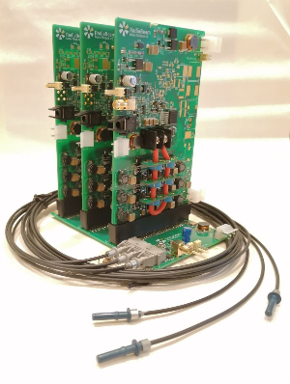
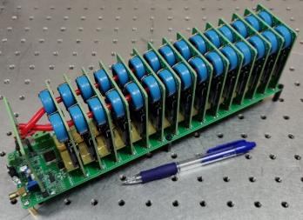
About RadiaBeam
Wide range of capabilities and in-house expertise:
RF design and engineering, microwave sources, modulators and power electronics
Magnetic design, engineering, alignment, production and testing
UHV systems, beamline instrumentation and diagnostics
1.6 cell S-band photoinjector (4 units sold)

Slide 4
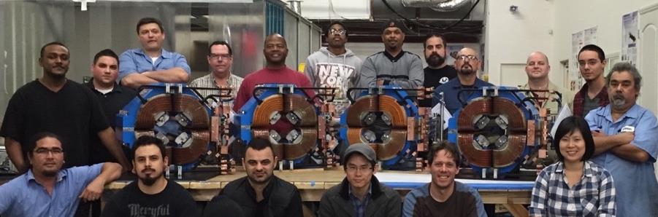
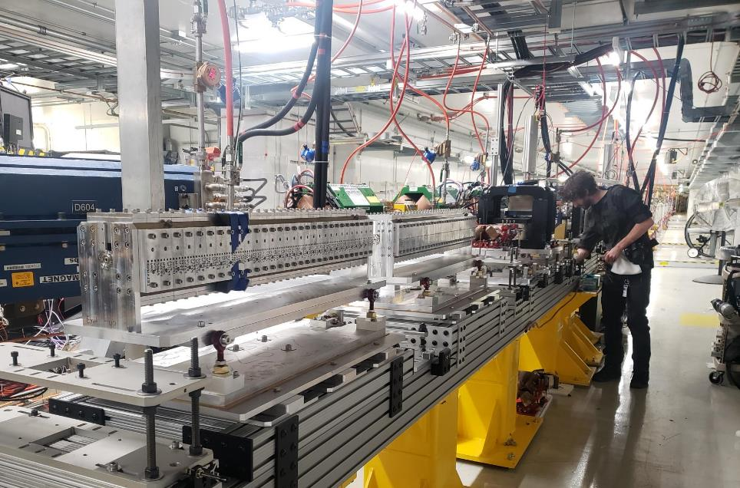
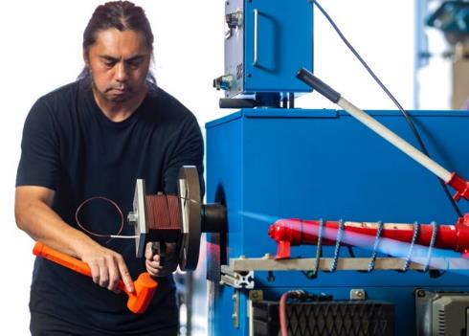
About RadiaBeam
Wide range of capabilities and in-house expertise:
RF design and engineering, microwave sources, modulators and power electronics
Magnetic design, engineering, metrology, production and testing
UHV systems, beamline instrumentation and diagnostics
TESSA helical tapered undulators installed at Fermilab FAST facility

Slide 5
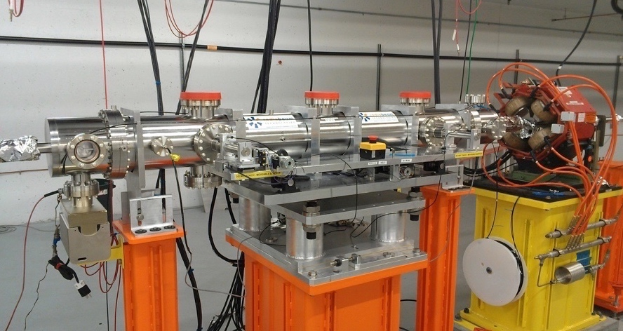
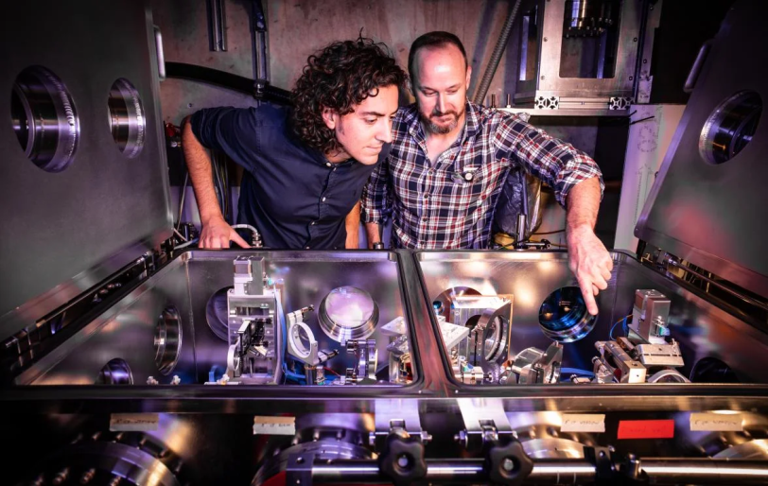
About RadiaBeam
Wide range of capabilities and in-house expertise:
RF design and engineering, microwave sources, modulators and power electronics
Magnetic design, engineering, alignment, production and testing
UHV systems, beamline instrumentation and diagnostics
4-m long, adjustable gap corrugated pipe dechirper (has been operational at LCLS facility since 2016), and FACET interaction chamber

Slide 6
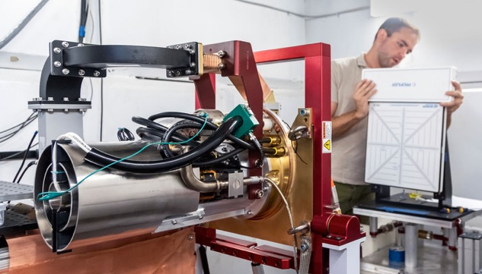
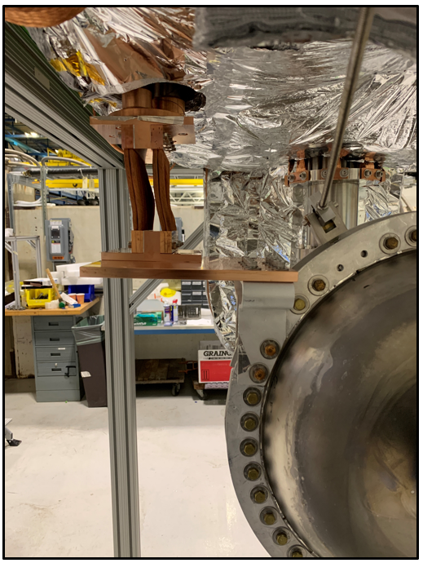
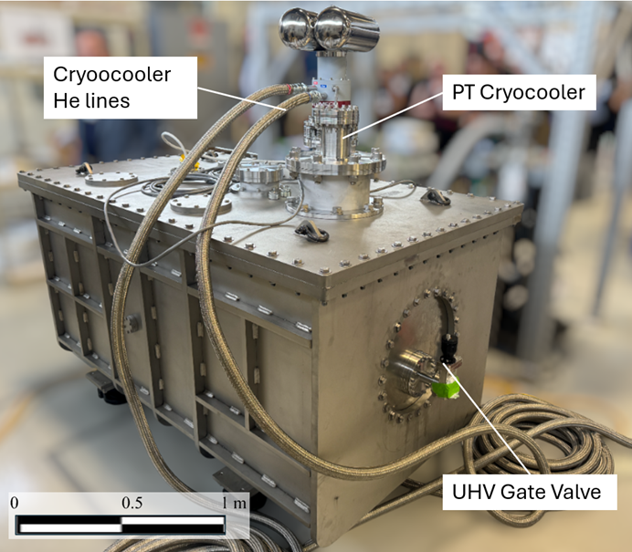
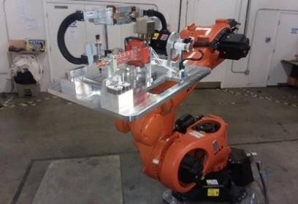
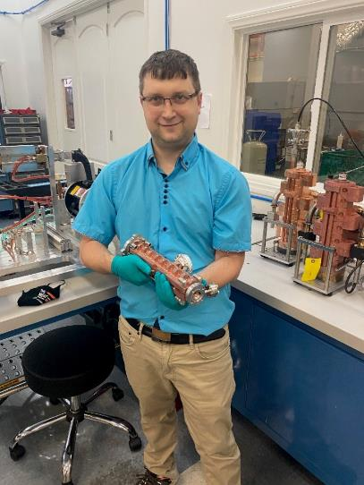
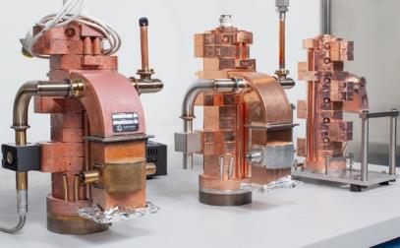
About RadiaBeam
Industrial linac, and irradiation systems pipeline
OEM medical and industrial linacs
Custom systems for specialized applications
R&D pipeline, and in-house testing services

Slide 7
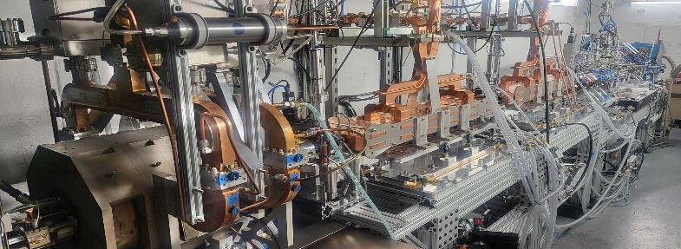
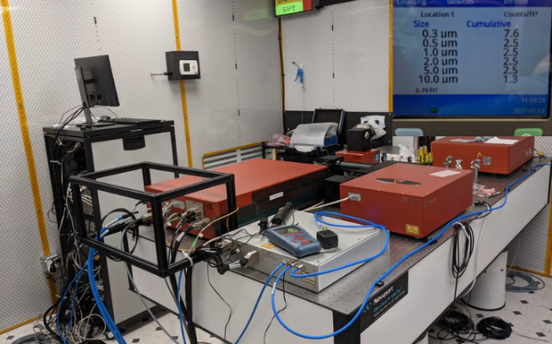
E-Beam and Laser Capabilities
Parameter | Value
Beam Type | Electrons and ICS Photons
Beam Energy | Electrons: 50-100 MeV ICS Photons: 50-200 keV
Pulse Rate Frequency | 1-60 Hz
Charge | 10-250 pC
Pulse Length | 1.5-3.0 ps
Beam Spot Size | 30-100 µm
Energy Spread | 0.3-1.0%
Parameter | Value
Beam Type | Electrons
Beam Energy | Electrons: 2-9.5 MeV
Pulse Rate Frequency | 1-120 Hz (being upgraded to 200Hz)
Average Beam Current | 20-220 mA
Pulse Length | 0.3-13.5 µs
Beam Spot Size | 1.7mm at converter
 | 15 GW Yb:YAG
Pulse Energy | 23 mJ @ 1030 nm 170 µJ @ 257 nm
Pulse Length | 1.5-10 ps
Pulse Rate Frequency | 1-120 Hz

Slide 8
General Interests
Ultimately manufacturing / Integration of key sub-systems or full mechanical packages
Inclusive of qualification
Based on lab developed Q/A procedures
Build to spec NOT to print
Initially to process spec and perhaps later to physics spec
Long term target
Continue engagement with ongoing technology / manufacturing maturation
Internal and external production
Supply chain development
Scaling / codification of mature technology solutions
Engage in workforce training/development

