Slide 1
Round Table 1 - Consortium for Basic Research on Nb3Sn Technology
Multi-disciplinary Synthesis and Characterisation of Niobium-Tin for Accelerators Consortium (MEISSNER)
What performance for Nb₃​Sn on Cu can we realistically envision in comparison to Nb₃​Sn on Nb by Sn diffusion?
In the framework of the current developments for Nb₃Sn on Cu (PVD, CVD, electrodeposition…), which has the highest likelihood to achieve first the benchmark performance of Q~1e¹⁰ at 10 MV/m at 4 K? For each approach, what are the identified challenges and which efforts are undertaken to overcome them?
What are the most critical, yet poorly understood, fundamental material science limitations (e.g., stoichiometry control, film roughness, grain boundaries, vortex nucleation) currently limiting the Q₀ and accelerating gradient (E_{acc}) of Nb₃Sn cavities?
Given the material's low specific heat and the presence of unavoidable surface defects, what is the maximum RF magnetic field (B_{peak}​) or accelerating gradient (E_{acc}​) that can be reliably sustained by Nb₃​Sn before thermal runaway occurs, and what specific thermal management strategies (e.g., enhanced thermal conductivity via Cu substrate or advanced post-processing) must be prioritized to exceed the current quench limit of ∼24 MV/m?

Slide 2
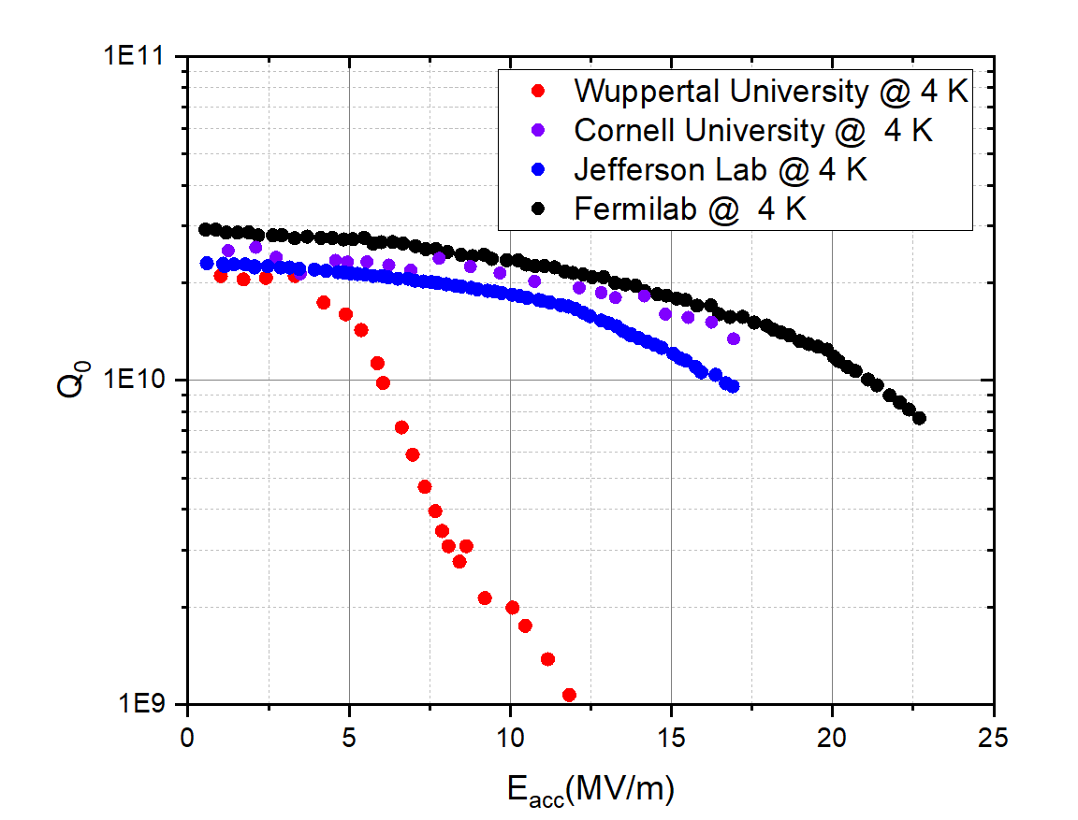
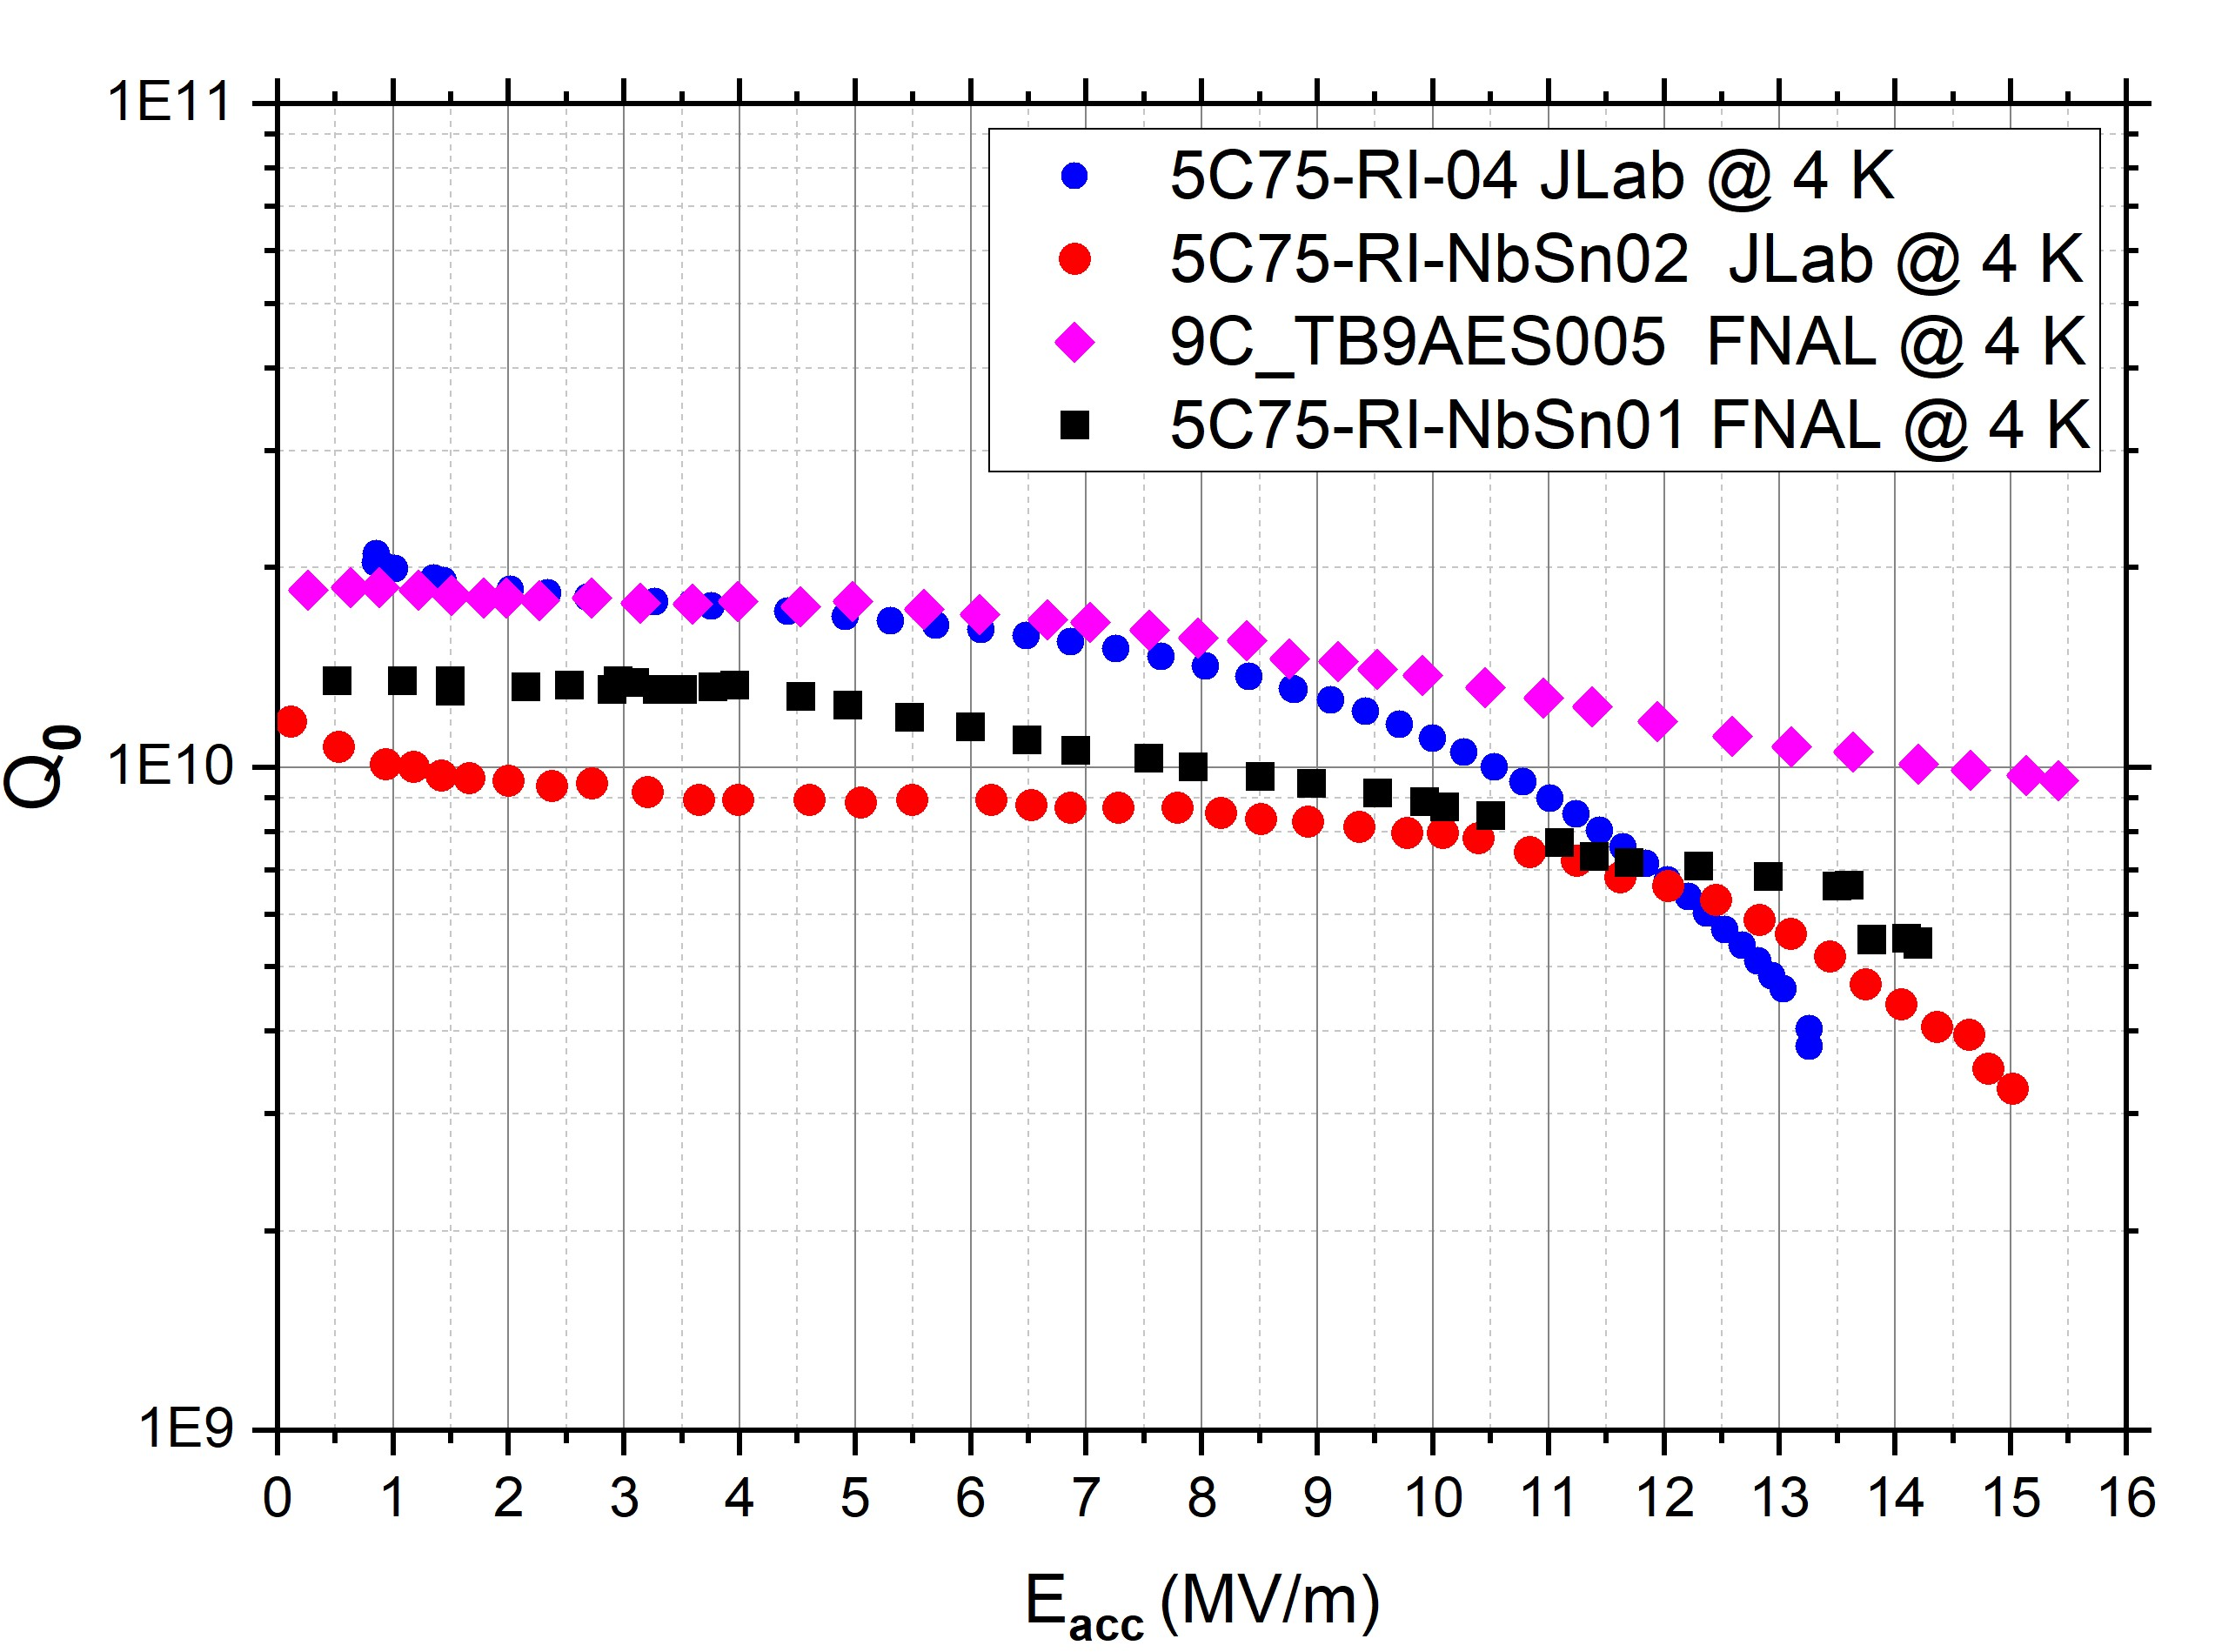
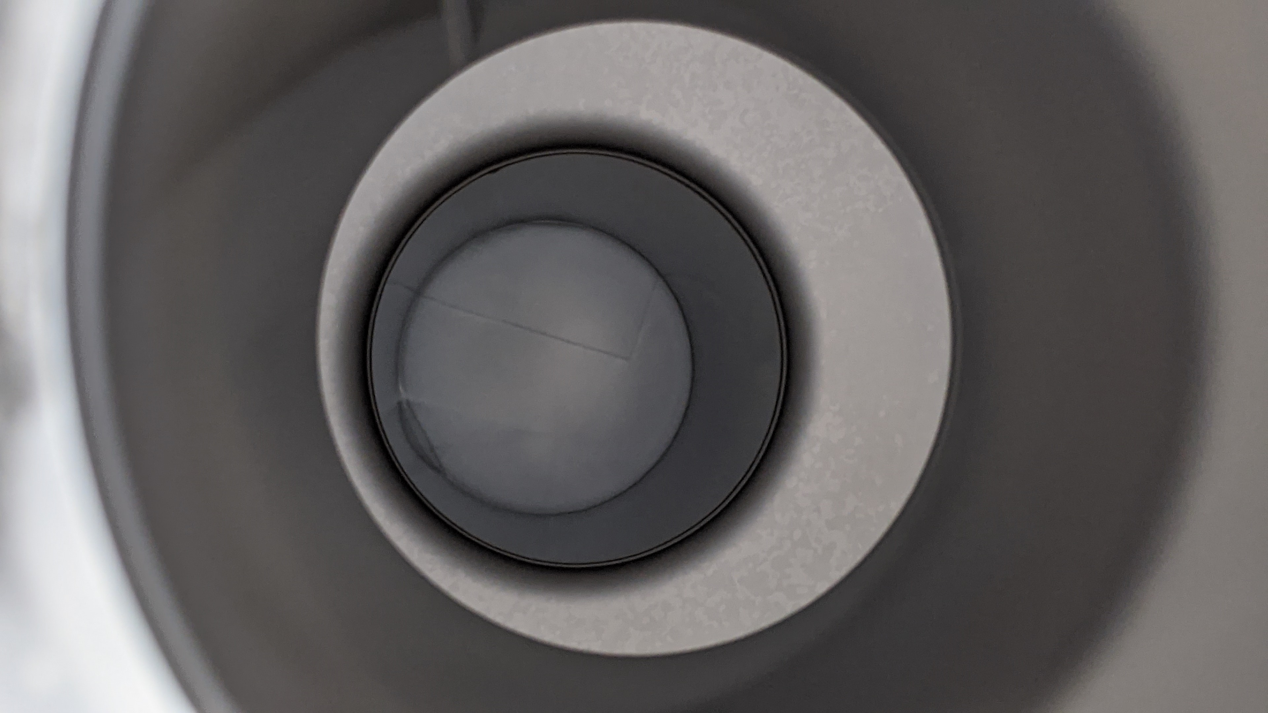
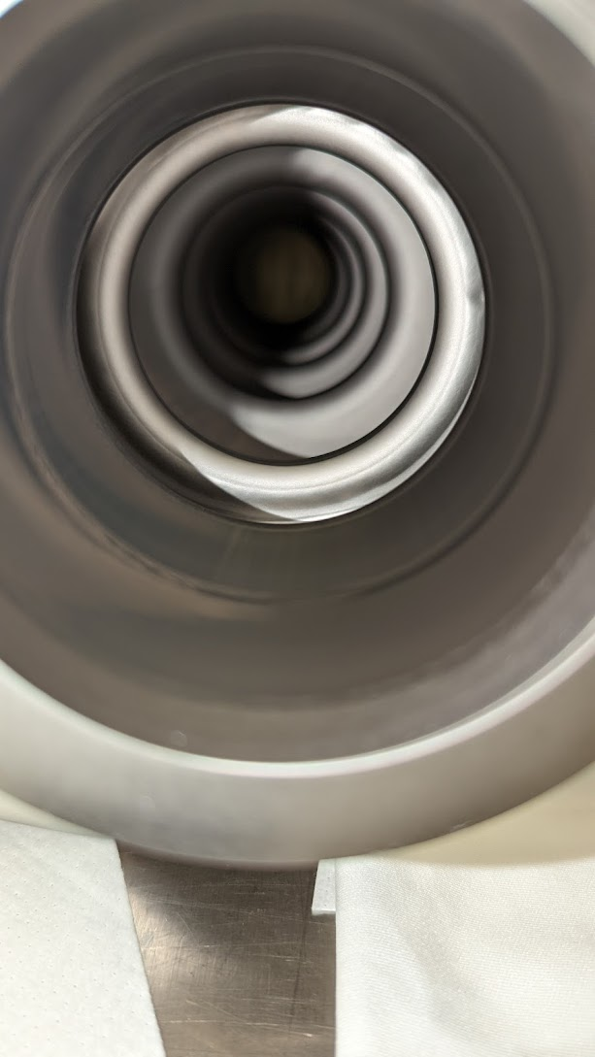
Cavity Performance of vapor-diffused Nb₃Sn
1.3/1.5 GHz R&D single-cell
1.3/1.5 Hz Multi-cell
1.3/1.5 GHz single-cell cavities attain an accelerating gradient over 20 MV/m with Q ~ 10¹⁰
Comparable performance for cavities of various frequencies (650 MHz, 952 MHz, 2.6 GHz, 3.6 GHz)
1.5 GHz five-cell and 1.3 GHz 9-cell cavities demonstrated Q ~ 10¹⁰ above 10 MV/m at 4.4 K
Maximum gradients achieved up to ~ 20 MV/m
Notable progress towards use in practical accelerators
U.Pudasaini et al. “Managing Sn-Supply to Tune Surface Characteristics of Vapor-Diffusion Coating of Nb₃Sn”, presented at the SRF'21, East Lansing, MI, USA, Jun.-Jul. 2021, doi:10.18429/JACoW-SRF2021-TUPTEV013.
S. Posen et al. “Advances in Nb₃Sn superconducting radiofrequency cavities towards first practical accelerator applications” Superconductor Science and Technology. 2021 Jan 11;34(2):025007.
D. Hall, “New Insights into the Limitations on the Efficiency and Achievable Gradients in Nb₃Sn SRF Cavities”, PhD thesis, Cornell University (2017).
G. Müller et al, "Status and prospects of Nb3Sn cavities for superconducting linacs," in Proceedings of the Workshop on Thin Film Coating Methods for Superconducting Accelerating Cavities, 2000
G. Eremeev “Progress in Nb3Sn developments for CEBAF-style quarter cryomodule” TTC-2022,
SRF Frontiers Workshop Nov 12, 2025

Slide 3
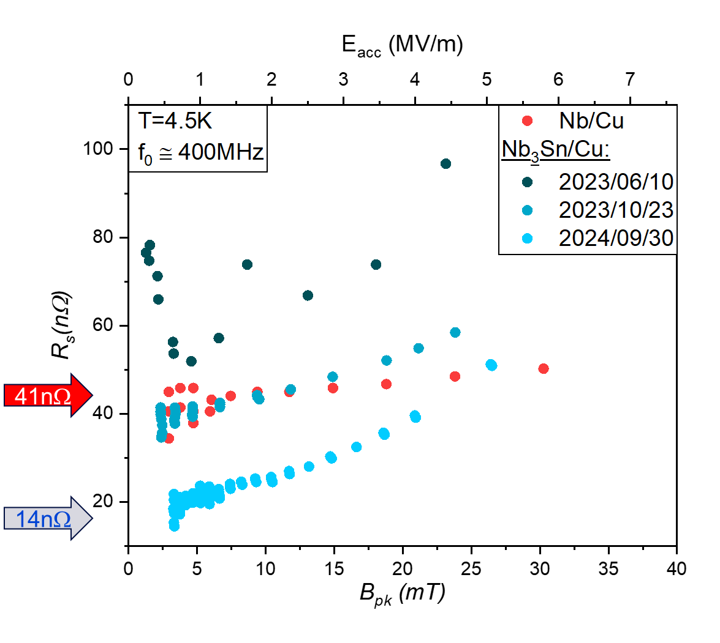
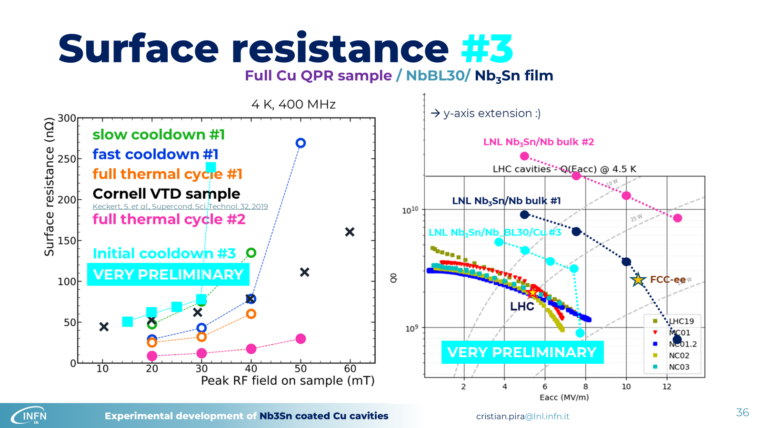


QPR Nb₃Sn/Cu
HiPIMS -50 eV bias
700 °C

Slide 4
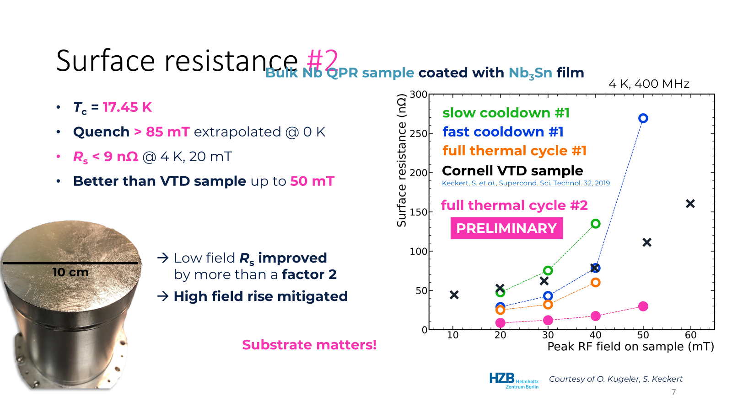
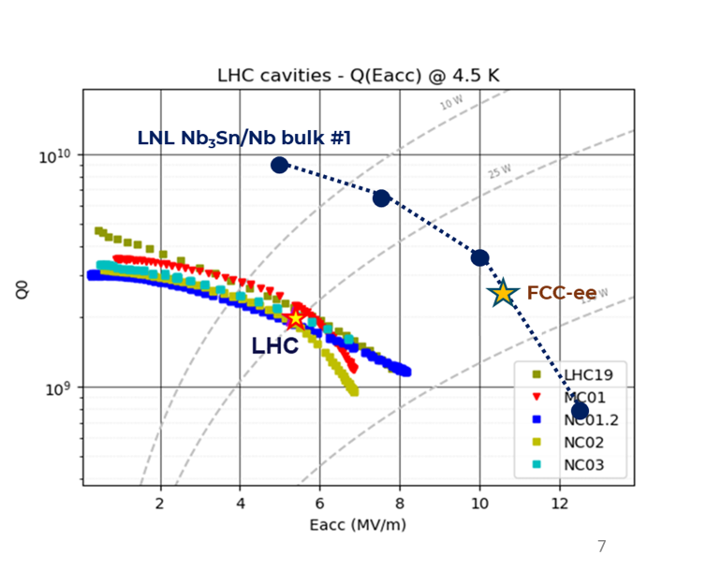
QPR Nb₃Sn/Nb

Slide 5
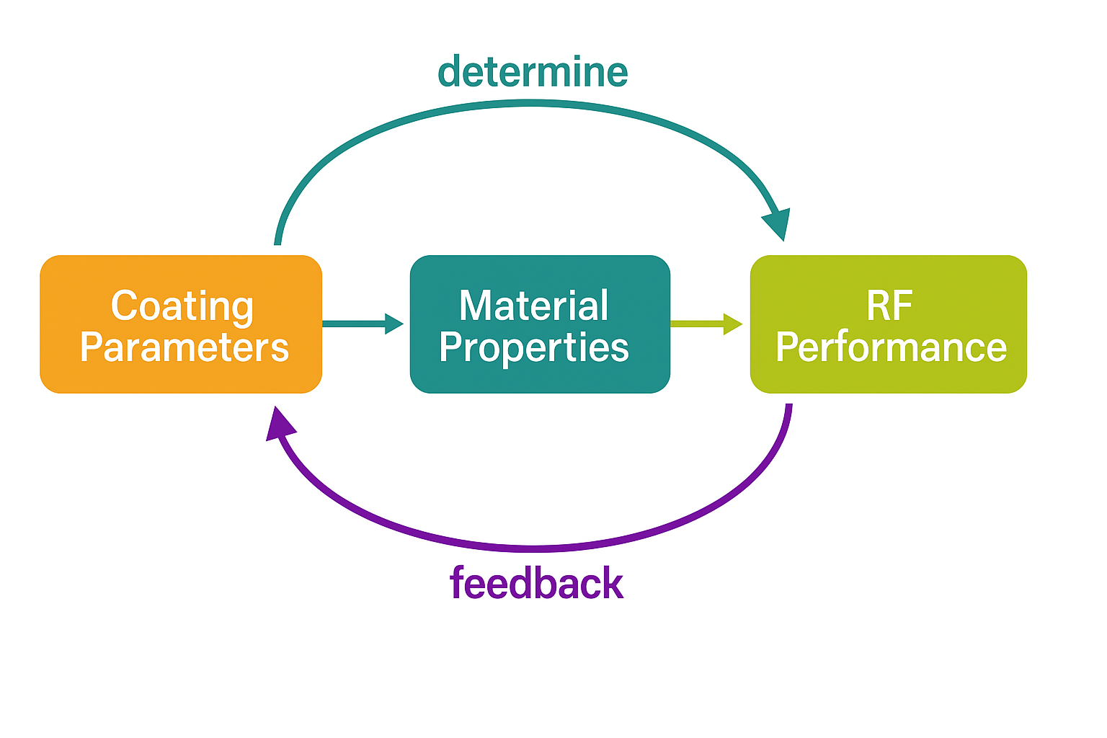
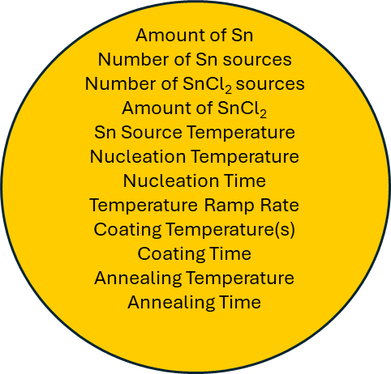

Pushing the Nb₃Sn Limits Further
Elucidate Nb₃Sn growth mechanisms in vapor diffusion coatings as a function of process parameters
Correlate material properties with RF performance to optimize coating parameters
Develop a feedback-driven coating growth model adaptable to arbitrary cavity geometries
Develop post-processing techniques for surface topography management
Study grain boundary structures and composition
Structure
Stochiometry
Morphology
Layer thickness
Uniformity

Slide 6
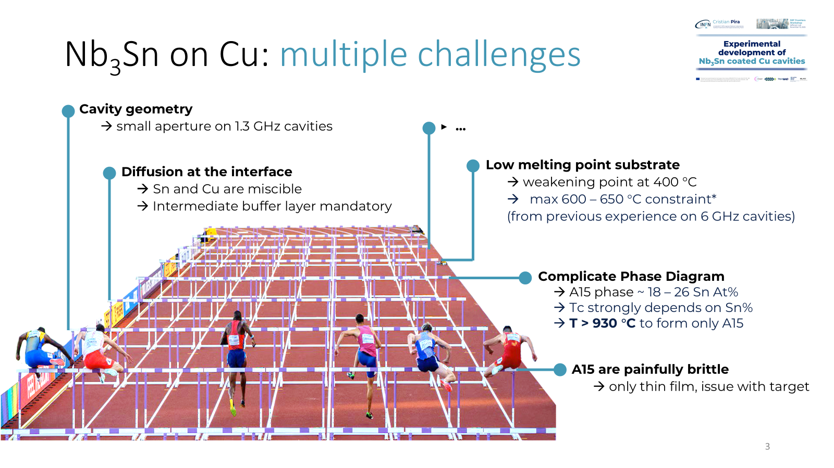
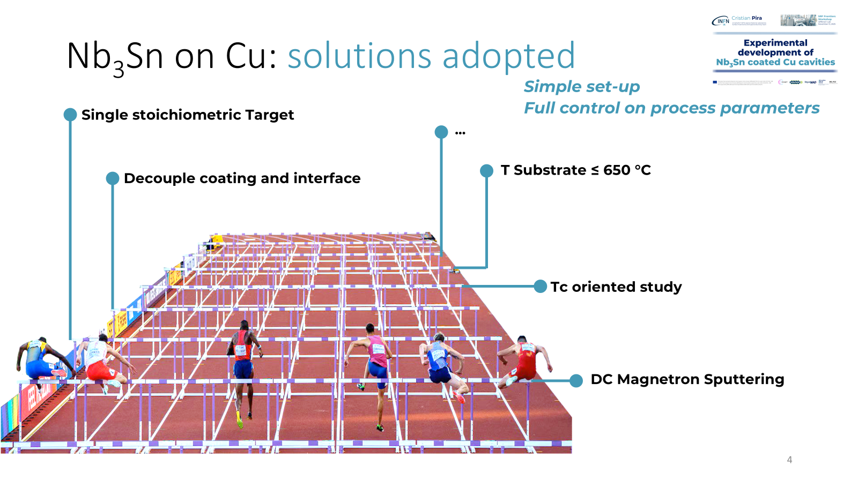
Nb₃Sn on Cu Challenges

Slide 7
Nb₃Sn Developments - requirements
Nb₃Sn, intermetallic A15 phase with long range order structure : the energetics are KEY
Sn vapor diffusion at 1100-1200 °C
CVD – pressure +substrate temperature 750-900 °C
DCMS – 5-7 eV ions + carrier gas pressure + substrate temperature 500-750 °C
HiPIMS – 50 eV + substrate temperature 700 °C

Slide 8
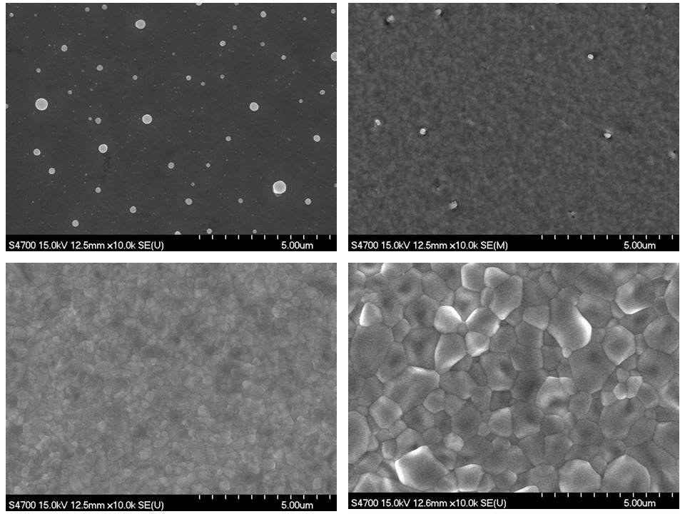
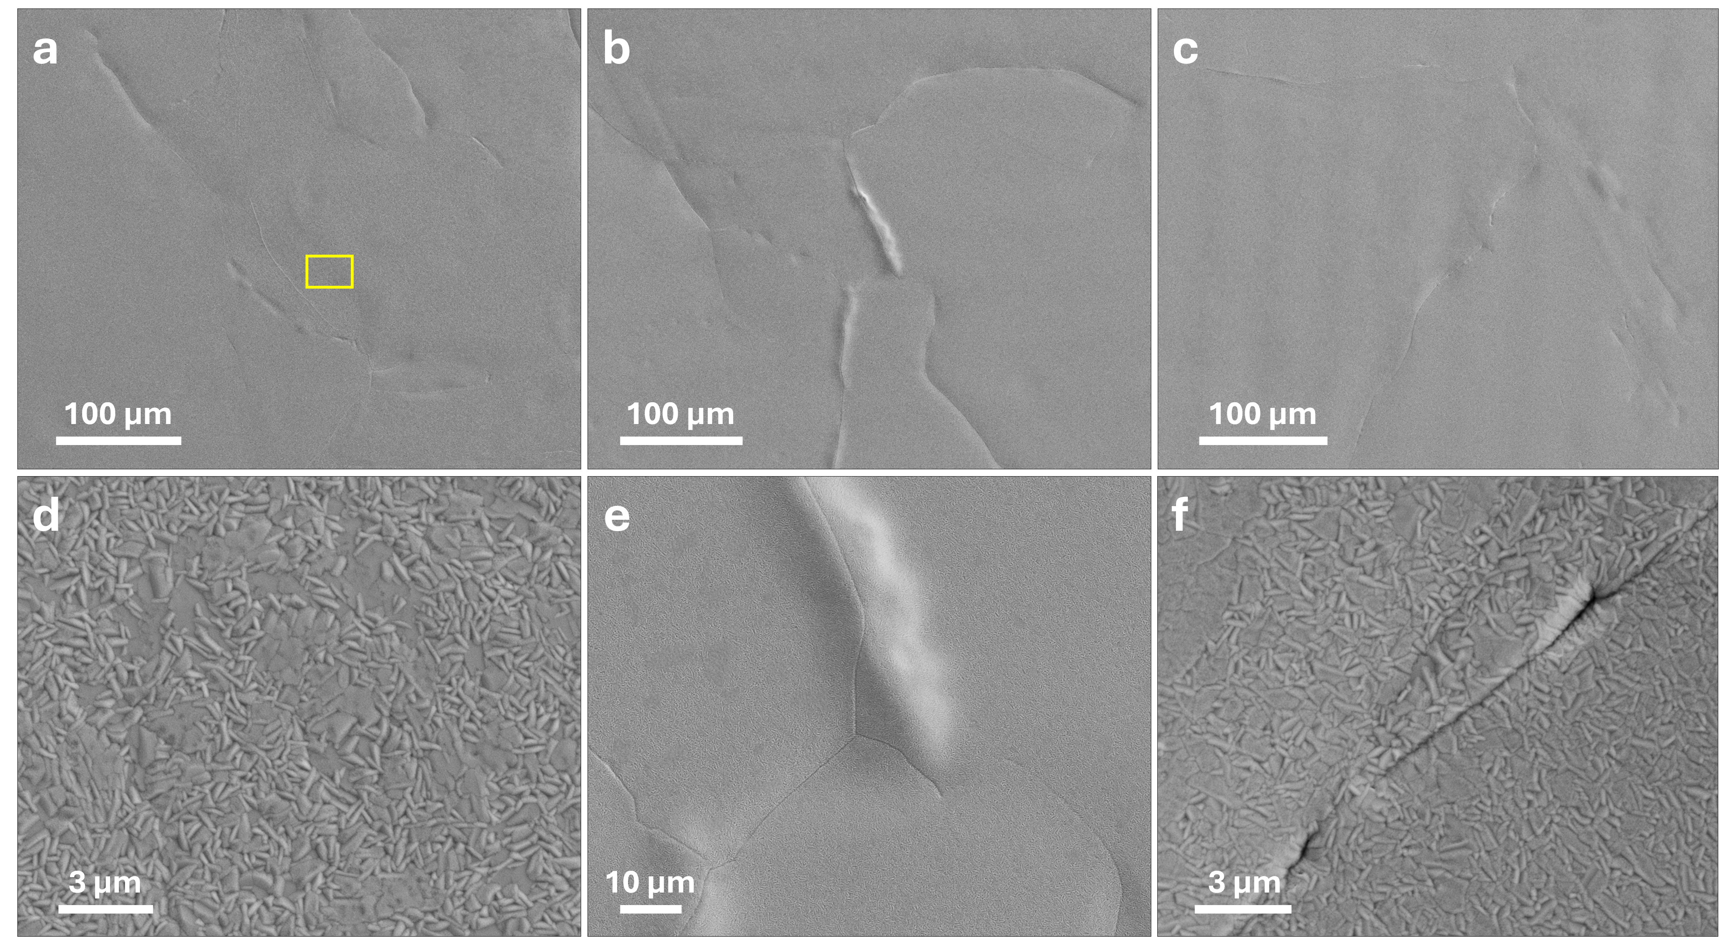
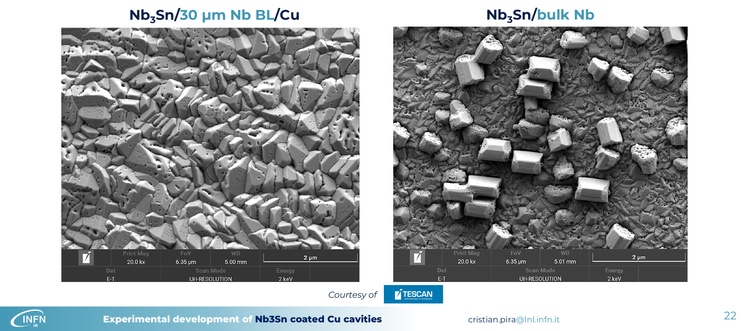
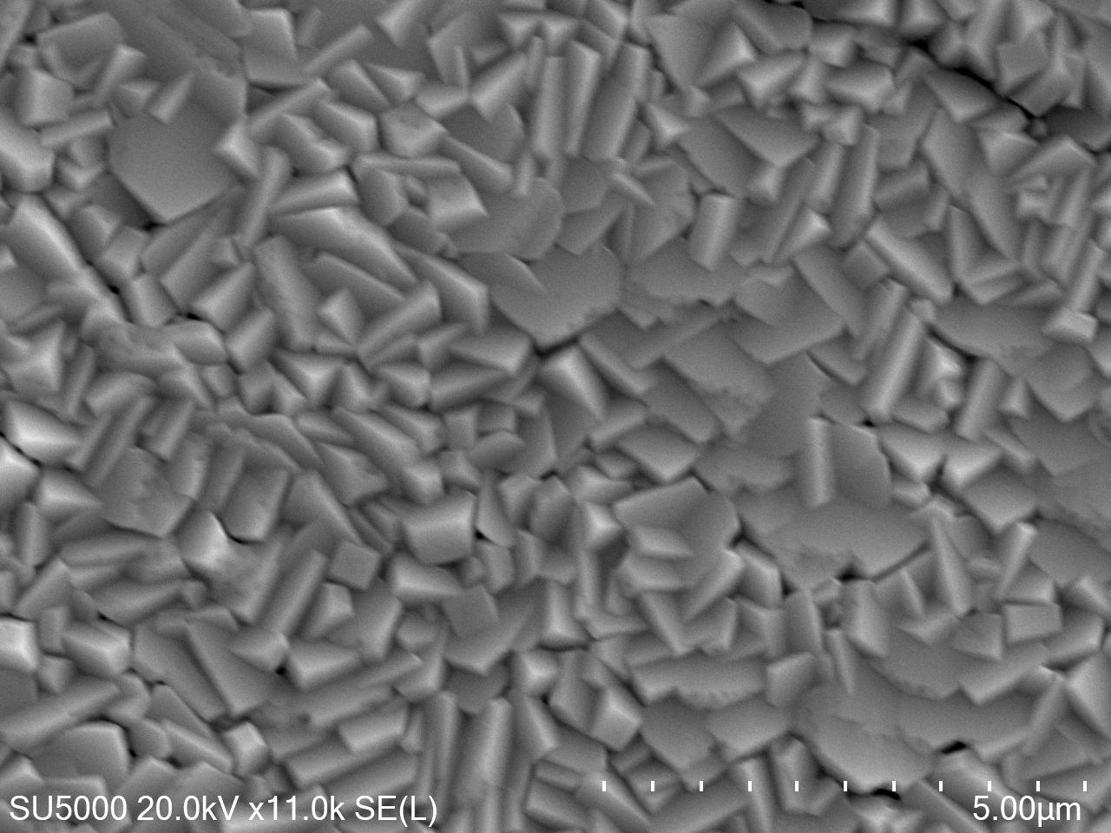
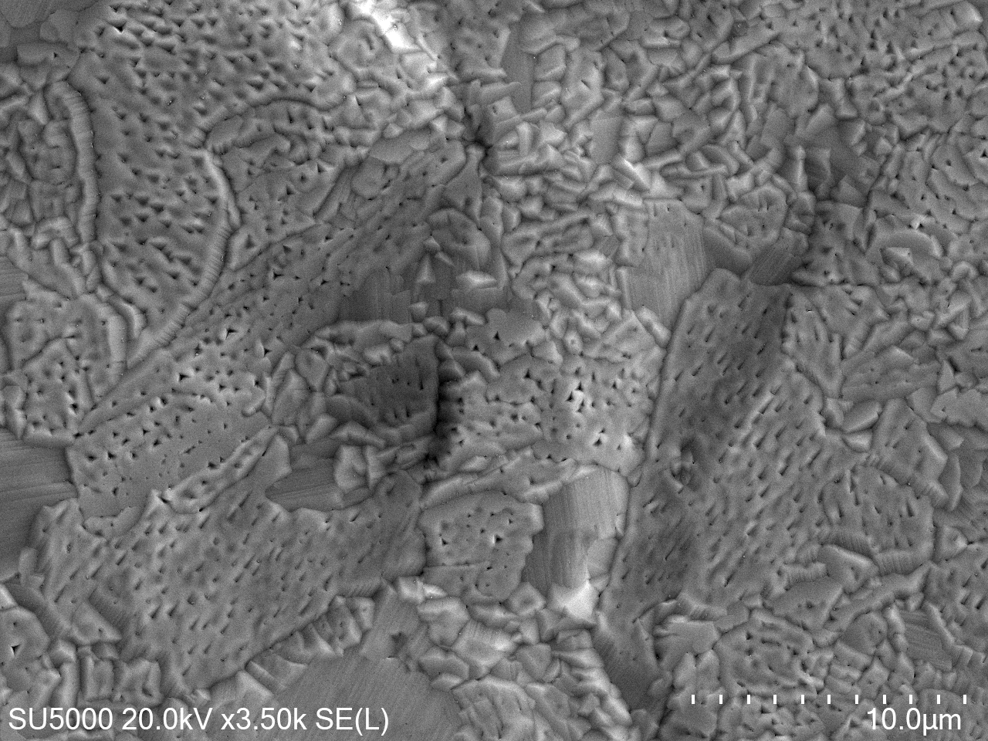
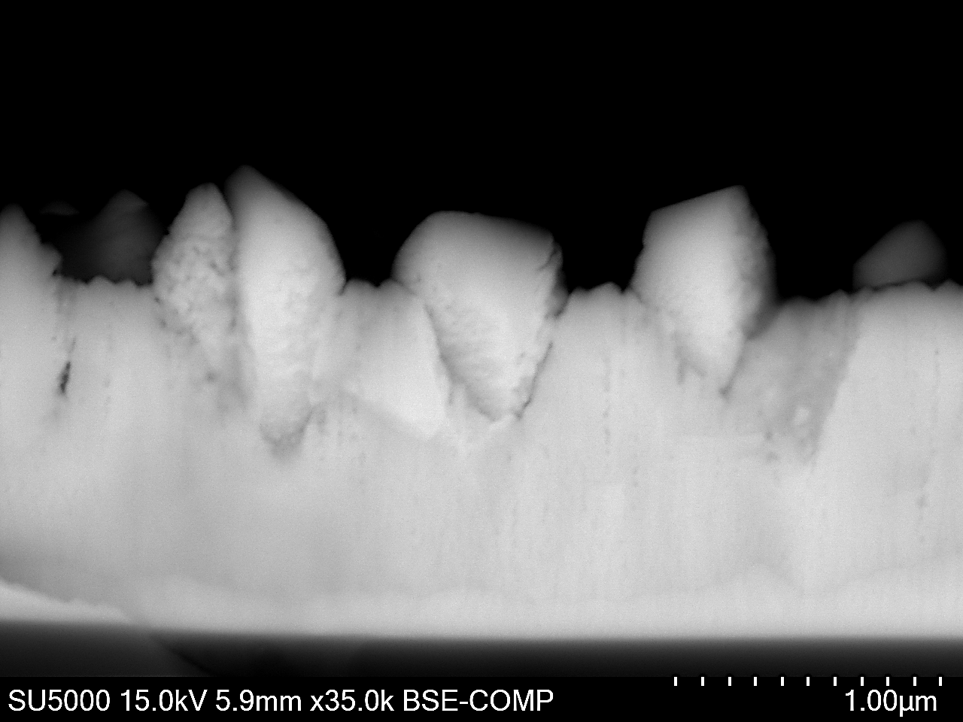

Nb₃Sn Morphology
Nb₃Sn/Nb by Vapor Diffusion
Nb₃Sn/Cu by HiPIMS
Nb₃Sn/Cu
Nb₃Sn/Nb
Nb₃Sn/Cu & Nb by DC-MS

Slide 9
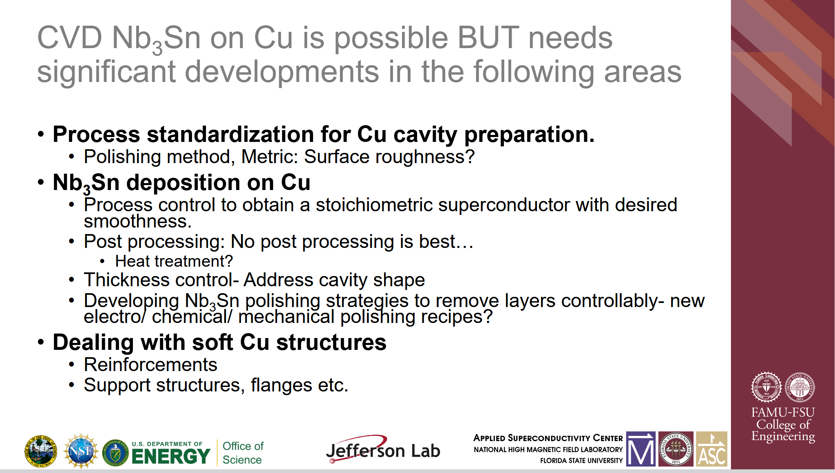
Tailor the Cu substrate : fabrication, processing…

