Slide 1
Materials science drivers for UEMs
11/14/2025 Jlab SRF workshop
Andrew R Lupini
Center for Nanophase Materials Sciences Oak Ridge National Laboratory

Slide 2
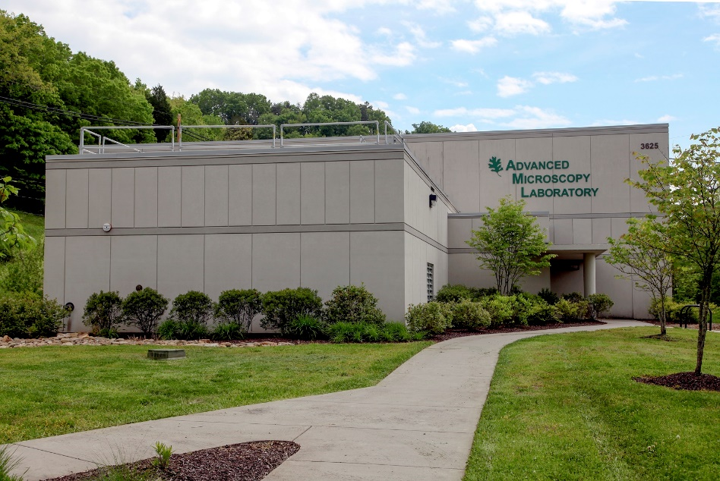
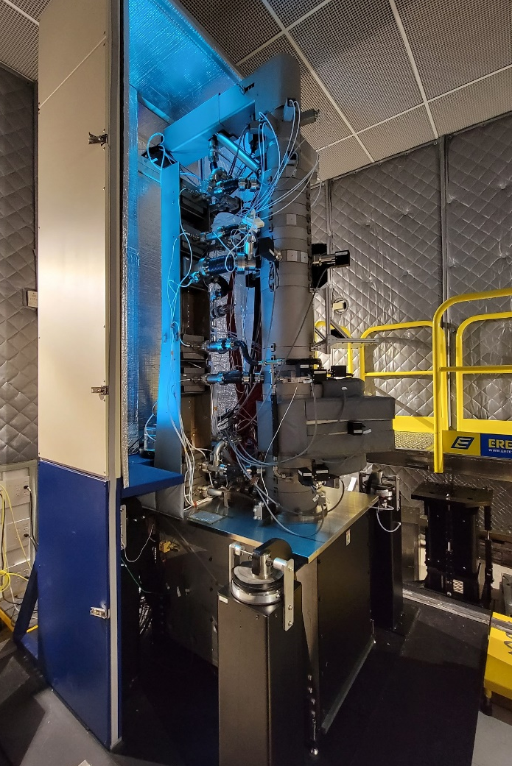
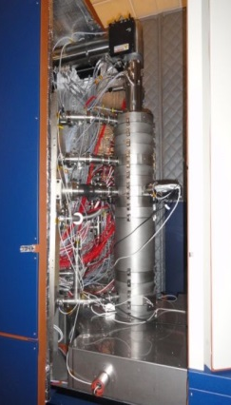
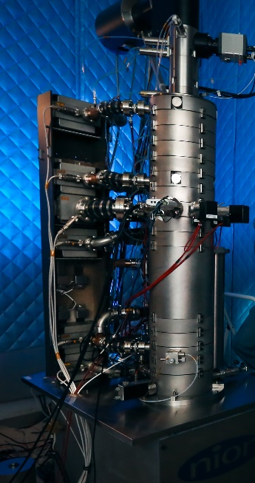
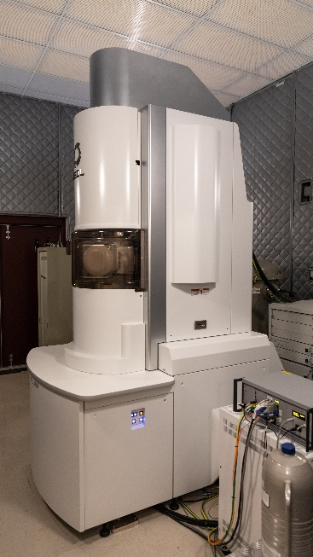
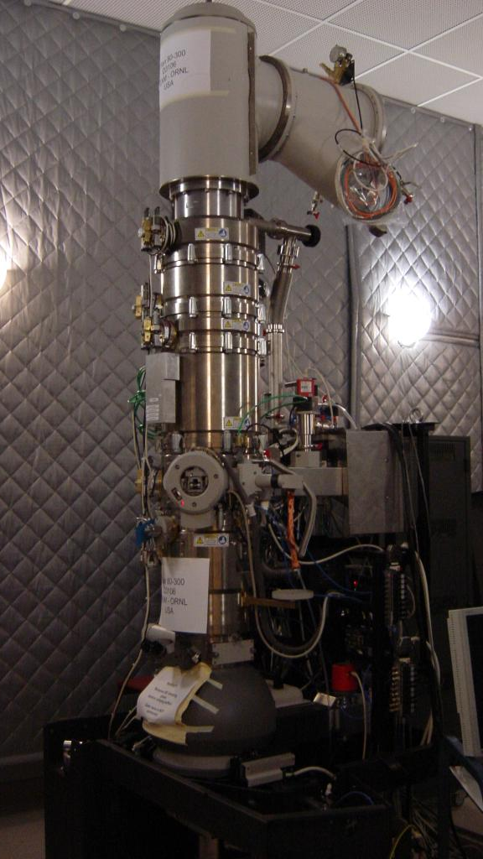
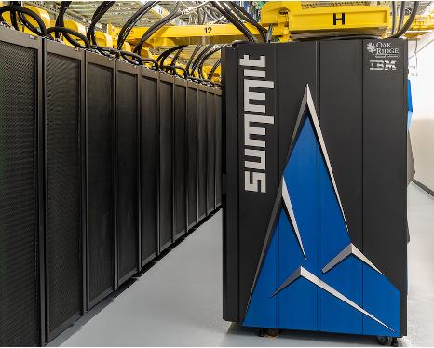
Electron microscopy at CNMS

Slide 3
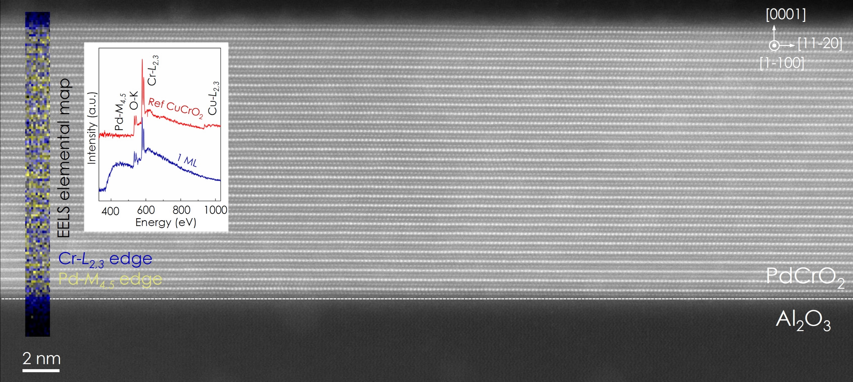
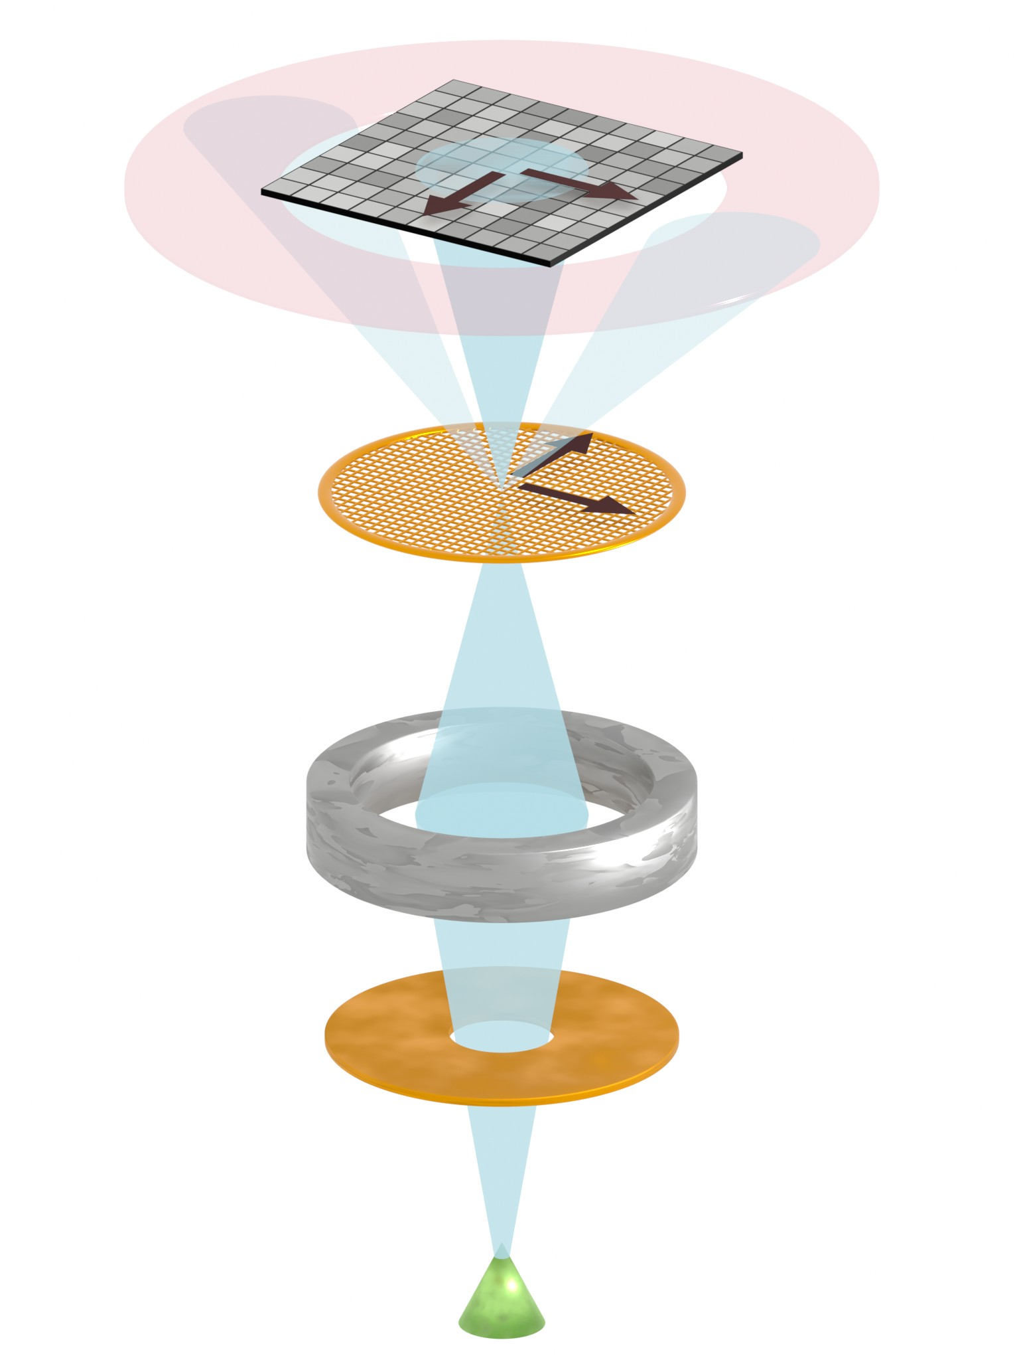
Scanning Transmission Electron Microscopy
Pixelated detector
Scan over sample
Lens
Electron
beam
J.M. Ok et al. APL Materials 8 (5), 051104 (2020)
Buffer layer (CuCrO₂) essential for single phase growth

Slide 4
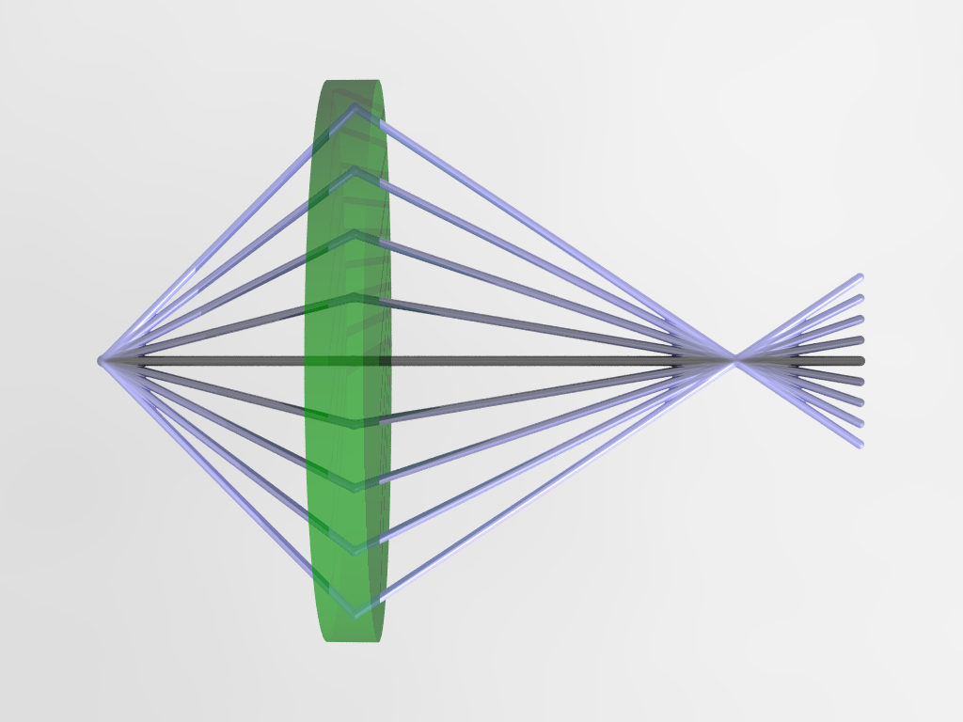
Ideal lens
Objective lens
Point source
High-angle rays
Low-angle rays
Minimum probe diameter
Source size needs to be small or be demagnified
Aperture
Gaussian focal plane
Ideal lens is diffraction limited:
Higher energies reduce wavelength

Slide 5
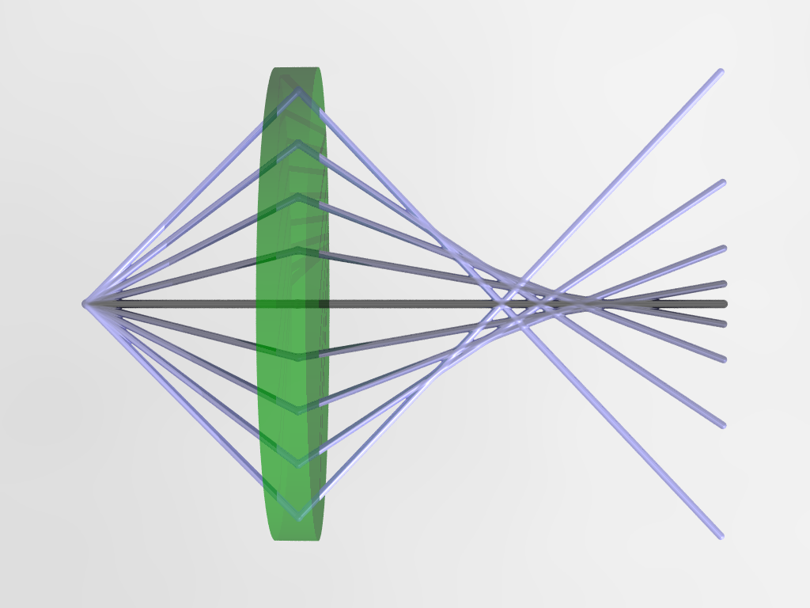
Aberrations
Objective lens
Over-focus
High-angle rays
Point source
Low-angle rays
Minimum probe diameter
Aperture
Gaussian focal plane
Real lens is limited by aberrations to ~ 50 wavelengths
Scherzer Theorem (1936) – Correction ideas (1947)
Notes:
Explain name spherical

Slide 6
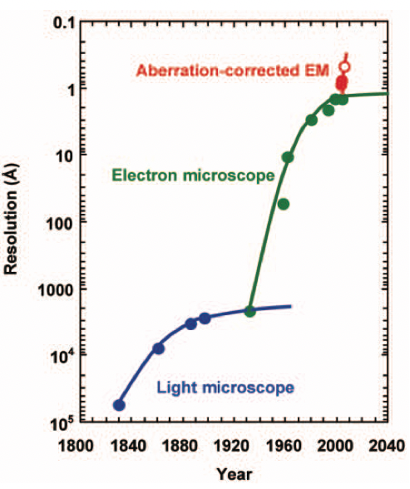
Spatial Resolution
Practical success by:
Krivanek et al. and Haider et al.
~2000
Pennycook et al. MRS Bulletin, 31, 2006

Slide 7
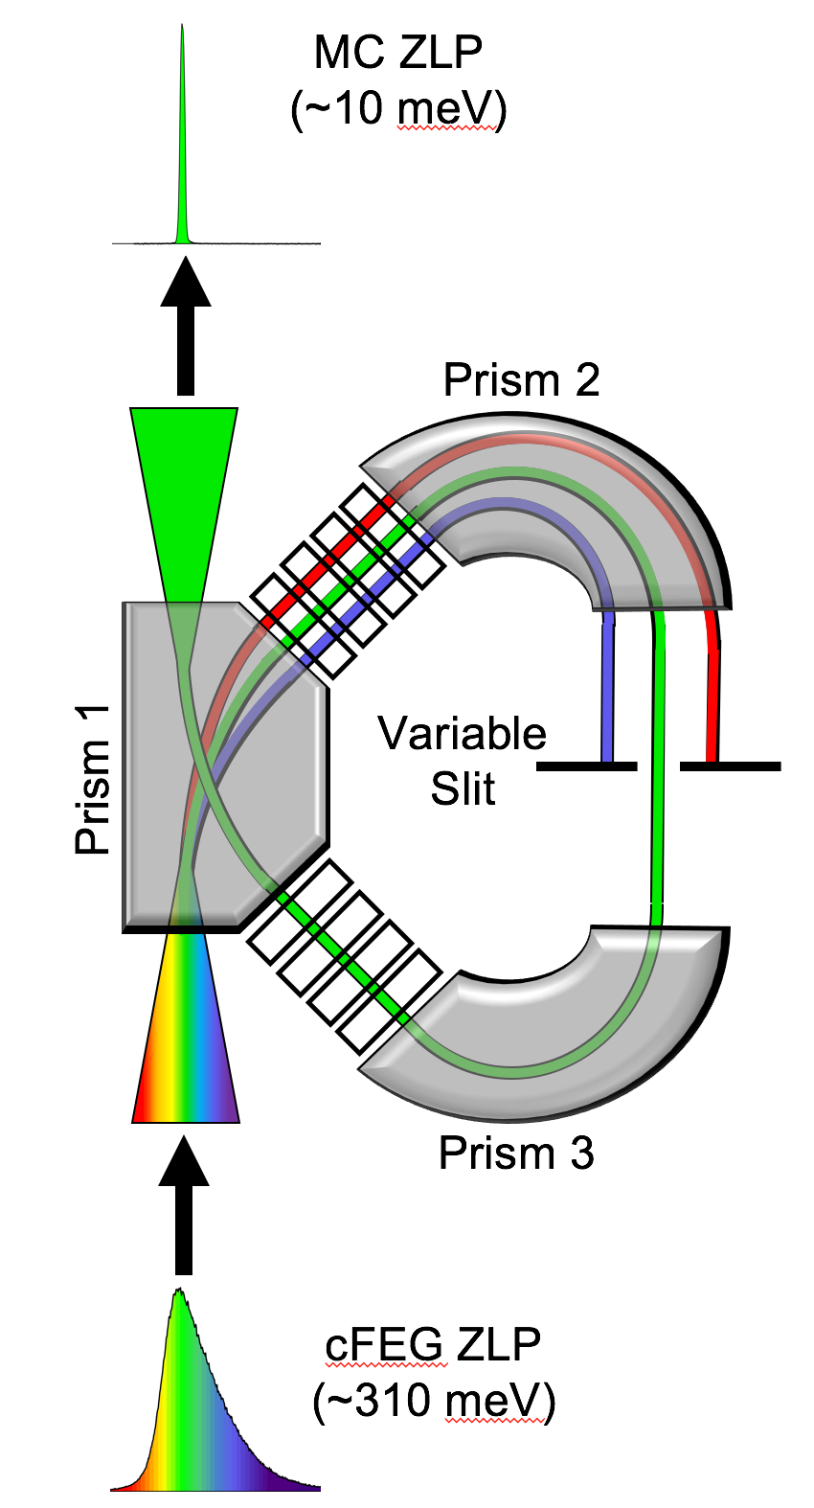
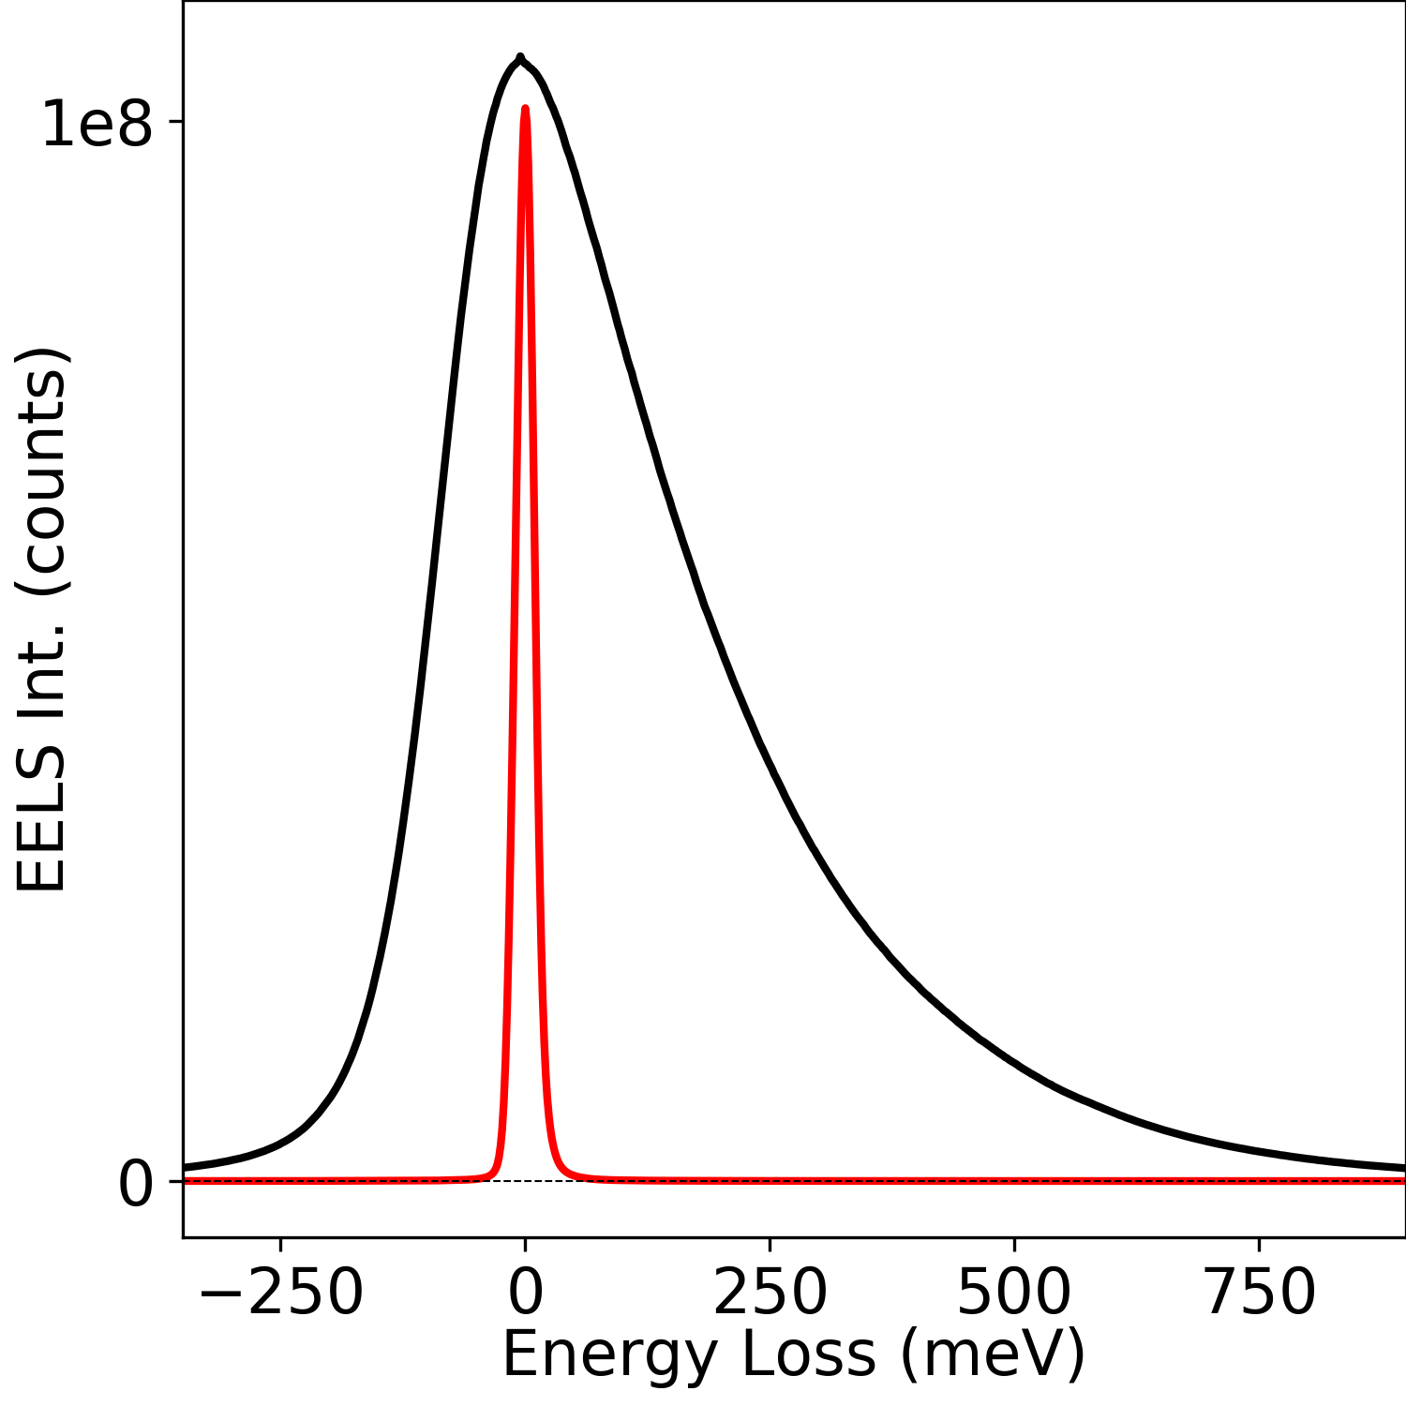
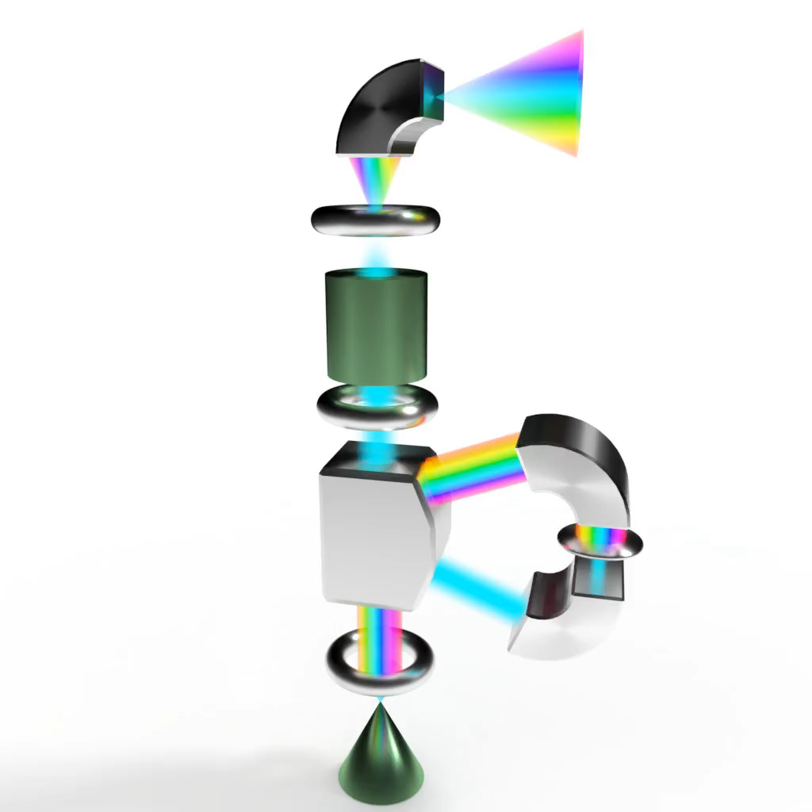
How else could the microscope be improved? Energy spread
Energy spread needs to be small
Krivanek et al (2014)
Hachtel et al (2018)

Slide 8
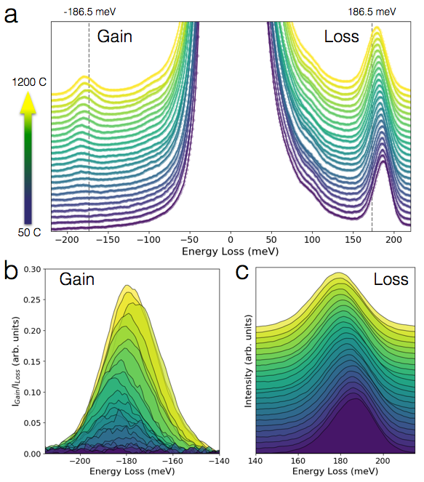
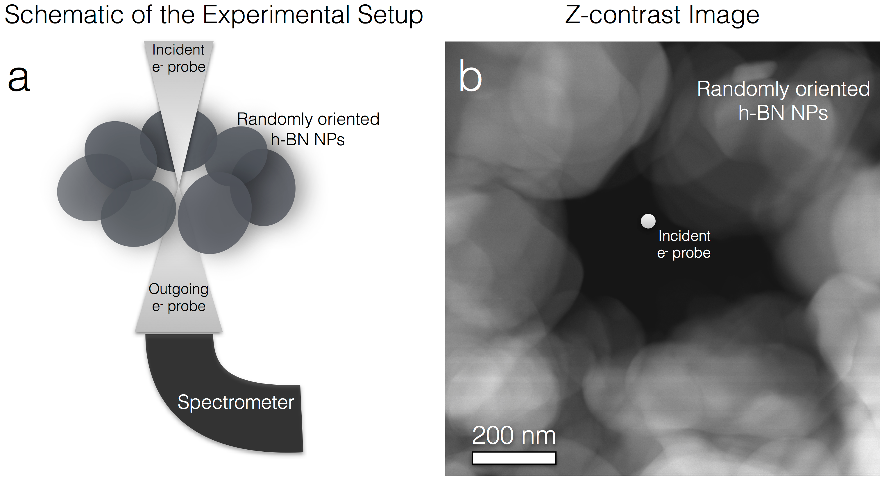
Phonon Spectroscopy in the Electron Microscope
Principle of detailed balance

Slide 9
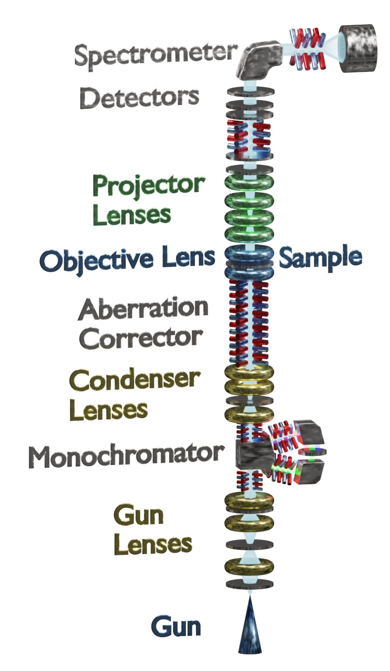
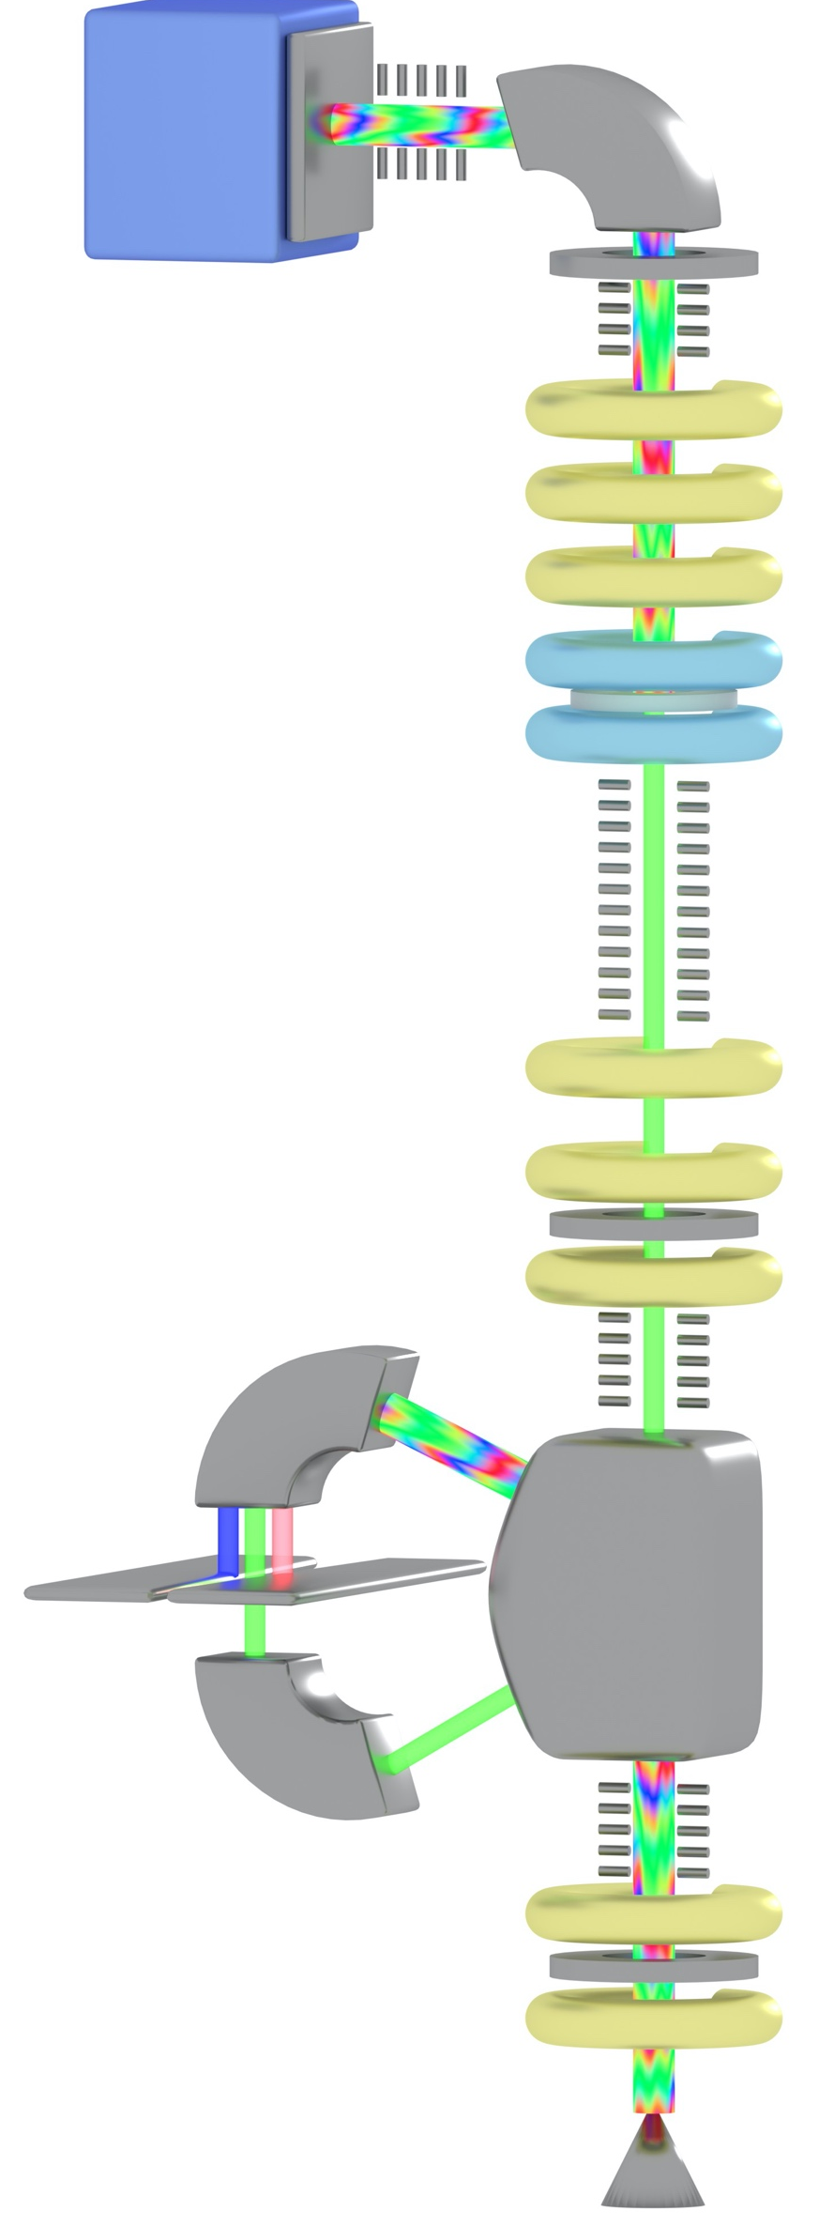
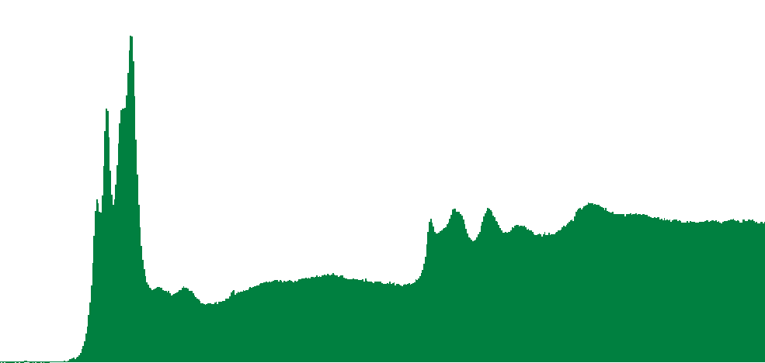
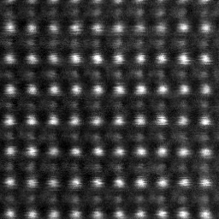
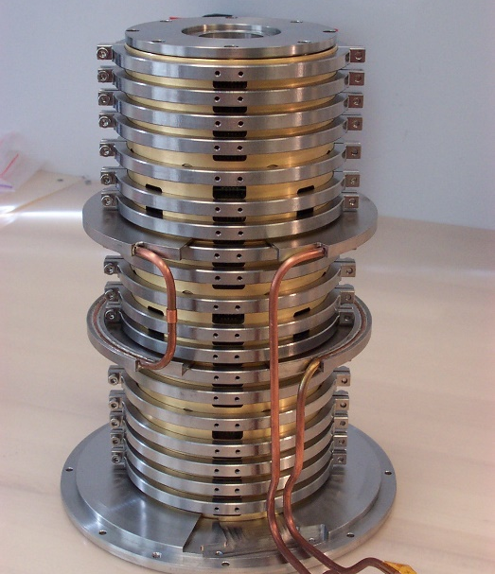
Scanning Transmission Electron Microscope
“Z-contrast”
Counts
Ti-L
O-K
Sample–
Energy
EELS: Chemical AND electronic information
Heavy
Light
Many other signals: BF, LAADF, MAADF, X-rays, secondary electrons, …
In HAADF mode we are not using most of the electrons that interact with the sample
Scattering to high angles depends on atomic number Z
Monochromator
A probe is focused onto the sample. Images are formed by scanning the probe and detecting the scattering on various detectors. HAADF only uses a small fraction of the electrons.
Aberration corrector has hundreds of optical elements

Slide 10
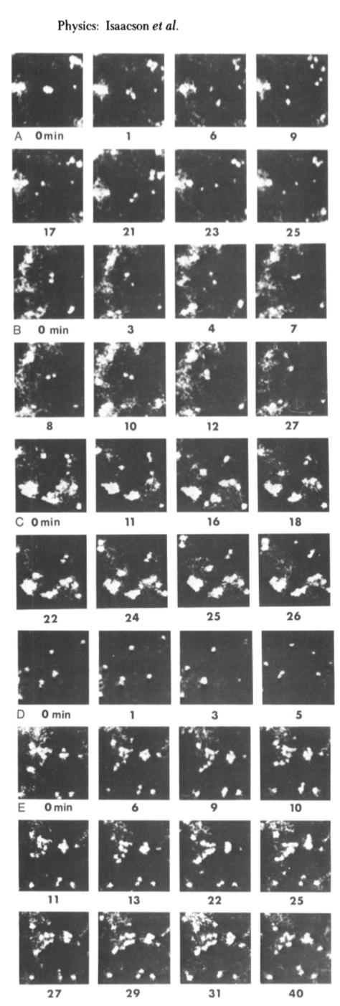
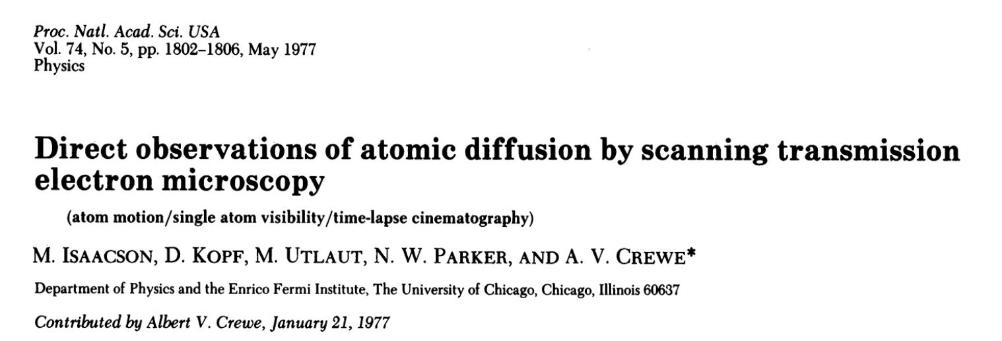
1977: First movies of single atoms
More motion at higher temperatures

Slide 11
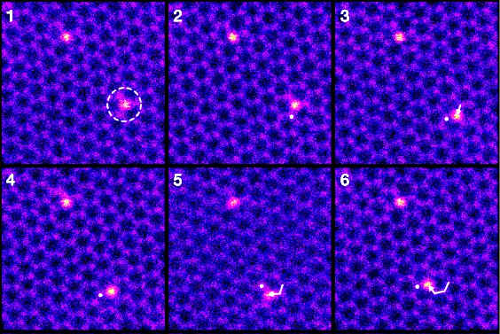
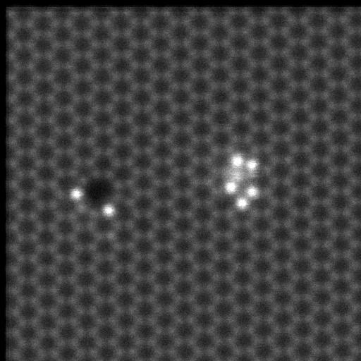
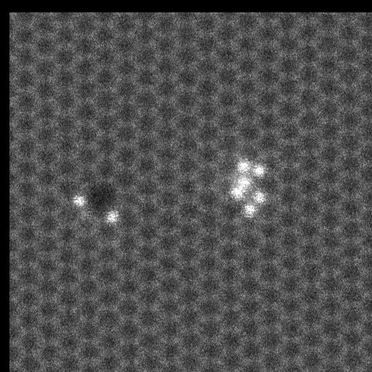
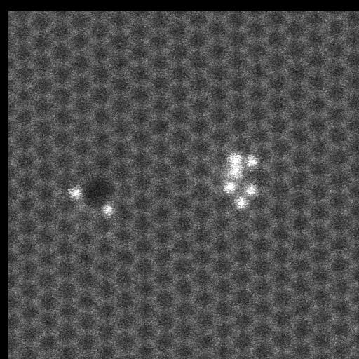
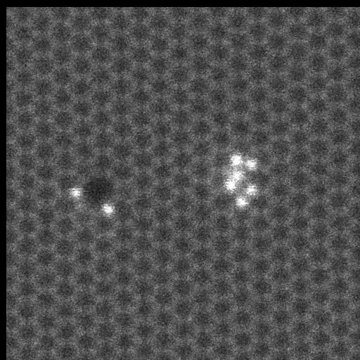
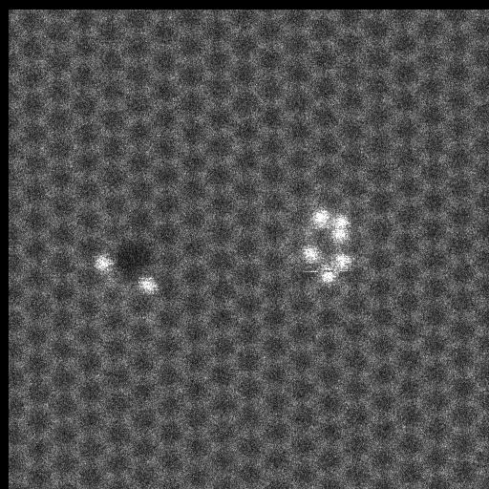
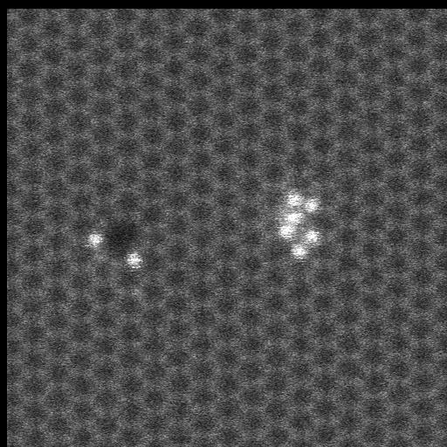
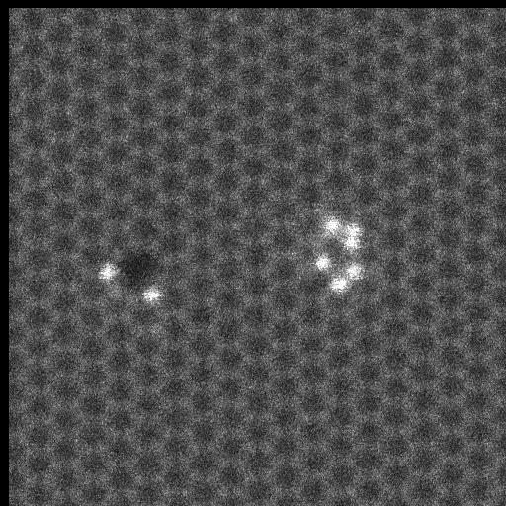
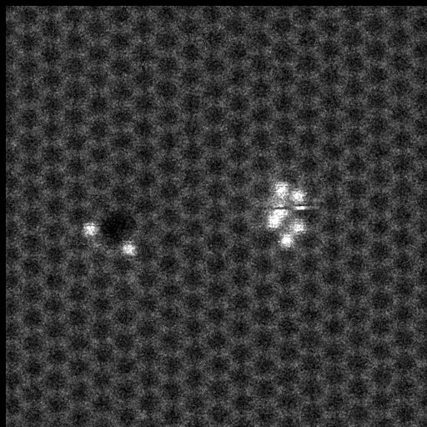
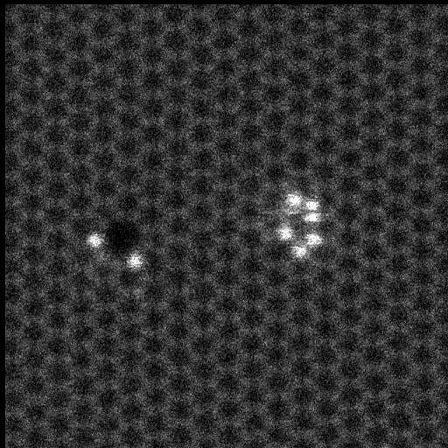
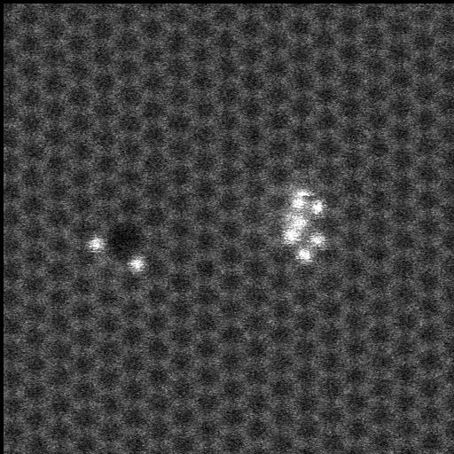
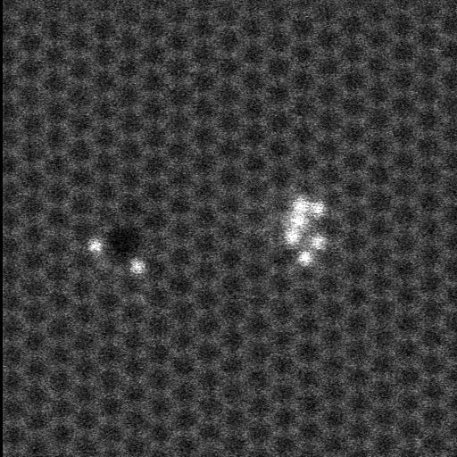
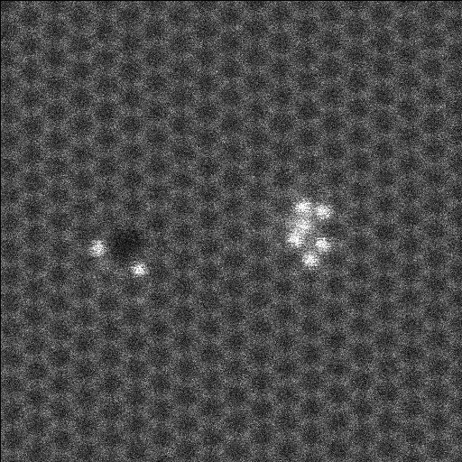
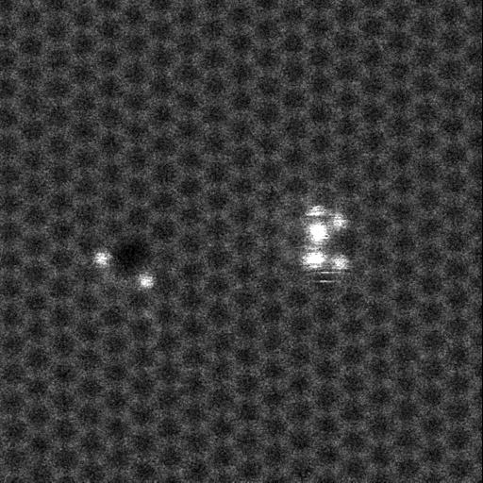
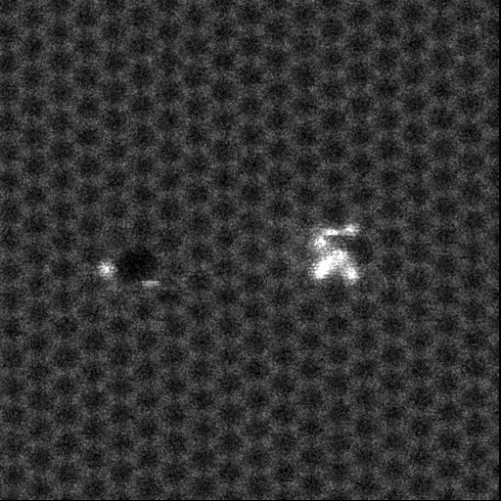
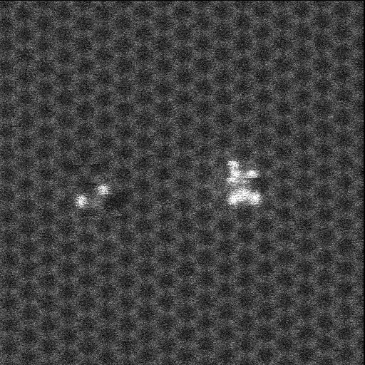
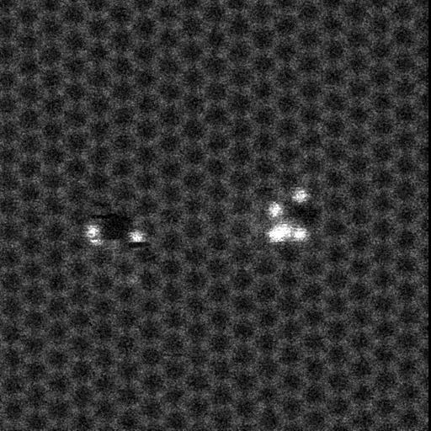
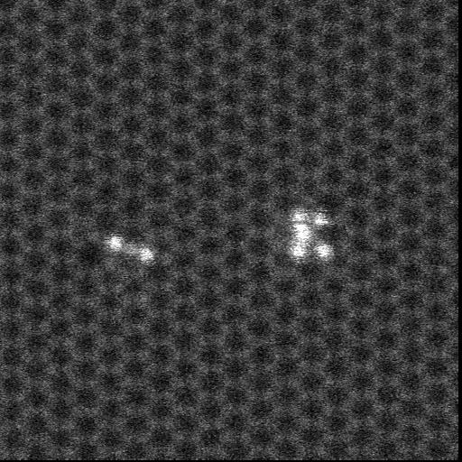
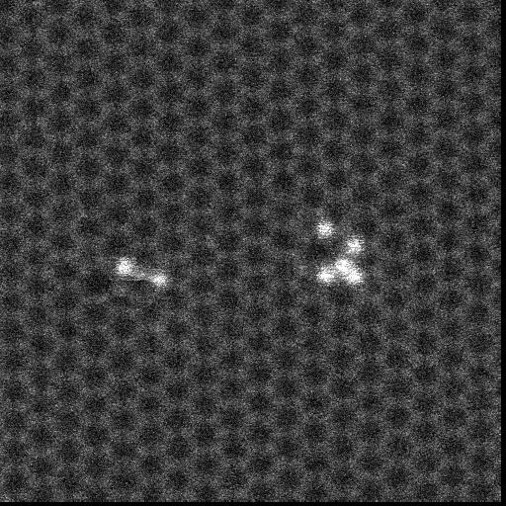
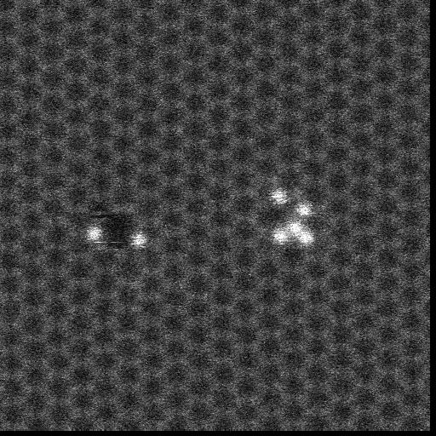
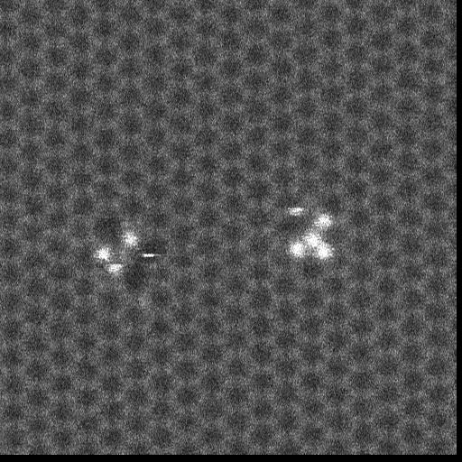
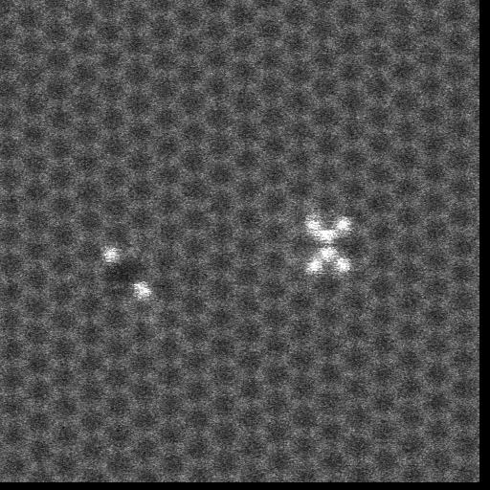
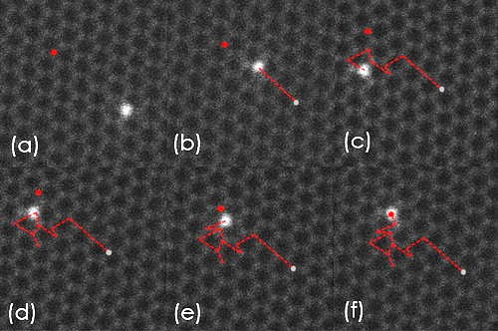
Moving Atoms in STEM
2D materials at 60 kV
Lee, J. et. al. Nat Commun, 4, 1650 (2013)
Zhou, W. (2011)
T. Susi et al., Phys. Rev. Lett. 113, 115501 (2014).
Susi, T. et. al. Ultramicroscopy, 180, 163-172 (2017).
Dyck, O. et. al. Appl. Phys. Lett. 111, 113104 (2017).

Slide 12
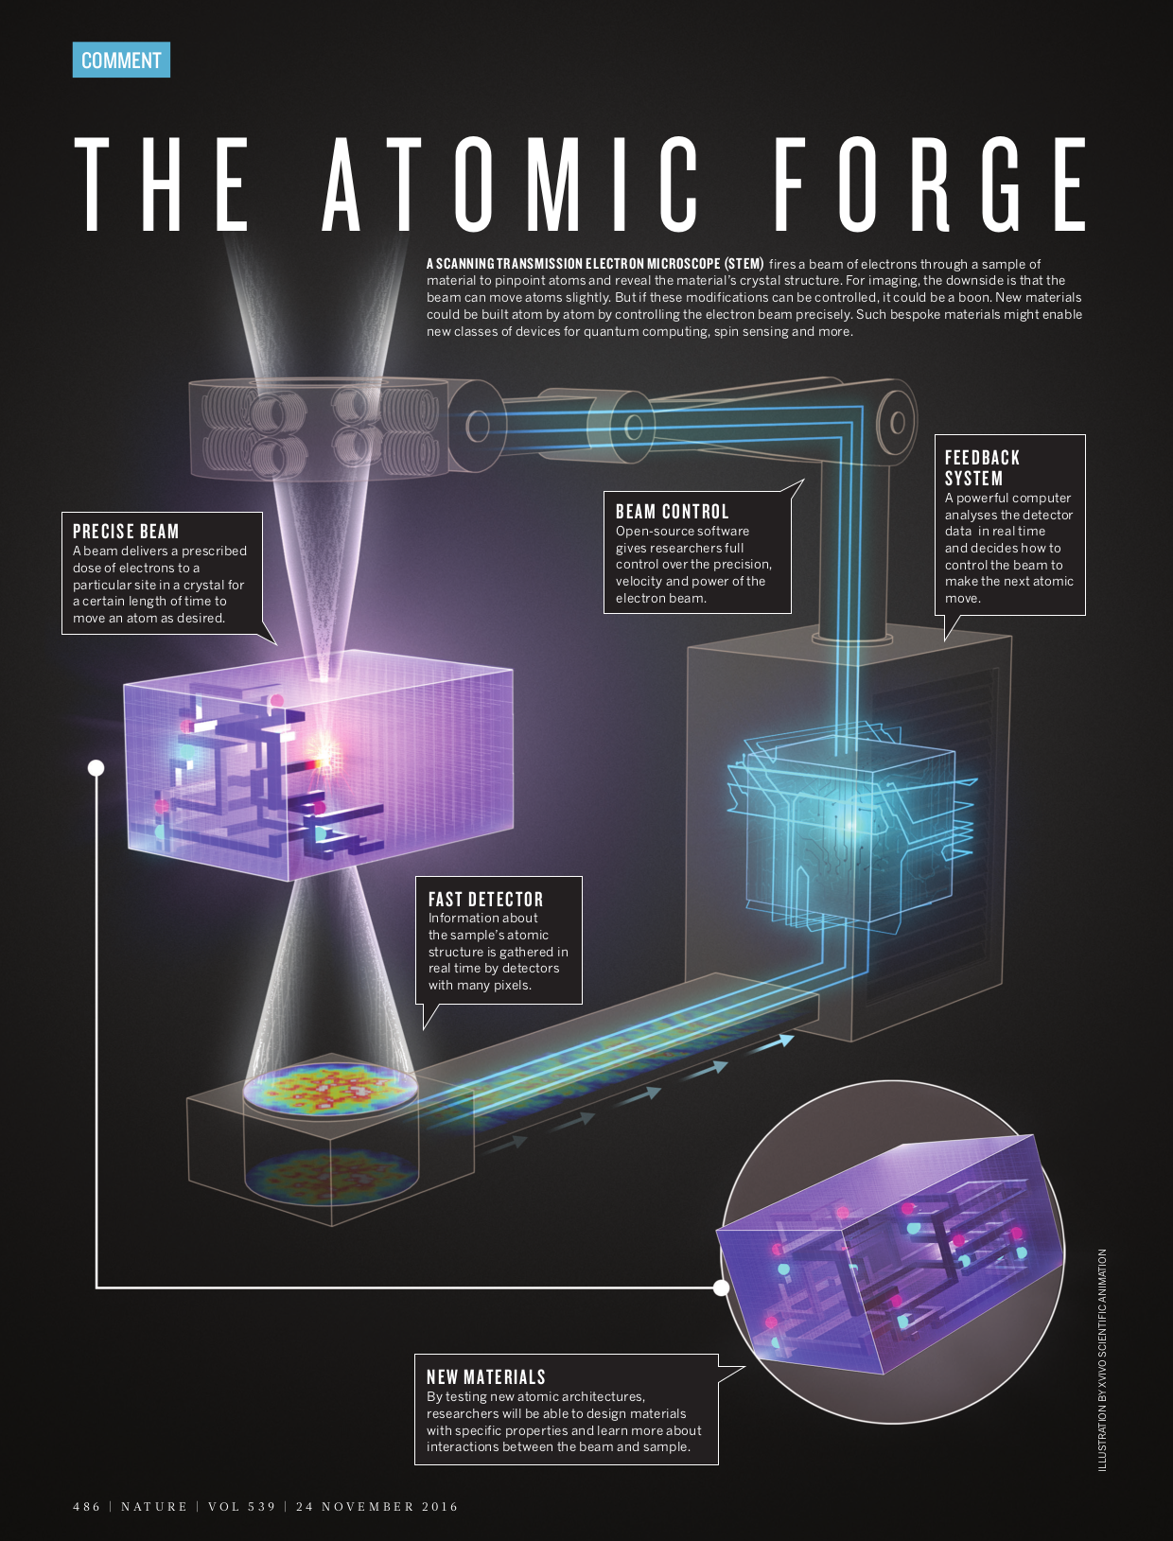
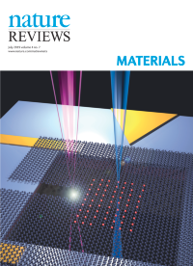
STEM Platform
High-precision beam (~1 Å)
Energy range (30-300 kV)
Can access material interior
Higher energies penetrate deeper but also cause more damage
Dyck, O., Ziatdinov, M., Lingerfelt, D.B. et al. Atom-by-atom fabrication with electron beams. Nat Rev Mater 4, 497–507 (2019). https://doi.org/10.1038/s41578-019-0118-z
Kalinin, Borisevich, Jesse, Nature 539, 485–487 (24 November 2016) doi:10.1038/539485a

Slide 13
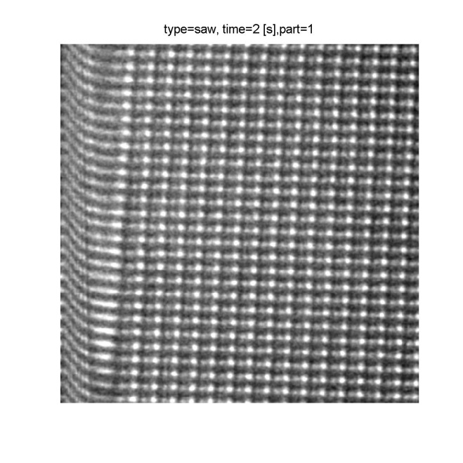



Automation: Higher speed and novel scans
Traditional Raster Scan for Imaging
Rapid change in direction,
Scan coils can’t keep up
Distortion due to mismatch of intended and actual beam position
Directed Defect formation
MoS₂
In a spiral scan, the signal to both scan coils is a single frequency sinusoid

Slide 14
Automation: Higher speed and novel scans
Traditional Raster Scan for Imaging
Rapid change in direction,
Scan coils can’t keep up
Distortion due to mismatch of intended and actual beam position
10 ms/frame
In a spiral scan, the signal to both scan coils is a single frequency sinusoid
Atom removal

Slide 15

Automation:
FPGA-based
Feedback Control
Array of Locations:
Single Location:
Dyck, O.; Yeom, S.; Lupini, A. R.; Swett, J. L.; Hensley, D.; Yoon, M.; Jesse, S. Top-down Fabrication of Atomic Patterns in Twisted Bilayer Graphene. arXiv January 4, 2023. https://doi.org/10.48550/arXiv.2301.01674.

Slide 16



Towards arrays of atoms
Dyck, O.; Yeom, S.; Lupini, A. R.; Swett, J. L.; Hensley, D.; Yoon, M.; Jesse, S. Top-down Fabrication of Atomic Patterns in Twisted Bilayer Graphene. arXiv January 4, 2023. https://doi.org/10.48550/arXiv.2301.01674.

Slide 17

High speed excitation? Laser concept

Slide 18


Laser illumination
Want:
Sample heating / cleaning
Differential (local) heating
Optical excitation
Problem:
Don’t want to have to tilt
UHV
Maintain existing capabilities
Budget!
Fiber-optically coupled laser

Slide 19



High- speed detectors: TimePix4
Merlin EELS
Quantum Detectors Merlin TimePix4
~200 pS time resolution
Design and model: Alexander Reifsnyder
Mathieu Benoit (ORNL) and CERN

Slide 20


Slide 21


Slide 22


Electrons hit multiple pixels
1e⁻
Escape peak
2e⁻
Need to separate/cluster events
Determine probe position at that time
Extensive processing to images
~ 160GB/sec!

Slide 23
Discussion: Could SRF technologies work with S/TEM?
From this talk:
  Source size needs to be small or be demagnified
  Energy spread should be small
  Higher voltages damage/change the sample more (roughly speaking) – I’d want 20-300kV
  Fast feedback can mitigate/use these changes
  Fast blanking would be useful
Pulsed source:
  S/TEM Time resolution? Detectors/laser approaching ~ nS
  Current source: ~uA, STEM beam (~pA) ~1 electron every few nanoseconds
  What if we knew when the electron left the source?
Other:
  Cryogenic S/TEM is improving (damage and ‘quantum’ materials)
  Interest in superconducting lenses
  Very fast scanning?
  Ultrafast projects: – mostly diffraction and TEM?
    e.g. Ruedi project in the UK
Electron microscopy is quite good at solving materials problems…

Slide 24






Center for Nanophase Materials Sciences
A DOE User Facility for Creating, Characterizing,
and Understanding Nanomaterials
Providing free access to staff expertise and equipment if intent is to publish results.
Proposals:
Research areas:
Simple, two-page narrative
Two general calls per year
Short-term projects accepted continuously
Joint proposals with neutron sources (SNS, HFIR)
Synthesis – Soft matter (precision synthesis, selective deuteration), 2D materials, hybrid structures, epitaxial oxides
Nanofabrication – Direct-write (3D) fabrication, e-beam lithography, multiscale fluidics,
10,000 sq. ft. cleanroom
Advanced Microscopy – AFM, STM, aberration-corrected and in situ TEM/STEM, He-ion microscopy, atom-probe tomography
Chemical Imaging – Multiple approaches based on mass spectrometry or optical spectroscopies
Functional Characterization – Laser spectroscopy, transport, magnetism, electromechanical phenomena
Theory/Modeling, Data Analytics – Including interactions and co-development with leadership-class, high-performance computing
Gateway to Neutron Sciences – deuterated materials, sample environments, multimodal measurements
cnms.ornl.gov

Slide 25
Acknowledgements
This work was supported by the U.S. Department of Energy, Office of Basic Energy Sciences, Division of Materials Sciences and Engineering. Experiments were performed at the Center for Nanophase Materials Sciences (CNMS), a U.S. DOE Office of Science User Facility at Oak Ridge National Laboratory (ORNL).
Collaborations with, Waviks Inc., Quantum Detectors and Nion Co. are gratefully acknowledged.
Includes contributions from:
Ondrej Dyck, Alexander Reifsnyder, Jacob Swett, Mina Yoon, Stephen Jesse, Miaofang Chi, Maxim Ziatdinov, David Lingerfelt, Ray Unocic, Bethany Hudak, Sergei Kalinin, Albina Borisevich, Songkil Kim, Cheng Zhang, Philip Rack, Jason Fowlkes, Bobby Sumpter, Elisa Jimenez-Izal, Ivan Kravchenko, Leslie Wilson, Ivan Vlassiouk, Ryo Ishikawa, Sangmoon Yoon, Ho Nyung Lee, Yueming Guo, Lizhi Zhang, Sinchul Yeom, Sarah Dillender, Dale Hensley, Jan Mol, Dave Geohegan, Toma Susi, Alexander Markevich, Steven Stevenson, Harry Dorn, Tanisha Richardson, Wu Zhou, Mathieu Benoit, Jordan Hachtel
Slides for: SRF Frontiers Workshop at Jefferson Lab, 2025/11/14

