Slide 1
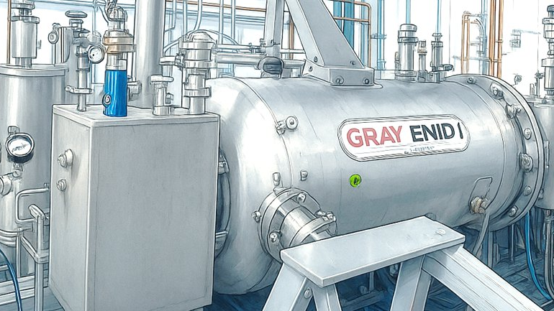

Applications of Compact SRF Accelerators
SRF Frontiers Workshop @ JLab ‘25
2025-11-13
John Vennekate
Notes:
Tip: Keep titles under 60 characters for readability
To change the photo: Right-click on photo and select change photo

Slide 2
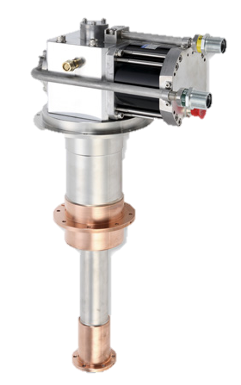
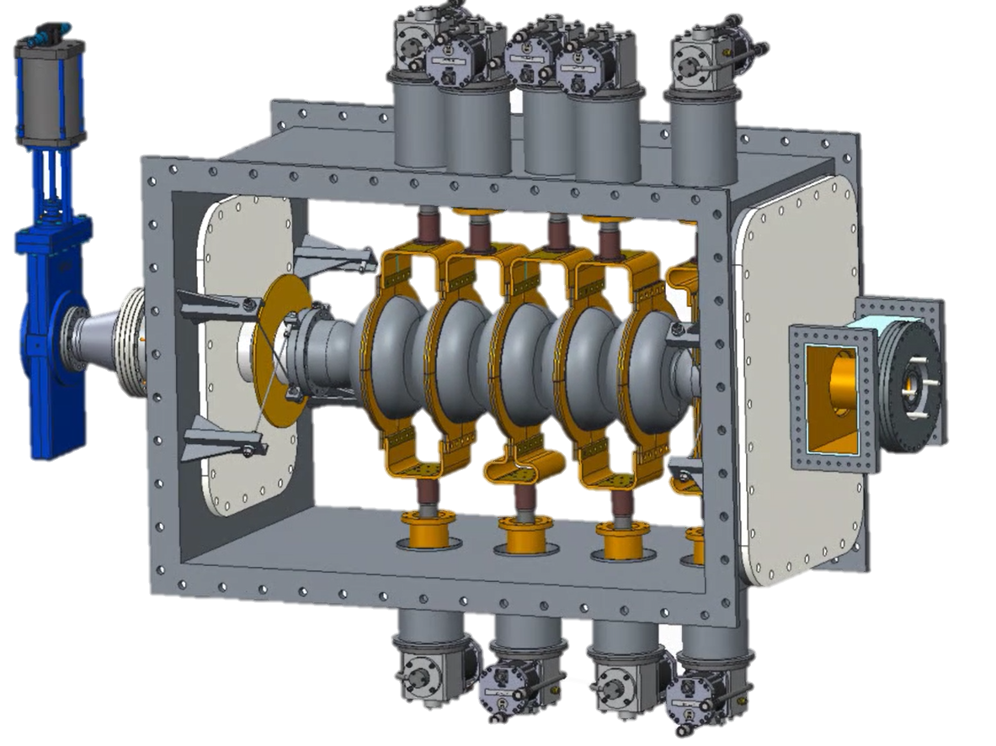
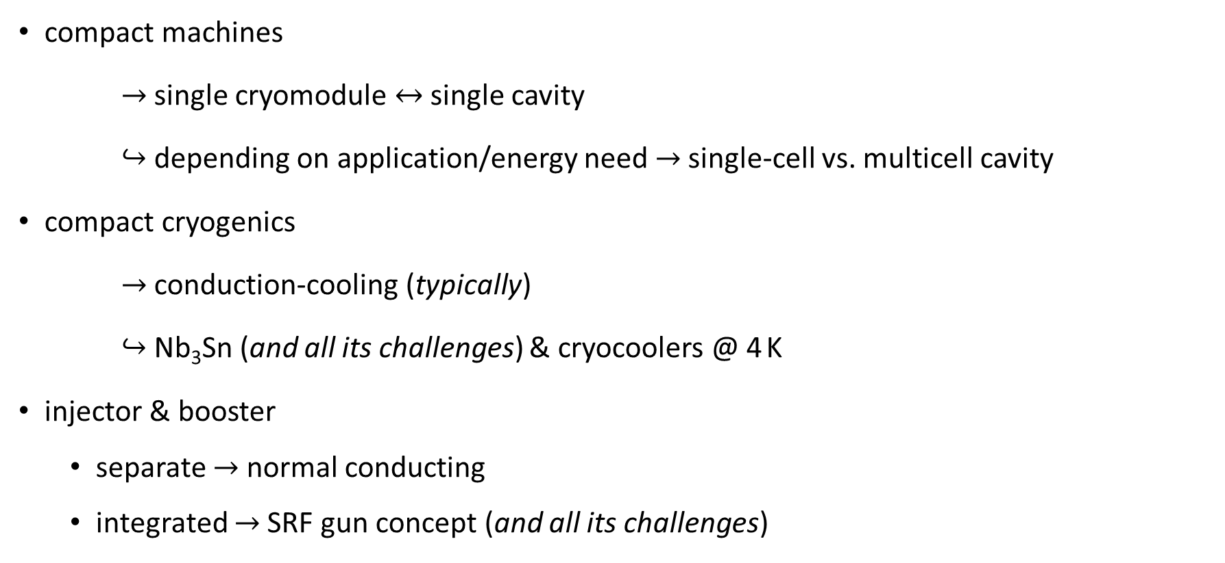
My Definition of Compact SRF Accelerators
compact machines
$→$ single cryomodule $↔$ single cavity
$↪$ depending on application/energy need $→$ single-cell vs. multicell cavity
compact cryogenics
$→$ conduction-cooling (typically)
$↪$ Nb₃Sn (and all its challenges) & cryocoolers @ 4 K
injector & booster
separate $→$ normal conducting
integrated $→$ SRF gun concept (and all its challenges)
Notes:
Guidelines: 6-8 bullets per slide; Use sentence fragments for bullets

Slide 3
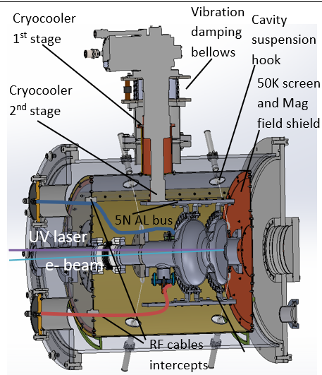
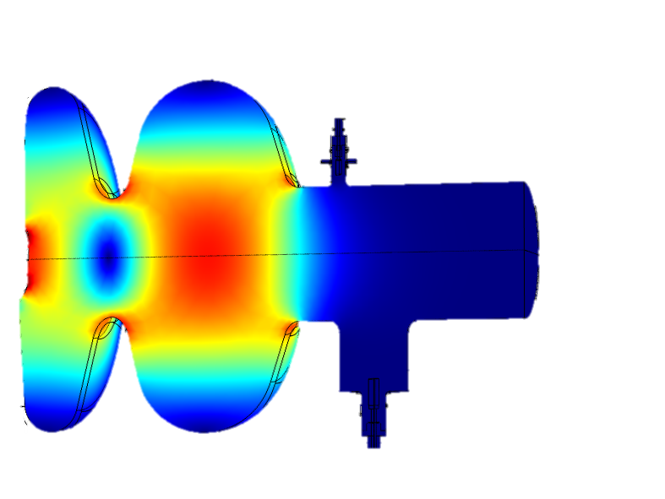
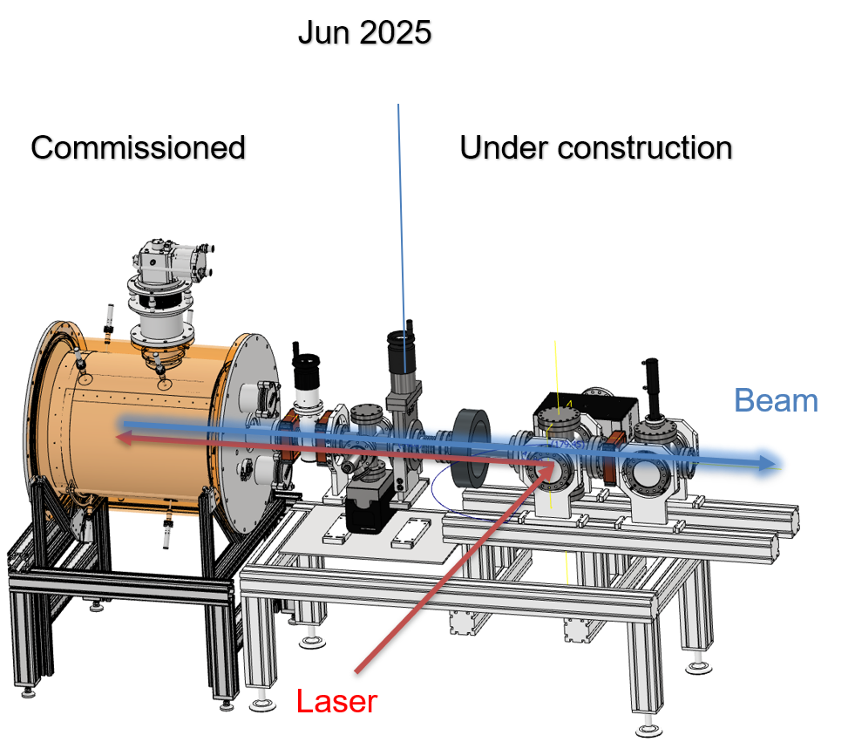
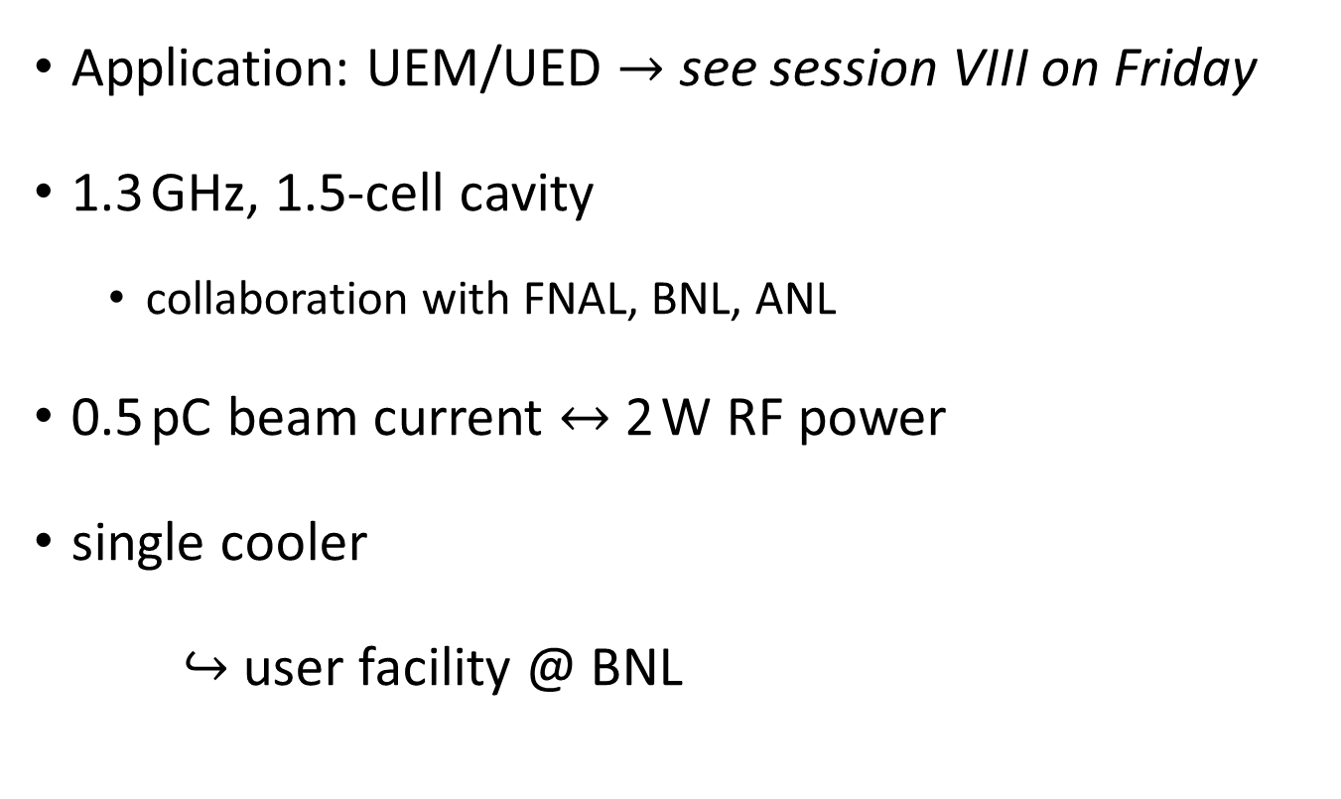
The Science Case – Euclid Beamlabs
Application: UEM/UED $→$ see session VIII on Friday
1.3 GHz, 1.5-cell cavity
collaboration with FNAL, BNL, ANL
0.5 pC beam current $↔$ 2 W RF power
single cooler
$↪$ user facility @ BNL
Notes:
Guidelines: 6-8 bullets per slide; Use sentence fragments for bullets

Slide 4
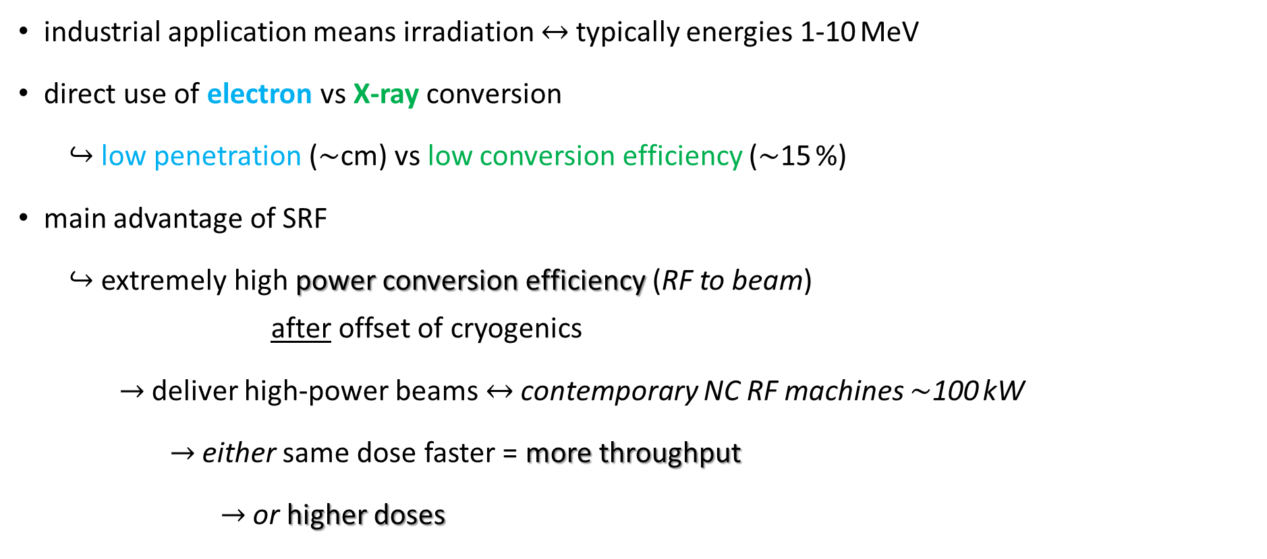
Outside of Research Realm – Industrial Applications
industrial application means irradiation $↔$ typically energies 1-10 MeV
direct use of electron vs X-ray conversion
$↪$ low penetration ($\sim$cm) vs low conversion efficiency ($\sim$15 %)
main advantage of SRF
$↪$ extremely high power conversion efficiency (RF to beam) after offset of cryogenics
$→$ deliver high-power beams $↔$ contemporary NC RF machines $\sim$100 kW
$→$ either same dose faster = more throughput
$→$ or higher doses
Notes:
Guidelines: 6-8 bullets per slide; Use sentence fragments for bullets

Slide 5
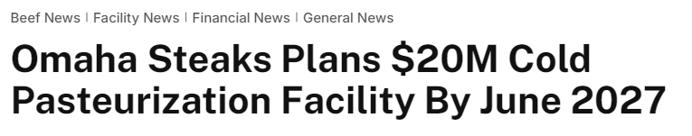
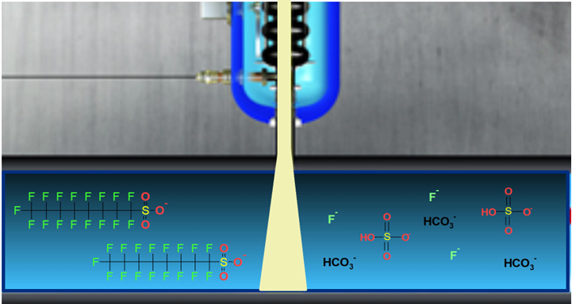
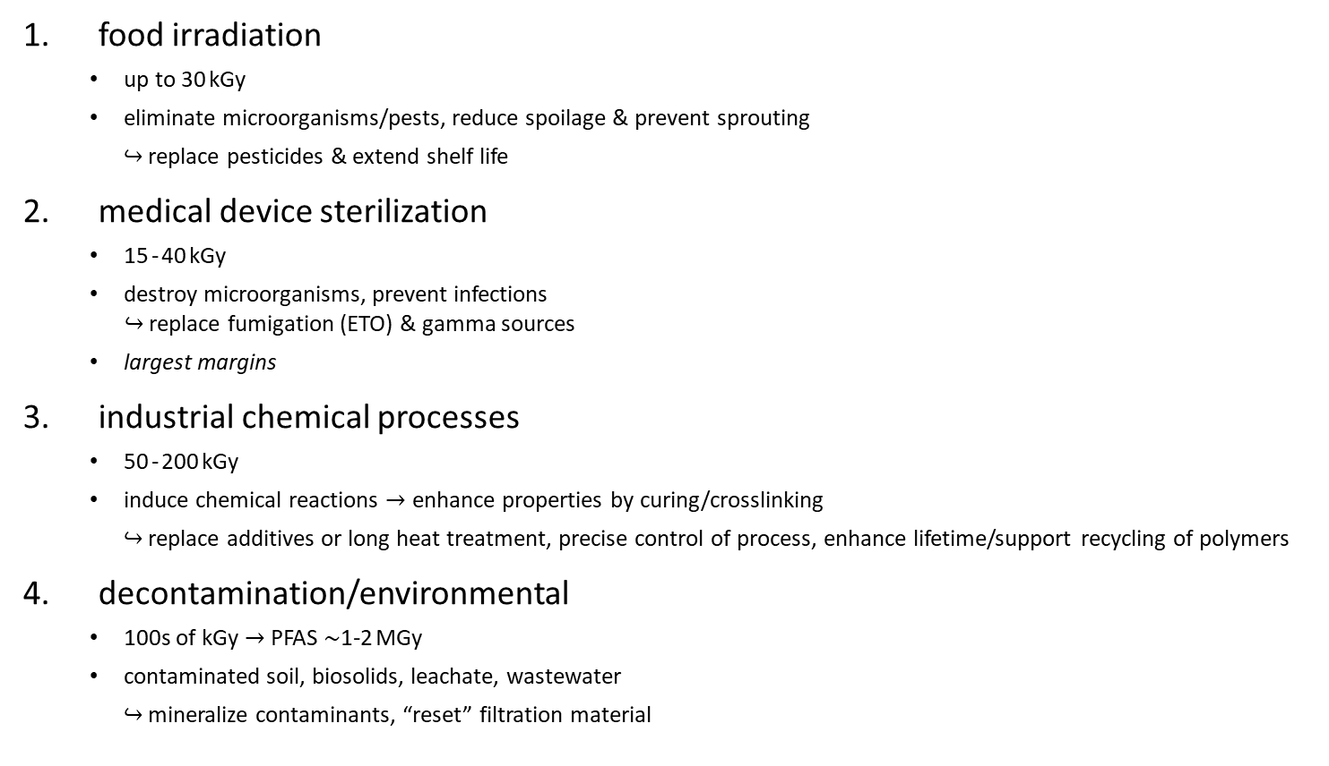
Spectrum of Applications
food irradiation
up to 30 kGy
eliminate microorganisms/pests, reduce spoilage & prevent sprouting
$↪$ replace pesticides & extend shelf life
medical device sterilization
15 - 40 kGy
destroy microorganisms, prevent infections $↪$ replace fumigation (ETO) & gamma sources
largest margins
industrial chemical processes
50 - 200 kGy
induce chemical reactions $→$ enhance properties by curing/crosslinking
$↪$ replace additives or long heat treatment, precise control of process, enhance lifetime/support recycling of polymers
decontamination/environmental
100s of kGy $→$ PFAS $\sim$1-2 MGy
contaminated soil, biosolids, leachate, wastewater
$↪$ mineralize contaminants, “reset” filtration material
Notes:
Guidelines: 6-8 bullets per slide; Use sentence fragments for bullets

Slide 6
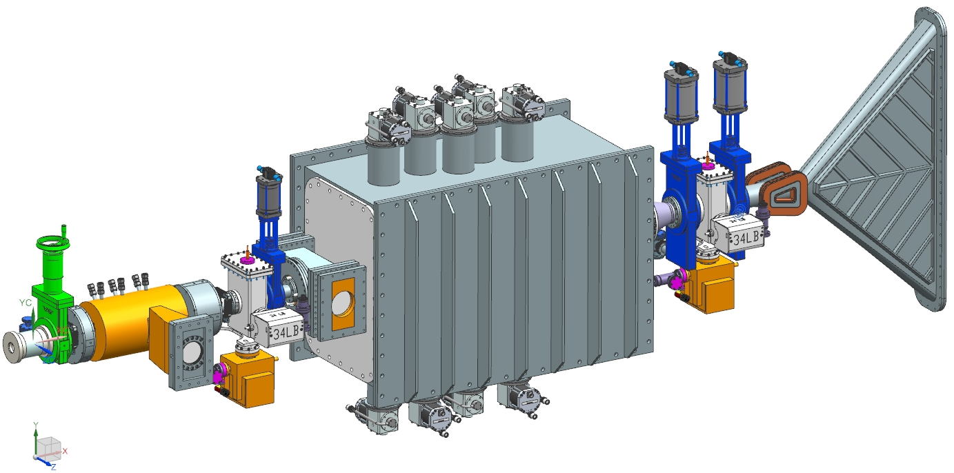
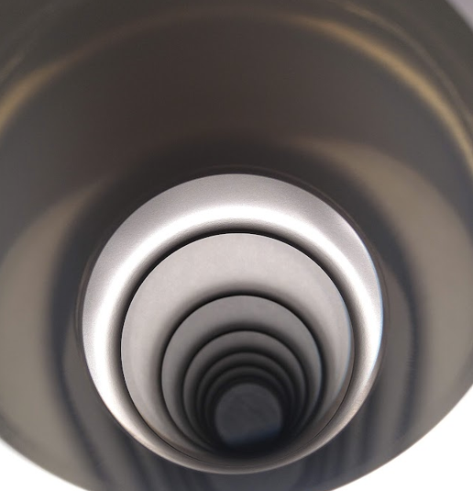
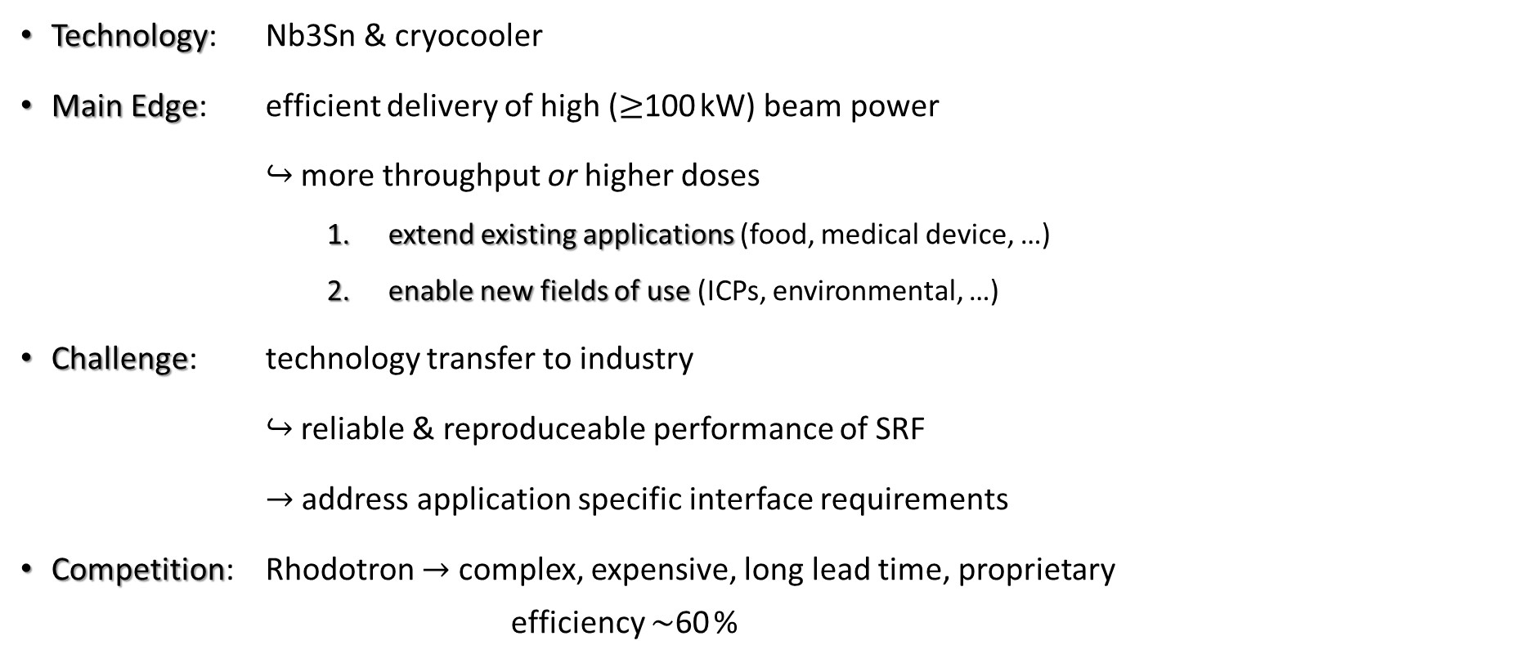
Summary
Technology: Nb3Sn & cryocooler
Main Edge: efficient delivery of high ($≥$100 kW) beam power
$↪$ more throughput or higher doses
extend existing applications (food, medical device, …)
enable new fields of use (ICPs, environmental, …)
Challenge: technology transfer to industry
$↪$ reliable & reproduceable performance of SRF
$→$ address application specific interface requirements
Competition: Rhodotron $→$ complex, expensive, long lead time, proprietary efficiency $\sim$60 %
Notes:
Guidelines: 6-8 bullets per slide; Use sentence fragments for bullets

Slide 7

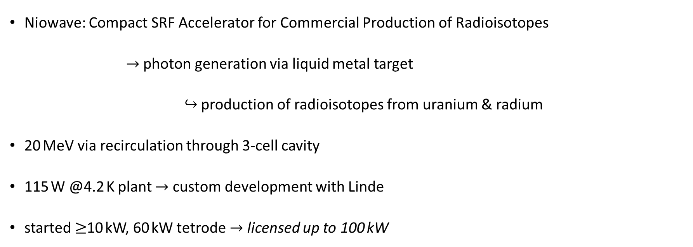
Exotic Application – Production of Radioisotopes
Niowave: Compact SRF Accelerator for Commercial Production of Radioisotopes
$→$ photon generation via liquid metal target
$↪$ production of radioisotopes from uranium & radium
20 MeV via recirculation through 3-cell cavity
115 W @4.2 K plant $→$ custom development with Linde
started $≥$10 kW, 60 kW tetrode $→$ licensed up to 100 kW
Notes:
Guidelines: 6-8 bullets per slide; Use sentence fragments for bullets

Slide 8
QUESTIONS?
Notes:
Before sharing your presentation, confirm:
Fonts are consistent
Images meet quality standards
Charts use template colors
Footer information is current
Spell check completed
Links are working
File size is optimized

