Slide 1
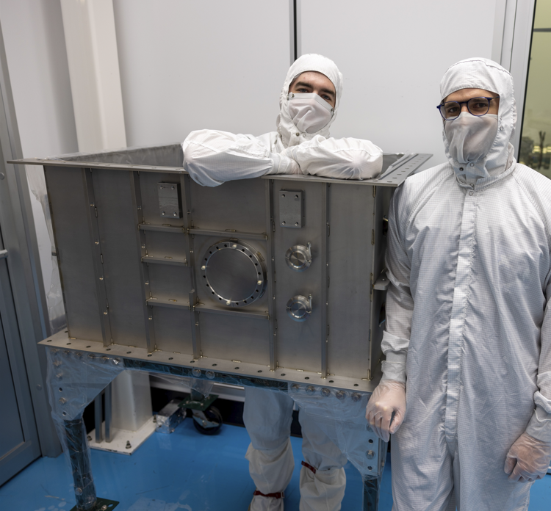

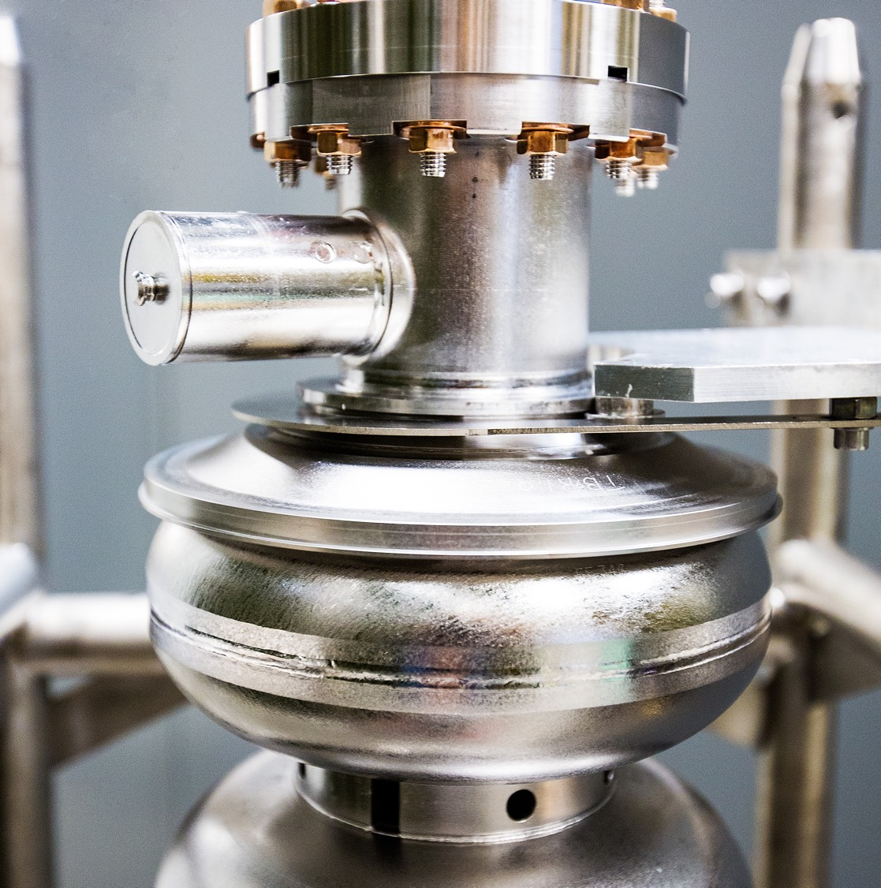
Experience with the Cornell Conduction-Cooled Nb3Sn Cryomodule (C4M)
With lessons learned
November 13, 2025
Neil Stilin
Notes:
Tip: Keep titles under 60 characters for readability
To change the photo: Right-click on photo and select change photo

Slide 2
Outline
Brief Motivation & System Design
Cavity Fabrication & Testing
Cryomodule Assembly & First Results
Lessons Learned
Notes:
Use for: Introducing new topics
To change the photo: Right-click on photo and select change photo

Slide 3
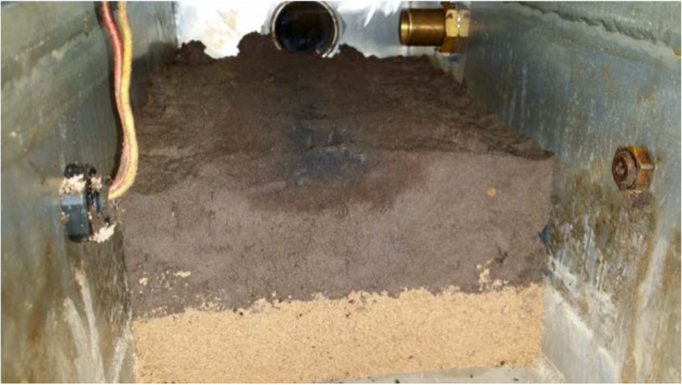
Brief Motivation
Applications for small-scale operations:
Energy and environment
Sterilizing waste water, sludge, medical waste
Flue gas treatment
Remediation of contaminated soil
Asphalt treatments (durability)
Medicine
Radioisotope production
Security & defense
Cargo inspection
Industry
Producing biofuel
Curing carbon fiber composites
… and many more!
Decontamination cross section for a 10 MeV beam into a high-clay-content 5% contaminated soil
Typical beam parameters
Moderate Energy: 1 – 10 MeV
High Current: ≥ 100 mA
High Avg. Power: ≥ 1 MW
High average current & power can be better obtained with superconducting cavities
Continuous-wave (CW) operation enables higher throughput
U.S. DOE Report, “Accelerators for America’s Future”
U.S. DOE Report, “Workshop on Energy and Environmental Applications of Accelerators”
Notes:
Guidelines: 6-8 bullets per slide; Use sentence fragments for bullets
To change the photo: Right-click on photo and select change photo

Slide 4
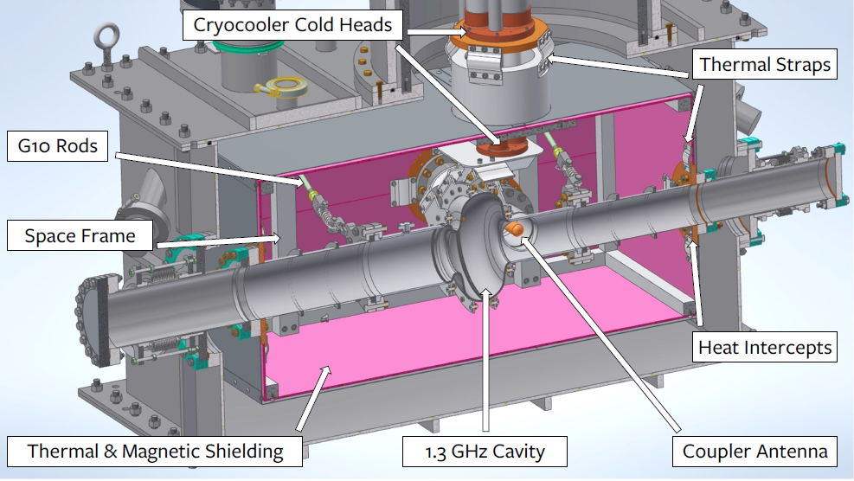
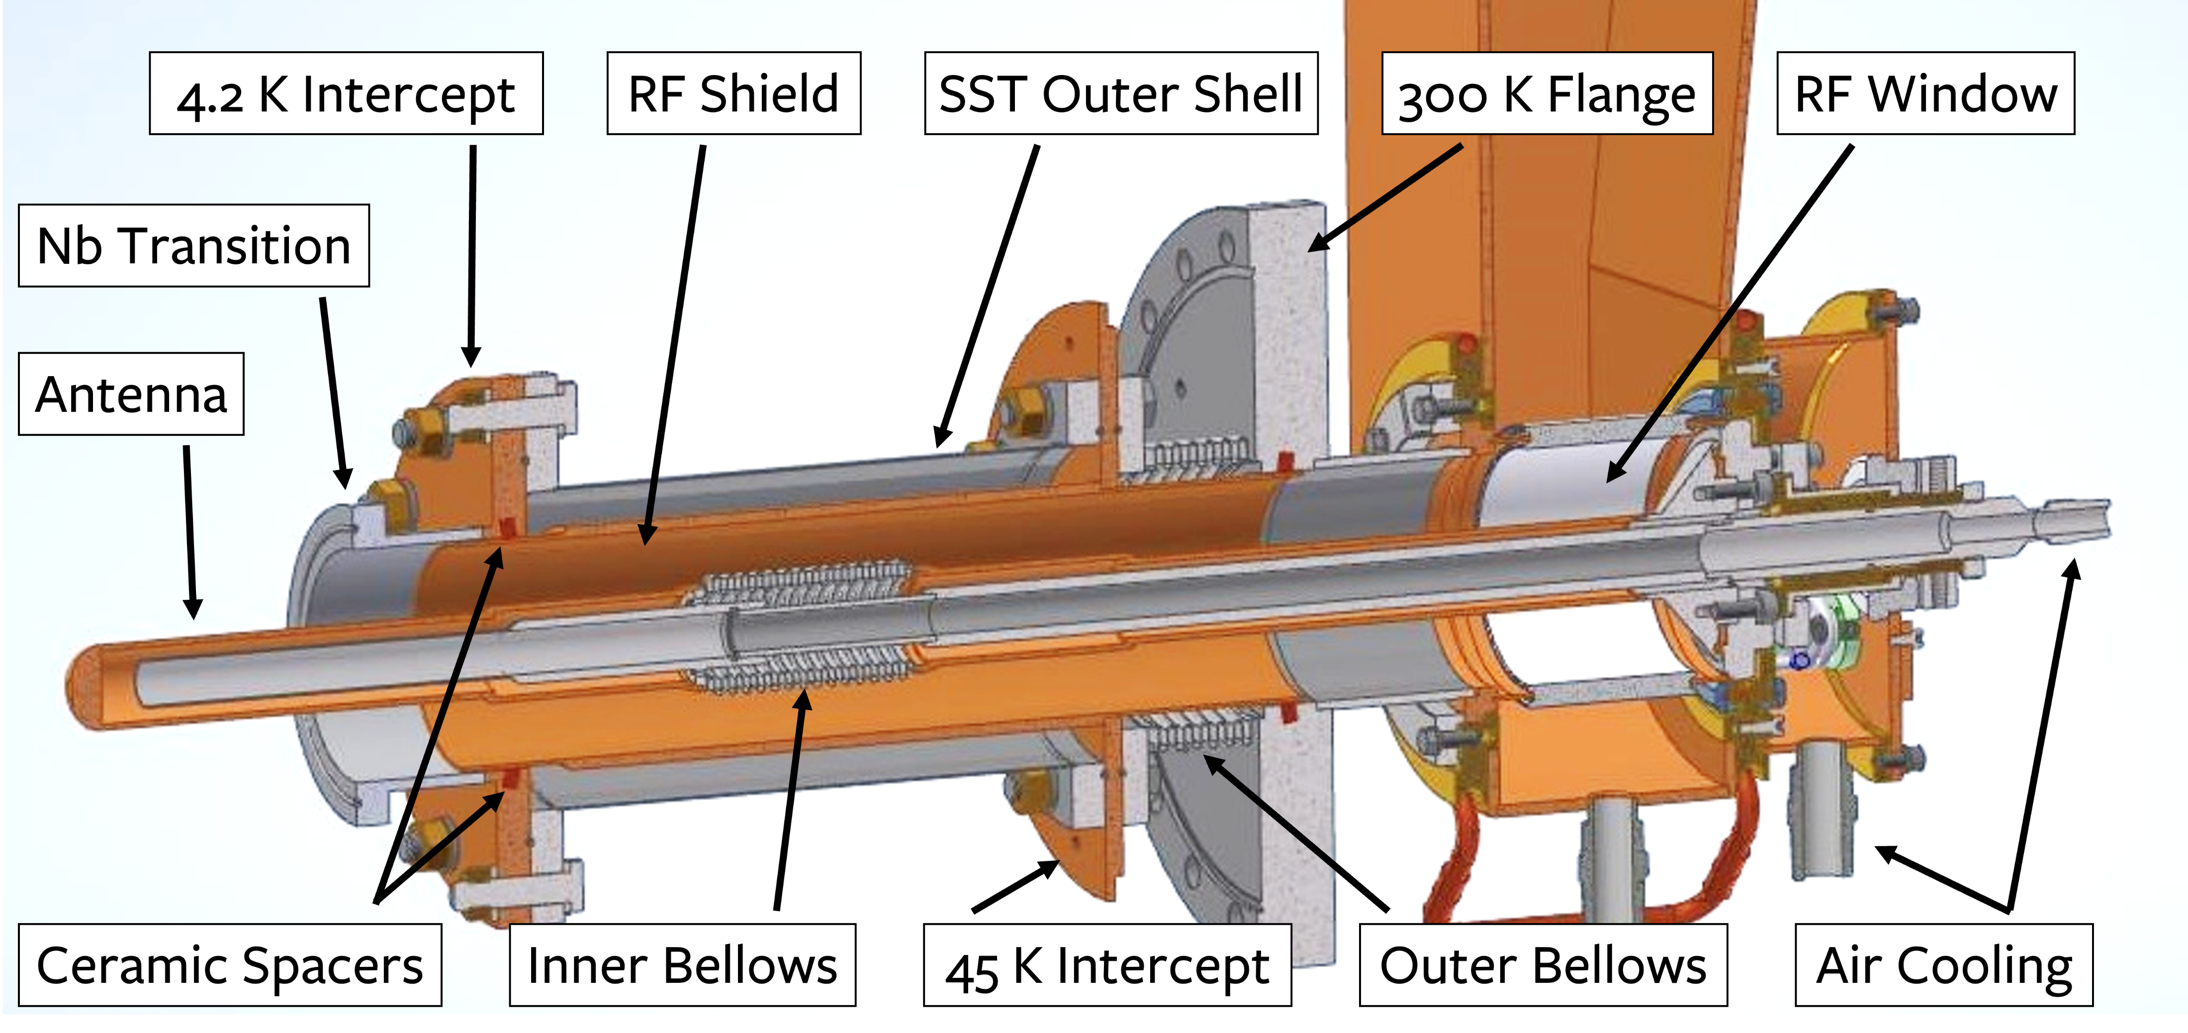
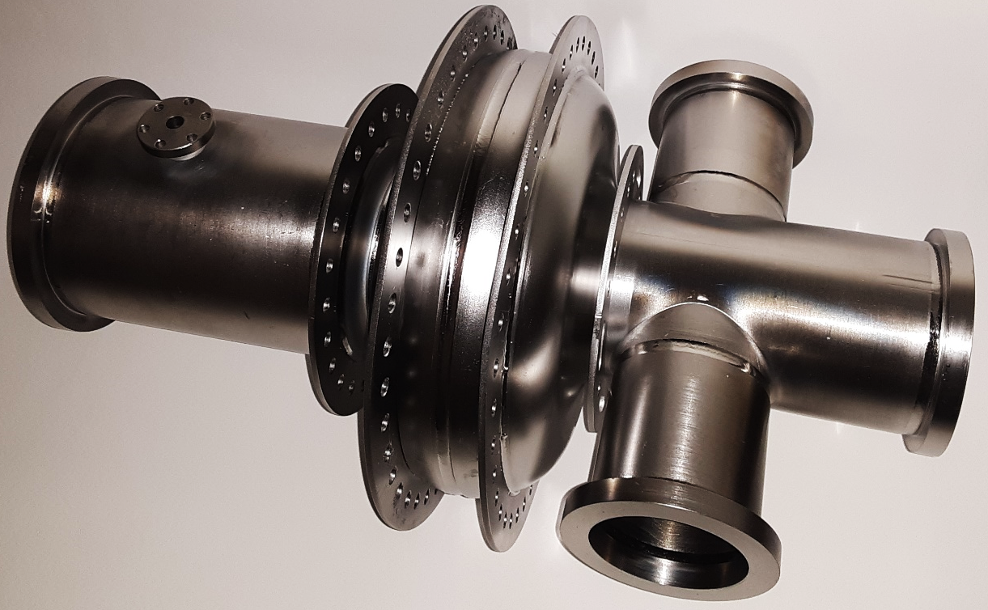
System Design
Energy Gain | 1 MeV
Beam Current | 100 mA
Average Power | 100 kW
Single-cell 1.3 GHz Nb₃Sn cavity
​Nb rings at cavity equator (2) and near cavity irises (2)
​​1 PT420 + 1 PT425 cryocoolers (Cryomech)
Total capacity: 4.15 W at 4.2 K; 100 W at 45 K
Finalized Cavity
Notes:
Guidelines: 6-8 bullets per slide; Use sentence fragments for bullets
To change the photo: Right-click on photo and select change photo

Slide 5
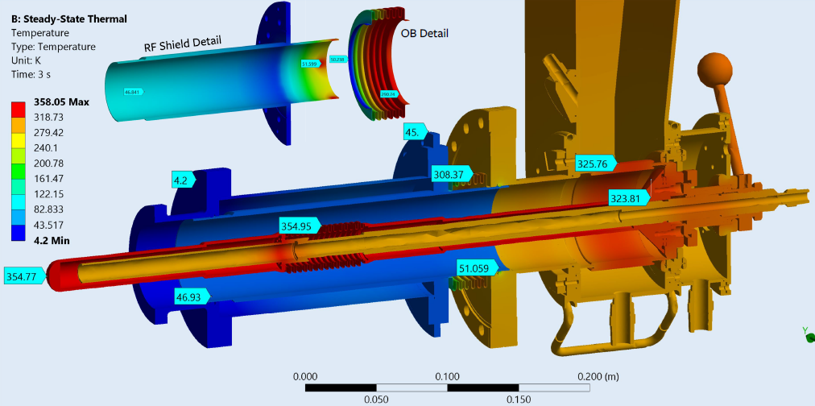
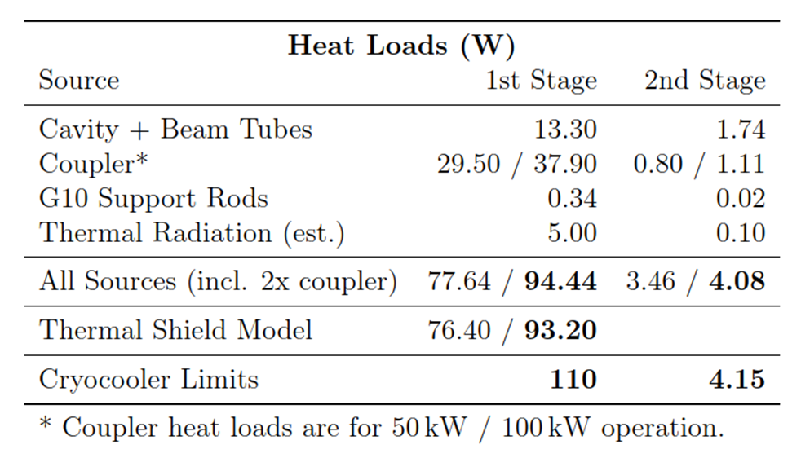
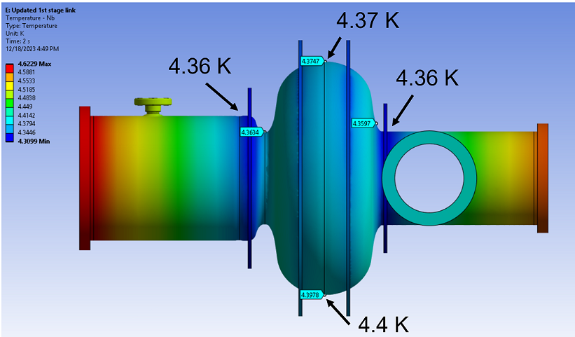
Simulation Results
Cold head: 4.2 K
Small thermal gradients across cavity & cold heads
Low-power (no coupler) heat loads:
18.6 W at 1st stage (45 K)
1.9 W at 2nd stage (4 K)
4.6 K
Notes:
Guidelines: 6-8 bullets per slide; Use sentence fragments for bullets
To change the photo: Right-click on photo and select change photo

Slide 6
Cavity Fabrication & Testing
Notes:
Use for: Introducing new topics
To change the photo: Right-click on photo and select change photo

Slide 7
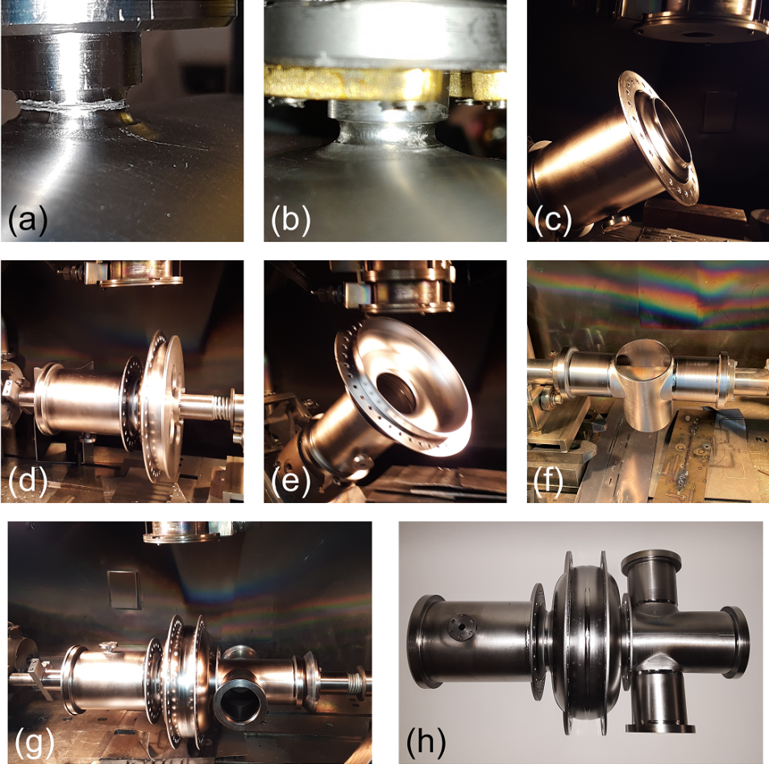
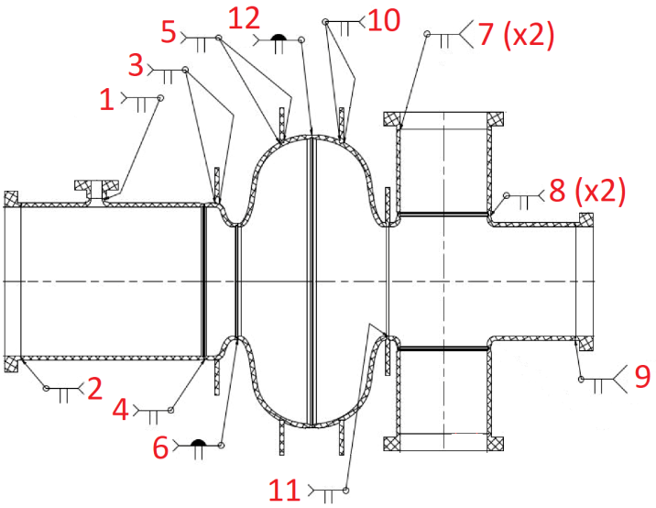
Electron-beam Welding
Careful planning required for complicated shape
Beam parameters optimized for different weld types
Notes:
Guidelines: 6-8 bullets per slide; Use sentence fragments for bullets
To change the photo: Right-click on photo and select change photo

Slide 8
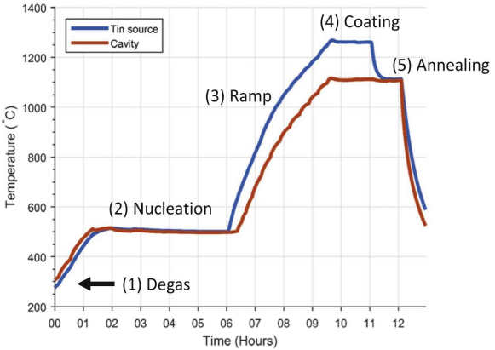
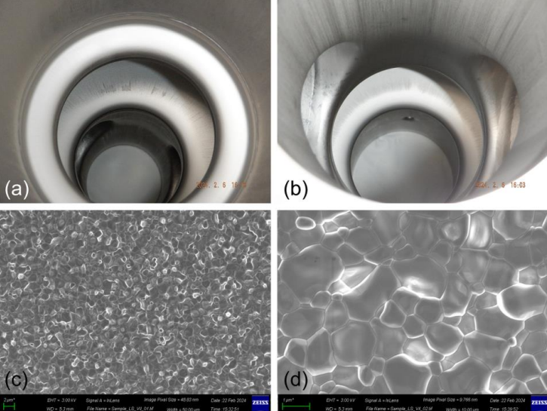
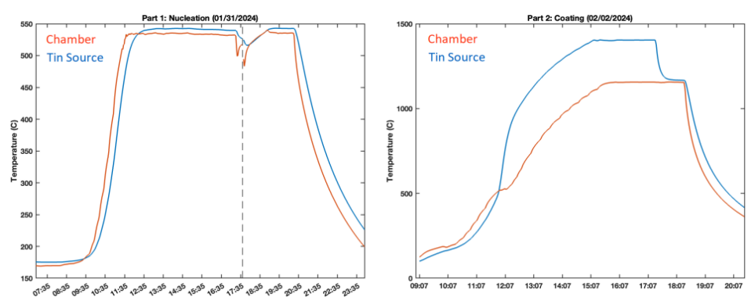
Cavity Treatment & Coating
Planned
Defects uncovered during chemical workup
Tin furnace interlock failure: interrupted coating
Witness sample images still look typical
Actual
Notes:
Guidelines: 6-8 bullets per slide; Use sentence fragments for bullets
To change the photo: Right-click on photo and select change photo

Slide 9
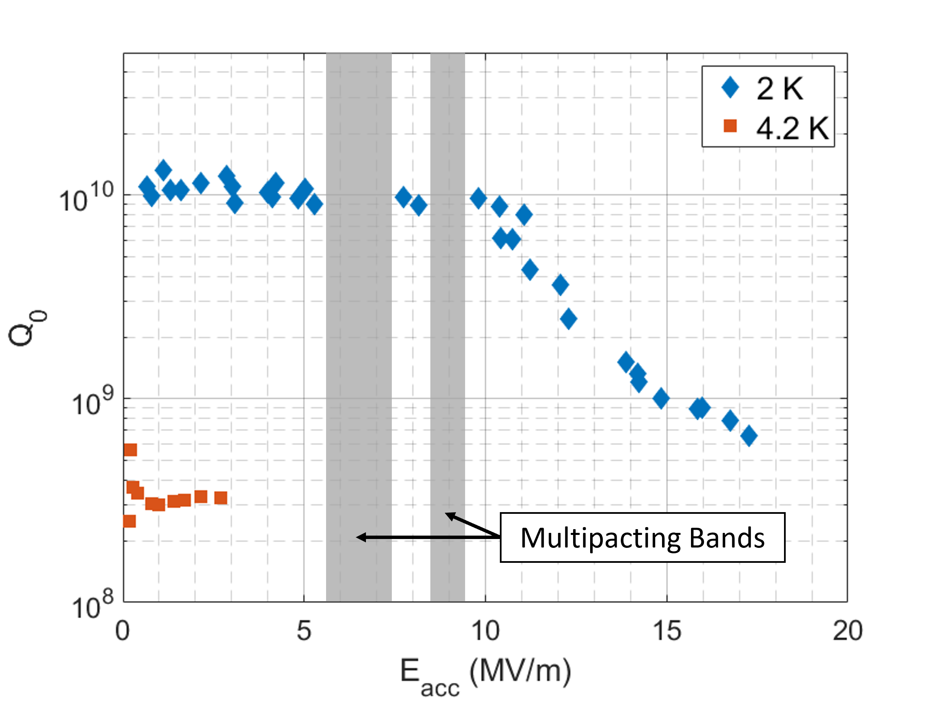
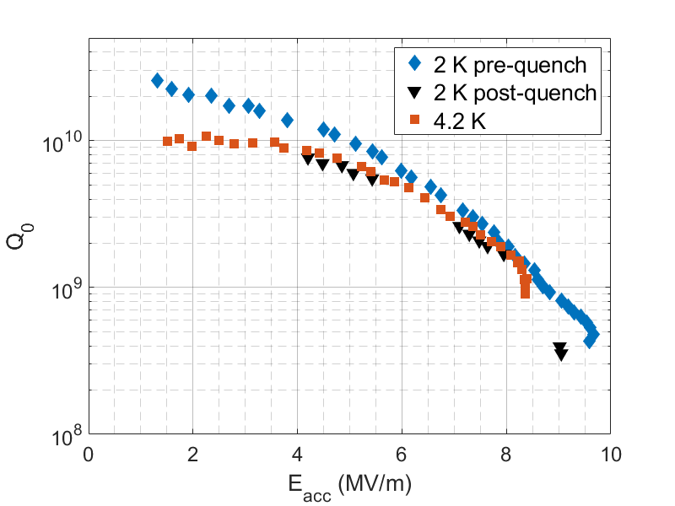
Cavity Test Results
Nb baseline: typical performance (no special treatments), ran into two multipacting bands
Nb₃Sn baseline: good low-field Q₀, strong Q-slope
Sufficient for low-power testing in cryomodule; long-term performance could be improved
Nb
Nb₃Sn
Notes:
Guidelines: 6-8 bullets per slide; Use sentence fragments for bullets
To change the photo: Right-click on photo and select change photo

Slide 10
Cryomodule Assembly & First Results
Notes:
Use for: Introducing new topics
To change the photo: Right-click on photo and select change photo

Slide 11
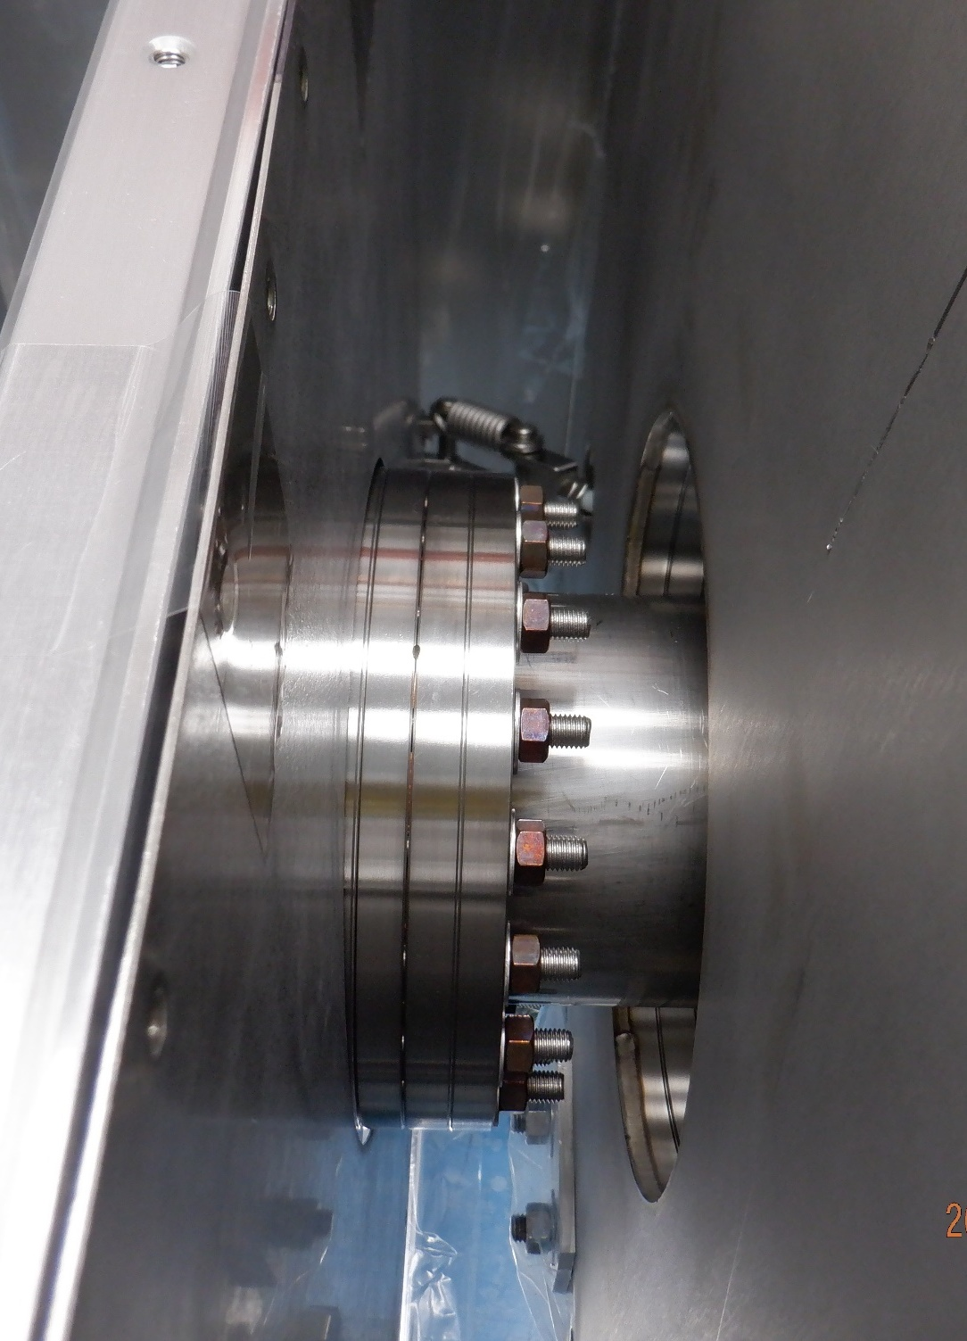
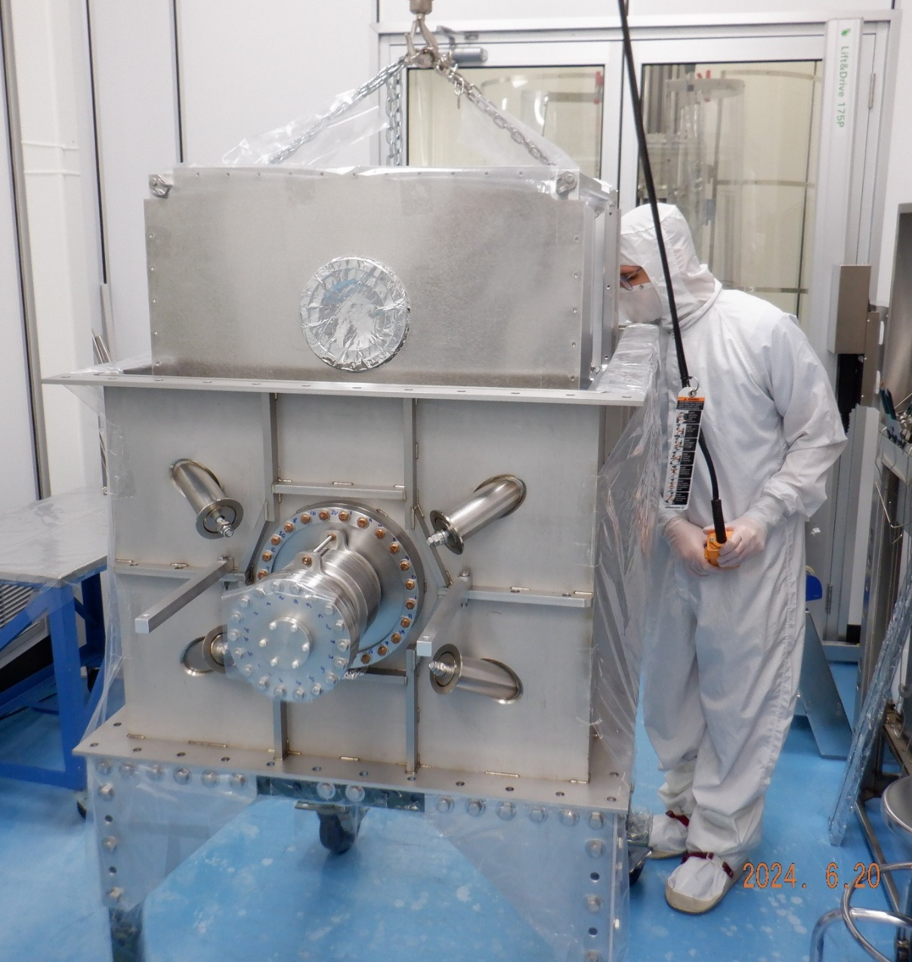
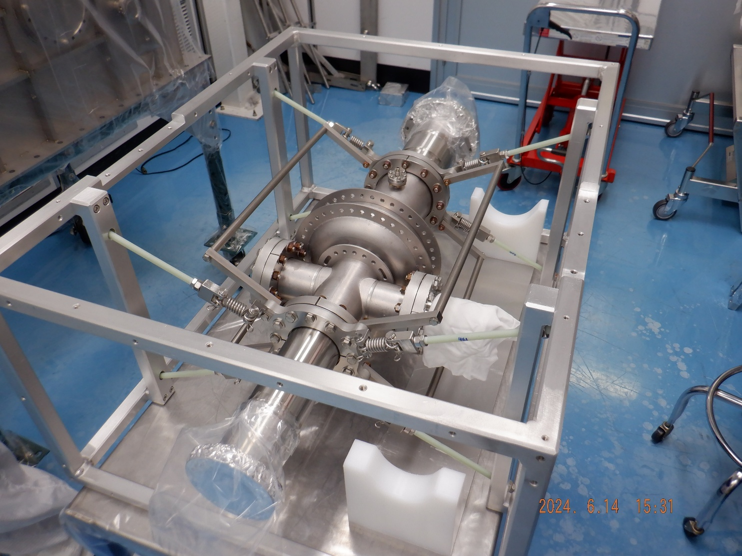
Beamline Assembly
Partial top-down assembly method
Simplifies structure but requires more parts in cleanroom
Tight connections
Final Seals & Support Connections
Lowering into Vacuum Vessel
Cavity Suspended from Frame
Notes:
Guidelines: 6-8 bullets per slide; Use sentence fragments for bullets
To change the photo: Right-click on photo and select change photo

Slide 12
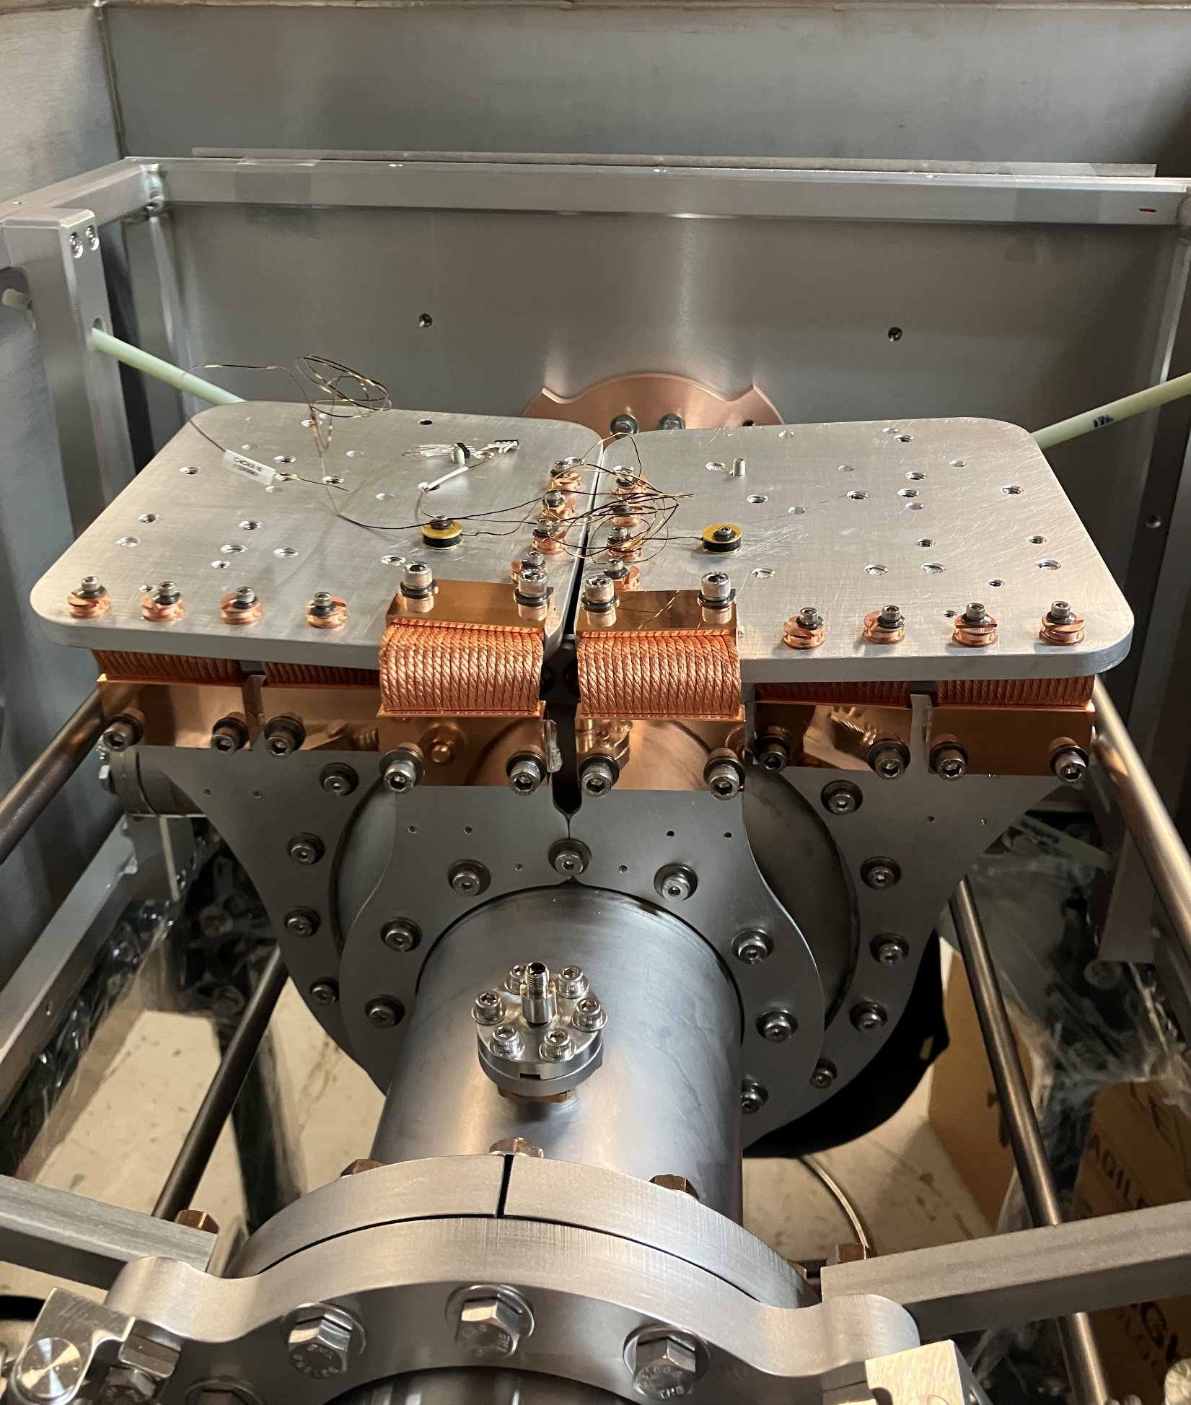
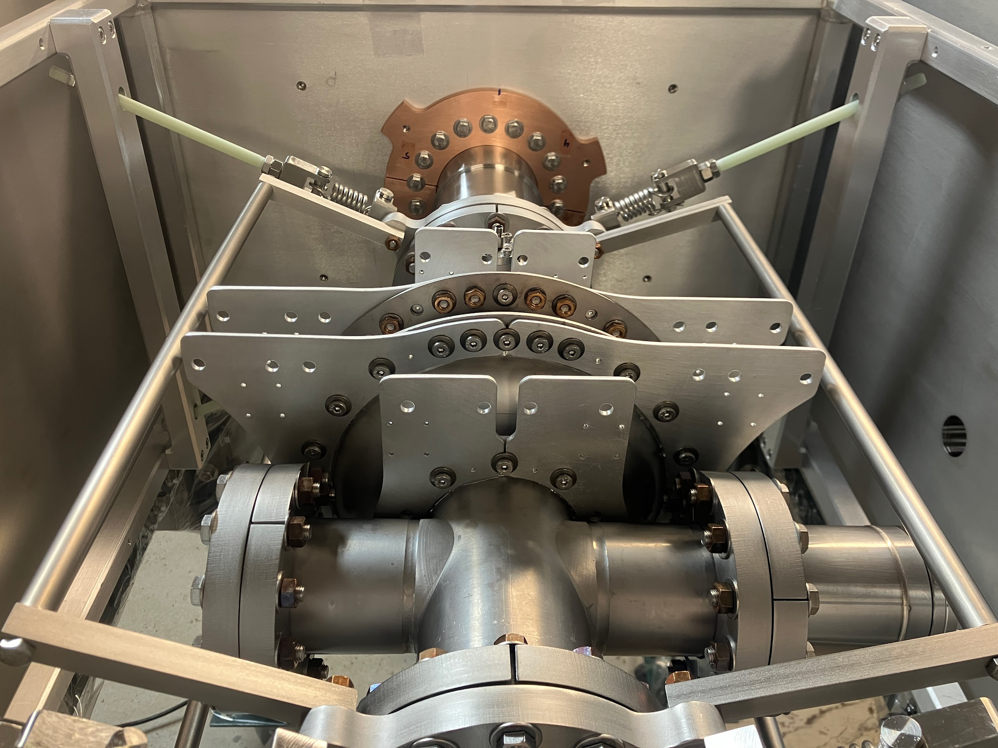
2nd Stage (4 K) Assembly
5N-purity Aluminum split rings & mounting plates
OFHC braided thermal straps for flexible connection
Notes:
Guidelines: 6-8 bullets per slide; Use sentence fragments for bullets
To change the photo: Right-click on photo and select change photo

Slide 13
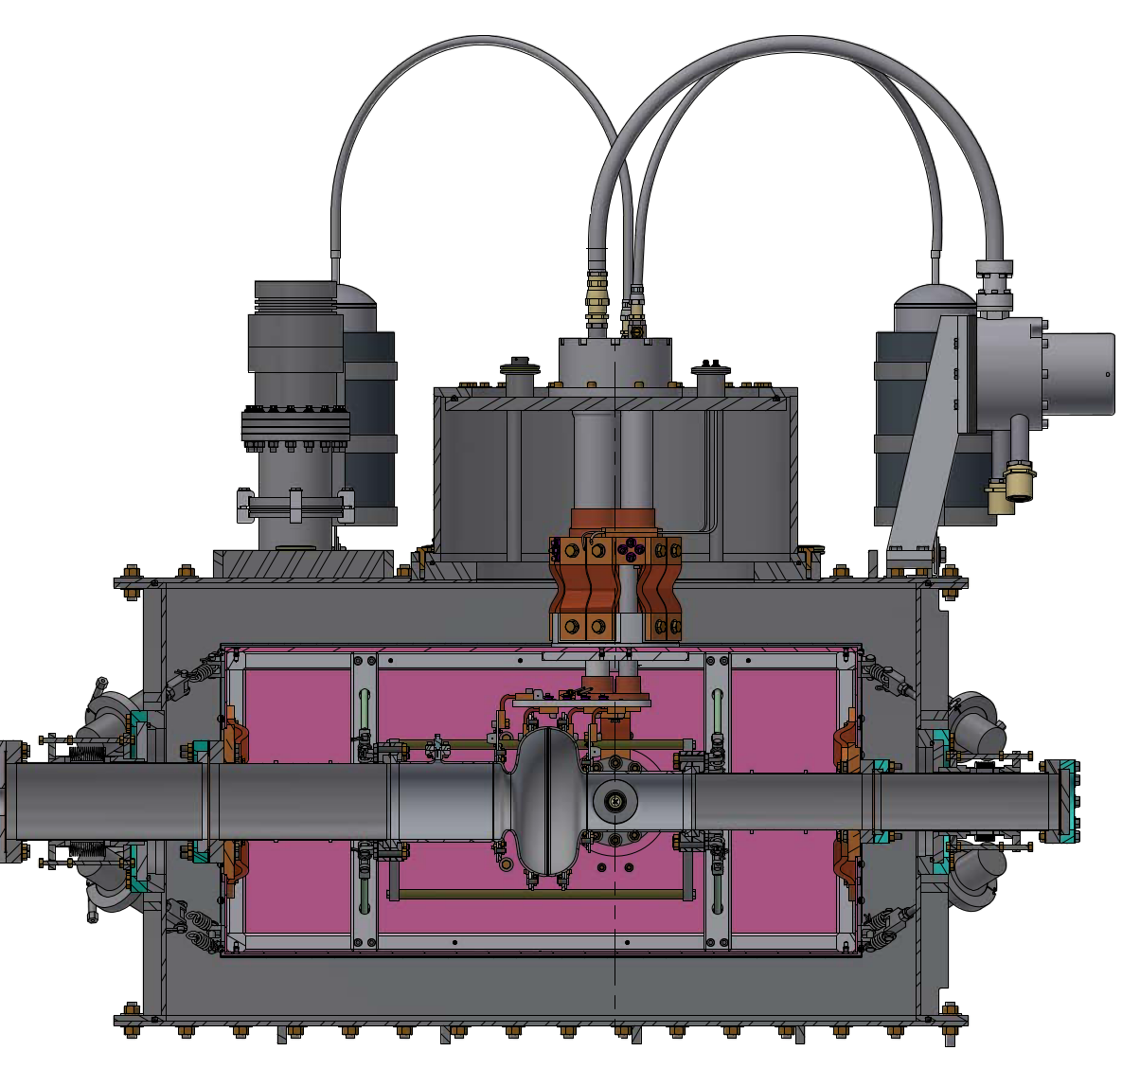
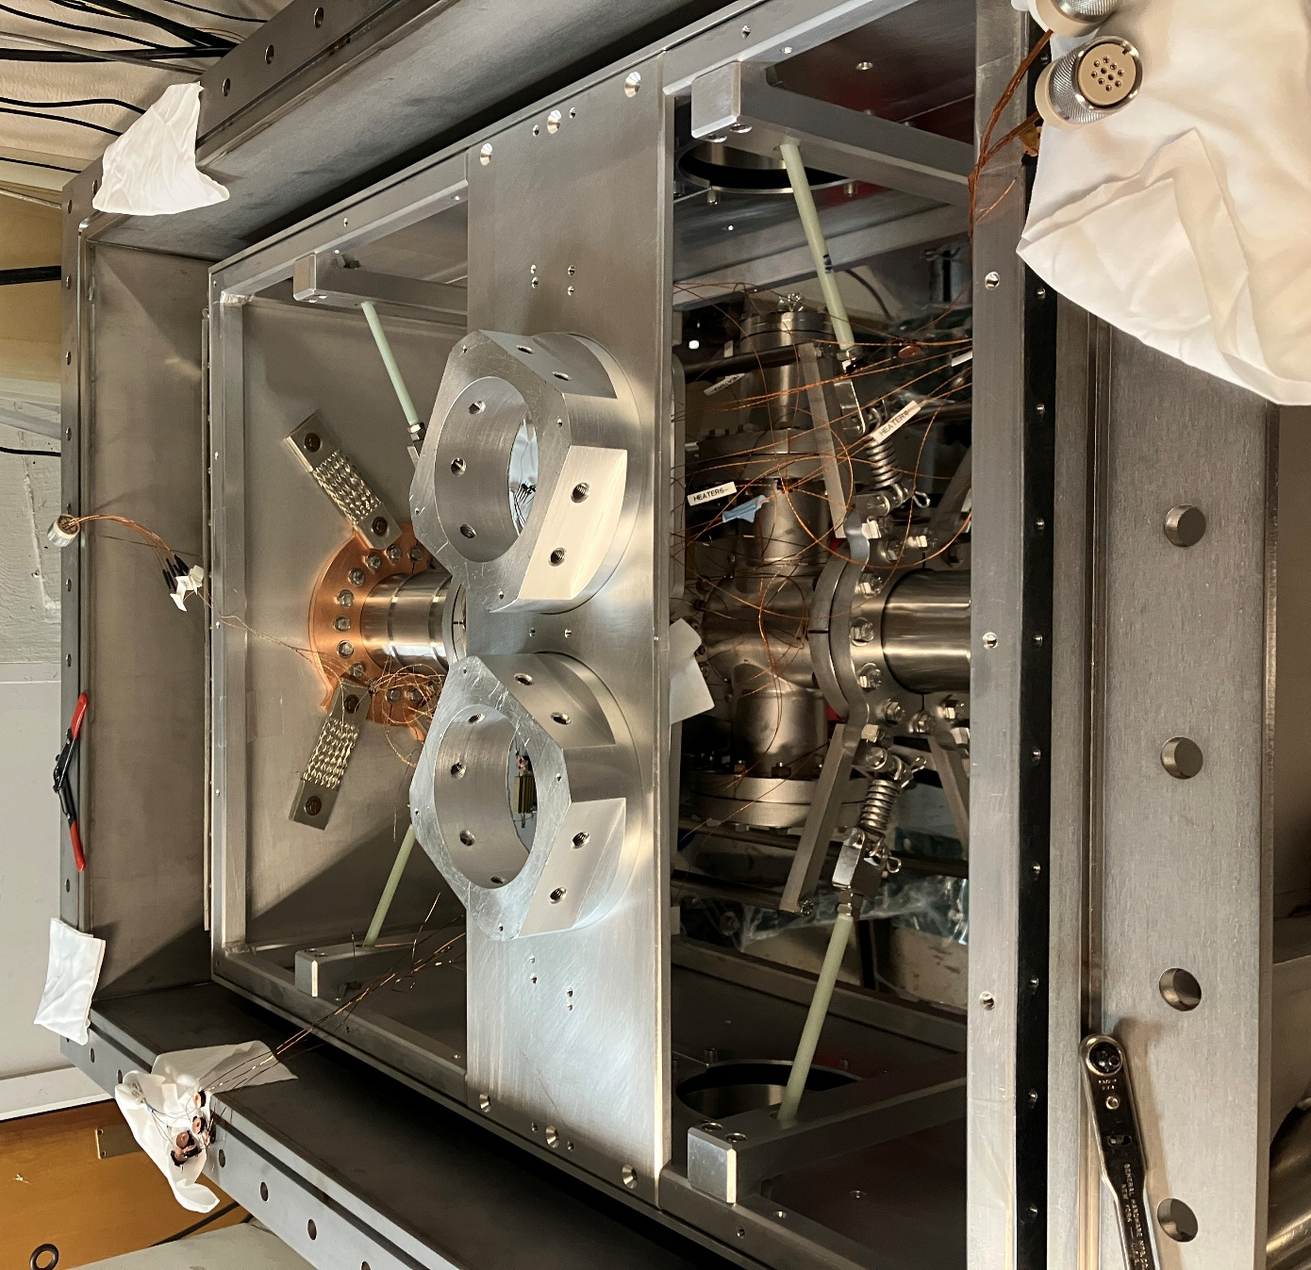
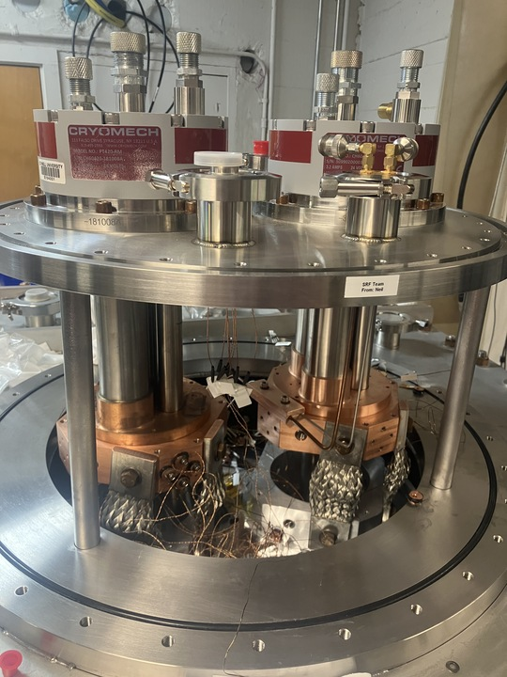
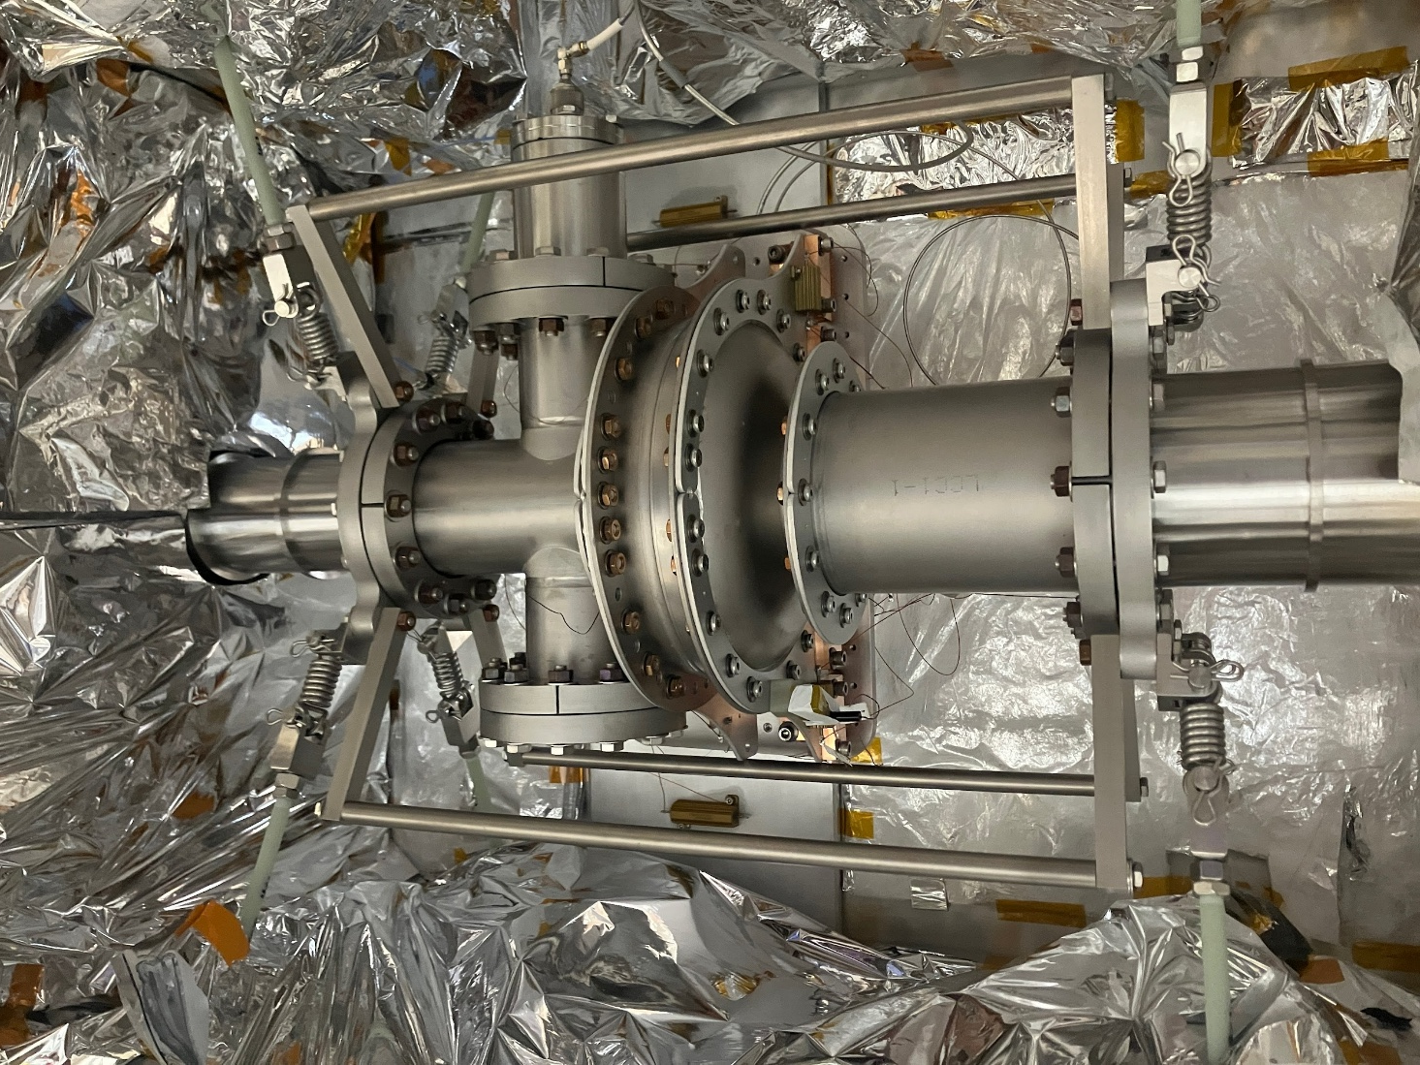
1st Stage (45 K) Assembly
1st stage
1100 Aluminum mounting plate with pass-through extensions
Final connections made after cryocoolers & vessel lid attached
2nd stage
Notes:
Guidelines: 6-8 bullets per slide; Use sentence fragments for bullets
To change the photo: Right-click on photo and select change photo

Slide 14
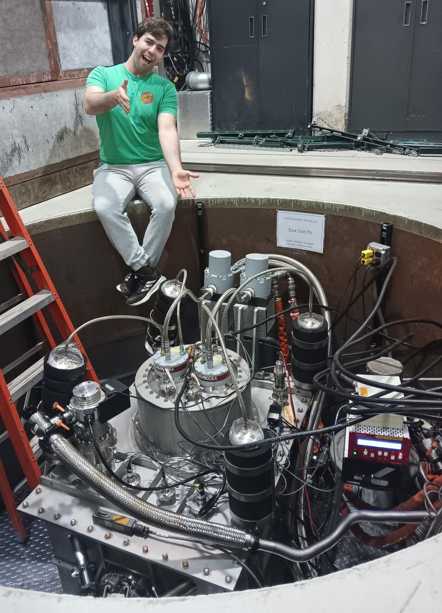
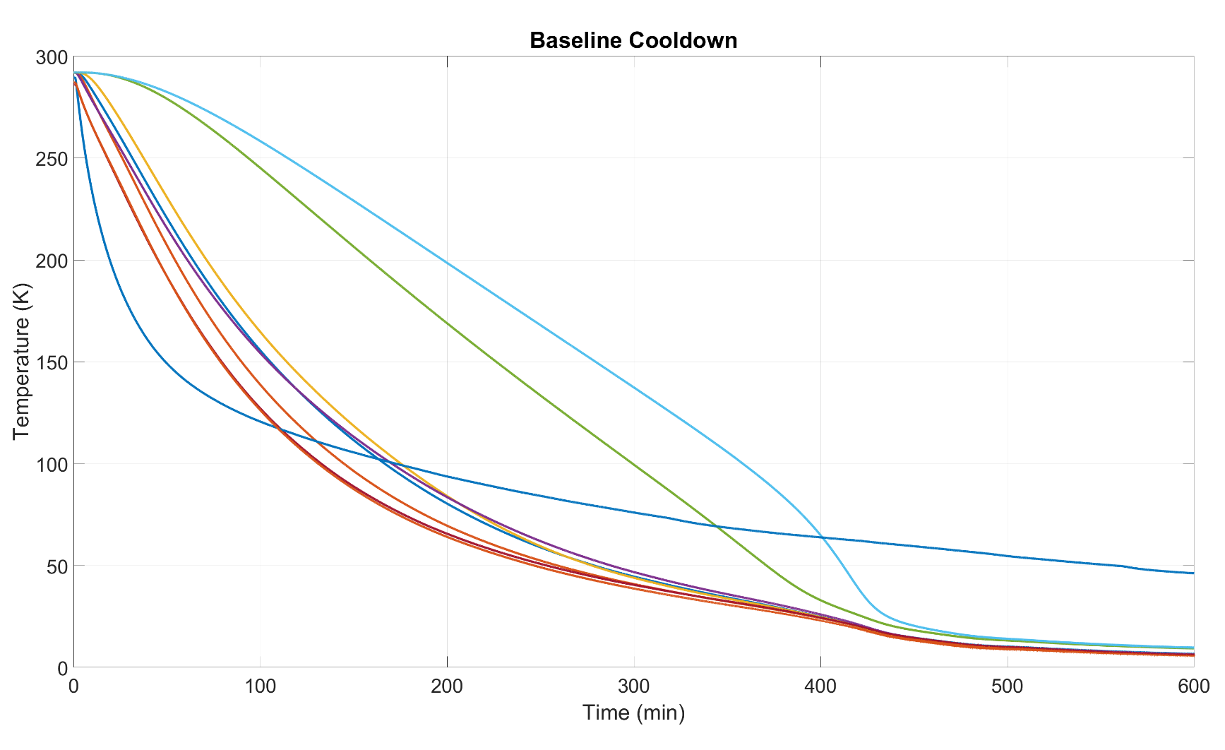
Cryomodule Cooldown
Cooldown completed in < 20 hrs
Ambient magnetic field at cavity ≈ 10 mG
Beam Tubes
4 K Stage
45 K Stage
Notes:
Guidelines: 6-8 bullets per slide; Use sentence fragments for bullets
To change the photo: Right-click on photo and select change photo

Slide 15
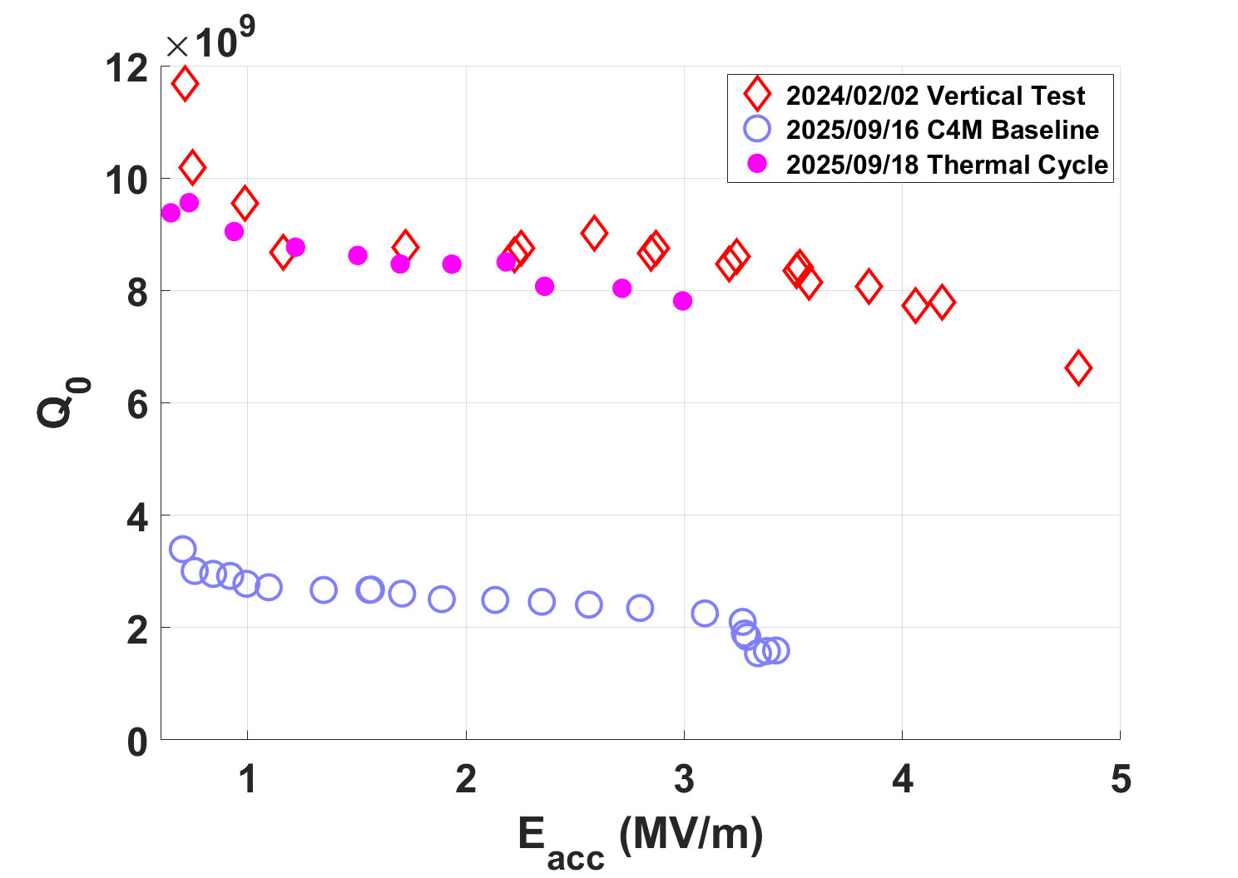
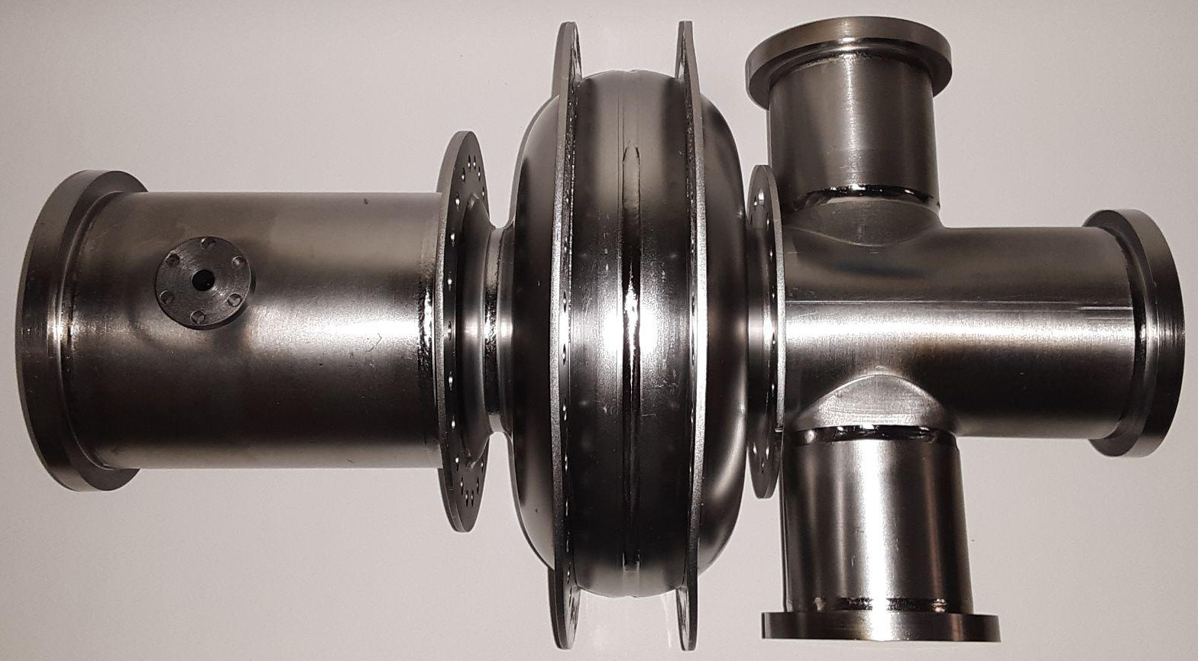
First Low-Power RF Results
Key Result: RF performance matches baseline test after thermal cycling!
Nb₃Sn performance dependent on ∆T_{cavity} at SC transition
Basic system cooldown: ∆T_{cavity} = 890 mK
Fast controlled cooldown: ∆T_{cavity} = 140 mK
Thermal intercept rings
PT425
PT420
Notes:
Guidelines: 6-8 bullets per slide; Use sentence fragments for bullets
To change the photo: Right-click on photo and select change photo

Slide 16
Cavity Temperatures
SR 1-4
2
3
Baseline (RF off) T_{cav} ≈ 3.6 K
With P_{diss} = 1 W, T_{cav} ≈ 4.4 K
Small ∆T across cavity indicates even, effective cooling
Estimated heat loads within expected range
1
BT
4
Key Result: Cavity temperatures and heat loads match predictions!
 | SR 1 | SR 2 | SR 3 | SR 4 | BT | Coldhead
Baseline | 3.85 K | 3.52 K | 3.54 K | 3.67 K | ~5.05 K | 3.46 K
1 W Diss. | 4.45 K | 4.35 K | 4.38 K | 4.33 K | ~6.41 K | 4.05 K
1.5W Sim | 4.36 K | 4.37 K | 4.37 K | 4.36 K | ~4.6 K | 4.2 K
 | Static Heat Load | Predicted (No coupler)
4 K | < 2.0 W | ~ 1.9 W
45 K | < 20 W | ~ 18.6 W
Notes:
Guidelines: 6-8 bullets per slide; Use sentence fragments for bullets
To change the photo: Right-click on photo and select change photo

Slide 17
Lessons Learned
Notes:
Use for: Introducing new topics
To change the photo: Right-click on photo and select change photo

Slide 18
Lessons Learned
Consolidate / centralize records of design choice rationale, not just end results
Especially important when project leadership is passed on
Examine practical assembly concerns early in design process
Spatial restraints on hardware, tools, arms / hands, etc.
Bare minimum room for tools does not guarantee practical use
Develop more standardized procedure for temperature cycling with cryocoolers
Using heater control can achieve smaller gradients vs basic cryocooler “off-on” method
Use only Lakeshore CD/CU Cernox sensors rather than SD Cernox
SD Cernox sensor readings become unreliable in dry (e.g. conduction-cooled) environments
Notes:
Guidelines: 6-8 bullets per slide; Use sentence fragments for bullets
To change the photo: Right-click on photo and select change photo

Slide 19
QUESTIONS?
Notes:
Before sharing your presentation, confirm:
Fonts are consistent
Images meet quality standards
Charts use template colors
Footer information is current
Spell check completed
Links are working
File size is optimized

Slide 20
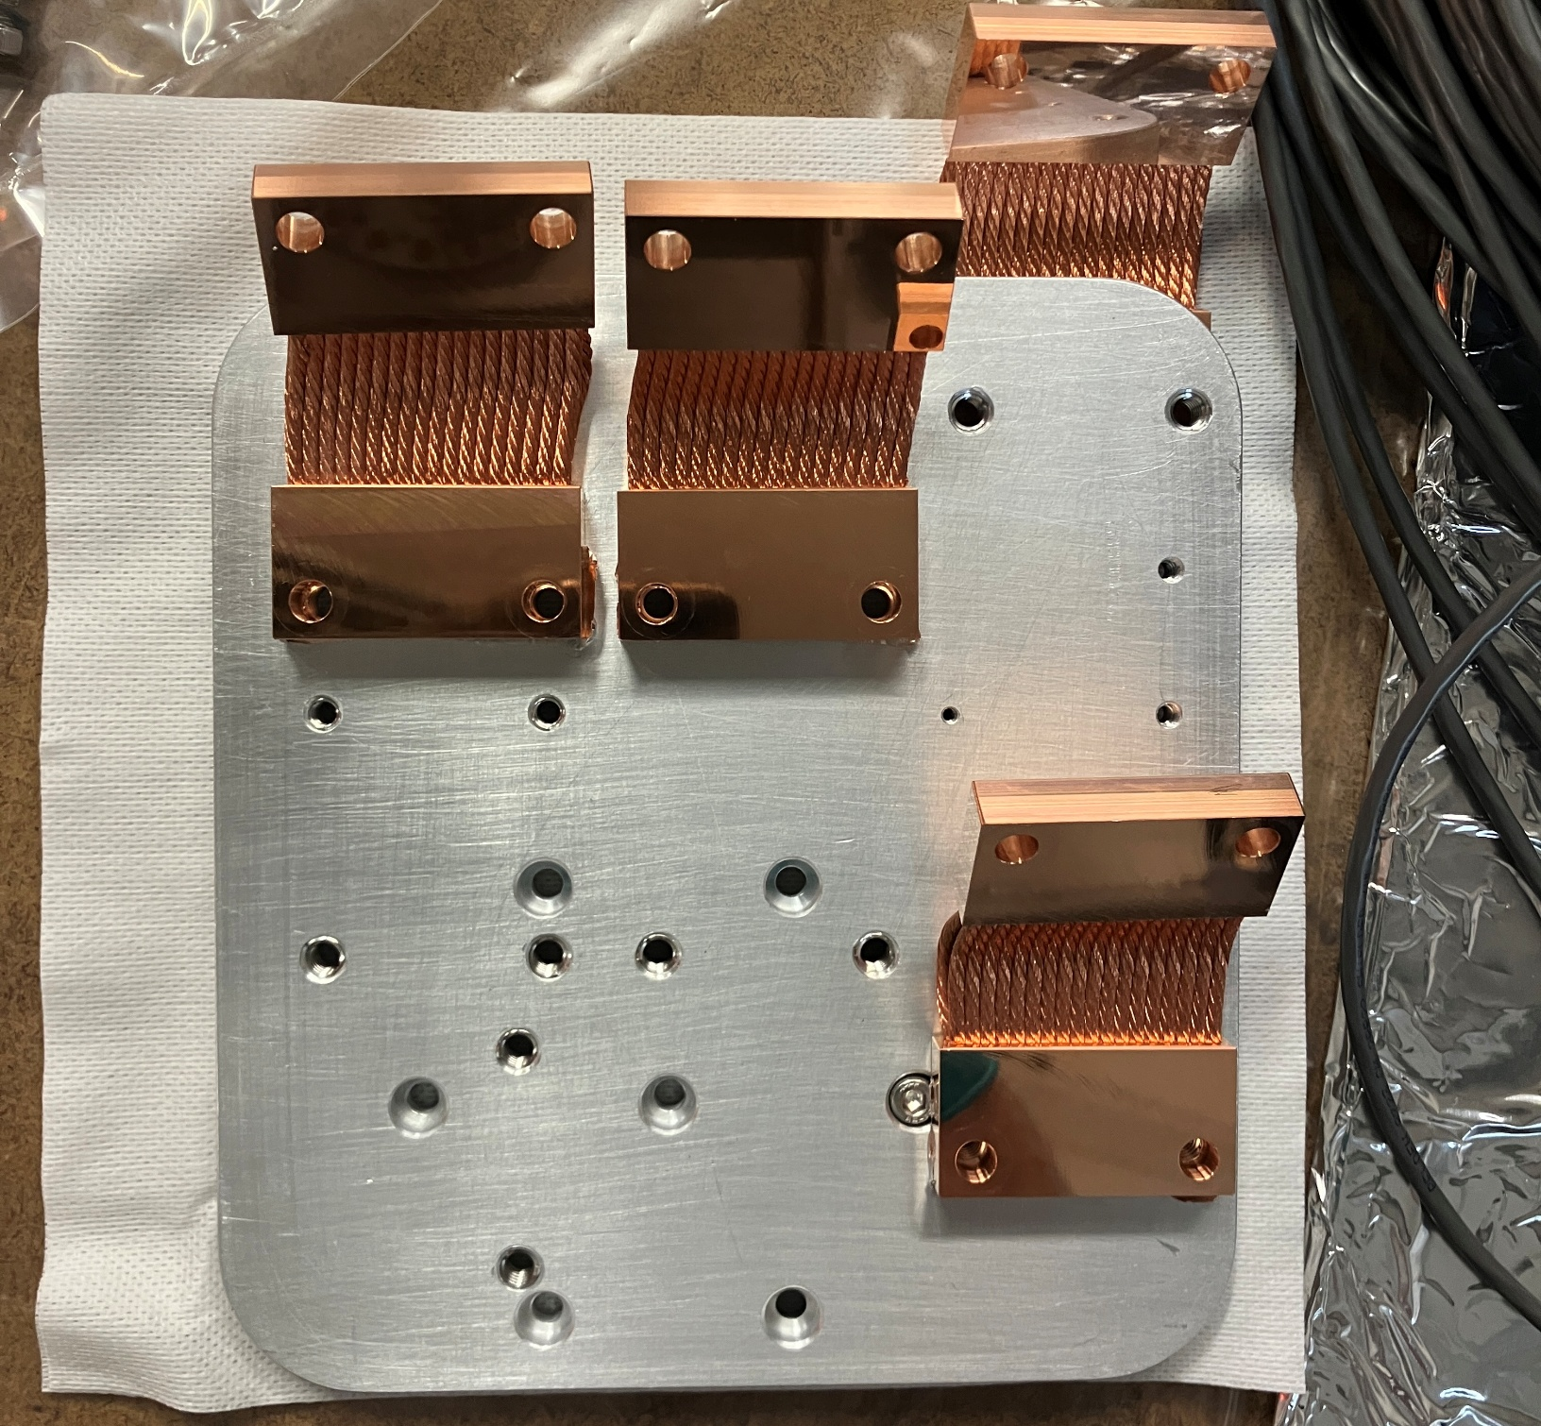
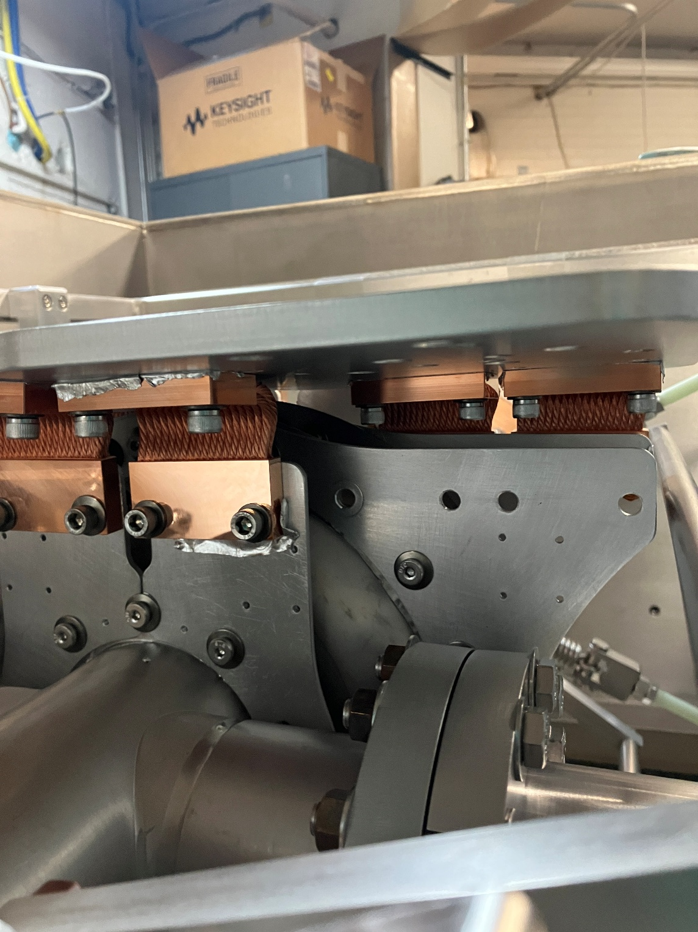
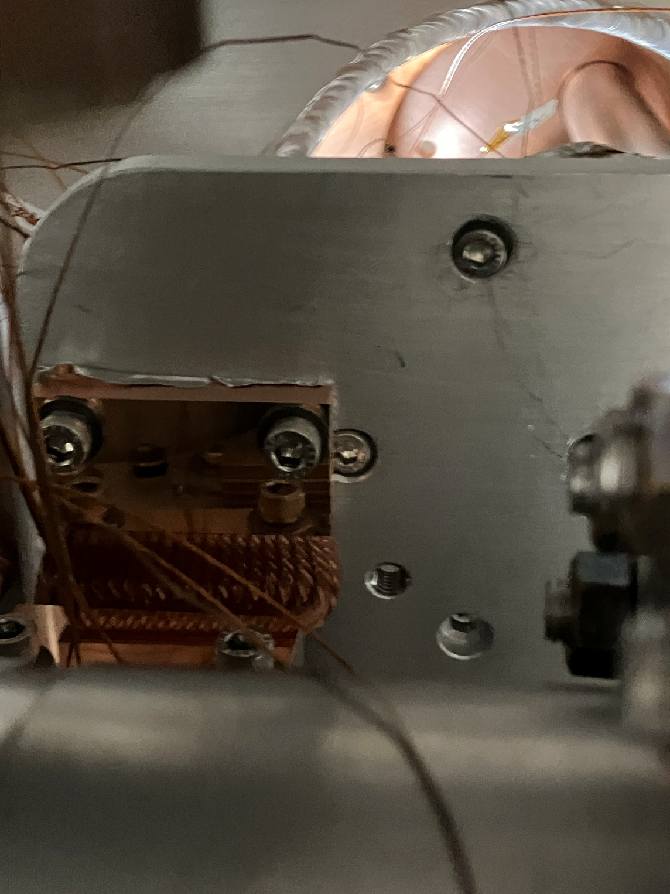
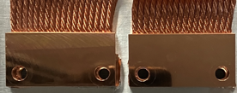
Extra – Interference on 4 K Mounts
Some thermal strap connections interfere with cold head connections
Cold head
Notes:
Guidelines: 6-8 bullets per slide; Use sentence fragments for bullets
To change the photo: Right-click on photo and select change photo

Slide 21
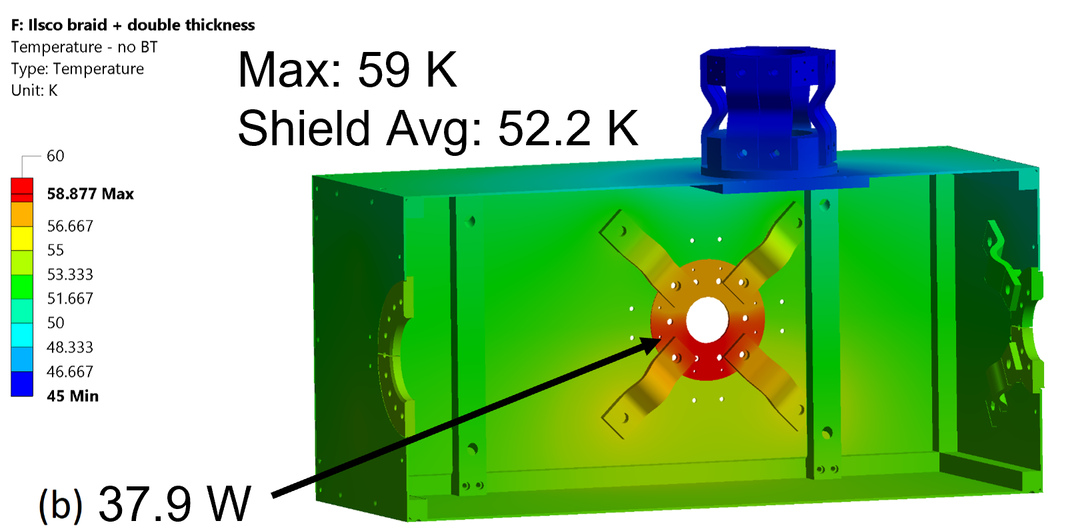
Extra – Thermal Shield Simulation
Semi-combined thermal simulation to compare temperature and heat load results
Notes:
Guidelines: 6-8 bullets per slide; Use sentence fragments for bullets
To change the photo: Right-click on photo and select change photo

