Slide 1
Resonance and Interlocks for EIC
SRF Frontiers Workshop
James Latshaw
11/13/2025

Slide 2
Outline
Introduction
System needs
Preliminary Design
Motivation for a Scalable Design
Generic Slot Concept
Integration into a Common Platform Daughter (CPD) chassis
Block Diagram
Initial Testing of Arc Detectors
Summary and Next Steps
PDR²
Planned Cavity Testing (RHIC 197 MHz Cavity)
FDR

Slide 3
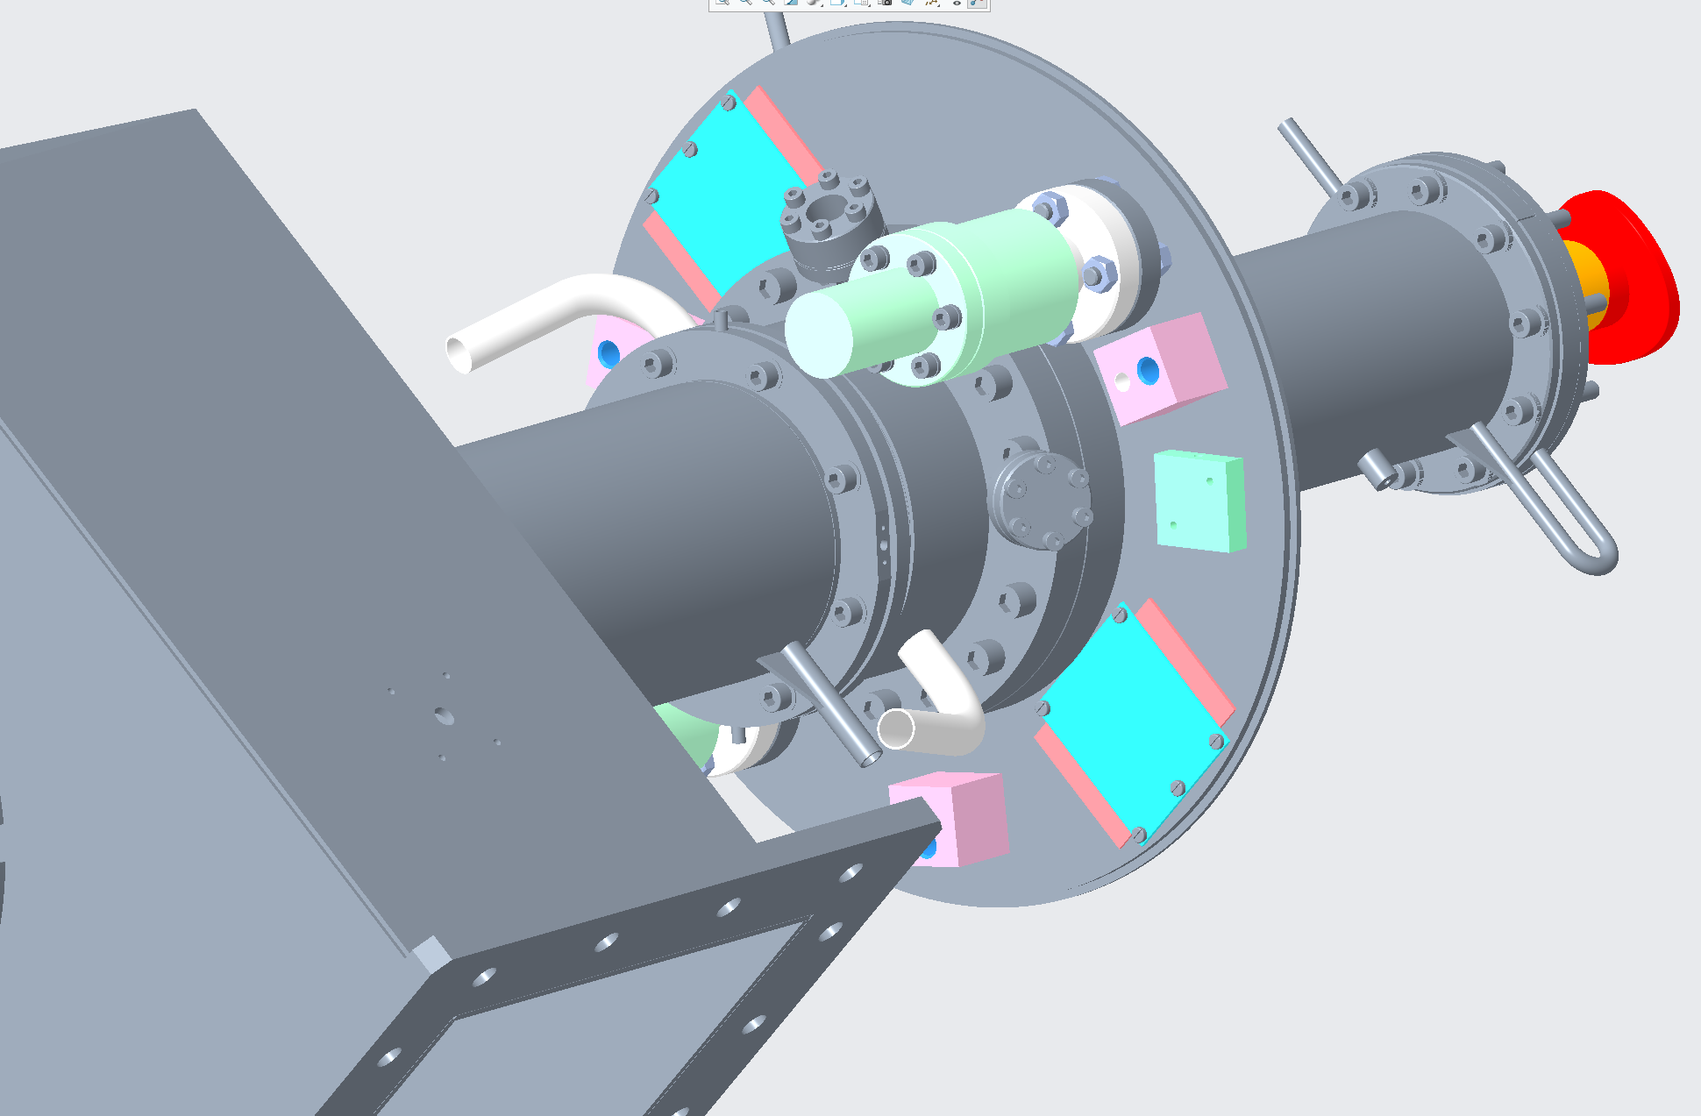
Introduction
Resonance control
Extend performance range of system by making it tunable
Motor, Piezo, Ferrite, Thermal Control (Warm cavities)
Some cavities need to be moved off and then back on reference when a beam loss event occurs.
Interlocks
Kill RF if a fault is detected
HPRF permit, RF DAC drive inhibit
System protection
Arc detectors, Temperature Monitoring
Subsystem Interlocks
Vacuum, HPRF/SSA Interlocks, Coupler Bias, etc.
System Diagnostics
Temperature sensors, readbacks from subsystems
Fault Annunciation, clearly show why RF is off
Currently there are 7⁺ cavity types for EIC (SC and NC)
Common interlock types but varying channel count needs
Work has been to develop a scalable system which can be used for all cavity types
Temperature and flow switch at every water channel
One vacuum side arc detector
Two vacuum gauges
Air side arc detector #1
a dry air flow inlet on the other side
One air side arc detector #2

Slide 4
Motivation for a Scalable Design

Slide 5
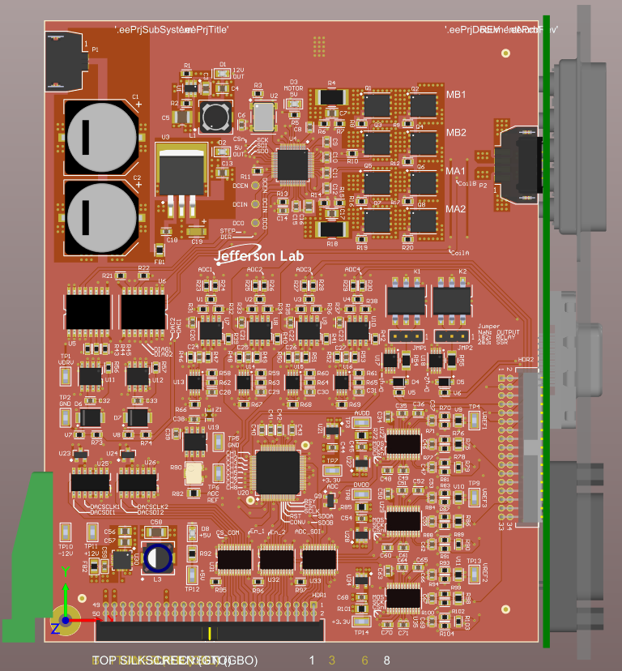
Preliminary Design – Generic Slot
A scalable slot design is being pursued
Leveraging the common signal types
By adding enough slots, all system needs will be met
Economy of scale, the same PCB can be used on all cavity types
Less slots will be used for the less demanding cavity types
Each slot (shown on right) contains the below IO interfaces
1, Stepper Motor Driver
3, Temperature Sensing 24 bit ADC (targeted towards RTD sensors)
2, 16 bit DACs with +/- 10V Drive range
2, Dry Relay, compatible IO (5 to 24V compatible)
4, 100 KSPS 16 bit ADCs (with instrumentation buffers, +/- 12V)

Slide 6
Preliminary Design – Generic Slot

Slide 7
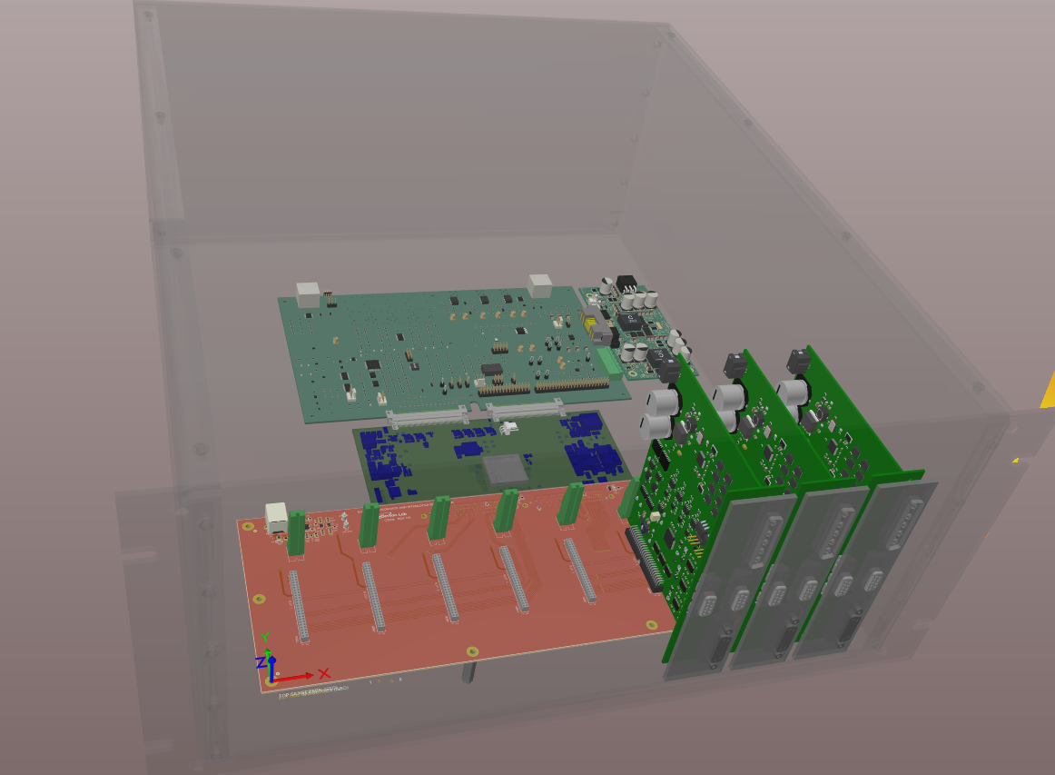
Preliminary Design – Integrating into BNL CPC/CPD Design
Up to 8 Generic Slot boards will go into a 5U chassis which will leverage BNL’s common platform system architecture
Artix Ultrascale + FPGA
Common platform will provide power needs including a 48VDC for motor drivers
Fast ferrite, high power RF SSAs, coaxial couple bias, vacuum systems are external subsystems which this chassis will interface with
Piezo needs are TBD, but most likely this chassis will provide low level drive signals and the piezo’s will be driven by an external subsystem
Extended Carrier
PDU
Generic Slot
DIO
Mother Board

Slide 8

Carrier to Daughter Interface – Block Diagram
Carrier
Daughter, Artix US+, XCAU25P
DMA
Stream Data
Application Top
8 Stepper Motor Drivers
48V, 10Amps, Bipolar
C2C_Slave_0
C2C_Master
24 Temperature Sensors ADCs, 24 bit
Zynq US+
MPSoC
AXI
Master IF
Aurora PHY 64B/66B
Aurora PHY 64B/66B
AXI
Slave IF
S_AXI_
16 DAC Channels
16 bit, +/- 10V
AXI-Lite
Slave IF
AXI-Lite
Master IF
Register Map
16 Dry Relay Contacts
5 to 24V, Configurable IO
M_AXI_
32 ADC Channels
16 bit, 100 KSPS, +/-12V
UART Debugger
Peripheral Management
C2C_Slave_1
AXI
Master IF
Aurora PHY 64B/66B
AXI-Lite
Slave IF
DDR4

Slide 9
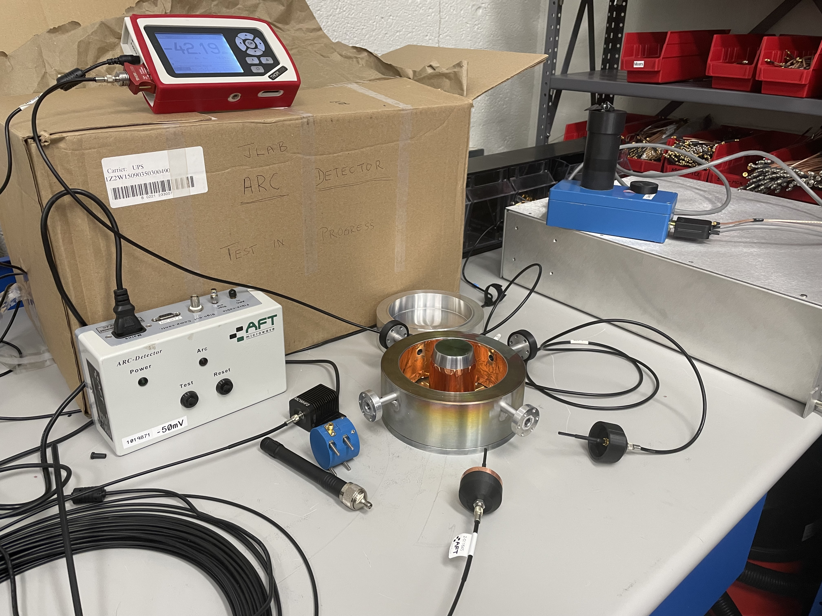
Arc Detector Selection
The Fundamental Power Coupler (FPC) is planned to be equipped with arc detectors (ESR FPC shown on right)
An effort lead by Kyle Fahey at BNL was to test various arc detectors with the planned for this FPC
PMT
Photodiode
Goal is to use light pipes to detectors arc events as well as to send a test light to validate the arc detector functionality
CEBAF Arc Detector
FPC

Slide 10
Summary and Next Steps
Continue lab testing of prototype boards
Evaluate results and determine if a re-spin is required.
Preliminary Design Review part 2
Address Review committees comments
Incorporate any additional recommendations
Cavity Testing
Test prototype system on one of BNL’s RHIC 197 MHz Cavity (notionally 4/2025)
Incorporate any lessons learned
Final Design Review

Slide 11
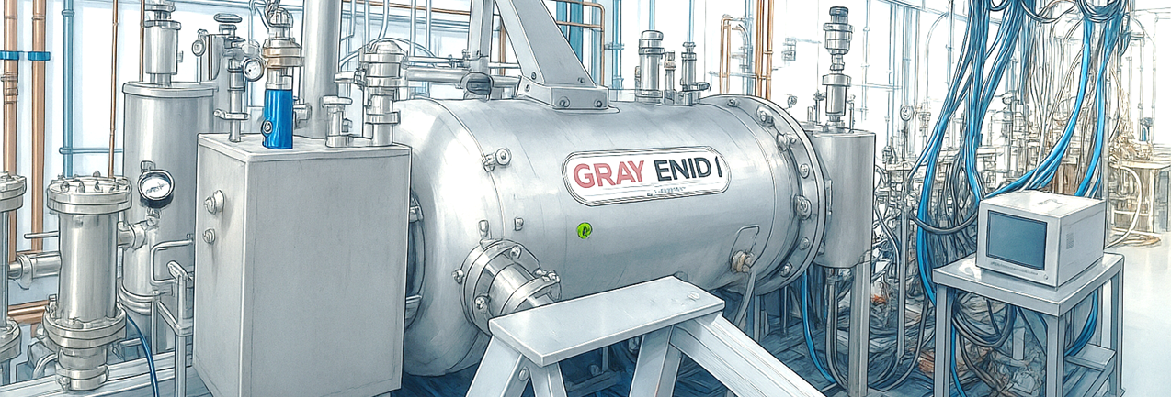
Thank you!
Questions?

