Slide 1

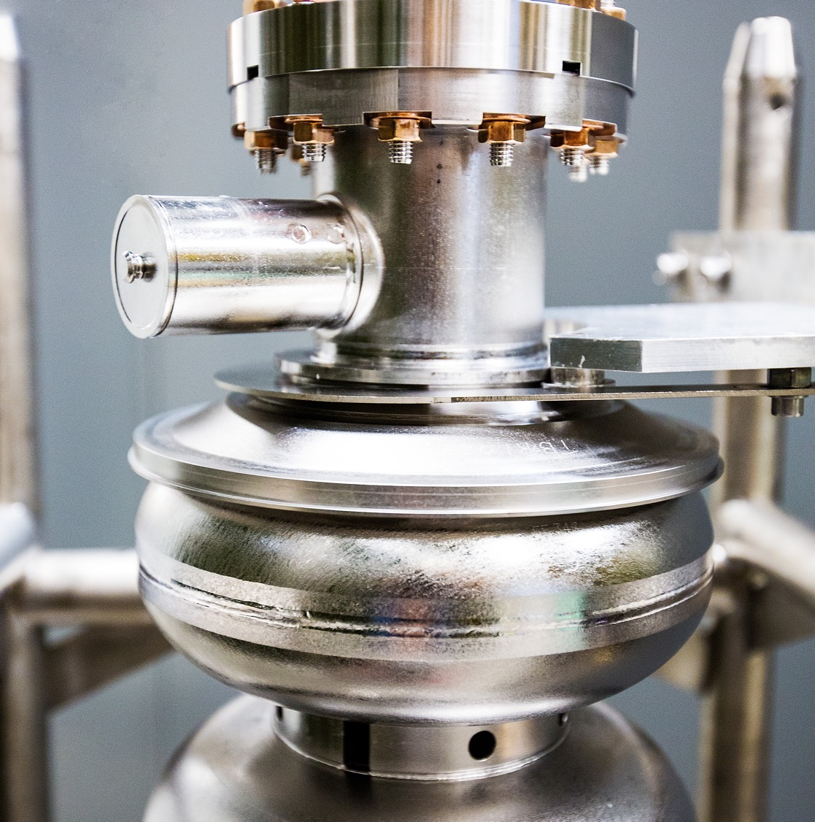
A new SRF cavity control system
SRF Frontiers Workshop
Jefferson Lab, Nov 2025
13 November 2025
Peter Owen*
*powen@jlab.org
Notes:
Tip: Keep titles under 60 characters for readability
To change the photo: Right-click on photo and select change photo

Slide 2
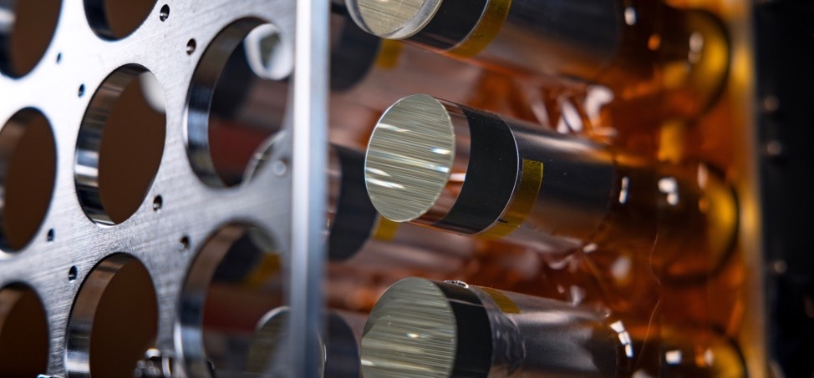
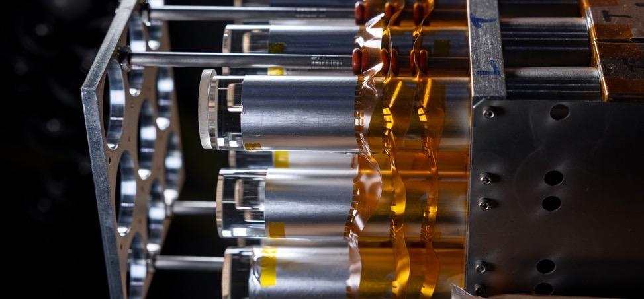
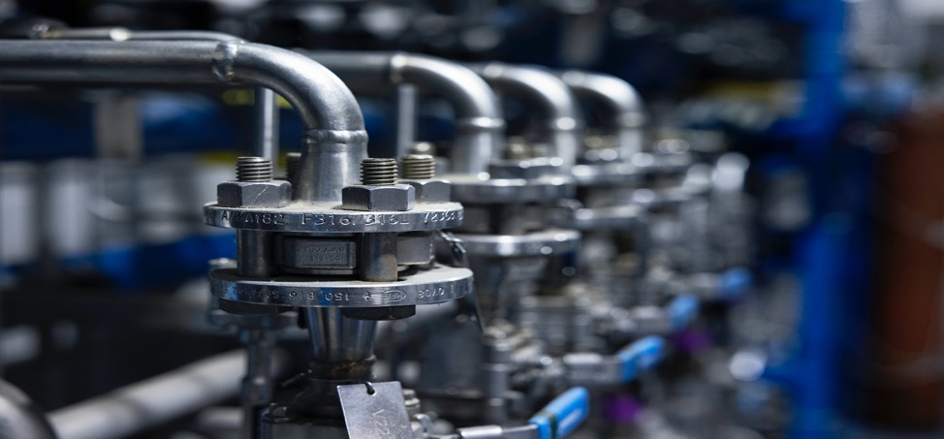
Outline
Background of RF Control systems
In General
At Jefferson Lab VTA
Upcoming RF challenges
Design of new RF system
LDRD Research
Year 1 Progress
Year 2 Goals
Mode Mixing and Suppression in LCLS-II HE cavities
Notes:
Guidelines: 6-8 bullets per slide; Use sentence fragments for bullets
To change the photo: Right-click on photo and select change photo

Slide 3
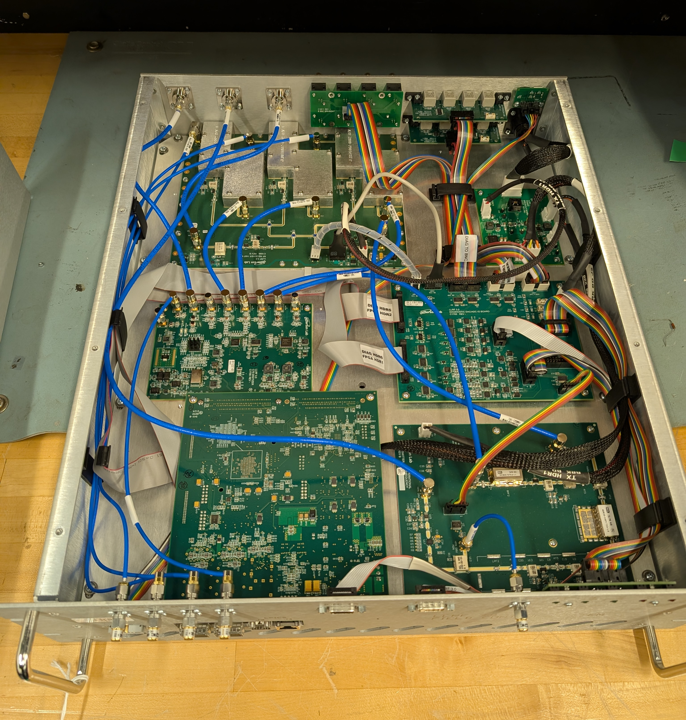
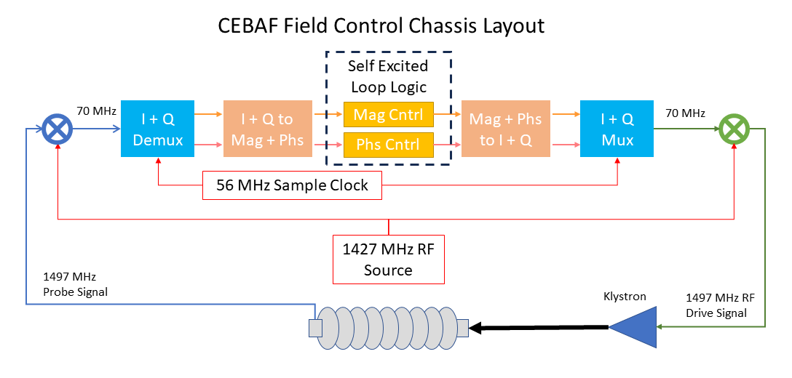
RF Control Systems - General
Custom RF FPGA design tuned for one frequency of operation
Perform measurement and control of RF signals to and from cavity
Connections and interlocks to external systems (tuners, RF permit, master oscillator, EPICS)
FPGA Performs Self Excited Loop controls
Optional regulation of Amplitude and Phase (SELAP)
LLRF control and measurement systems in CEBAF
Notes:
Guidelines: 6-8 bullets per slide; Use sentence fragments for bullets
To change the photo: Right-click on photo and select change photo

Slide 4
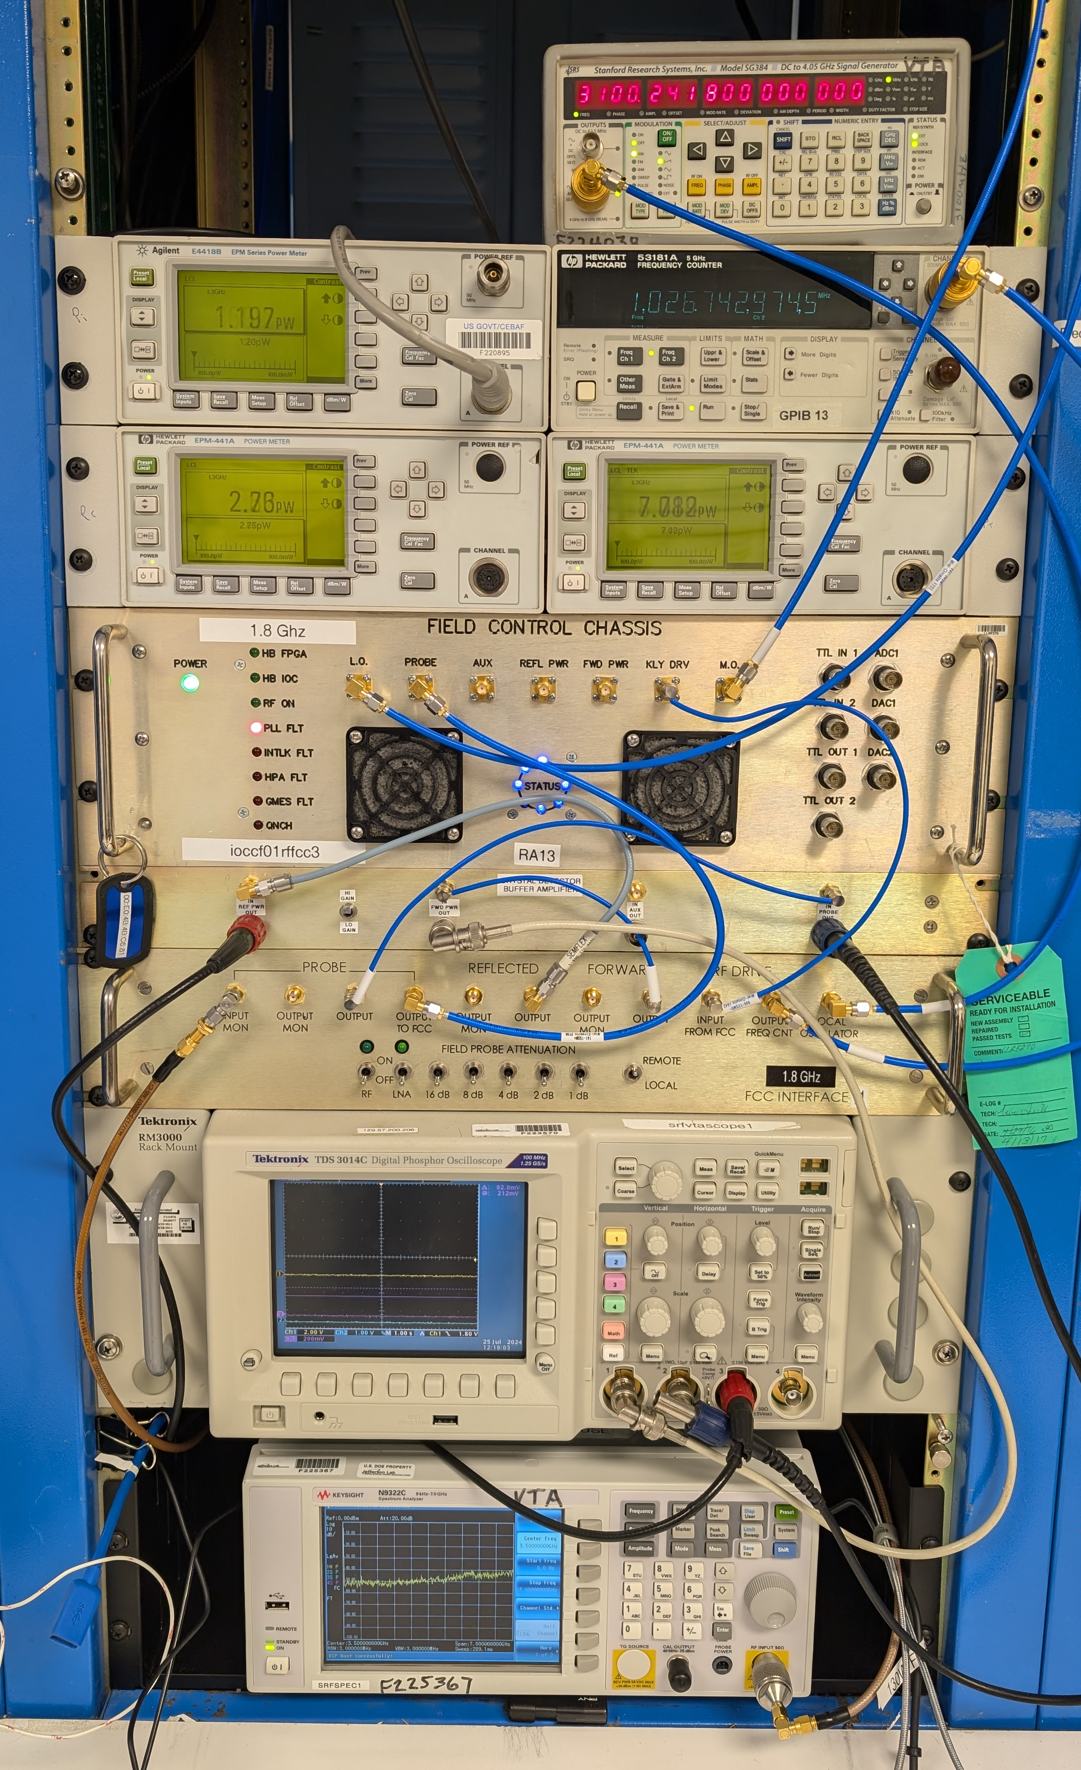
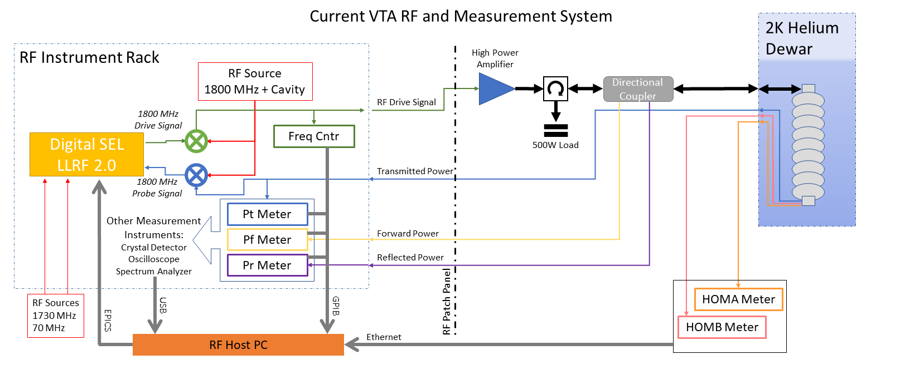
RF Control Systems - VTA
Wide range of cavities and frequencies, 0.2 – 7 GHz
Up to 100W of power, critically coupled cavities
High throughput, up to 400 cavity tests per year
Cavity control (SEL) from CEBAF LLRF2.0 system, adapted through interface chassis
Measurement done with power meters
LLRF control and measurement system in the VTA
Notes:
Guidelines: 6-8 bullets per slide; Use sentence fragments for bullets
To change the photo: Right-click on photo and select change photo

Slide 5
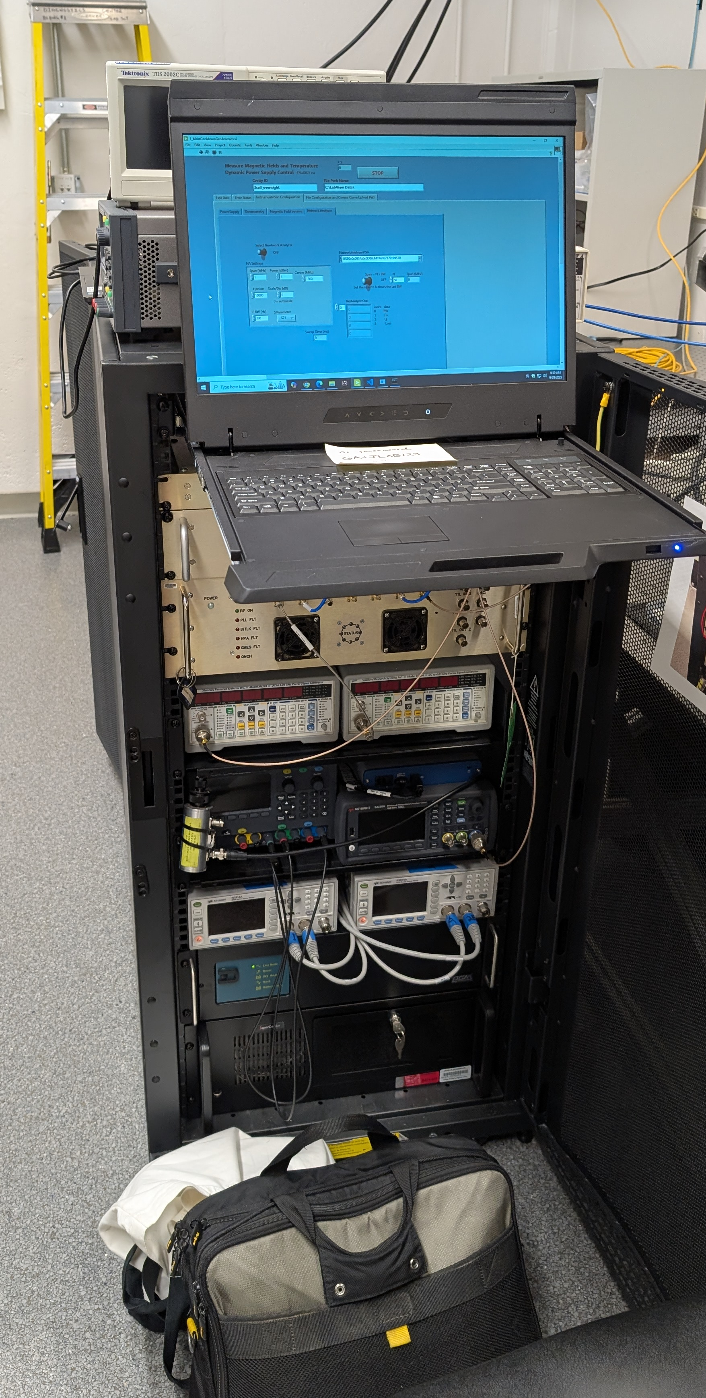
Upcoming RF Challenges
SRF Operation at smaller scales (conduction-cooled, compact)
Operation of non-linear amplifiers (magnetron)
Capturing raw signal data for new measurement methods and AI training
Proposed Magnetron Controller layout - R. Rimmer
LLRF control and measurement system ported from VTA to General Atomics
Notes:
Guidelines: 6-8 bullets per slide; Use sentence fragments for bullets
To change the photo: Right-click on photo and select change photo

Slide 6
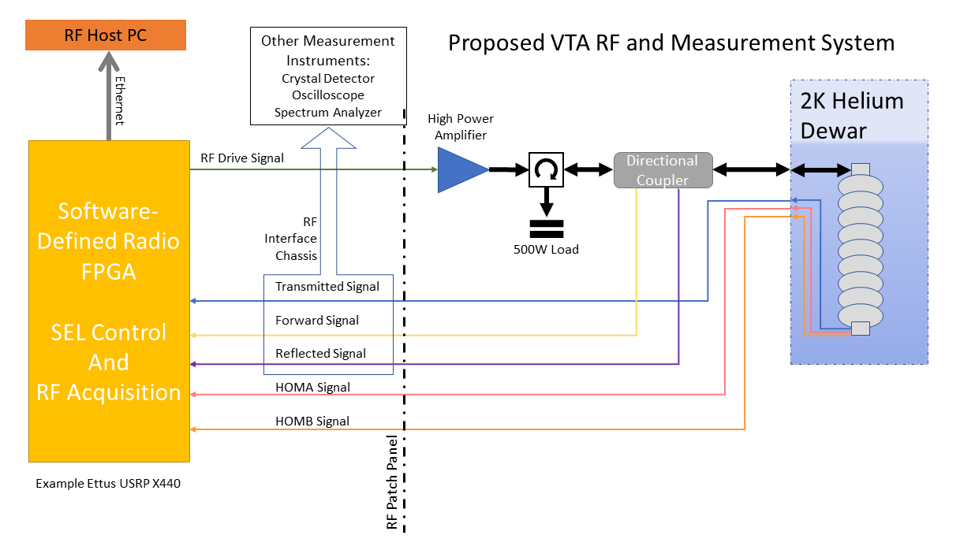
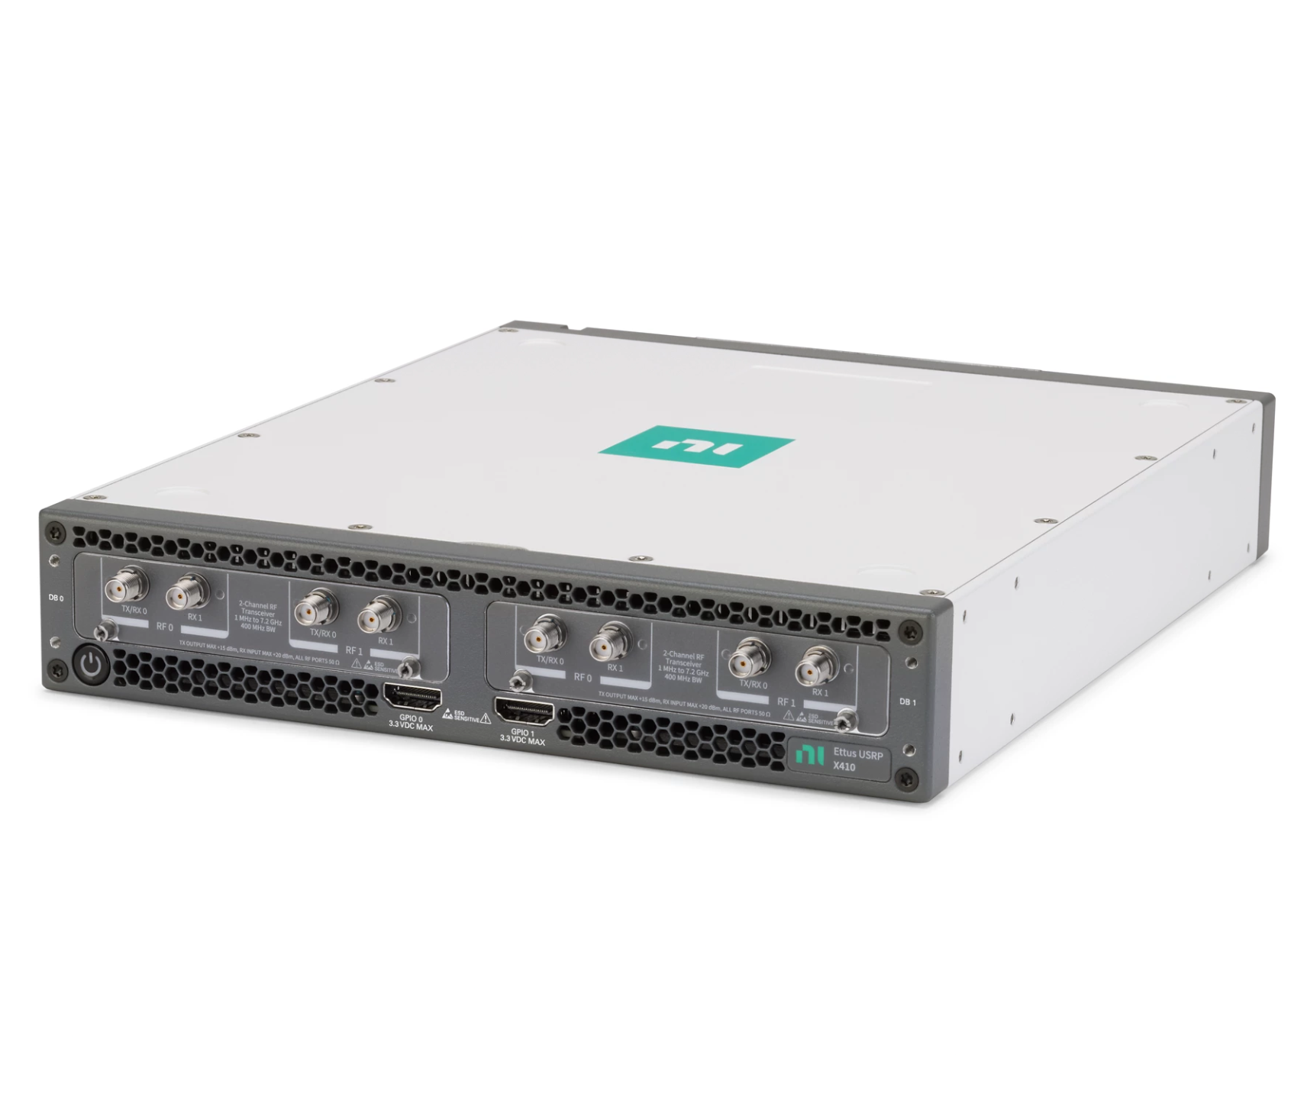
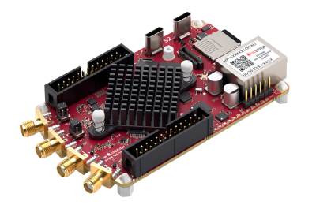
New RF System Design
Replace Custom FPGA hardware with Software Defined Radio ($40k)
Wide frequency range and bandwidth
FPGA to process signals and control
Computer interface, no other external systems needed
Red Pitaya FPGA ($1k)
2x Rx and Tx channels
Lower sample rate, 50 MHz
Perform SEL control, measurement from Power Meters or separate digital acquisition
All commercially available
Improve system flexibility at the cost of amplitude and phase stability
New FPGA based system design
Notes:
Guidelines: 6-8 bullets per slide; Use sentence fragments for bullets
To change the photo: Right-click on photo and select change photo

Slide 7

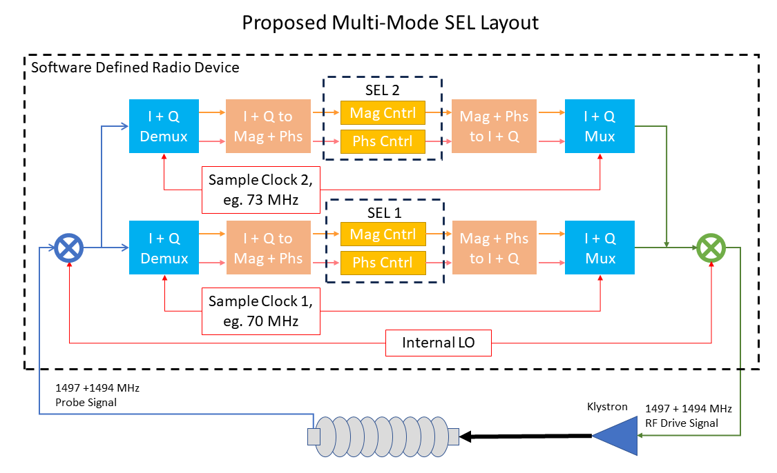
LDRD Research Project
Cavity test results with SDR acquisition
Goals for 2024-2025
Use SDR to replace power meters in cavity test
Goals for 2025-2026
Perform SEL control on SDR platform
Use digital acquisition to improve accuracy of measurements in VTA
Multi-mode excitation (or suppression) of multicell SRF cavities from one FPGA
Notes:
Guidelines: 6-8 bullets per slide; Use sentence fragments for bullets
To change the photo: Right-click on photo and select change photo

Slide 8
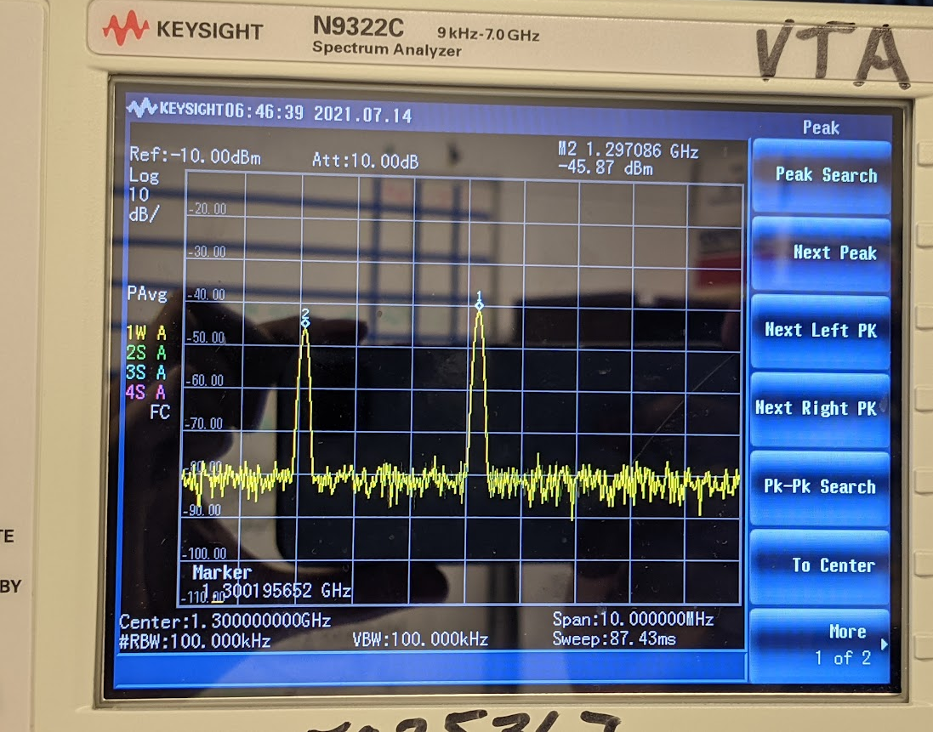
Mode Mixing
The two modes that are commonly excited are the pi mode (1300.2 MHz), and the 7/9 pi mode (1297.8 MHz)
When the 7/9 mode is self-excited, the RF system can only measure the sum of both modes, and any data points taken are invalid
New RF Control scheme suppresses 7/9 mode, Setup a second SEL 180 degrees off resonance
~ 1s
Reverse RF phase 180º

Slide 9
Anti-Mode Mixing System (AMMS)
High Power Amplifier
RF Sources
1730 MHz
70 MHz
RF Source
3100.2 MHz
1800 MHz
Field Control Chassis 1
Directional Coupler
1300 & 1297 MHz Drive
1800 MHz
Probe Signal
Forward Power
Reflected Power
FCC Downconverter
RF Splitters/Combiners
Peter Owen, 2023
1300 MHz Field Probe
1803 MHz
RF Sources
1733 MHz
70 MHz
Measurement instruments:
Power Meters
Frequency Counter
Crystal Detector
Spectrum Analyzer
Field Control Chassis 2
1300.2 MHz = 3100.2 – 1800 MHz
Conversion done with RF Mixer in FCC downconverter
Allows easy switching between cavity types and frequencies
1803 MHz
Probe Signal
1297.2 MHz = 3100.2 – 1803 MHz
FCC #2 is locked onto 7/9 mode

Slide 10
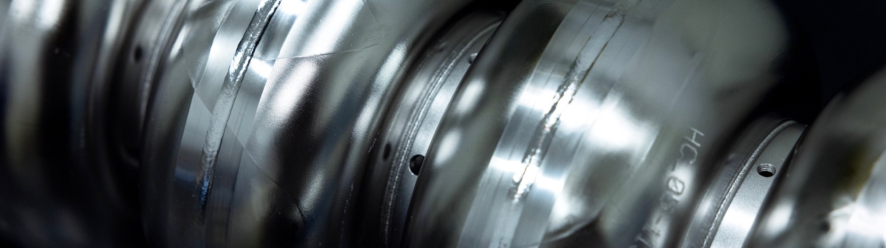
Questions?
This material is based upon work supported by the U.S. Department of Energy, Office of Science, Office of Nuclear Physics under contract DE-AC05-06OR23177.
Work funded by Jefferson Lab LDRD.
Notes:
Guidelines: 6-8 bullets per slide; Use sentence fragments for bullets
To change the photo: Right-click on photo and select change photo

Slide 11
Abstract
At Jefferson Lab, work is under way to develop a new Low Level RF control and measurement system using off-the-shelf components to test SRF cavities. This system will operate independently of EPICS or other control systems, making it ideal for offsite tests and quick prototype development. New methods of RF measurement are considered for cavity quality factor (Q0) and reducing error in existing measurement techniques using the flexibility of the system architecture.
Notes:
Guidelines: 6-8 bullets per slide; Use sentence fragments for bullets
To change the photo: Right-click on photo and select change photo

