Slide 1
Nb₃Sn coating on Cu via CVD
Shreyas Balachandran
Department of Mechanical Engineering, FAMU- FSU College of Engineering, Tallahassee, FL.
Collaborators and work presented on behalf of colleagues at Ultramet, Jefferson Lab, and FSU
Acknowledgement: The work was performed under the DOE- ACCELERATE program, and DOE grant- DE-SC0026206. Additional support for the National High Magnetic Field Laboratory facilities is from the NSF: NSF-DMR-2128556, and the State of Florida. This work is authored by Jefferson Science Associates, LLC, under U.S. DOE Contract No. DE-AC05-06OR23177.

Slide 2
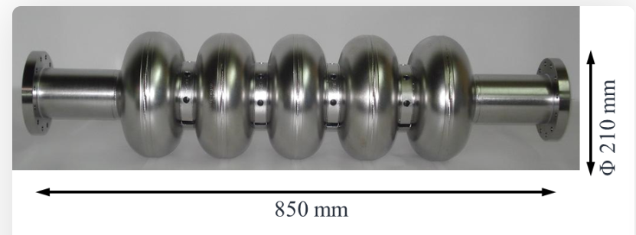
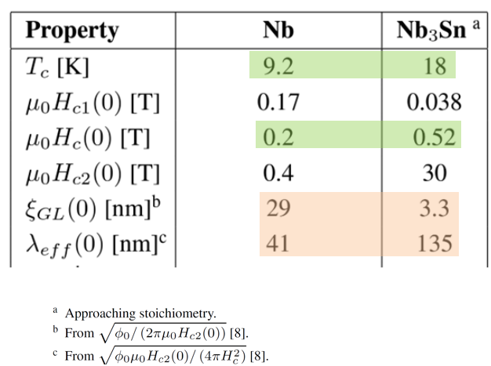
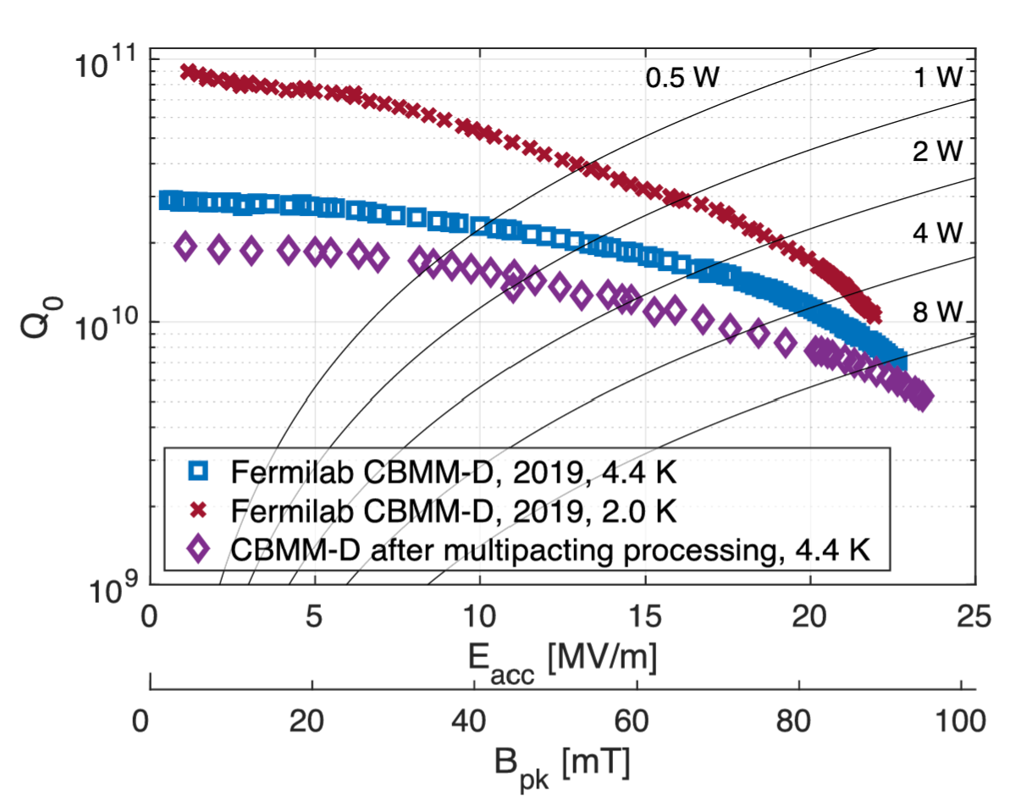
Beyond SRF Nb- Alternative materials: Focus on Nb₃Sn
4W
at ~4 K
Posen, S., Lee, J., Seidman, D. N., Romanenko, A., Tennis, B., Melnychuk, O. S., & Sergatskov, D. A. (2021). Advances in Nb₃Sn superconducting radiofrequency cavities towards first practical accelerator applications. Superconductor Science and Technology, 34(2), 025007.

Slide 3
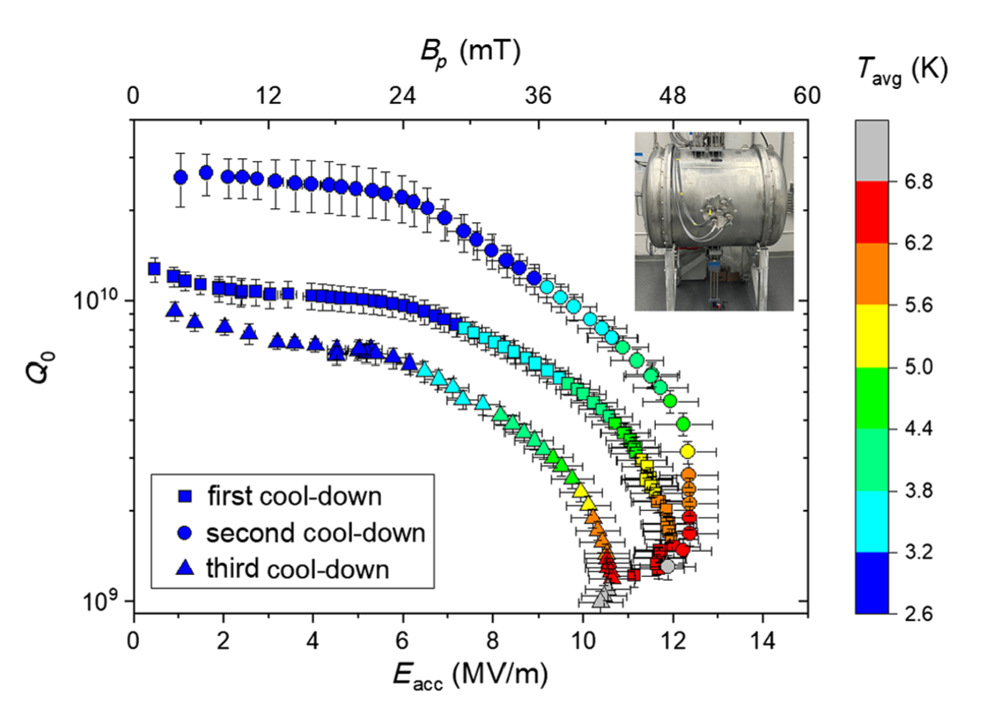
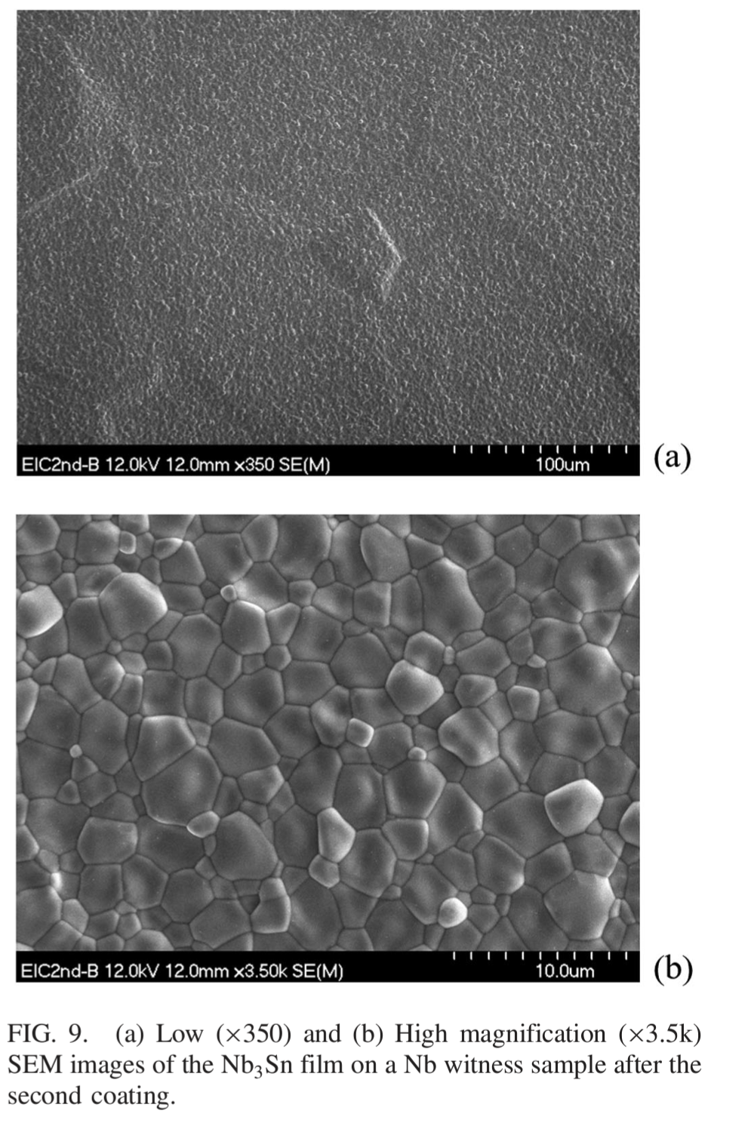
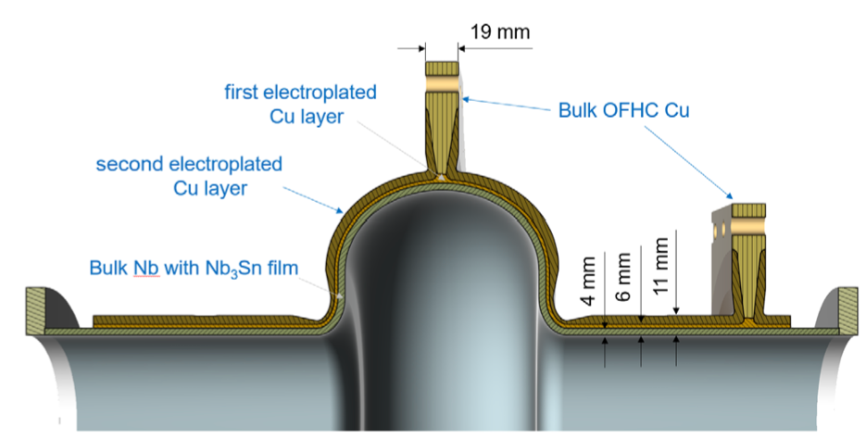
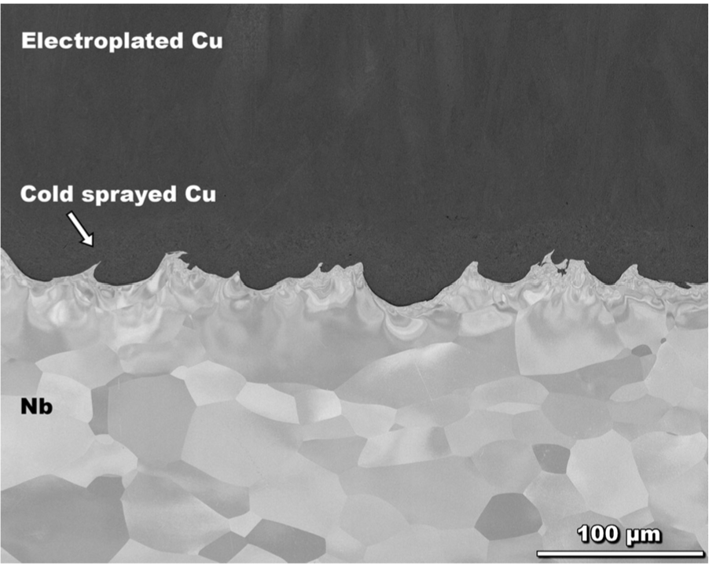
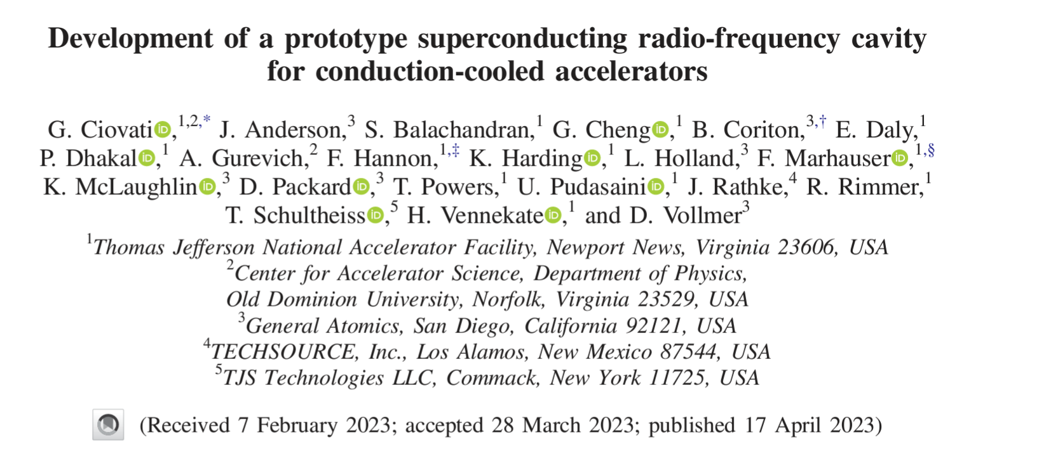
Cryocooled Nb₃Sn on Nb successfully tested in Jefferson Lab- 1MW, 1MeV compact electron accelerator possible.
10 MeV, 1 MW system in the works!

Slide 4
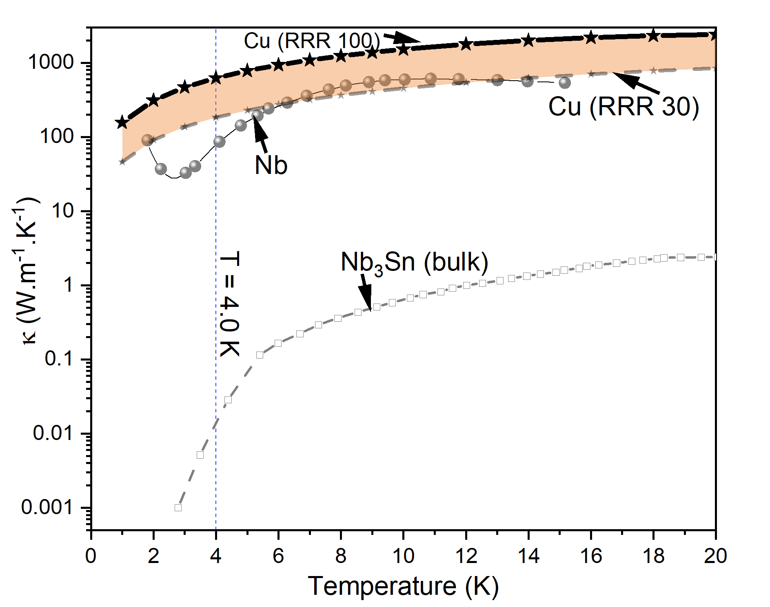
Nb₃Sn on Cu for SRF applications
Current
Nb₃Sn
Cu melts at ~1100°C.
Nb
Cu
Cu-based Nb₃Sn is a widely studied system.
Proposed
Nb₃Sn
Cost of RRR 100 Cu ~ 1/20 of RRR 300 Nb
Cu
~ 5 times improvement in thermal conductivity at 4K with Cu

Slide 5
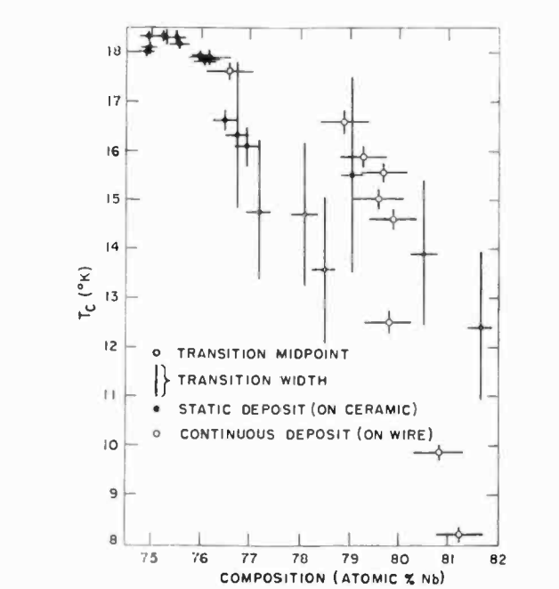
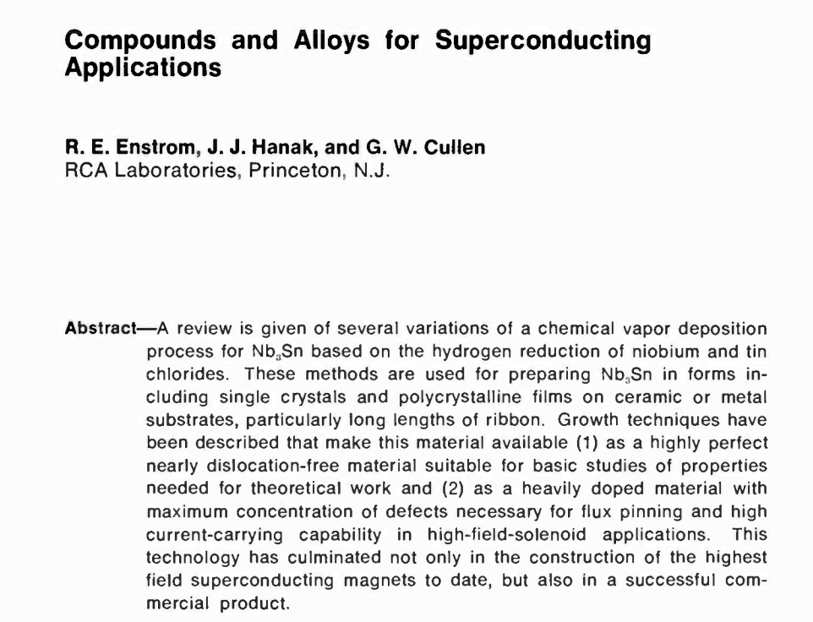
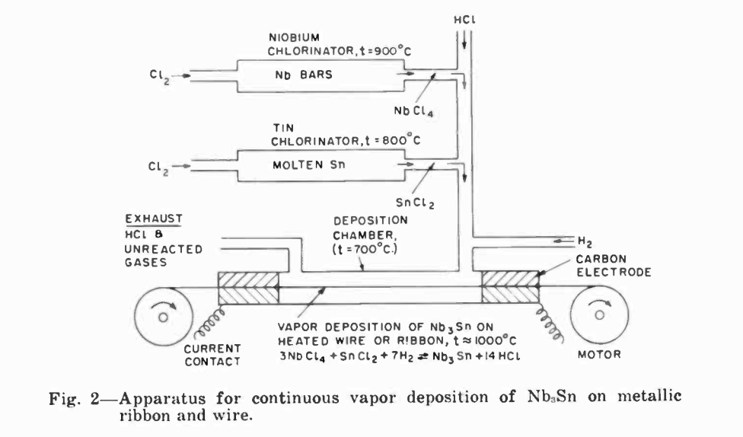
CVD Nb₃Sn by Nb and Sn chloride reactions
December 1970, RCA Reviews
Deposition temperature is 700℃
Ribbon or wire heated to ~1000 ℃
Nb: Sn vapor ratio control is important

Slide 6
Ultramet, Inc deposited Nb₃Sn on Cu cavities at temperatures of 750℃ - 900℃
Nb₃Sn (77-78:23-22)
Ta
Nb₃Sn (75:25)
Nb₃Sn (75:25)
50 µm
Nb
50 µm
Cu
50 µm
Cu
Precursors are largely proprietary.
Process details are unknown.

Slide 7
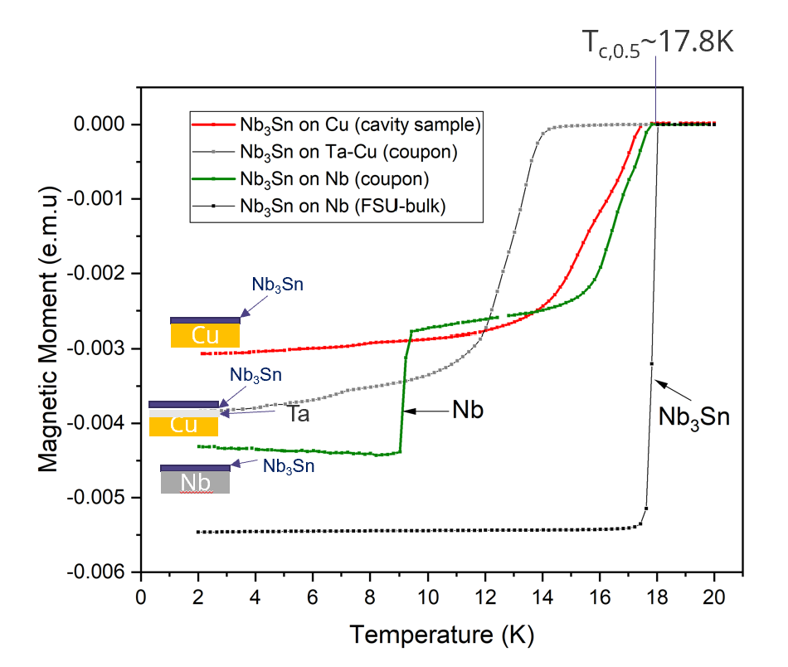
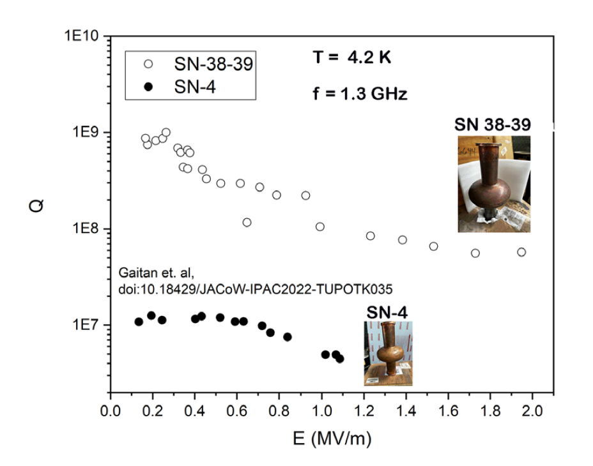
High T_{c}, Nb₃Sn is possible in the temperature range of 750- 900℃.
Cavity performance needs to improvement

Slide 8
Issues beyond obtaining high-quality CVD Nb₃Sn need to be addressed for success in SRF applications.

Slide 9
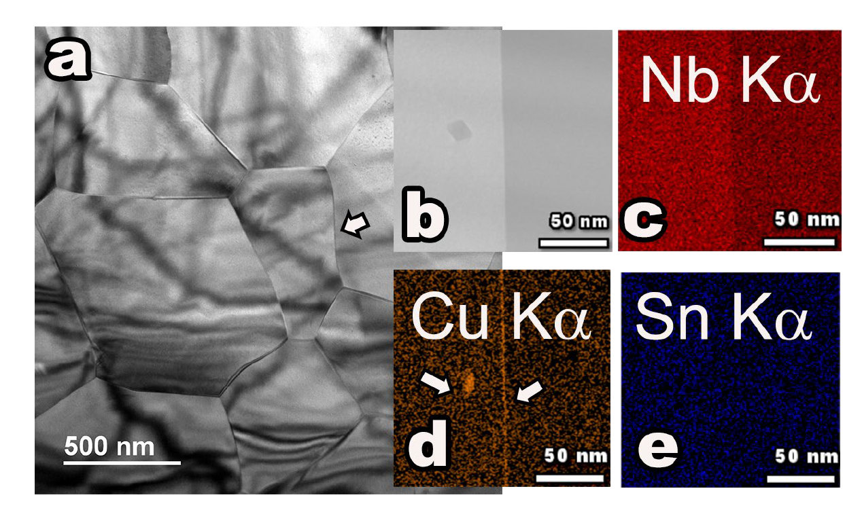
Cu in Nb₃Sn {grain boundaries}
Degradation of performance due to Cu in GB’s.
Cu Diffusion barriers are important

Slide 10
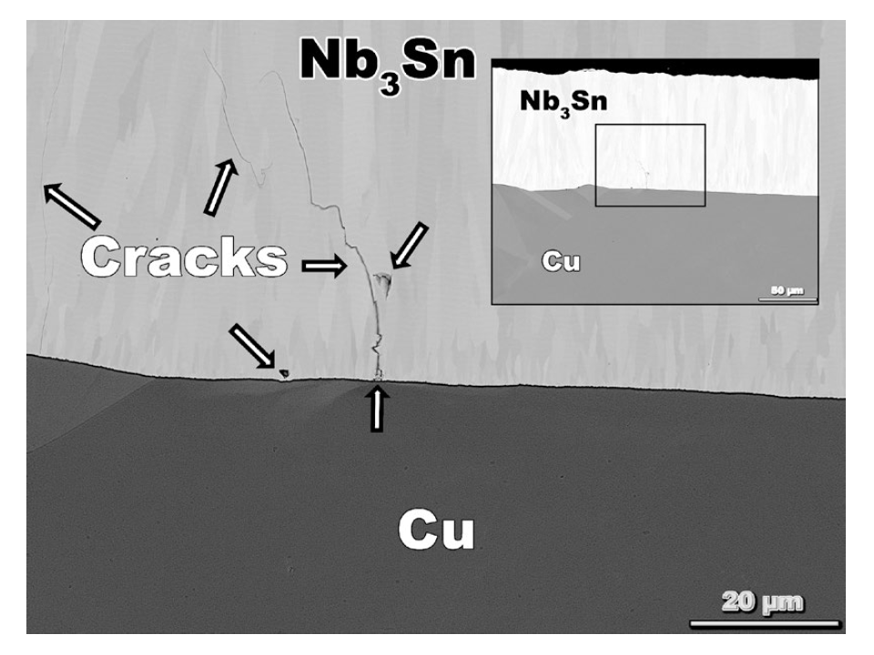
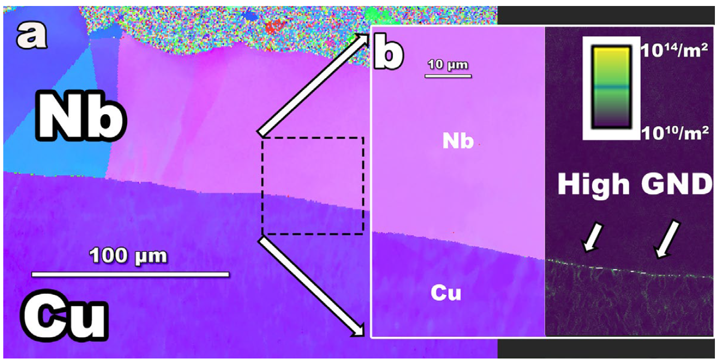
Thermal strains: Coefficient of thermal expansion.
Thermal expansion mismatch:
Cu: 17 x 10⁻⁶/℃
Nb₃Sn: 7.6 x 10⁻⁶/℃
Nb/ Ta: ~8 x 10⁻⁶/℃

Slide 11
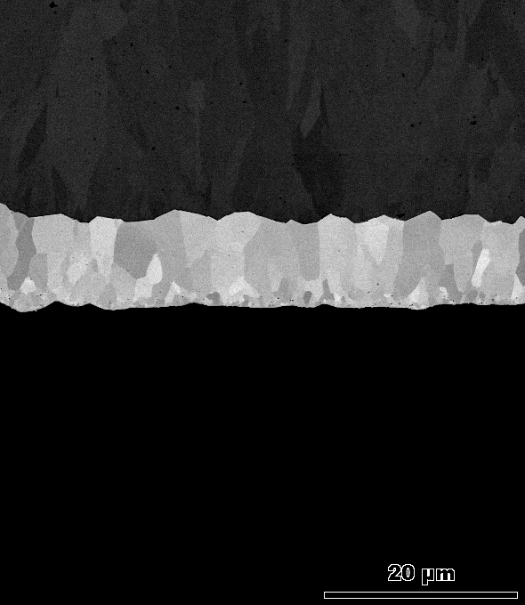
Surface roughness: Substrate + growth
Nb₃Sn
Nb₃Sn
Ta / Nb
Ta / Nb
Cu
Grain sizes are µm in size
Polishing processes for Nb₃Sn

Slide 12
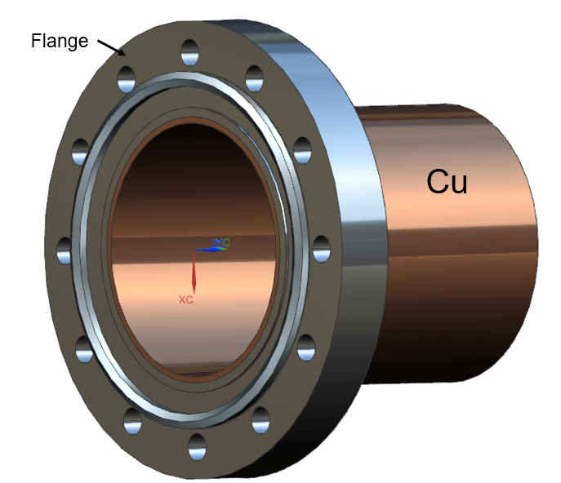
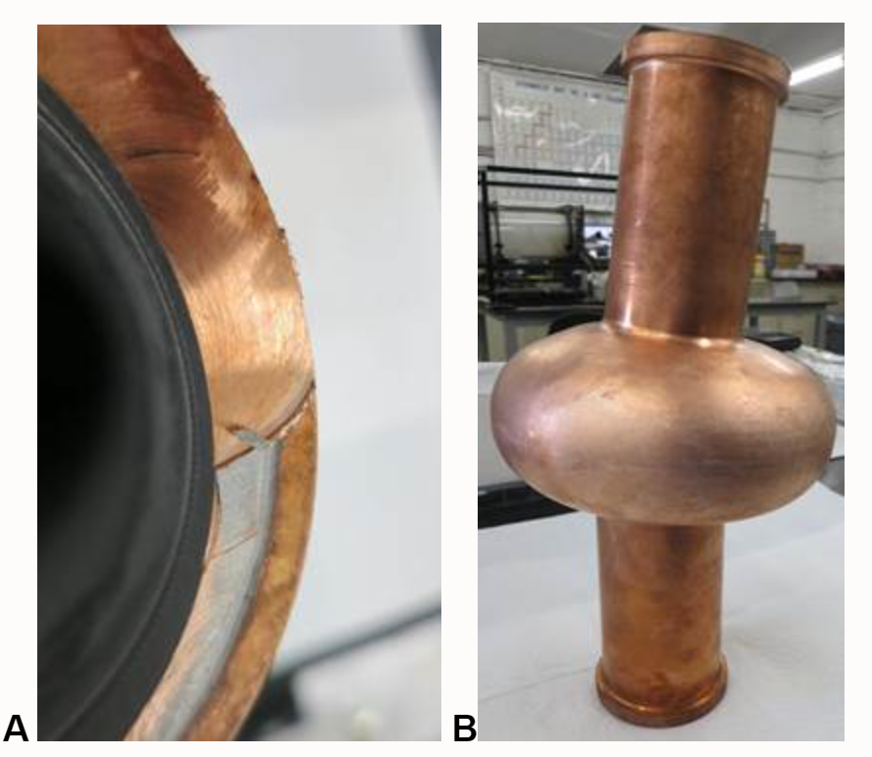
Structural stability of Cu structures after heat treatments

Slide 13
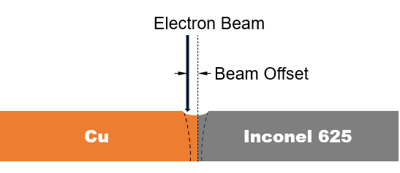
RD&D at Jefferson Lab to weld Inconel 625 to Cu
Inconel 625- 3.1mm sheet and 1 in. plate
Cu- C10100, off the shelf- 3.1 mm sheet
Element | Weight percent
Chromium | 22.0
Molybdenum | 9
Niobium + Tantalum | 1.2
Iron | 1.8
Aluminum | 0.3
Titanium | 0.26
Silicon | 0.16
Manganese | 0.3
Carbon | 0.04
Sulphur + Phosphorus | <0.005
Nickel | Bal.
Welding parameters for 3mm thick sheets of Cu and Inconel 625. Beam current = 50 mA, beam Voltage = 50 kV, and oscillation diameter of 2mm, 10 kHz.
Sample ID | Weld speed (mm/s) | Beam Offset (mm) | Energy per unit length (W/mm)
O1-C | 6.8 | 0.4 | 328
O2-C | 6.8 | 0.6 | 328
O3-C | 6.8 | 0.9 | 328
O4-C | 6.8 | 1.1 | 328
V1-C | 7.6 | 1.0 | 328
V2-C | 6.8 | 1.0 | 369
V3-C | 5.9 | 1.0 | 422
V4-C | 5.1 | 1.0 | 492
O7-I | 7.2 | 0.4 | 328
O8-I | 7.2 | 1.0 | 328
Beam
Offset
In Cu
In A-625

Slide 14
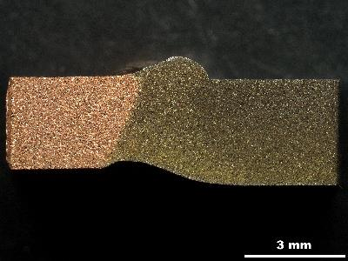
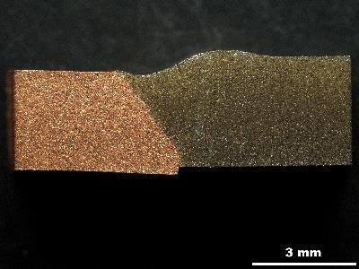
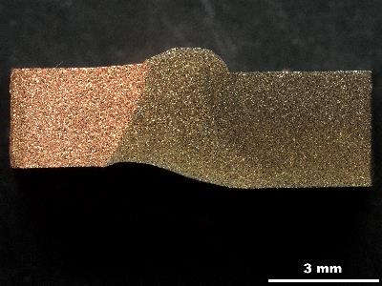
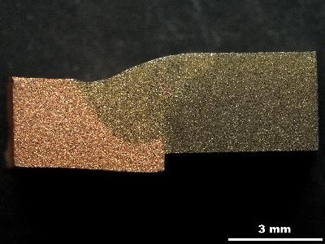
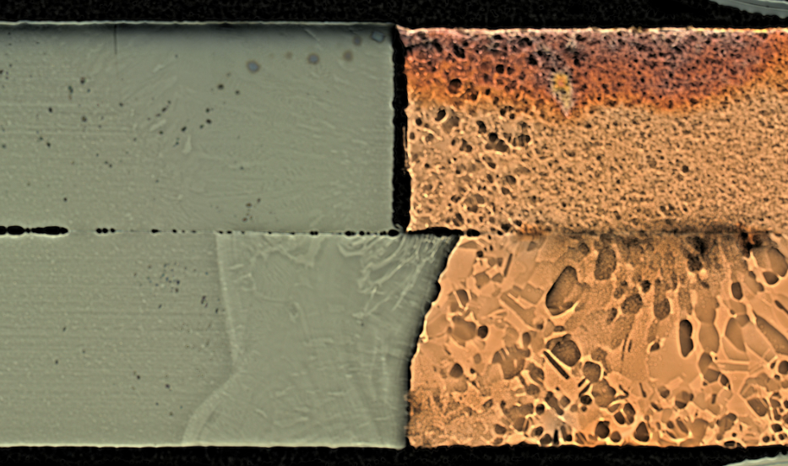
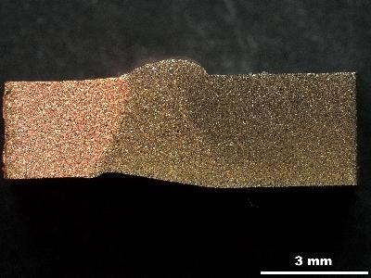
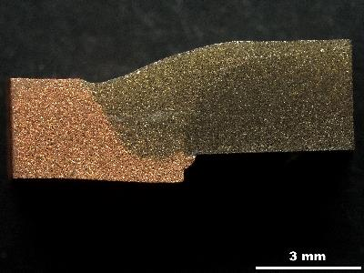
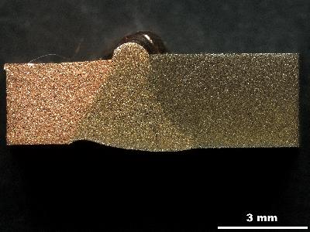
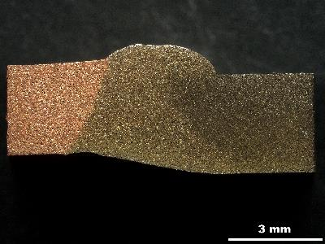
EB welds Cu to Inconel 625. Offset in Cu NOT in Inconel
Offset in Cu, v = 6.8 mm/s
Varying speed, Offset in Cu = 1mm
V= 7.6 mm/s
Cu
Alloy 625
Cu
Alloy 625
0.4 mm
V= 6.8 mm/s
Offset in Inconel 625, v = 6.8 mm/s
0.6 mm
1.0 mm
V= 5.9 mm/s
0.9 mm
0.4 mm
V= 5.1 mm/s
3 mm
1.1 mm
O = 1 mm

Slide 15
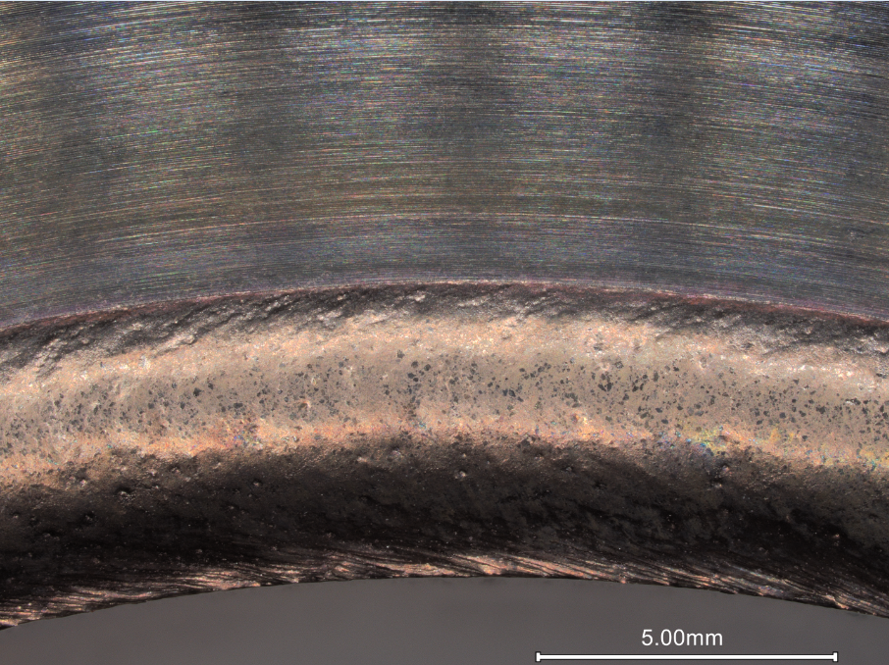
Inconel Flange welded to Cu tube

Slide 16
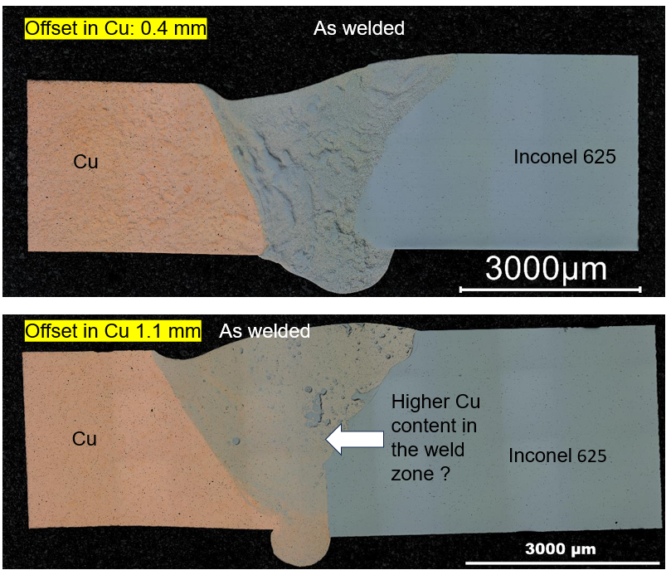
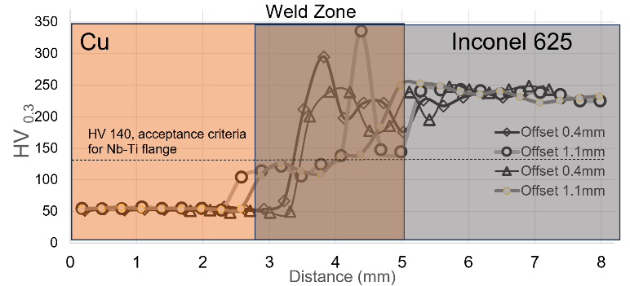
Cu- Inconel welds maintain high strength after welding.

Slide 17
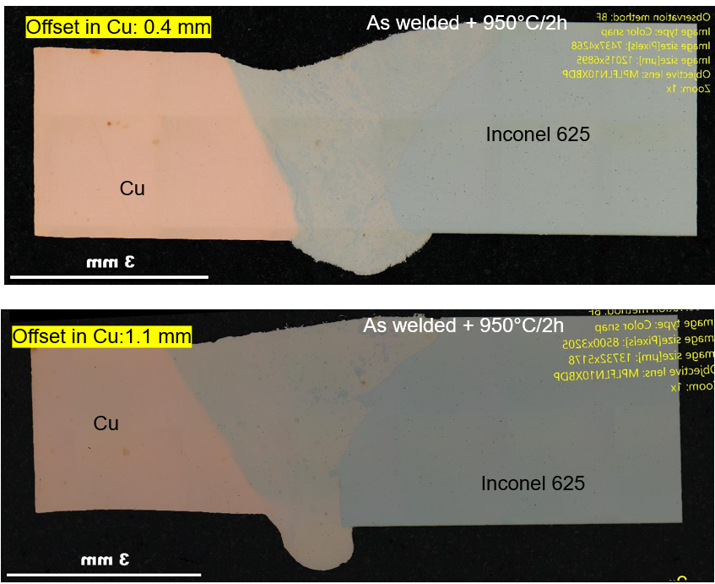
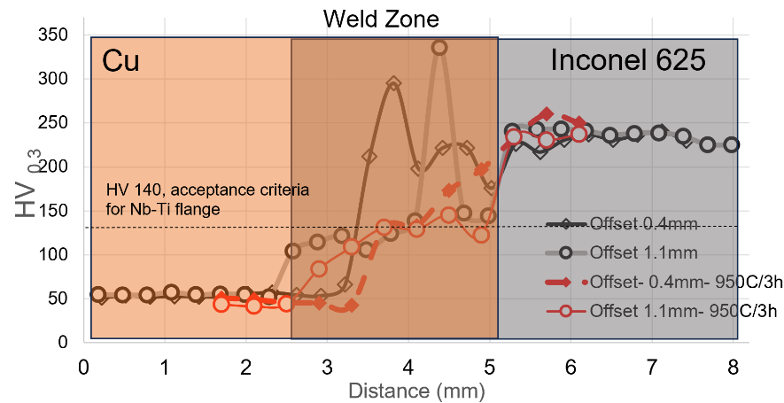
And continue to maintain higher strength after heating to 950℃ for 3 hours.

Slide 18
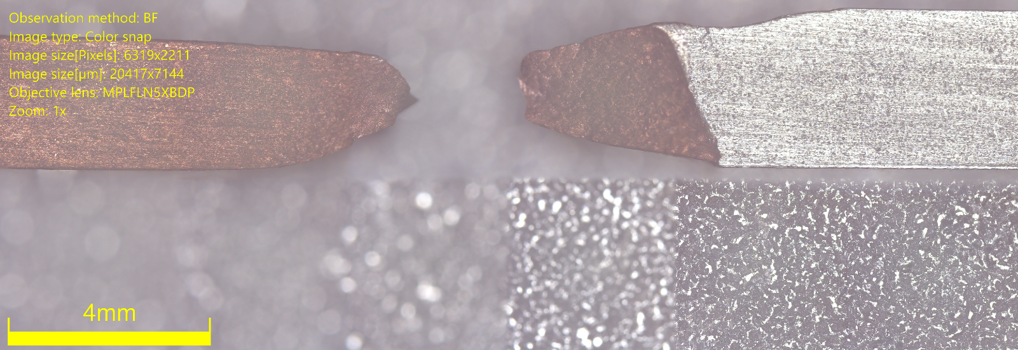
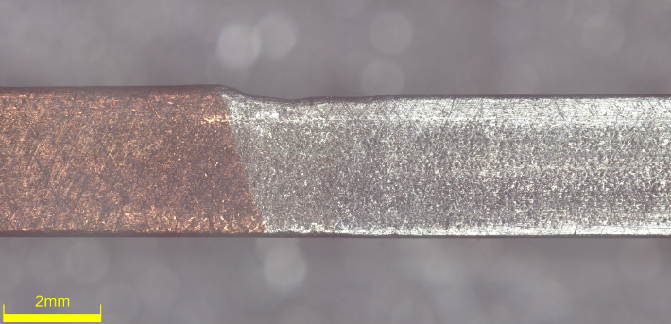
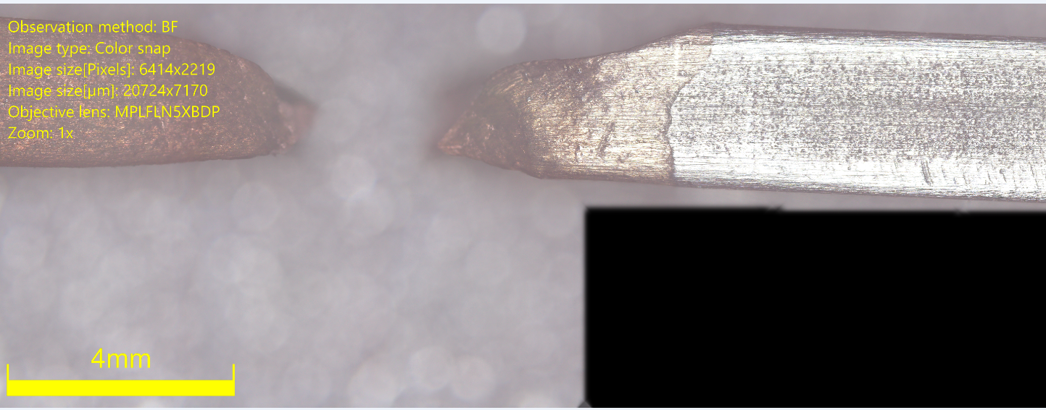
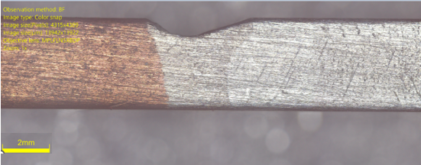
Mechanical testing: Fracture in Cu (weakest spot)
Offset in Cu 1mm
Offset in Cu 0.4 mm

Slide 19
So what?
Inconel 625 could be further explored for vacuum flanges.
Weakly paramagnetic at 4K. Susceptibility of 1.01- 1.03
How about using Inconel 625 for structural support as needed?
EBW of Cu- Inconel 625 is straightforward.
Applications in a CVD (hot chloride) environment need to be evaluated.

Slide 20
CVD Nb₃Sn on Cu is possible BUT needs significant developments in the following areas
Process standardization for Cu cavity preparation.
Polishing method, Metric: Surface roughness?
Nb₃Sn deposition on Cu
Process control to obtain a stoichiometric superconductor with desired smoothness.
Post processing: No post processing is best…
Heat treatment?
Thickness control- Address cavity shape
Developing Nb₃Sn polishing strategies to remove layers controllably- new electro/ chemical/ mechanical polishing recipes?
Dealing with soft Cu structures
Reinforcements
Support structures, flanges etc.

