Slide 1


Experimental development of Nb3Sn coating on Cu for SRF applications
Reza Valizadeh
On behalf of VISTA team at Daresbury Laboratory

Slide 2

Outline
Aims & Objectives
Facility and capability
Calibration of Deposition parameters & SC properties
Nb₃SN deposition on 1.3 GHz Cavity
Cavity RF Testing
Summary

Slide 3
Aims & Objectives
Short Term:
To develop and validate a novel class of SRF cavities based on Nb₃Sn and NbTiN thin films, superconducting materials with T_{c} > T_{cNb} to improve accelerator performance and efficiency through higher accelerating fields, better stability, reduced material costs, and lower operational costs compared to traditional bulk niobium cavities
Development of in-house skills and capabilities to deposit, measure and test thin film cavities
Long term:
Development of FRTs
Thin film cavity of high T_{c} tested in cryomodule with beam

Slide 4
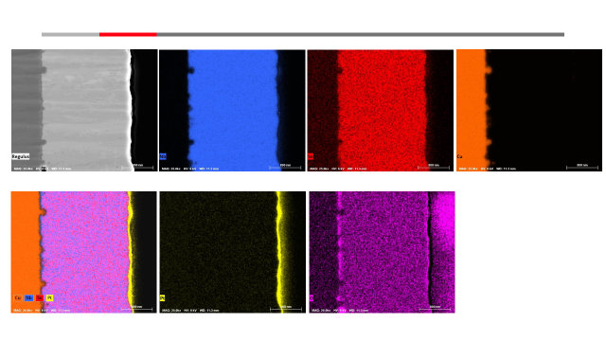
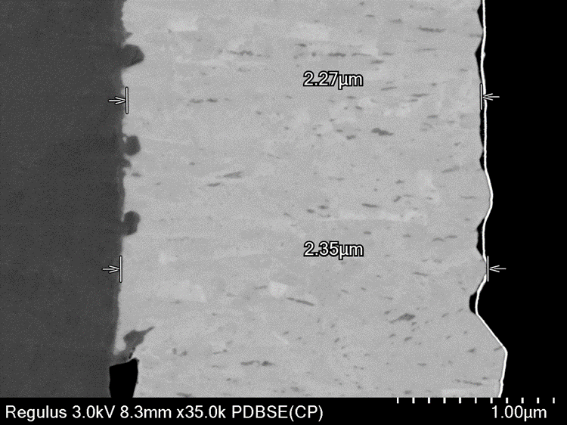
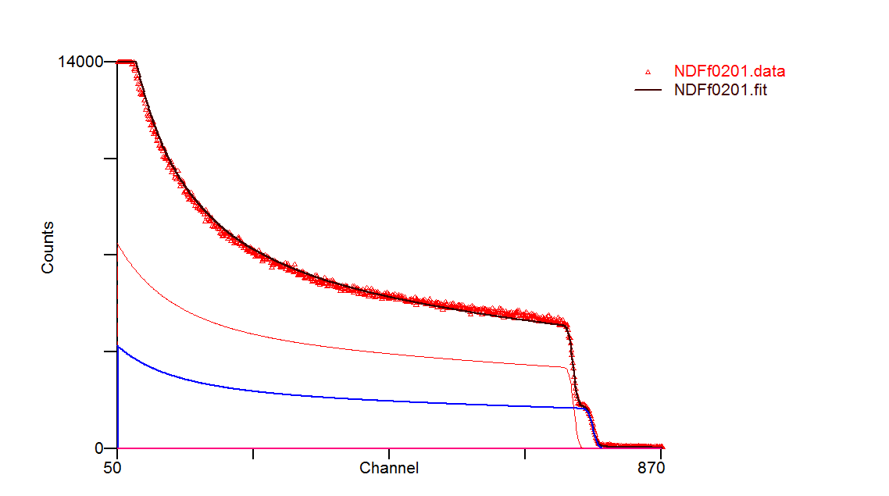
Cu (EP)LNL / Nb₃Sn (single layer) deposited at 650C
There are area that seems to be Sn deficient where there are dark contrast spots.
The onset of Tc was determined to be between 17.75K (on sapphire) and 17.5 on copper
First Ben is estimated to be 50mT and 140mT deposited on Cu and Sapphire respectively, and H_{C2} above 16 T.
An interesting results which gives the opportunity of direct deposition of copper cavity rather than Niobium cavity.
Film thickness of 2.5 Microns
Layer t (1e15at/cm2) t (nm) r(1e22at/cm3) Nb Sn Al O
1 7606.631 1489.817 5.106 75.0000 25.0000 0.0000 0.0000
2 821647.625 69631.156 11.800 0.0000 0.0000 40.0000 60.0000
Notes:
There are area that seems to be Sn deficient where there are dark contrast spots.
The Tc was determined to be between 17.75K (on sapphire) and 17.5 on copper
the A15 stoichiometry was confirm by Rutherford Backscattering
First flux entry Ben is estimated to be 50mT and 140mT deposited on Cu and Sapphire respectively, and H_{C2} above 16 T.
An interesting results which gives the opportunity of direct deposition of copper cavity rather than Niobium cavity.

Slide 5
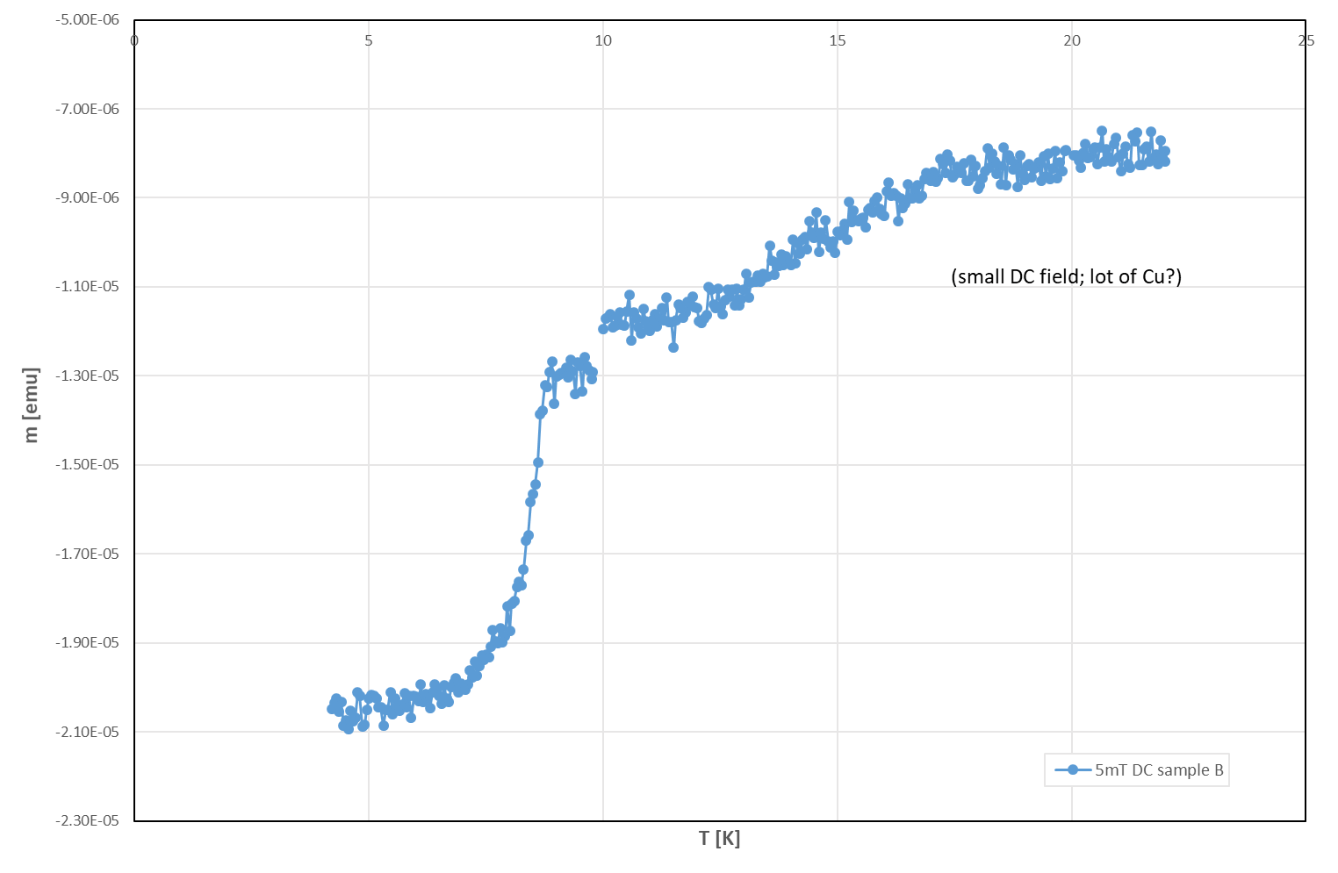
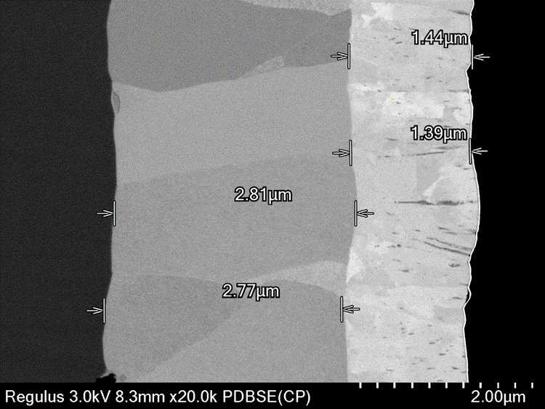
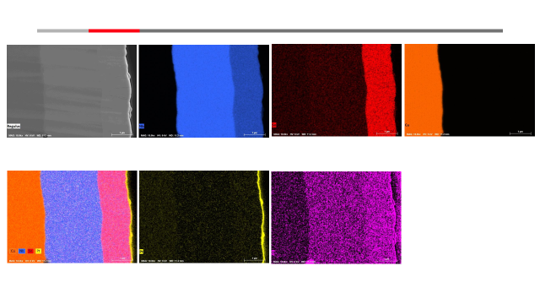
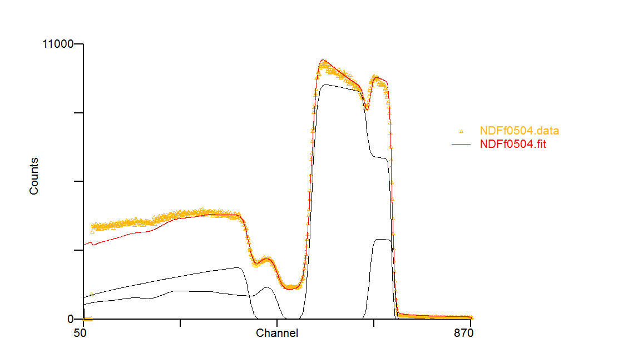
Cu /Nb/Nb₃Sn (double layer)
The interfaces both at Cu/Nb and Nb/Nb3Sn is well define
Nb layer is grown in large grain and in a perpendicular direction to the substrate surface
No intermixing of elements is observed
However some area of Sn deficiency and rich Sn in Nb3Sn layer can be observed
First B_{en} is estimated to be at 95mT.
RBS analysis shows a uniform film with good stoichiometry which matches the SEM results
Tc(Nb3Sn)~17K
Tc (Nb)~8.8K
Layer t (1e15at/cm2) t (nm) r(1e22at/cm3) Nb Sn O Al
1 7644.333 1497.201 5.106 75.0000 25.0000 0.0000 0.0000
2 15920.986 2855.270 5.576 100.0000 0.0000 0.0000 0.0000
3 898207.563 76119.281 11.800 0.0000 0.0000 60.0000 40.0000
Notes:
The interfaces both at Cu/Nb and Nb/Nb3Sn is well define
Nb layer is grown in large grain and in a perpendicular direction to the substrate surface
No intermixing of elements is observed
However some area of Sn deficiency and rich Sn in Nb3Sn layer can be observed
First B_{en} is estimated to be at 95mT.
RBS analysis shows a uniform film with good stoichiometry which matches the SEM results

Slide 6
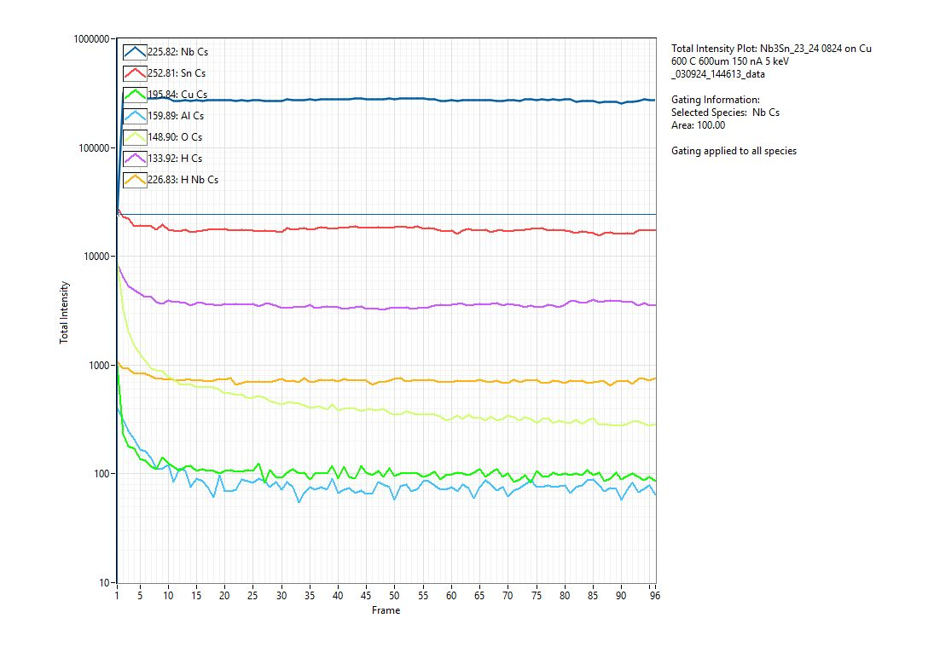
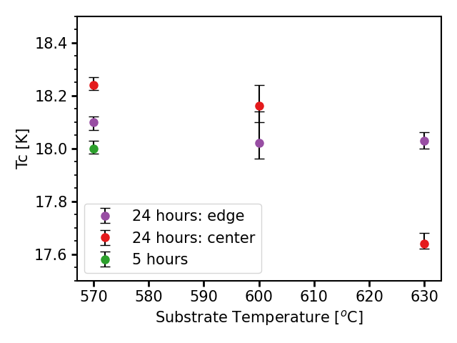
Nb3Sn Deposition Temperature Optimisation
Nb3Sn on sapphire
Nb3Sn on sapphire
Nb
Cu
Nb3Sn with bulk like properties is synthesised at 570 C and 50 W
The film is very uniform in stoichiometry through out the depth with the lowest level of oxygen and Cu
Very sharp interface and good adhesion
Four-point probe on sapphire

Slide 7
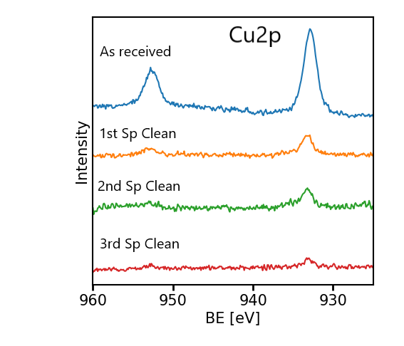
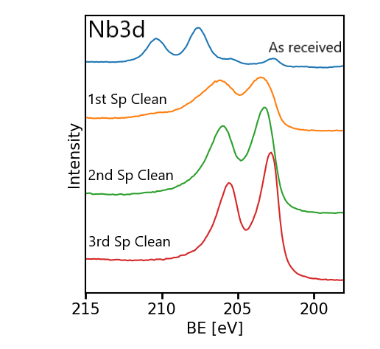
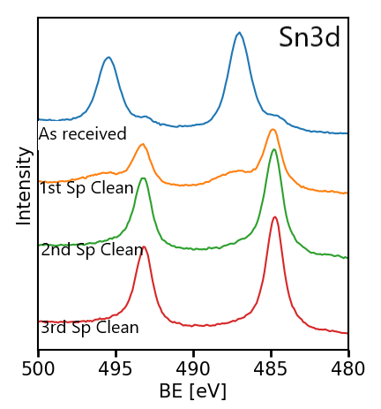
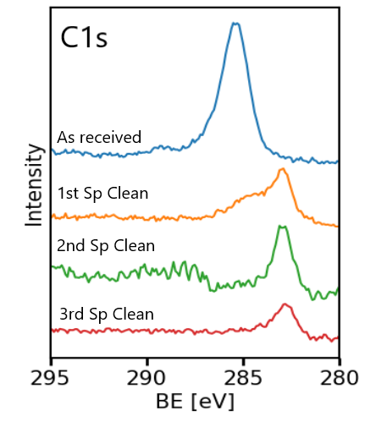
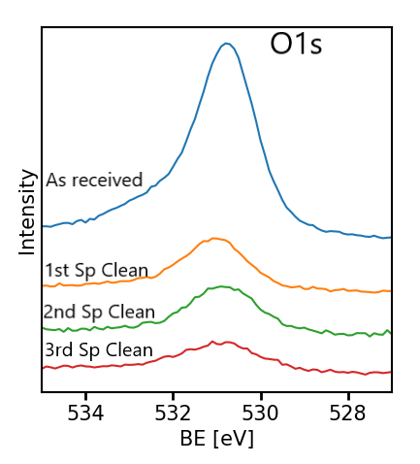
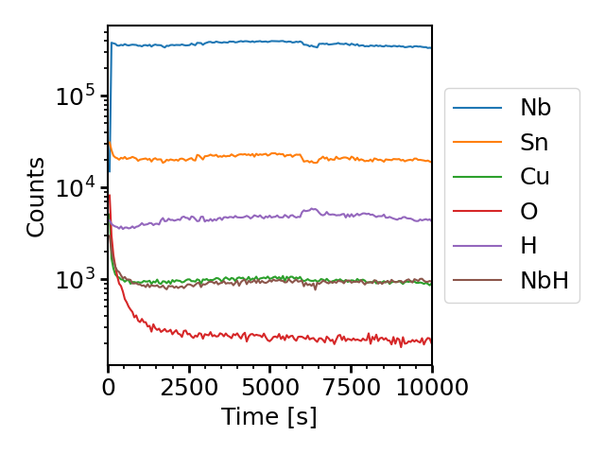
XPS and SIMS analysis of 50 W DC and 600 C
Both Sn and Nb at the surface are in oxide state.
Nb is present is Nb2O5
Carbon is also present at the surface.
Consecutive surface bombardment reduces both oxygen and copper from the surface and the stoichiometric Nb3Sn is below the surface
SIMS analyses shows exactly the same with the surface is Sn rich and dominated by oxygen and copper.

Slide 8
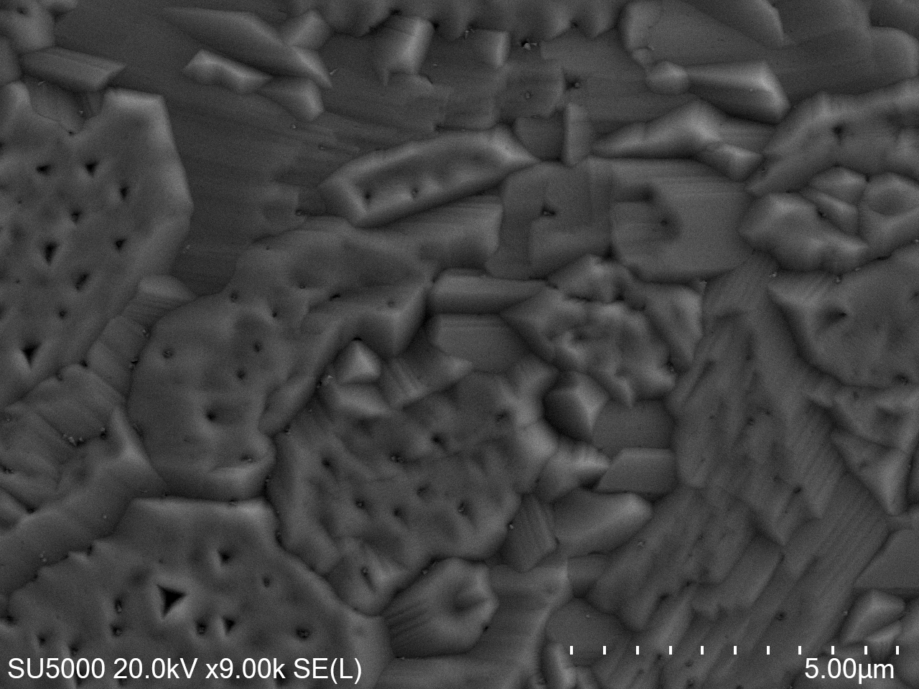
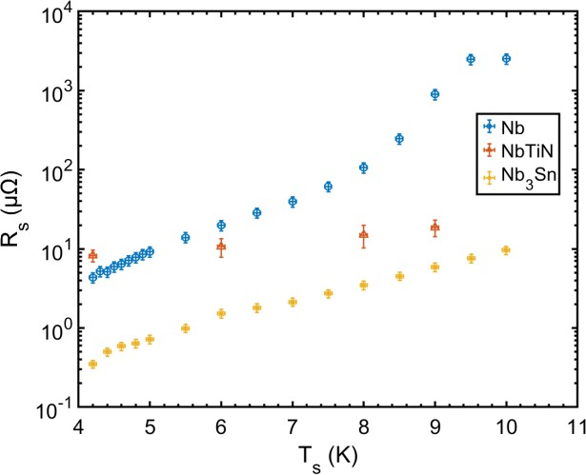
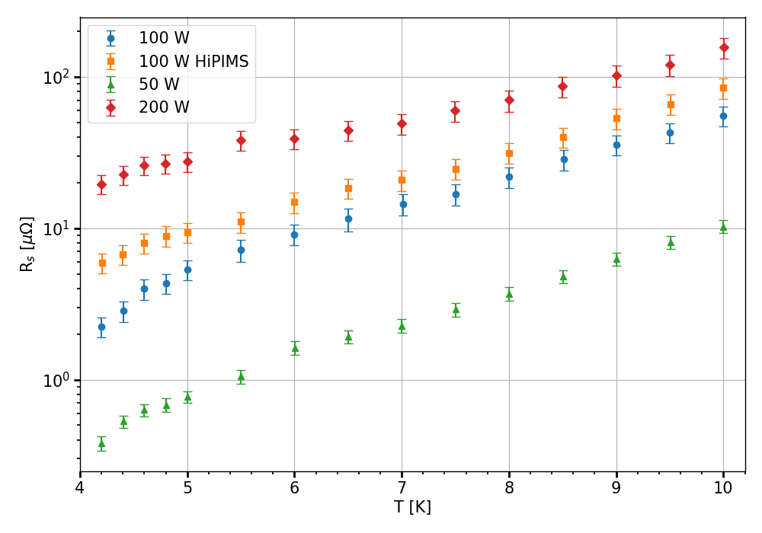
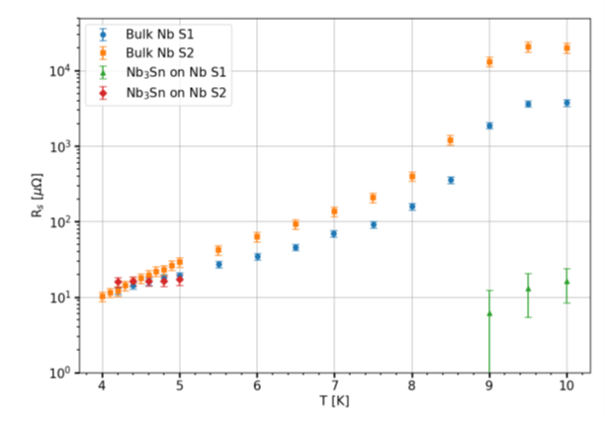
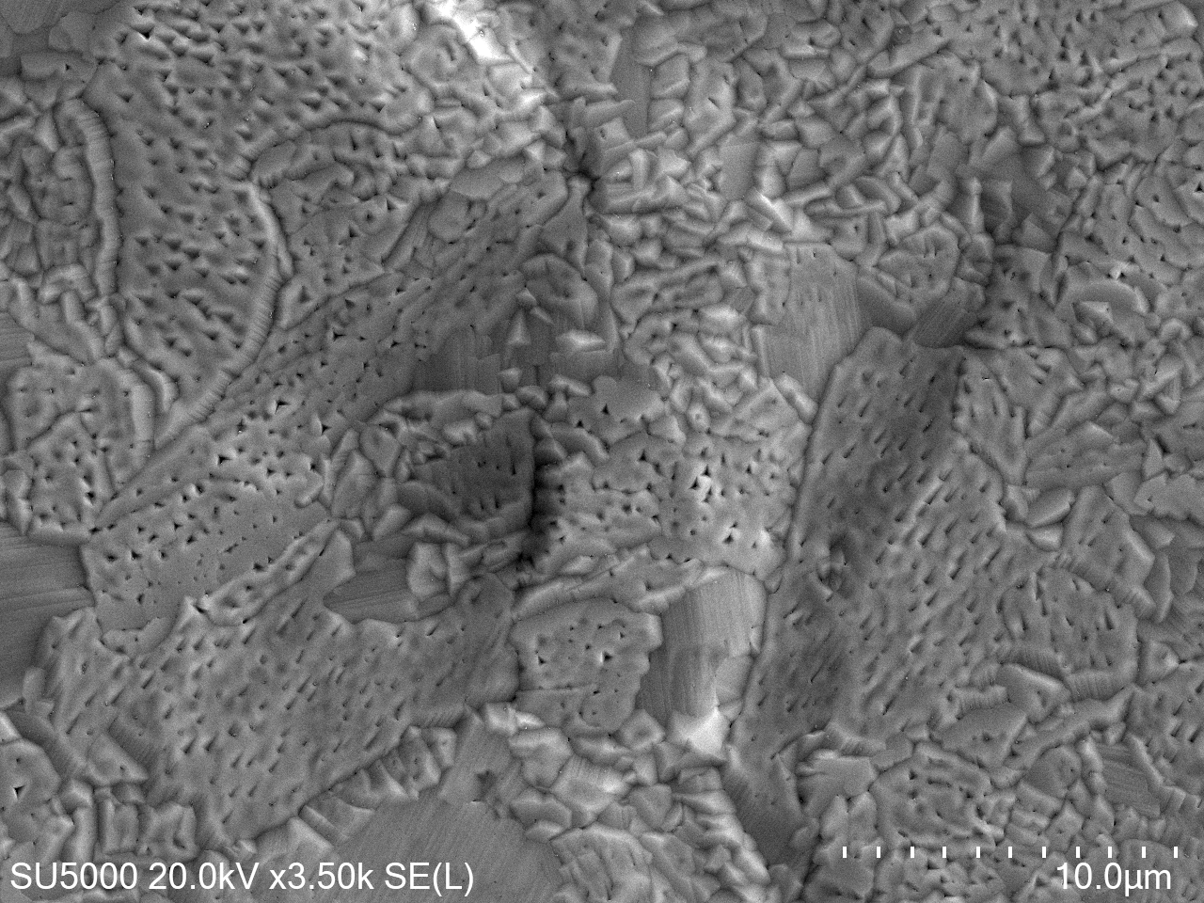
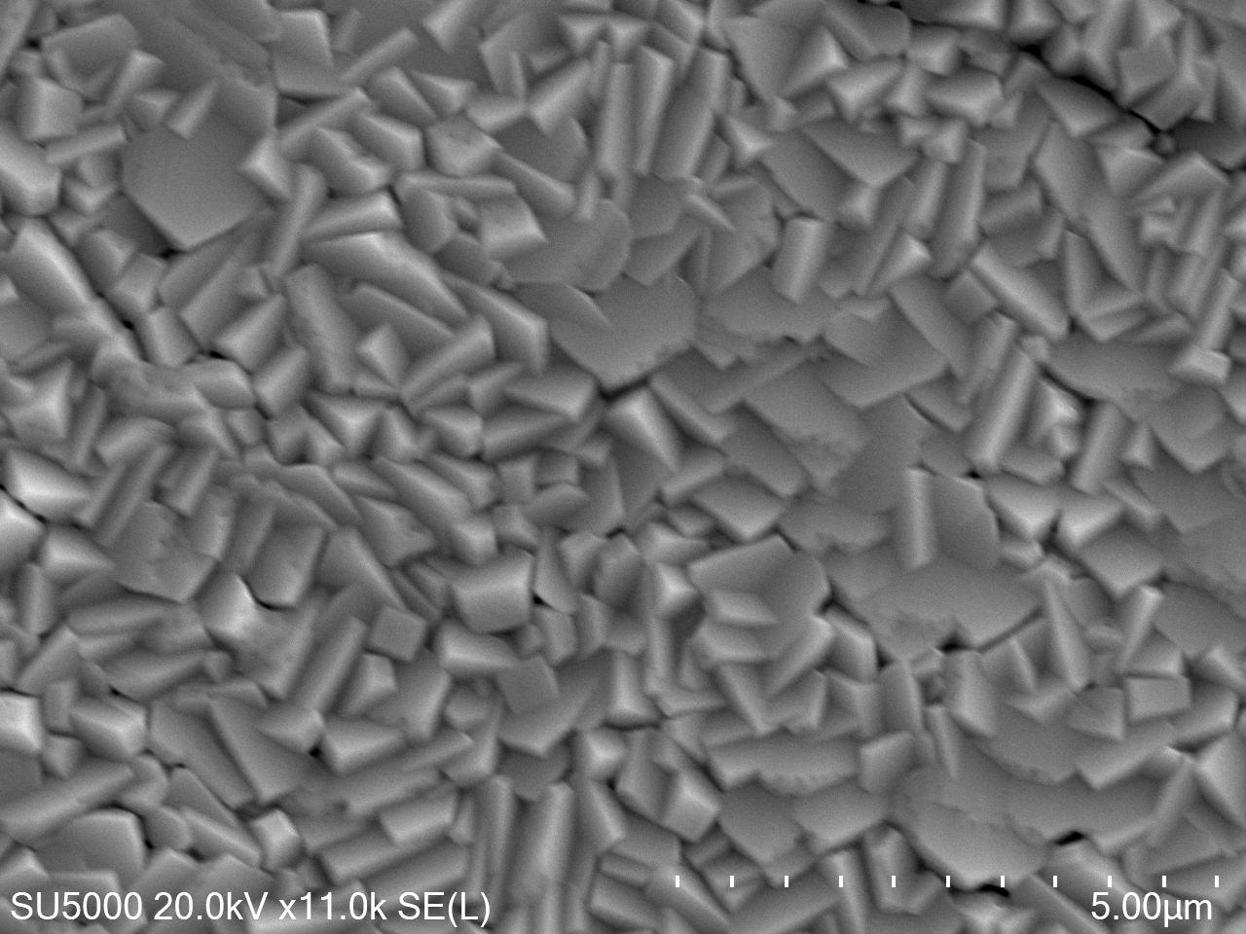
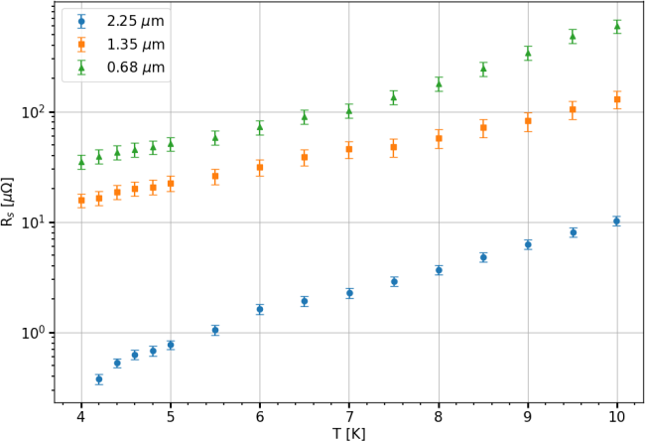
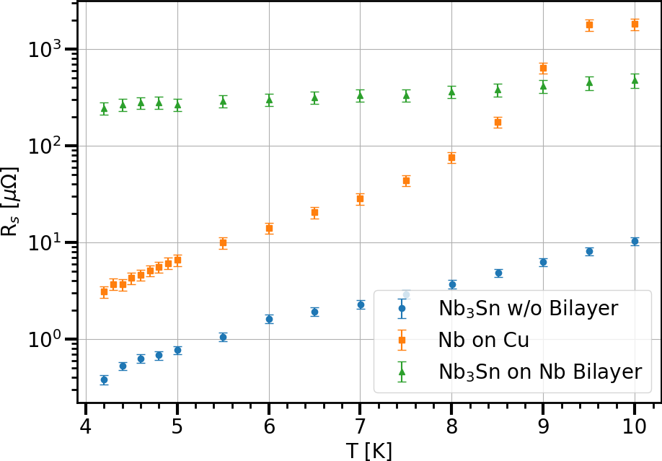
Surface resistance at 7.8 GHz of SRF thin film of Nb₃Sn and deposited on planar samples
Surface resistance of different SC thin film on Cu
Surface resistance on Nb with different surface roughness surface preparation
Optimisation of deposition power for Nb₃Sn on Cu
Optimum deposition power for Nb₃Sn is stablished at 50 W DC power.
Film Thickness dependence of Nb₃Sn on Cu.
Thick Nb3Sn layer without Nb buffer layer resulted much lower Rs than with Nb buffer layer.
Best surface resistance so far is achieved on Nb substrate
For high T_{c}, Nb₃Sn seems to be more suitable candidate for 4 K operation having lower R_{s} than NbTiN.
Surface resistance of different thickness on Cu
Rs dependense on Nb buffer

Slide 9



Deposition Facilities
Notes:
The abstract pattern can be removed or repositioned if required. Be careful to ‘Send to Back’ so that it does not obscure any important information.

Slide 10
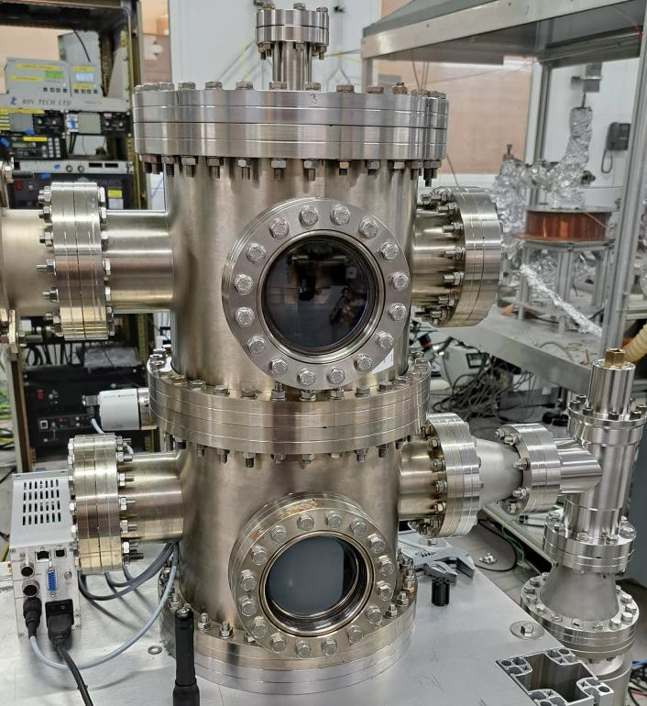
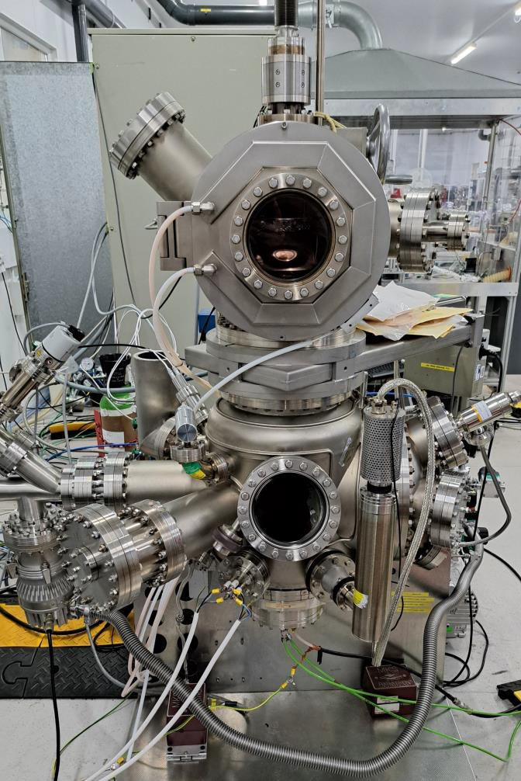
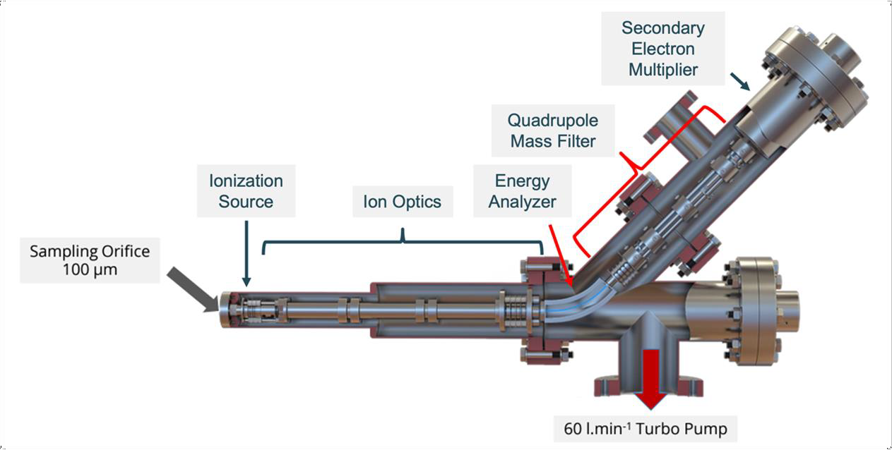
Plasma Diagnostic and Cavity deposition
Fixed target and movable cavity
Fixed cavity and movable target
PSU
Pinnacle DC power supply
HiPSTER 1
HiPSTER 1 Bipolar
Analysis
OES
EQP from Hidden
Impedance
Langmuir Probe
Simulation
PICLas (scientific computational dep)
Good rigs for initial tests,
proof of concept, plasma analysis
Full control on plasma parameters
working gas, target, exposure
time, heating, etc

Slide 11
Nb₃Sn deposition
Notes:
The abstract pattern can be removed or repositioned if required. Be careful to ‘Send to Back’ so that it does not obscure any important information.

Slide 12
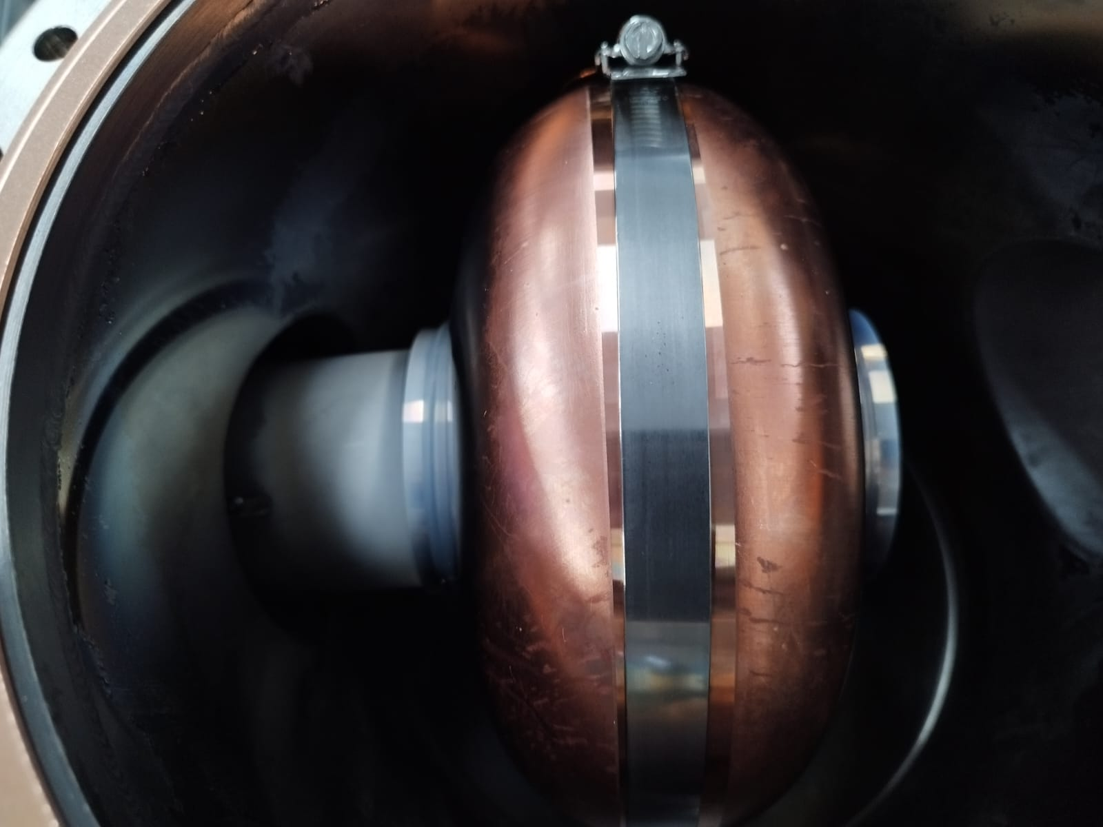
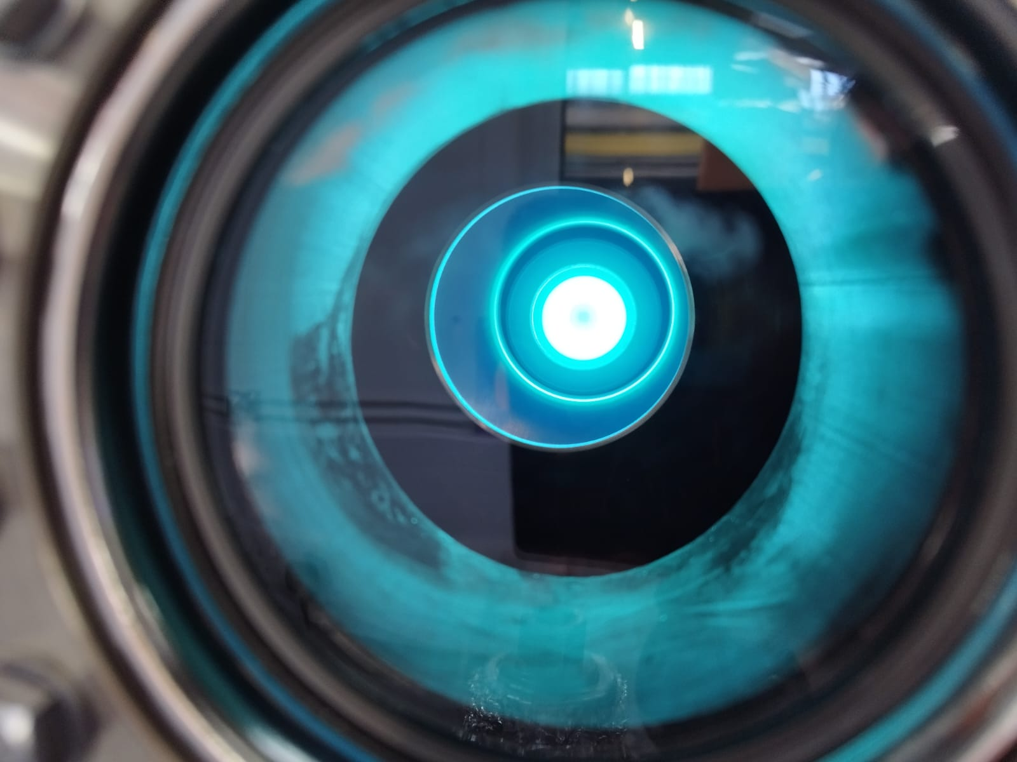
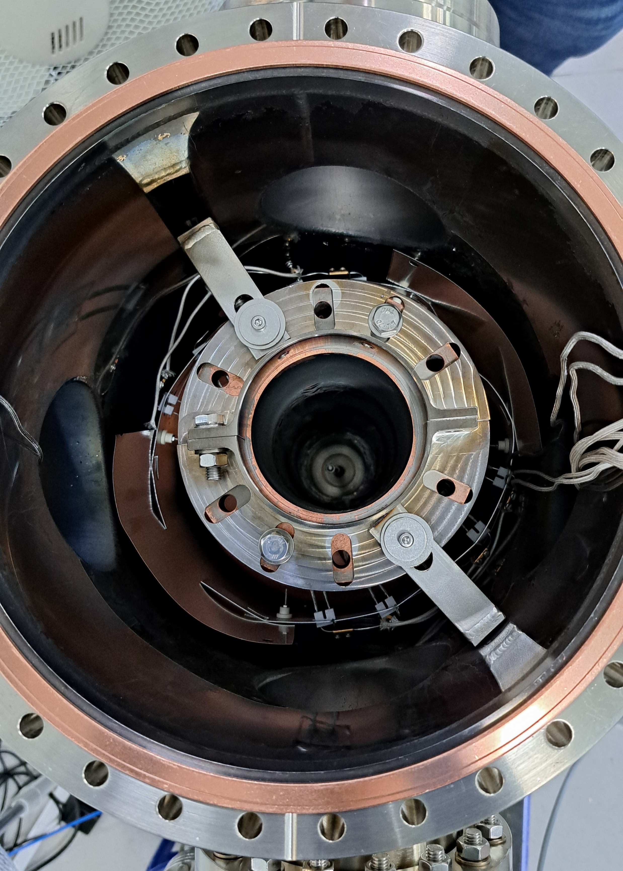
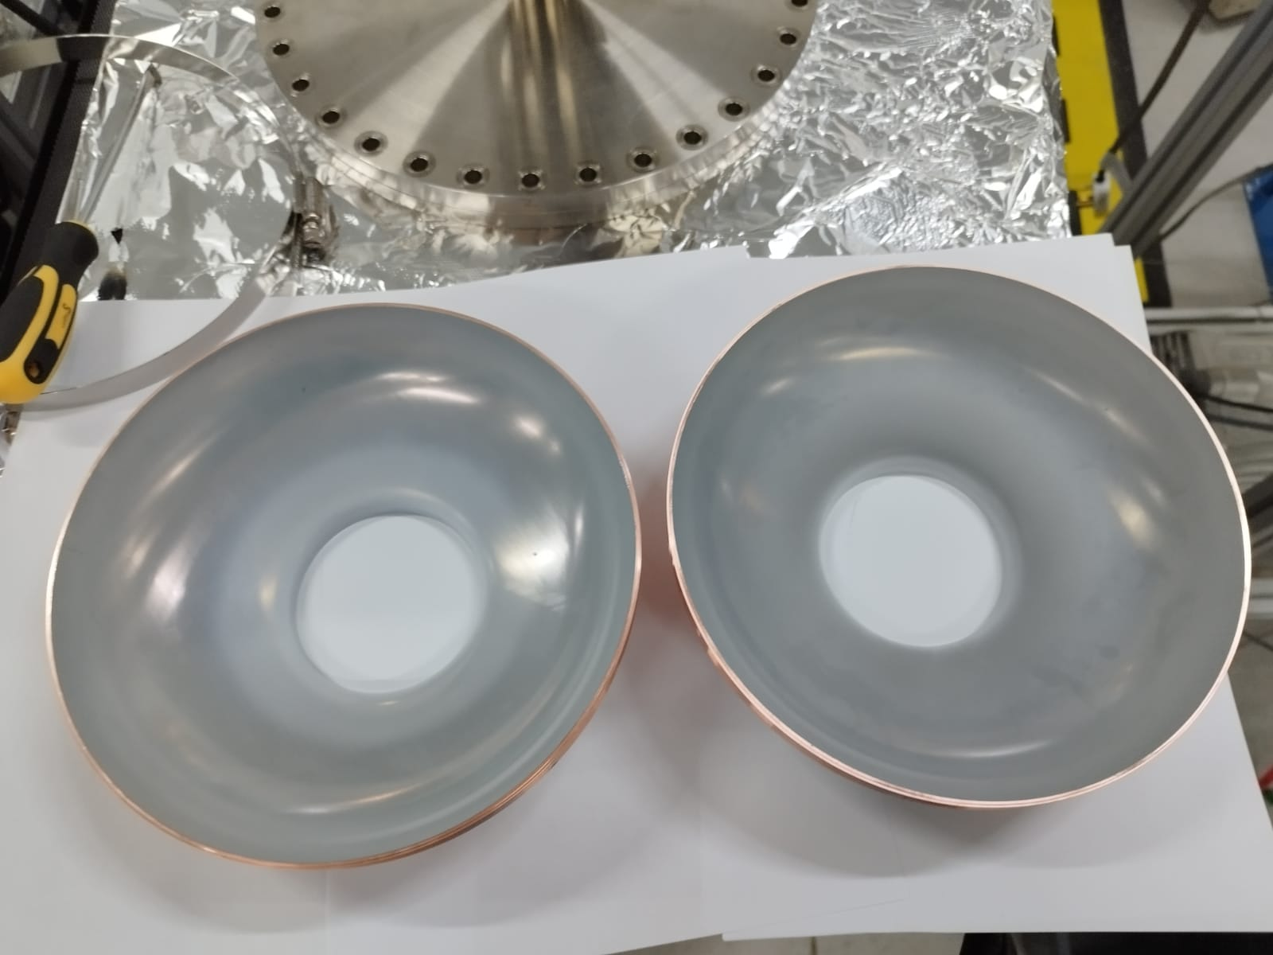
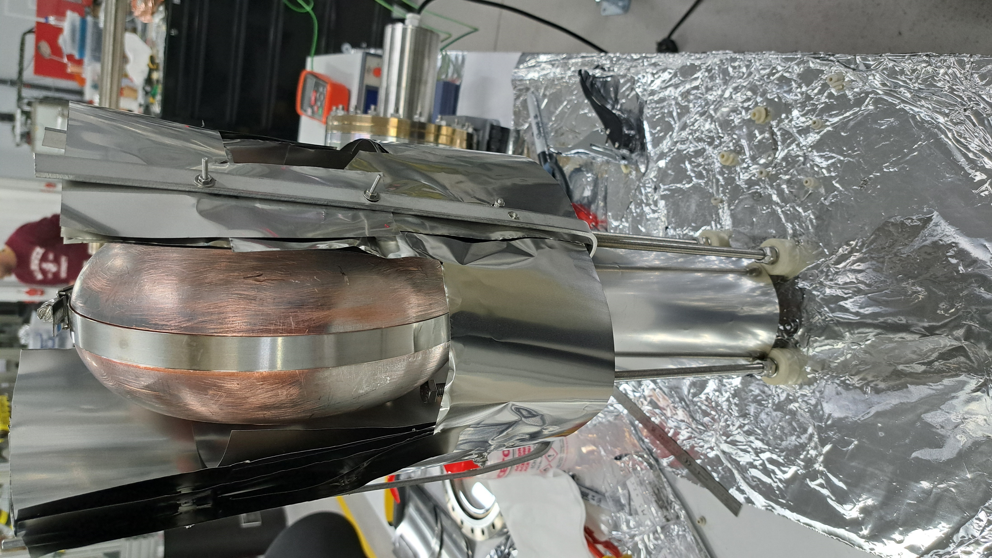
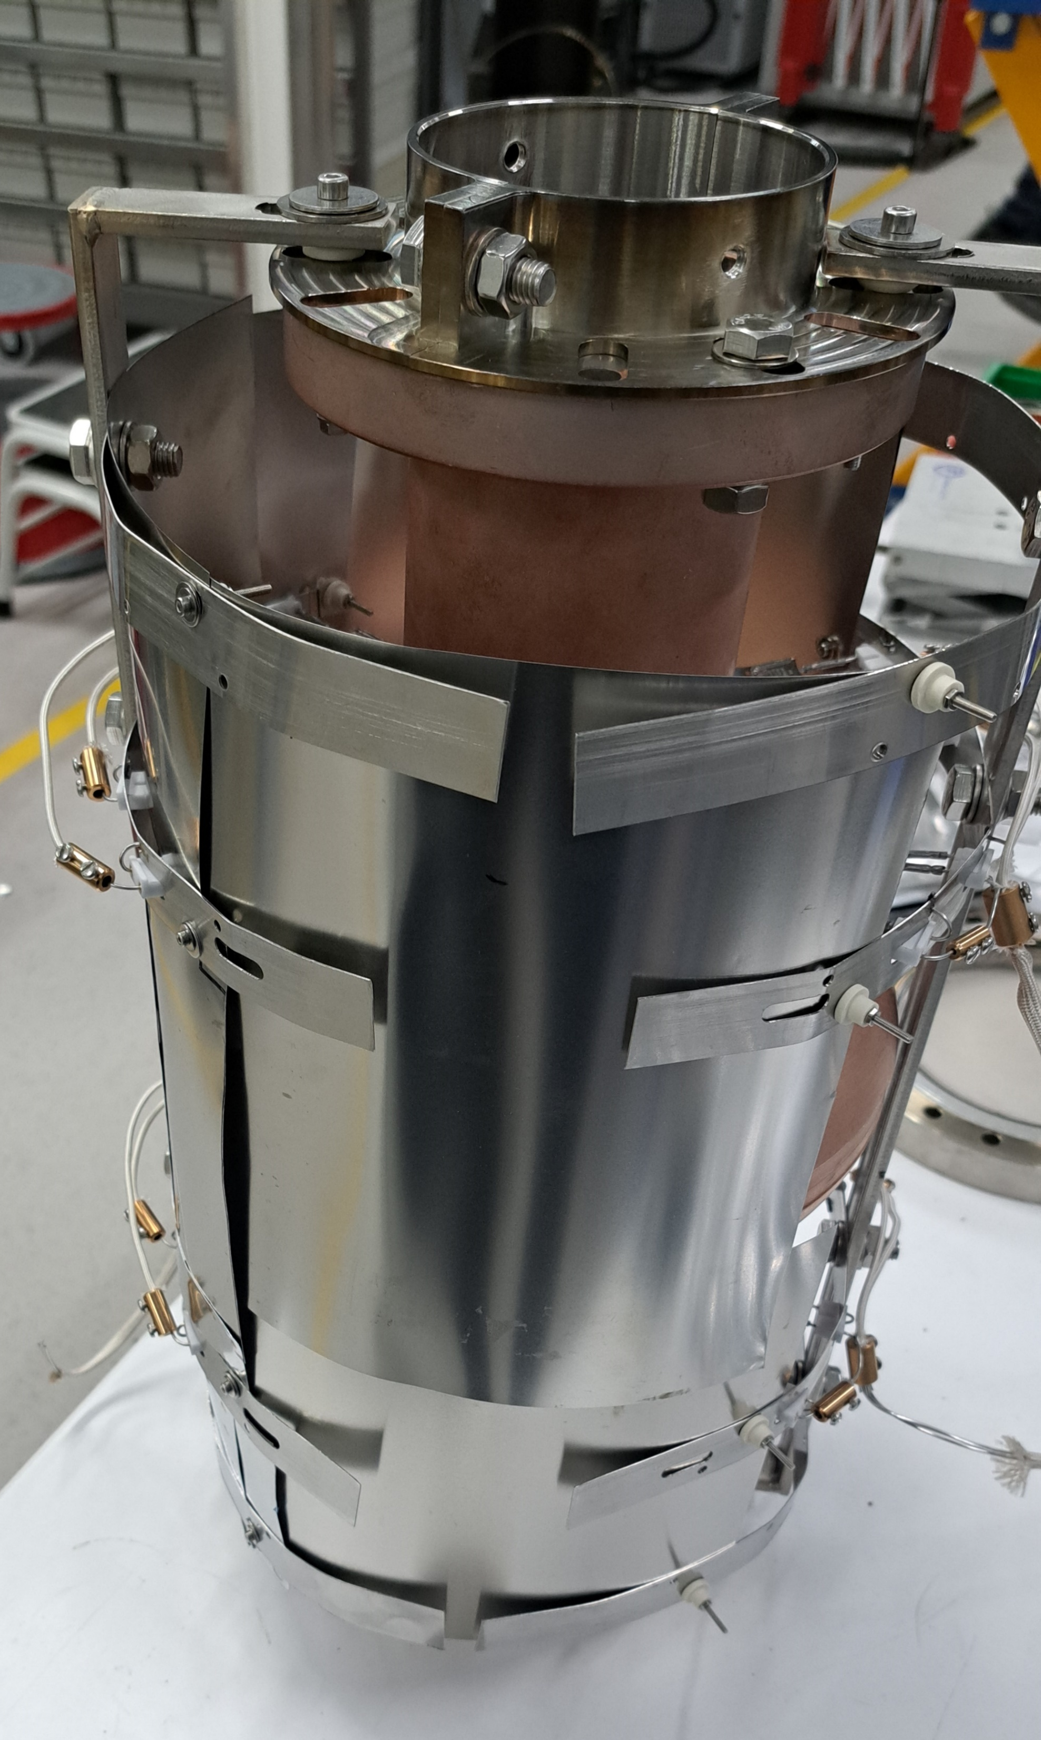
Thin Film Depositions: 1.3 GHz Cavities with planar target
Can Nb3Sn sputtered match or exceed performance of Sn diffusion into bulk Nb?
No cylindrical Nb₃Sn targets available. Can we deposit with a planar target instead?
Clamped Half-Cell
Plasma through the IRIS
Magnetron
Resulting Coating
Notes:
Analysis of positive ions for DC and HiPIMS deposition techniques – lower pressure favours production of positive ions with higher ion energy

Slide 13
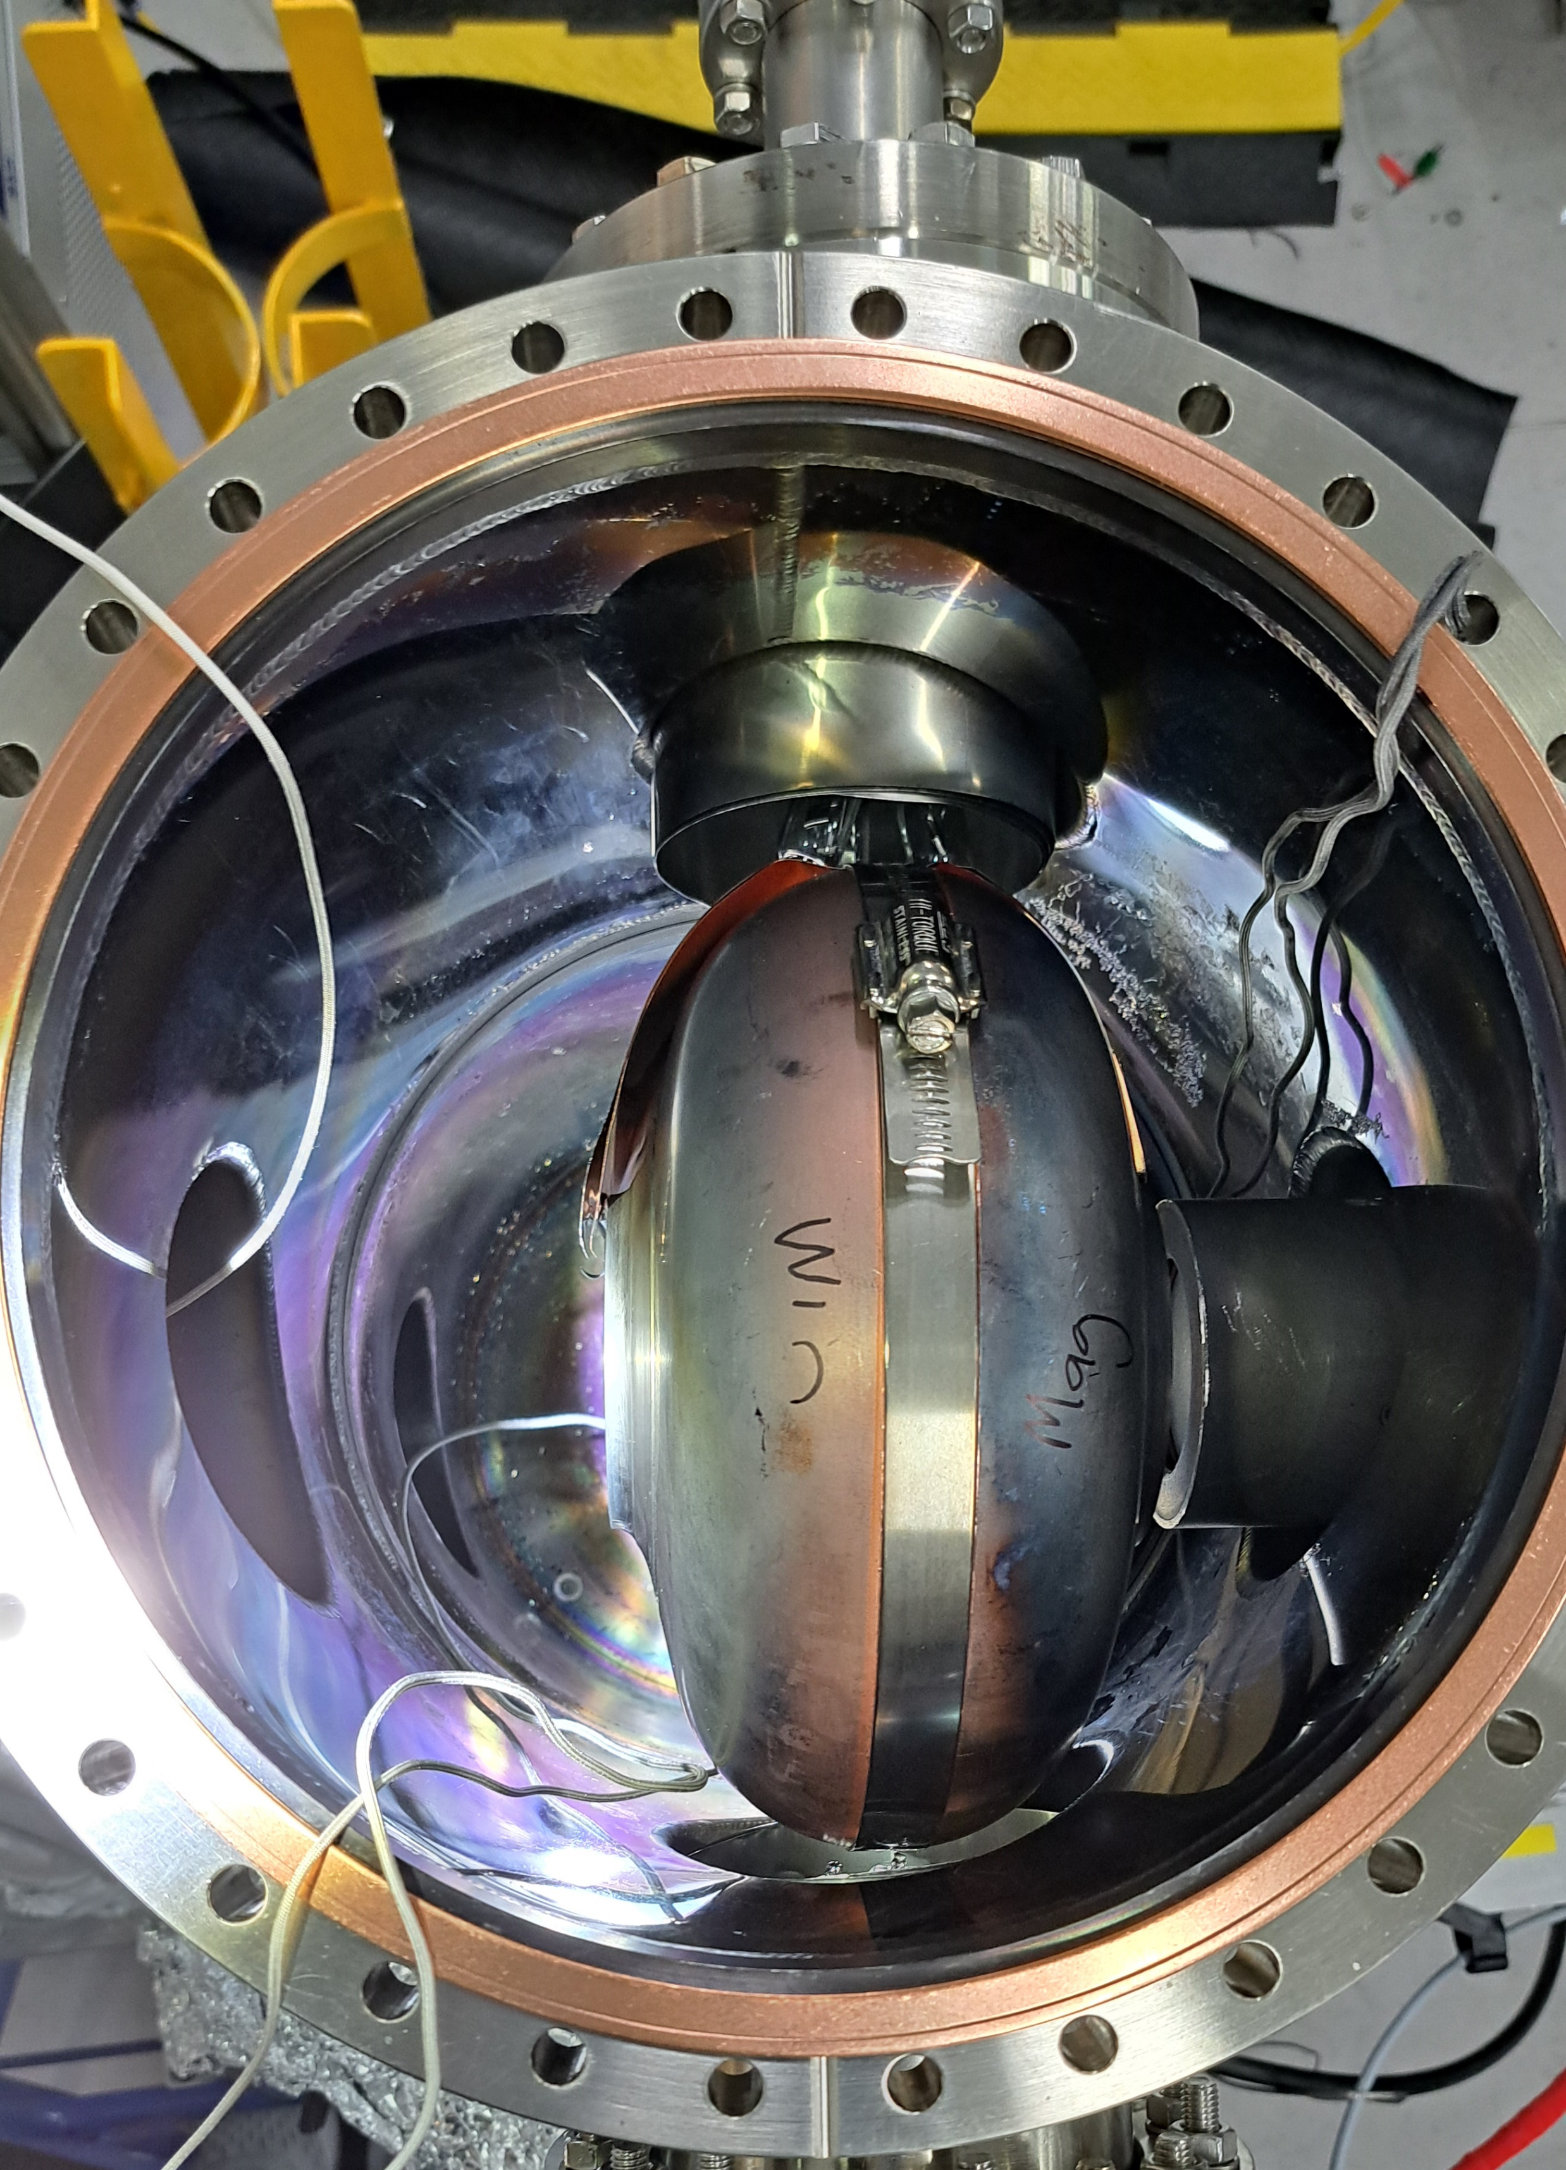
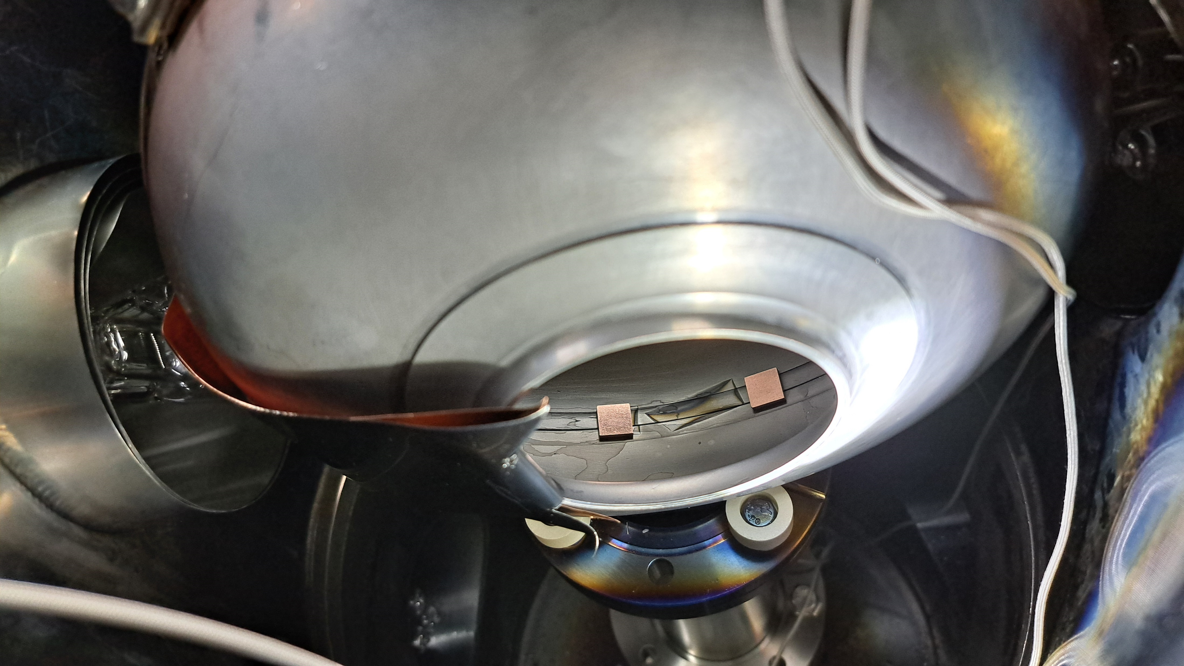

Nb₃Sn deposited at equator 1.3 GHz cavity at 340C
Initial work on half cell split cavities
Nb3Sn target
Pressure 4.5x10-3 mbar / cavity biased at -75V
DCMS 430V / 0.23A / 100W
Deposition time 7h45
Temp recorded 340$℃$
4th I.FAST Annual Meeting / 8th - 11th April 2025
4

Slide 14
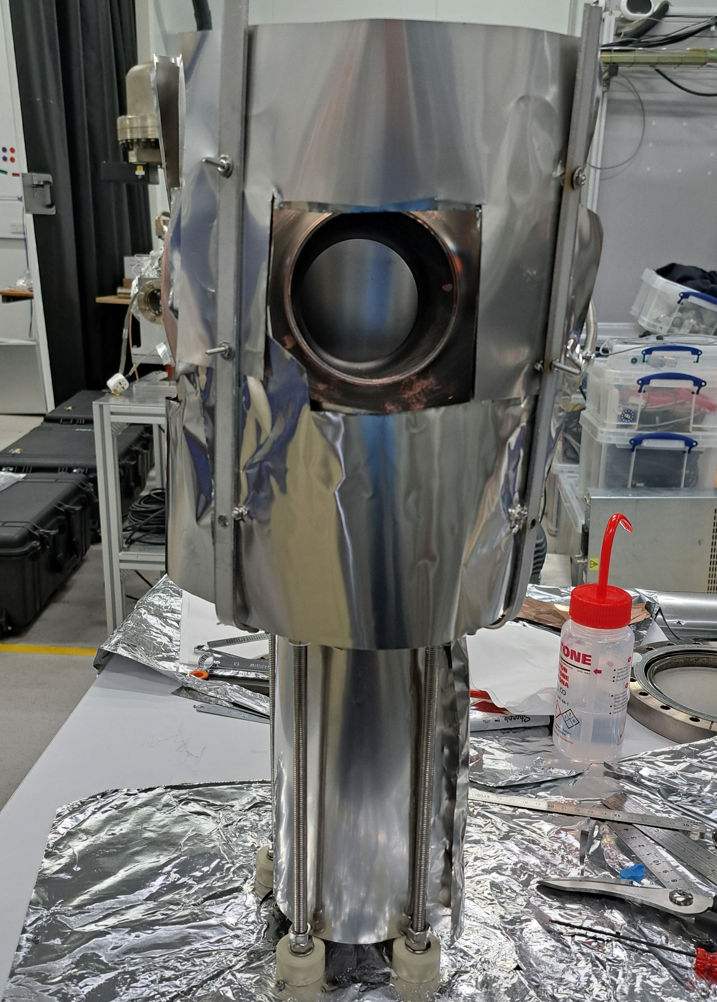
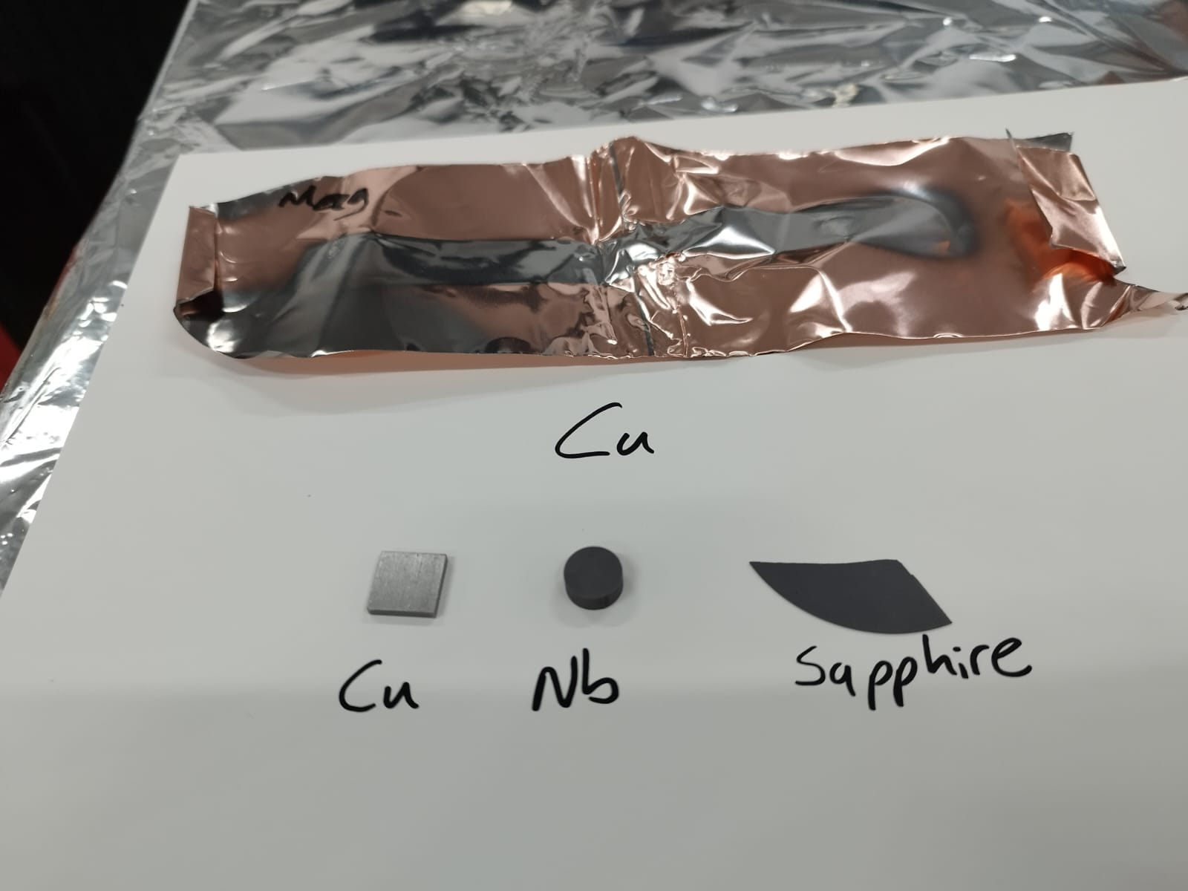
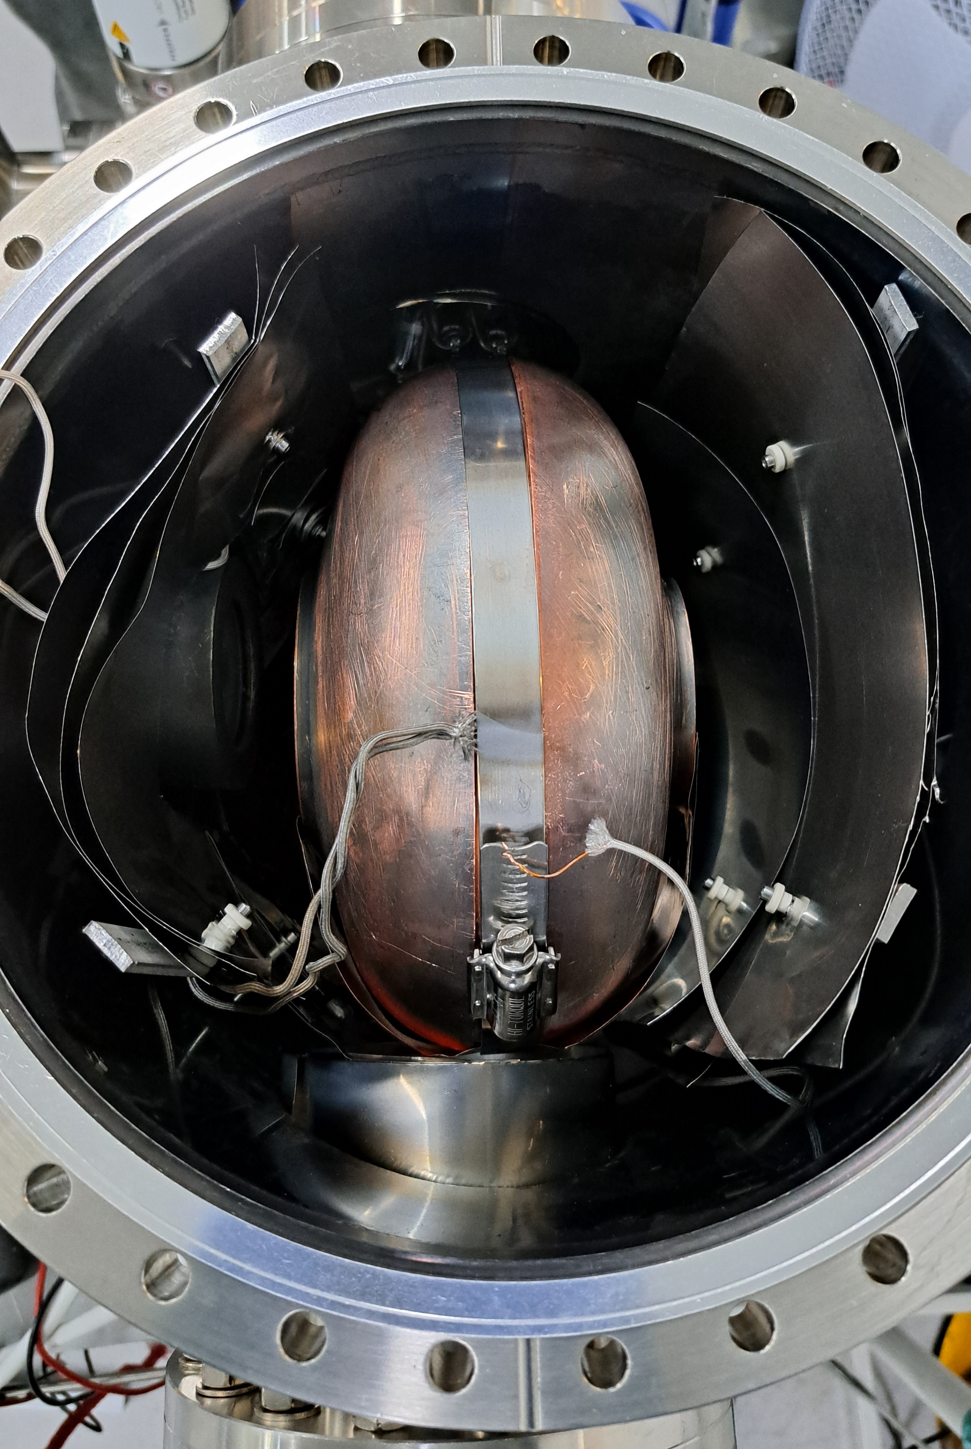

Nb₃Sn deposited at equator 1.3 GHz cavity at 440C
Nb3Sn target
Pressure 5.9x10-3 mbar / No bias
DCMS 430V / 0.23A / 100W
Deposition time 6hrs
Temp recorded 440$℃$
4th I.FAST Annual Meeting / 8th - 11th April 2025
6

Slide 15
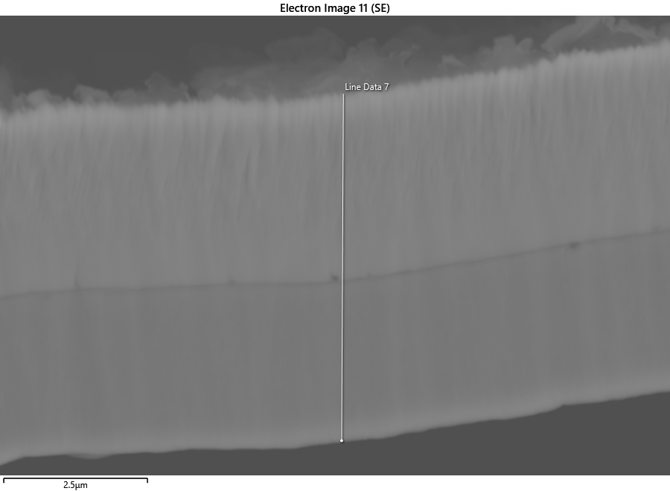
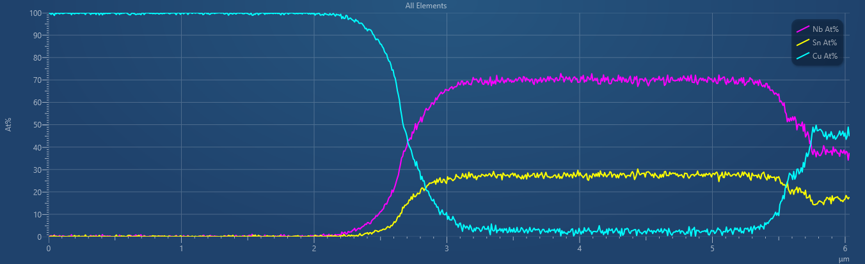
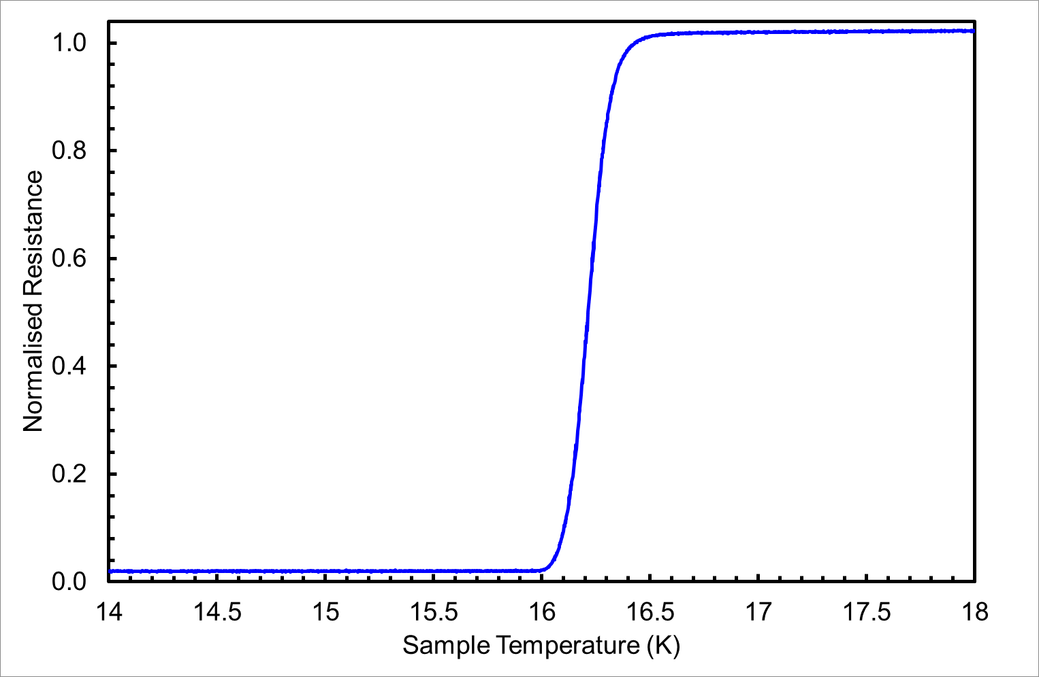
Nb3Sn deposited at equator 1.3 GHz cavity
340 C
Nb3Sn
Cu
440 C
Tc = 16.22 +/- 0.11 K
Nb3Sn
Cu

Slide 16
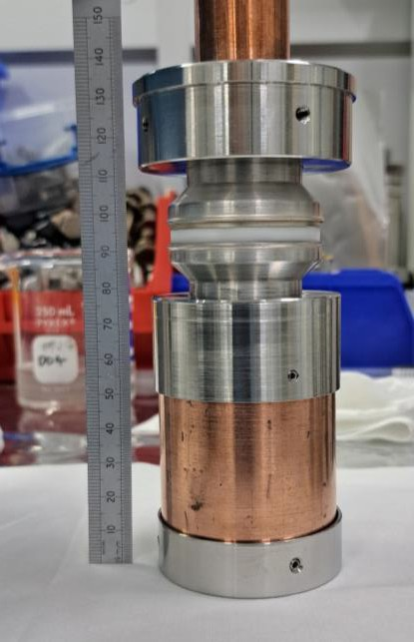
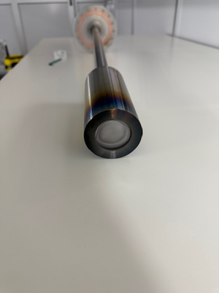
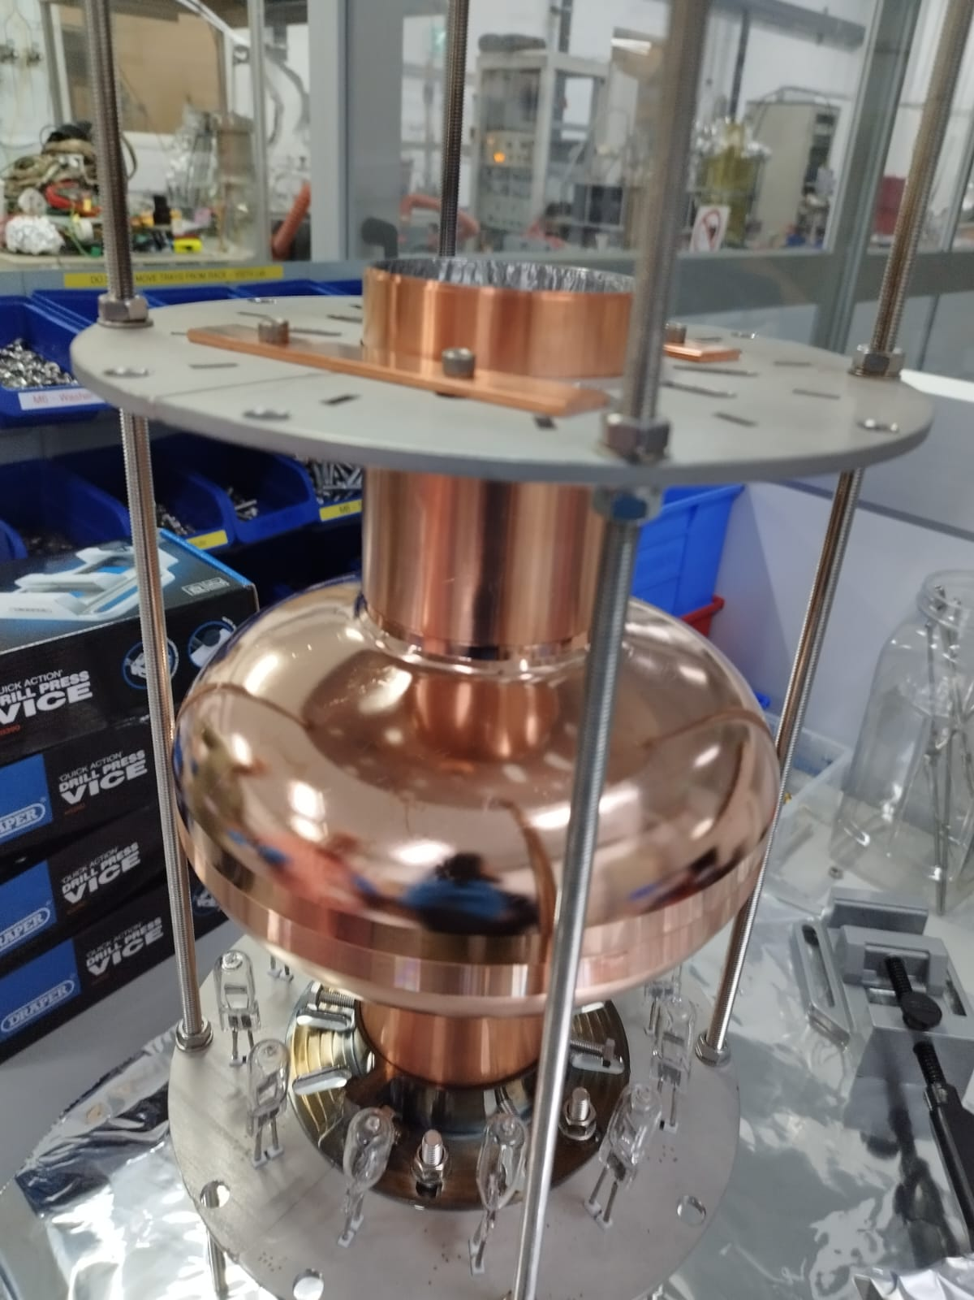
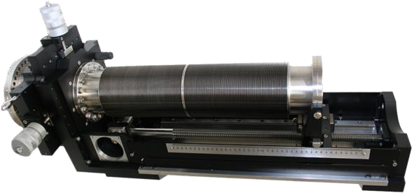
Design and commission of new magnetron
Segmented Cavity
2” planar Magnetron to go inside 1.3 GHz cavity and operate at 700°C over 60 hours

Slide 17
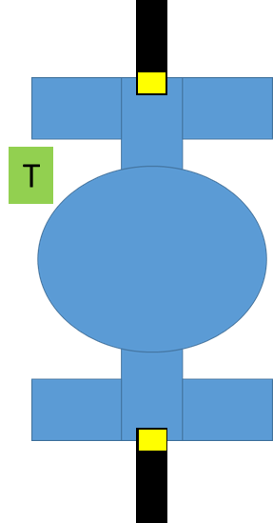
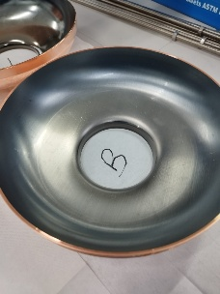
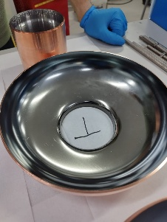
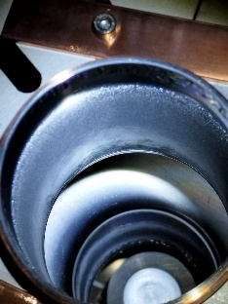
Coated cavity with magnetron at the flange position
Top view of entire cavity
BPS172 chemically cleaned
SUBU5 polished

Slide 18






Coated cavity with magnetron at the iris position.
top view of the entire cavity.
BPS172 chemically cleaned
SUBU5 polished

Slide 19




Magnetron development and installation
11

Slide 20









Nb3Sn calibration on 1.3 GHz Nb Cavity
First trial run of Nb3Sn deposition of 1.3 GHz Nb cavity with deposition parameters established on planar samples.
The trial run proved to be successful. Tc of 17.5 K
View after deposition of Nb3Sn and uncoated area under witness sample
View from bottom flange
Nb3Sn on Nb Witness sample
Nb3Sn
Cu
View during deposition at 650 C

Slide 21






Slide 22


Visual inspection before and after coating
Before deposition
After deposition

Slide 23




RF Test At HZB
No HPR after Deposition
The RF couplers were designed for Qo of 10⁹
Manually slow cool Down
No thermo-currents were recorded with the azimuthally placed sensors.
While the Tc was at 18.1 K this did not help with the RF surface resistance of 8 x 10⁶
No Tc of Nb was detected: Possibly cavity fully coated.
Poor Q factor:
Cu contamination at surface layer due to diminishing target
Present of other normal conducting material due to poor cavity handling.
Or other reasons to be determined.
Frequency and loaded quality factor vs temperature
Just after venting chamber
After target removed

Slide 24





Designated 1.3 GHz deposition new facility
Chamber already mounted
Manipulators for each magnetron are delivered and mounted
Few modification is on the way before full assembling.

Slide 25
Immediate Plan
At HZB
A cleaning step with a mixture of nitric acid and phosphoric acid which has been successfully used for bronze route samples
Determining the correct pressure for HPR on calibration Nb cavity
Perform HPR on the test cavity and equip it with an adjustable input coupler allowing for smaller Q values
At STFC
A 10 cm EP Nb disk mounted inside two Nb semi cell and deposit with Nb3Sn using the exact condition as used for the cavity coating.
Further calibration of deposition (power, DC or HIPIMS)
Determine the Rs with choke cavity
Nb cavity being prepared at CEA will be deposited with new parameters.
Move to deposit Nb and NB₃Sn on 1.3 GHz cavity from CERN, KEK and INFN.

Slide 26
Summary
Over 10 years of progress since 2014:
Building a strong team including members of ASTeC, Liverpool and Lancaster Universities, Nottingham University
Strong international collaboration, leadership in H2020 ARIES, iFAST, iSAS, EPITA programmes
Optimisation of deposition parameters & techniques on planar samples
Small sample depositing, characterising and testing
Optimising Nb, Nb₃Sn, NbTiN, V₃Si depositions
DC Superconducting property facilities built and employed: RRR, Magnetic field penetration, …
Low temperture STM analysis for superconducting band gap measurement.
RF testing at 7.8 GHz with choke cavity
1.3 GHz cavity development
Optimisation and design of deposition facilities
Two new RF cavity test facilities being developed to be operational in 2025
First 1.3 GHz Nb₃Sn cavity prototyped by PVD using Nb cavity as substrate
A few problems keep persisting at STFC and delaying the progress:
In-house surface polishing & HPR
Cylindrical target for Nb₃Sn (may be)

