Slide 1
Prototyping a 591 MHz single cell SRF cavity for EIC
David Savransky
11/12/2025

Slide 2
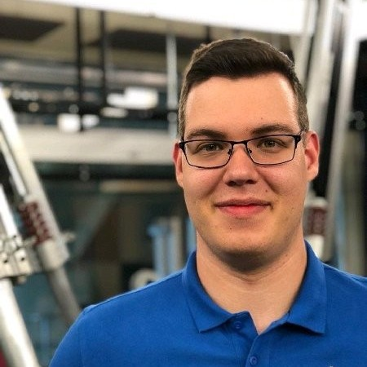
About Me
Current Roles:
  EIC L3/CAM – 591 MHz Production Cryomodules
  SRF Ops - Mechanical Engineer
Relevant Experience:
  Technical lead for LCLS-II & LCLS-II-HE, SNS-PPU and CEBAF component procurements.
  ISO9001:2015 Production Coordinator within SRFOPS @ Jlab
  Master in Mechanical Engineering from ODU 2019

Slide 3
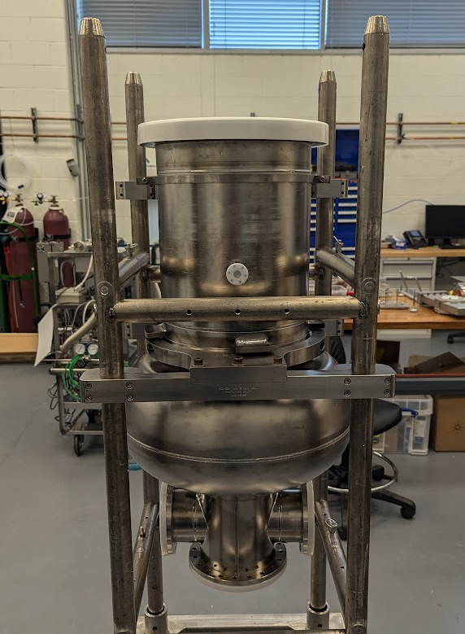
Outline
TJNAF Cavity Fabrication Experience
TJANF & EIC Partnership
DVC Fabrication at SRF Ops

Slide 4
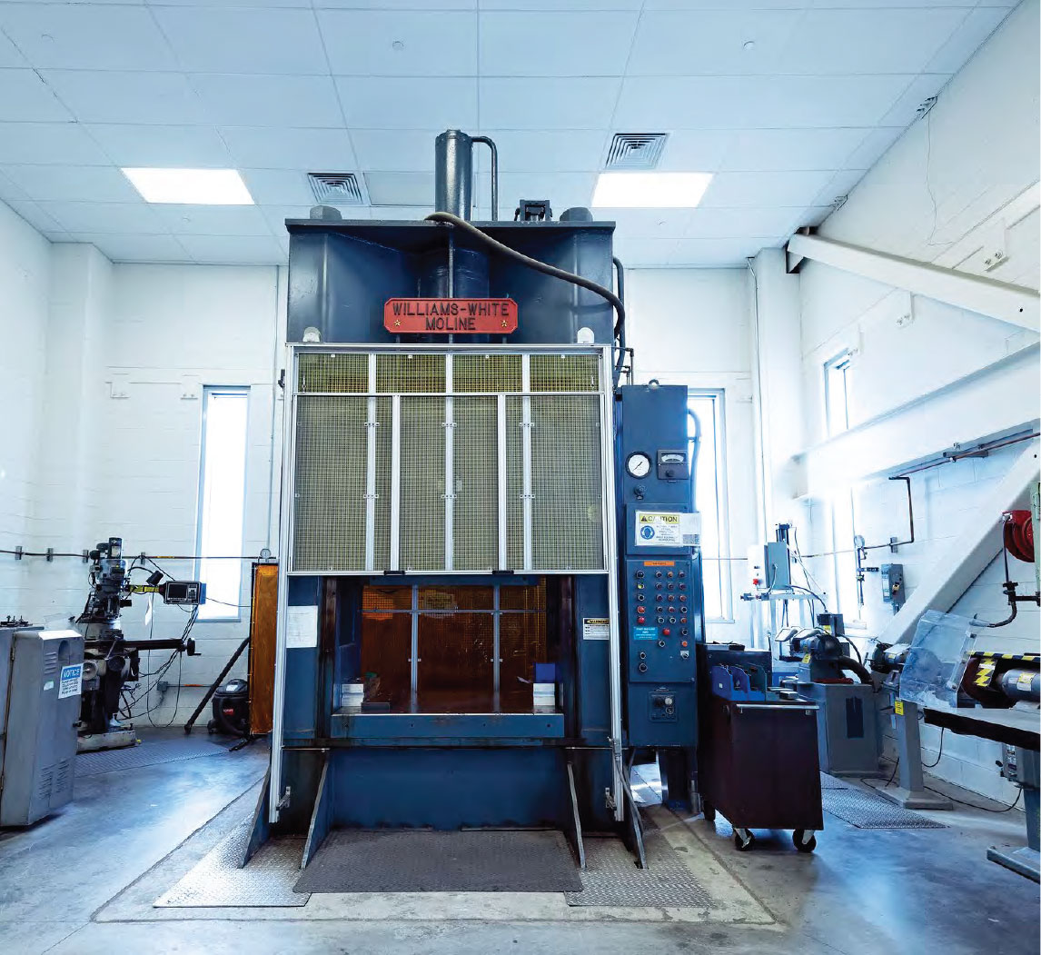
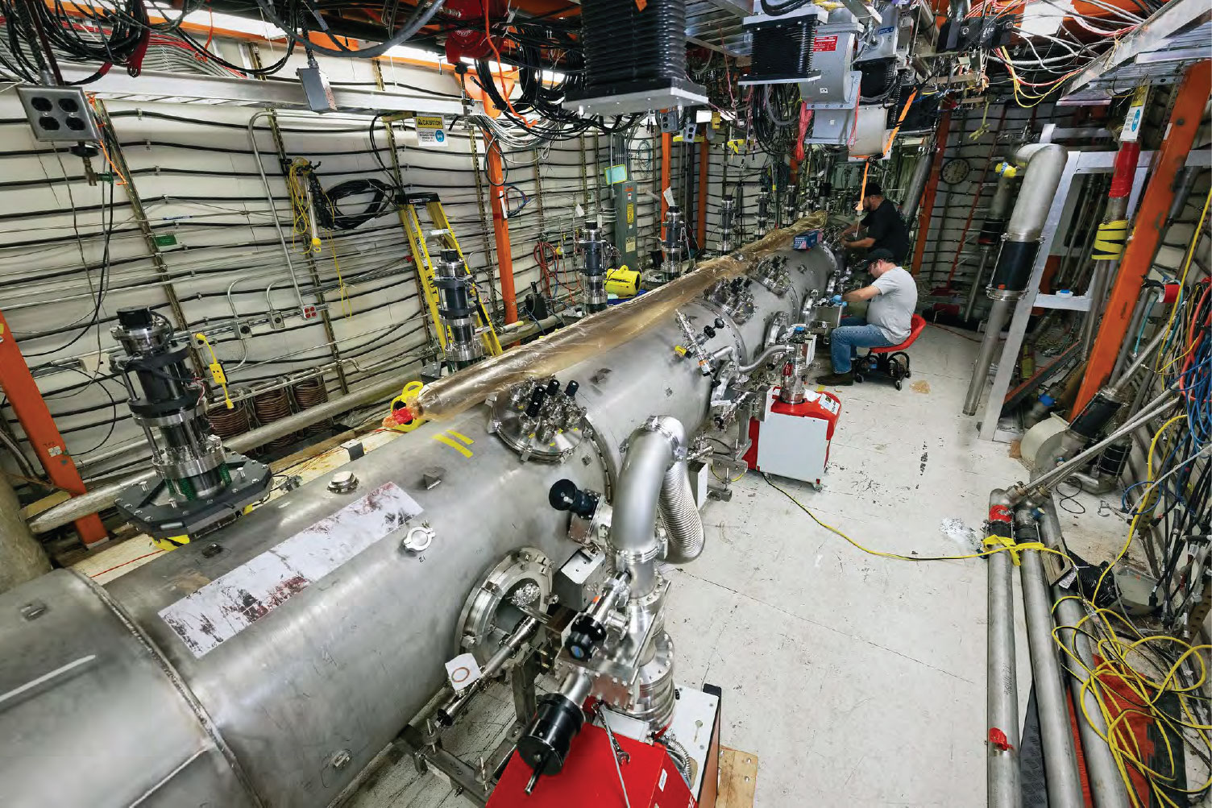
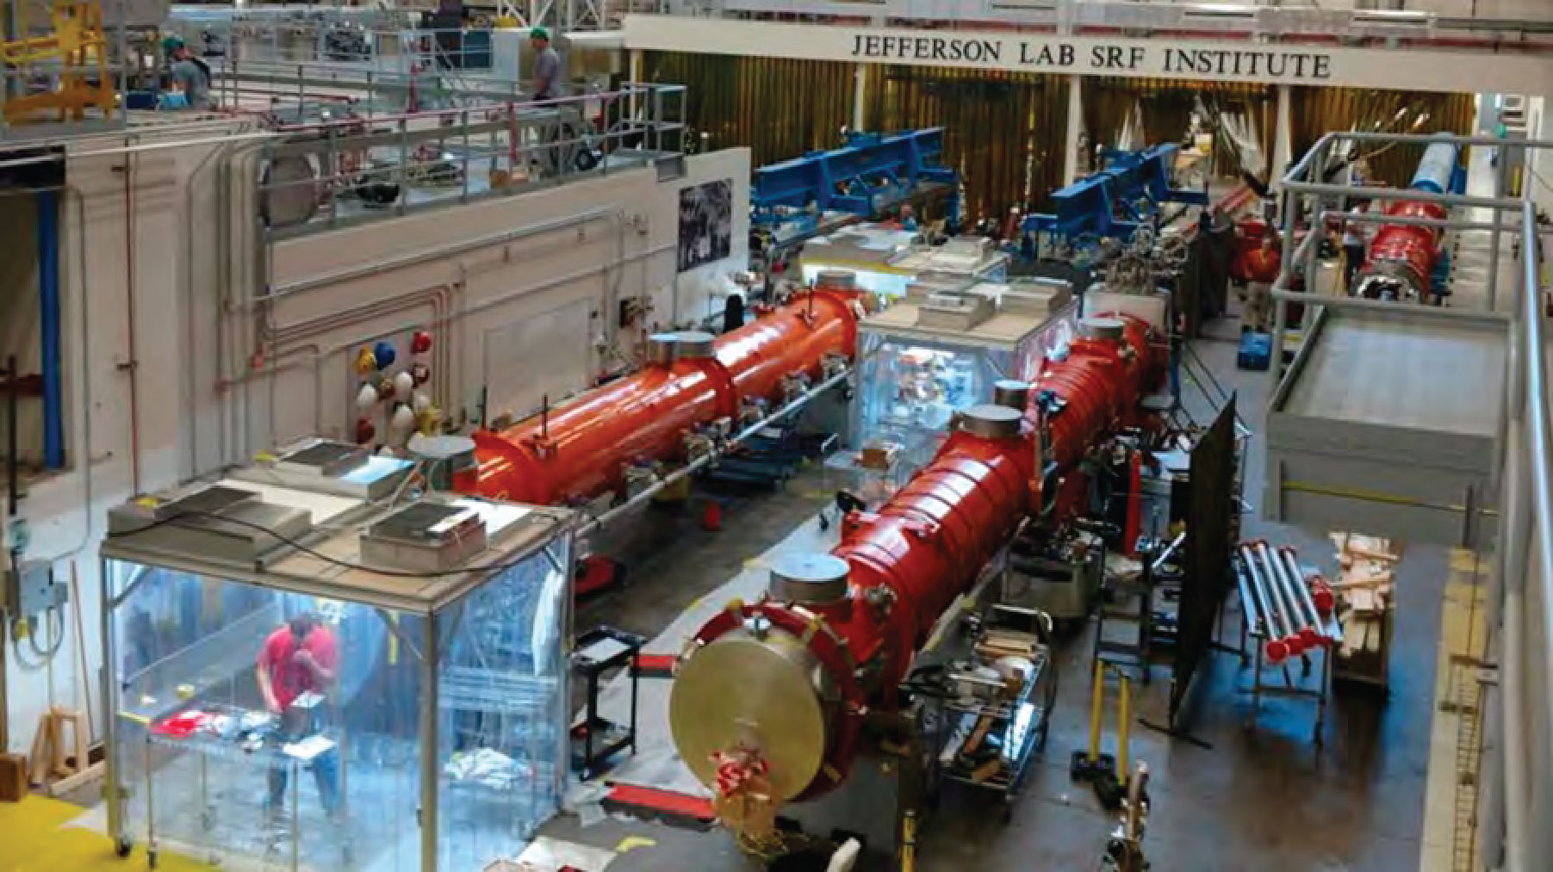
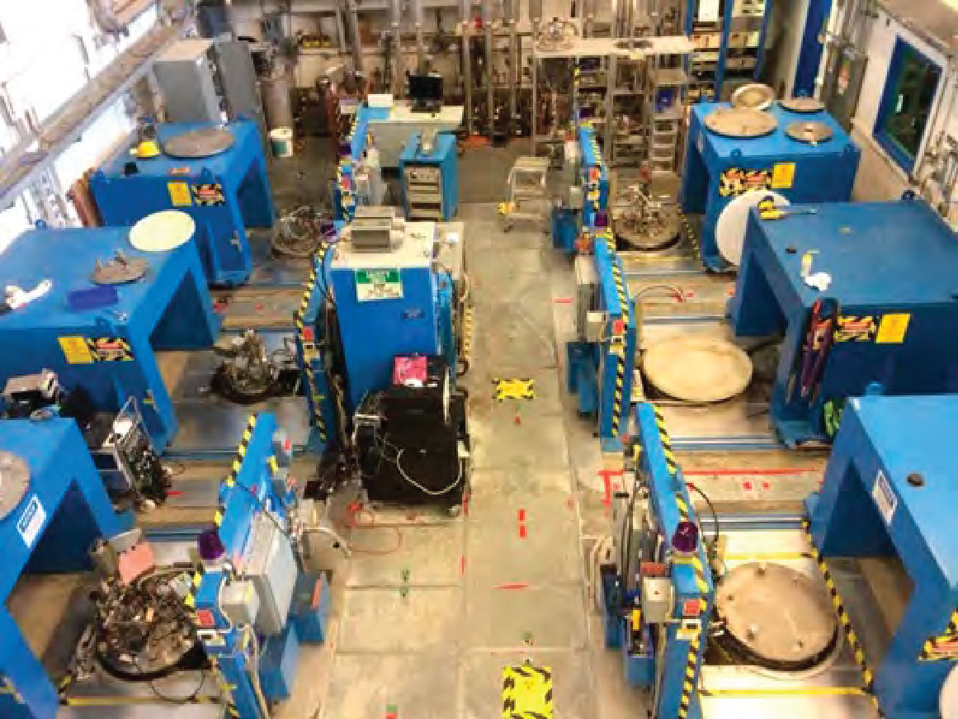
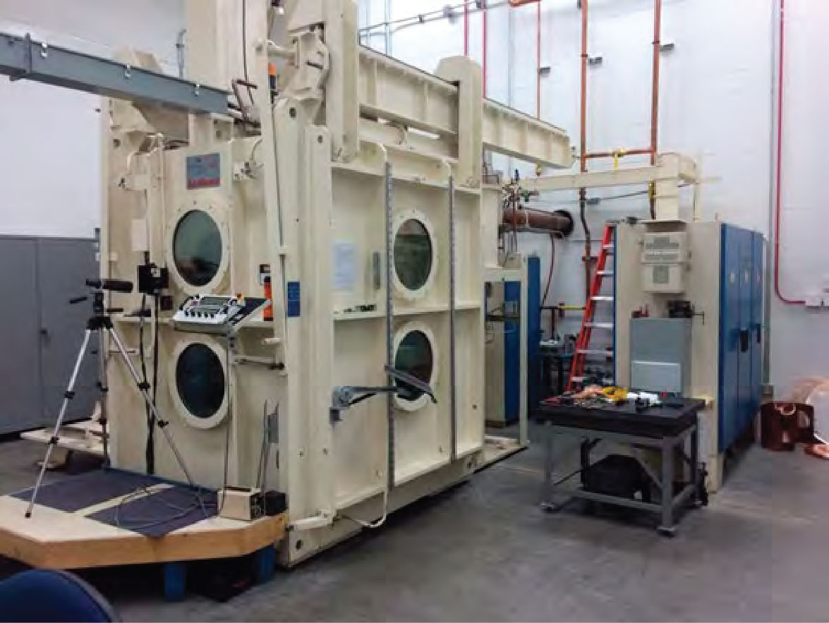
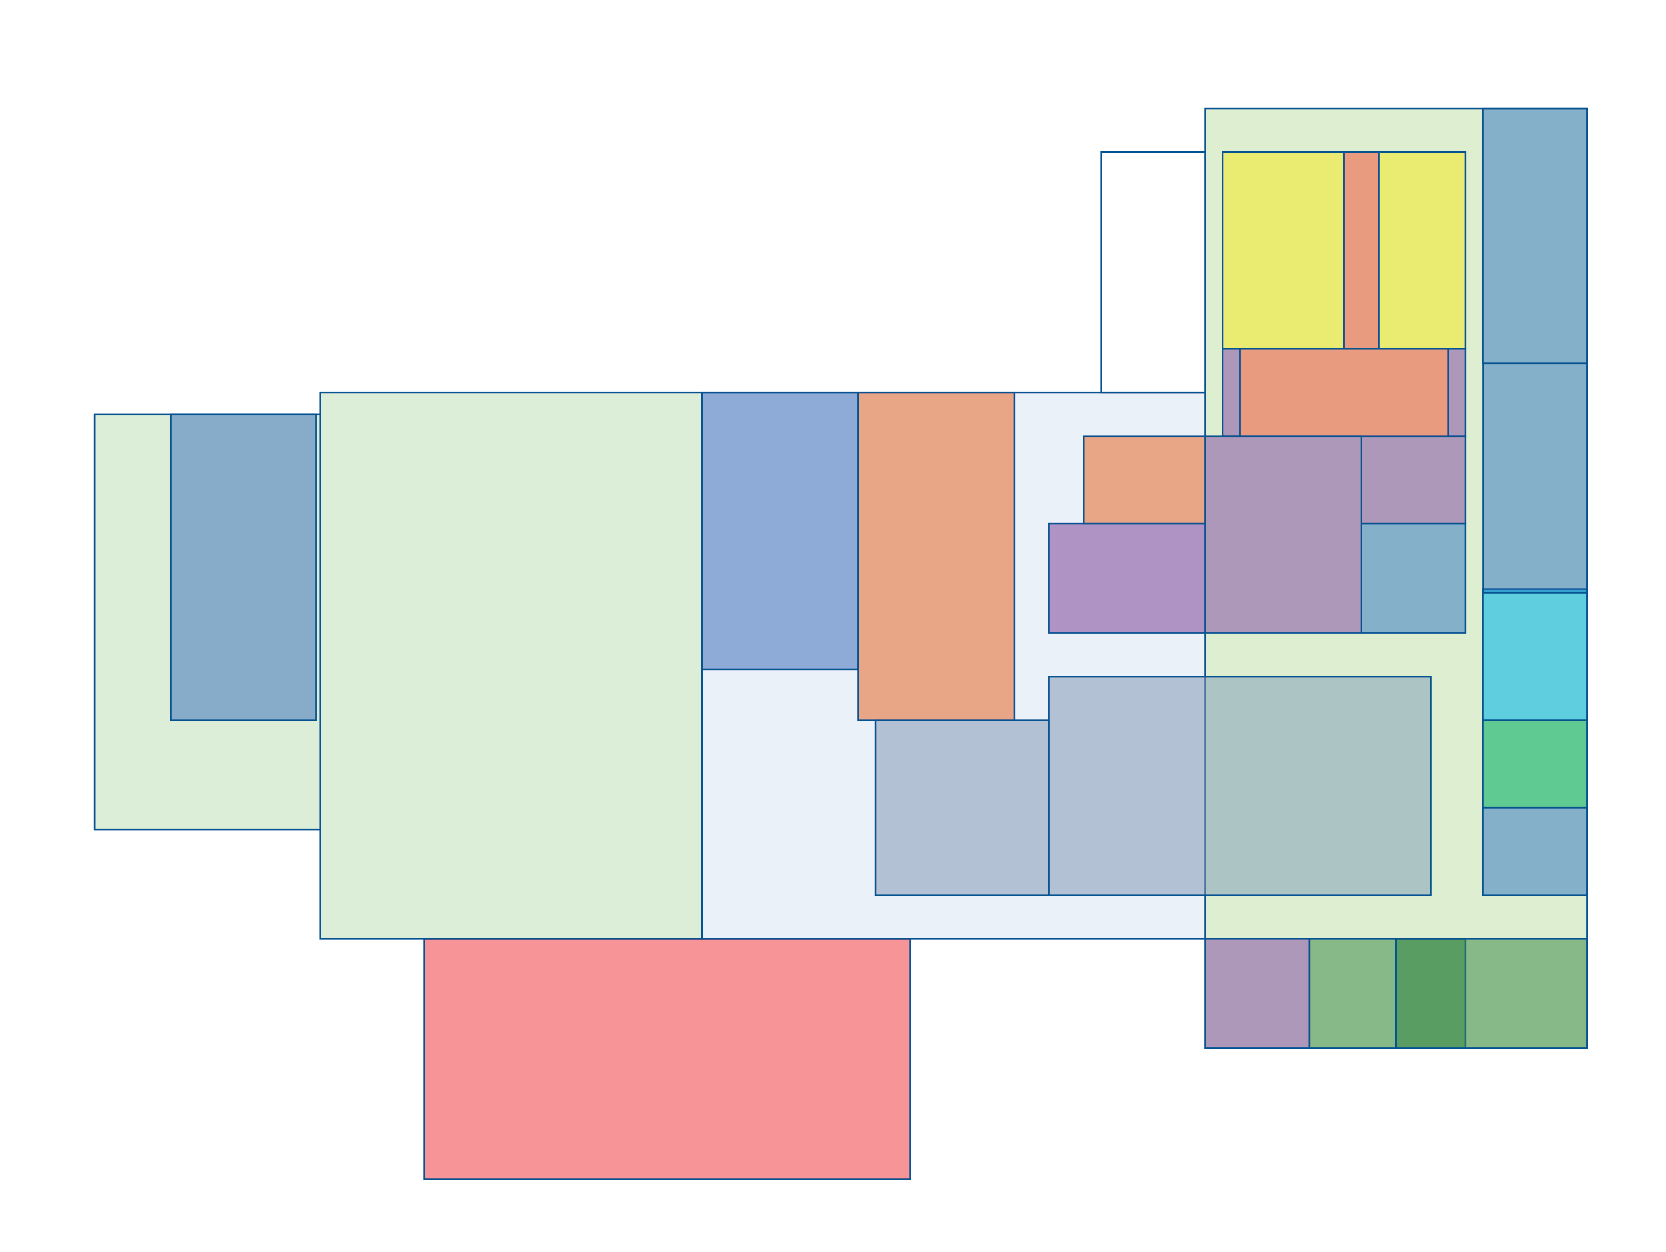
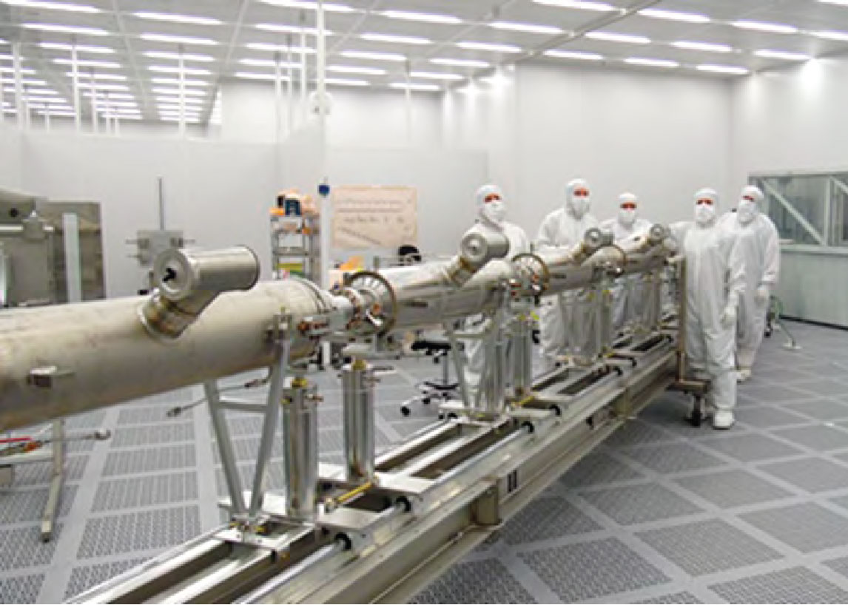
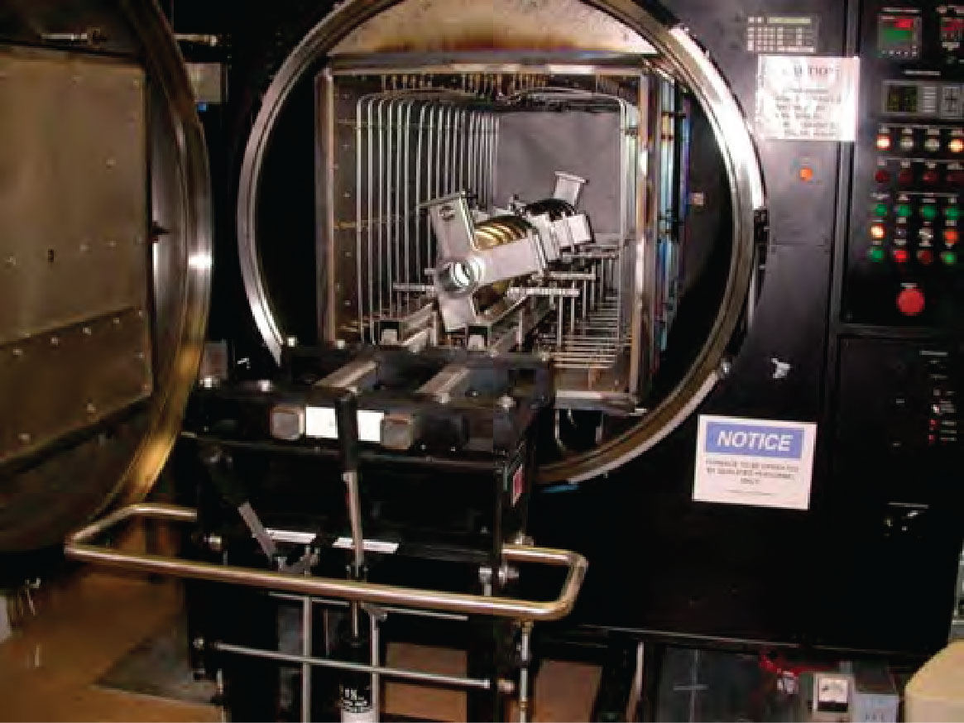
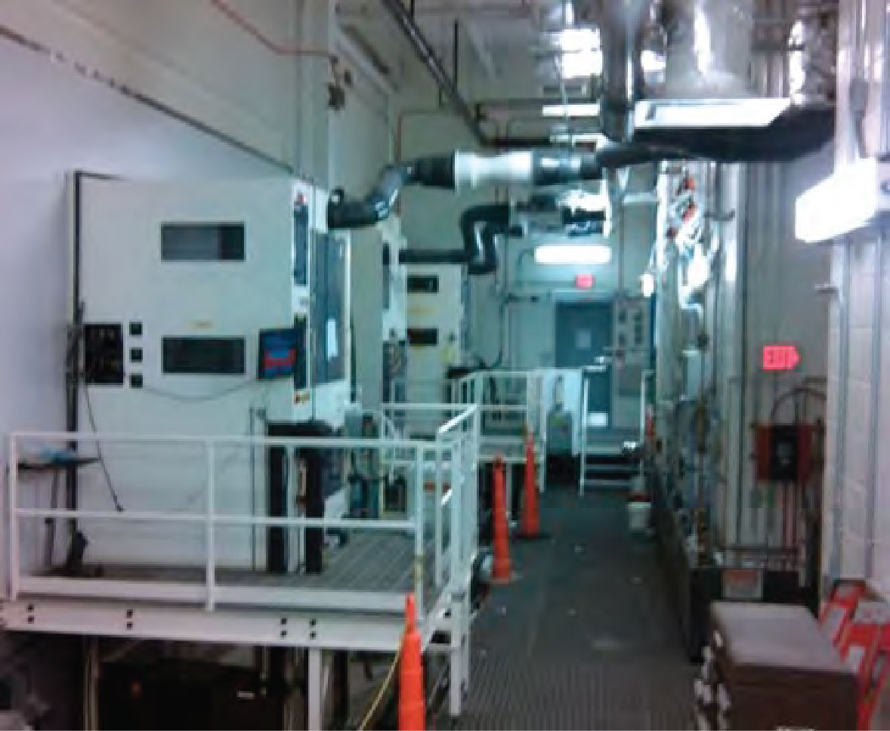
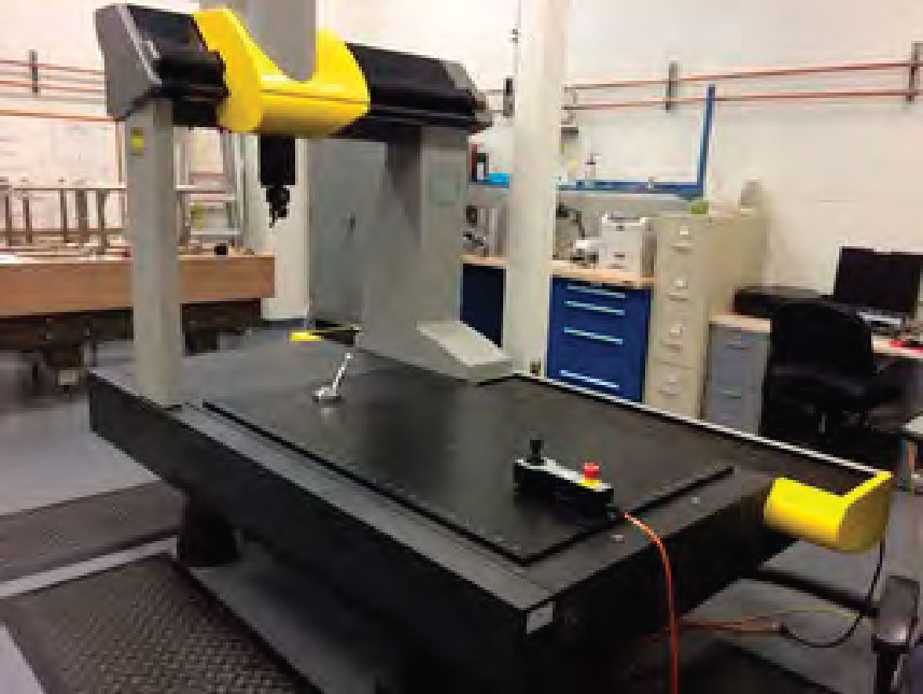
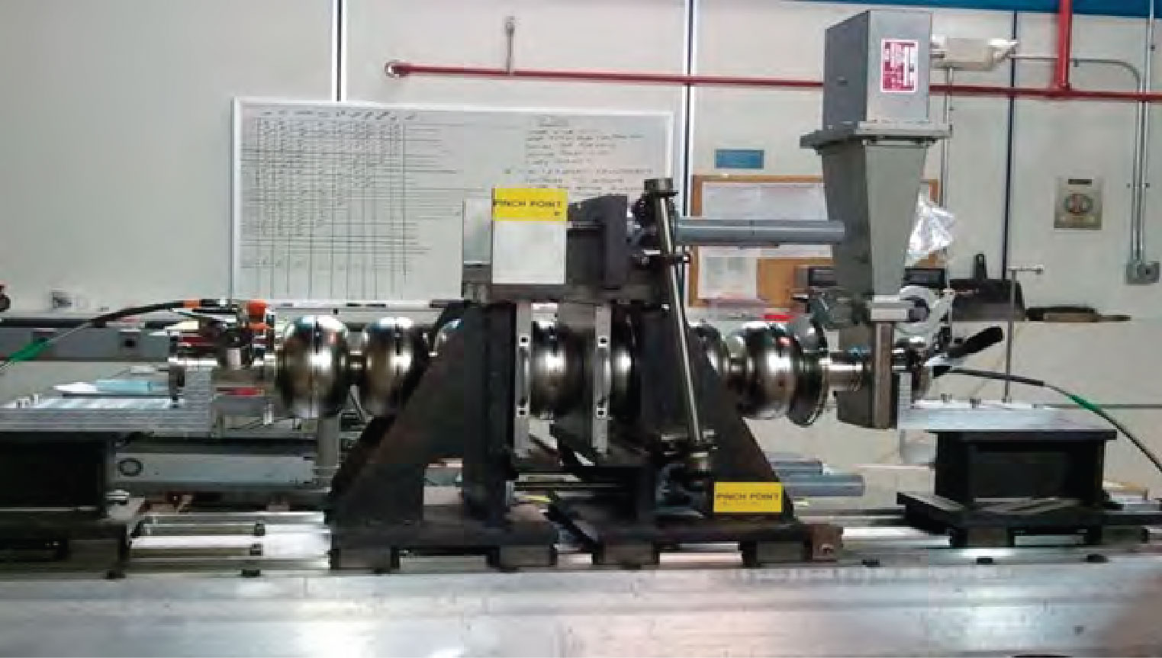
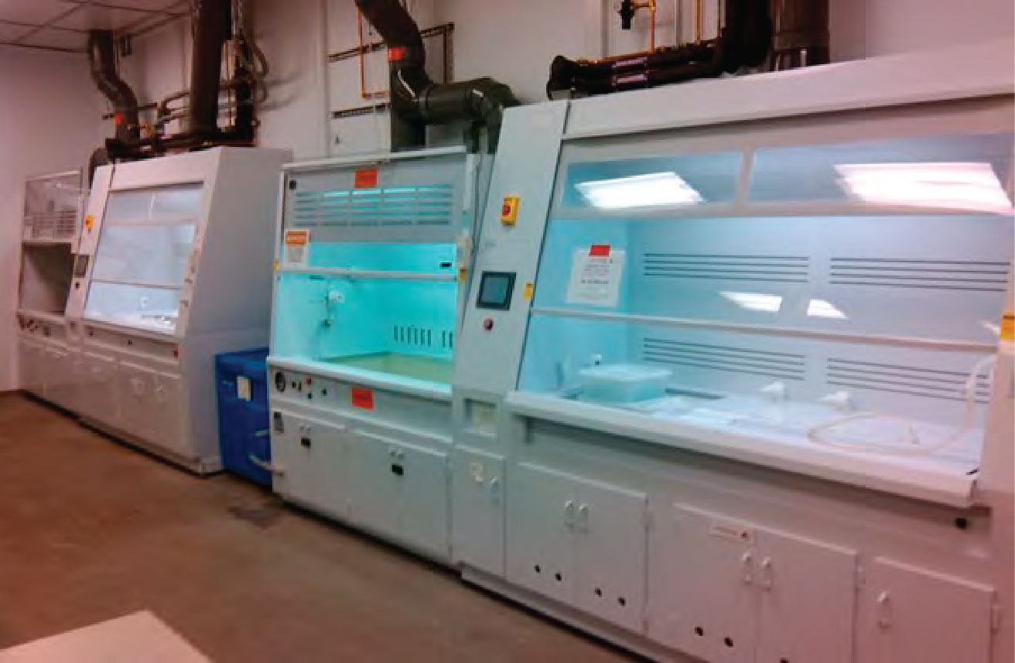
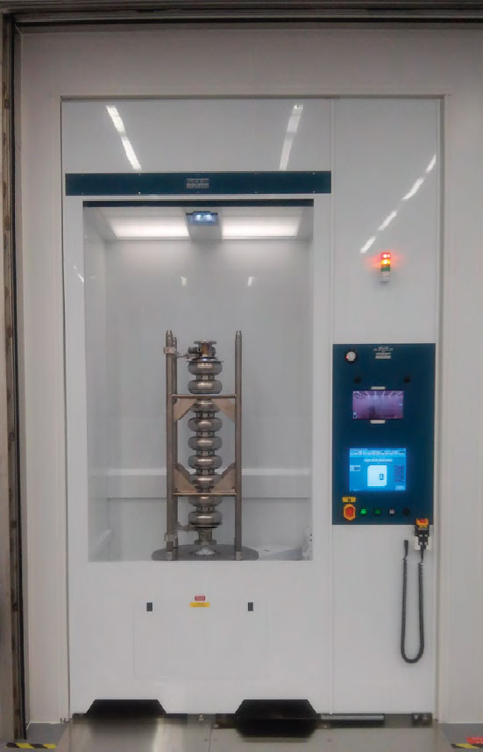
SRF Ops @ Jlab
Under One Roof – Development to Delivery
1
11
10
Fabrication
Cryomodule Test Area
Cryomodule Assembly
9
Electronics Shop
Vertical Test Area
R&D Chemistry Labs
Vertical Attachment
6
7
R&D Labs
2
Inventory
And R&D
11
9
8
R&D Clean Lab
Electron Beam Welding
5
10
8
Lapping
Cleanroom
Physics
Offices
3
2
4
1
3
Furnaces
7
4
5
6
Process Support Area
Coordinate measuring machine
& quality assurance inspection
Tuning
Parts Cleaning and Etching

Slide 5
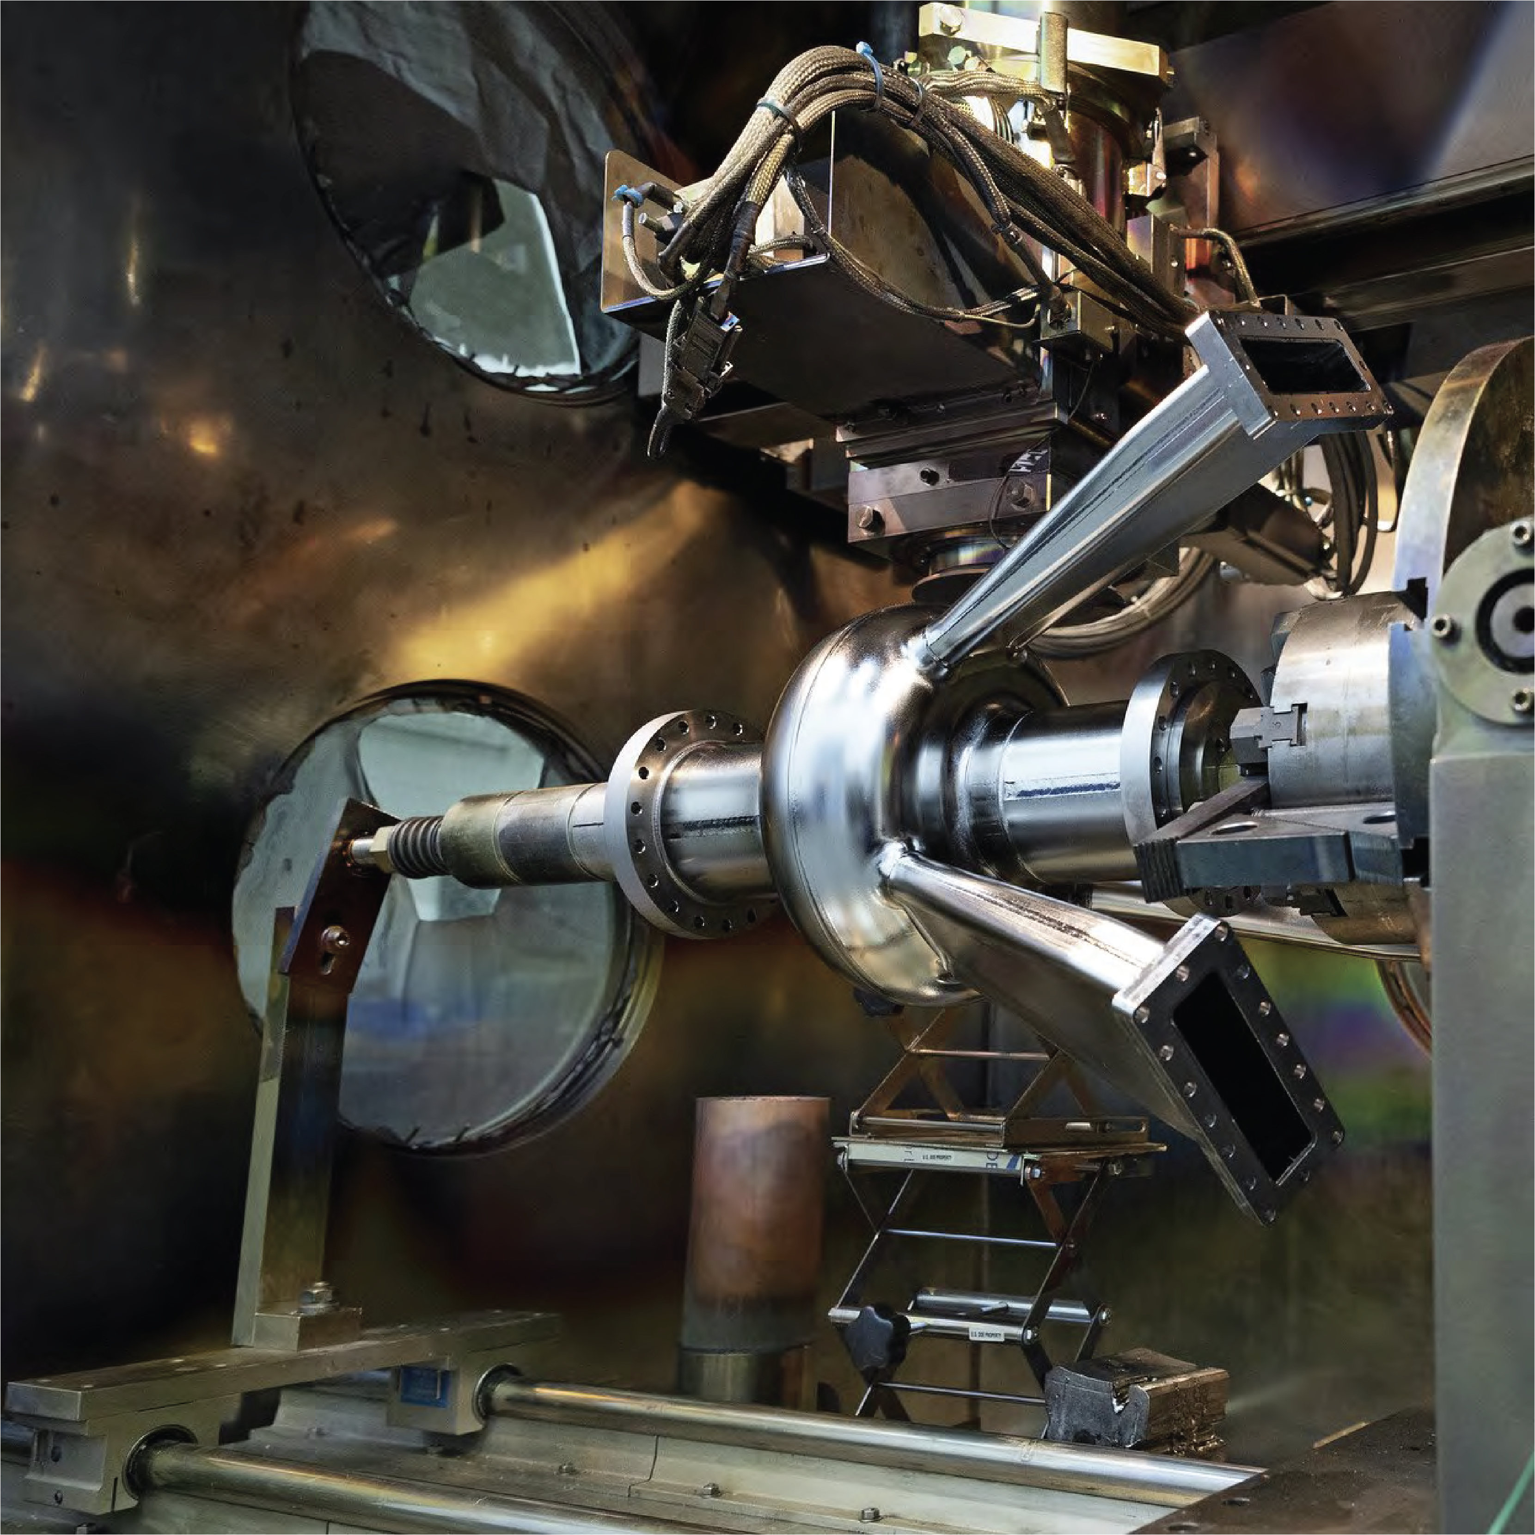
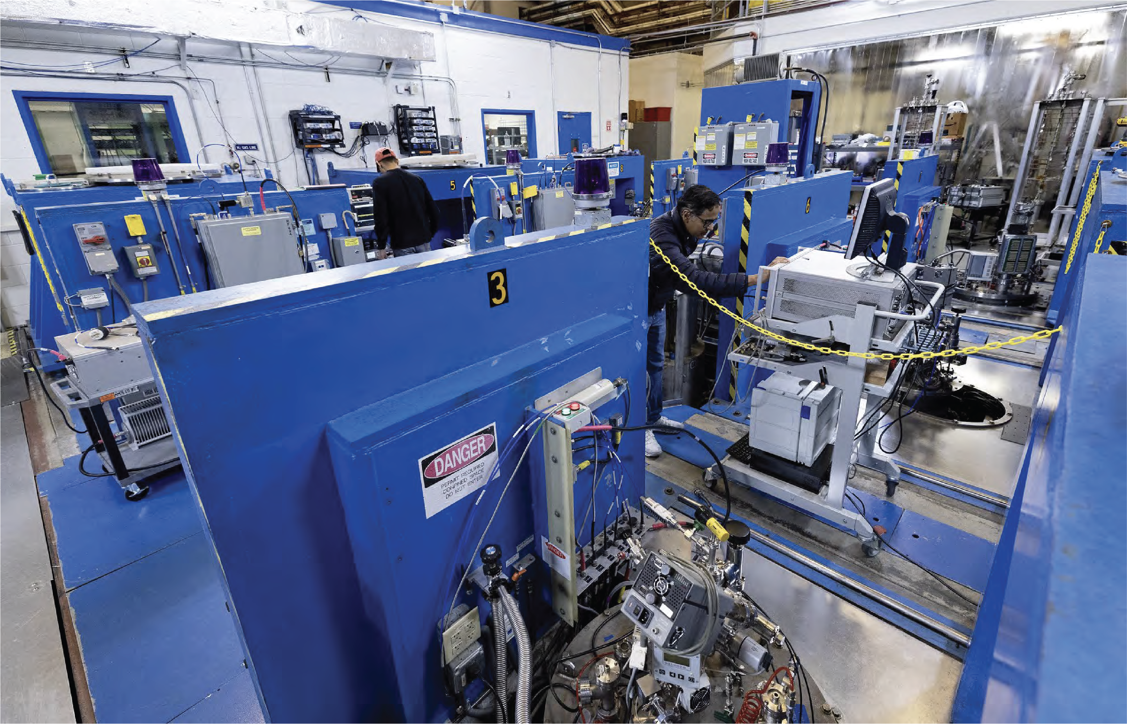
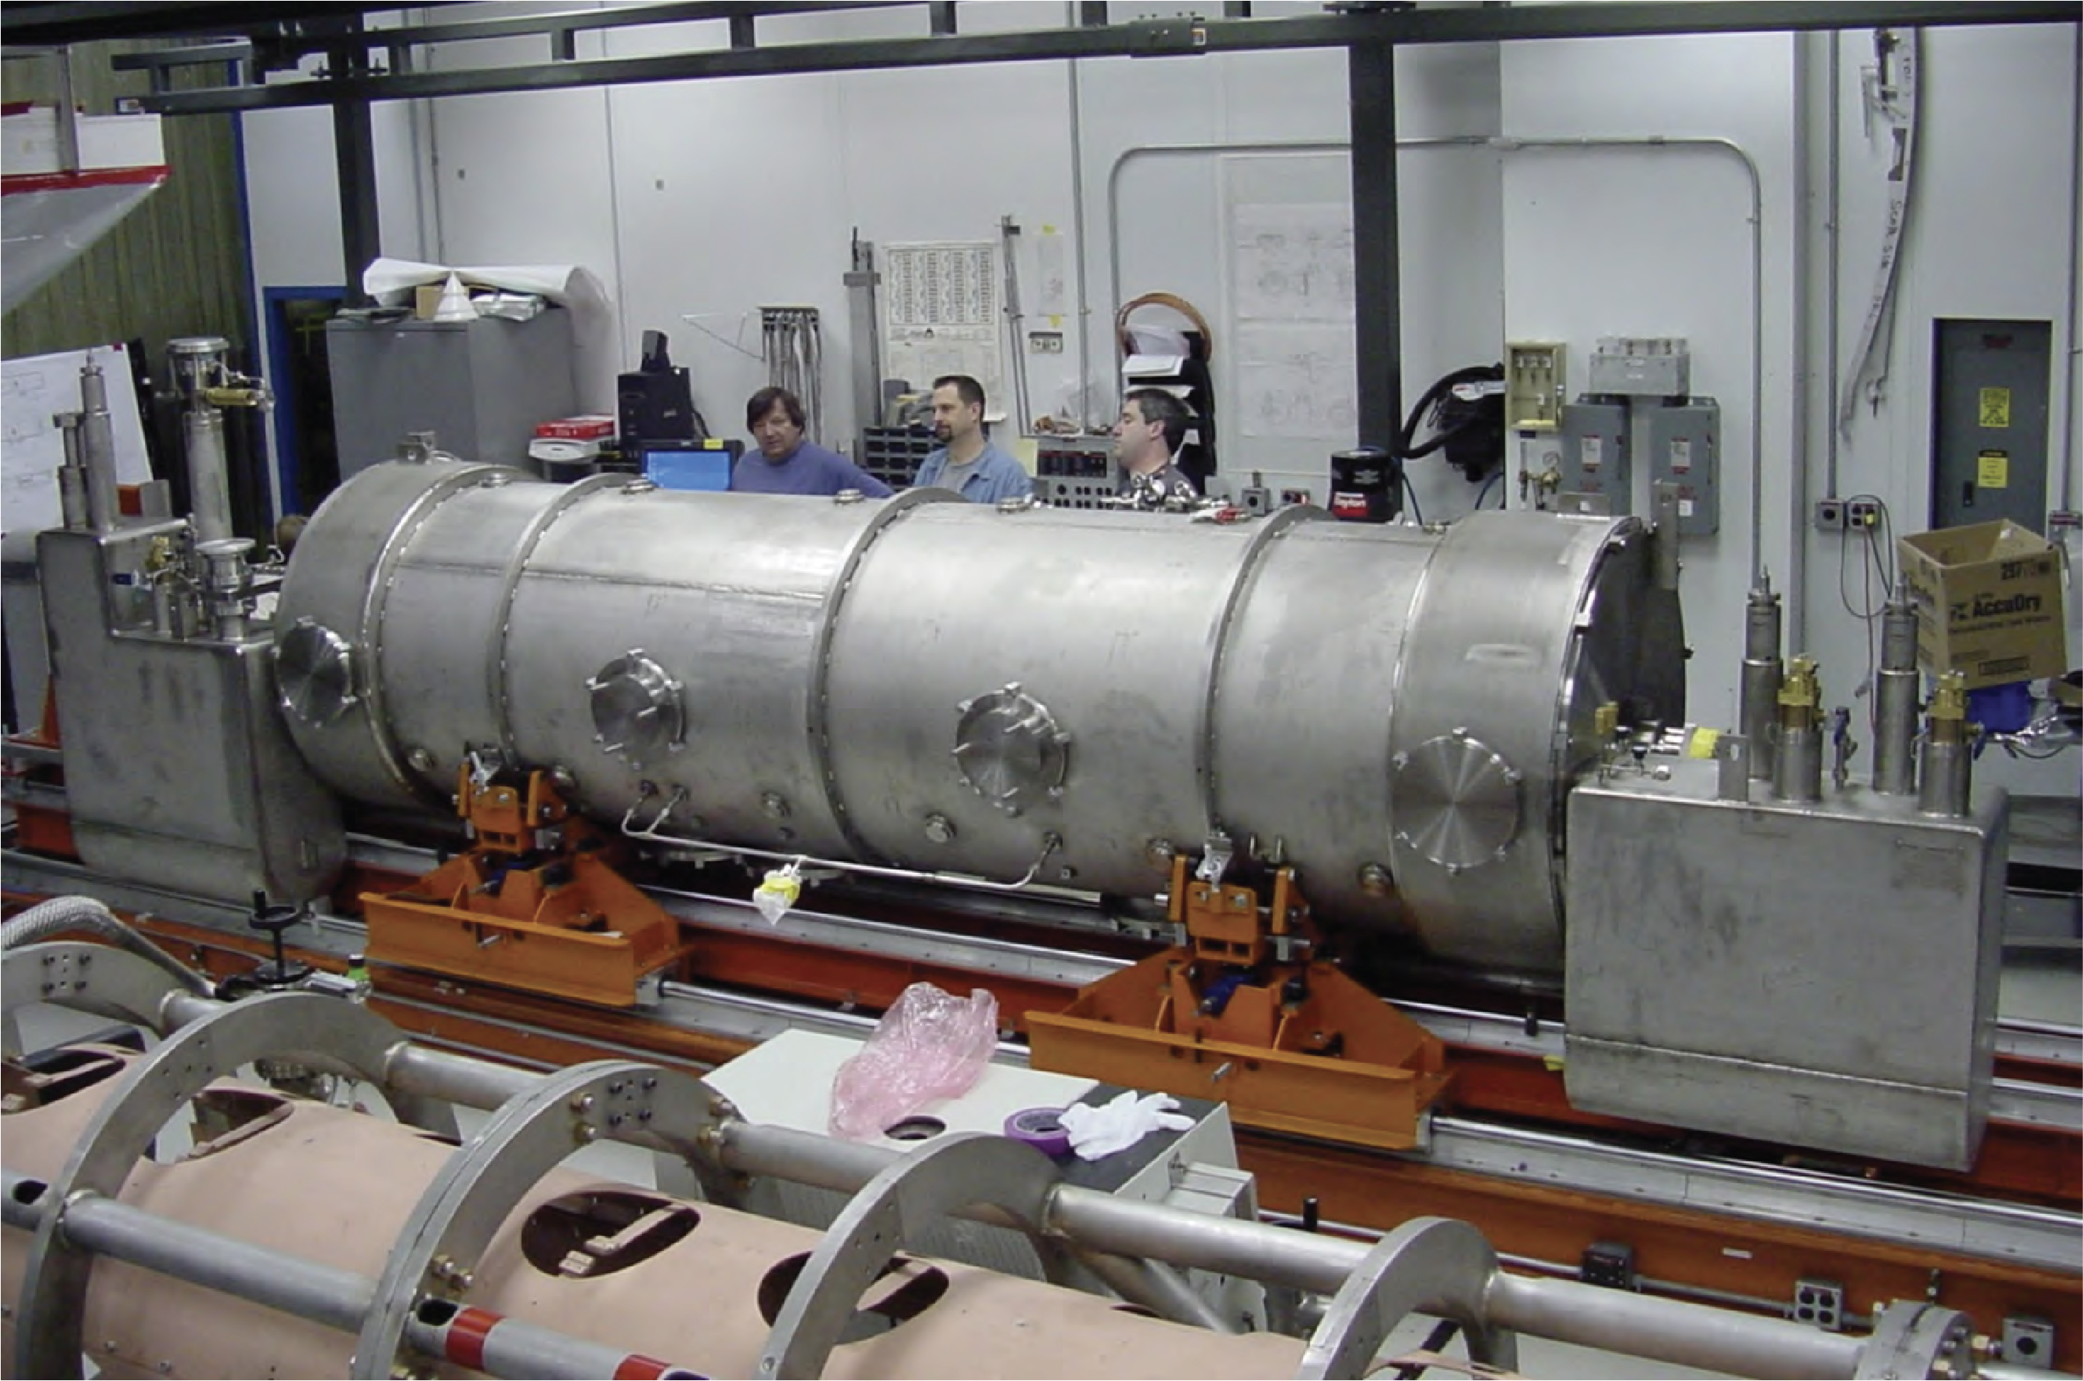

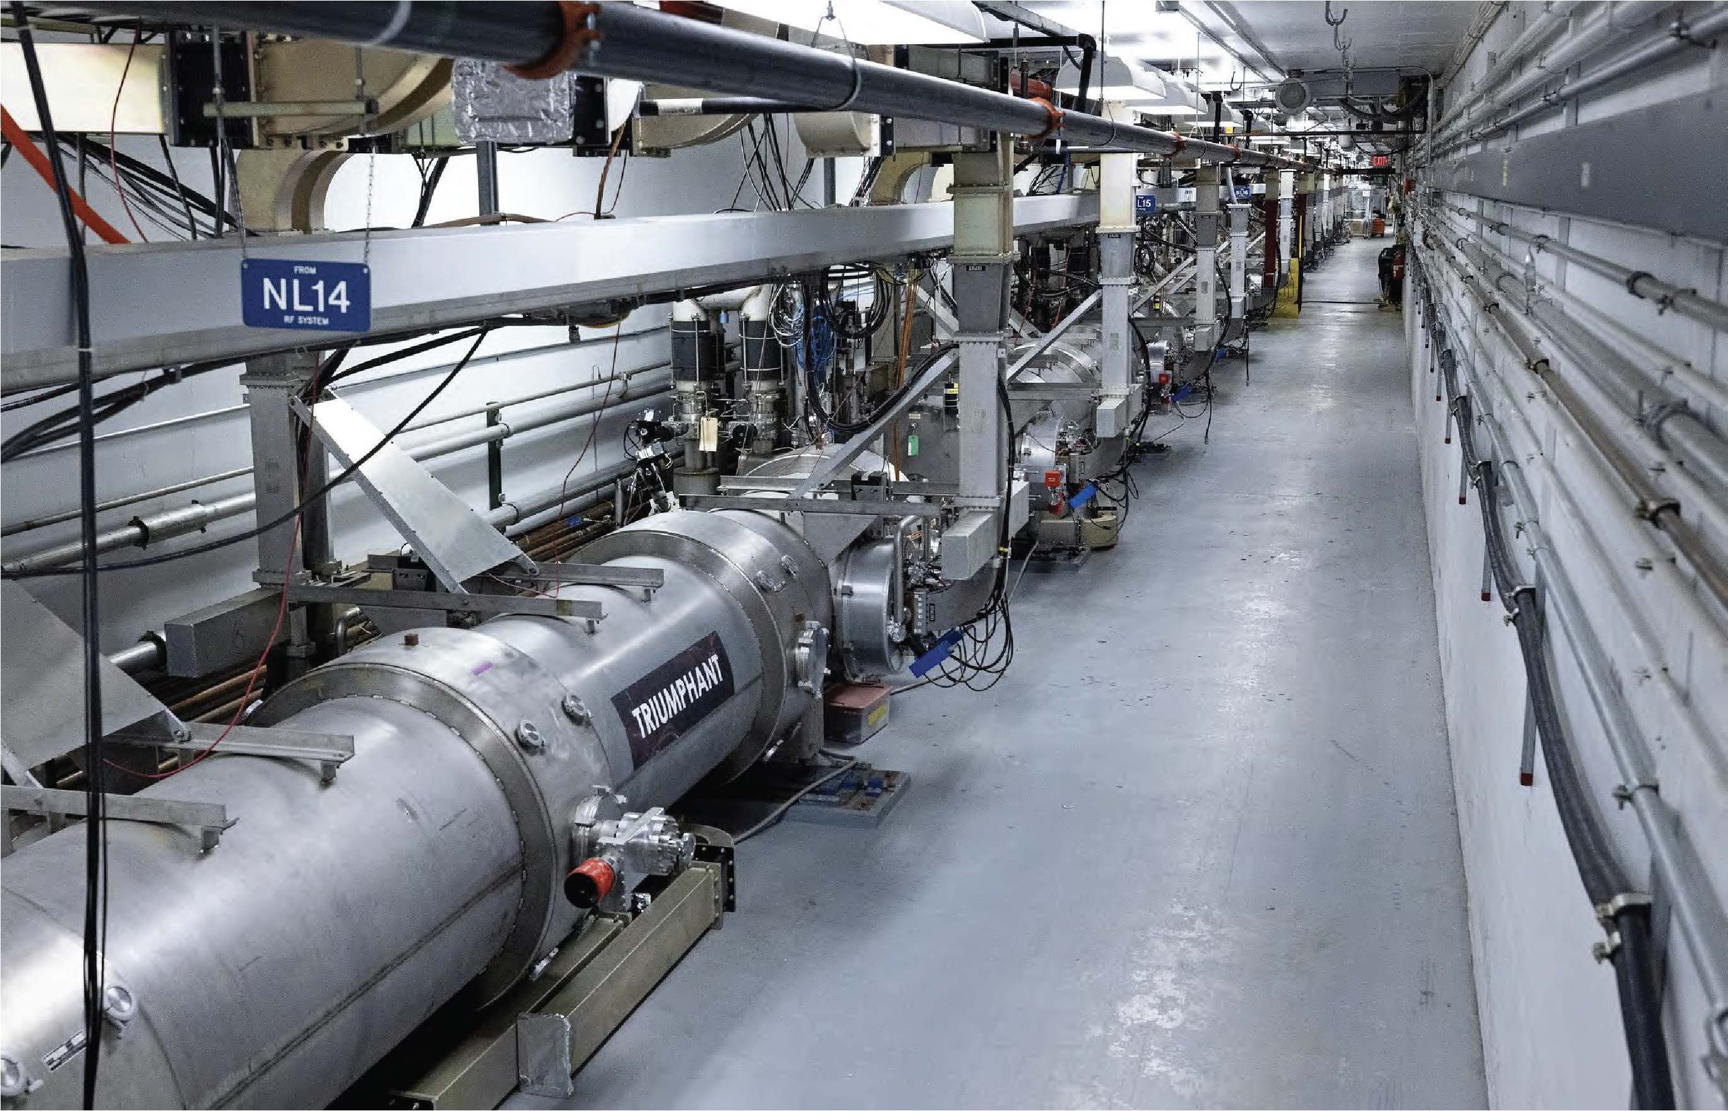

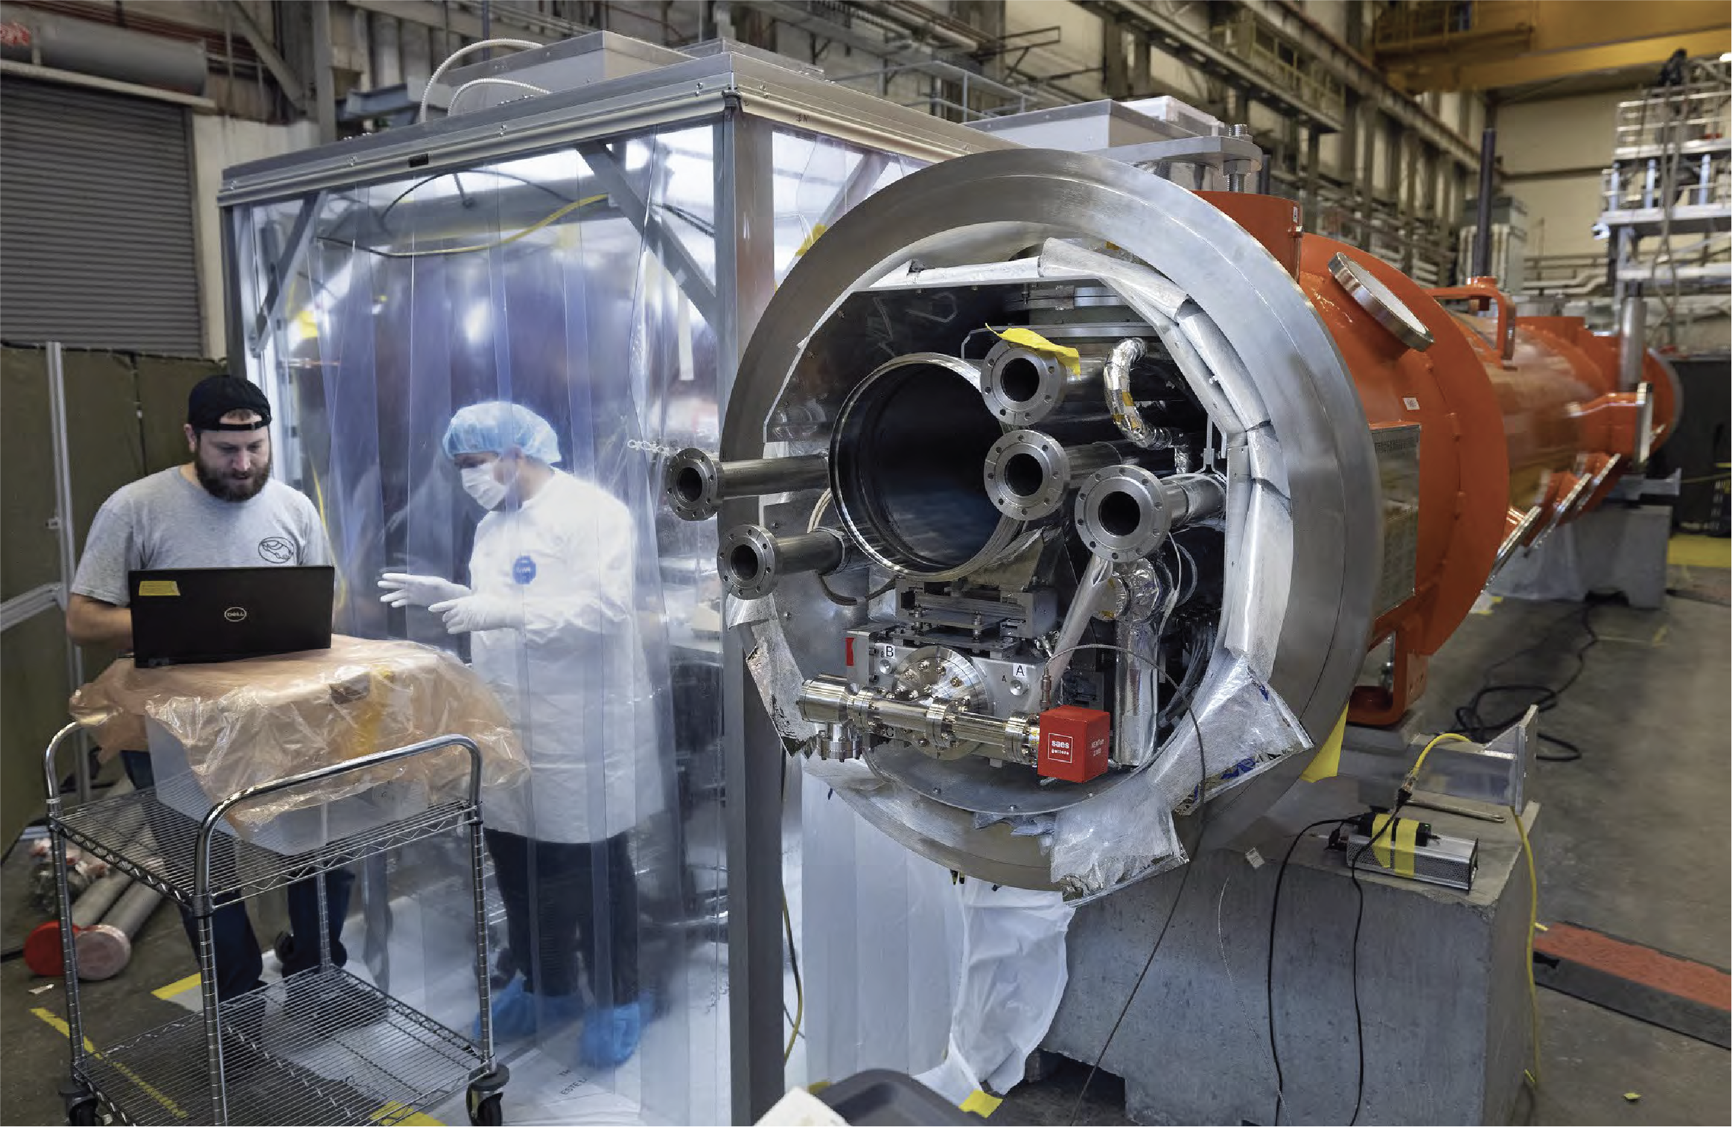

SRF Ops Relevant Experience
CAVITY ASSEMBLY
& TESTING
SNS
SNS + PPU
CEBAF
C20 + C50 + C75
+ C100 + 1 booster
Fabrication & Inspection
From niobium sheet to dressed cavity
>12 Cavities built and delivered since 2020
Vertical Testing
More than 6800 cavity tests
Record 420 tests in 2022
LCLS-II
LCLS-II + HE

Slide 6
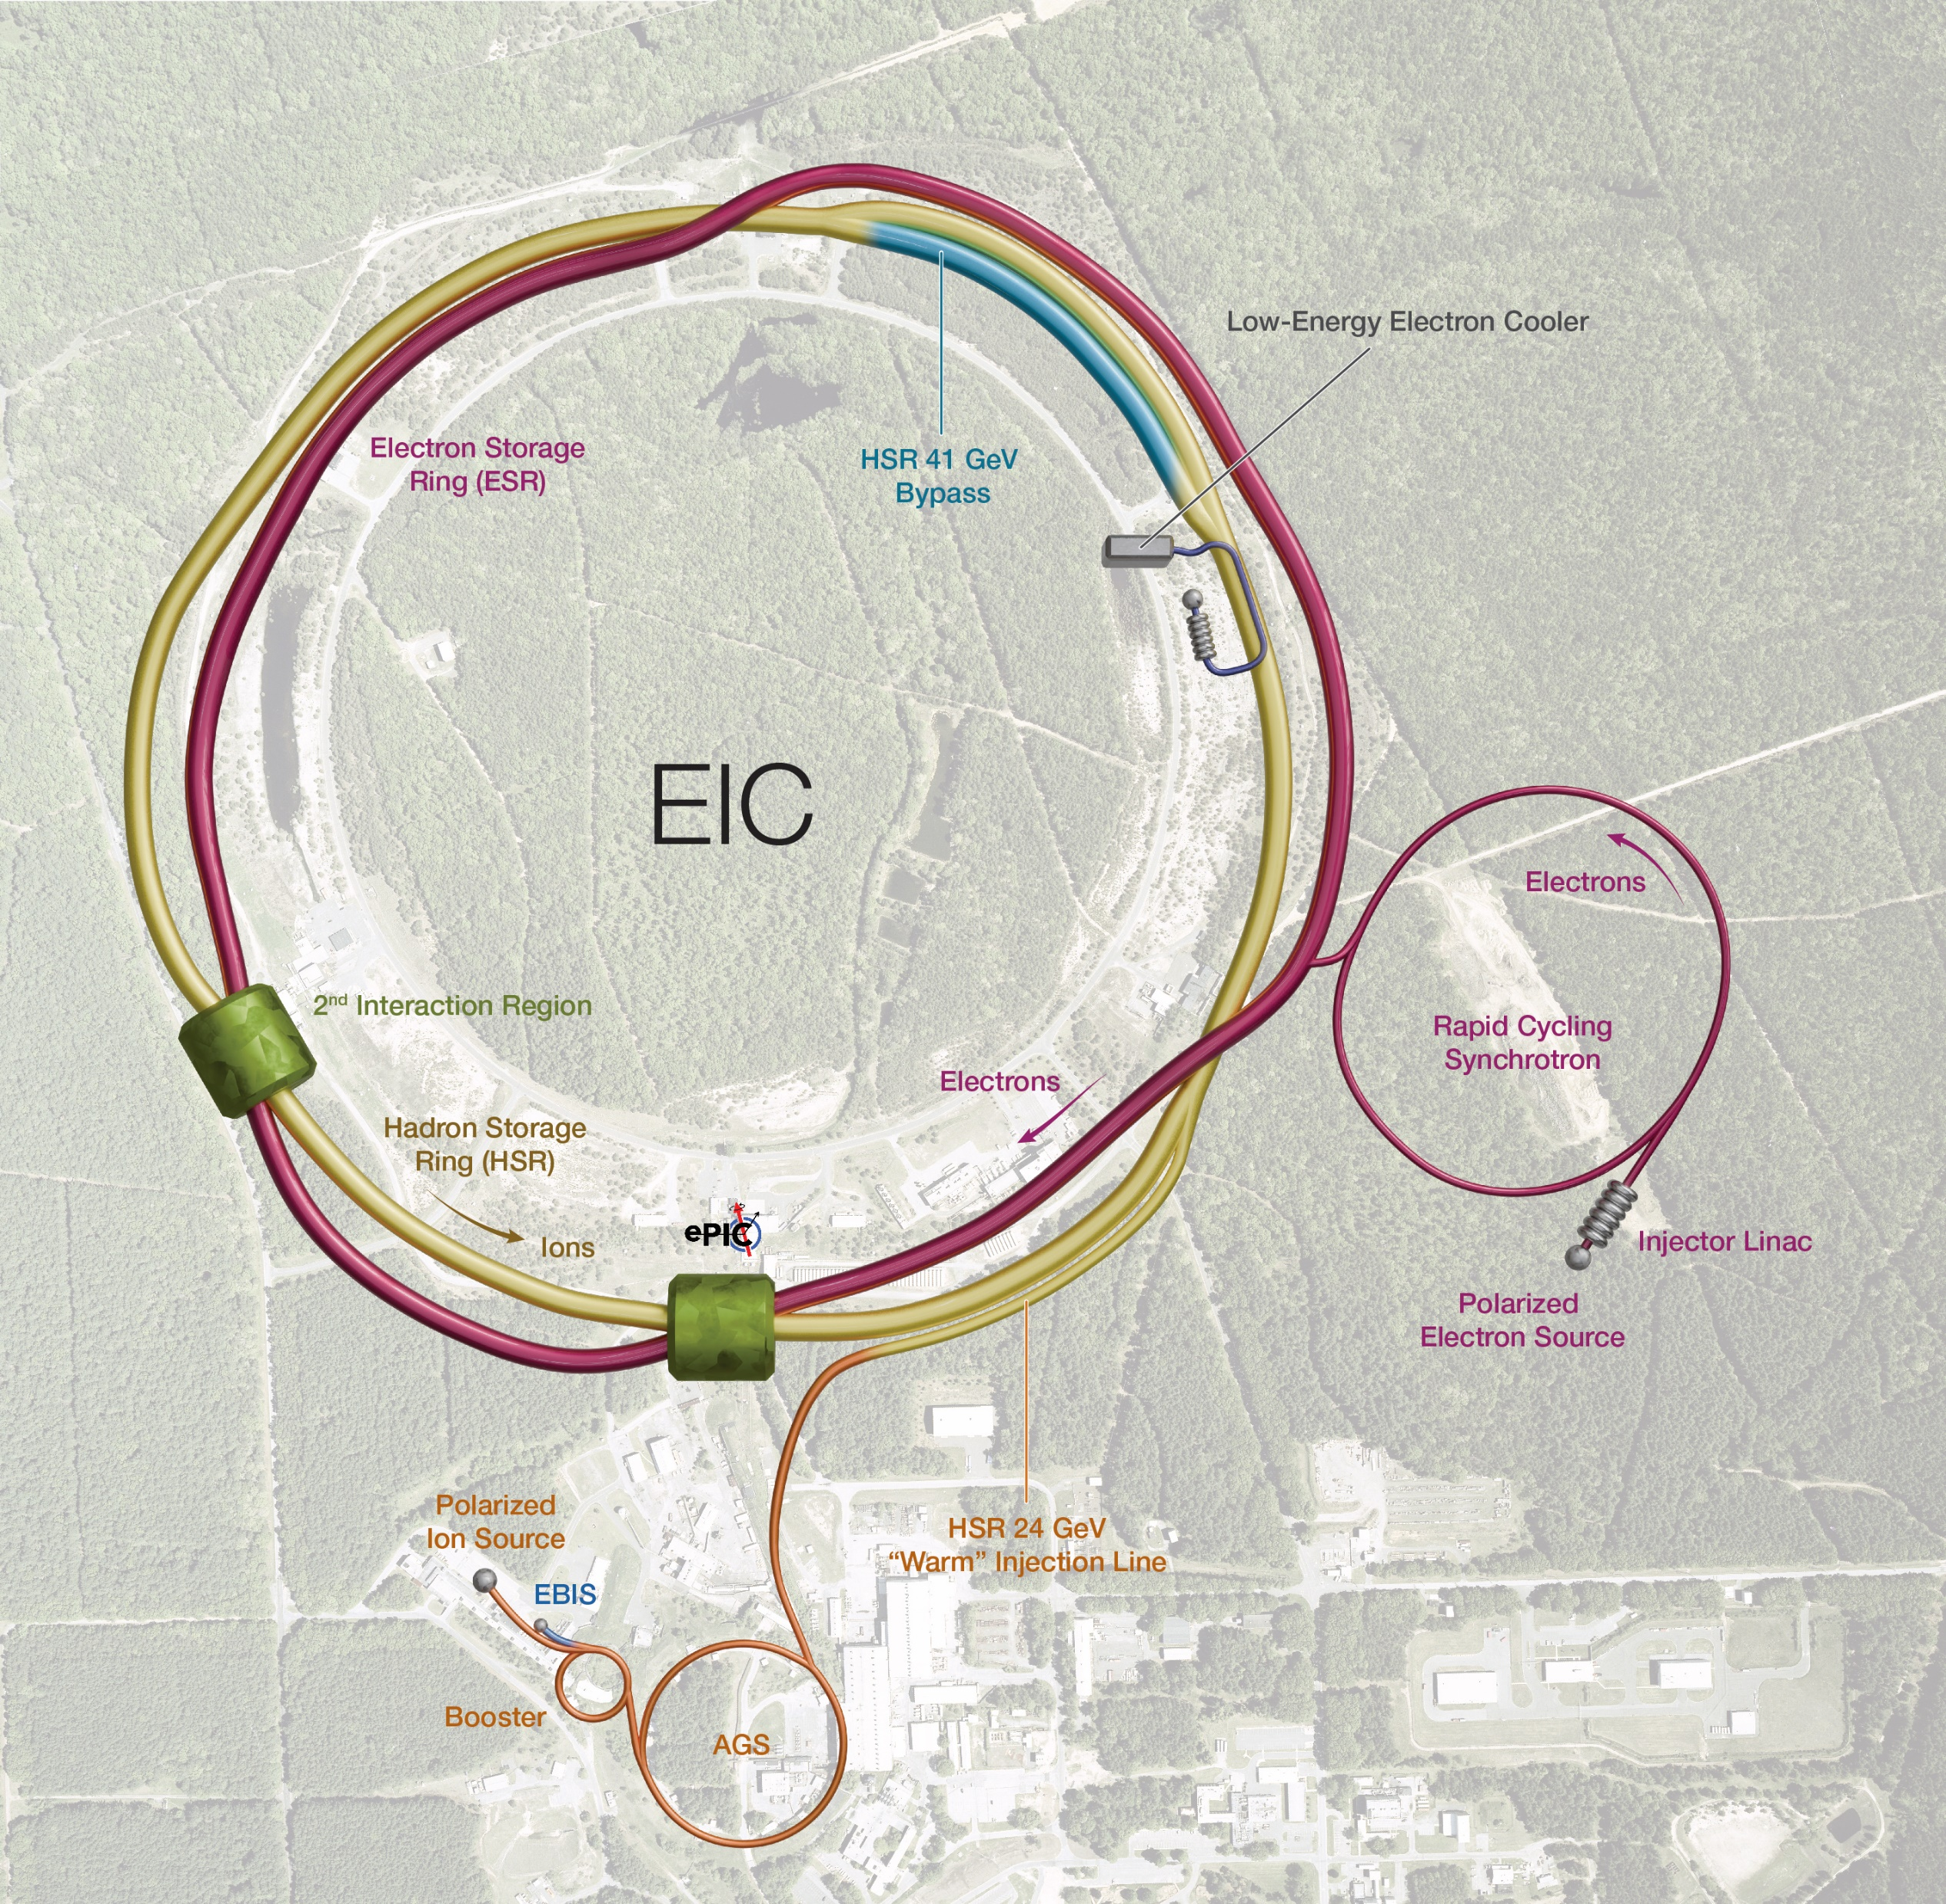
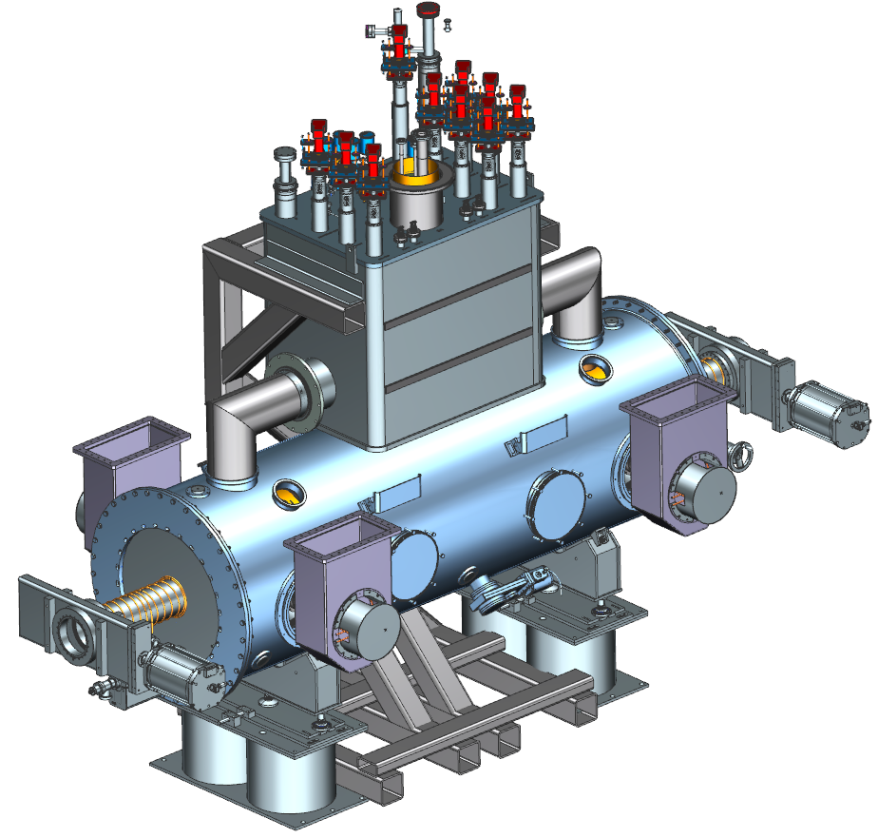
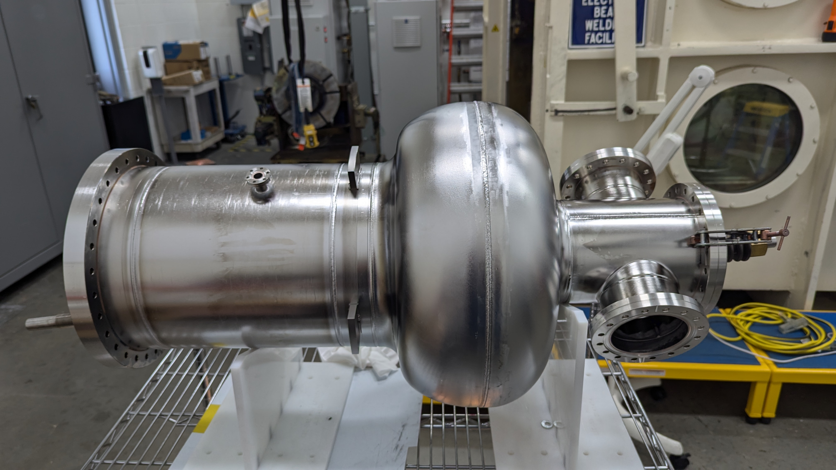
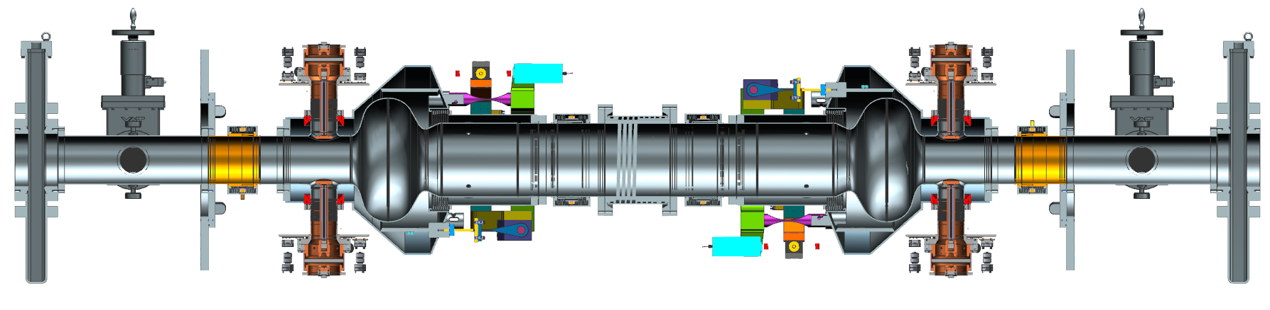
Requirements of EIC
 | Protons | Electrons
Energy (GeV) | 275 | 10
CM Energy (GeV) | 104.9
Bunch Intensity (10¹⁰) | 6.9 | 17.2
# of Bunches | 290 | 1160
Beam Current (A) | 1 | 2.5
Bunch Length (cm_{rms}) | 6 | 0.7
Δp/p (10⁻⁴_{rms}) | 6.8 | 5.8
Luminosity (cm⁻² s⁻¹) | 1x10³⁴
9 MW Synchrotron Radiation
27.5 nC per bunch
~1 MW Device Losses
Short Bunches
Still Need Crab Cavities
6

Slide 7
Tooling design for DVC @ SRF Ops
Half-Cells
Forming Die
Coining Die
Trimming Die
RF Measurement Fixture
Beampipe
Forming Die
Extrusion Pulling Fixture
EBW
EBW Holding Rings
Field Probe EBW Fixture
Component Tooling
Back-Tech Tooling
Safe Lifting Tooling

Slide 8
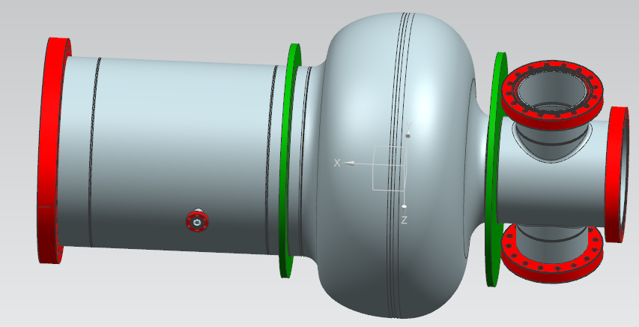
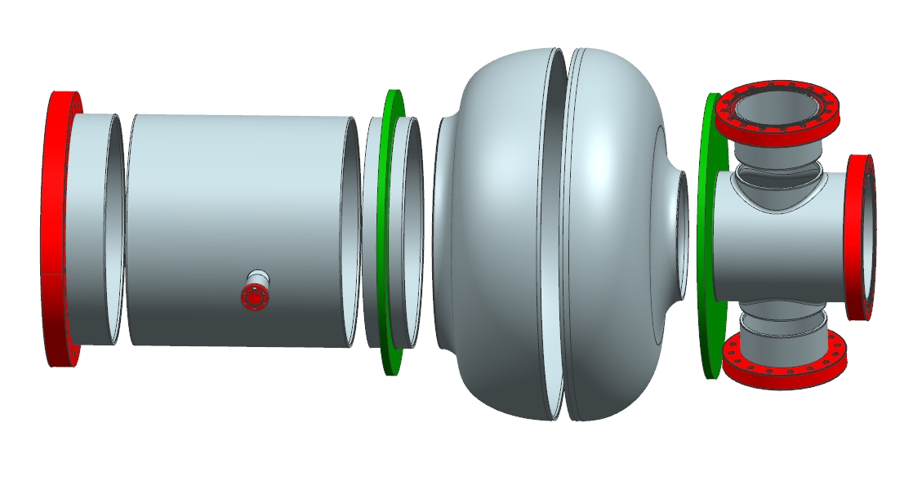
591 MHz Design Verification Component (DVC) Cavity
Large Beampipe Half-Cell
Small Beampipe Half-Cell
Large Beampipe Helium Brazing Stub
Large Beampipe Helium Vessel Stub
Length | .93m
Weight | 55 kg
FPC Port Beampipes
Small Beampipe
Field Probe
Large Beampipe Center

Slide 9
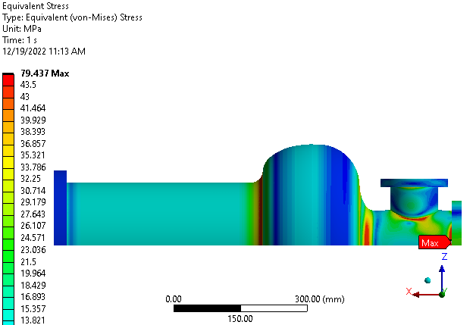
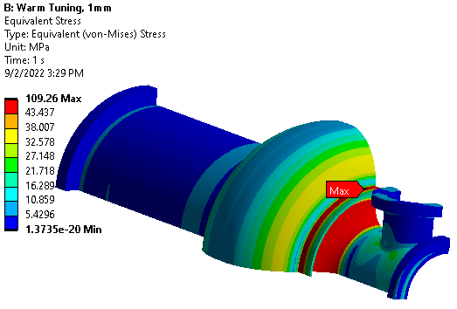
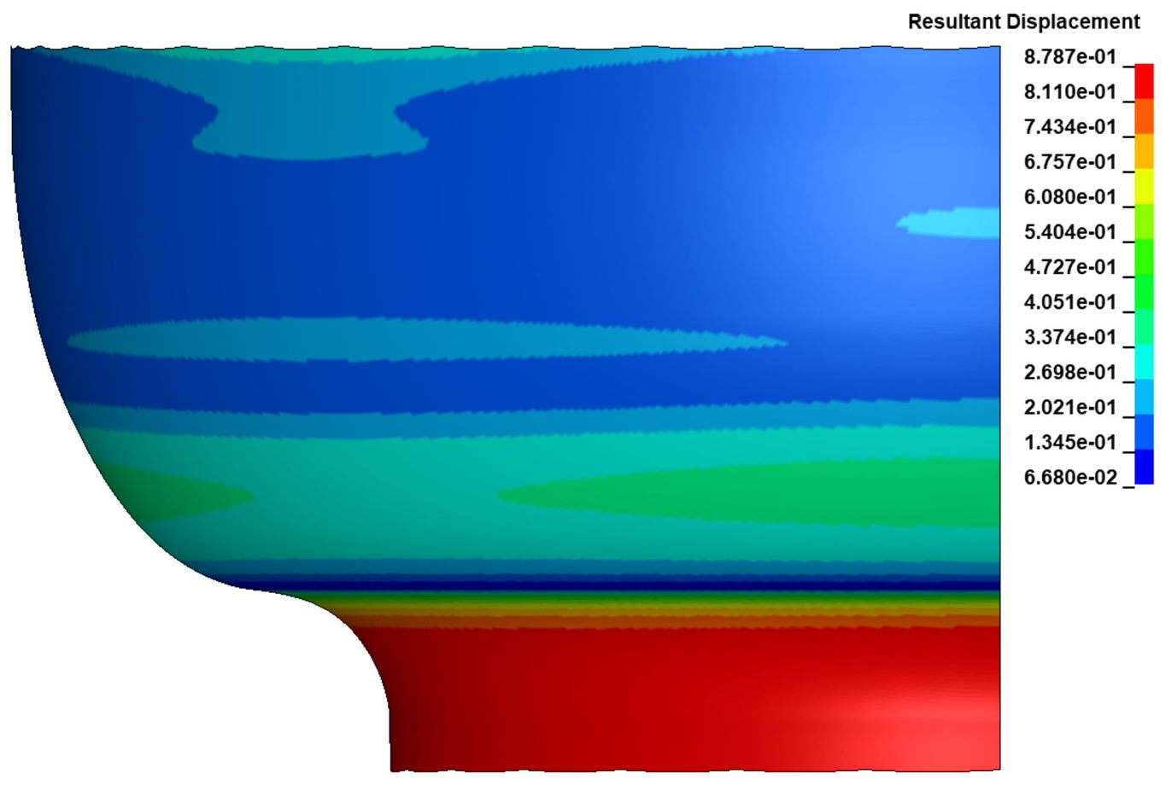
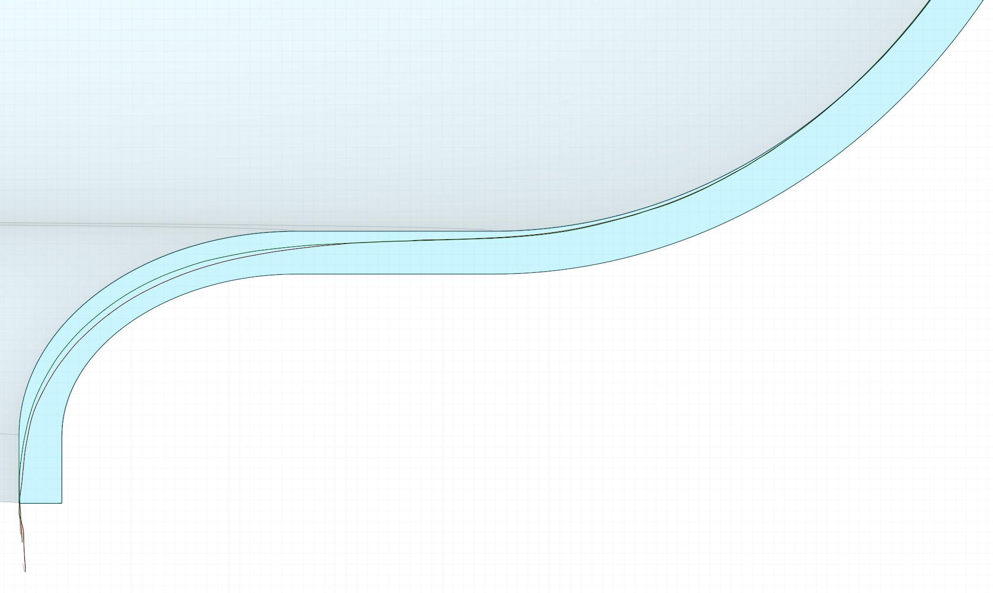
DVC Design/Engineering @ SRF Ops
Cavity Stress Simulation
  Pressure Stress
  Cooldown Stress
  Brazing
Spring Back/Thinning Simulation
  Half-cells shape optimization
  Small Beampipe FPC ports

Slide 10
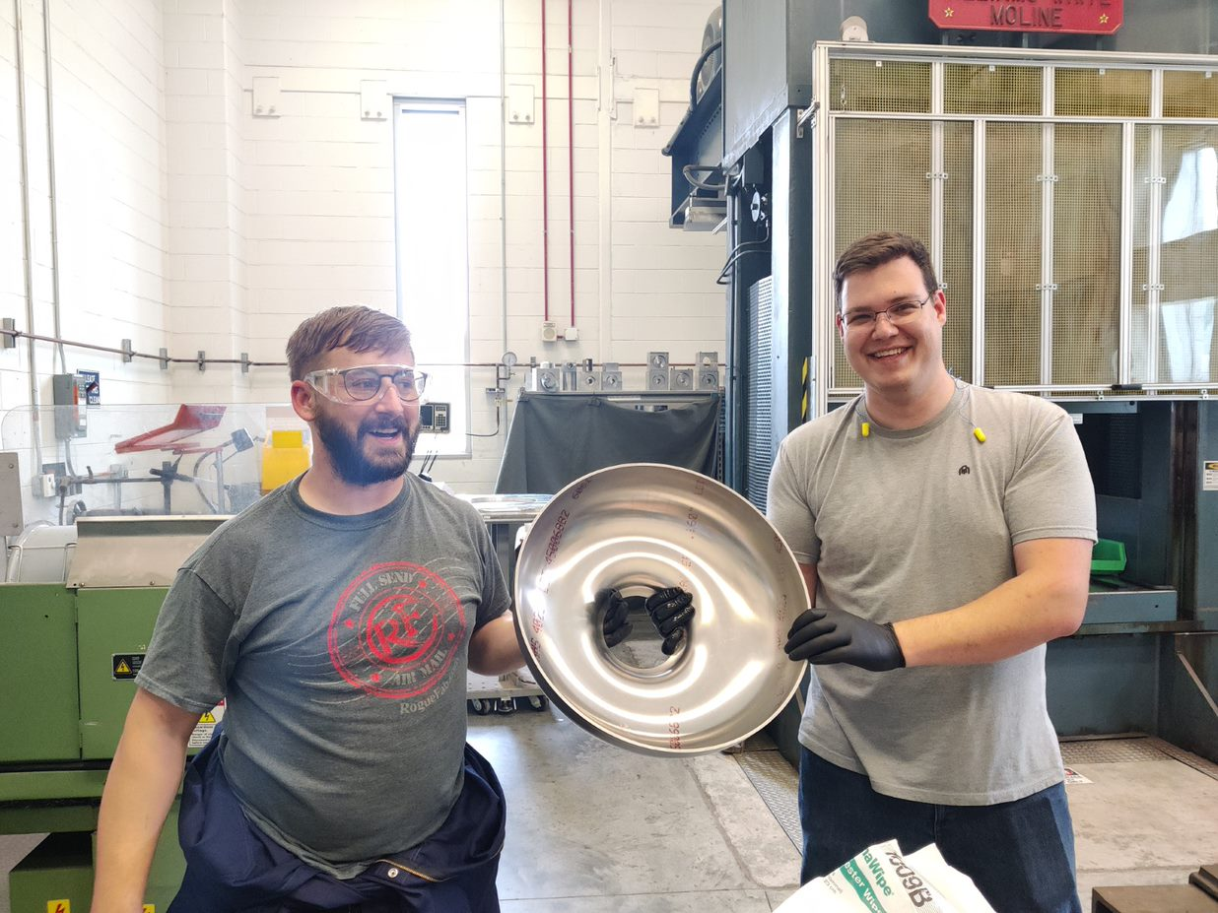
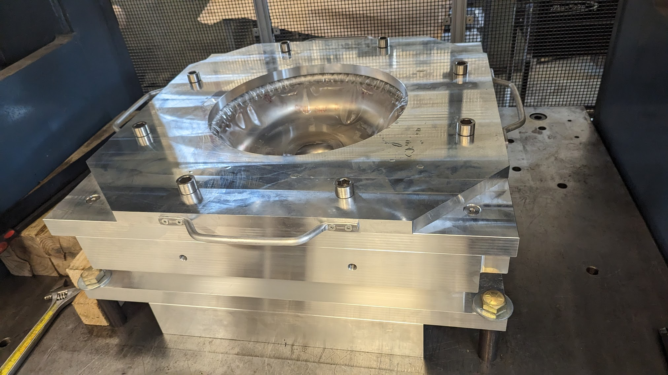
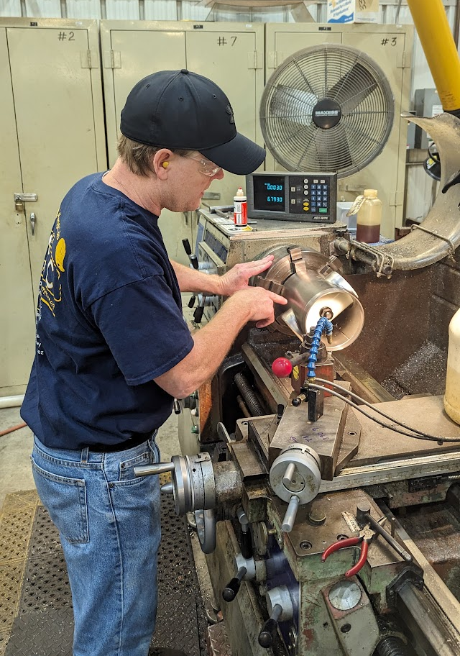
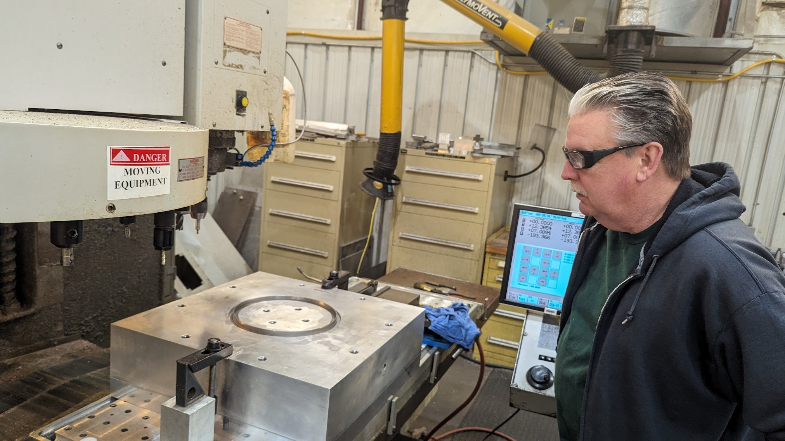
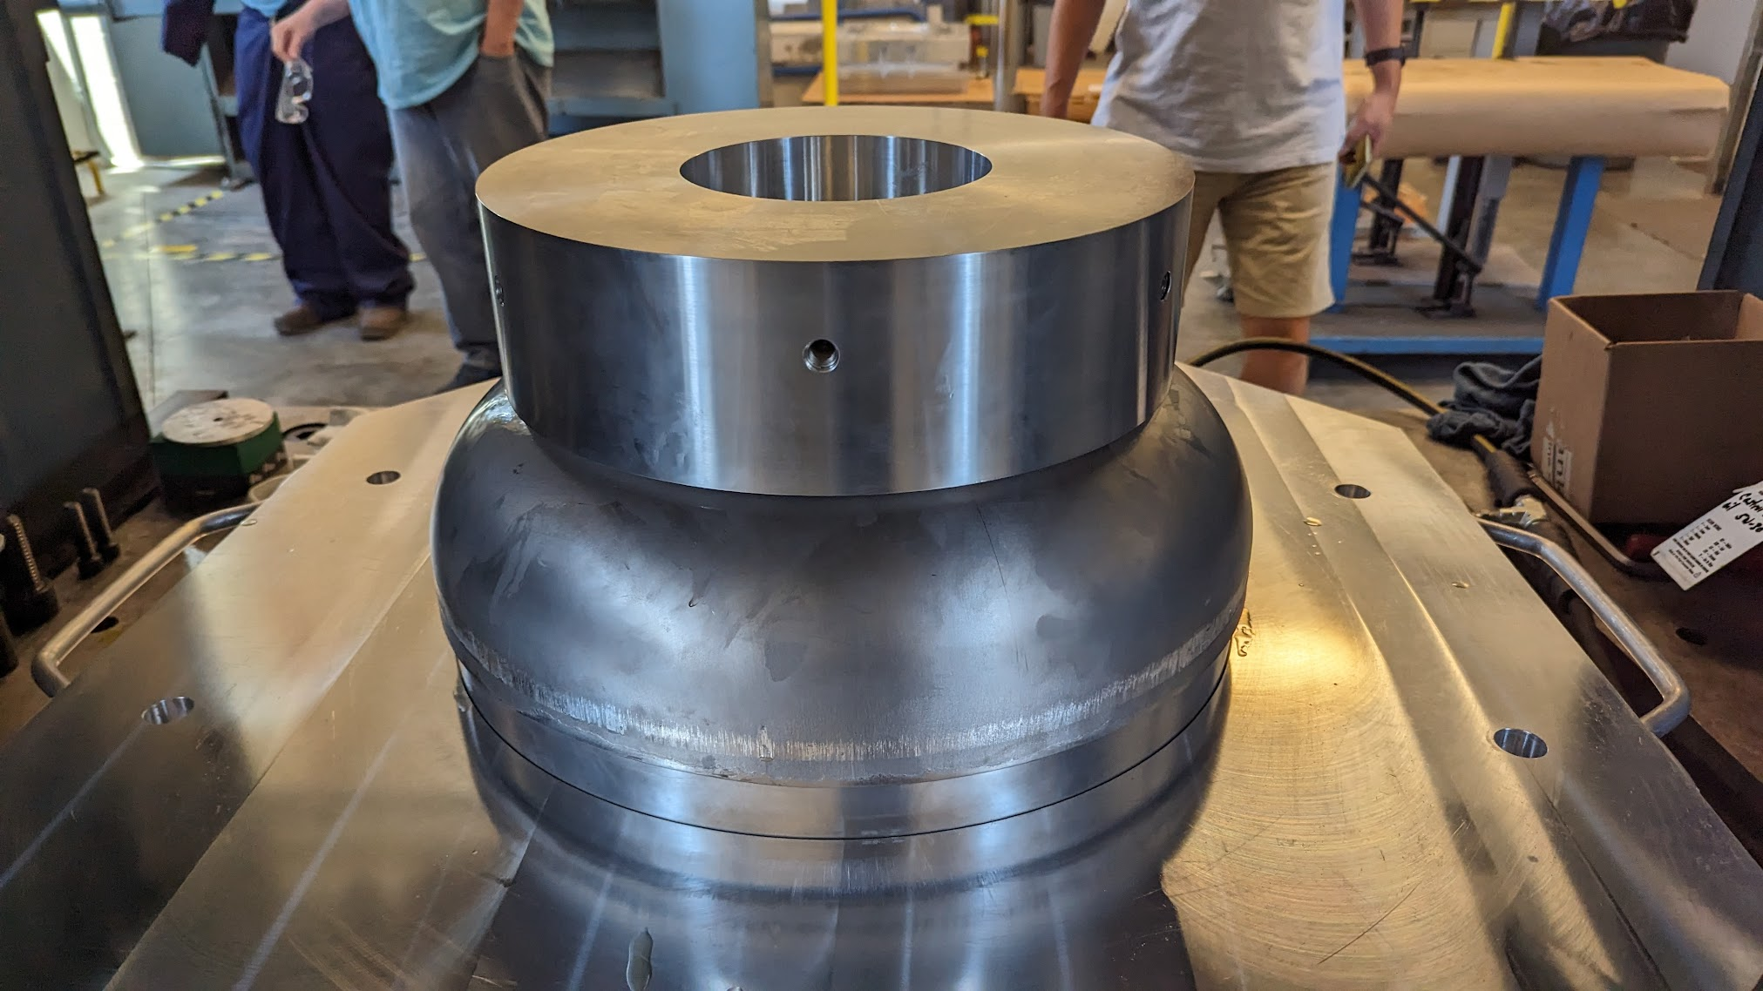
DVC Pressing, Rolling, and Machining @ SRF Ops
All pressing and machining work done @TJNAF SRF Ops and Machine Shop

Slide 11
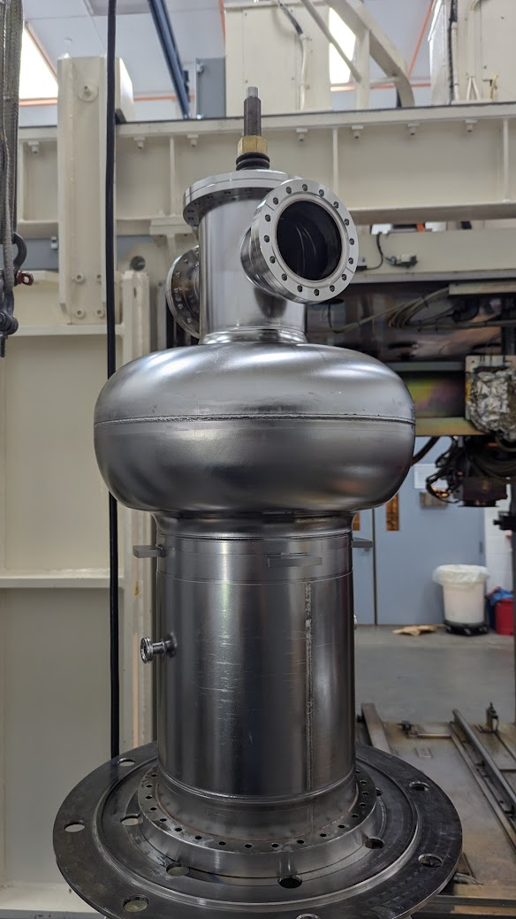
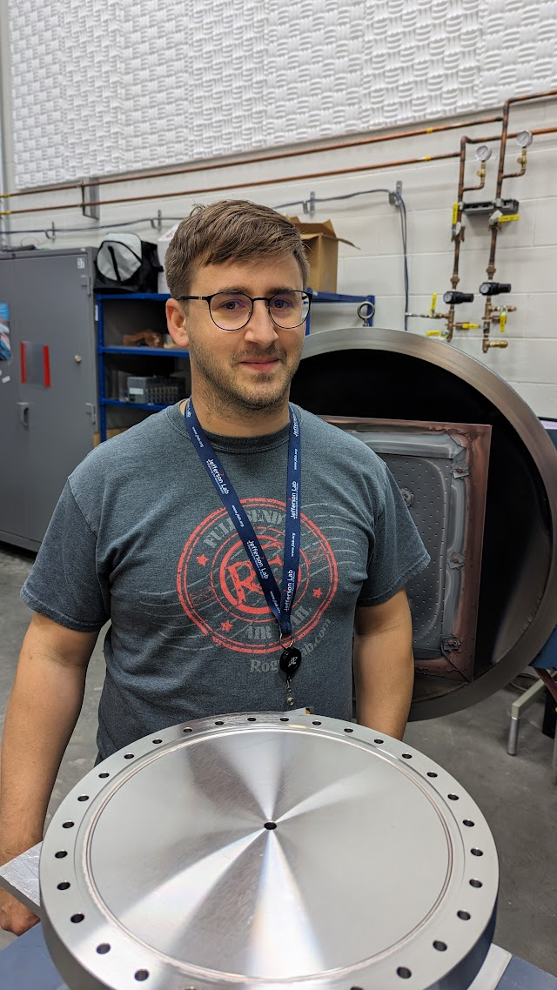
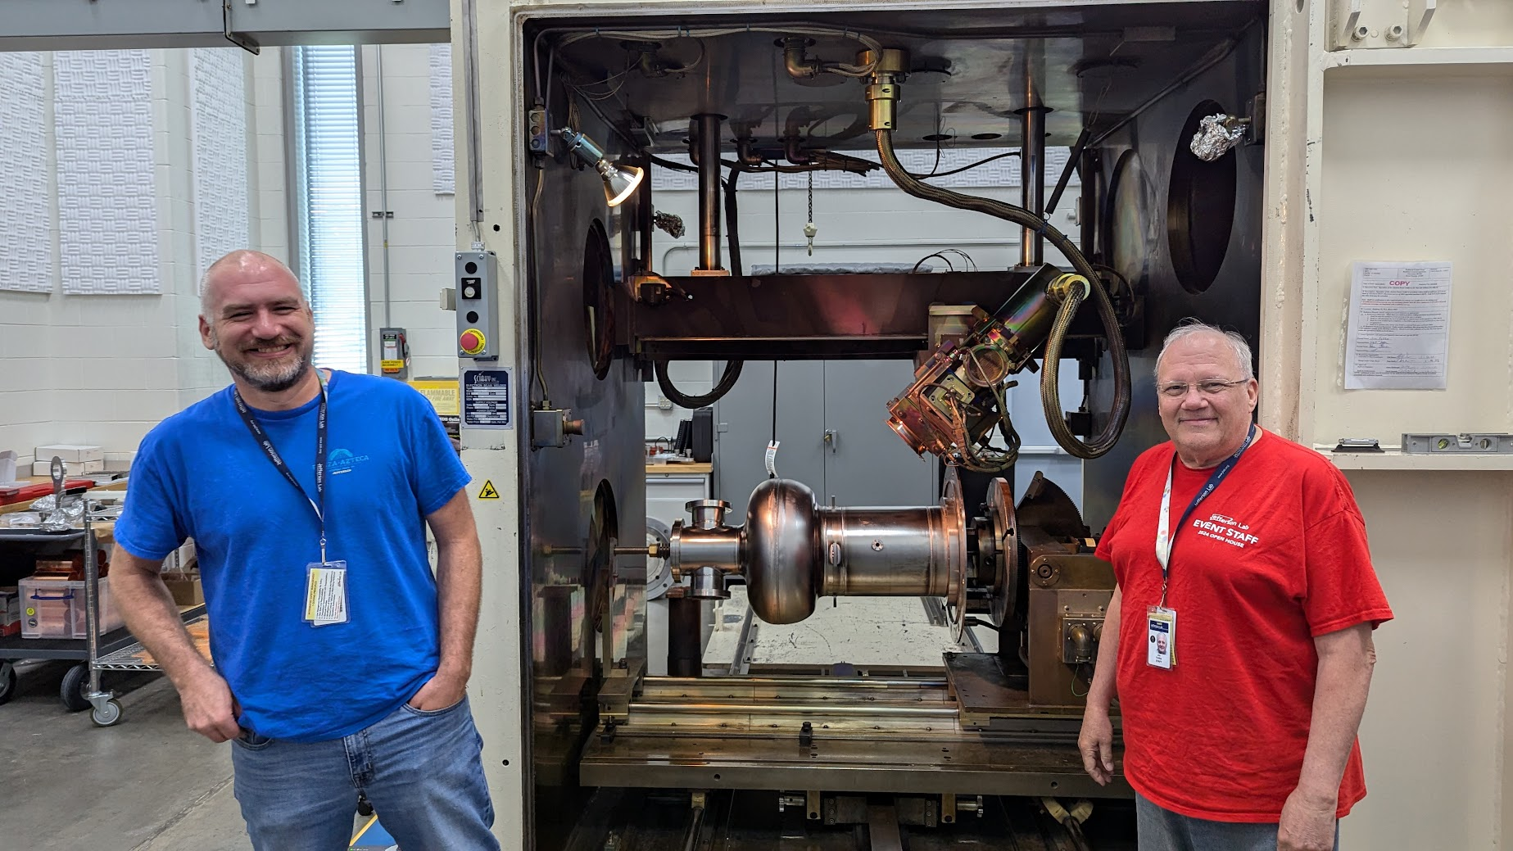
DVC EBW and Brazing @ SRF Ops
All brazes and welds were tested before being used on final components
Total:
  Brazes: ~14 (6 for cavity)
  Welds: >25 (15 for cavity)

Slide 12
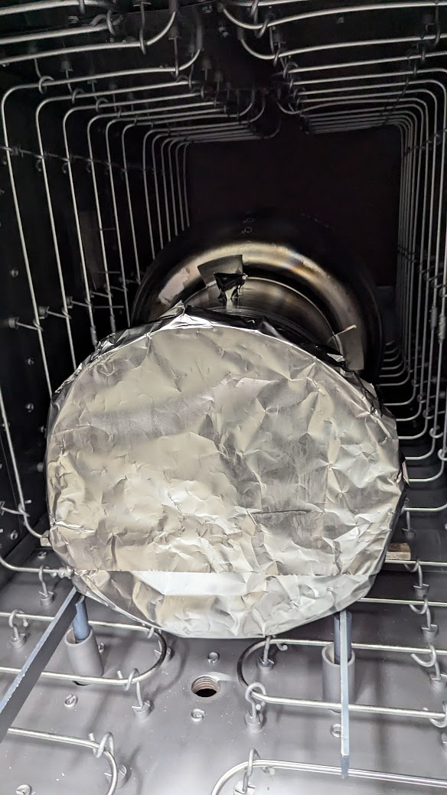
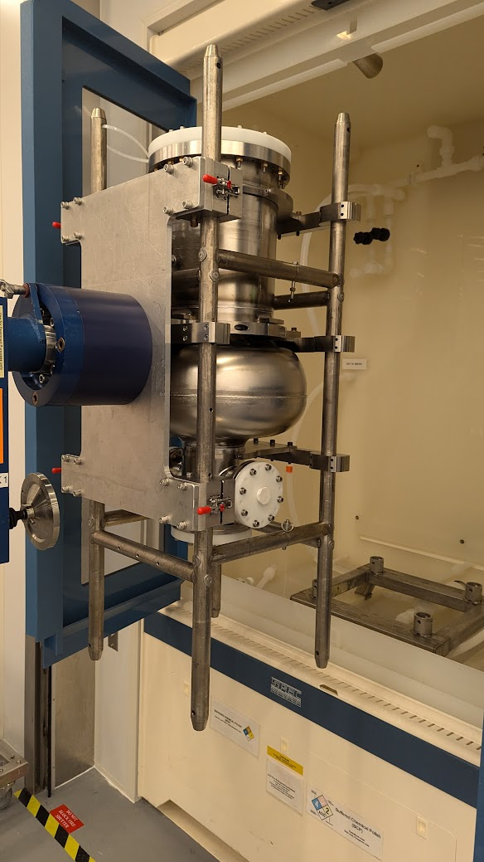
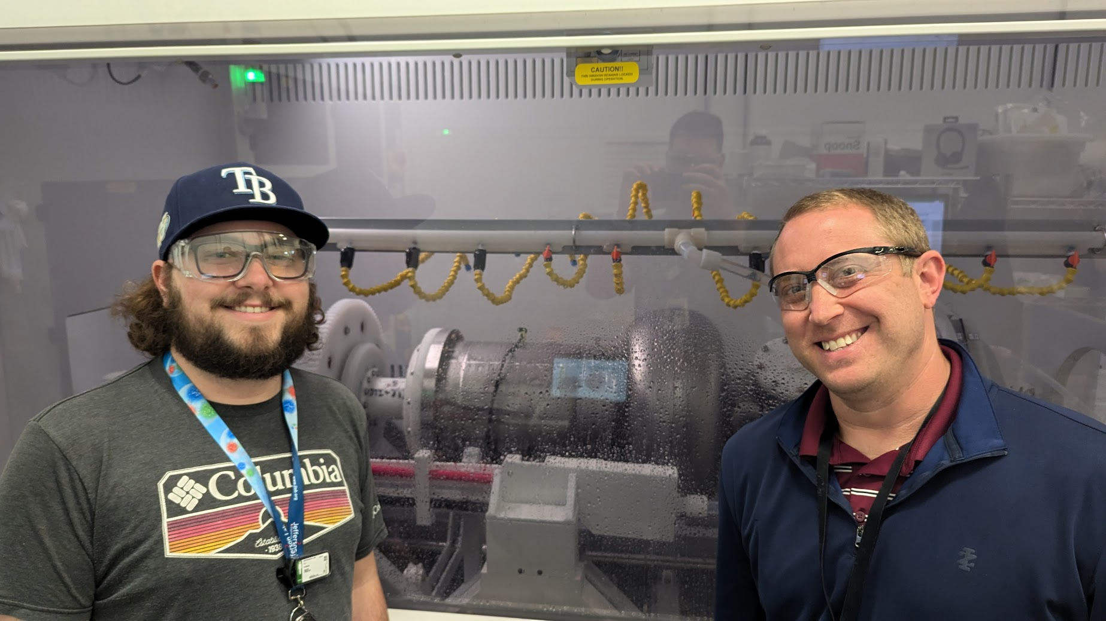
DVC Processing @ SRF Ops
All process steps were carried out at SRF Ops:
BCP
EP
600C Bake Degass
HPR and Cleanroom Assembly

Slide 13
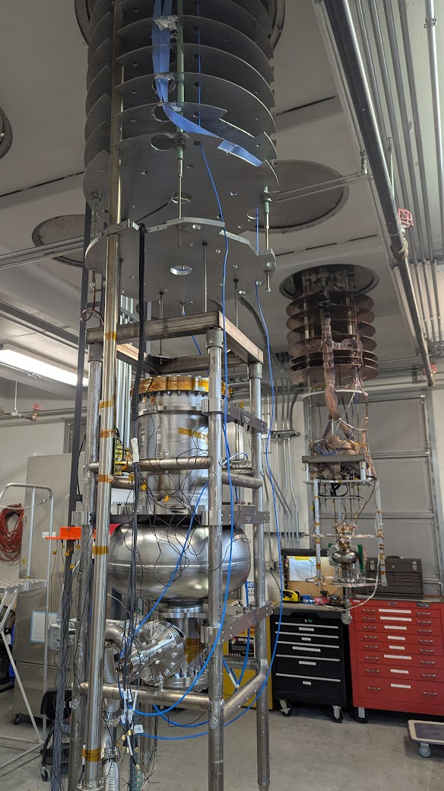
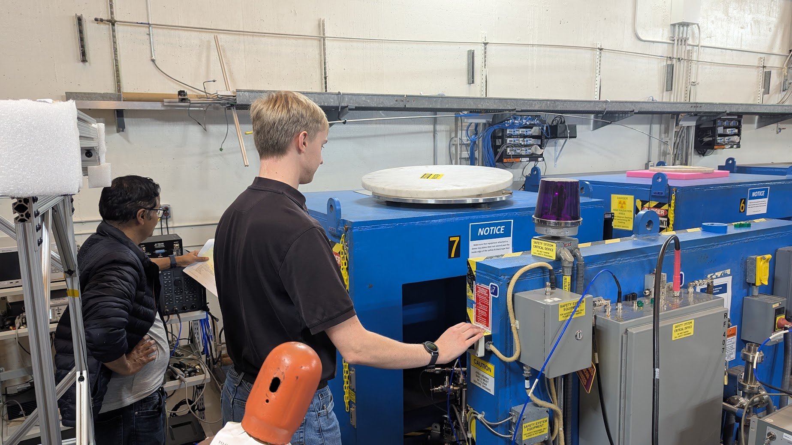
DVC VTRF Testing @ SRF Ops
Cavity has been prepped for 2K VTRF Test
Cold leaks have caused some testing delays

Slide 14
Summary
All fabrication, assembly, processing, and testing steps were successfully carried out at TJNAF.
Lessons learned from this DVC were baked into the production cavity

Slide 15
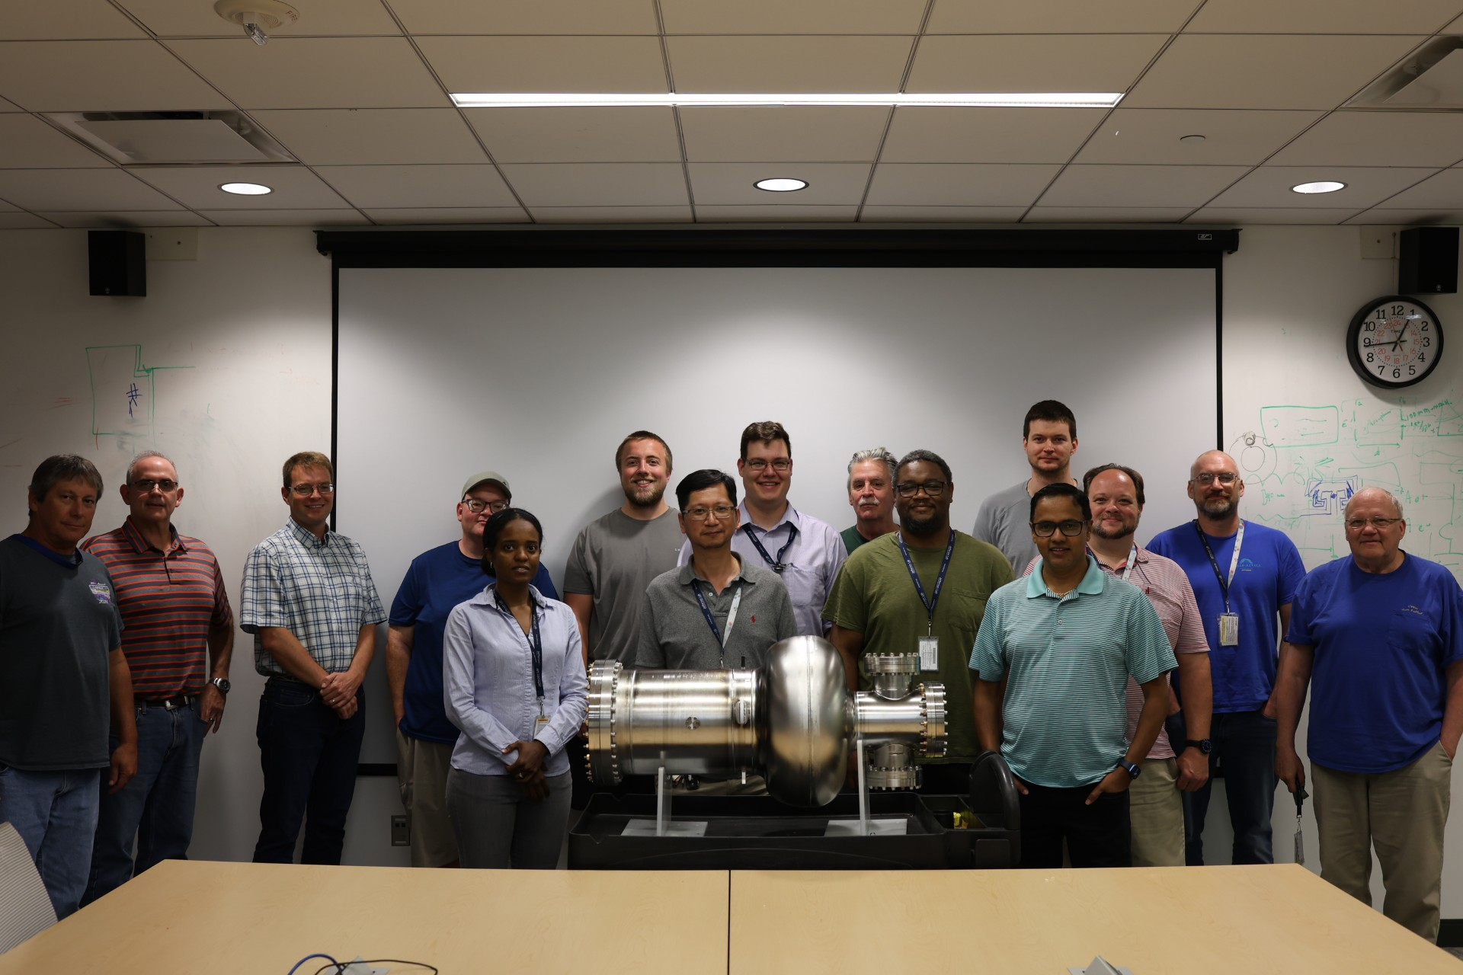
Thank you and Questions?

