Slide 1

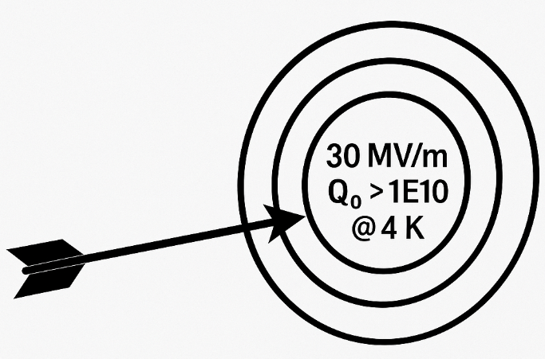
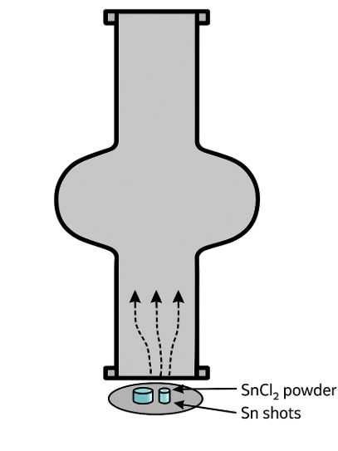
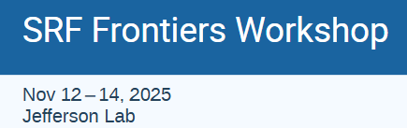
Pushing the Limits
of
Vapor-Diffused Nb₃Sn Cavities
Nb₃Sn
Uttar Pudasaini
Nov 12, 2025
Nb₃Sn
Sn Vapor
Nb Cavity

Slide 2
Outline
Vapor Diffusion Coating of Nb₃Sn
State-of-the-art Cavity Performance
Performance-limiting Factors and Mitigation
Pushing Further
Summary

Slide 3
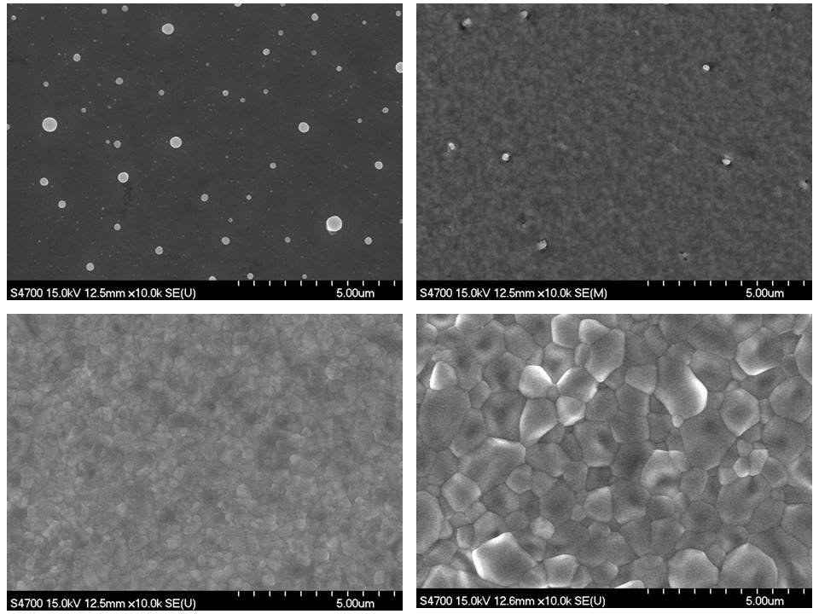
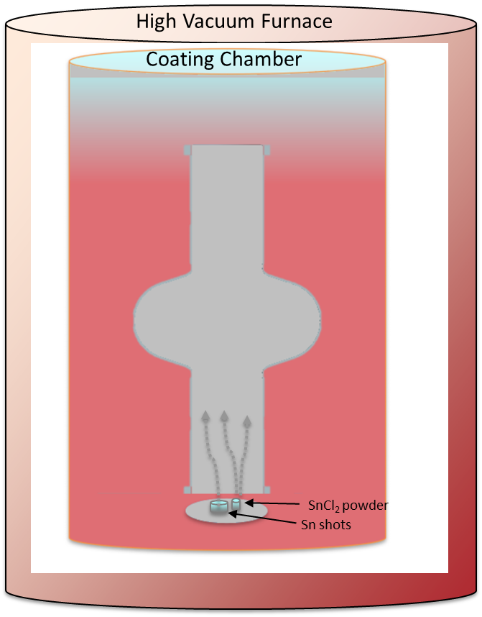
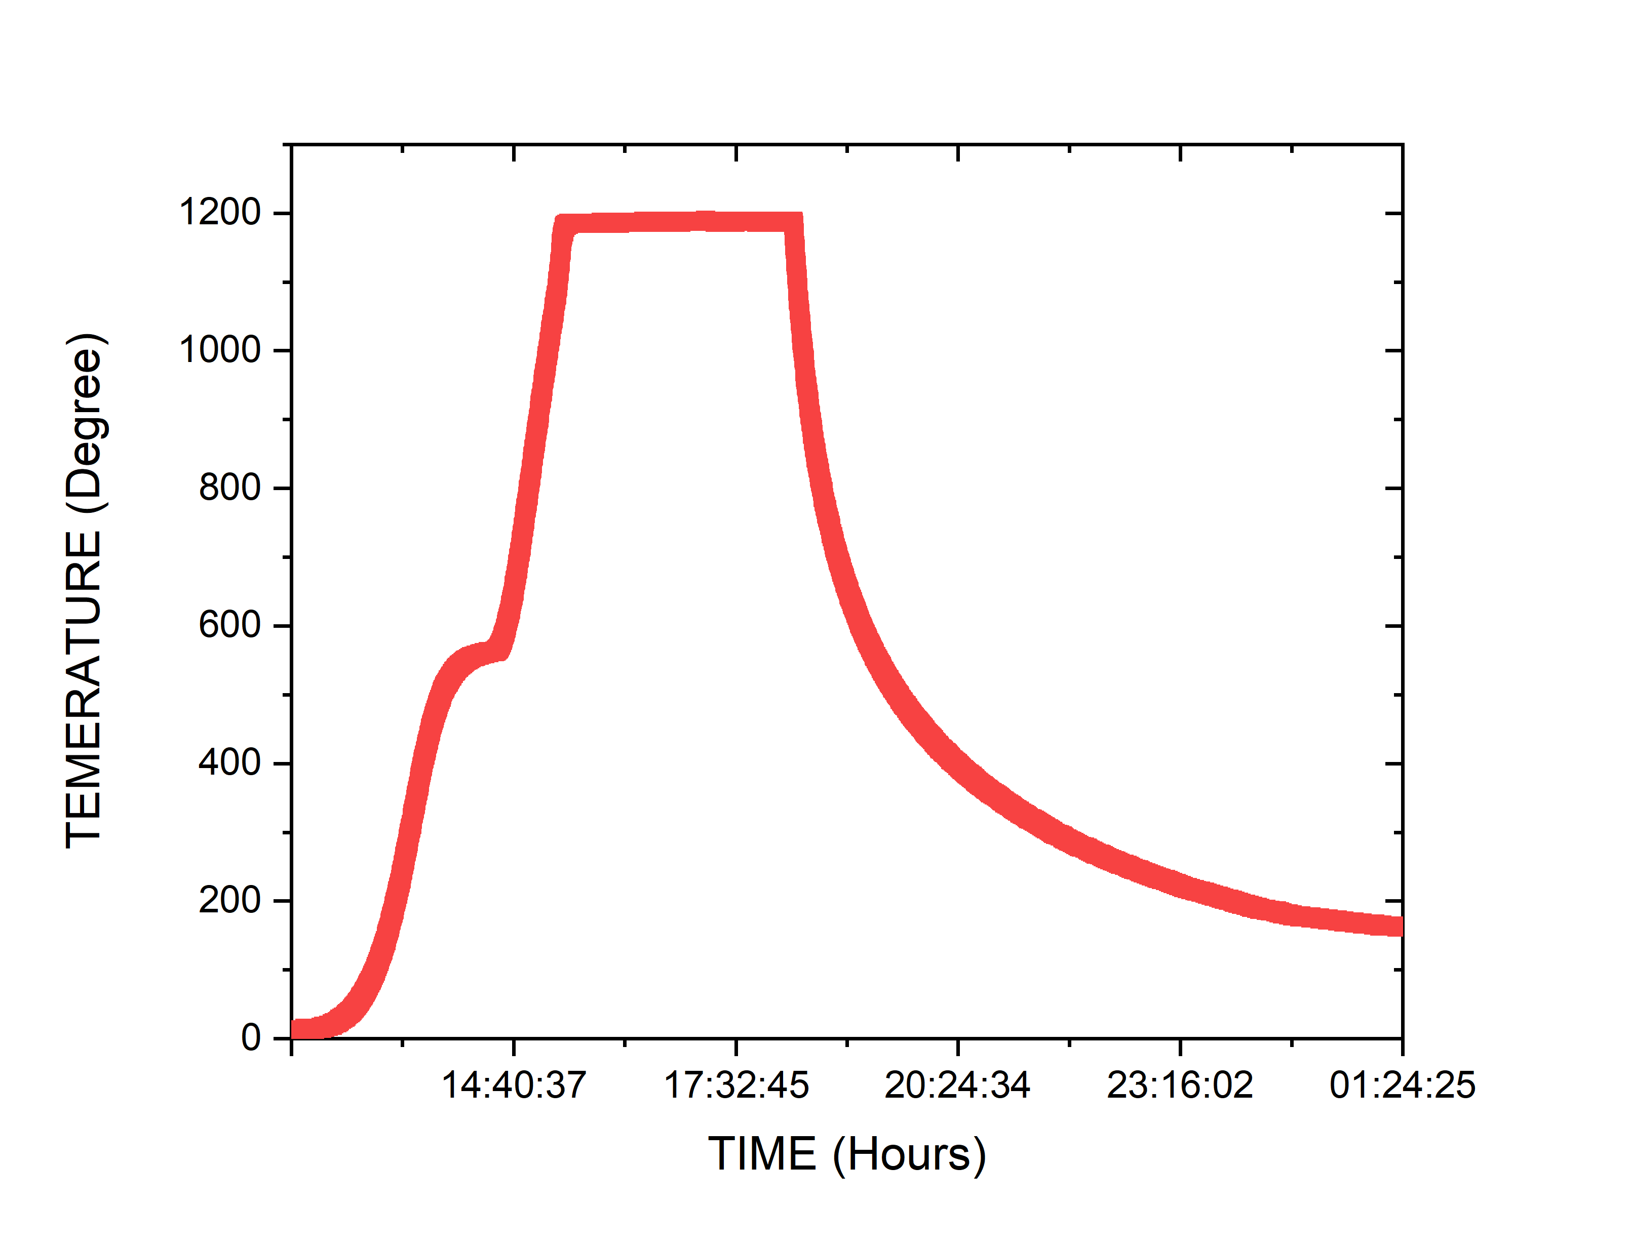
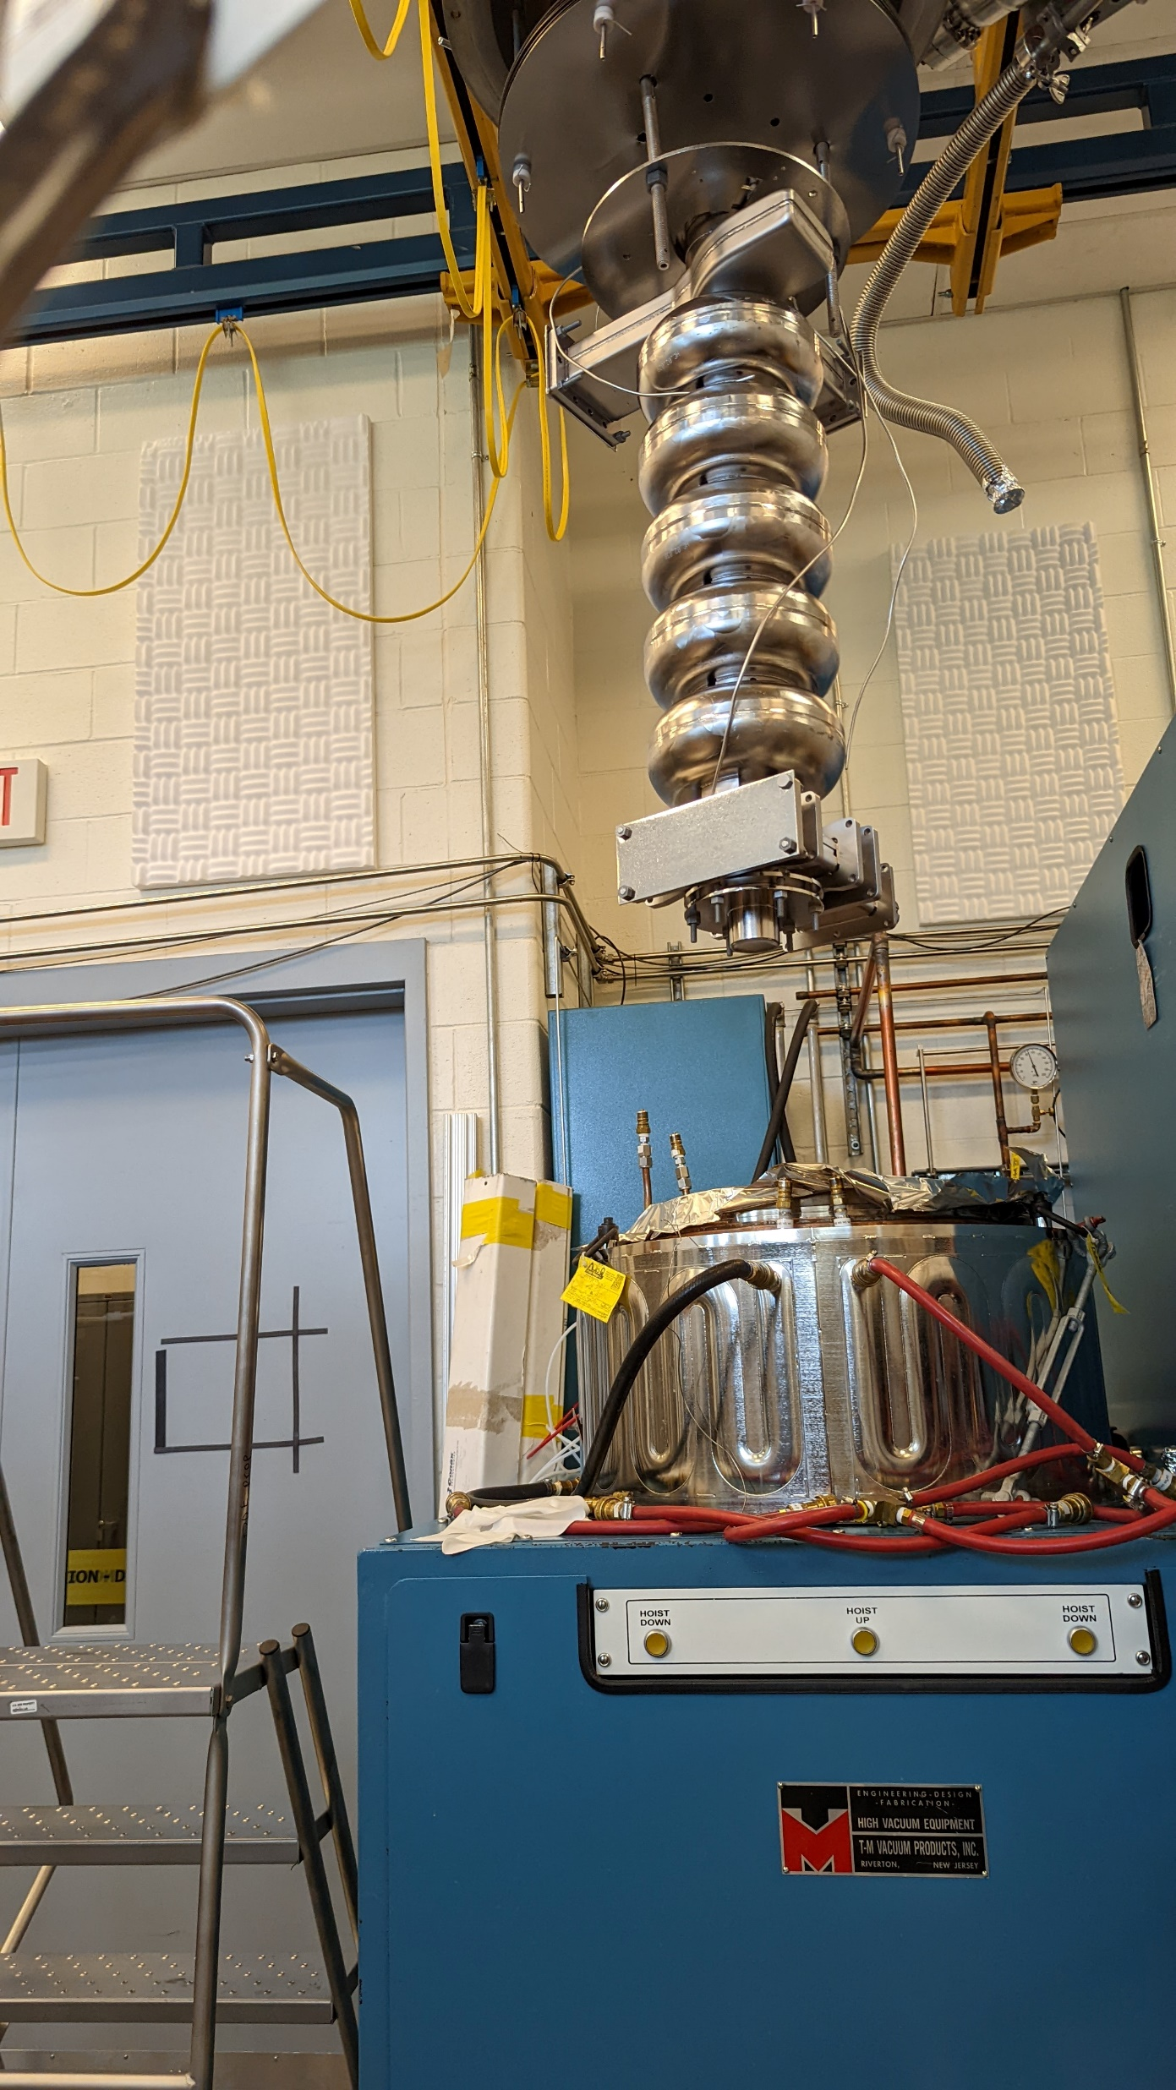
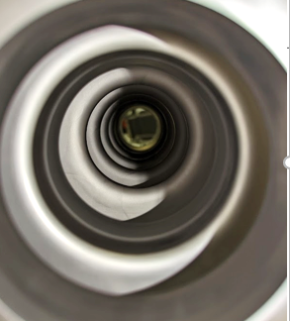

Sn Vapor Diffusion
Growth
Temperature ($° C)$
Nucleation
Sn
Since the 1970s: revived and refining
Create Sn-vapor and transfer to the interior surface of Nb cavity
So far ‘THE’ technique to produce practical Nb₃Sn cavities
“Wuppertal” or “Siemens” configuration
w/ Secondary heater for Sn source
SRF Frontiers Workshop Nov 12, 2025

Slide 4
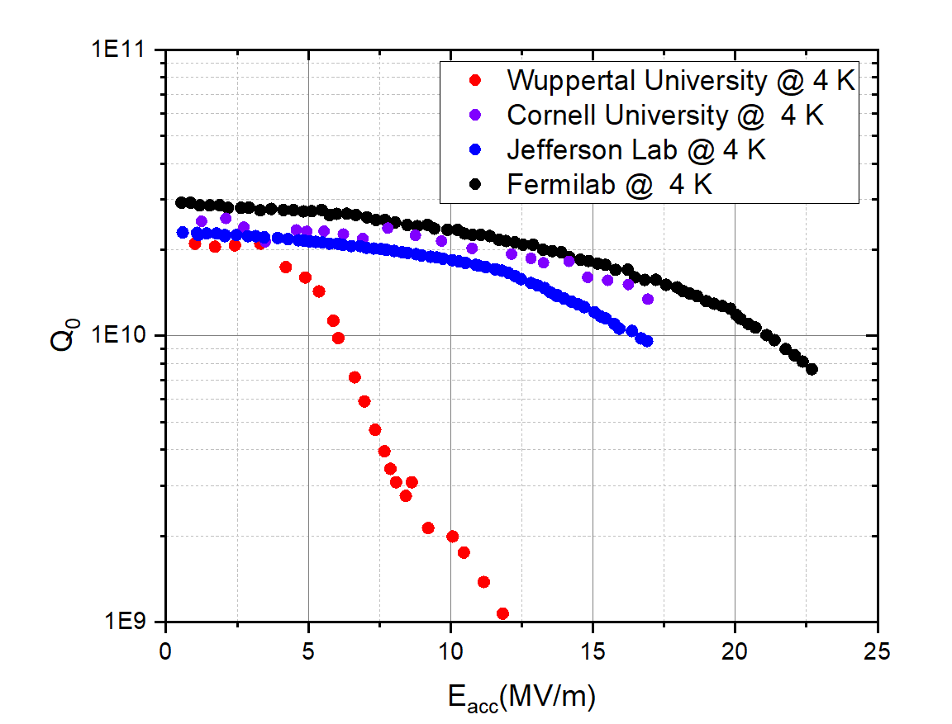
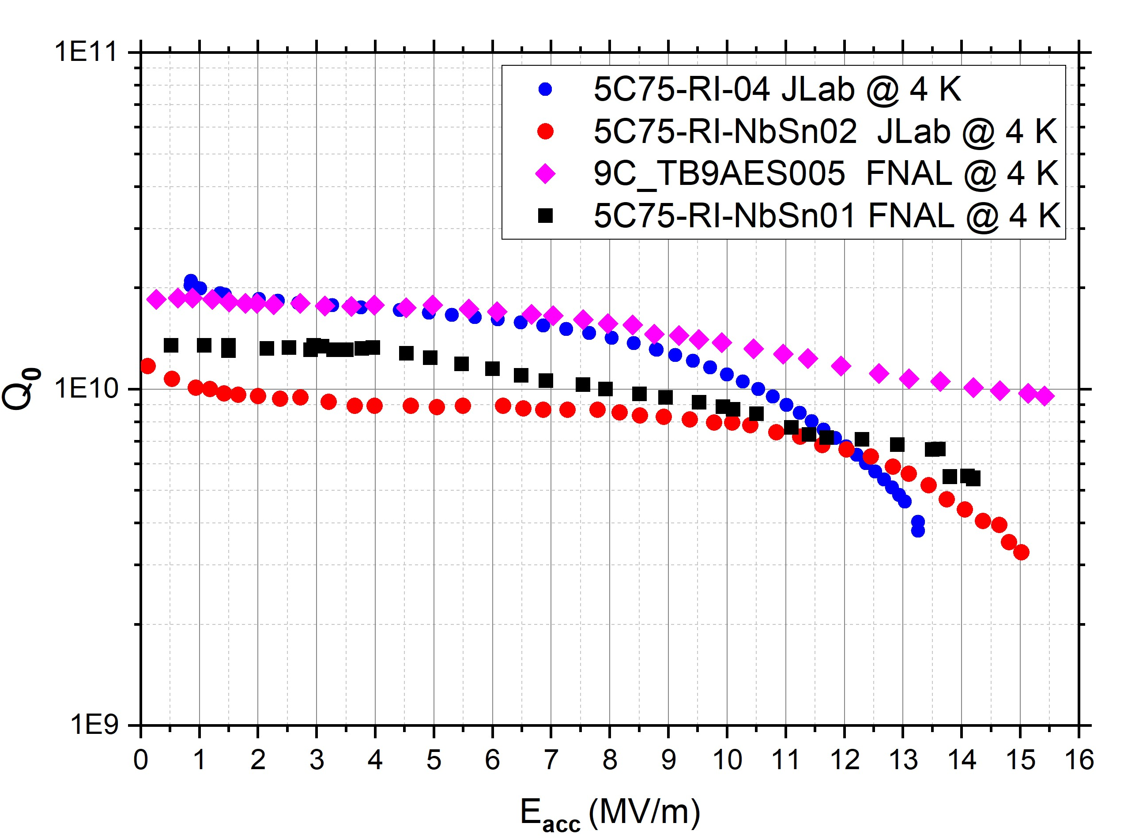
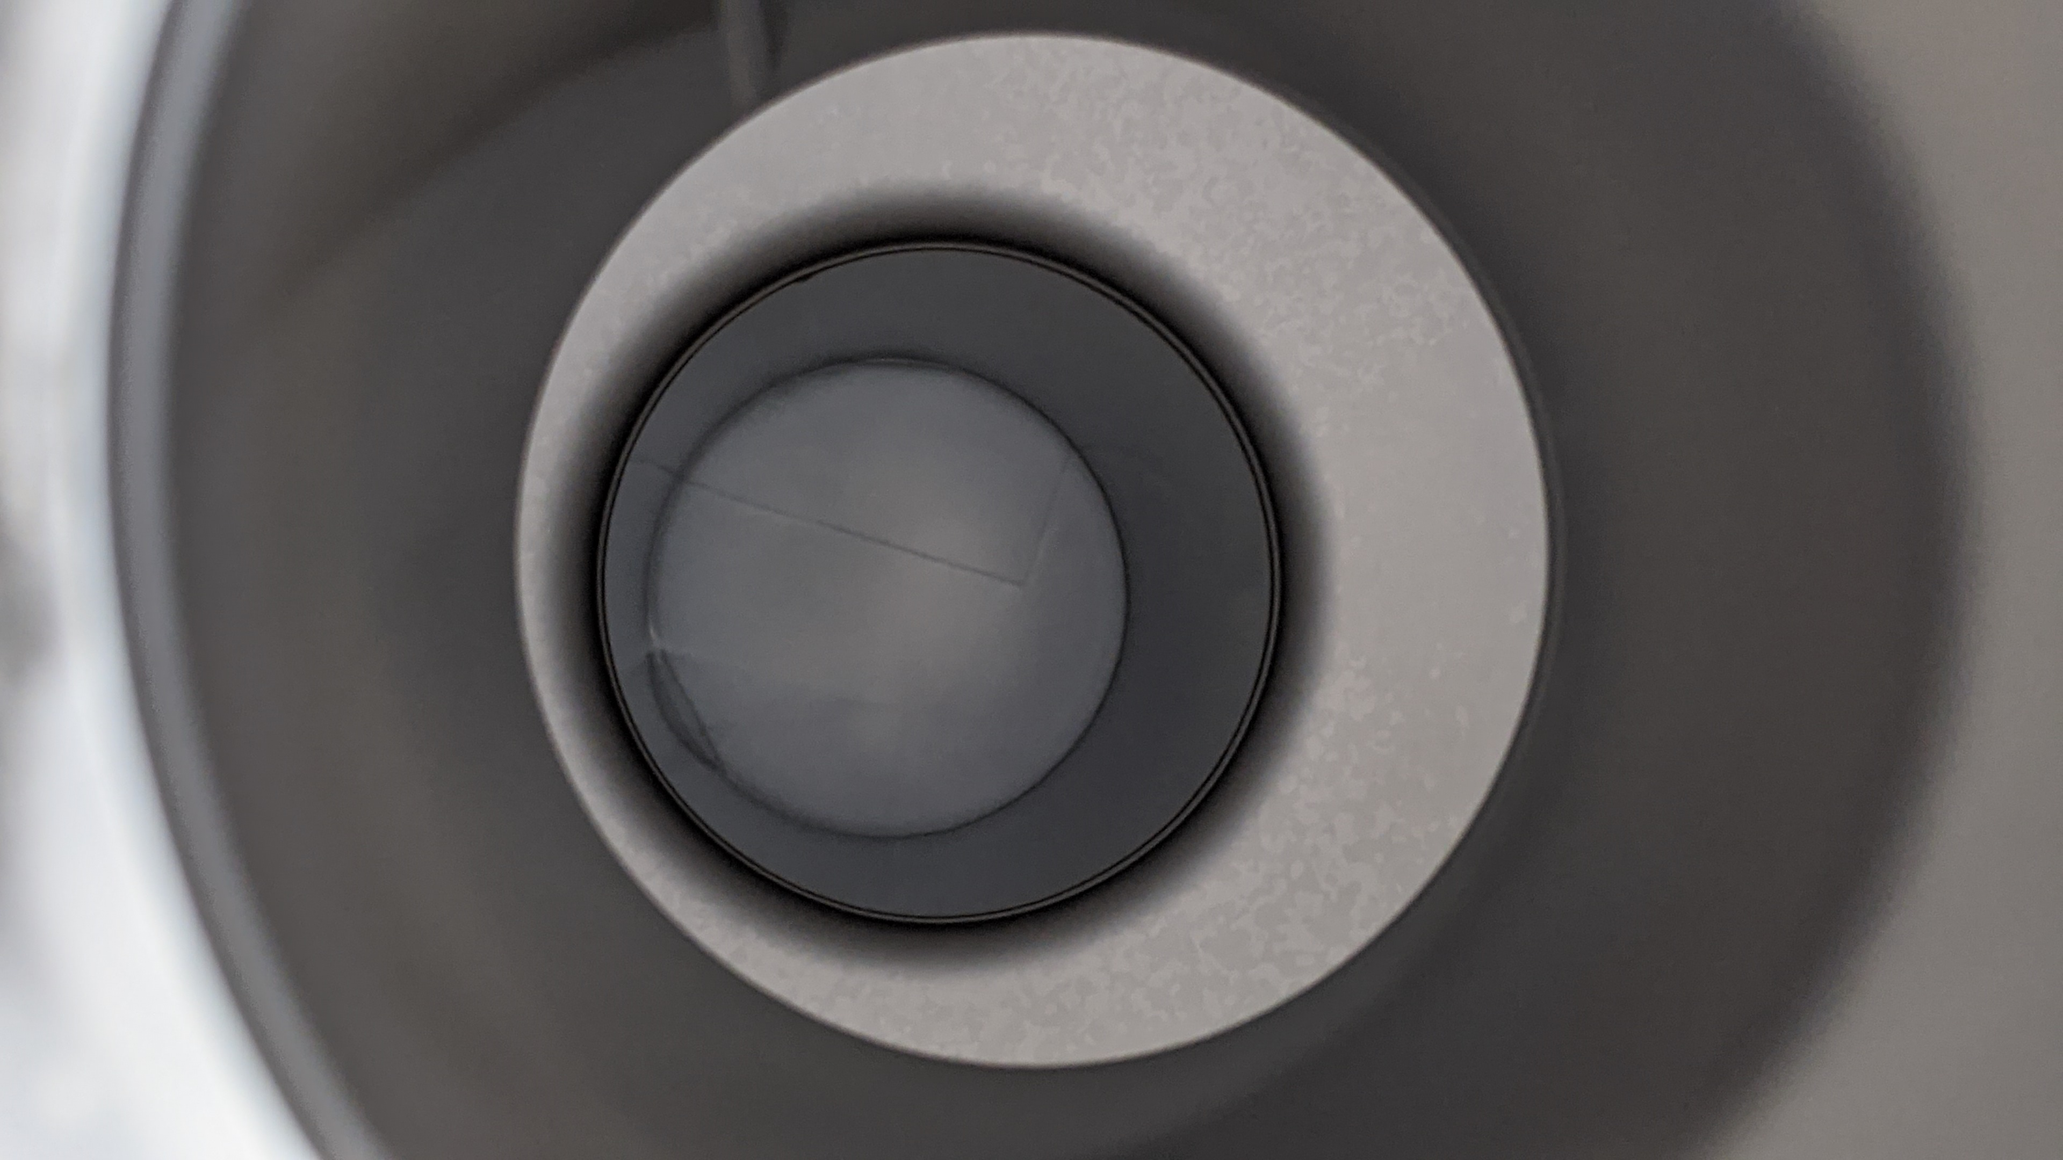
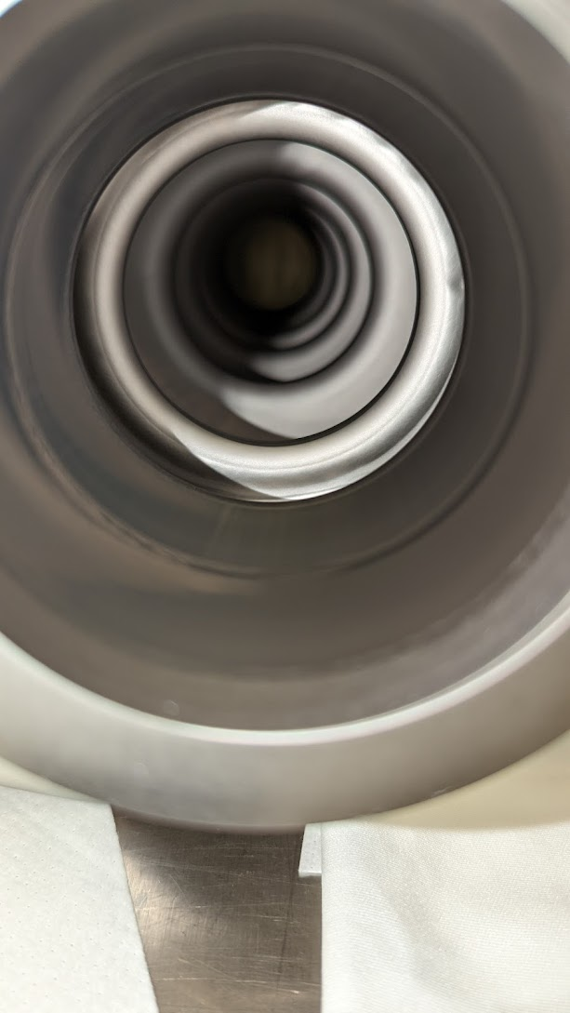
Cavity Performance of vapor-diffused Nb₃Sn
1.3/1.5 GHz R&D single-cell
1.3/1.5 Hz Multi-cell
1.3/1.5 GHz single-cell cavities attain an accelerating gradient over 20 MV/m with Q ~ 10¹⁰
Comparable performance for cavities of various frequencies (650 MHz, 952 MHz, 2.6 GHz, 3.6 GHz)
1.5 GHz five-cell and 1.3 GHz 9-cell cavities demonstrated Q ~ 10¹⁰ above 10 MV/m at 4.4 K
Maximum gradients achieved up to ~ 20 MV/m
Notable progress towards use in practical accelerators
U.Pudasaini et al. “Managing Sn-Supply to Tune Surface Characteristics of Vapor-Diffusion Coating of Nb₃Sn”, presented at the SRF'21, East Lansing, MI, USA, Jun.-Jul. 2021, doi:10.18429/JACoW-SRF2021-TUPTEV013.
S. Posen et al. “Advances in Nb₃Sn superconducting radiofrequency cavities towards first practical accelerator applications” Superconductor Science and Technology. 2021 Jan 11;34(2):025007.
D. Hall, “New Insights into the Limitations on the Efficiency and Achievable Gradients in Nb₃Sn SRF Cavities”, PhD thesis, Cornell University (2017).
G. Müller et al, "Status and prospects of Nb3Sn cavities for superconducting linacs," in Proceedings of the Workshop on Thin Film Coating Methods for Superconducting Accelerating Cavities, 2000
G. Eremeev “Progress in Nb3Sn developments for CEBAF-style quarter cryomodule” TTC-2022,
SRF Frontiers Workshop Nov 12, 2025

Slide 5
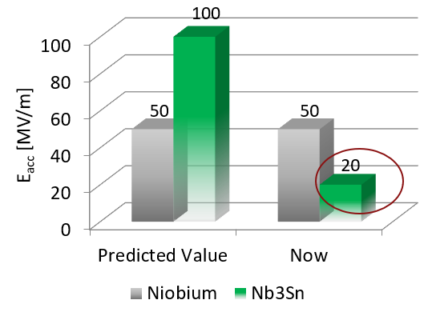

Current Performance Limitations
1.3/1.5 GHz R&D single-cell cavity performance
Q-slope and quench due to material imperfections or surface defects
Pushing limits $→$ defect Identification and elimination/mitigation
SRF Frontiers Workshop Nov 12, 2025

Slide 6
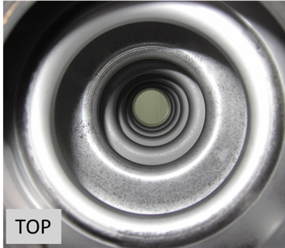
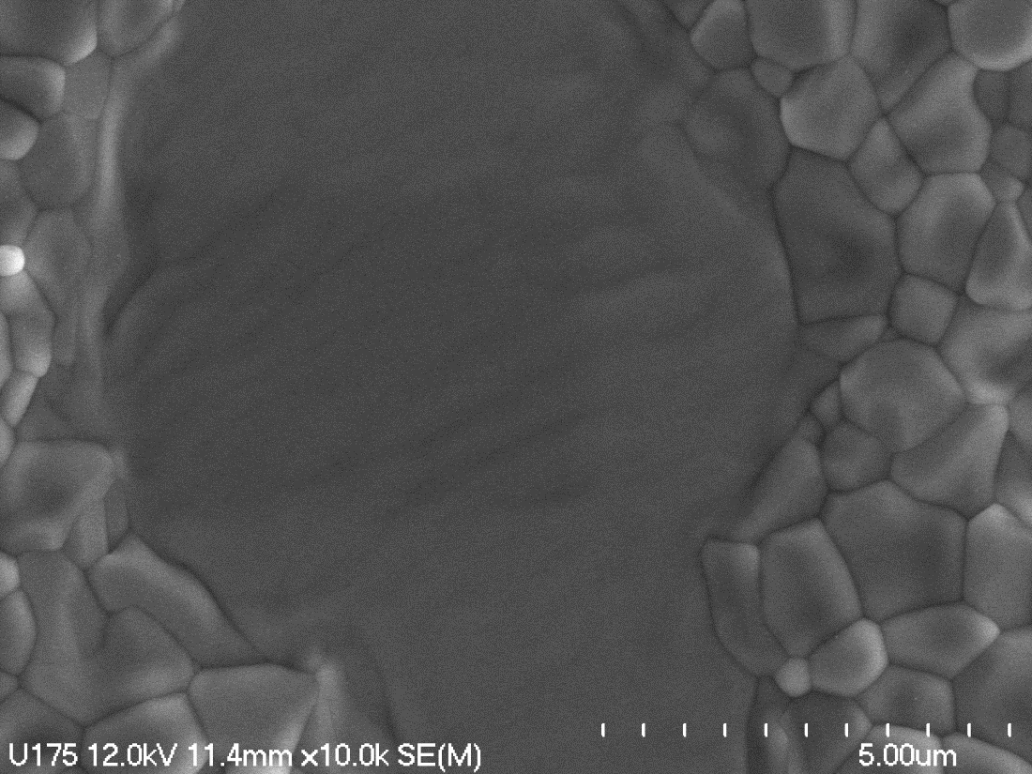
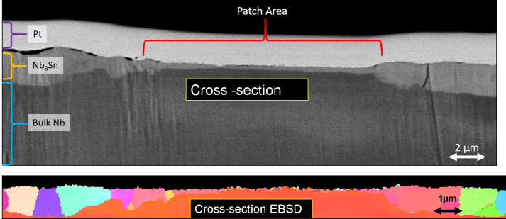
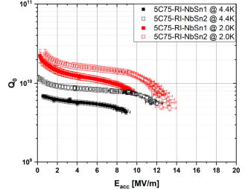
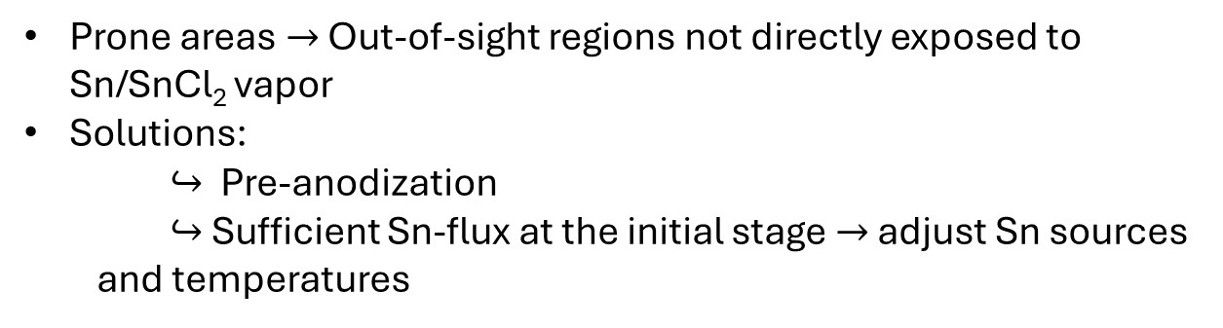
Non-uniformity - “Patchy” Region
~ 1.75 µm
~ 250 nm
U. Pudasaini, G.V. Eremeev, M.J. Kelley, C.E. Reece, and J. Tuggle, “Surface Studies of Nb₃Sn Coated Samples Prepared under Different Coating Conditions”, in Proc. 18th International Conference on RF Superconductivity, Lanzhau, China, July 2017, paper TUPB069.
Prone areas $→$ Out-of-sight regions not directly exposed to Sn/SnCl₂ vapor
Solutions:
$↪$ Pre-anodization
$↪$Sufficient Sn-flux at the initial stage $→$ adjust Sn sources and temperatures
Uniform
Non-uniform

Slide 7
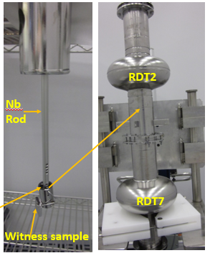
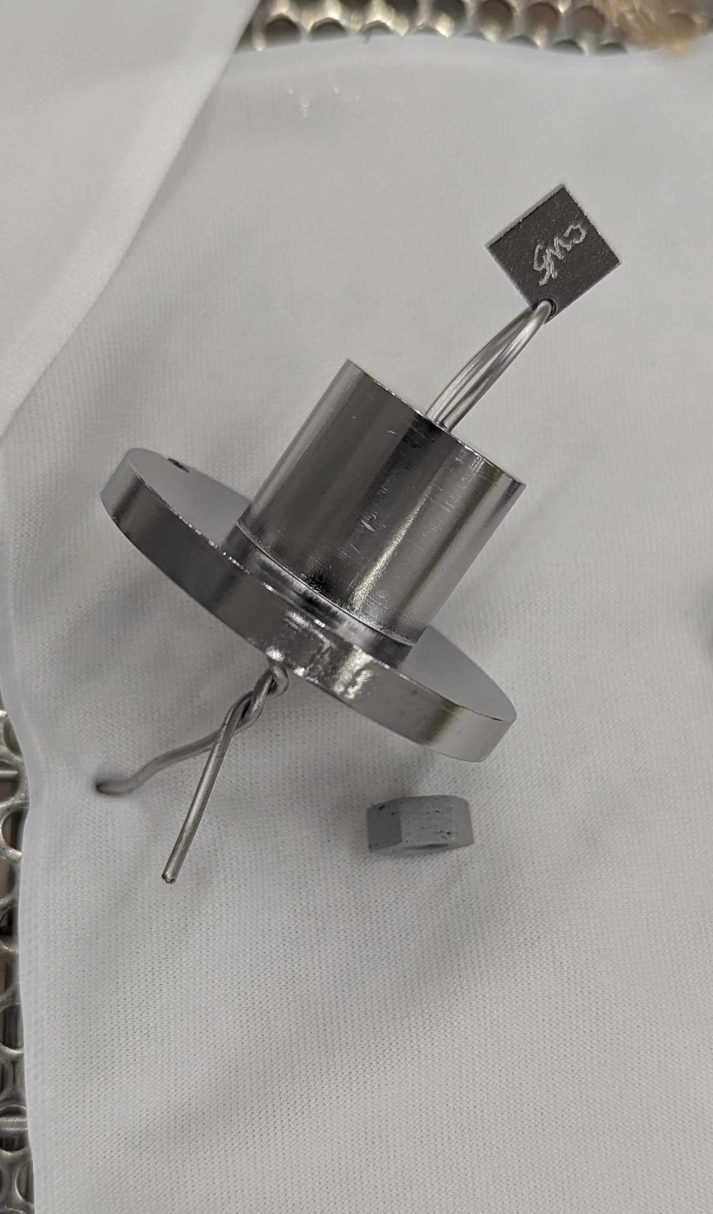
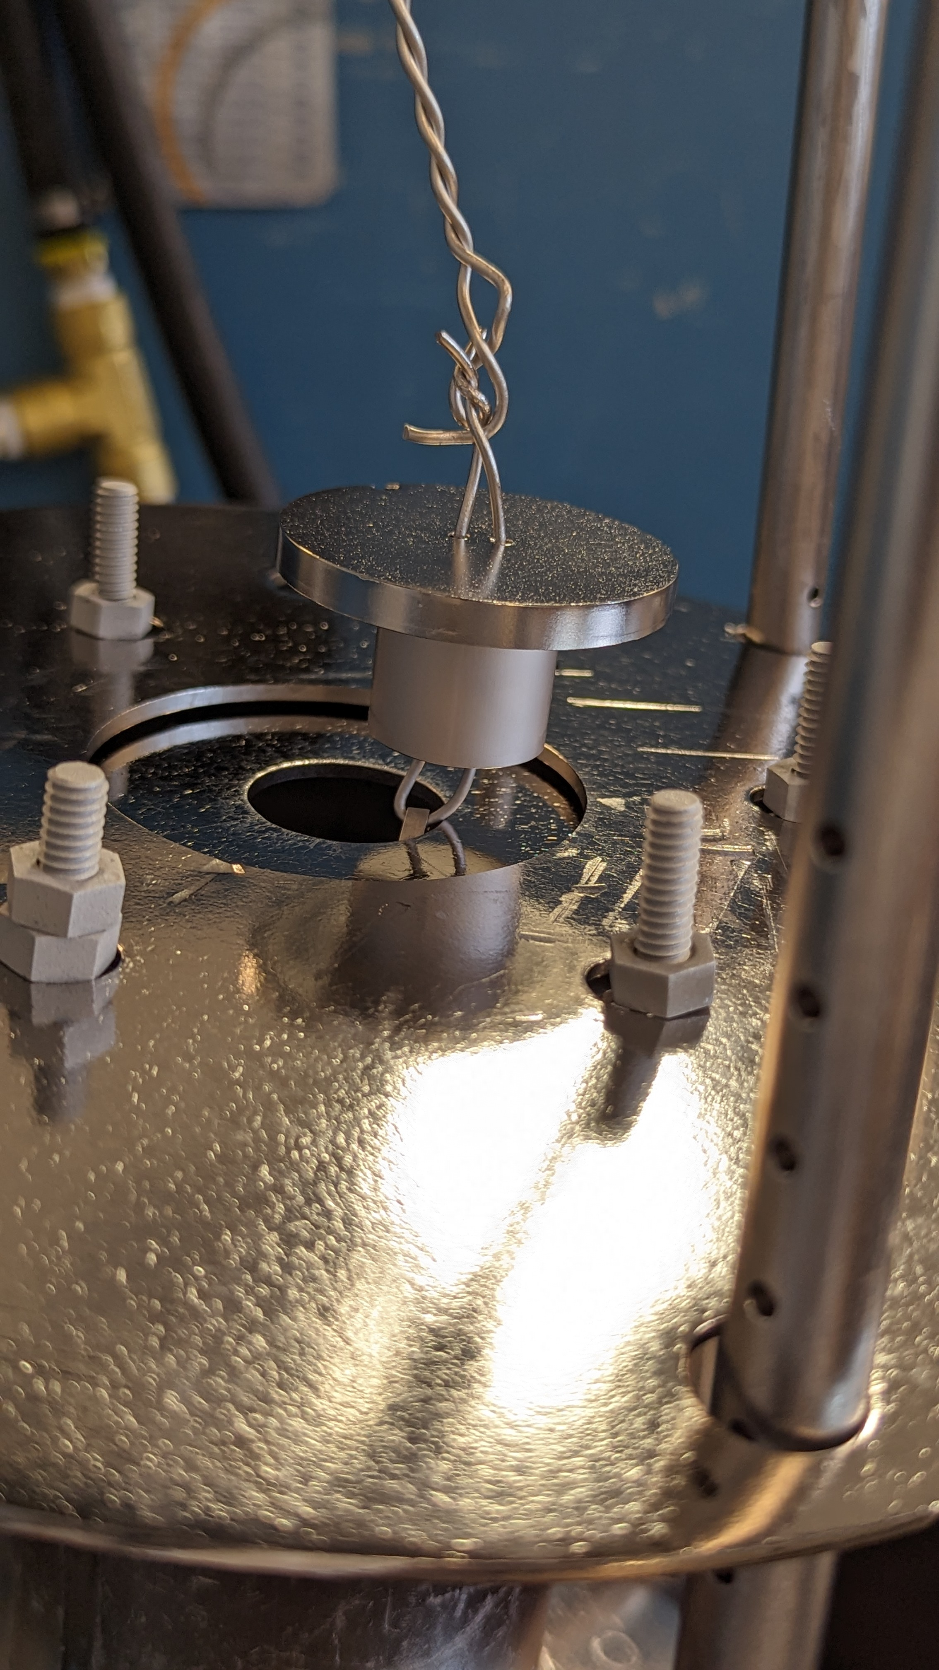
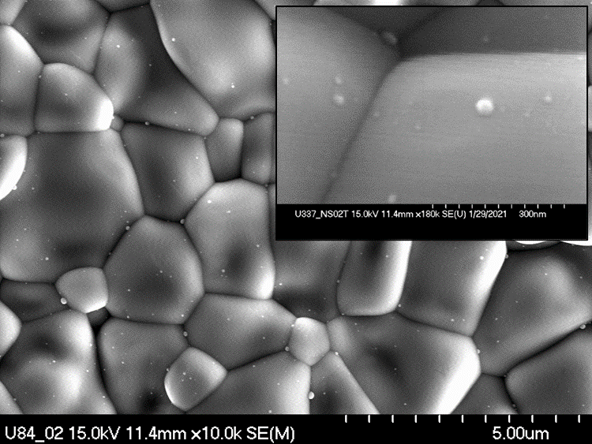
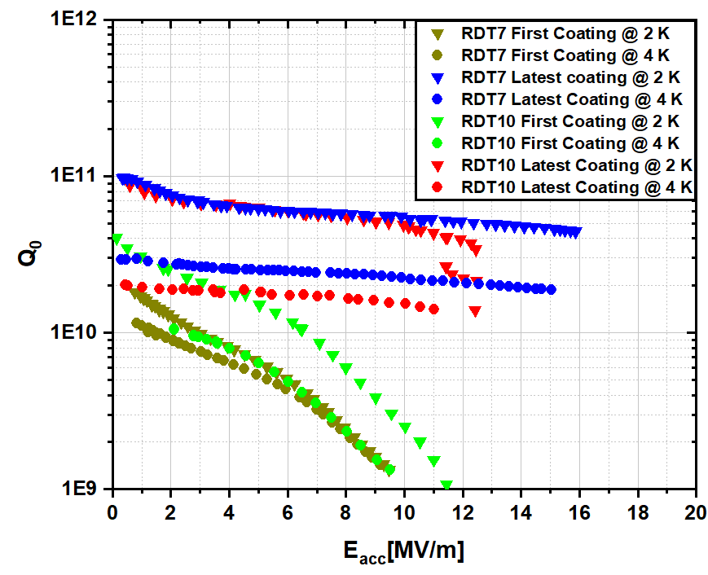
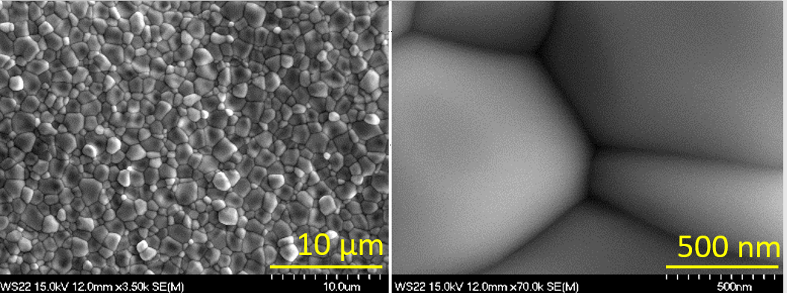
Sn Residues
Sn-vapor condensation at the end of the process
Specific challenge for us
Mitigation approaches
Sn

Slide 8
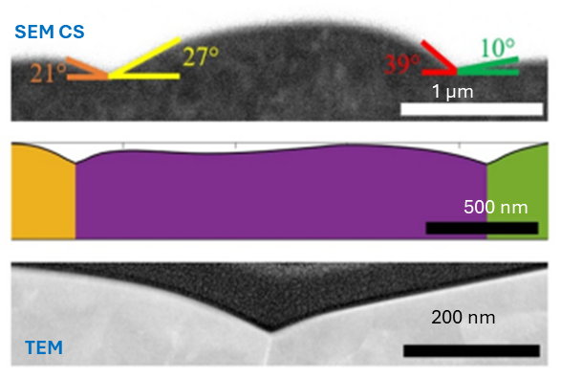
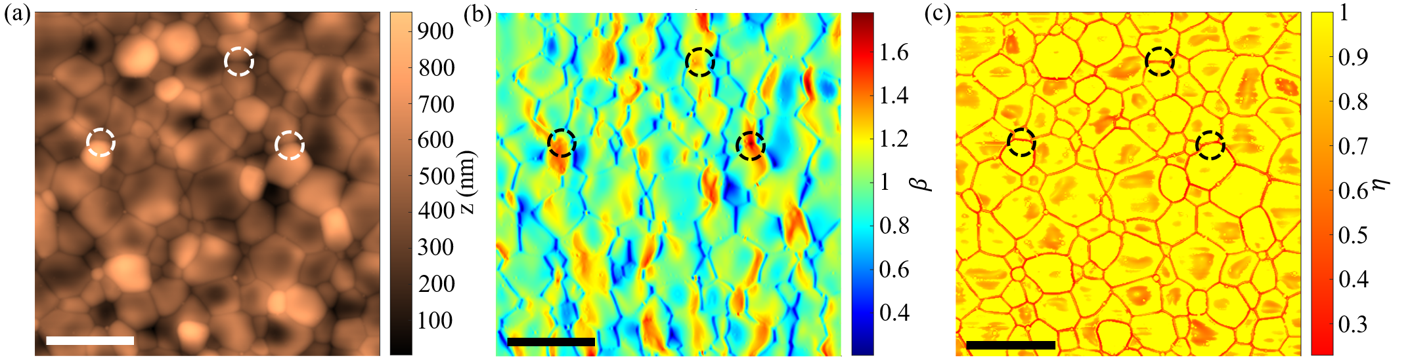
Surface Topography and Grain Boundary Structure
Grooved grain boundaries and substantial surface roughness
Surface roughness poses threats to the stability of the Meissner state
Magnetic field enhancement and superheating field suppression
AFM
5 µm
5 μm
Eric Lechner et al. , 2025 , Supercond. Sci. Technol. 38 01LT01

Slide 9
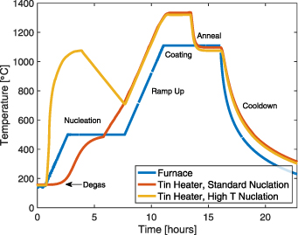
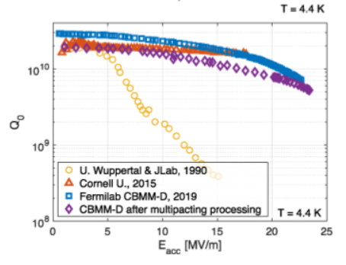
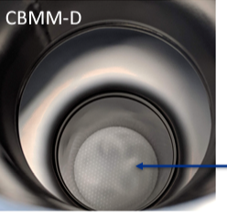
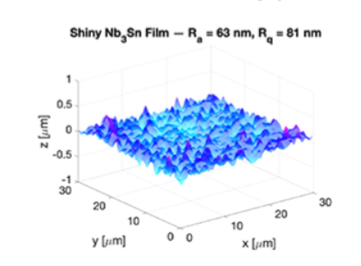
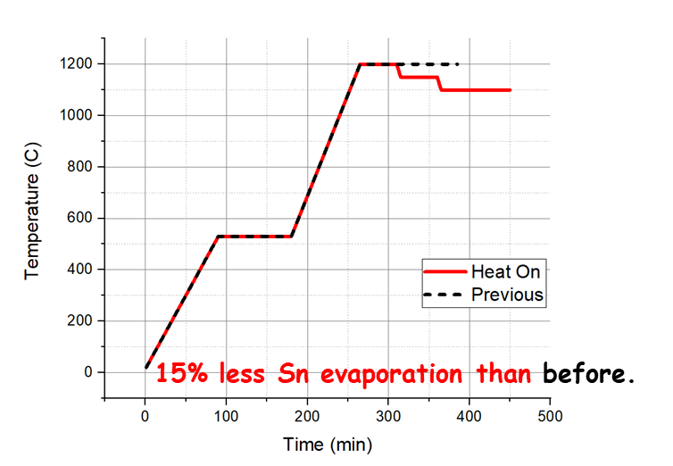
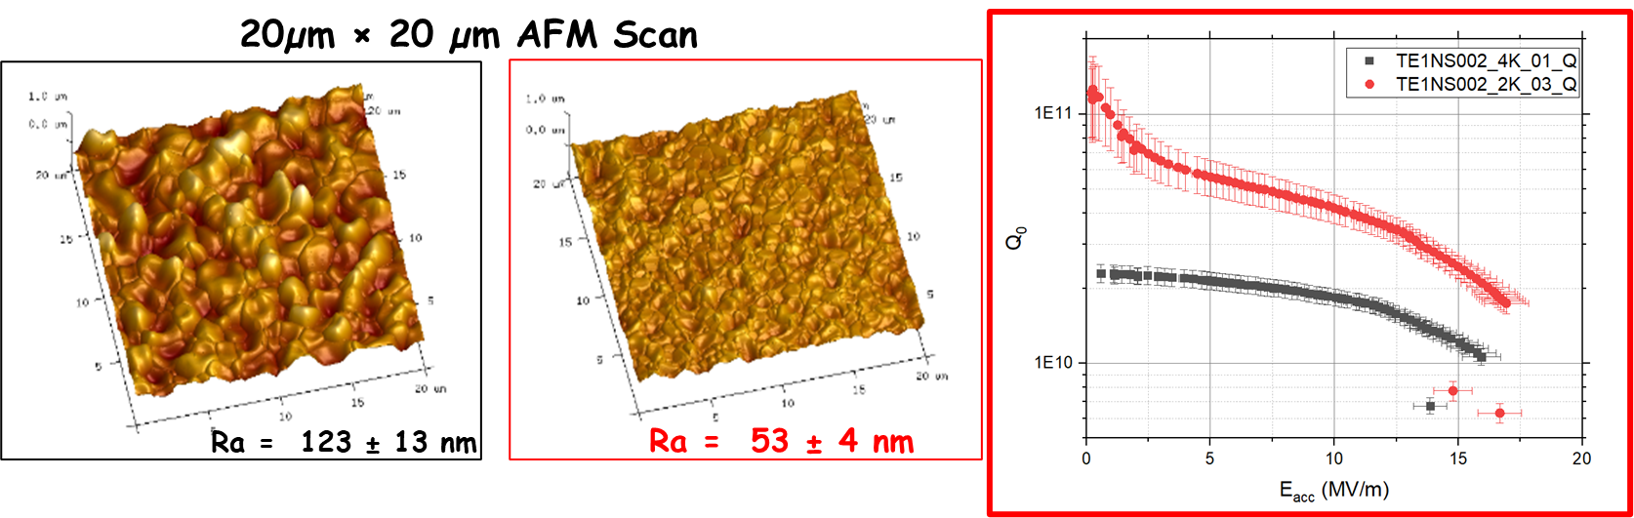
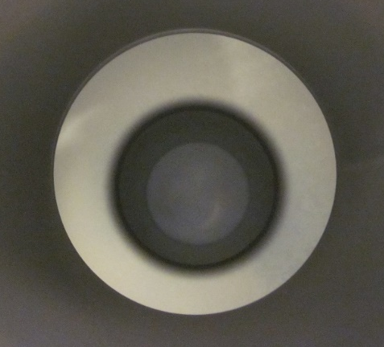
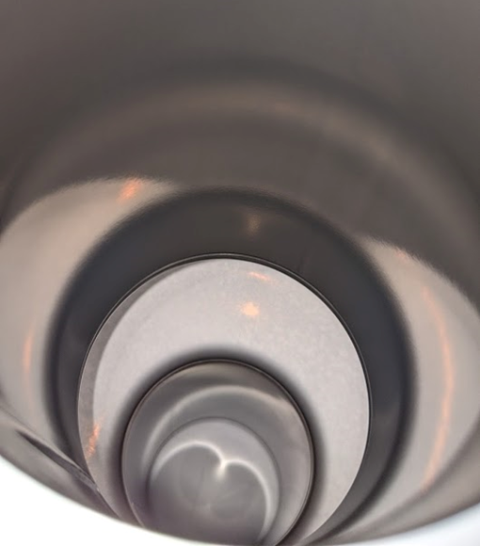
Roughness and Cavity Performance
Best Performance so far.
‘High-temperature’ nucleation
S Posen et. al. 2021 Supercond. Sci. Technol. 34 025007
9

Slide 10
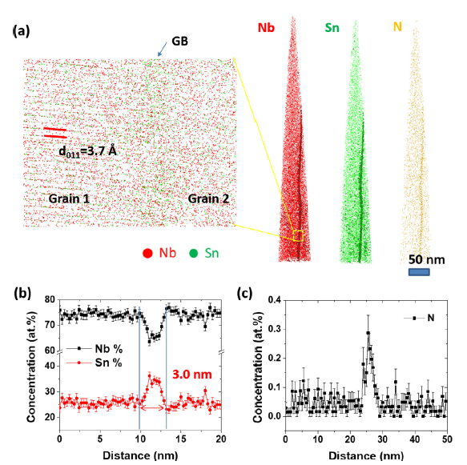
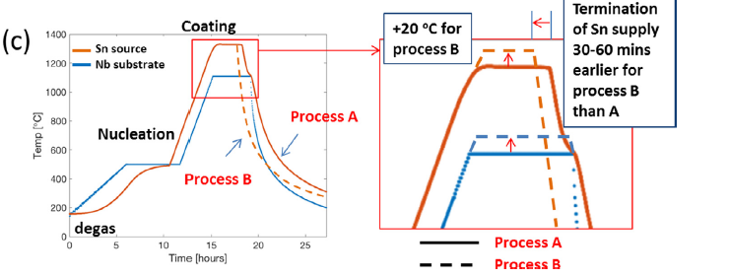
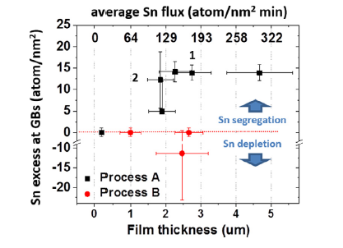
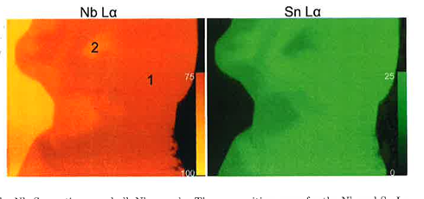
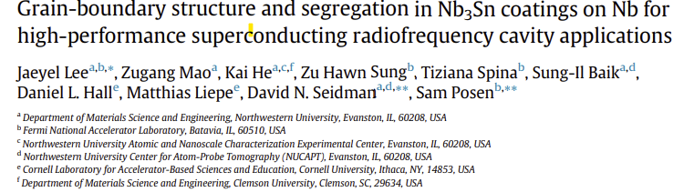
Non-stoichiometric Defects
Atom-probe Tomography
Line profile across GB
Nb
Nb₃Sn
C. Becker et. al . " Analysis of Nb3Sn surface layers for superconducting radio frequency cavity applications " Appl. Phys. Lett. 106, 082602 (2015)
D. Hall “New insights into the limitations on the efficiency and achievable gradients in Nb3Sn SRF cavities”
Dissertation. Cornell University 2017.

Slide 11
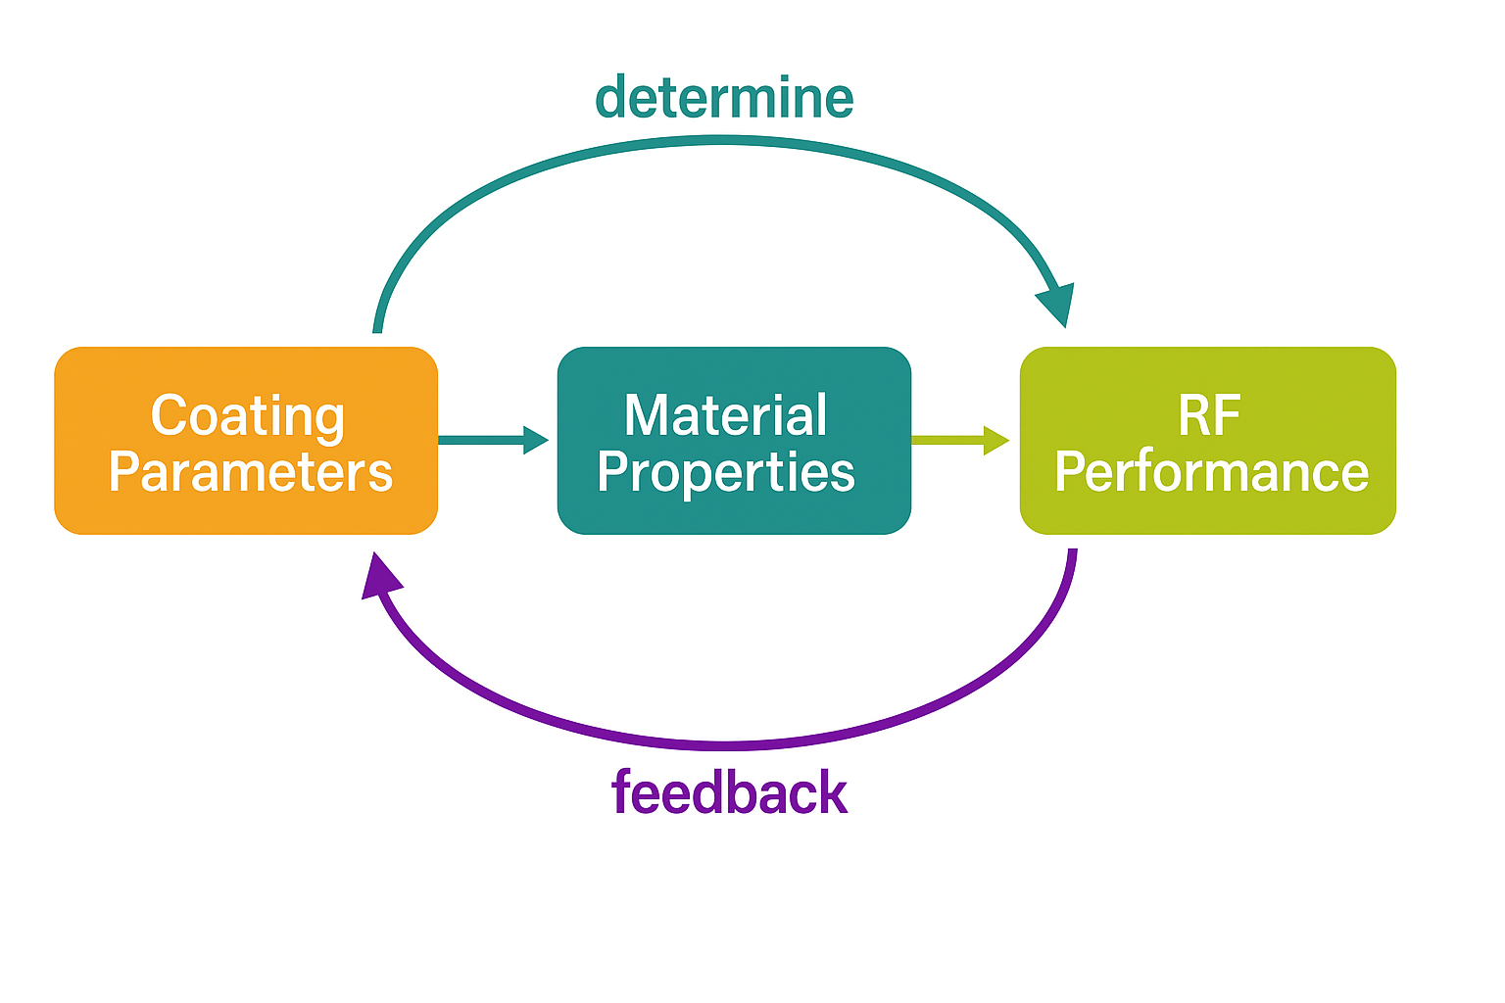
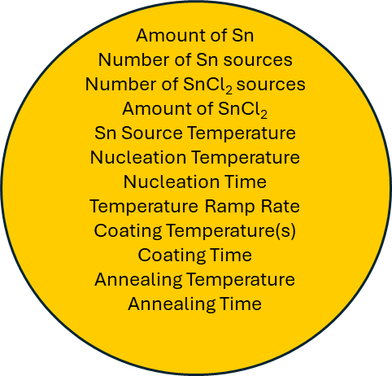
Pushing Limits Further
Elucidate Nb₃Sn growth mechanisms in vapor diffusion coatings as a function of process parameters
Correlate material properties with RF performance to optimize coating parameters
Develop a feedback-driven coating growth model adaptable to arbitrary cavity geometries
Develop post-processing techniques for surface topography management
Study grain boundary structures and composition
Structure
Stochiometry
Morphology
Layer thickness
Uniformity

Slide 12
Summary
Vapor diffusion is the leading fabrication method for Nb₃Sn cavities and will likely remain dominant.
Process improvements targeting identified defects have improved vapor-diffused Nb₃Sn performance, yet still short of their full potential
Performance gains hinge on addressing and avoiding material “defects” via process optimization, requiring broadened R&D efforts for full realization.

Slide 13
Thank you for your attention! Questions?

