Slide 1

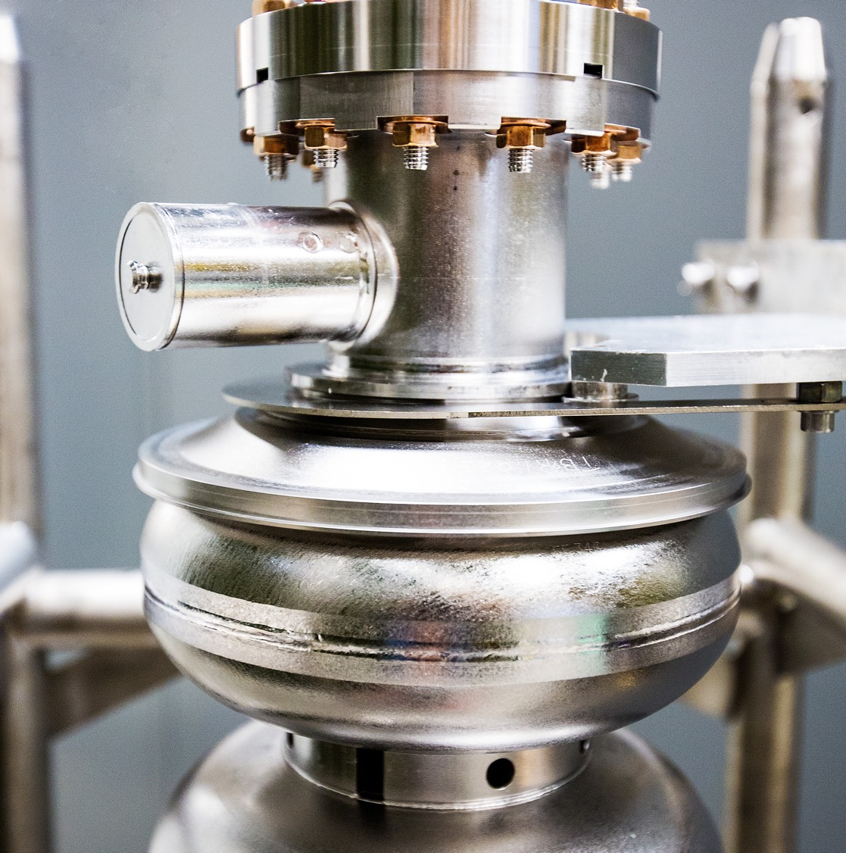
Surface Finish and Field Limitations of SRF Cavities
11/12/25
Eric M. Lechner

Slide 2
Outline
Characterization of the ultimate surface finish of electropolished Nb
Examine to what extent this surface finish influence performance-limiting factors
  Superheating Field Suppression
  Magnetic Field Enhancement
  Impurity Diffusion

Slide 3
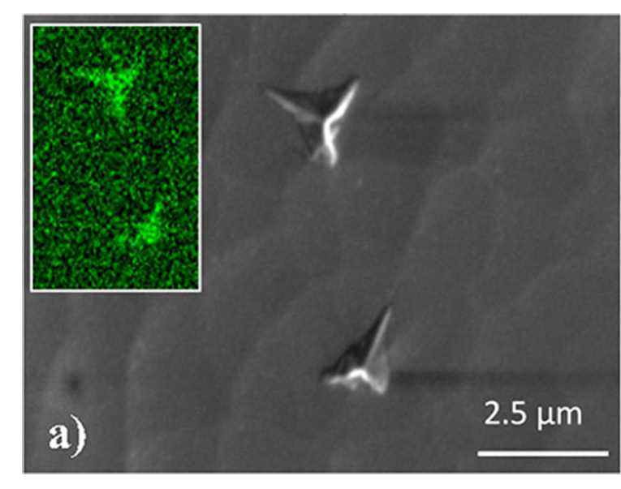
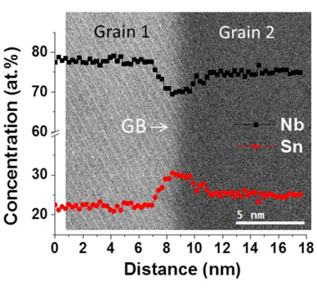
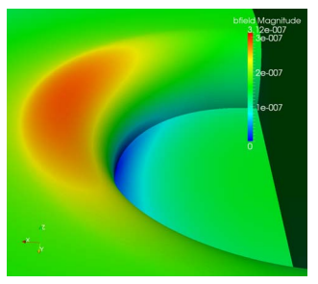
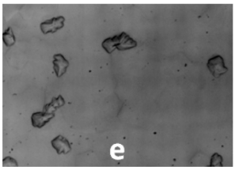
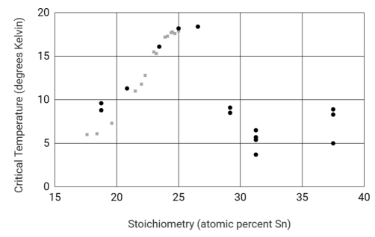
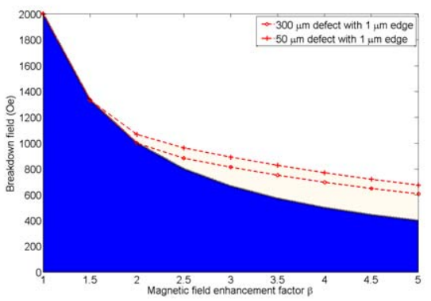
Performance Limiters
Main Focus
Precipitates - Nb
Non-stoichiometry – Nb₃Sn
Surface Roughness
[1]
[3]
[4]
Nitrides
[2]
Hydrides
[1] Dangwal Pandey, Arti, et al. Journal of materials science 53.14 (2018): 10411-10422.
[2] Barkov, F., et al. Journal of Applied Physics 114.16 (2013).
[3] Carlson, Jared, et al. Physical Review B 103.2 (2021): 024516.
[4] Xie , et al. Quench Simulation Using a Ring-Type Defect Model SRF’11, 2011

Slide 4
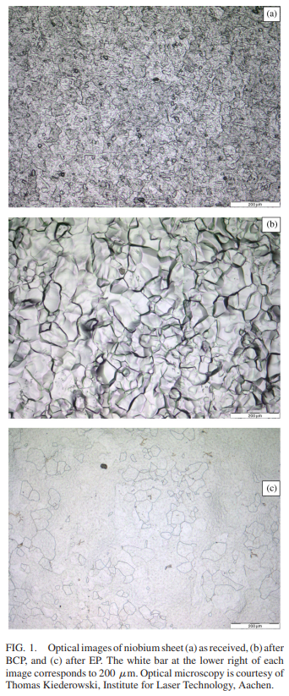
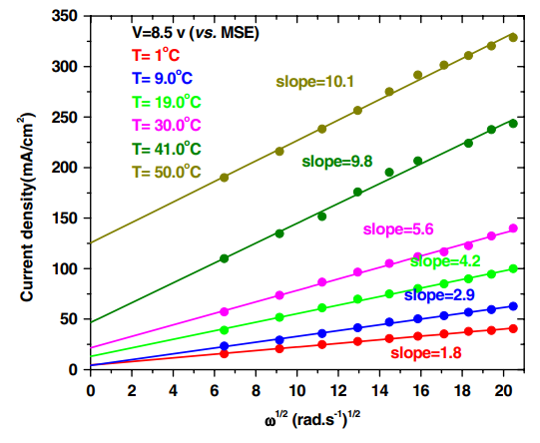
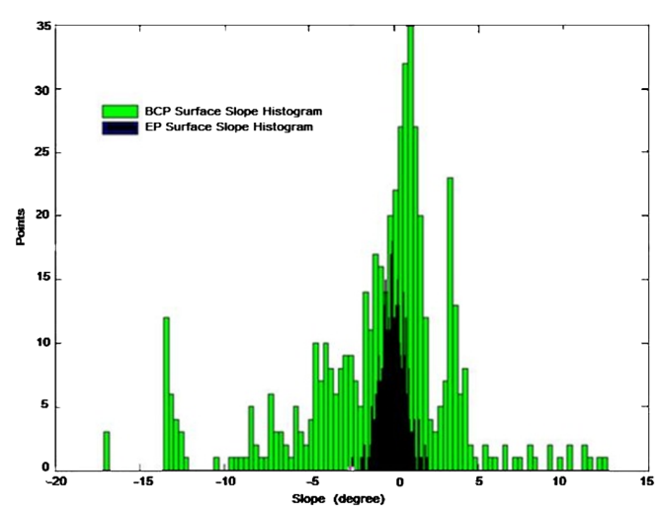
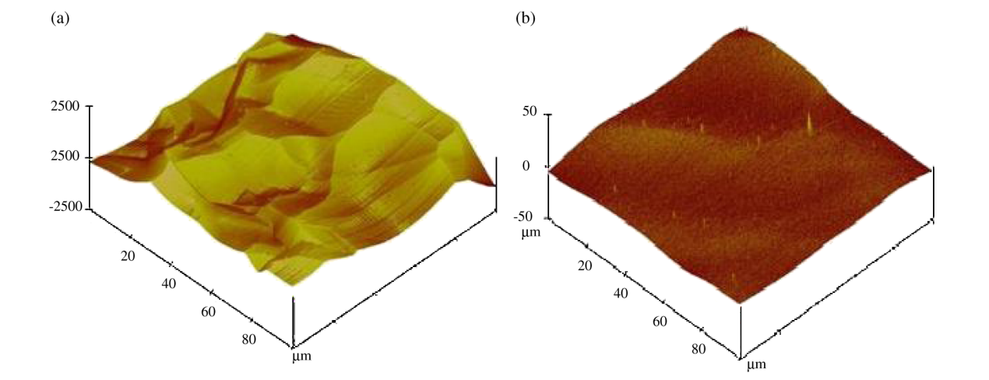
For Nb, What Is Known?
[1]
As-received
BCPed
EPed
For EPed surfaces visual surface roughness remains in the optical microscopy.
Rotating disc electrode (RDE) measurements clearly show a parallel etching process.
[2]
BCPed
EPed
Grain boundary roughness uncharacterized in EPed Nb.
What does the surface roughness look like at the grain boundary?
Hold on… we can see the roughness from the optical microscopy… so where’s the grain boundary in the AFM?
[1] Xu, Chen, et al. Physical Review Special Topics—Accelerators and Beams 14.12 (2011): 123501.
[2] Tian, H., and Reece, C.E. Physical Review Special Topics—Accelerators and Beams 13.8 (2010): 083502.

Slide 5
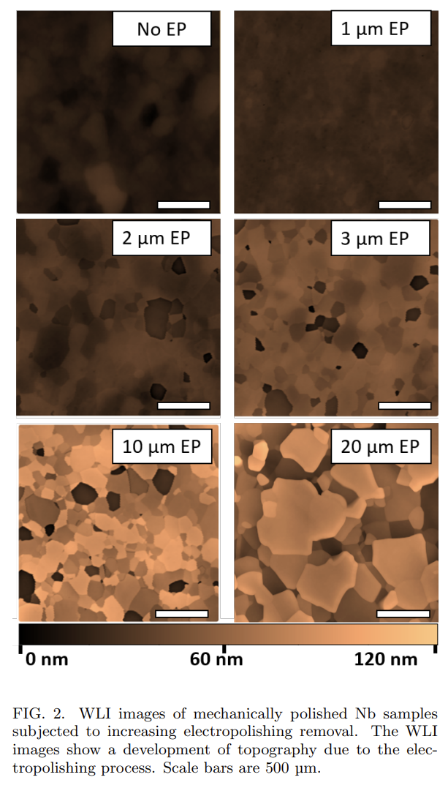
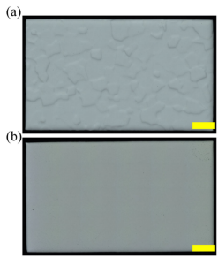
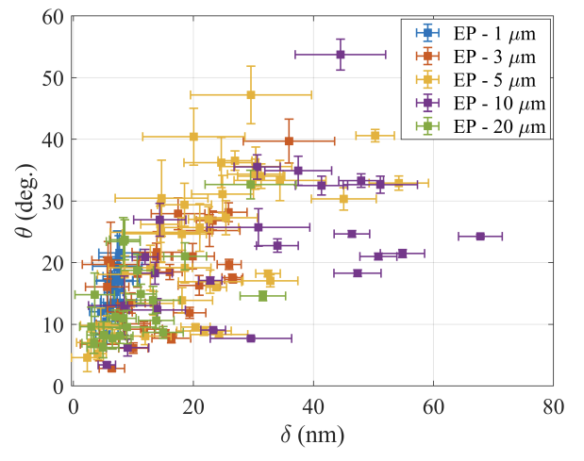
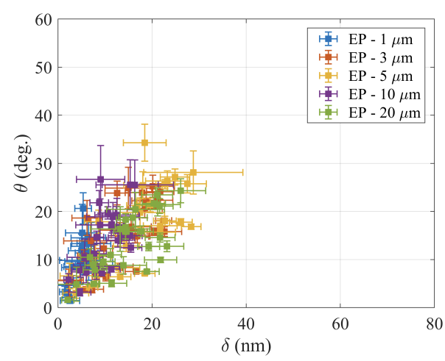
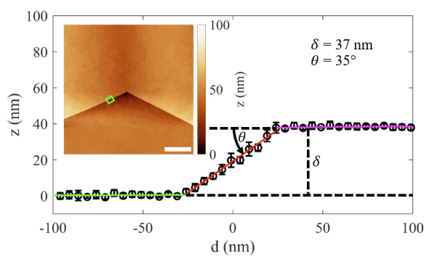
Ultimate Surface Finish of EPed Nb
[2]
Examining Ultimate Surface Finish
[1]
500 µm
500 µm
500 µm
500 µm
500 µm
500 µm
WLI shows a progressive etching effect - RDE ✓
WLI cannot characterize the defects at the grain boundary (poor lateral resolution)
w/o H₂O₂
1 mm
w/ H₂O₂
1 mm
2 µm
One must start from as smooth a surface as possible.
A CMP process described in [2] is suitable for such an investigation.
Atomic force microscopy can characterize the defect.
Randomly sampling grain shows that severity of defect does not depend on total removal alone.
Sequentially sampling the same grain boundaries after different removal shows tight clustering – likely implicating nearest-neighbor misorientation.
[1] Lechner, Eric M., et al. Physical Review Accelerators and Beams 26.10 (2023): 103101.
[2] Hryhorenko, O., et al. arXiv preprint arXiv:2509.25423 (2025).

Slide 6
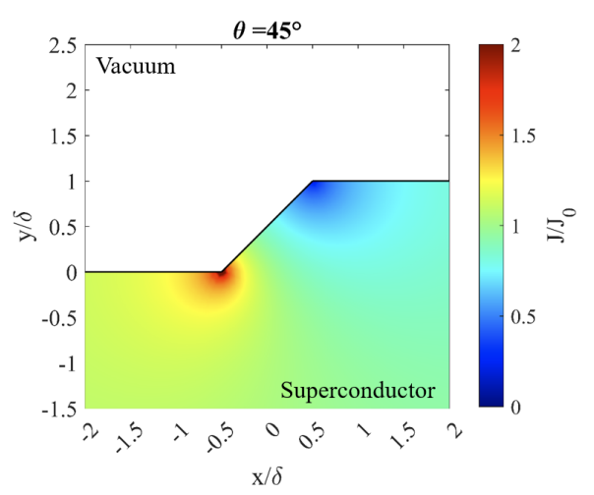
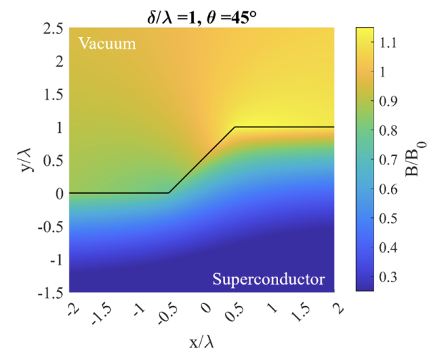





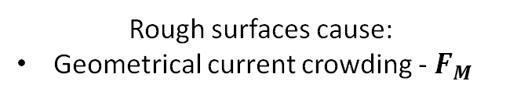

Geometrical Field Limitations – London Models
Superheating Field Suppression (SFS)
Magnetic Field Enhancement (MFE)
Rough surfaces cause:
Geometrical current crowding - $F_{M}$
Rough surfaces cause redistribution of the RF field and local amplifications of magnetic field.
Degraded surface barrier -${ F}_{S}$
- $B=B_{0}\hat{z}$
- $B(x,∞)=B_{0}\hat{x}$
$$F_{S}↑$$
$$r_{v}$$
$$F_{M}↓$$
Each of which can assist in low-field breakdown of the Meissner state

Slide 7
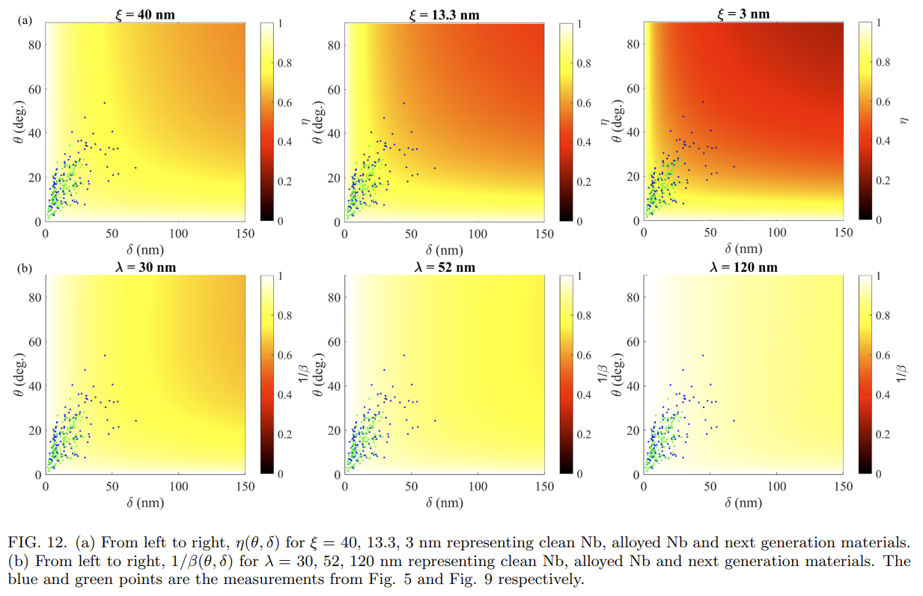


Landscape SFS and MFE for Sloped Steps
“Clean” Nb
Impurity Alloyed Nb
Higher $κ$ SRF materials
As the material becomes dirtier, superheating field suppression becomes more severe.
The step height and slope angles observed account for a field degradation factor of ~0.8.
SFS
“Clean” Nb
Impurity Alloyed Nb
Higher $κ$ SRF materials
MFE decreases as the material gets dirtier since δ/λ decreases. From the perspective of MFE, the alloyed Nb surface is smoother.
Tshe step height and slope angles observed account for a field degradation factor of ~0.8.
1/MFE
Their combined effect, η/β, can account for a substantial reduction in field limit by a factor of ~0.64 in “clean” Nb
Imperfections have direct consequences on ideal coating parameters for SIS coatings¹
¹For more details see Kubo, Takayuki. Superconductor Science and Technology 30.2 (2016): 023001.

Slide 8
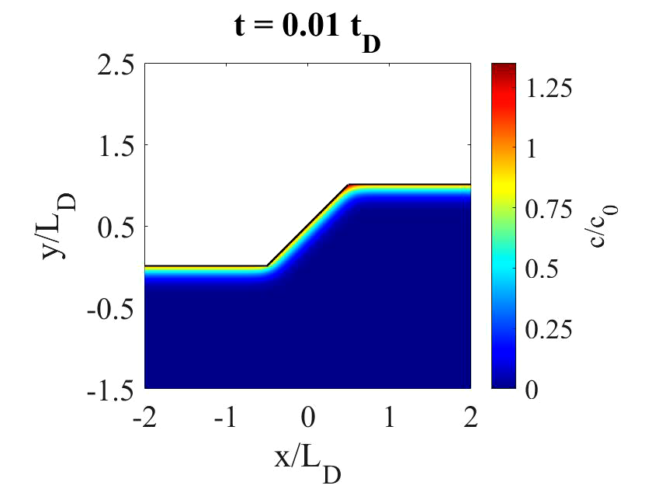
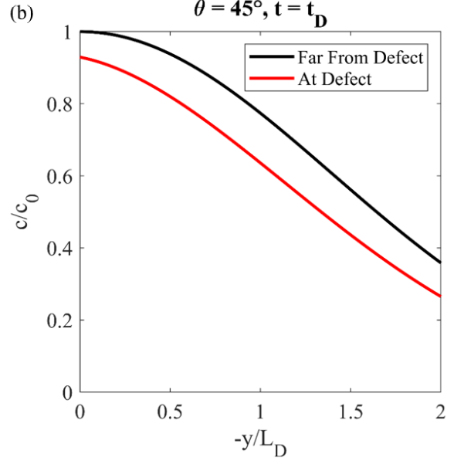
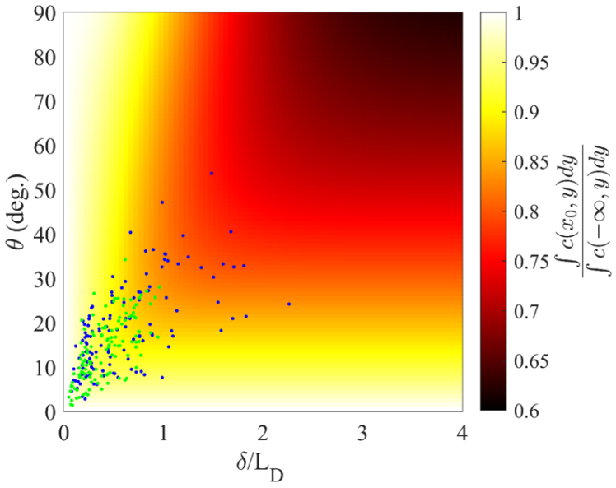
Shallow Impurity Diffusion – Low Temperature Baking
Reduction in impurity content near large internal angles which coincides with the vortex nucleation site
The impurity content throughout the profile can be substantially reduced at the vortex nucleation site.
Impurity content is an important parameter in S-S’ bilayers and modifying hydride nucleation.
Assuming a L_{D} of ~30 nm our measurements can be placed on the landscape. The landscape of relative impurity dose shows a suppression of ~0.75.
More uniform impurity content possible when defects are small compared to L_{D}

Slide 9
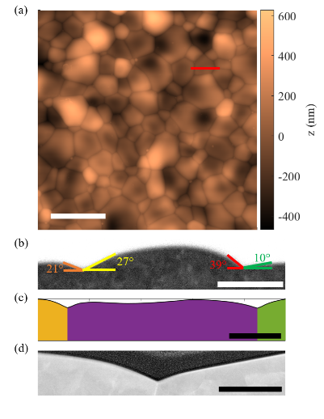
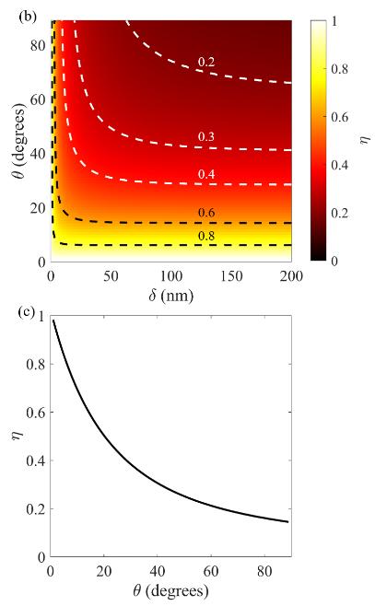
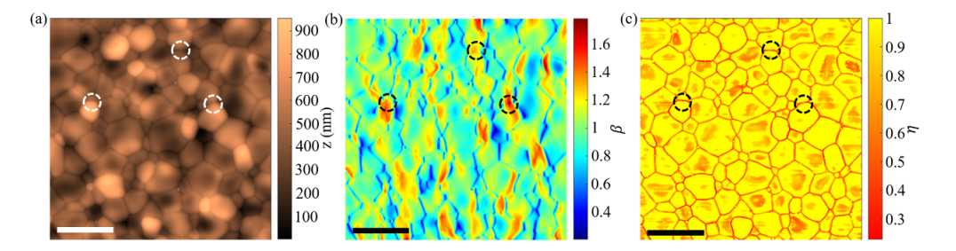
Nb₃Sn – Surface Roughness
Nb₃Sn also hosts V-shaped thermally grooved grain boundaries.
Very high slope angles of up to ~60° observed.
Groove depths approaching the deep-groove limit.
Can account for a substantial reduction in peak field.
Deep groove limit
5 µm
500 nm
200 nm
Performance limiting mechanism likely concurrent:
Non-stoichiometry
Tin droplets
Patchy regions
5 µm
5 µm
5 µm
Notes:
Polishing on single cell
Follow-up cavity test that apparently showed
Brandi’s made all measurements on
-Nb on Cu, VSM /EBSD
-Presentation

Slide 10
Summary
Using AFM we revealed the existence of high slope angle sloped steps comparable in size to the London penetration depth and diffusion length of low-temperature baked Nb cavities. These defects can account for a much larger reduction in peak field than previously expected.
Simple surface roughness metrics like average roughness totally neglect slope angle, a key parameter in geometrically modified field limits. This is also true for power spectral density (PSD) analysis¹.
Don’t just throw your measurements through the analysis grinder and see what comes out. Use theoretical frameworks that connect directly to performance metrics.
Poor metrics open vulnerabilities for processes to be poorly optimized in sample studies.
There are many polishing methods under development. Quantifying ultimate surface roughness is of interest.
¹For more details see Hryhorenko, O., et al. arXiv preprint arXiv:2509.25423 (2025).

Slide 11
QUESTIONS?

