Slide 1
Muon Collider Development R. Rimmer SRF Frontiers Workshop, Jlab, Nov 12-14 2025

Slide 2
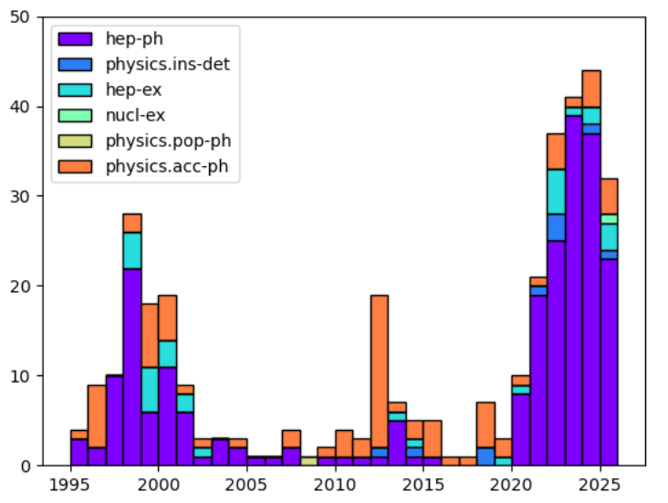
Sergo Jindariani (Fermilab)
MC (recent) Timeline
Long and rich history of Muon Collider research in the US pre-2020, including most recently the Muon Accelerator Program (MAP)
Muon Collider timeline since 2020
2020: 2019 European Strategy, Muon Colliders become part of the EU Accel. R&D Roadmap:
• Community meetings, followed by formation of the International Muon Collider Collaboration (IMCC) with CERN as the host laboratory
2021 - 2022: US Snowmass study reveals strong interest in Muon Colliders • Muon Collider Forum Report: a vision from the US perspective 2023: Formation of the US Muon Collider R&D coordination group: • Provide input to the P5 panel on US-based Muon Collider research
• Input document submitted to P5: 2023-2025: P5 and NAS Reports released, both providing strong support for Muon Collider
2024: PI meeting in Princeton focused on R&D Priorities: 2025: Formation of a US Muon Collider Collaboration (USMCC)
2025 Formation of National Laboratory Accelerator Study Group (NLASG)
ESR
Annual MC related publications

Slide 3
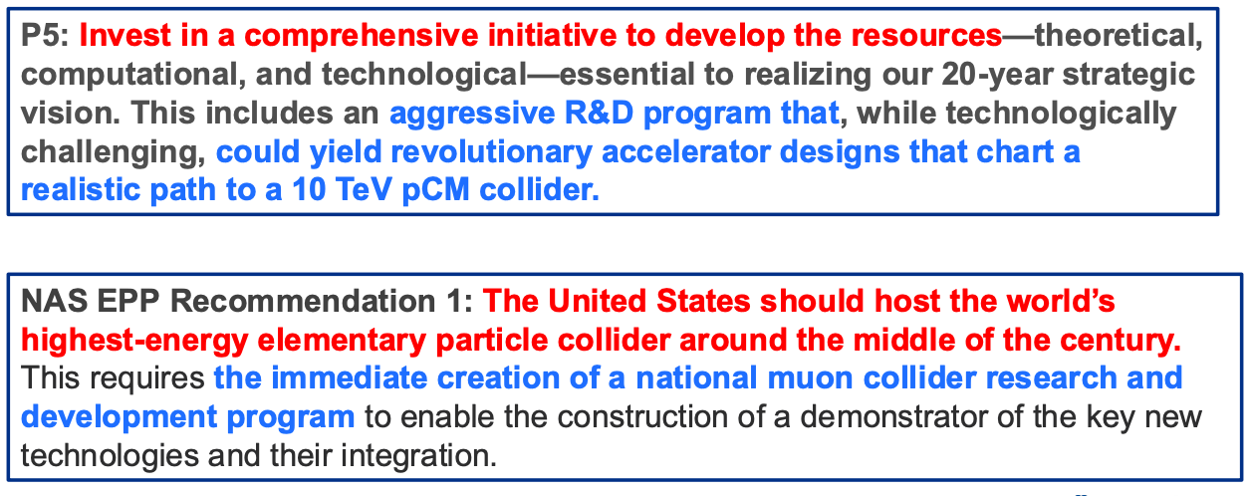
Statements from the P5 and NAS panel reports

Slide 4
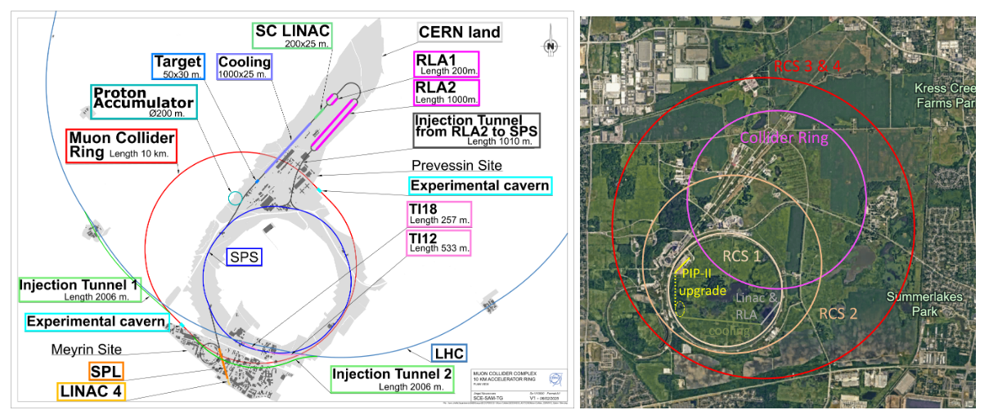
CERN and FNAL concepts
Utilize as much as possible of existing or upgraded infrastructure
Green field design also possible

Slide 5
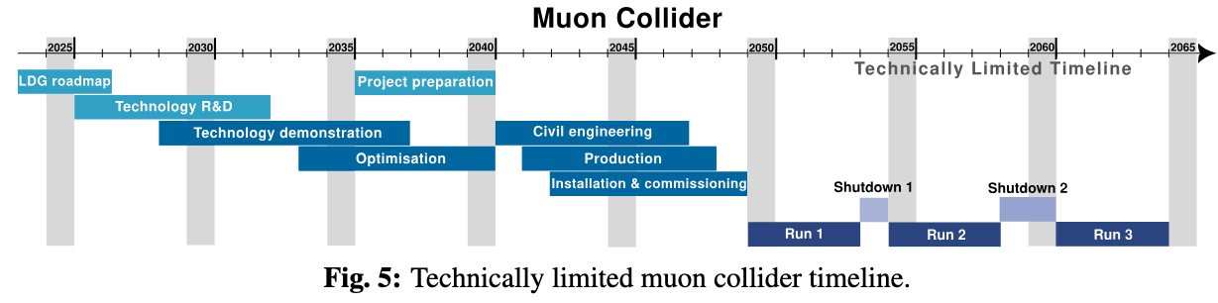
Future timeline
https://indico.cern.ch/event/1439855/contributions/6461618/attachments/3045996/5381966/ESPPU_MuonCollider.pdf

Slide 6
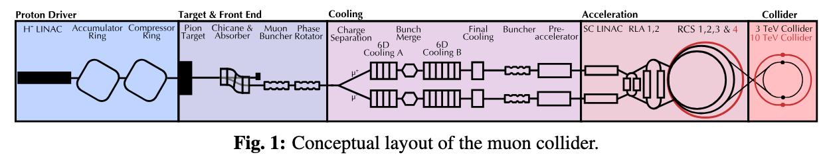
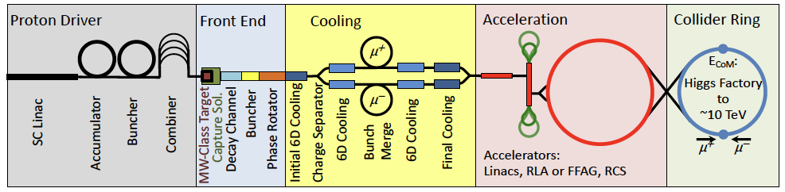
Similar concepts in USA and EU

Slide 7
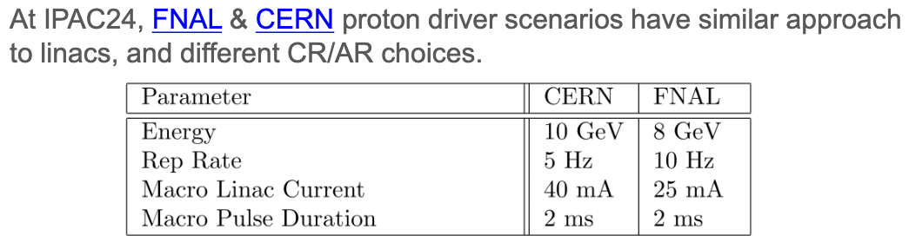
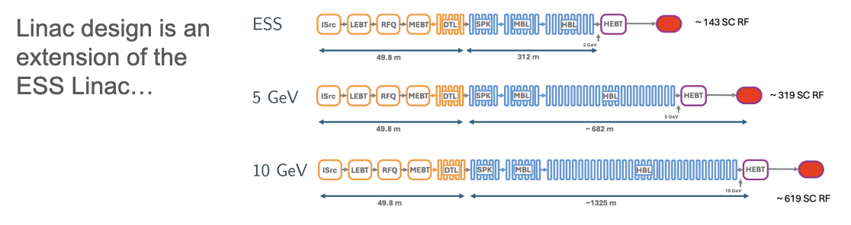
Proton Driver R&D
PIP-III?
Technology ready? Could benefit from further R&D, Nb₃Sn?

Slide 8
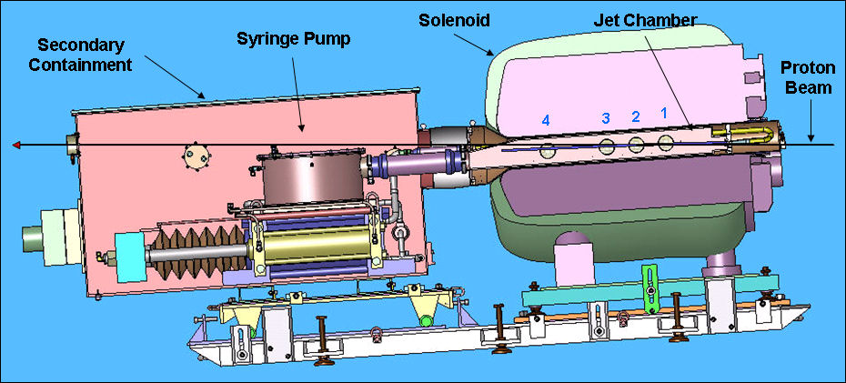
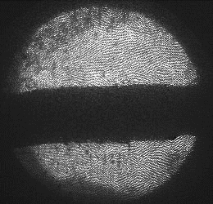
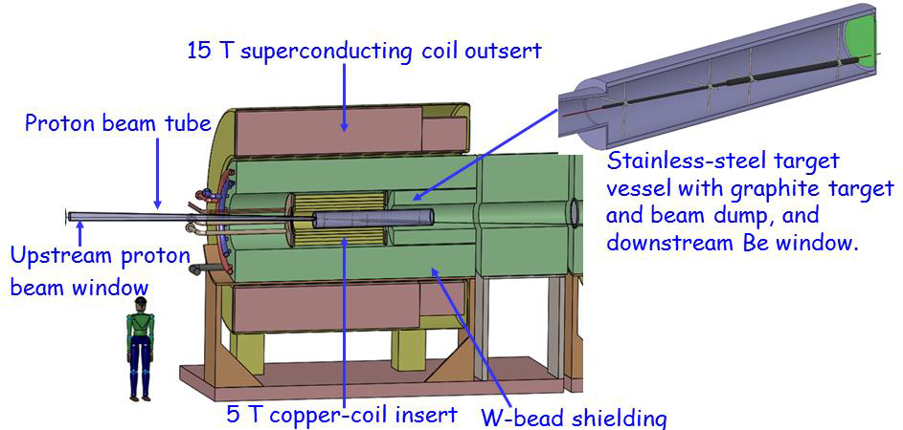
Target
Layout of MERcury Intense Target (MERIT)
1 cm
MERIT was conducted in 2007 at the CERN nTOF11 beamline
A proof-of-principle demonstration of a free liquid-metal (Hg) jet target with intense proton beams, within a 15-T solenoidal field
Used 14 & 24 GeV protons, up to 16 bunches/pulse, with 3.5e12 protons/bunch at a 67 mrad beam angle relative to the solenoid axis
360 beam pulses in total
The mercury jet was magnetically confined as predicted by MHD simulation
Secondary particle flux was observed using diamond detectors (no PID)
C Target Option
NB: This design is probably outdated. However, it illustrates several critical challenges
~4MW in 20T field
SNS and ESS are approaching this power level
Kirk Macdonald, Princeton

Slide 9
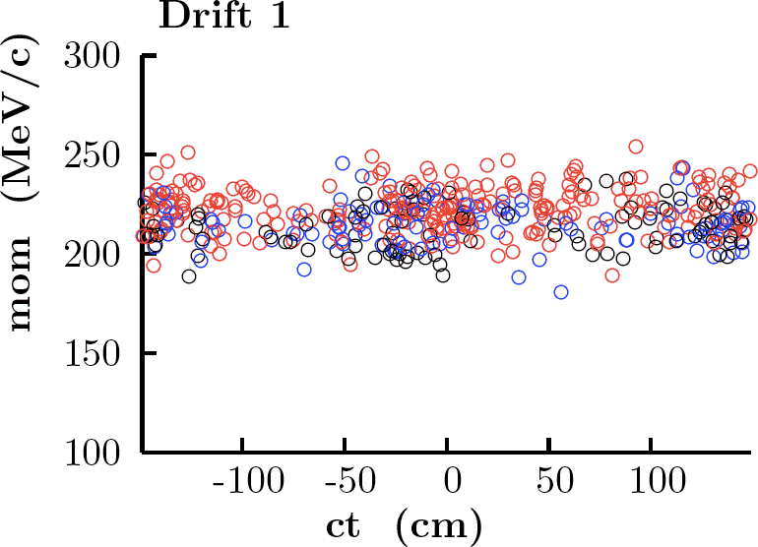
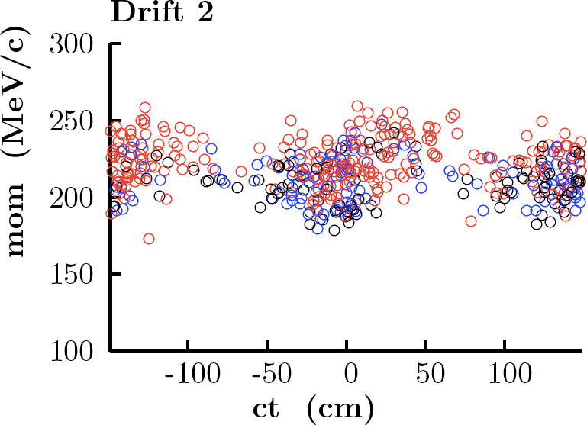
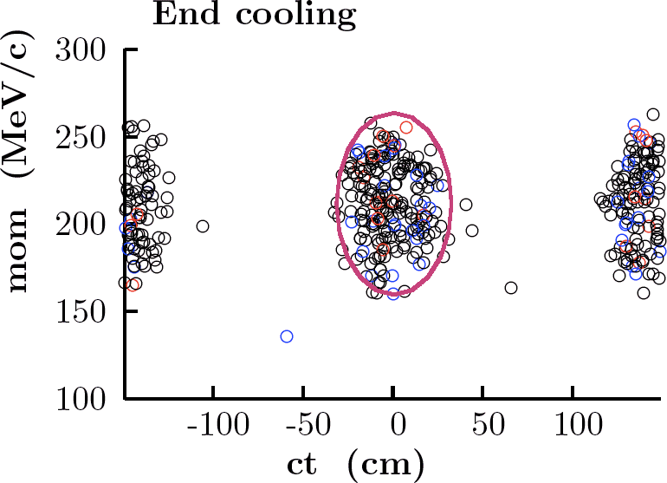
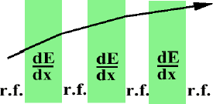
Bunching, capture ionization cooling
Phase rotated beam is bunched and captured in NCRF channel before cooling.
Ionization cooling
Requires multi-T solenoid channel
Prohibits use of SRF
So simple it must work!
Demonstration of realistic ionization cooling was core purpose of Mucool and MICE
Involves absorbers, RF, solenoid channel, instrumentation, integration, etc.

Slide 10
RF Breakdown in high magnetic field
Final “Be” cavity
Button cavity
PHYSICAL REVIEW ACCELERATORS AND BEAMS 23, 072001 (2020) Operation of normal-conducting rf cavities in multi-Tesla magnetic fields for muon ionization cooling: A feasibility demonstration, D. Bowring et. Al.

Slide 11
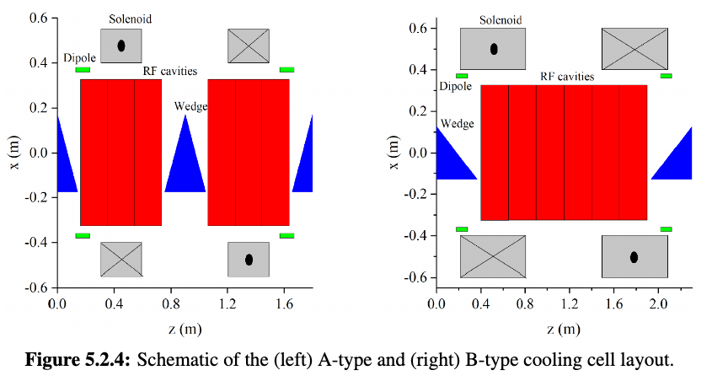
Ionization cooling demonstration(s)
MICE experiment at RAL
CERN proposals
21-32 MV/m NCRF in high magnetic fields,
352-704 MHz, 2.5-17T
New demonstrators being proposed at FNAL and CERN
New cavity designs under way in LBNL and CERN
Program terminated without installing RF after DOE canceled MAP

Slide 12
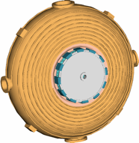
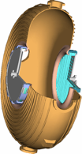
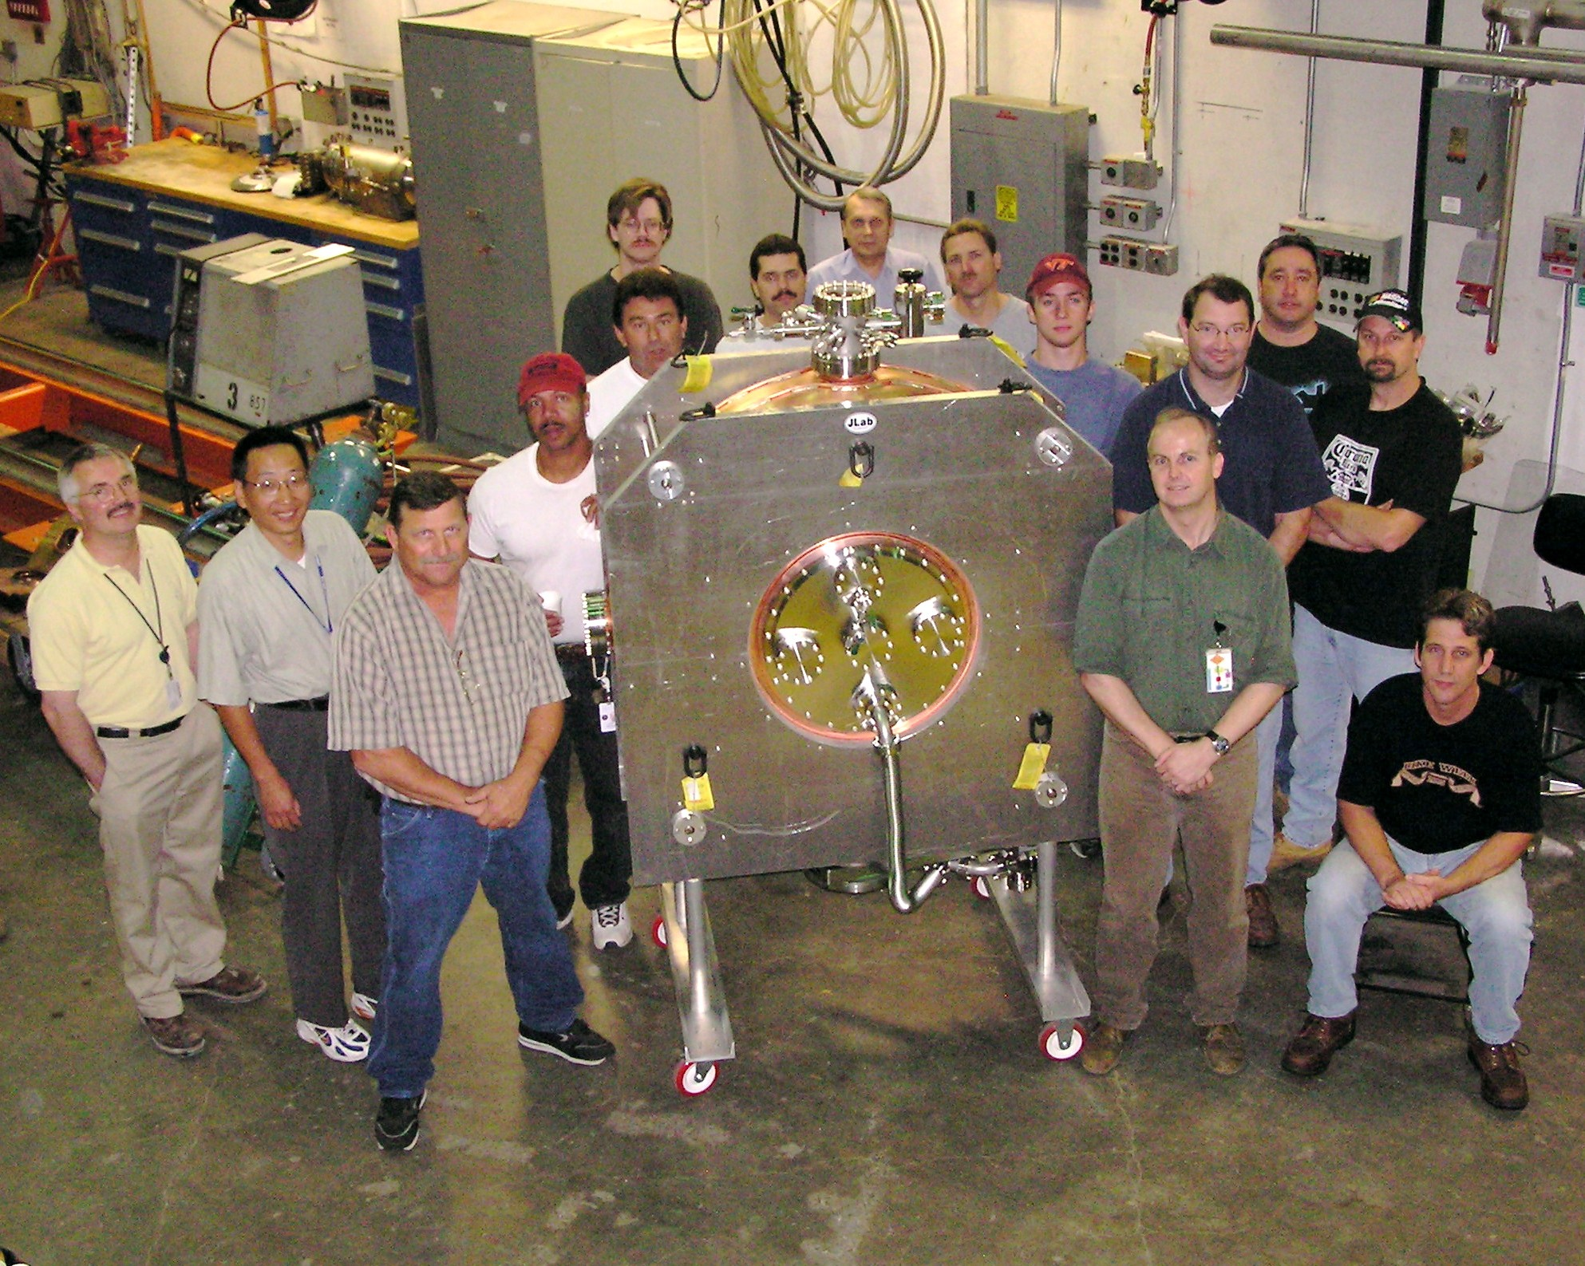

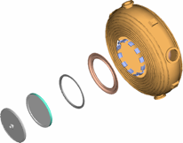
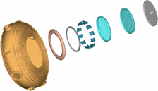
High-gradient RF (ANL/FNAL/IIT/LBNL/U.Miss/JLab)
201.25 MHz cavity conceptual design
First 200 MHz cavity welded and EP’d by Jlab. Assembled in clean room
Exploded views showing foil and grid mounting hardware

Slide 13
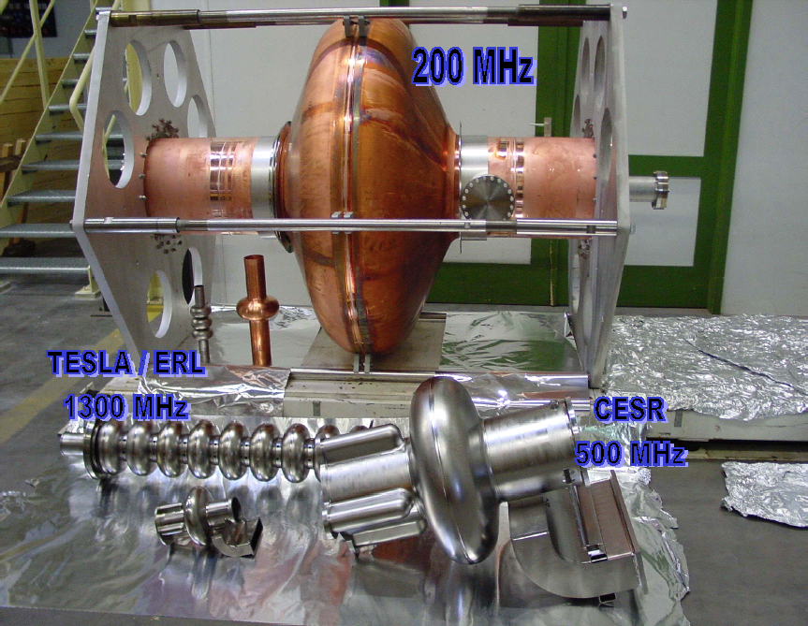
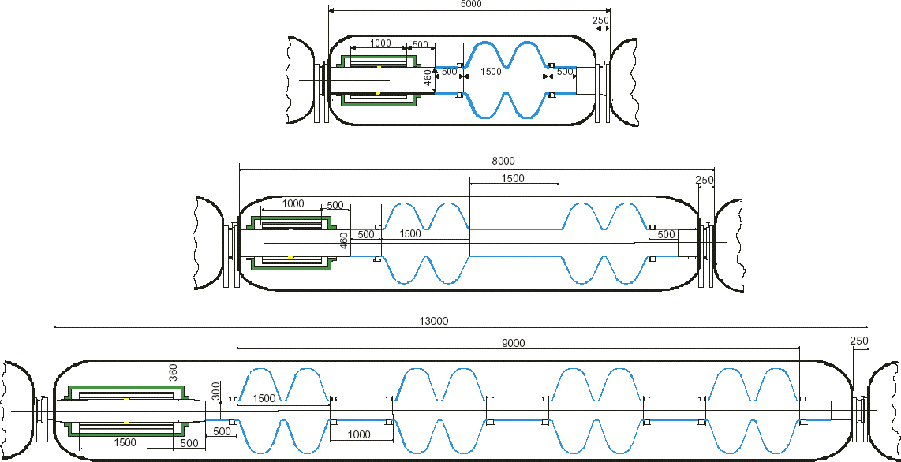
Initial SRF acceleration
Low frequency cavities (Nb on Cu)
interleaved with solenoids
200 MHz Superconducting cavity R&D
(Cornell, CERN)
Expect Qo = 4.6 x 10⁹ at 4.5 K and 1.0 x 10¹⁰ at 2.5 K
NbCu cavities have a “Q Slope” requiring x3 power at 15 MV/m accelerating gradient

Slide 14
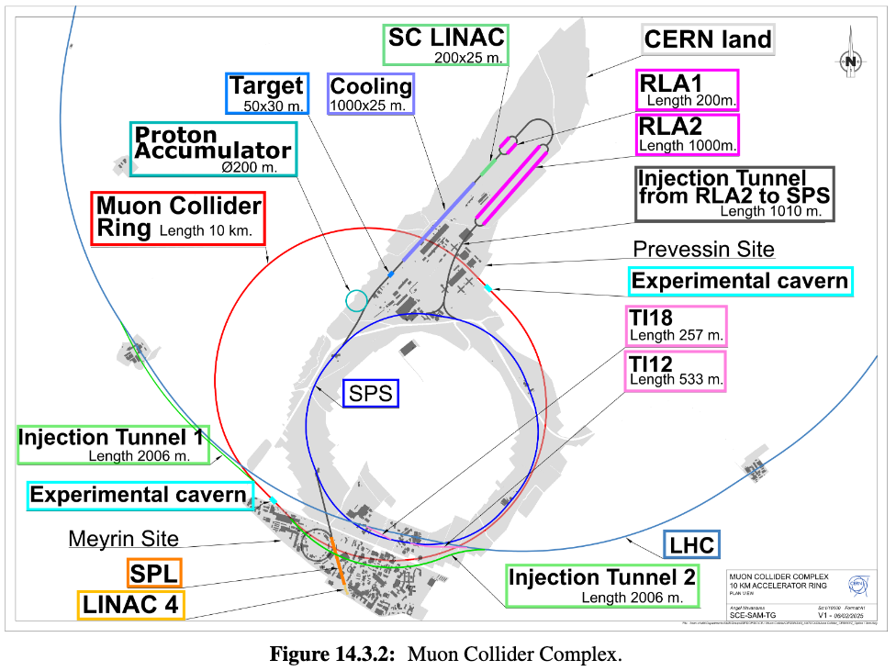
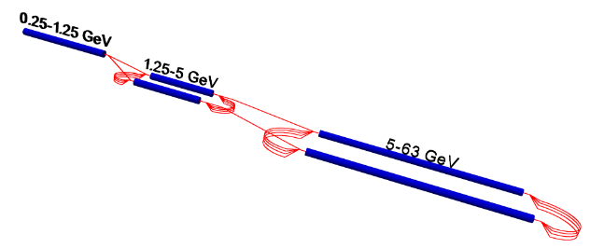
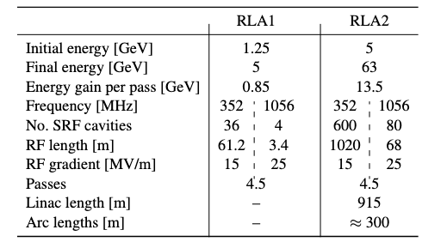
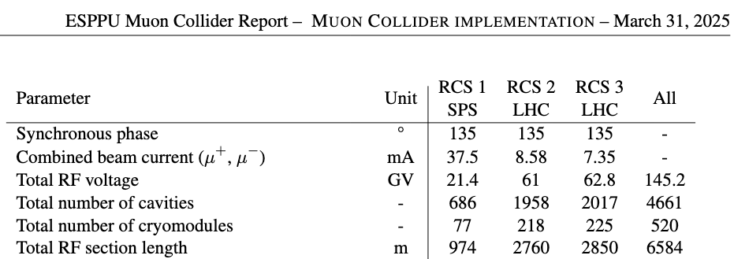
High-Energy Acceleration, RLA’s and RCS’s
1.3 GHz Tesla type

Slide 15
Conclusions
MC can offer a pathway to 10 TeV
Can be realized on the FNAL site or at CERN
Much interesting R&D left to do
Lots of SRF needed
Can benefit from progress in SRF materials and designs in the next 10+ years

