Slide 1






Superconducting Thin Film Development for Microelectronics
A versatile platform around NbTiN
11/12/25
Anne-Marie Valente-Feliciano
Notes:
Tip: Keep titles under 60 characters for readability
To change the photo: Right-click on photo and select change photo

Slide 2
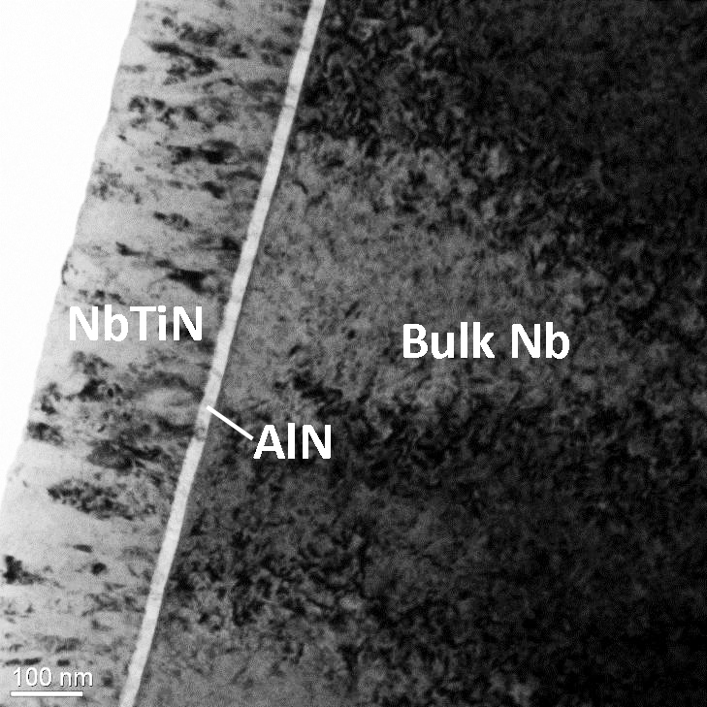
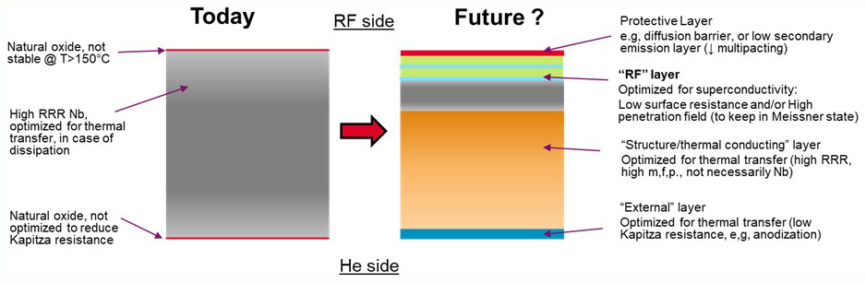
Motivation
Leveraging Next-Generation SRF Materials Developments for SRF cavity materials based on thin film technologies.
Beyond cavity applications, the developments in SRF thin film technologies find a variety of applications in the fields of superconducting metamaterials, electronics, sensors and quantum devices.
Unifying theme across these technologies is that the same physics and material properties such as extreme low loss, stability, and manufacturability are required.
NbTiN film based structures
Functionalization of SRF Materials

Slide 3
Superconducting Digital Logic (SCD): Main Goals
Support the on-going development of quantum and classical superconducting electronics and complement R&D program on superconducting fabrication stack consisting of several metal layers by exchanging information, samples and/or complementary characterization.
Main research vision = develop a deep-submicrometer, scalable superconducting process for future generations of computing hardware for ultra-high-compute-density and high-energy-efficiency superconducting autonomous AI systems with ExaScale performance.
New fabrication process to enable dense logic and memory, and inform performance architectural optimizations on the hardware- software level.
Develop improved superconducting and barrier materials that perform better and tolerate higher processing temperatures, making them fully compatible with the fabrication processes of conventional electronics technology.
Proposed backend process based on NbTiN wires recently introduced by the quantum and RF superconducting communities.

Slide 4
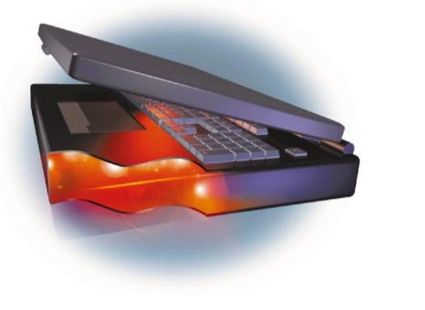












Superconducting Digital Logic (SCD)
100x faster execution time
Interconnect bandwidth
1000x compute density
Emersion cooling, 3DHI
100x energy efficiency
Zero resistance, JJ
Low power dissipation
High power
dissipation
CMOS
technology
SCD
Thermal
Limitations
Cryo-
temperature
High speed
operations
RC Delay
Classical technology leveraging CMOS EDA, process flow, and packaging

Slide 5
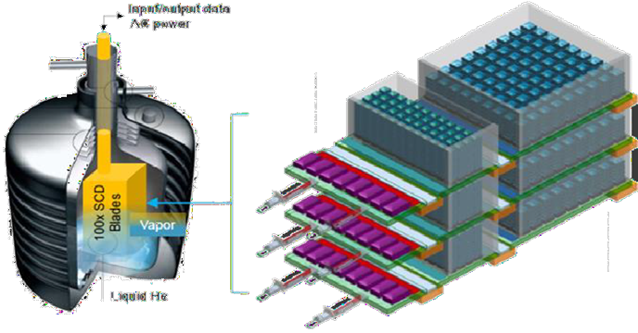

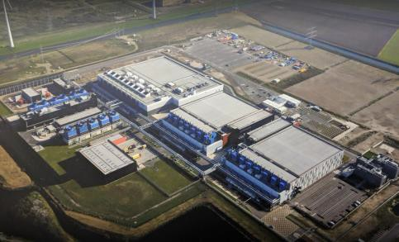
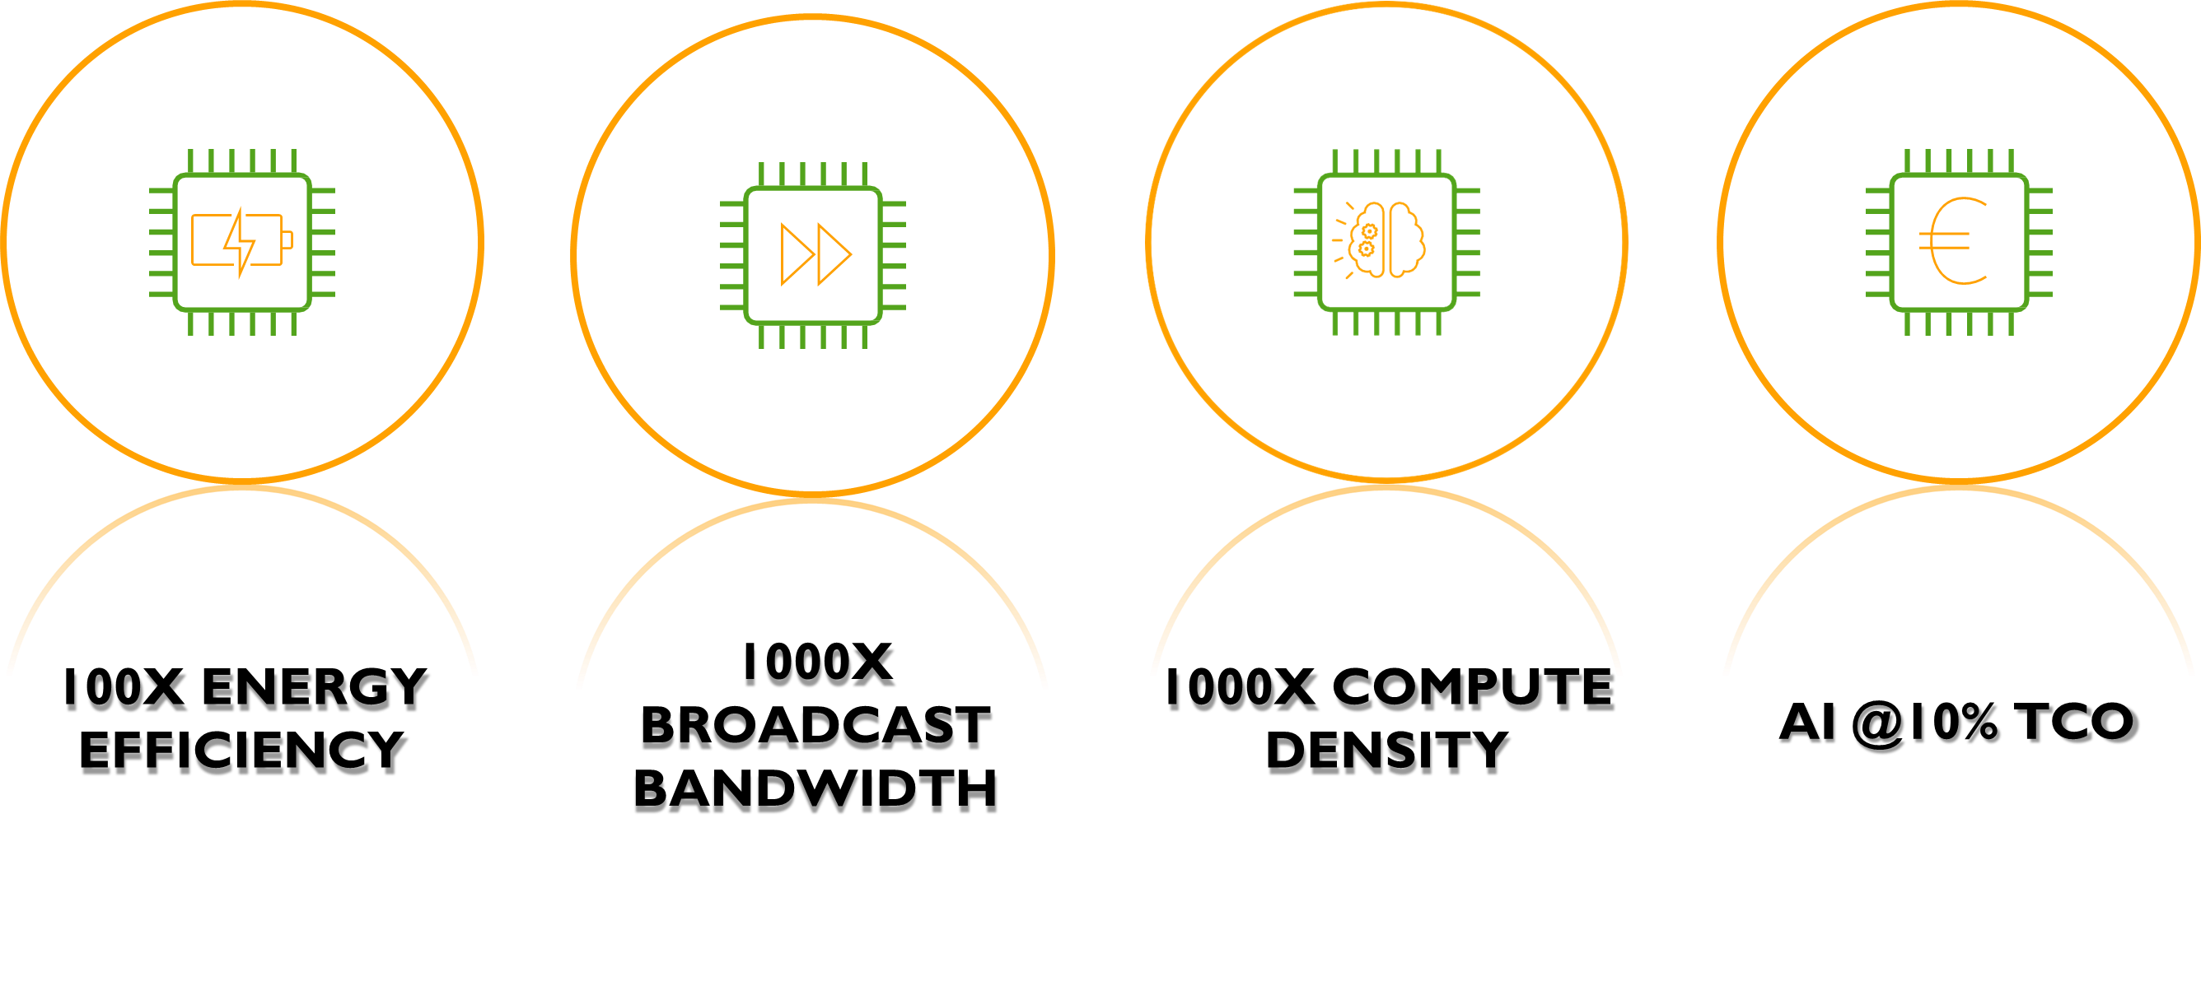
Superconducting Digital Logic (SCD)
From a football field to a shoe box
The same performance as NVIDIA EOS: 79.32 ExaFlOPS
18 Trillion devices 150 x 320 x 100 mm
AI & Quantum Compute Loads Sustainable with Advanced Superconducting Integration Process
Bridging the gap from CMOS to Quantum Superconducting Digital Logic based on NbTiN

Slide 6
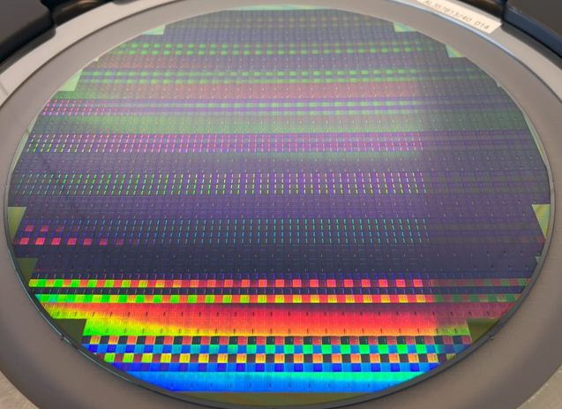
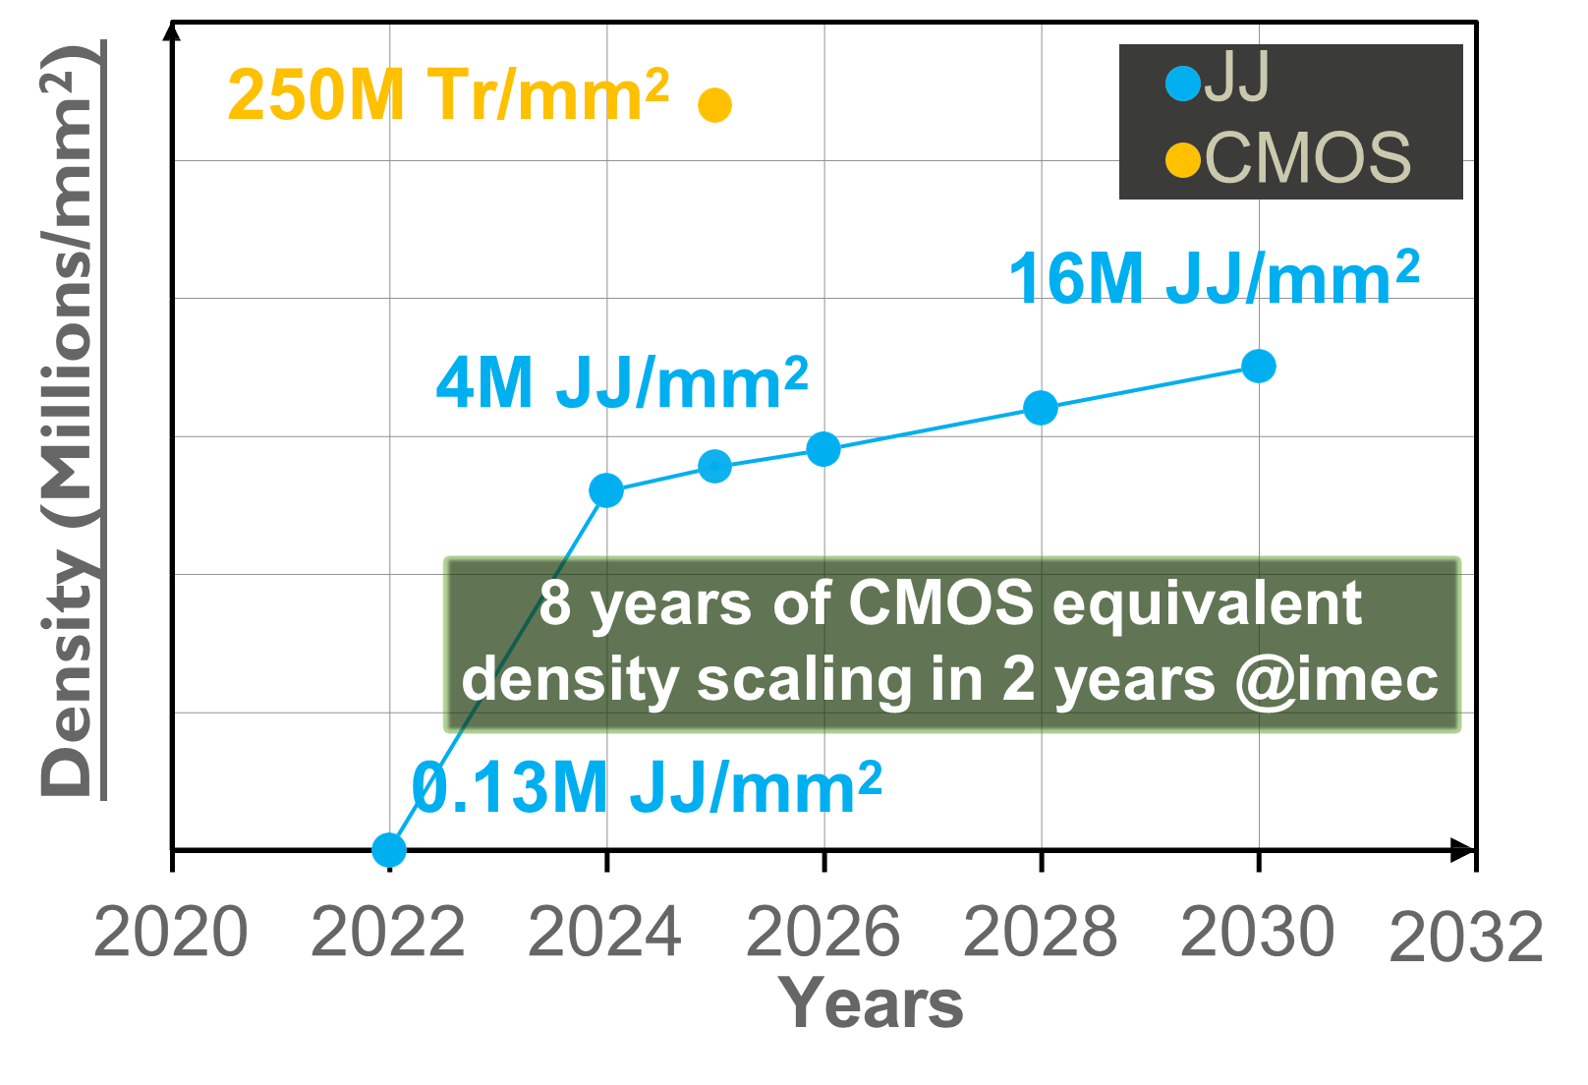
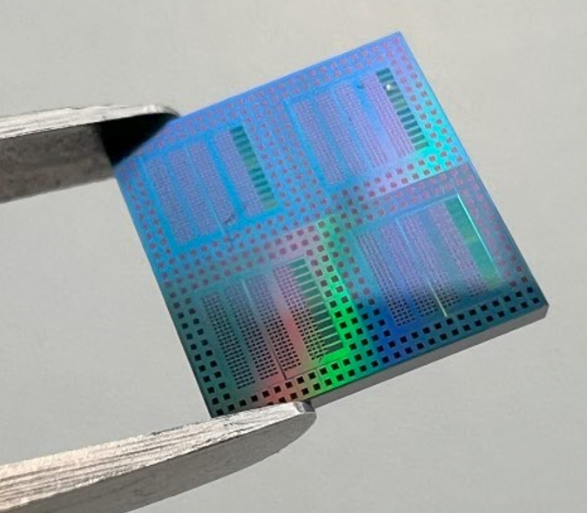
Superconducting Digital Technology: Focus Areas
241 dies/wafer
“Re-starting Moore’s law”
40/28 nm design rules for fabrication
Scalable fabrication (300mm wafers)
Standard processes
Compatible BEOL thermal budget
Scaling path ➔ N+2
❑ Fundamentals and failure mechanisms
4 chips/die
7.8mmx7.8mm dies

Slide 7
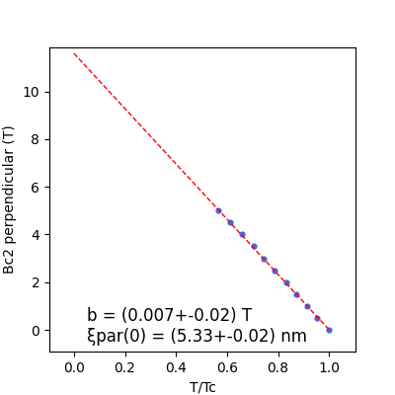
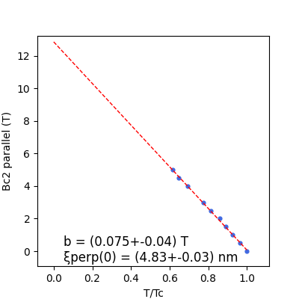
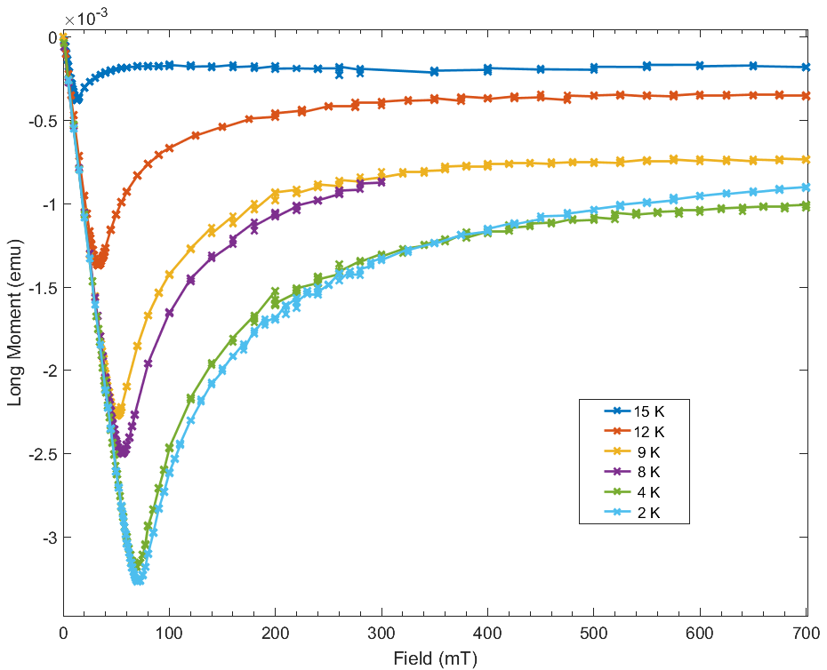
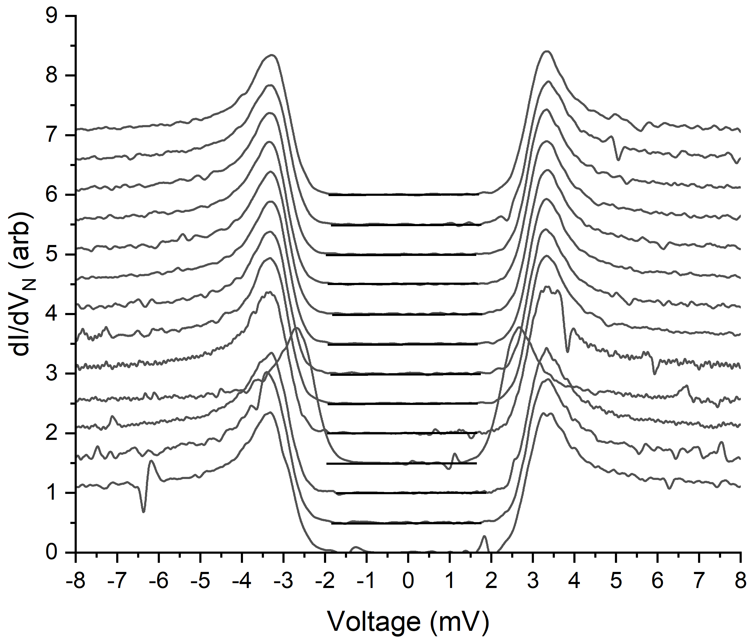
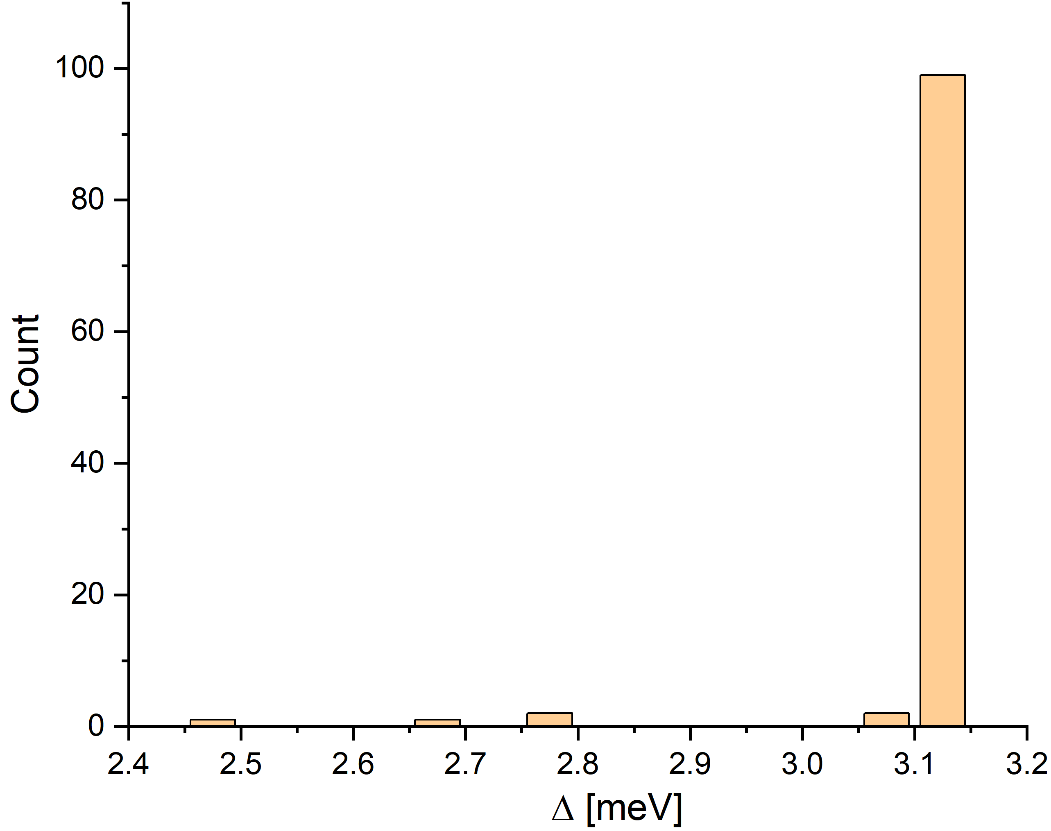
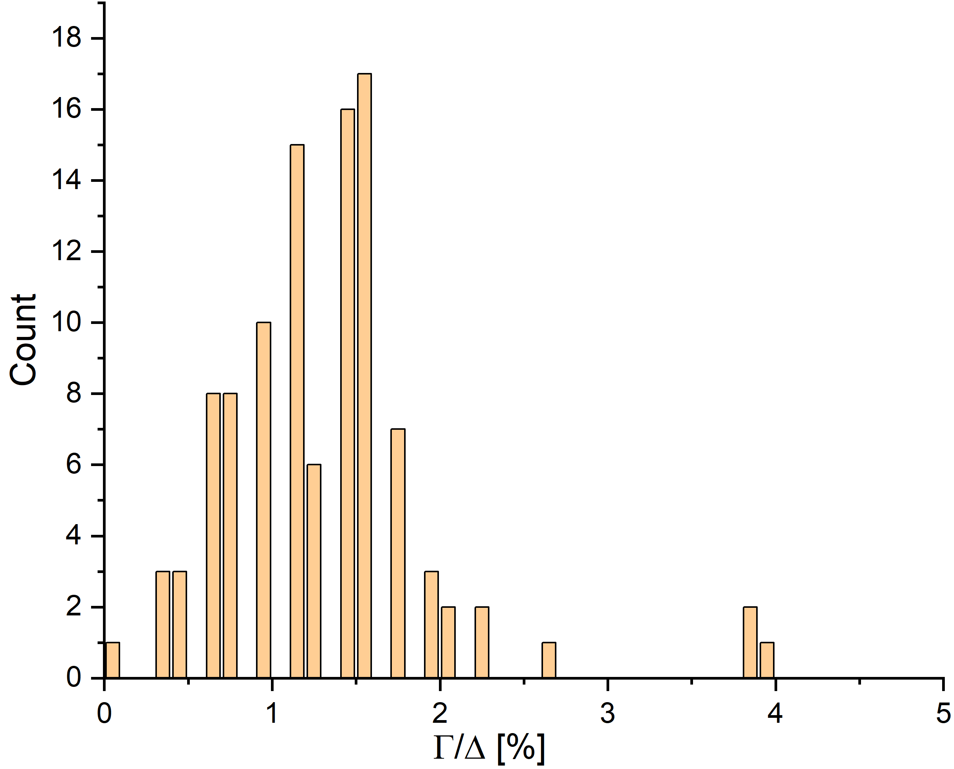
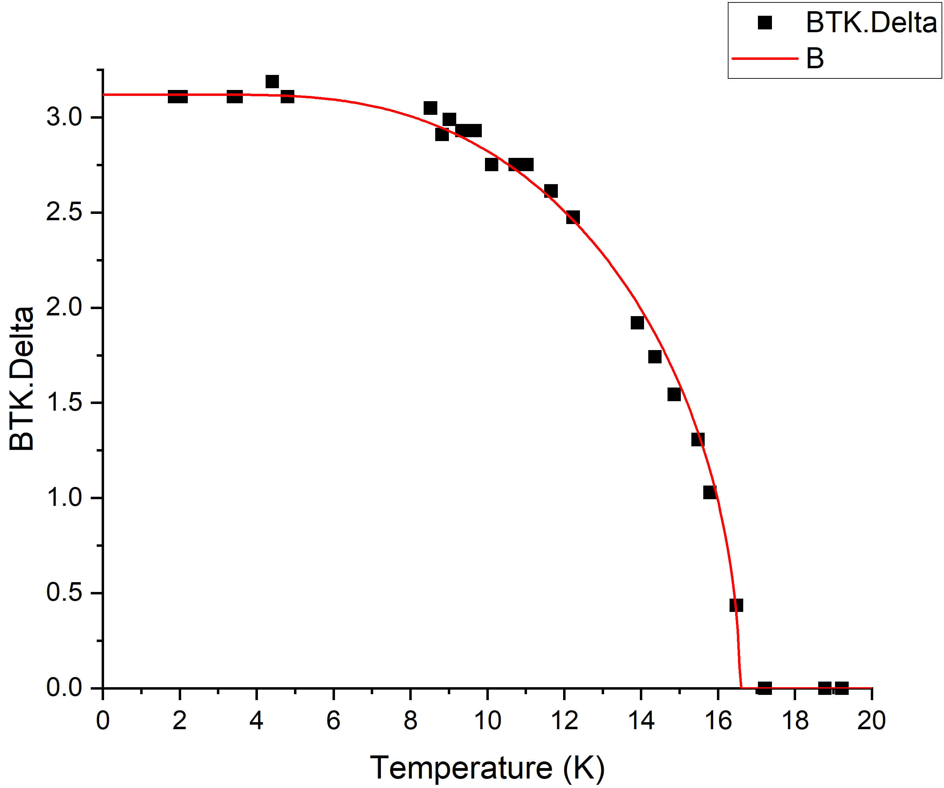
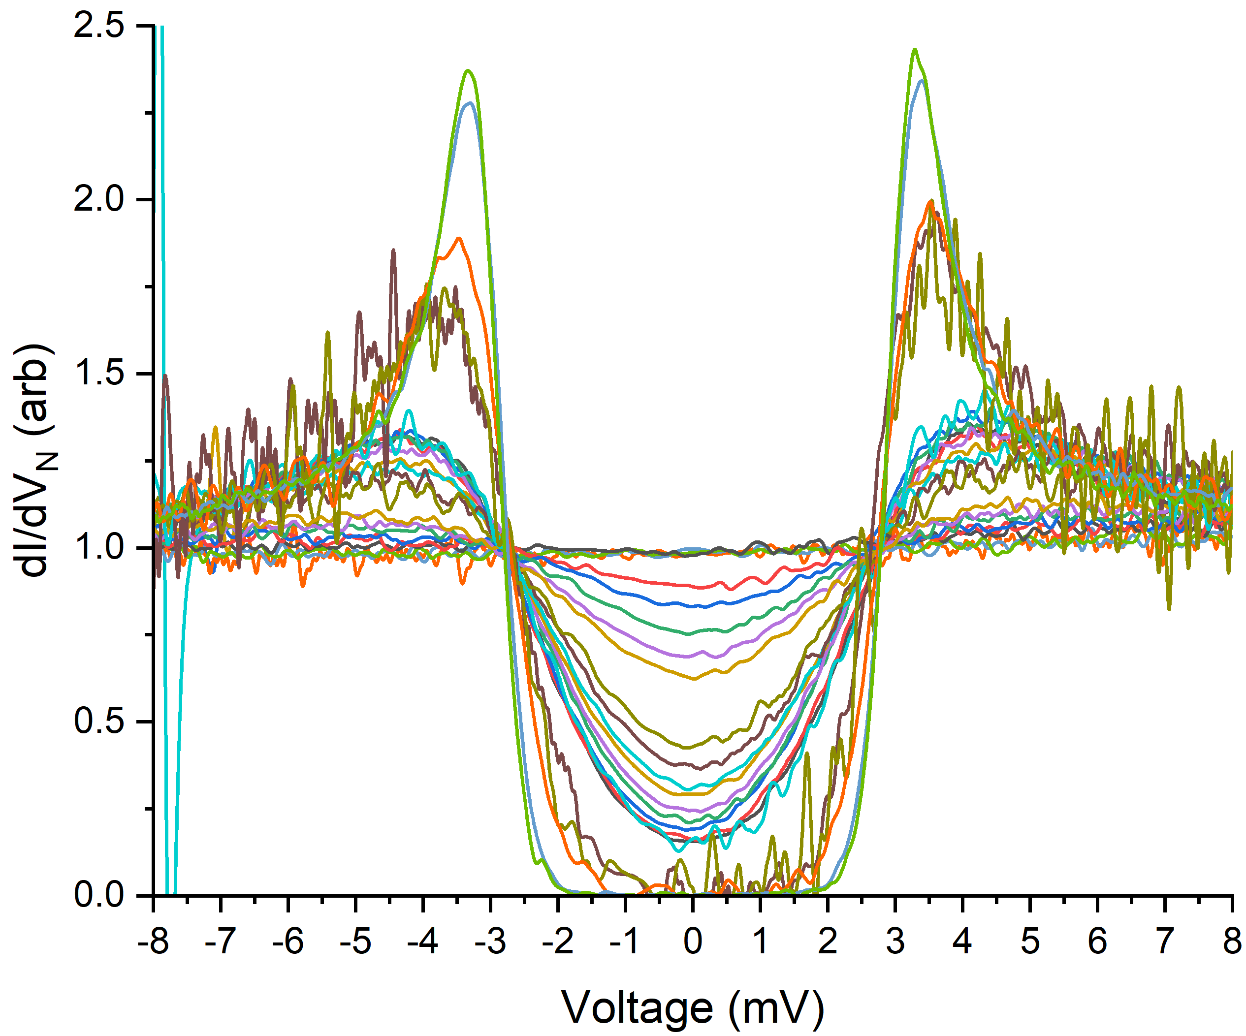
Base Material: NbTiN
2µm NbTiN (001)/MgO(001)
T_{c}~17.25 K
T_{c} = 17.2 K in both field directions
H_{c1} = 70 mT
H_{c2}(0) ~12-13 T
The uncertainties are underestimated, but linear behavior is very clean.
b is the linear coefficient of the fits.
TEM at NbTiN/MgO interface
SQUID meas – RAL & KU Leuven
PCT meas – CEA Saclay
Δ= 3.1 meV
ACCELERATE SCD

Slide 8
Preliminary Results on NbTiN Wires
SEM images of two metal layers with 50 nm critical dimension.
Anna Herr, et al. ,arXiv:2303.16792 [physics.app-ph]
Number of vortices as a function of applied field in 10 µm strips fabricated from 50 nm and 100 nm-thick films
Images of field-cooled NbTiN patterned films
Images in a single cooldown in 12 µT field (a) and average across 50 cooldowns (b-c) of a 20 µm-wide, 100 nm-thick strip show grouping of vortices along the center of the strip with 42% trapping probability per site. d)-f) Similar data for a 50 nm-thick strip field-cooled in 14 µT. Preferred trapping sites here include locations near the edge of the strip indicating more defectivity. g) Low-field images of a 180 µm x180 µm NbTiN film with 0.5 µm moats spaced 20 µm in a single cooldown (top) and average across 15 thermal cycles (middle). Extracted locations of vortices (bottom) show 100% trapping probability in the holes.

Slide 9
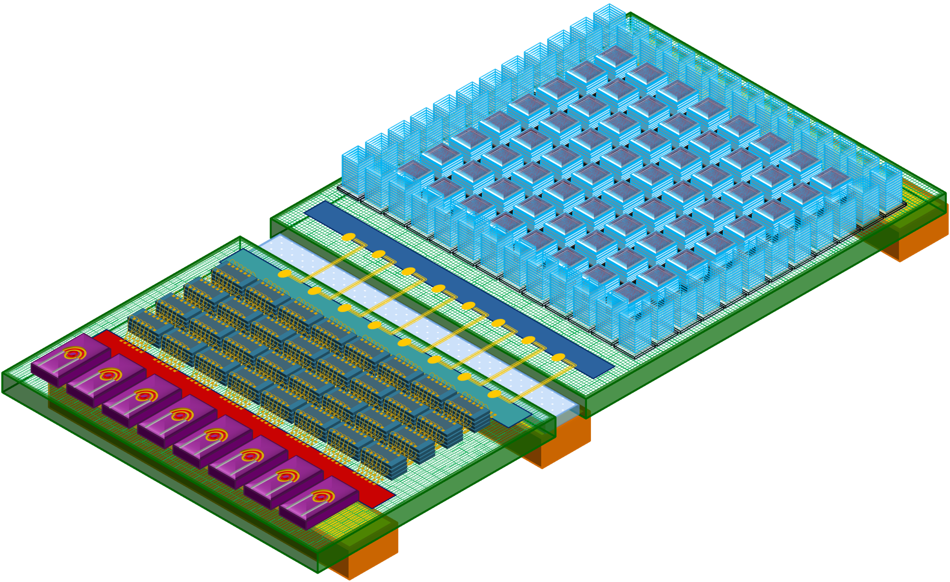



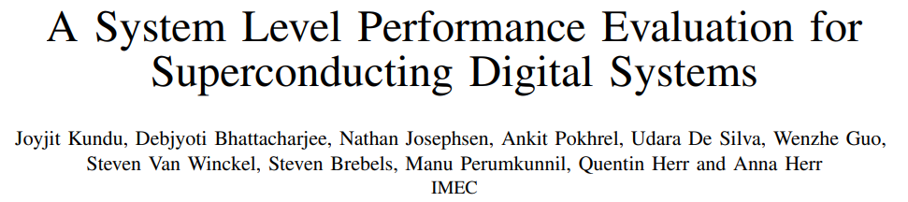
Superconducting Digital Technology: the Vision
System
Glass bridge/ thermal break
4K-77K link
Cryo-CMOS interposer (77K)
Cryo-DRAM
Cryo-optical modulators
Architecture
Superconducting interposer (4K)
Superconducting compute stacks
Superconducting network stacks
Integrated Circuits
Device/component
Tech & process
Copper
Plate (4K)
FP2
M6
M5
MF
M4
M3
M2
M1
M0
GND
MP5
MP4
MP3
MP2
MP1
FP1
Optical
Network)
Copper
Plate (12K)
Optical
Network)
Copper
Plate (77K)
Design, Automation and Test in Europe Conference (DATE2025 on Arxiv)

Slide 10


Superconducting Digital Technology: Focus Areas
System
16ML stack vision to enable scalable superconducting digital technology
Architecture
Integrated Circuits
420°C budget
High $Lkinetic$
Device/component
Tech & process
Stoichiometry
FP2
M6
M5
MF
M4
M3
M2
M1
M0
GND
MP5
MP4
MP3
MP2
MP1
FP1
Flux trapping layer
Full NbTiN platform
Superconducting BEOL
(wires & vias)
Superconducting FEOL
(JJs)
$TC$ > 13 K
AC Power delivery network
(tunable capacitors)
Flux trapping layer

Slide 11
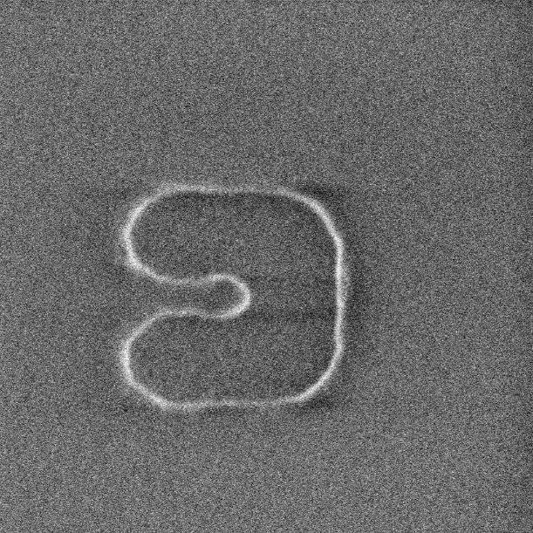
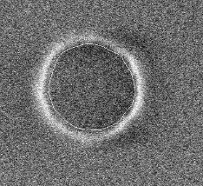
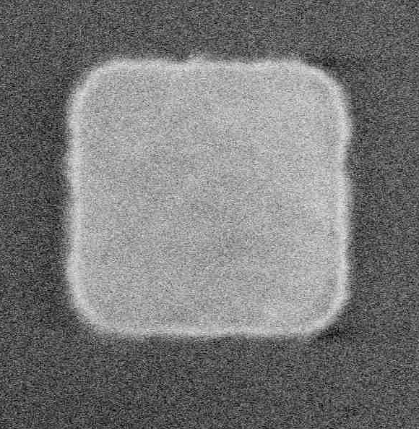
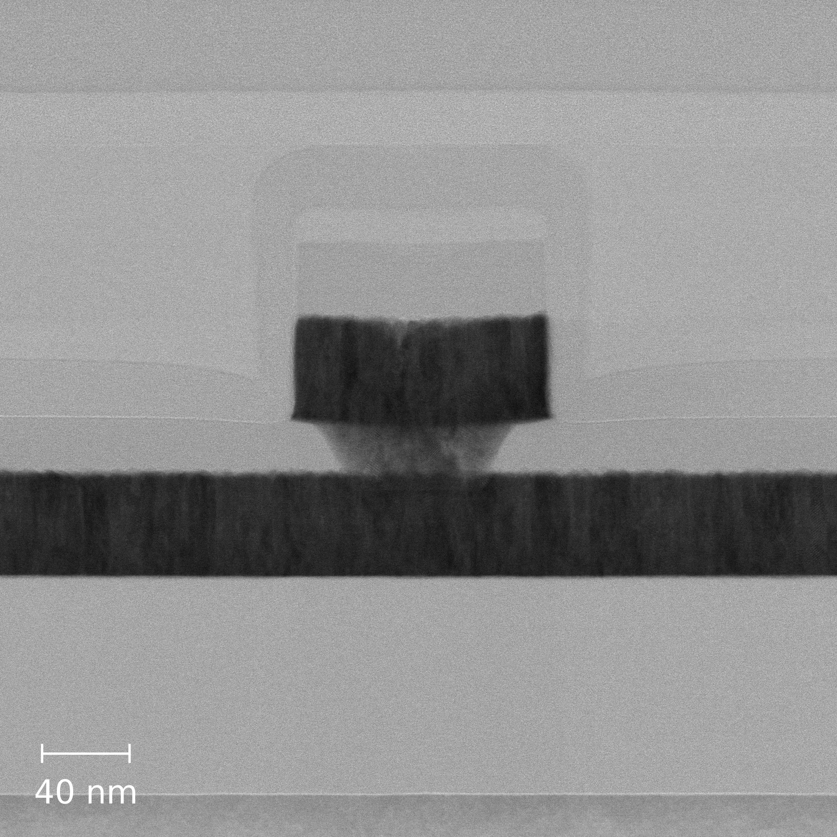
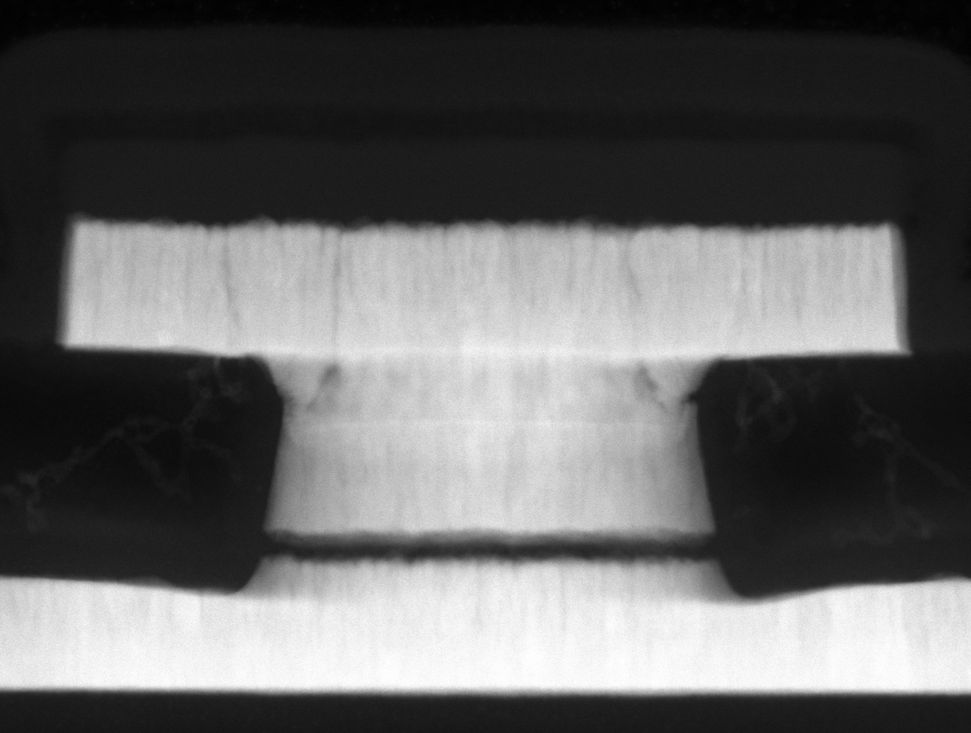
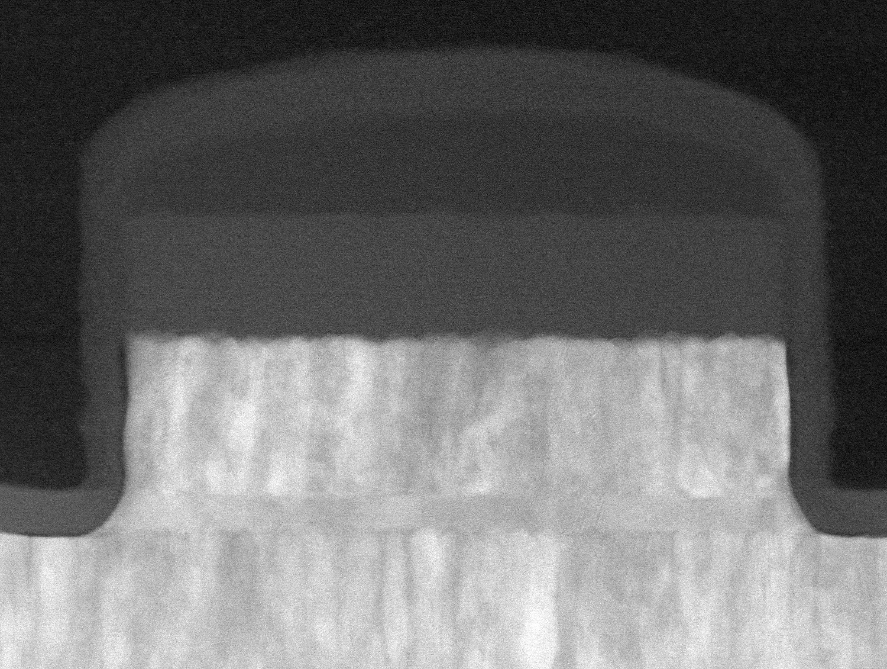
Superconducting Digital Technology: Focus Areas
System
16ML stack vision to enable scalable superconducting digital technology
Architecture
Integrated Circuits
Moats & flux trapping structures
Device/component
Tech & process
CD 330nm
CD 130nm
CD 500nm
Wires & vias
FP2
M6
M5
MF
M4
M3
M2
M1
M0
GND
MP5
MP4
MP3
MP2
MP1
FP1
Flux trapping layer
α-Si barrier JJs
SiOx
SiN
M2
40nm
V1
M5
M1
M2
V1
αSi
M1’A’
100nm
M1’B’
SiOx
SiN
M1’A’
HZO MIMCAP
HZO
50nm
M1’B’
Flux trapping layer

Slide 12
Superconducting Digital Technology Scale-up
Material set
&
Process flow defined
Integrated stack defined.
Unit processes characterization complete, PDK alpha.
Material and process flow development
Integration
Validation optional
NYCreates
NYCreates
NYCreates
NbN, NbTiN
2 & 5 ML stack, failure modes vehicles
Test functional vehicles
Material set A, PCM, resonators
Imec VZW
NbTiN, Si, HZO
imec
imec
Demo Design & Test:
5ML stack meets material specifications
Material set B, PCM, resonators
JJ with integrated transfer, UPD scaling
UPD scaling, knowledge transfer
7 ML stack characterization complete: density, power, failure modes
Imec USA
Design, test, performance modeling
Jefferson Lab
NbTiN optimization by EC, material science, advanced experimental techniques
Cornell
Material science, advanced experimental techniques

Slide 13
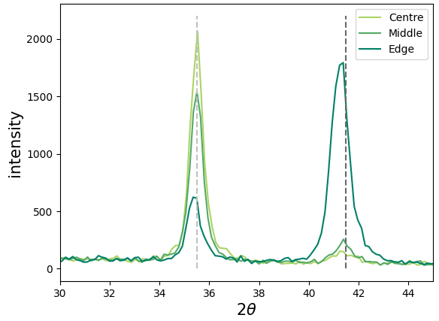
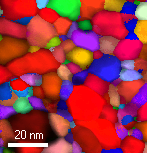
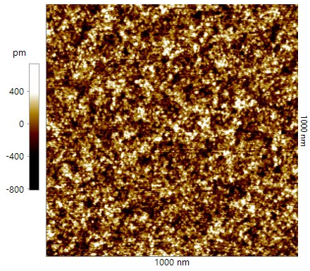
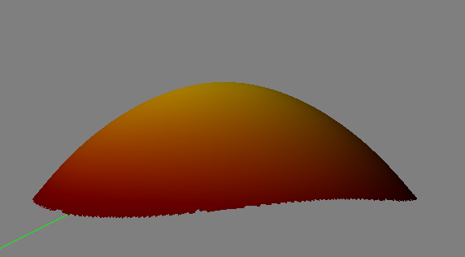
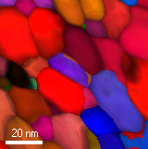
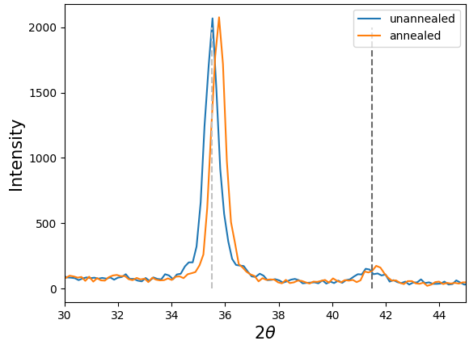
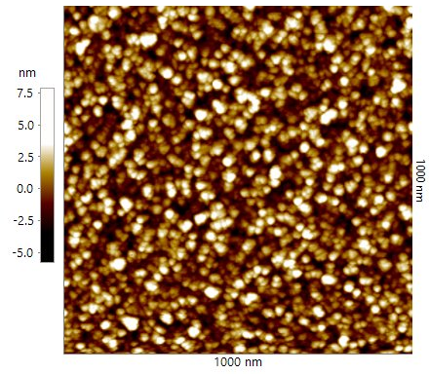
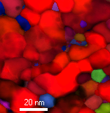
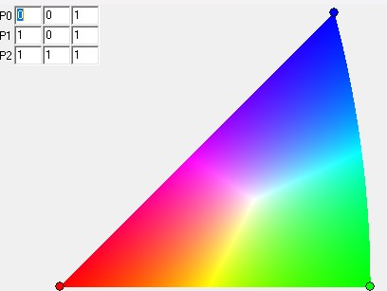
NbTiN Engineering/Flavor Portfolio
Transfer research lab development to Nanoelectronics research hub to develop processes for foundries
Stress (bow/Stoney)
Crystallinity (XRD)
Grain size (PED)
Roughness (AFM)
(111)
(200)
50nm on SiO2
Single-target, 200nm
Single-target, 7nm
Stoichiometry (RBS/ERD)
200nm on SiO2
C
ST
ST Low N
E
C
E
50nm on Si
MT
E
Single-target, 200nm
Single-target, 200nm
(annealed at 650C)
C
<111>
<001>
<110>

Slide 14
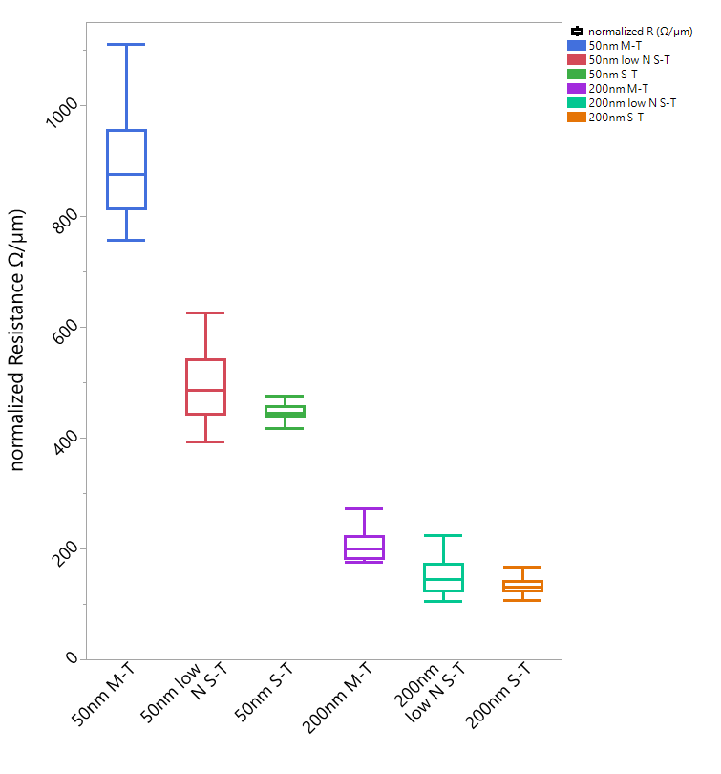
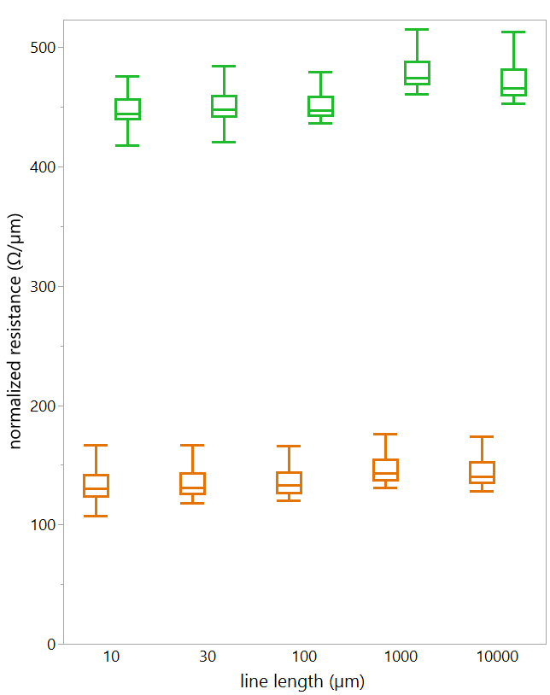

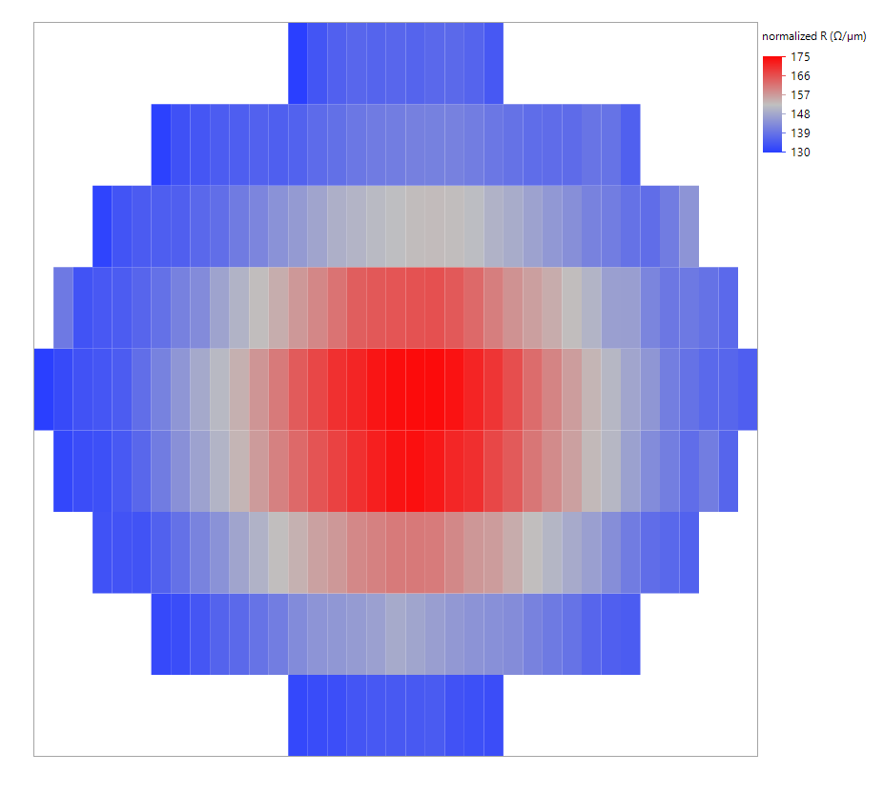

1ML BEOL electrical testing
Wire electrical measurements are in line with film properties
50nm S-T
Wafer distribution
CD lines:
Width: 70 nm
Meanders:
Width: 70 nm
CD lines:
Width: 70 nm
Length: 10 um
200nm S-T

Slide 15
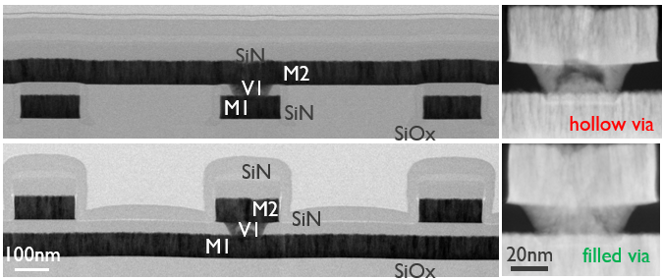
3ML BEOL
M3
M2
M1
Wires with width scaled down to 50nm (yield >95%)
Uniform distribution of Nb, Ti and N with clean O-free interfaces
Optimized via etch and Ar pre-clean for optimal via filling QA

Slide 16

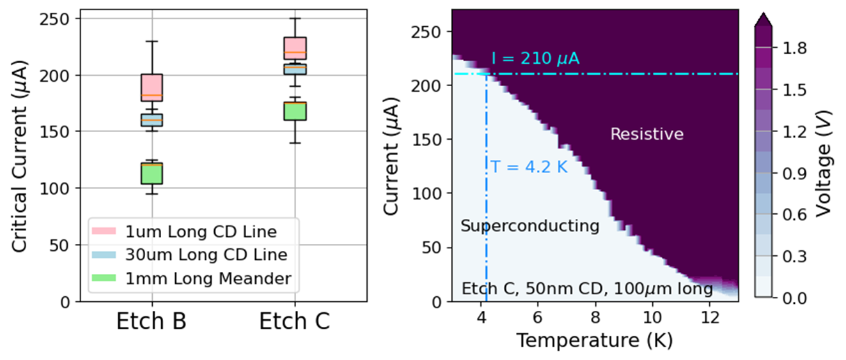
Electrical testing
B. Hodges et al., IITC 2025
2024
2025
Process generation
Critical current dependence on length, etch, and temperature

Slide 17
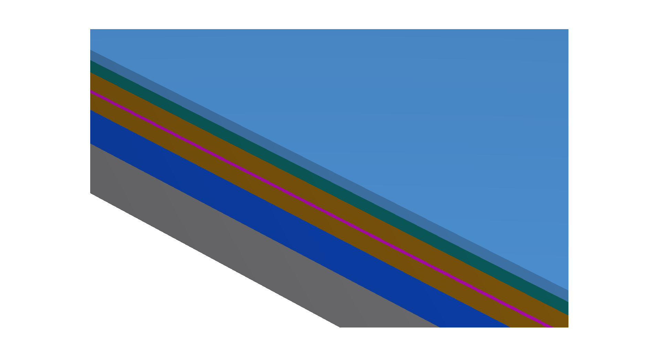
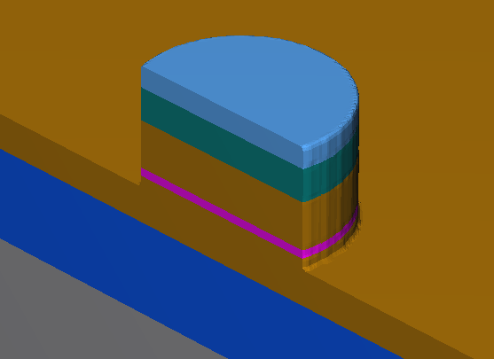
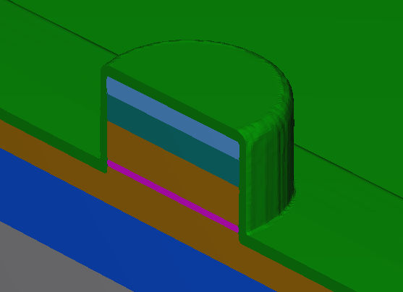
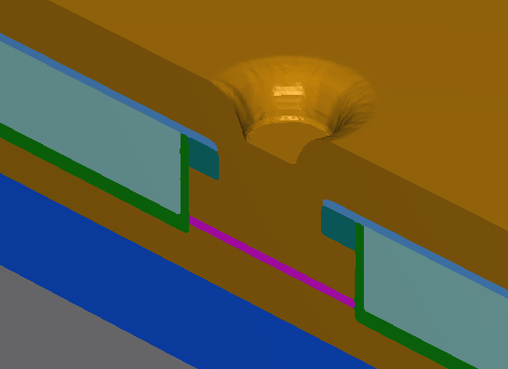
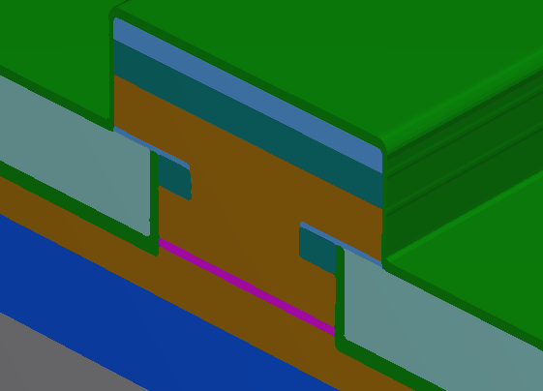




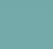
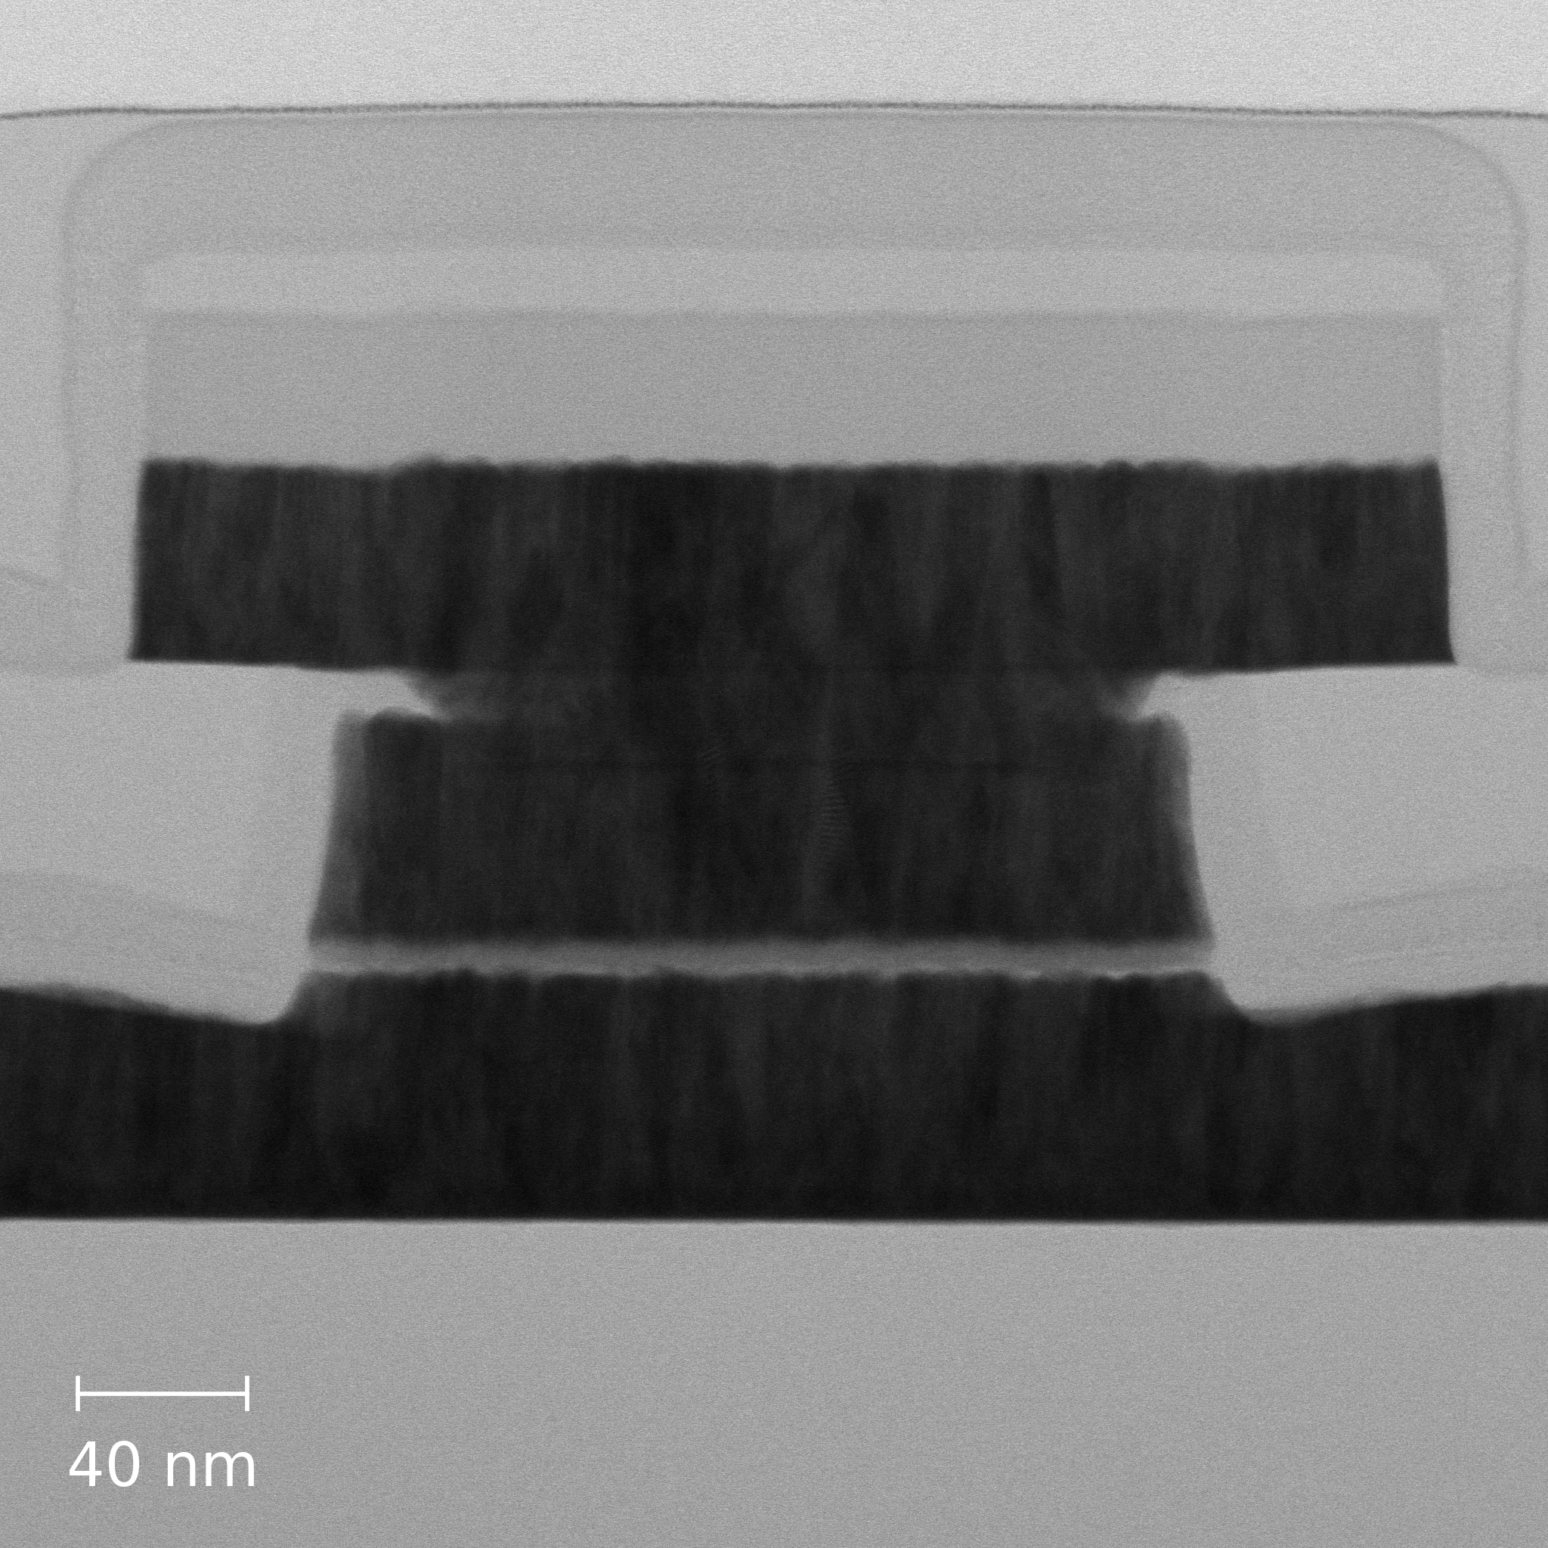
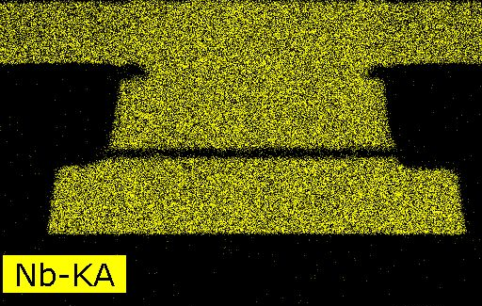
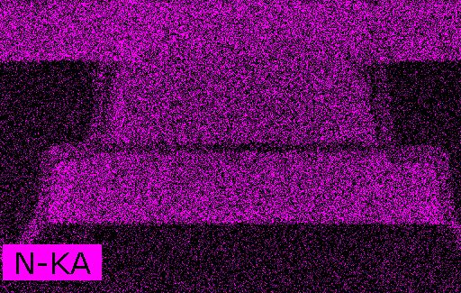
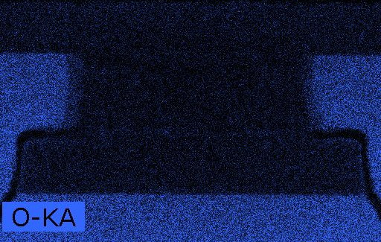
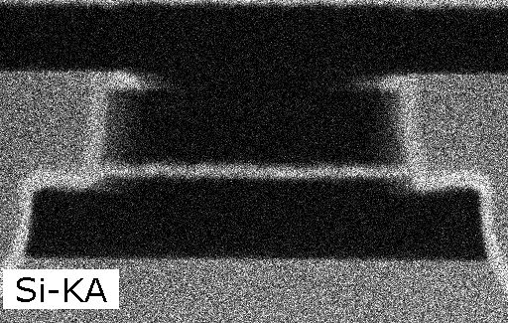
Josephson Junctions (JJ) fabrication flow
Stack Deposition
JJ Etch
Base Patterning
Via Etch and Fill
Top Patterning
Si substrate
Thermal SiOx
NbTiN
aSi barrier
HM SiN
HM SiOx
Encapsulation SiN
ALD SiOx
New stack: NbTiN/aSi/NbTiN
Litho: 193i (210nm CD)
Process: PVD & etch
Base
SiN encap
JJ
HM SiOx
HM SiN
NbTiN
aSi
NbTiN
17

Slide 18


Cryogenic performance
A. Pokhrel et al.,
IEDM 2024
Typical nonhysteretic behavior corresponding to low capacitance and IcRn of ~1.1 mV
Ic between 27-55 μA corresponding to Jc of 0.8 mA/μm² and scales with device area

Slide 19

Cryogenic performance
Critical current density scales with Si
J_{c}: 0.5-2.9 mA/µA²
I_{c}R_{n}: 1.1-1.3 mV
Olaya et al., Appl. Phys. Lett. 2023
Tolpygo et al., IEEE Trans. Appl. Superconduct. 2023
Cyberey et al. IEEE Trans. Appl. Supercond.2024

Slide 20

MIM Capacitor Fabrication
Stack Deposition
JJ Etch
Base Patterning
Via Etch and Fill
Top Patterning
Si substrate
Thermal SiOx
NbTiN
HZO
HM SiN
HM SiOx
Encapsulation SiN
ALD SiOx
New stack: NbTiN/HZO/NbTiN
Litho: 193i (195nm CD)
Process: PVD (NbTiN), ALD (HZO) & etch
Devices with diameters of 195-600 nm
CD control of <2% across the 300 mm wafer
Clean interfaces between different layers.
Uniform distribution of Nb, Ti, and N in the electrodes
20

Slide 21




Capacitors are Tunable at Cryogenic Temperature
Tunability ~5%
Symmetric CV
Coercive Voltage = 1V
Saturation = 2V
49000 caps
49000 caps
RT
spec
Cryo
$$I_{per cap}\left(3V\right)=160 fA$$
Capacitance and ferroelectric properties are temperature independent between 3-15 K
Leakage current at 2.6K is 2 orders of magnitude lower than at 300K
C_{f}: 3 µF/cm² @RT, 2.9 µF/cm² @4.2K
Tunability: 10% @RT, 5% @4.2K
S. Ibrahim et al.,
Arxiv 2025

Slide 22

Conclusions and outlook
NbTiN based 3ML wires and vias, 2ML αSi JJs and 2ML HZO MiMCaps meet specifications for SCD circuits targeting 0.4BJJ/cm².
These properties and processing temperature budget of 420 ºC open a path for fabrication of SCD circuits compatible with current 300mm CMOS technology.
Continuous improvement of performance through
Better process control
New integration schemes
Material engineering
Pushing scaling limits
Failure Mode analysis
Incrementally develop processes to 7 ML
Technology Transfer to foundries for full stack (16 ML) fabrication

