Slide 1
Activities at INFN LASA towards HighQ/HighG
D. Sertore
INFN Milano – LASA
for the SRF group

Slide 2
Outline
Motivation
High Q and High G
Treatment selection
Industrialization
INFN activities
PIP-II
ESSP
Synergies
ITN
EPITA
BriXSinO

Slide 3
Motivation

Slide 4
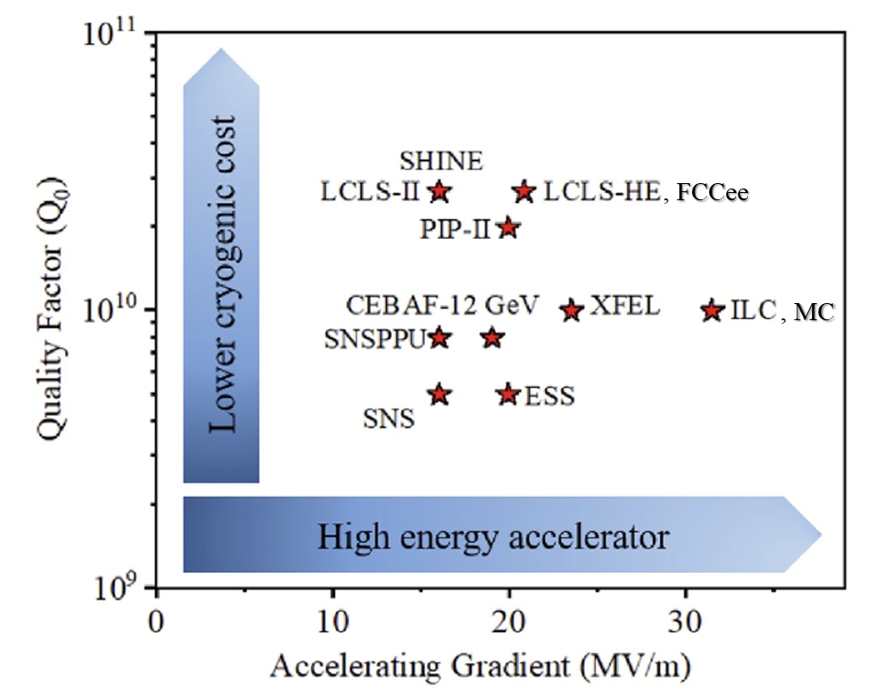
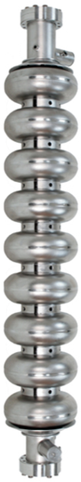
Requirement for future accelerator: HighQ & HighG
Future machines require increasingly high SRF cavity performance -> HighQ & HighG
Example of High Q₀ e High E_{acc} (ESS, 704.4 MHz, β=0.67)
HighQ -> power saving
HighG -> shorter machine
Sustainability & Cost reduction
Specs for cavities in operational condition (cryomodules)
Project | Frequency | Cavity type | E_{max} (MV/m) | Q₀
FCC-ee | 800 MHz | 5-cell | 20 | 3.10¹⁰
ILC, pulsed | 1.3 GHz | 9-cell | 31.5 | 1.10¹⁰
muon collider (base scenario), pulsed | 1.3 GHz | 9-cell | 30
E-XFEL, pulsed / CW E-XFEL | 1.3 GHz | 9-cell | 23.6 / 17 | 1.10¹⁰ / 2.10¹⁰
PIP-II (low β), from 20Hz to CW | 650 MHz | 5-cell | 16.7 | 2.4.10¹⁰
LCLS-II (CW) | 1.3 GHz | 9-cell | 16 | 2.7.10¹⁰
9-cell 1.3 GHz cavity for ILC Japan
Cavity qualification goal (vertical test) typically 10% higher w.r.t operational goal
As an example, for ILC:
E_{acc} ≥ 35 MV/m @ Q₀ ≥ 1.10¹⁰ (qualification)
E_{acc} ≥ 31.5 MV/m @ Q₀ ≥ 1.10¹⁰ (operational)

Slide 5
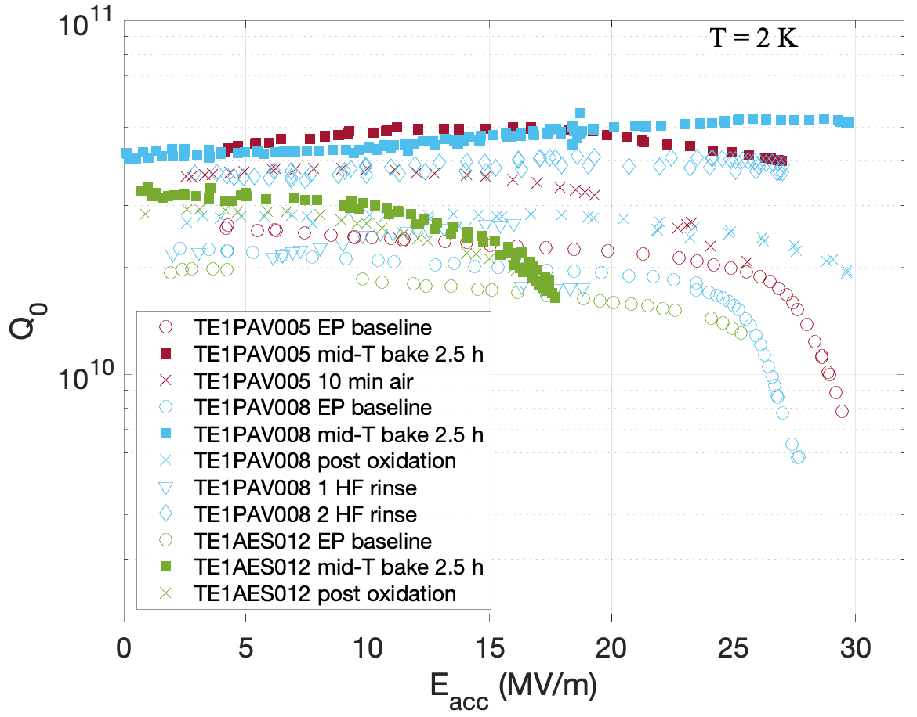
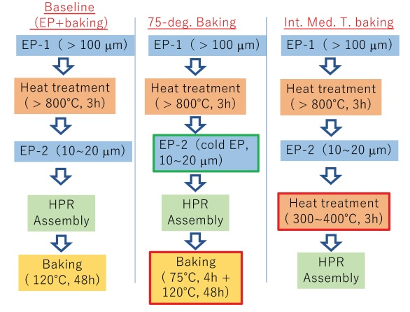
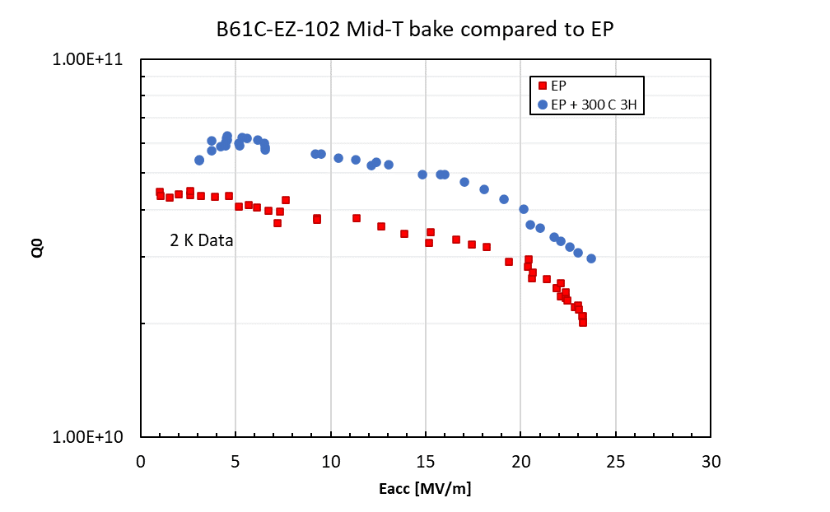
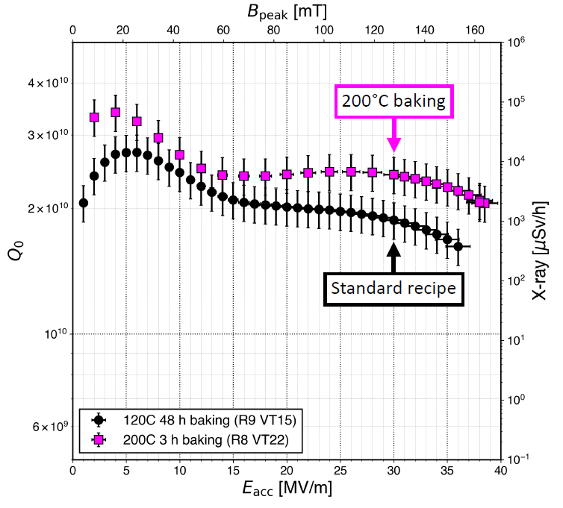
R&D up today
Mid-T baking
Two step baking
Typical treatments (HighQ/HighG):
EP cold (best surface finishing)
High temperature Annealing
From 800 °C a 900 °C
Final heat treatment
Two-step baking
Mid-T baking
…but on-going R&D suggests possible improvements (different Ts, etc.)
US
US/EU/Japan
Possible treatments
baseline
Two-step
Mid-T
China
PIP-II
«New» 200 °C bake treatment
EU (INFN)/US
Japan

Slide 6
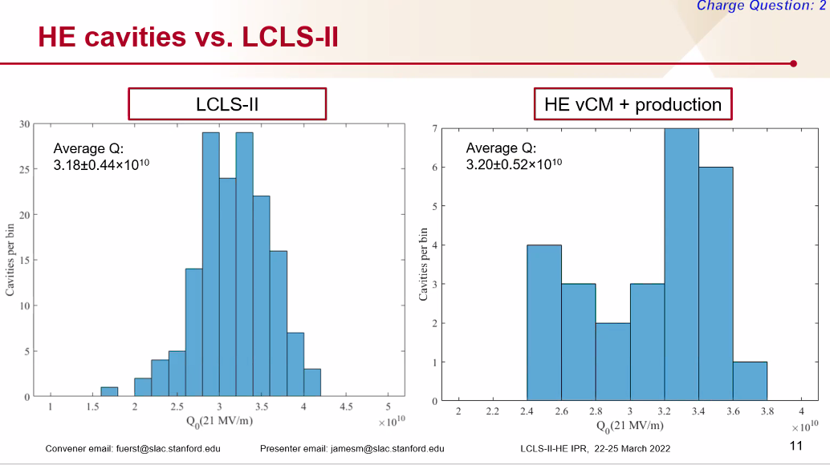
R&D and industrialization
R&D (Single and Multi-cells): select “recipes” for performance optimization (cold VT @ 2K)
Clean room, High pressure rinsing (HPR), Buffer Chemical Polishing (BCP), Electropolishing (EP), low T baking, N doping, 2-step baking, Mid-T baking, etc.
Optimization of cavity geometry (RF and geometry)
Field Emission Reduction
Migration to multi-cells and industrialization for large machines: Yield and reproducibility
R&D results vs time & Large Machines
Reproducibility over large series
800 cavities
E-XFEL
280 cavities
LCLS-II
Vertical Test
Q₀ goal : 2.7x10^10
Vertical Test
Snapshot: 28 December 2018

Slide 7
INFN LASA Activities

Slide 8
INFN Milano LASA strategy
The SRF group at LASA is a leader in the field of bulk niobium SRF cavities, with participation in international projects such as European-XFEL, ESS, and PIP-II.
To maintain this excellence, in view of future high-performance accelerators such as lepton
colliders and light machines, it is essential to develop SRF cavities with high Q₀ and High G.
Our strategy consists of R&D activities with 1.3 GHz single cells to develop treatments to extend the high Q towards the high gradient required by projects such as ILC, FCC-ee, CePC, Muon Collider, etc.
It is also essential to transfer the recipe to multi-cell cavities for possible large-scale production.
The activities we propose can be summarized as follows:
Development of recipes for high Q/high gradient (high-Q/high-G)
Process transfer to multi-cells
R&D on cavity ancillary systems (tuners, magnetic screens, etc.)
Profit from synergic program as our contribution to PIP-II (high Q) or other international programs.

Slide 9
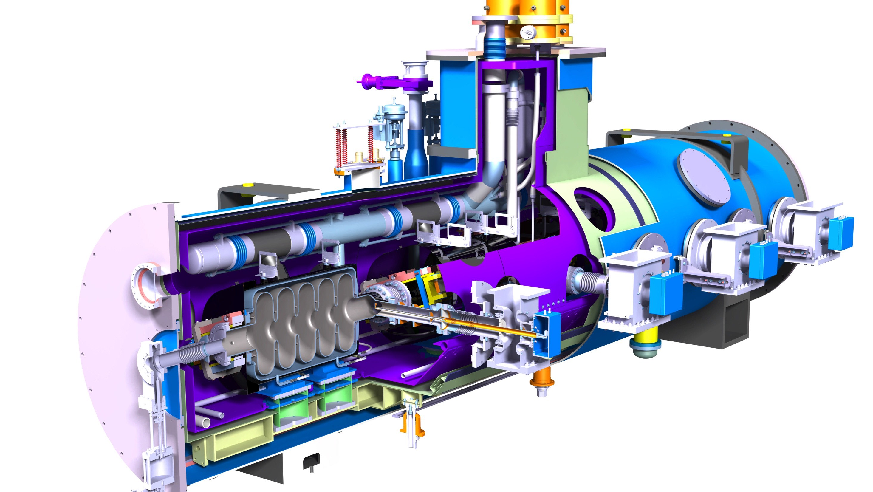
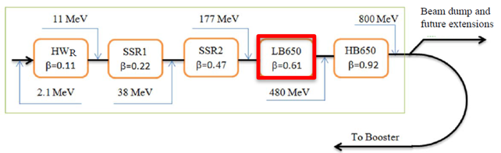
PIP-II: INFN contribution
INFN firstly provided a novel RF design for the LB650 cavities, fully plug compatible with the Fermilab technical interfaces and performances specifications.
Cavity design meets the CW RF performance requirements
INFN contribution aims to cover the needs of LB650 section, and this includes:
38 (36+2) SC cavities required to equip 9 cryomodules with 2 spares, delivered as ready for string assembly.
Qualification via vertical cold-test through a qualified cold-testing infrastructure acting as a subcontractor
Compliance to the PIP-II technical management plans and interfaces: System Engineering, Project Review, Quality Assurance and Risk Management.
PIP-II LB650 Project Specifications
Acc. Gradient | 16.9 MV/m
Q₀ in operation | 2.4 10¹⁰
RF rep rate | 20 Hz to CW
β | 0.61
Low-Beta (LB650, b=0.61) cryomodule
RT
SC
Cryomodule picture is a courtesy of Nicolas Bazin, CEA, France

Slide 10
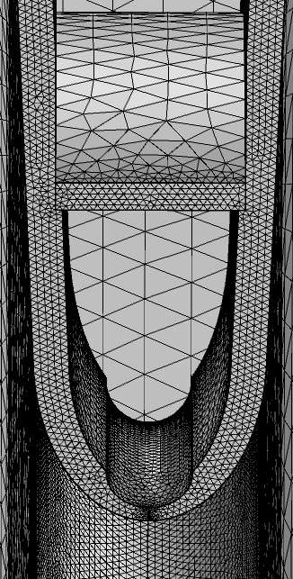
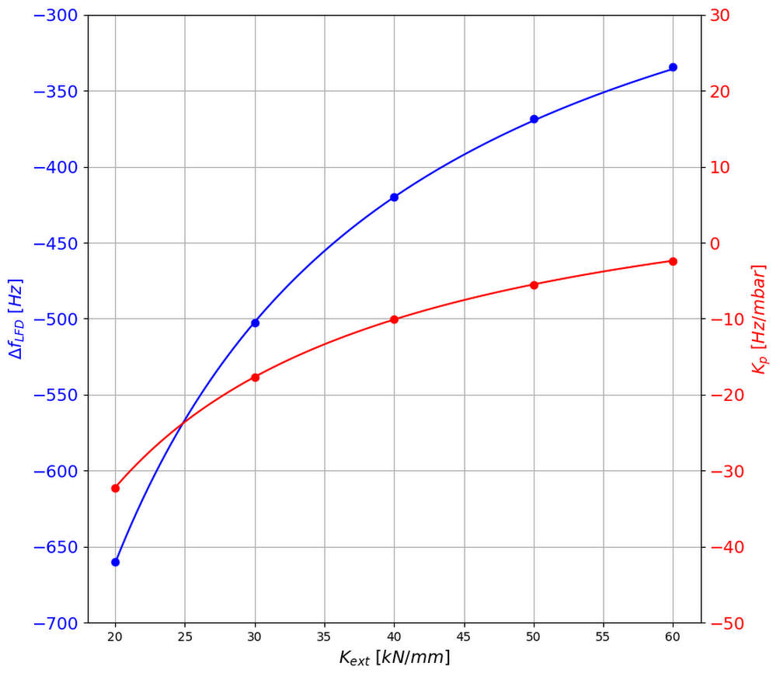
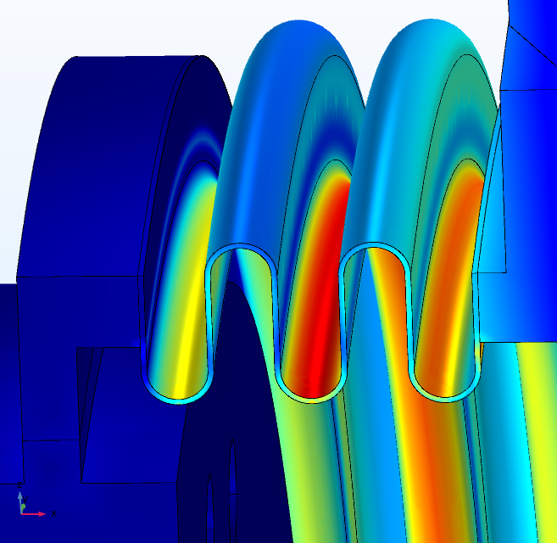
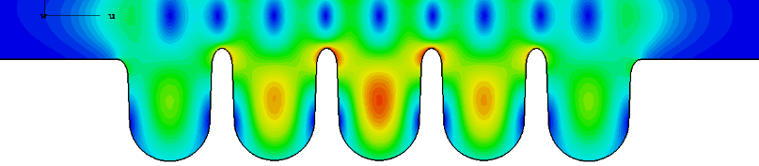
PIP-II: INFN LB650 cavity challenges
INFN LB650 for PIP-II, cold cavity
β_{geometric} | 0.61
Frequency | 650 MHz
Number of cells | 5
Iris diameter | 88 mm
Cell-to-cell coupling, k_{cc} | 0.95 %
Frequency separation π-4π/5 | 0.57 MHz
Eq. diameter - IC | 389.8 mm
Eq. diameter - EC | 392.1 mm
Wall angle – Inner-End cells | 2 °
Effective length (10*L_{hc}) | 704 mm
Optimum beta β_{opt} | 0.65
E_{peak}/E_{acc} @ β_{opt} | 2.40
B_{peak}/E_{acc} @ β_{opt} | 4.48 mT/(MV/m)
R/Q @ β_{opt} | 340 Ω
G @ β_{opt} | 193 Ω
Inner cells stiffening radius | 90 mm
External cells stiffening radius | 90 mm
Wall thickness | 4.2 mm
Longitudinal stiffness | 1.8 kN/mm
Longitudinal frequency sensitivity | 250 kHz/mm
LFD coefficient k_{ext} at 40 kN/mm | -1.4 Hz/(MV/m)²
Pressure sensitivity k_{ext} at 40 kN/mm | -11 Hz/mbar
Maximum Pressure VM stress at 50 MPa | 2.9 bar
Maximum Displacement VM stress at 50 MPa | 1.5 mm
The successful cavity design from INFN-LASA is the result of an interplay of multiple, state-of-the-art competences in electromagnetic, mechanical and technical domains.
PIP-II LB650 cavities are among the key scientifical challenges of the project:
an unprecedented quality factor is required for these resonators.
Accelerating and High-Order Modes must be assessed so that neither instabilities nor additional cryogenic losses are posing critical issues.
PIP-II operational scenario is an uncharted territory in terms of detuning control, and this requires deep understanding of Lorentz Force detuning, pressure sensitivity and mechanical leading parameters as rigidities, yield limits, stresses.
Detailed finite element analysis to ensure compliancy to ASME codes.
LFD frequency shift (blue) and pressure coefficient (red) as a function of external cavity stifness at cold.
Example of FEM structural analyses on LB650
Last HOM in 3rd monopole passband

Slide 11
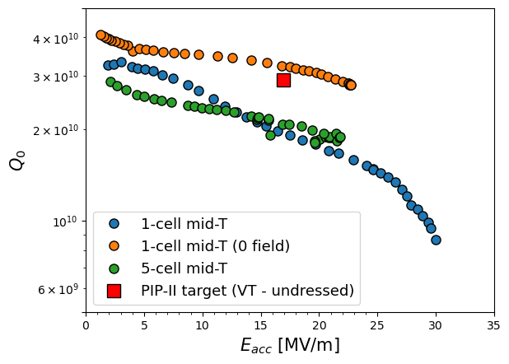
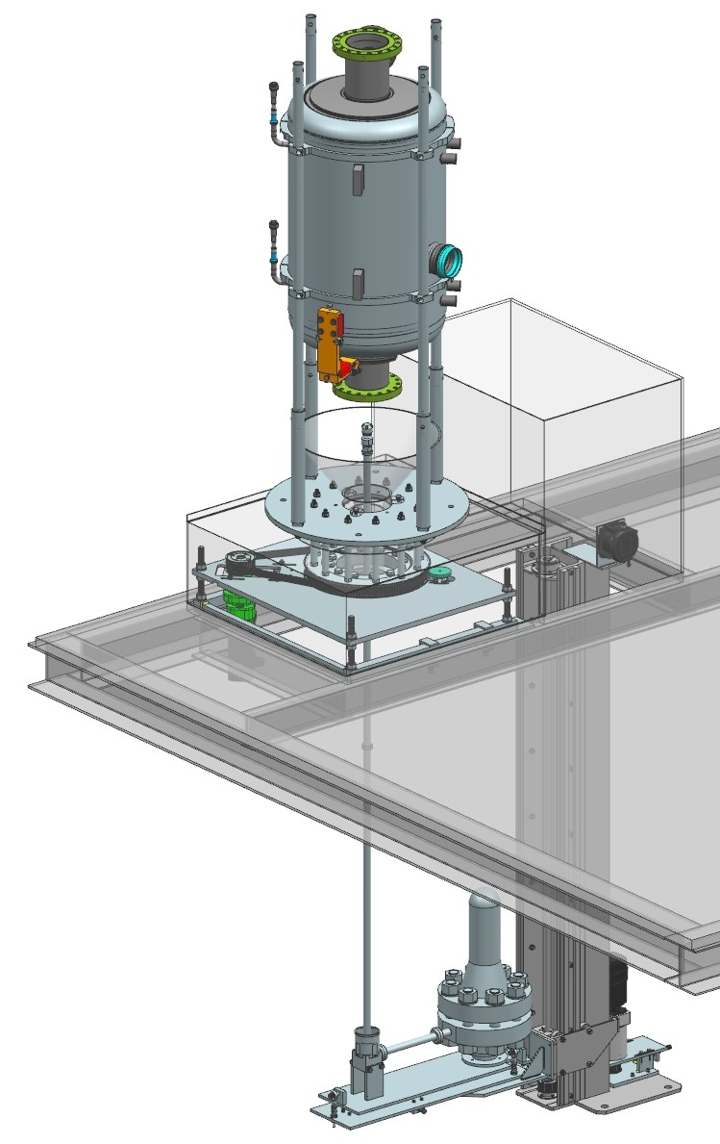
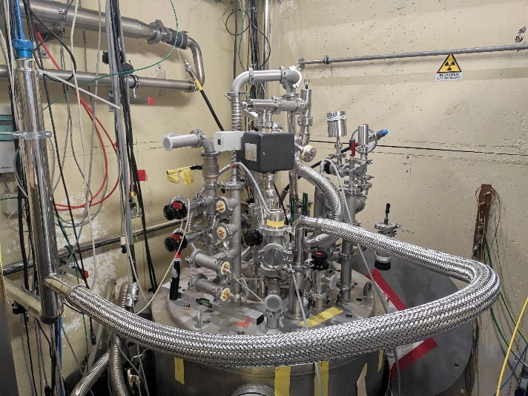
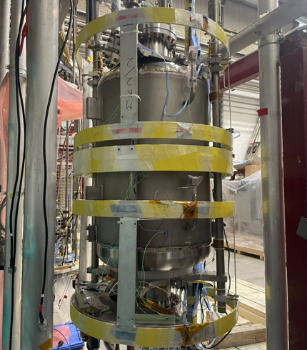
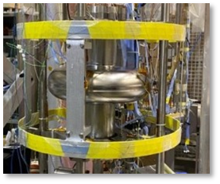
PIP-II: Latest achievements
Single and 5-cell cavities test results
5-cell B61-EZ-002 fully treated and tested jointly with FNAL.
Now available at CEA for the pLB650 CM
B61-EZ-103 tested at INFN and at FNAL. Data analysis cross-check in progress.
Single cell tested with full magnetic field compensation to validate cancellation procedure.
LASA test stand update for High-Q measurement
Upgraded LHe filling line installed, it improves cooldown rate and reduce losses. Expected faster Tc crossing.
Helmholtz coils for single and multi-cell cavity developed and successfully tested in cryogenic conditions. Dedicated optimization procedure developed and applied during cavity test.

Slide 12
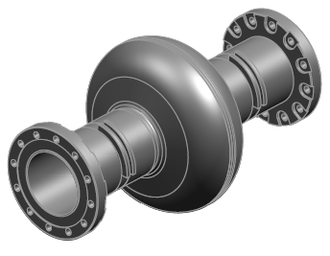
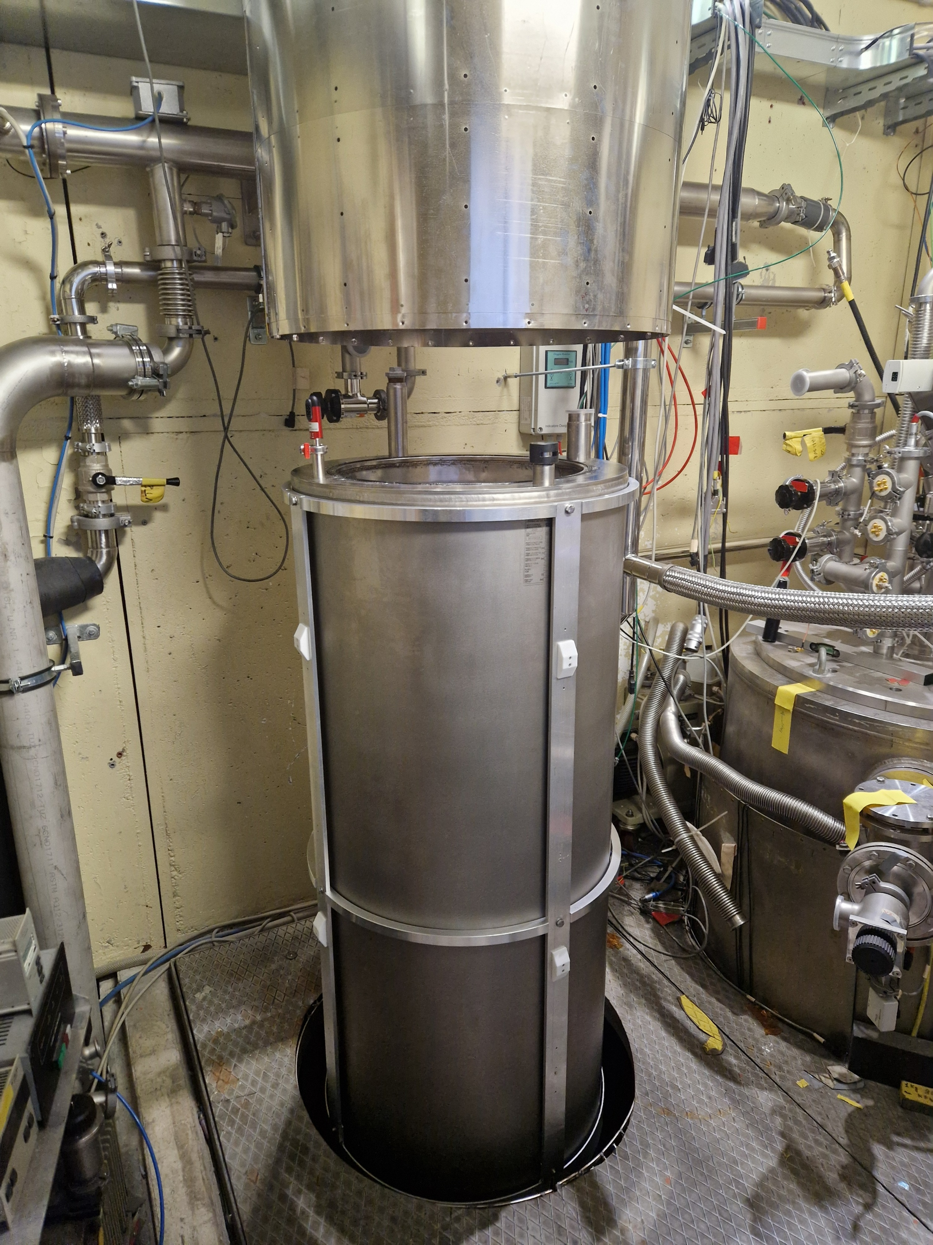
INFN LASA R&D Activity Plan
Use of single-cell and multi-cell cavities at 1.3 GHz in bulk Nb
2 Single cells: study and development of surface and thermal
Mechanical production (Production is on-going)
Baseline treatment (Eu-XFEL optimized with EP cold and 900 °C)
Innovative treatments (two-step baking, mid-T baking, etc.)
2K testing at LASA; cross-checking in other international laboratories (e.g., CEA)
2 Multicells: migration of treatment identified for industrialization
Mechanical fabrication
Reproducibility of treatments and robustness verification
Upgrade of the SRF system for LASA cold VT:
New cryostat for cold vertical testing (2K) of single cells:
Lower LHe consumption, reduced test duration, fast transition to 4.2K
Implementation for active magnetic field cancellation (Helmholtz coils)
Sensors for diagnostics
New cold vertical test acquisition system (2K):
1.3 GHz amplifier
From analog to digital (PLL design completed)

Slide 13
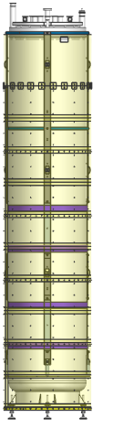
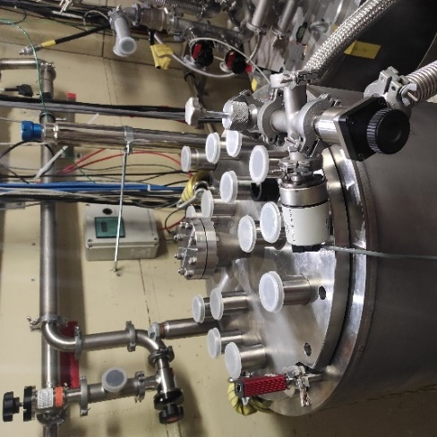
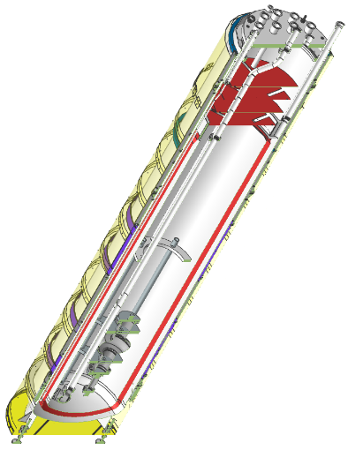
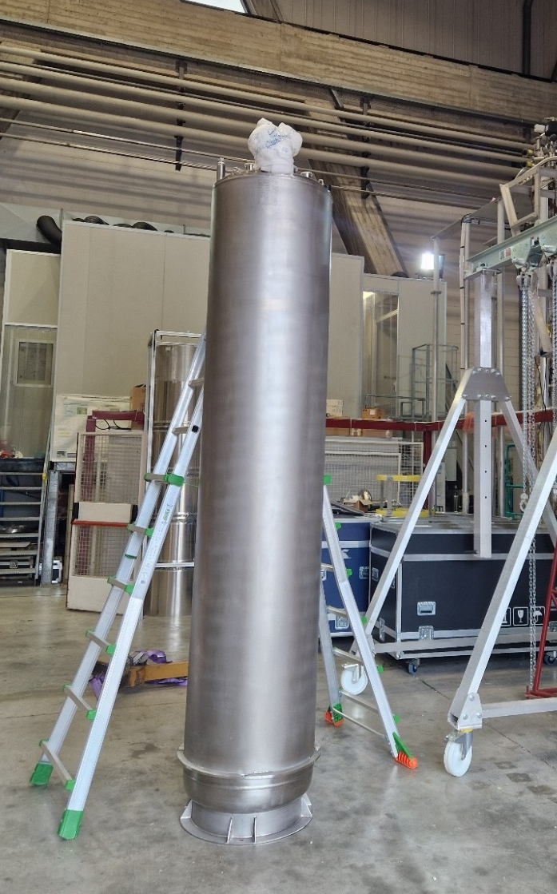
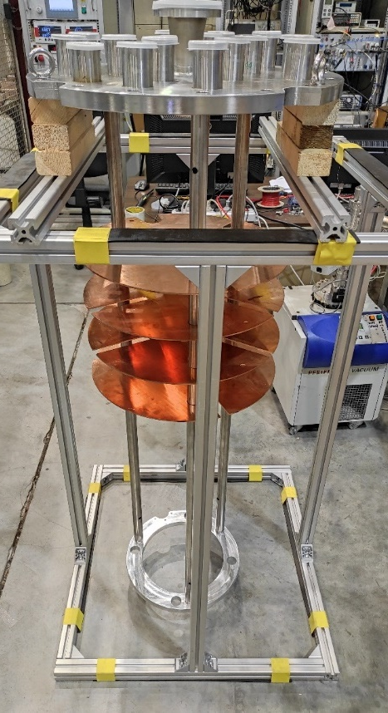
New Cryostat for Cold Vertical Testing
Dedicated cryostat
L = 3000 mm, OD 610 mm
Useful volume 730 liters
Specific design for 1.3 GHz cavity
Cold testing up to 2 single cells or one 9-cell.
Overall faster test cycle time
¼ of total liquid helium inventory required (w.r.t. to present cryostat)
Dedicated insert
Optimized cavity installation and removal process
Test Configuration

Slide 14
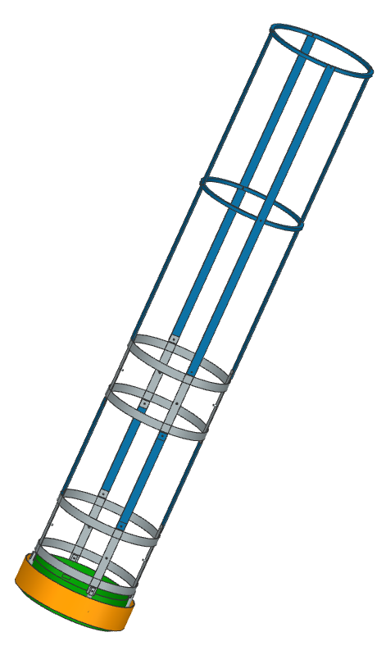
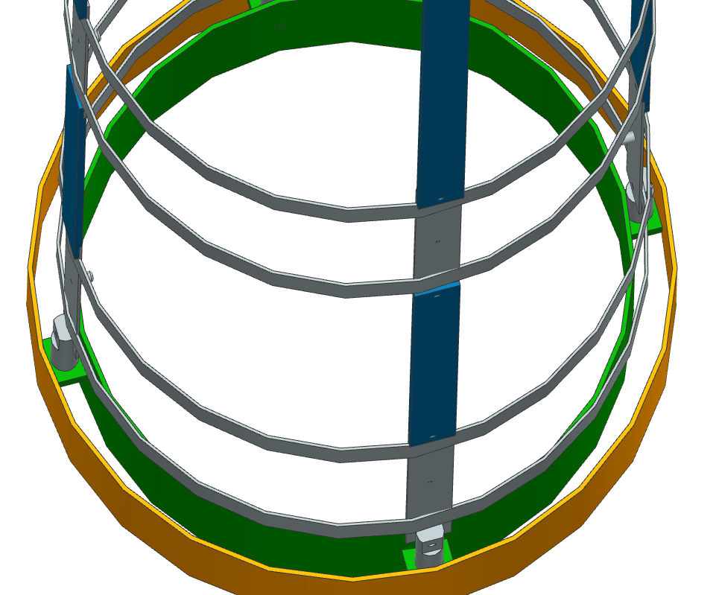
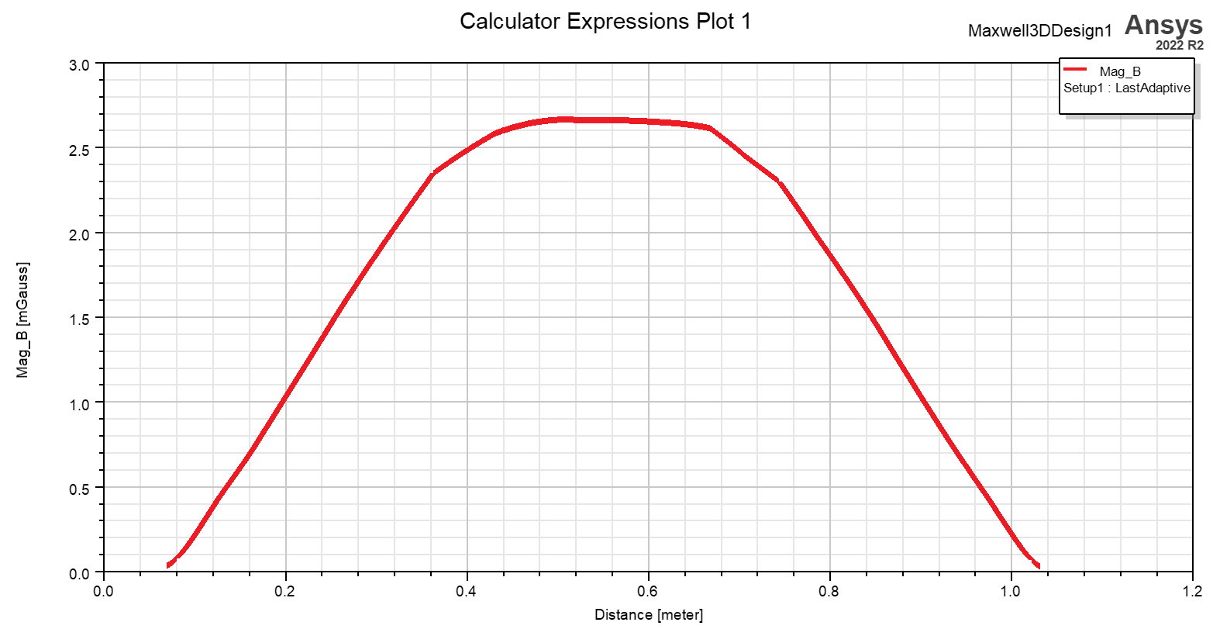
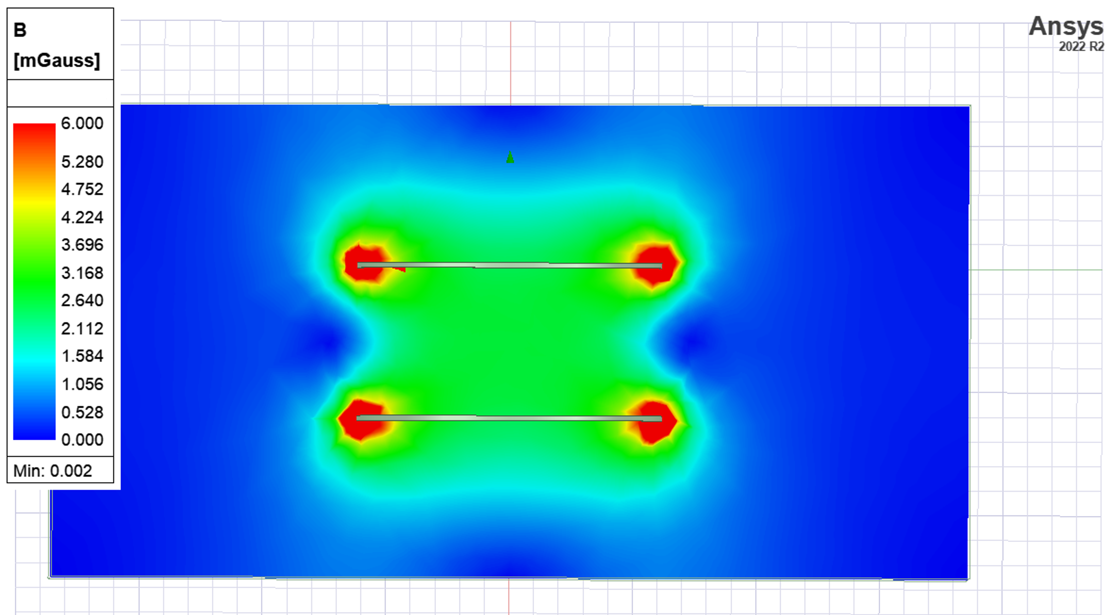
Helmholtz coil frame design
2 frames for Helmholtz coils
Spacers between screen and cryostat to secure the structure
Spacers between the 2 frames to adjust their height
Support structure for positioning and handling the coils L 2000mm
Material for the coil windings
Cryostat
Cryoperm shield
Helmholtz coils support structure

Slide 15
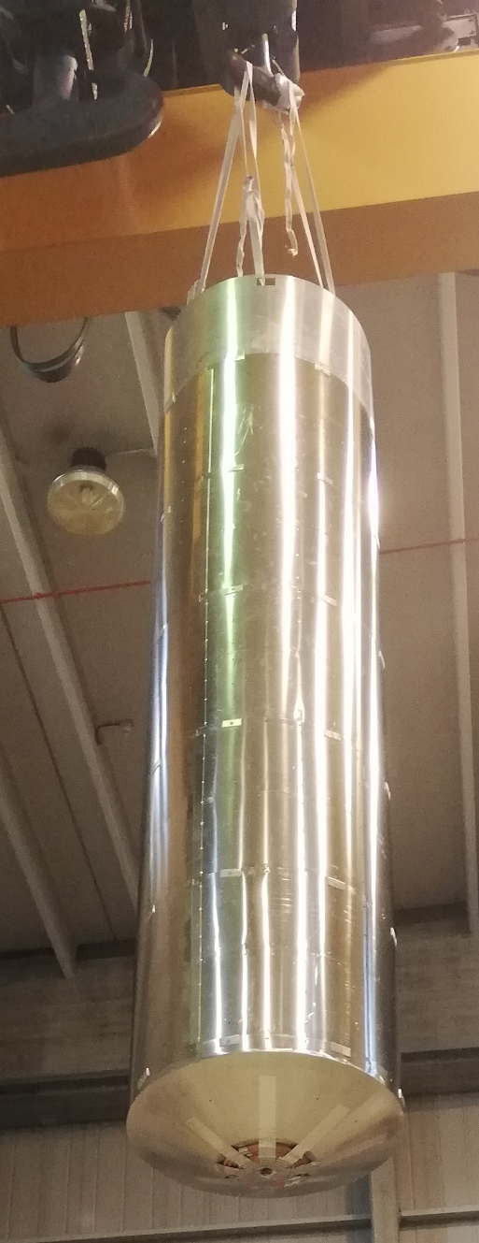
External Magnetic Shield
Magnetic screen already available (L=2500 mm, ID 680 mm)
Characterization of current screen
Triaxial measurements of residual field (on axis and at equatorial positions)
Optimizations underway using high mu materials
Modification of bottom (plate)
Closing plate machining
Firing to restore high μ
Characterization of modified screen
Triaxial measurements of residual field
Optimization of shielding efficiency

Slide 16
Synergies

Slide 17
ITN-EU
International Technology Network - Europe
ILC Technology Network (ITN)
Belong to ILC IDT, ITN is a network that collects labs/institutes from Asia, US and EU whose final goal is R&D in three technical areas: SRF, Sources, Beams
March ’23: budget approved by Japan; KEK-CERN agreement: signed in July 2023
Activities scheduled 2023-2026
ITN-EU main activities (coordinated by CERN)
INFN Milano LASA involved in WP1 (cavity production) and WP2 (cryomodule design) for:
Treatments targeted to ILC goal (single and 9-cell cavities) towards industrialization with qualified vendors
Harmonization of pressure vessel codes (PED/ASME/HPGS)
Fine Grain and Mid Grain Nb studies for cost reduction
VT and diagnostics at cold in a dedicated cryostat
Assembly at KEK of an ILC cryomodule with 2 EU cavities
WP1 & WP2 EU partners: CEA, CERN, CEA, DESY, INFN

Slide 18
ITN-EU: R&D strategy from 1-cells to 9-cells (1.3 GHz)
Single-cells for R&D studies of the “best recipes” for ILC
Baseline (Eu-XFEL modified) on FG and MG cavities -> only one industry (mechanical and baseline) for trustable comparison in performances
Only FG will be later used for “new” recipes studies
Mid-T, two-step baking and their combination -> Optimization of parameters (EP cold, T-treatments) -> Cold VT cross check between labs
Migration to MG for cross-check performances of the “best” recipe
9-cells for industrialization
Best recipe will be migrated to 9-cell FG cavities:
EU industries will be involved
HPGS requirements must be fulfilled
Final goal -> install two EU cavities in the ILC cryomodule planned at KEK
Active participation also in:
Cryomodule activities, string assembly, development of diagnostics, and cryomodule test
900°C HT for better flux expulsion
Cold EP with 2-step baking may help to improve cavity performance
Mid-T at 200°C could reach a higher gradient and is promising for in-situ treatment
Mid-T at 300°C -350°C in combination with 2-step baking

Slide 19
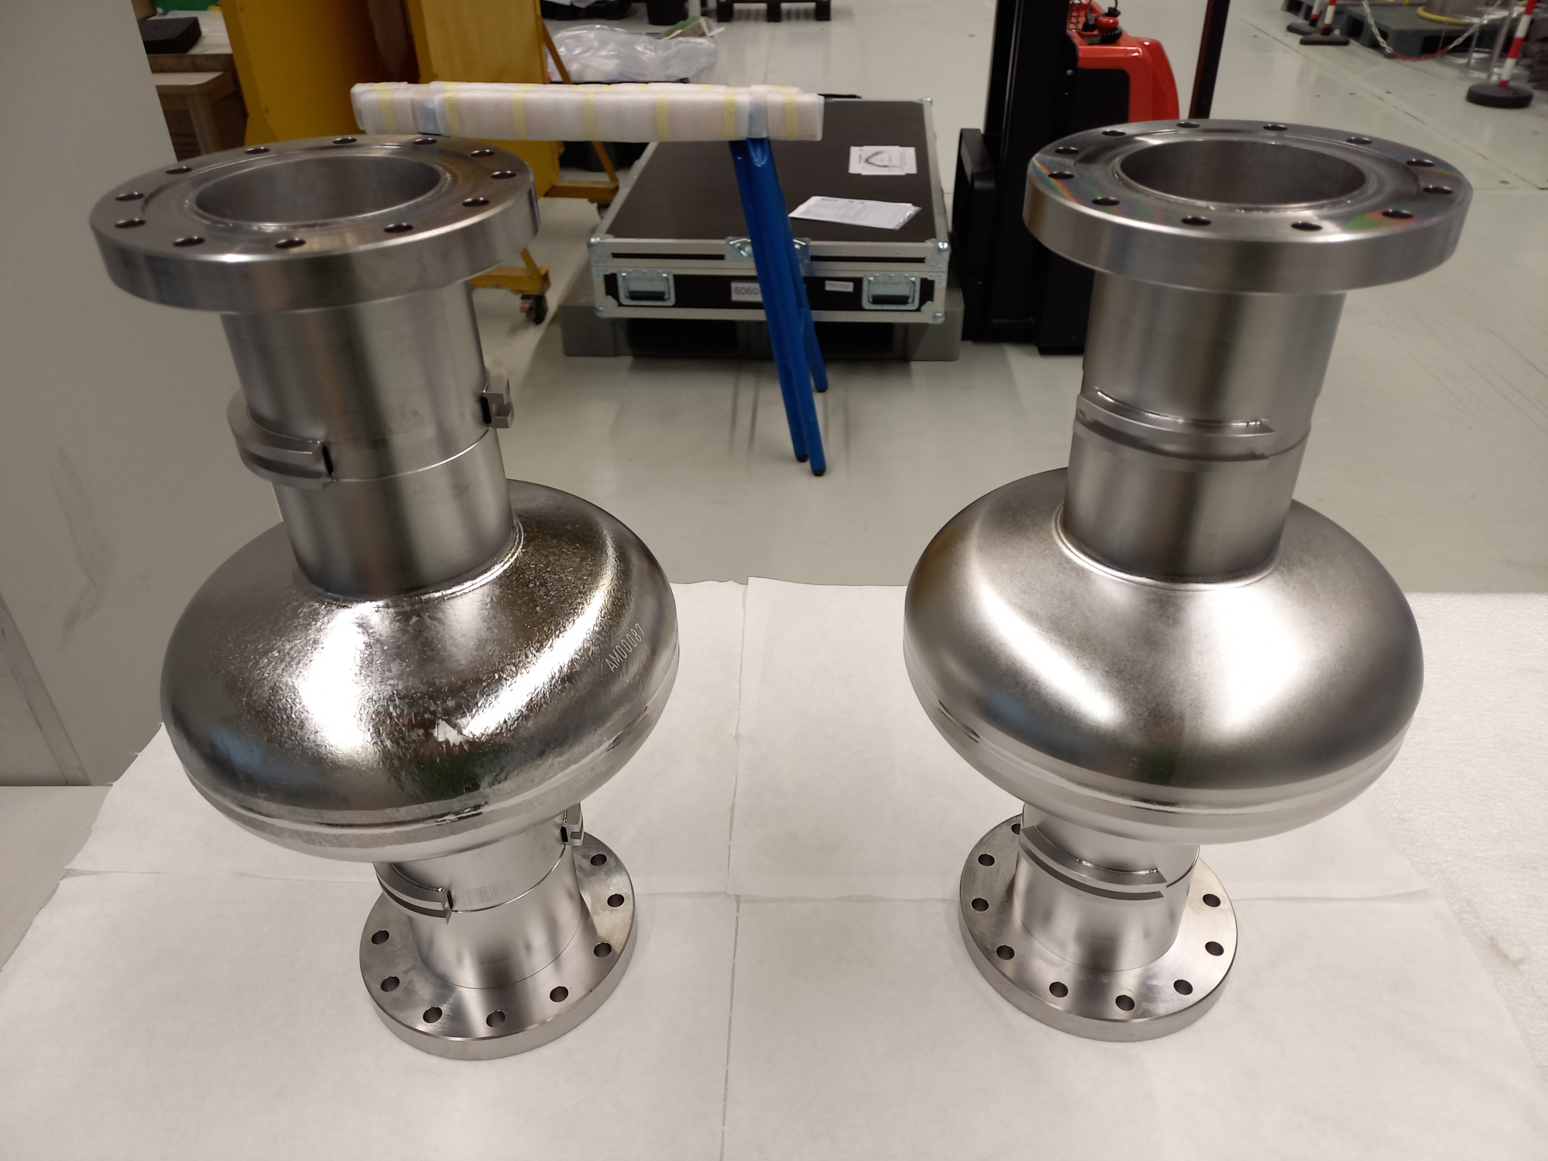
ITN-EU: Single-cell R&D activity, status and goal
Material procurement and ECS (Nb):
Done
Mechanical production and treatments:
Specs prepared by CEA-INFN-CERN (treatments as option)
Order (mechanical + baseline) placed in industry (RI) in March 2025
2 single-cell cavities mechanical fabricated in September 2025
Baseline treatment of FG & MG cavities will start soon at RI -> expected within the end of November 2025
Cross-check of performances at 2 K -> MG/FG comparison
FG treated with most promising recipes (mid-T at low temperature & a combination of mid-T and low-T baking)
NEXT STEPS:
R&D on FG single-cell will continue for fine tuning of the best recipe
MG/FG performance comparison (best recipe)
OUR STRATEGY:
Quality Control (QC) used for large series production applied also on single-cells fabrication and treatment (in view of the industrialization)
Treatments will be done preferable at industries (industrialization goal)
Part of the activities could be done in ITN-EU labs (VT, HPR, cleaning and final assembly operation, annealing, etc.).
CEA/INFN responsible of the technical support at industry
MG
FG

Slide 20
ITN-EU: 9-cells industrialization goals, strategy, status
ITN-EU main goals for 9-cells cavities:
Production of 9-cells jacketed cavities at the EU Industries (RI and Zanon)
Material procurement and ECS
Mechanical specs prepared by KEK-CEA-INFN (treatments as option)
Tender underway (ends on November 21), started just after KEK one (2 cavities at RI, mech. fab.)
Order expected in December
Qualification of EU Industries in term of pressure vessel code (harmonization with HPGS)
Installation into the ILC type cryomodule of 2 EU cavities
Timescale and strategy:
To accomplish the timescale, our priorities are:
produce and prepare (best recipe) 2 (+2) 9-cells cavities, check of performances (VT cross-check)
deliver 2 surface treated cavities to KEK for jacketing phase within Oct 2026
CEA-INFN will follow the jacketing process at KEK, HPGS qualification, string assembly operation, and participate to cryomodule test
remaining 2 naked cavities will be jacketed in the EU industries and qualified in term of HPGS, VT used as cross-check of the jacketing process
Even if they will not be installed into ITN cryomodule, this step is needed to qualify the industrialization process

Slide 21
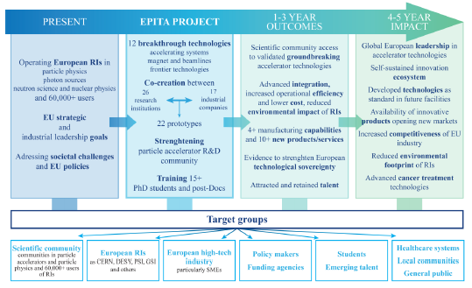
EPITA Enabling Partnerships for Innovation & Accelerator Technology Advancement
HORIZON-INFRA-2025-01 Proposal for a 4 years program – Decision expected in Spring 2026
“EPITA is a consortium of 43 beneficiaries from 16 countries with a total budget exceeding €21 million, funded by a €10 million EU contribution and over €11 million in matching funds. The project's main goal is to integrate various research and development initiatives into a coordinated, vision-driven program, aligned with the established roadmap for accelerator research infrastructures (RIs). EPITA is structured around three key technology tracks: Accelerating Systems, Magnets and Beamlines, and Frontier Technologies”

Slide 22
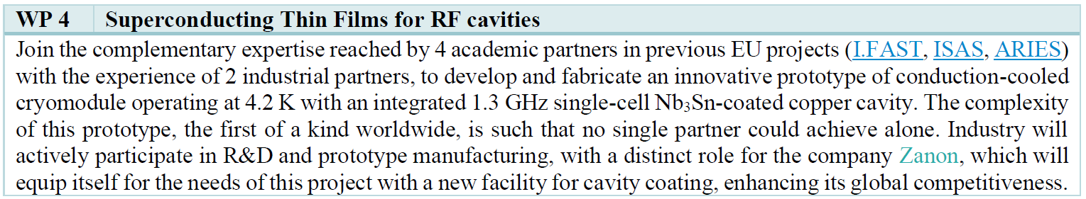
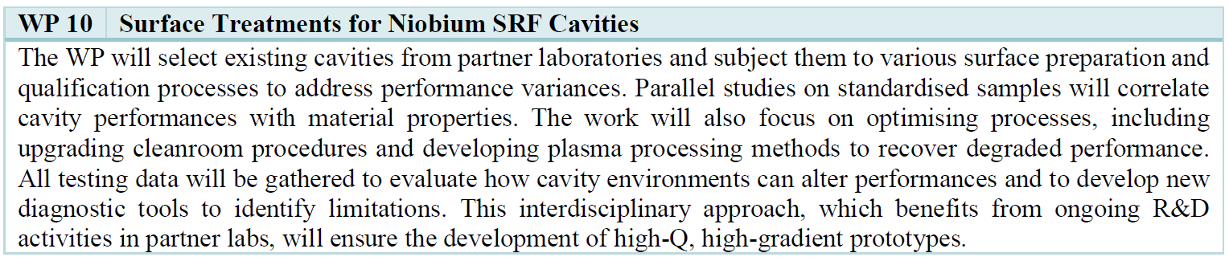
EPITA – SRF related Work Packages

Slide 23
WP Detailed Structures
Strategy and Industrialization
Horizontal Cavity Integration and RF tests
1.3 GHz Cavity Production and Coating
Superconducting Thin Film Development
Surface preparation for High-Q at High-G
HPR and Cleanroom Assembly Improvements
Performance preservation and recovery
Test and Diagnostics
WP 4.1
WP 10.1
WP 4.2
WP 10.2
WP 4.3
WP 10.3
WP 4.4
WP 10.4

Slide 24
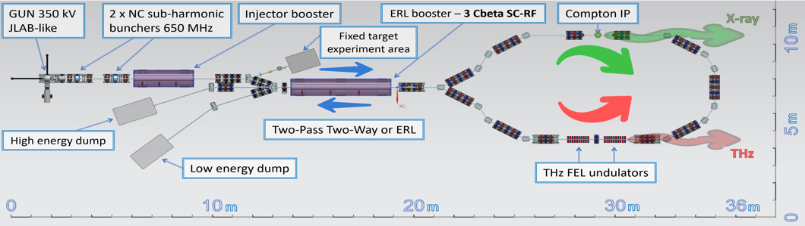
BriXSinO Brilliant Source of X-Rays Based on Sustainable and Innovative Accelerators
A “newly” conceived scheme of ERL with counter propagating beams is proposed in BriXSinO.
This scheme allows:
ERL operation
two-pass operation: the beam is reaccelerated when reinjected in the accelerating module (low current)
The importance of the full BriXSinO is then twofold.
a test facility for fundamental questions of accelerator physics and strategies of Dynamics and Energetic by maximizing the energy sustainability and minimizing the AC power consumption.
A user facility by providing large quality coherent THz and X-Rays emission from its high brightness accelerated electron beam, enabling important and advanced applications.
Parameter | two-pass acc. | ERL
Energy (MeV) | 80 | 45
Bunch charge (pC) | 100 | 100
Repetition rate (MHz) | 0.9286 | 92.86
Average Current (mA) | 5 10⁻³ | 5
Beam power @ dump (W) | 22.5 10³ | 400
ε^{n}_{x,y} (mm − mrad) | < 1.6 | < 1.6
Energy spread (%) | < 0.2 | < 0.2

Slide 25

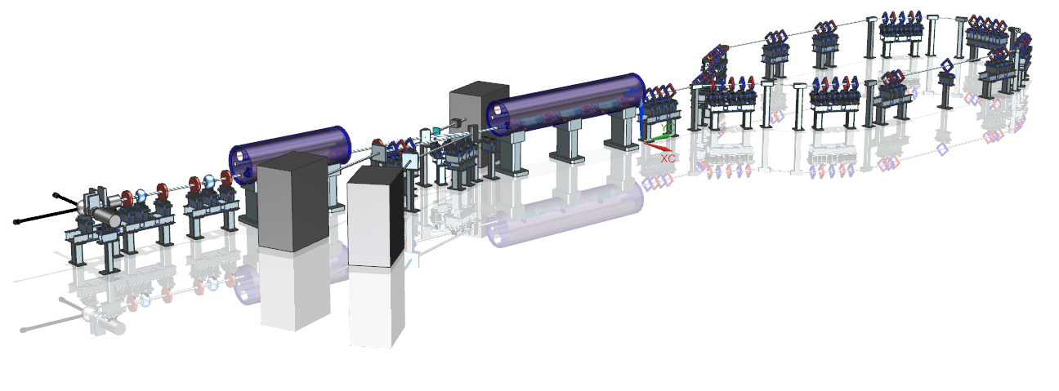
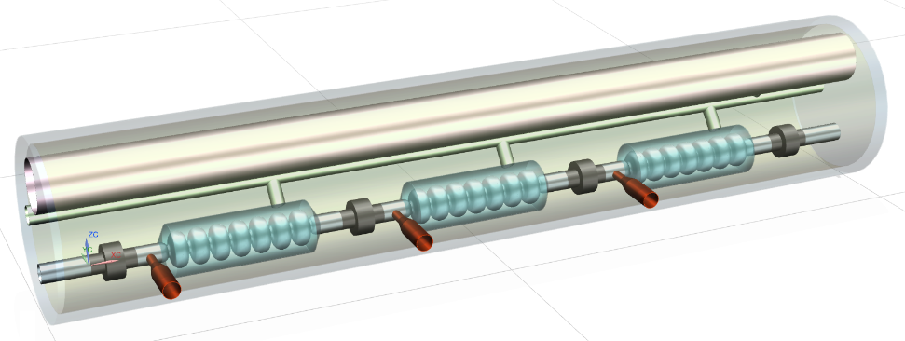
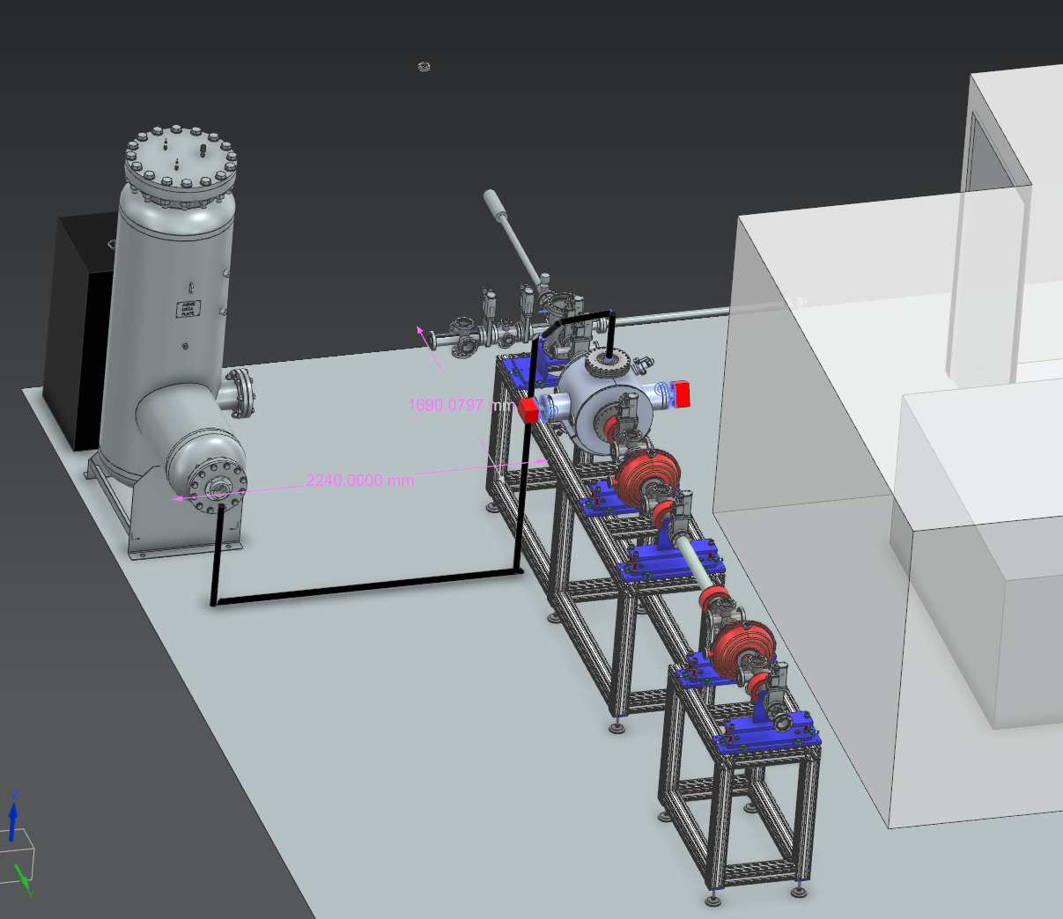
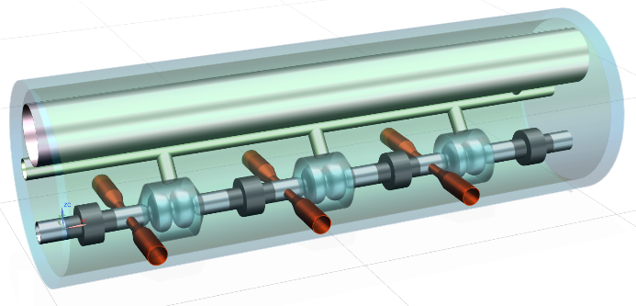

Activities for BriXSinO
... BriXSinO aims at developing at INFN LASA laboratory a test-facility that would enable addressing the physics and technology challenges posed by the ERL generation ...
BriXSinO Parameters
Beam Current Max | 5 mA
Bunch Charge | 50 pC
ERL energy | 45 MeV
Two-pass energy (5 uA) | < 80 MeV
Superconducting Booster Conceptual design of a 3, two-cells 1.3 GHz cavities Superconducting module
Superconducting Linac Conceptual design of a 3, 7-cells 1.3 GHz cavities SC module for ERL and two-pass acceleration
SCB Cavity
Q₀ | 2 10¹⁰
E_{acc} [MV/m] | 7.5
Q_{L} | 1.5 10⁶
SCL Cavity
Q₀ | 2 10¹⁰
E_{acc} [MV/m] | 16.5
Q_{L} | 3.25 10⁷
HB²TF – A 5mA 300 kV DC gun injector with photocathode and bunchers

Slide 26


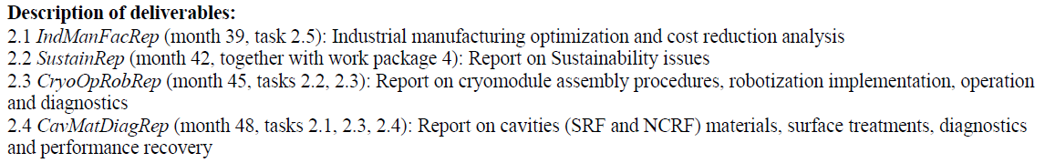
EAJADE
Marie Skłodowska-Curie Actions Staff Exchanges
Staff exchange network for accelerator R&D within elementary particle physics
Exchange between:
EU labs/university and US-Japan labs/universities
EU labs/university and EU industries
started in March 2023, 4 years duration
Six WP
INFN responsibility WP2 (L. Monaco, co-leaded with E. Cenni CEA):
State-of-the-art high-gradient, high-efficiency, reduced-cost radio-frequency structures and power Sources
INFN in other WPs: WP1 (R&D&I at currently operating state-of-the-art accelerator facilities); WP4 (Sustainable technologies for scientific facilities); WP5 (Investigation of potential early applications of novel and advanced technologies for colliders)
Deliverables

Slide 27
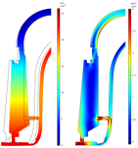
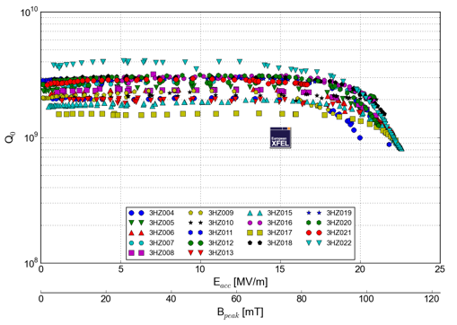
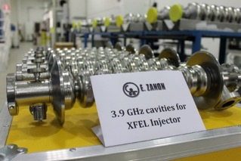
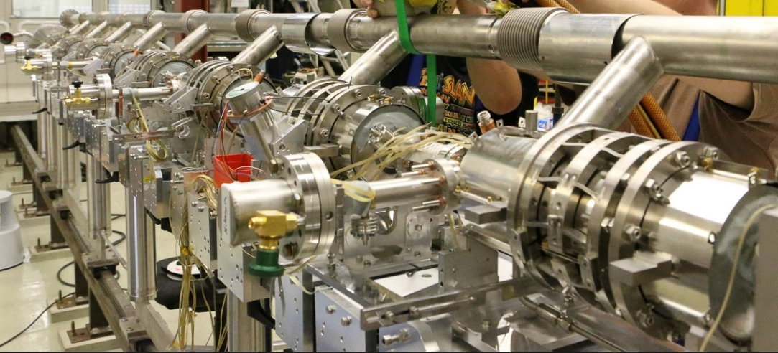
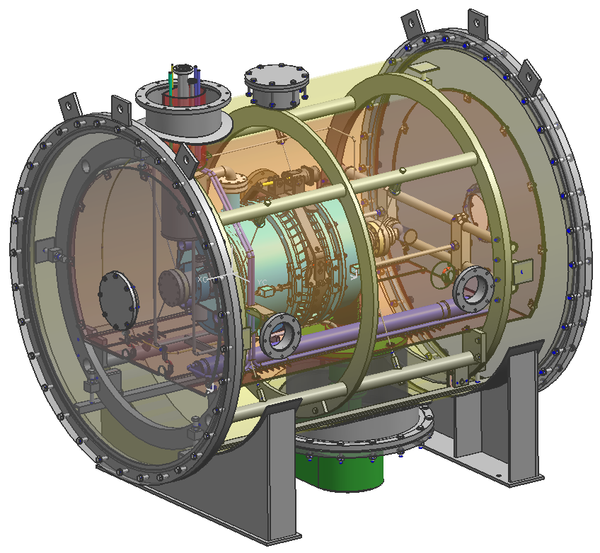
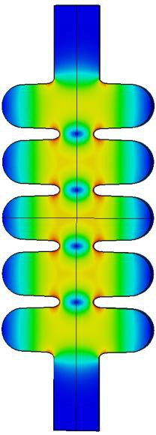
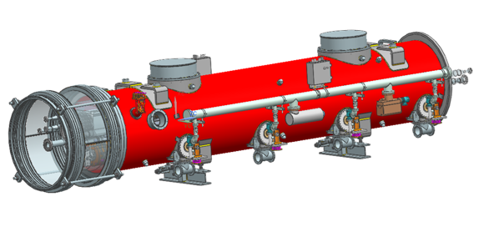
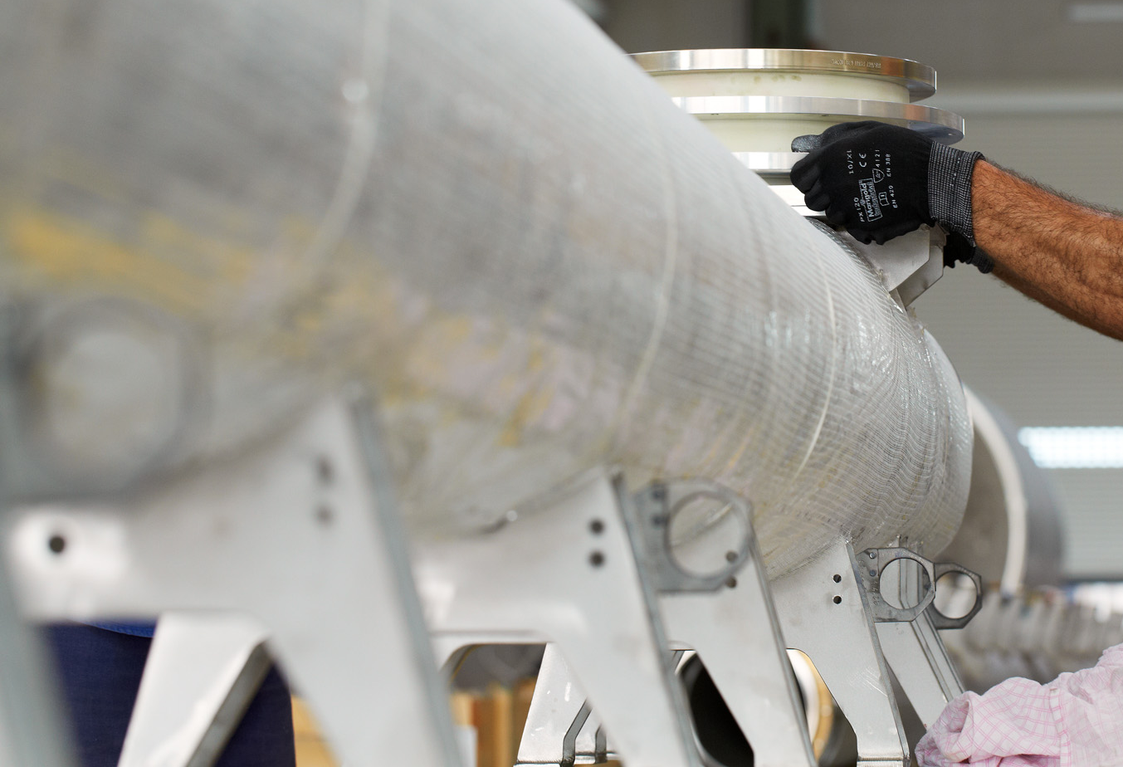
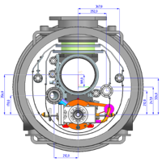
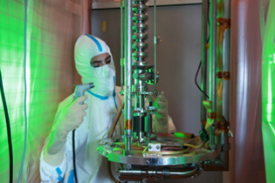




















LASA SRF Group: expertise and experience in SRF
SRF cavity from design to series production
SRF cryomodule components developments
E.M. Design
Mechanical DEsign
Prototypes
2K Vertical Test
Series Production
Cavity String
Cold Mass
Cryomodule
VT bunker
Tuner
Contribution to International Projects
S1- Global

Slide 28


ACKNOWLEDGEMENT
“This work was partially supported by the European Union’s Horizon Europe Marie Sklodowska-Curie Staff Exchanges programme under grant agreement no. 101086276.”

Slide 29
Thanks for your attention. Questions?

Slide 30

ITN-EU: R&D strategy from 1-cells to 9-cells (1.3 GHz)
Single-cells for R&D studies of the “best recipes” for ILC
Baseline (Eu-XFEL modified) on FG and MG cavities -> only one industry (mechanical and baseline) for trustable comparison in performances
Only FG will be later used for “new” recipes studies
Mid-T, two-step baking and their combination -> Optimization of parameters (EP cold, T-treatments) -> Cold VT cross check between labs
Migration to MG for cross-check performances of the “best” recipe
9-cells for industrialization
Best recipe will be migrated to 9-cell FG cavities:
EU industries will be involved
HPGS requirements must be fulfilled
Final goal -> install two EU cavities in the ILC cryomodule planned at KEK
Active participation also in:
Cryomodule activities, string assembly, development of diagnostics, and cryomodule test
H. Ito doi:10.18429/JACoW-SRF2021-FROFDV01
900°C HT for better flux expulsion
Cold EP with 2-step baking may help to improve cavity performance
Mid-T at 200°C could reach a higher gradient and is promising for in-situ treatment
Mid-T at 300°C -350°C in combination with 2-step baking

Slide 31

ITN-EU: R&D strategy from 1-cells to 9-cells (1.3 GHz)
Single-cells for R&D studies of the “best recipes” for ILC
Baseline (Eu-XFEL modified) on FG and MG cavities -> only one industry (mechanical and baseline) for trustable comparison in performances
Only FG will be later used for “new” recipes studies
Mid-T, two-step baking and their combination -> Optimization of parameters (EP cold, T-treatments) -> Cold VT cross check between labs
Migration to MG for cross-check performances of the “best” recipe
9-cells for industrialization
Best recipe will be migrated to 9-cell FG cavities:
EU industries will be involved
HPGS requirements must be fulfilled
Final goal -> install two EU cavities in the ILC cryomodule planned at KEK
Active participation also in:
Cryomodule activities, string assembly, development of diagnostics, and cryomodule test
H. Ito doi:10.18429/JACoW-SRF2021-FROFDV01
900°C HT for better flux expulsion
Cold EP with 2-step baking may help to improve cavity performance
Mid-T at 200°C could reach a higher gradient and is promising for in-situ treatment
Mid-T at 300°C -350°C in combination with 2-step baking
L. Steder et al., arXiv:2407.12570v1 [physics.acc-ph] 17 Jul 2024

Slide 32

HZB
ITN-EU: R&D strategy from 1-cells to 9-cells (1.3 GHz)
Single-cells for R&D studies of the “best recipes” for ILC
Baseline (Eu-XFEL modified) on FG and MG cavities -> only one industry (mechanical and baseline) for trustable comparison in performances
Only FG will be later used for “new” recipes studies
Mid-T, two-step baking and their combination -> Optimization of parameters (EP cold, T-treatments) -> Cold VT cross check between labs
Migration to MG for cross-check performances of the “best” recipe
9-cells for industrialization
Best recipe will be migrated to 9-cell FG cavities:
EU industries will be involved
HPGS requirements must be fulfilled
Final goal -> install two EU cavities in the ILC cryomodule planned at KEK
Active participation also in:
Cryomodule activities, string assembly, development of diagnostics, and cryomodule test
H. Ito doi:10.18429/JACoW-SRF2021-FROFDV01
900°C HT for better flux expulsion
Cold EP with 2-step baking may help to improve cavity performance
Mid-T at 200°C could reach a higher gradient and is promising for in-situ treatment
Mid-T at 300°C -350°C in combination with 2-step baking
L. Steder et al., arXiv:2407.12570v1 [physics.acc-ph] 17 Jul 2024

