Slide 1

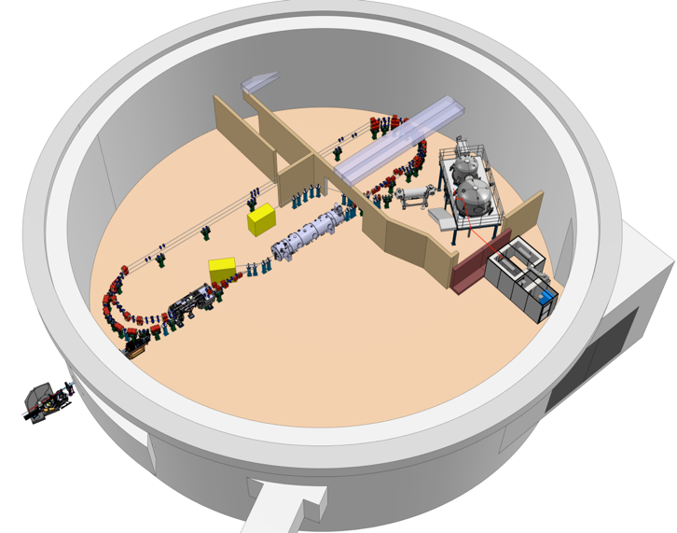







SRF Frontiers Workshop
ERL Development at the PERLE project
Walid Kaabi
IJCLab / Université Paris-Saclay/ IN2P3-CNRS
On behalf of PERLE Collaboration

Slide 2
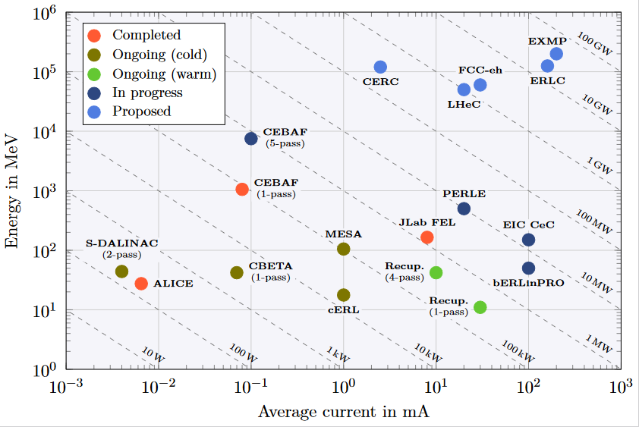
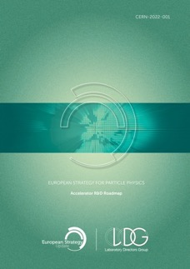
ERL - The global landscape
ERLs were recognized as one of the five main axis of accelerators R&D in support of the ESPP:
  High-field magnets
  High-gradient RF structures & systems
  High-gradient plasma laser accelerators
  Bright muon beams and muon colliders
  Energy Recovery Linacs
Two projects: PERLE & bERLinPro were recognized as "essential pillars of the ERL development," with milestones to be achieved by the next ESPP in 2026.
Funding Limited
Technology Limited
ESPP R&D Accelerator Roadmap: https://arxiv.org/ftp/arxiv/papers/2201/2201.07895.pdf

Slide 3

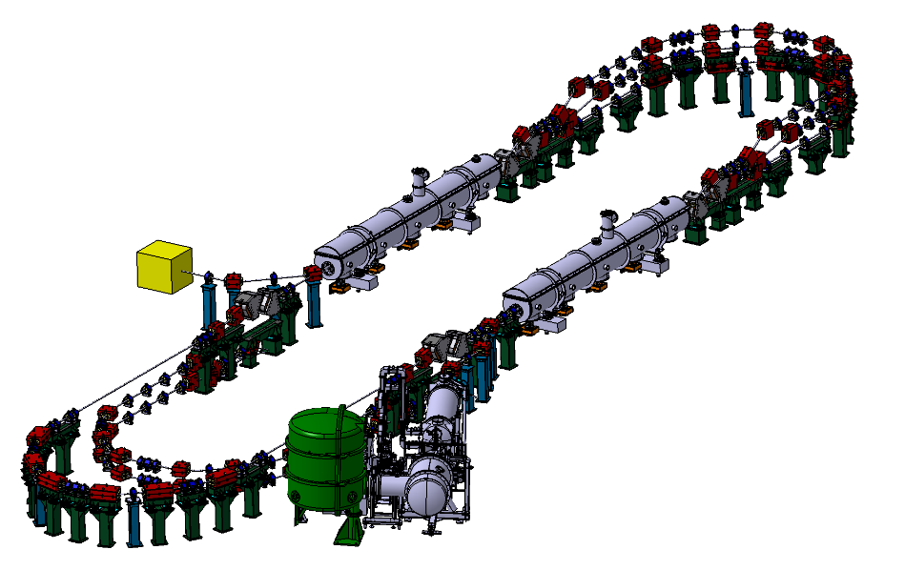
PERLE’s Impact on ERL panorama
PERLE main objectives:
Demonstrate multi-turn and high current operation → access to unexplored power regimes
Validation of important technical choices:
  High-charge electron gun: 500 pC at 40 MHz
  Optimized 800 MHz SRF system: Maximise the efficiency
  Common circulation arcs for accelerated and decelerated beams
  Non-invasive diagnostics
Host experiments of interest for our lab and institute.
Target Parameter | Unit | Value
Injection energy | MeV | 7
Electron beam energy | MeV | 500
Normalised Emittance γε_{x,y} | mm mrad | 6
Average beam current | mA | 20
Bunch charge | pC | 500
Bunch length | mm | 3
Bunch spacing | ns | 25
RF frequency | MHz | 801.58
Duty factor |  | CW
PERLE 500 MeV version

Slide 4
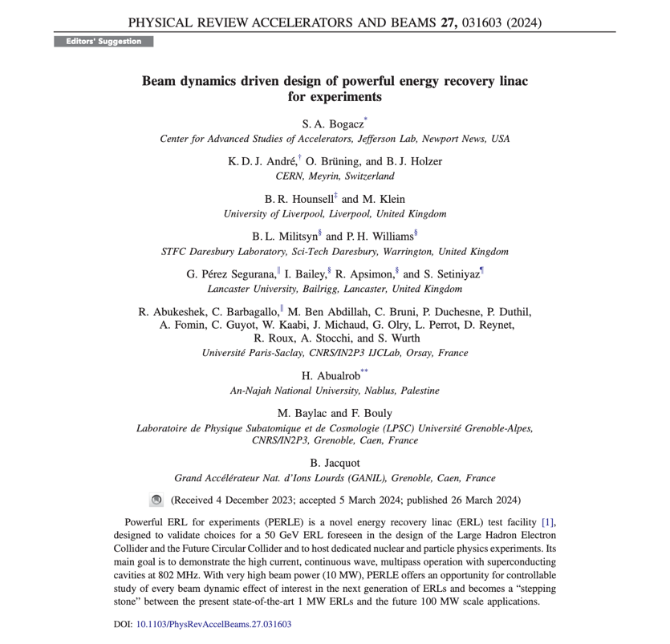
First paper of PERLE collaboration (centered on beam dynamics)
The first paper on Beam Dynamics and PERLE Design has been published in Physical Review Accelerators and Beams (PRAB) and was also selected as a « PRAB Editors Suggestion » on the journal homepage alongside other highlighted articles: https://journals.aps.org/prab
The following studies was reported in this paper for the 500 MeV version of PERLE:
  Lattice architecture and optics
  Staging construction
  Injector and merger, space charge study
  Longitudinal matching
  Filling pattern and bunch timing options
  Start to end simulations with CSR and Wakefield
  BBU study

Slide 5
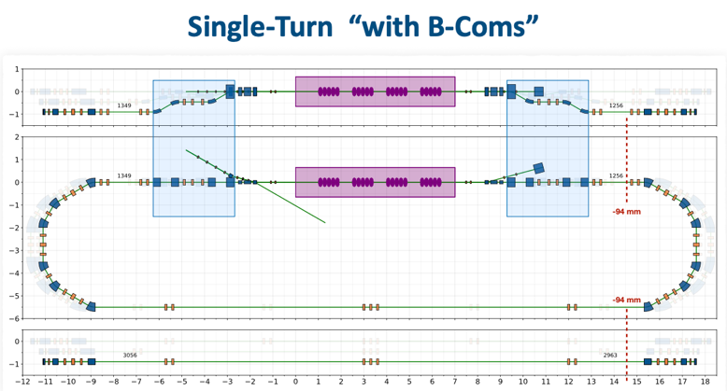
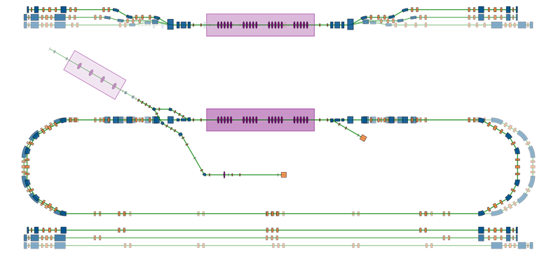
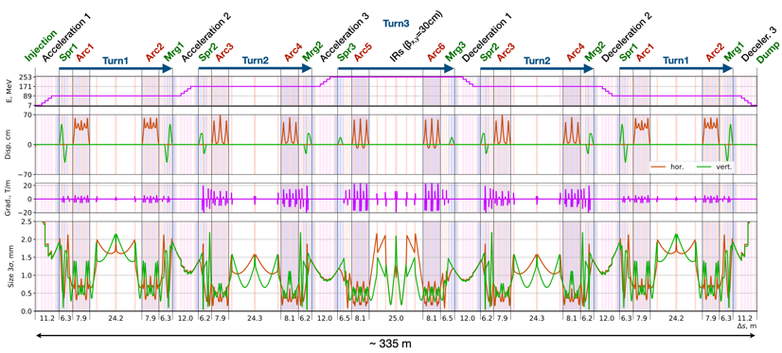
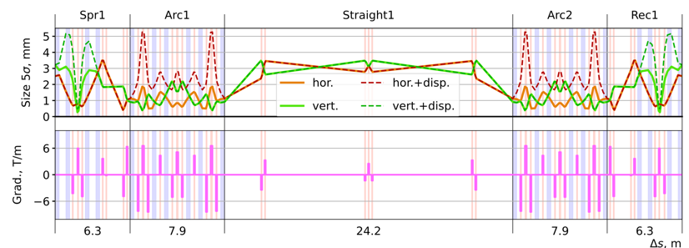
Further design and beam dynamics studies
PERLE 250 MeV version
89 MeV
171 MeV
253 MeV
Booster
Merger
Cryomodule
IP1 (FP)
Diag. Line
7 MeV
7 MeV
IP2

Slide 6
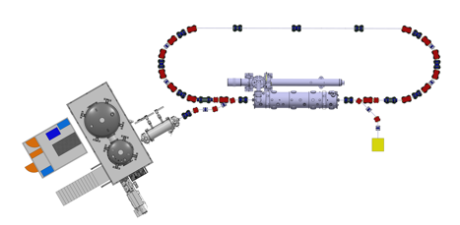

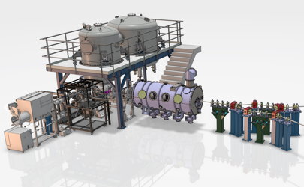
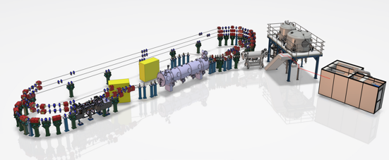
PERLE Timeline (macroscopic view)
“Partially”
TDR and prototyping phase
Phase 2: PERLE 1 tour
CM funded by EU Program iSAS + Matching funds (IN2P3)
Phase 1: Injection line
Phase 3: PERLE 250 MeV
Extra funding needed for 6 arcs configuration
By CNRS National Program RI2
2022
2023
2024
2025
2026
2027
2028
2029
2030
2031
Phase 4: PERLE 500 MeV

Slide 7
PERLE global planning
Design
First electrons April 2026
Upgrade
Laser
Procurement/Construction/Installation
5 mA
20 mA
Commissioning
DC Gun @ 350 keV
Buncher installation
Booster installation
Booster
RF sources upgrade
20 mA
5 mA
Injector @ 7 MeV
Cryomodule installation
0.5 MW
2 MW
ERL 1-loop @ 89 Mev
Civil engineering work
5 MW
ERL 3-loop
TDR
2025
2026
2027
2028
2029
2030
2031
We are here

Slide 8
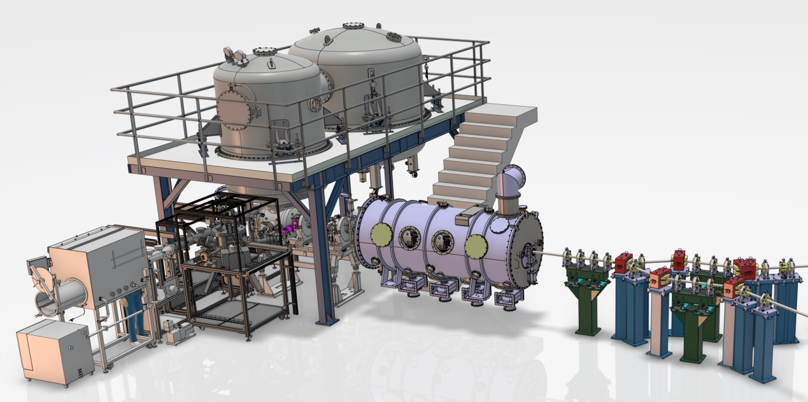
The injection line
HV system
Funded by the national program RI2 (CNRS)
Booster
DC Photogun
Merger
Buncher
Photocathode Preparation Facility (PPF)
Diagnostics line

Slide 9
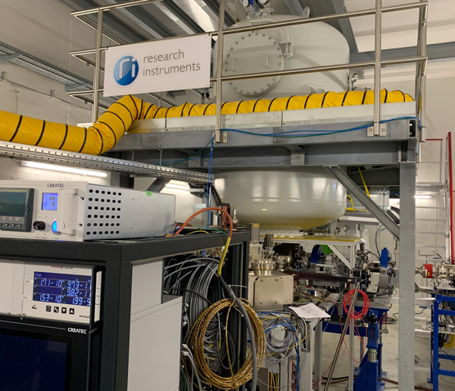
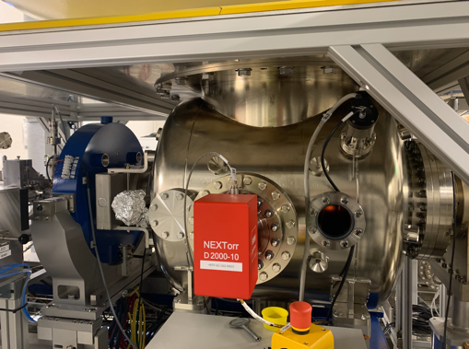
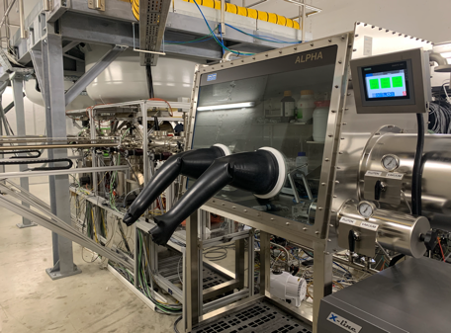
PERLE e- Source
Collaboration IJCLab-LPSC & RI GmbH
Within a Collaboration Agreement for photoinjector R&D between IJCLab (IN2P3) and Research Instruments GmbH (RI), Hardware of lighthouse project (terminated) transferred to IJCLab for PERLE. The gun was commissioned and tested at high rep rate, at a limited bunch charge. It includes:
A DC Gun, Cornell design (400 pC, 50 MHz demonstrated), fully equipped (all pumps) in load-lock version
A Photocathode Preparation Facility (PPF)
HV power supply suited for high bunch charge (designed for 40 mA, 450 kV)

Slide 10
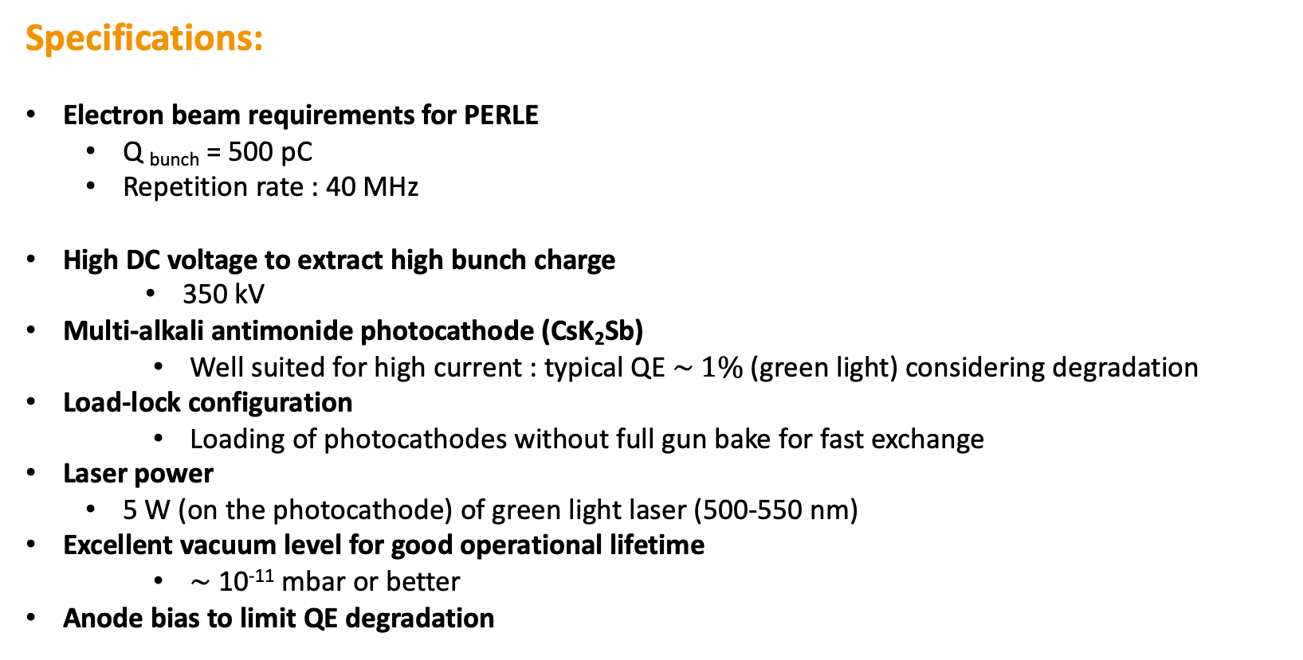
PERLE e- Source
Specifications:
Electron beam requirements for PERLE
  Q _{bunch} = 500 pC
  Repetition rate : 40 MHz
  High DC voltage to extract high bunch charge
    350 kV
  Multi-alkali antimonide photocathode (CsK₂Sb)
    Well suited for high current : typical QE $\sim 1\%$(green light) considering degradation
  Load-lock configuration
    Loading of photocathodes without full gun bake for fast exchange
Laser power
  5 W (on the photocathode) of green light laser (500-550 nm)
  Excellent vacuum level for good operational lifetime
    $\sim$10⁻¹¹ mbar or better
  Anode bias to limit QE degradation
  I= 20 mA

Slide 11
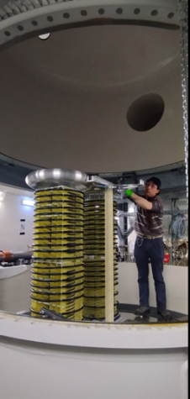
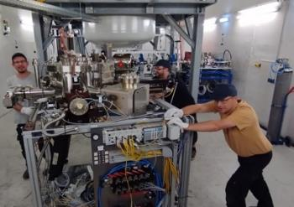
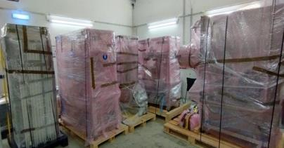
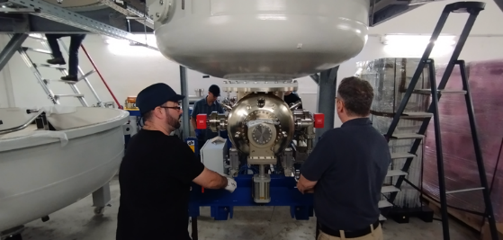
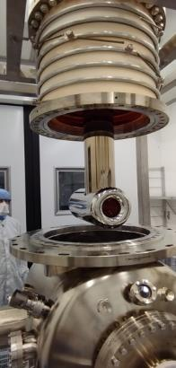
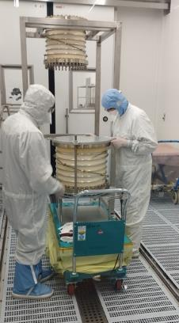
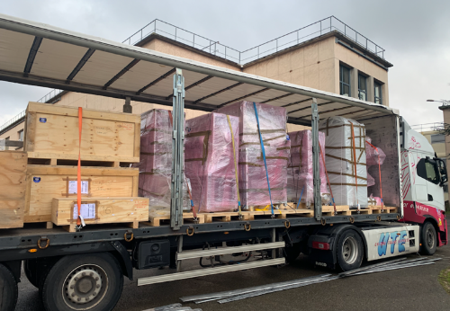
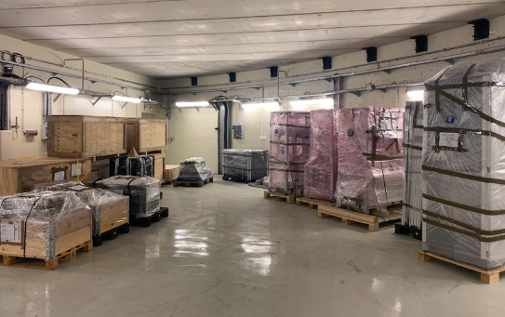
PERLE e- Source
Dismantling of the PPF (September 2023)
Dismantling of the PPF (September 2023)
Dismantling of the HV Columns tanks
Dismantling of the platform done by Baumann (November 2023)
Dismantling of the HV Columns tanks
Dismantling of the platform done by Baumann (November 2023)
Gun status : dismantling of the gun in clean room (January 2024)
The equipment were received at Orsay end of January 2024

Slide 12
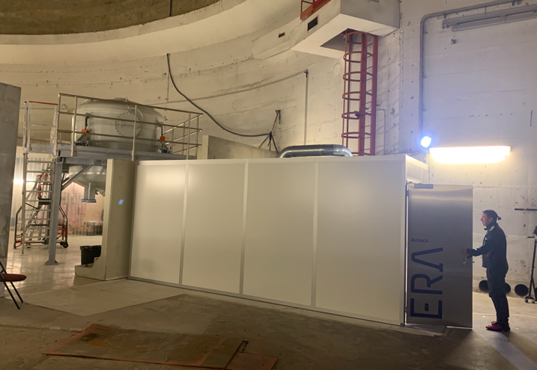
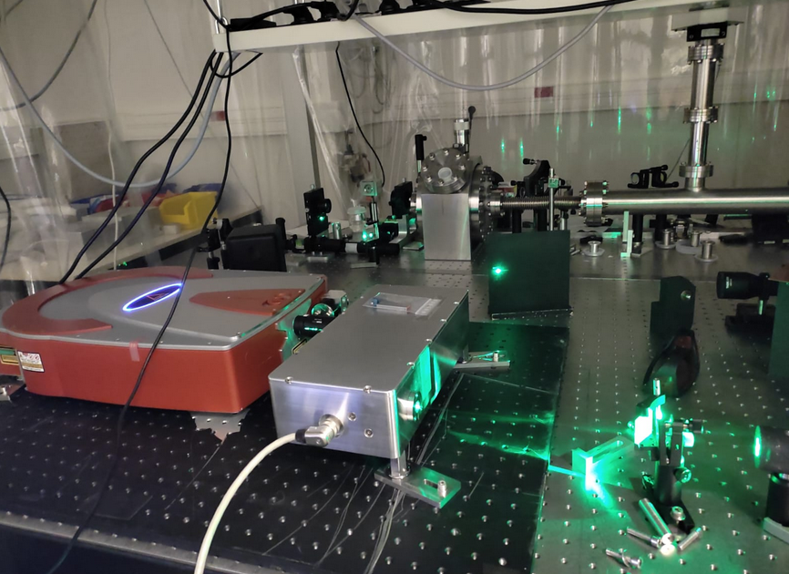
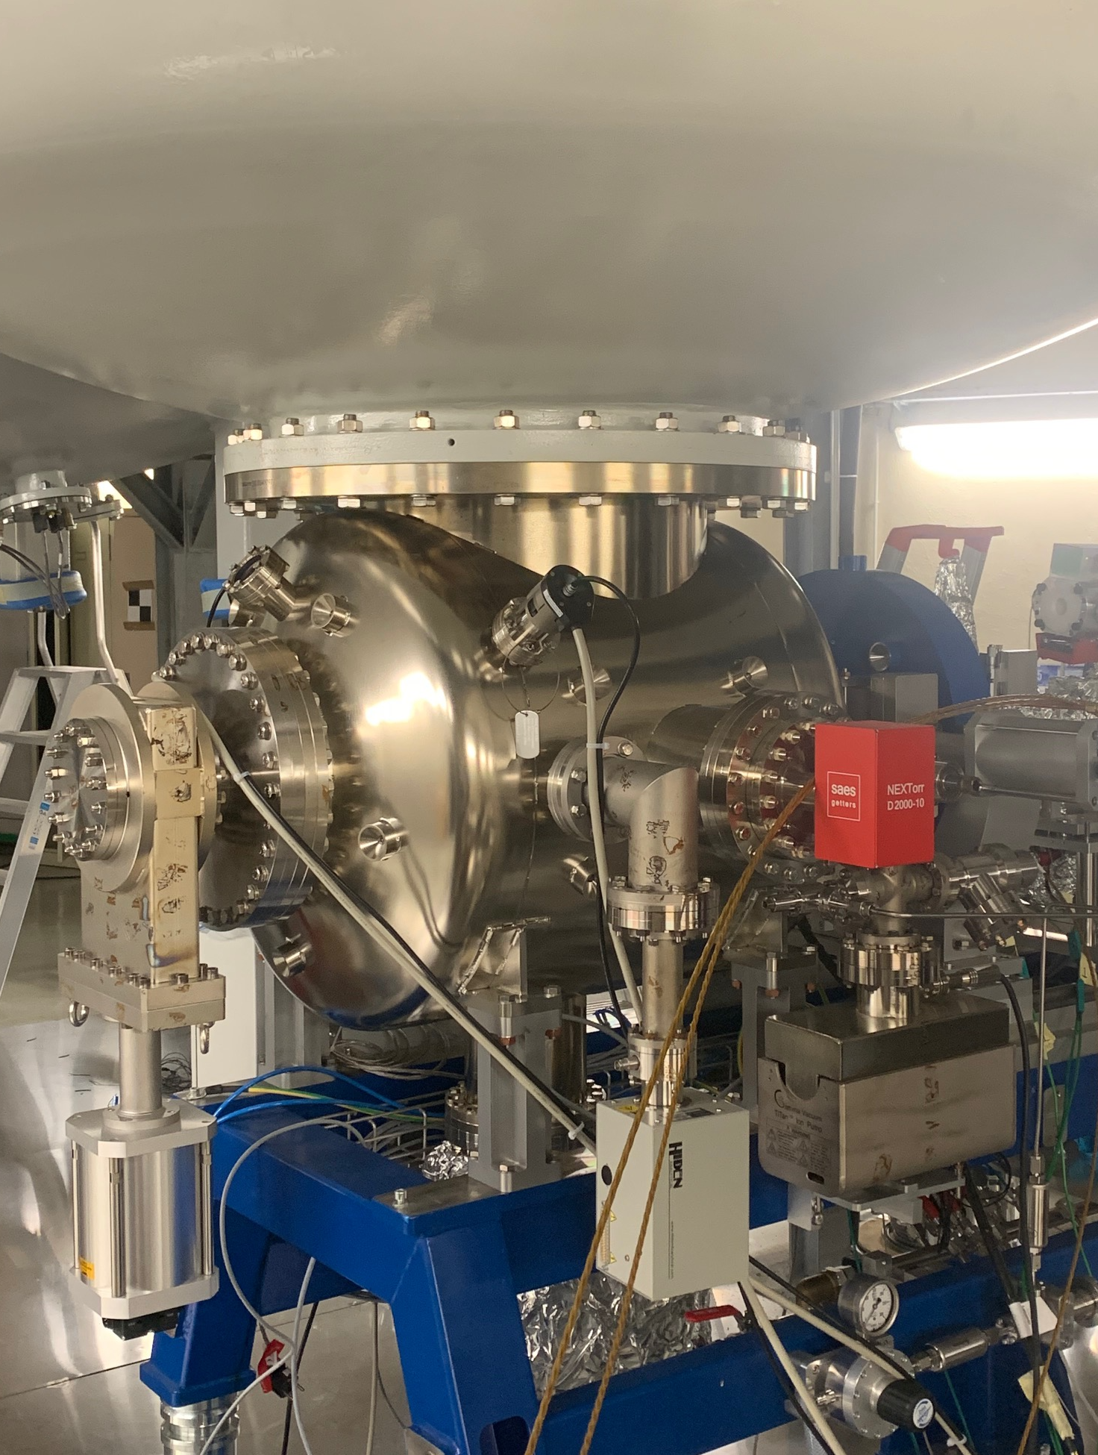
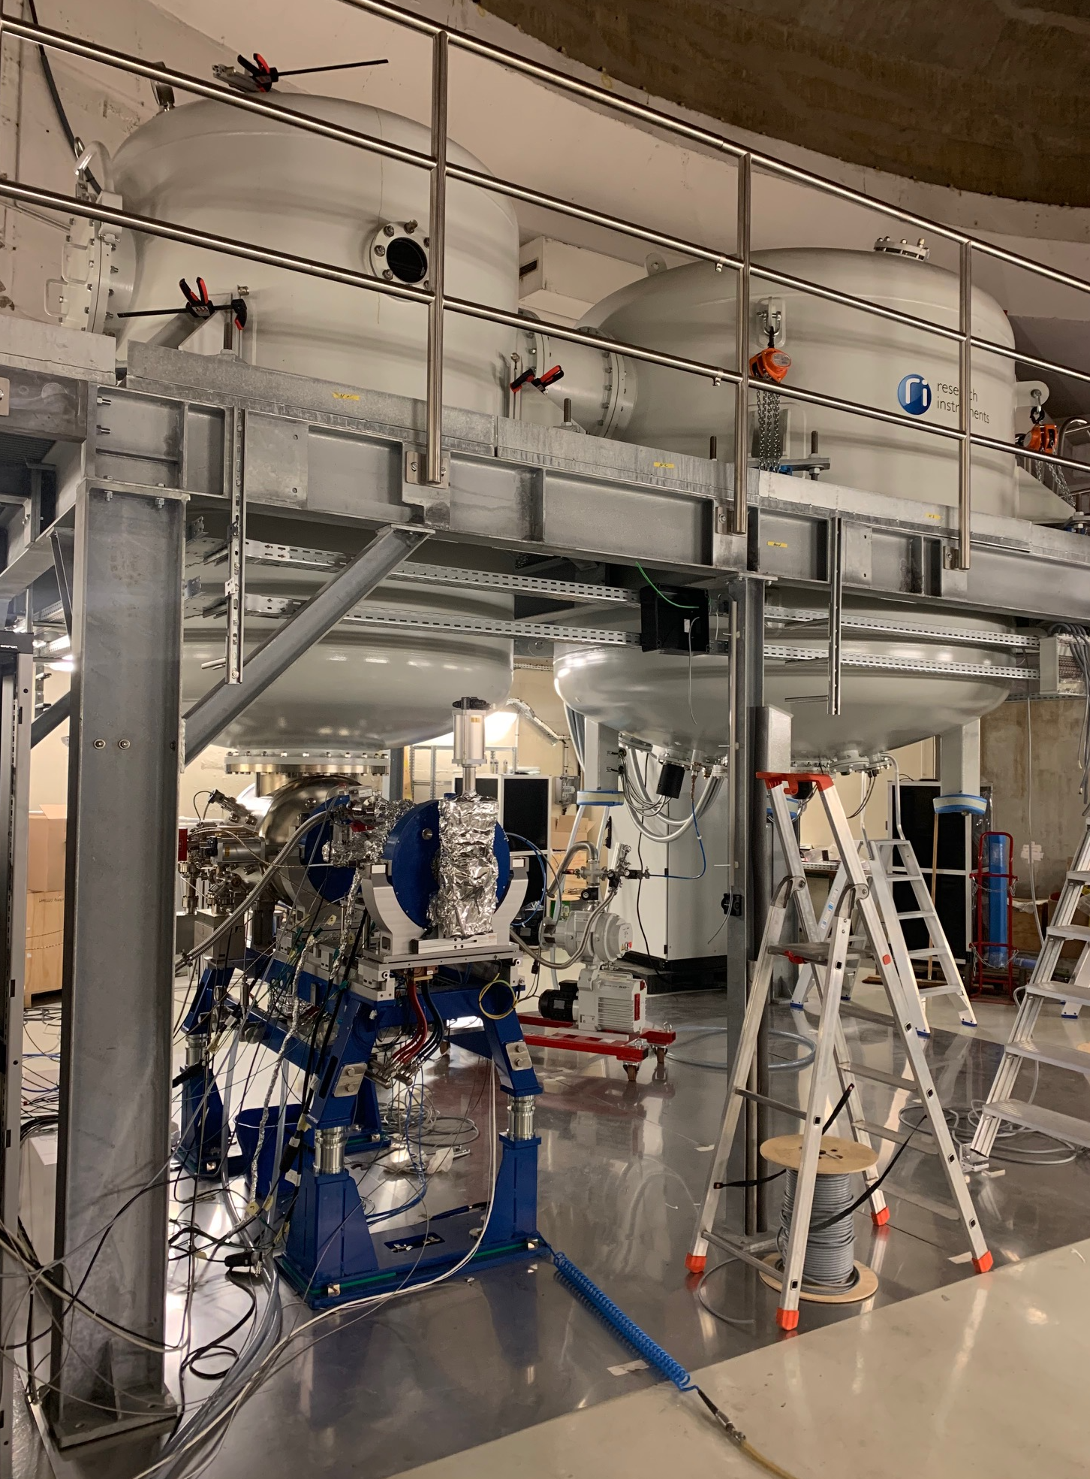
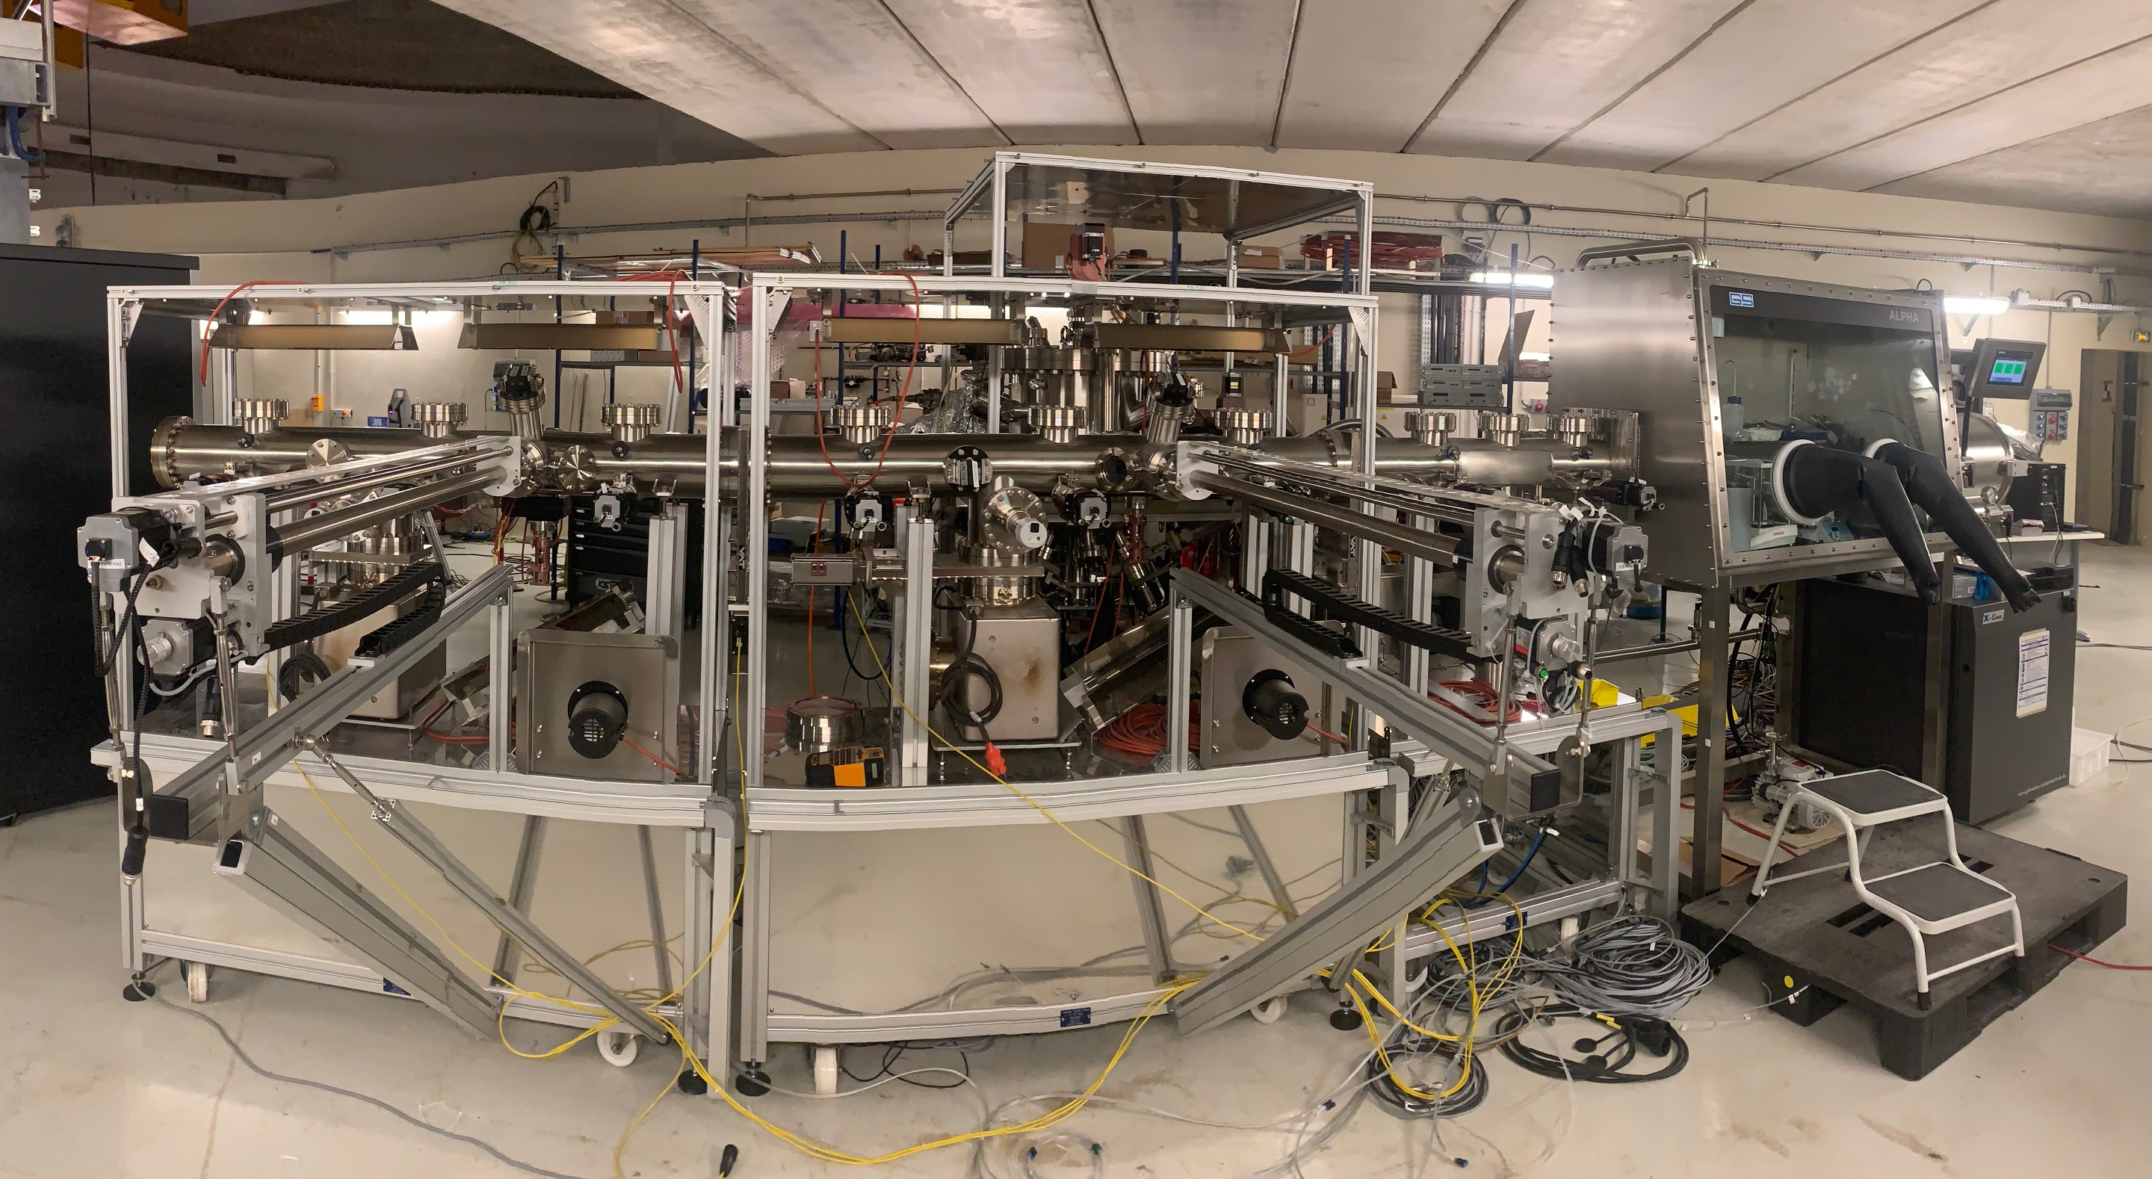
PERLE e- Source:
Electron source Installation in the « Igloo »:
Photocathode Laser room
Laser system
DC Gun
DC Gun & HV system
Photocathodes Production Facility (PPF)

Slide 13
PERLE e- gun: Achieved milestones
  DC-Gun under utra-high vacuum:
    DC Gun assembled, pumped, baked (@ 200°C during 10 days) and integrated to the beam line.
    Vacuum level reach to date : 5 10⁻¹² mbar.
  Installation and test of the photocathode laser:
    Green laser (515 nm), Satsuma model (Amplitude) tested in laser clean room salle: Power 1,5 W @ 40 MHz at the laser exit → 1W foreseen at photocathode surface.
  Production of the first CsK2Sb photocathode:
    PPF assembled: composed of a glove box with a load-lock system, automatised system for substrate trolly transfer, a deposition chamber (backed and under ultra-high vacuum) with 3 evaporators (Cs, K, Sb) and a low power green laser for photo-current measurement during depositions.
    First photocathode production beginning of October → QE: 3%, degraded the following days 1% and 0,1% after 1 month (investigations ongoing).
  Installation of the command-control and safety systems:
    Command-control system and the Machine Protection System (MPS) of the gun developed and installed.
    Personnel Safety System (PSS) also installed.
  Beam Diagnostics:
    BPM successfully tested (Libera module- Readout Electronics).
    Faraday cup (charge and beam current measurements): Ordered and received. Installation will follow soon.
  Installation and conditioning of the HV system:
    HV system assembled and tested at 30 kV under air, HV tanks assembled, HV interconnection settled and tested, leak tested then left under dried nitrogen at low pressure.
    HV system conditioning is foreseen from end November to mid January. We are still waiting for tank certification.

Slide 14
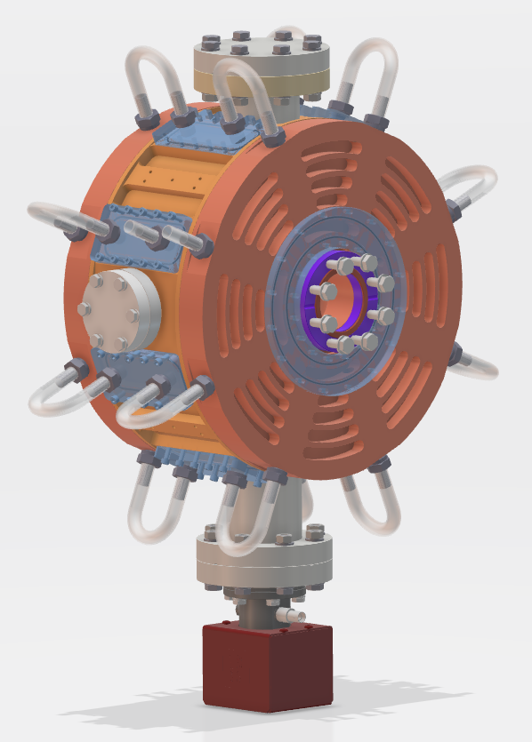
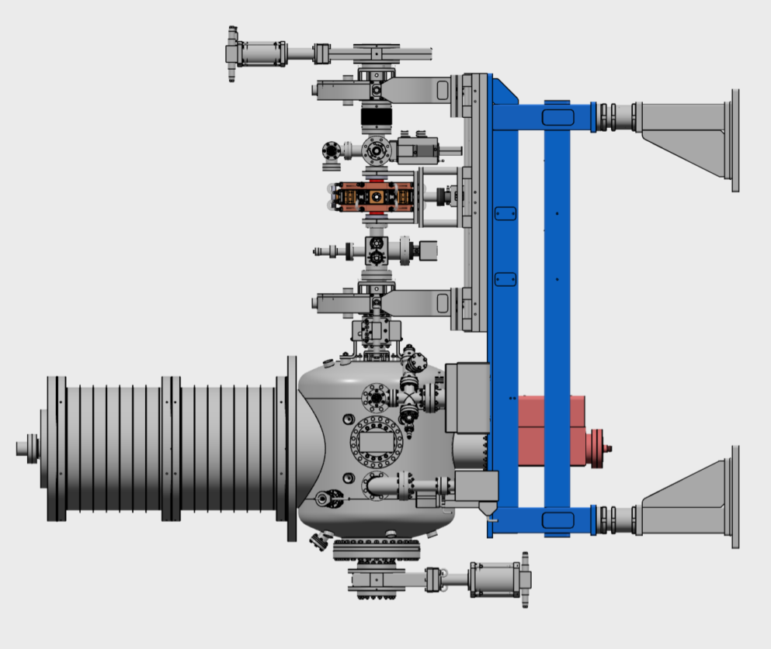
Design of the buncher cavity:
Specifications :
Frequency = 801 MHz
Maximum length = 200 mm
Targeted temperature = 30°C
Power dissipated = 1kW
Material : OFHC
Beam axes flange : CF50
Antenna port : CF 16
Plunger port : CF 40
Vacuum port : CF63
RF power coupler port : CF63

Slide 15
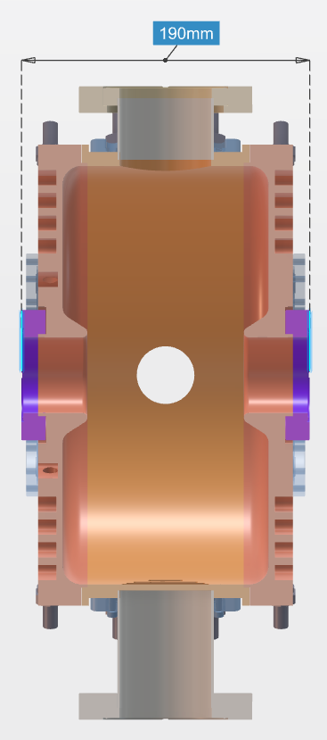
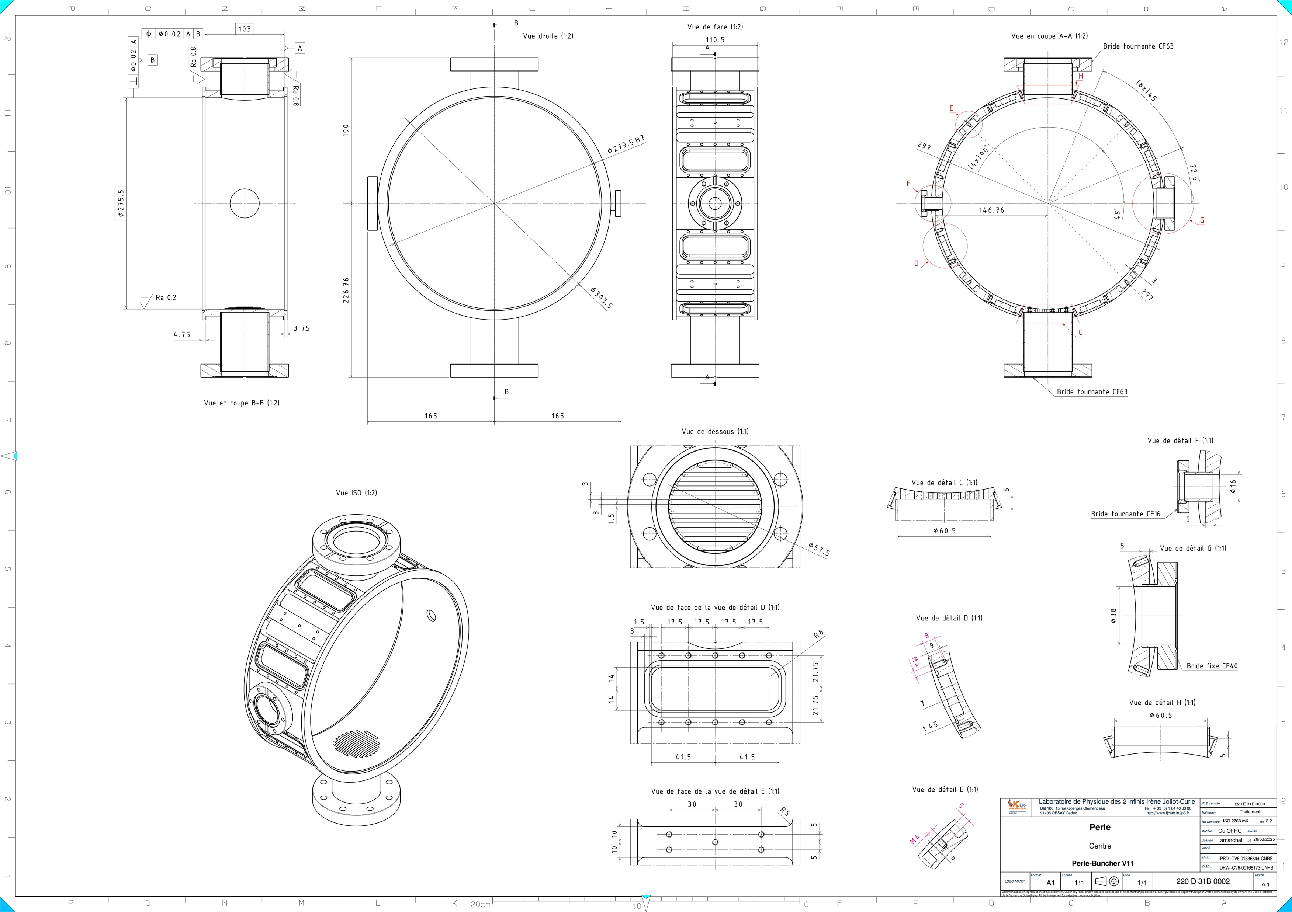
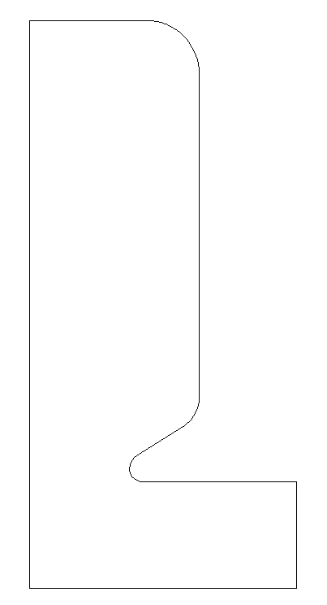
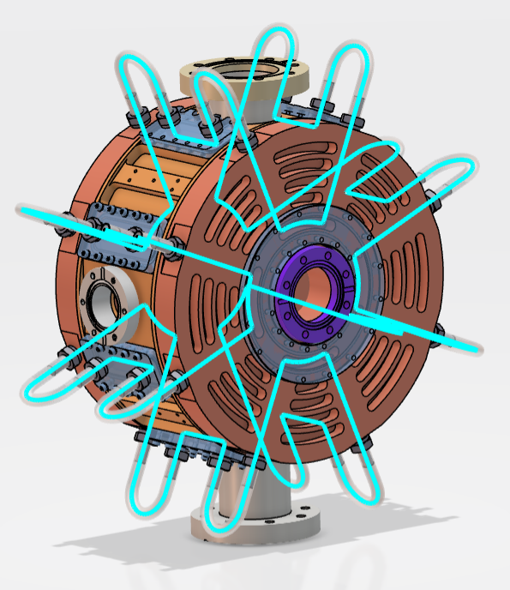

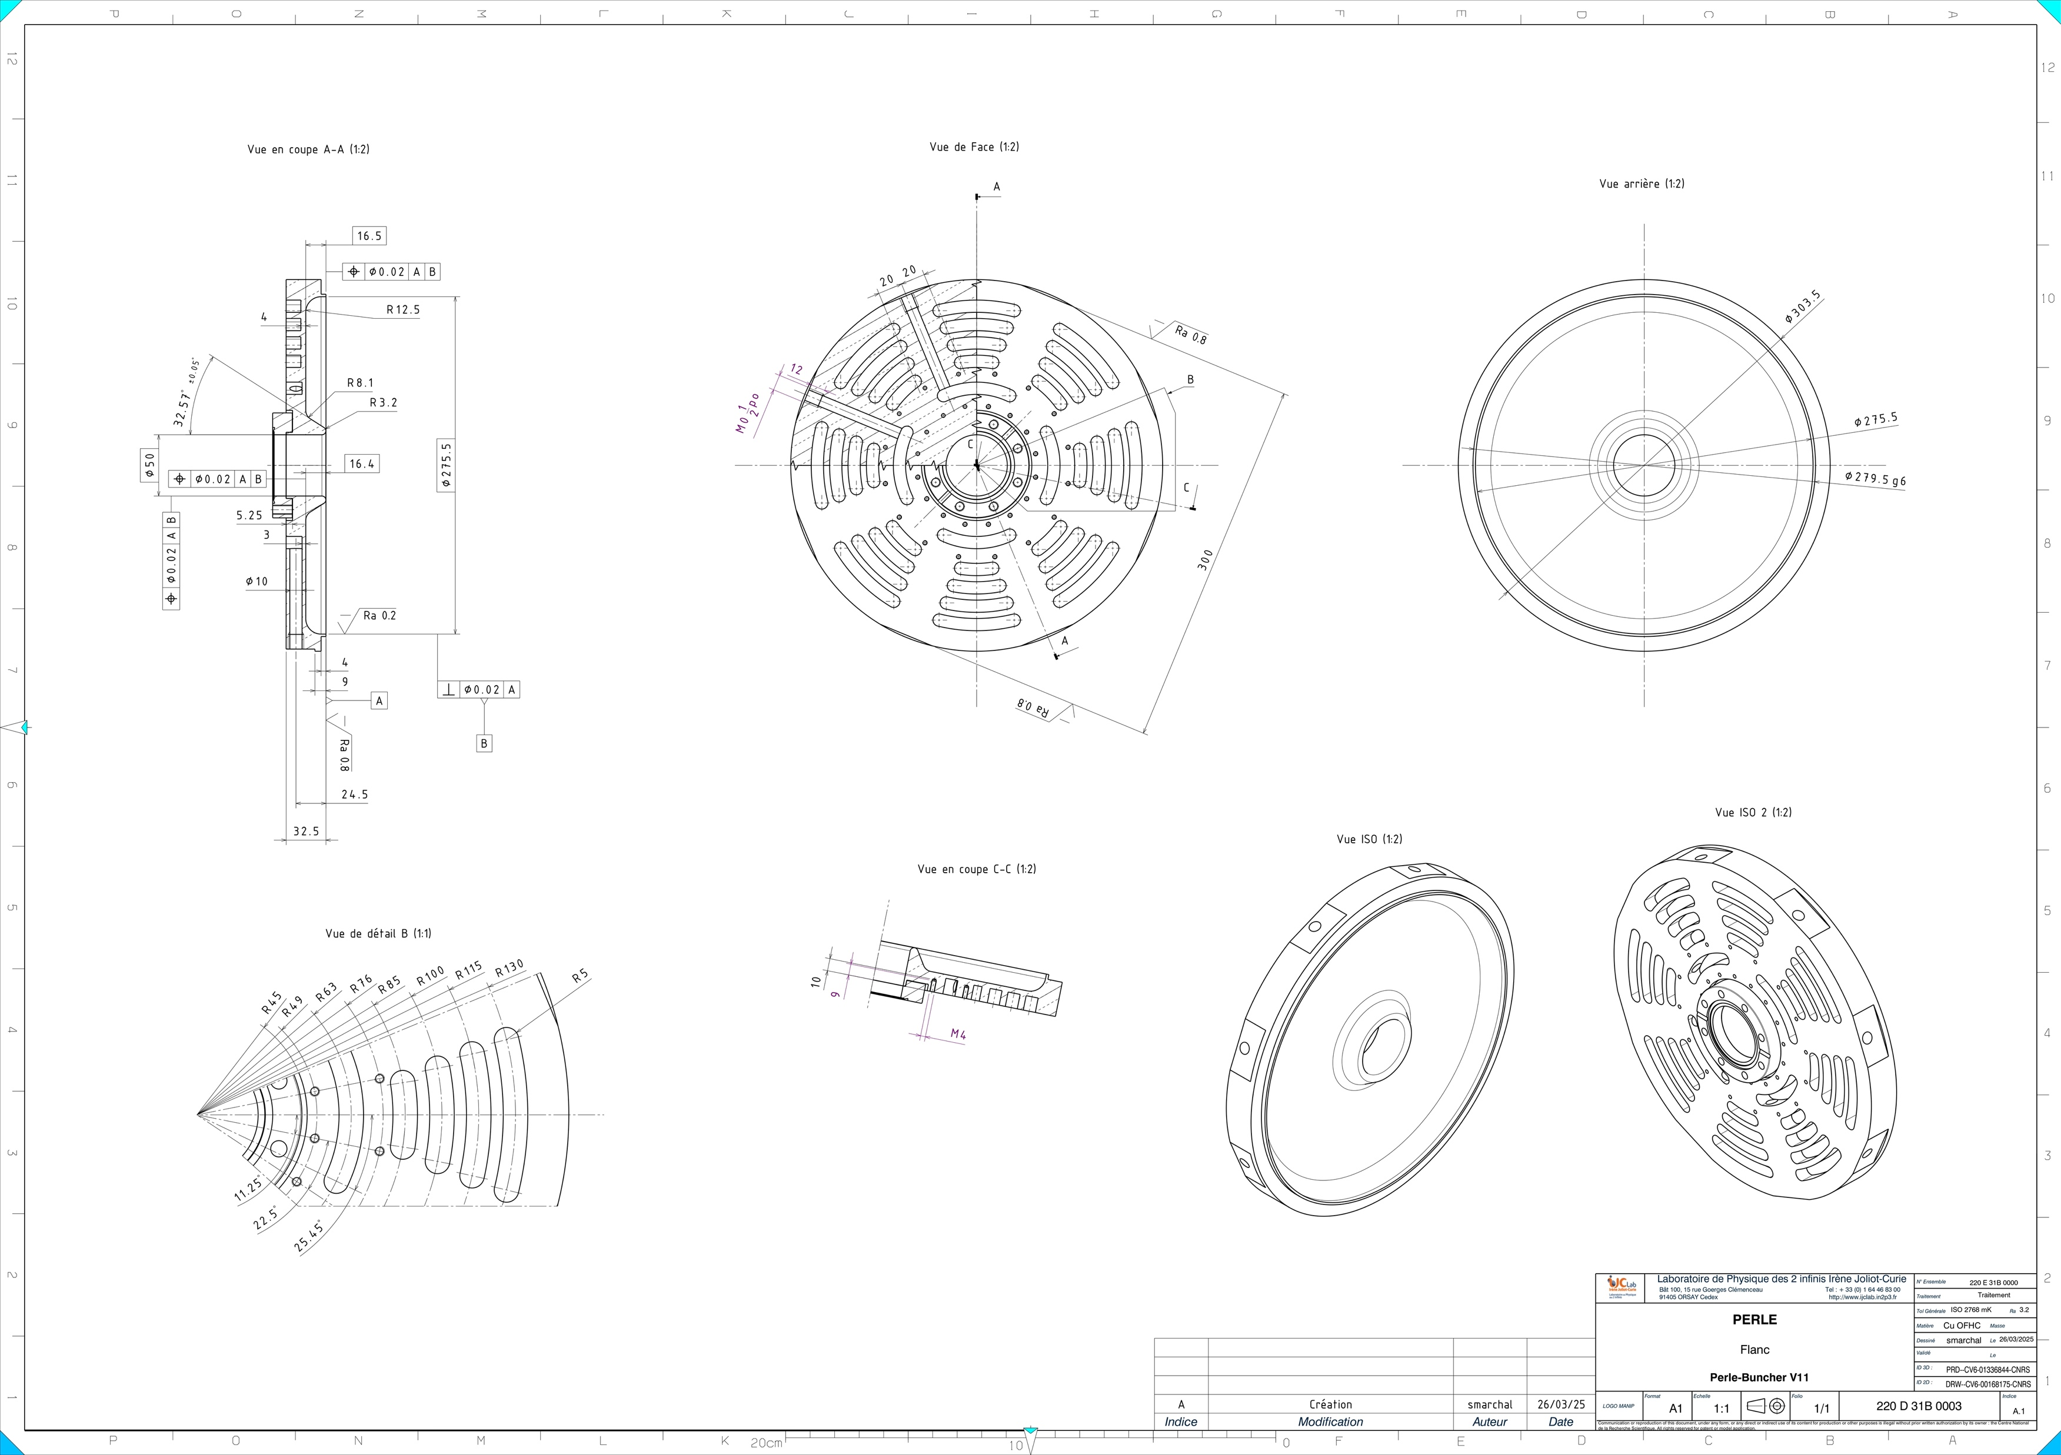
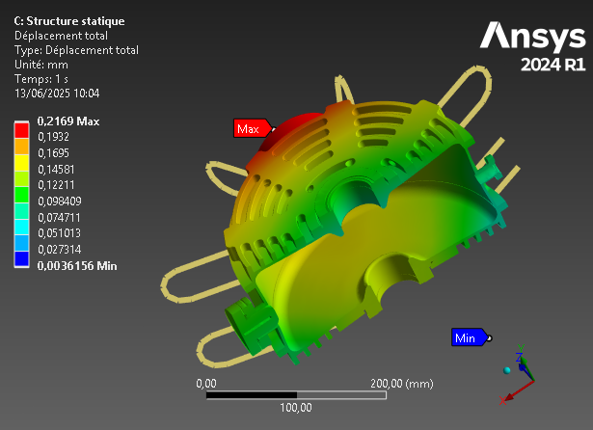
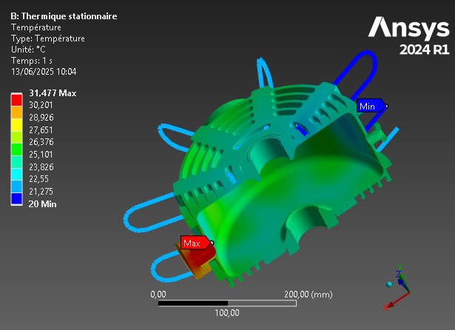
Design of the buncher cavity:
W/2
g/2
Lcav/2
Cooling scheme optimization
Mechanical drawings folder preparation
RF studies & geometry optimization
Thermal & mechanical studies

Slide 16
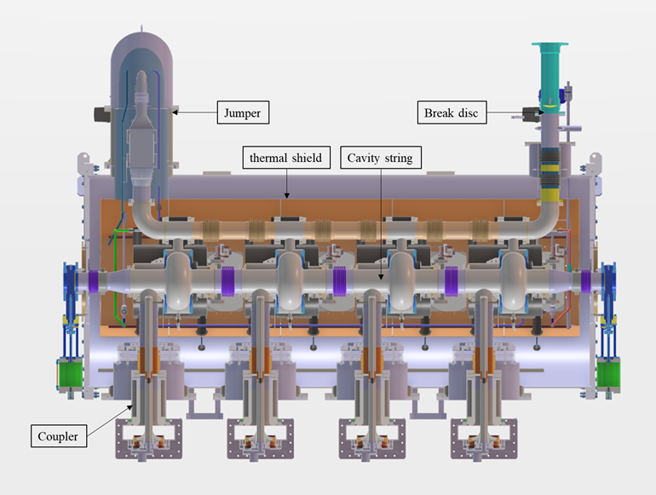
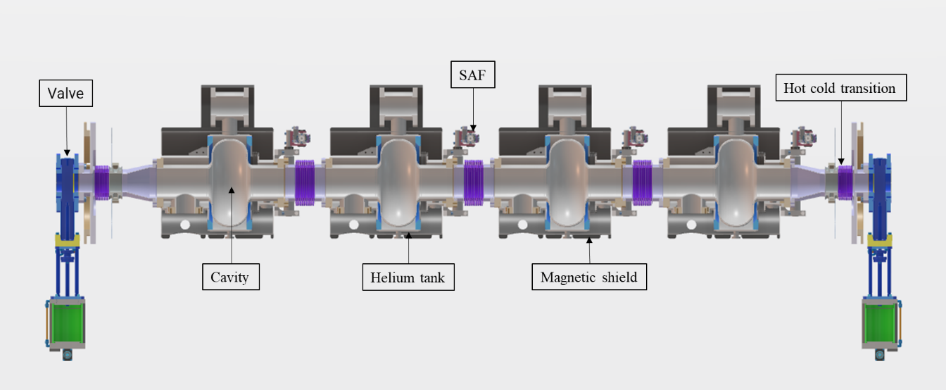
Design of the booster cryomodule:
The booster specifications are:
Bring the beam energy up 7 MeV:
  x 4 single cell SRF cavities, Qo > 3E+10 @ 10 MV/m
  T= 2K (dynamic losses < 5W /cavity)
  F = 801.58 MHz
  RF Power/cavity~40kW
  No HOM couplers but absorbers needed (under discussion)
Adapt as much as possible the Linac cryomodule design to the booster requirements:
  Same vacuum vessel type (same diameter, alignment supports, openings for accessibility, end-caps...)
  Same cryogenic interface (jumper connection)
  Same power couplers
  Same interface to the RF network
  Same tuning systems
1.2 m
2.9 m

Slide 17
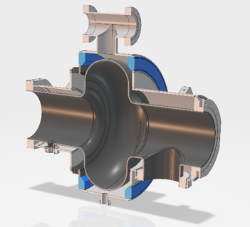
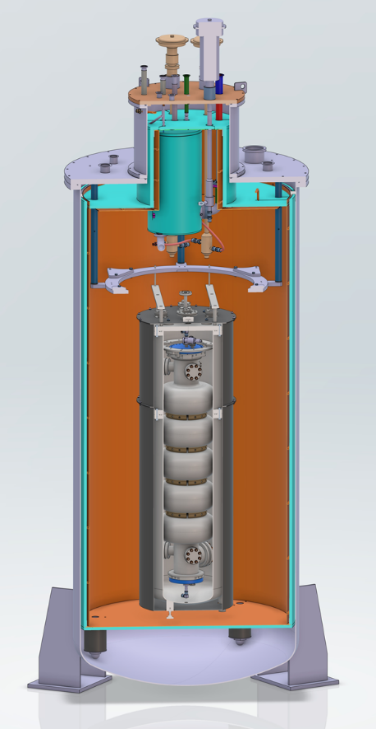
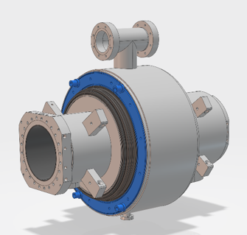
Booster single cell cavity
We tried to standardize its design as much as possible w.r.t the 5-cell cavity design:
  RF design from the 5-cell cavity
  Helium vessel made also of Titanium
  Same flanges
  Same coupler port aperture
  Same bellows
  Same tuning system
  ... no HOM coupler port, but BLAs?
To be compatible with our vertical cryostat configuration for testing at 2K
Simulations & Injector design optimization studies were performed with different codes (OPAL and Astra)
PERLE 5-cell cavity in vertical cryostat

Slide 18
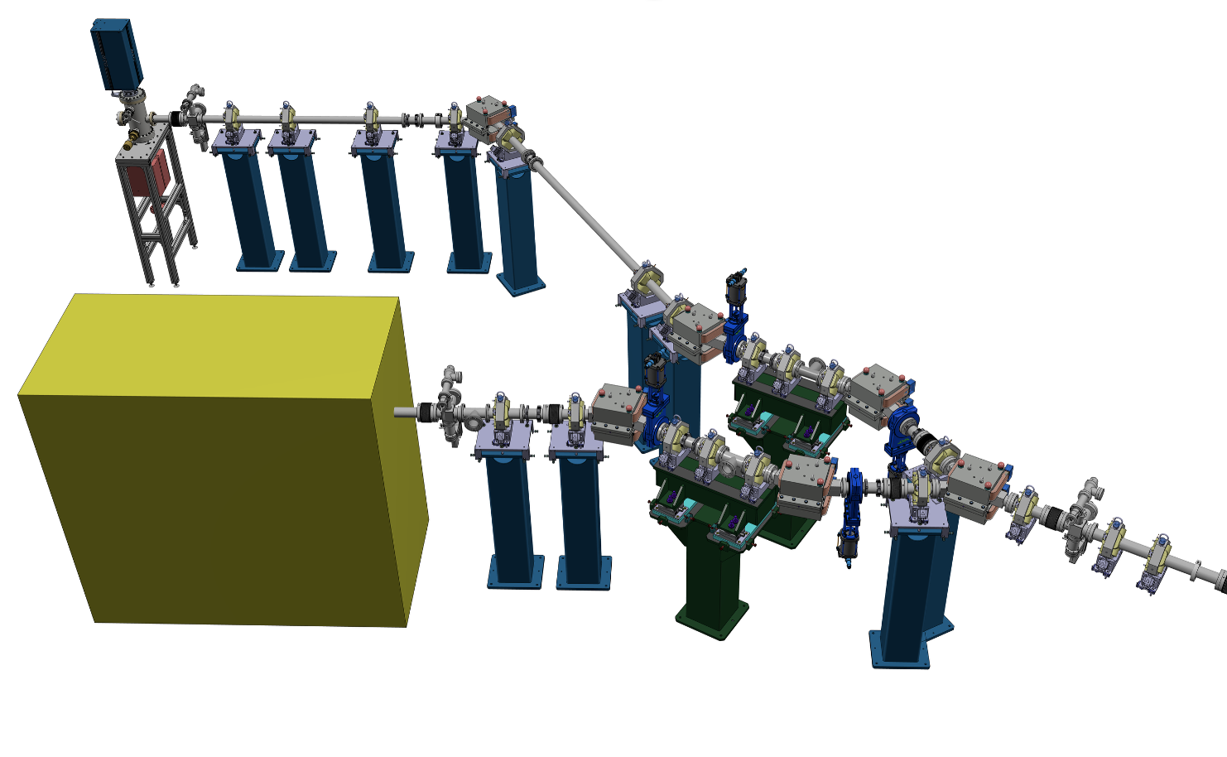
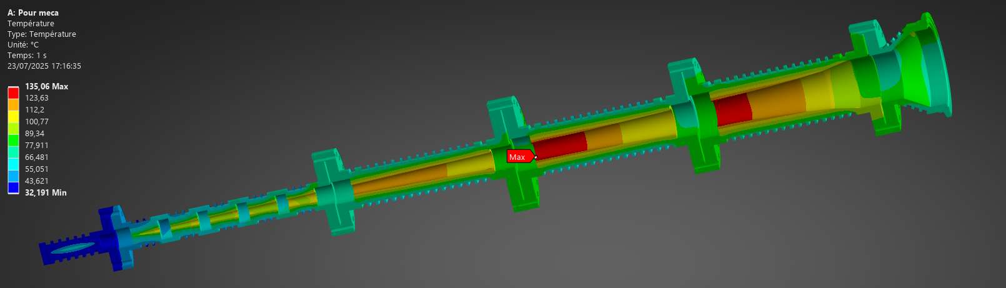
Other systems of the injector:
The Diagnostic line: merroir symmetric w.r.t the merger, with the same optics, containing diagnostics to characterise the beam at the ERL loop entry.
Faraday cup
Beam Dump: for a 7 MeV/ 20 mA → 140 kW beam
The merger: Connecting the injector and the ERL loop, composed of optic elements (Dipoles, quads, steerers) and BPMs.

Slide 19

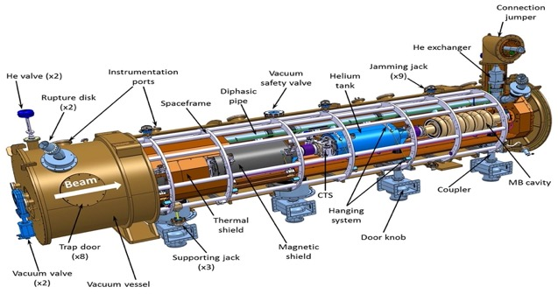
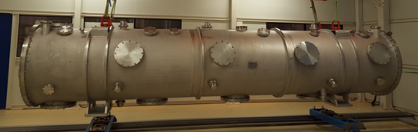
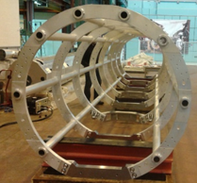
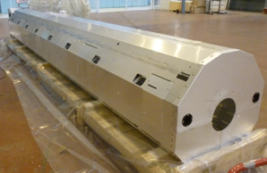
Linac cryomodule design
PERLE cryomodule is adapted from ESS design and will be optimised for efficient high current ERL operation. It will integrate the RF systems (SRF Cavities, HOM couplers & absorbers, Fundamental Power Couplers) optimized and developed within the European project ISAS.
As In-kind contribution of ESS to iSAS, the cryomodule of the linac will reuse ESS medium beta prototype components:
Vacuum vessel
ESS, CEA, CERN and INFN-LASA
are involved in this work
Spaceframe
Thermal shield
And will host new optimized components developed within the iSAS project
  Cavity string (SRF cavities, RF couplers, Tuning systems, Beam Line Absorbers, HOM couplers...)
  Magnetic shield
  Cryogenics circuit...

Slide 20

PERLE SRF cavity : reminder
Collaboration IJCLab-CERN and JLab
PERLE Requirements | Impacts | Challenges | Possible Solutions
CW operation (RF) | High dynamic losses | The highest cavity Q₀ | Cavity post-treatment (Doping, infusion…)
High current operation | High HOMs excitation | Efficient HOMs extraction & damping | Act on cavity design: low frequency cavity choice (< 1GHz), larger cavity aperture, fewer cells for the a given gradient, optimisation of end-cell design.
Muti-bunches operation | Increase beam instabilities | The highest BBU threshold | Regular spacing of bunches: optimisation of the bunch filling pattern during Lattice design + BBU study after HOM optimisation (including collective effects).
Q₀ (2k) = 3 e10 @ ~27 MV/m
Quench @ E_{acc} ~ 30 MV/m
PERLE requirements
First Nb 802 MHz 5-Cell cavity fabricated @ JLAB
F. Marhauser et al. “802 MHz ERL cavity design and development”- IPAC2018 (Vancouver, BC, Canada)- doi:10.18429/JACoW-IPAC2018-THPAL146

Slide 21


SRF cavity : latest news
With the results of the previous studies, we complete the design of the 5-Cell cavity by adapting and integrating:
  A helium jacket made of Titanium (including the beam pipes)
  4 HOM couplers and the FPC ports to the end-groups
  A “classical” tuning system as the one developed for the ESS Spoke cavities
  Cold BLAs between cavities (PhD just started in this thematic)
  A “cold” magnetic shield
A review meeting on the cavity post-production processes recipes (EP, BCP, Mid-T baking…) was organised last year with international experts.
→ An R&D program ongoing for recipe optimization (Coll. IJCLab, Jlab, Fermilab, CERN and KEK)
→ A call for tender for four 5-cell cavities was published last summer, offers received in September, analysed then the order was placed end of October 2025.
2 years to get the 4 cavities ready for clean room assembly
(NB: no spare cavity!)
Goal: High Qo > 3 10¹⁰ (at 2K) @ Eacc=22 MV/m

Slide 22








Status of HOM studies :
HOM coupler optimization of 3 different designs
Collaboration IJCLab-Jlab and CERN
Monopole transmission
Dipole transmission
TM010
Optimized region
Probe Coupler
Hook Coupler
DQW Coupler
Optimized region
TM011
TM110
TM012
TE111
TM111
Couplers were geometrically optimized according to HOM spectrum ($Z_{||}$and $Z_{⊥}$) & S-parameters btw port 1 (beam pipe) & port 2 (coupler output) were studied.
The hook coupler provides higher damping of the first two dipole passbands (TE111 and TM110)
The DQW coupler exhibits a better monopole coupling for TM010 mode than the probe design.
Study of 2 damping schemes with 4 HOM couplers (Especially for dipole HOM extraction)
Longitudinal impedance spectra of the cavity
Transverse impedance spectra of the cavity
beam
beam
→ Promising results of the 4 DQW scheme: It allows damping both monopole and dipole HOMs below the analytically-computed beam-stability limits

Slide 23






Status of HOM studies :
From RF design to performance measurements: Successful collaborative effort between IJCLab, Jefferson Lab & CERN
Probe coupler
DQW coupler
Hook coupler
3D-printed prototype (Epoxy Accura 48) copper-coated @CERN
Ultimately, we aim to produce Nb HOM couplers with optimised design and to install them on a new Nb 5-cell PERLE cavity with optimised end groups. The Production of 4 cavity scheduled within the ISAS program
C. Barbagallo et al. “First RF measurements of coaxial HOM coupler prototypes in a copper cavity for the PERLE project”- IPAC’23- MOPA025

Slide 24







Coupleurs HOM et absorbeurs:
Two Hook-type HOM couplers are needed per cavity → 8 in total to equip the CM.
To reduce manufacturing costs:
The RF design has been optimized to integrate a commercial RF feedthrough (PHOM max 2W @ 2K).
Optimization of the cooling circuit and two He jacket designs are proposed (SS and Ti).
→ Only 4 will be produced by CERN within the iSAS framework.
→ Quotations requested from manufacturers for the production of the 4 additional HOM couplers.
Cold absorbers: A PhD thesis has just started on this topic, to be investigated:
What material to use (SiC, AlN, others...)?
How many BLAs in the CM? Two options: 3 cold BLAs + 2 hot or 5 cold.
Cooling with gaseous He at 50K via a dedicated cryo circuit.
A preliminary design to extract PHOM = 100W still needs optimization.
design simplification by adding a standard RF feedthrough on CF16 flange
Cooling circuit Optimization
He jacket
BLA Thermal mapping
Config with 5 cold BLAs

Slide 25



Coupleur de puissance:
Power couplers
SPL is the baseline with some adaptations to cope with PERLE requirements
Design completed and validated (technical review last June)
4 couplers will be produced by CERN by end of 2026
Same cooling configuration than the one of ESS: helium circulation from 4/5 K to 300 K through a double wall tube
Double-wall tube procurement was not included in ISAS: need to be ordered in 2026. We got 2 options:
  Take the ESS design (baseline) → need to sign an NDA with CEA.
  Mitigation: modify/adapt the DWT of the ESS double-spoke → Study about to start.

Slide 26
Summary:
We are making good progress on design phase, PERLE TDR is foreseen to be released beginning 2026.
We adopt a staging approach to build PERLE in respect to available funds and in-kind contributions. More funds are needed for the complete program.
DC-gun + photocathode+ preparation chamber acquired by RI within a Collaboration Agreement. All material has been shipped to IJCLab end of January 2024, installed on site at IJCLab (in the “Igloo”) and is now partially operational (Photocathode production). First beam is scheduled on March 2026. The Laser has been also purchased, installed and tested.
Funds obtained within RI2 national program (CNRS) which should allow to finance the full injection line.
iSAS: European INFRA-TECH project 11 research partners (CNRS, CERN, ESS, DESY, VUB, CEA, HZB, INFN, UKRI, UL, EPFL). Financial support for the construction of the full LINAC cryomodule (with IN2P3 matching funds + CM vessel from ESS). The 4 SRF cavities are already ordered. Reception is foreseen in one year from now.

Slide 27
Thank you for your attention!

