Slide 1
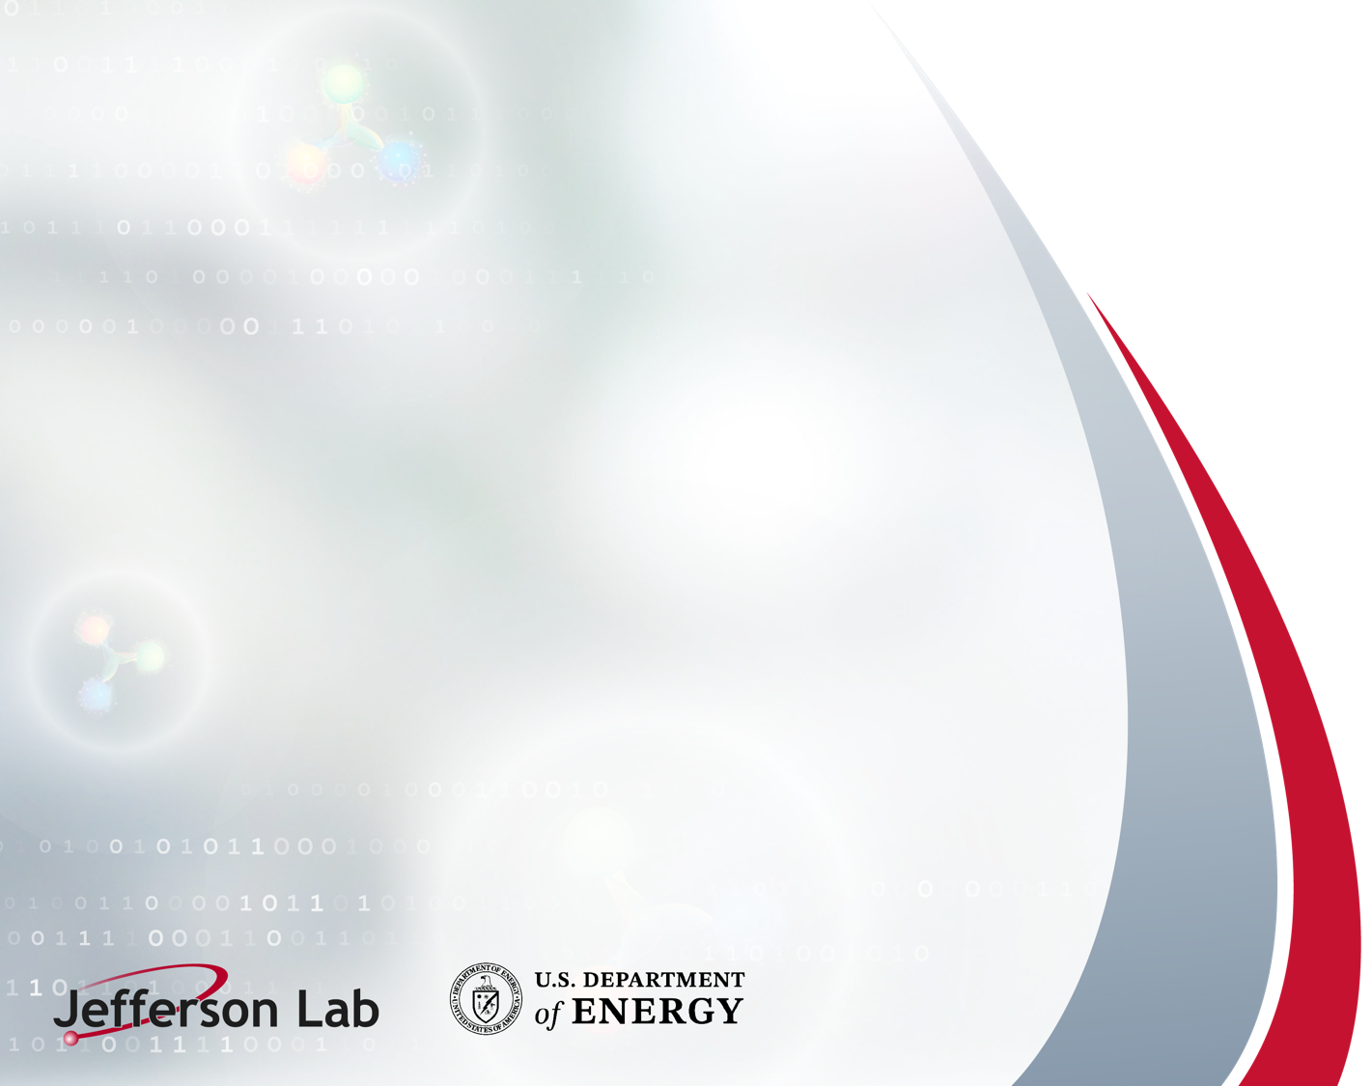
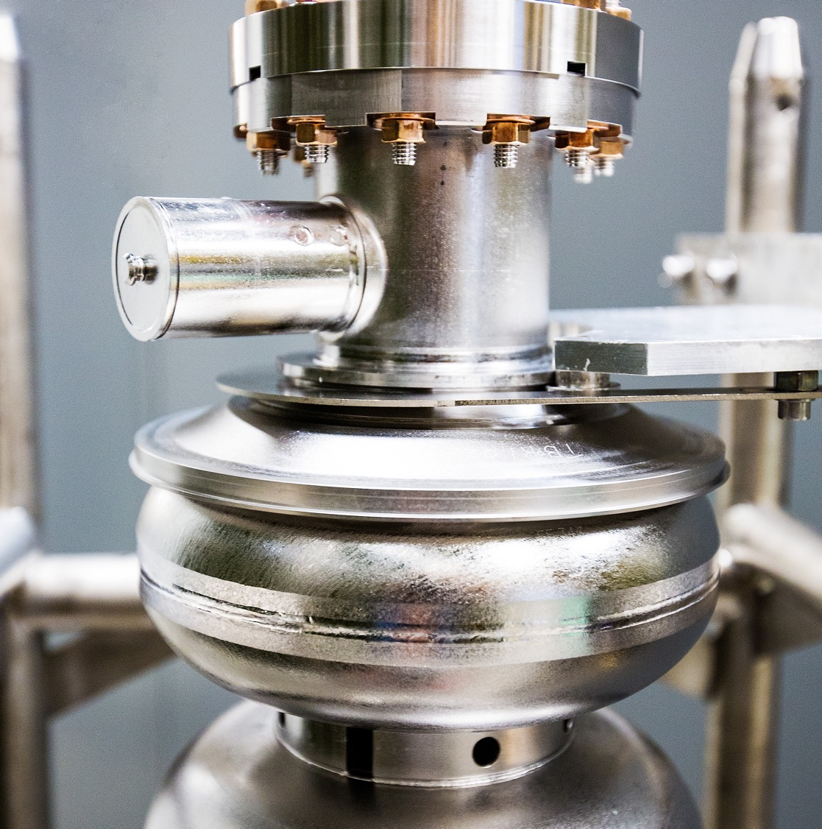
Conduction-cooled SRF cryomodule for compact accelerators
SRF Frontiers Workshop
November 12, 2025
Gianluigi Ciovati

Slide 2
Overall features of Cryomodule design
Low-cost
Minimize the heat load at 4 K
Minimize the number of joints between the cryocoolers’ 4 K-stage and the cavity
Ease of assembly and maintenance
The absence of LHe eliminates the need for a He tank
Many possible applications require a beam energy of 1-10 MeV → single-cavity linac → eliminate the need for a cold tuner

Slide 3
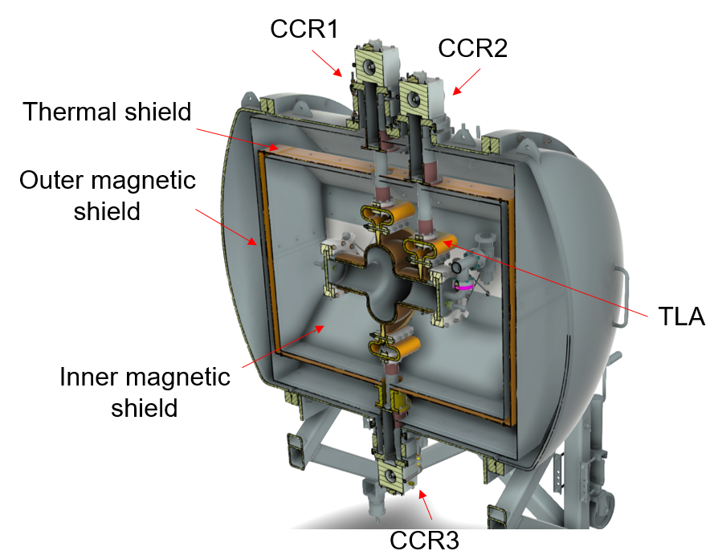
Horizontal Test Cryostat - Design
Cylindrical vacuum vessel with domed caps: ~59” long, ~42” diameter
952 MHz cavity supported by Nitronic rods
Two layers of magnetic shields
Three GM-type cryocoolers at top and bottom
Flexible Cu thermal links used to connect cryocoolers directly to the cavity
Top and bottom halves of thermal shield allowed to slide
Thermally intercepted RF cables
Design and procurement of components by JLab
Assembly done by General Atomics

Slide 4
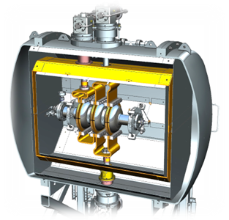
Horizontal Test Cryostat - Performance
Cavity cooled from 300 K to 3.7 K in 1 day
Residual magnetic field at cavity equator at 3 locations before cool-down was 0.9 – 2.2 mG
Bottom thermal shield temperature: 52 K
Top thermal shield: 38 K
Static heat load to thermal shield ~100 W (no MLI)
Static heat load to 4 K stage: ~1 W
Cavity was thermally stable up to ~18 W of RF heat load
Cu/Nb/Nb₃Sn cavity: evidence for residual magnetic field produced by thermoelectric current
The cryostat was used for testing a 1.3 GHz 3-cell cavity

Slide 5
Horizontal Test Cryostat – Cost (2021)
Vacuum vessel: ~$125k
Inner and outer magnetic shields: ~$25k
Thermal shield: ~$15k
Three GM-type cryocoolers, Sumitomo RDE-418D4 (2 W at 4 K): ~$150k
Thermal links: ~$10k
Instrumentation
  16 temperature sensors: ~$6k
  3 flux-gate magnetometers: ~$5k
Total: ~$336k

Slide 6
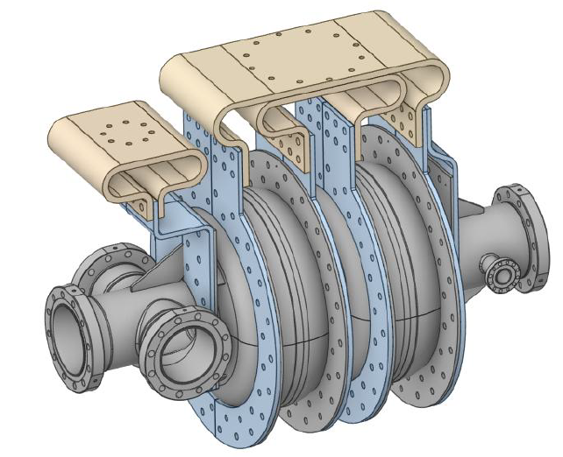
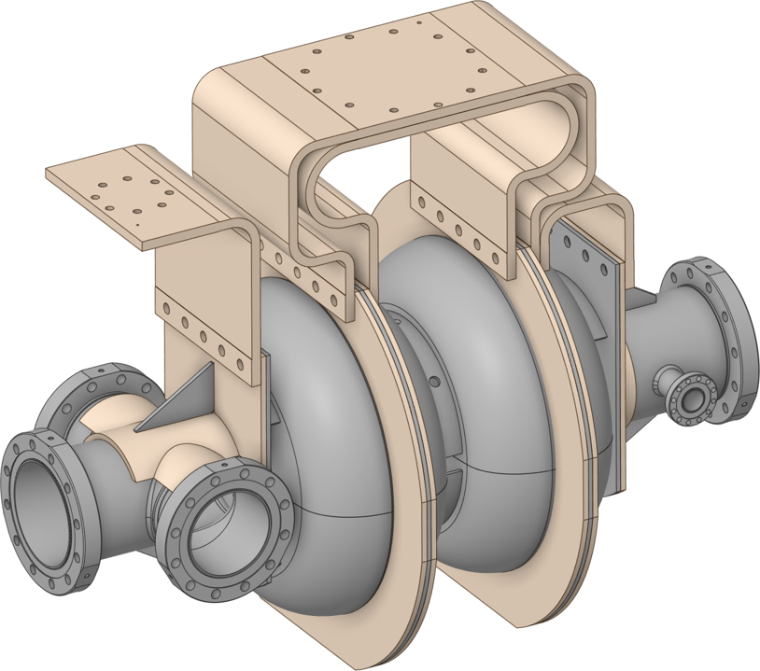
Cryomodule design for 915 MHz 2-cell cavity
Same design principles as for the horizontal test cryostat – re-use the vacuum vessel
Replaced one top and bottom GM-type cryocoolers with one 5 W at 4 K PT-type cryocooler
Flexible Cu thermal links
Two types of thermal link connections to the cavity:
  Direct connection to Cu-plated Nb cooling rings on the cavity
  Connection to 5N Al rings bolted to Nb cooling rings on the cavity
OFHC Cu flexible thermal links
OFHC Cu flexible thermal links
5N Al rings
Cu-plated rings

Slide 7
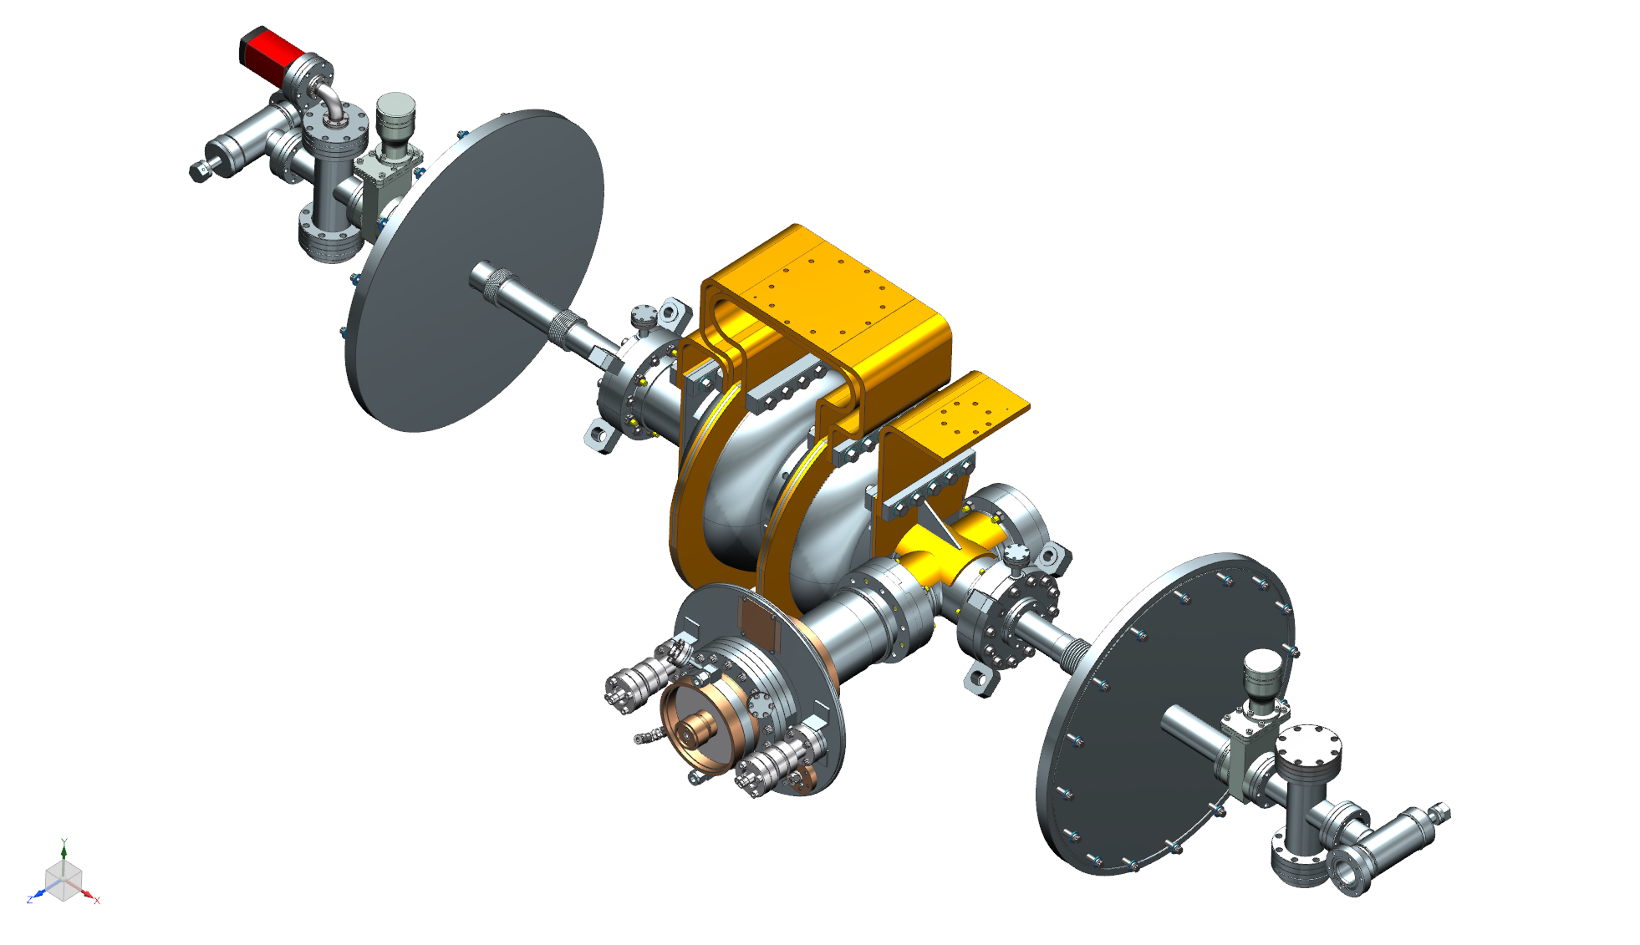
Hermetic assembly
Vacuum gauge
NEG pump
Vacuum vessel interface plate
Nitronic rods mounting flange
Gate valve
Coaxial FPC

Slide 8
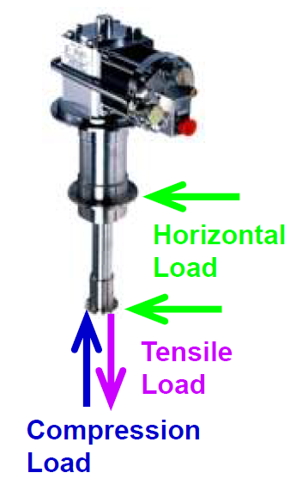
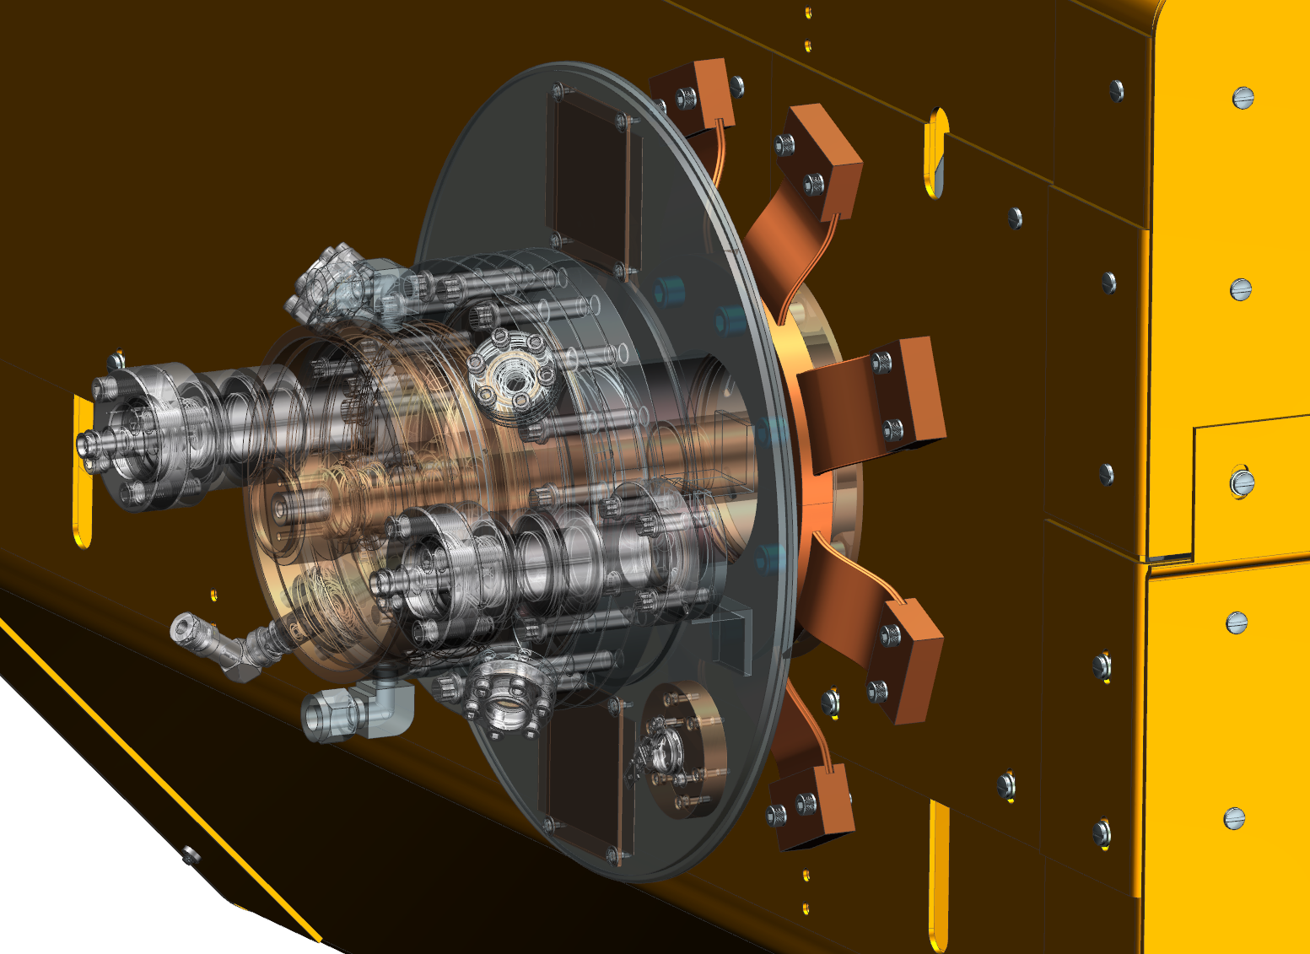
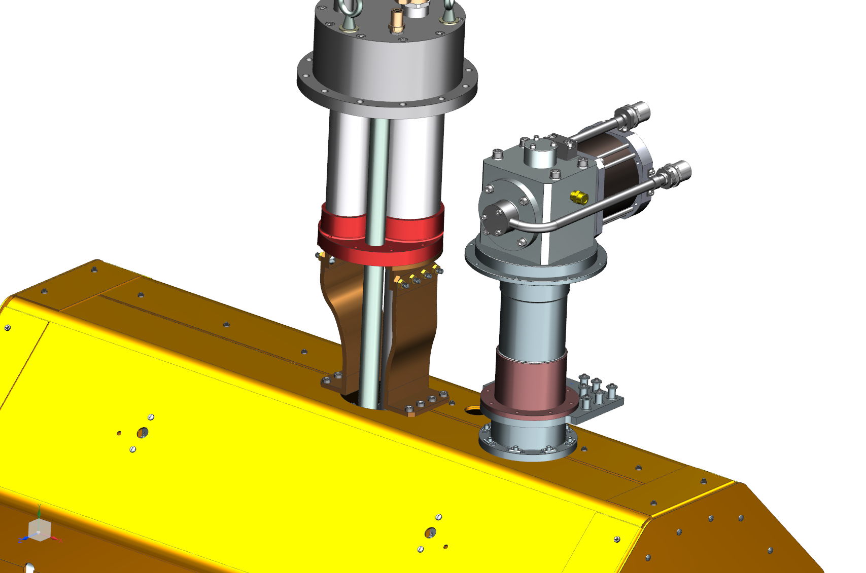
Connections to thermal shield
Mechanical load limits for cryocoolers’ heat stations:
  GM-type
  PT-type: < 20 kgf combined in the 𝑥, 𝑦 and 𝑧 directions and for both stages
 | 1st stage | 2nd stage
Horizontal load (kgf) | 10 | 5
Tensile load (kgf) | 30 | 30
Compression load (kgf) | 200 | 100
1st stage
2nd stage
Mechanical analysis of the CM after cool-down indicated the need to mechanically decouple the two cryocoolers and the FPC from the thermal shield

Slide 9
Thermal analysis
Aiming at operating the cavity with up to 18 kW of CW forward power and E_{acc} = 11 MV/m. Meeting these specifications would allow accelerating a 5 mA CW electron beam by 3.5 MeV
Surface fields in the model for 3 cases:
  Cavity on-resonance, with beam, P_{fwd} = 18 kW
  Cavity on-resonance, without beam, P_{fwd} = 4.5 kW
  Cavity off-resonance, without beam, P_{fwd} = 18 kW
A radiative heat load of 55 W applied to the thermal shield
A heat load of 1 W applied to the cavity outer surface
Cooling with water at 303 K for the FPC window and the air-side section of the FPC. Air cooling for the vacuum-side section of the inner conductor
Temperature versus heat load capacity maps of the cryocoolers
Temperature dependent thermal conductivity and thermal interface resistance tables for all of the materials and joints which were part of the models

Slide 10
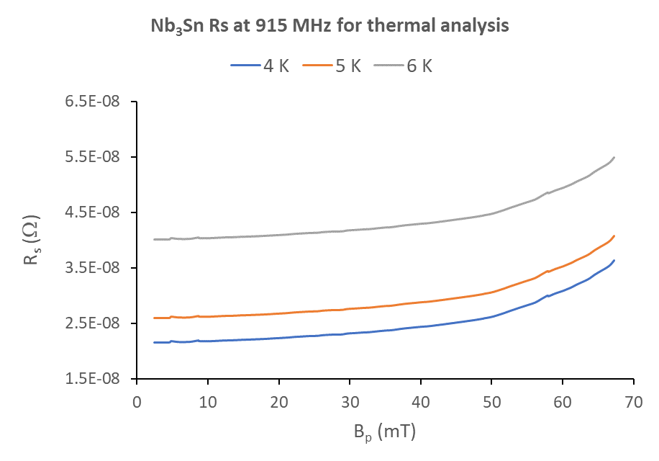
Nb₃Sn surface resistance
Field and temperature dependent surface resistance assuming:
  Residual magnetic field: 10 mG
  Temperature gradient at T_{c}: 3 K/m
  Intrinsic residual resistance: 5 nΩ
R_{res} = 21 nΩ
Target
Q₀(4 K)~1.3×10¹⁰

Slide 11
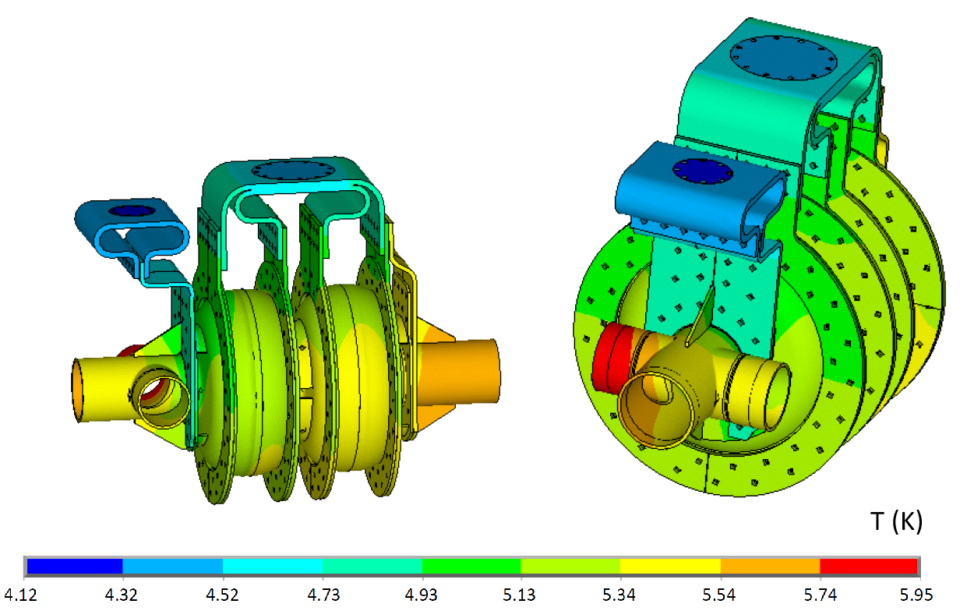
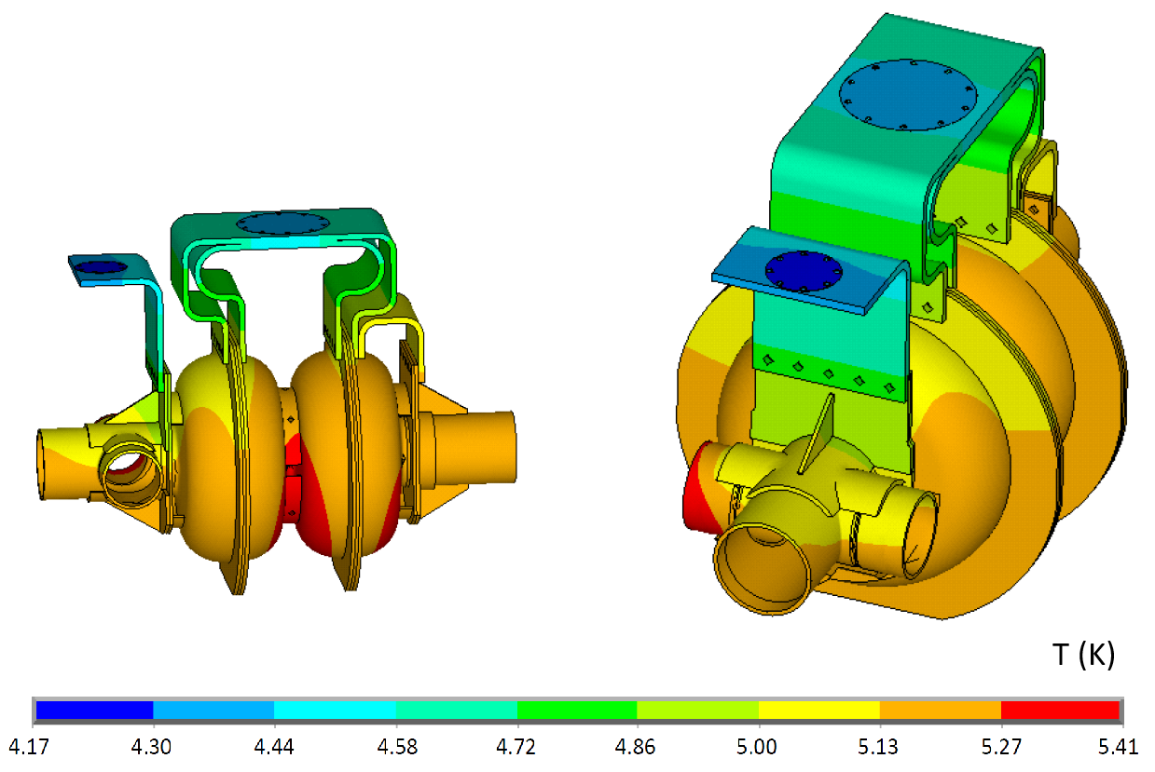
Thermal analysis - results
Similar results were achieved with either thermal link configuration
Temperature distributions in the cavity and thermal links for case with beam loading, 11 MV/m, P_{fwd} = 18 kW

Slide 12
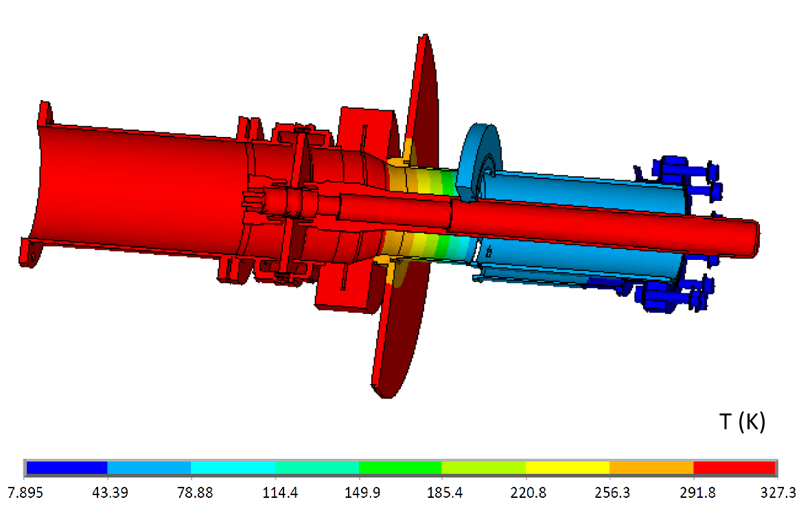
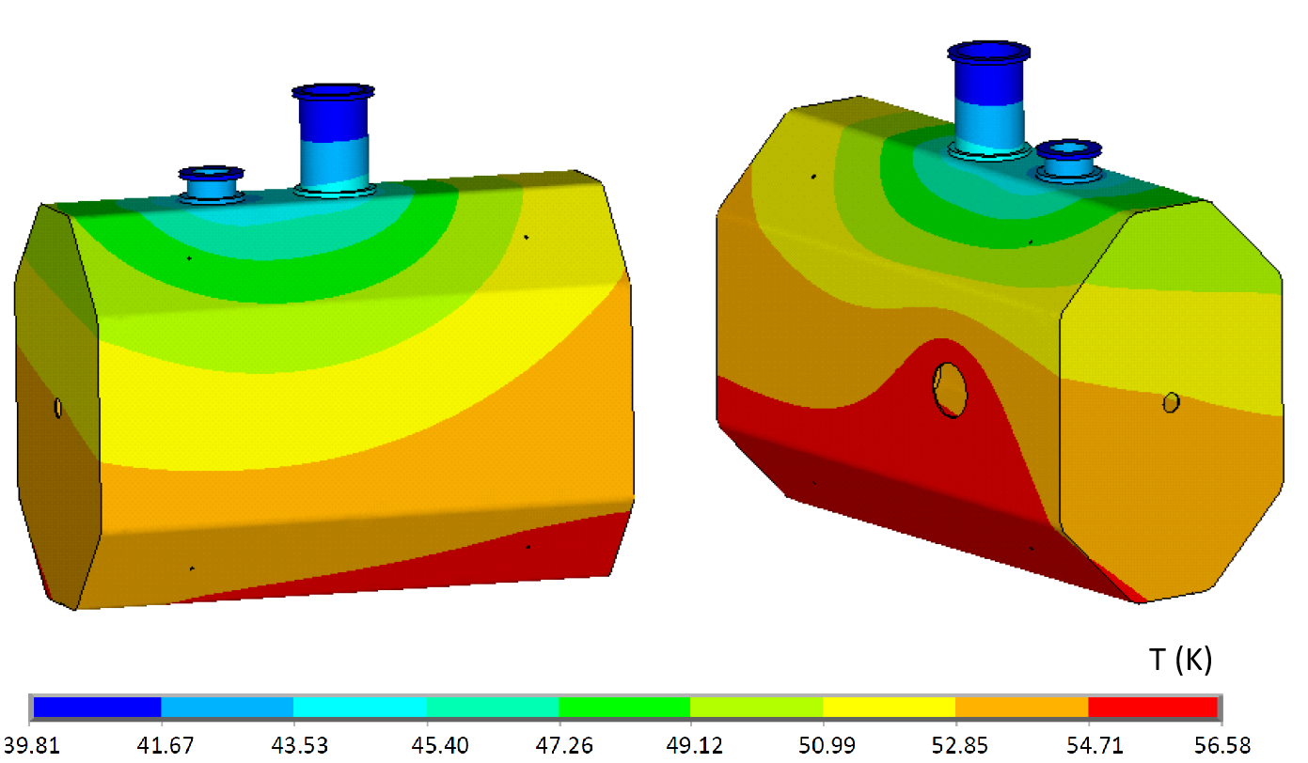
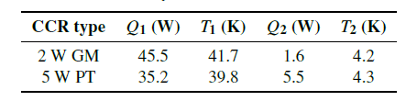
Thermal analysis – total heat loads
Temperature distributions in the cavity and thermal links for case with beam loading, 11 MV/m, P_{fwd} = 18 kW
Temperatures T₁, T₂ and total heat loads Q₁, Q₂ for each stage of each cryocooler

Slide 13
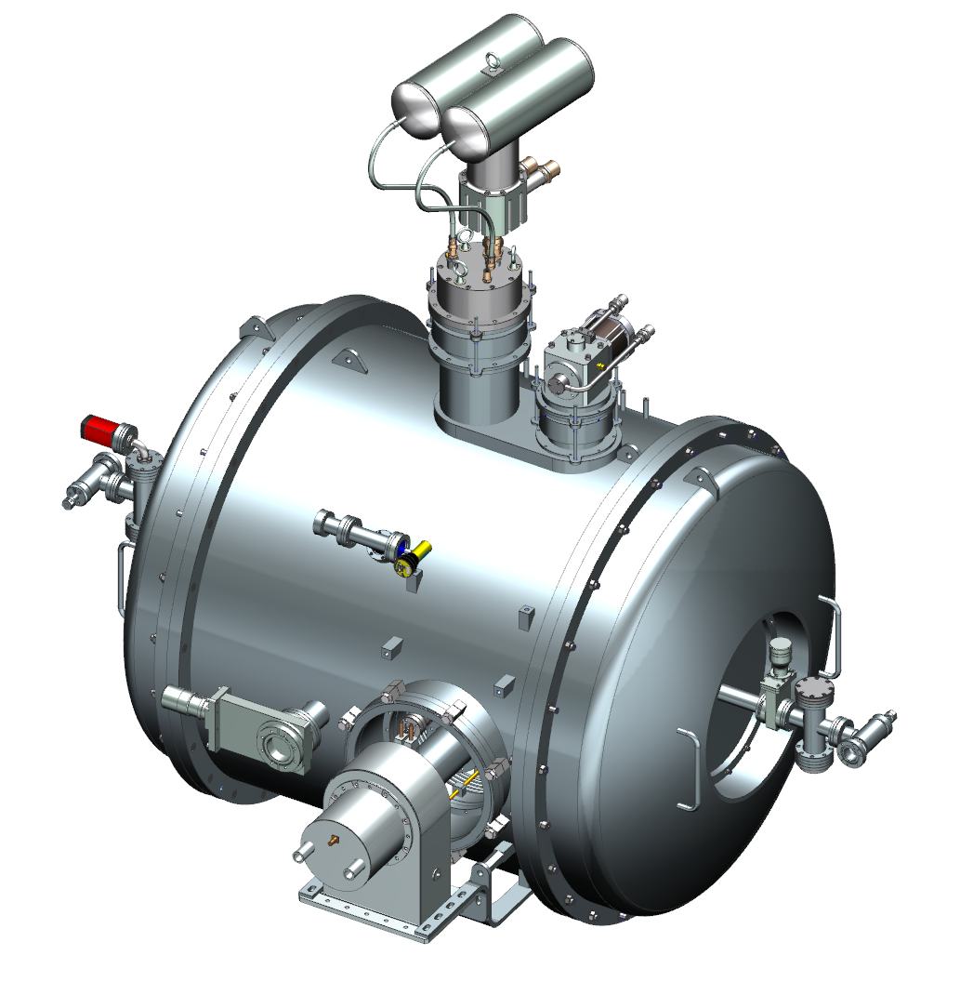
Cryomodule components – cost (2025)
Vacuum vessel: ~$180k
Inner and outer magnetic shields: ~$25k
Thermal shield: ~$18k
One GM-type cryocooler, 2 W at 4 K: ~$50k
One PT-type cryocooler, 5 W at 4 K: ~$150k
Thermal links: ~$25k
Warm-to-cold transitions: ~$20k
NEG pumps: ~$6k
Instrumentation
  16 temperature sensors: ~$7k
  3 flux-gate magnetometers: ~$5k
Total: ~$486k

Slide 14
OTHER DESIGNS

Slide 15
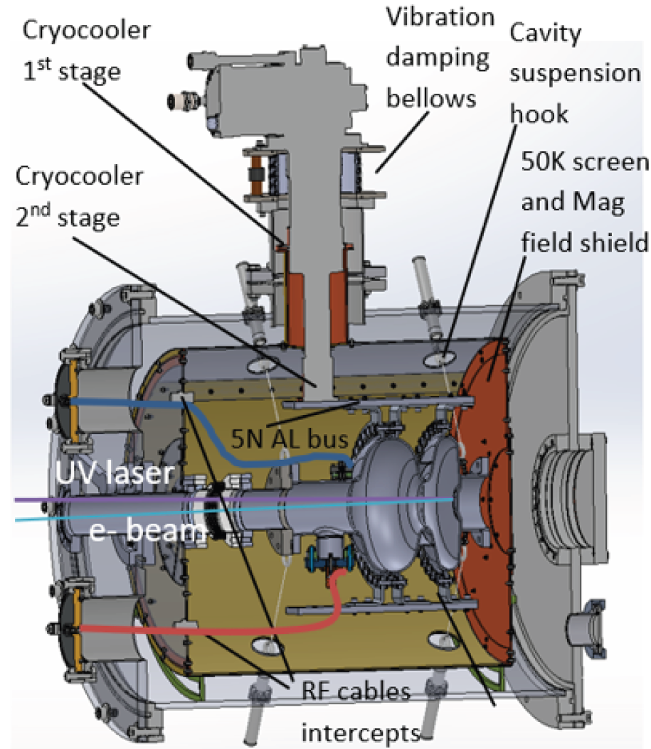
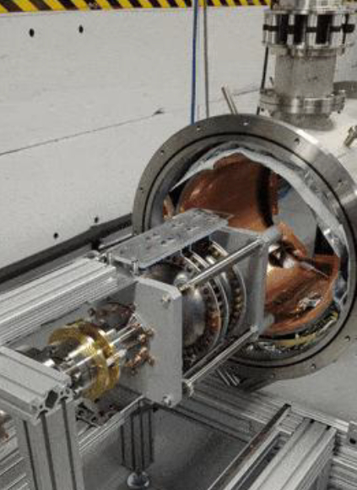
EUCLID TECHLABS
1.5 cell, 1.3 GHz cavity
1.6 MeV, 6.5 – 650 μA
5N Al thermal links
One GM-type 2 W at 4 K cryocooler
Static heat load at 4 K ~0.2 W
Cylindrical vacuum vessel, space frame

Slide 16
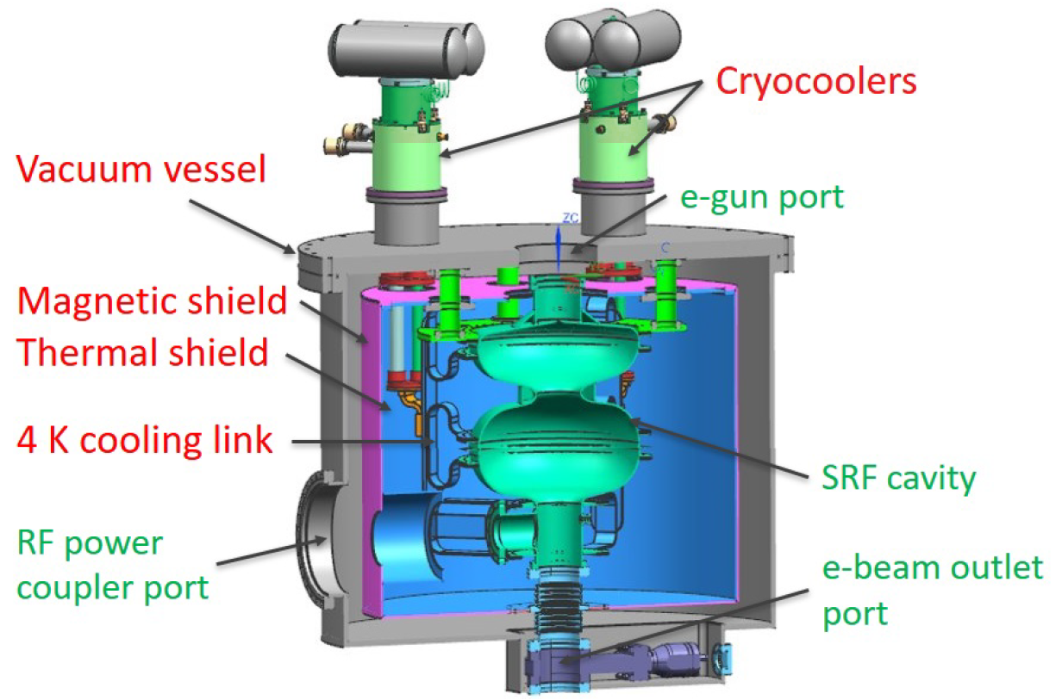
fermilab
1.6 cell, 650 MHz cavity
1.6 MeV, 20 kW
5N Al thermal links
Two PT-type 2 W at 4 K cryocoolers
Cylindrical vacuum vessel

Slide 17
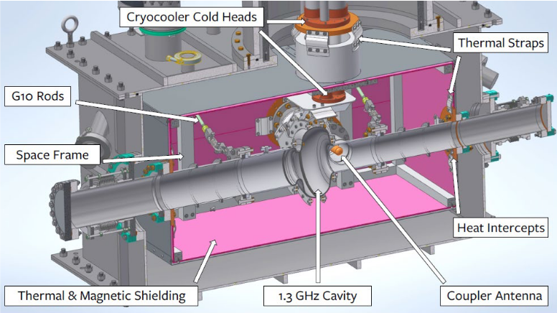
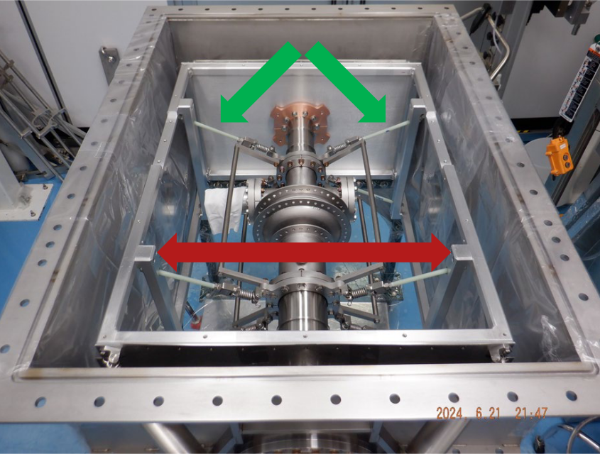
Cornell university
Single-cell, 1.3 GHz cavity
1 MeV, 100 kW
5N Al thermal links
Two PT-type 2 W at 4 K cryocoolers
Static heat load: ~1.1 W at 4 K
Box-type vacuum vessel, space-frame

Slide 18
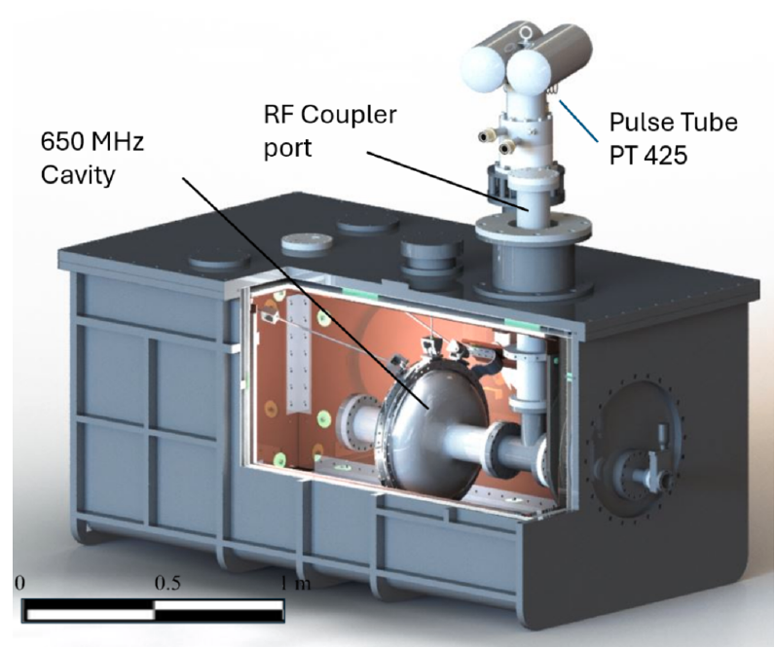
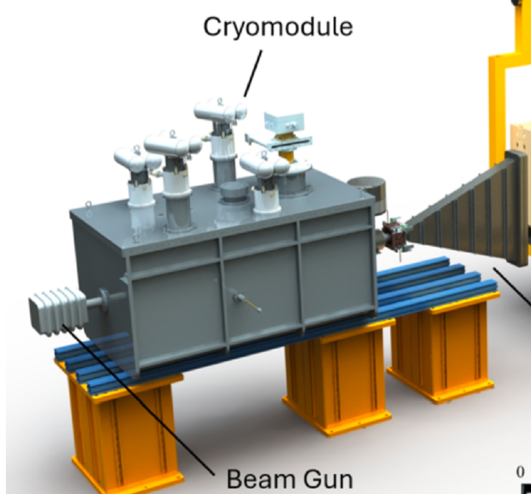
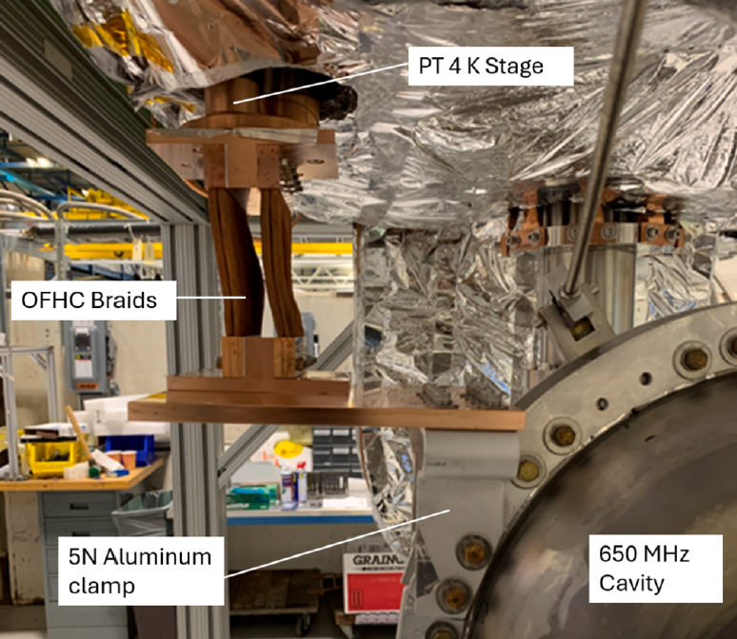
radiabeam
4.5-cell, 650 MHz cavity
10 MeV, 1 MW
5N Al thermal links
Four PT-type 2.5 W at 4 K cryocoolers
Box-type vacuum vessel, top-loaded
Two-layers magnetic shield
Prototyped with a single-cell 650 MHz, one cryocooler
  Static heat load ~3.2 W at 4 K, limited by non-optimal MLI

Slide 19
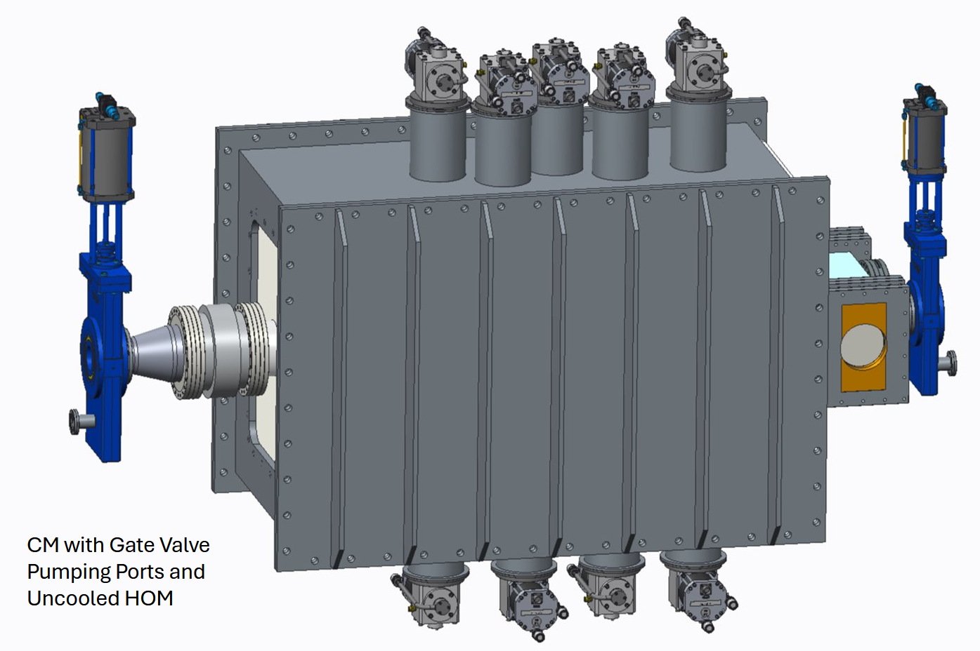
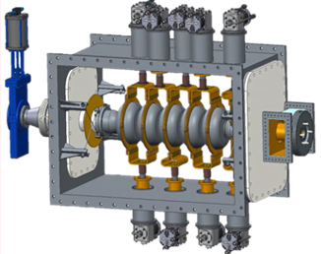
JLAB – 10 MeV
5-cell, 915 MHz cavity
10 MeV, 1 MW
OFHC Cu thermal links
Four GM-type 2 W at 4 K cryocoolers
Box-type vacuum vessel
Two-layers magnetic shield
Coaxial beamline FPC

Slide 20
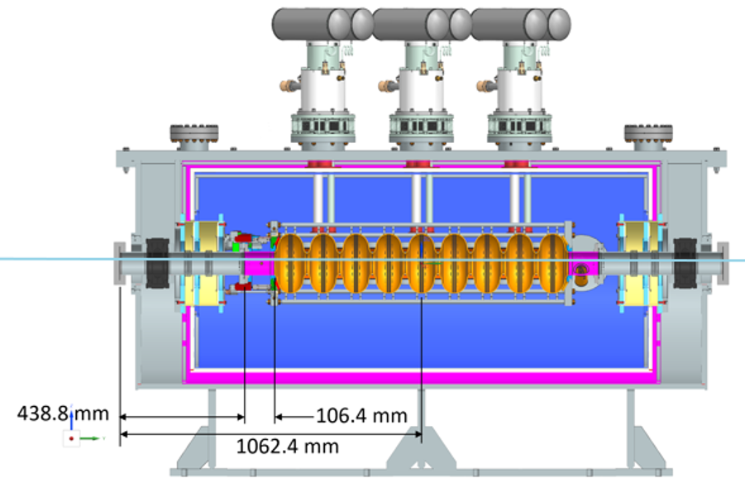
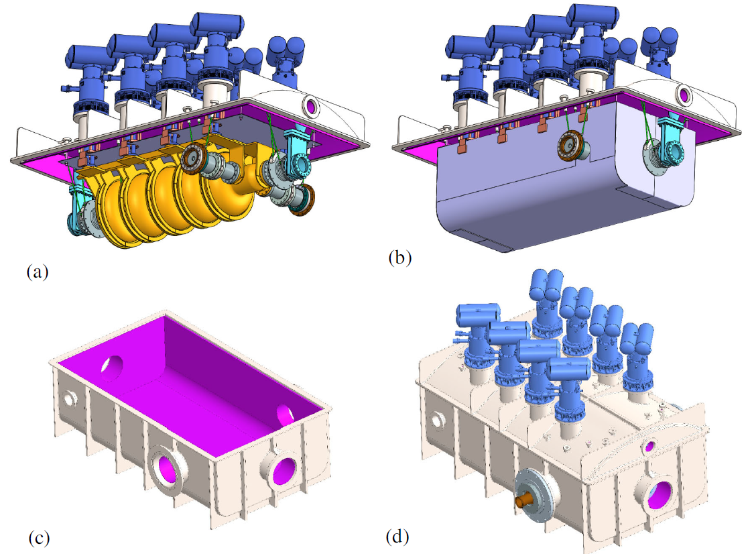
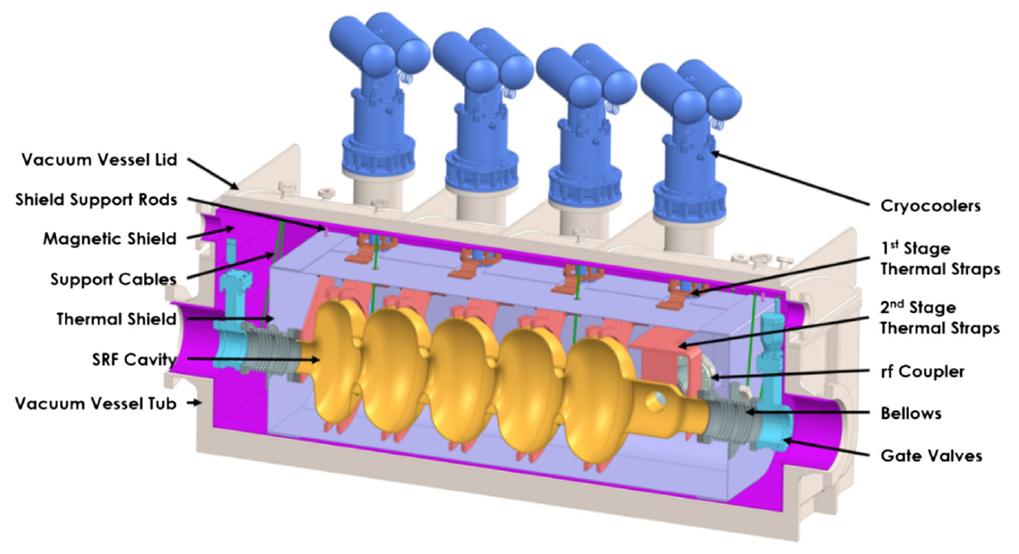
FERMILAB – 10 MeV
Two designs:
9-cell, 1.3 GHz cavity
  10 MeV, 20 kW
  Six PT-type 2.5 W at 4 K cryocoolers
4.5 cell, 650 MHz cavity
  10 MeV, 1 MW
  Four PT-type 2 W + two PT-type 2.5 W at 4 K cryocoolers
Commonalities:
5N Al thermal links
Box-type vacuum vessel, top-loaded
Single magnetic shield

Slide 21
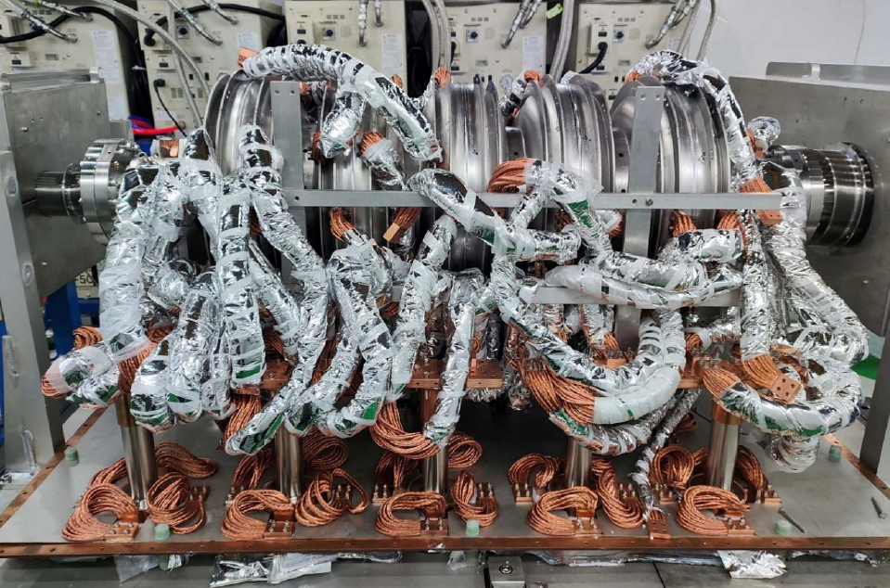
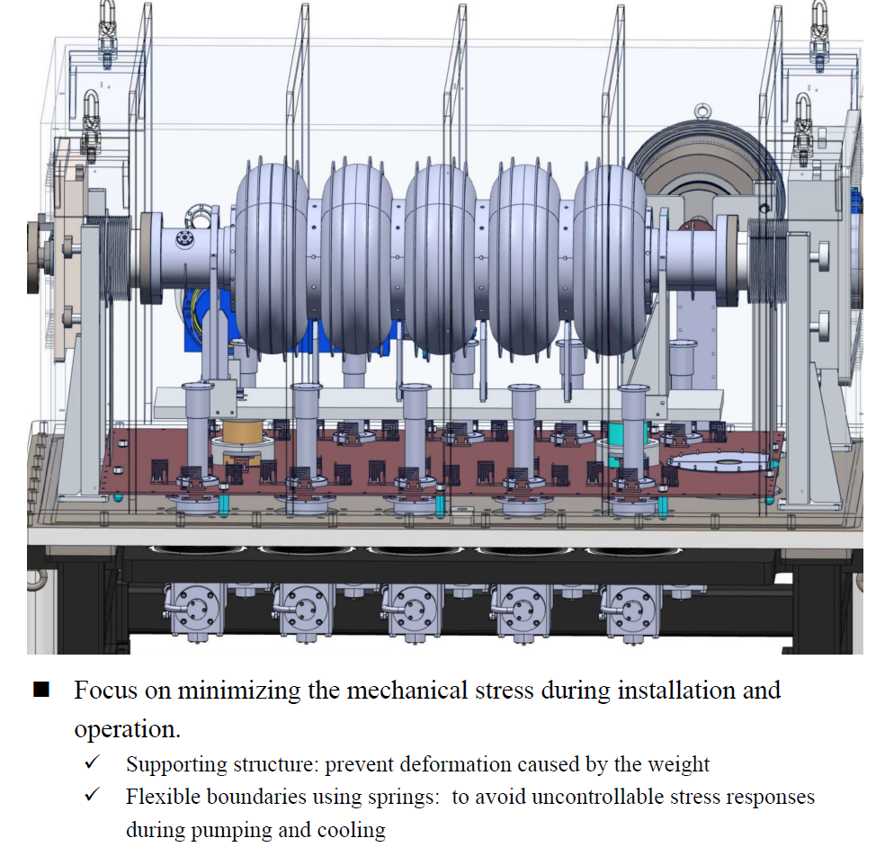
IMP
6-cell, 650 MHz cavity
1.9 MeV beam acceleration
OFHC Cu thermal links
Ten GM-type 2 W at 4 K cryocoolers
Box-type vacuum vessel

Slide 22
Summary
Cryomodules for conduction-cooled SRF cavities have fewer components than those based on cooling with LHe.
Different designs have been developed:
  Cylindrical and box-type vacuum vessels
  Front-loaded, top-loaded
  5N Al thermal links (most popular), OFHC Cu thermal links
Designs requiring more than 2 in-line cryocoolers favor box-type vacuum vessel for ease of assembly.
Single or double layer of magnetic shielding for <10 mG or <5 mG residual field requirement.
It would be useful to compare the cost and performance of the different designs.
A conduction-cooled SRF linac has accelerated a “quasi-CW” beam up to 1.9 MeV in China in 2024. The US is lagging behind.

