Slide 1
Mechanisms of nonlinear surface resistance in superconducting cavities
Alex Gurevich
Department of Physics, Old Dominion University, Norfolk VA
Supported by DOE under grant SC 0025560

Slide 2
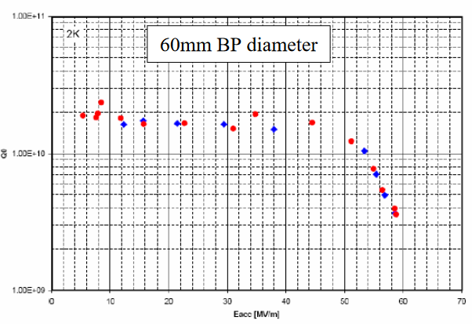
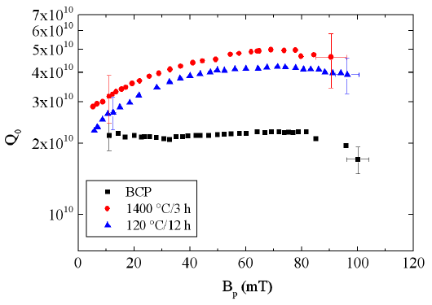
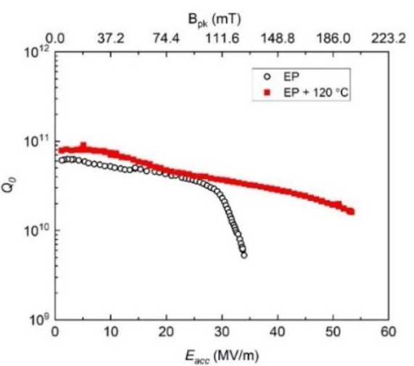
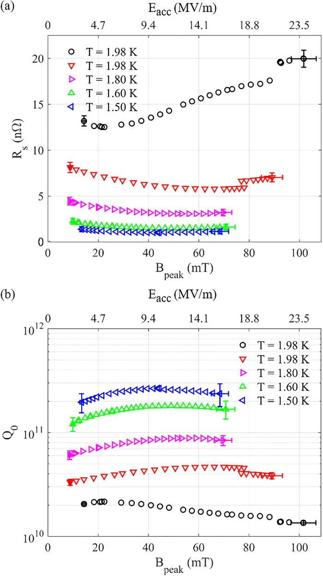
Variety of field dependencies of Q(H)
Positive Q slope,
high Q and highest
breakdown fields
Reentrant shape
Negative Q slope,
high Q, reduced
breakdown fields,
usually after infusion
of Ti, N O, or not
Dhakal, Ciovati et al.
PR STAB 16. 042001 (2013)
Single-cell: 59 MV/m (223 mT) 1.3 GHz at 2 K
Lechner et al,
APL. 119, 082601 (2021)
Grasselino et al, FNAL
53.3 MV/m in 650 MHz single-cell!

Slide 3
Contributions to SRF losses
intrinsic (BCS)
extrinsic (residual)
Intrinsic:
Quasiparticle losses due to thermal dissociation of Cooper pairs, field-dependent R_{s}(H) of a nonequilibrium superconductor driven by strong rf currents
Extrinsic:
Nonsuperconducting precipitates and surface layers (hydrides, suboxides)
Grain boundaries, arrays of dislocations, impurity segregation on GBs, nonstoichiometric regions
Vortices trapped in the cavity during cooldown through Tc, hotspots on cavity surface
Materials-related subgap quasiparticle states: TLS in surface oxides.
Complex interplay of mechanisms contributing to Q(H) slope and Q(H) rise
BCS and residual parts of R_{s} depend on frequency, temperature and rf field

Slide 4
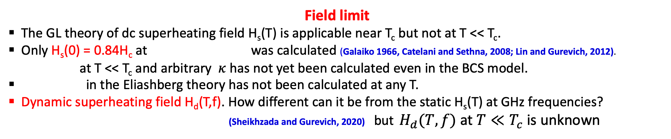
What do we know (or do not know)?
Field limit
The GL theory of dc superheating field H_{s}(T) is applicable near T_{c} but not at T << T_{c}.
Only H_{s}(0) = 0.84H_{c} at was calculated (Galaiko 1966, Catelani and Sethna, 2008; Lin and Gurevich, 2012).
at T << T_{c} and arbitrary $κ$ has not yet been calculated even in the BCS model.
in the Eliashberg theory has not been calculated at any T.
Dynamic superheating field H_{d}(T,f). How different can it be from the static H_{s}(T) at GHz frequencies?
(Sheikhzada and Gurevich, 2020) but $H_{d}(T,f)$ at $T≪T_{c}$ is unknown
Low-field Q limit
Low-field BCS surface resistance R_{s}(T,f) is well-understood. How far can the residual resistance be decreased? Many contributions to R_{i}: trapped vortices, subgap quasiparticles, two-level states, proximity-coupled suboxide layers, …..
Complex effects of nonequilibrium superconductivity on Q(H)
Field-dependent R_{BCS} controlled by nonequilibrium kinetics of quasiparticles driven by strong rf current.
Extreme dynamics and nonlinear losses of trapped vortices driven by strong rf current
Multiple mechanisms of negative Q(H) slope.

Slide 5
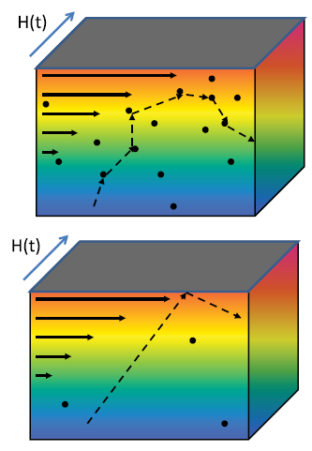
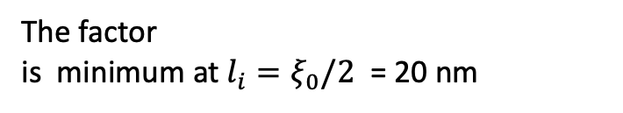
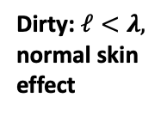
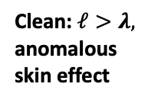
BCS surface resistance
D.C. Mattis and J. Bardeen, Phys. Rev. 111, 412 (1958)
In the dirty limit of l < ξ, the relation between current density J(r)
and the electric field E(r) is local:
Dirty: $ℓ<λ,$
normal skin
effect
λ
Clean: $ℓ>λ,$
anomalous
skin effect
The larger the gap the better:
Nb₃Sn has lower R_{BCS} than Nb at low fields
λ
Is the optimal Q at GHz
frequencies and low T
limited by the idealized
BCS surface resistance?
Vanishes at T→ 0.
The factor
is minimum at $l_{i}=ξ_{0}/2$ = 20 nm
Nb cavities have R_{BCS} ≈ 10-20 nΩ
at 2 GHz and 2K

Slide 6
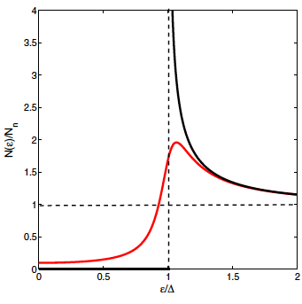
Broadening the gap peaks in DOS can reduce R_{s}
Low-frequency surface resistance at 1-2 GHz, hf/kT ≈ 10⁻²
Broadened gap
peak and subgap
states in the
Dynes model
Idealized
BCS
Density of states with broadened gap peaks:
R_{s} can be reduced by:
electron-phonon inelastic
scattering
proximity-coupled
metallic suboxides
Dilute magnetic impurities
Optimal inhomogeneities
The BCS log singularity in R_{s} at $ω=0$ is removed by the DOS broadening:
Optimal broadening the gap peaks can reduce R_{s} by 4-5 times

Slide 7
Residual surface resistance from subgap states
Gurevich, SUST 30, 034004 (2017)
Gurevich and Kubo, PRB 96, 184515 (2017)
Residual resistance is a part of BCS surface resistance which takes into account the broadening of gap peaks in
R_{i} increases with but R_{s}(T) at higher T is decreased by moderate DOS broadening
R_{i} = 10 nohm at 1.5 GHz and $λ=40$nm at

Slide 8
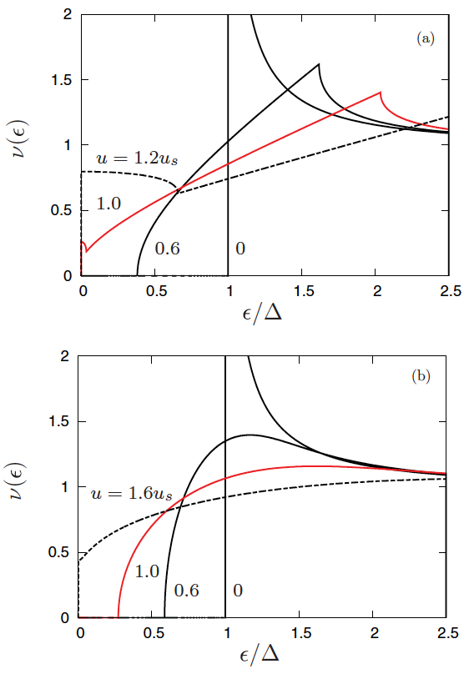
Reduction of SC gap and superfluid density by current pairbreaking
Lin and Gurevich, PRB 85, 054513 (2012)
Maki, Prog. Theor. Phys. 29, 10; 333 (1963);
Fulde, Phys Rev. 137, A783 (1965)
Supercurrent density reduces the
density of Cooper pairs
Supercurrent reduces the SC gap
The effect of current on the DOS:
Gap singularities are smeared out
The quasiparticle gap is smaller
than , both and
decrease with H
Clean limit: the gap vanishes at H < H_{s}
Dirty limit: the gap remains finite at H_{s}
clean
The gap reduction with H
does not mean that Rs(H)
always increases with H:
dirty

Slide 9
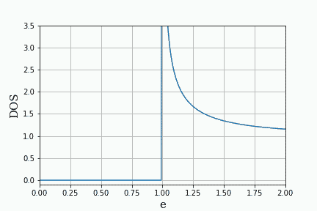
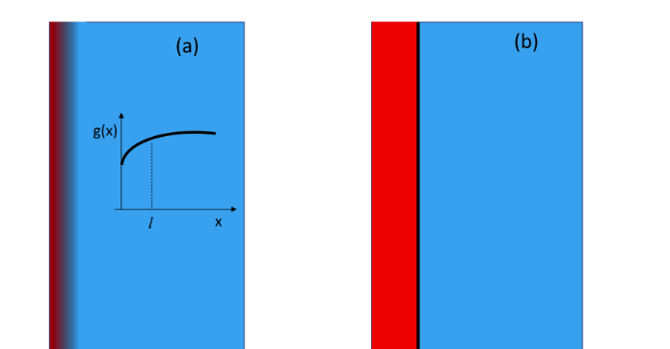
Engineering optimal DOS broadening by pairbreaking mechanisms
Surface resistance can be reduced by RF current, surface nanostructuruing and magnetic impurities
Gurevich, PRL 113, 087001 (2014)
Gurevich and Kubo, PRB 96, 184515 (2017)
Kubo and Gurevich, PRB 100, 064522 (2019)
Gurevich, SUST 36, 063002 (2023)
Calculations of Rs in the dirty limit
based on the Usadel equations
Current-induced broadening of DOS peaks causes a negative Q(H) slope
Subgap states caused by finite quasiparticle lifetimes.
Surface layer of reduced BCS pairing constant (surface nonstoichiometry)
Proximity coupled thin normal (suboxide) layer on the surface
Small density of magnetic impurities
DOS oscillating under RF currents
Reducing Rs by engineering an optimum DOS by surface nanostructuring and impurity management
magnetic
impurities
N
S
Current-induced DOS broadening

Slide 10
Reduction of R_{s} by magnetic impurities and interface resistance
Gurevich and Kubo, PRB 96, 184515 (2017)
DOS broadening
Tc suppression
optimum DOS broadening
Proximity effect increase of Rs

Slide 11
Negative and positive Q slopes caused by current pairbreaking
Change the suboxide thickness
Negative Q slope can appear
due to current-induced DOS
broadering
Negative and positive
Q slope can be changed
by materials treatment
Equilibrium
Kubo and Gurevich,
PRB 100, 064522 (2019)
Change N/S diffusivity ratio by impurities

Slide 12
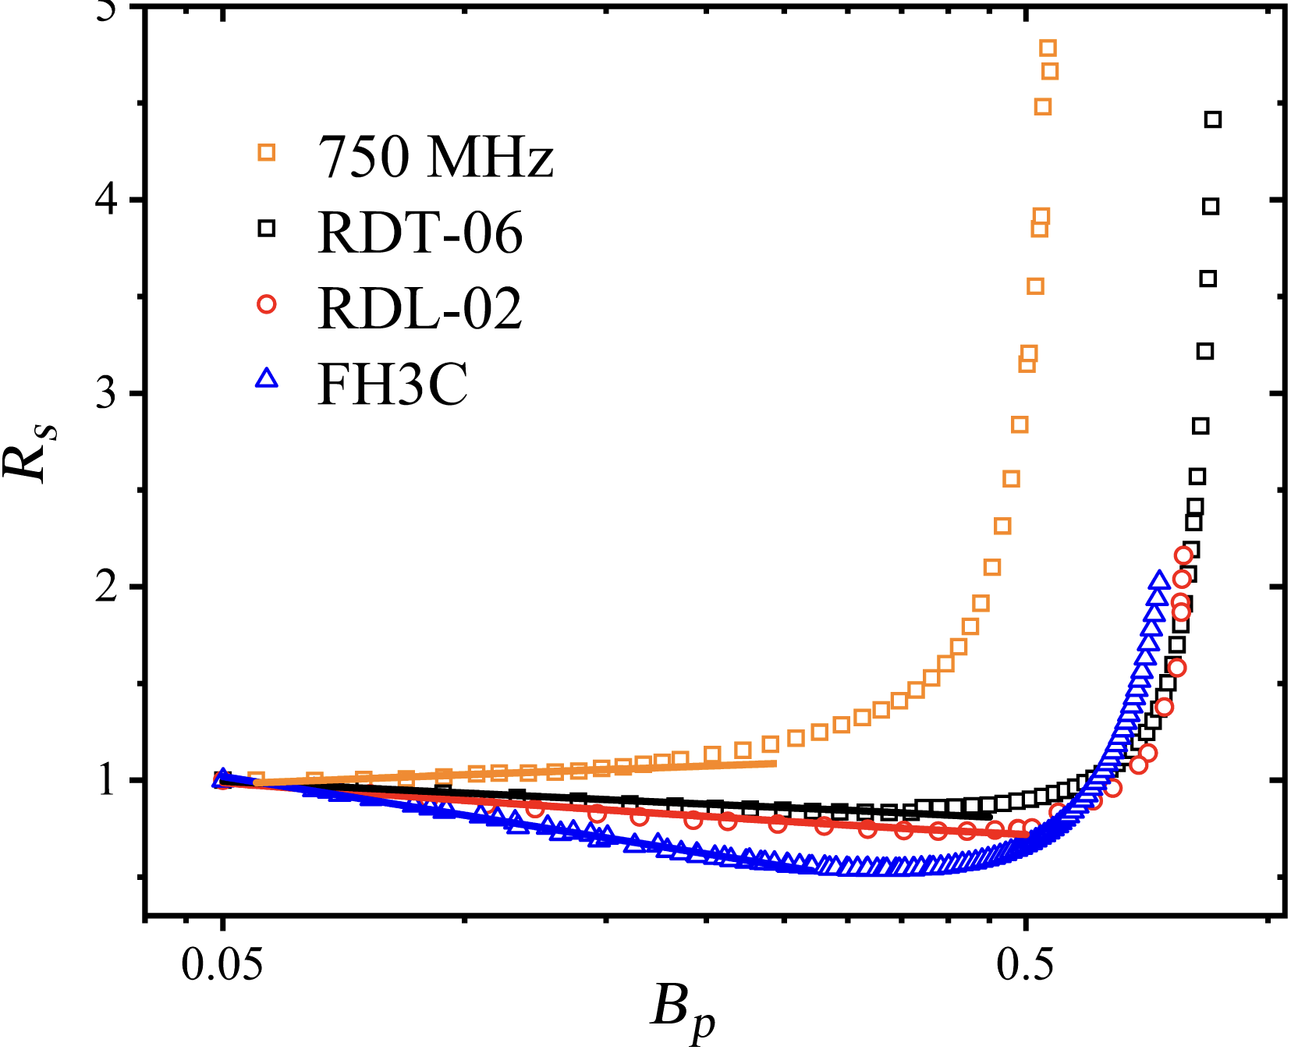
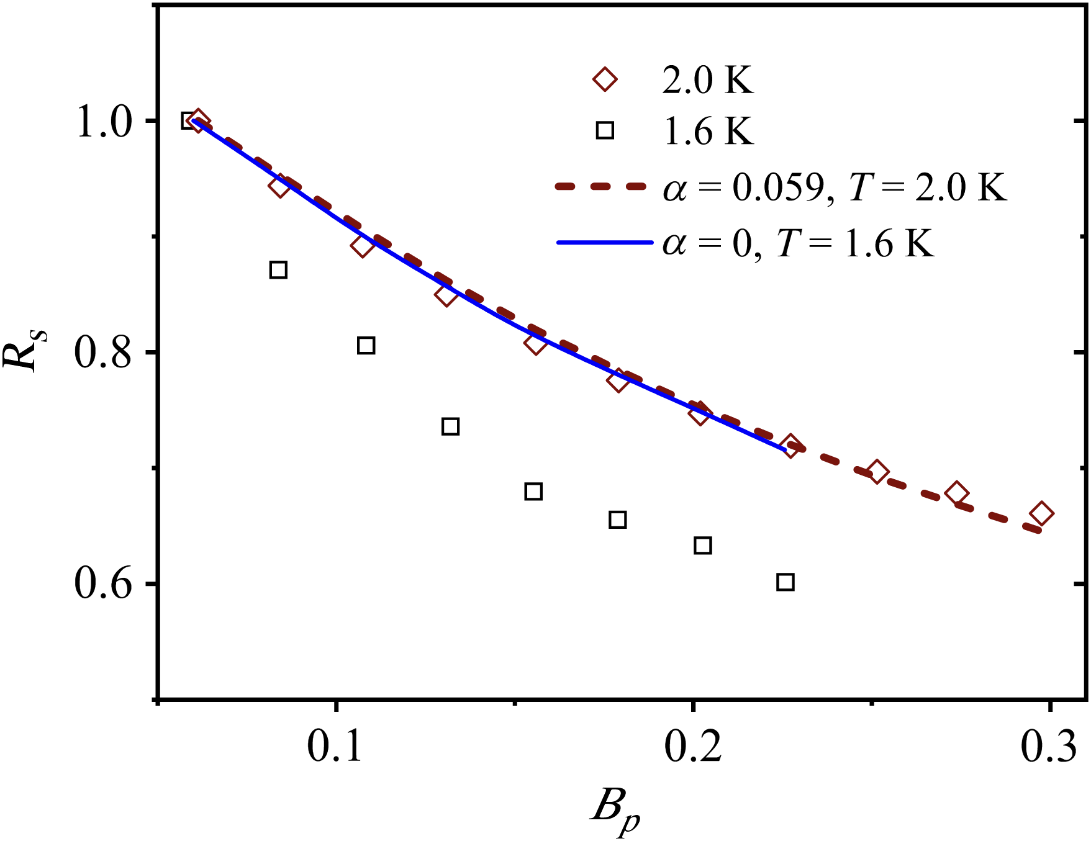
What does the experiment say?
Dhakal, Khanal, Gurevich, Ciovati, PR-AB 27, 062001 (2024)
1.3 GHz
1.5 GHz
3 GHz
Consistent with the earlier FNAL results
Martinello et al PRL 121, 224801 (2018).
Strong nonequilibrium effects at low T
Negative Q slope becomes more pronounced as the frequency increases.
Negative Q slope becomes more pronounced as the temperature decreases.
Likely caused by nonequilibrium SC
but can trapped vortices do it too?

Slide 13
RF dissipation of a trapped vortex in a random pinning potential
Numerical simulation of nonlinear dynamics of a curvilinear elastic vortex driven by strong RF current
Mesoscopic effects in RF response for different pinning configurations
LO instability in the presence of surface, bulk and cluster pinning
Vortex losses as function of frequency and rf field have been calculated.
Pathirana and Gurevich, PRB 101, 064504 (2020);
PRB 103, 184518 (2021)

Slide 14
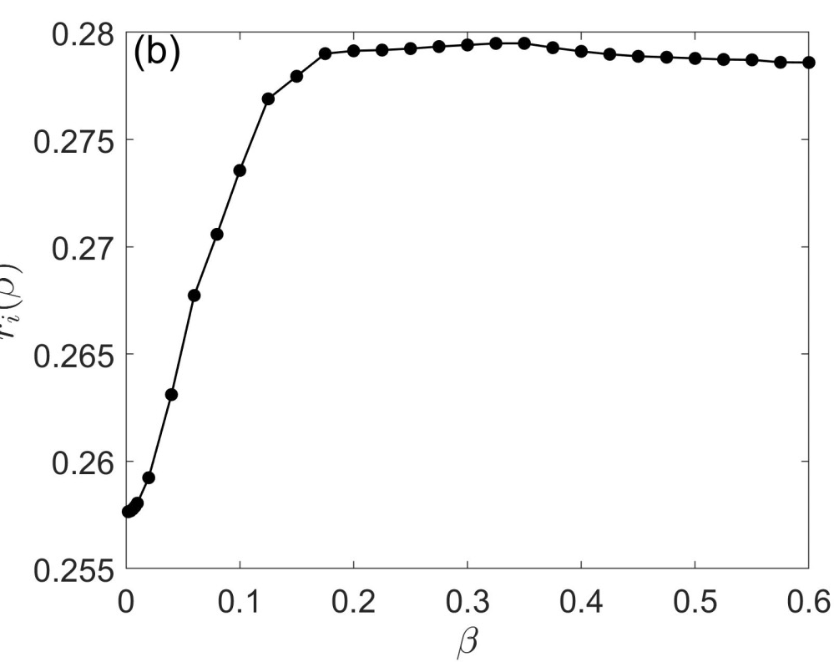
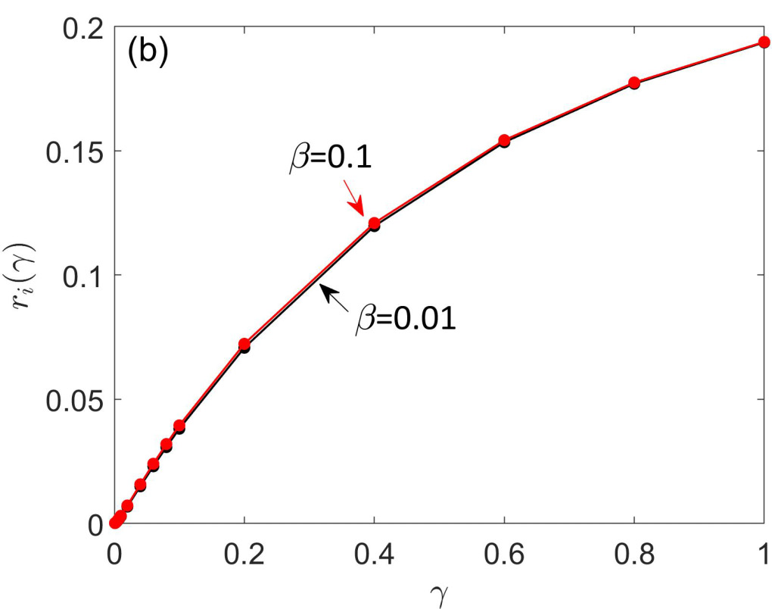
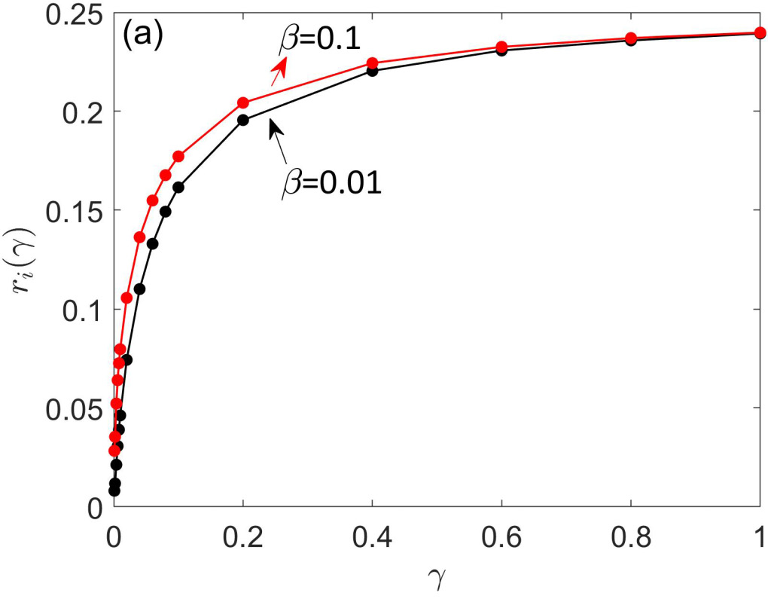
Residual resistance due to trapped vortices
viscous losses
rf depinning
weak pinning
pinning
hysteretic losses
strong pinning
Residual resistance increases with field due to depinning of vortices
Residual resistance increases with frequency: (weak pinning), (strong pinning)
At lower frequencies trapped flux gives dominant contribution to R_{s} as compared to
Contribution of R_{i}(H,f) can reverse the NQS as the frequency decreases
Can the NQS also come from trapped vortices?

Slide 15
What happens to the vortex drag at high velocities?
Slow vortex
Fast vortex
v
v
Velocity-dependent Larkin-Ovchinnikov vortex drag:
A nearly round vortex core
Cloud of dissipative quasiparticles is
locked onto the moving core
Bardeen-Stephen vortex drag
TDGL simulations show that the fast vortex core stretches along v
A cloud of nonequilibrium quasiparticles lags behind a fast vortex core
Decrease of the drag force with velocity can cause
runaway acceleration of the vortex above a threshold current

Slide 16
Velocity dependence of vortex drag
Larkin-Ovchinnikov mechanism
Electron overheating
Reduction of the vortex drag due to diffusive depletion of quasiparticles in the moving core
The drag coefficient depends on the electron temperature T_{v} of the vortex
Power balance:
LO critical velocity:
Thermal conductivity contains both quasiparticle and phonon contributions
Solving for T_{v} yields the LO vortex drag with v₀(T) decreasing as T decreases:
The energy relaxation time due to scattering on phonons:
Hence, decreases as T decreases of the
the impurity density increases
Bezuglyj and Shklovskii, Physica C 202, 234 (1992)
Kunchur, PRL 89, 137005 (2002)
Gurevich and Ciovati, PRB 77, 104501 (2008)
Larkin and Ovchinnikov. JETP 41, 960 (1975)

Slide 17
Larkin-Ovchinnikov instability
Balance of drag and Lorentz forces for a vortex:
Observations on different materials:
Musienko et al, JETP Lett. 31, 567 (1980); Klein et al., JLTP 61, 413 (1985);
Amenio et al, PRB 76, 054502 (2007); Grimaldi et al, J Phys C97, 012111 (2008);
Villard et al, JLTP 131, 957 (2003); Doettinger et al, PRL 76, 1691 (1994) ;
Samoilov et al, PRL 75, 4118 (1995); Bezuglyj et al PRB 99, 174518 (2019)
Runaway acceleration of a vortex at v > v₀ , jumps on V-I curves
In In Nb km/s near T_{c} and decreases as T decreases.
The LO critical field decreases as T decreases:
dc transport
in Nb films:
Peroz and Villard,
PRB 72, 014515 (2005)

Slide 18
LO nonlinear drag of a trapped vortex
At mT the superflow velocity of Cooper pairs in Nb reaches the pairbreaking threshold
Terminal velocity of the vortex tip at the pairbreaking limit:
H(t)
u(z,t)
For Nb, v_{d} = 10 km/s exceeds both the speed of sound (2-4 km/s) and v_{c} = Δ/p_{F} = 1 km/s. Velocities = 10-20 km/s were observed by Embon et al. Nature Comm. 8, 85 (2017); Dobrovolsky et al, Nature Comm. 11, 2391 (2020).
LO
unstable
Since km/s is 10-10² times smaller than vortex velocities at H = 10 -100 mT, the LO nonlinearity of is essential for SRF.
LO
stable
What happens to the vortex if its supersonic tip driven by rf current is LO-unstable while the rest of the elastic vortex is LO-stable?
Field dependence of RF residual surface resistance caused by
trapped vortices with nonlinear LO drag?

Slide 19
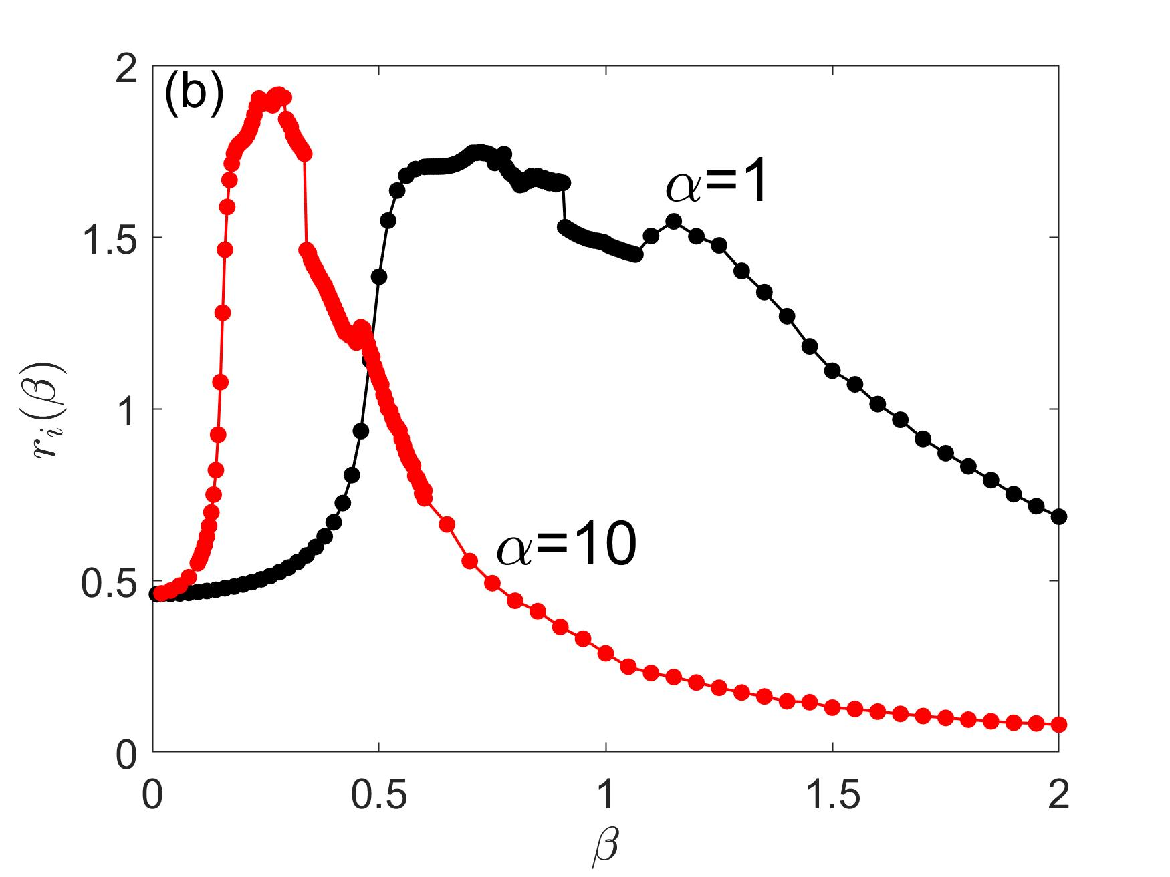
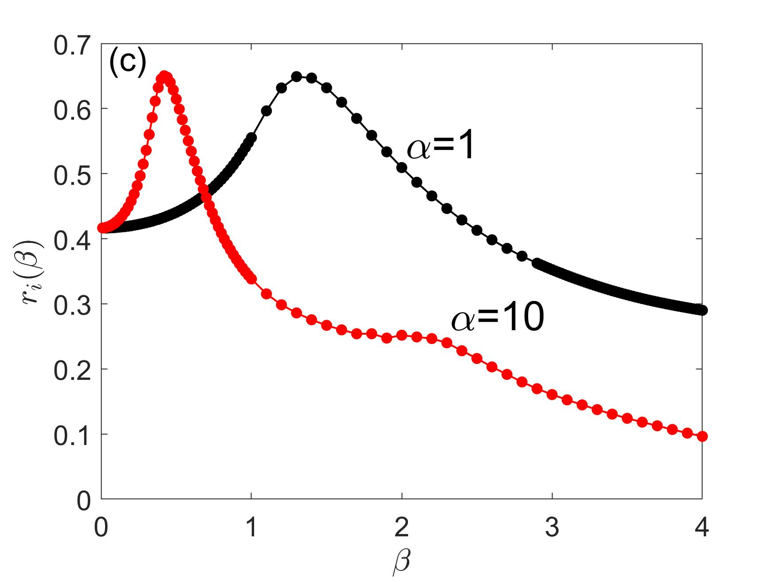
Residual resistance with the LO drag
The control parameter
The initial R_{i}(H) rise at low H is
followed by R_{i}(H) drop due to
the LO reduction of vortex drag.
Negative Q slope from R_{i} (H) which
gets more pronounced as:
Frequency is increased
Temperature is decreased
Surface gets dirtier
Suppressed by overheating
if flux density is too high
Fit to the experimental data
for a 1.47 GHz Nb cavity
Ciovati, JAP 96, 1591 (2004)
f₀ = 22 GHz for dirty Nb with nm.
Pathirana and Gurevich, PRB 101, 064504 (2020);
PRB 103, 184518 (2021)

Slide 20
Conclusions
Interplay of even two basic mechanisms: current-induced DOS broadening and nonlinear rf losses of trapped vortices can produce a great variety of Q(H) behaviors tunable by materials treatments
Negative Q slope:
The DOS broadening by rf current in R_{BCS}(H) (weakens as lower temperatures and higher frequencies)
The LO reduction of vortex drag with velocity (gets stronger at lower temperatures and higher frequencies)
Can be suppressed by overheating at high flux density
At low frequencies, the raising R_{i}(H) can overwhelm the decreasing R_{BCS}(H) and reverse the Q slope
These predictions are consistent with experiments, but how do we know that the NQS is not coming from nonequilibrium kinetics of quasiparticles driven by strong rf fields?
Separate the thermally-activated R_{BCS}(H) from the residual R_{i} by doing the Arrhenius plots in a broad
range of T and f. Detailed Q(H,T,f) measurements below 1.5K in a dilution fridge can show which component of Rs gets dominant upon increasing f and decreasing T.
But different frequencies imply different cavities with different surface properties and trapped flux.

