Slide 1
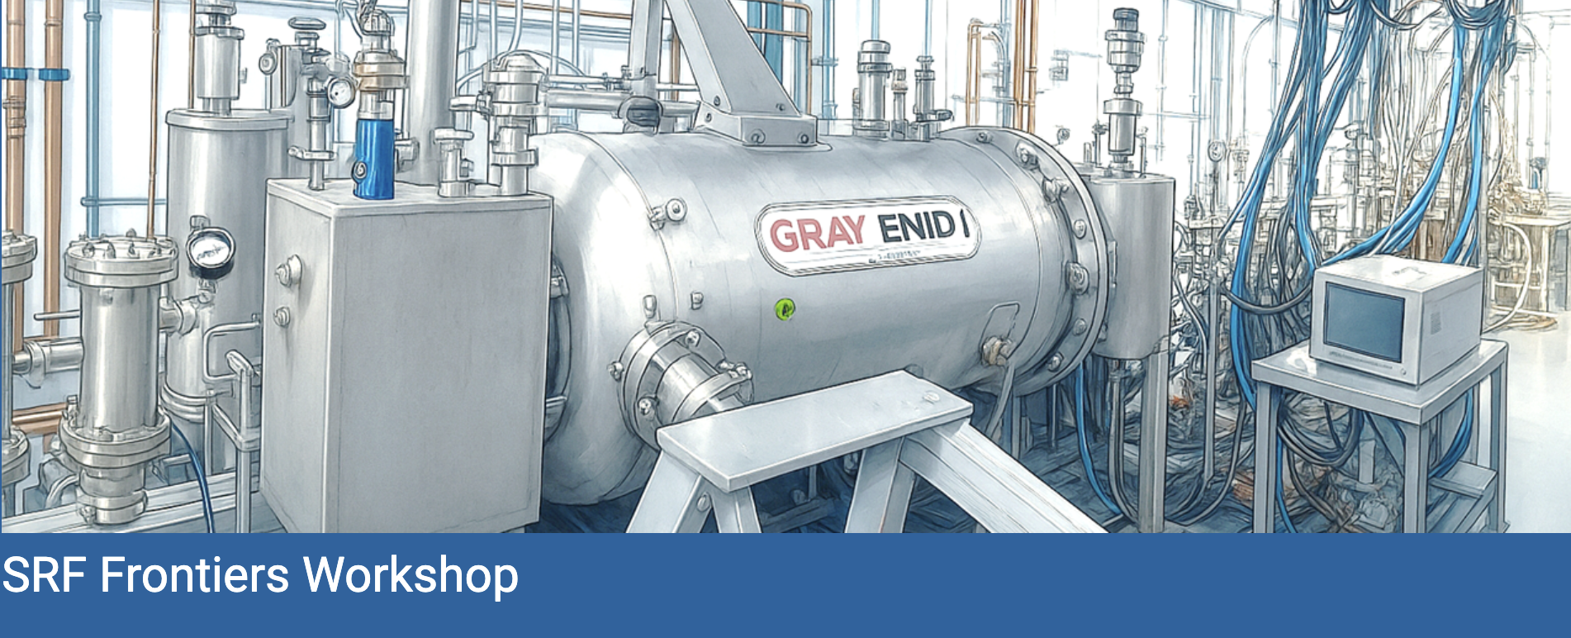
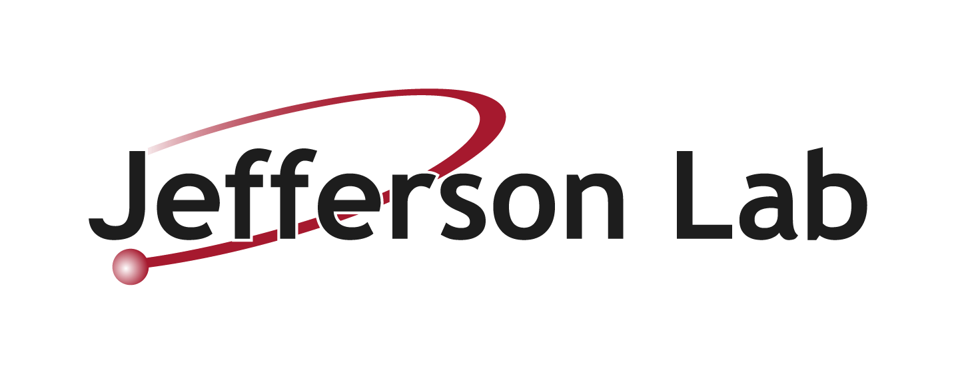

Nov 12-14, 2025, Newport News, VA
Logistics and Workshop Charge
Rongli Geng
Notes:
Tip: Keep titles under 60 characters for readability
To change the photo: Right-click on photo and select change photo

Slide 2
Workshop Focus and Aim
Latest advancements in SRF sciences and technologies and their potential impact to SRF-based accelerators at Jefferson Lab and elsewhere. CEBAF, UITF, and next-generation SRF innovations
Strengthen collaboration among experts and institutions in areas of shared interest
Foster partnerships with funding agencies and industry where strategic interests align
Provide a forum for discussing new ideas, addressing challenges, and shaping directions
Notes:
Guidelines: 6-8 bullets per slide; Use sentence fragments for bullets

Slide 3
Focus Areas
Future SRF scenarios at JLAB
Approaches to enhancing CEBAF’s energy efficiency and discovery potential in context of 2023 Nuclear Science Advisory Committee (NSAC) Long Range Plan for Nuclear Science.
SRF for future scientific facilities
Electron-Ion Collider (EIC)
U.S. Higgs Factory Circular Collider (HFCC)
Muon collider
SRF beyond basic research for nuclear and particle physics
Approaches to accelerator driven systems for transmutation of nuclear waste (projects selected by ARPA-E NEWTON program)
Compact SRF technologies for industry (projects awarded by DOE ARDAP)
SRF-based new tools for material sciences and biomedical applications (a proposed SRF microscope initiative)
Notes:
Guidelines: 6-8 bullets per slide; Use sentence fragments for bullets

Slide 4
Roundtables and Consortium Kickoff
Roundtable | Consortium | Objective/Success Metric
Fundamental research and development of Nb₃Sn | Multi-disciplinary Synthesis and Characterisation of Niobium-Tin for Accelerators Consortium (MEISSNER) JLab, academia collaborators | Nb₃Sn on Cu by electrodeposition A15 phase and Tc at least 17.0 K Nb₃Sn on Cu by PVD R_{s}=100 nΩ at B_{pk} 50 mT and cavity E_{acc} = 5 MV/m Q₀ =5E9 at 4K
Nb₃Sn cryomodule beam acceleration demonstration | Niobium-tin Cryomodule Electron Beam Acceleration Consortium (ONNES) JLab, lab partners, US industry | Gray Enid II: Conduction cooled Nb₃Sn cryomodule designed, built, beam tested at JLab’s UITF in 12 months from now
SRF workforce & talent pipeline | JLab, Virginian Universities, US industry | Broader Virginian university graduate students working on SRF science and engineering at JLab within context of broader applications including industrial applications
Notes:
Guidelines: 6-8 bullets per slide; Use sentence fragments for bullets

Slide 5
Early Career Sessions
Early career sessions
Lunchtime presentations
Roundtable participation
Thanks to the generous sponsorship of Jefferson Lab’s Chief Research Officer
Uttar Pudasaini | Pushing limits to vapor diffusion Nb3Sn cavities
Eric Lechner | Modeling and probing fundamental limits of SRF cavities
Oleksandr Hryhorenko | Development of low-loss window for CEBAF SRF cryomodules
Peter Owen | Development of a new SRF cavity control system
David Savransky | Prototyping a 591 MHz single-cell SRF cavity for EIC
James Latshaw | Resonance Control and Cryomodule Interlocks for the EIC
Neil Stilin | Box cryomodule experience from the Cornell conduction-cooled SRF development
John Vennekate | Applications of compact SRF accelerators
Notes:
Guidelines: 6-8 bullets per slide; Use sentence fragments for bullets

Slide 6
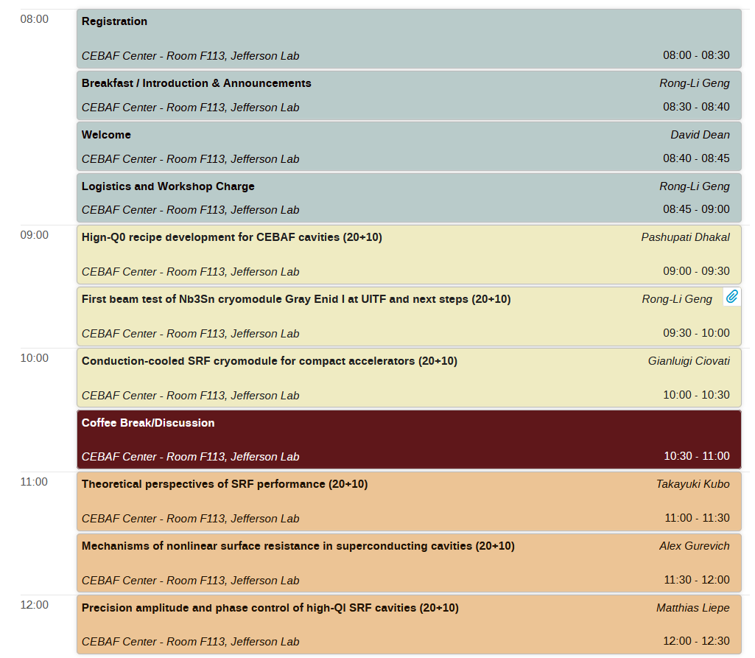
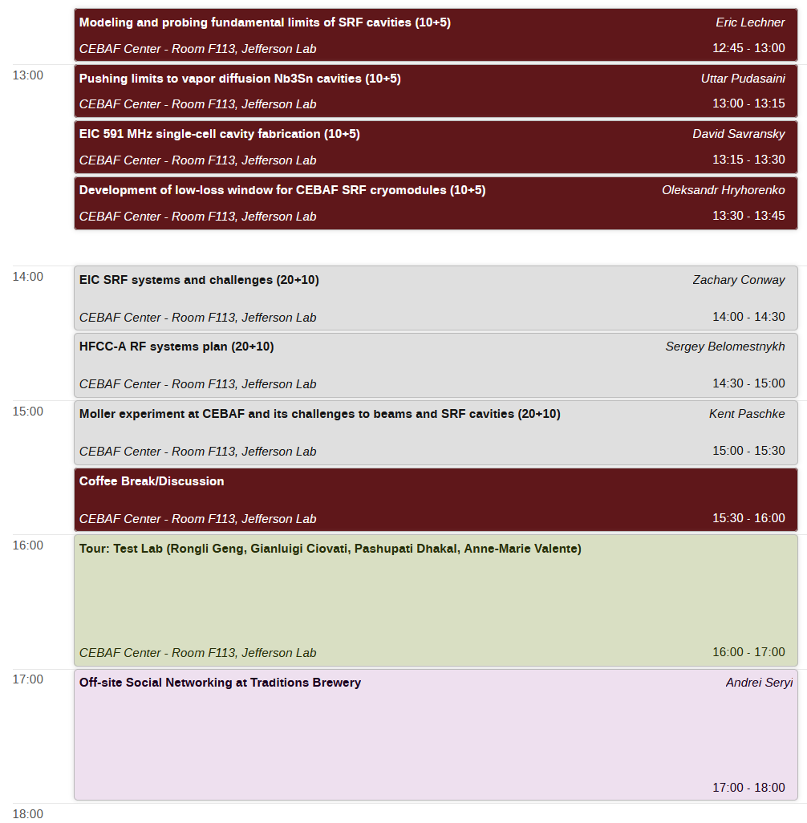
Workshop Agenda: Wednesday Nov 12
Notes:
Guidelines: 6-8 bullets per slide; Use sentence fragments for bullets

Slide 7
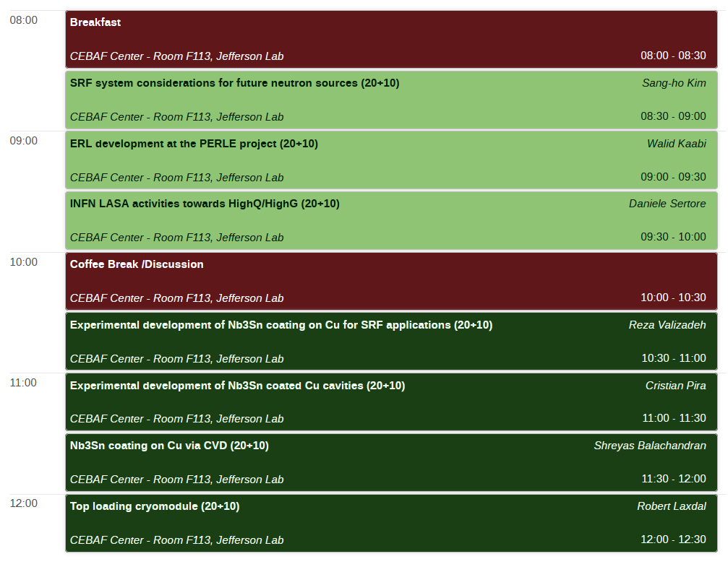
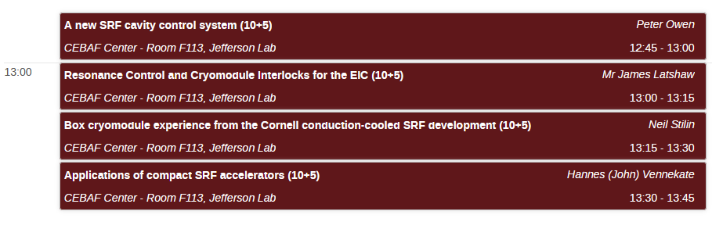
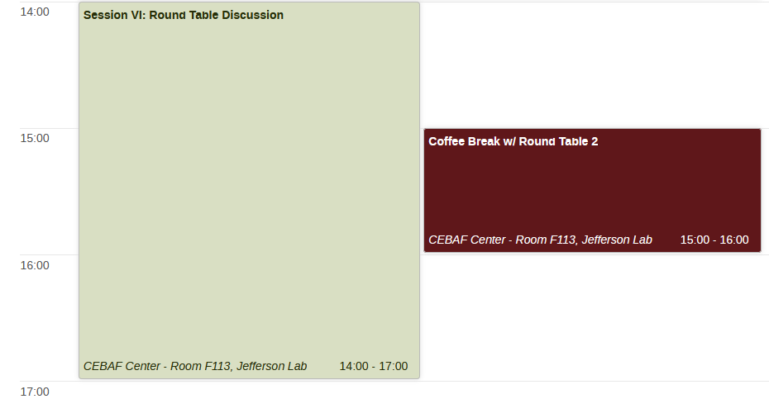
Workshop Agenda: Thursday Nov 13
Notes:
Guidelines: 6-8 bullets per slide; Use sentence fragments for bullets

Slide 8
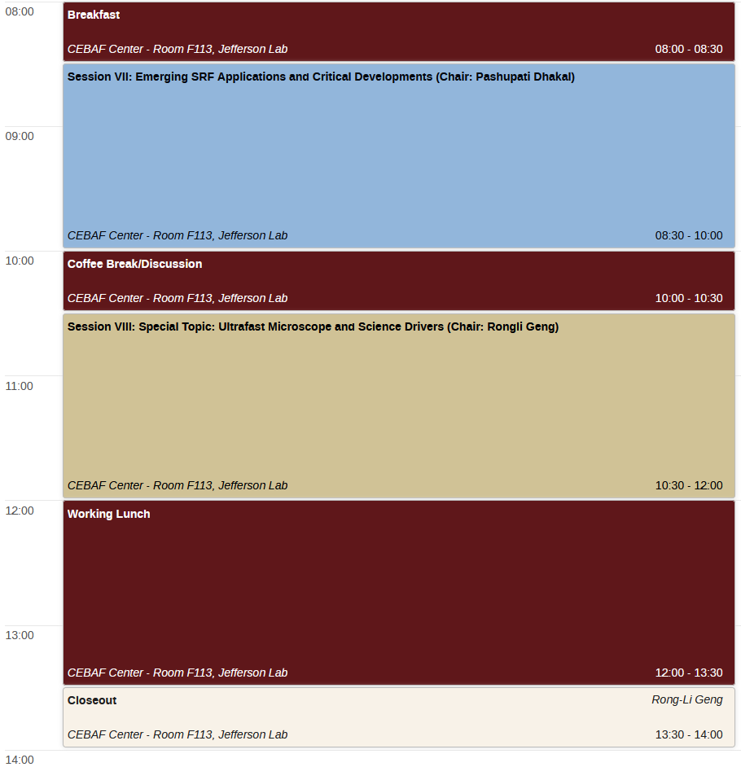
Workshop Agenda: Friday Nov 14
Notes:
Guidelines: 6-8 bullets per slide; Use sentence fragments for bullets

Slide 9
Helpful Information
Breakfast: 8:00 – 8:30 AM, Room F113
Lunch: 12:30 – 2:00 PM, Room F113
Working lunch with presentation by early career scientists and engineers
Wi-Fi Access:
Network: jlab_guest
Security key: testPAV82gren
Parking:
Any space not marked as reserved for handicapped or other uses. No permits are required.
Notes:
Guidelines: 6-8 bullets per slide; Use sentence fragments for bullets

Slide 10
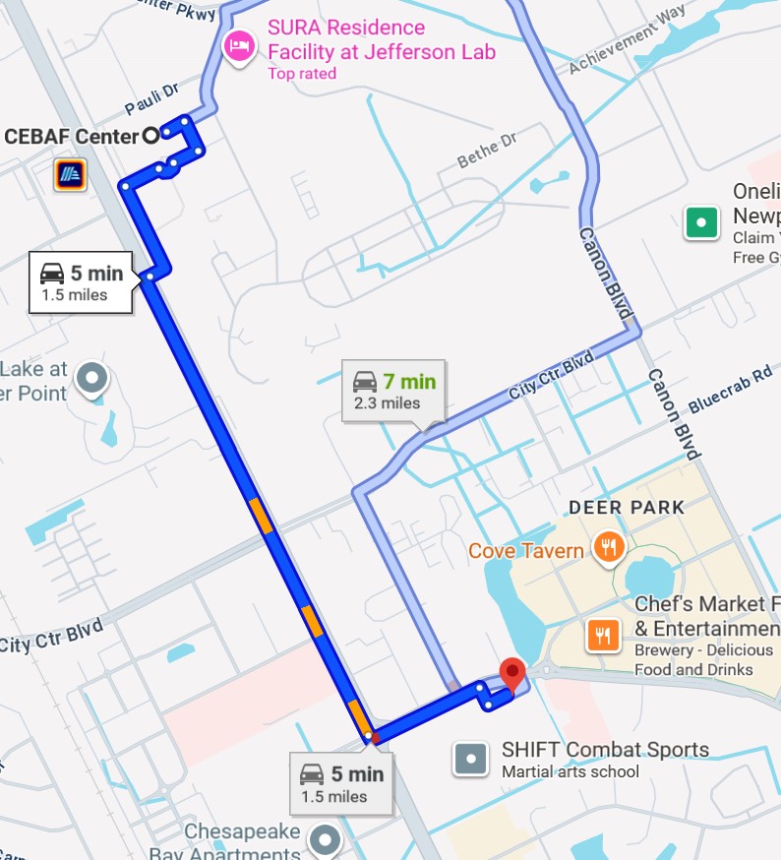
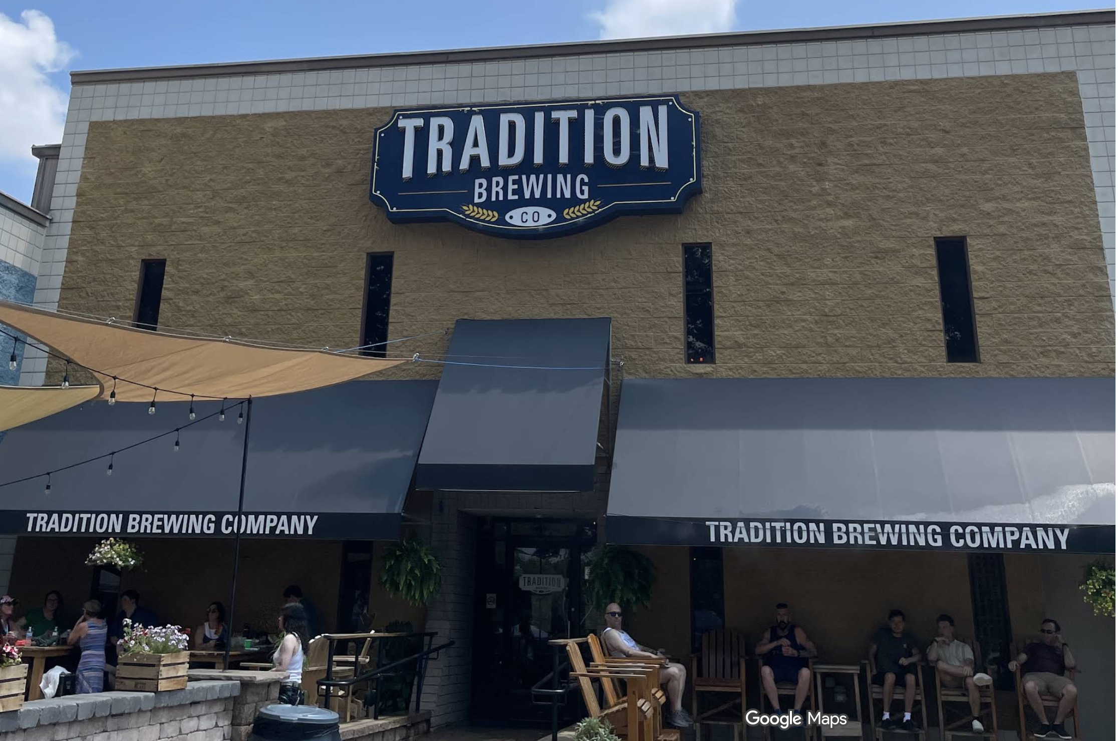
Social Networking at Traditional Brewing
Time: Wednesday 5:00-7:00 PM
Location: 700 Thimble Shoals Blvd #100, Newport News, VA 23606
Notes:
Guidelines: 6-8 bullets per slide; Use sentence fragments for bullets

Slide 11
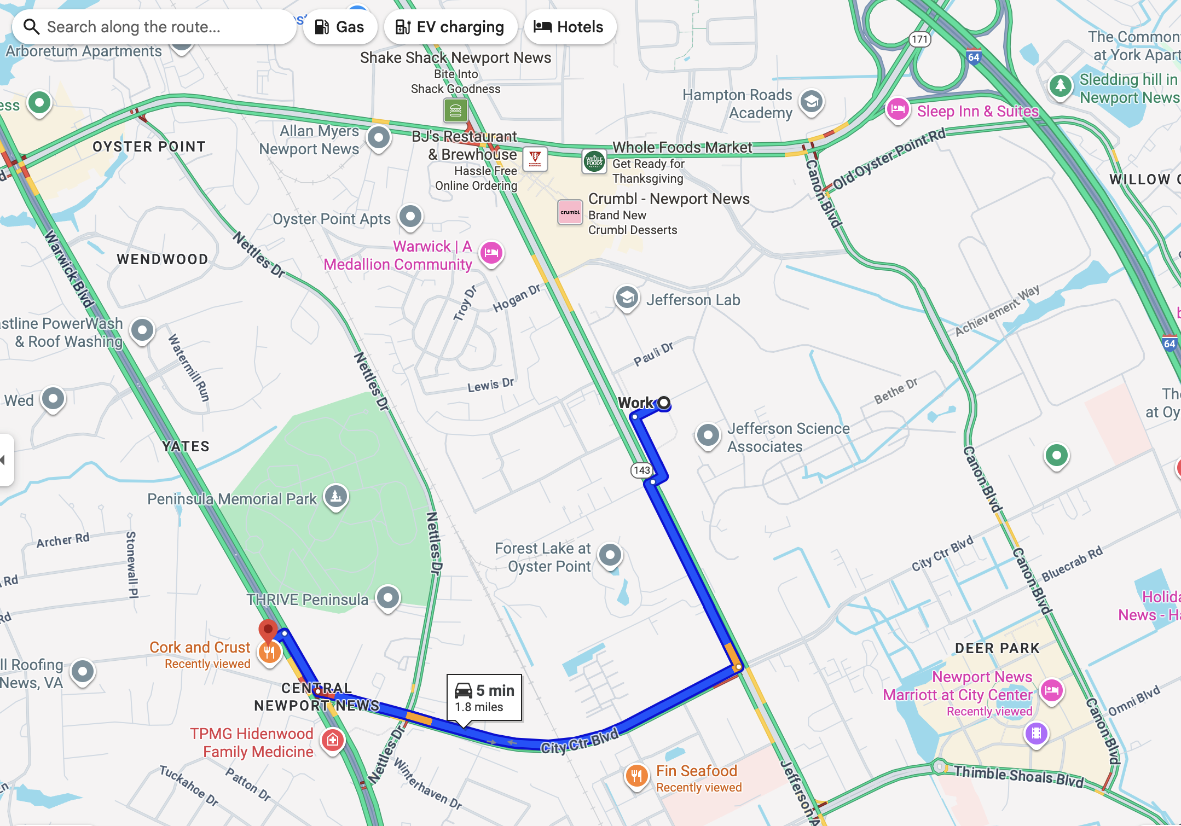

No-Host Dinner at Cork and Crust
Time: Wednesday 6:00-8:00 PM
Location: 12715 Warwick Blvd C, Newport News, VA 23606
Suggestions for transportation:
Drive or carpool with other participants
Notes:
Guidelines: 6-8 bullets per slide; Use sentence fragments for bullets

Slide 12
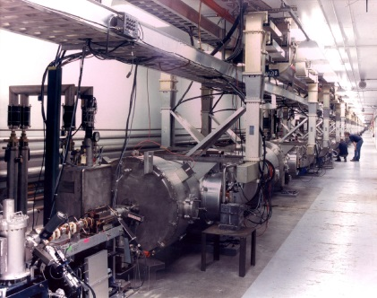
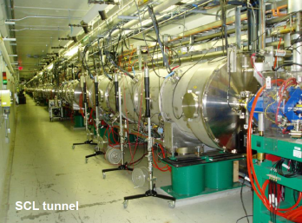
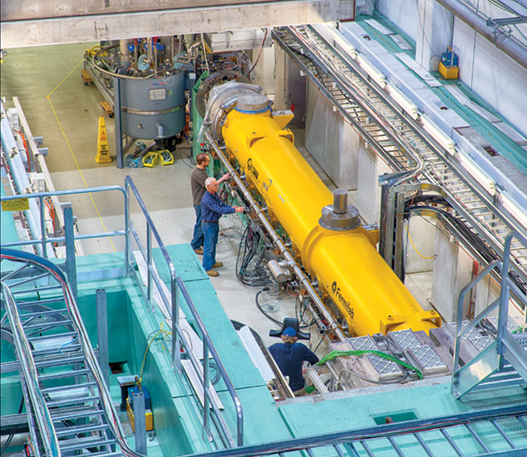
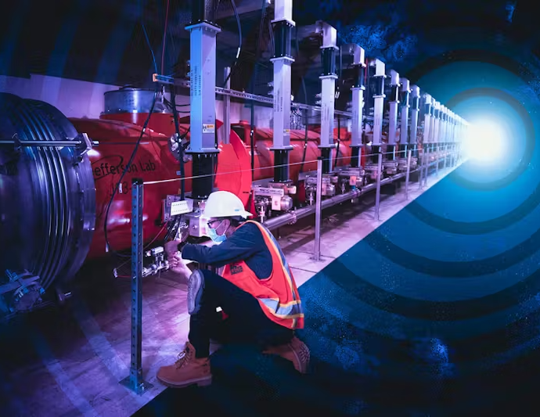
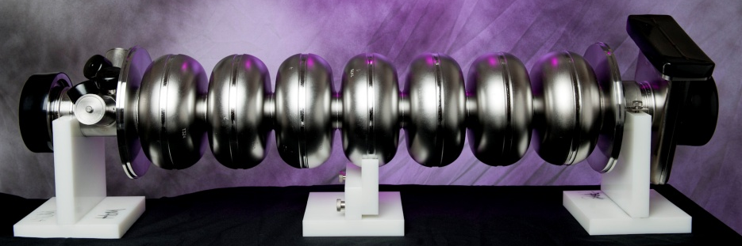
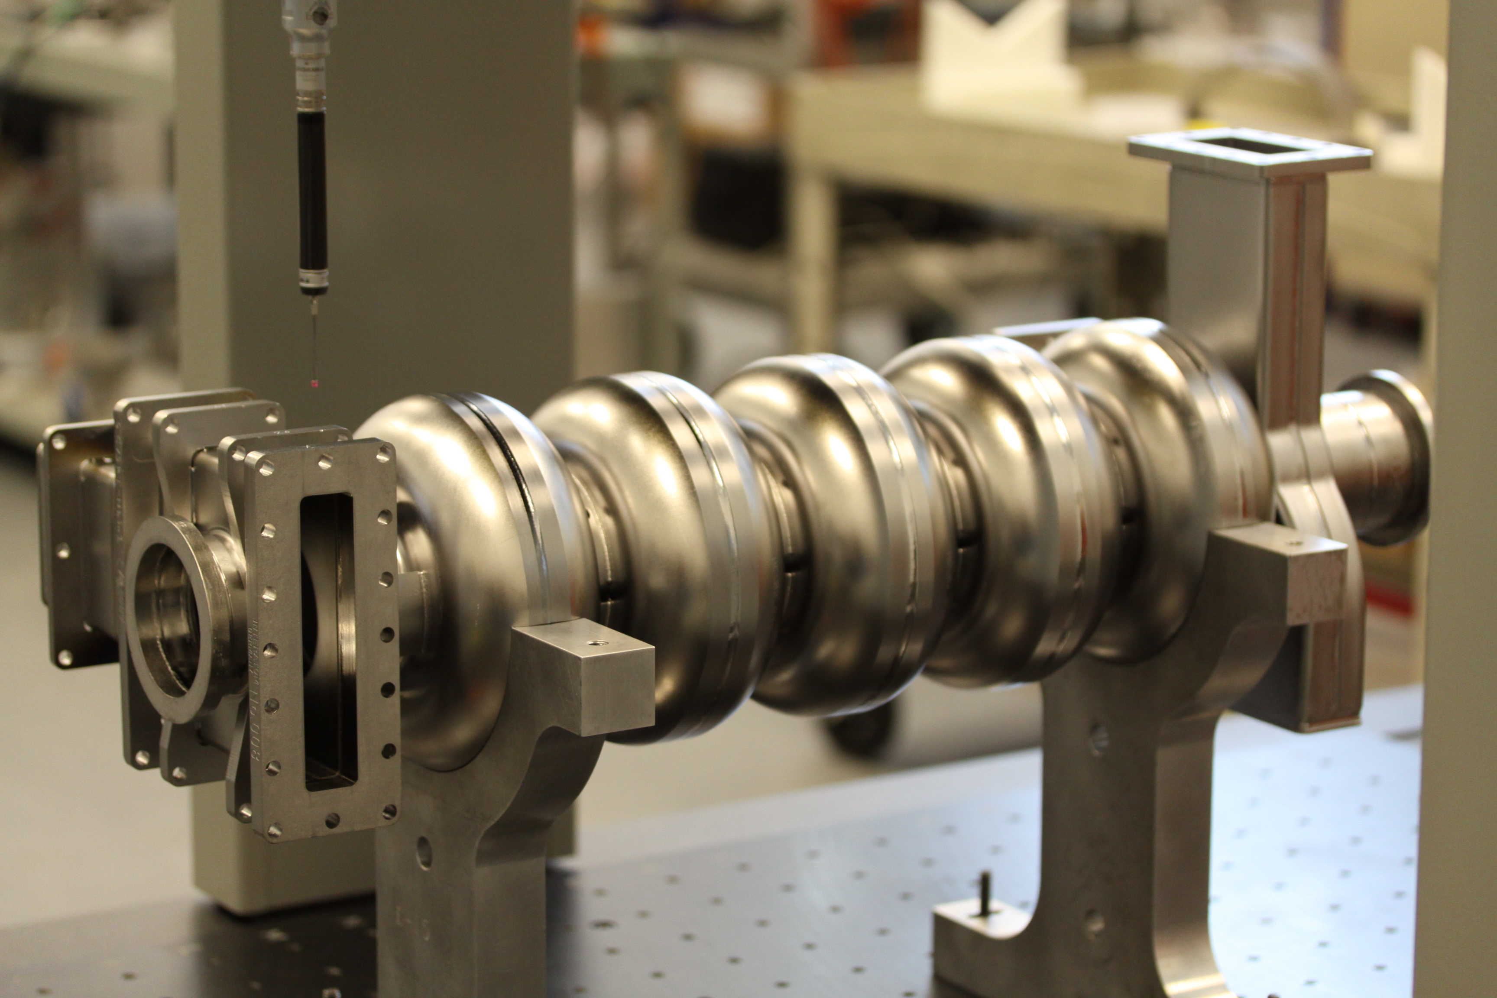
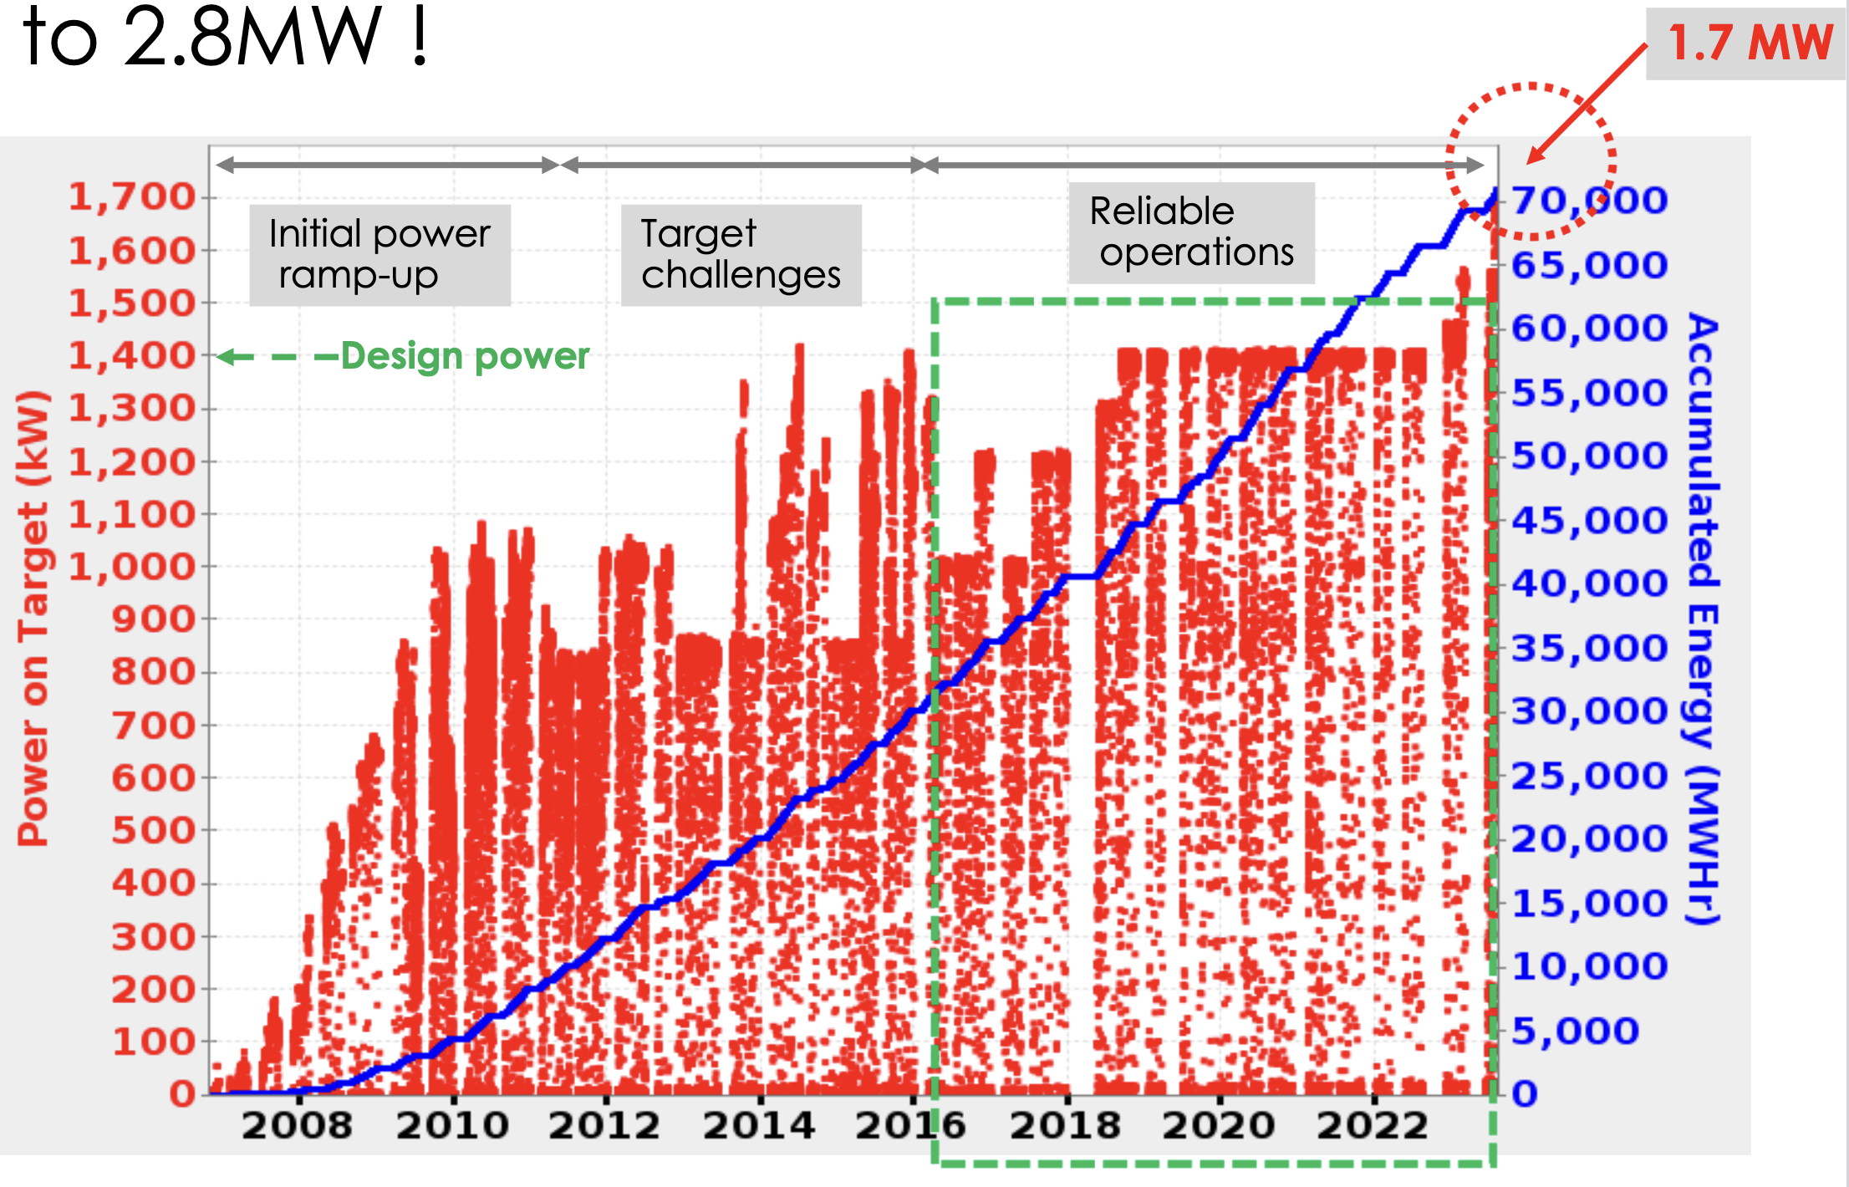
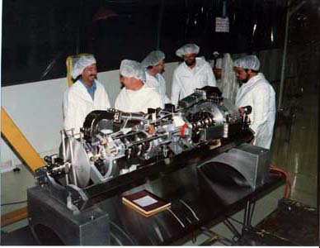

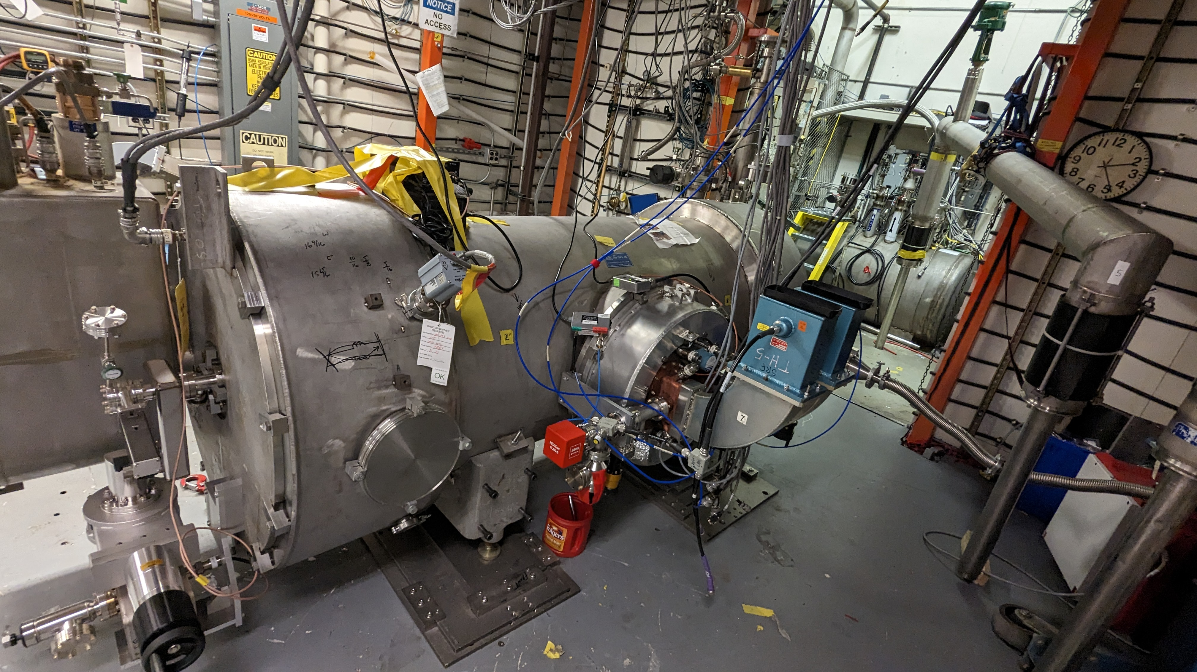
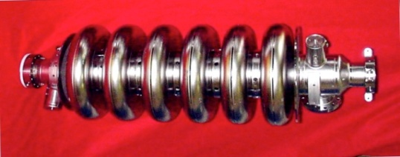
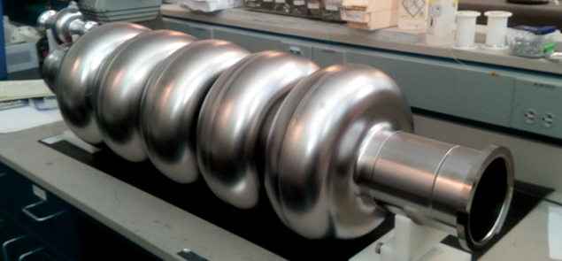
2025: 40 Years of SRF at Jefferson Lab
JLAB’s SRF Institute is responsible for the design, construction, qualification, installation and maintenance of SRF cavities and cryomodules for CEBAF, LERF and UITF. The institute also prototypes and tests SRF cavities, parts and cryomodules for R&D projects and constructs in volume for other national and international facilities such as the Fermilab Accelerator Science and Technology Facility (FAST) at Fermi National Accelerator Laboratory in Batavia, IL, the Spallation Neutron Source (SNS) at Oak Ridge National Laboratory in Oak Ridge, TN, and the Linac Coherent Light Source-II (LCLS-II) at SLAC National Laboratory in Menlo Park, CA.
CEBAF ceases 6 GeV operation for 12 GeV upgrade
CEBAF 12 GeV accelerator upgrade completed
Adding 80 7-cell cavities
First beam operation using low-loss shape cavities
SNS Beam operation began at ORNL
81 SRF cavities, 805 MHz, niobium.
First large-scale SRF application in a proton linac
FAST first 300 MeV electron beam at FNAL with JLAB processed Nb cavities in CM2
LCLS-II first lasing at SLAC with JLAB assembled cryomodules
CEBAF
338 5 cell cavities installed
physics run began
1500 MHz, niobium
First large-scale SRF application in a linac
108 MeV demonstrated in 12 GeV upgrade SRF cryomodule
JLAB participation cryomodule contribution to LCLS-II
1st SRF cryomodule, Gray Ghost II, installed in CEBAF injector
6 GeV beam energy achieved at CEBAF
12 GeV CEBAF energy upgrade construction began
JLAB SRF
First niobium cavity built by using sliced ingot
CEBAF operation in 12 GeV era began
JLAB SRF
5-cell Nb₃Sn coated Nb cavity reaching regime 12 MV/m at 4.2 K
SNS reached 1.7 MW beam power at ORNL with JLAB designed and assembled cryomodules
1985
1990
1993
1995
1996
2000
2005
2007
2009
2010
2012
2013
2015
2017
2018
2019
2020
2023
2024
2025
SRF’93 @ JLAB
TTC’12 @ JLAB
4 GeV beam energy achieved at CEBAF
SRF based ERL driven FEL construction began
SRF based ERL driven FEL achieved 1kW Infrared light
SRF based ERL driven FEL reached 14 kW infrared light
SRF based ERL driven FEL demonstrated UV light
JLAB SRF
Multi-cell cavity LSF5-1, 3 out of 5 cells reaching regime 50 MV/m
JLAB partnership in SNS upgrade cryomodule
JLAB shipped last of the eight cryomodules to ORNL for SNS PPU project
CEBAF
Switching to SRF
adopting Cornell cavity design Goal: Eacc=5 MV/m, Q₀=2.5×10⁹
JLAB SRF
Breakthrough Q₀=5x10¹⁰ at B_{pk}=90 mT at 2K
1.5 GHz, large-grain niobium with Ti doping
JLAB SRF
Single cell cavity demonstrated high Q₀=7x10¹⁰ at E_{acc}=40 MV/m at 1.8K. 1300 MHz, large-grain niobium
SNS design switched to SRF
JLab invited to design and deliver cryomodules for 1 GeV proton linac
81 Nb 805 MHz cavities
JLAB
Demonstration of 38 MV/m with 90% yield . 16 EA 9-cell cavities for ILC high-gradient R&D & ILC design
JLAB shipped last cryomodule for LCLS-II
JLAB SRF
1st Nb₃Sn cavity cryomodule, Gray Enid I, with a pair of 5-cell Nb₃Sn cavities tested reaching 8 and 13 MV/m at 4.2 K
JLAB SRF
Breakthrough E_{acc}>40 MV/m single-cell, 1300 MHz, niobium cavity
JLAB SRF
5-cell 802 MHz Nb cavity breakthrough Q₀=3x10¹⁰ at E_{acc} 27 MV/m at 2K for FCC R&D. Cavity design adopted by PERLE

Slide 13
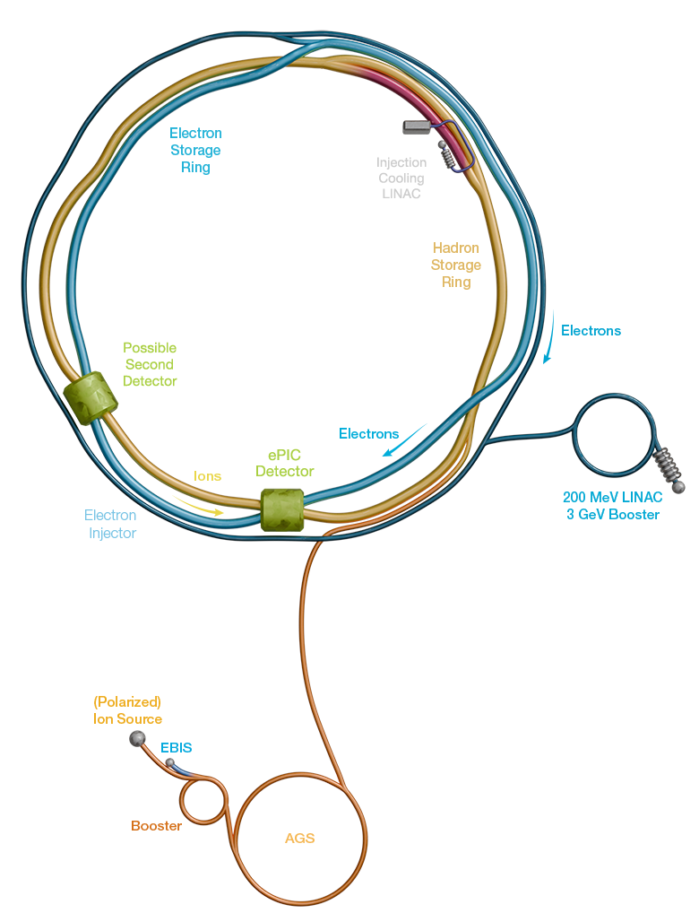
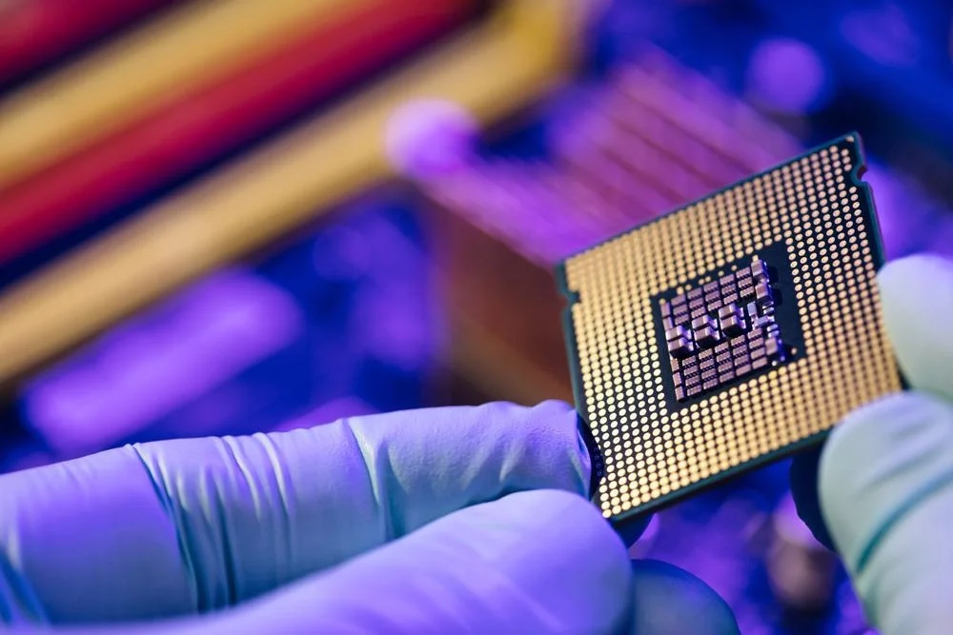

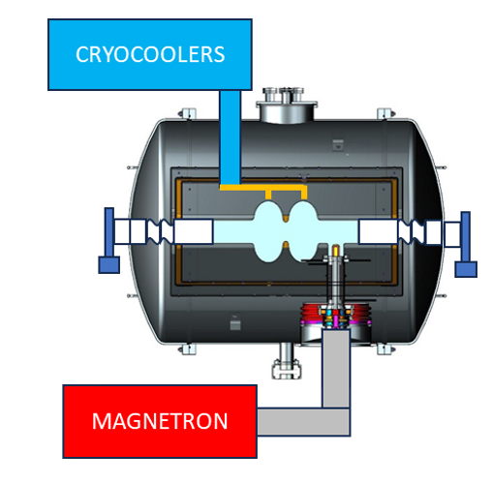
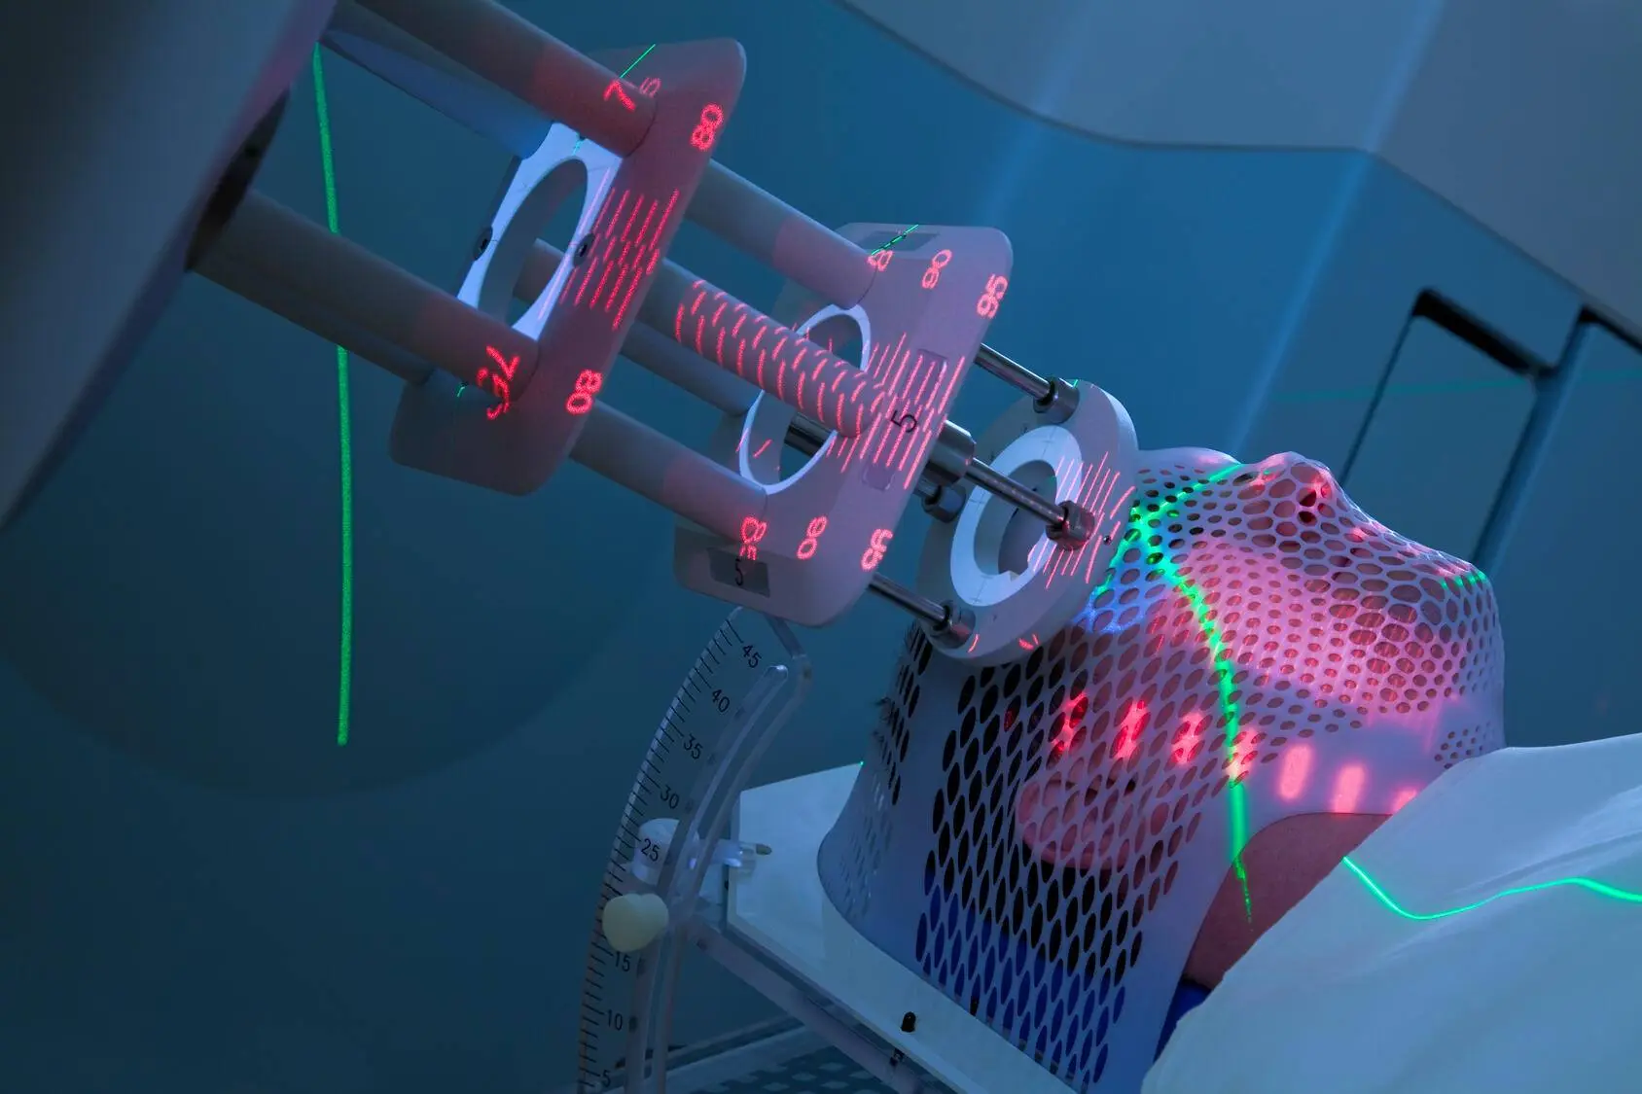
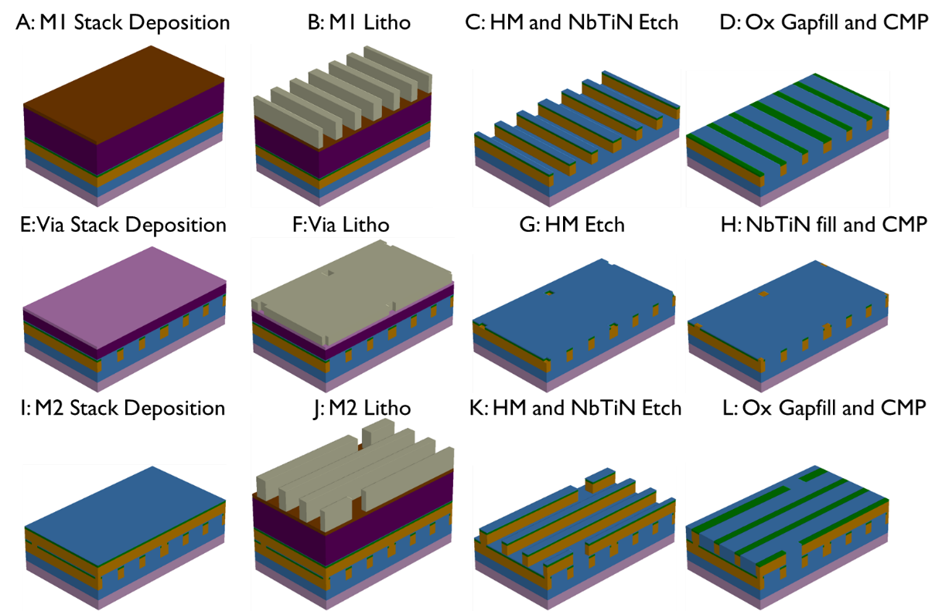
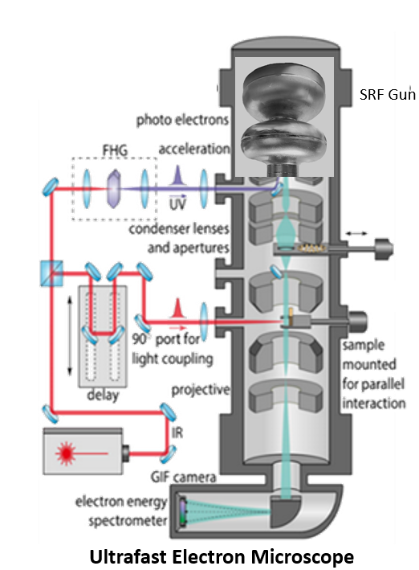
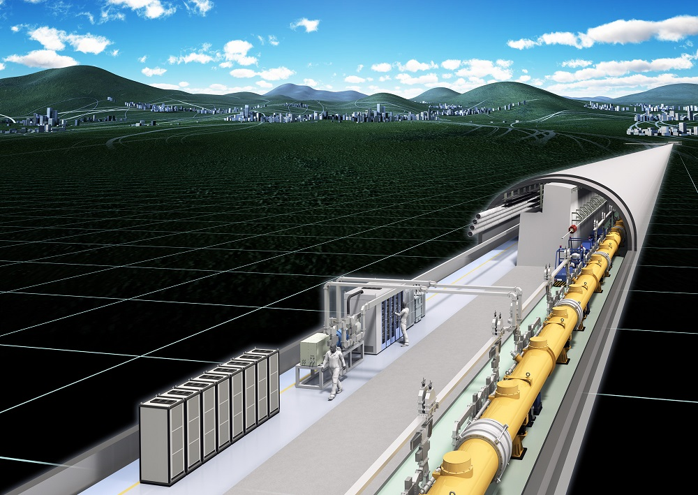
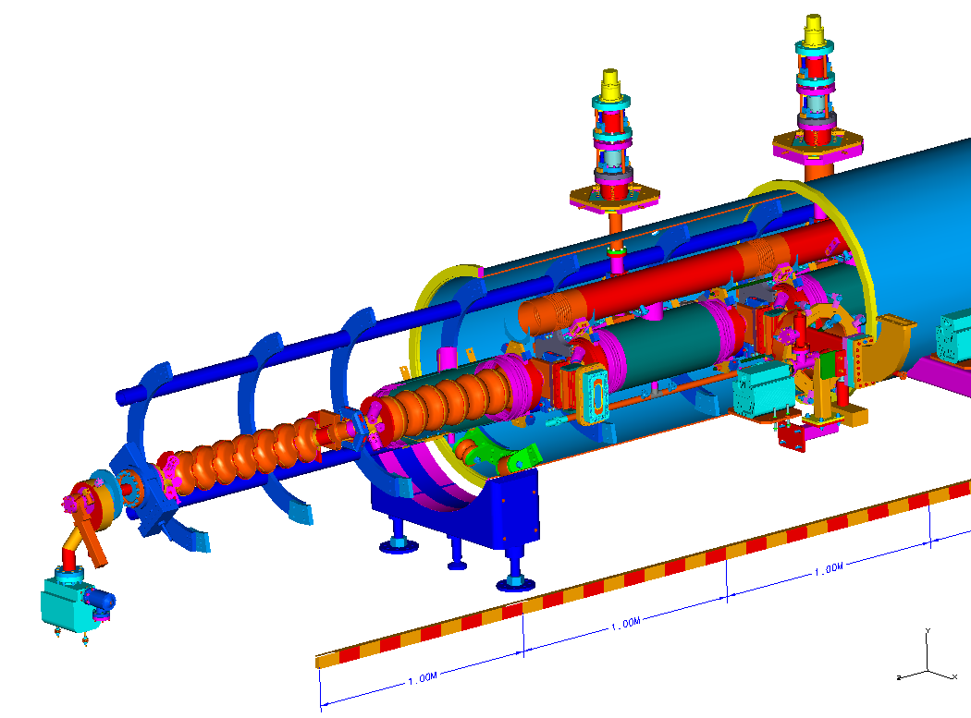
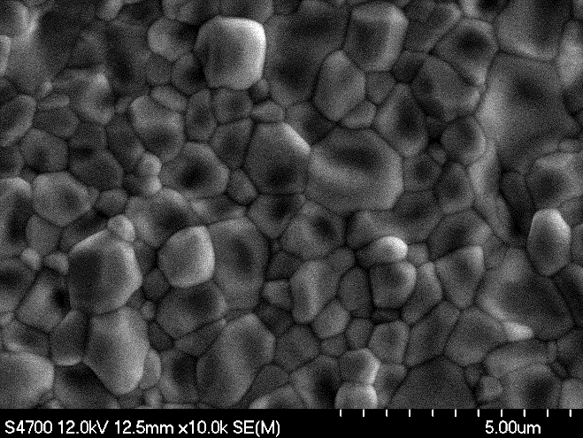
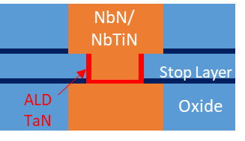
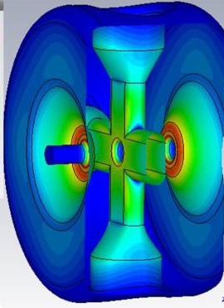
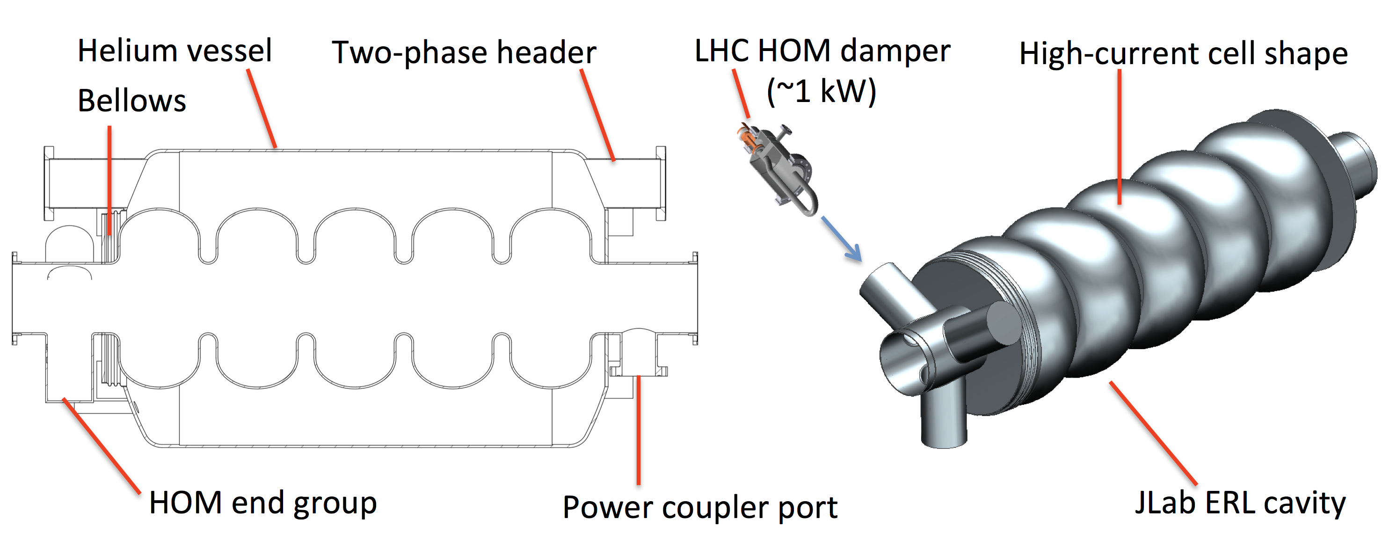
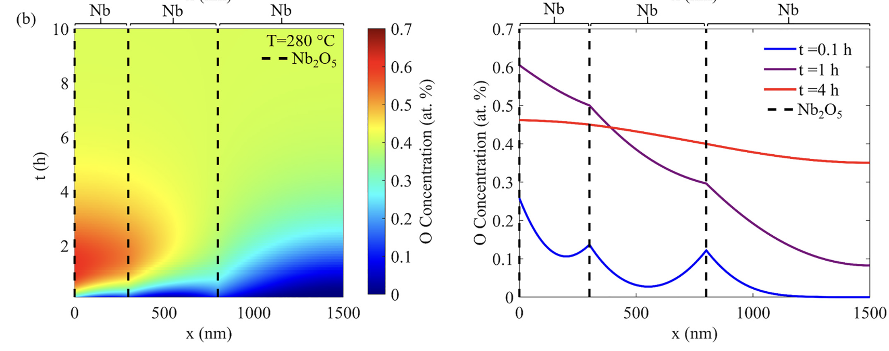
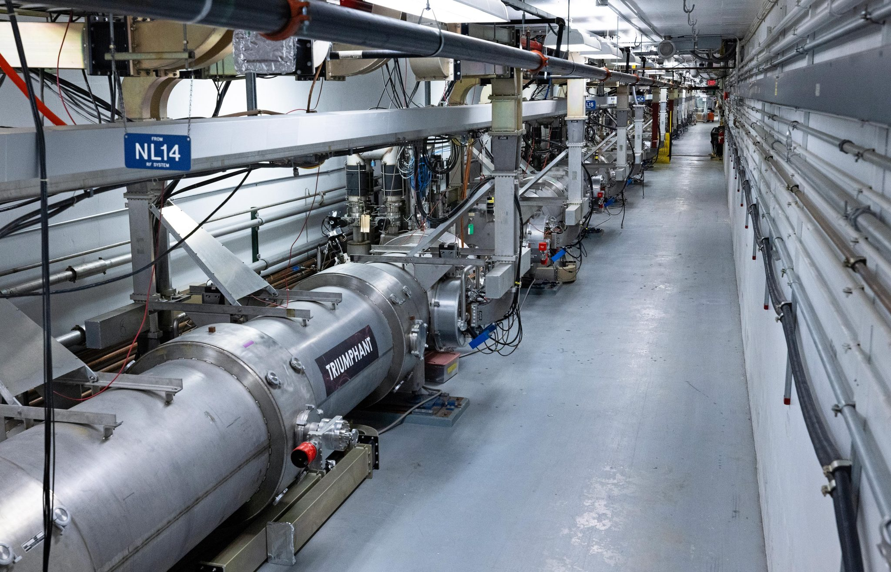
2025-2065: Next 40 Years of SRF at Jefferson Lab (a personal view)
JLAB’s SRF Institute leads the advancement of SRF science and technology by developing new SRF materials, building innovative SRF devices, and expanding applications of SRF technology beyond the realm of fundamental research. We are working to raise the effectiveness of particle accelerators and accelerator-driven sources of specialized light and particles. These are tools that benefit not only researchers, but also engineers and technologists, in fields ranging from particle and nuclear physics to materials science, life science, energy, environment and industry.
1st beam acceleration with Nb₃Sn SRF cavities at JLAB
Contribution to advanced industrial SRF accelerators for lithography
Leadership in design SRF accelerators for FPNS and ADS
JLAB designed SRF cavities operation in EIC
Next-generation SRF cryomodule
High-Q₀ high-current SRF cavity operation in CEBAF to sustain NP at JLAB
Contribution to advanced SRF accelerators for radiotherapy and isotope production
Participation in SRF-based superconducting microelectronics
Demonstration of multi-layer thin film SRF cavities
Conduction-cooled compact SRF accelerator technology adopted by industry
Partner in US accelerator driven system for transmutation of used nuclear fuel and advanced nuclear electricity
Participation of Higgs Factory construction
SRF TEM demonstrated
2025
2027
2030
2035
2040
2045
2050
2055
2060
2065
TTC’27 @ JLAB
SRF’29 @ JLAB
Fundamental
SRF R&D
SRF system Design
and Engineering
SRF Linac
Operation
SRF Materials
SRF Devices
Five SRF Pillars Enabling Accelerator Tools for Discovery Science and Wider Applications of National Interest

