Slide 1

faultHunter
Adam Carpenter
RF/Software Group Meeting
July 31, 2025

Slide 2
Overview
FSD Event
3C12 Data File
Goal: Help RF and Operations staff identify cavities that may have tripped beam without triggering an FSD
Suspicious Trip/Cavity Detection:
  Assumes that 3C12 file is created only for FSD
  Assumes smartRAT data only created for suspicious (beam loss w/o RF FSD) trips
  Checks if 3C12 Energy Jitter had a range of > 1.0 MeV
  Highlights cavity with gradient range > 0.5 MV/m
Two Modes:
  Batch: Process file within a date range
  Monitor: Watch for files created in real time
If large jitter range
If smartRAT data
If smartRAT cavity with large gradient range
Record suspicious BPM event
Produce aligned GMES/Jitter plot
Record suspicious cavity event

Slide 3
Operational Modes
Batch Mode: SME review
  Give a date range and process every BPM FSD file in that range
Monitor Mode: Operations Tracking
  Watches for BPM file creation
  Once new BPM file is seen, wait 30 seconds for smartRAT to collect data
  Trigger workflow on that BPM file

Slide 4
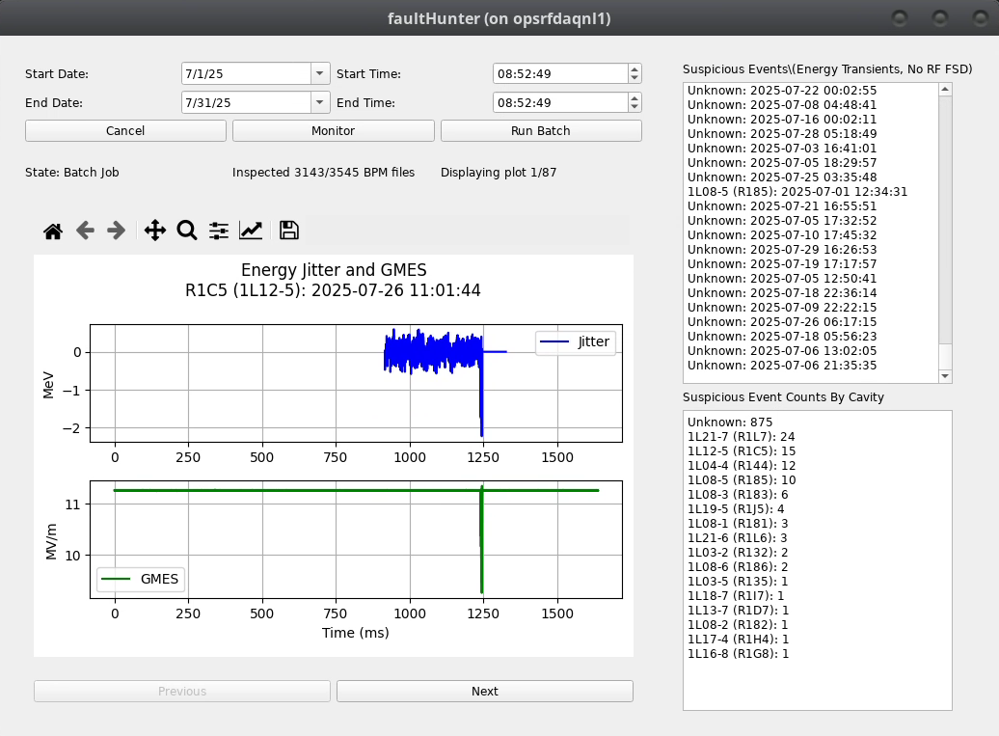
Tracks any beam loss FSD with large jitter range and smartRAT data
Job controls and status
Plots of suspicious cavities and related BPM energy jitter.
(Attempts to align them. Close, but not perfect.)
Event counts by cavity. Unknown means smartRAT didn’t have a suspicious cavity

Slide 5
To be released soon
Feedback welcome!

