Slide 1

Recent smartRAT Results
Adam Carpenter
Gradient Team Meeting
2025-07-21

Slide 2
RF Faults w/o RF FSD
Data captured for each FSD trip if the following are true
Beam in the machine
Involves a BLM, ion chamber, or other indication of beam loss
Does NOT include an actual cavity trip
Dennis Turner emails a report with plots of top 5
anomalous events from each day

Slide 3
Sunday July 20, 2025
1x R137
1x R1G7
1x R1G8
1x R1I8

Slide 4
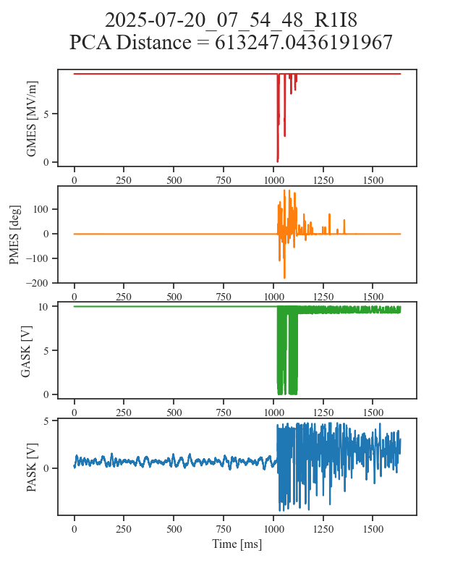
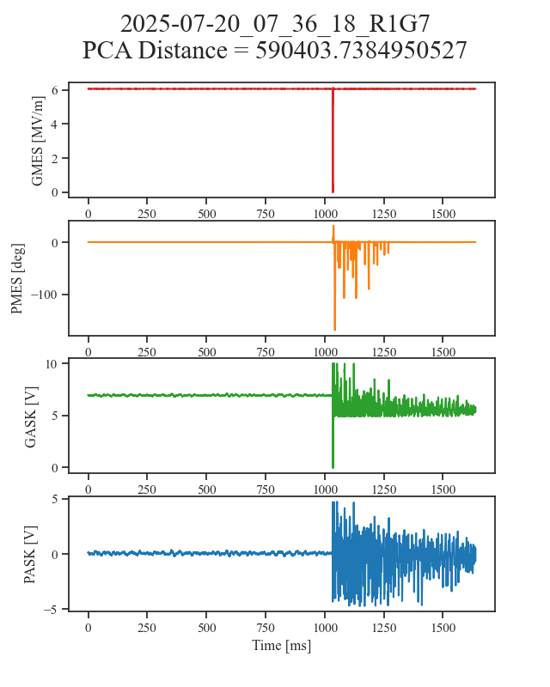

Slide 5
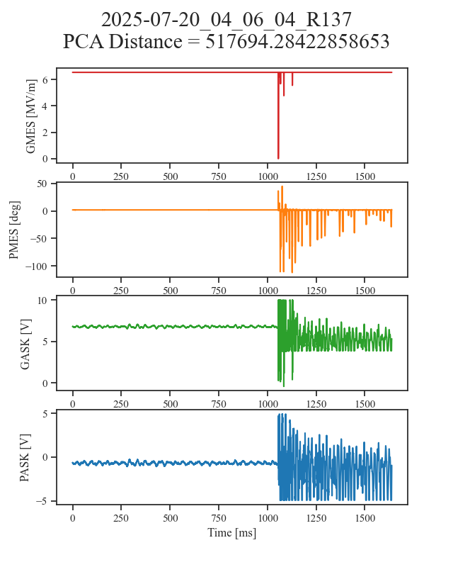
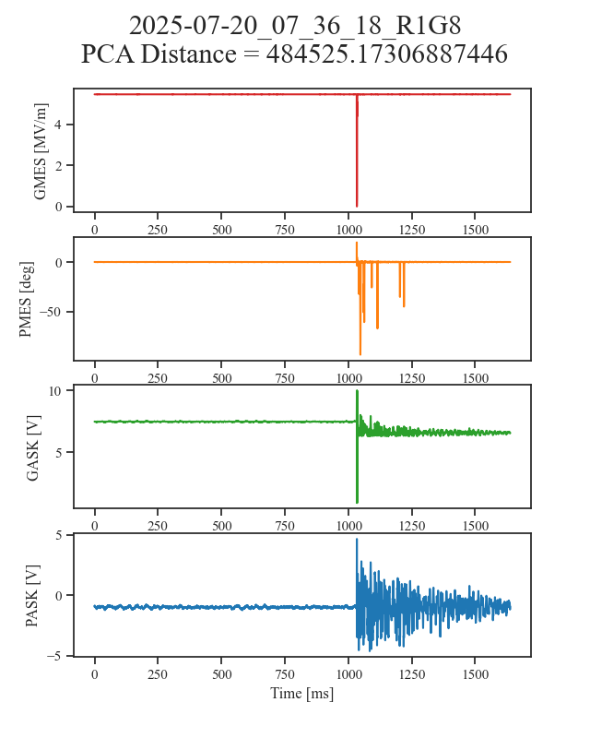

Slide 6
Saturday July 19, 2025
2x R132
1x R183
1x R1I7

Slide 7
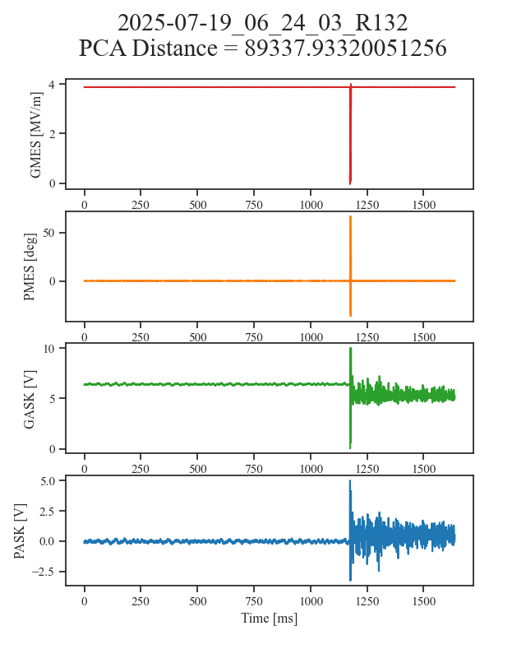
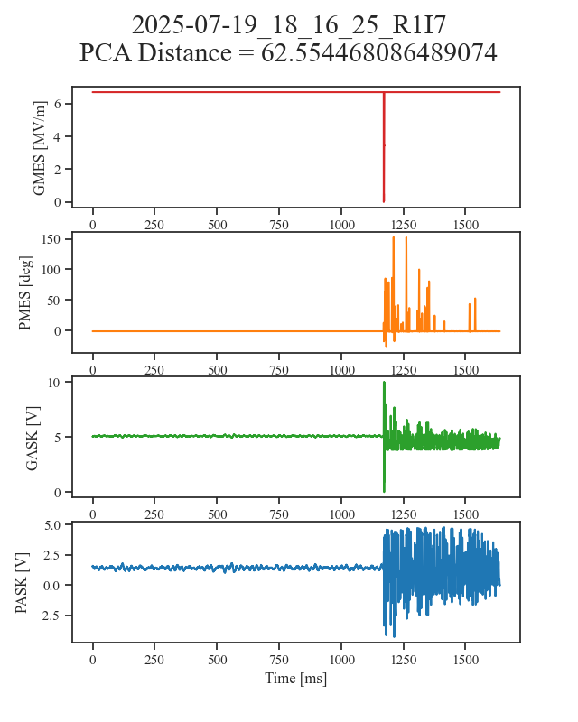

Slide 8
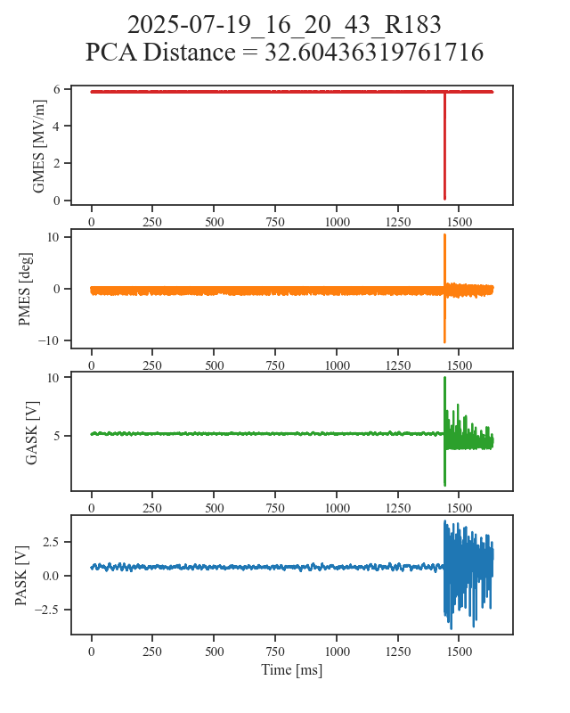

Slide 9
Friday July 18, 2025
1x R182
1x R1I7

Slide 10
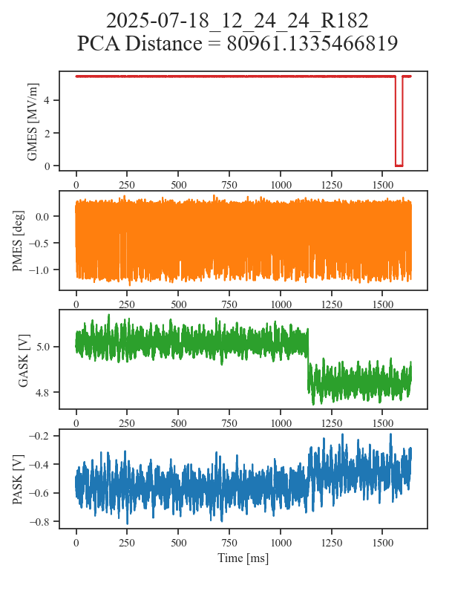
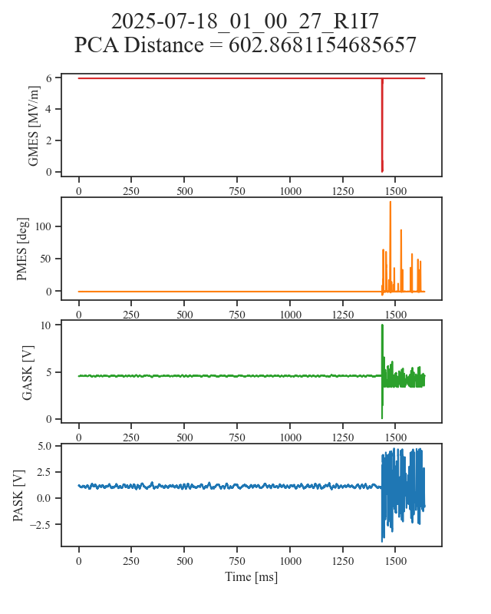

Slide 11
Thursday July 17, 2025
3x R1L7

Slide 12
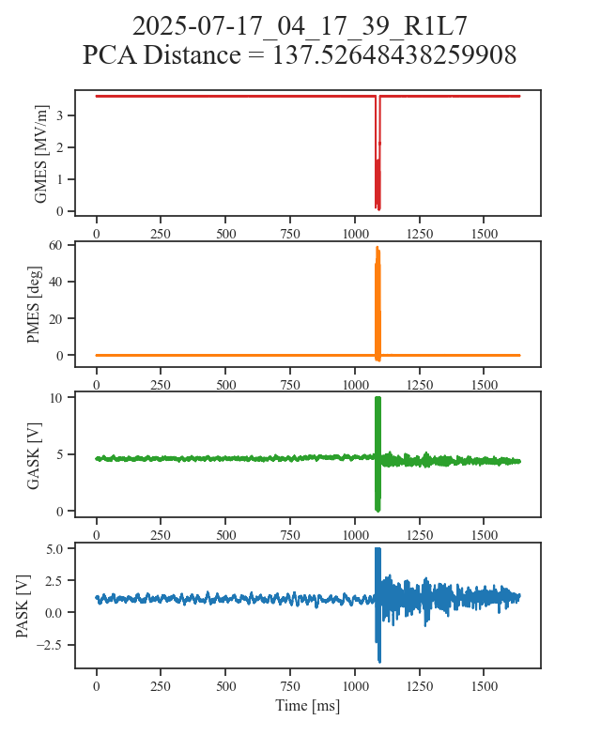
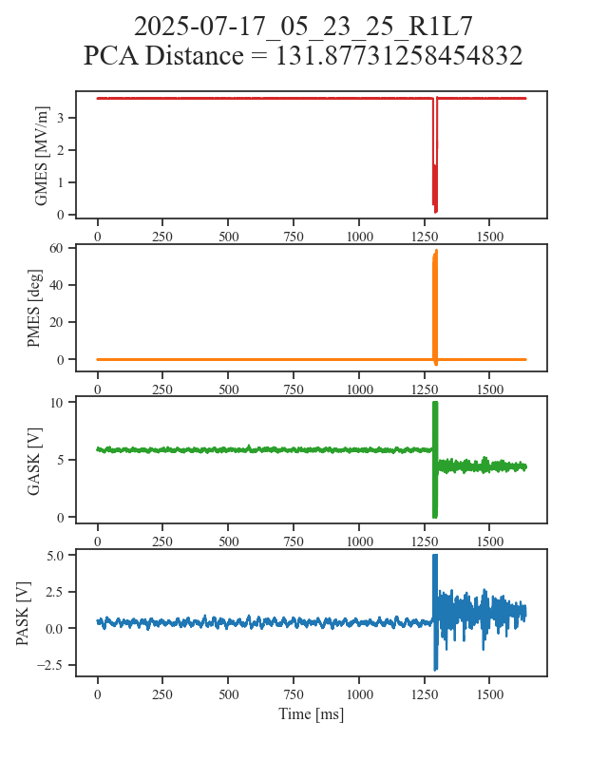

Slide 13


