Slide 1
ES&H Director Situational Report to the JSA Users Board
June 23, 2025
Paul Gubanc
Environment, Safety & Health Director
and Chief Safety Officer

Slide 2
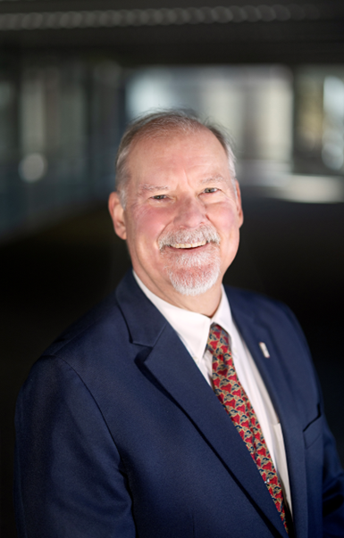
New ES&H Director, Paul F. Gubanc
Start date Monday, February 17, 2025
On-site Monday, March 3, 2025
Background
BS/MS Chem Engineering MIT, MBA University of Tennessee
Office of Naval Reactors
US Defense Nuclear Facilities Safety Board (SRS, Hanford, Oak Ridge)
ORNL (Nuclear Facilities, Lab Protection, National Security)
Amentum consulting services (Chief Nuclear Safety Officer)
Credentials – Professional Engineer (PE-VA), Certified Safety Professional (CSP), Project Management Professional (PMP)

Slide 3
ES&H Accomplishments (February 17, 2025, to date)
Five Vacancies filled (Director, ES&H Dept. Manager, RadCon Manager, WP&C Manager, Capital Projects PM)
FY25 budget austerity measures in place
ES&H stability and expectations established, accepted by the team
All ES&H Division position descriptions updated and approved
Overdue CATS actions driven down from 77 (as of February 14, 2025) to 1 (as of June 12, 2025)
ES&H Prioritization
Accelerator Safety violations resolved and transition to 420.2D near complete
“I Can Help Lead” Safety Culture model launched
Follow-up Safety Culture Assessment completed and showing improvement
ES&H Manual “Get Well Plan” transitioned to visual management and collaborative workshops
ePAS tool productivity and security updates in place, Advisory Team more effective
OSHA+ pilot initiative launched
FY25 PEMP Mid-year feedback recognizes improvements

Slide 4
Injury & Illness Dashboard
Jefferson Lab Injury Dashboard
Input Date Range: |  | Total Count of Injuries:
Start Date: | 10/1/2024 | First Aid | Recordable | DART | COVID
End Date: | 5/31/2025 | 21 | 1 | 1 | 0
Notes: DART Cases are included in the reported count of Recordable injuries. COVID cases are excluded from the DART total and reported separately in the COVID column. COVID Rate is the TRC, including COVID-19 cases |  | Case Rates:
 |  | First Aid | Recordable | DART | DART w/ COVID
 |  | X | 0.18 | 0.18 | 0.18
 |  | FY25 Projected Rate w/o New Injuries:
 |  | First Aid | Recordable | DART | DART w/ COVID
 |  | X | 0.12 | 0.12 | 0.12
 |  | FY 24 Final Case Rates:
 |  | First Aid | Recordable | DART | COVID DART
 |  | X | 0.24 | 0.12 | 1.19
TRC & DART RATES FY17- FY25 Q2 TJNAF vs. DOE Office of Science (Without COVID Cases)

Slide 5
What is Safety Culture? Launched April 8, 2025
Integrity Doing the right thing even when no one is watching
Curiosity Asking what can go wrong or could be improved
Humility Actively seeking and accepting help ​
Leadership Leading by example, regardless of your role

Slide 6
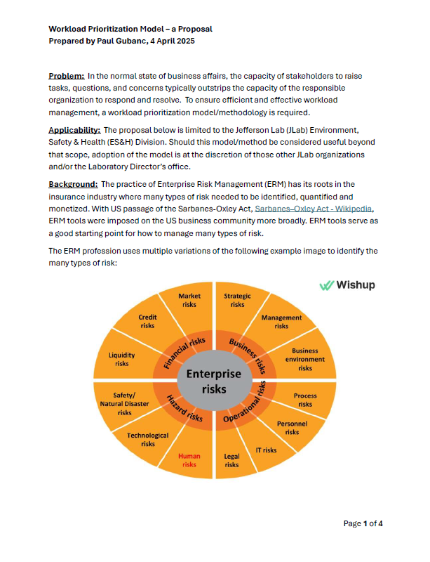
Status of Safety Priorities
To have priorities, ES&H had to first prioritize
Not everything is a “10”
Failure to prioritize was a key contributor to:
Leadership frustration
Lack of predictability and resources
ES&H Staff exhaustion and morale issues
ES&H developed and, with COO endorsement, deployed a prioritization model

Slide 7
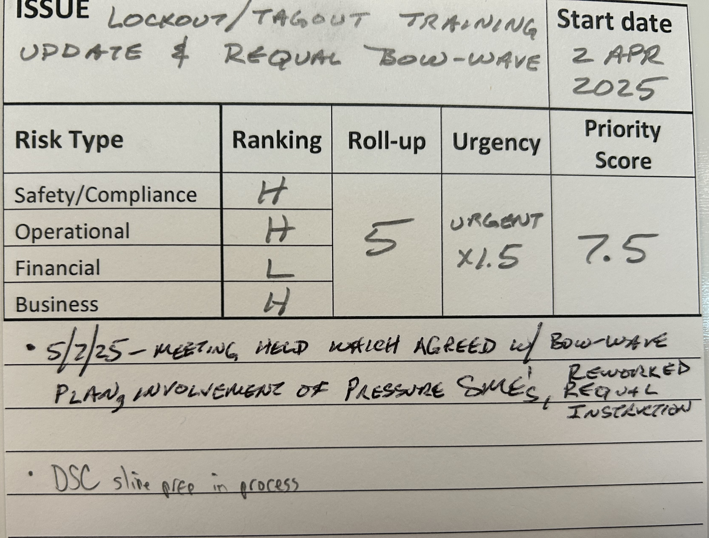
ES&H Prioritization Methodology
Immediate (required in days) – x2
Urgent (required in weeks) – x1.5
Routine (required in months) – x1

Slide 8
Status of Safety Priorities
Topical List of Issues
ES&H Staffing and Stability
Accelerator Safety Program
Work Planning & Control (ePAS)
ES&H Manual Updates
Radiological Controls
Safety Culture/ISM
Safety-related Committees (DSC, WSC, ePAS AT)
Fact-finding & Causal Analysis (w/Q&PA)
Emergency Management
Environmental Management
Budget
INSTEAD, the JLab User Board will be walked through the ES&H issues by priority (as of June 1, see following slides).
CAUTION, a lower priority does not mean it is not being actively worked. “Fire fighting” is not effective management.
If any issues of interest/concern are not touched upon, I’m happy to speak to them.

Slide 9
Status of Safety Priorities
Priority 10
Replace ePAS Assistant Administrator
Friday, May 23, 2025 – Incumbent offered/accepted Engineering DSO position (a promotion)
Wednesday, May 28, 2025 – Transition timeline and ES&H/Eng’g sharing arrangement agreed
Friday, May 30, 2025 – Posting for replacement went active
Resolve CMTF/VTA Accelerator Readiness Review (ARR) pre-starts (closed & replaced)
ARR out briefed Thursday, May 22, 2025
Factual accuracy review completed Friday, May 23, 2025
Two pre-starts tied to defining “bounding conditions” in the CMTF and VTA Accelerator Safety Envelope (ASE) documents
Pre-starts are also applicable to CEBAF/LERF and UITF ASEs also awaiting TJSO approval
Tuesday, May 27 – Friday, May 30, reworked language for all four ASEs (100+ manhours of deliberations)
Week of June 2-6, 2025, the four ASEs, the Safety Assessment Document (SAD), and the associated Operating Directives are being reworked, groomed, and internally approved
ASEs require submission to and approval by TJSO
Monday, June 30, 2025, is the DOE approved deadline to come into full compliance with DOE O 420.2D
ES&H FY25 Budget Overrun Resolutions
Both Direct and Indirect budget accounts are overrun (~$1M total) for a variety of reasons; many outside current ES&H management control

Slide 10
Status of Safety Priorities
Priority 8 to 7.5
Position Paper on achieving DOE O 420.2D compliance (start May 9, 2025)
Not a “requirement” but recommended best practice to assure completeness
Suggested pre-requisite to the Lab Director’s declaration that Jab has achieved compliance
Develop, Launch, and Embed Safety Culture definition at JLab (start March 14, 2025)
“I Can Help Lead” safety culture model launched April 9, 2025
Weekly reinforcement delivered through April into May, monthly reinforcement commencing in June
May 6-8, 2025, L&A Safety Culture Follow-up Assessment (discussed in later slides)
Monday, June 2, 2025, L&A out brief to the JSA Board and final report delivery
Safety Culture Assessment response plan to be developed (pending Board inputs also)
Decision on how much is “enough” to declare this issue closed
Lockout/Tagout Training Update & Requalification Bow-wave (start April 2, 2025)
Annual LOTO requals coming due in June, needed a plan to spread the bow-wave
LOTO practitioner complaints that requal was too electricity-centric and needed option for other hazard checkouts (pressure, lasers)
Wednesday, May 7, 2025, meeting held, which agreed to proposed solutions
Implementation actions initiated
Roll-out/Socializing at Director’s Safety Council planned for June 17, 2025

Slide 11
Status of Safety Priorities (updated June 16)
Priorities 6 and below
6 – ePAS Advisory Team Effectiveness (expected to close week of June 16)
6 – 2025 Summer Student Safety Assurance
5 – Accelerator Safety Long-term Health
5 – Hire replacement Accelerator Safety Program Manager
4.5 – Simplify LOTO PPE Requirements for 120V Breakers
4 – ePAS/Prometheus Contract Expiration/Replacement
4 – ES&H Manual “Get Well Plan” & War Room (see next slide)
4 – Deliver OSHA+ Pilot Successfully
3 – Get ES&H CATS backlog understood and under control (expected to close week of June 16)
3 – Worker Safety Committee (WSC) Charter refocus
3 – Train Q&PA staff on ORNL “Critique Pilot” model and tools for use at JLab
2 – Emergency Management DOE O 151.1E Implementation Plan

Slide 12
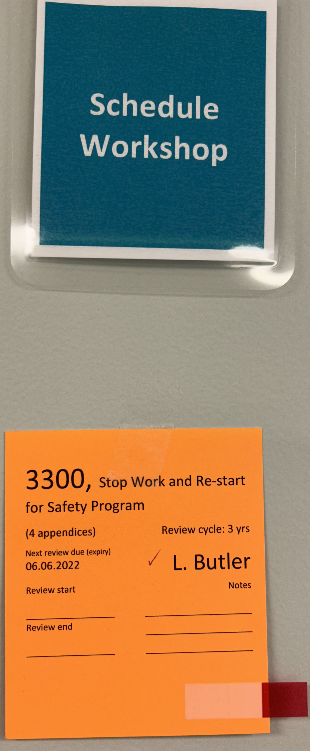
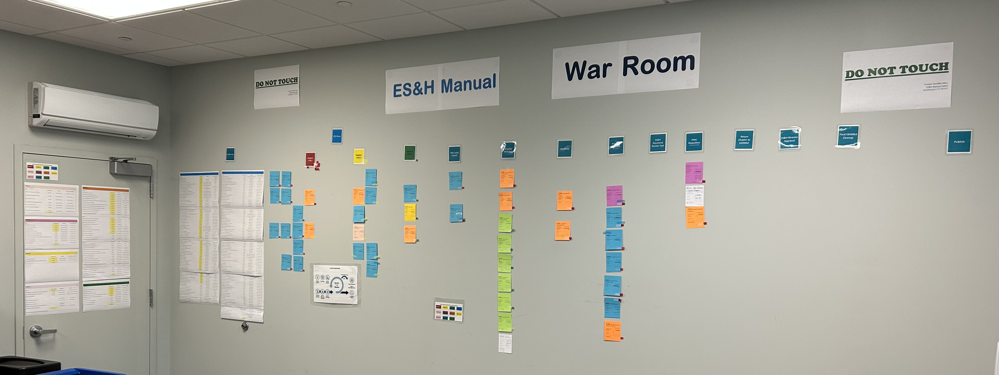
ES&H Manual “War Room”

Slide 13
ES&H Vision for the Future
Within 1-2 Years
PEMP grade for ES&H recovered to B+ or better (FY24 grade was C+)
Accelerator Safety program is documented and stable long-term
Corrective initiatives (e.g., ES&H Manual, WP&C/ePAS, WSC) completed and effective
Managed austerity measures that don’t cripple mission or safety
Contract transition enables continuity of ES&H initiatives
Within 3-5 Years
“I Can Help Lead” Safety Culture model – embedded here and adopted by other small DOE labs
ES&H succession planning in place
Healthy balance between “Line Management Responsibility for Safety” and ES&H Division

Slide 14
Questions?

Slide 15
Back up

Slide 16
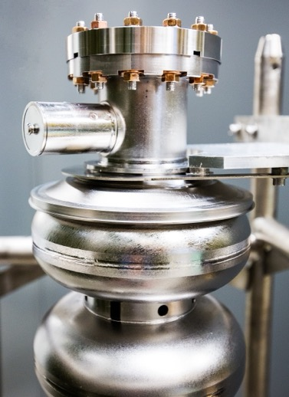
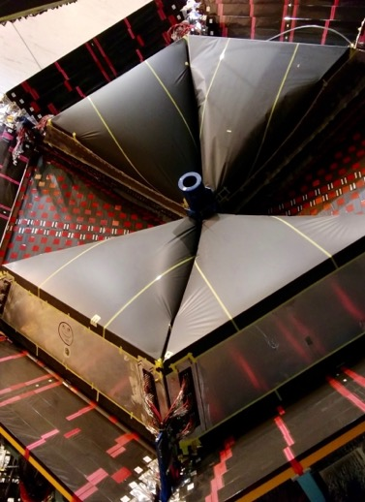
Safety Culture Assessment follow-up
Paul Gubanc

Slide 17
Safety Culture Assessment follow-up
SURA commissioned Longenecker & Associates (L&A) to perform a follow-on Safety Culture assessment
Follow-on to April 2024 assessment
Pre-visit Survey conducted April 21-28
On-site visit May 6-8
L&A exit briefing provided May 8
Draft report provided for factual accuracy review on May 23
L&A briefing to Board provided June 2
Final report expected by June 6
What follows is JLab’s perspective on assessment results & initial response

Slide 18
Safety Culture Assessment follow-up
Perspectives on Conduct & Delivery of the Safety Culture Assessment
What Went Well | What Could Be Improved
A pre-visit survey was administered lab-wide | Short-lead time, limited duration, and survey fatigue (?) resulted in only 166 responses (11%) and some anomalies
The assessment team got time with each major hands-on lab organization (Accelerators, Physics, Eng’g, FM&L, CST) | 3-man on-site team, 2.5 day duration, limited how much they could see/experience
Lab efforts to reinforce ISM (lanyard cards, safety shares, etc.) resulted in improvements visible to the L&A team | Our “I Can Help Lead” Safety Culture model launch was too late to get sufficient traction by May 6-8 (next slide)
The L&A assessment team was highly competent and actively engaged | L&A team expectations are steeped in commercial nuclear. Suggested rigor may not be proportional to risk at an accelerator laboratory (e.g., 5S/6S, training, ConOps)
All but a couple of the issues identified by L&A were not a surprise | Quantifying the extent of “new” issues will require follow-on evaluation (e.g., hesitation to report concern)

Slide 19
Safety Culture Assessment follow-up
JLab will develop a response to each Recommendation. Below are initial thoughts.
L&A Recommendations | Initial Expected Responses
Develop Disciplined Operations Standards & Expectations | Dovetail into planned DOE O 422.1 Chg 4 assessment & response (planned, QPA)
Examine Practices that can Hinder a Reporting Culture | Conduct extent of condition review (ES&H, QPA, DSO’s) Reinforce expectations with Comms campaign, especially for summer students (ES&H, Comms)
Review/Improve Lab-Wide Change Management Processes | Apply Kotter CM tools to major program initiatives such as HR, Finance (ongoing, COO) Utilize ES&H Manual “War Room” to enhance change comms (ongoing, ES&H) Improve use of other vehicles (e.g., DSC, DSOs) to socialize change (ES&H)
Leverage CAS Assessment Program | Review areas of concern with SMEs for their follow-up (ES&H) Build FY26 Annual Assessment Plan to collect objective evidence on effectiveness and deep-dive into particular areas of concern (planned, QPA & ES&H)
Adopt Metrics and Progress Indicators | Develop lab-level balanced scorecard (underway, COO) Update/improve SPECTRUM tool for ES&H metrics (planned, ES&H)
Increase Collaboration on WP&C Software Optimization | Conduct WP&C procedure update workshops w/ users (completed in May, ES&H) Utilize ePAS Advisory Team in evaluating ePAS v4→v5 transition (initiated, ES&H)
OVERALL | Adopt a risk-informed, proportional response to each recommendation that JLab can afford and sustain (ongoing, COO)

