Slide 1
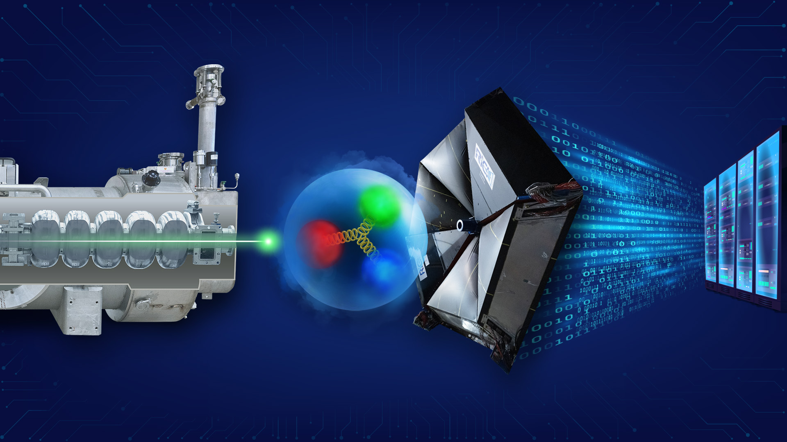
CEBAF Now and in the Future
Cynthia Keppel and Andrei Seryi
Slides from the recent Jefferson Lab All-Hands

Slide 2
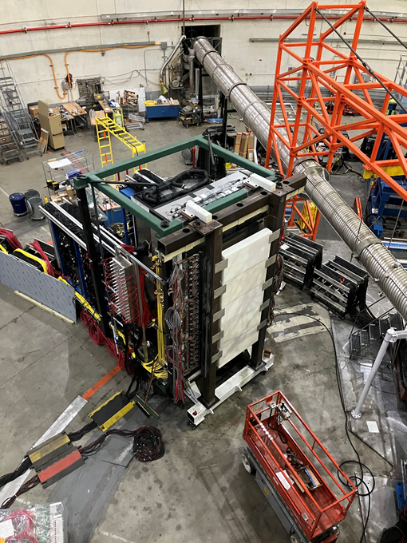
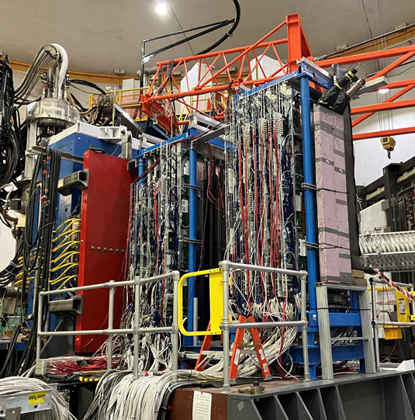
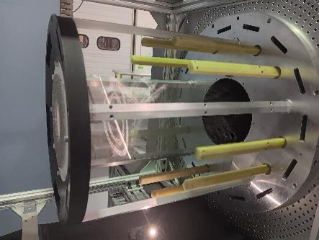
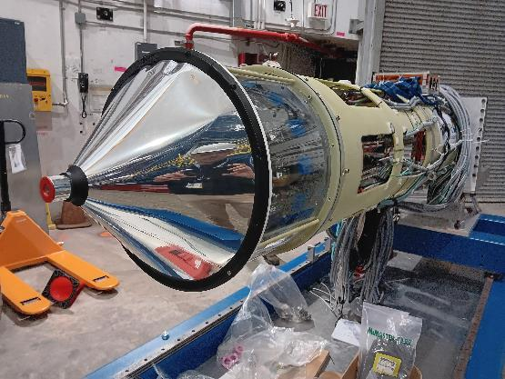
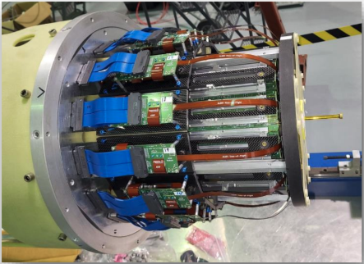
Hall A GEp: Where is the electric charge distributed in a proton?
Hall B ALERT (A Low Energy Recoil Tagger): What is the gluon radius of Helium?
Two Super BigBite Spectrometers (SBS) weighing ~50 tons each with 43,000+ detector readout channels
A first-ever device!
45 cm long, 6 mm diameter straw gas target operating at 5.5 atm pressure
- inside -
A 30 cm long Hyperbolic Drift Chamber with 3026 wires
- with -
Two layers of scintillation counters positioned inside the gas volume for particle identification
Coordinate Detector and Electron Calorimeter
16 GEM layers on Super BigBite Spectrometer
GEp deploys the largest GEM detectors used anywhere to date
In Hall B, before installation

Slide 3

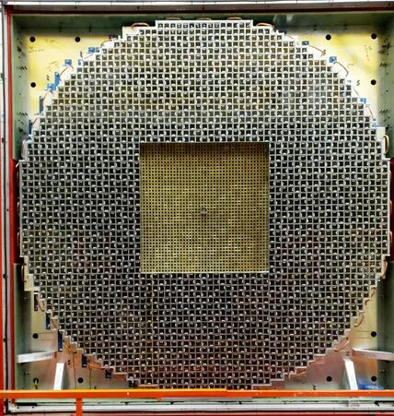
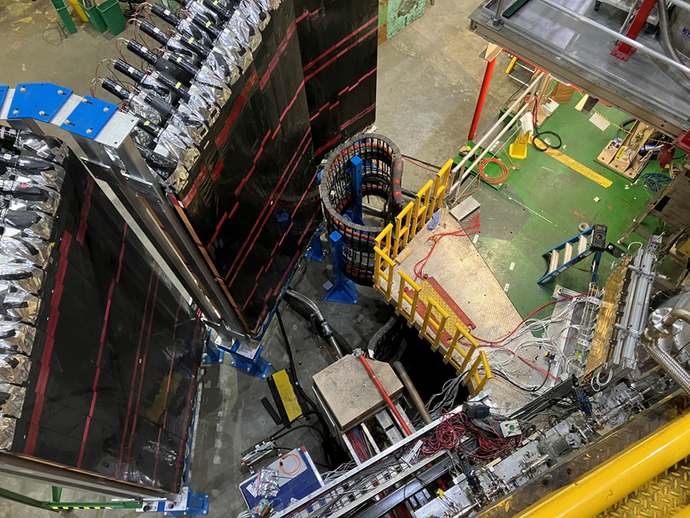
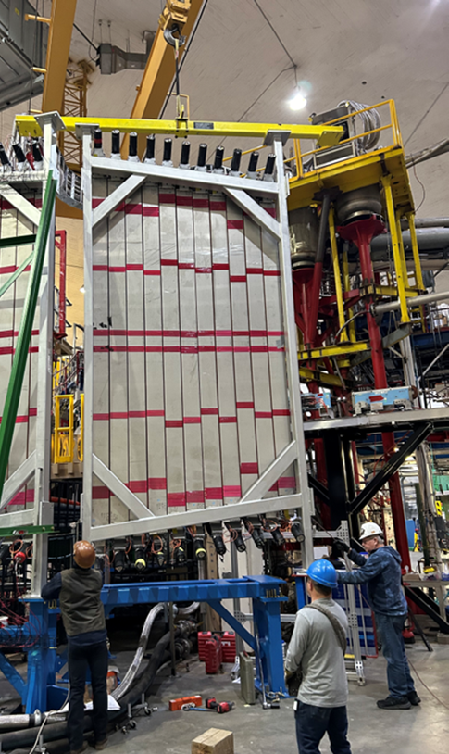
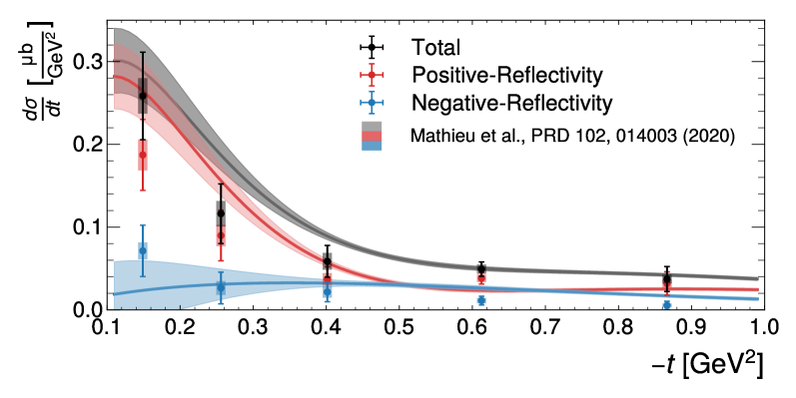
Hall C Large Angle Detector (LAD): What causes nucleons to change in the nucleus?
Hall D : :The Search for Exotic Mesons
FCAL upgrade:
+1600 PbWO modules finished!
GlueX-II/JEF is running
10 PhDs awarded in 2024
a2(1320)
recently accepted for publication
Top view of LAD scintillators and GEM detectors near target
The LAD detector repurposes scintillator bars from the decommissioned CLAS (6 GeV) spectrometer
Exotic mesons are particles that have quantum numbers not possible in the quark model. The a2(1320) is a benchmark to validate the GlueX experimental setup and analysis techniques before moving on to searches for exotic hybrid mesons.
Installing LAD plane

Slide 4
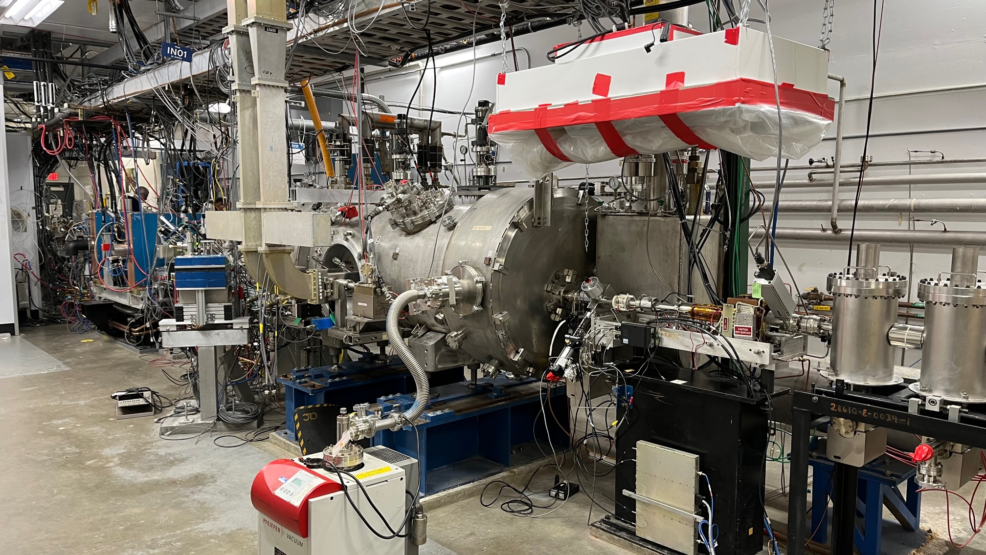
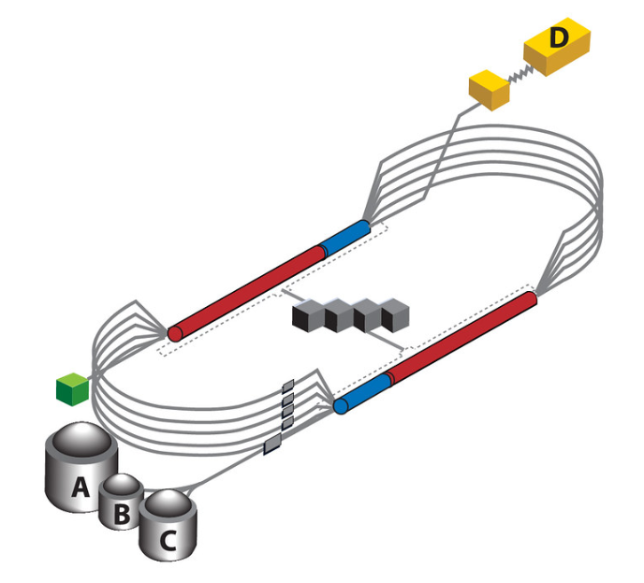
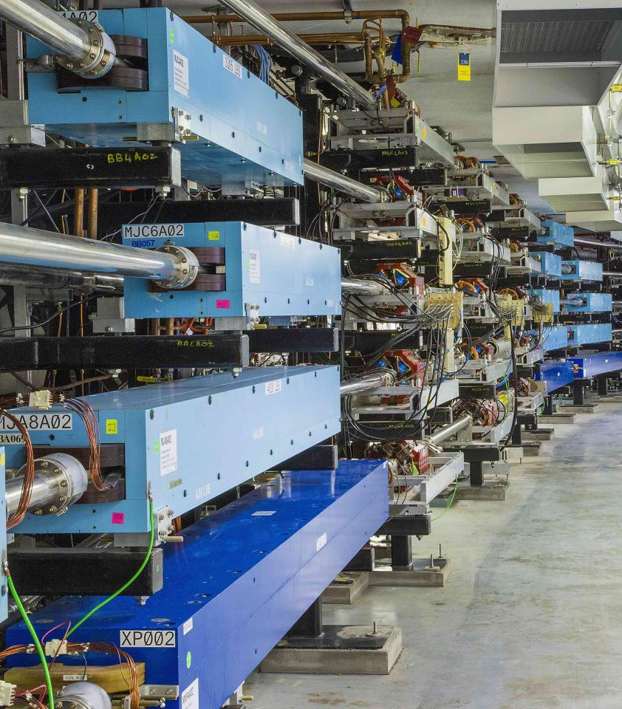
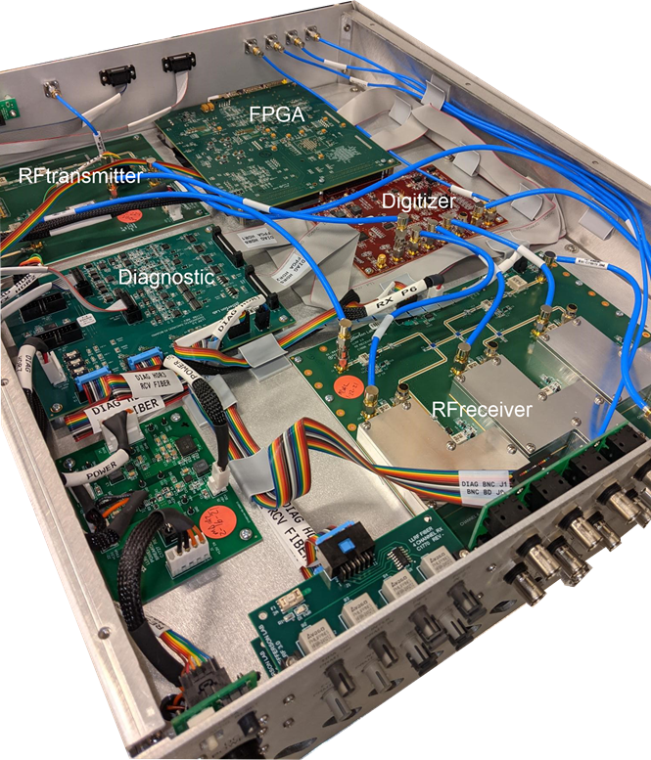
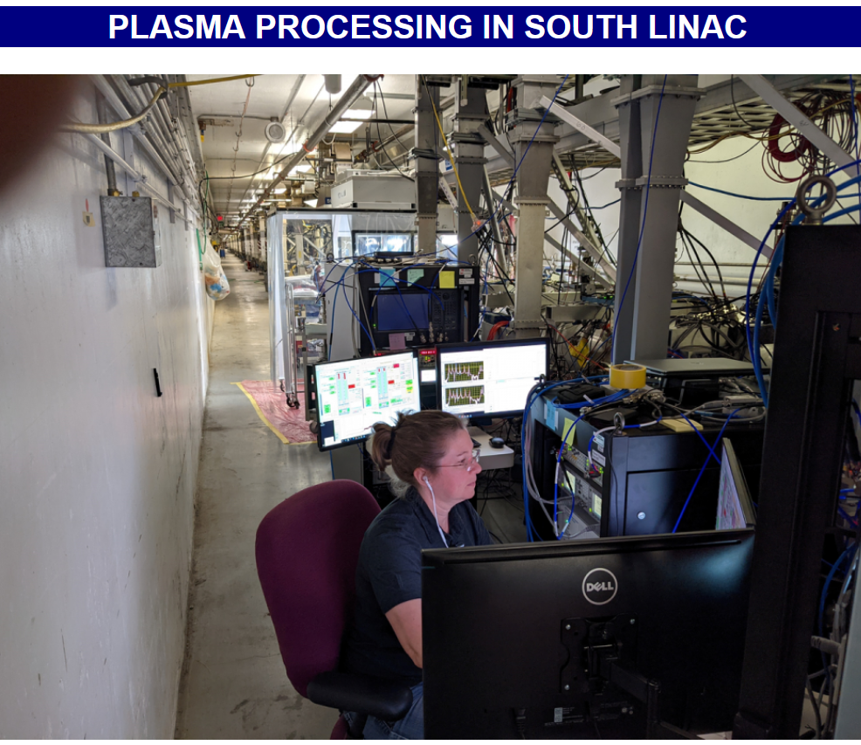
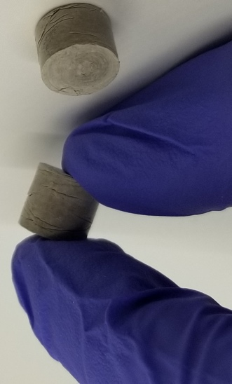
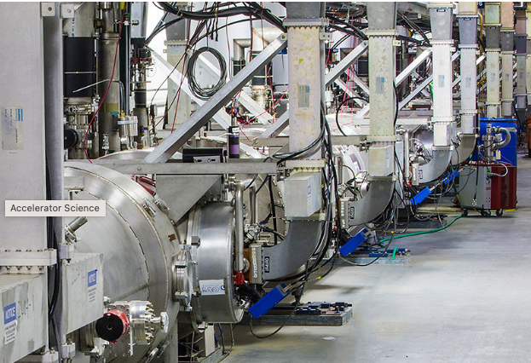
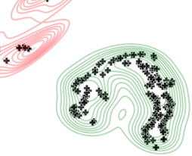
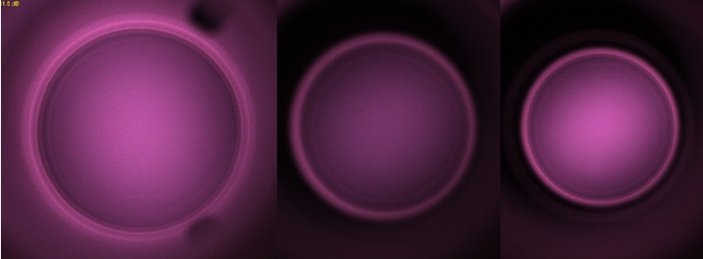
CEBAF Accelerator
Upgraded Injector (AIP)
Maintaining & enhancing performance via
  CEBAF Performance Plan (CPP):
    (I) Spare Parts, (II) Energy Reach
  Accelerator Improvement Projects (AIP)
  R&D that turned into Acc Ops use
5 Magnetic Arcs
LLRF 3.0 Chassis (AIP)
1.1 GeV Linac
Clean cryomodule with plasma processing
BNNT to mitigate microphonics
AI for Acc Ops improvements
Anode bias to double photocathode lifetime
BNNT=Boron Nitride Nanotubes

Slide 5
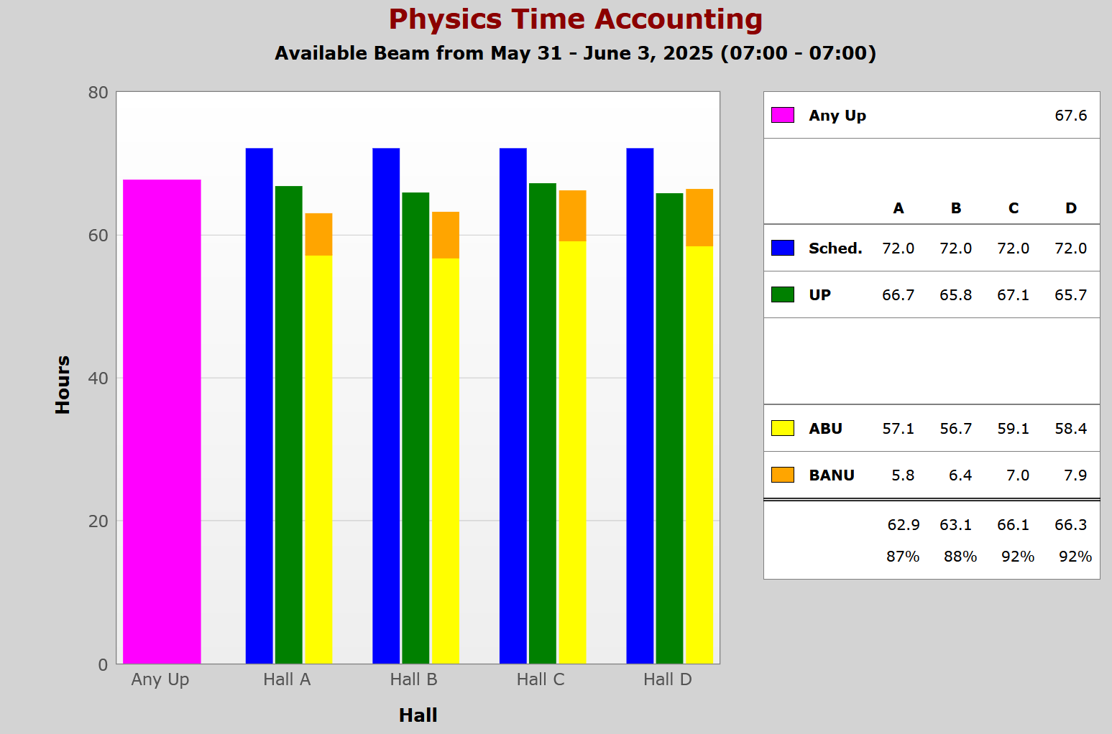
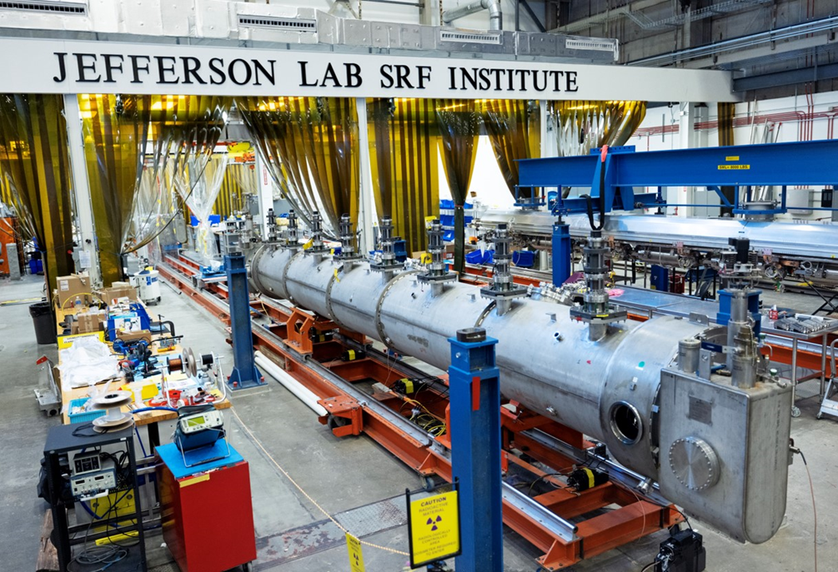
CEBAF Accelerator
Example – availability > 85% for three consecutive days
Refurbished C100 cryomodule in final assembly
AIP, R&D and CPP efforts → enabling healthy accelerator
CPP Energy – installed two C75 cryomodules and one refurbished C100 in 2024 SAM period
  Sufficient energy margin → low number of RF trips → higher reliability
  Spare parts in hands allow quick replacement of hardware → higher reliability
Current run: good beam delivery to all four halls – the accumulated reliability is 81.2%
Update this number on June 11
SAM = Scheduled Accelerator Maintenance
Notes:
Use for: Introducing new topics
To change the photo: Right-click on photo and select change photo

Slide 6
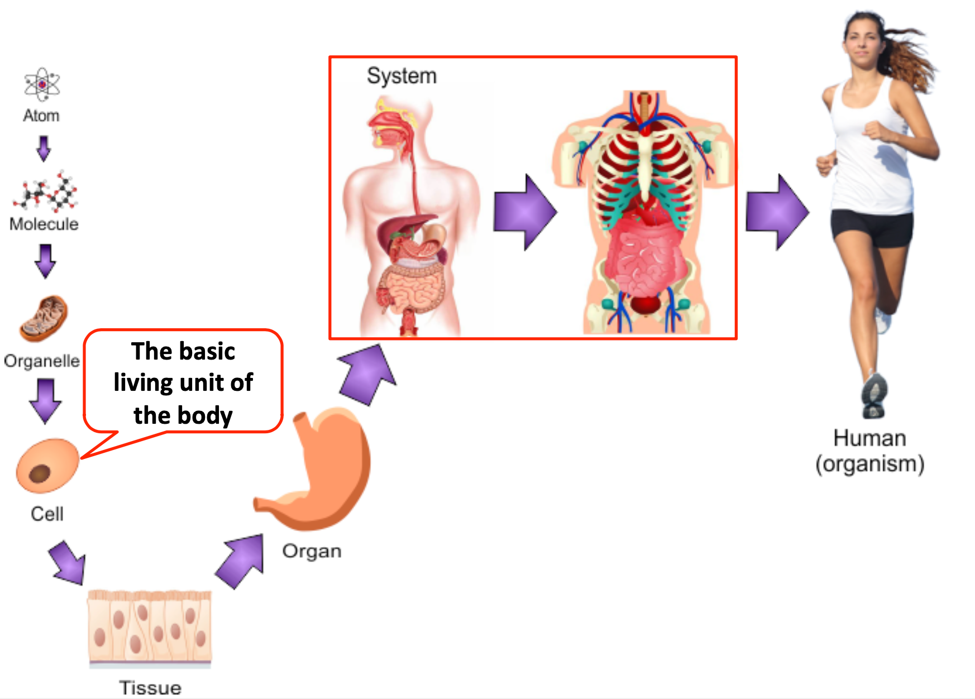
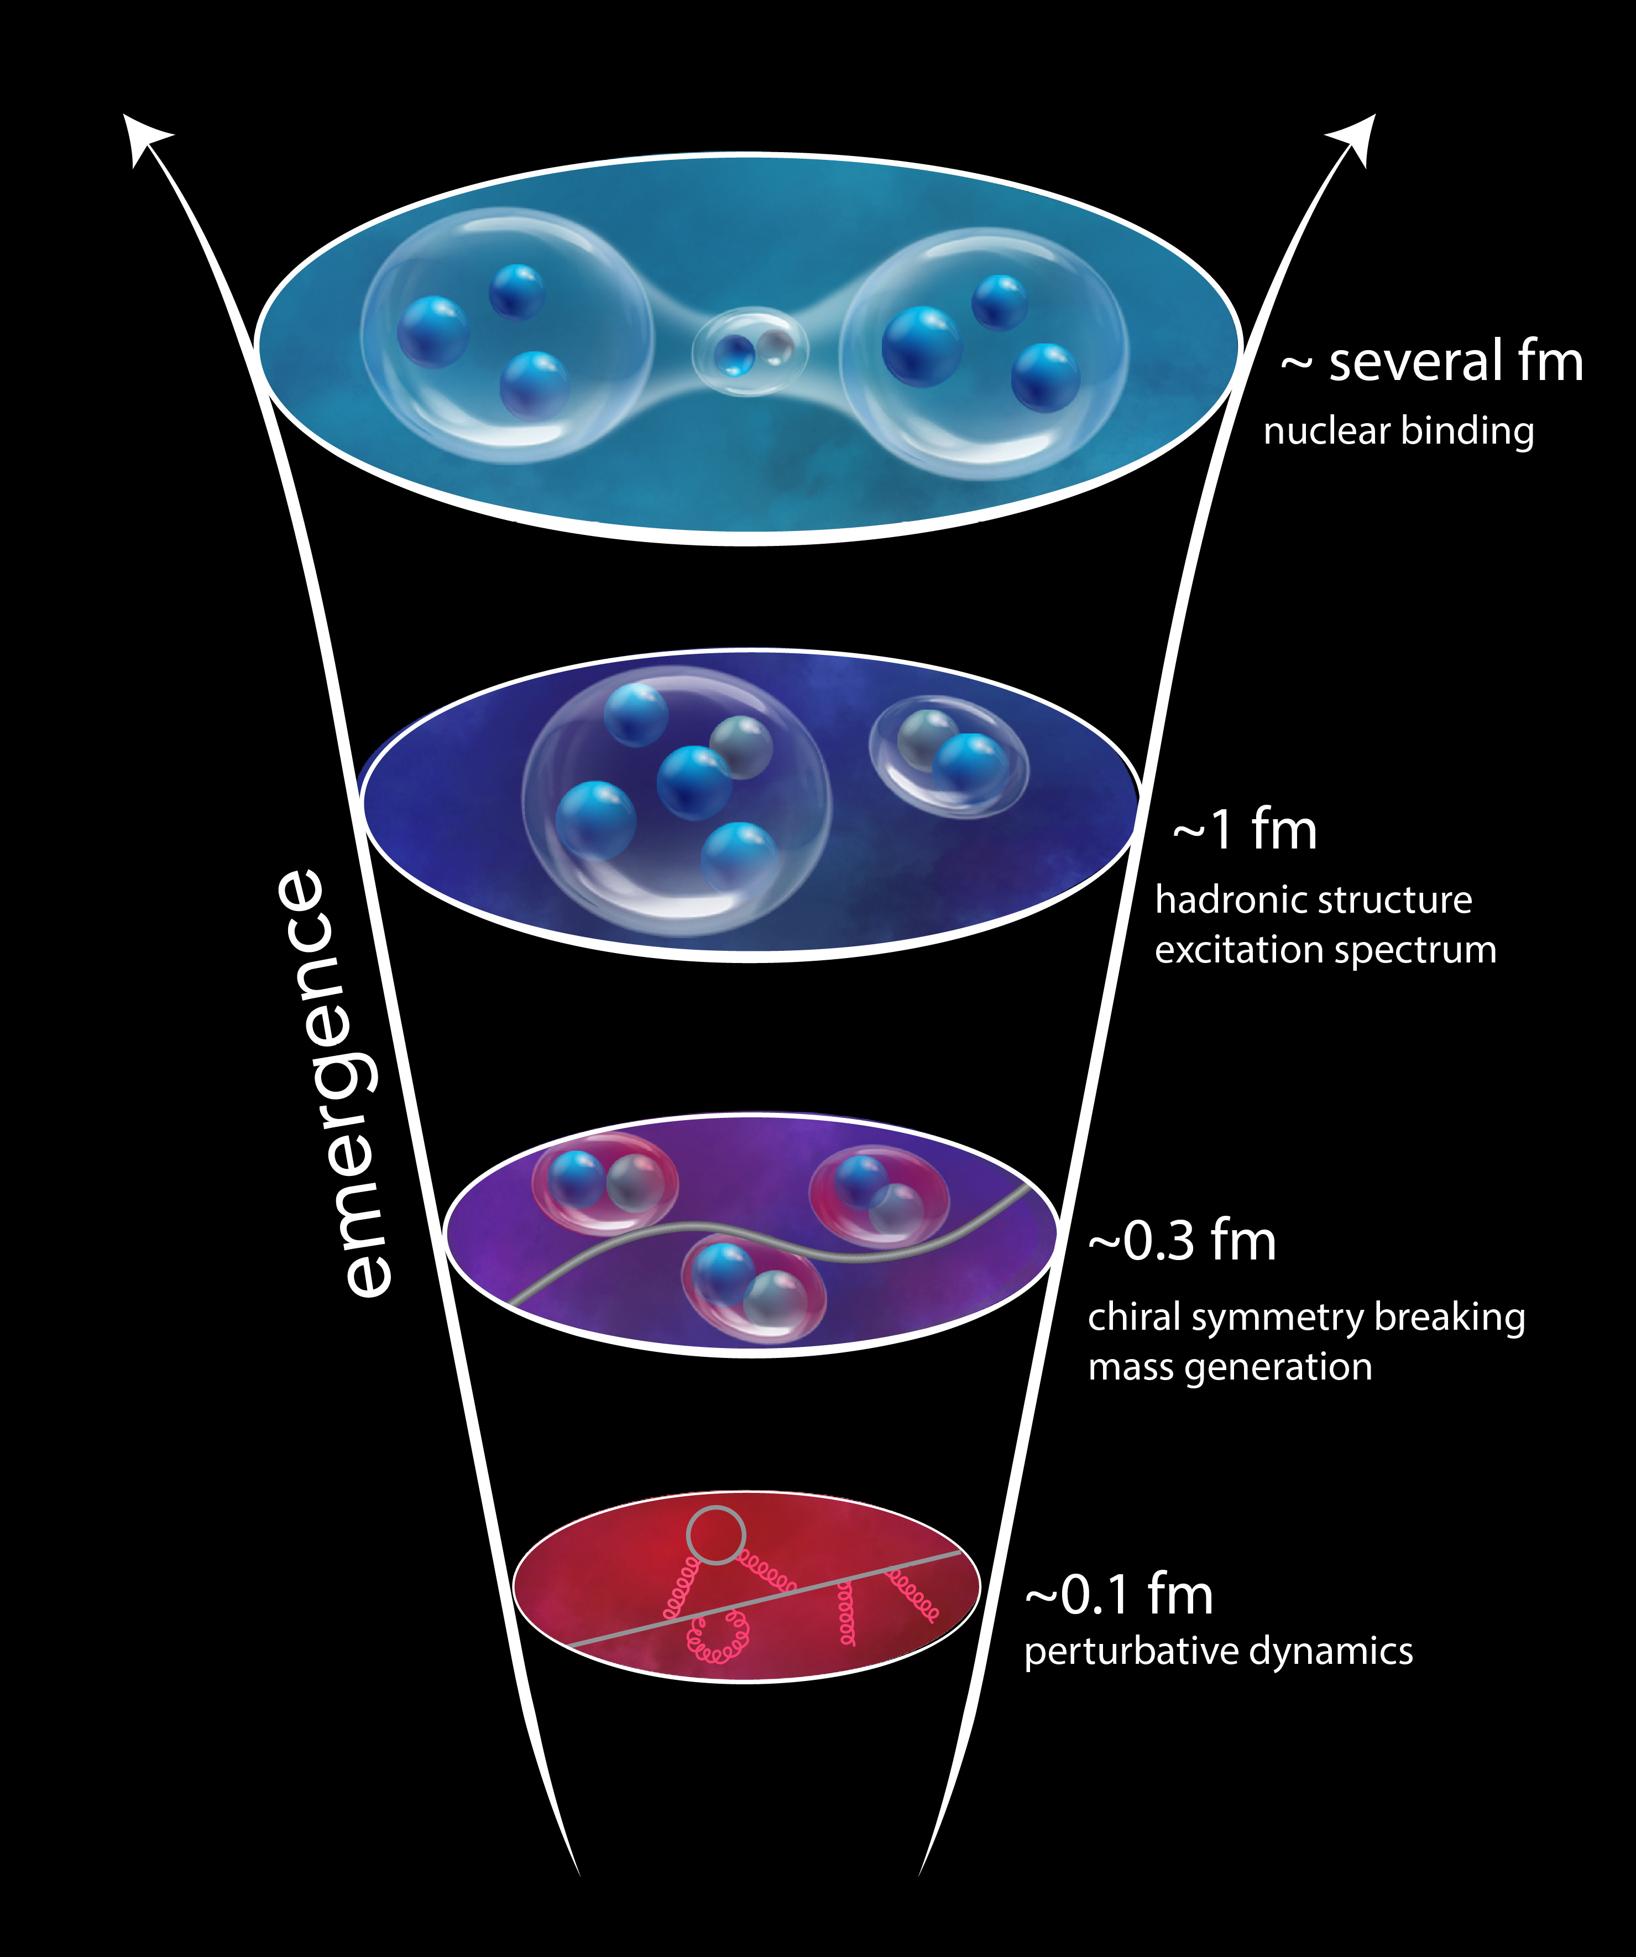
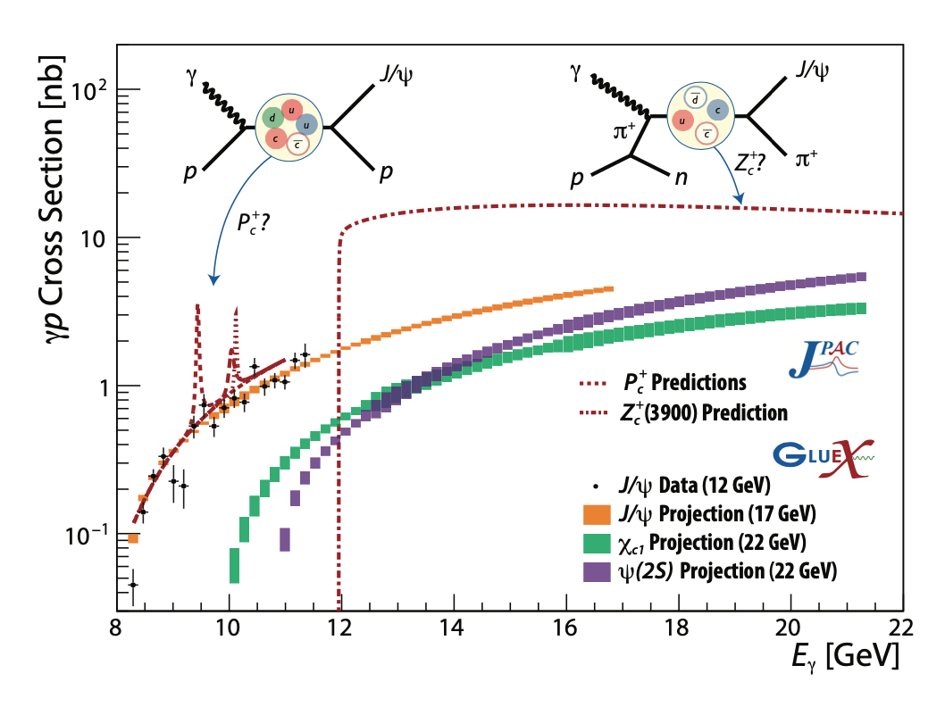
Why 22 GeV?
“The ability to reduce everything to simple fundamental laws does not imply the ability to start from those laws and reconstruct the universe.” - More is Different, P. W. Anderson [Science 177, 393 (1972)]
In this landmark paper Anderson established complexity as a fundamentally important subject of inquiry. He highlighted profound limitations of reductionist approaches in understanding nature’s complexity, and set in motion new lines of investigation that have led to, for instance, condensed matter physics and systems biology.
Example: Tetraquark candidates, ”XYZ states”, a surprise observed in B decays, e⁺e⁻ colliders - their internal structure is not yet understood
Polarized photo-production is a promising mechanism to study such states
Why do cells [protons/neutrons] form one organ [nucleus] or another?
How does DNA [do quarks] drive cellular [hadron] type and structure?
Why are organs [hadrons] the size they are based on their cellular [quark] composition?

Slide 7
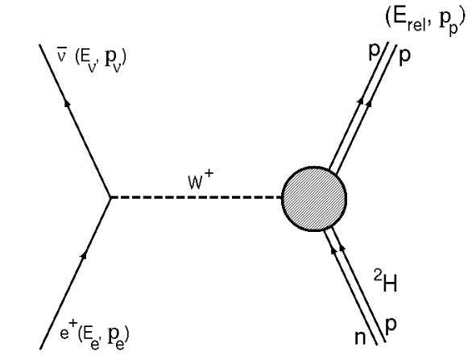
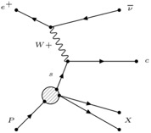
Why Positrons?
Example: Understanding the role of two-photon exchange
- crucial to accurately describing the proton's size and charge distribution.
Beam charge asymmetries
  Two-photon exchange
  Deeply Virtual Compton Scattering
Annihilation processes
  Light dark matter searches
Charged-current processes
  Inverse beta-decay
  Access strangeness with charm-tagging
  Charged lepton flavor violation
  Axial Form Factor
Accessible with JLab 12 GeV
Theoretical models disagree on the size and form of this correction, and experimental data is not yet sufficiently precise to definitively settle the matter.
GEp​/GMp​ ratio by polarization transfer in e⃗p→ep⃗
M.K. Jones et al., JLab Hall A Collaboration
Phys. Rev. Lett. 84 (2000) 1398-1402 Over 1000 citations to date

Slide 8
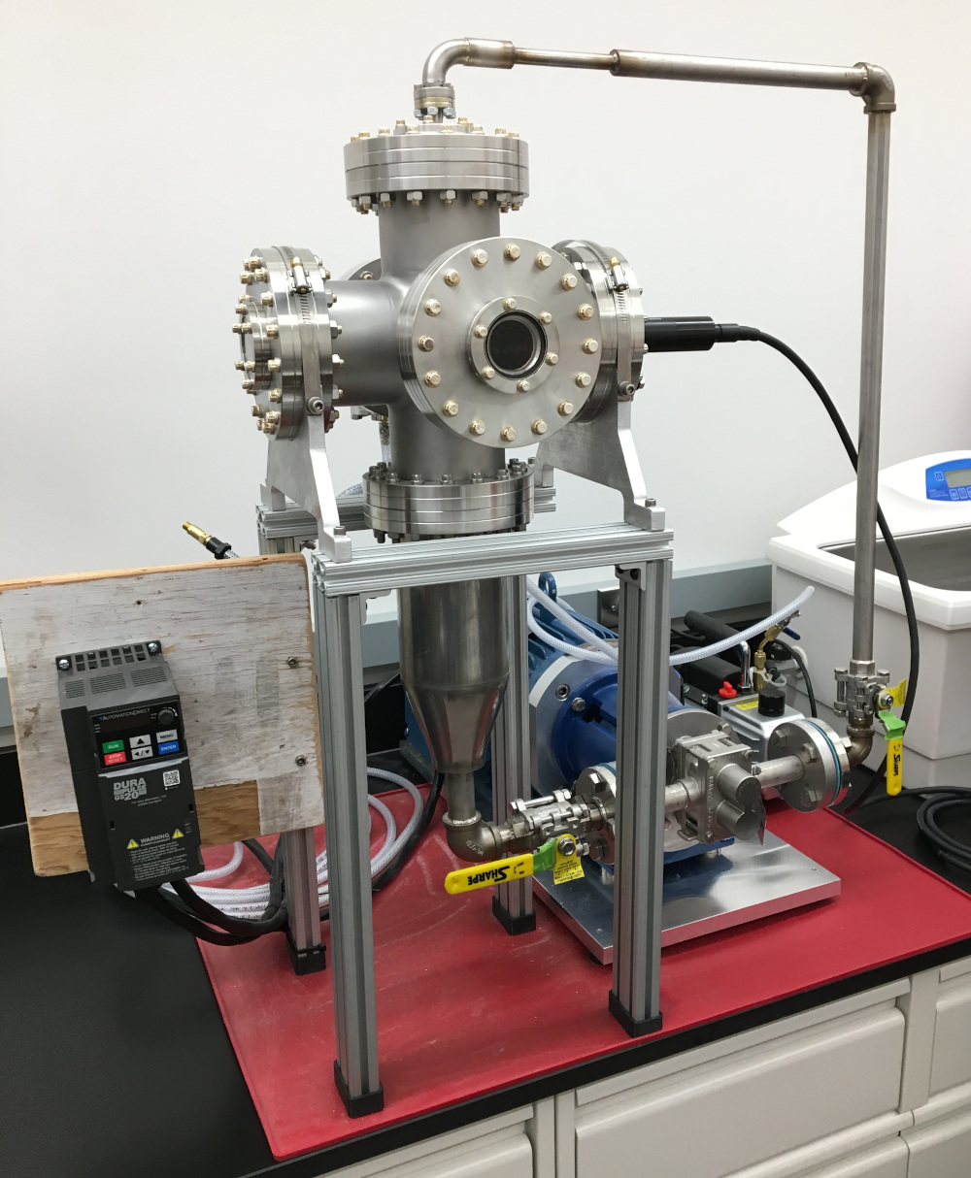
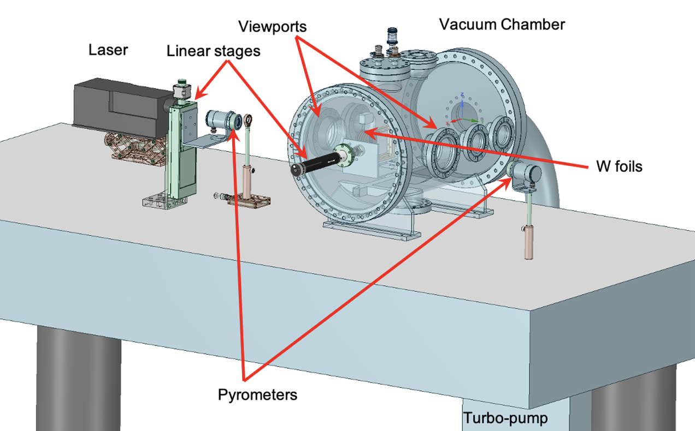
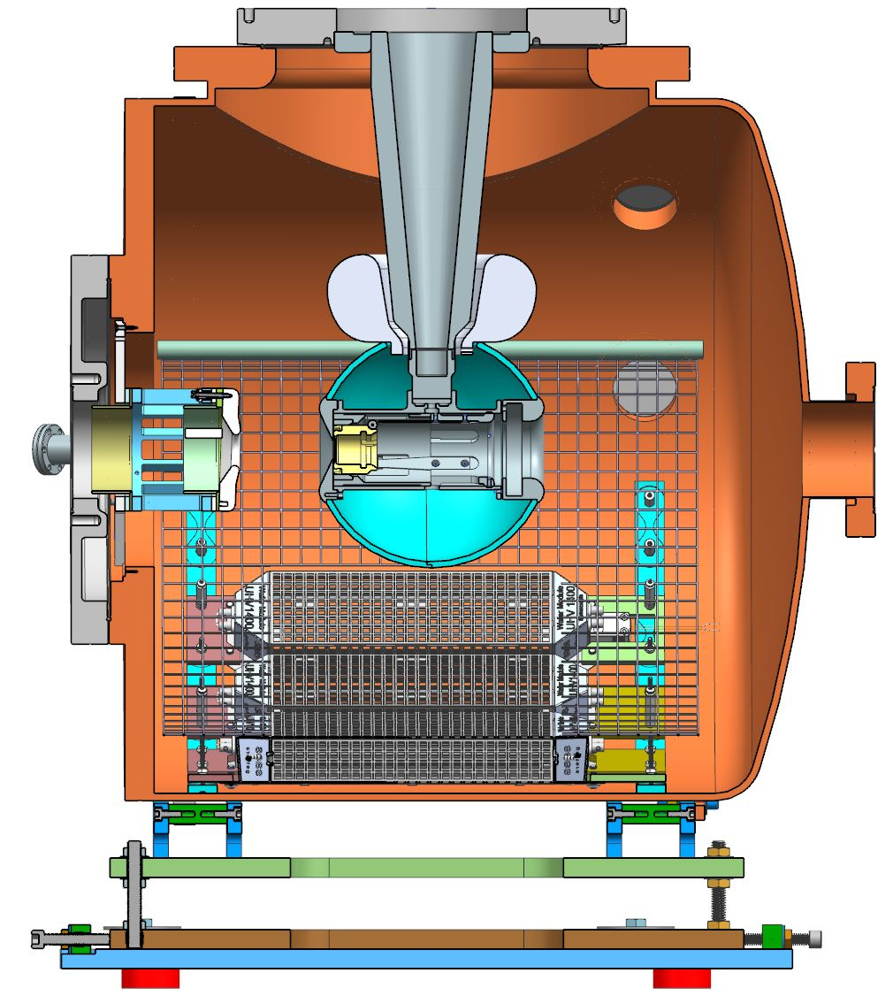
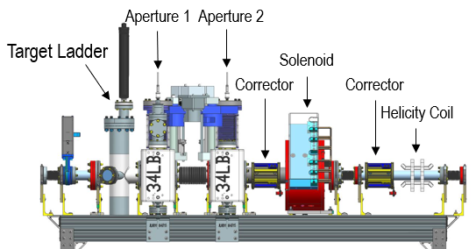
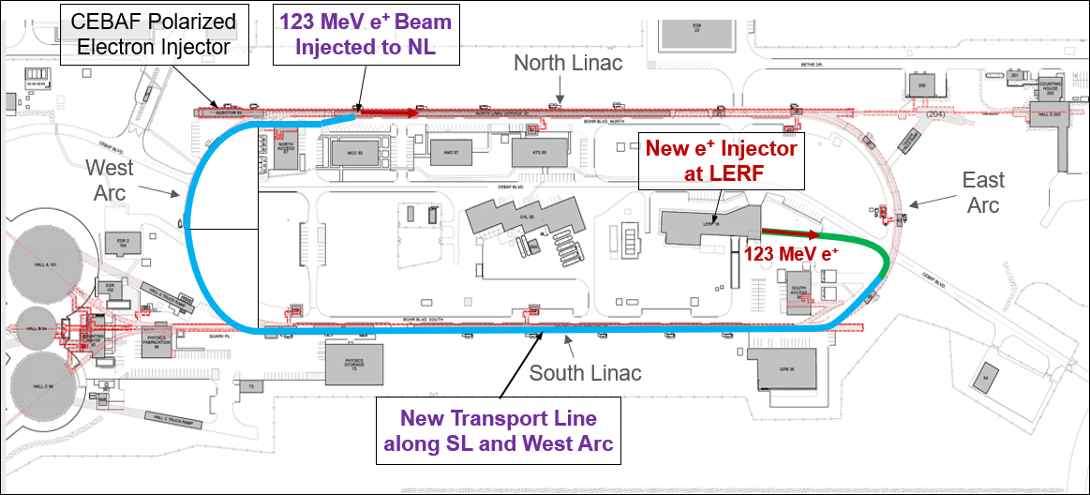
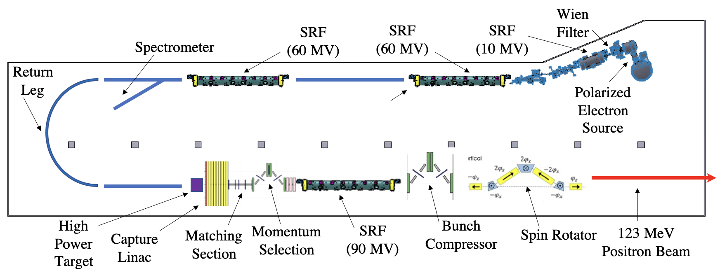
CEBAF e+ and 22 GeV accelerator design
Design of Ce⁺BAF injector and critical risk areas
Plan to test two prototype targets at LERF
  Rotating solid tungsten (JLab/ODU) and liquid GaInSn (Xelera SBIR Phase 2)
LDRD for high current photogun at GTS & Beam Degrader
  Aim for 10 mA @ 10 MeV, up to 90% polarization, long lifetime
  Degrade e- beam to mimic larger emittance e+ beam
Positron generation and capture simulations
  Integrated optimized design is emerging
GaInSn and Tungsten Targets
Polarized e⁻ Source
Beam Degrader

Slide 9
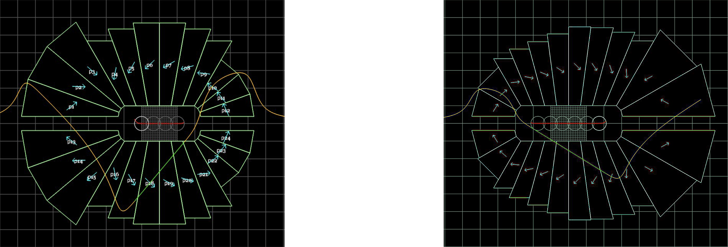
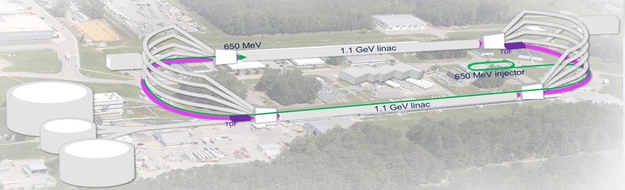
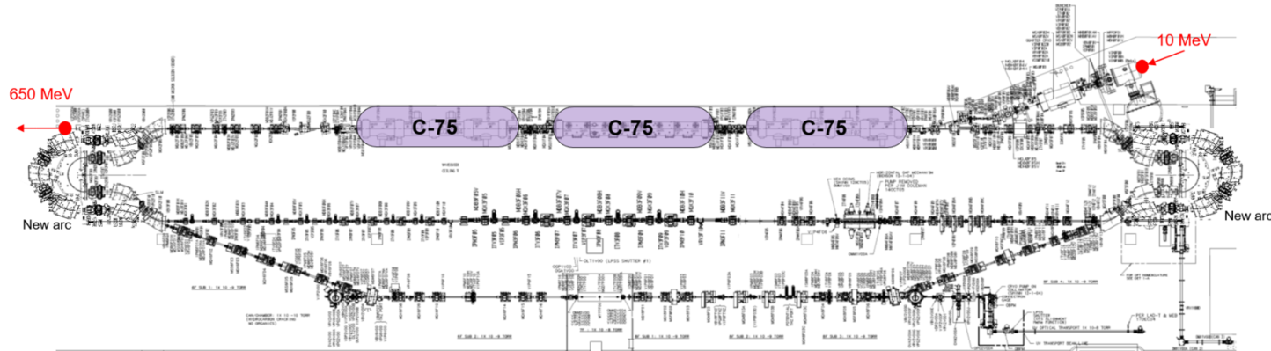
CEBAF e+ and 22 GeV accelerator design
Increase the energy without additional RF
Increase the number of recirculation passes with Fixed Field Accelerator (FFA) technology
  Remove the highest recirculation pass (Arc 9 & A) and replace them with two compact FFA arcs
  Include time-of-flight (TOF) Splitter bend systems.
  New 650 MeV recirculating injector
Permanent Magnets for FFA arcs
Focusing Magnet BF
Defocusing Magnet BD
FFA arc
FFA arc
650 MeV Recirculating Injector
S. Brooks

Slide 10
Things we didn’t talk about at the All-Hands…
Schedule – available online, no surprises at the moment
Two more weeks of running this year!
Future budgets, and therefore run weeks, uncertain
Other future plans
SoLID remains a laboratory priority, difficult funding times
”BDX and Beyond” workshop coming up – potential new facility behind Hall A?
MPGD Center
CLAS12 High lumi, K_long, hypernuclear,… (planned program)
Assume Kim, David, Johnathon talked about new Director, budgets, contract, user email changes

Slide 11
More Physics Division specific topics to discuss
We will be reporting now to DOE Research (maybe starting in FY26 sometime) time from run to publication experiment by experiment, developing a dashboard for tracking publications, etc. A DOE review recommendation
Information requested in ERR – track against this for progress
Understand that some experiments take longer than others to analyze
Joint/bridge positions
Not anticipating cuts in experiment, but we don’t know the budget
Must have operational responsibilities and time at the laboratory
We do support some phenomenology within theory (JPAC, JAM, CJ, 3D)
But, don’t let me decide… what would you all like to talk about?

