Slide 1
Welcome and News from Jefferson Laboratory
David J. Dean
Deputy Director for Science and Technology
Presented To:
JLUO Annual Meeting at Jefferson Lab
June 24, 2025

Slide 2

Outline…
Updates
Science
Future

Slide 3
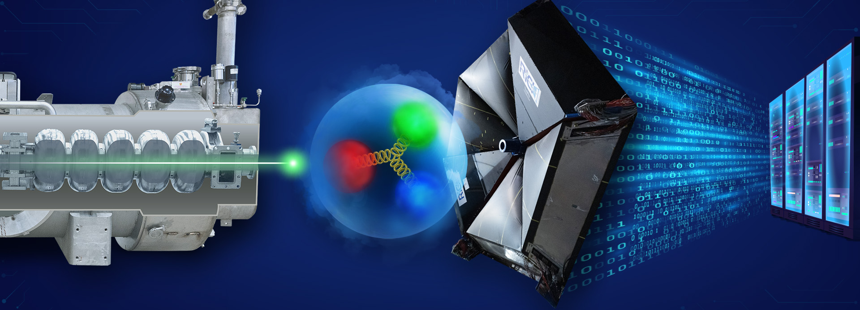
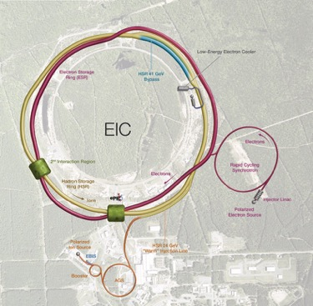
Graphic artist interpretation Jefferson Lab
Accelerator Science & Technology
Data and Computational Science & HPDF
Deliver accelerator component production for DOE construction projects across the National Lab complex: LCLS-II HE; SNS-PPU; LCLS refurb; cold-box refurbs
Develop CEBAF upgrade concepts for positrons and 22 GeV upgrades
Perform R&D in accelerator, detectors and applications in nuclear imaging and medicine
Plan and execute the High Performance Data Facility Project. $300-500M with BNL; Excellent leadership in Kate Mace
Develop and execute an AI/ML strategic plan and investments
Opens the door to other areas of science in partnership. HPDF will be a data and AI/ML capability
Utilize L-QCD and accelerator control using AI/ML implementations
Nuclear Physics at CEBAF
Foster a vibrant nuclear physics research program at CEBAF with optimal 34 weeks/yr supporting ~1,650 annual users
Moller CD-2/3 in May 2024; Executing the MOLLER Project
Develop future scientific opportunities complementary to EIC (CEBAF upgrades)
Pursue SoLID as the next major Detector
Execute theory and computation supporting NP/HEP goals

Slide 4
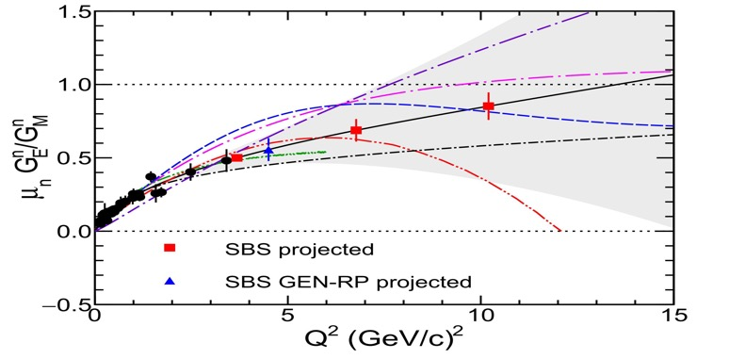
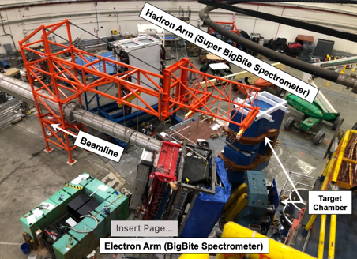
Nuclear Physics Questions:
‘How big is the proton?’
Form factors at highest Q² measured to date
Electric and magnetic form factor measurements give distribution of charges and currents inside the proton.
Differing approaches to QCD calculations predict different behavior at high momentum transfer Q
Years of effort to build the spectrometer and targets.
This experiment is very high priority and is the last one in Hall A before MOLLER Installation

Slide 5
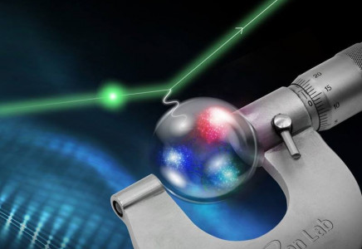
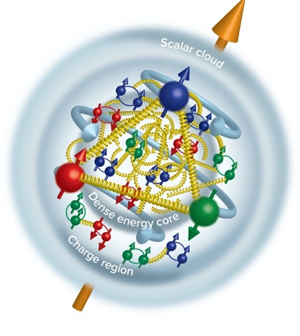
Nuclear Physics Questions:
‘How big is the proton?’
Proton Radius Measurements: 0.831+/-0.014 fm
    Xiong et al.,Nature 575, 147 (2019)
Duran et al “Determining the gluonic gravitational form factors of the proton," Duran et al, Nature 615, 813 (2023)
‘Inner gluon Rms’: 0.52 +/-0.03 fm
Future ‘PRad-II’ experiment will yield a 2.5x more precision: confirm the smaller radius

Slide 6
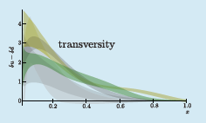
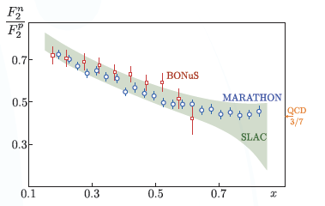
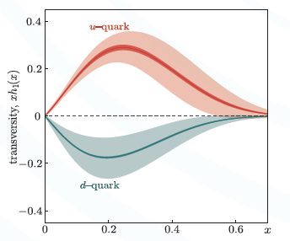
Nuclear Physics Questions:
‘How are quarks distributed in the proton?’
Phys. Rev. Lett. 128, 132003 (2022)
Example of a SoLID SIDIS measurement: huge error improvement (GPD)

Slide 7
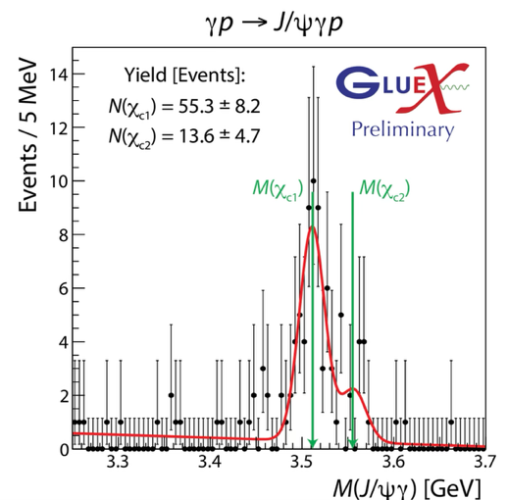
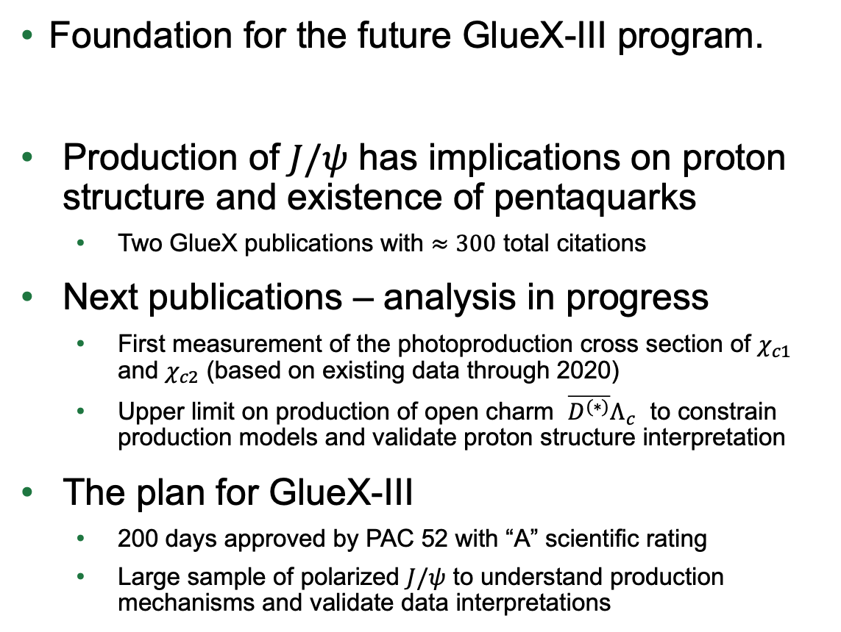
Nuclear Physics Questions:
What is the Spectrum of excited hadrons?
Charmonium production in Hall D
Foundation for the future GlueX-III program.
Production of $J/ψ$ has implications on proton structure and existence of pentaquarks
  Two GlueX publications with $≈300$ total citations
Next publications – analysis in progress
  First measurement of the photoproduction cross section of $χ_{c1}$ and $χ_{c2}$ (based on existing data through 2020)
  Upper limit on production of open charm $\overline{D^{(∗)}}Λ_{c}$ to constrain production models and validate proton structure interpretation
The plan for GlueX-III
  200 days approved by PAC 52 with “A” scientific rating
  Large sample of polarized $J/ψ$ to understand production mechanisms and validate data interpretations

Slide 8
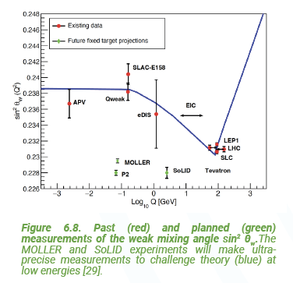
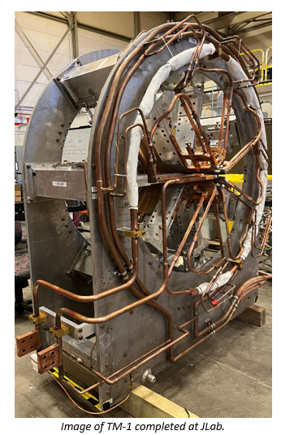
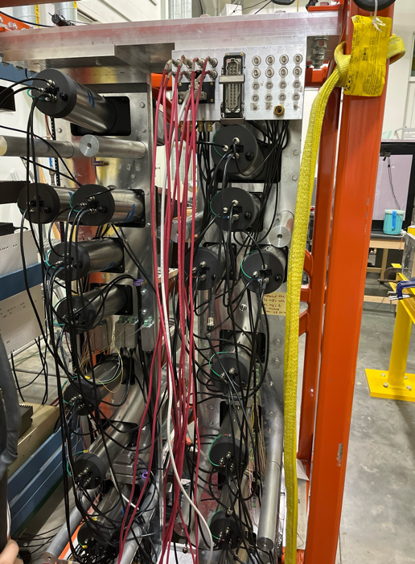
Nuclear Physics Questions:
Can NP techniques be used to for precision tests the Standard Model?
MOLLER probes BSM in the multi TeV range through Parity Violation
Construction and assembly continues

Slide 9
DOE and TJNAF Mission (FY25)
NP Operations Budget:
  Funding to operate CEBAF for 22 weeks of beam at 80% reliability (optimal is ~33 weeks)
  To maintain our core competencies: NP R&D, Accelerator S&T, User Facility
ASCR Budget
  HPDF: FY25 is unknown (we have received no FY25 funds; requesting $7M OPC)
  Corresponding R&D programs must get started (in partnership, e.g., PEMP language)
NP Research Budgets:
  Competitive with the Nation (Medium Energy Experiment and Theory)
  Competing for ‘NOFO’ funding
  Budget is being optimized to perform high-priority research as NP funding is constrained
NP Project Budgets:
  MOLLER – Fully funded; must maintain SPI > 0.9
  EIC; CD-3A scope, CD-3B to be approved; Funding for full CD-2/3 is an issue; move to sub-projects is an issue; cost is an issue
SLI Program
  Delegated CRE project (construction)

Slide 10
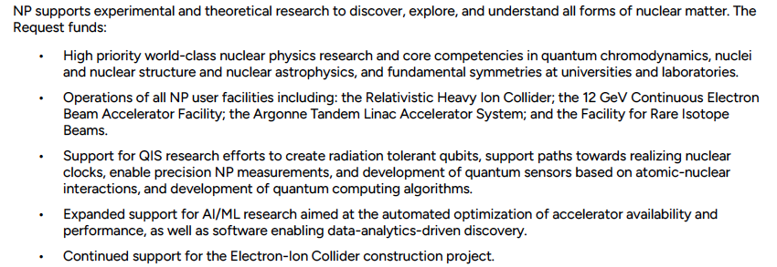
Working Through FY25 and FY26 uncertainties
FY25 provides 22 weeks of operations of CEBAF; sparse data on FY26
https://www.energy.gov/cfo/articles/fy-2026-budget-justification

Slide 11
The Federal Budget: DOE NP Program
Inflation Data https://www.bls.gov/data/inflation_calculator.htm

Slide 12
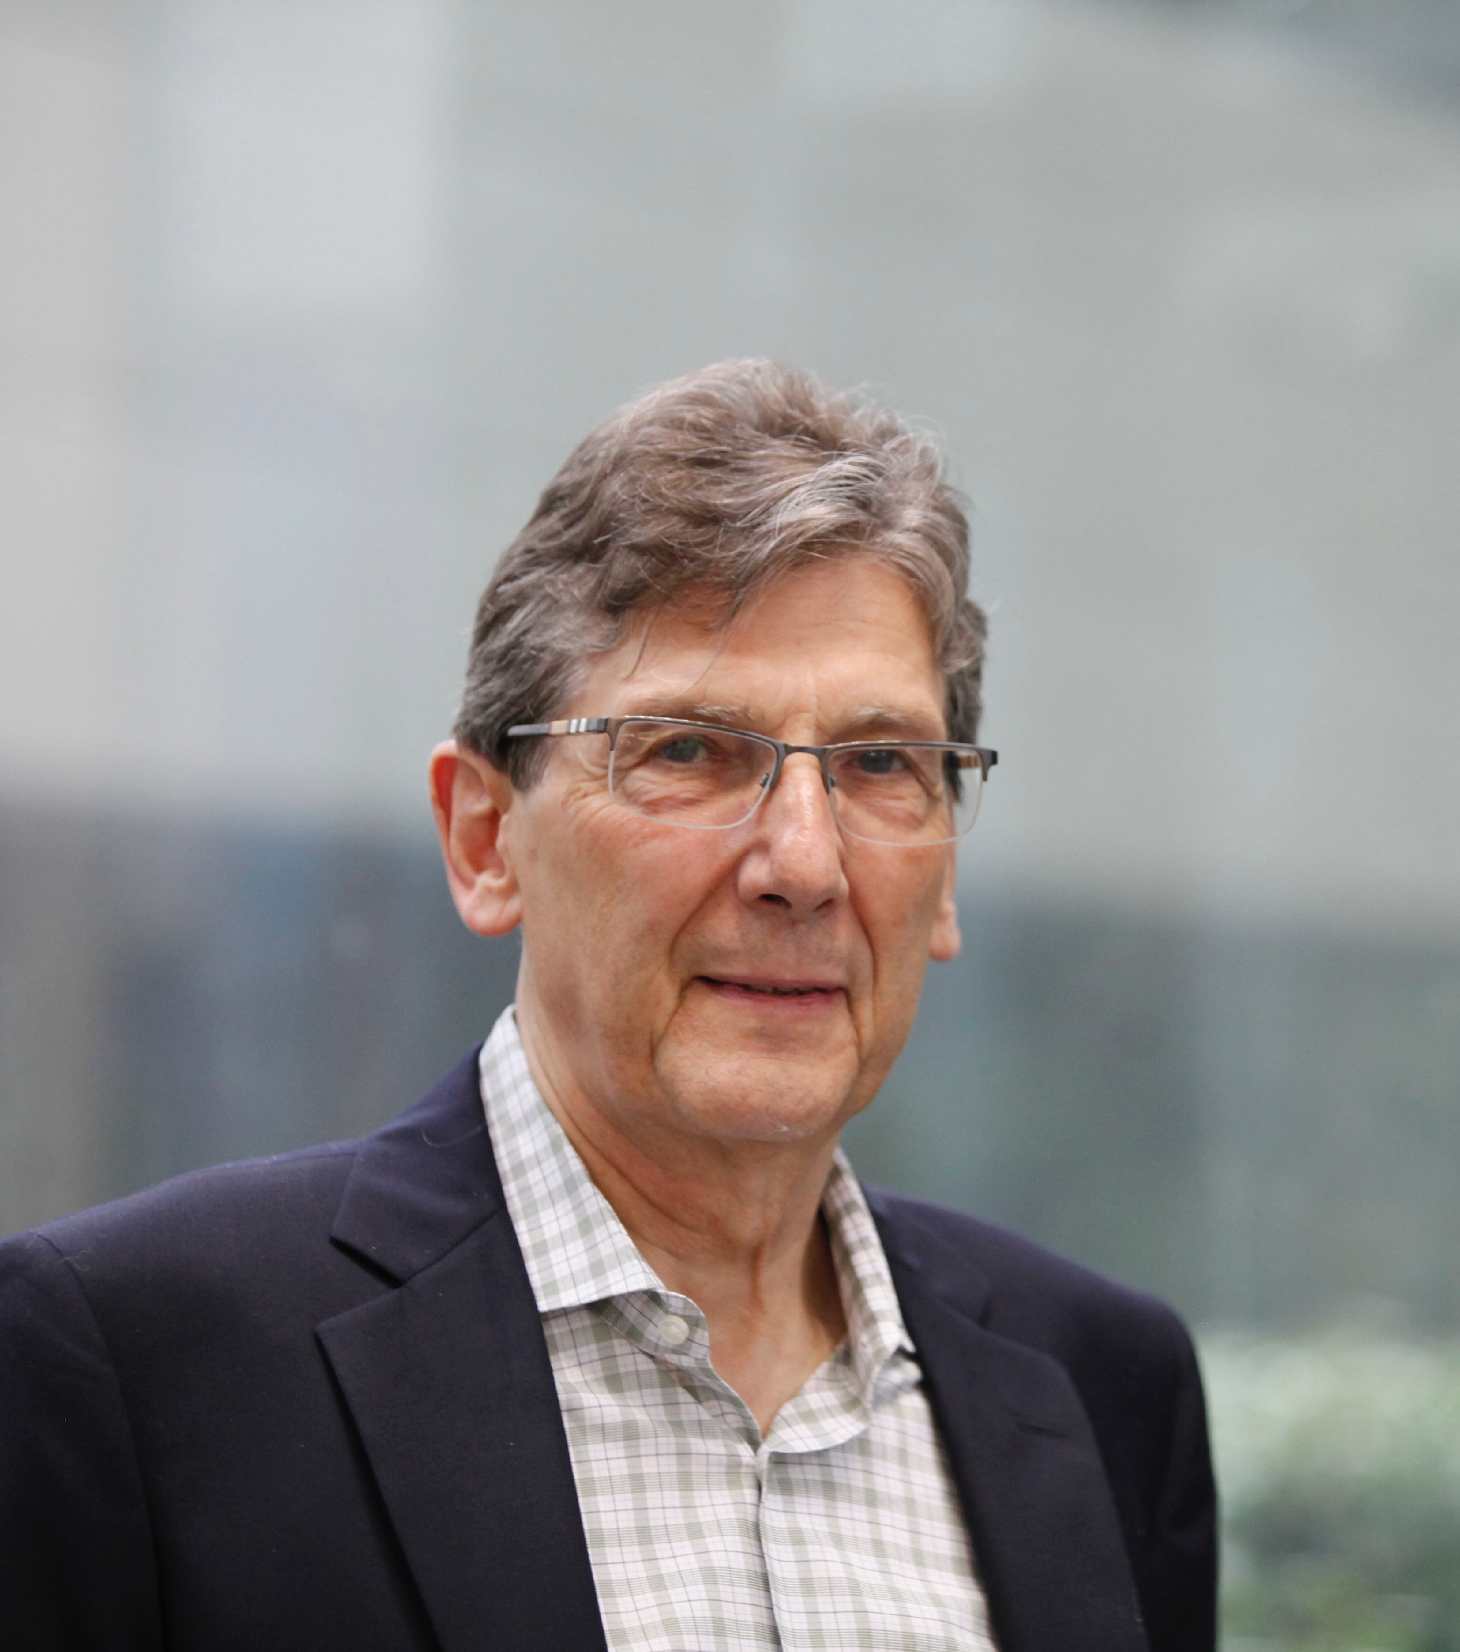
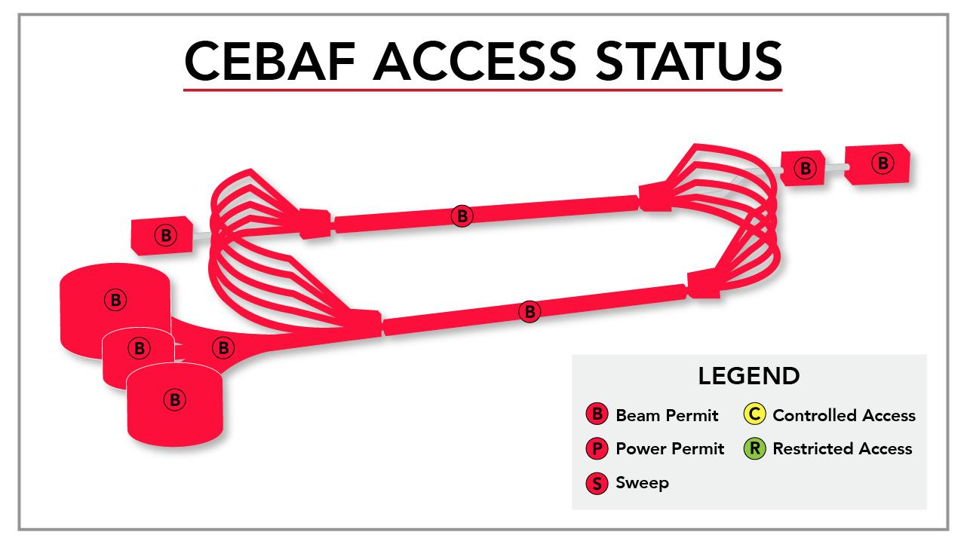
Mid Year Performance Evaluation Highlights (Goals 1-3)
8 high-impact publications (PRL and above); 19 additional publications in NP specific journals with high impact
2 patents
Maintenance of the core capability in SRF technology
Major APS award: Bonner Prize (Volker Burkert); four new APS fellows
135 invited talks at international conferences and workshops (38 of these organized by staff)
Highly rated experiments running in all four halls
Significant staff involvement in reviews for DOE and other agencies
Through June 15: CEBAF Reliability at 81.7%

Slide 13

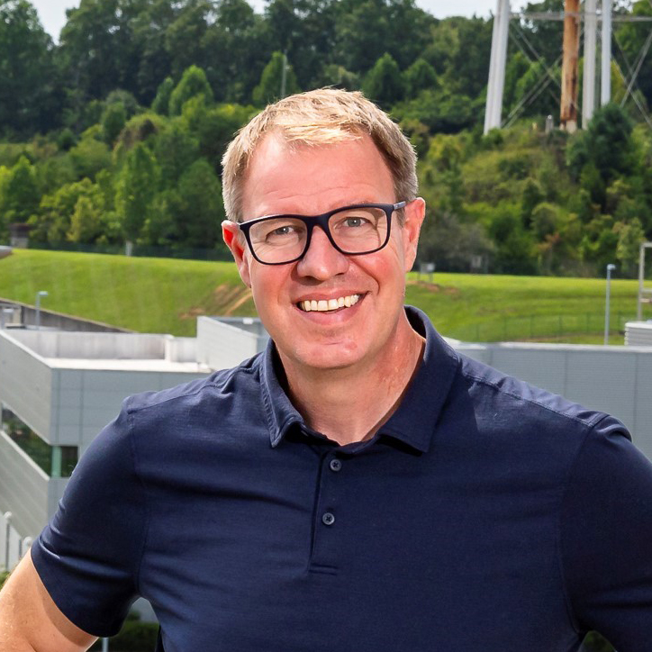
WELCOME
JEFFERSON LAB’S NEW DIRECTOR
Jens Dilling
Currently at: Oak Ridge National Laboratory, ALD Neutron Sciences,
leading the HFIR research reactor and the Spallation Neutron Source (SNS)
science portfolio
Previously at: ORNL, Director of Institutional Strategy Planning
TRIUMF, ALD Physical Sciences
Education: Atomic and Nuclear Physics B.S. & Ph.D.,
University of Heidelberg, Germany
Honors: American Physical Society Fellow
APS Francis M. Pipkin Award
CAP-TRIUMF Vogt Metal, Canadian Association of Physicists
FAIR-GENCO Scientific Achievement Award
Rutherford Memorial Medal, Royal Society of Canada
DOE Oppenheimer Leadership Fellow
Joint Appointment: Duke University
Start Date:
June 30, 2025

Slide 14

Discussion

