Slide 1

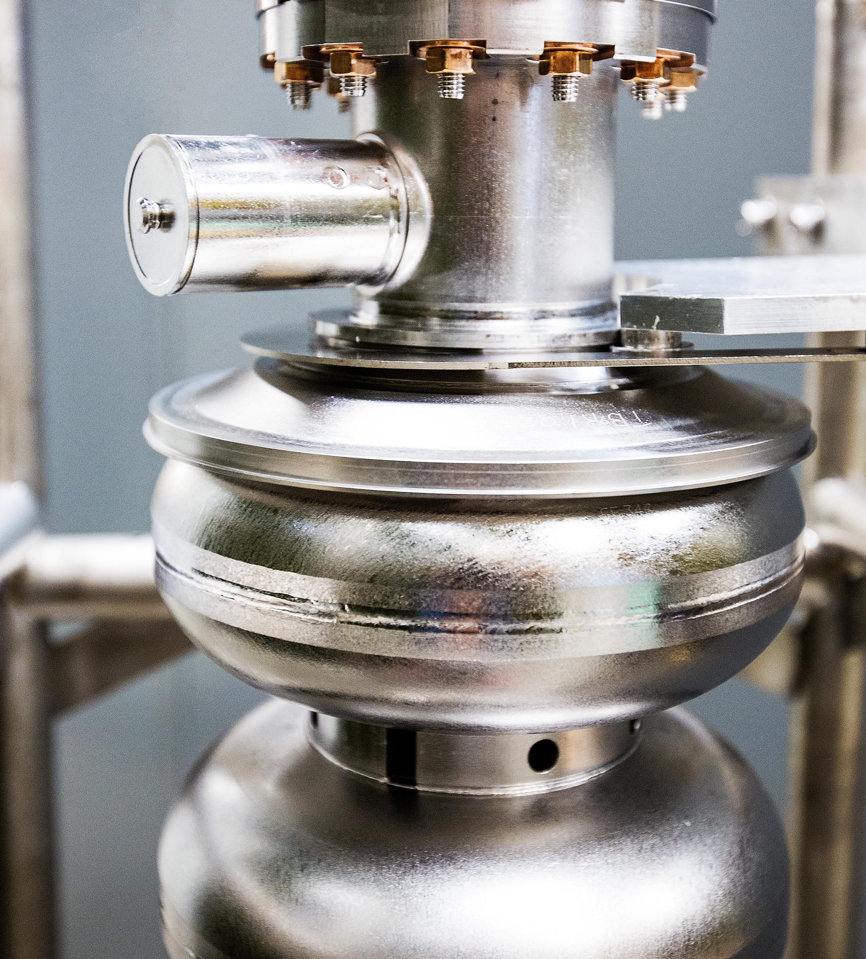



Jefferson Lab Status
Presented to: JLUO Board
Kimberly Sawyer, Lab Director
Thomas Jefferson National Accelerator Facility
June 23, 2025
Notes:
Let me introduce myself, I am Kim Sawyer, the new Director of Jefferson Lab. I am excited to meet with you today. Ultimately, our user community is what Jefferson Lab is all about - collaboration, cooperation, and innovation across institutions, across state and national boundaries – to deliver the best science in our field in a safe and efficient way.

Slide 2

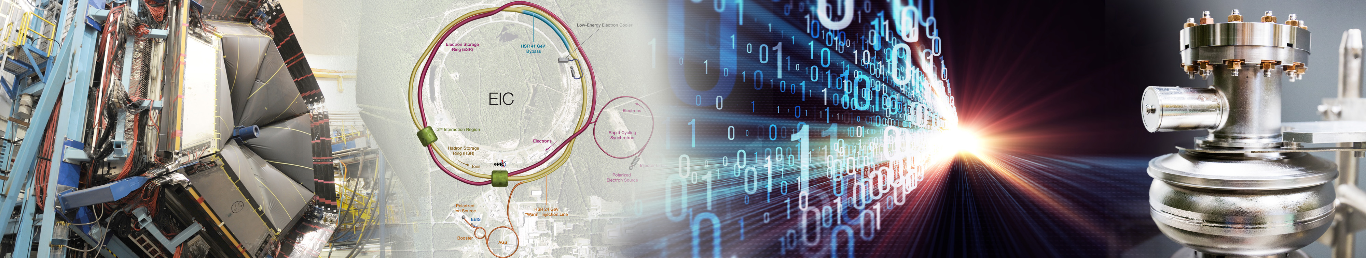
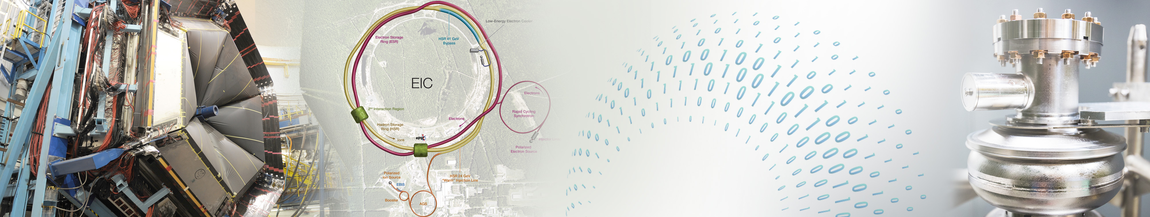











Jefferson Lab's Science and Technology Vision
The future S&T Vision builds upon our present strengths, founded on four pillars:
Nuclear Physics at CEBAF
Electron-Ion Collider Project
HPDF
World-leading Data Facility
Superconducting Radio Frequency Accelerator S&T
User Community
Partnerships and collaborations are imperative to achieve our vision​

Slide 3
DOE Updates
Budget
Secretary Wright Messages
  FY 25 NP Budget
  Theory Budget Cut
  HPDF FY25 Funding
  DOE President Budget Request FY26
  Committed to the National Laboratories
  Top three priorities: AI, Quantum and Fusion
  AI program focus: Science, Energy, Security
  Lab’s impact and stories are necessary
  Focus will be modernizing technology and regulatory reform
  DOGE is not coming after head count

Slide 4
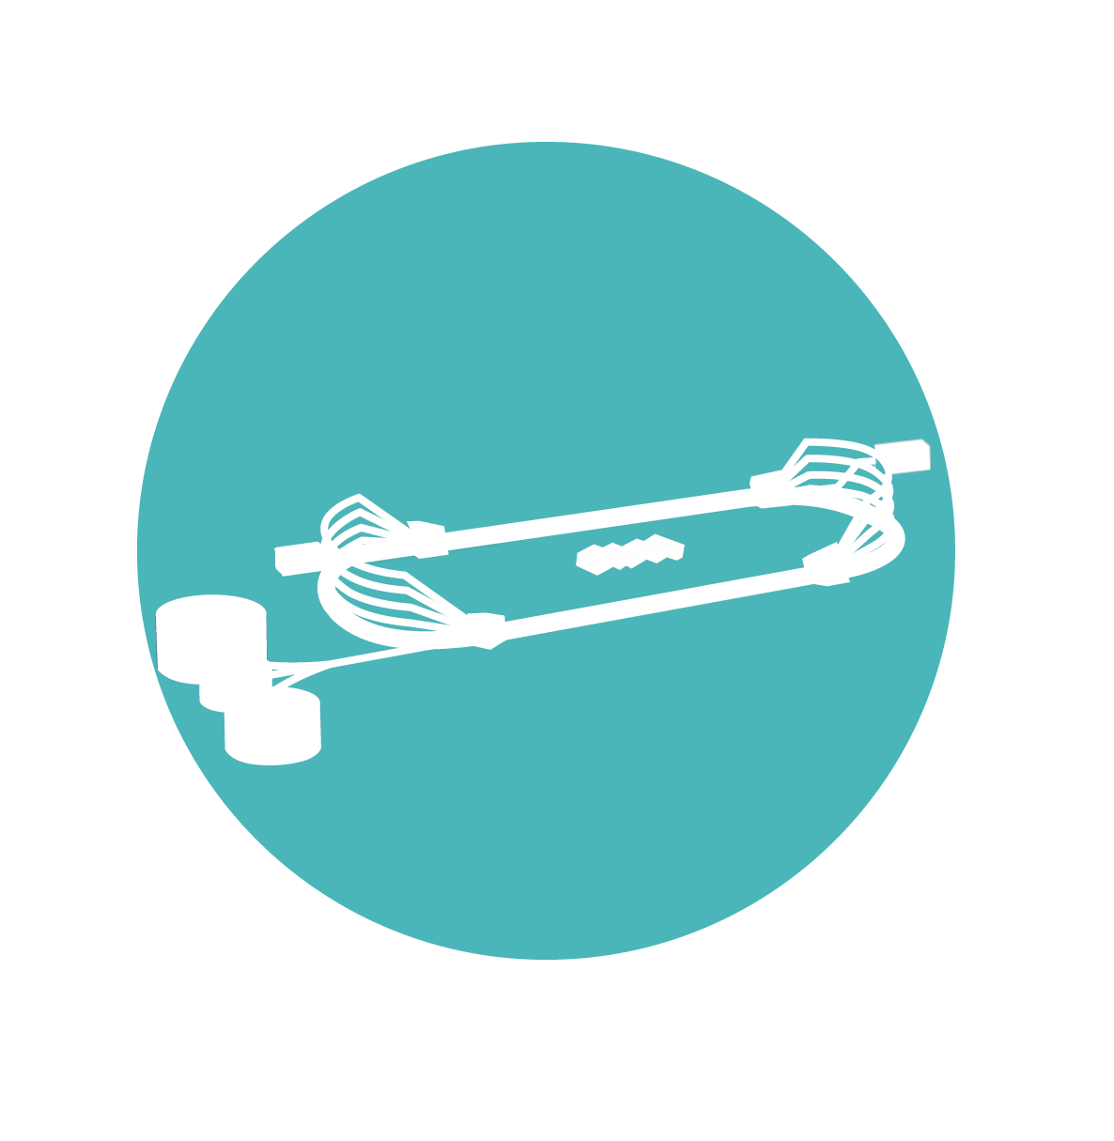
S&T Updates
Accelerator & Physics Experiments
  CEBAF is funded to run 22 weeks, 3,000 hours at 80% reliability
  - Current reliability is 81.5%
  Nuclear Physics experiments in Halls A, B, C and D are operational
Visits & Reviews
  Accelerator Readiness Review for 420.2D (May 20-22)
  Technical Review of CEBAF Restart Delay (May 13-14)
  CEBAF Associate Laboratory Director position reposted
AI Strategy
  AI Strategy complete
  - AI Jam with AWS, Google, ChatGPT and Anthropic
  Copilot and ChatGPT approved for use cases – reducing training hours
  AI Apprenticeship program put on hold due to JLDC priority

Slide 5
Technical Review of CEBAF Restart Delay
Key Findings
Recommendation
  Strengthen risk mitigation and develop criteria for cryomodule performance
  Implement formal work planning and progress tracking
  Empower a single project manager responsible for SAM planning and execution
  Develop a comprehensive Configuration Management Program
1. Technical Assessment
  Improper valve configuration led to degradation of the superconducting cavity
  Magnet mis-wiring issue resolved within expected timeframe
  Aging instrumentation and timing systems limit real-time corrections
  Transformer failures due to design flaws caused delays
2. Operational Challenges
  Inconsistent implementation of work planning processes
  High personnel turnover and lack of qualified individuals
  Safety stan down and LOTO pauses extended the restart period
3. Project Management
  Communication gaps and unclear planning
  Need for formal progress tracking and metrics
  High turnover and staffing shortages affected readiness
4. Root Cause Analysis
  Ineffective corrective actions for recurring issues
  Administrative pauses and staffing shortages delayed readiness
  Vendor-caused transformer failures

Slide 6

Change Management Update
Jefferson Lab, like many organizations, is in a fast-evolving environment with multiple sources of change.
Not a one-time event – in the future we are going to be operating in an environment of greater change and uncertainty.
Change doesn’t have to be scary; can create exciting opportunities for us to advance our mission.
Having a common language and a better way to lead change enables us to better navigate uncertainties and take advantage of opportunities.

Slide 7
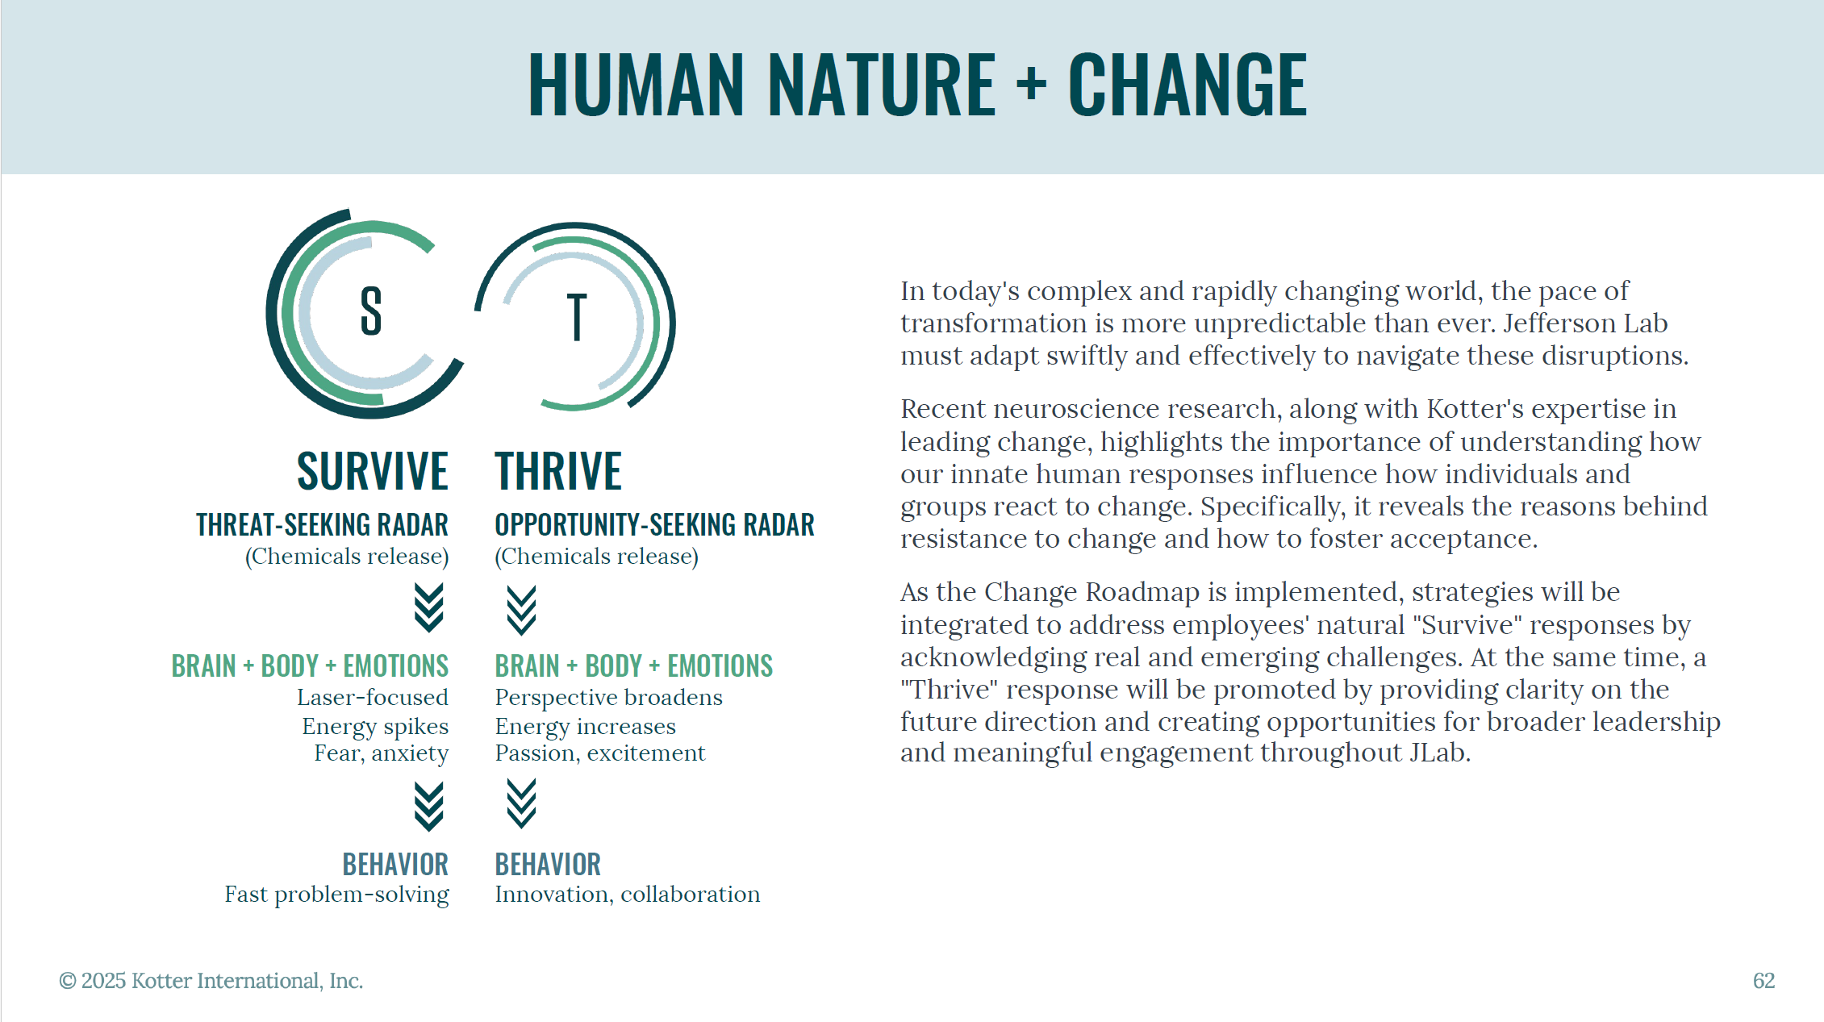

Slide 8

Voice of the Lab
More communication is desired around the “Why” behind changes at the lab. Broader forums are appreciated but some feel the messages are not consistently cascading through the lab. |  | Jefferson Lab’s “Shaping Our Future” statement answers the “Why this” and “Why now” questions, while providing full alignment among leadership, staff and users on what is necessary to adapt to a rapidly changing world.
There is a strong and exciting connection to the mission, however transitioning to a multipurpose laboratory raises questions for many in terms of resource balancing and focus. |  | It also provides the common language necessary to effectively communicate with all audiences quickly and clearly, rallying everyone under a common goal (e.g. from a single to a multipurpose mission.)
Some feel frequent changes without early input from key SME personnel negatively impact employee morale, resulting in fatigue, anxiety and a loss of the prized lab culture. |  | Engagement of all stakeholders (staff, users, government officials) across Jefferson Lab creates buy-in. The Urgency Team and Guiding Coalition form the mechanism to move efforts from “Have to” to “Want to.”
The sentiment is that despite hurdles and ineffective implementation, the lab figures out ways to make things work. The ePAS rollout, Pcard policy change, safety oversight and policy changes were some of the less-than-ideal implementation mentioned. |  | Enabling cross-functional teams creates a bridge between silos in the hierarchy and nimble teams that focus on addressing strategic initiatives. The Guiding Coalition ensures alignment, oversight and continuity.
Leadership &
Messaging
Identity &
Mission
EMPLOYEE & USER FEEDBACK
ROADMAP ACTIVITIES
Employee
Morale
Implementation
Success

Slide 9
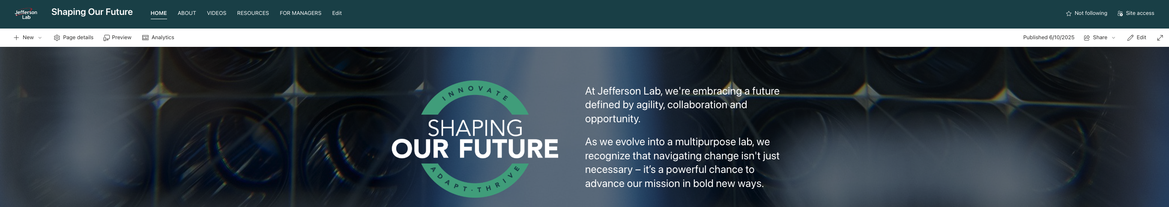
Keeping the momentum
Pivot: Design an alternate path for continuing with change management without Kotter support
  Created an Integrated Change Management framework (Kotter, Prosci, Gartner)
  Developed a Shaping Our Future SharePoint site
    Resource hub with leadership testimonials, change materials, FAQs, templates & worksheets
  Designed multiple turnkey products for use: ex. “Managing Change Guide,” white paper, change poster, process placemat, infographics
Next Steps:
  Change management update/message to leaders and workforce
  Launch the Shaping Our Future SharePoint site
  Lab Leadership begins work on defining change initiatives in their organizations
  Bring Incoming Director Jens Dilling up-to-speed on the change management plan and activities
  Engage Dilling (video/message/meeting) to capture his remarks on change

Slide 10
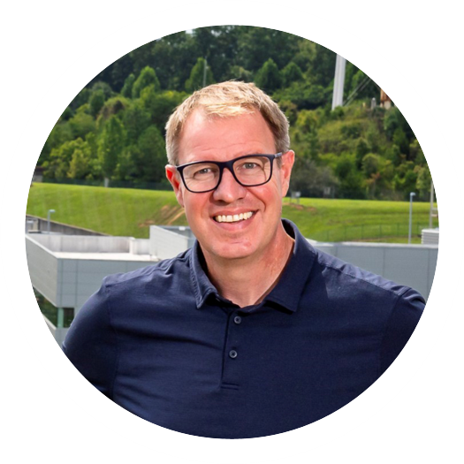
Moving Forward
New Lab Director Jens Dilling
Mission Delivery
Operational Excellence
Hire a CEBAF Associate Laboratory Director
Hold Associate Directors accountable for their operations, safety, and Lab-wide improvement
Improve communications on Accelerator outages and leverage external resources for assistance
Watch Moller project and tariff impacts
Deliver an IT strategy that includes AI
Focus on a few improvements using Change Management
Develop a dashboard to demonstrate operational improvements
Utilize AI/ML to revolutionize policies, processes and procedures
Modernize business systems with an integrated, enterprise solution

Slide 11

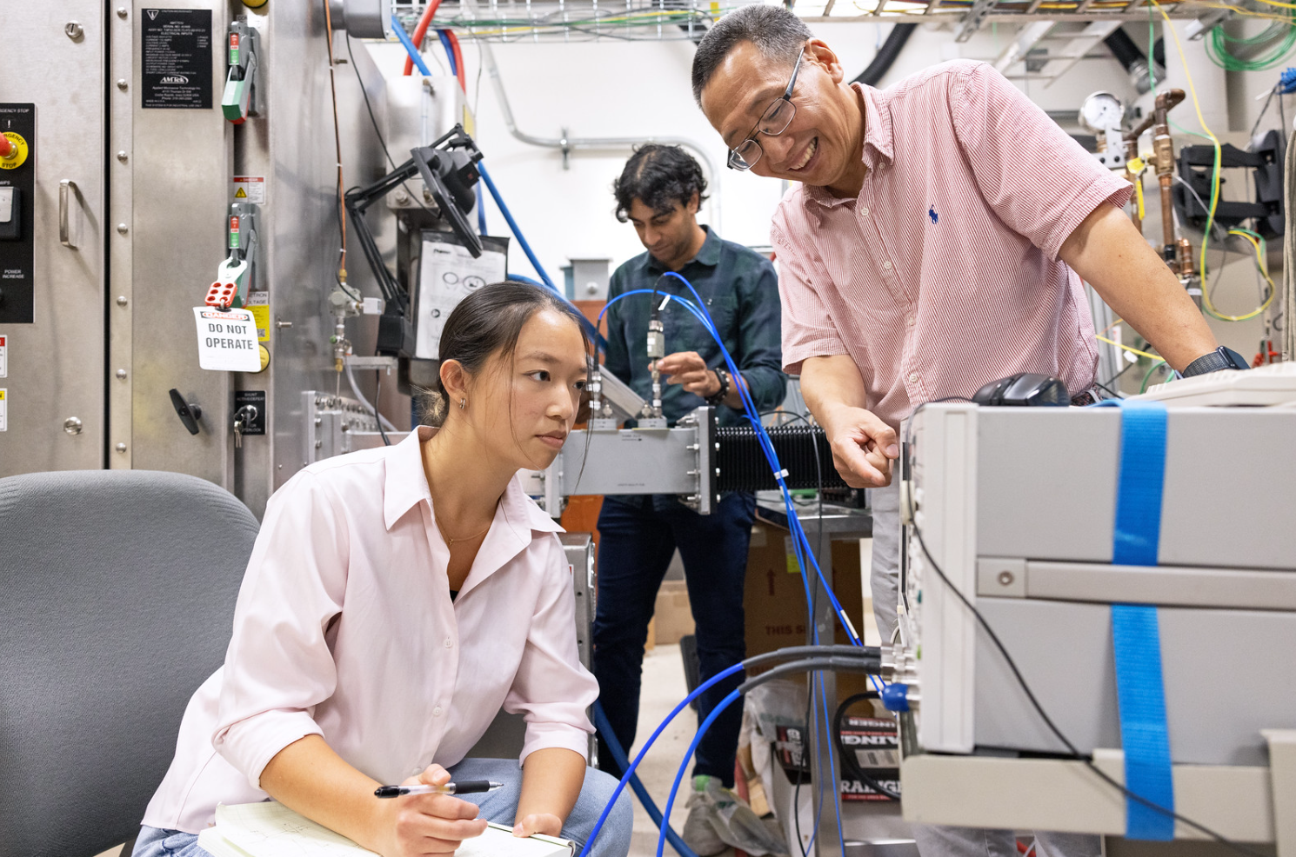
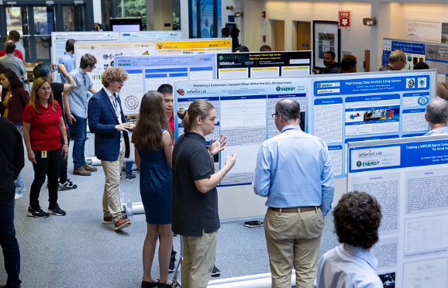
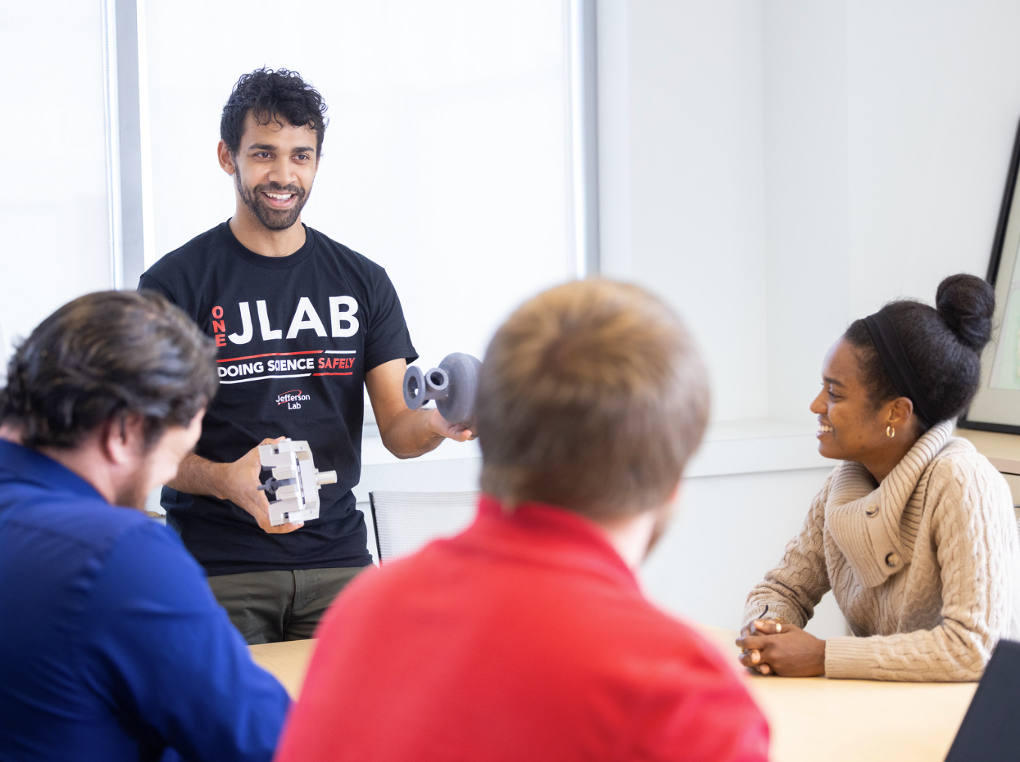
Thank you for your …
Continued enthusiasm
Engagement with Jefferson Lab and its programs
Partnership in delivering our present and ensuring our future

