Slide 1
γd → π⁻pp_{S} from CLAS (g10) data
How to proceed?
Nikolai A. Pivnyuk
National Research Center Kurchatov Institute - ITEP
(represented by Volker Burkert)
CLAS Collaboration meeting, July 8 – 12, 2025
Notes:
This presentation is based on the analysis work by Nikolai Pivnyuk of G10 photoproduction data. These results have been already described and reviewed within an analysis note. The review process was partially completed but was interrupted when the CLAS coordinating committee became involved. I cannot comment on this any further as I was not involved in the decision how this came about.

Slide 2
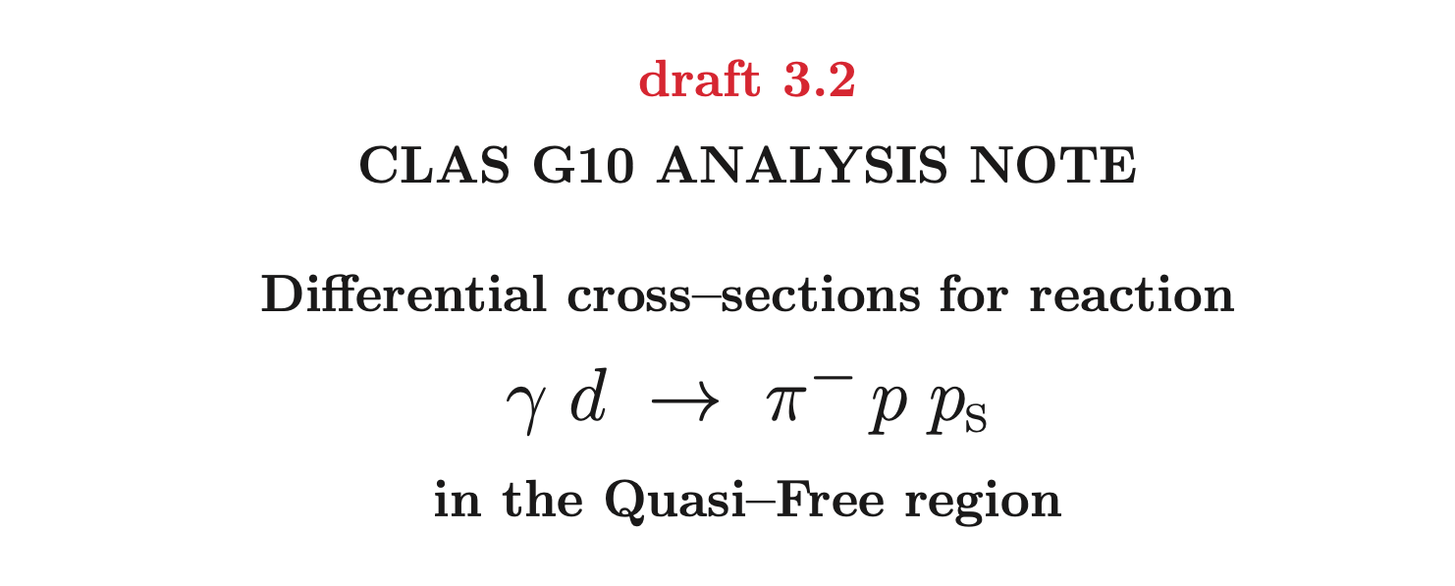
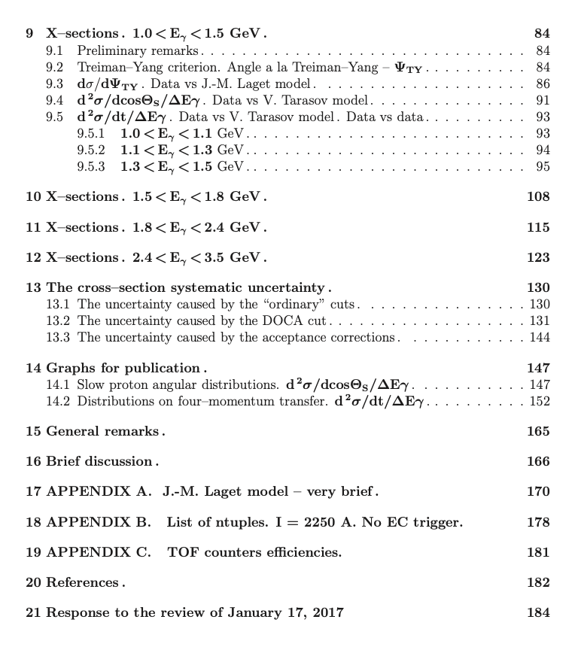
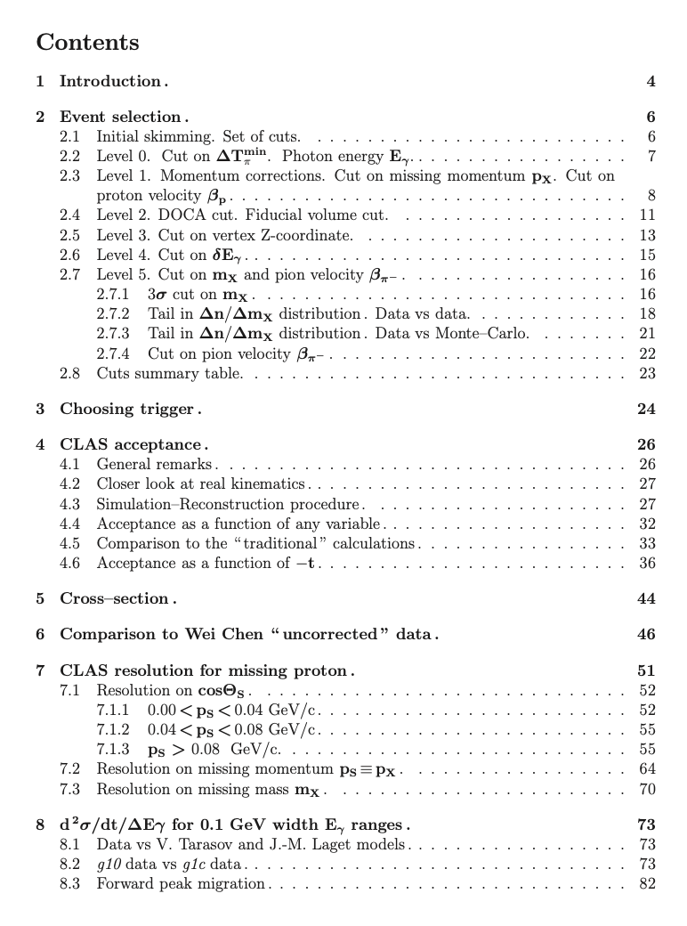
Analysis Note
Comments: This work is largely based on the analysis work by Nikolai Pivnyuk and co- workers of the G10 photo-production data. These results and procedures have already been thoroughly reviewed based on the analysis note. The review process was partially completed but ended ~June 2023 at which point the CLAS CC became involved. I cannot comment on this as I was not involved or even aware of any decision that might have been taken at that point. My involvement came from Patrick asking me if I could work with Nikolai to make progress with this project. VB.
Analysis committee: N. Baltzell, M. Bondi, M. Paolone

Slide 3
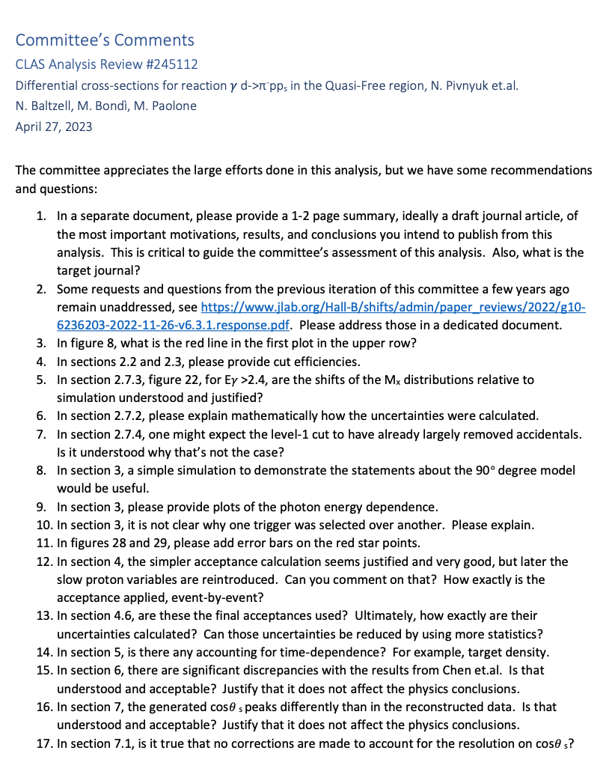
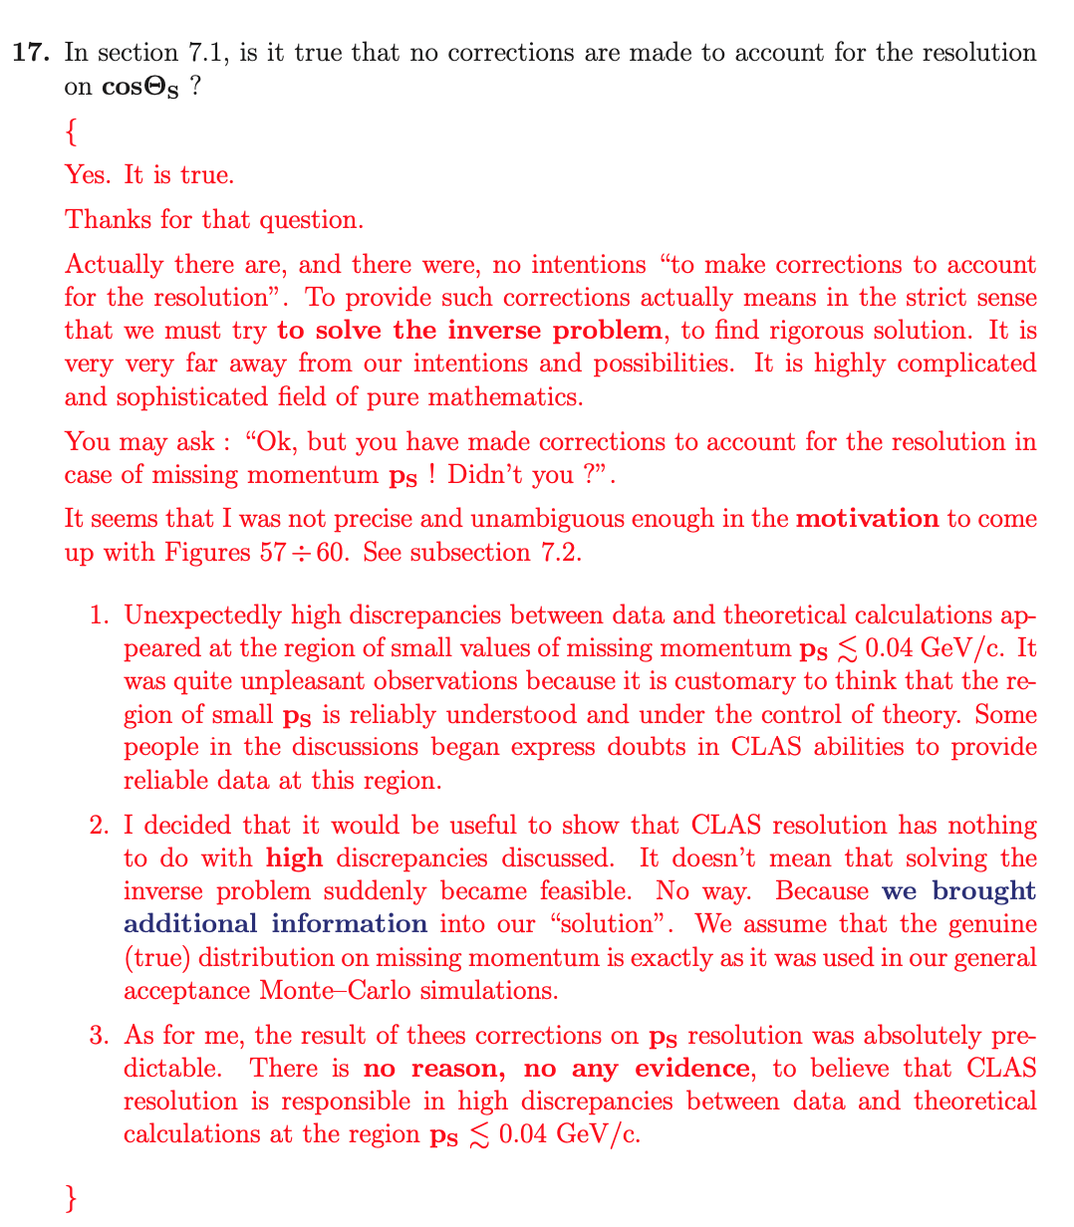
Example of last communication between committee and NP.

Slide 4
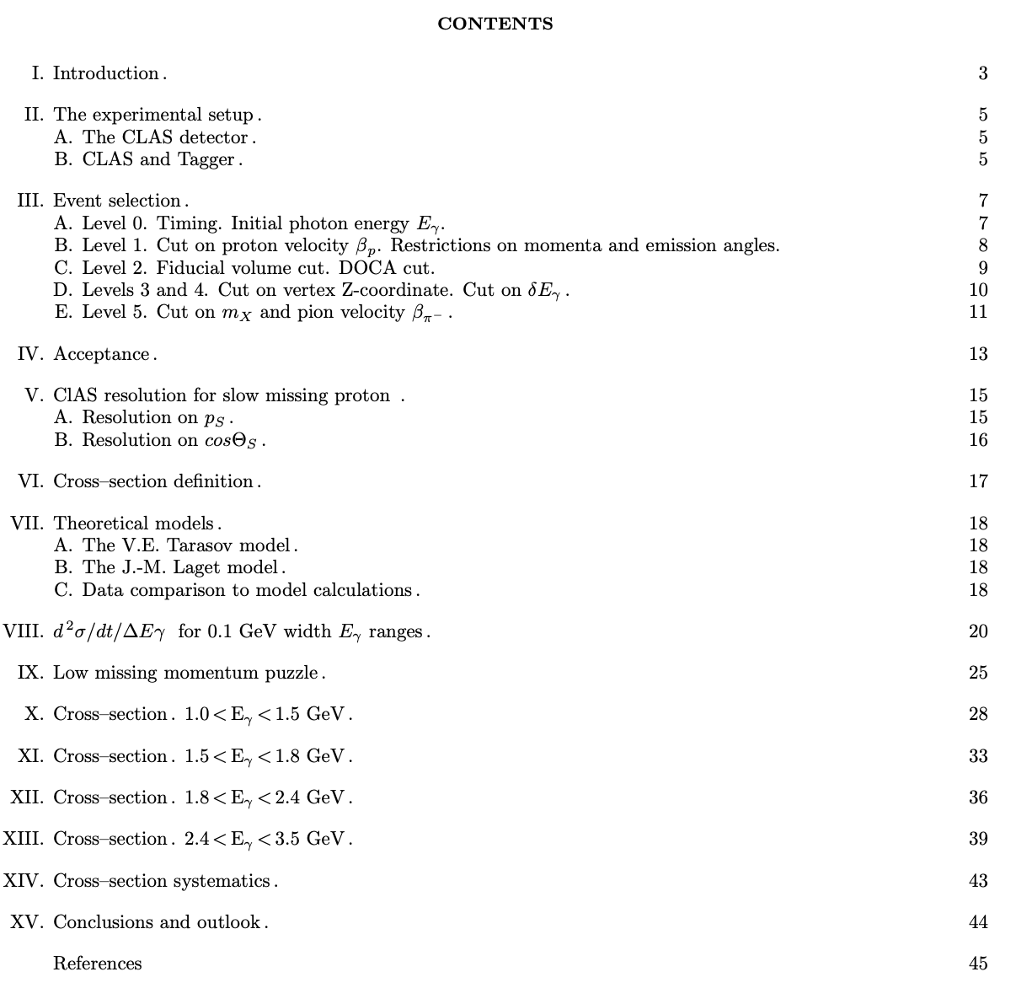
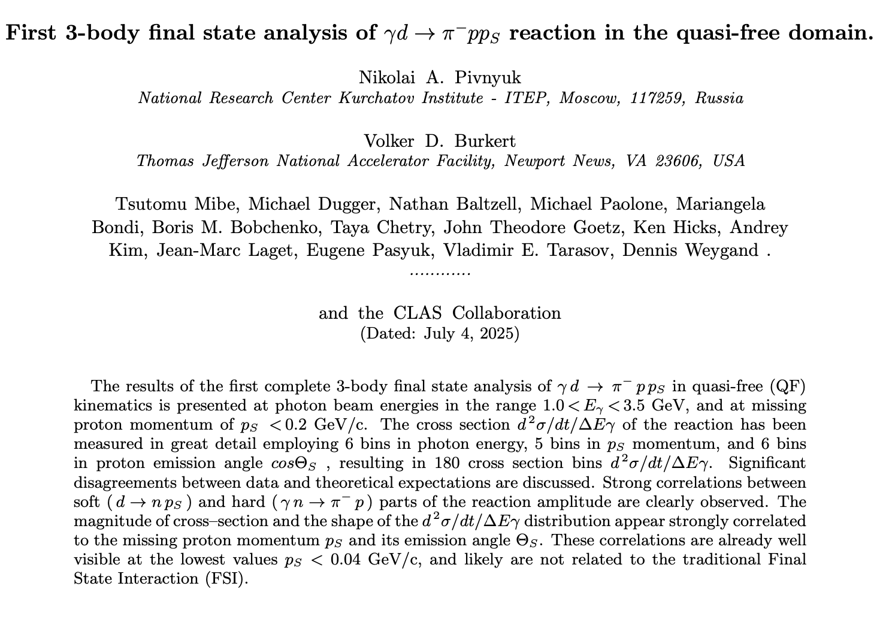
Draft article (for Physical Review C)

Slide 5
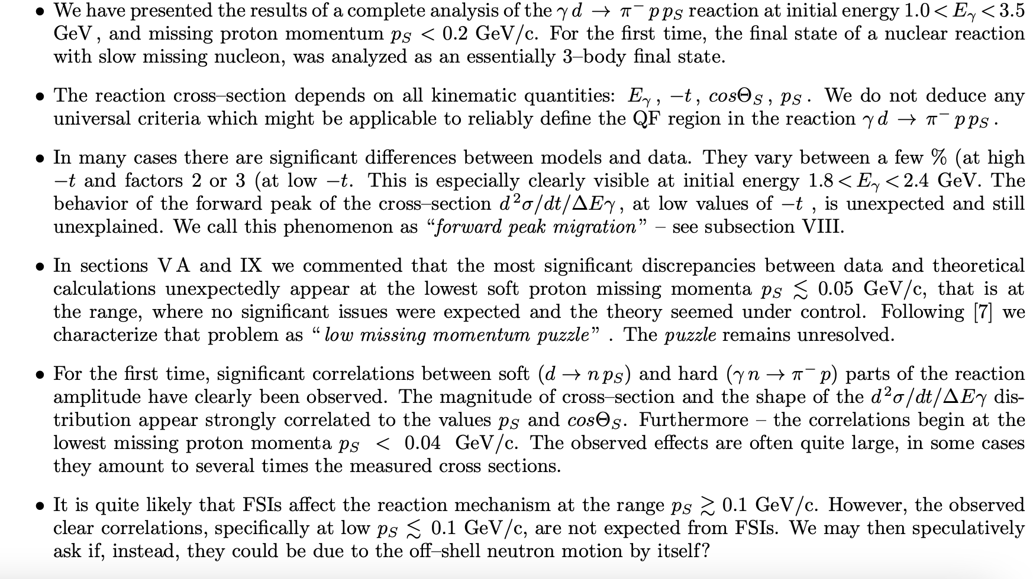
Article conclusions

Slide 6
Proposed path forward
The Nuclear Physics working group re-constitutes the latest analysis note review committee.
The committee may pick up where it had left off and refer to the last communications to Nikolai with clear questions related to the analysis note.
Nikolai (and I) will respond in appropriate time (X days/weeks) to address the questions.
The committee evaluates the response and replies in appropriate time (Y… days/weeks)
If some questions remain, we will ask for a meeting with the committee to clarify any remaining points and agree on a final timeline.
The process could be completed within the calendar year 2025, with a decision on how to proceed or not.

