Slide 1

RG-K Cascade Analysis Update
Bianca Gualtieri
CLAS Collaboration Meeting July 2025

Slide 2
Outline
Background/motivation
Event reconstruction
Background template
Yield with mixed events background
Simulations

Slide 3
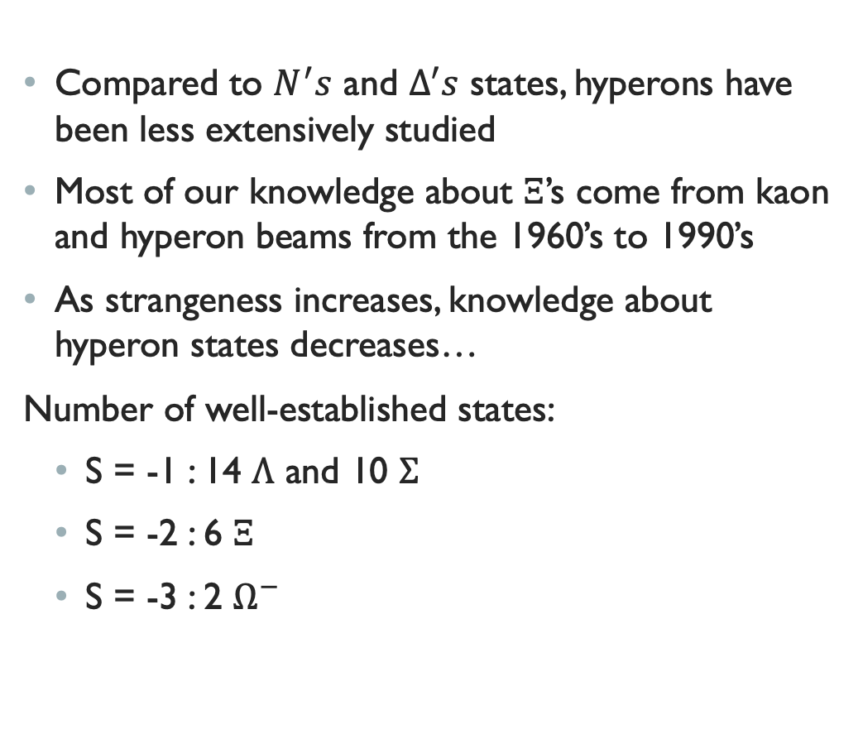
Hyperons in the Hadron Spectrum
Compared to $N^{′}s$ and $Δ^{′}s$ states, hyperons have been less extensively studied
Most of our knowledge about $Ξ$’s come from kaon and hyperon beams from the 1960’s to 1990’s
As strangeness increases, knowledge about hyperon states decreases…
Number of well-established states:
  S = -1 : 14 $Λ$ and 10 $Σ$
  S = -2 : 6 $Ξ$
  S = -3 : 2 $Ω^{−}$

Slide 4
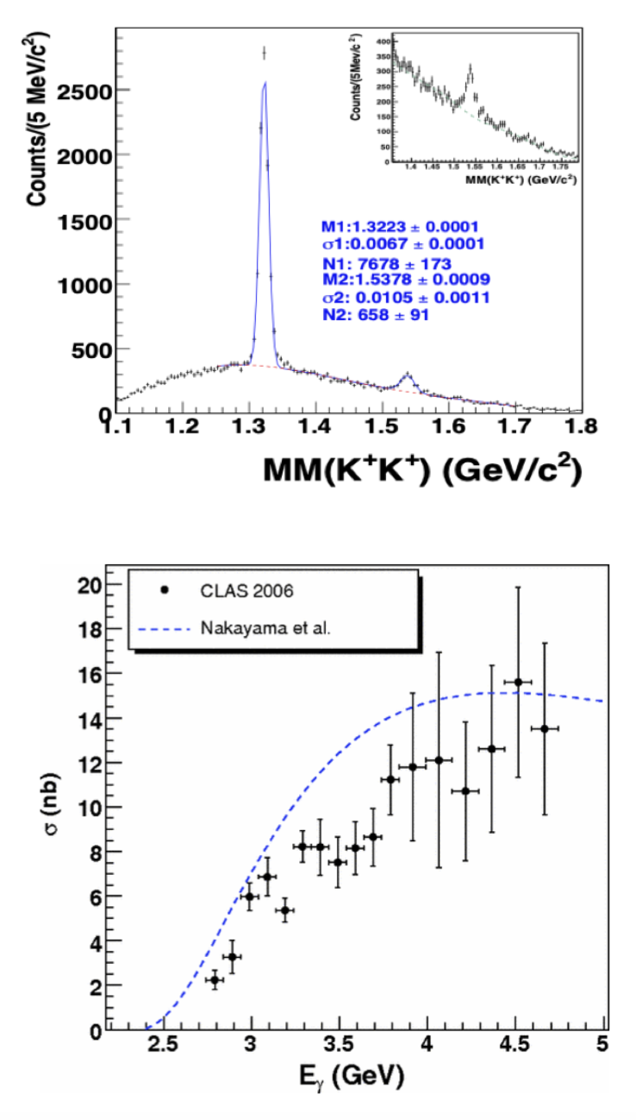
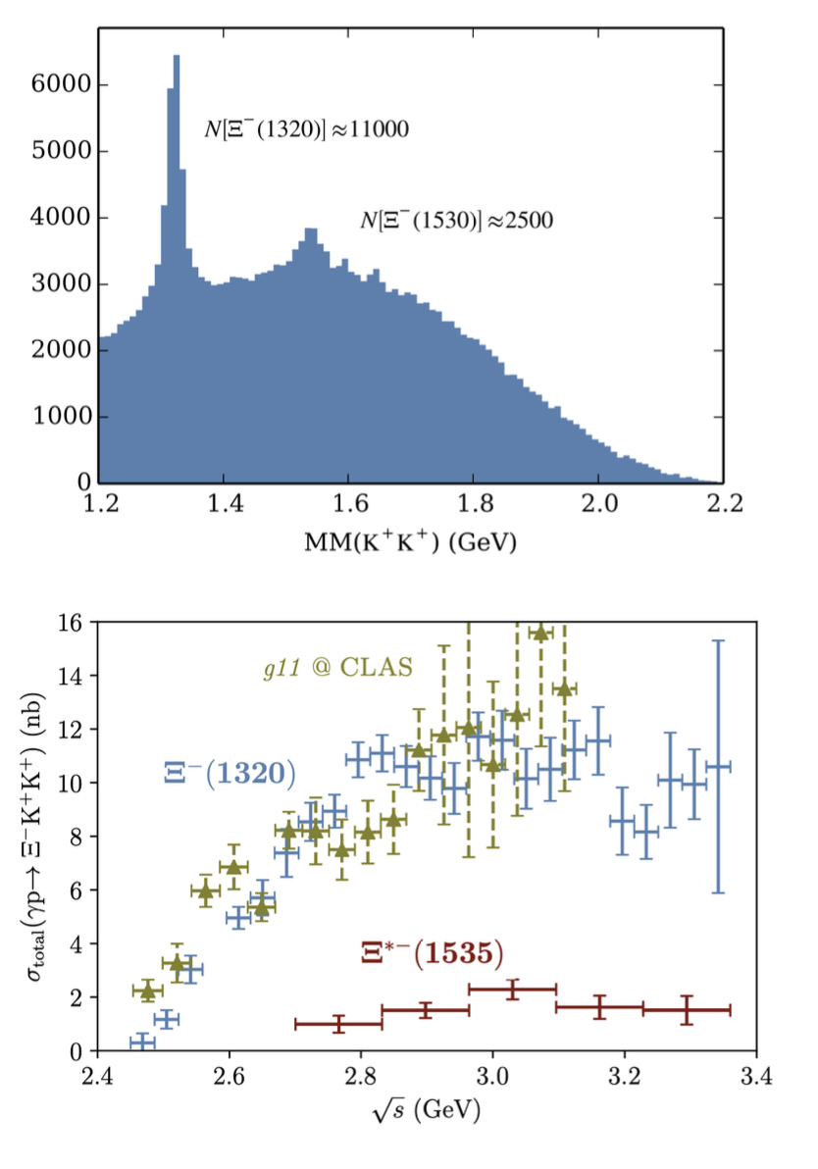
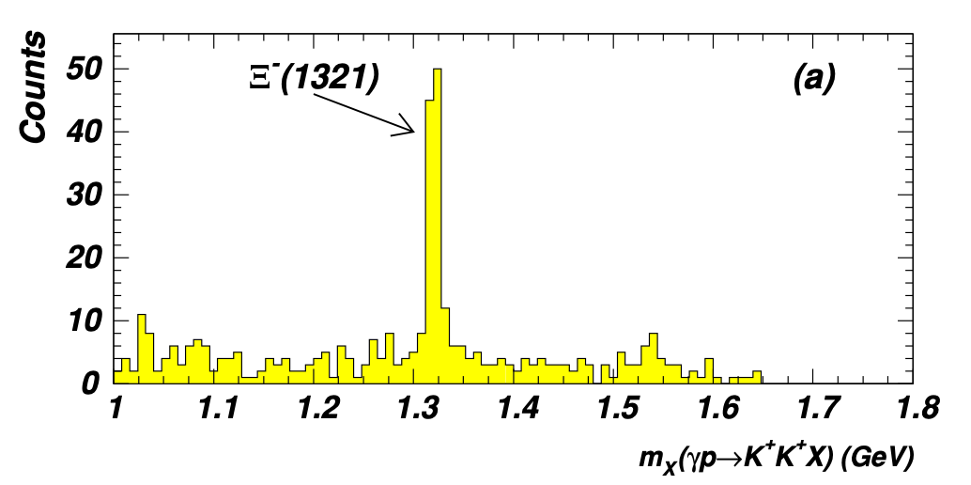
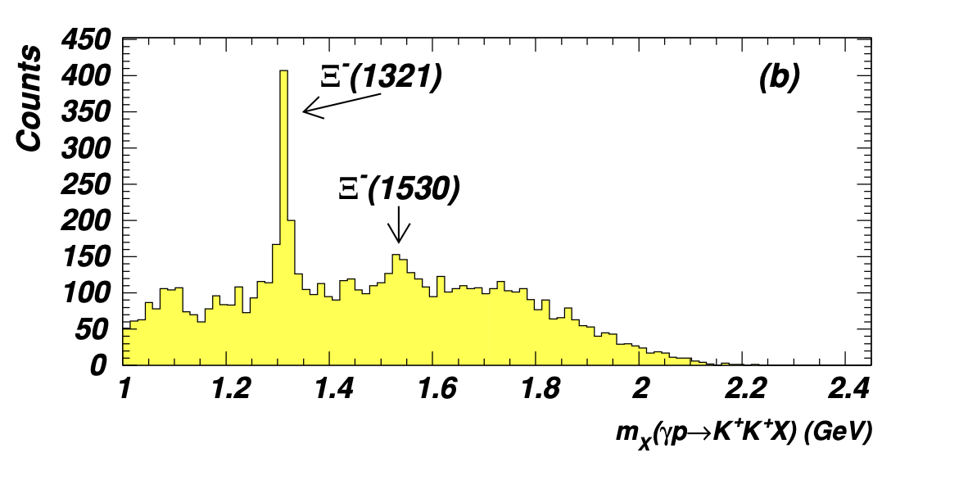




Previous Photoproduction Results
2005: CLAS g6 provided the first-ever exclusive measurement of $Ξ^{−}$ in $γp→K^{+}K^{+}Ξ^{−}$
2007: g11data, provided cross section results for $Ξ^{−}$ (1320) and $Ξ^{−}$(1530)
2018: g12 expanded the kinematic region of study (W=3.3GeV) as well as increased statistics
L.Guo et al. Cascade production in the reaction $γp→K^{+}K^{+}\left(X\right)$ and $γp→K^{+}K^{+}π^{−}(X)$
J.T. Goetz et al. $Ξ^{∗}$Photoproduction from Threshold to W=3.3 GeV
J.W.Price et al. Exclusive photoproduction of the cascade hyperons

Slide 5
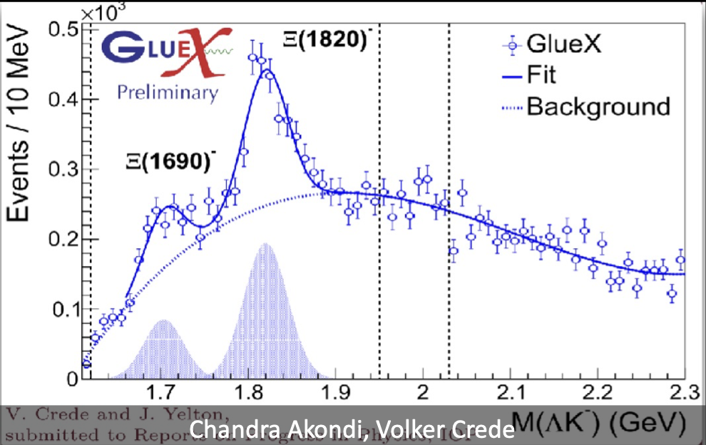
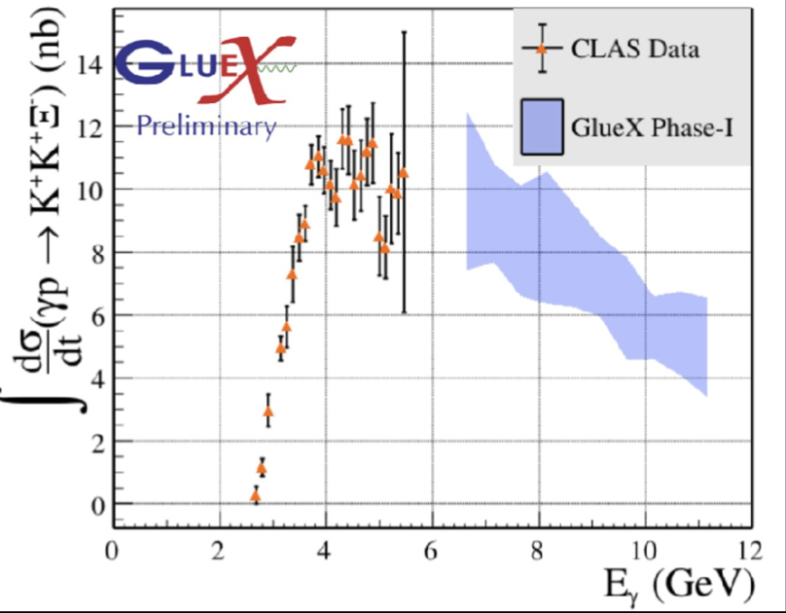
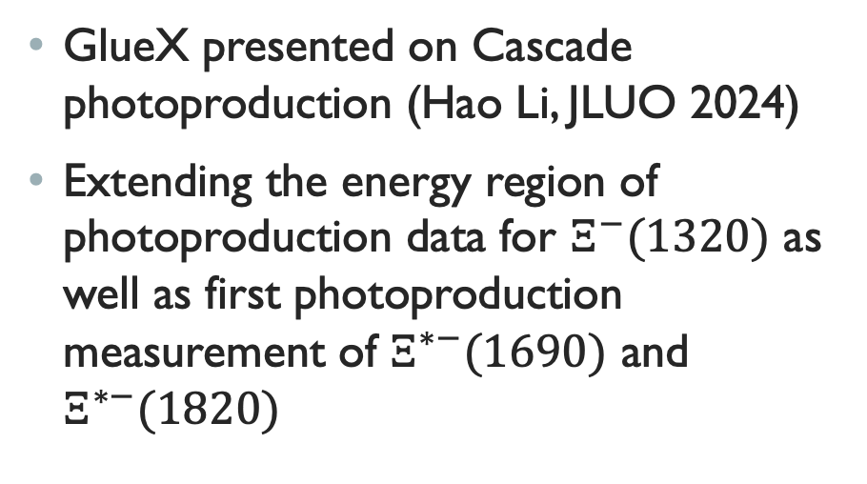
Gluex cascade studies
GlueX presented on Cascade photoproduction (Hao Li, JLUO 2024)
Extending the energy region of photoproduction data for $Ξ^{−}(1320)$ as well as first photoproduction measurement of $Ξ^{∗−}(1690)$ and $Ξ^{∗−}(1820)$

Slide 6
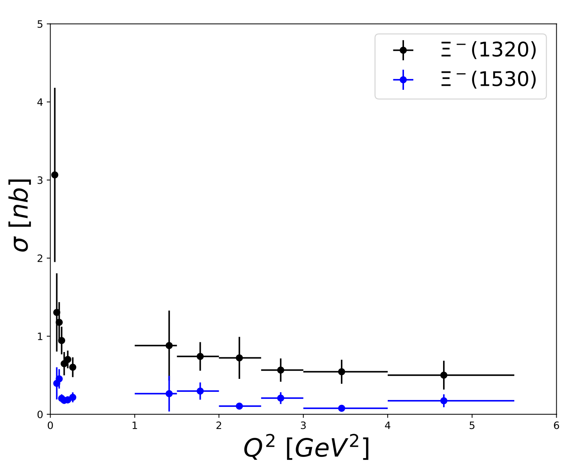
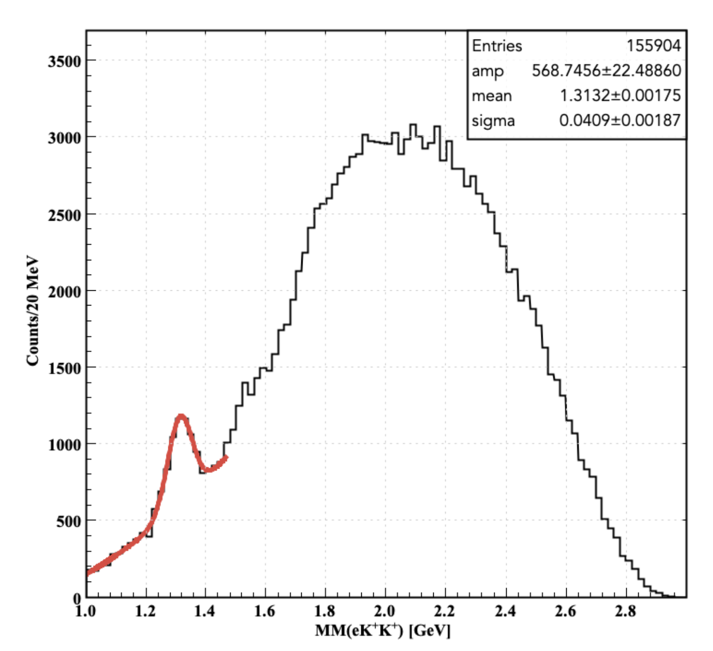
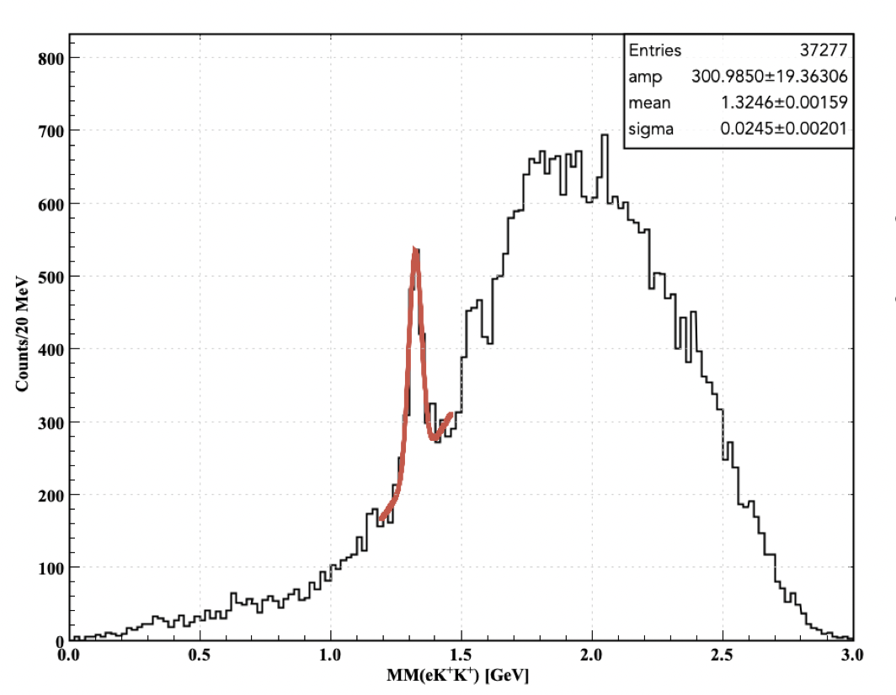
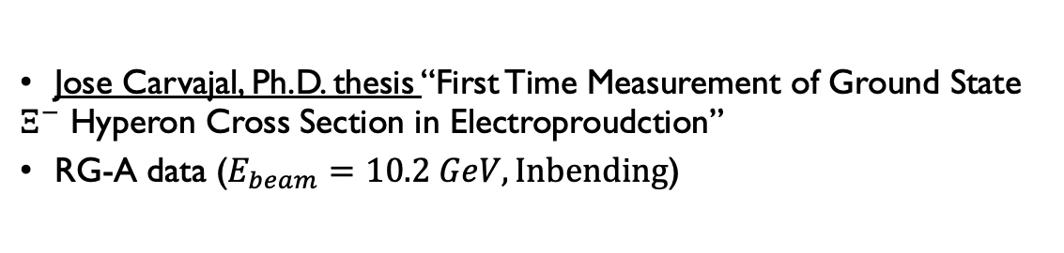

First time C.S. for $Ξ^{−}(1320)$ in Electroproduction (2024)
Jose Carvajal, Ph.D. thesis “First Time Measurement of Ground State $Ξ^{−}$ Hyperon Cross Section in Electroproudction”
RG-A data ($E_{beam}=10.2 GeV, Inbending$)
FT
FD
FT
FT
FD
FD

Slide 7
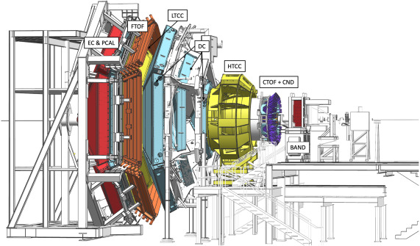
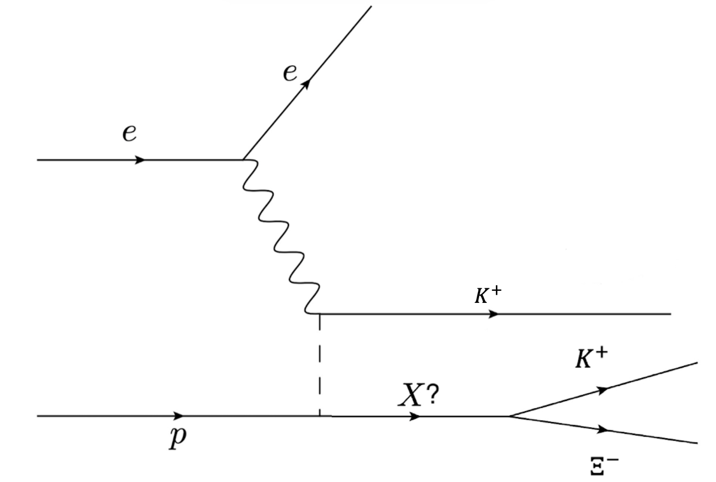
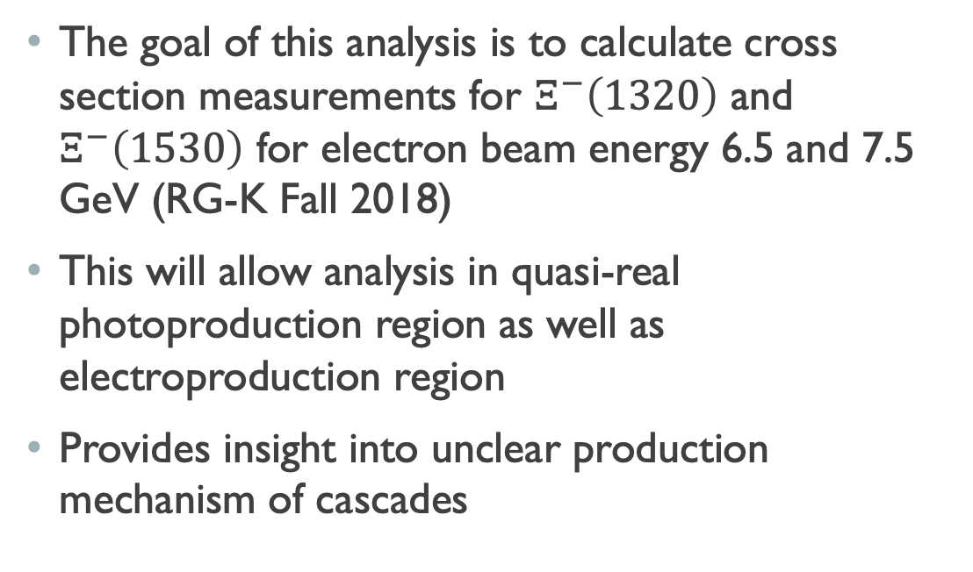
Motivation
The goal of this analysis is to calculate cross section measurements for $Ξ^{−}\left(1320\right)$ and $Ξ^{−}\left(1530\right)$ for electron beam energy 6.5 and 7.5 GeV (RG-K Fall 2018)
This will allow analysis in quasi-real photoproduction region as well as electroproduction region
Provides insight into unclear production mechanism of cascades

Slide 8
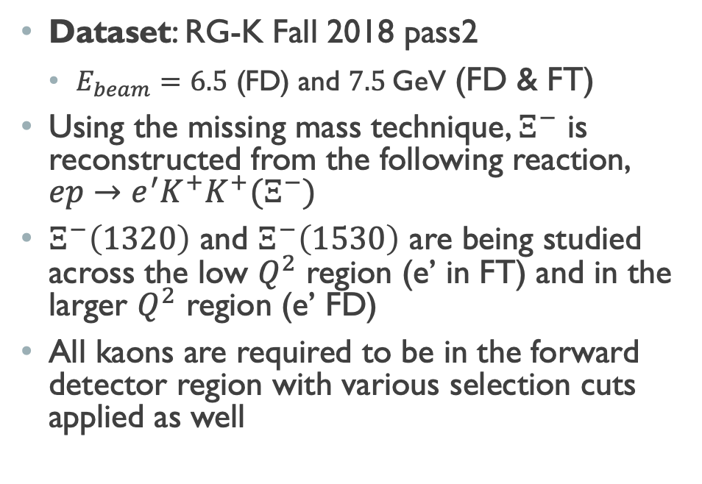
Event reconstruction
Dataset: RG-K Fall 2018 pass2
  $E_{beam}=6.5$ (FD) and $7.5$GeV (FD & FT)
Using the missing mass technique, $Ξ^{−}$ is reconstructed from the following reaction, $ep→e^{′}K^{+}K^{+}(Ξ^{−})$
$Ξ^{−}\left(1320\right)$ and $Ξ^{−}\left(1530\right)$ are being studied across the low $Q^{2}$ region (e’ in FT) and in the larger $Q^{2}$ region (e’ FD)
All kaons are required to be in the forward detector region with various selection cuts applied as well

Slide 9
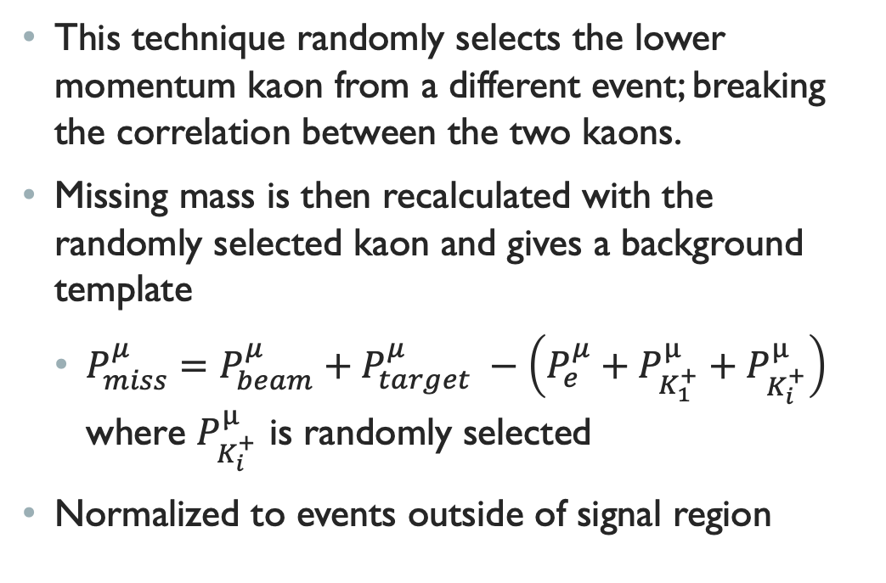
Understanding the background
Mixed events
This technique randomly selects the lower momentum kaon from a different event; breaking the correlation between the two kaons.
Missing mass is then recalculated with the randomly selected kaon and gives a background template
  $P_{miss}^{μ}=P_{beam}^{μ}+P_{target}^{μ} −\left(P_{e}^{μ}+P_{K_{1}^{+}}^{μ}+P_{K_{i}^{+}}^{μ}\right)$ where $P_{K_{i}^{+}}^{μ}$ is randomly selected
Normalized to events outside of signal region

Slide 10
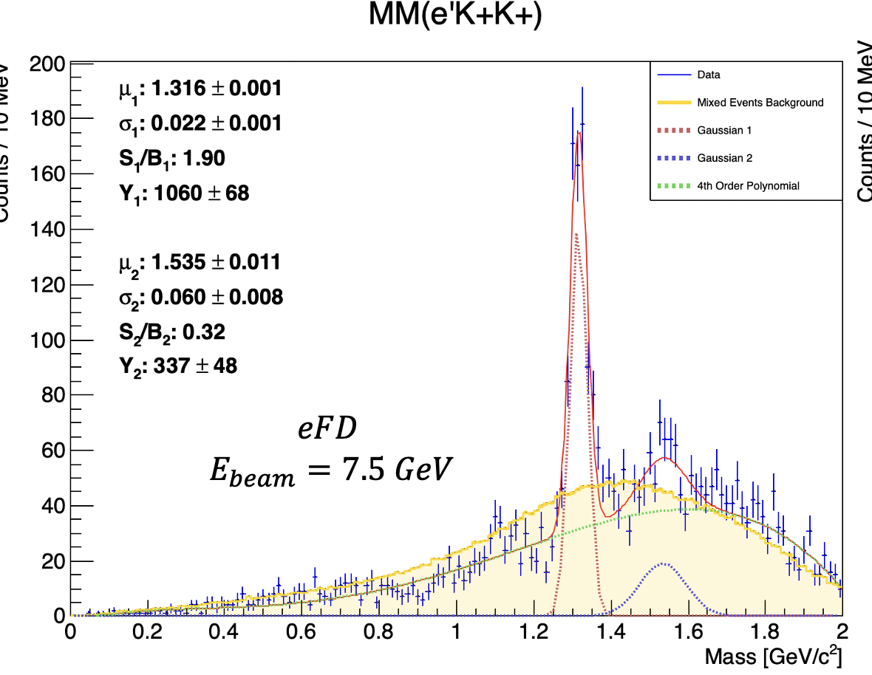
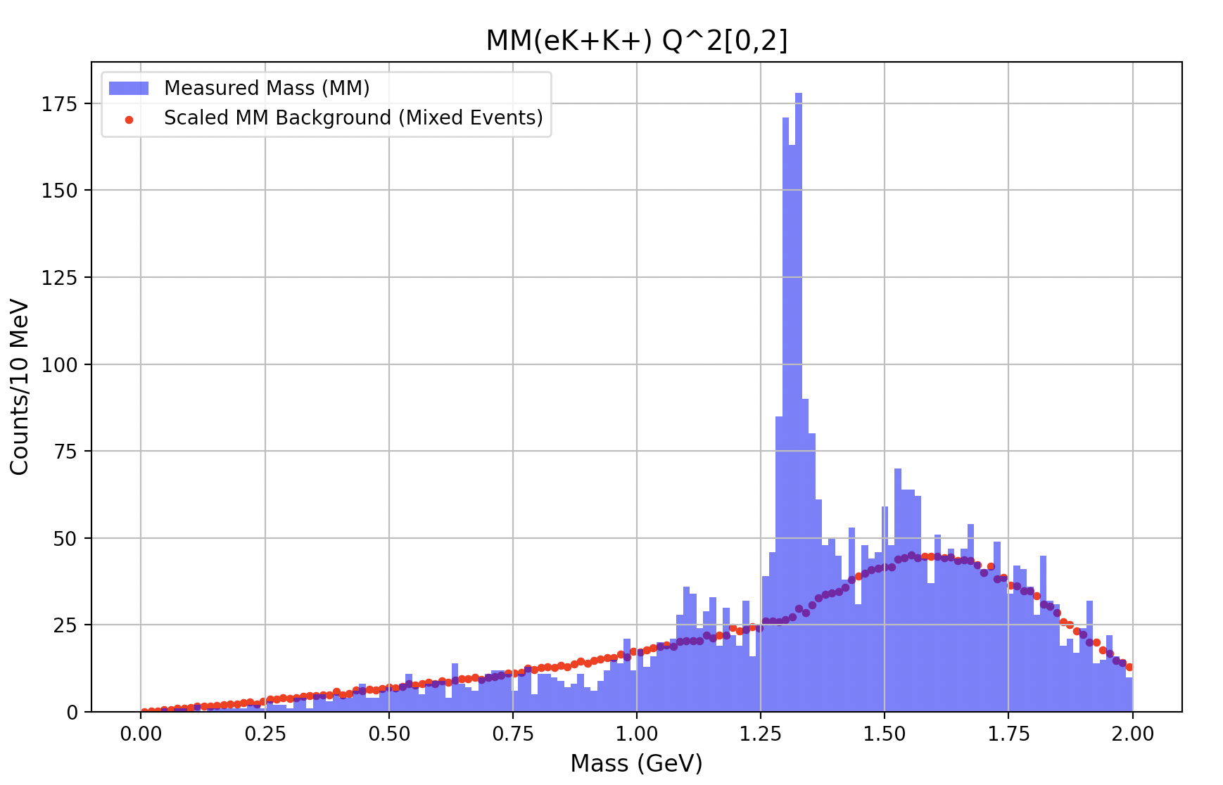
Mixed events
Previously:
The earlier mixed events template, presented at a previous collaboration meeting, did not provide an accurate background estimate.
However, more refined selection cuts to the kaon that is randomized, the mixed events background has significantly improved.
Currently:

Slide 11
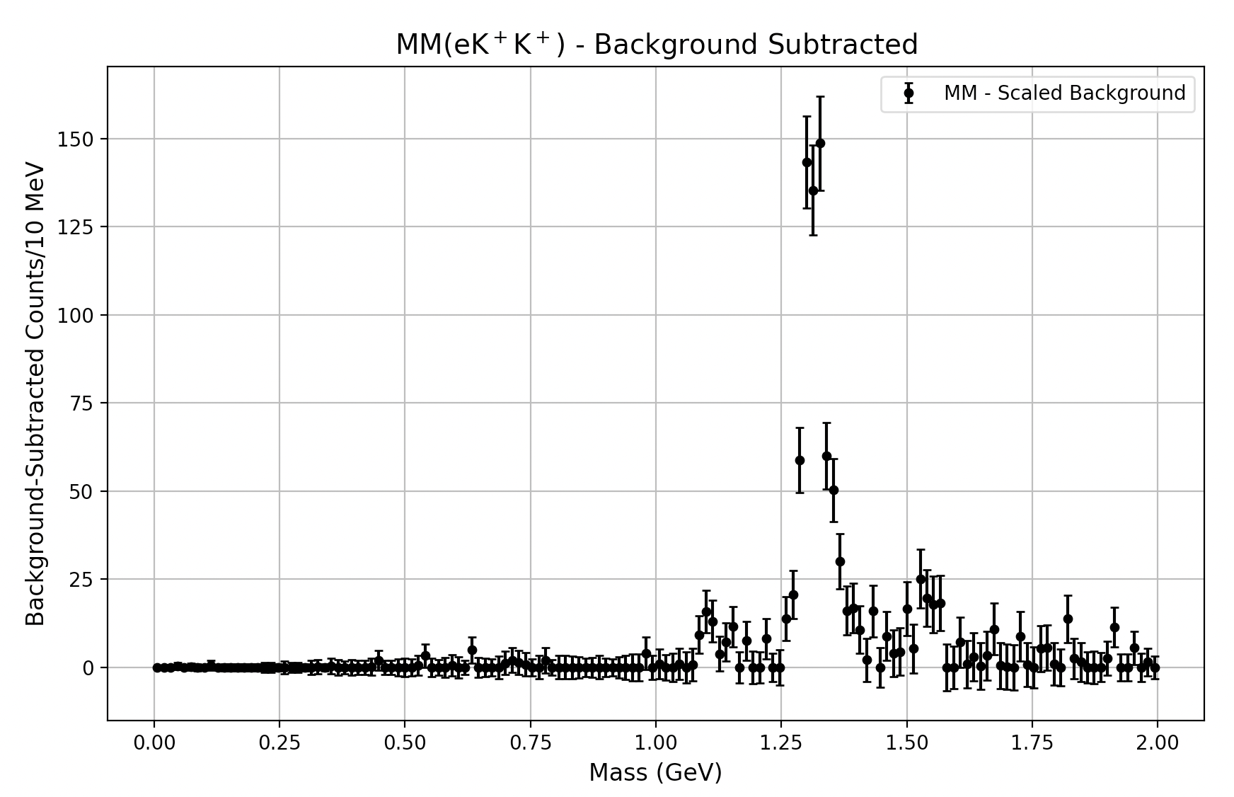
Mixed events
The earlier mixed events template, presented at a previous collaboration meeting, did not provide an accurate background estimate.
However, more refined selection cuts to the kaon that is randomized, the mixed events background has significantly improved.
Currently:

Slide 12
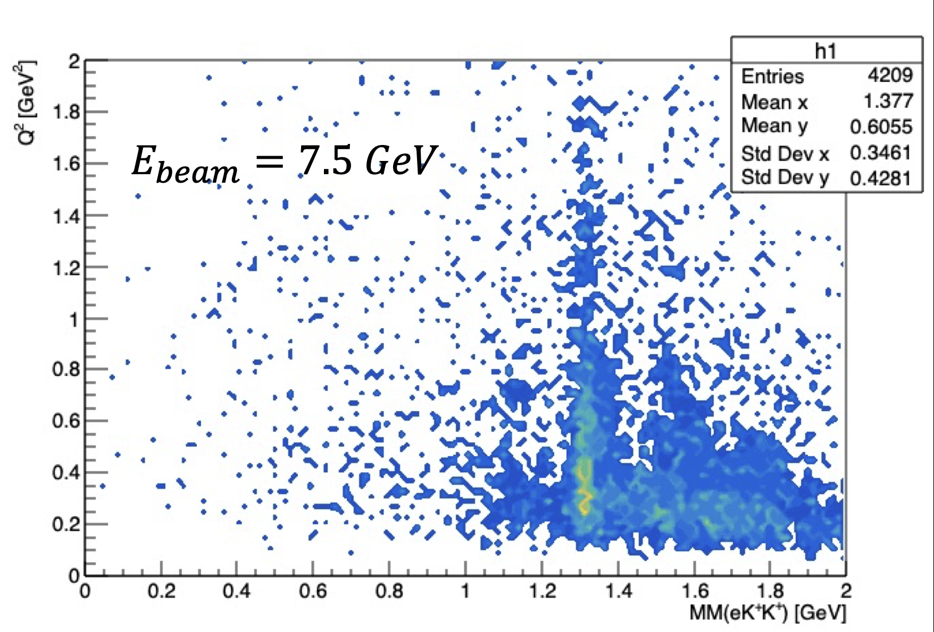
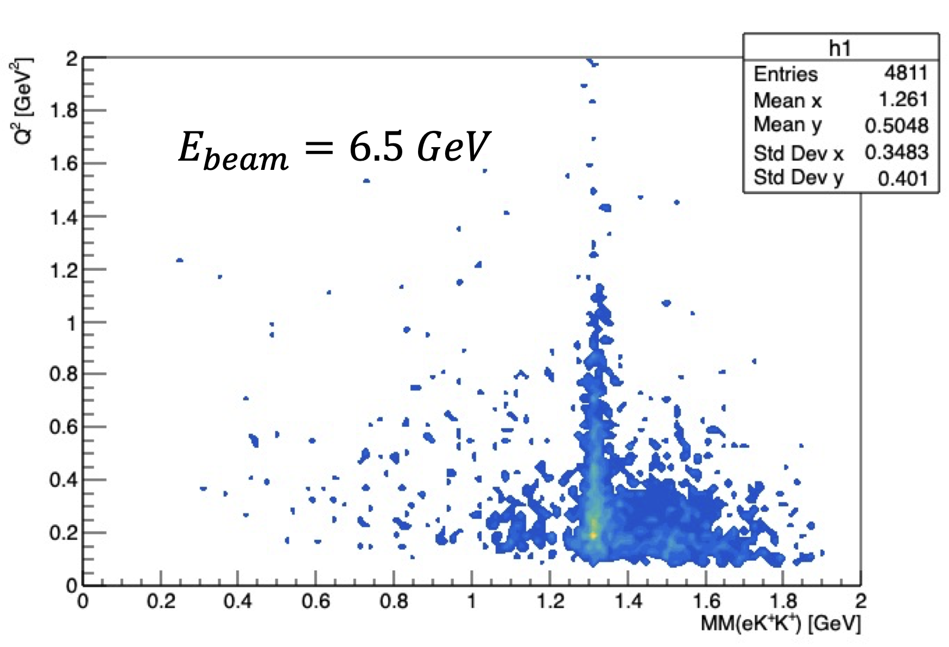
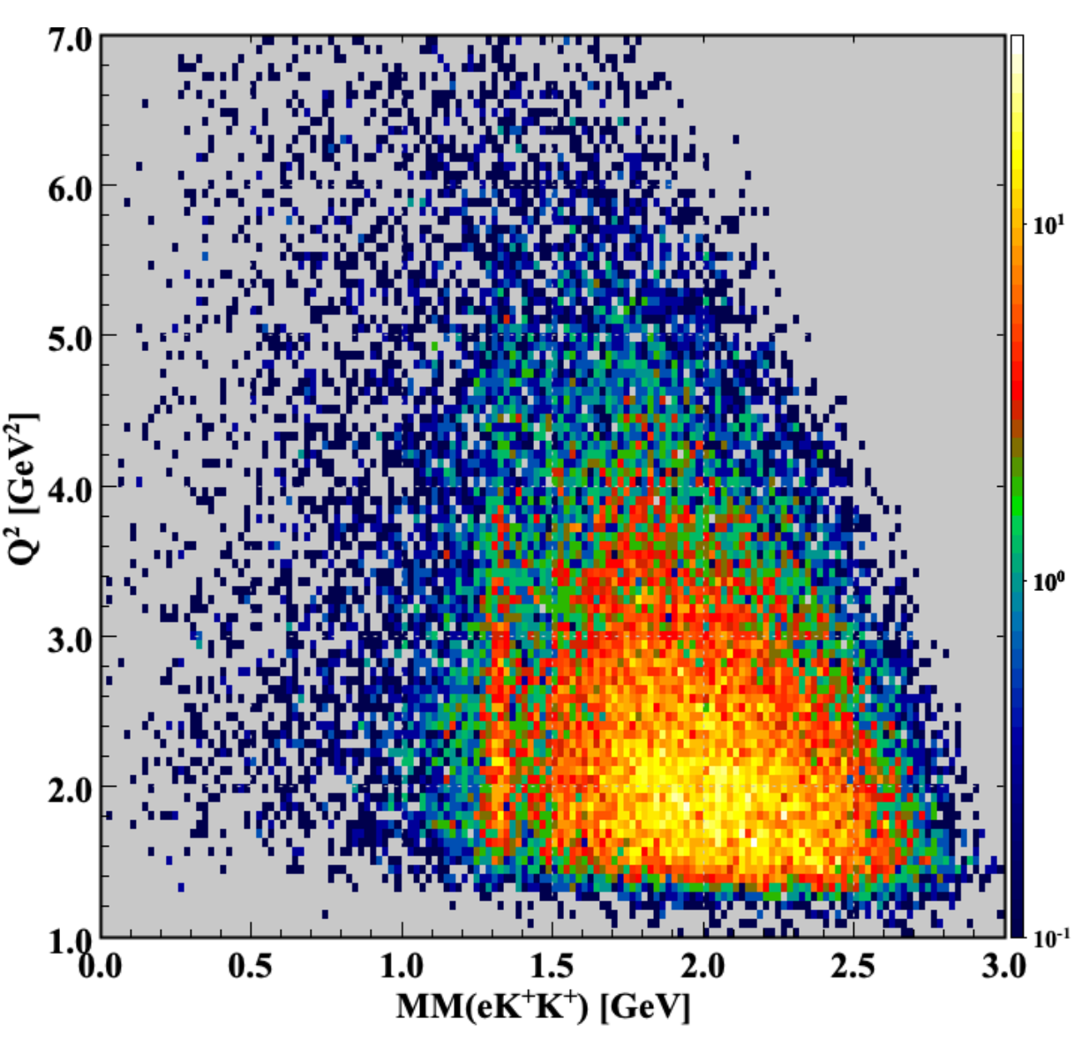

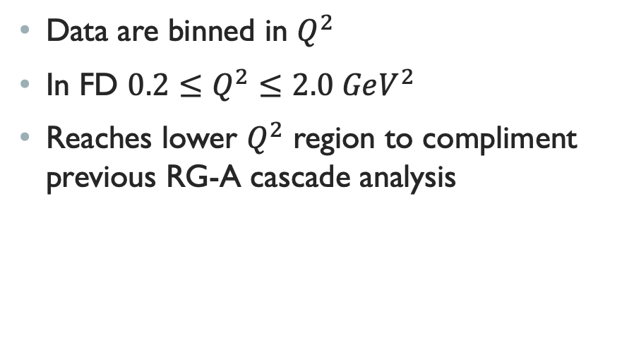
Kinematic coverage
Forward Detector
Data are binned in $Q^{2}$
In FD $0.2≤Q^{2}≤2.0 GeV^{2}$
Reaches lower $Q^{2}$ region to compliment previous RG-A cascade analysis
Jose Carvajal, Ph.D. thesis “First Time Measurement of Ground State $Ξ^{−}$ Hyperon Cross Section in Electroproudction”

Slide 13
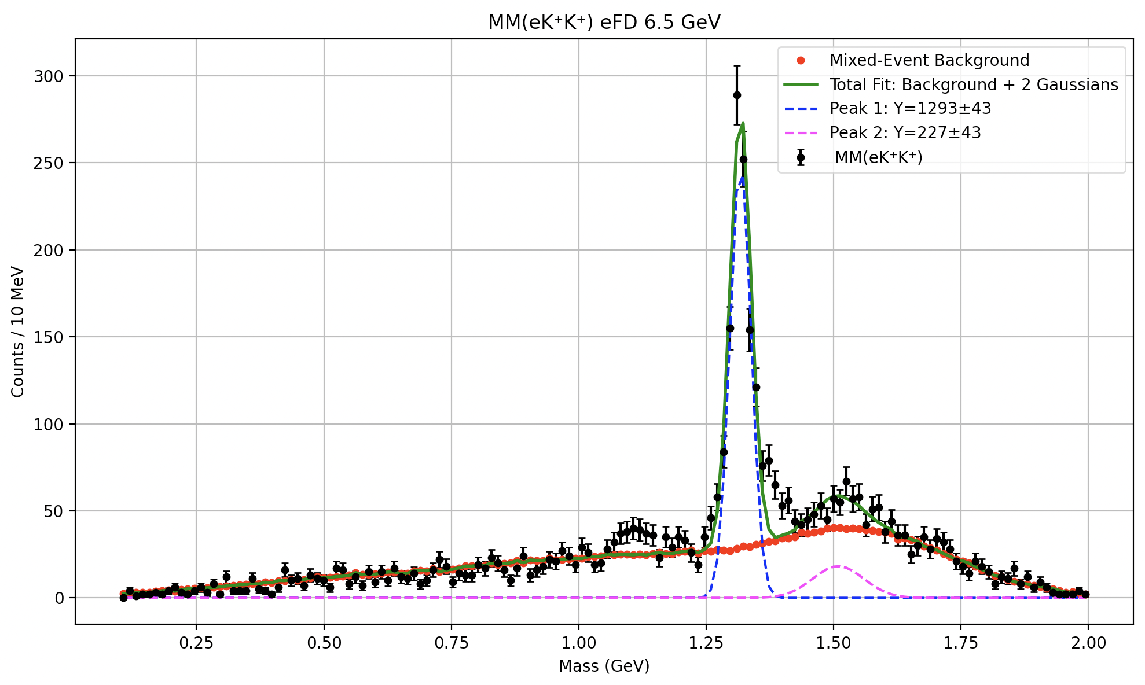
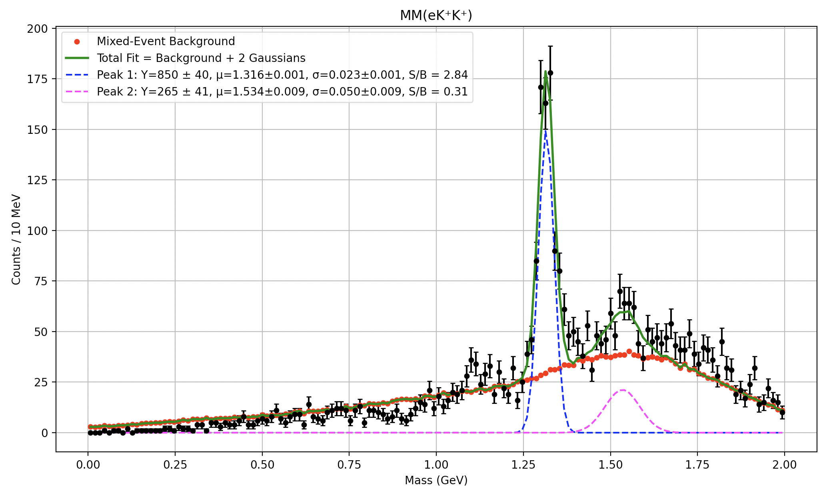


Forward Detector missing mass distribution
$$E_{beam}=6.5 GeV$$
Both signals are fitted to a gaussian
Background is fit to the mixed events function
Green represents the total fit
$$E_{beam}=7.5 GeV$$

Slide 14
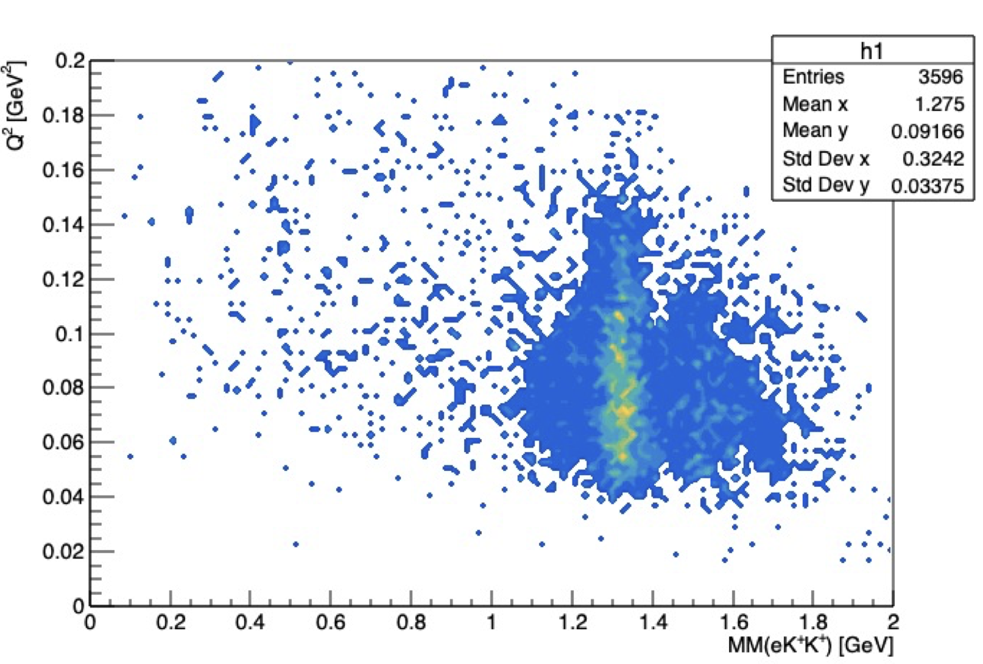
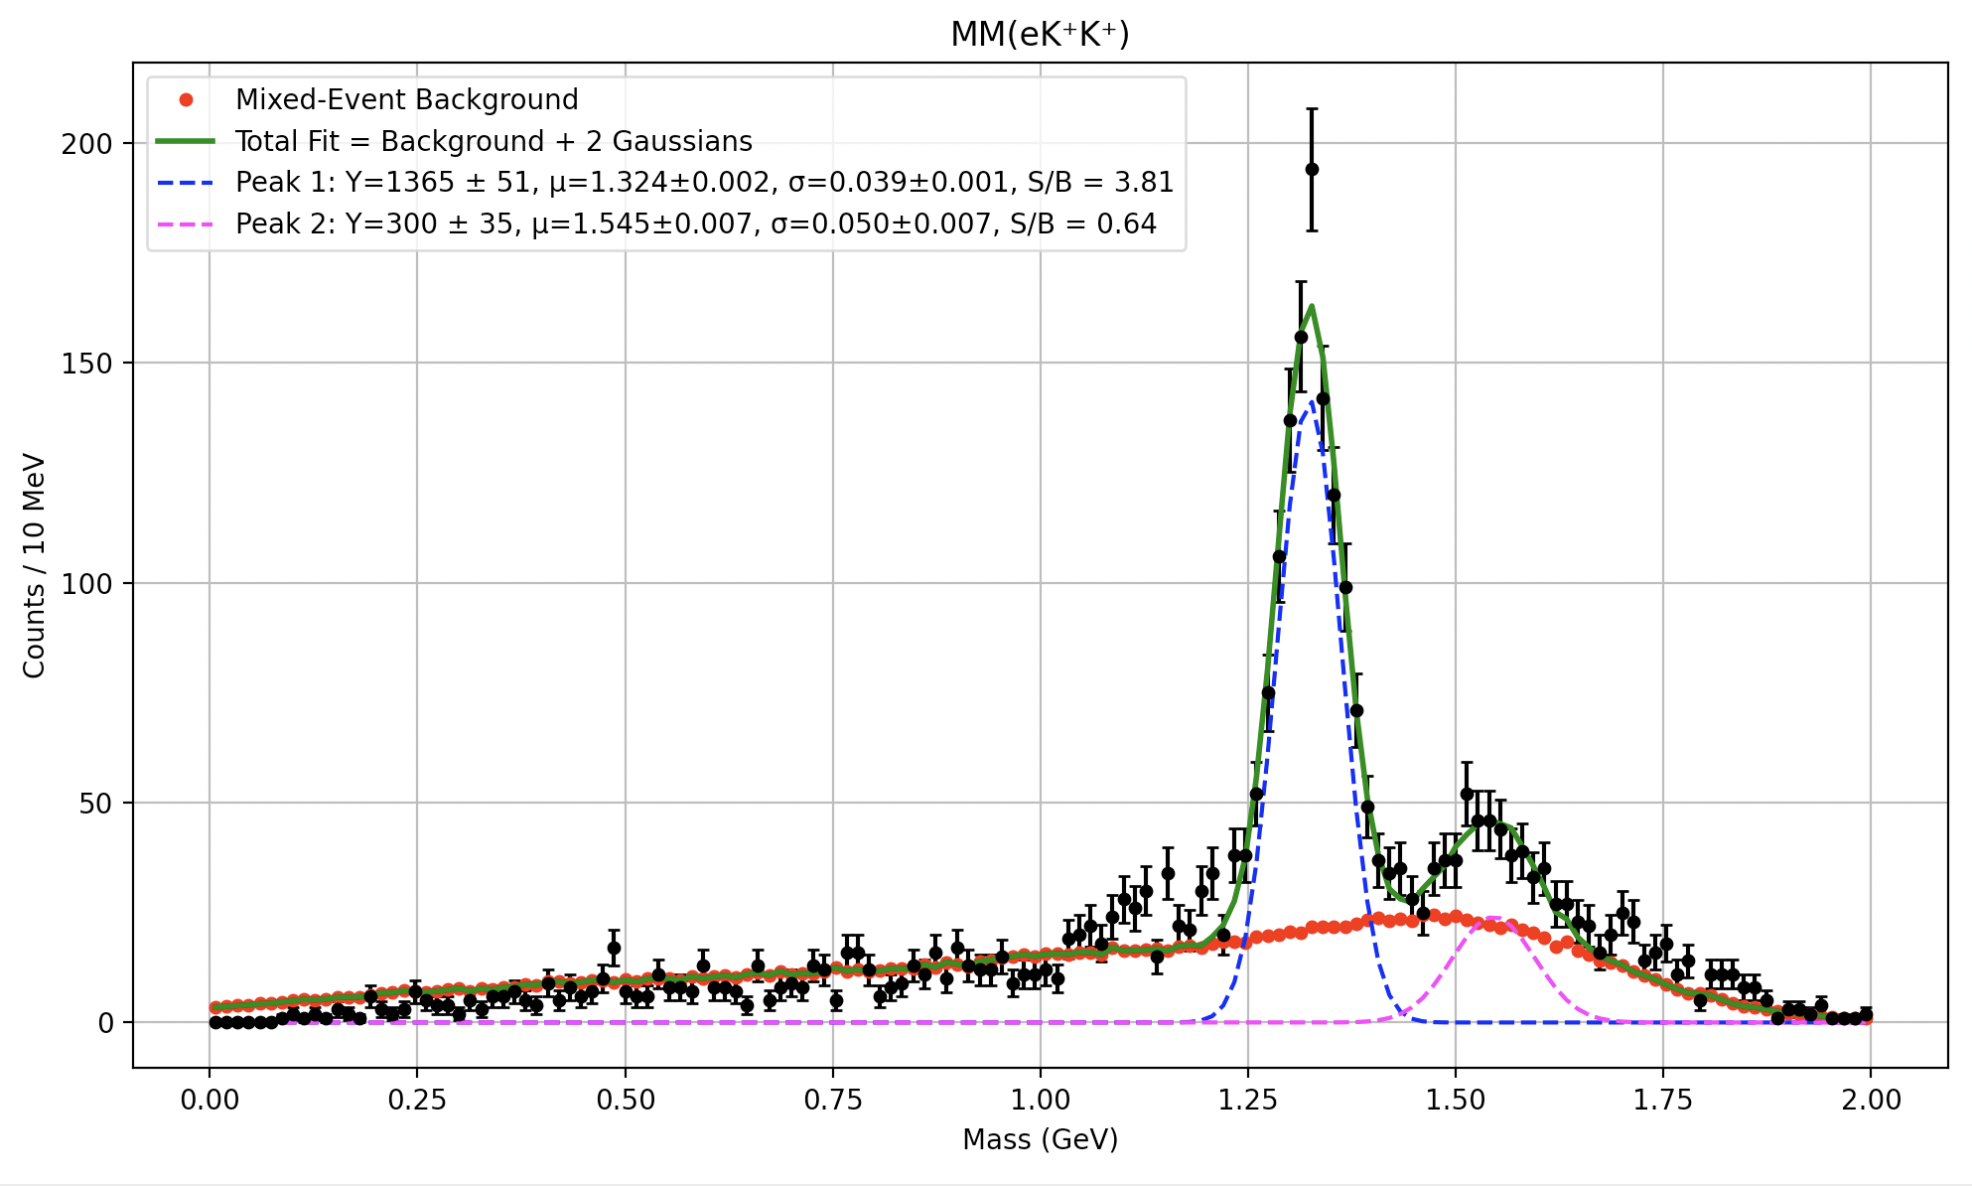
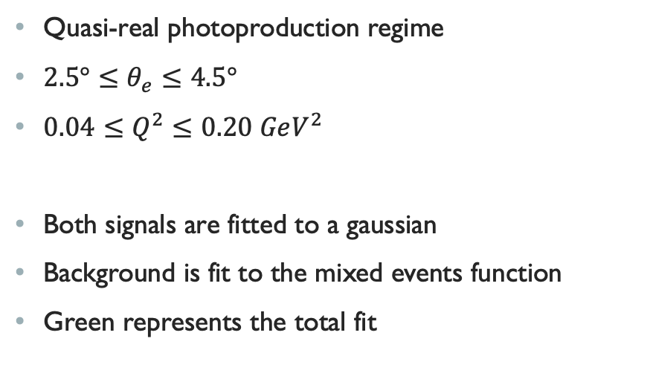
Forward tagger
Quasi-real photoproduction regime
$2.5°≤θ_{e}≤4.5°$
$0.04≤Q^{2}≤0.20 GeV^{2}$
Both signals are fitted to a gaussian
Background is fit to the mixed events function
Green represents the total fit

Slide 15
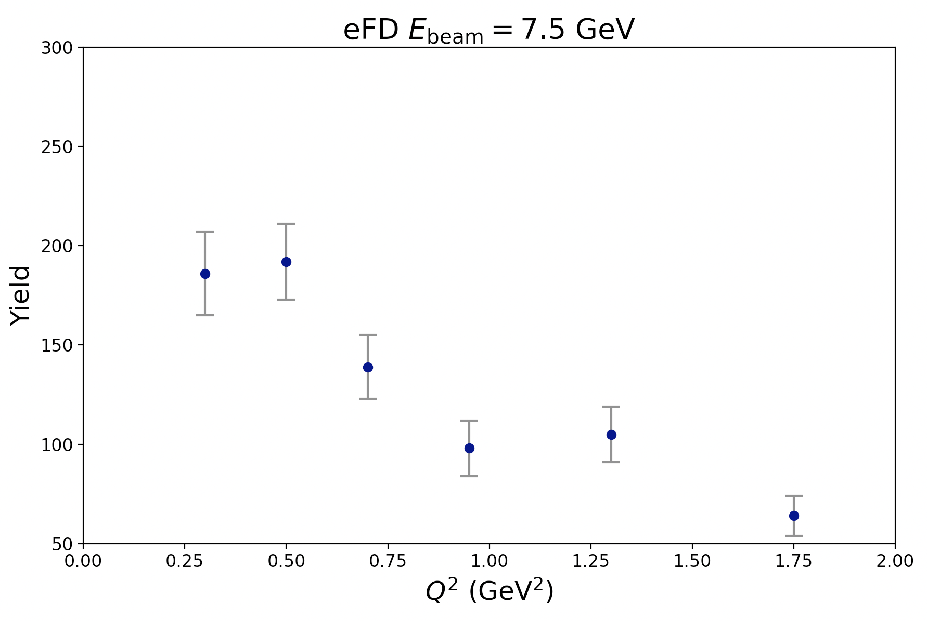
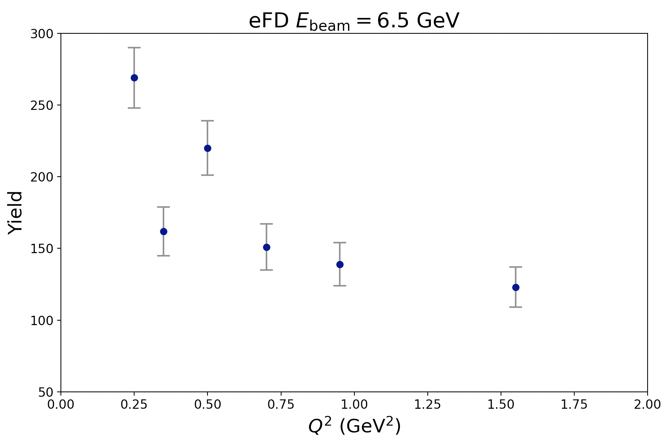
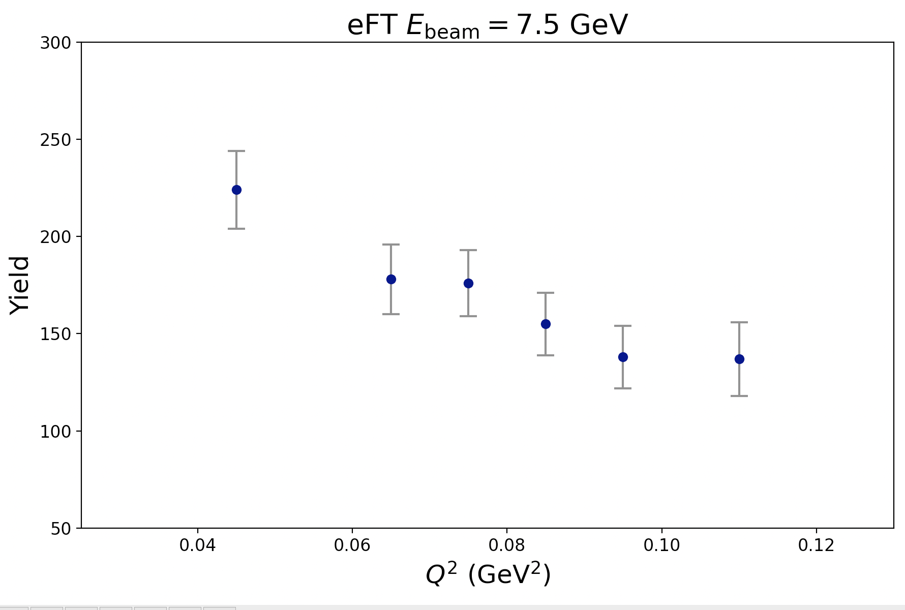
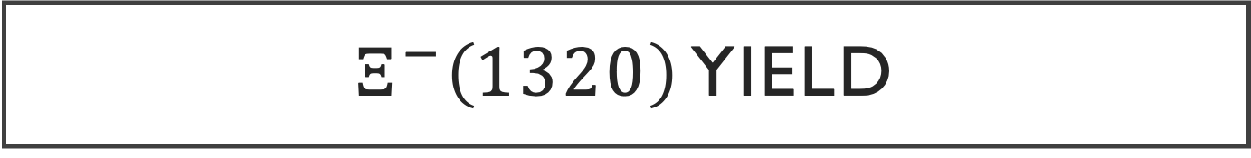
$Ξ^{−}\left(1320\right)$ Yield

Slide 16
Simulations

Slide 17

Current simulation Model
FIU students, Leonel Martinez and myself have been working on our own MC generator
The following reaction is used in the simulation:
$$γ^{∗}p→K_{meson}^{+}X→K_{meson}^{+}K_{Y^{∗}}^{+} Ξ^{−} → K_{meson}^{+}{ K}_{Y^{∗}}^{+} π^{−} Λ→K_{meson}^{+} K_{Y^{∗}}^{+} π^{−} p π^{−}$$
Phase space generator as of right now
Provide input info (beam energy, scattered e’ location)
Provide intermediate particle distribution info
Add in any t-slope dependances etc.
Run simulation
Output is a lund file
Submit to OSG for reconstruction

Slide 18
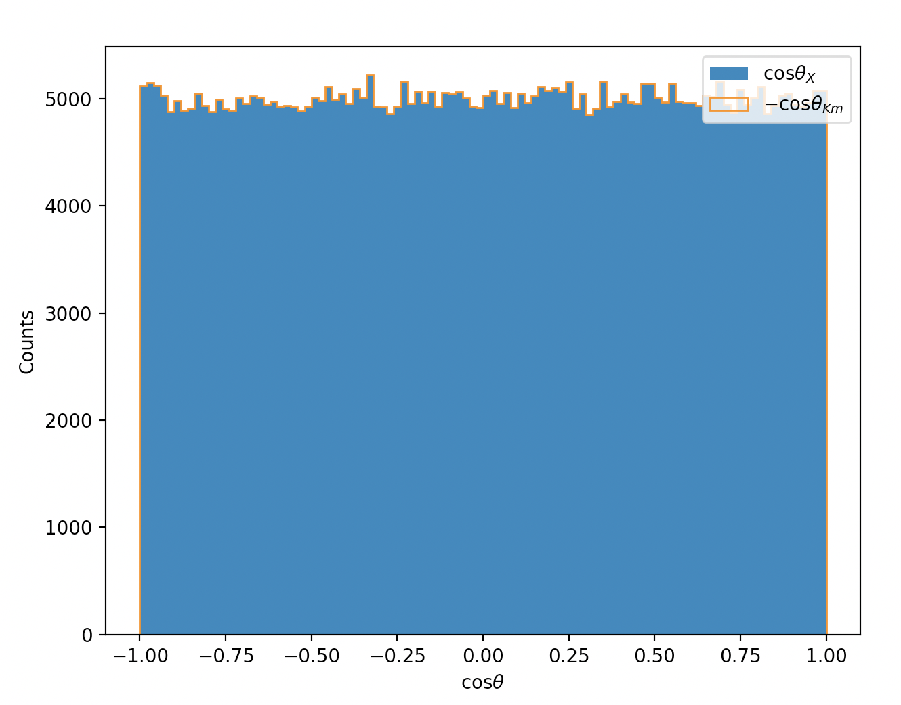
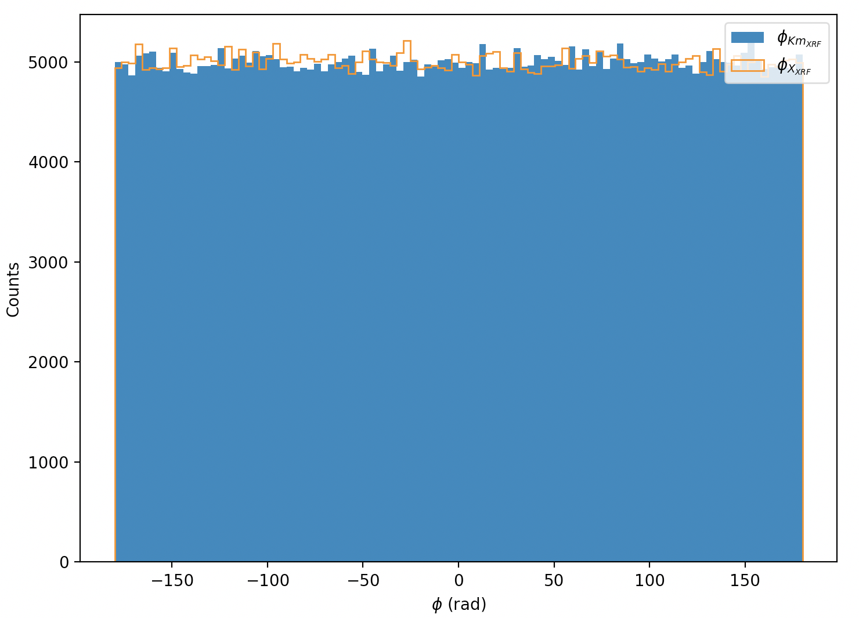
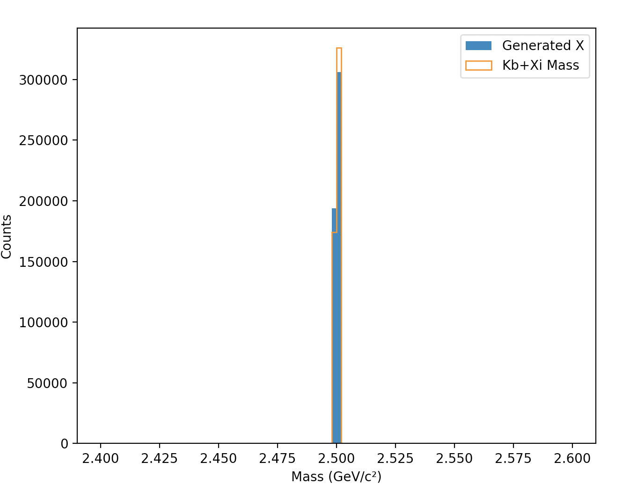
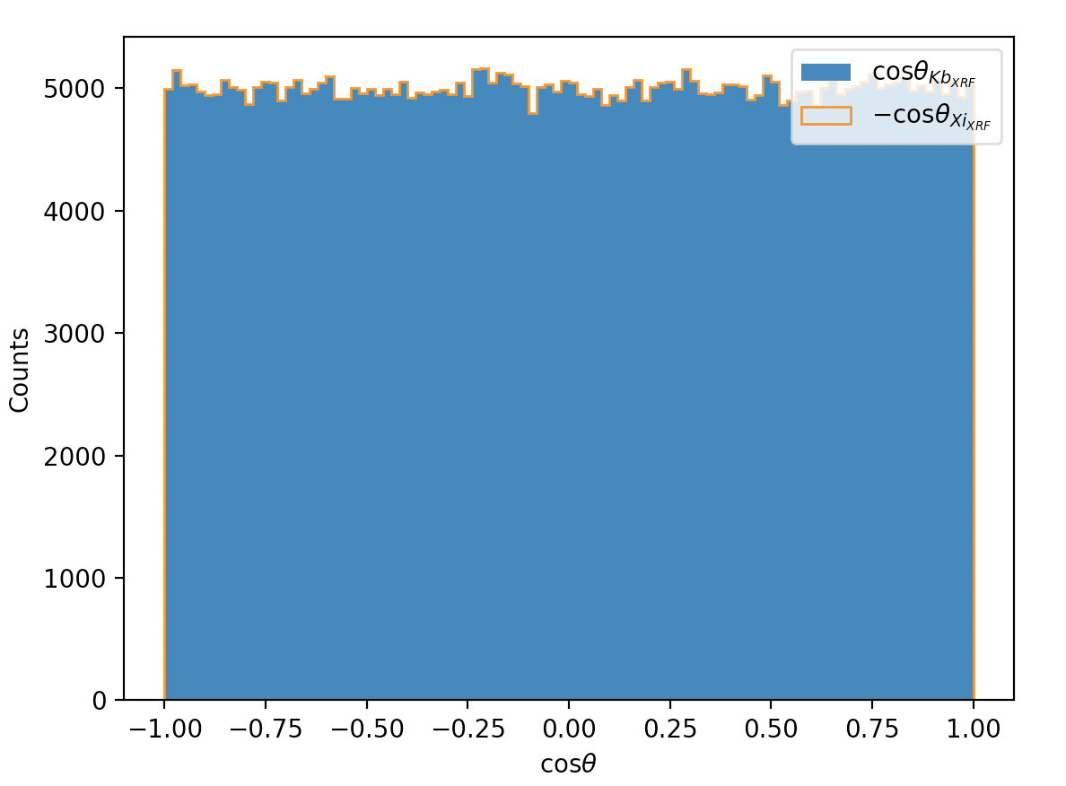
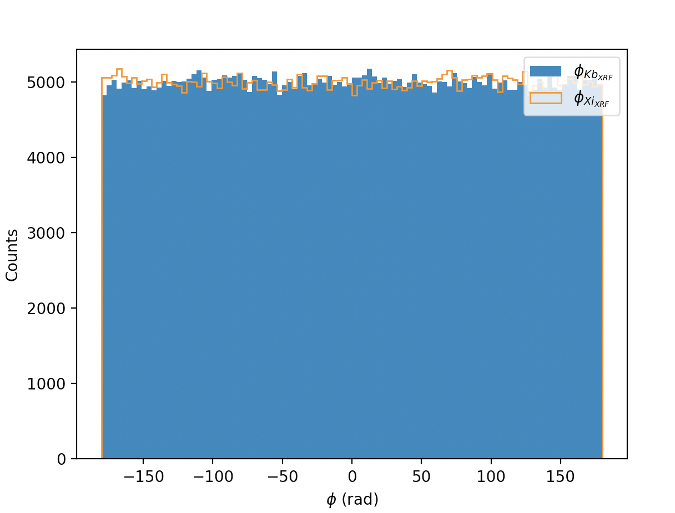
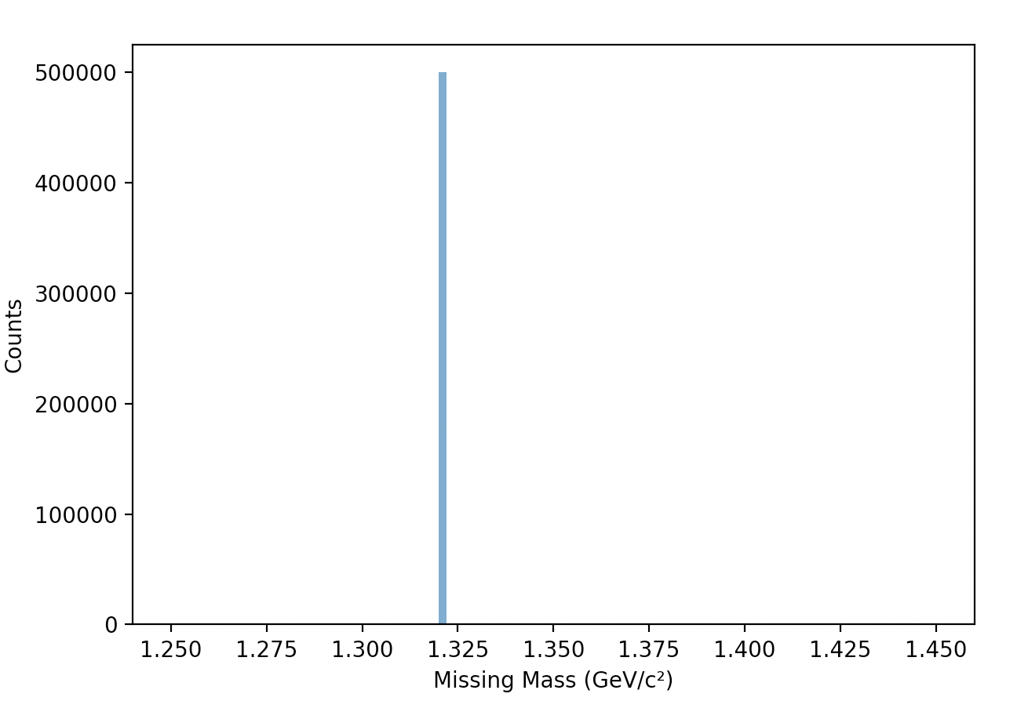



simulation
$$Cosθ, φ$$
for $X and K_{m}^{+}$
Intermediate particle, X
$$Cosθ, φ$$
$$Ξ^{−} and K_{B}^{+}$$
$$Ξ^{−}\left(1320\right)$$

Slide 19
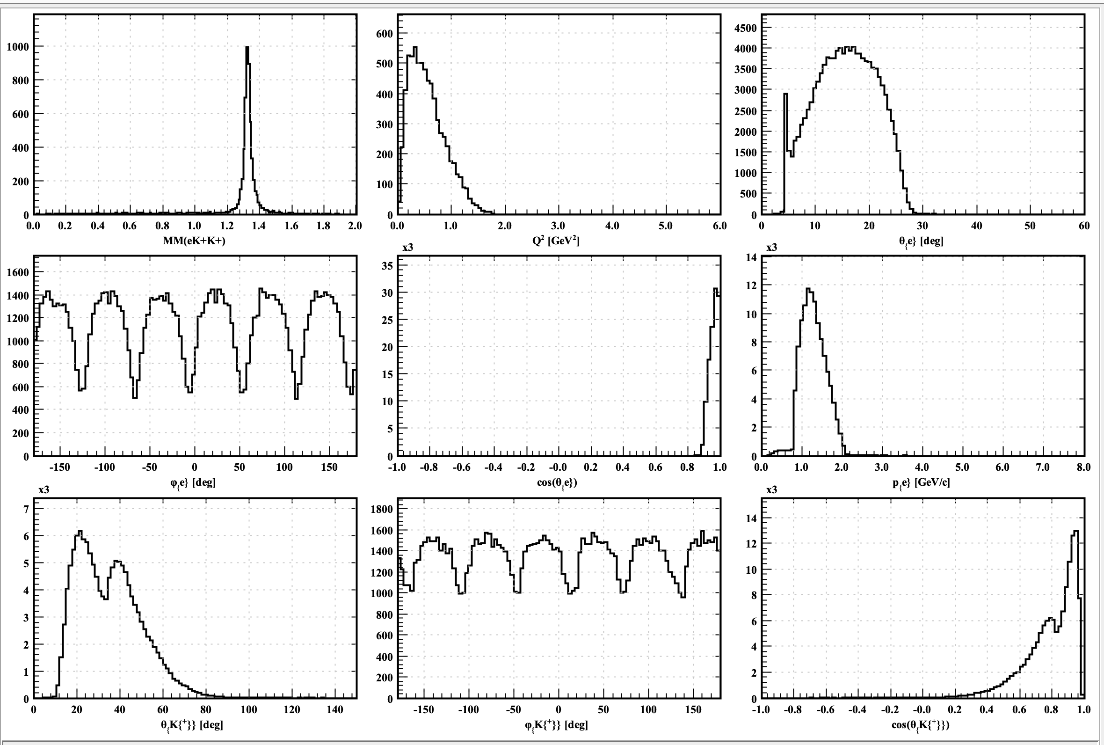
Reconstructed distribution

Slide 20
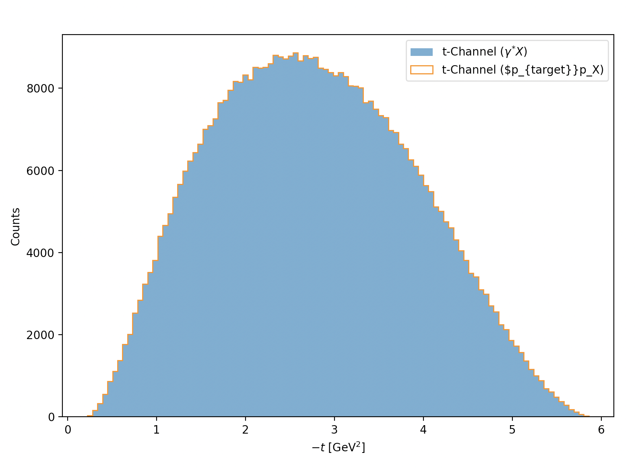
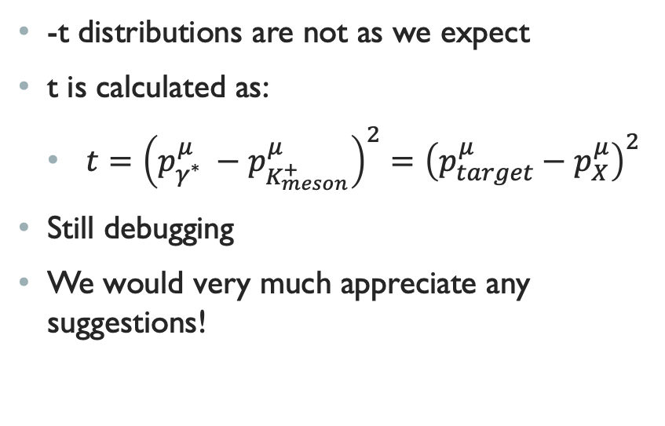
Issue with simulation
-t distributions are not as we expect
t is calculated as:
  $t={\left(p_{γ^{∗}}^{μ} −p_{K_{meson}^{+}}^{μ}\right)}^{2}={\left(p_{target}^{μ}−p_{X}^{μ}\right)}^{2}$
Still debugging
We would very much appreciate any suggestions!

Slide 21
outlook
Primary focus is to fix generator
  Once this issue is fixed, perform full simulation to obtain acceptances
  Leading to preliminary cross section results
Momentum corrections for FD particles are currently being worked on

Slide 22

Thank you!

Slide 23
Backup slides

Slide 24
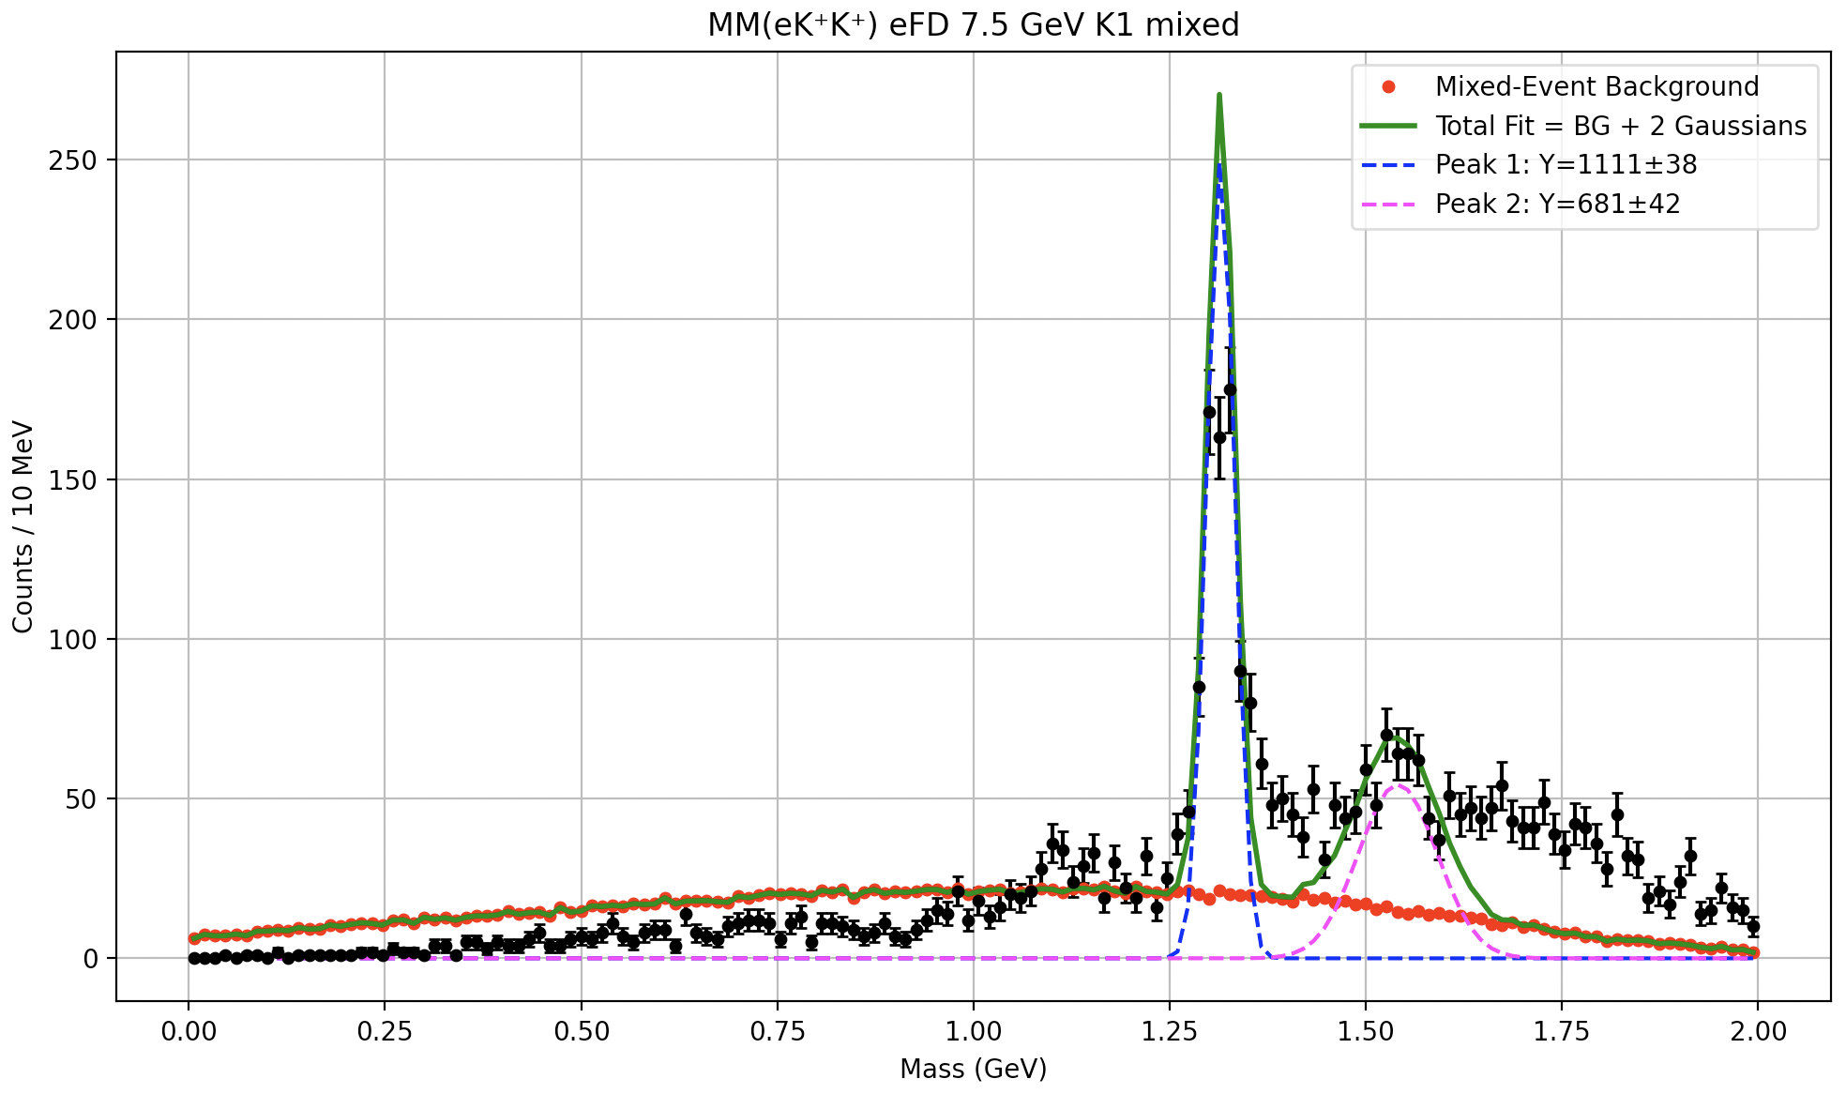
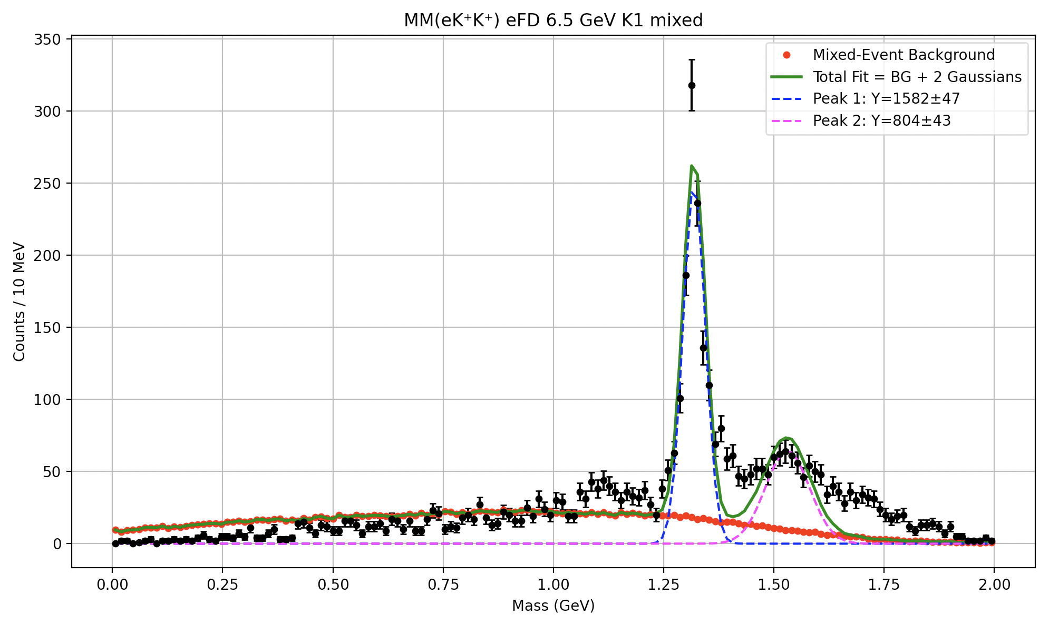
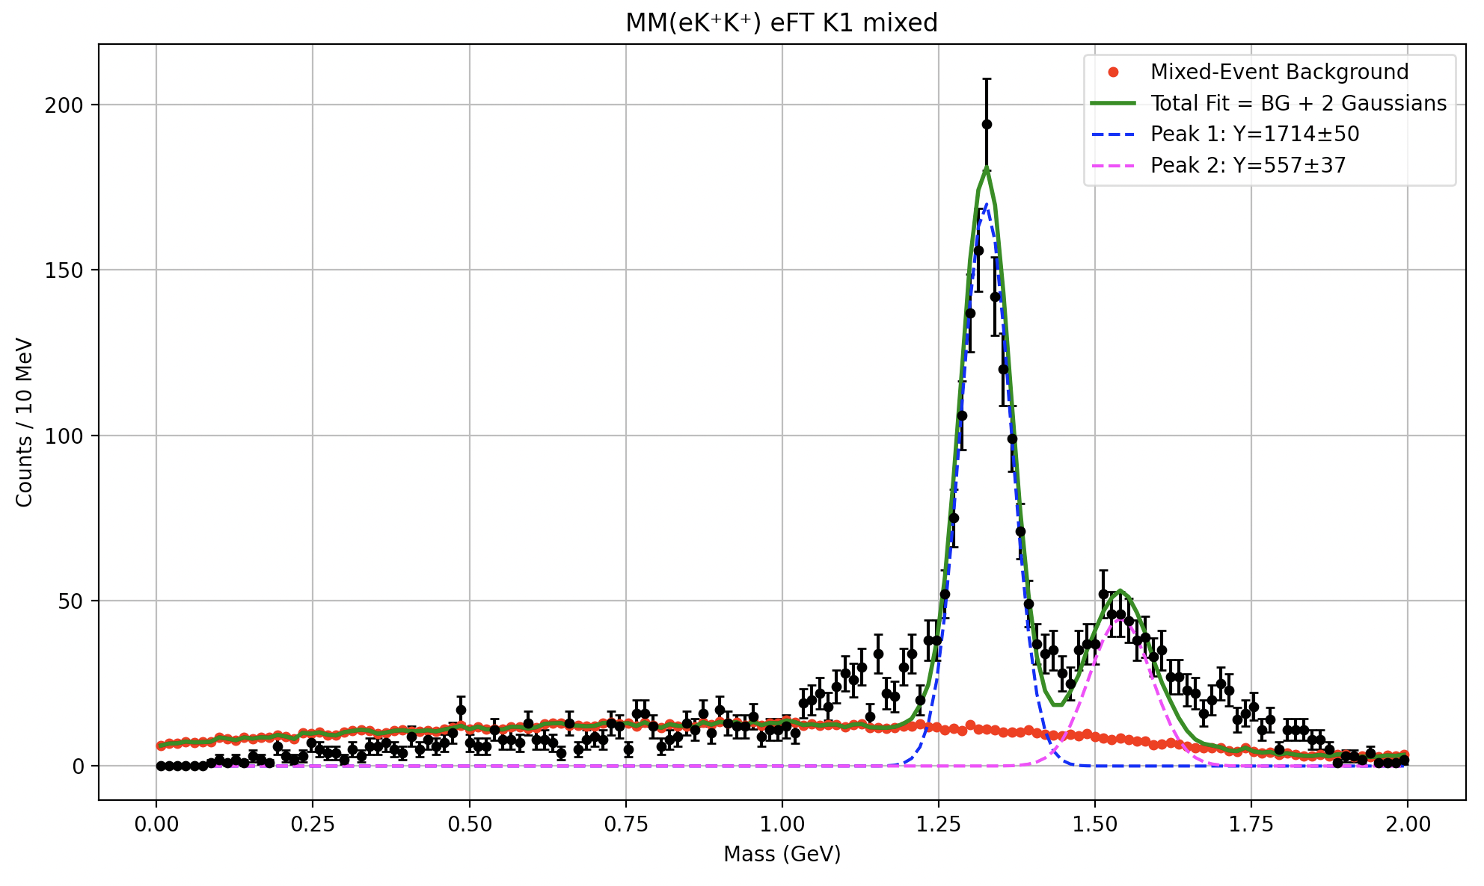
Mixing the higher momentum kaon

Slide 25



Addressing potential $π^{+}/K^{+}$ mis-ID bump at ~1.1 GeV
$$E_{beam}=6.5 GeV$$
$$E_{beam}=7.5 GeV$$

Slide 26
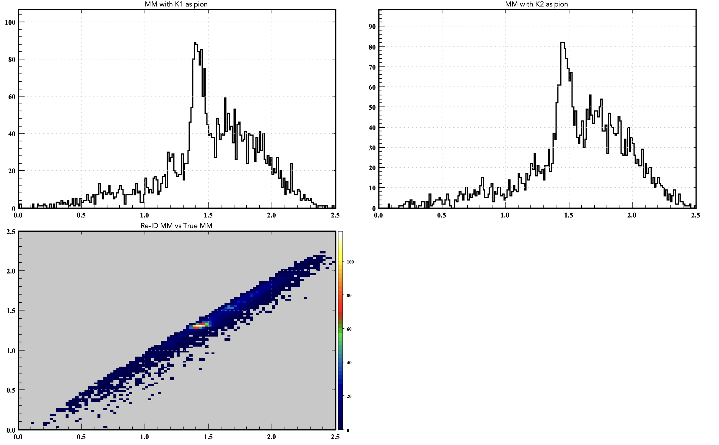
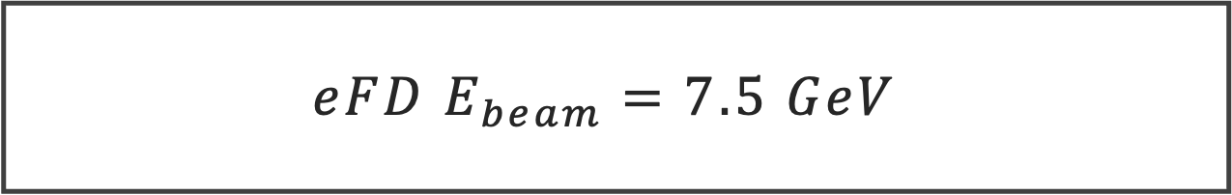
$$eFD E_{beam}=7.5 GeV$$

Slide 27
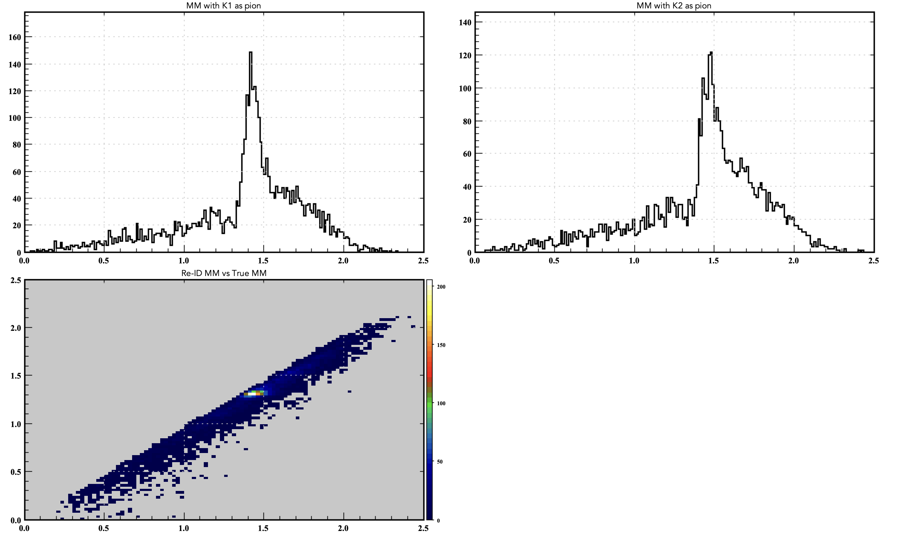

$$eFD E_{beam}=6.5 GeV$$

Slide 28
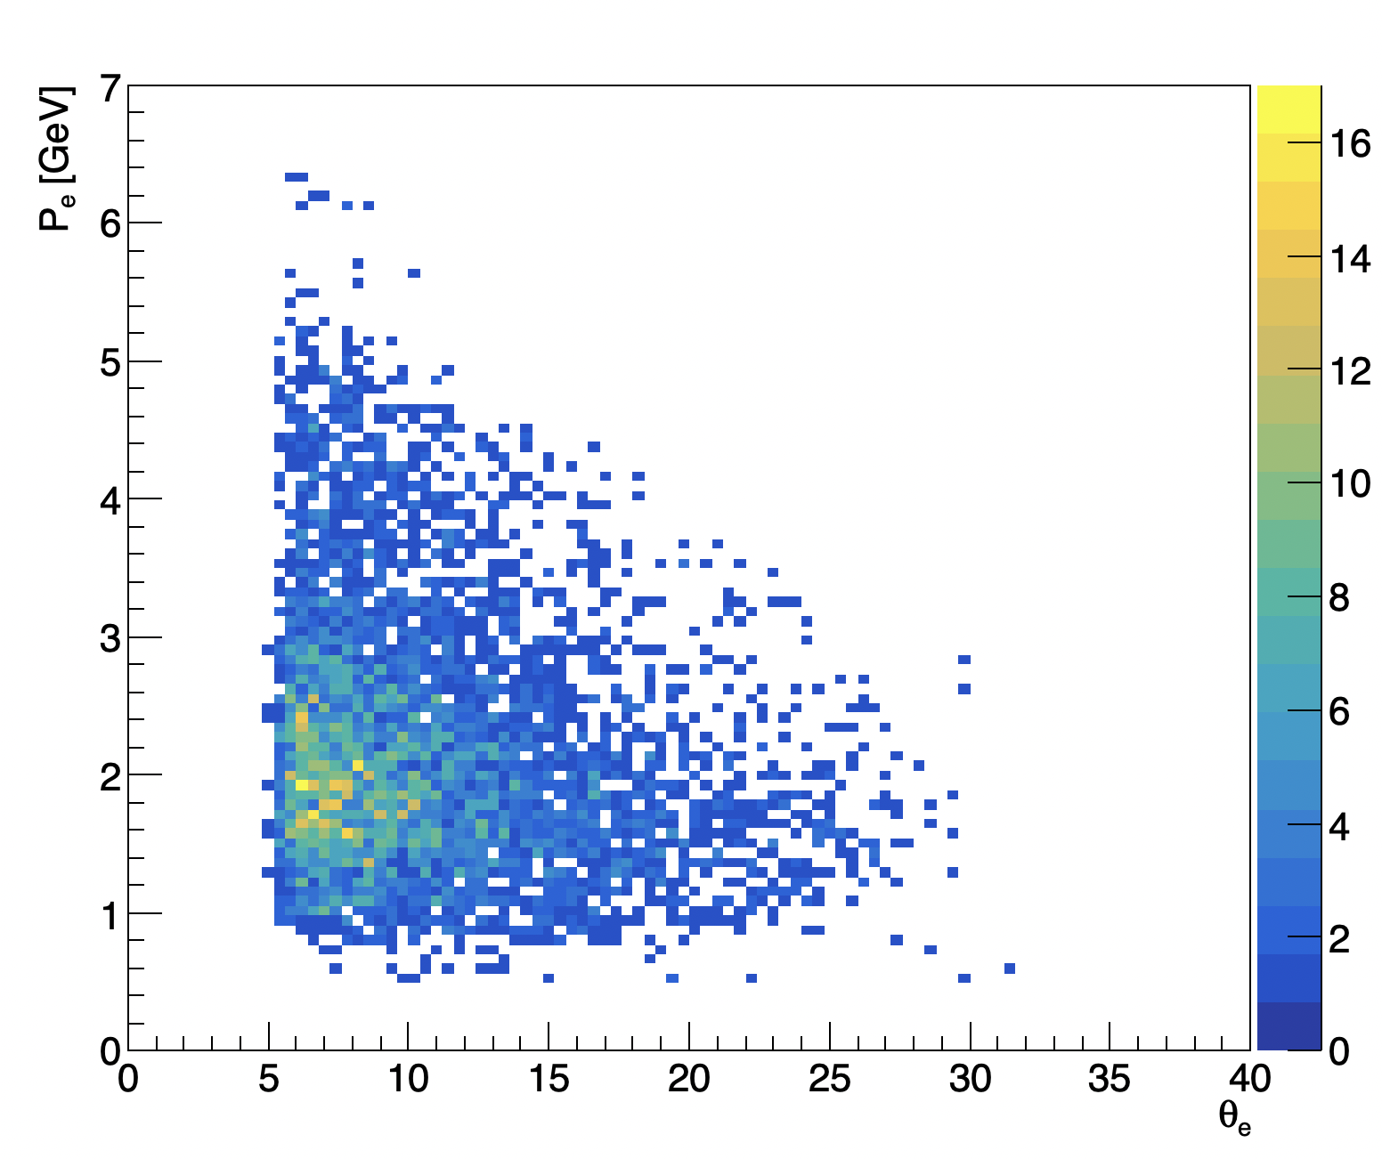





Electron Selection
Forward Detector
$$P>0.4 GeV$$
$5°≤θ≤35°$
$$N_{e}=1$$
$$ToF:21≤ToF≤26 ns$$
$$Vertex Positon:−10≤V_{z}≤2$$
Forward Tagger
$$P>1 GeV$$
$2°≤θ≤4.5°$
$$N_{e}=1$$
$$ToF:21≤ToF≤26 ns$$
$$Vertex Positon:−10≤V_{z}≤2$$

Slide 29



Kaon Selection
All Kaons from each data set are required to be in forward detector as their resolution drastically worsens in central detector
$P>0.4 GeV$
$5°≤θ≤35°$
$N_{K^{+}}=2$
$ToF:20≤ToF≤35 ns$
$Vertex Positon:−10≤V_{z}≤2$

