Slide 1



CLAS12 Double-Pion (N ππ)
Electroproduction Analysis
Krishna Neupane
USC, Columbia, SC
Supported by NSF Grant 10014377
CLAS Collaboration Meeting 2025 (July 8-11)

Slide 2
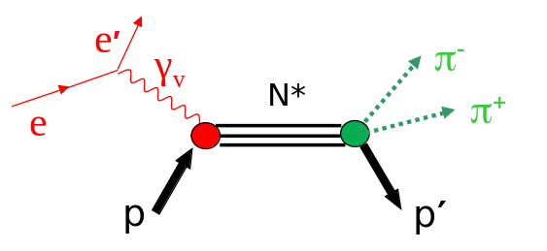
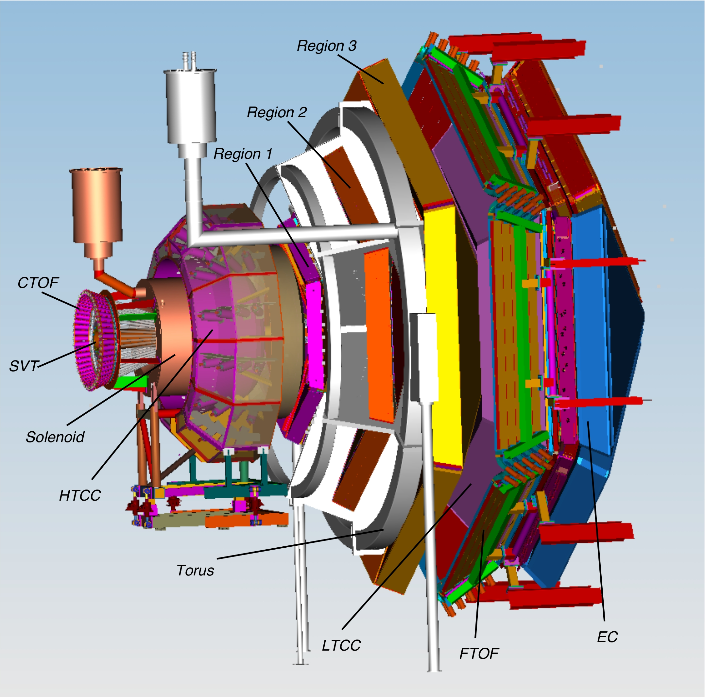
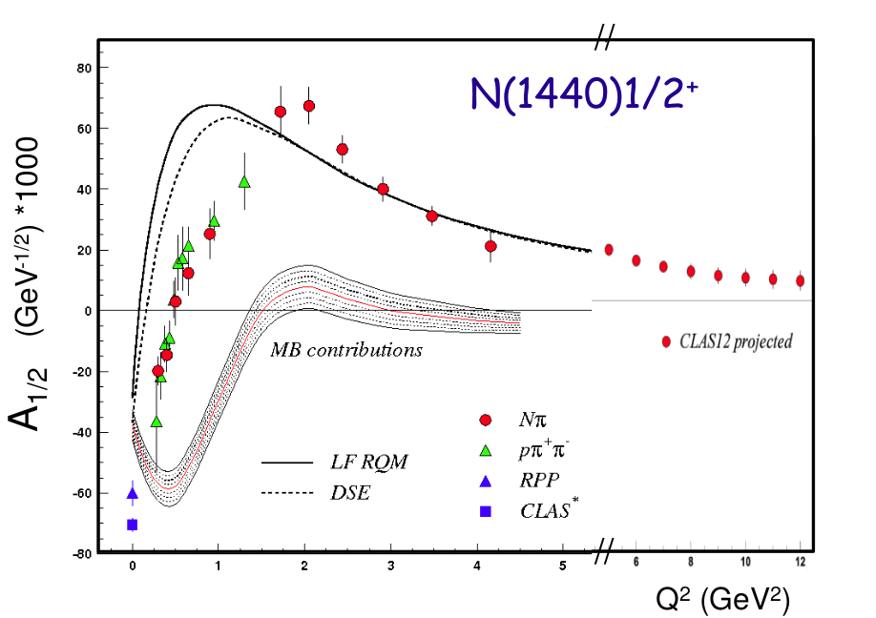
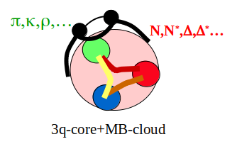
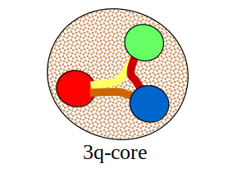
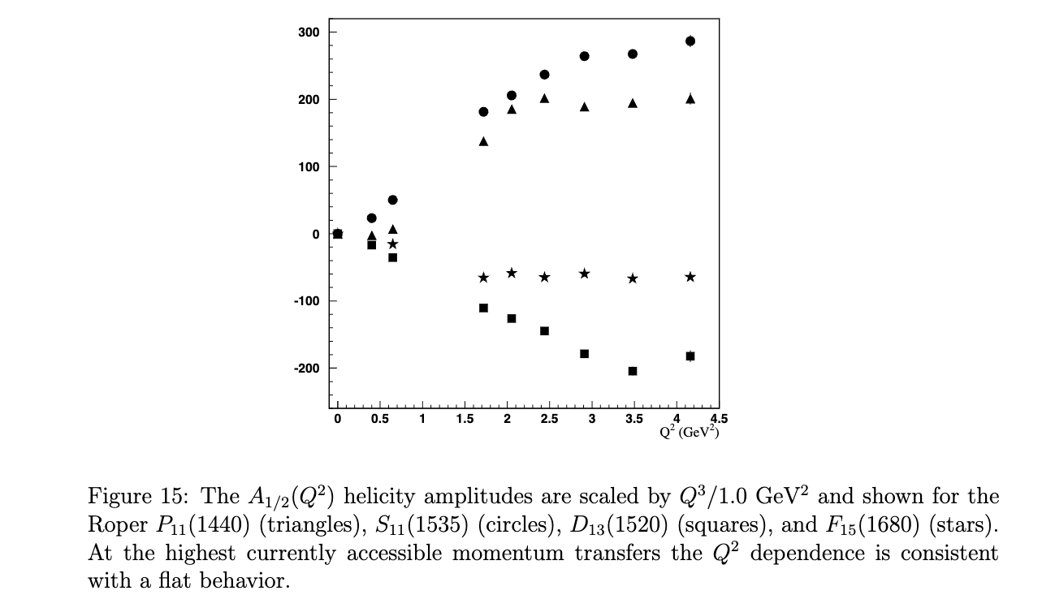
Physics motivation
The objective of this analysis is to extract differential cross sections in the charged double-pion electroproduction using CLAS12 RGA data
These cross sections will be used as input to the phenomenological JM reaction model to extract resonance electrocouplings
The Q² evolution of resonance electrocouplings uncovers the relevant degrees of freedom in the transition from sQCD to pQCD, and explore the quark-gluon dynamics for N* formation, dressing of quarks, hadron mass generation
With CLAS12 data it is possible to extract the resonance
electrocouplings for Q² > 5.0 GeV² (mostly unexplored region)
Q²
ep→N*→e′p′π+π-
Low Q²
High Q²
pQCD
JM23
Experiment
Final State
Cross Section
CSM
QCD Theory & Models
Reaction Amplitudes
Reaction Models
N* with CLAS12 Proposal submitted to JLab PAC34
I. G. Aznauryan et al., Phys. Rev. C80, 055203 (2009)
Phys. Rev. C 80, 055203 (2009) 1-22
and Phys. Rev. C 86, 035203 (2012) 1-22

Slide 3
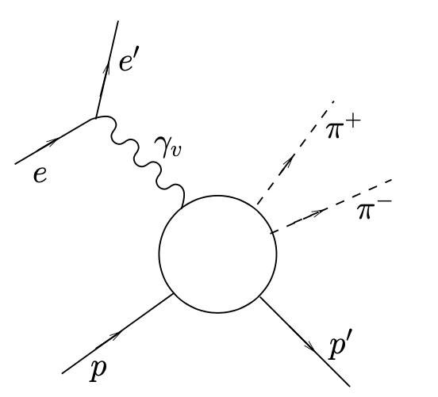
Physics Analysis: Outline
Exp. data: Run Group A, Fall 2018 data with inbending configuration (pass2)
Simulations: TWOPEG event generator is used (gemc 5.10) (pass2), JLab’s osg portal
Topology: Missing pim topology (ep->e’p’pi+)
Particle Identification:
- Electron pid cuts
- Hadron pid cuts
-Detector Inefficiency Cuts
Simulations, Smearing
Event Selection
Cross Sections Extraction
Corrections
Acceptance and Holes
Results: Cross Sections
Systematic uncertainties
Conclusion
ep-->e’p’ π⁺π⁻
Energy loss, Momentum, ΔP
Acceptance Correction
Detector Efficiency from Experimental Data
Bin centering Corrections
Radiative Effects
Background subtraction

Slide 4
Particle identification
Electron pid cuts:
- Electron must have negative charge -1
- Event-builder electron pid cut
- Momentum of electron > 1.5 GeV
- The electron is detected in forward detector
- Vertex position cut around target
- 3.5 sigma cut on sampling fraction
- PCAL fiducial cuts:
- DC fiducial cuts:
- Cuts on V and W planes of the PCAL
- PCAL inefficient region cuts
- 1.4 GeV < W < 2.15 GeV
- 2.0 GeV² < Q² < 9.0 GeV²
Hadron pid cuts:
Event-builder pid cuts for proton, π⁺ and π⁻
Charge cut
Status Cuts
- Δt cut: 3 sigma cuts for all hadrons
Momentum of FTOF pip > 0.5 GeV
Momentum of FTOF protons > 0.4 GeV
Momentum of CTOF particle > 0.2 GeV
Chi-Square pid cuts
Difference between vertex position of hadron and electron cut
DC fiducial cuts for FD hadrons
Transverse momentum versus phi cuts for CD positive hadrons
DC inefficient regions cuts
Removal of CD-FD tracks
$Δt= \frac{lsc}{βc}−tSC$+ vertex time,
where l_{SC}, t_{SC} are path length and time from vertex to SC,
vertex time = l^{e}_{SC} - $\frac{teSC}{c}$, for electrons
β =$\sqrt{\frac{p2}{m2+p2}}$
CLAS12 First Experiment Run Group A Analysis Wiki : Double pion channel Analysis
Notes:
velocity of the hadron β = pc/E
E=γmc² => γmc = E/c
p =γmv. Thus β = v/c = p /(γmc) = p / (E/c) = pc /E
Chi-Square pid described as a signed Nσ (number of standard deviations) from the nominal timing, particularly related to timing information from the FTOF (Forward Time-Of-Flight) detector.

Slide 5
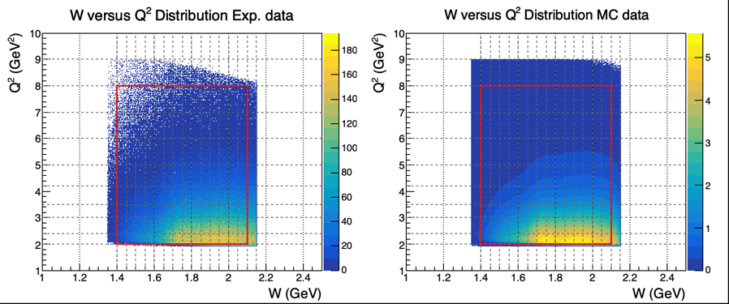
Event selection: Kinematic coverage
Exp
Sim

Slide 6
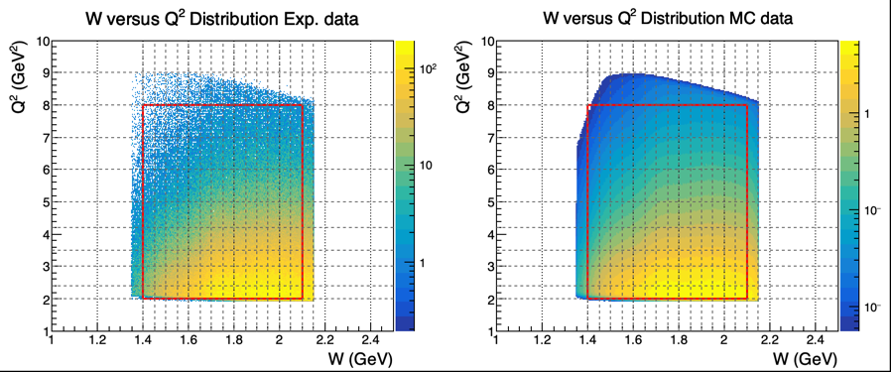
Event selection: Kinematic coverage

Slide 7
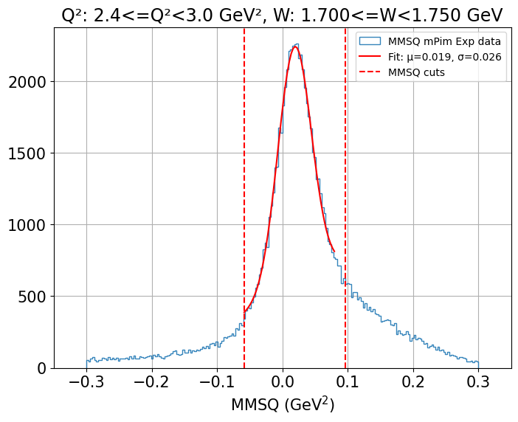
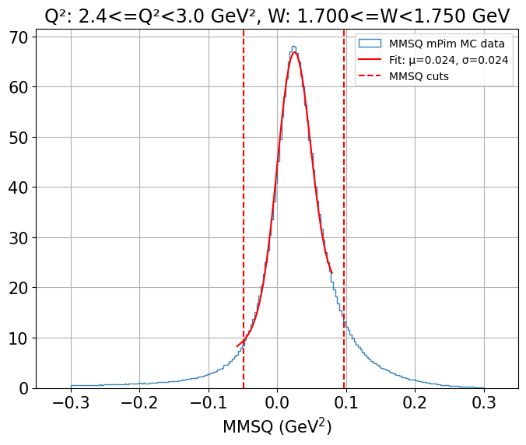
Event selection: MMSQ Cuts
Exp
Sim

Slide 8
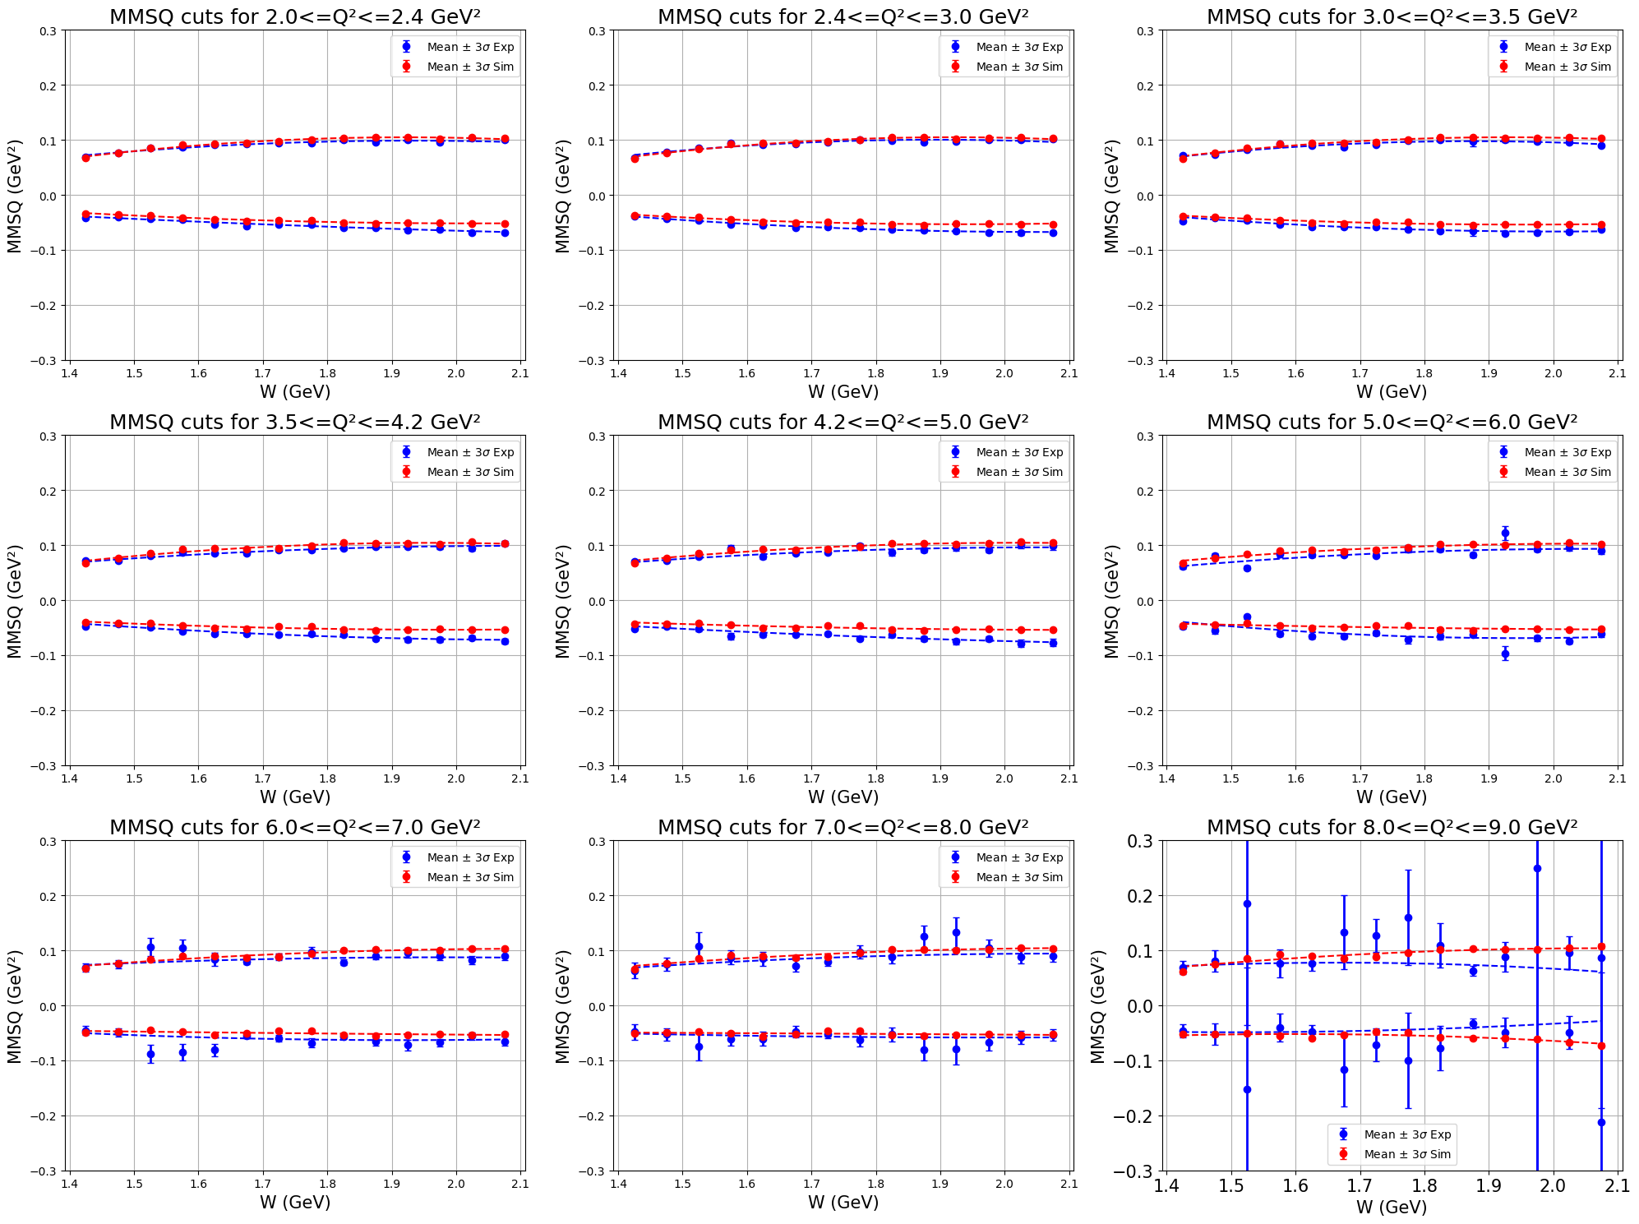
Event selection: MMSQ Cuts
error = sqrt(covariance)

Slide 9



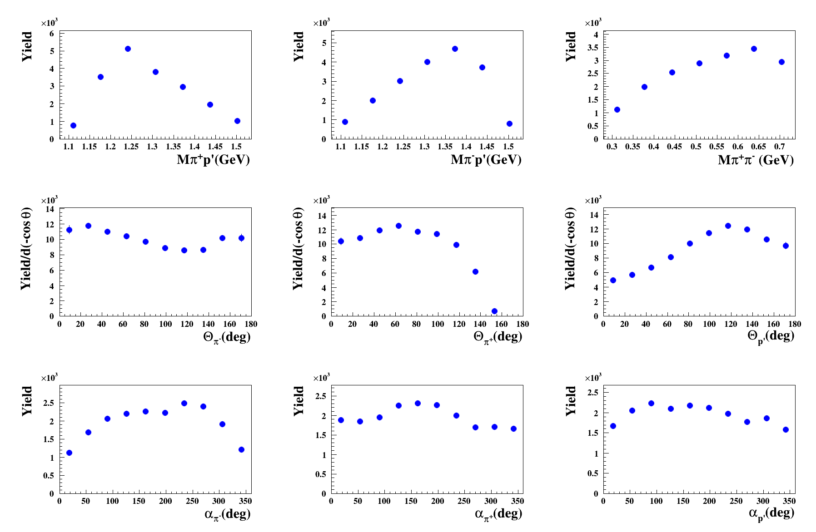
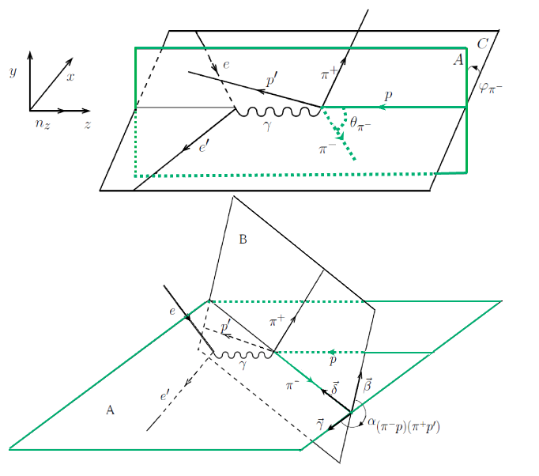
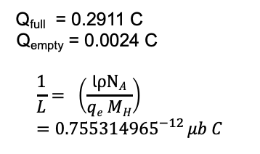
Double-pion channel cross section
Electron Scattering Cross-Section:
Q_{full} = 0.2911 C
Q_{empty} = 0.0024 C
$$\frac{1}{L}= \left(\frac{\text{l}ρNA}{qe MH}\right)={0.755314965}^{−12} μb C$$
Hadronic Cross-Section:
Single Differential Cross-Section:
1) M_{π-π+}, M_{π+p’}, θ_{π-}, φ_{π-} and α _{(pπ-)(p’π+)} (ie. α_{π-}) [π−, π+, p′]
2) M_{p’π+}, M_{π+π-}, θ_{p’} , φ_{p’} and α_{(pp’)(π+π-)} (ie. α_{p’} ) [p′, π−, π+]
3) M_{π+π-}, M_{π-p’} , θ_{π+}, φ_{π+} and α_{(pπ+)(p’π-)} (ie. α_{π+}) [π−, π+, p′]
Binning:
50 MeV W bin size
8 Q² bins
7 bins for invariant masses
10 bins for θ
6 bins for φ
10 bins for α
Nine 1D experimental yields for 1.65-W-1.70 GeV 3.5-Q²-4.2 GeV²
The goal of the analysis is to extract the virtual photoproduction cross section σ_{v} of the reaction γ_{v}p → p′π+π−. This virtual photoproduction cross section σ_{v} is five-fold differential and in the single-photon exchange approximation connected with the seven-fold differential electron scattering cross section σ_{e} via :
Notes:
9

Slide 10
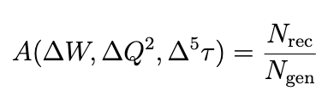
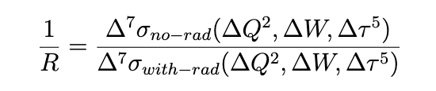
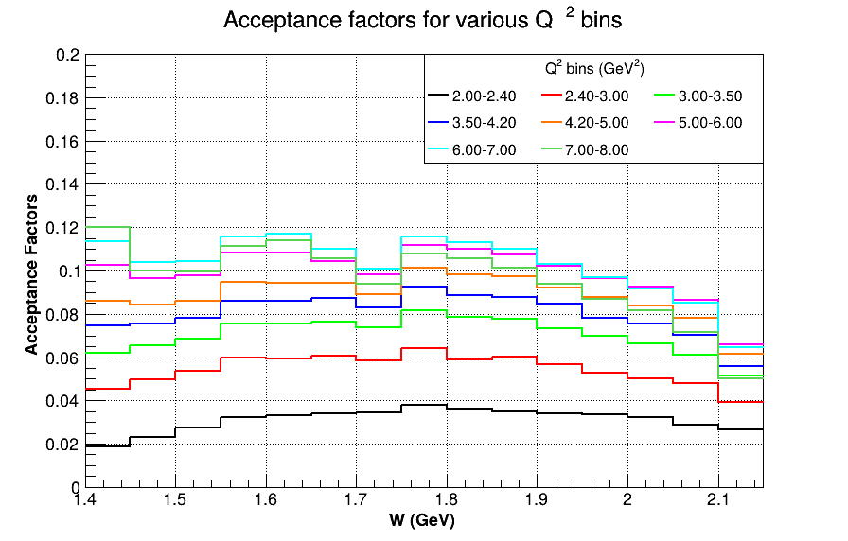
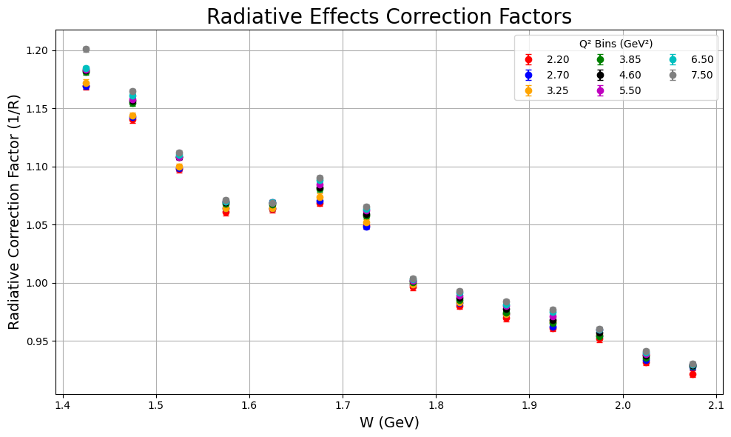
Acceptance and Radiative correction factors
A[ΔW,ΔQ²,Δ⁵𝜏] = (THnSparseD*)acceptance_7D_hist[ΔW,ΔQ²,Δ⁵𝜏] =
(THnSparseD*)h_sim_rec_7D_hist[ΔW,ΔQ²,Δ⁵𝜏]/(THnSparseD*)h_thrown_7D[ΔW,ΔQ²,Δ⁵𝜏]

Slide 11
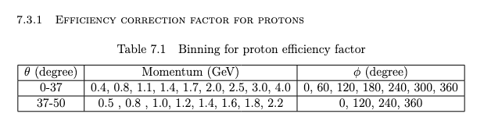
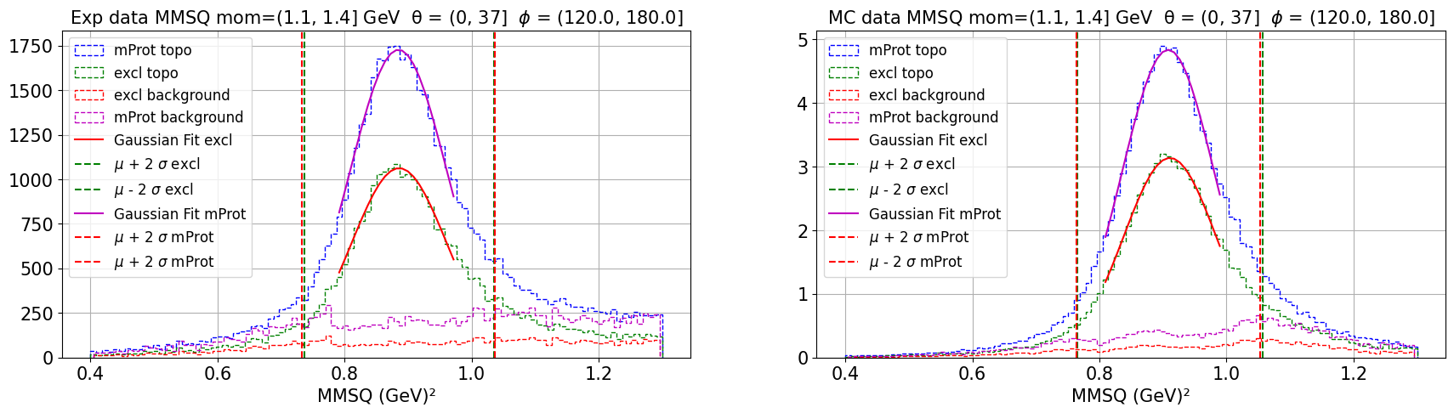
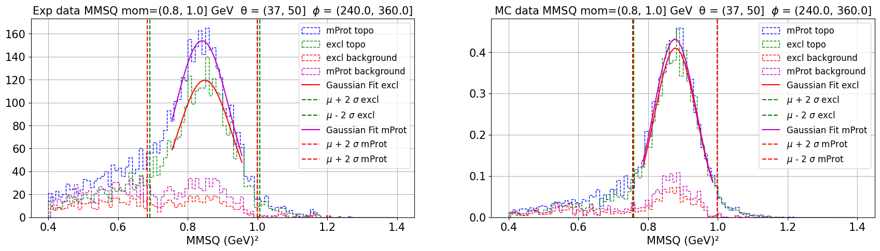
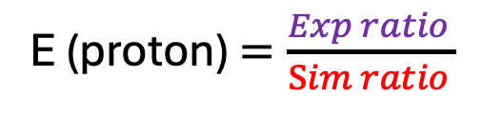
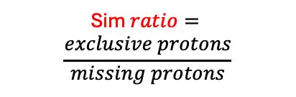
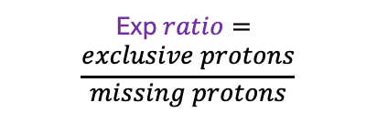
Particle efficiency correction factor
E = E (proton) x E (pip)
The green curve represent the no. of protons measured by the detector in our channel.
Blue curve represent the actual no. of protons in our channel.
Exp $ratio=$
$$\frac{exclusive protons}{missing protons}$$
Sim $ratio=$
$$\frac{exclusive protons}{missing protons}$$
E (proton) $=\frac{Exp ratio }{\operatorname{Sim}{ratio }}$

Slide 12
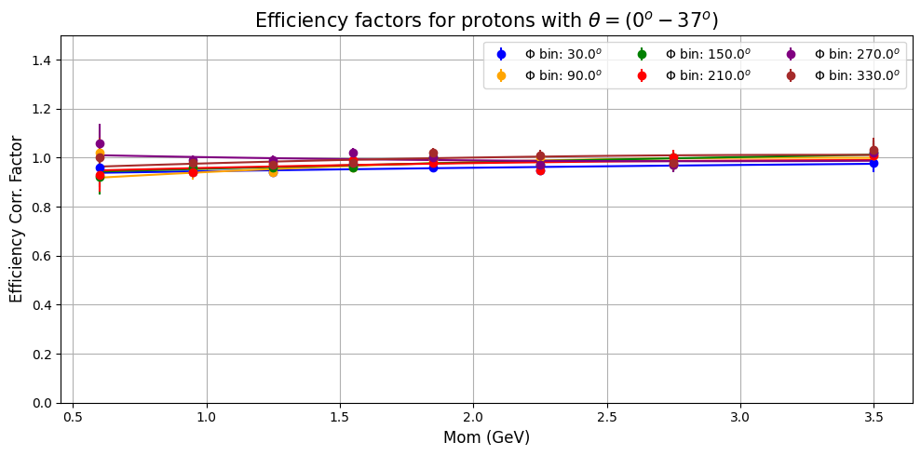
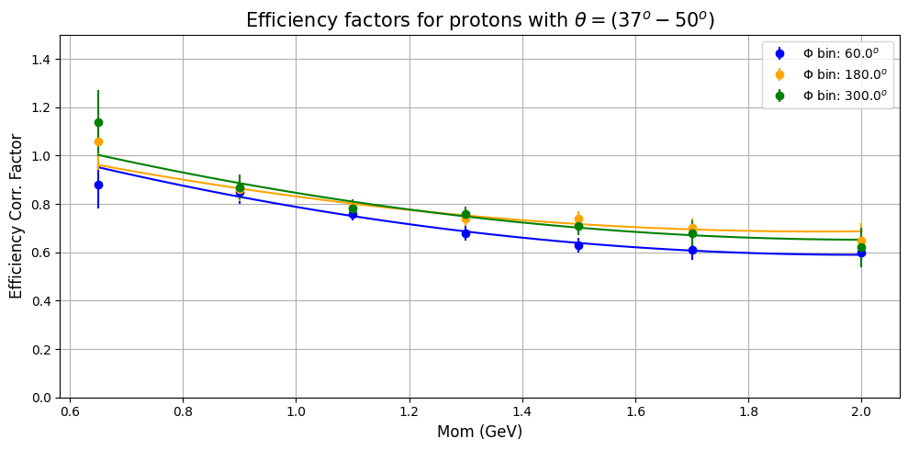
Particle efficiency correction factor
E = E (proton) x E (pip)
This show the experimental measurement and simulation reconstruction are equally efficient.
This shows the experimental measurement is less efficient than reconstruction in simulations.

Slide 13
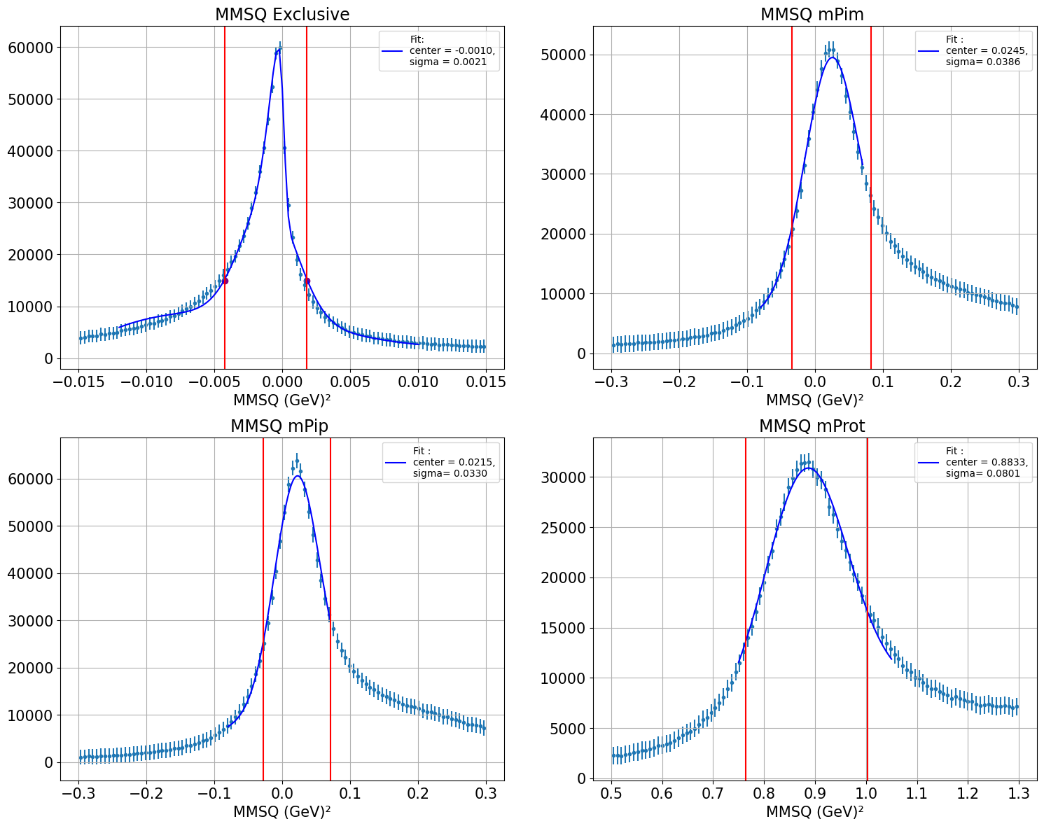
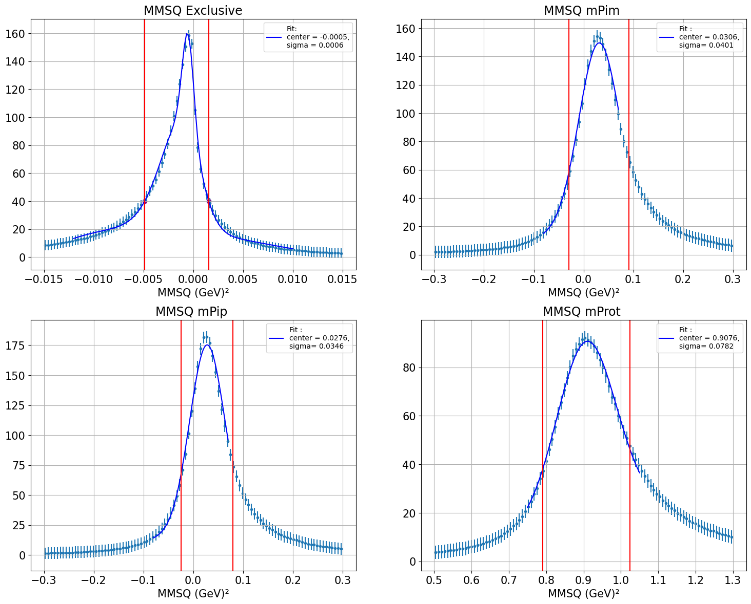
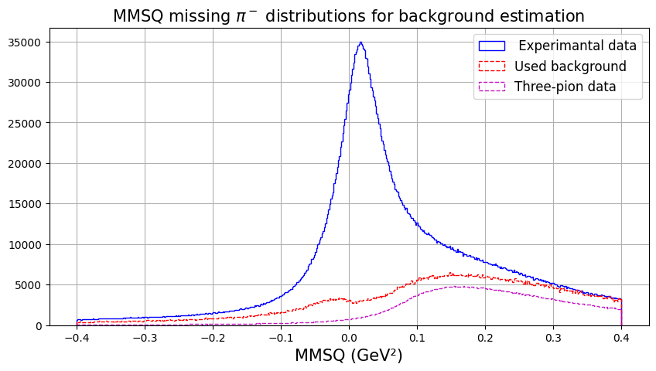
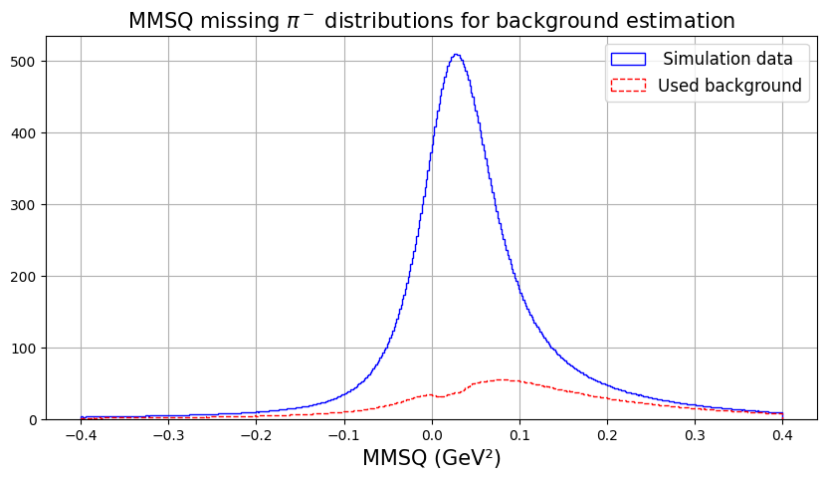
Background subtraction
✅
Experiment
✅
Simulation
Exclusive topology
Exclusive topology
✅
✅
✅
✅
mPim topology
mPim topology

Slide 14
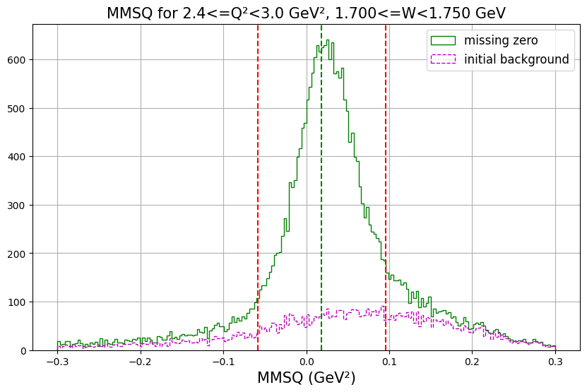
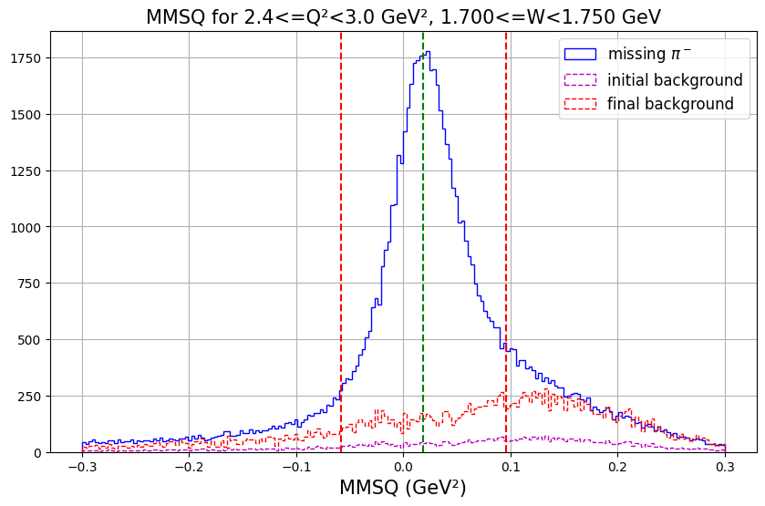
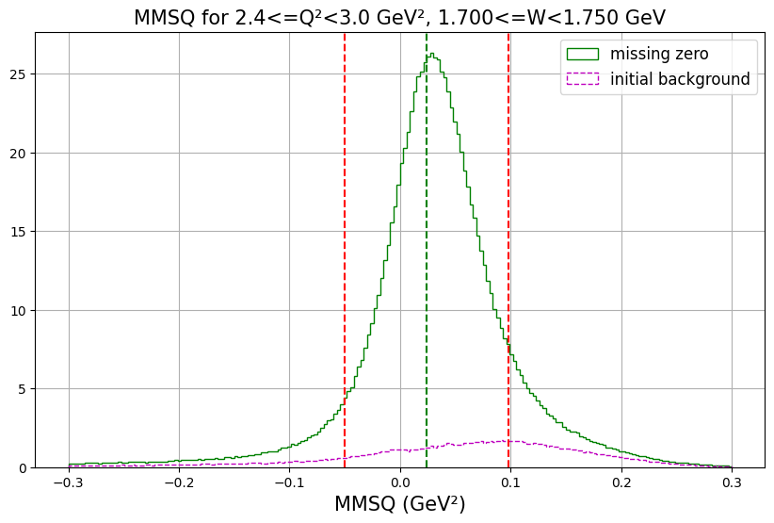
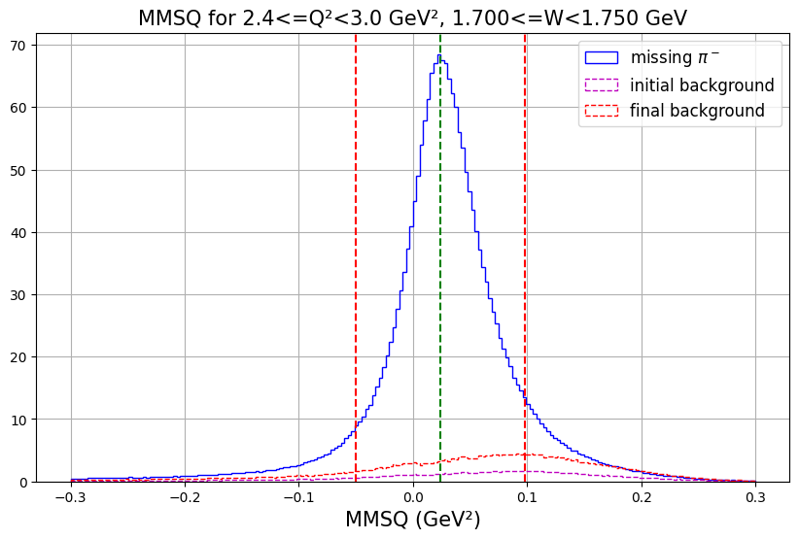
Background subtraction
Exclusive topology
Missing pim topology
Experiment
Simulations

Slide 15
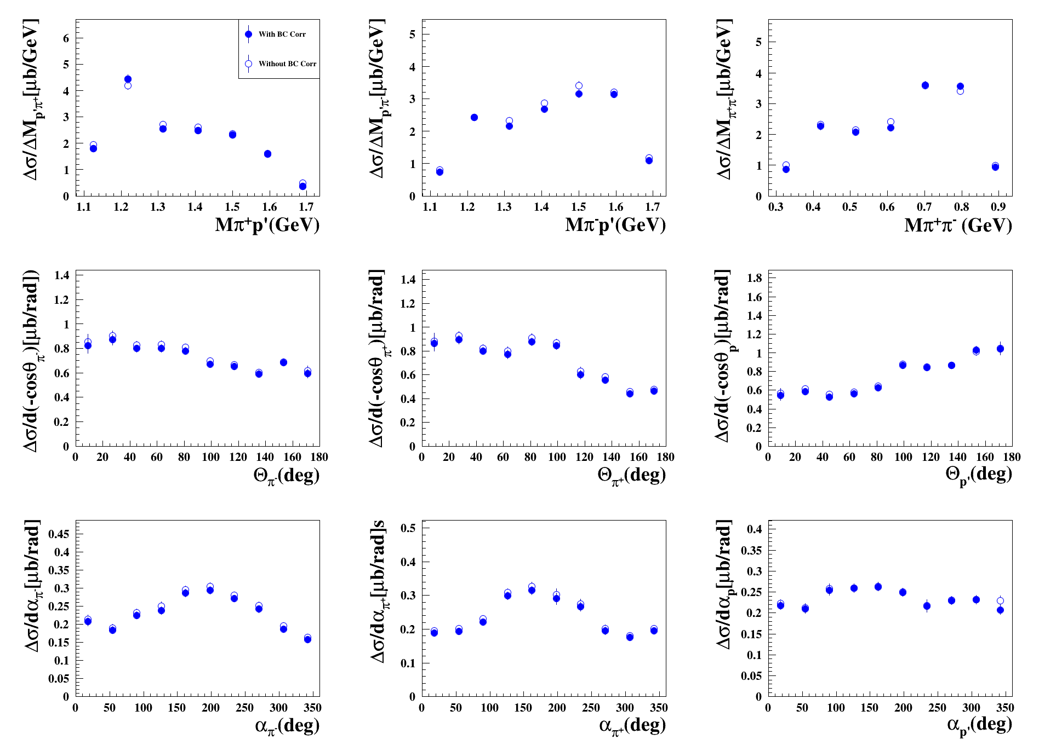
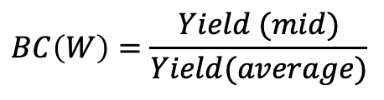


Bin centering corrections
The extracted cross sections are
reported at the central value of each bin. However, these reported values represent the average cross section across the entire bin.
$$BC\left(W\right)=\frac{Yield (mid)}{Yield(average)}$$
BC$corr=BC\left(W\right)$ x $BC\left(Q2\right)$ x $BC\left(H\right)$
𝞂$corr=BCcorr \text{x} \text{σ}uncorr$
W[1.85, 1.90] GeV, Q²[4.2, 5.0] GeV²

Slide 16
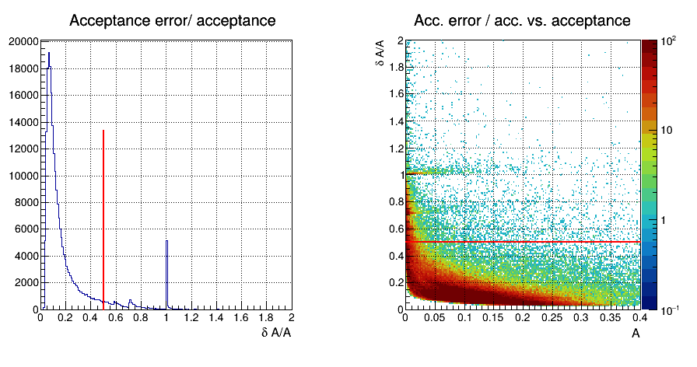
Relative acceptance errors cut
Total 7D bins = 9 X 14 X 7 x 7 x 10 x 6 x 10 = 3,704,400
In each W-Q² bin = 7 x 7 x 10 x 6 x 10 = 29,400 5D bins
Sufficient simulations in each 5D bins is crucial to get the proper acceptance factors
Low filled 5D bins can leads to the higher acceptance errors
1.80-W-1.85 GeV, 4.2-Q²-5.0 GeV²

Slide 17
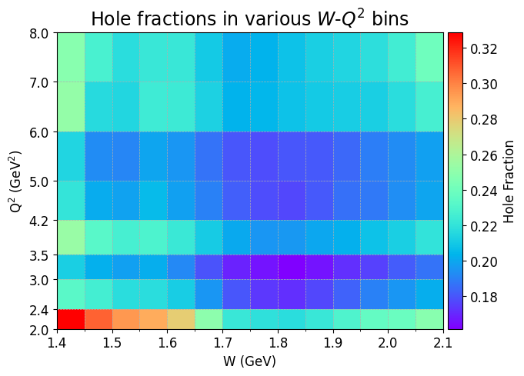
Hole fractions (A=0) in simulations
- CLAS12 detector does not fully cover 4π angular area - Design constraint of detector leads to some physical gaps called holes
- Insufficient simulations, and the acceptance error cuts also increases (artificial) holes
- We need to fill those holes by using scaled generated yields
As hole filling is model dependent its systematics is 50 % of the total hole contribution, for integrated cross sections it is estimated to be 5.24 % (worse in lowest Q² bin 9.3 % and better 3.46% in high Q² bin.

Slide 18
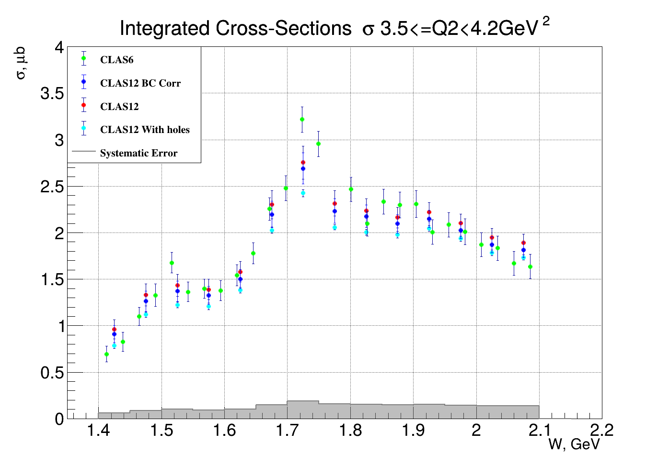
Results: Integrated cross sections
Error bars are including statistical errors and the hole filling errors
Preliminary
Systematic error dose not include hole filling errors
Notes:
CLAS e1-6 Data 5.74 GeV

Slide 19
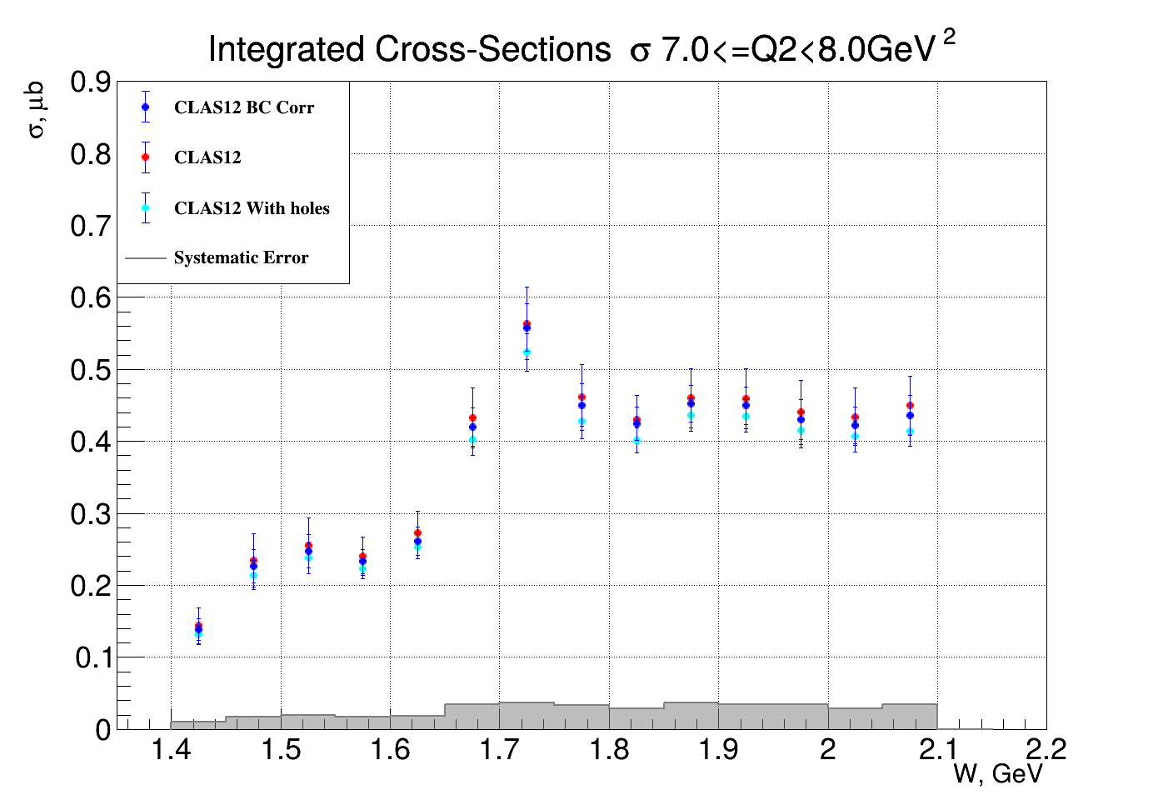
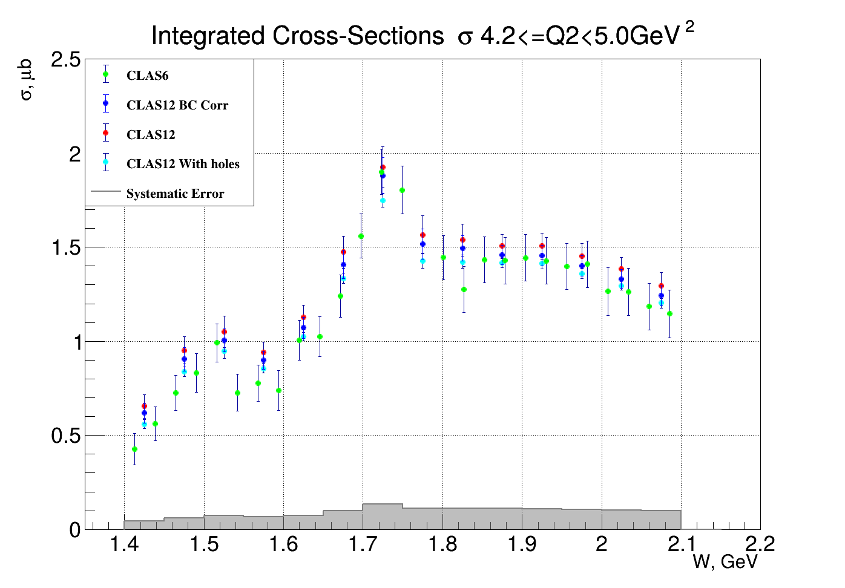
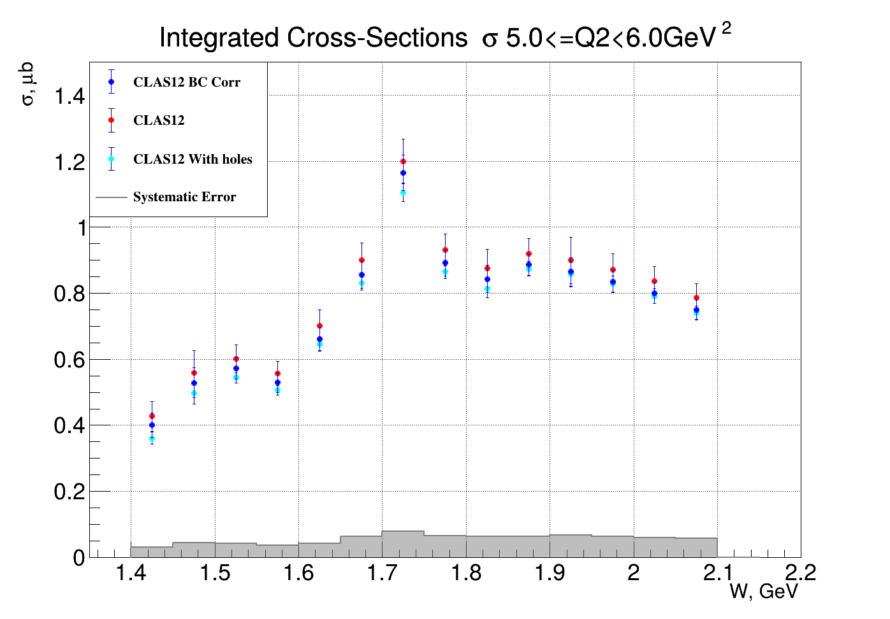
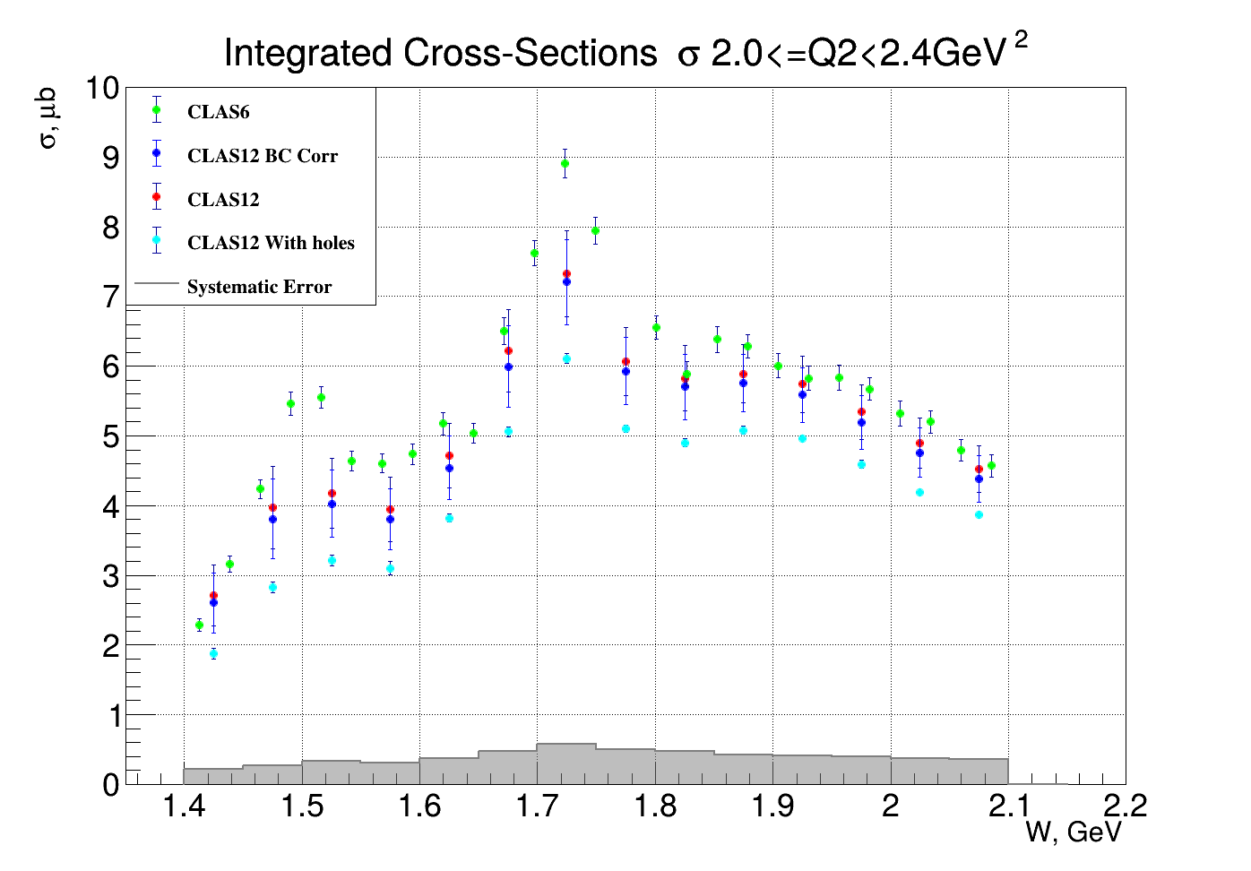
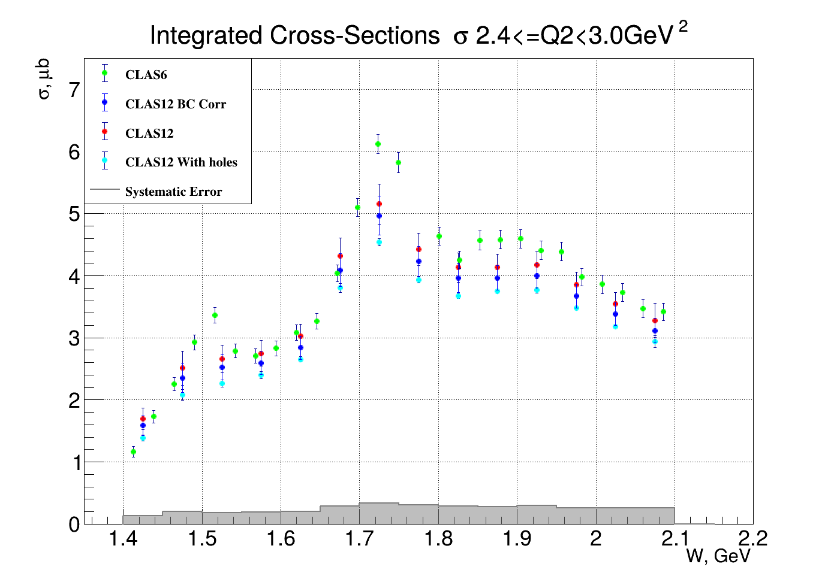
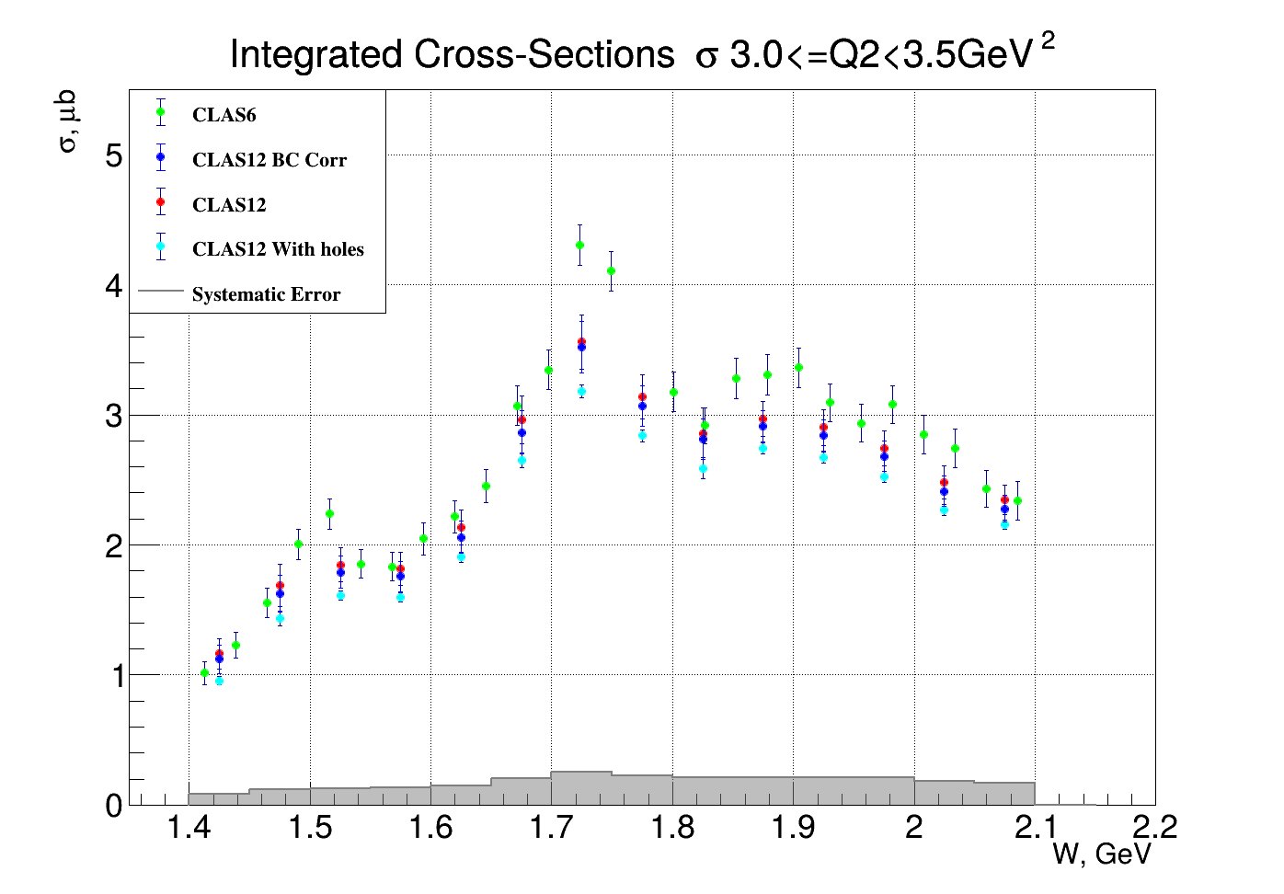
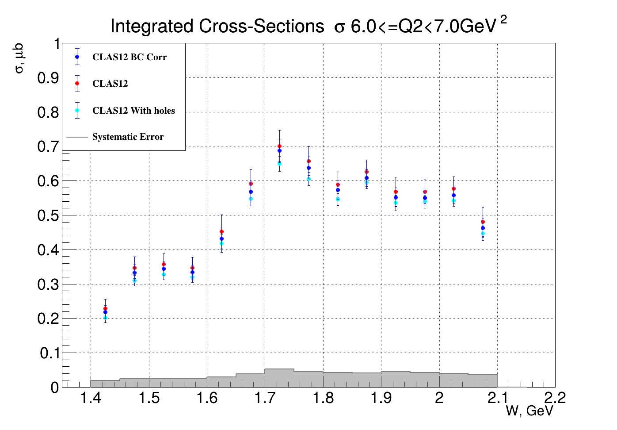
Results: Integrated cross sections
Error bars are including statistical errors and the hole filling errors
Preliminary
Systematic error dose not include hole filling errors

Slide 20
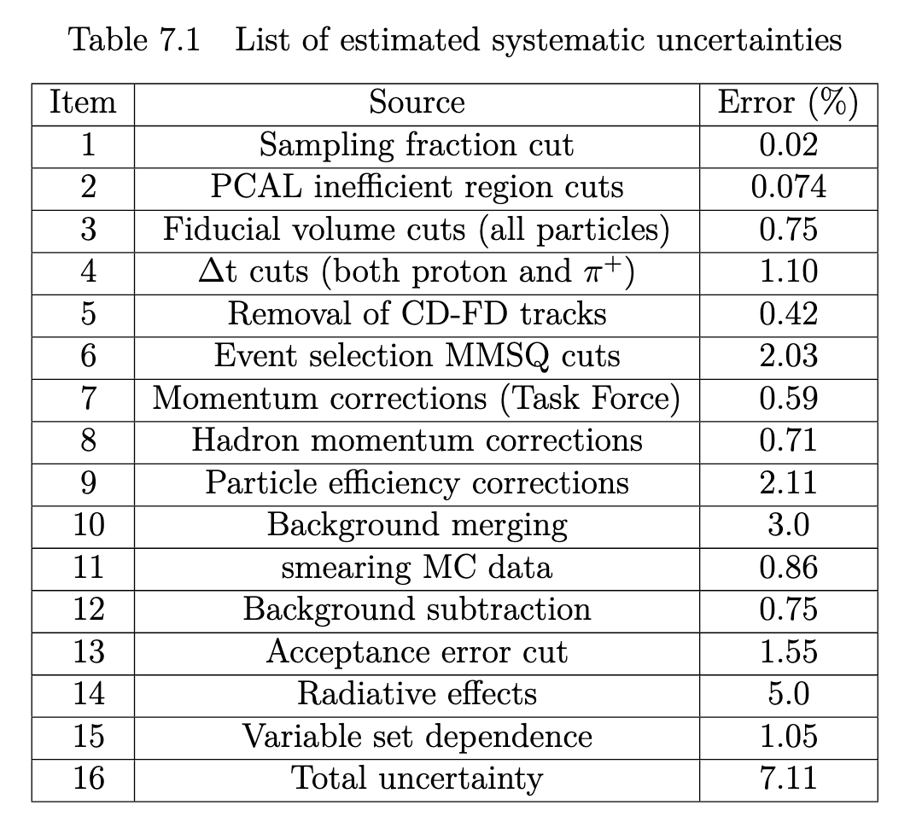
List of all systematic uncertainty
Preliminary

Slide 21
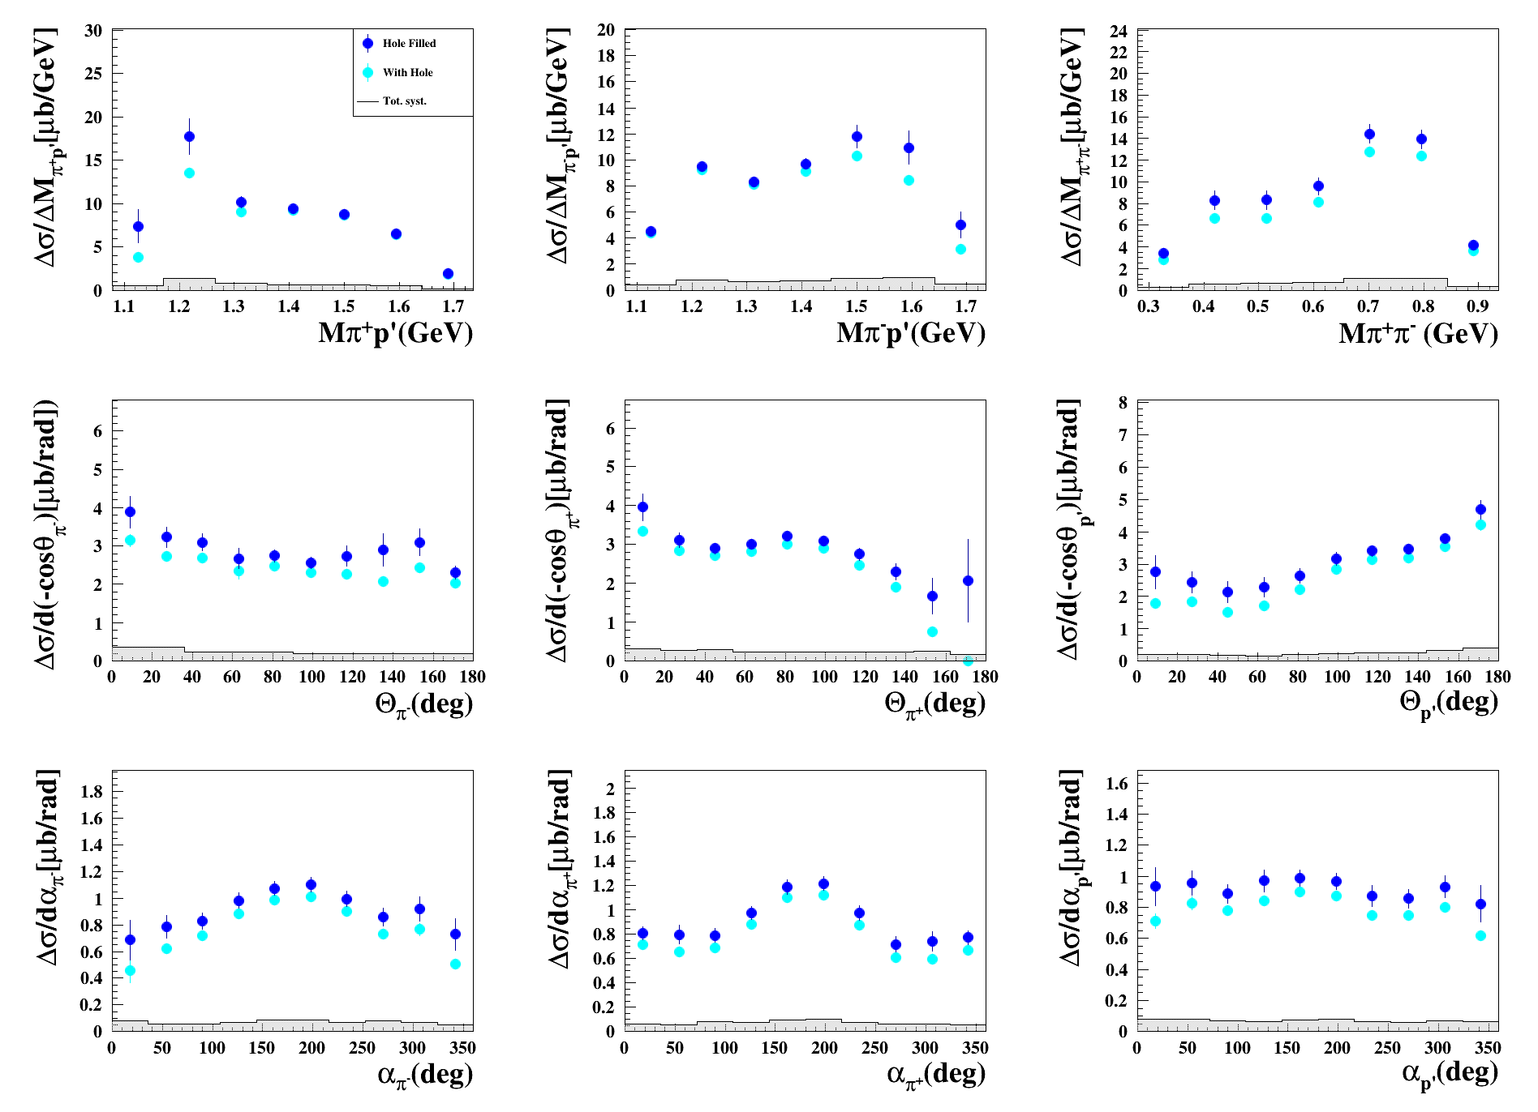
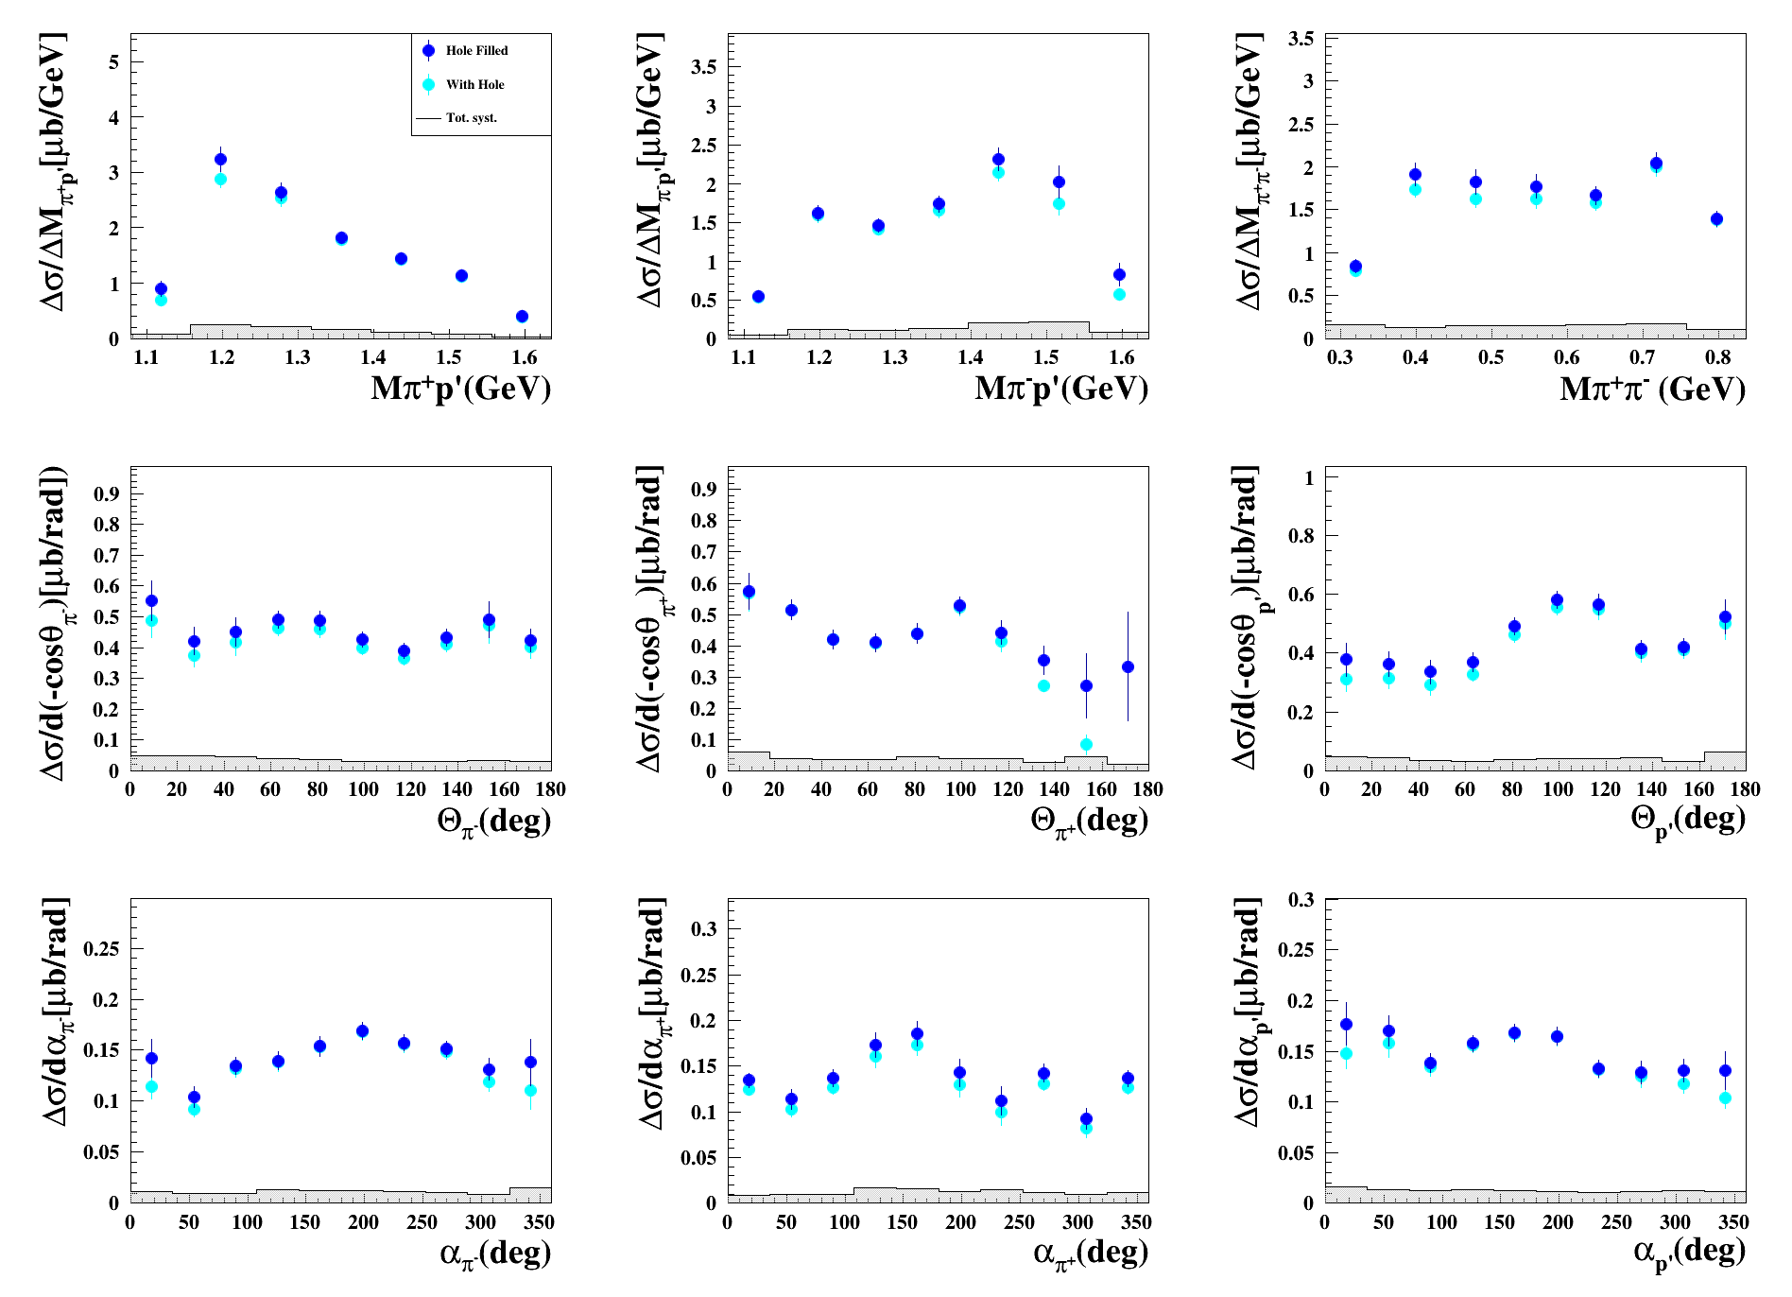
Results: Nine single-differential cross sections
Preliminary
W [1.85,1.90] GeV, Q² [2.0, 2.4] GeV²
W [1.75,1.80] GeV, Q² [5.0, 6.0]GeV²
These 1-D cross sections will be modified to finer invariant mass binning for JM Model

Slide 22
Conclusions and remarks
Preliminary cross sections for exclusive double-pion electroproduction extracted using CLAS12 (RGA Fall 2018).
Q² coverage of cross sections has been extended from 5 GeV² up to 8 GeV² for the first time, which will be crucial for the JM model to extend its kinematic coverage.
Extracted integrated cross sections have been compared with previous CLAS results for overlapping bins, showing agreement within error bars.
Systematic error studies have been performed, it is estimated to be 7.11 % for total integrated cross sections, excluding hole filling systematics estimated to be 5.24%.
A CLAS Analysis Note and a journal paper are in preparation. Target submission is planned for December 2025, following updates to the invariant mass binning and a careful review of all analysis steps.
Notes:
22

Slide 23
Thank You!!

Slide 24

Back up Slide: Virtual Photon Flux
24

Slide 25

Backup Slide : Hole Filling Process
25
Notes:
25

Slide 26


Helicity transition amplitudes of N(1440)1/2⁺
electrocouplings from the different models/
studies of two major Nπ, pπ⁺π⁻ channels
26

Slide 27

Back up slide: CLAS6 and Twopeg cross sections

Slide 28



Back up slide: CLAS and Twopeg cross sections
$$\frac{d5σ}{d5τ}\left(Q2\right)=\frac{d5σ}{d5τ}\left(0.65 GeV2\right) ∗ \frac{F2(Q2)}{F2(0.65 GeV2)}$$
$$Where, F(Q2)=\frac{1}{\left(1+\frac{Q2}{0.7 GeV2}\right)}$$
$$\frac{d5σ}{d5τ}\left(Q2\right)=\frac{d5σ}{d5τ}\left(0.65 GeV2\right) ∗ \frac{F2(Q2)}{F2(0.65 GeV2)} ∗ \frac{\left(F2\left(Q2\right)\right)a}{\left(F2\left(0.65 GeV2\right)\right)b}$$
a and b will be calculated from the fit

Slide 29

Back up slide: CLAS and Twopeg cross sections
$$\frac{d5σ}{d5τ}\left(Q2\right)=\frac{d5σ}{d5τ}\left(0.65 GeV2\right) ∗ \frac{F(Q2)}{F (0.65 GeV2)} ∗ \frac{\left(F\left(Q2\right)\right)a}{\left(F \left(0.65 GeV2\right)\right)b}$$

