Slide 1
Welcome and News from Jefferson Laboratory
David J. Dean
Deputy Director for Science and Technology
Presented To:
CLAS Collaboration Meeting
July 8, 2025

Slide 2

Outline…
Our Vision and Strategy
Some Science Highlights
Short-term futures

Slide 3
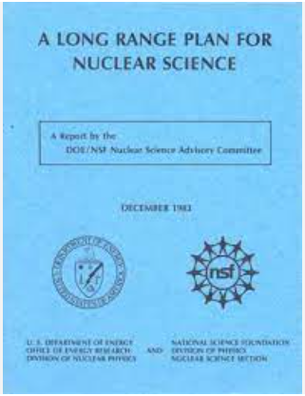
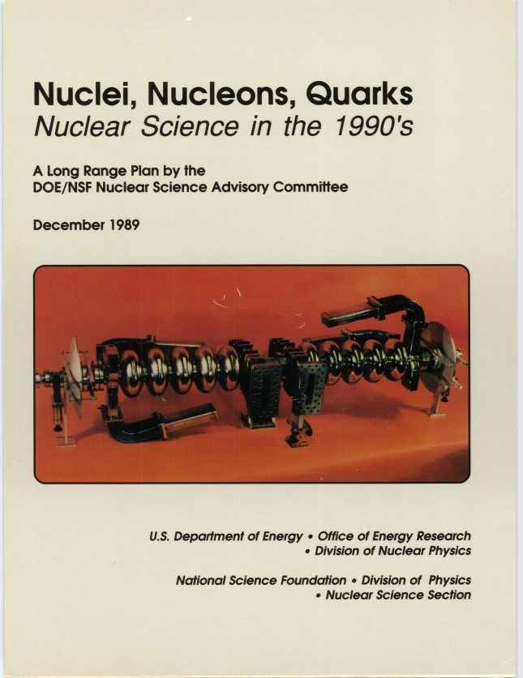

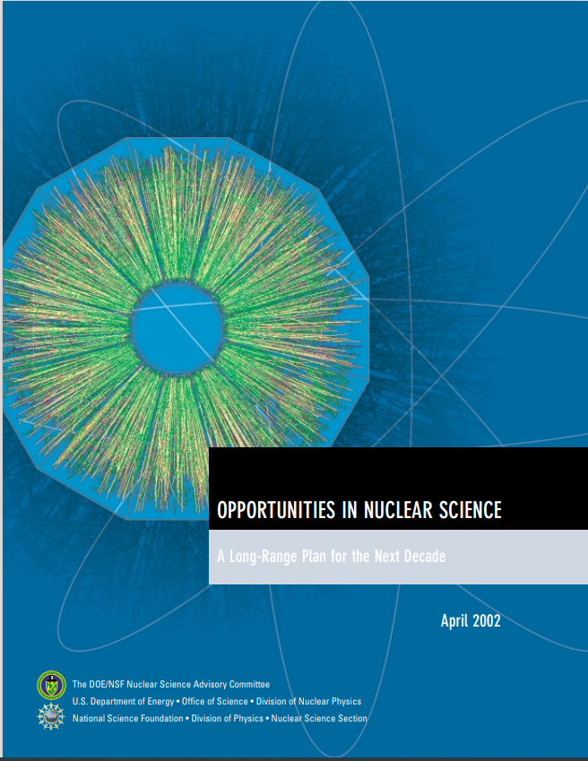
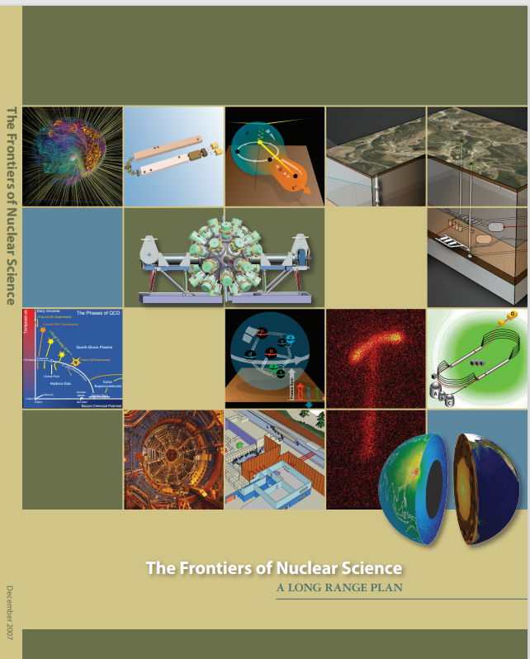


DOE/NSF Long Range Plans set the NP community direction
Since 1979 the Department of Energy Office of Science and the National Science Foundation periodically have charged the Nuclear Science Advisory Committee, NSAC, to provide a framework for coordinated advancement of the Nation’s nuclear science research program
A consistent strategic plan for investments was developed
NSAC engaged the community though town meetings organized by the Division of Nuclear Physics of the American Physical Society
Dean, Ent,
Meringa, Thomas
Dean, Ent, Hutton,
Rossi
Keppel, Qiu
1979
1983
1989
1996
2002
2007
2015
2023

Slide 4
2023 NSAC Long Range Plan Priorities
Nuclear Physics future
  Run the 12 GeV program (1st Recommendation in FY23 LRP)
  Execute SoLID
  (4th recommendation)
  Contribute to EIC
  (3rd recommendation)
  Plan for e+ and 22 GeV
  (in the text)
  Build an EIC research program
  Exploit opportunities
  (Dark Matter; neutrino nucleus;…)
I: The highest priority of the nuclear science community is to capitalize on the extraordinary opportunities for scientific discovery made possible by the substantial and sustained investments of the United States. We must draw on the talents of all in the nation to achieve this goal. [Operation of CEBAF and R&D is here]
III: We recommend the expeditious completion of the EIC as the highest priority for facility construction. [The Partnership is here]
IV: We recommend capitalizing on the unique ways in which nuclear physics can advance discovery science and applications for society by investing in additional projects and new strategic opportunities. [SoLID is here]
Upgrades to CEBAF mentioned in document text.

Slide 5
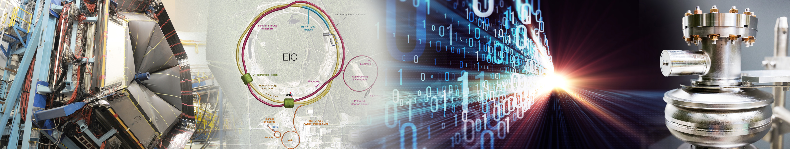










Jefferson Lab’s Science and Technology Vision
The future S&T Vision builds upon our present strengths, founded on four pillars:
Nuclear Physics at CEBAF
Electron-Ion Collider Project
HPDF
World-leading Data Facility
Superconducting Radio Frequency Accelerator S&T
User Community
Partnerships and collaborations are imperative to achieve our vision​

Slide 6
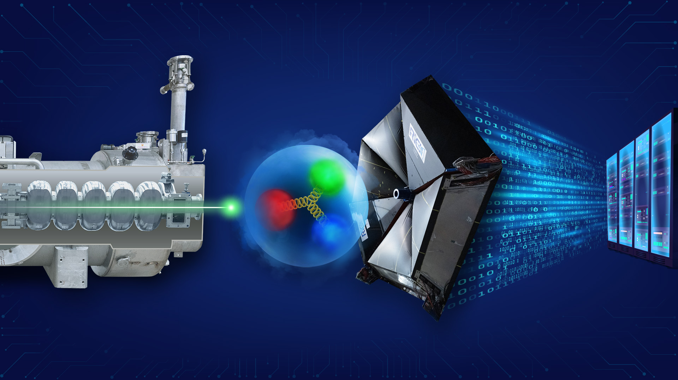
Jefferson Lab core capabilities support our vision & strategy
Accelerator and Detector Science & Technology
Data and Computational Science
Perform cutting edge R&D for next-generation accelerators and cryo-systems
Deliver cryomodules for construction projects such as: LCLS-II HE; SNS-PPU, and EIC
Develop CEBAF upgrade concepts for positrons and 22 GeV
Perform R&D that enables new nuclear physics detectors to deploy to applications in nuclear imaging and medicine
Develop and deploy computational capabilities aimed at understanding the strong force
Develop and implement streaming readout capability at both CEBAF and EIC
Develop a data science R&D program in support of HPDF
Execute the High Performance Data Facility Project with LBNL
Nuclear Physics and the CEBAF National User Facility
Drive strong-force discovery and connections of quarks and gluons to the proton and atomic nuclei
Steward a vibrant nuclear physics research program at CEBAF supporting ~1,650 annual users
Execute the MOLLER Project on budget and on time
Pursue SoLID as the next major Detector in Hall A
Pursue R&D relevant for both CEBAF and EIC
Deliver best in class theory program to guide and interpret experiments

Slide 7
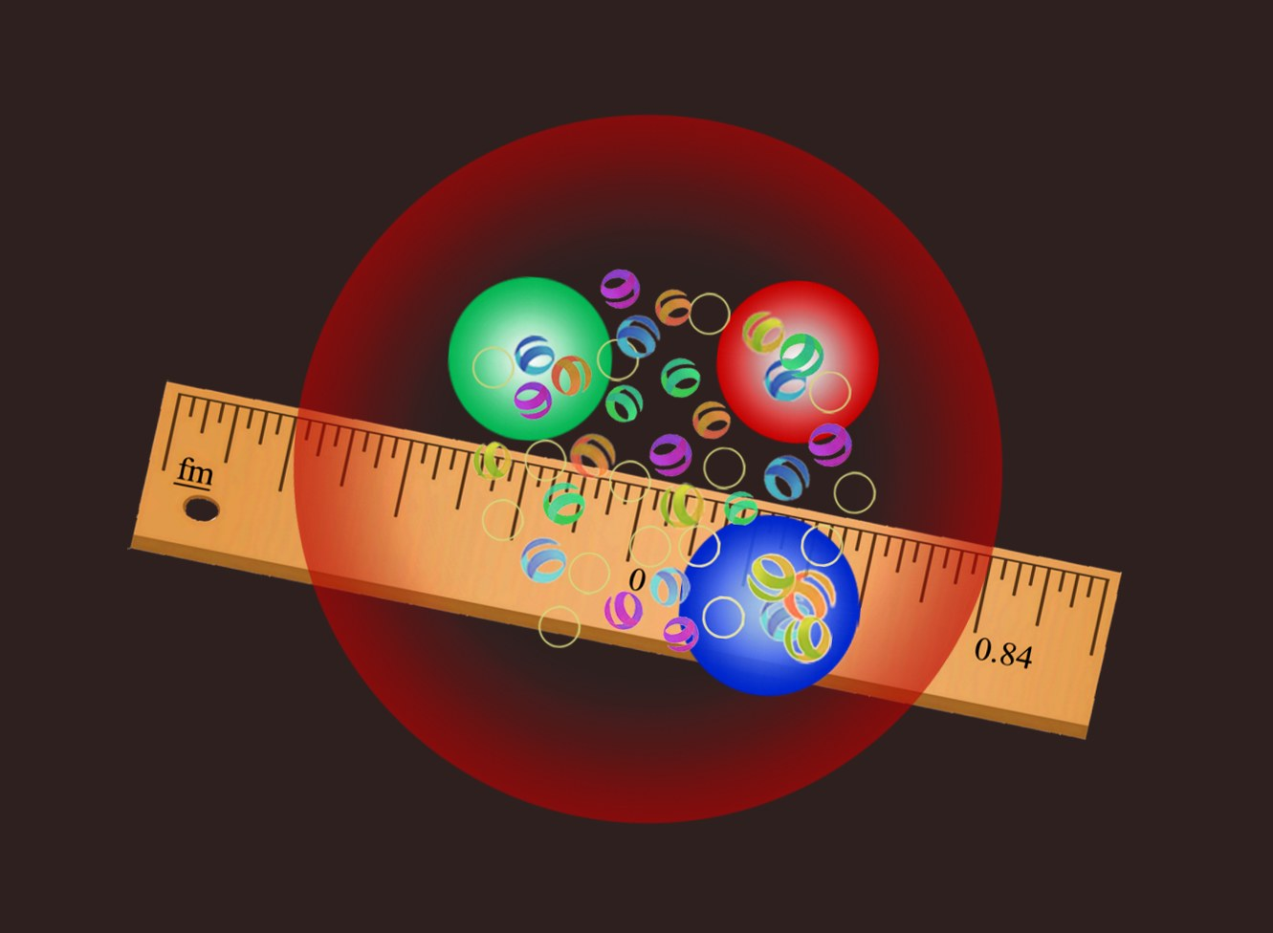
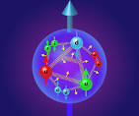
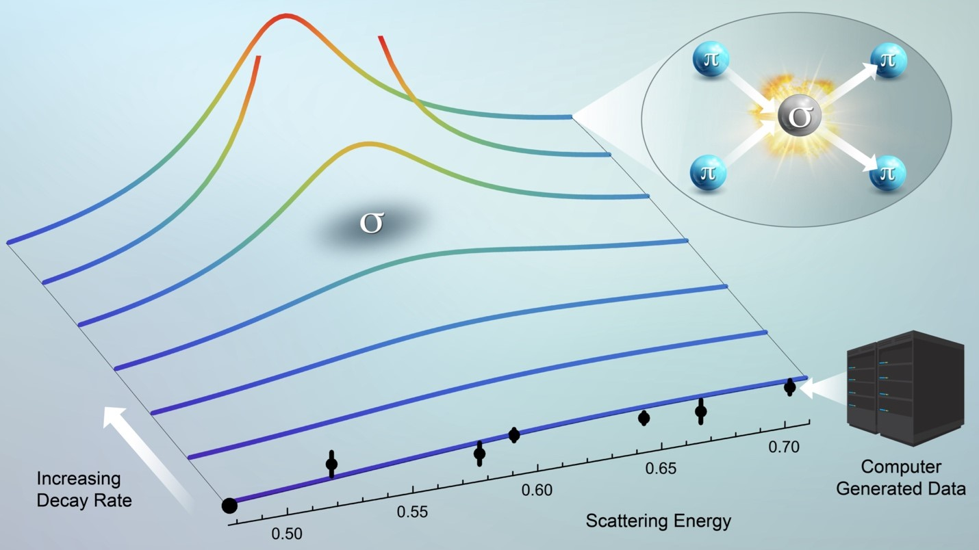
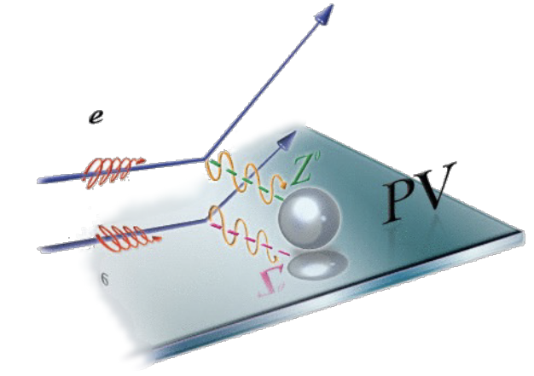
We investigate nuclear forces to answer questions
How big is the proton?
How are quarks distributed in the proton?
What is the spectrum of excited hadrons?
What is the evidence for physics beyond the
standard model?

Slide 8
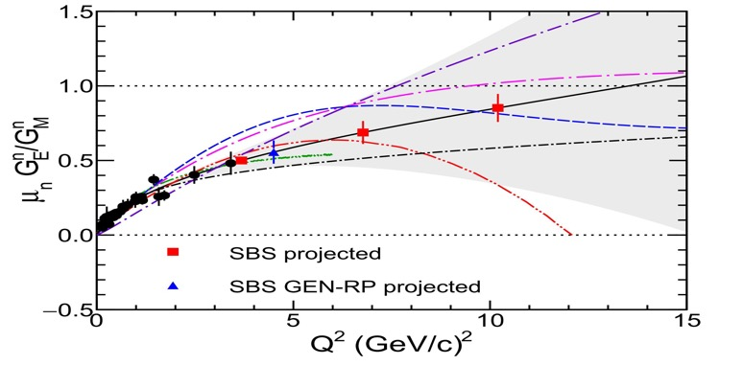
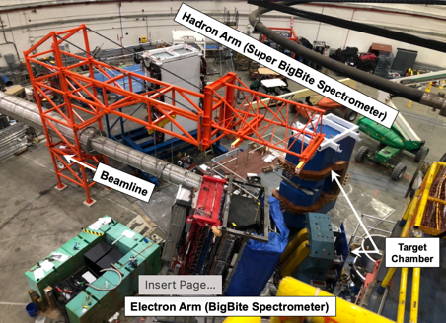
Nuclear Physics Questions:
‘How big is the proton?’
Form factors at highest Q² measured to date
Electric and magnetic form factor measurements give distribution of charges and currents inside the proton.
Differing approaches to QCD calculations predict different behavior at high momentum transfer Q
Years of effort to build the spectrometer and targets.
This experiment is very high priority and is the last one in Hall A before MOLLER Installation

Slide 9
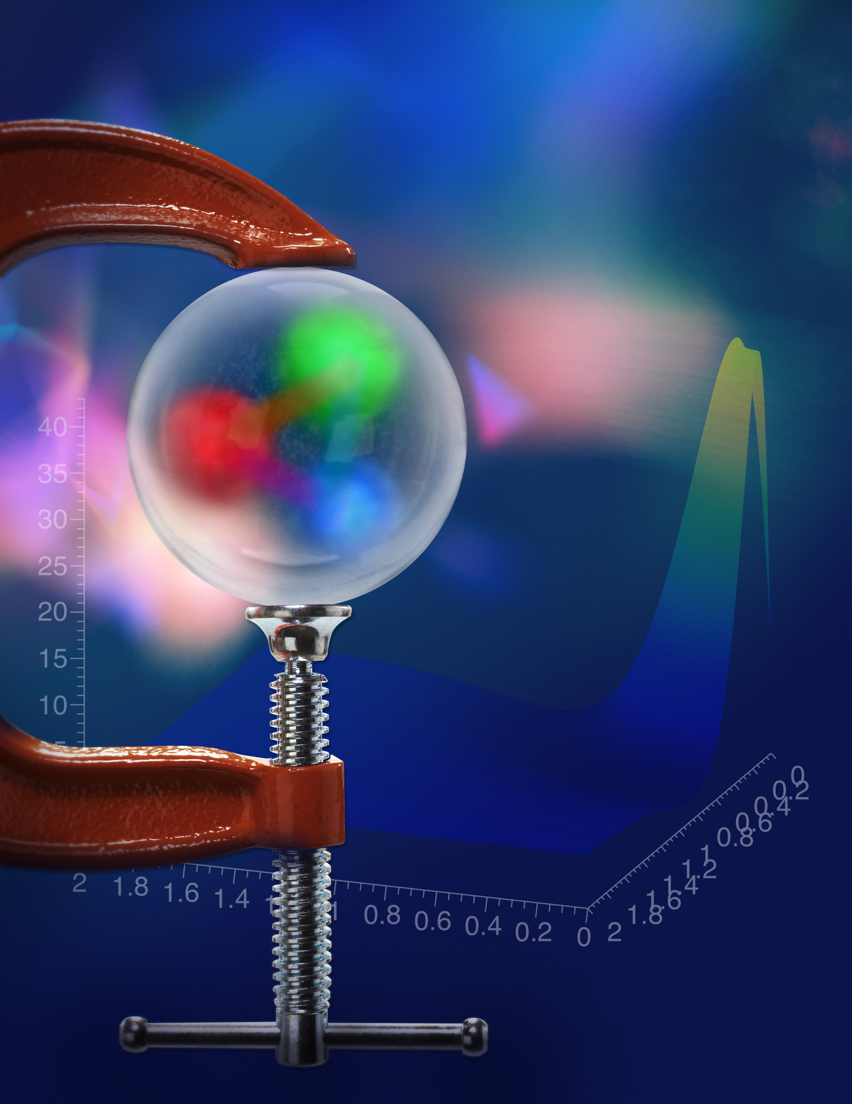
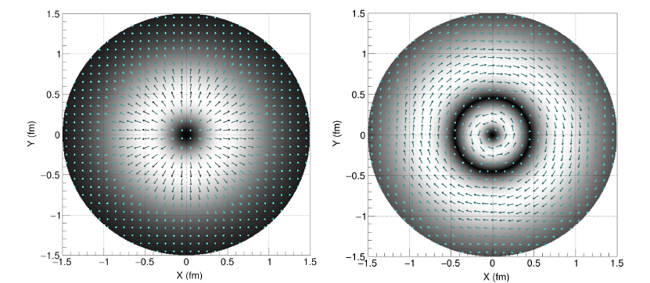
Nuclear Physics Questions:
What are the mechanical properties of the proton?
Burkert, et al., Colloquium: Gravitational form factors of the proton. Reviews of Modern Physics 95, 041002 (2023)

Slide 10
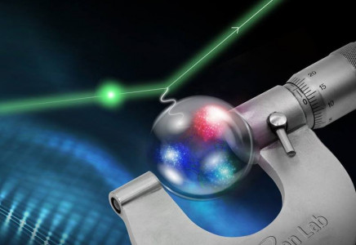
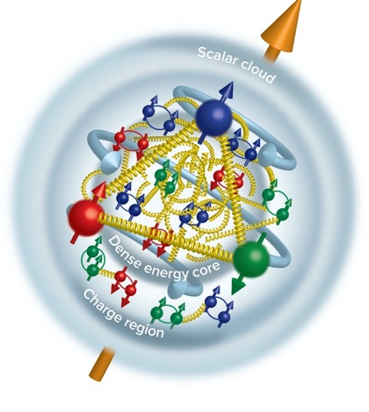
Nuclear Physics Questions:
‘How big is the proton?’
Proton Radius Measurements: 0.831+/-0.014 fm
    Xiong et al.,Nature 575, 147 (2019)
Duran et al “Determining the gluonic gravitational form factors of the proton," Duran et al, Nature 615, 813 (2023)
‘Inner gluon Rms’: 0.52 +/-0.03 fm
Future ‘PRad-II’ experiment will yield a 2.5x more precision: confirm the smaller radius

Slide 11
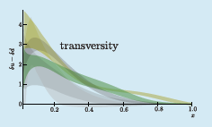
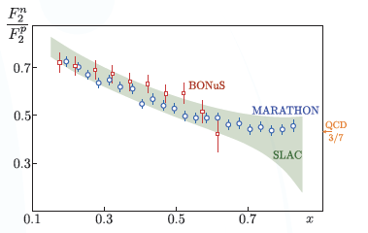
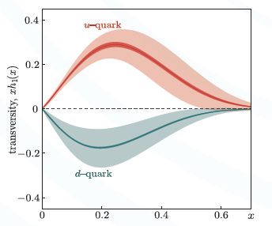
Nuclear Physics Questions:
‘How are quarks distributed in the proton?’
Phys. Rev. Lett. 128, 132003 (2022)
Example of a SoLID SIDIS measurement: huge error improvement (GPD)

Slide 12
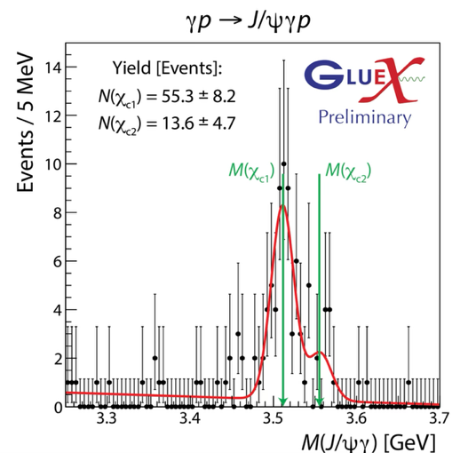
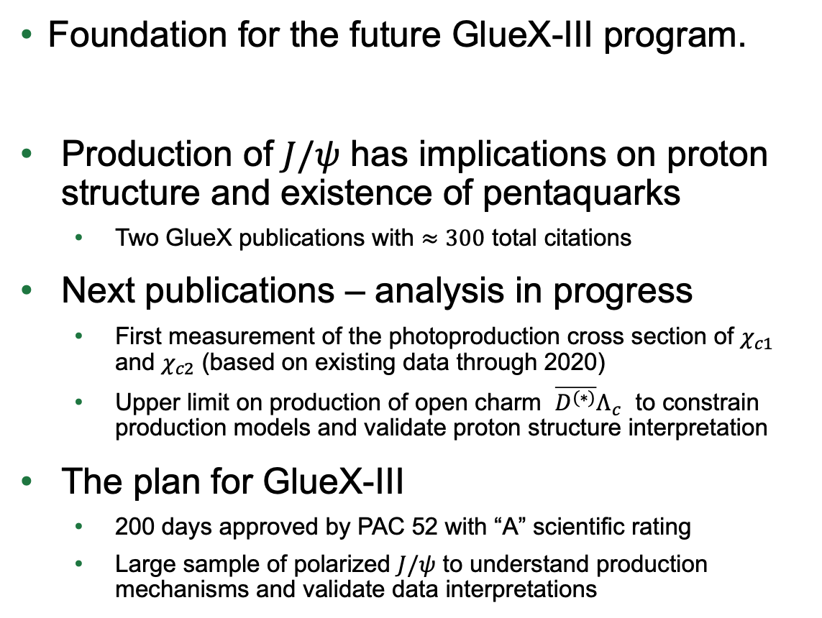
Nuclear Physics Questions:
What is the Spectrum of excited hadrons?
Charmonium production in Hall D
Foundation for the future GlueX-III program.
Production of $J/ψ$ has implications on proton structure and existence of pentaquarks
  Two GlueX publications with $≈300$ total citations
Next publications – analysis in progress
  First measurement of the photoproduction cross section of $χ_{c1}$ and $χ_{c2}$ (based on existing data through 2020)
  Upper limit on production of open charm $\overline{D^{(∗)}}Λ_{c}$ to constrain production models and validate proton structure interpretation
The plan for GlueX-III
  200 days approved by PAC 52 with “A” scientific rating
  Large sample of polarized $J/ψ$ to understand production mechanisms and validate data interpretations

Slide 13
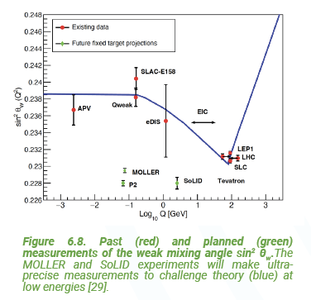
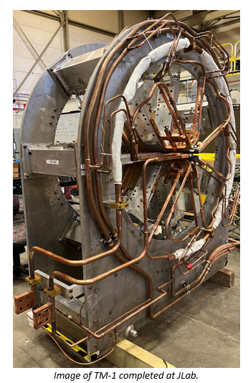
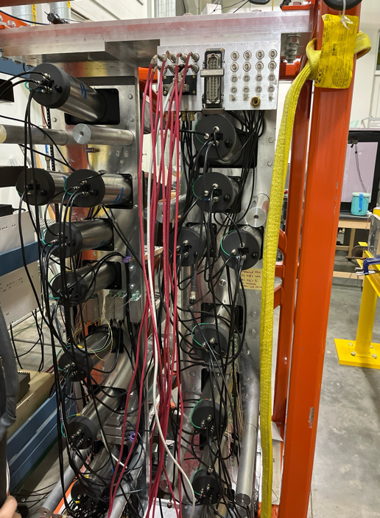
Nuclear Physics Questions:
What is the evidence for physics beyond the Standard Model?
MOLLER probes BSM in the multi TeV range through Parity Violation
Construction and assembly continues

Slide 14
DOE and TJNAF Mission (FY25)
NP Operations Budget:
  Funding to operate CEBAF for 22 weeks of beam at 80% reliability (optimal is ~33 weeks)
  To maintain our core competencies: NP R&D, Accelerator S&T, User Facility
ASCR Budget
  HPDF: FY25 is unknown (we have received no FY25 funds; requesting $7M OPC)
  Corresponding R&D programs must get started (in partnership, e.g., PEMP language)
NP Research Budgets:
  Competitive with the Nation (Medium Energy Experiment and Theory)
  Competing for ‘NOFO’ funding
  Budget is being optimized to perform high-priority research as NP funding is constrained
NP Project Budgets:
  MOLLER – Fully funded; must maintain SPI > 0.9
  EIC; CD-3A scope, CD-3B to be approved; Funding for full CD-2/3 is an issue; move to sub-projects is an issue; cost is an issue
SLI Program
  Delegated CRE project (construction)

Slide 15
The Federal Budget: DOE NP Program
House E&W subcommittee mark for FY26 is $8.39B which is $150M above the FY24 level, and well above the $7.09B FY26 PBR
The federal budget is a year-long process!!!
Inflation Data https://www.bls.gov/data/inflation_calculator.htm

Slide 16
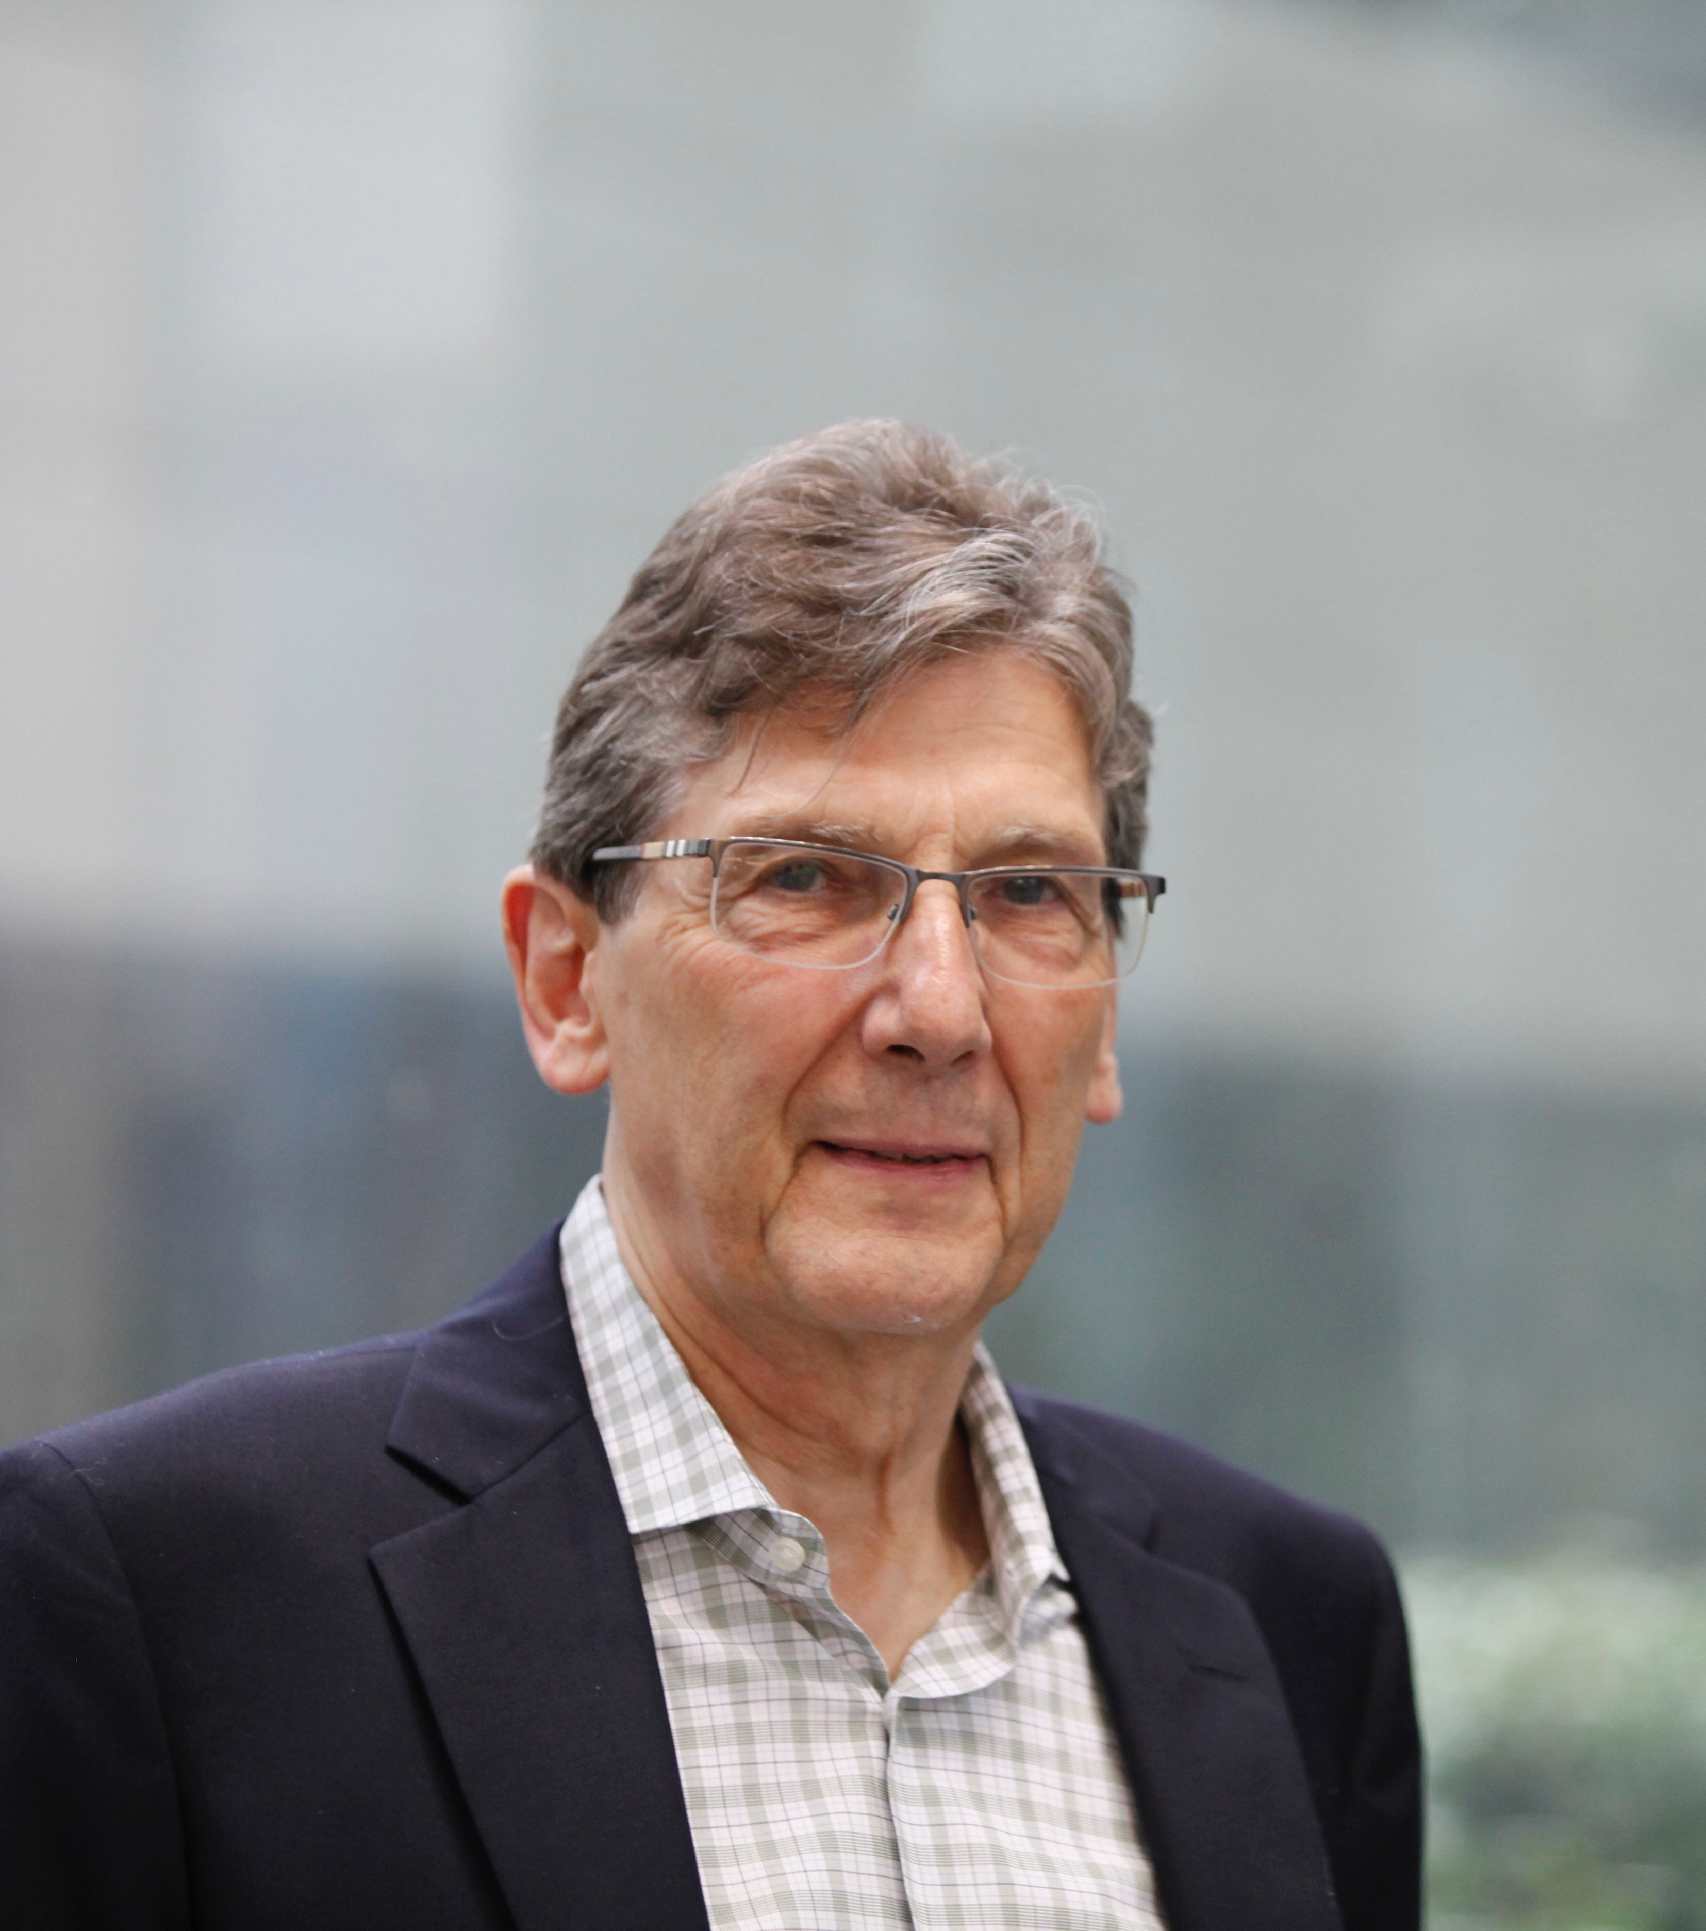
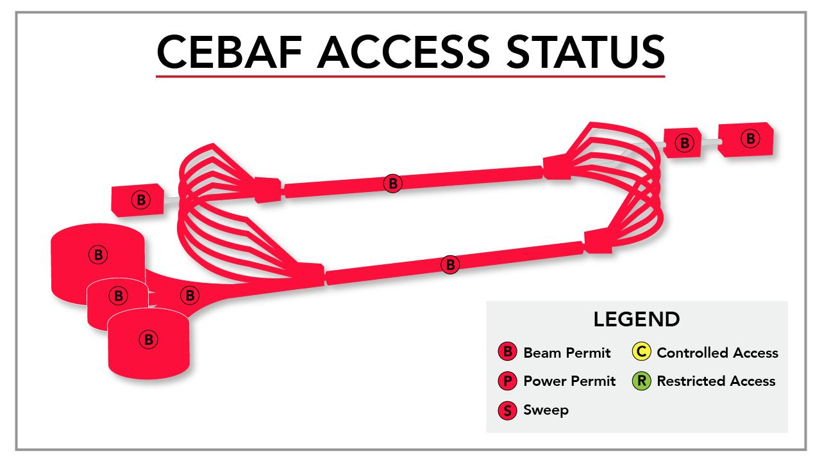
Mid Year Performance Evaluation Highlights (Goals 1-3)
8 high-impact publications (PRL and above); 19 additional publications in NP specific journals with high impact
2 patents
Maintenance of the core capability in SRF technology
Major APS award: Bonner Prize (Volker Burkert); four new APS fellows
135 invited talks at international conferences and workshops (38 of these organized by staff)
Highly rated experiments running in all four halls
Significant staff involvement in reviews for DOE and other agencies
Through July 7: CEBAF Reliability at 83.2%

Slide 17

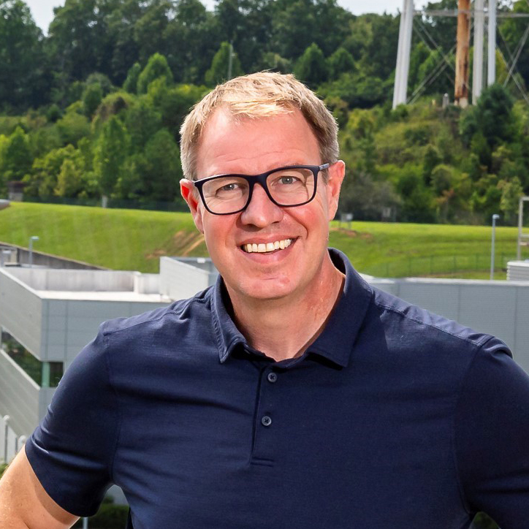
WELCOME
JEFFERSON LAB’S NEW DIRECTOR
Jens Dilling
Currently at: Oak Ridge National Laboratory, ALD Neutron Sciences,
leading the HFIR research reactor and the Spallation Neutron Source (SNS)
science portfolio
Previously at: ORNL, Director of Institutional Strategy Planning
TRIUMF, ALD Physical Sciences
Education: Atomic and Nuclear Physics B.S. & Ph.D.,
University of Heidelberg, Germany
Honors: American Physical Society Fellow
APS Francis M. Pipkin Award
CAP-TRIUMF Vogt Metal, Canadian Association of Physicists
FAIR-GENCO Scientific Achievement Award
Rutherford Memorial Medal, Royal Society of Canada
DOE Oppenheimer Leadership Fellow
Joint Appointment: Duke University
Start Date:
June 30, 2025

Slide 18

Discussion

