Slide 1
C75 tuners and cavity oscillations.
2 June 2025
Tom Powers
Accelerator operations SRF meeting
Notes:
Tip: Keep titles under 60 characters for readability
To change the photo: Right-click on photo and select change photo

Slide 2
Tuner Response Experimental process
29 out of 32 cavities tested. (Everything that would turn on.)
5 had significant dead bands. All in C75-3 and C75-4.
1 in C75-1 had an odd step.
1 had an odd tuner step request that was not linear when in SELA mode.
Data plots are located here: M:\asd\asddata\CMTF\C75 Tests\C75 tuners
Operate the cavity in SELA mode so that one can change the gradient and measure the frequency shift due to Lorentz forces and watch the cavity tune up.
Disable the tuner.
Adjust the gradient and wait for the FCC to ramp the gradient up/down.
Enable the tuner and watch how the cavity recovers.
Repeat in the other direction by changing the gradient back to the original setting.
There is a 4.6 kHz difference between the RF source and the machine LO.
Scaling things
Cryo likes to have slow drifts of less than 0.5 Torr.
Pressure sensitivity is on the order of 20 Hz/Torr
The real issue for big changes is changes in gradient.

Slide 3
4 June experiments
Measure the tuner range and step responses at different frequencies.
Gain statistics on cavity frequencies with respect to the transition between compression and tension (I think we should call this the natural frequency of the cavity).
Cavities are supposed to be tuned a few 100 kHz high higher than the natural frequency.
Cavities are typically tuned +/- 400 kHz in acceptance testing.
The plan was to go up and down by 100 to 150 kHz.
Cavities 5 and 8 got “stuck” at -114 kHz and -134 kHz respectively. After that they went down very slowly as we were trying to see if it was a dead spot which has been observed in past acceptance testing measurements.
Due to time constraints, we gave up after about 150,000 micro steps and started retuning the cavities to an operational state.
We took step response data for the cavities at 1496.86 MHz, 1496.92 MHz, followed by 1497 MHz. Cavities 5 and 8 were not measured at the lower frequency.
Of note it only took 10,000 steps to get the cavity 5 from the “stuck” to 4 kHz closer to tuned when we changed the motor direction. This supports the hypothesis that the motor is stalling.
The step response curves changed substantially on 3 of the cavities, some were substantially worse than before.

Slide 4
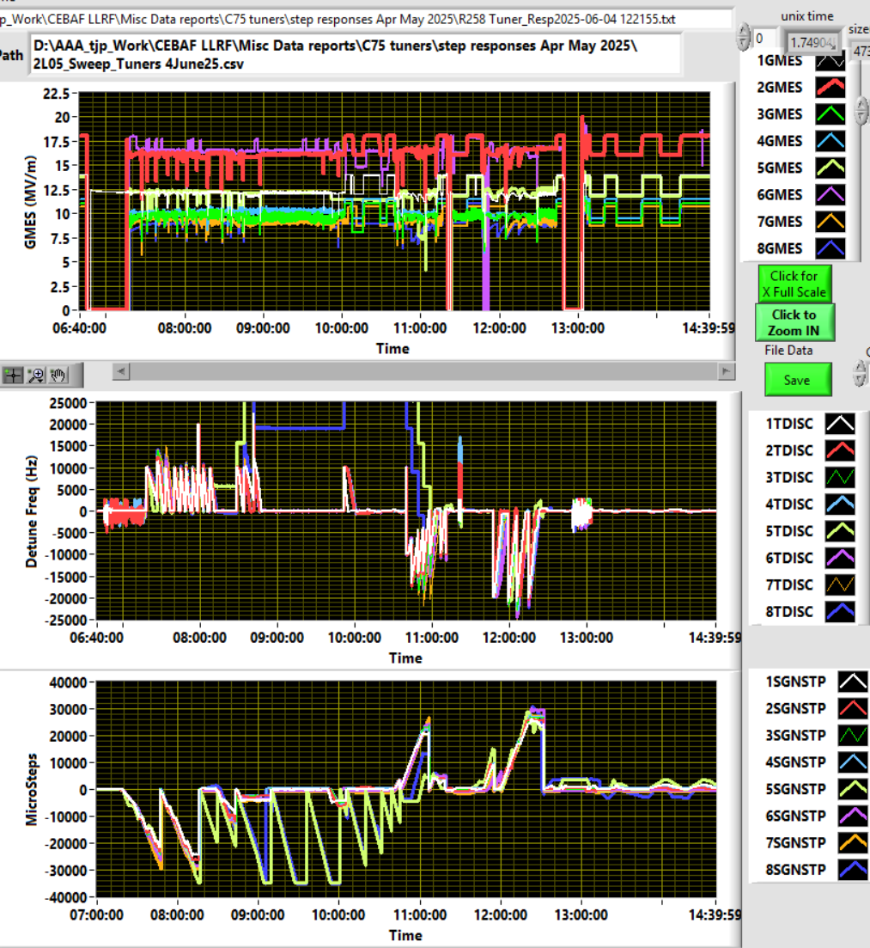
Overall test data plots
Top traces are gradients, step responses are where it looks like a square wave.
Center set of data shows cavity frequency shift from the RF source. Each step upward is where we clicked the “frequency up” button.
The lower step upward in the sign step plots (low set) is where we reset the variable. Note the tuner stops moving when sigh step is about 35,000.

Slide 5
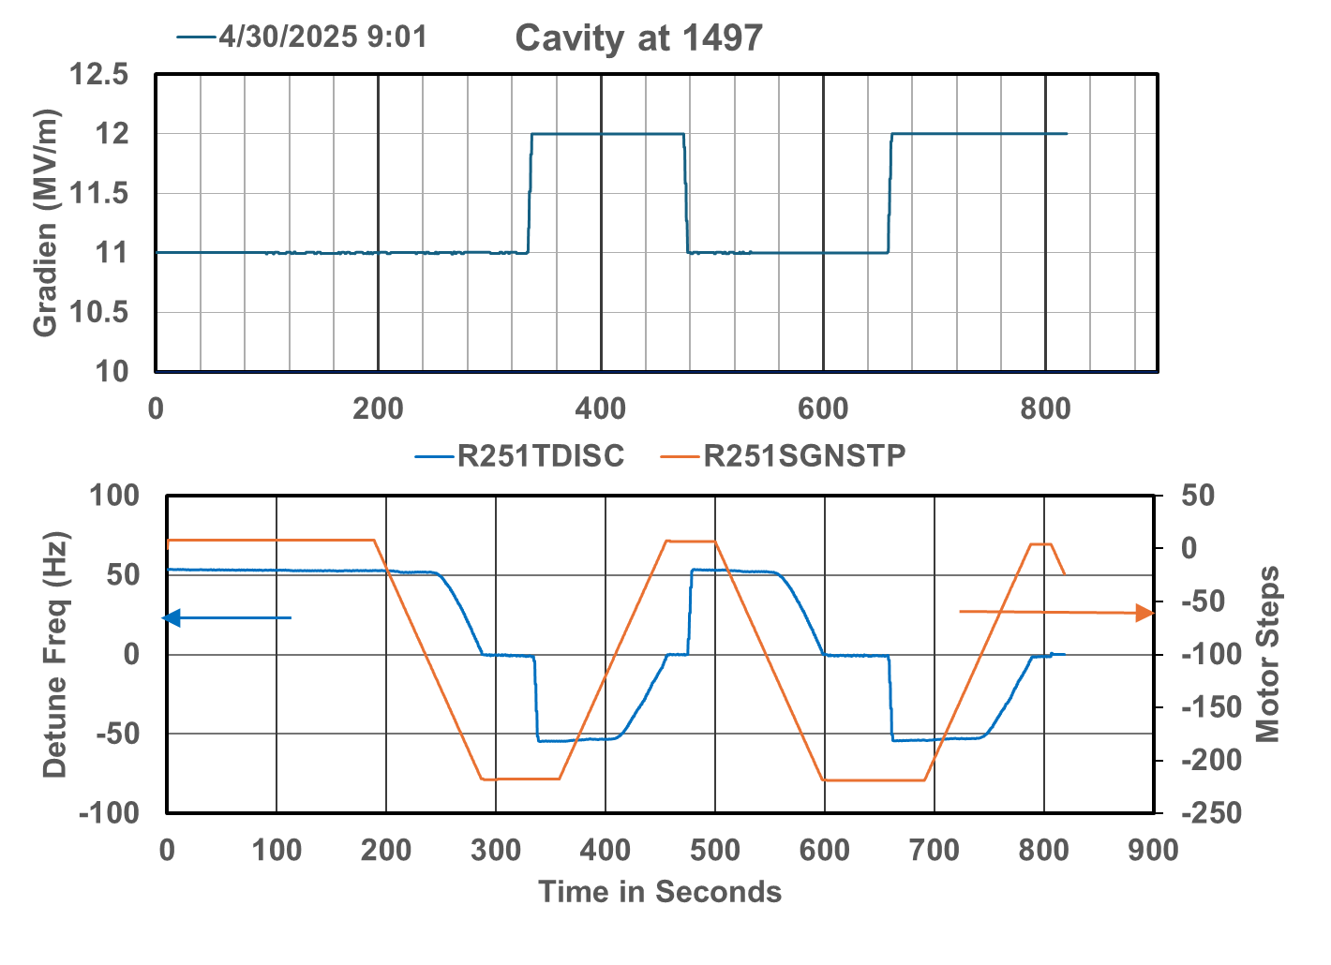
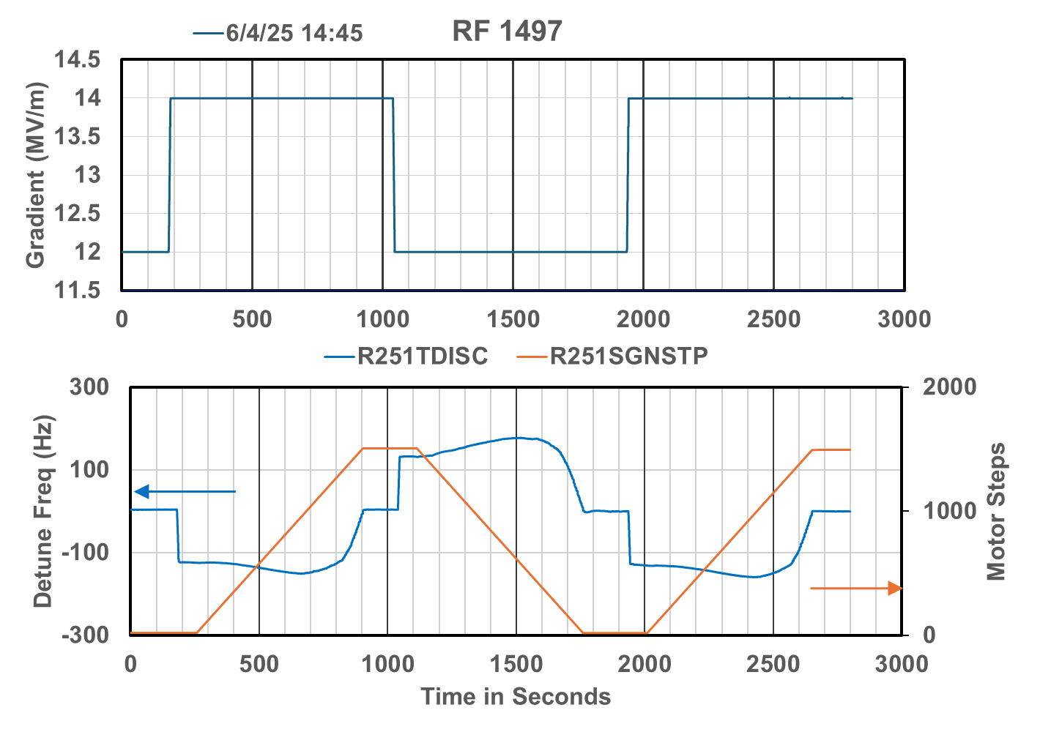
Cavity 1 (a month before) and after cycling -150-ish kHz and back.
After cycling down to -150 kHz and back.
The response was completely different
Has negative slope on the detune frequency.
Takes 2000 micro-steps to tune 100 Hz as compared to 200 steps to tune 50 Hz before. Most of the extra is getting past the “dead band”.

Slide 6
Pulse response all cavities
Most of the cavities are all that great.
Cavities 1 and 5 are pretty bad.
Cavity 2 has a has a negative response at the beginning (e.g. the frequency goes up even thought the tuner is driving it downward.
Eventually all of the cavities tune so long as you just run the tuner based on the target value rather than the effects of the previous move.
Tuning time to a 100-ish frequency change takes 5 minutes for 6 of the cavities and about 15 minutes for cavities 1 and 5 . . . and this is in Turbo mode.

Slide 7
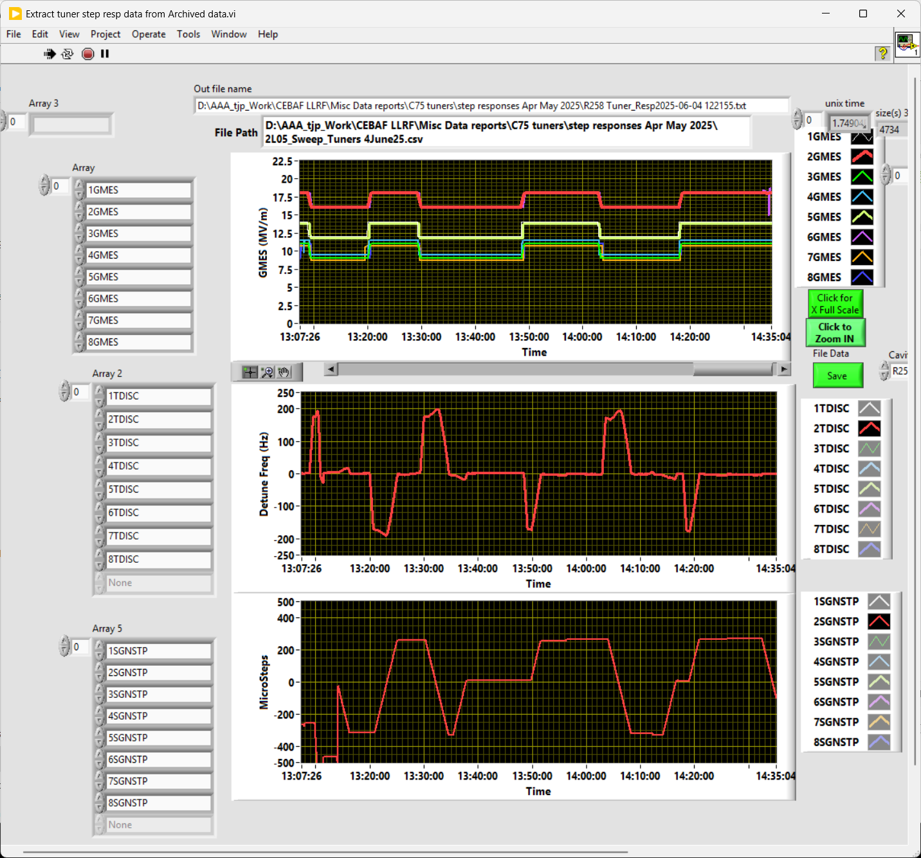
Watch out for cavities that overshoot.
A nuance about cavities that overshoot is that they will run in the direction of the next step response

Slide 8
Watch out for cavities that overshoot.
A nuance about cavities that overshoot is that they will run in the direction of the next step response.
This is what the negative transient should look like.
Frequency overshoots and the tuner starts running in a positive direction.
This pulse shape is wrong and should include the part in the upper circle only offset.
Tuner running in a positive direction before the gradient is changed.

Slide 9
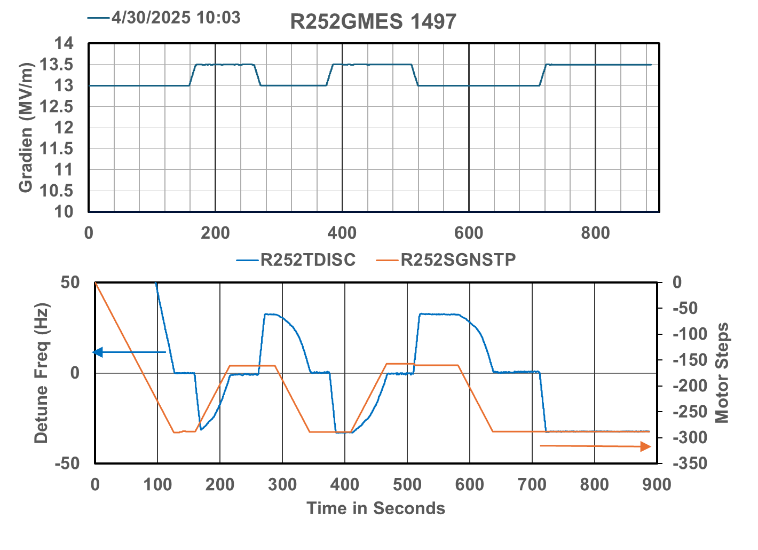
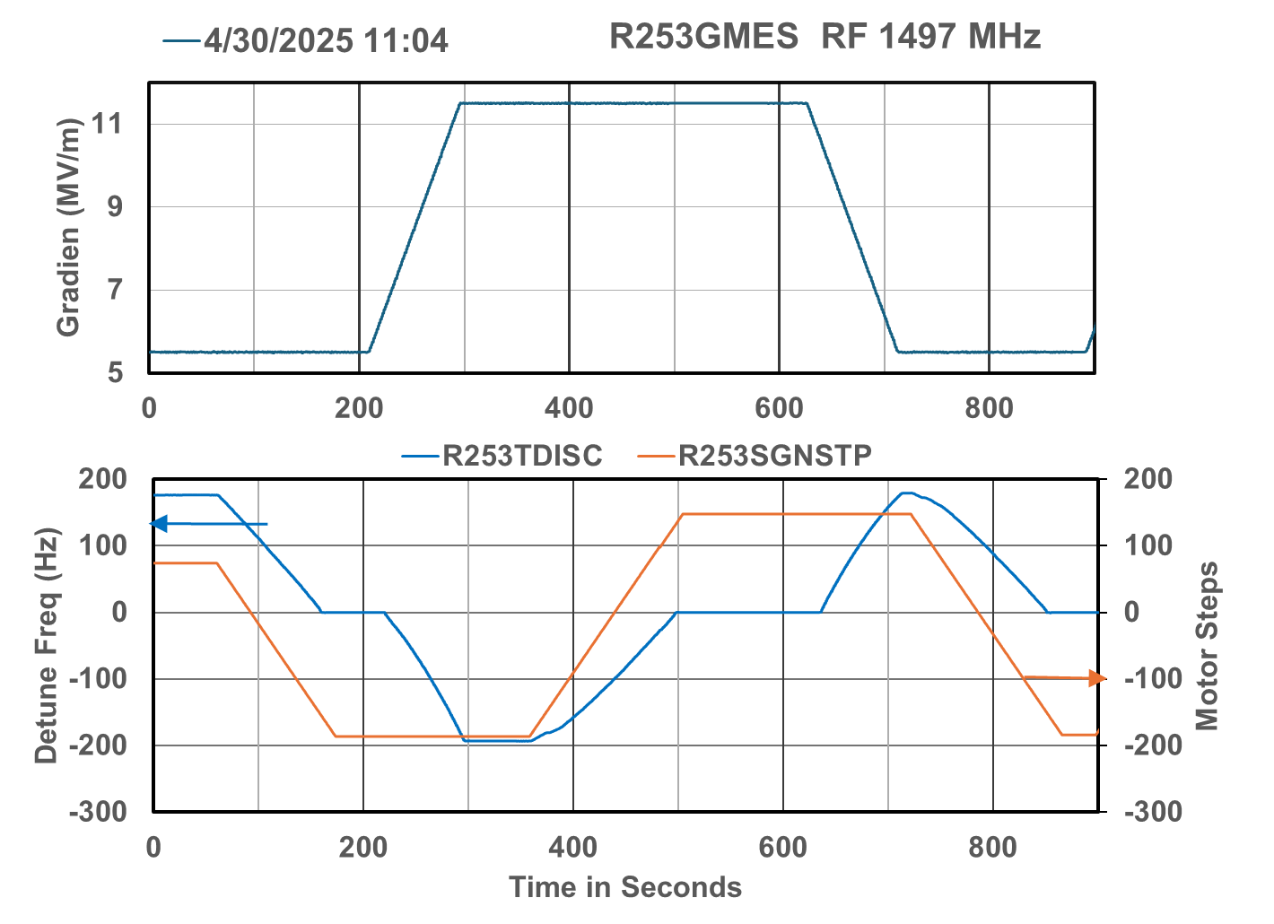
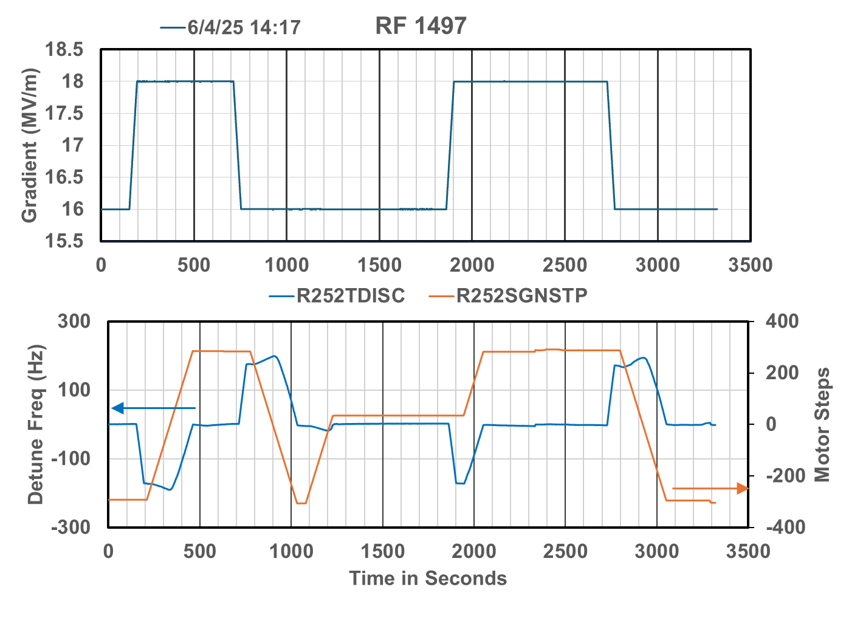
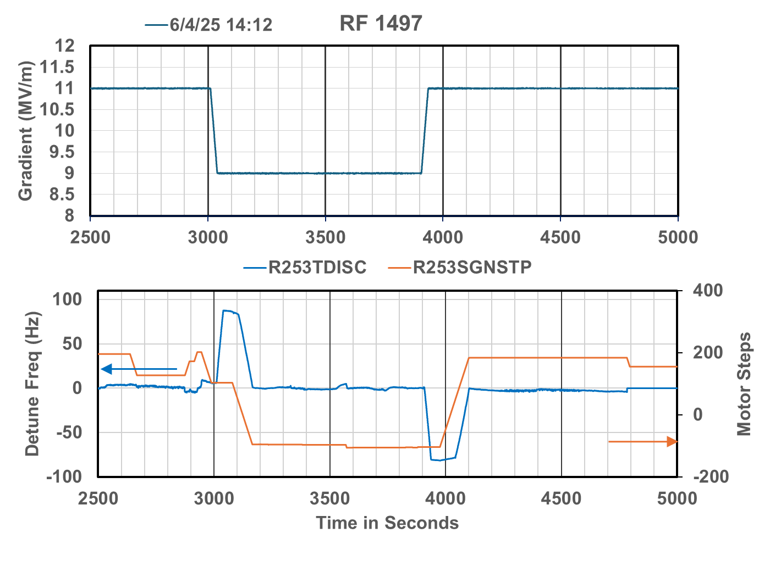
Summery of step responses before and after -120 kHz test

Slide 10
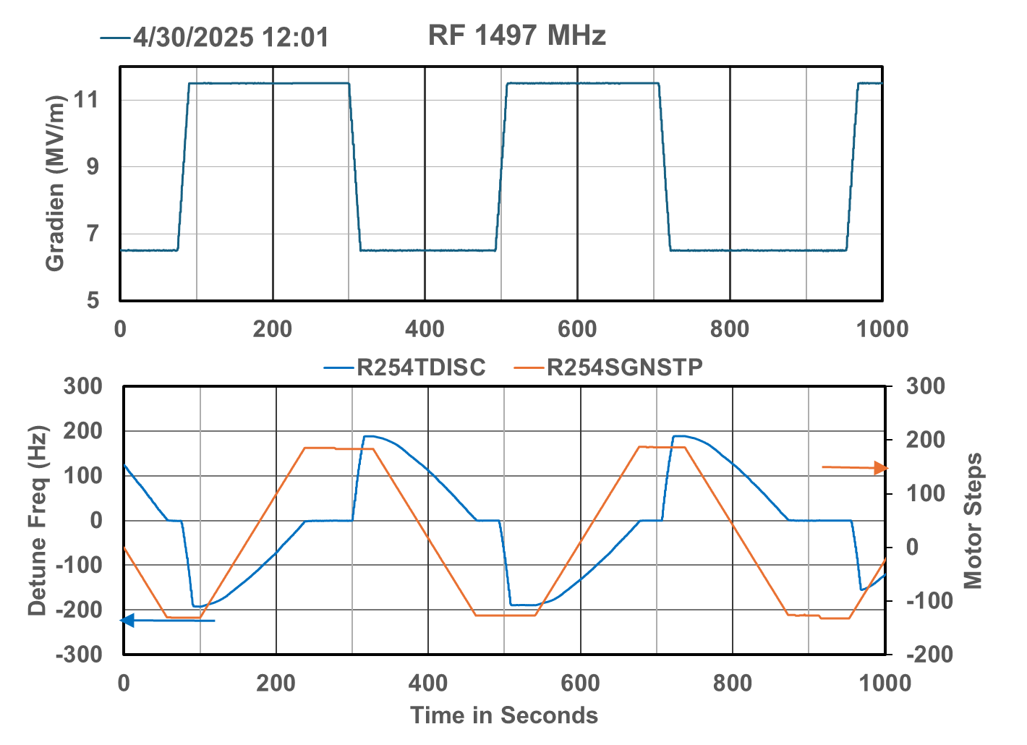
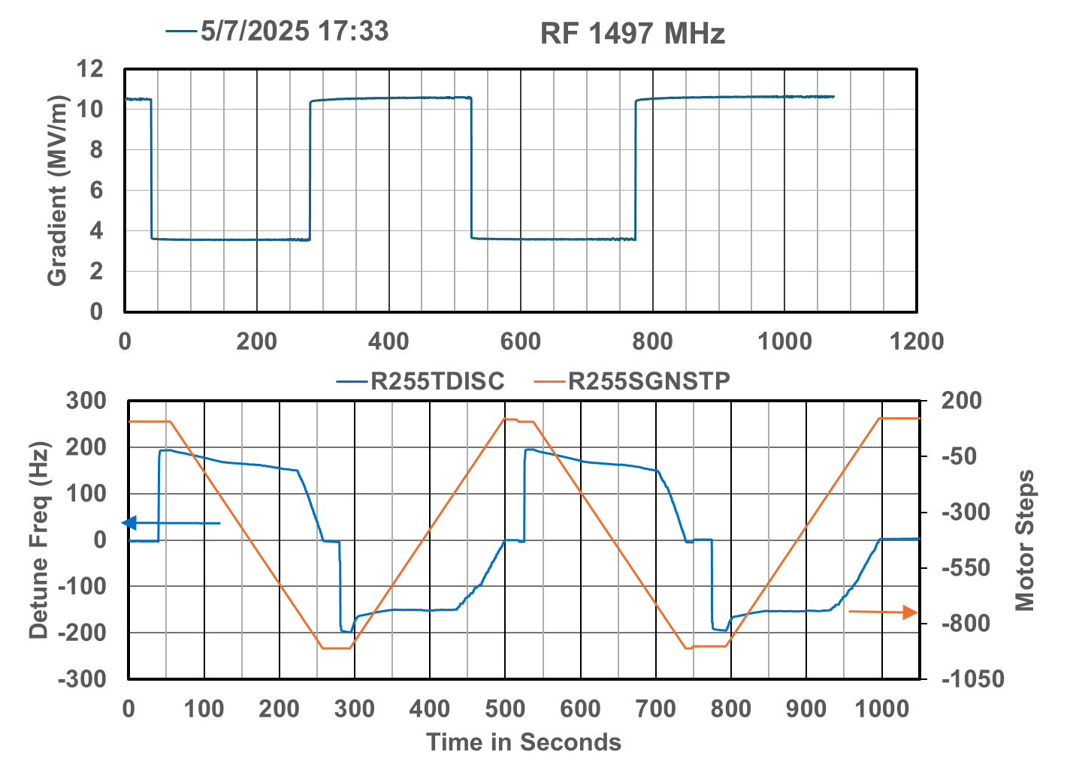
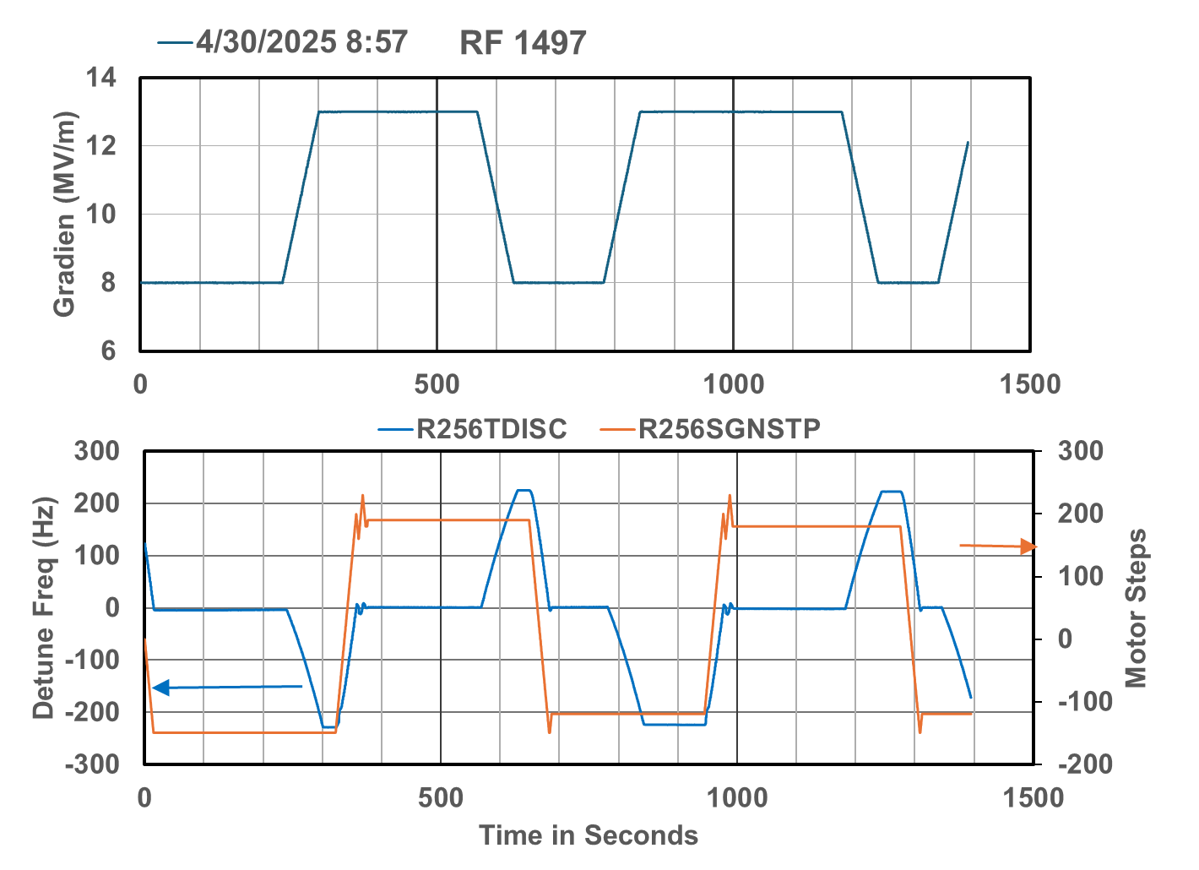
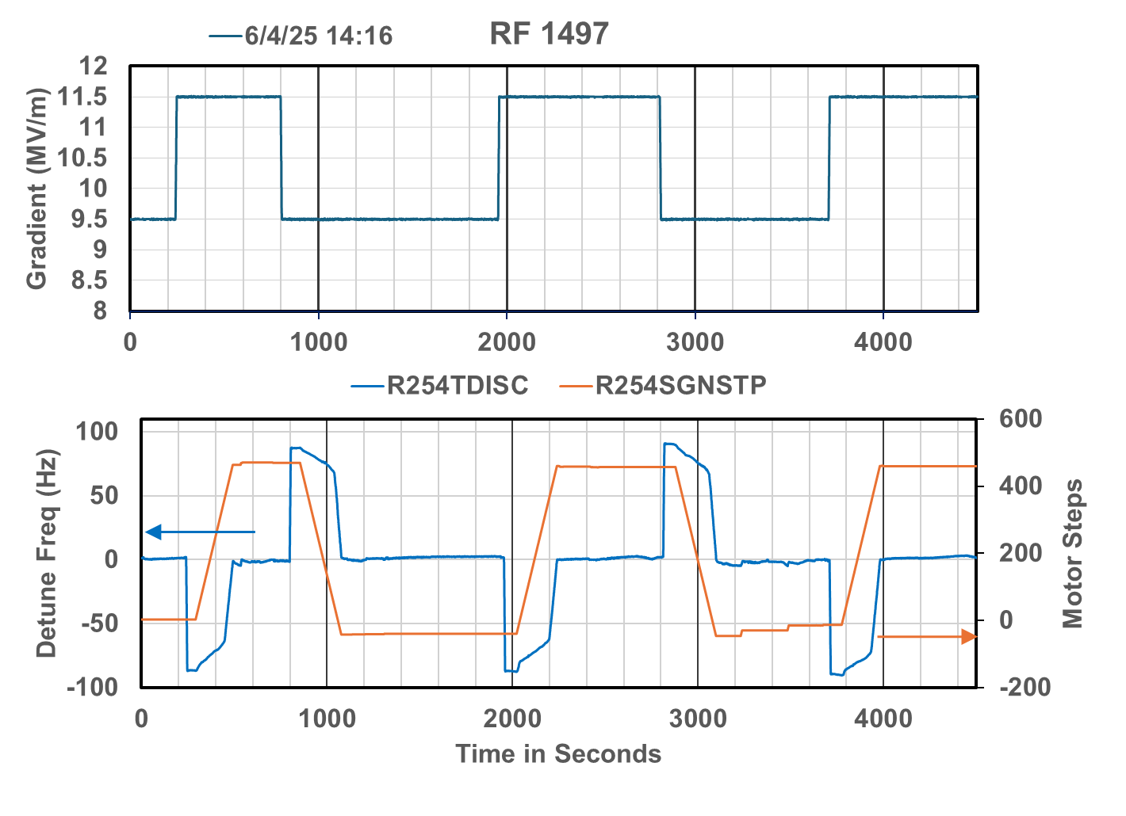
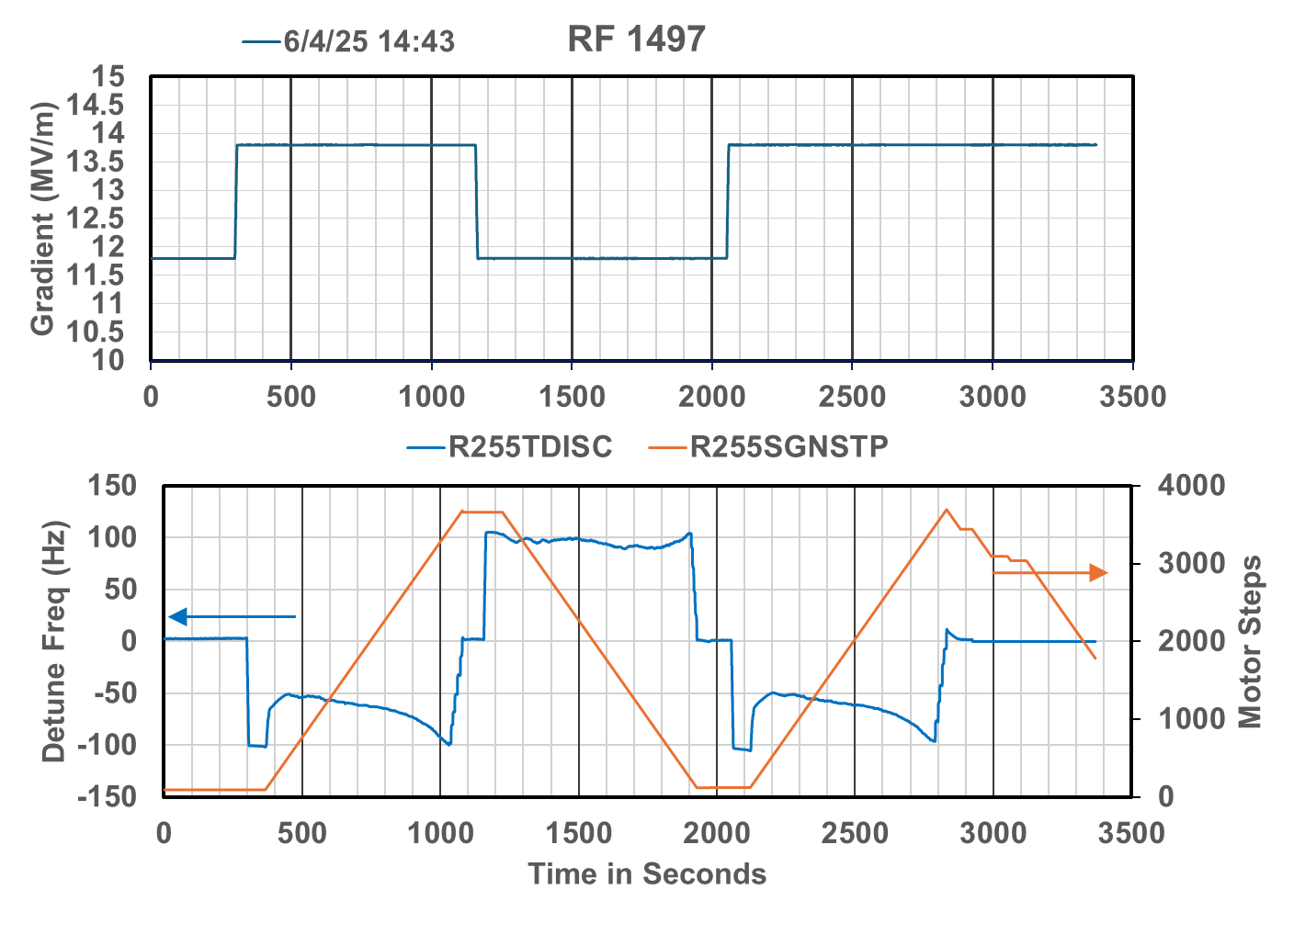
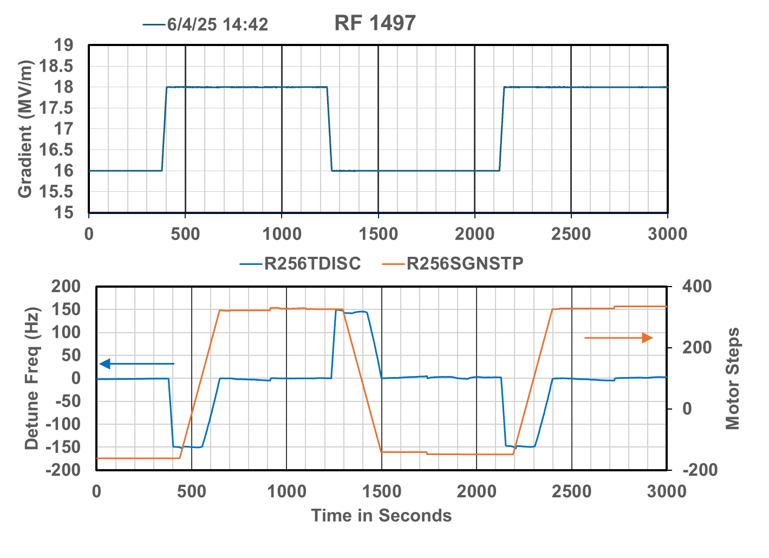
Summery of step responses before and after -120 kHz test

Slide 11
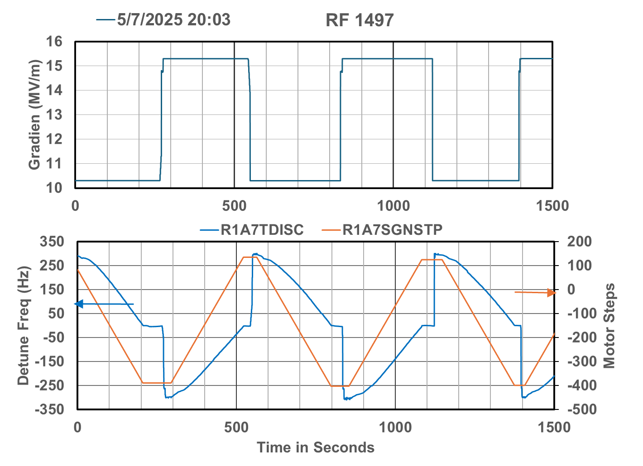
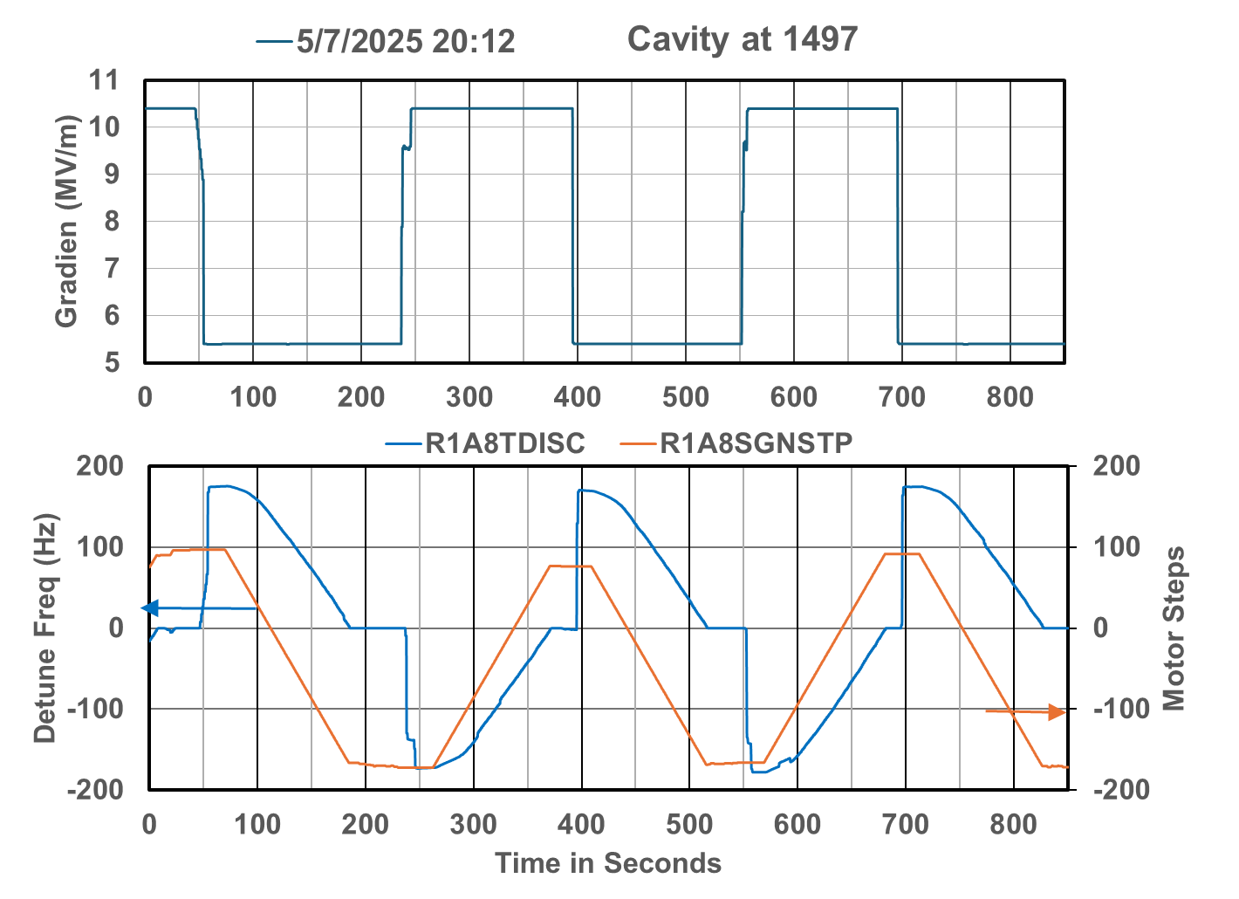
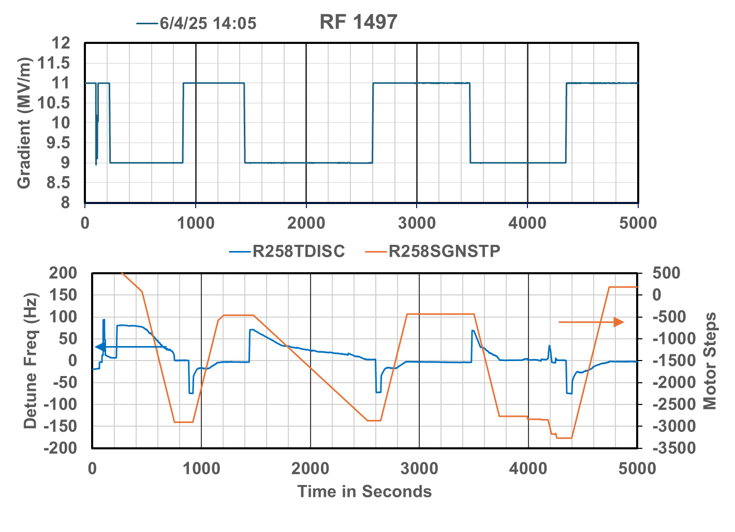
Summery of step responses before and after -120 kHz test

Slide 12
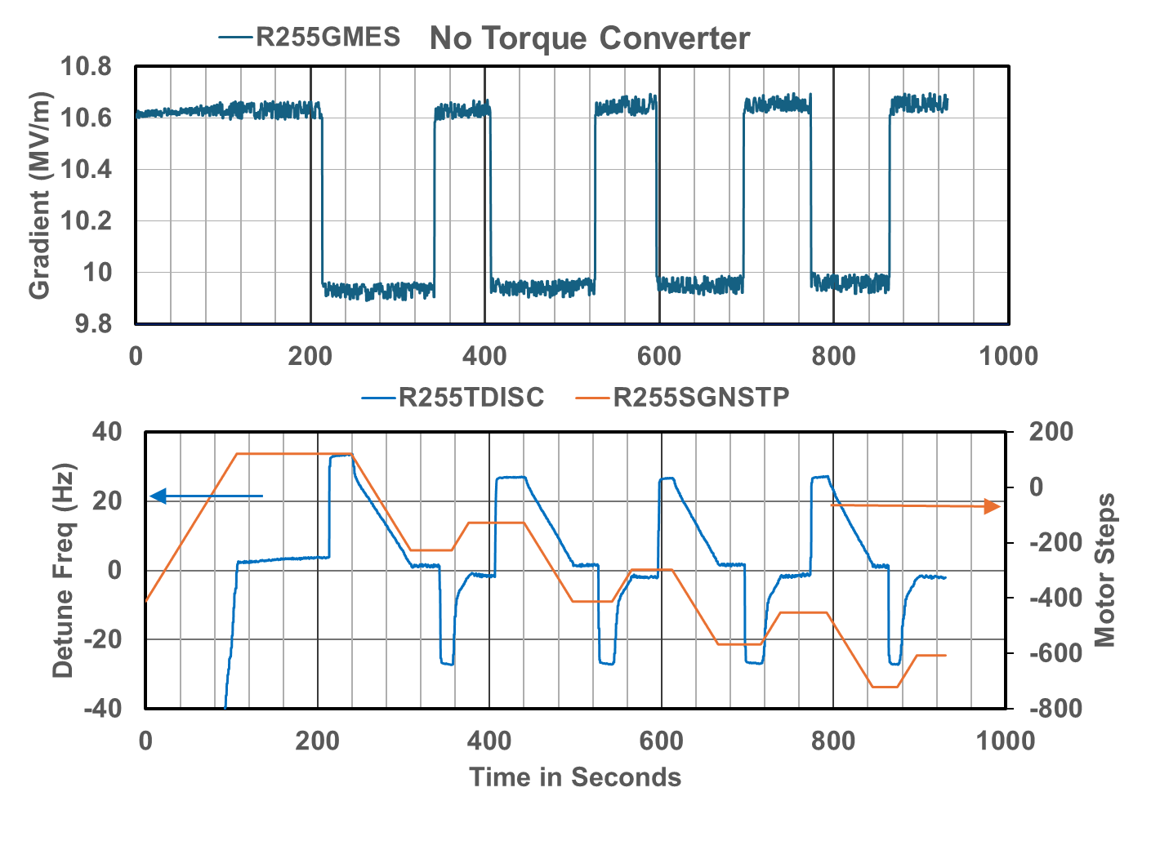
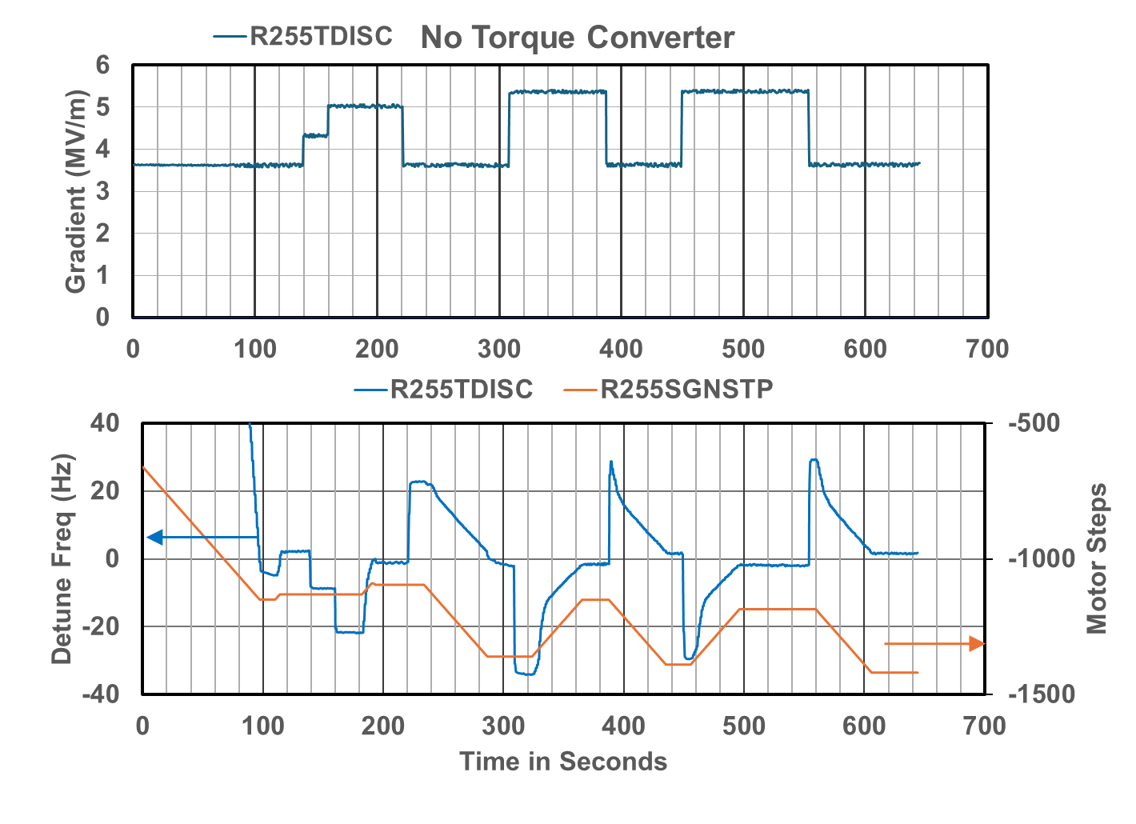
2L05-5 small step response why is it drifting.
Concern about the dF/dStep at the beginning of tuning after changing direction. Makes me wonder how fast we can run when we are close in. This data was taken with TSTPHZ set to 5 where 1 is part of the normal mode setting and 10 is turbo.
Oddity of the tuner walking away in one direction to what one would assume a steady state condition driven by the system “relaxing”. In this case it went the same direction independent of if the cavity was last driven more negative in frequency or more positive.

Slide 13
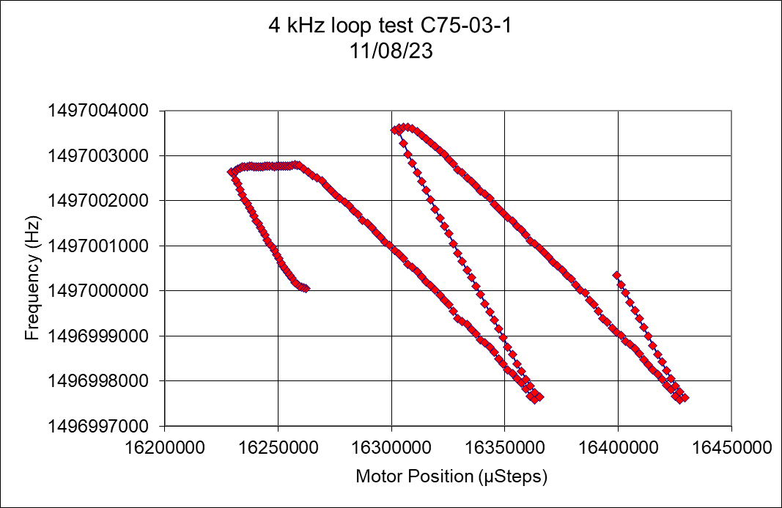
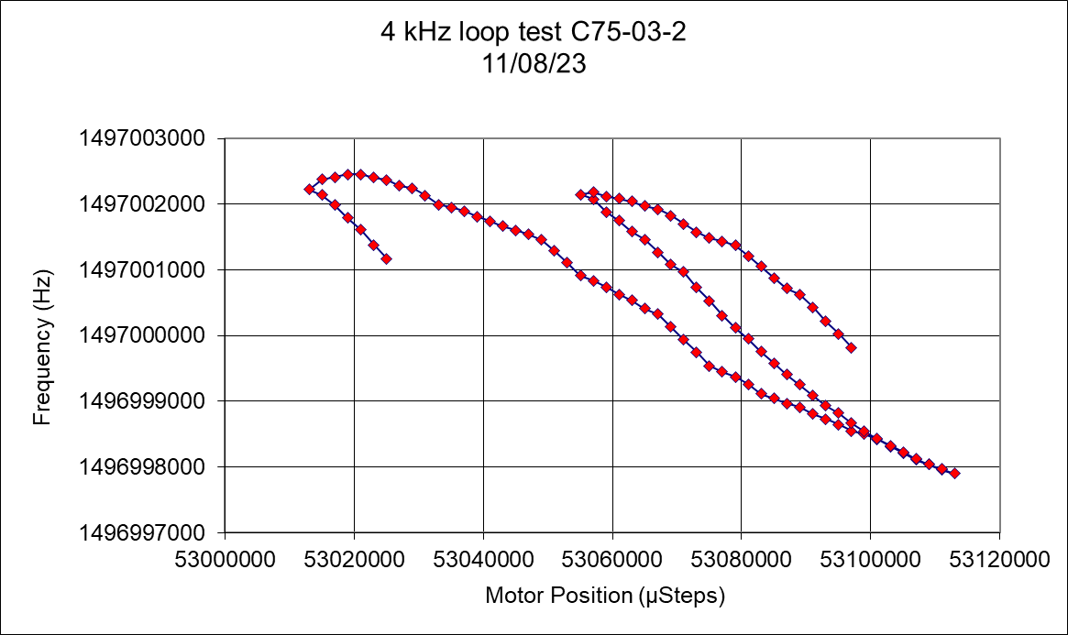
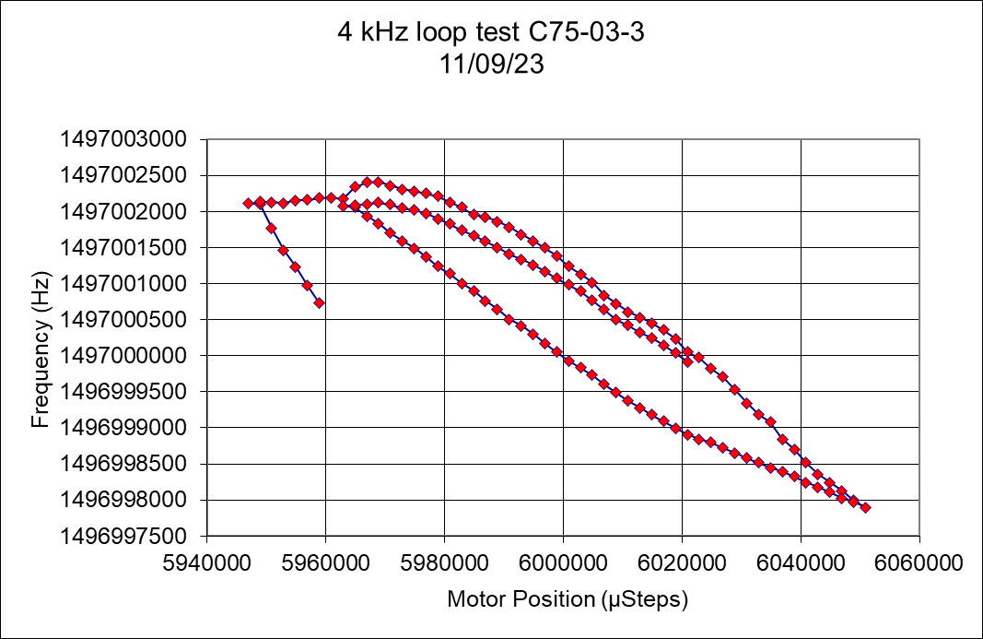
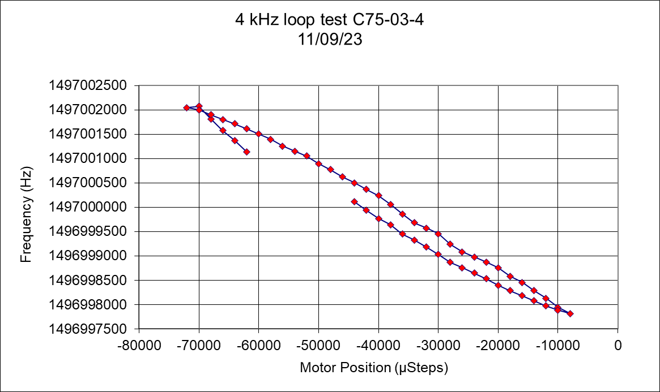
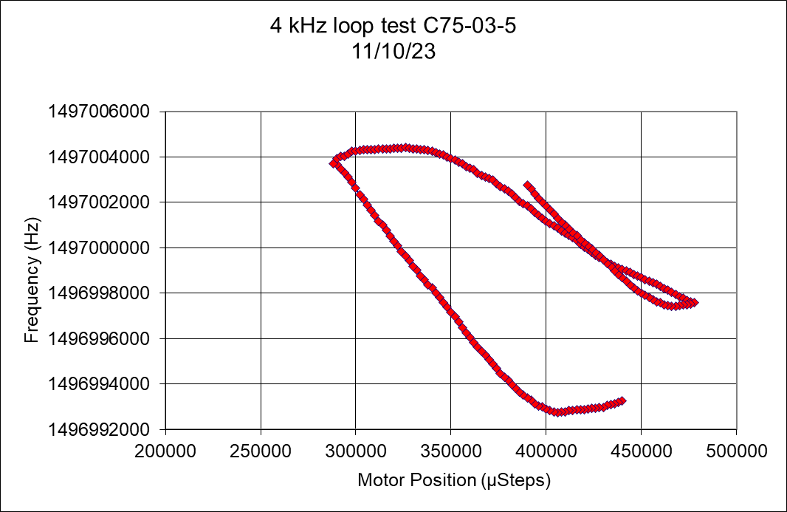
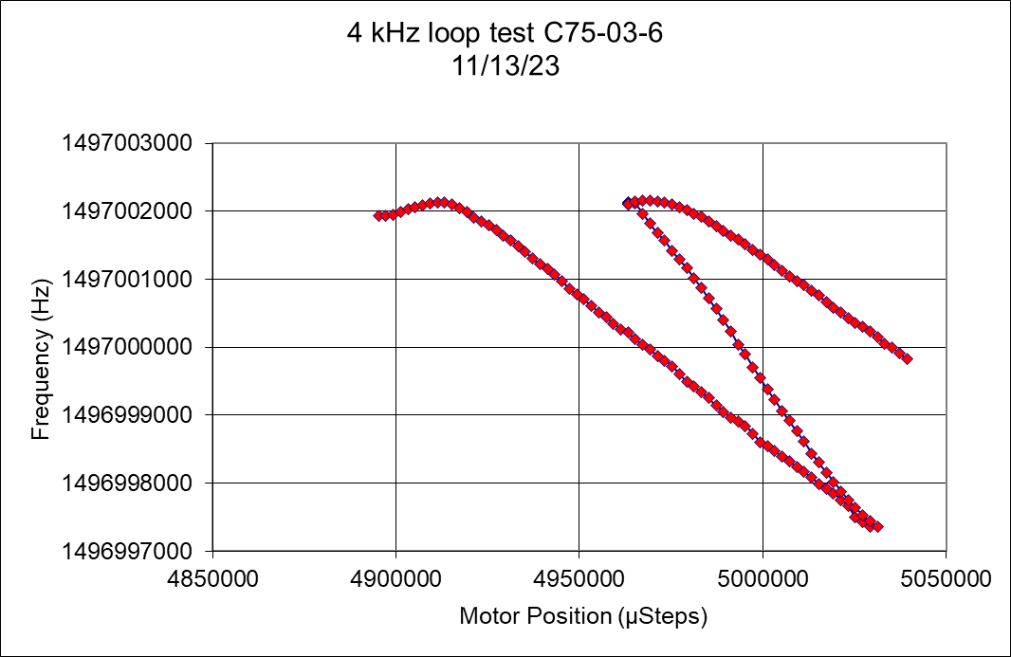
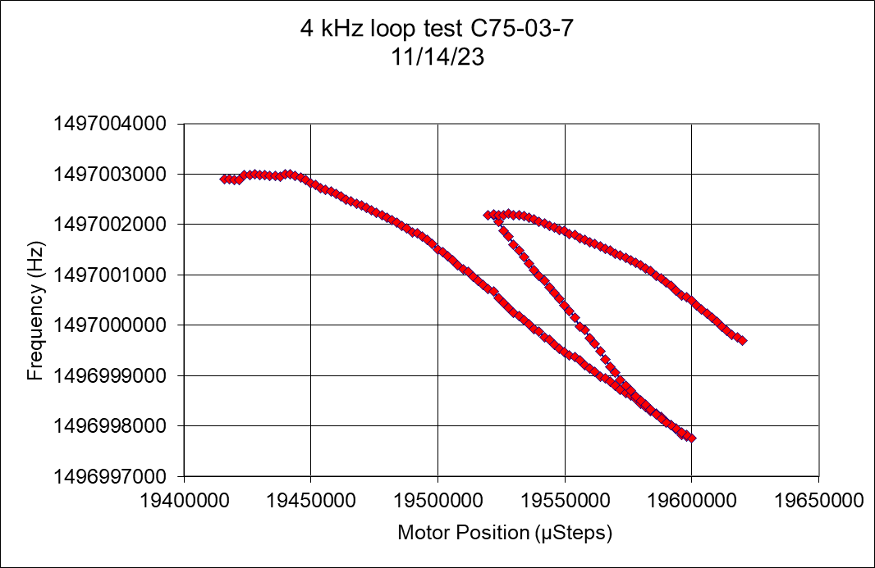
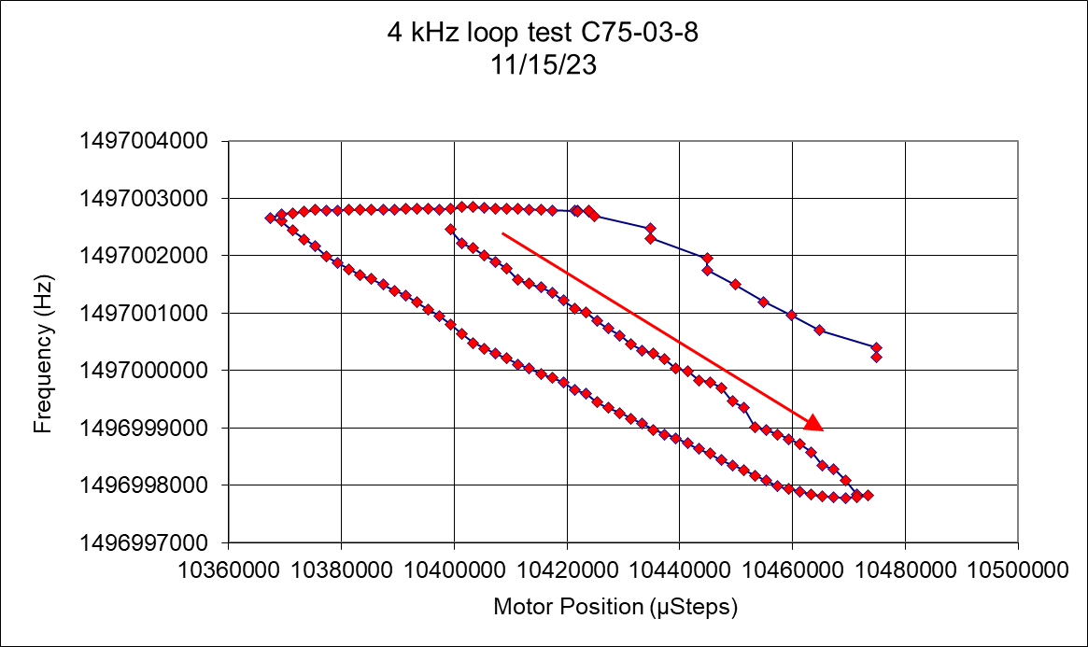
4 kHz tuner “loop” test from acceptance testing.
If everything was elastic these loops would look more like cavity 4 in the above data plots where the system changes in frequency and comes back to more-or-less the same spot.

Slide 14
What next?
Unless someone else comes up with something better my plan is to cycle these cavities through a +/- 2 kHz range around 1497 MHz while taking some stepped response measurements to see if.
I can get a closed loop response that looks like it should.
If the step response curves become better e.g. closed loops in plots of frequency as a function of tuner steps.

Slide 15
Looking at the 3C12 BPM data
300 ms of data taken before the fault
In addition to seeing the turn off transient it provides us with data regarding the quality of the beam energy just before the fault.
Data clipped at 0.2 MeV rms.
Control loop oscillation probably need to adjust POFF

Slide 16
FFT of energy as function of time since first in set.
Low frequency “noise” at about 25 hours is probably due to low current noise in BPM system.
One source of the 300-ish Hz peaks is 2L24-1 oscillating
Some have cavity trips some do not.
Some last through several trips but not in this data set.
383 Hz is MO mod system.
In theory we can mine more data at lower frequencies.
Below about 100 Hz a lot of the noise is due to microphonics.
Fast feedback is effective at suppressing 60, 120, 180 Hz energy jitter.
Low frequency noise due to low beam current.

Slide 17
5/31/25 through 6/6/25

Slide 18
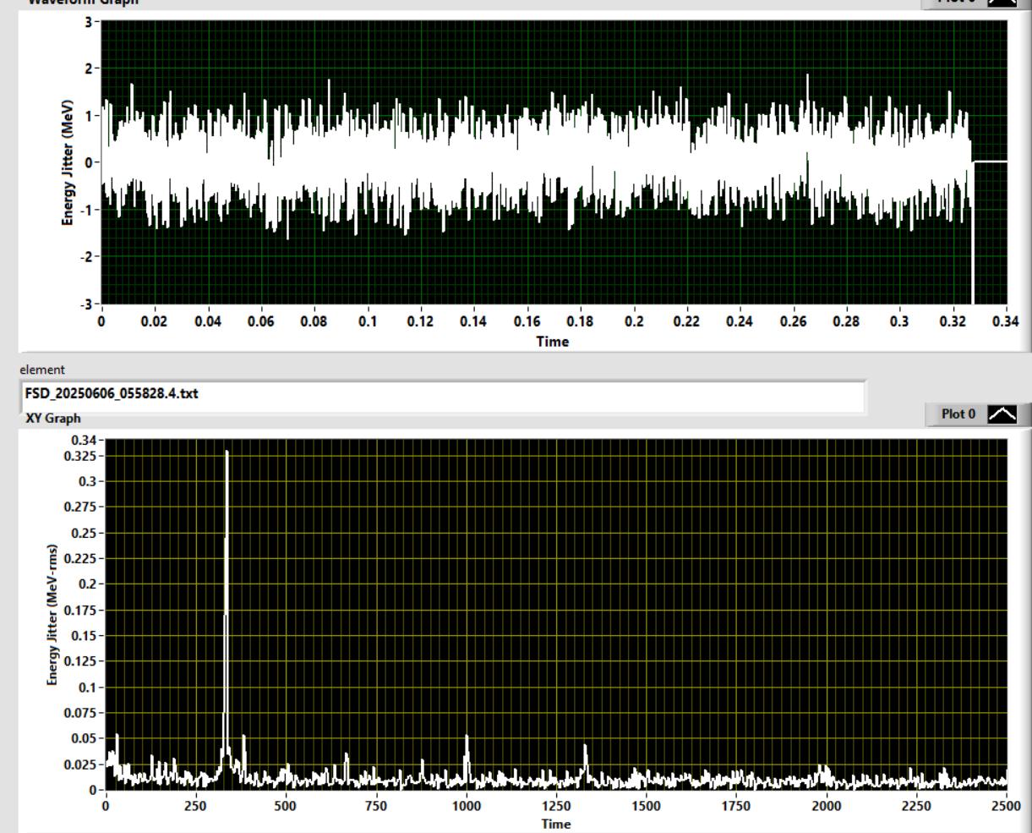
Time and frequency domain for file 134 BLM trip no cavity fault.
Energy jitter with no cavity fault in DTM.
I think it would be nice for the energy jitter spectrum to show up on the wall after every trip so that the operators know if they are dealing with energy oscillations when the beam trips with no cavity trips.
Tracking these energy oscillations down with the ML DAQ and with the FCC DAQ systems.
It MAY also be useful acquire this data continuously and analyze it by frequency bands
Date and Time Stamp

Slide 19
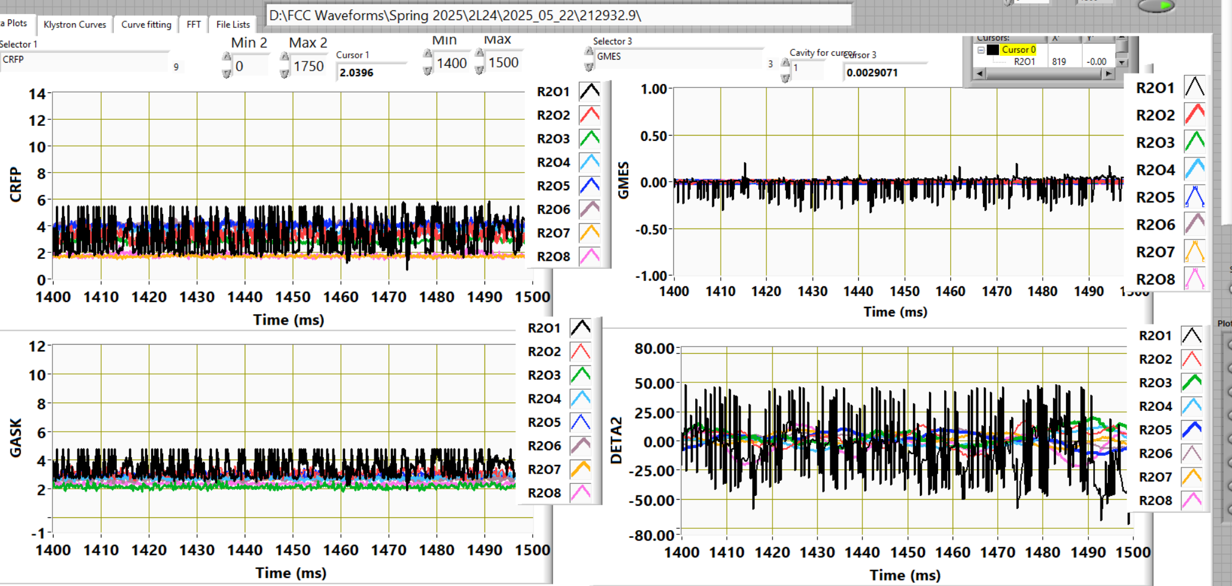

Slide 20
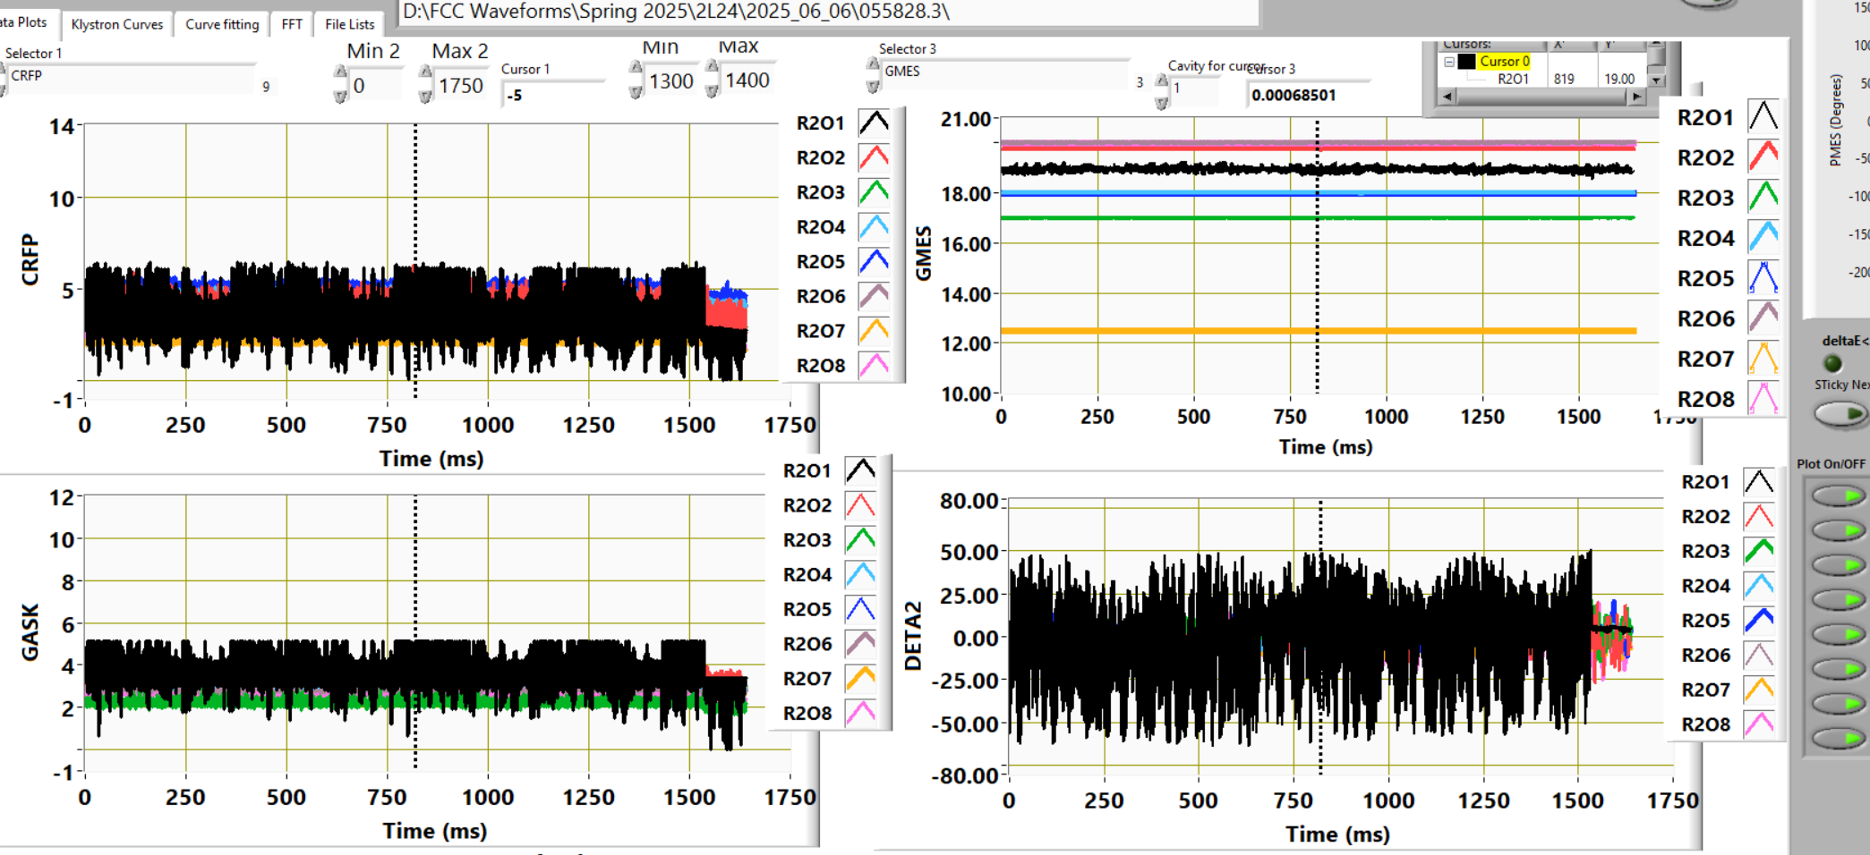
Same time stamp 2L24-1 with unknown oscillation.

Slide 21
I think swapping out the 2.5 W amplifier fixed it (I WAS WRONG) I just did not wait long enough

Slide 22
2L24-1 what next?
At least some of the operators know what this oscillation does to the beam.
We can try changing the interlock so that the cavity trips when GMES gets lower that (GSET – 0.15 MV/m) as compared to (GSET – 0.25 MV/m)
We know that taking it to SEL mode does not fix this problem.
Having it trip will give us a chance to see if it is happening more frequently then we though.
This should help us not send ratty beam to the halls.
We are still investigating what is causing this.
So far we have replaced the FCC, and the 2.5 W klystron preamp
What other components are cavity by cavity specific?

Slide 23
Probably out of time.

Slide 24
14 May experiments
Find a cavity that has a non-linear response with two distinct slopes. 1L09-1, 3 and 8 have this characteristic. We chose 3 because it was easiest to reach.
Goal explore the step responses 150 kHz high and low in order to see if the issue is that we are not properly tuned after cooldown.
Ended up running it up 100 kHz and down 30 kHz.
In both directions things seemed to stop moving.
In the downward direction things appeared to stop moving. In fact the frequency was moving much slower than it was previously.
Is this the point between tension and compression?
If yes, doesn’t this mean that the cavity at 1497 MHz is under tension by about 30 kHz.

Slide 25
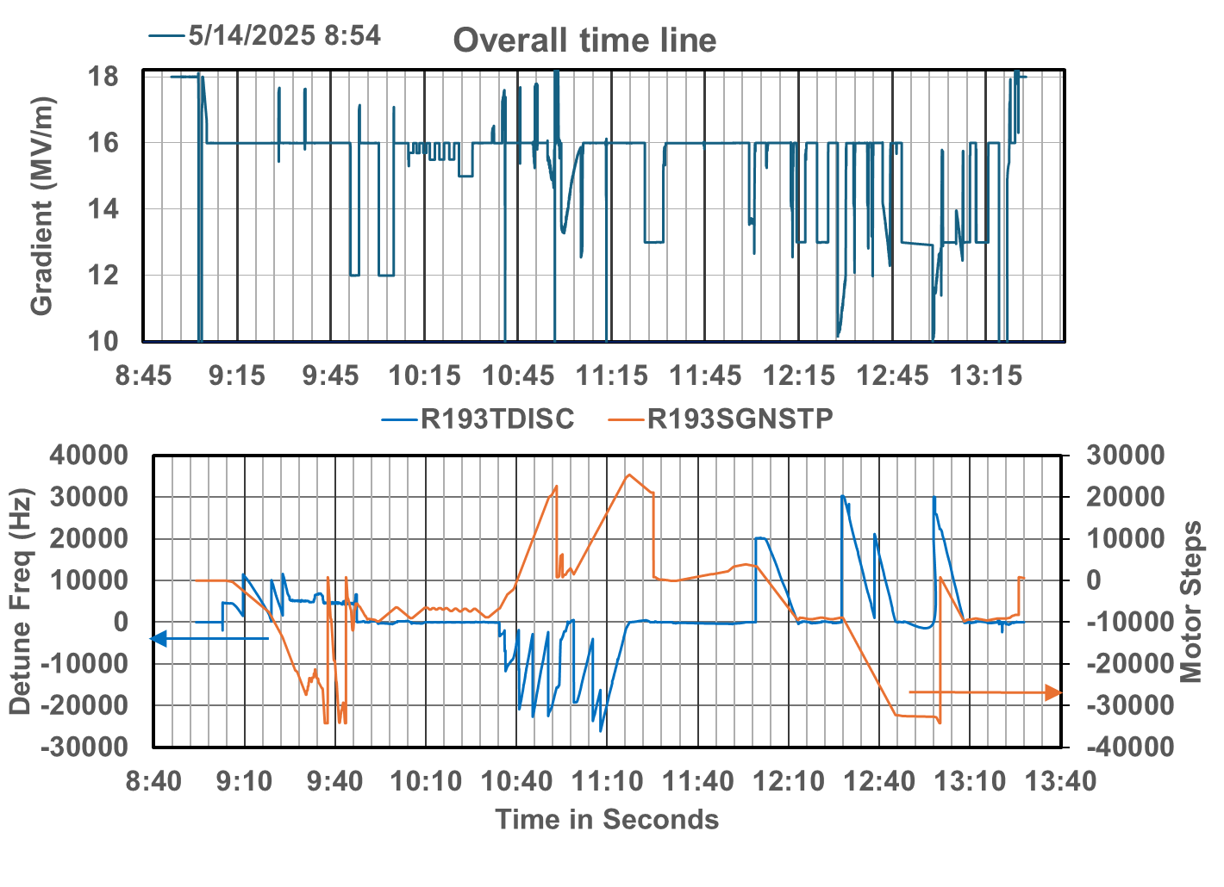

Slide 26
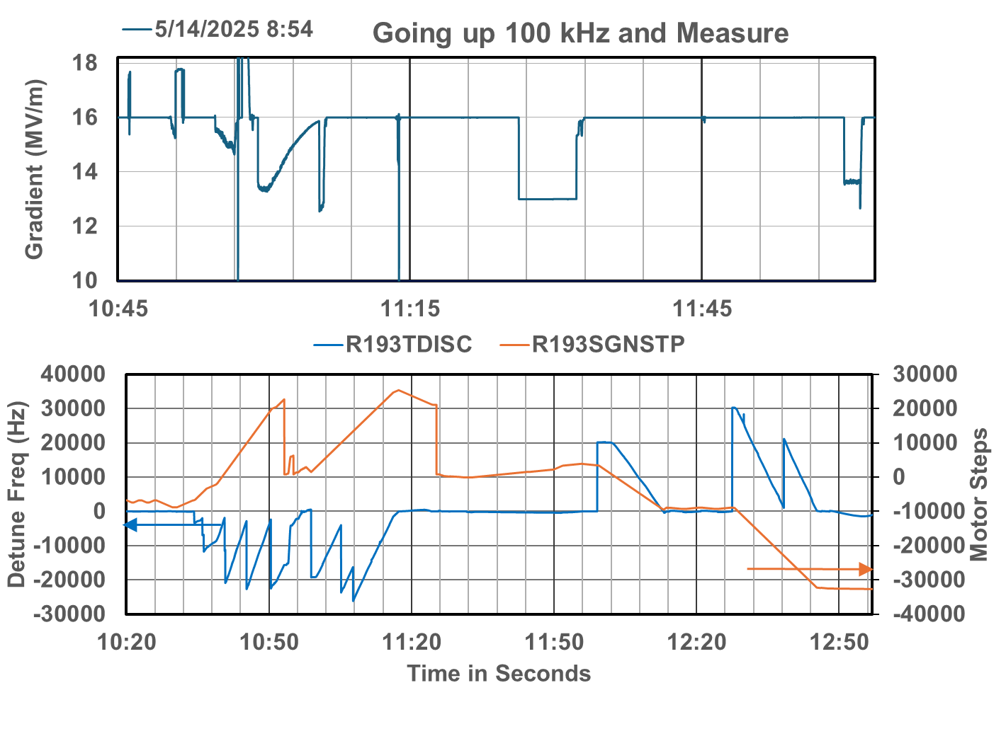

Slide 27
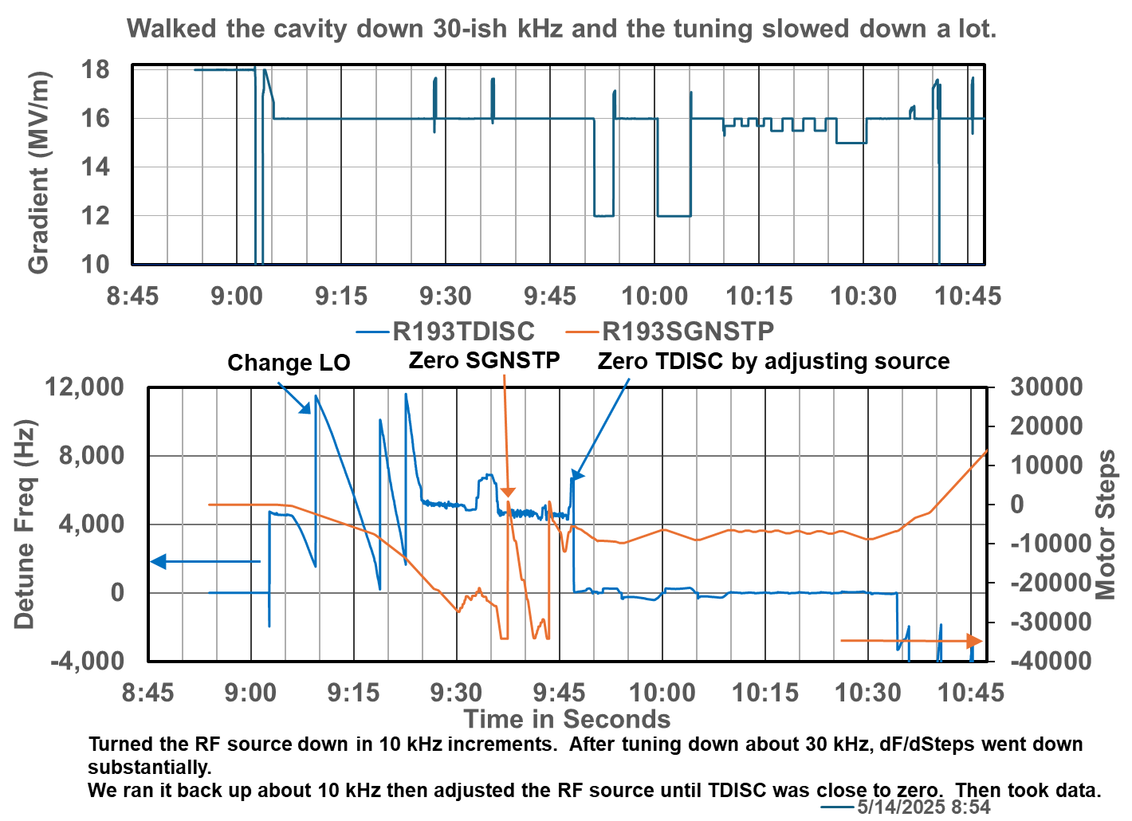

Slide 28
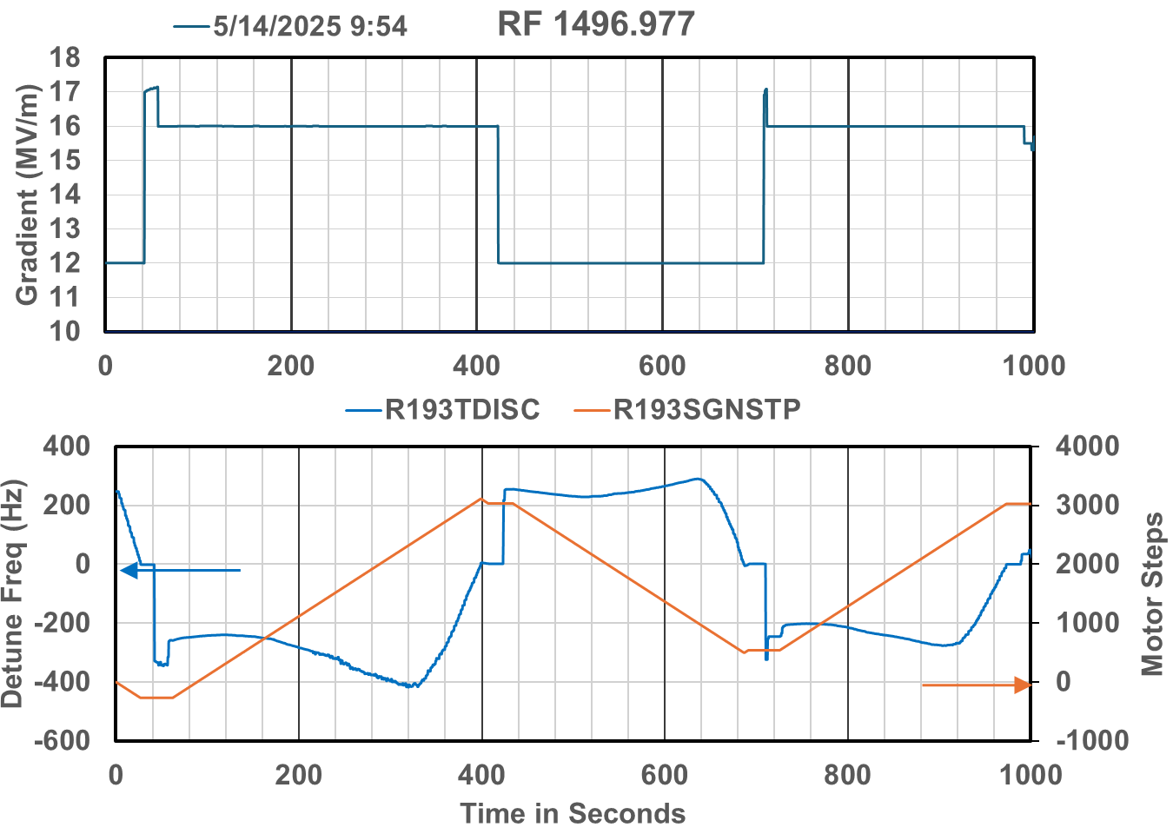
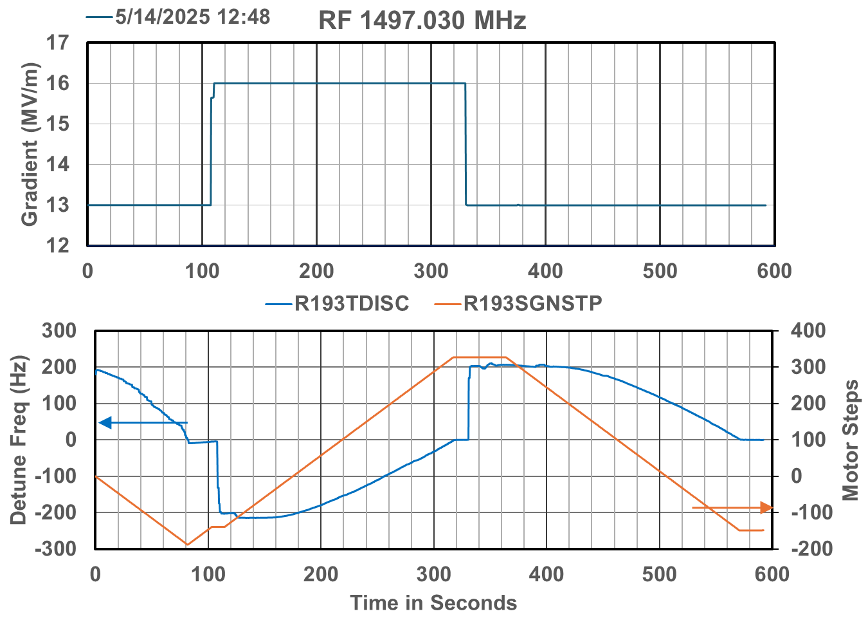
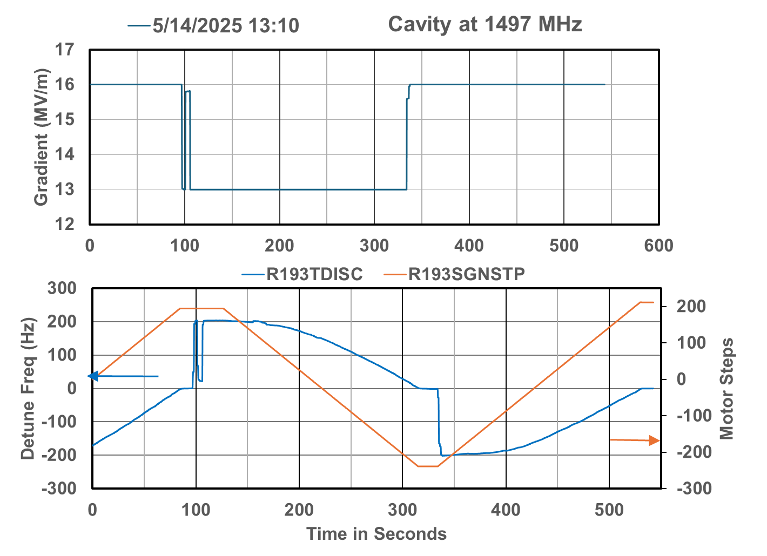
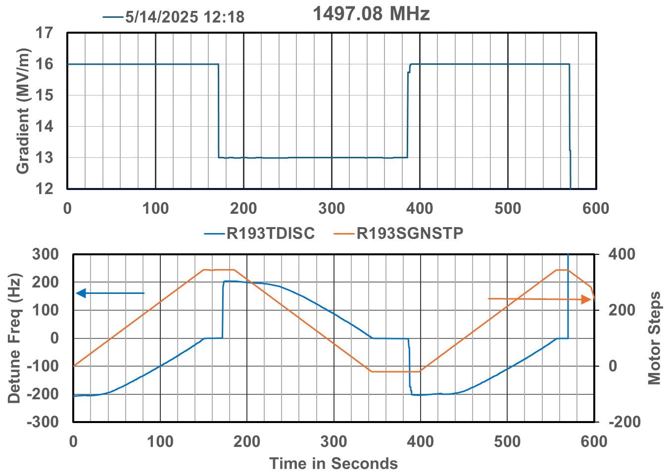

Slide 29
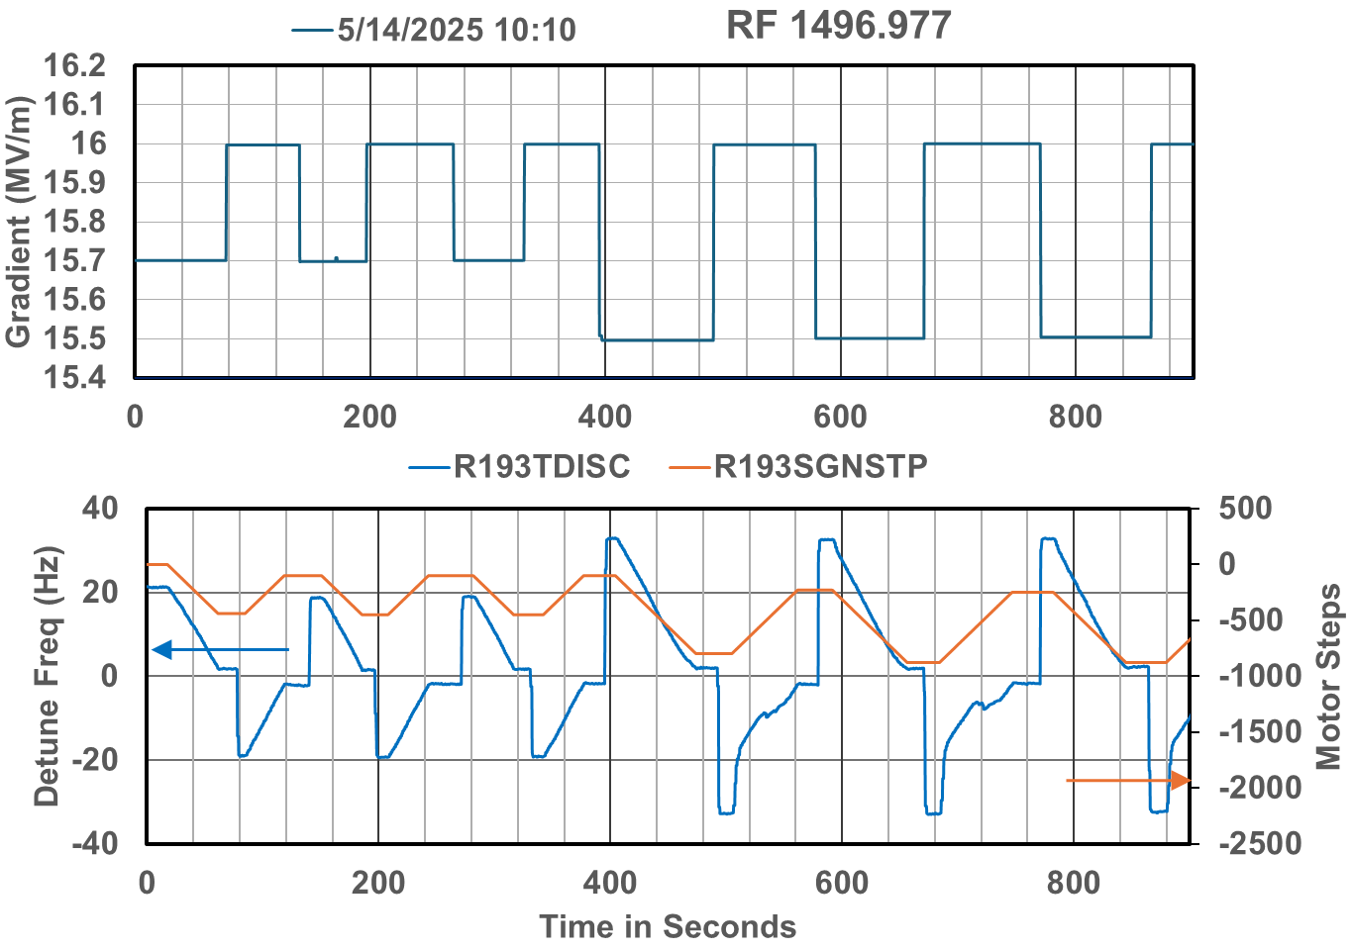
Close in operation as compared to longer range operation
The cavity still seems to be operable for low frequency excursions in this state.

Slide 30
Next step ? ?
1L09 never had a set of tuner measurements when it was commissioned.
Set up an entire zone with an external LO (plug in upstream of the spitters)
Vary the frequency up and down 100 kHz looking for the dead band between compression and tension.
The goal is to do this with 1L09 and 2L05 so that we can determine the proper place to tune the cavities in advance of cooling them down.
ATLis approved waiting on a linac locked up maintenance day

Slide 31
Data from past talks

Slide 32
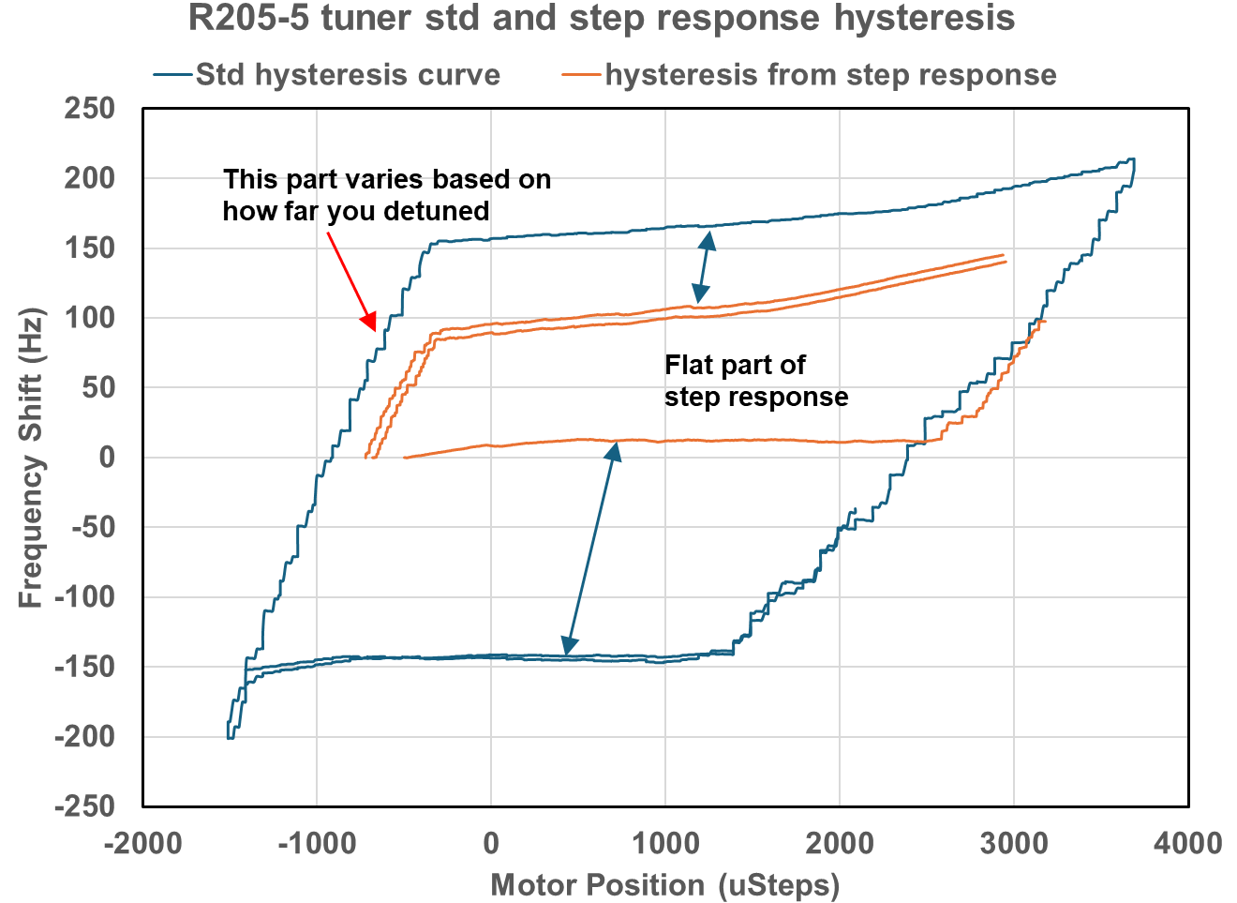
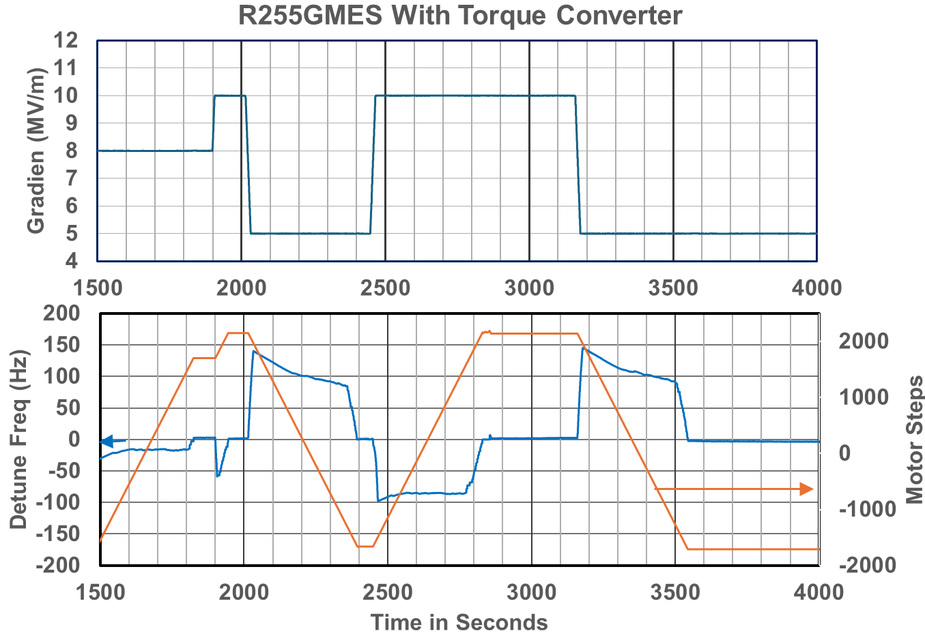
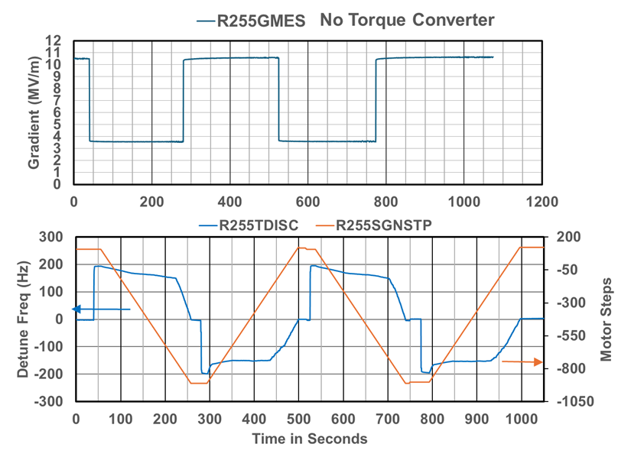
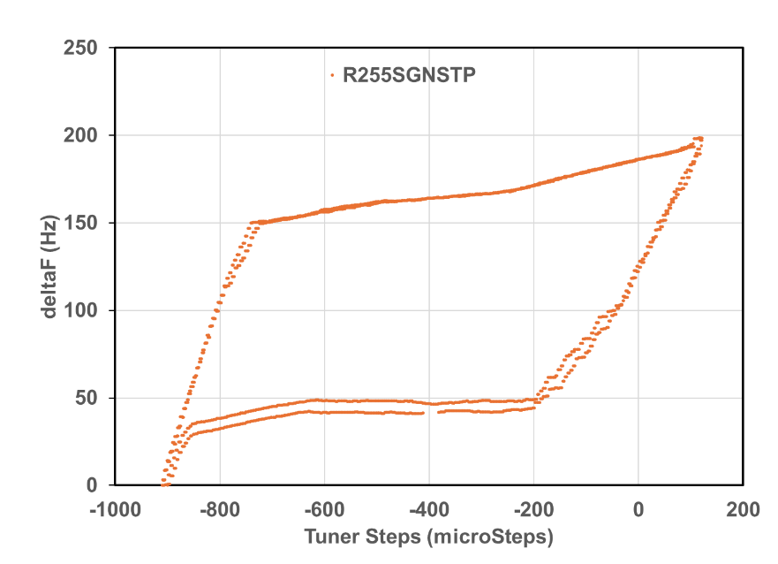
2L05-5 with torque converters
C75-03

Slide 33
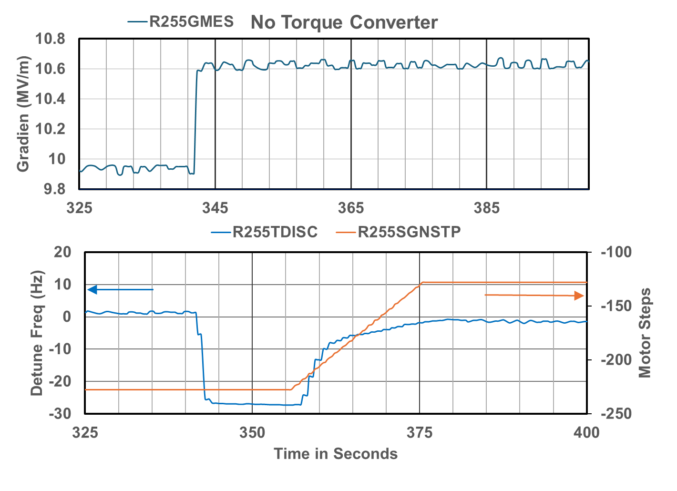
2L05-5 small step response
Lots of non linearities but it seems to be controllable.
Note the large slope in deltaF at T = 358 where the slope starting at T = 365 is more “normal”.

Slide 34
2L05-5 small step response
Concern about the dF/dStep at the beginning of tuning after changing direction. Makes me wonder how fast we can run when we are close in. This data was taken with TSTPHZ set to 5 where 1 is part of the normal mode setting and 10 is turbo.
Oddity of the tuner walking away in one direction to what one would assume a steady state condition driven by the system “relaxing”. In this case it went the same direction independent of if the cavity was last driven more negative in frequency or more positive.

Slide 35
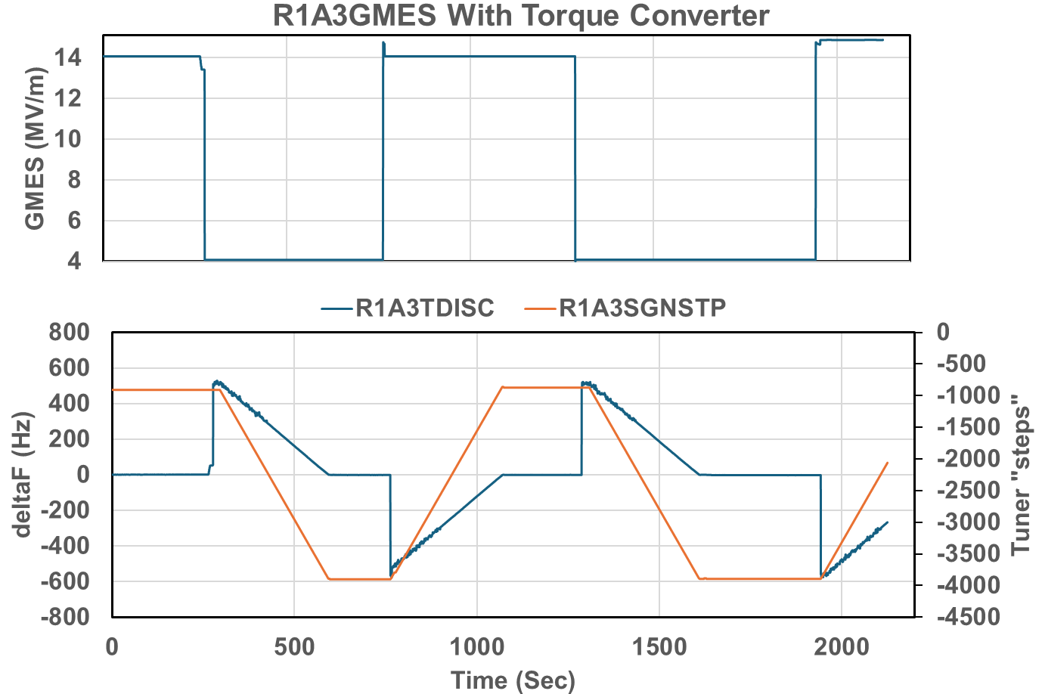
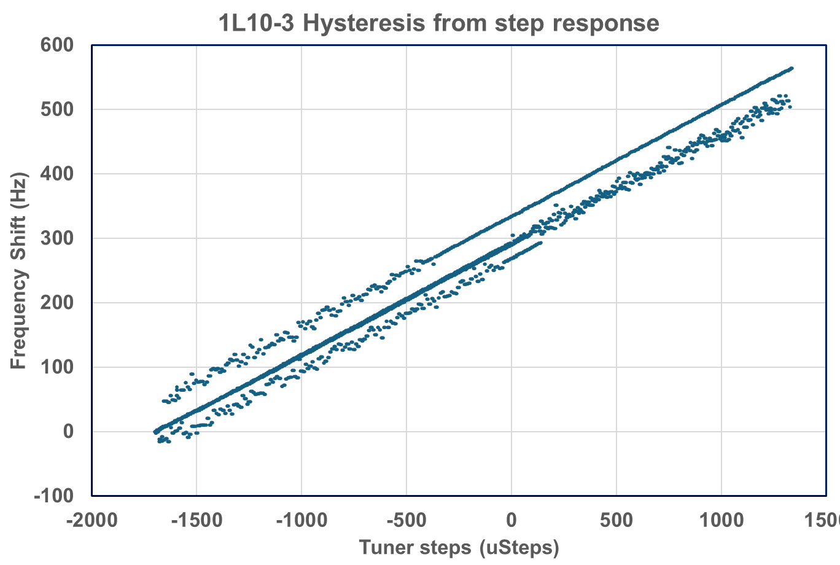
Step 1L10-3 with torque converter
C75-02

Slide 36
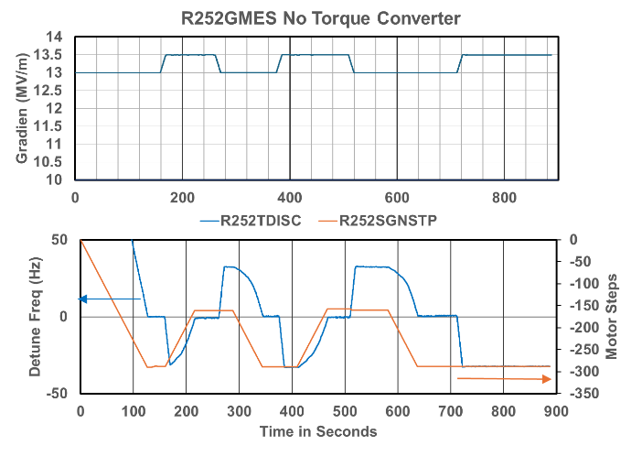
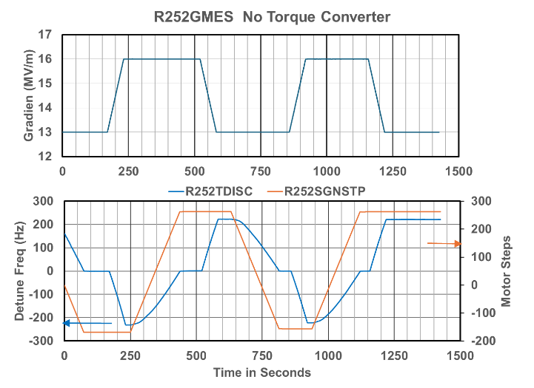
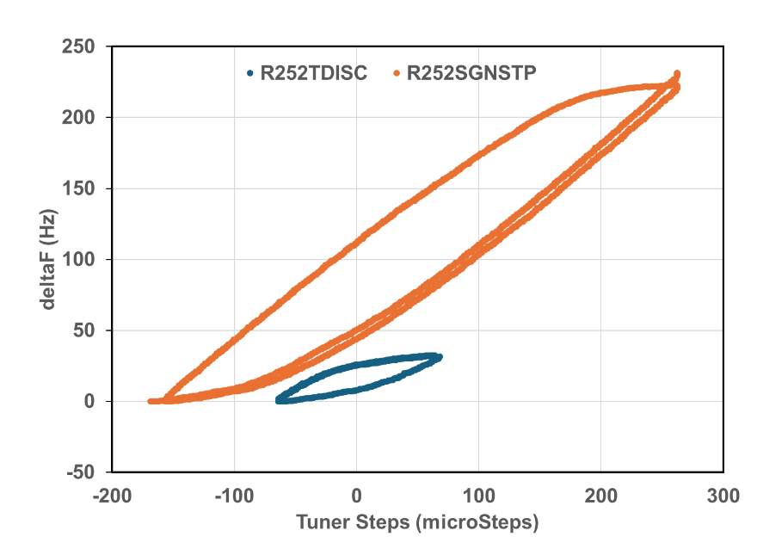
2L05-2
Hysteresis curves for a 30 Hz and 250 Hz variation.
No torque converter.
Pretty well behaved response.

Slide 37
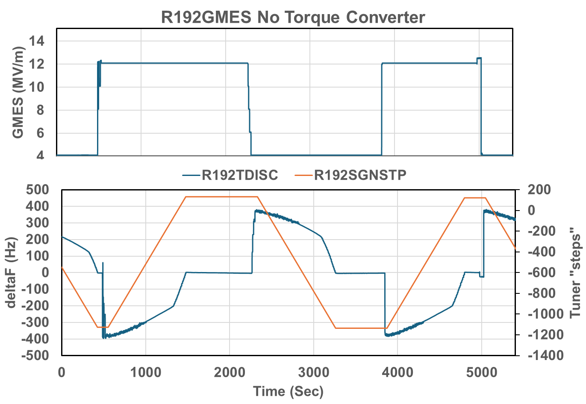
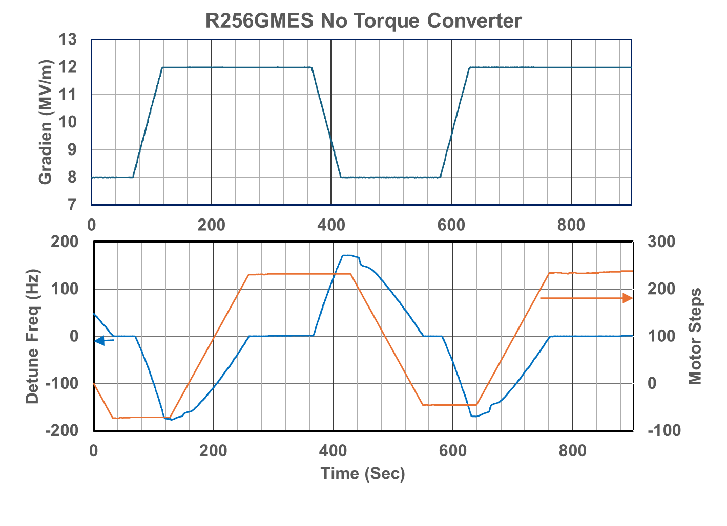
1L09-2 No torque converter
C75-04
C75-03

Slide 38
A collection of odd responses
Weird step in detune response after 50 or so steps. In positive direction and a smaller effect in the negative direction
Very small motion for first 750 steps in either direction.

Slide 39
A collection of odd responses
Very small motion for first 550 steps
Very small motion for first 550 steps

Slide 40
A collection of odd responses
Very small motion first 4200 steps.
Cavity probably is in turbo mode. Note that it is overshooting.

Slide 41
A collection of odd responses
Why is the motor steps not a linear ramp like all of the other cavities?
It is a linear ramp when it is in SEL Mode

Slide 42
Data indicates that different motor “speeds” lead to overshoot.
C75-04-5 was having problems with overshooting in “turbo” mode.
It was still overshooting when we set TSTPHZ to the default value of 1.
It behaved nicely but slower at 0.3.
The data indicates that it takes the same number of indicated SGNSTP to move the same frequency independent of the speed.

Slide 44
The boring details follow.

Slide 45
Hysteresis Loops for C75 cavity with and without gear box.
Cavity set up in SEL mode.
Tuner cycled.
Tuner with gear box has a large hysteresis loop. This presents issues when, for example, following slow pressure drifts up and down.
There is something odd with the setup without a gear box between segments 3 and 4. It appears that the sensitivity is reduced substantially where it rolls over.

Slide 46
2L05-5 with gear box and 2L05-6 without gear box
Cavity with the gear box has a “dead band” for about 3000 steps where the cavity is less sensitive to tuner motion.
After the dead band cavity 5 cavity responds rapidly.

Slide 47
Tuning as a function of microsteps

Slide 48
Tuning as a function of microsteps

Slide 49
Sensitivity changes after changes in tuning direction
Time it takes to tune.
Even in Turbo mode the cavity with the gear box took 400 seconds to tune the cavity after a 4 MV/m step as compared to about 80 seconds for one without the gear box.
Different sensitivity depending on history.
Before you load the gear box up it responds with a sensitivity less than 0.026 Hz/step which is about times10 less than once it is loaded up in one direction.
Once you load up the gear box the tuner responds with a sensitivity of about 0.15 Hz/step in the direction that the gear box is loaded and 0.02 in the reverse direction.
It is not clear what happens if one changes direction during the middle of winding up the gear box.
0.015 Hz/Step
0.0263 Hz/Step
0.230 Hz/Step
0.0126 Hz/Step
0.162 Hz/Step
- 0.0005 Hz/Step
The gradient was adjusted from 8 to 10 MV/m.
The frequency changed downward due to Lorentz forces.
The cavity quickly retuned because the tuner was already running in a positive direction when the gradient was changed.

Slide 50
Concerns
Time it takes to tune.
Even in Turbo mode the cavity with the gear box took 400 seconds to tune the cavity after a 4 MV/m step as compared to about 80 seconds for one without the gear box.
Different sensitivity depending on history.
History includes slow drifts in one direction then some time later back in the other direction due to pressure sensitivity.
I can not imagine how one would do a predictive move for the tuner which is what is done with the C75 and C100 cavities. (e.g. decide that the cavity is off by N Hz. Apply a tuner motion equal to N Hz times the sensitivity in Hz.
It is not clear with happens to the C75 cavity with no gear box between segments 3 and 4 as well as why the hysteresis loop looks different between segment 2 and 4.
Next measurements.
Measure the tuner response to changes in gradient on 1L05-3 (?)
Measure the hysteresis loop for 2L05-6
Measure what happens when one changes direction while in the middle of loading up the gear box.

Slide 51
QUESTIONS?
Notes:
Before sharing your presentation, confirm:
Fonts are consistent
Images meet quality standards
Charts use template colors
Footer information is current
Spell check completed
Links are working
File size is optimized

