Slide 1

LEEPP Workshop Practical
LEEPP @ JLab
D. Cassidy, J. Grames, D. Higinbotham, K. Jordan, T. Kutz, A. Schmidt, F. Selim, E. Voutier et al.
Welcome to
LEEPP @ JLab
LEEPP will be hold in the same F113 room for the whole week (presentations, discussions, breaks, lunches).
Low Energy Electron Positron Physics at JLab
March 23th-27th, 2026

Slide 2
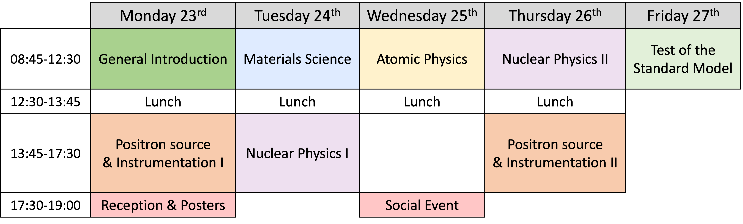
LEEPP @ JLab
Agenda
JLab Tour
Dinner
JLab Tour attendants will gather on Wednesday at 2 pm in CEBAF auditorium.
LEEPP proceedings will be published in Proceedings of Science (PoS).
Please upload your talk on the indico before your session.
2/4
March 23rd, 2026

Slide 3
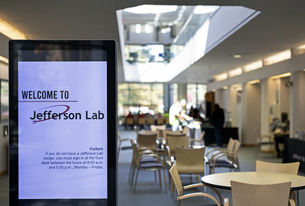
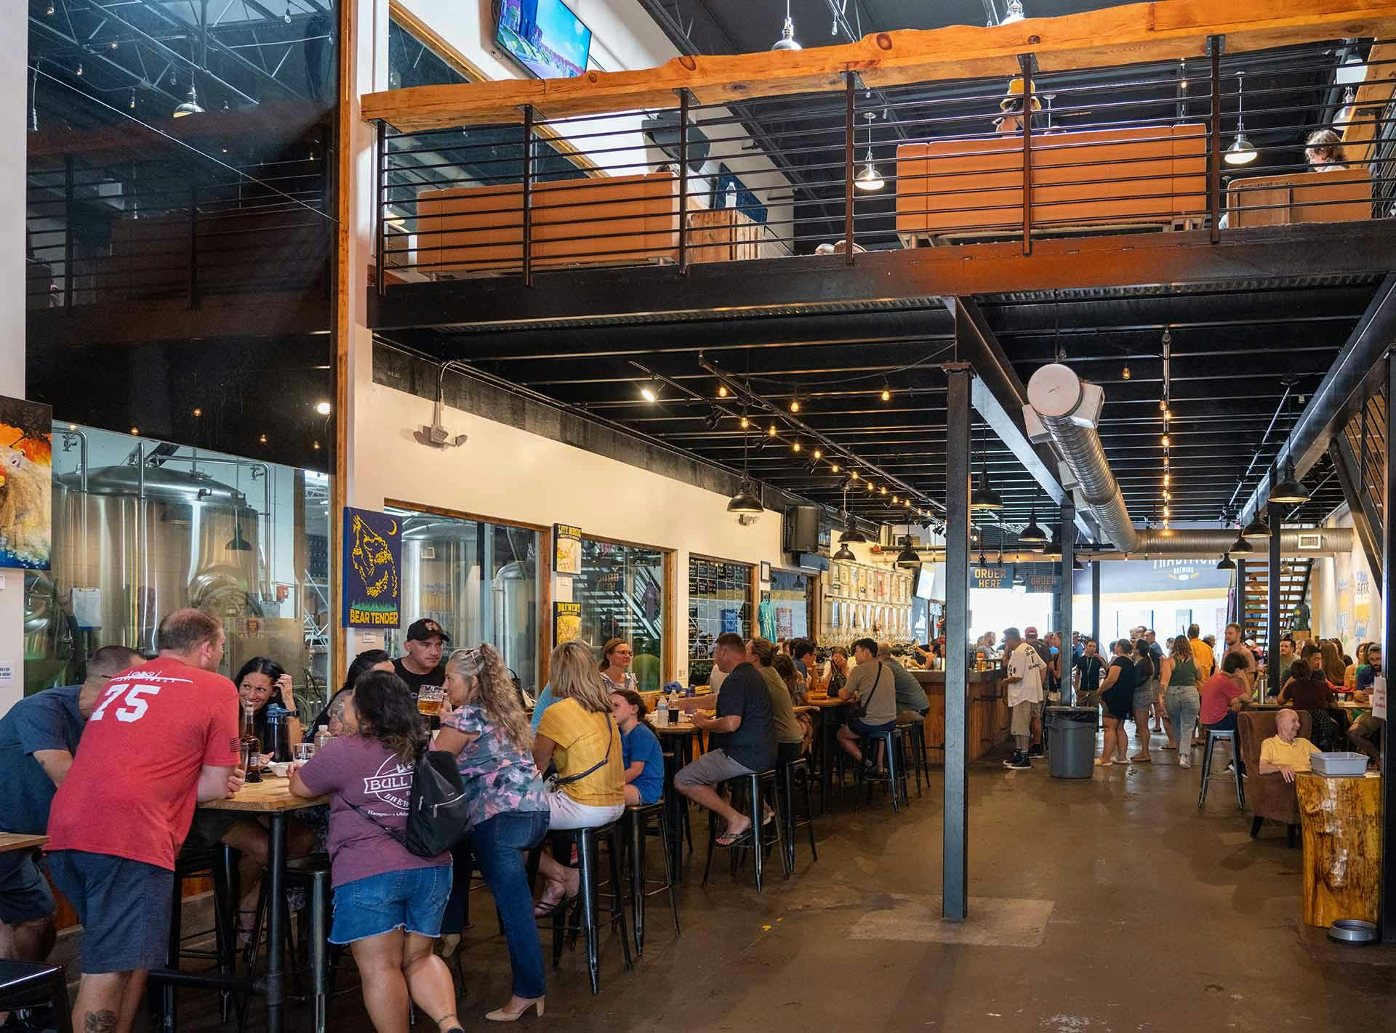
LEEPP @ JLab
Get Together
LEEPP reception will take place on Monday 17:30 in the main lobby of CEBAF center.
Boards will be available for poster show.
We will gather on Wednesday 17:30 at the Tradition Brewery located 700 Thimble Shoals Blvd in Newport News.
3/4
March 23rd, 2026

Slide 4
LEEPP @ JLab
Get Together
We are planning for a diner Thursday evening (not supported by the workshop)
A sign-up sheet will circulate (transportation requirements)
Place to be determined based on interest
Reach-out to us (Axel, Doug, Eric, Farida, Joe, Kevin, Tyler) if you need any assistance.
Enjoy LEEPP !!
Questions ?
4/4
March 23rd, 2026

