Slide 1
Laser cooling of positronium toward precision measurement
Kenji Shu
RIKEN
Low Energy Electron Positron Physics Workshop at Jefferson Lab

Slide 2
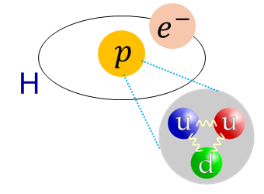
Simplest atom: Positronium
Contains only light leptons
Negligible weak & QCD effects in calculation
Positronium
Hydrogen
Precise prediction of e.g. energy intervals with m_{e−} (= m_{e+} w/ CPT), α, and QED
Textbook system for testing QED

Slide 3
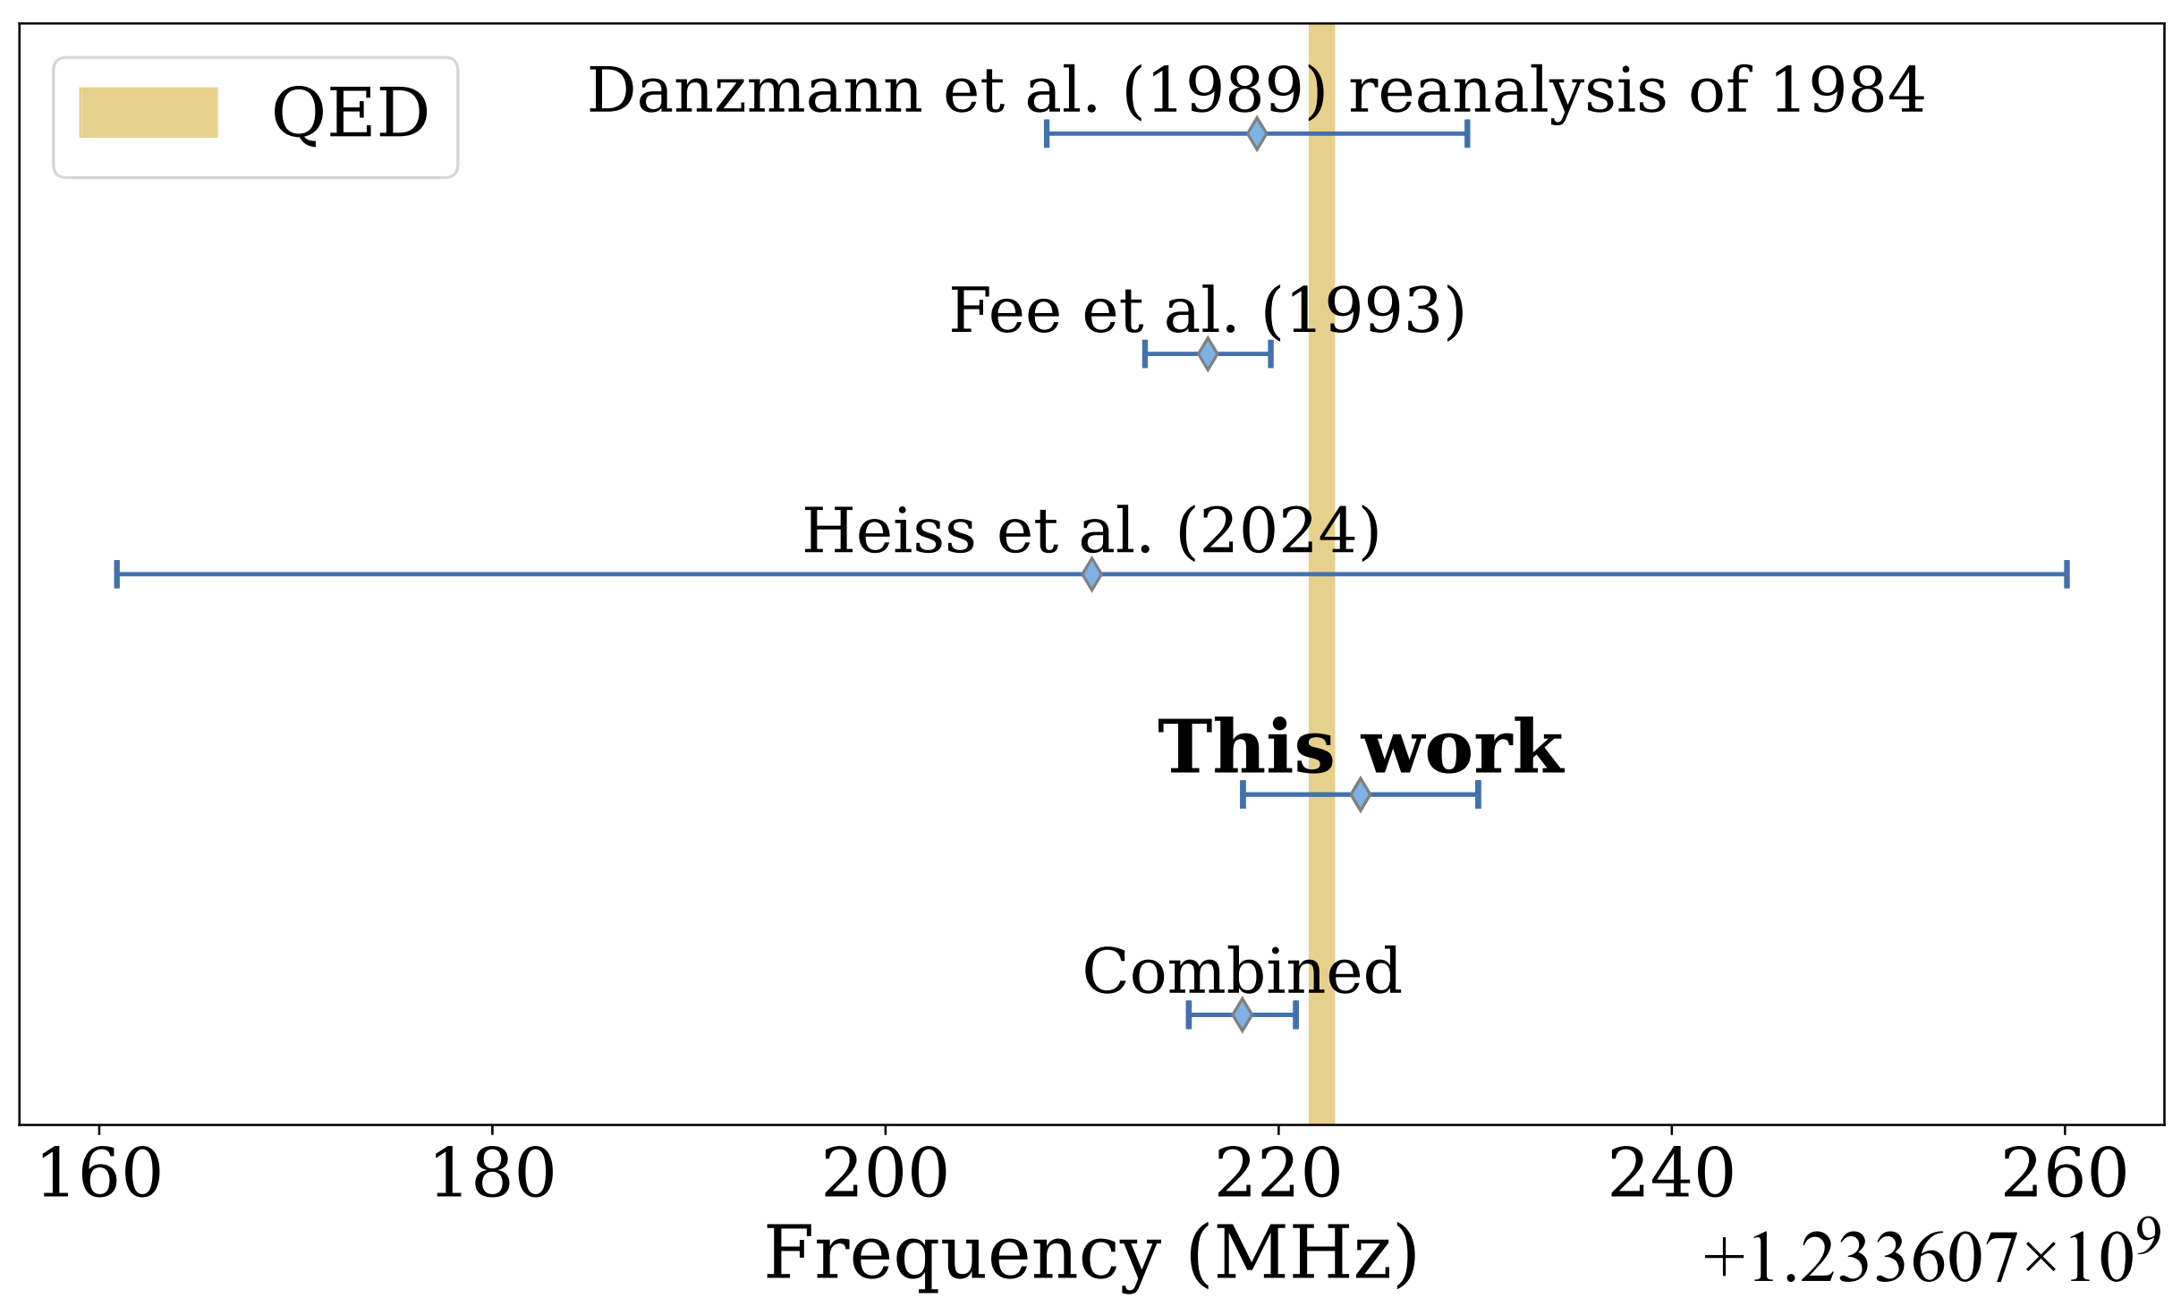
1S – 2S precision spectroscopy
A few ppb (meas.)
0.5 ppb (theory)
ETH Crivelli group,
PRA 113, 032804 (2026)
Bottleneck is high temperature of Ps
→ Laser cooling

Slide 4
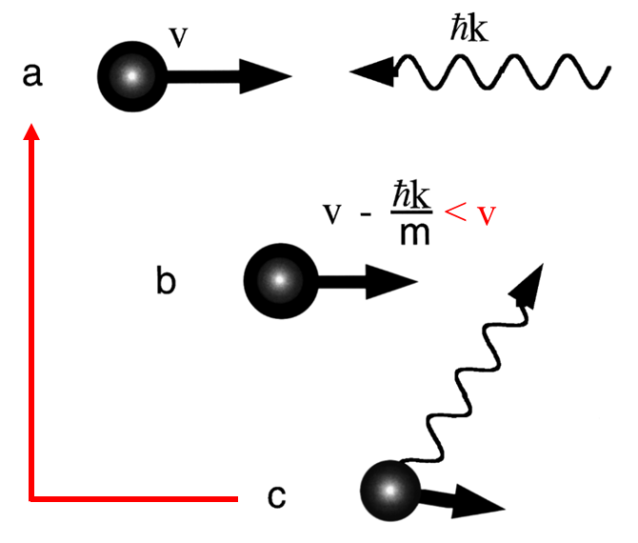
Principle of laser cooling
Photon momentum
E_{photon}
Lower state
Deceleration
E’_{photon} > E_{photon}
Repeat
Excited state
Energy release
Averaged kick = 0
Lower state
W. D. Phillips, Rev. Mod. Phys. 70, 721(1998).

Slide 5
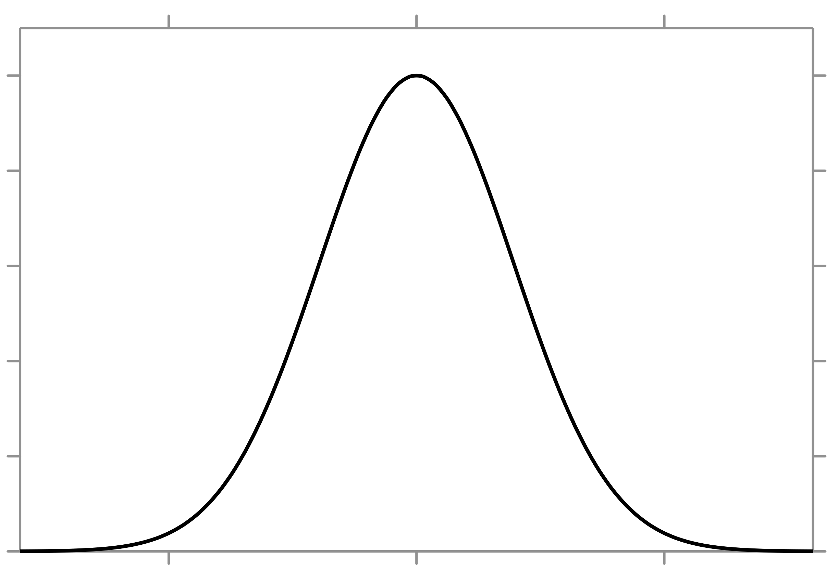
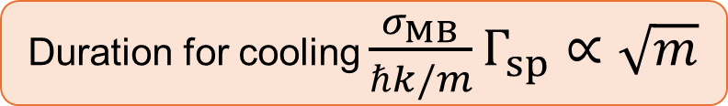

In the case of Ps laser cooling
Typical velocity with Maxwell-Boltzmann dist.
$$σ_{MB}≃\sqrt{\frac{k_{B}T}{m}}$$
Probability density
Spontaneous decay rate Γ_{sp}
Velocity
Duration for cooling $\frac{σ_{MB}}{ℏk/m}Γ_{sp}∝\sqrt{m}$
Lighter leads faster cooling
Ps’s Lyman-α: ~100ns cooling time

Slide 6

Doppler shift to let Ps absorb only counter-propagating photon
Transition angular freq. for stopped Ps
Δ_{Doppler} < 0
e
Only counter-propagating photon becomes resonant
Energy
$${ℏω}_{ge}$$
Set laser freq. lower
Δ_{Doppler} > 0
g

Slide 7
Laser properties for Ps cooling
Resonant freq. for stopped Ps
Necessary time for enough number of recoils
Laser freq. dist.
Laser heating!
Laser intensity
Intensity
Optical freq. that Ps can absorb
Optical freq. that Ps can absorb
Time
Broad spectrum
to cool various velocity
~100 GHz
Steep cutoff at high freq. side
To avoid heating ~10 GHz
(= Shift by one photon recoil)
Keep cooling for
necessary ~100ns
No commercially available laser → Develop by ourselves

Slide 8
Laser system
Put EOM (optical frequency modulator) in a pulsed laser cavity was essentially new

Slide 9
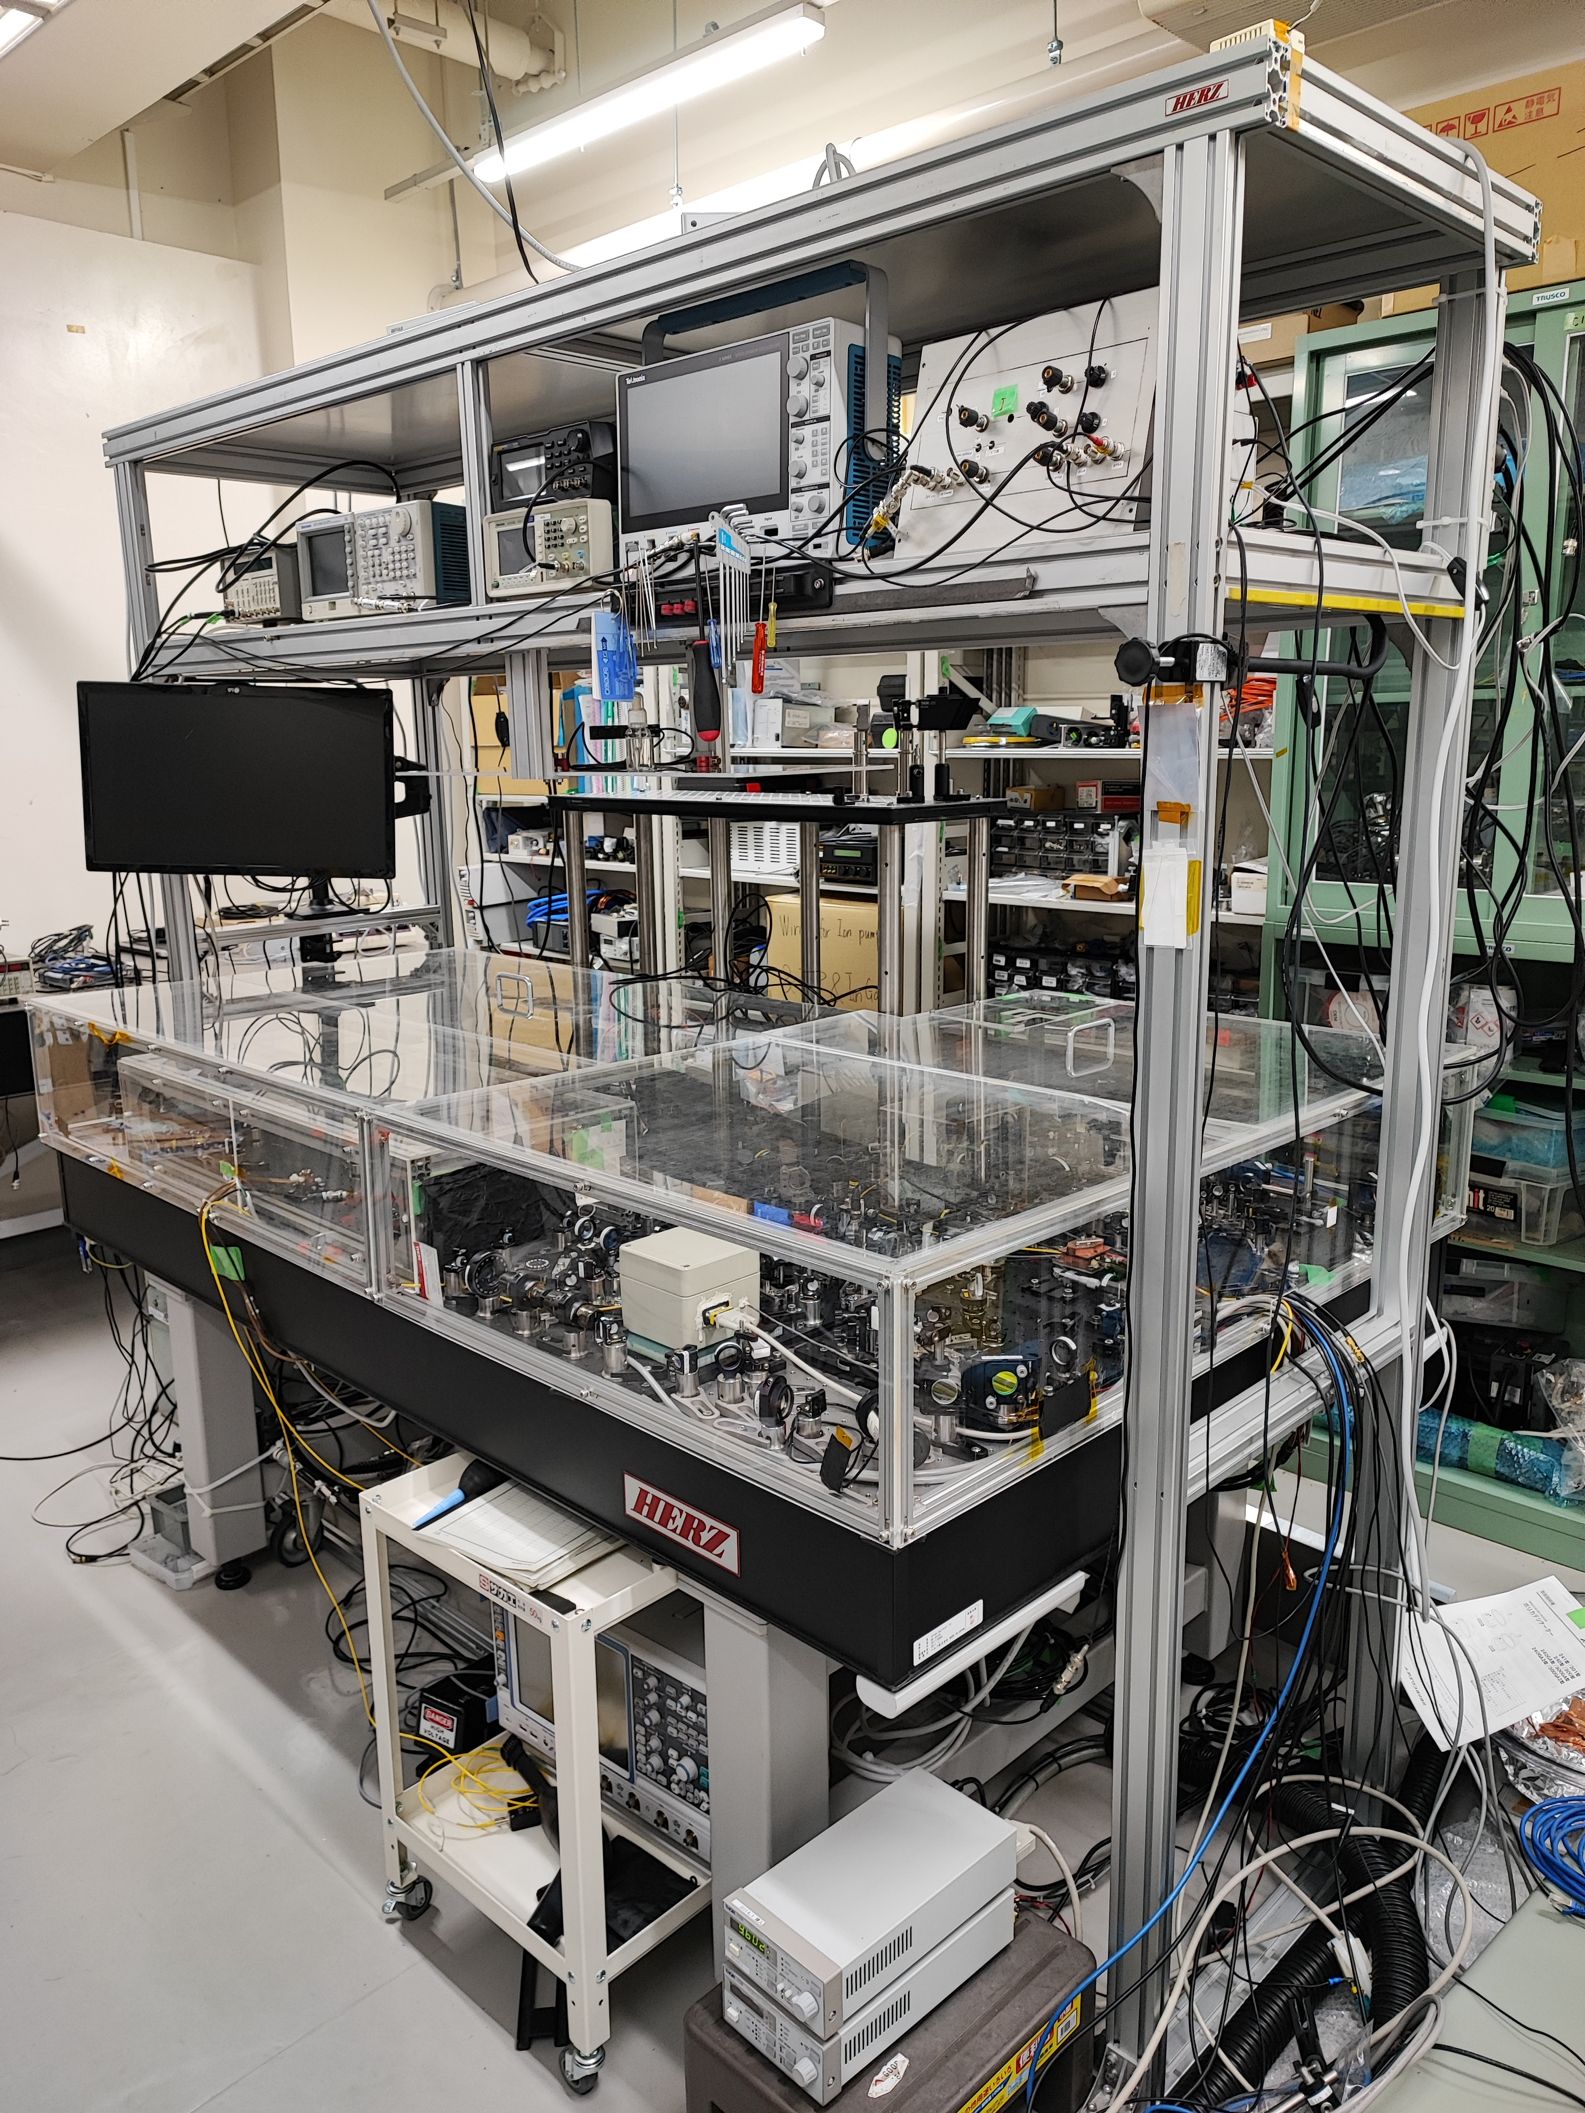
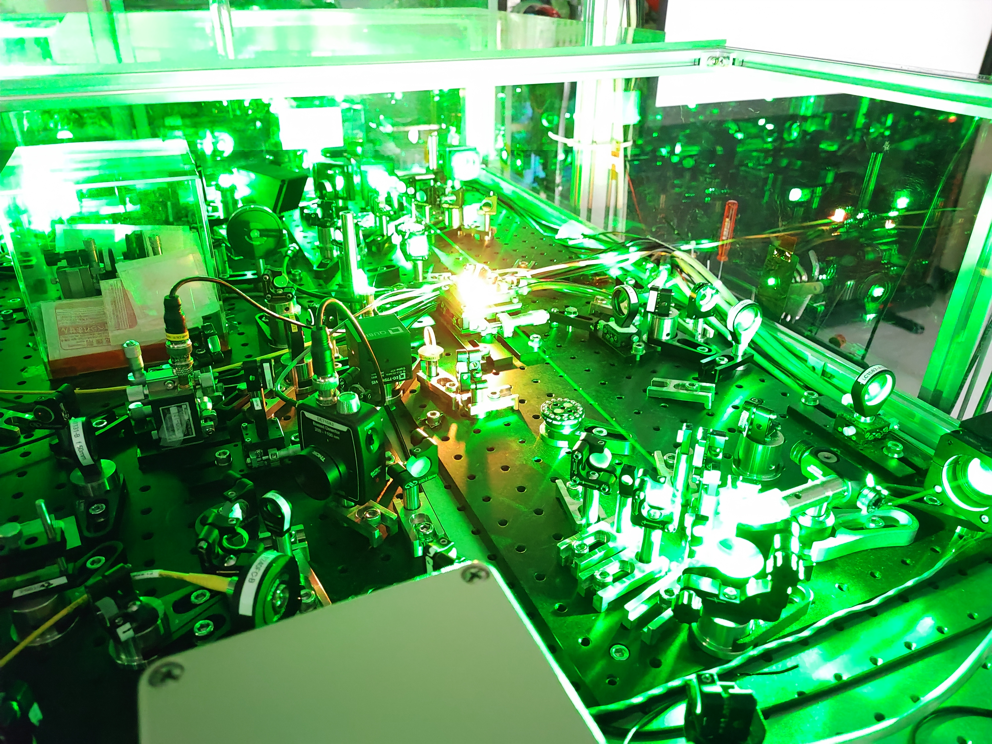
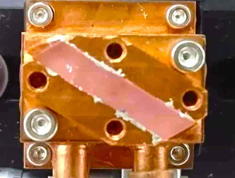
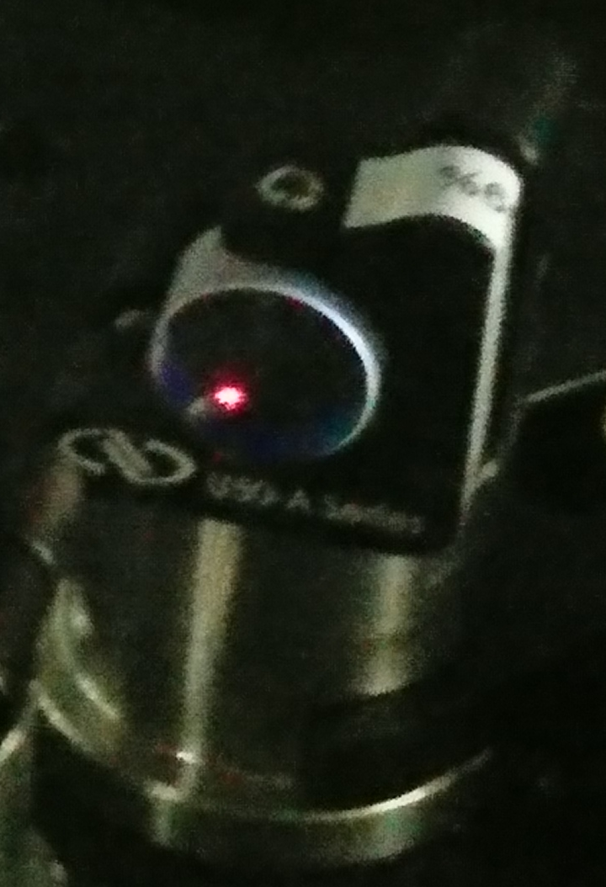
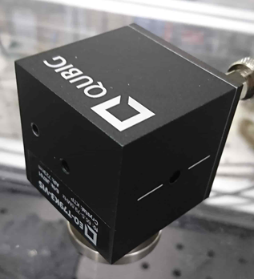
Laser development

Slide 10
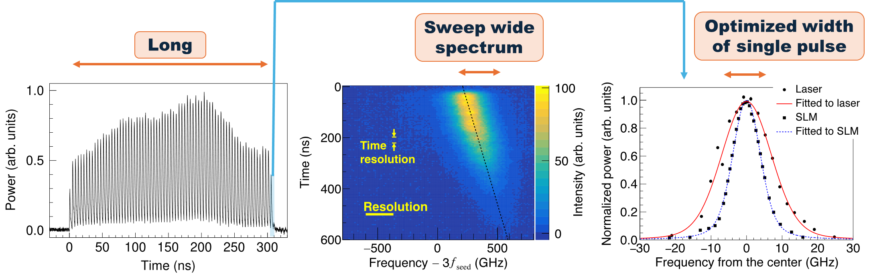
Developed laser properties
Sweep wide spectrum
Optimized width of single pulse
Long
All requirements fulfilled
Laser frequency shifts in time (chirp) === Chirp cooling ===
Chirp cooling: a pulse decelerate Ps, then chirps for that decelerated Ps, …

Slide 11
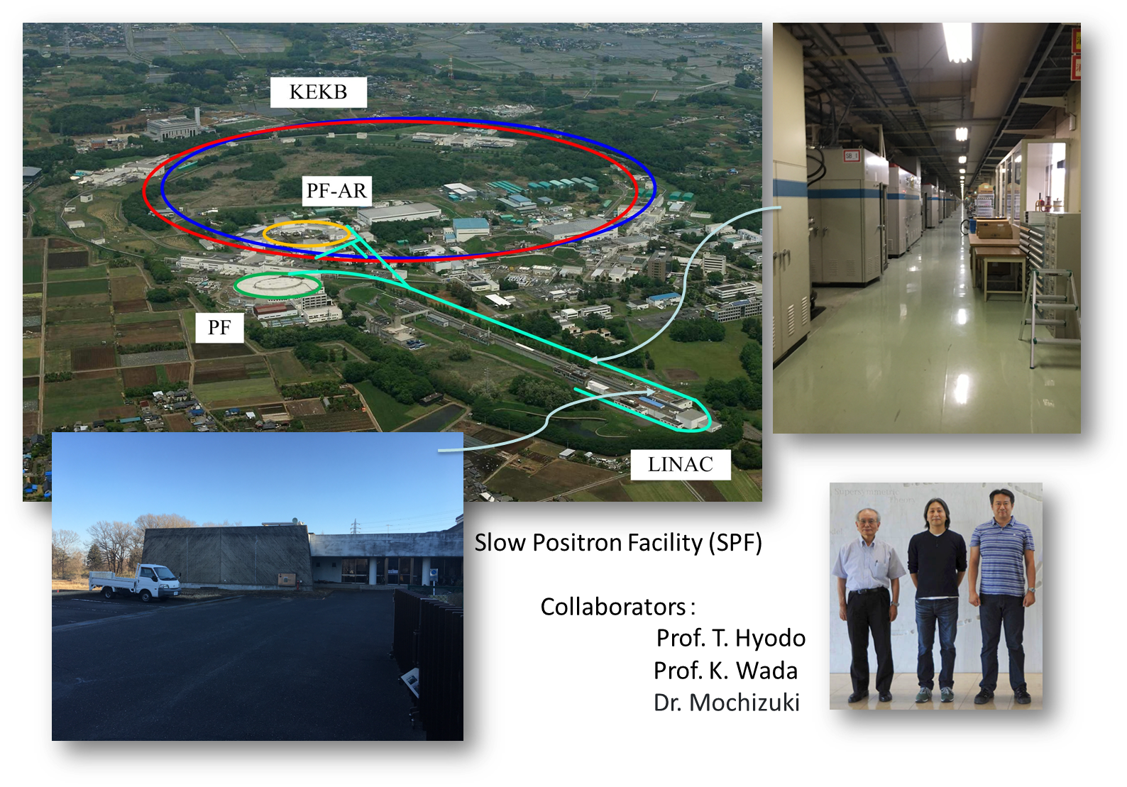
Time for positron: let’s go to KEK

Slide 12
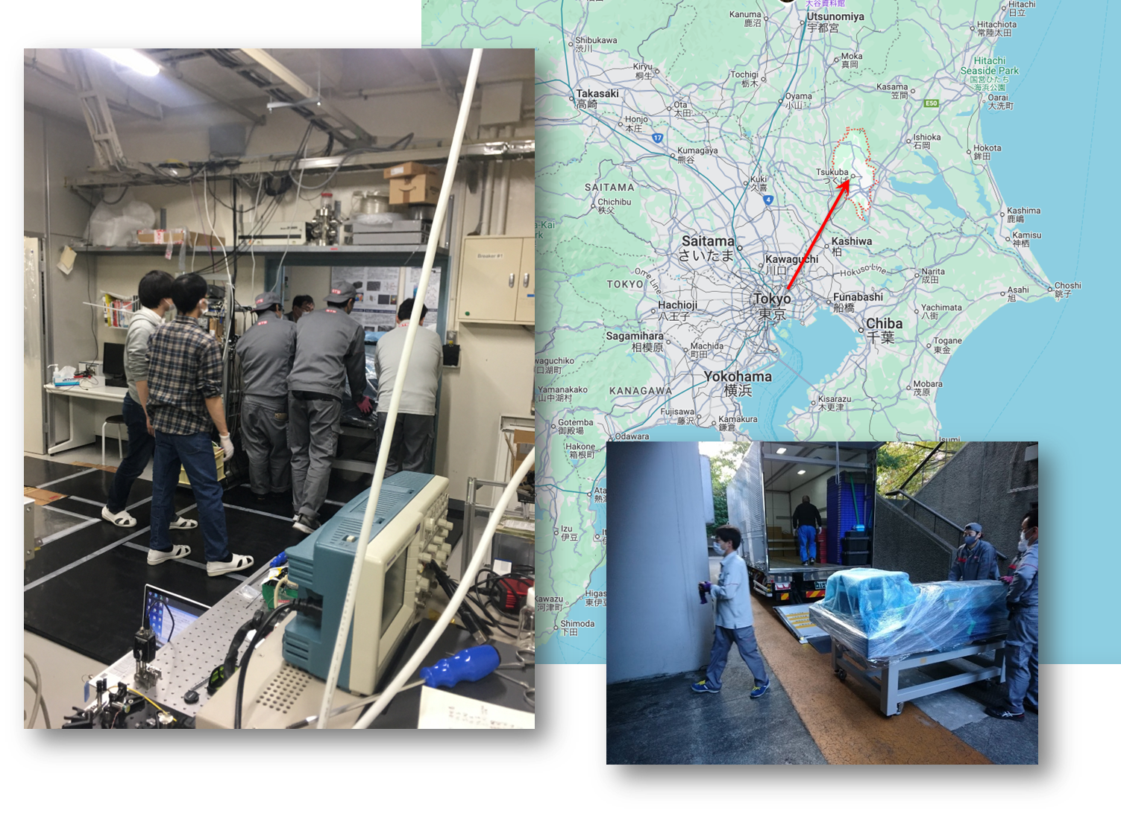
Laser transport
1.5hr through highway

Slide 13
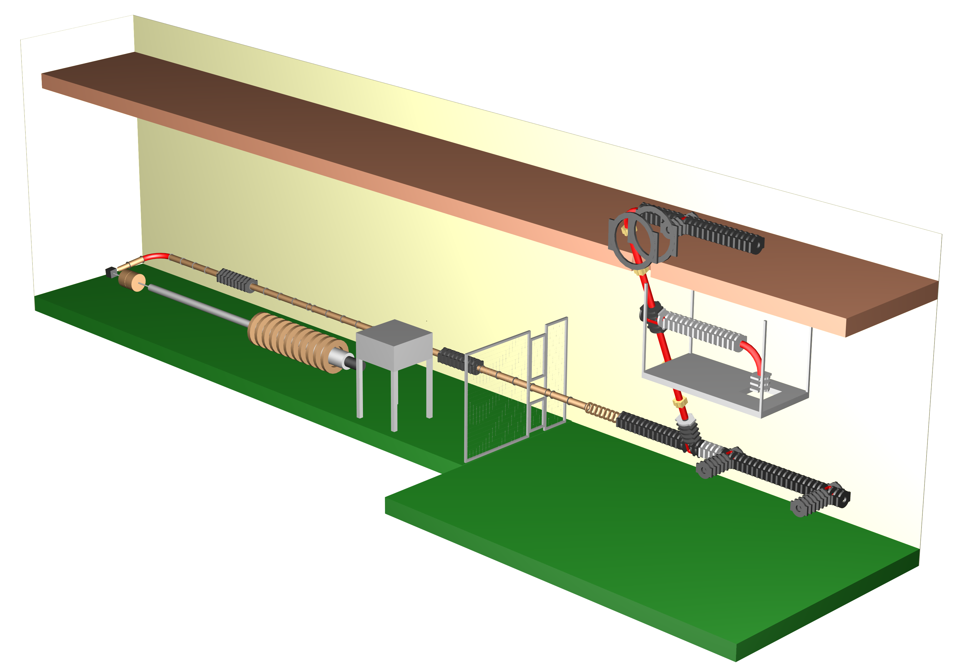
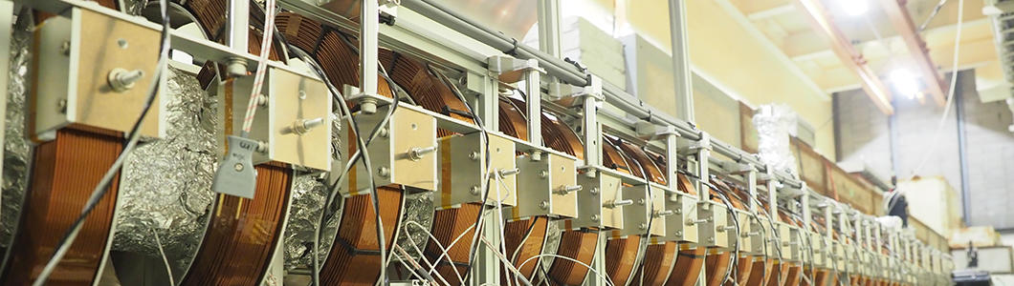
Slow Positron Facility
Two operation modes
Long pulse (1.2 µs) 1×10⁸ slow e⁺ /s
Short pulse (1-10ns) 1×10⁷ slow e⁺ /s
Electron LINAC
50Hz pulsed
50MeV, 600W
This short pulse mode is really essential since our lasers operate low repetition (~10Hz), requiring synchronization
Pioneered by Ps-ToF measurements and Nagashima-sensei’s Ps− projects, unique facility it is

Slide 14
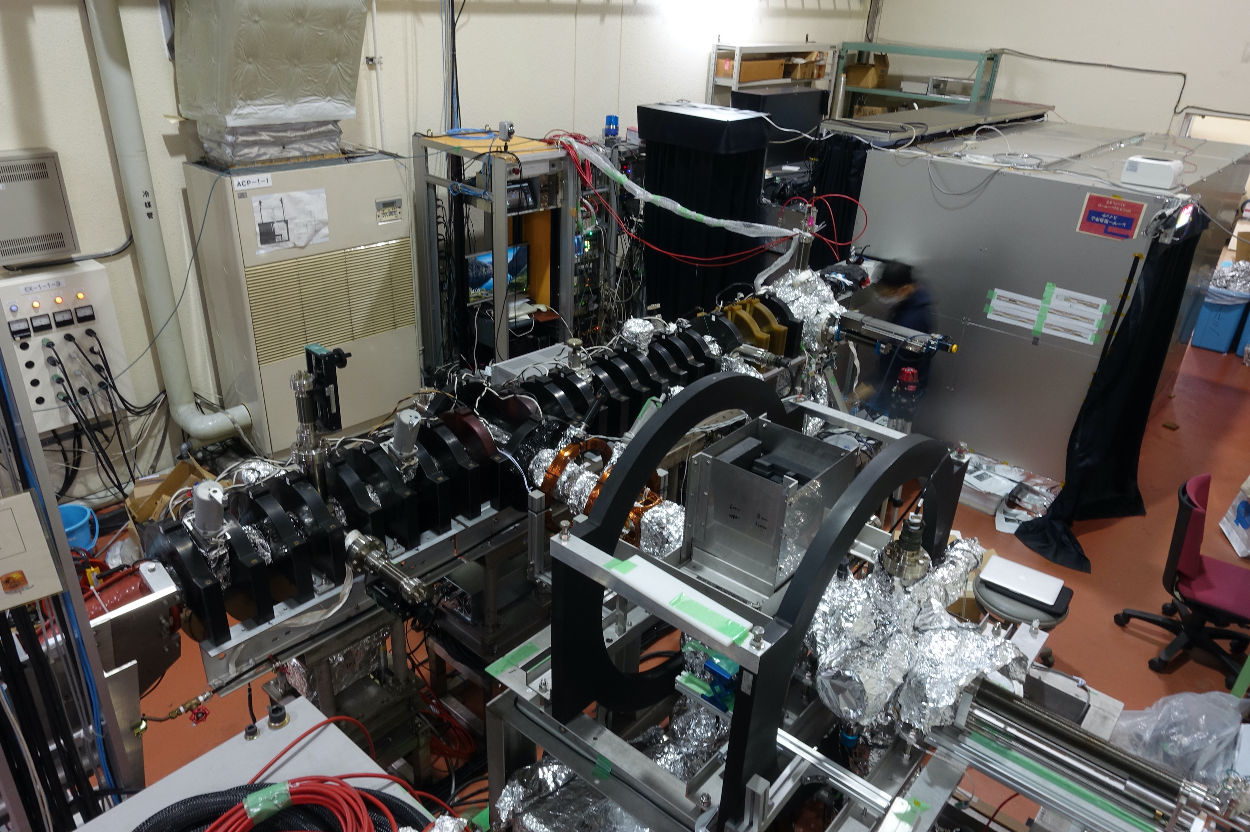
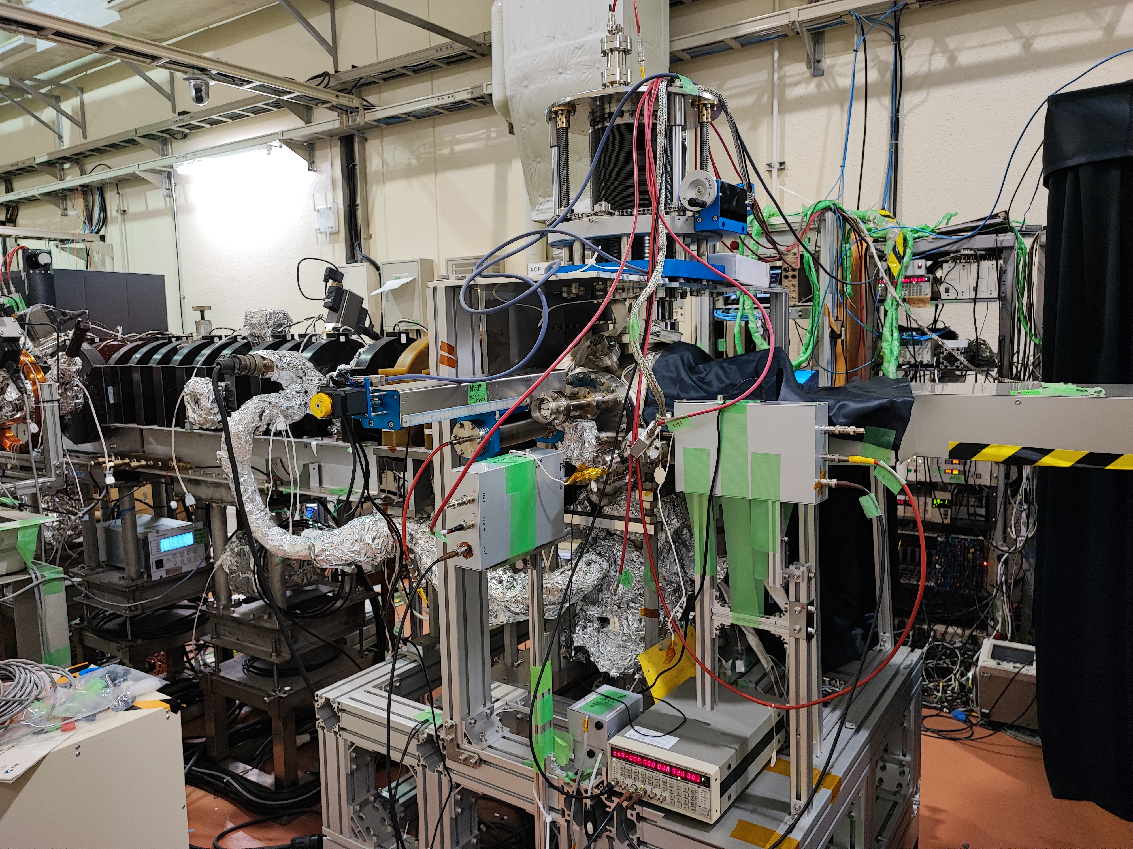
Experimental setup
Laser booth
Laser beams
Positron beam
Experimental station

Slide 15
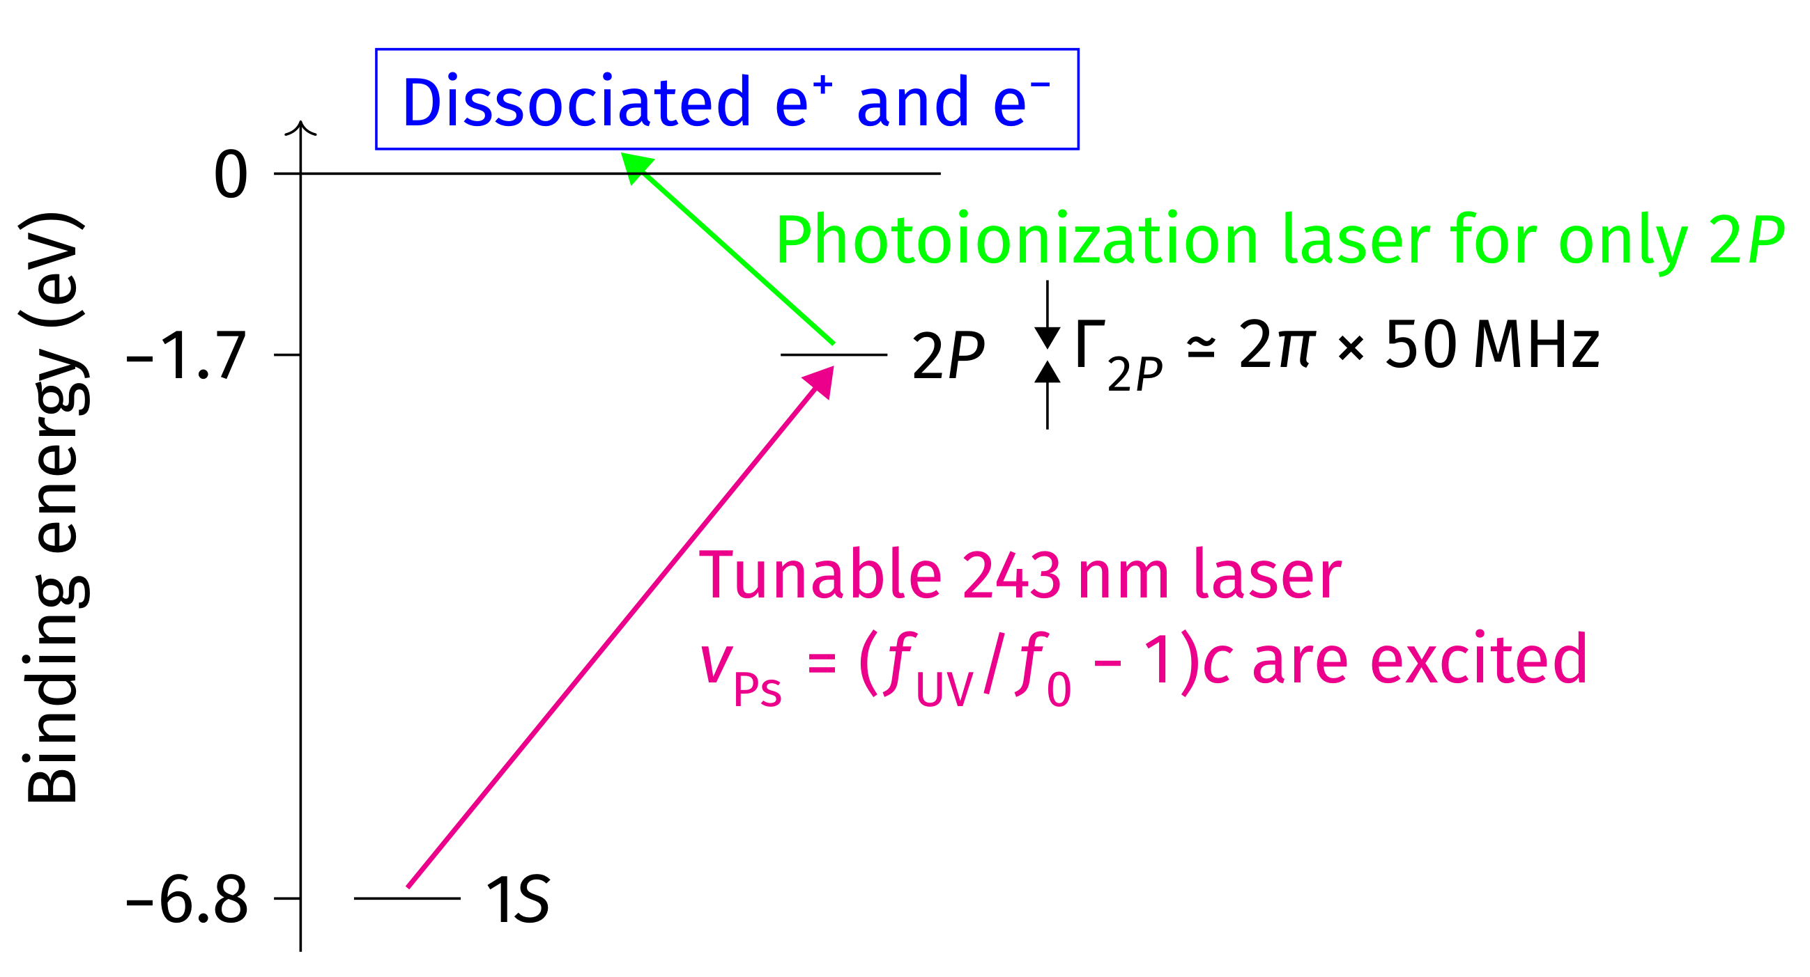

Measurement principle
0
$$v_{x}$$

Slide 16
Doppler profile of uncooled Ps
(Larger freq. probes faster Ps)

Slide 17
Laser cooling effect – control measurement –
Spectrum to see laser cooling effect
Ratio of difference by cooling laser
Narrowed to see ultracold

Slide 18
Laser cooling effect – control measurement –
Cooling laser
Intentionally detuned
Control run

Slide 19
Laser cooling effect – control measurement –
No systematic variation as expected
Cooling laser
Intentionally detuned
Control run
~4hrs per point

Slide 20
Laser cooling effect – optimized cooling range –
Optimized to cool Ps to zero velocity

Slide 21
Laser cooling effect – optimized cooling range –

Slide 22
Laser cooling effect – optimized cooling range –
×3 increase
< 1.4K (95%CL)

Slide 23
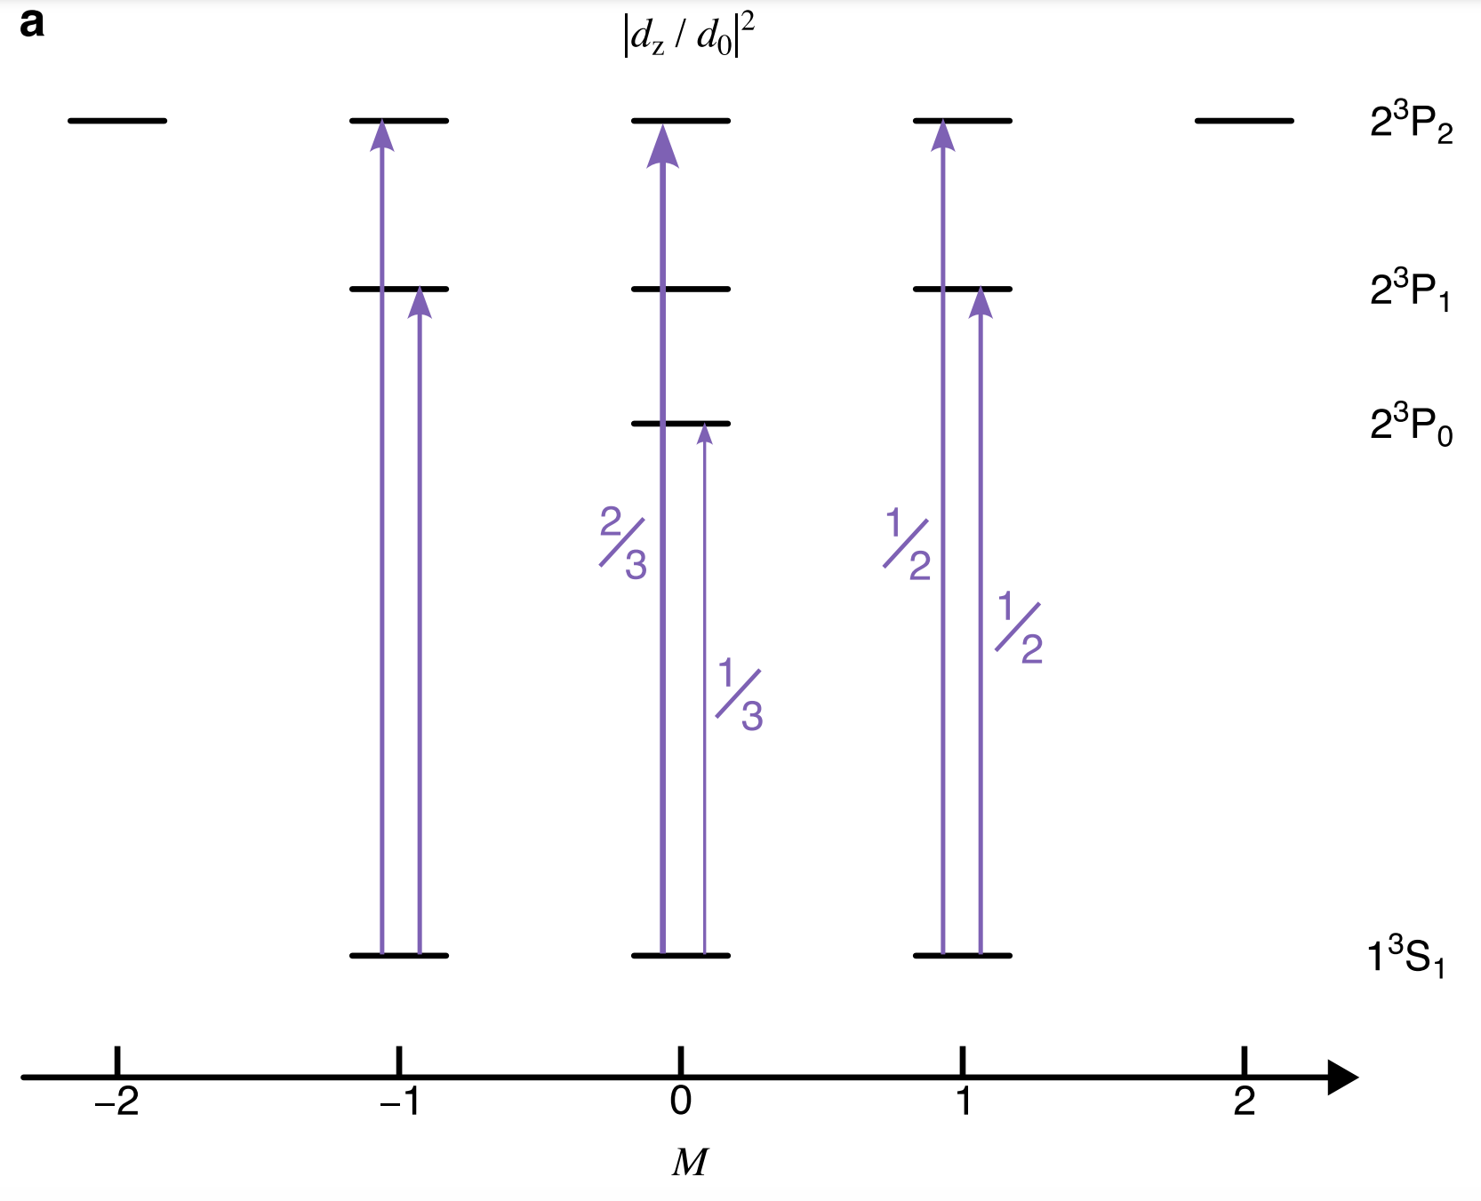
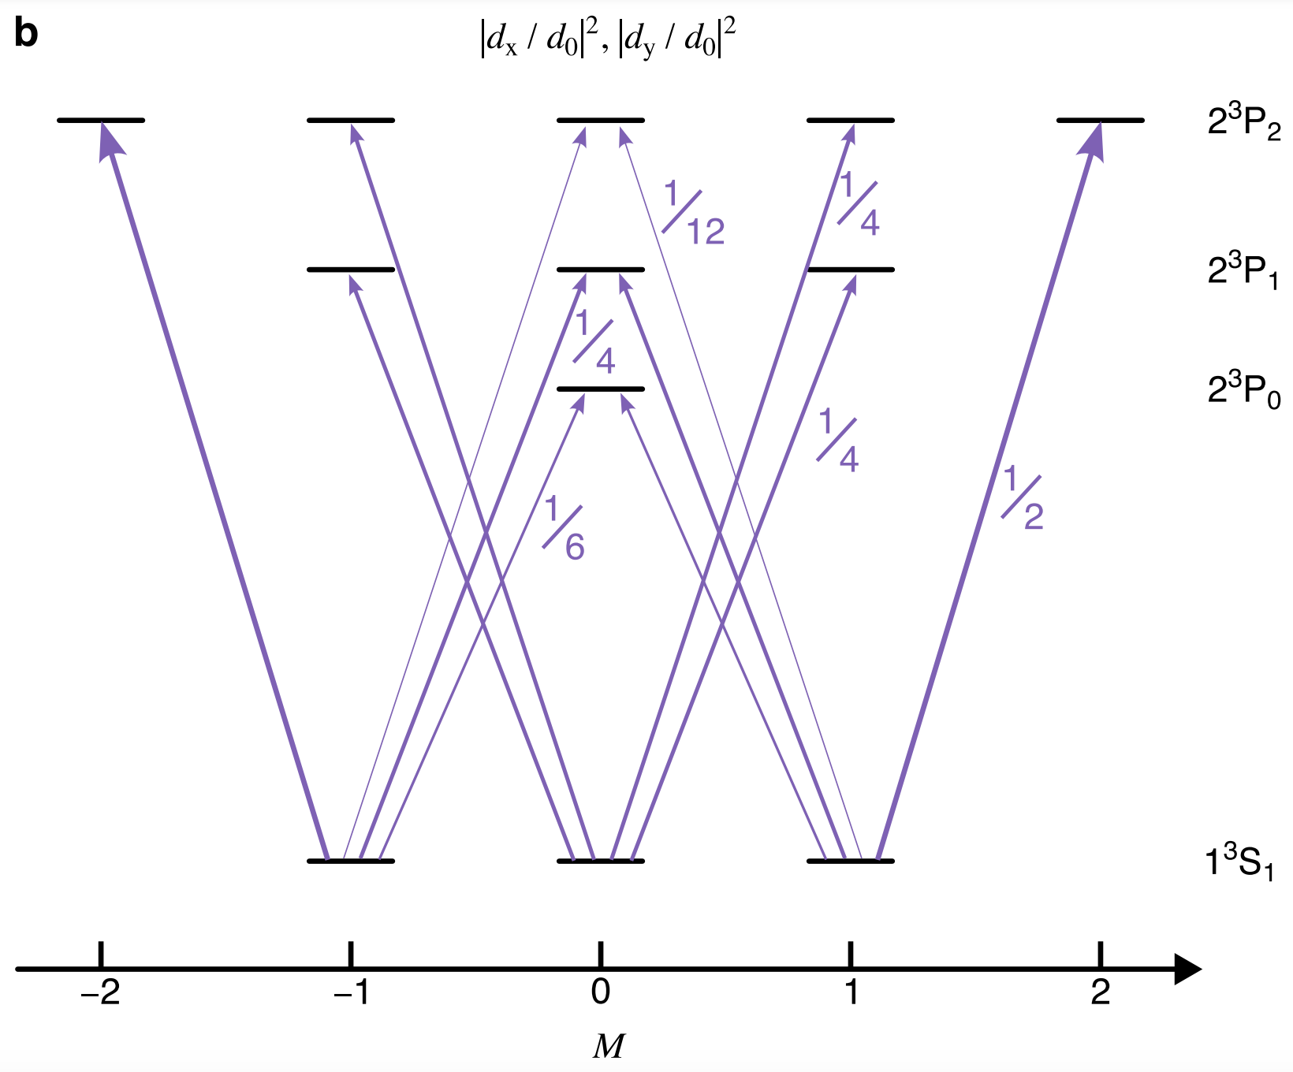
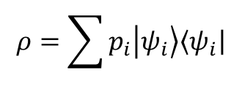
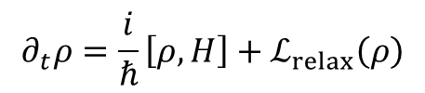
Consistency check with numerical simulation
Full quantum simulation formalized by Lindblad master equation
Necessary to incorporate atomic coherence (multi levels, ultrafast laser pulses)
$$∂_{t}ρ=\frac{i}{ℏ}\left[ρ,H\right]+ℒ_{relax}\left(ρ\right)$$
$$ρ=\sum{p_{i}\left.\left|ψ_{i}\right.\right\rangle \left\langle \left.ψ_{i}\right|\right.}$$
Experimental result was well reproduced
10⁵×10⁵ sparse matrices
Solved by custom C++/MPI codes running on Supercomputer Fugaku (RIKEN)

Slide 24
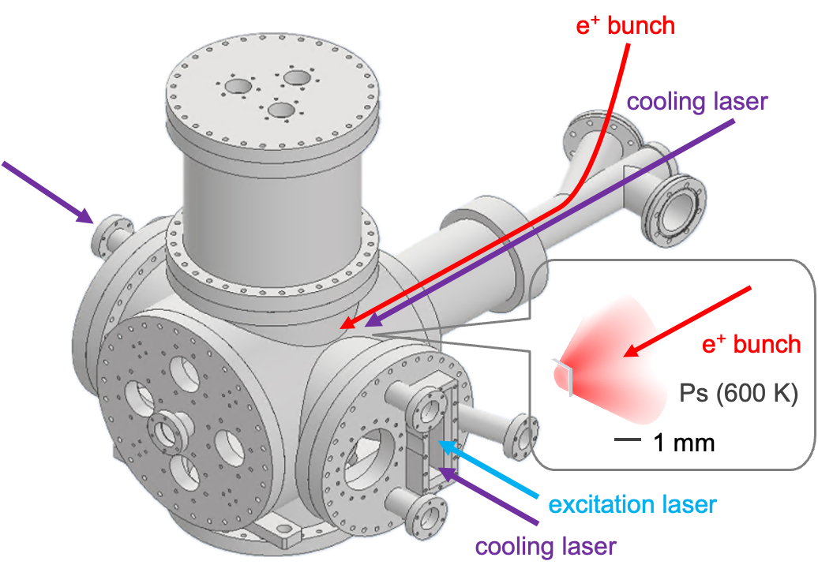
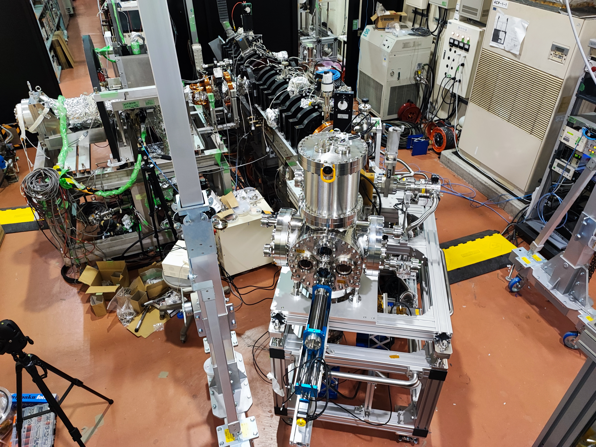
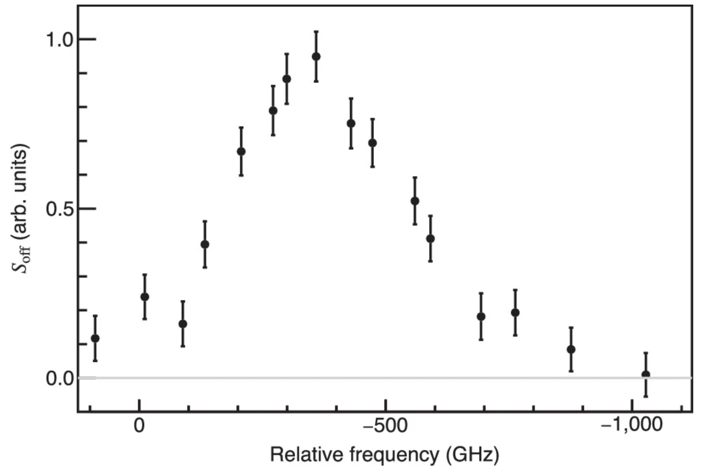
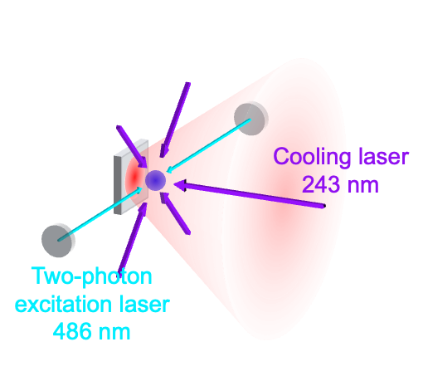
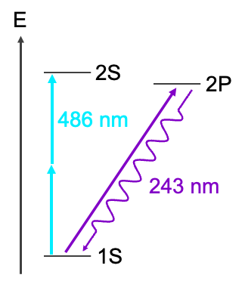
Next step: 3D cooling
longitudinal
lateral

Slide 25
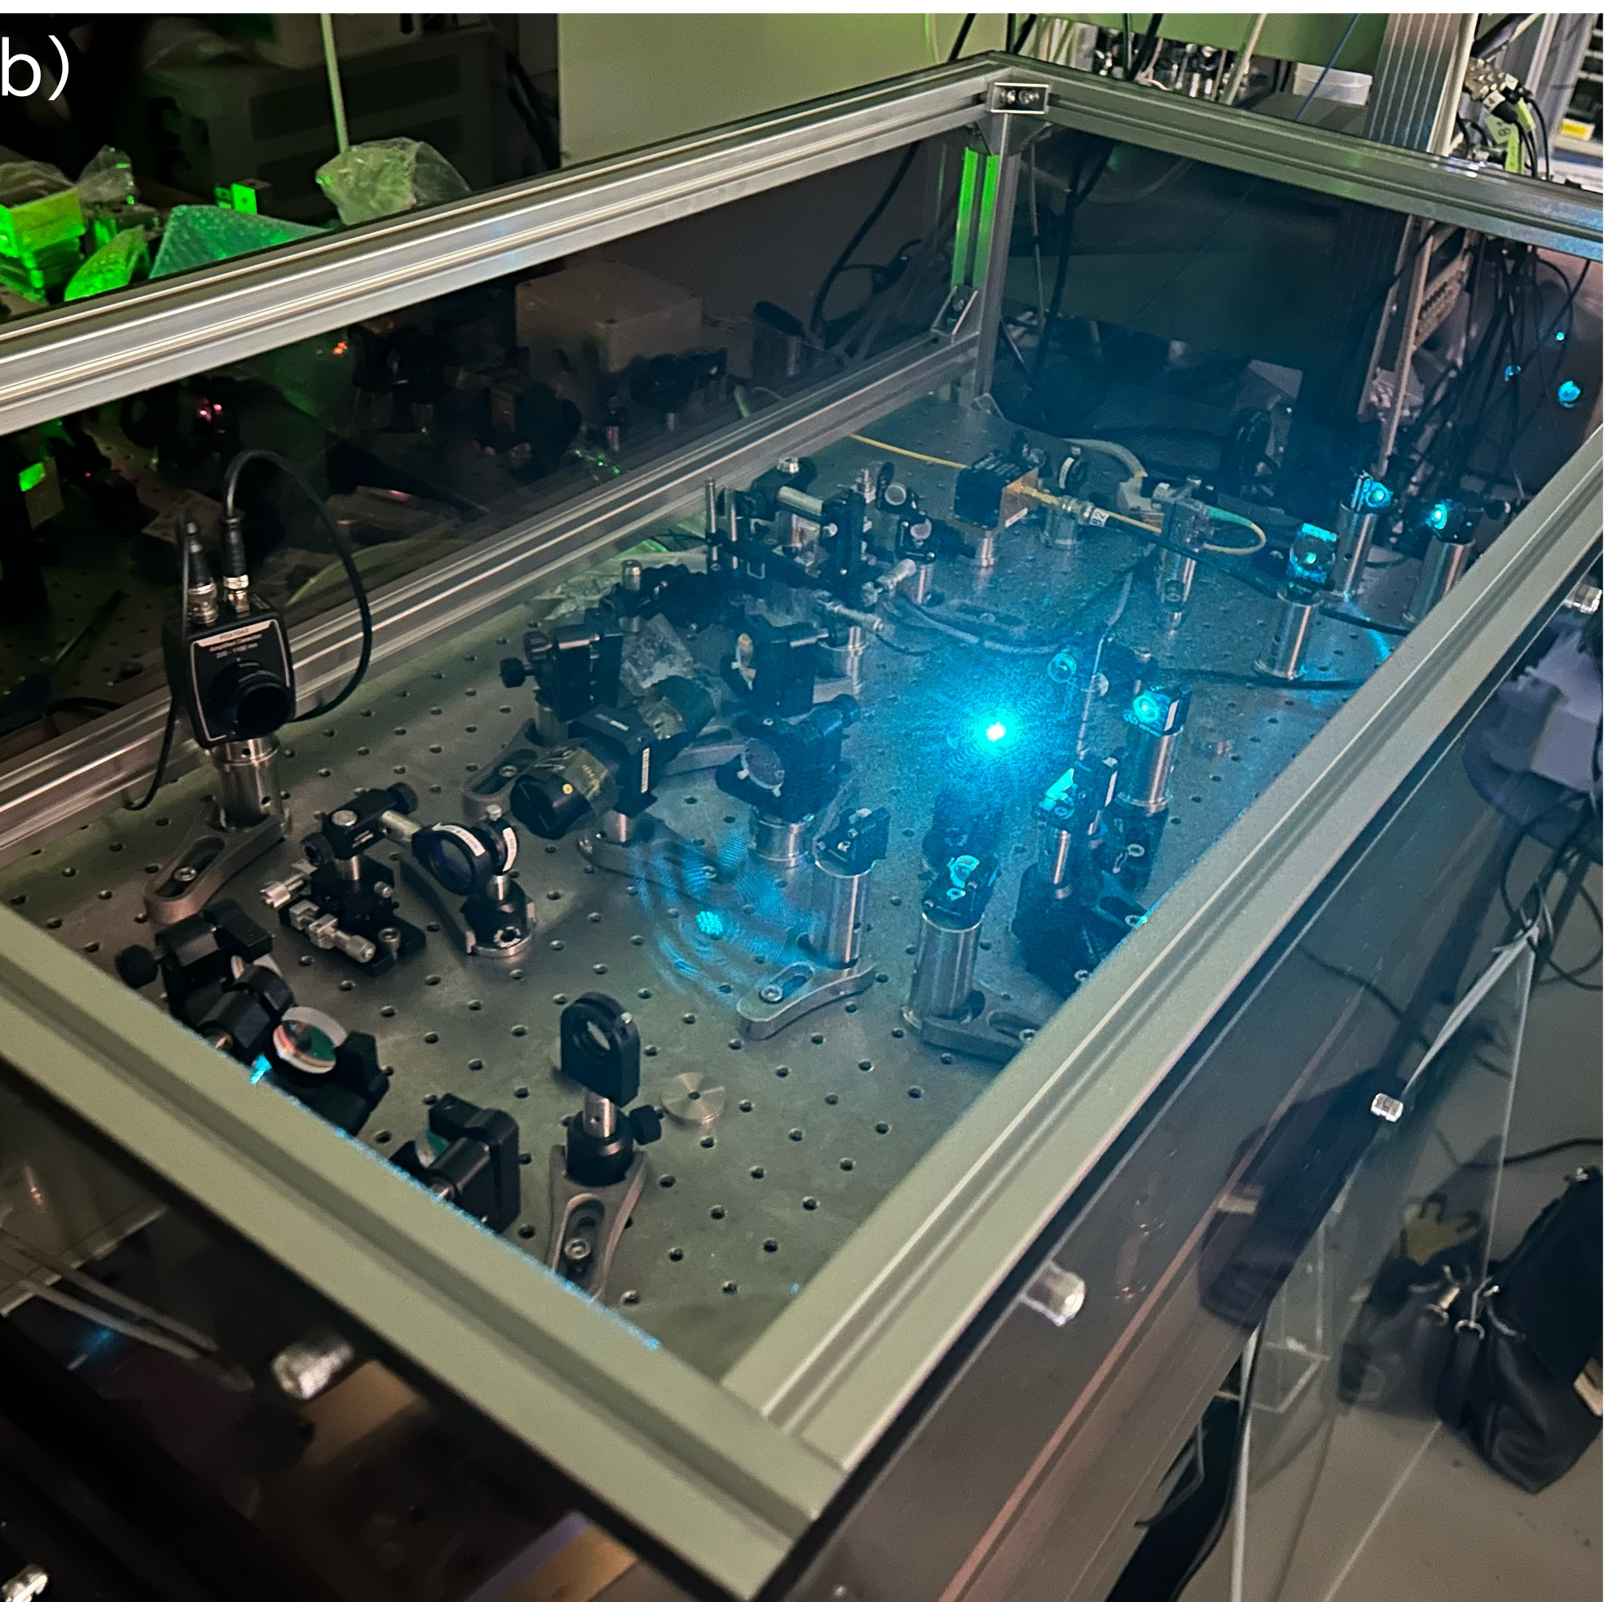
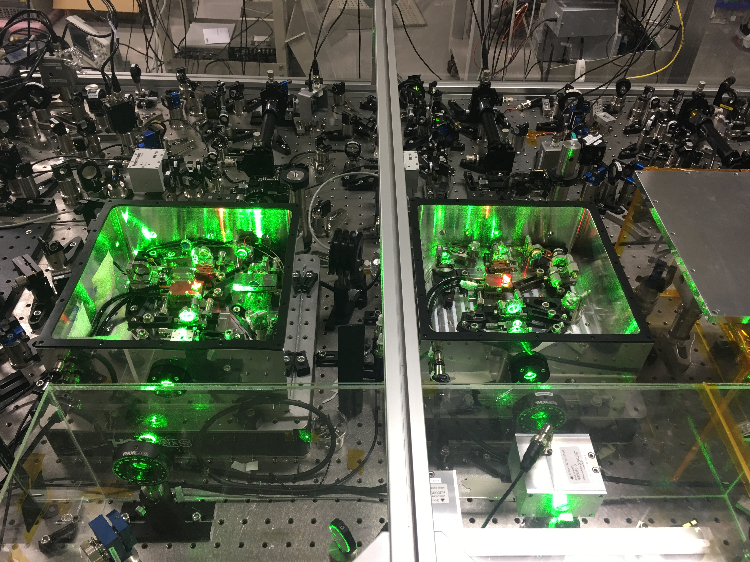
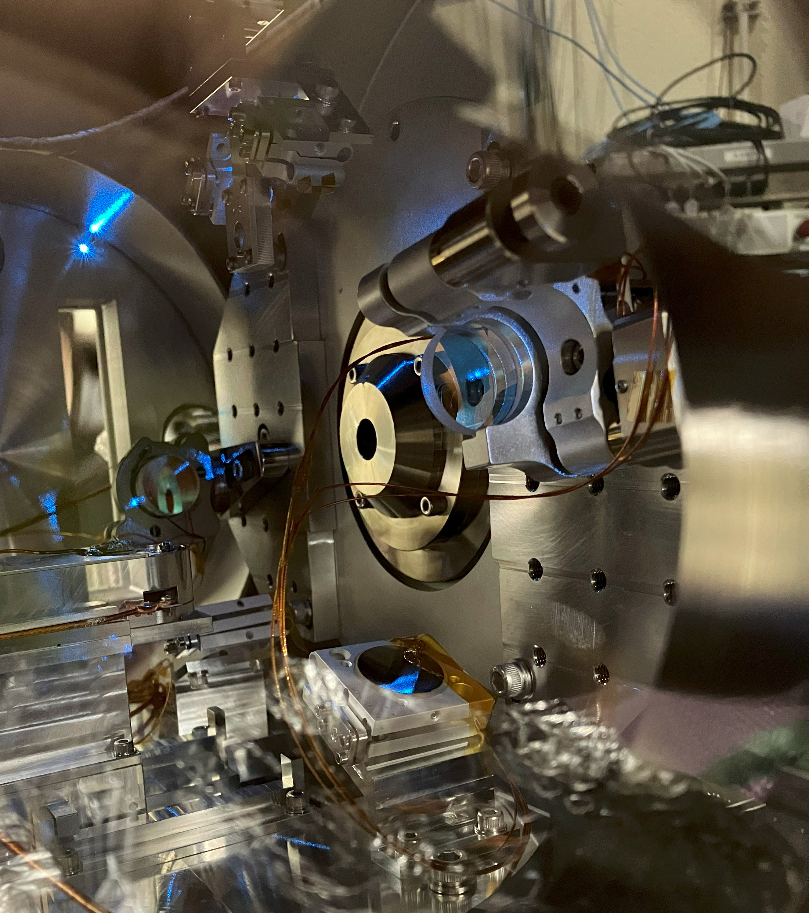
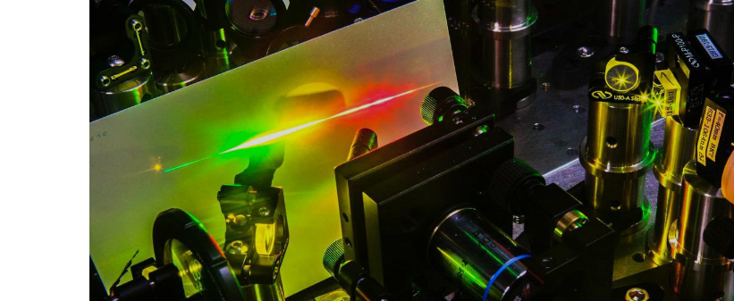
1S – 2S spectroscopy laser and frequency metrology
Ti:S optical frequency comb
Fabry-Perot build-up cavity
e⁺ exit aperture
Single-frequency, high-power cw laser at 486 nm
Three-dimensional cooling, a comb-referenced 486 nm laser, and a build-up cavity are ready to operate
cavity mirror

Slide 26
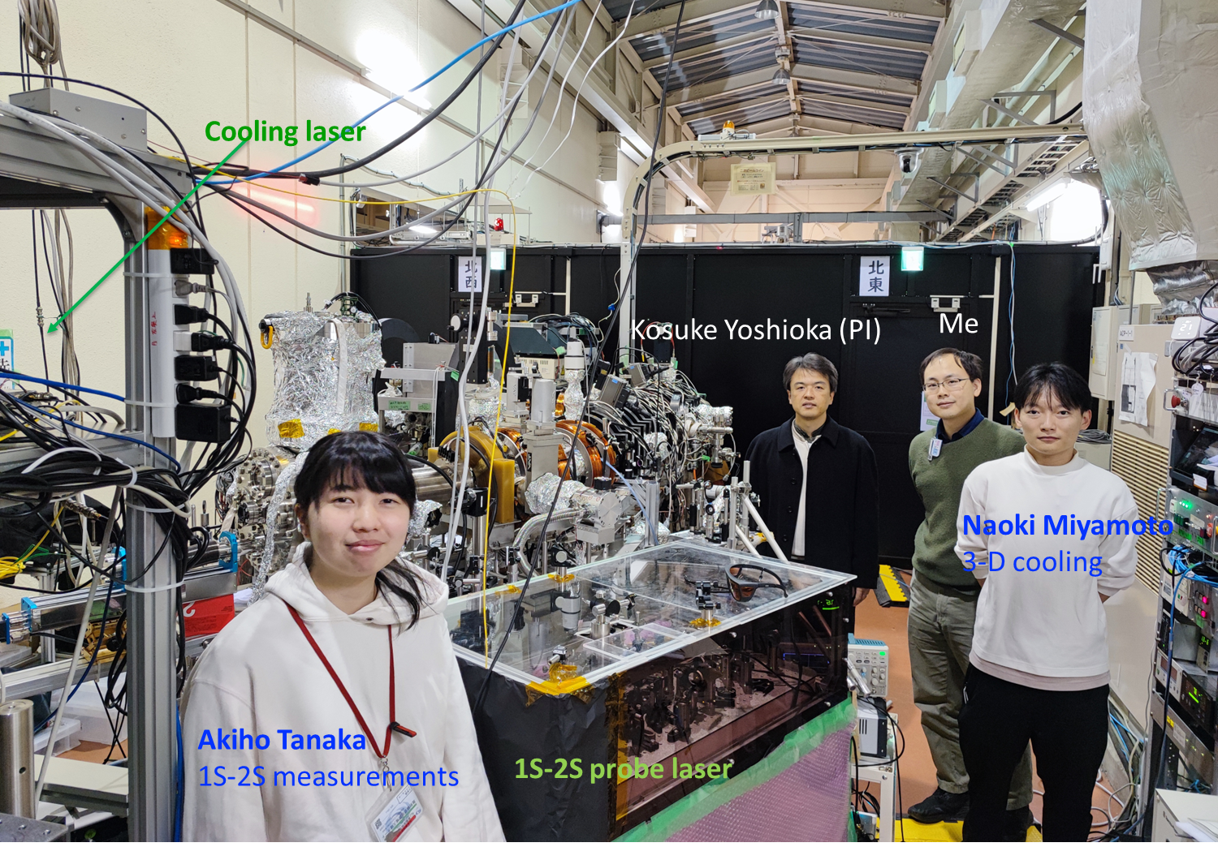
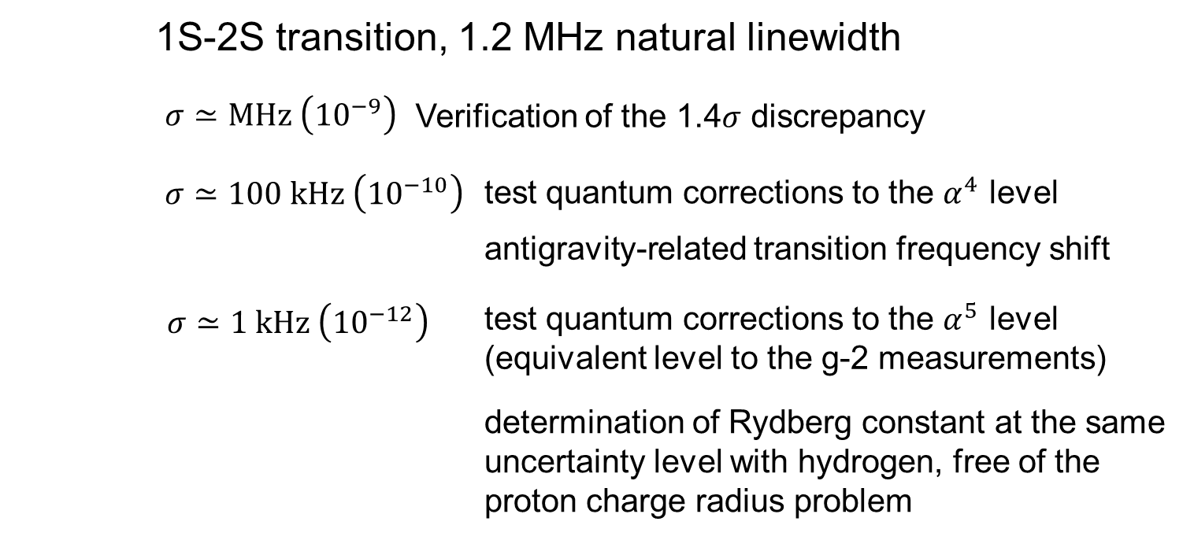
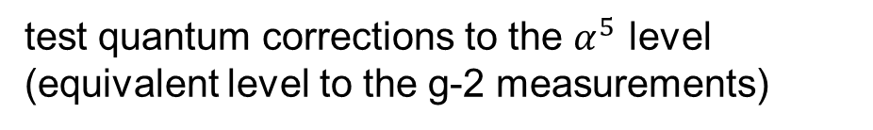


3D laser cooling & spectroscopy apparatus
1S-2S transition, 1.2 MHz natural linewidth
$$σ≃MHz \left({10}^{−9}\right)$$
Verification of the 1.4$σ$ discrepancy
$$σ≃100 kHz \left({10}^{−10}\right)$$
test quantum corrections to the $α^{4}$ level
antigravity-related transition frequency shift
$$σ≃1 kHz \left({10}^{−12}\right)$$
test quantum corrections to the $α^{5}$ level
(equivalent level to the g-2 measurements)
determination of Rydberg constant at the same uncertainty level with hydrogen, free of the proton charge radius problem

Slide 27
3D laser cooling & spectroscopy apparatus
High intensity beam is critically important
1S-2S transition, 1.2 MHz natural linewidth
$$σ≃MHz \left({10}^{−9}\right)$$
Verification of the 1.4$σ$ discrepancy
$$σ≃100 kHz \left({10}^{−10}\right)$$
test quantum corrections to the $α^{4}$ level
antigravity-related transition frequency shift
$$σ≃1 kHz \left({10}^{−12}\right)$$
test quantum corrections to the $α^{5}$ level
(equivalent level to the g-2 measurements)
determination of Rydberg constant at the same uncertainty level with hydrogen, free of the proton charge radius problem

Slide 28
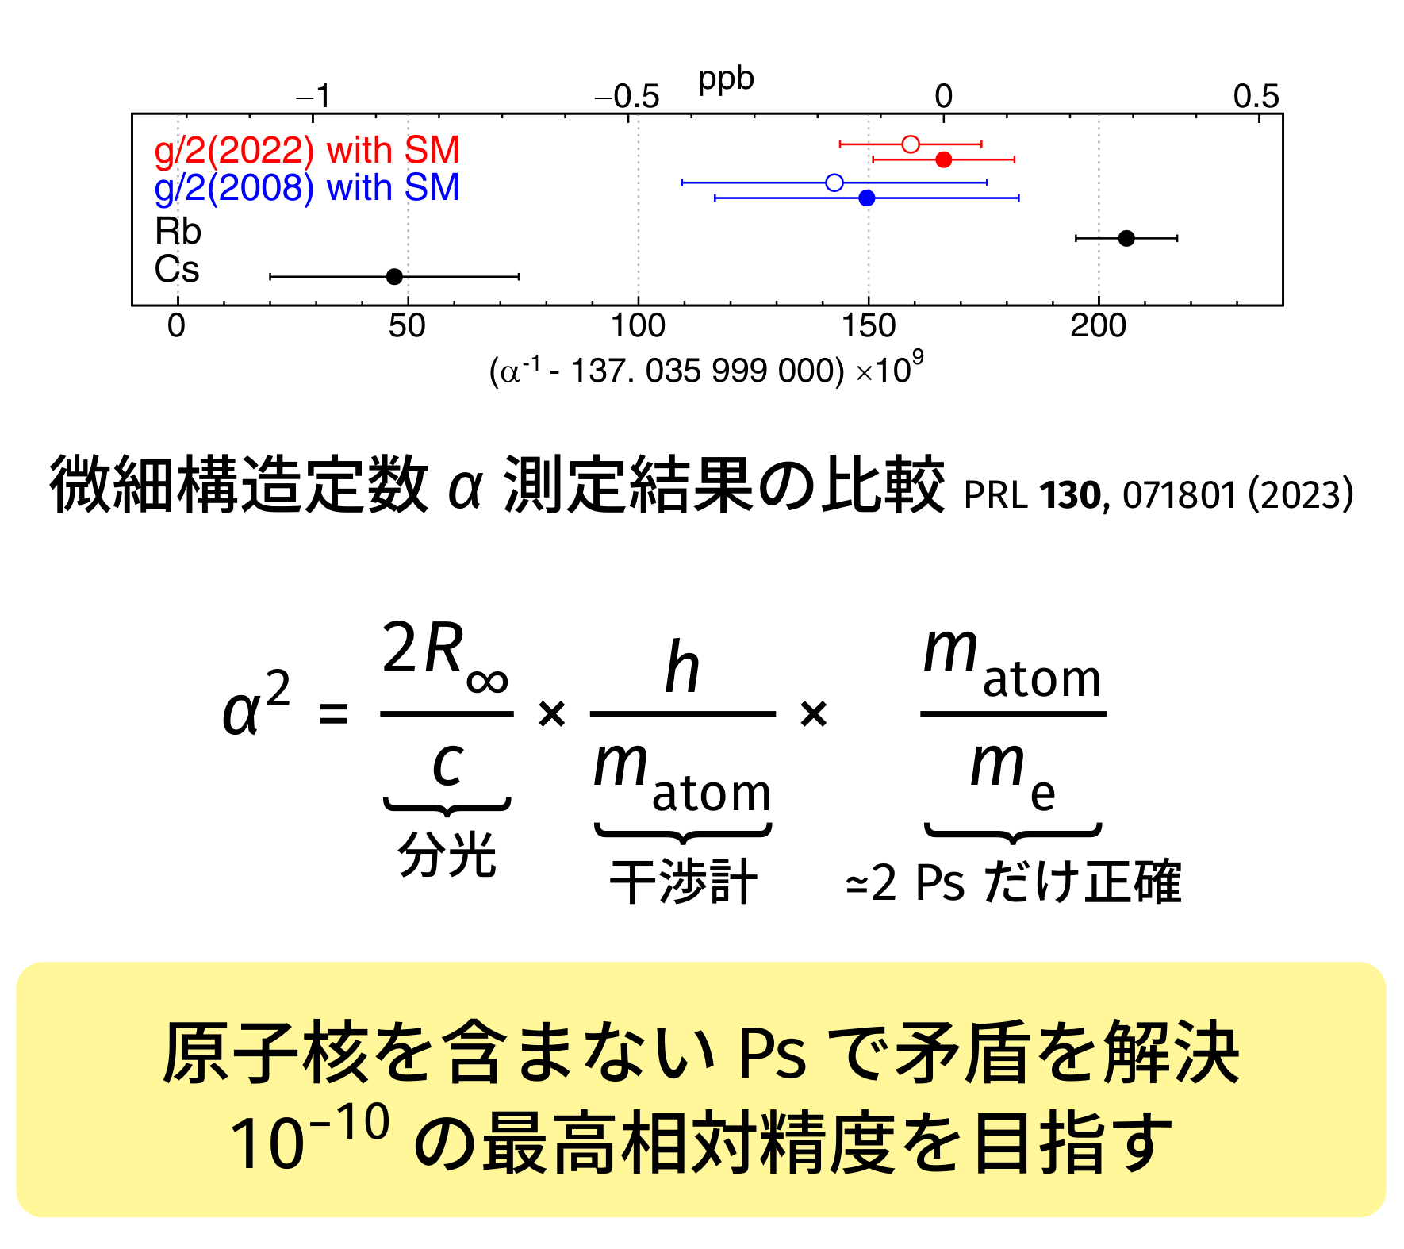
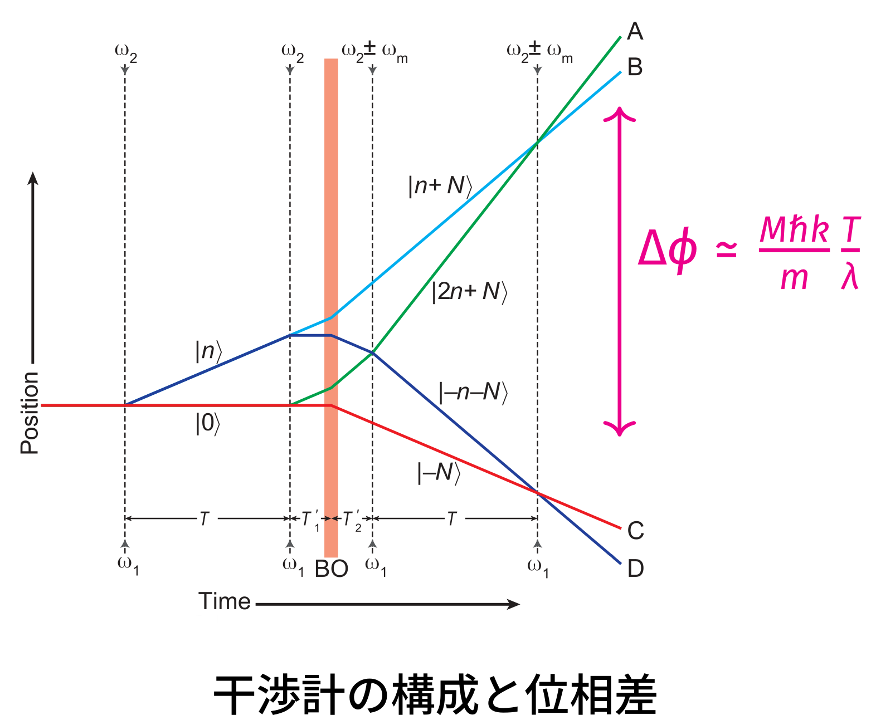
Positronium interferometer to measure α
Recoil
velocity
Comparison of α measurement
Spectroscopy
Interferometer
~2 Can be calculated only for Ps
Unique measurement by atom without nuclei

Slide 29
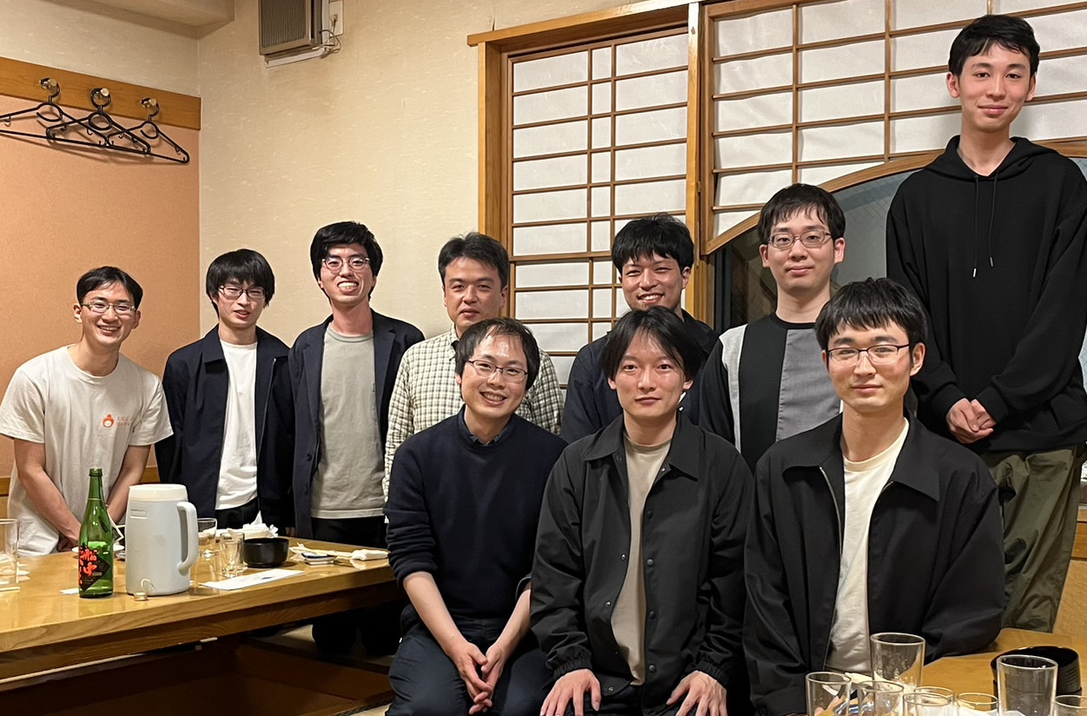
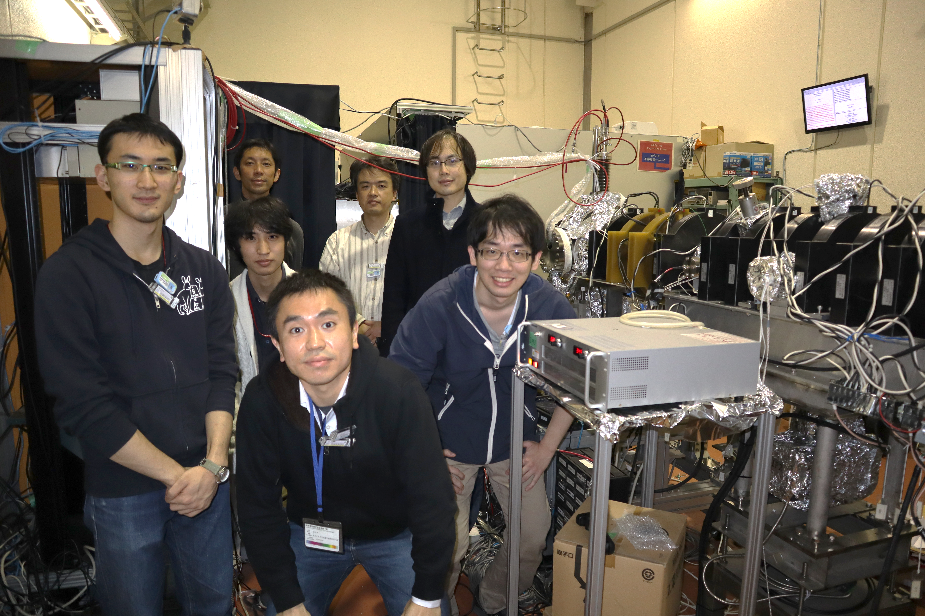
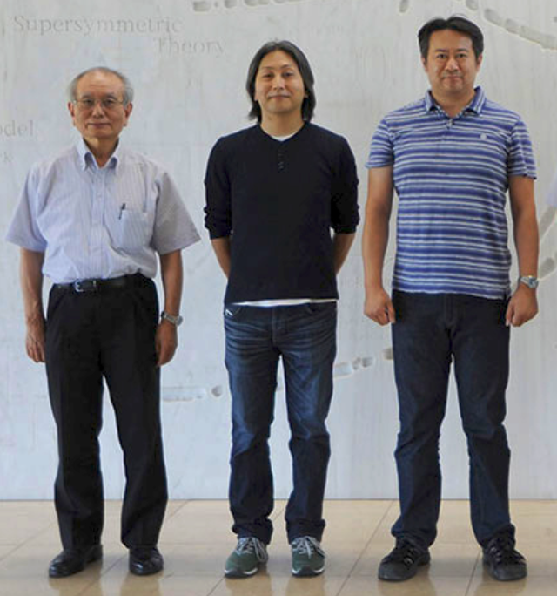
Acknowledgement
Yoshioka group (The University of Tokyo)
K. Shu, Y. Tajima, R. Uozumi, N. Miyamoto, S. Shiraishi, T. Kobayashi, K. Yoshioka (PI)
Asai group (The University of Tokyo) KEK, AIST
A. Ishida, R. W. Gladen, T. Namba, S. Asai, K. Wada, I. Mochizuki, T. Hyodo, K. Ito, K. Michishio, B. E. O’Rourke, N. Oshima
Funding: MEXT Quantum Leap Flagship Program (MEXT Q-LEAP) Grant No. JPMXS0118067246, JST FOREST Program (Grant Number JPMJFR202L), JSPS KAKENHI Grant Numbers JP16H04526, JP17H02820, JP17H06205, JP17J03691, JP18H03855, JP19H01923, JP21K13862, MATSUO FOUNDATION, Mitutoyo Association for Science and Technology (MAST), Research Foundation for Opto-Science and Technology, The Mitsubishi Foundation, Sumitomo Foundation Grant No. 2200632.

Slide 30
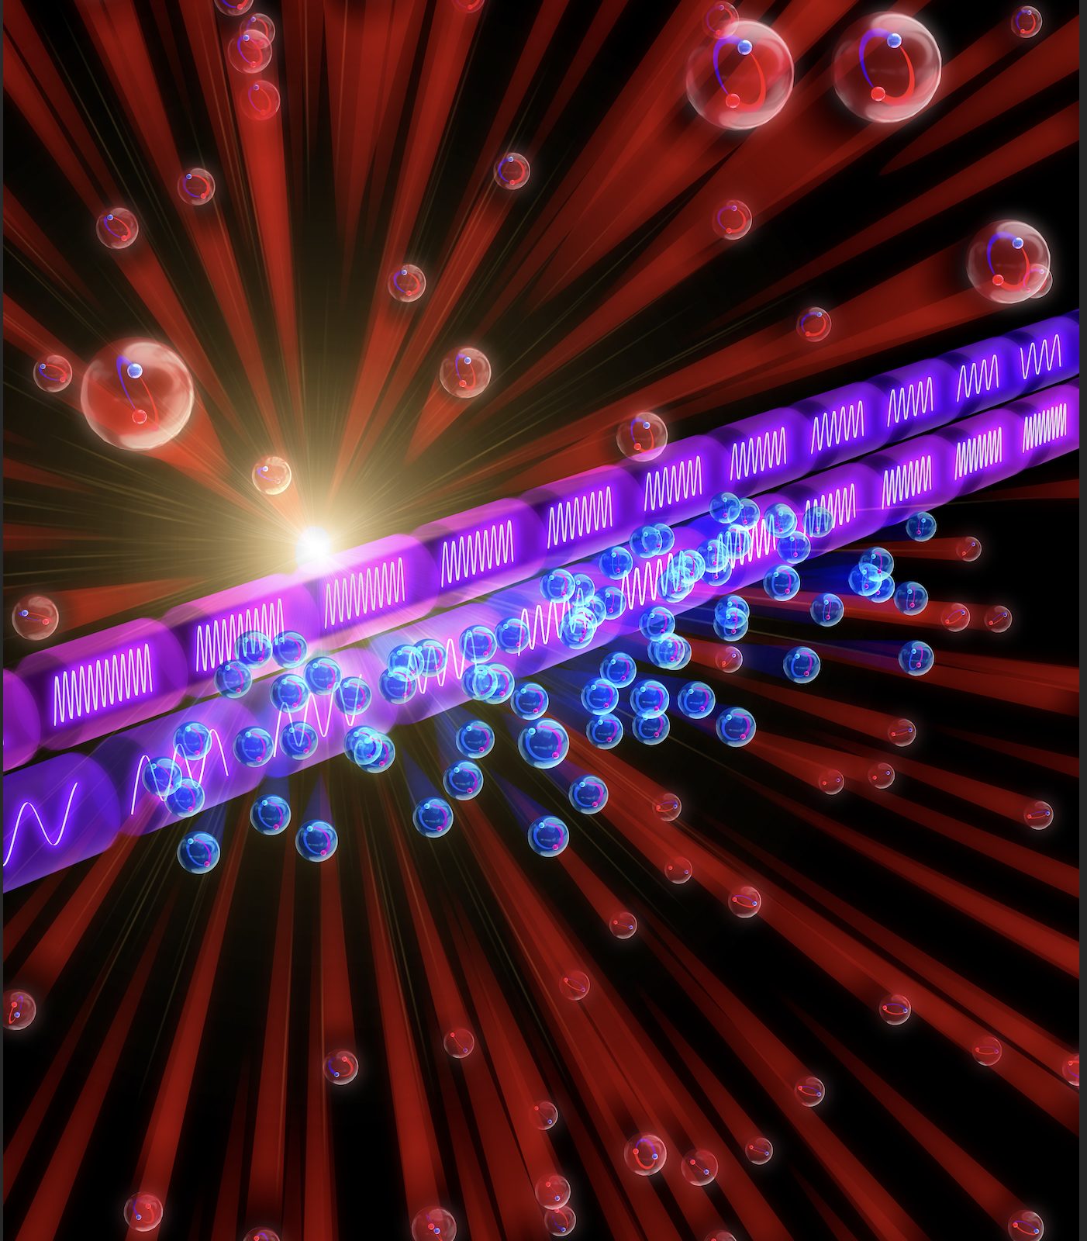
Summary
One-dimensional laser cooling of Ps
Chirp cooling using the 1S-2P transition in the counter-propagating configuration
A chirped train of optical pulses at 243 nm cools gaseous Ps rapidly
Cooling laser:
K. Yamada et al., Phys. Rev. Applied 16, 014009 (2021).
K. Shu et al., Phys. Rev. A 109, 043520 (2024).
Demonstration:
K. Shu et al., Nature 633, 793 (2024).
Next steps: three-dimensional laser cooling and precision spectroscopy
1S-2S transition frequency measurements revisited
Matter-wave interferometry
Bose-Einstein condensation and comparison with exciton (e-h pair) BEC (not covered in this talk)

