Slide 1
High energy and slow positron sources at KEK
2026/3/26
KEK Accelerator Lab.
Yoshinori Enomoto

Slide 2
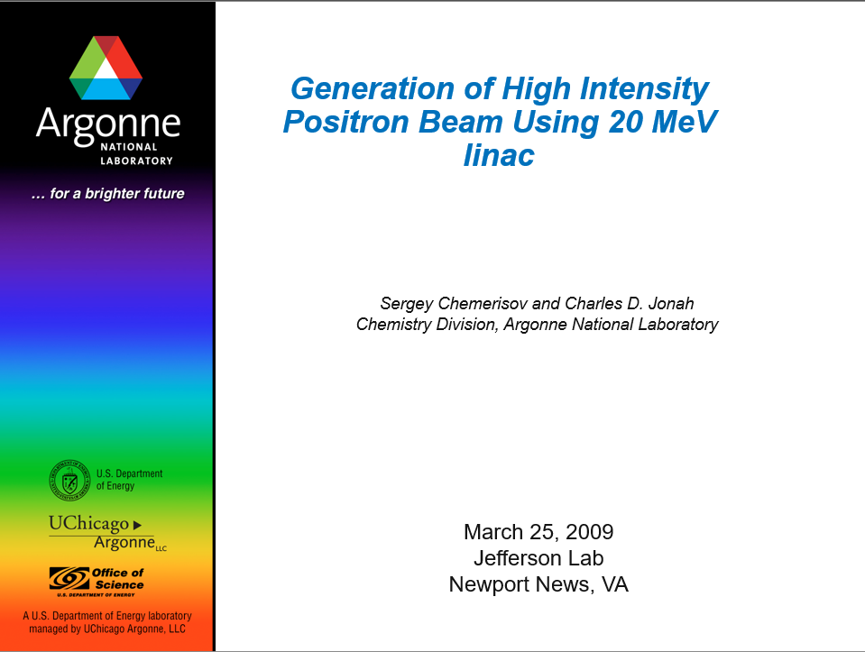
Outline
Introduction of positron facilities in KEK
Difficulties and challenges for R&D of positron sources
----------------------------------------------------------
Slow positron source with deceleration cavity
  High energy positron source technology adopted to slow positron production

Slide 3
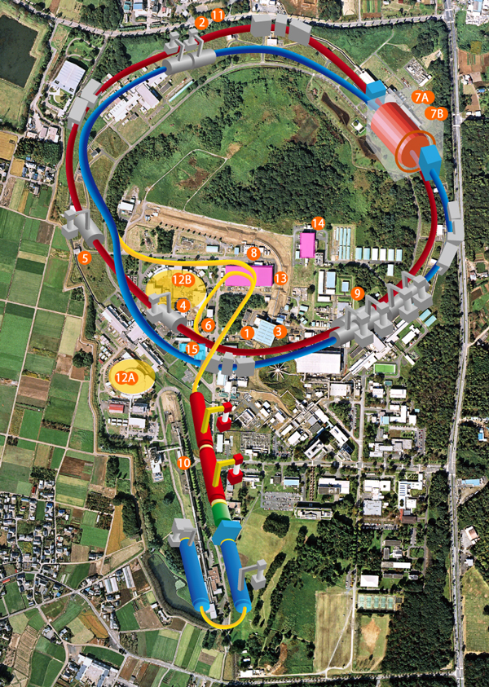
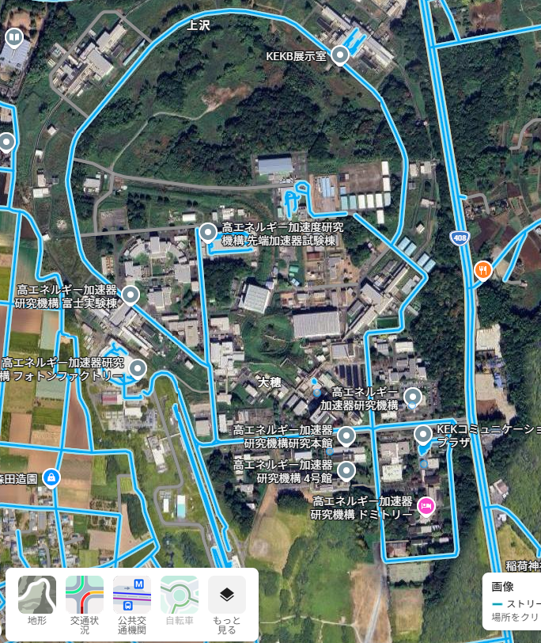
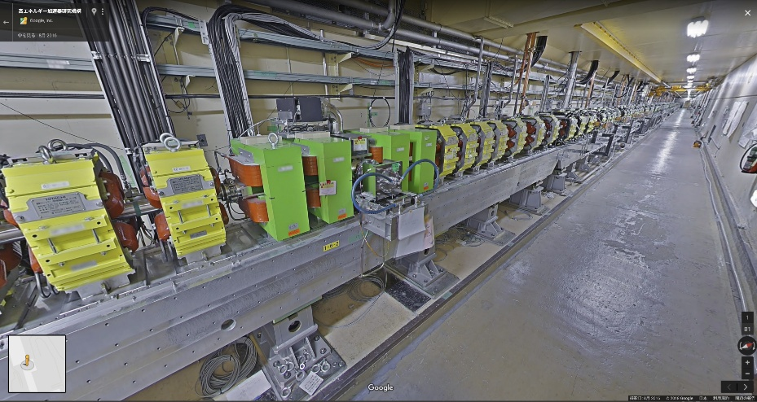
SuperKEKB
R&D area
Positron source for ILC
PF
Injector linac
Positron source for SuperKEKB
Main entrance
SPF (slow positron facility)
Google street view is available

Slide 4
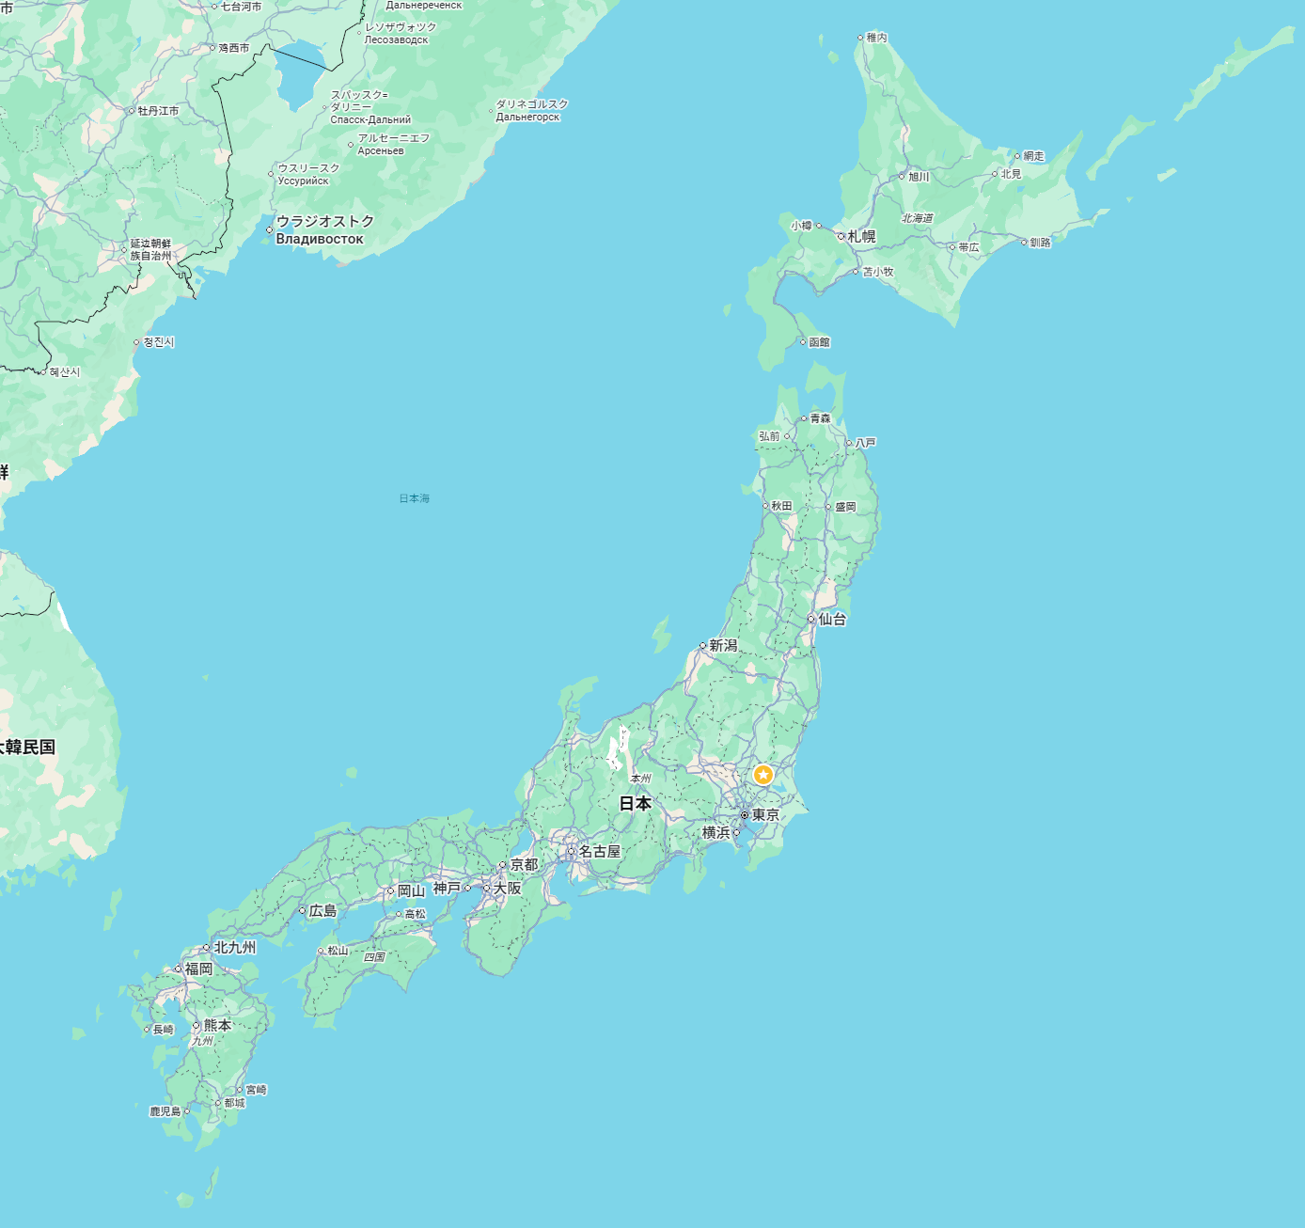
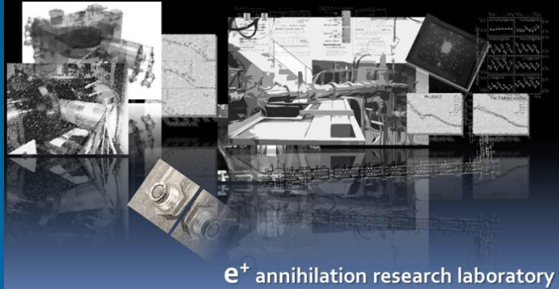
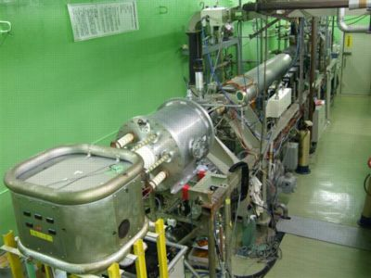
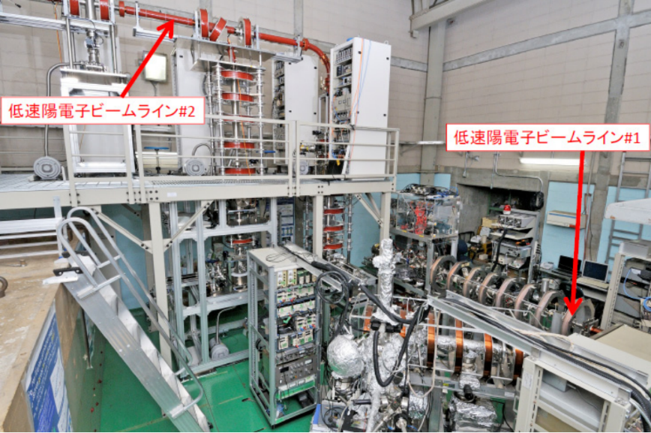

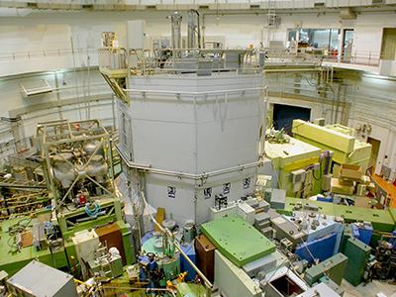
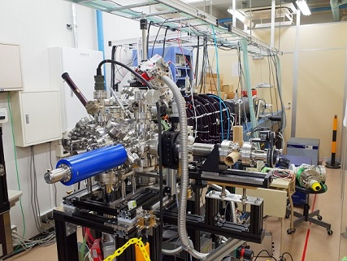
Slow positron facilities in Japan
QST (National Institute for Quantum Science and Technology)
RI
KURNS-LINAC(Kyoto University,Institute for Integrated Radiation and Nuclear Science)
Linac
AIST (National Institute of Advanced Industrial Science and Technology),
Linac
KUR (Kyoto University Research Reactor)
Reactor
Tokyo university of science
RI & Trap

Slide 5
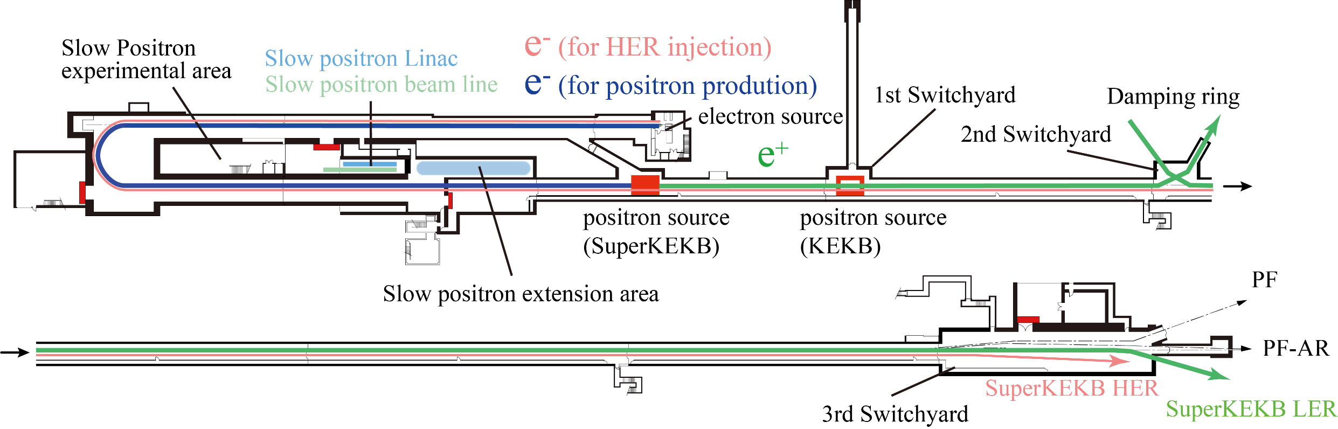
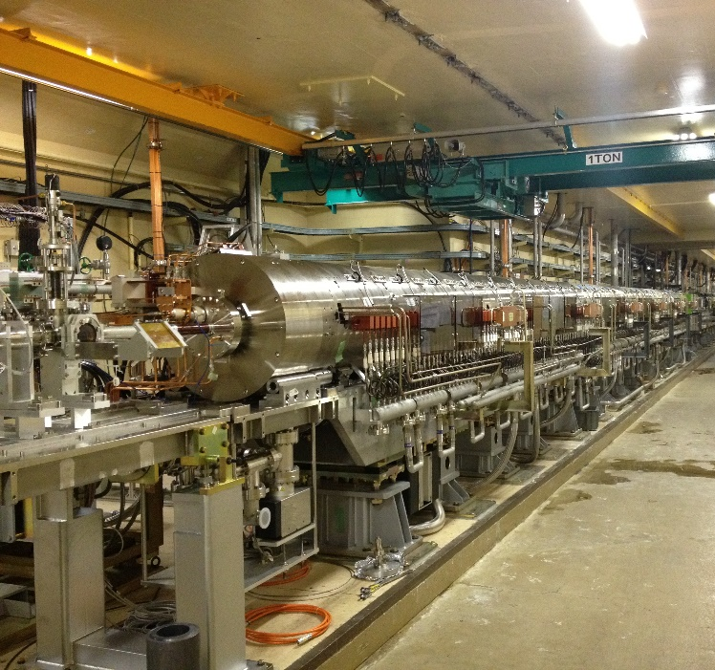
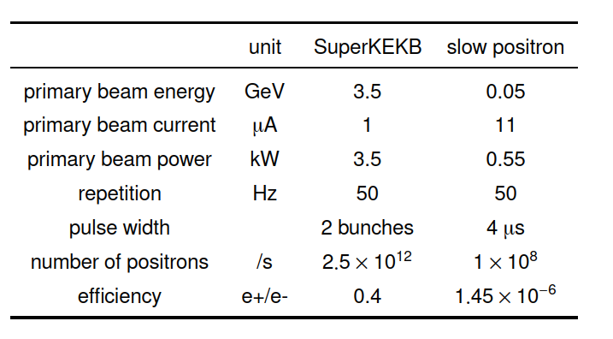
positron facilities and KEK injector linac
Positron source
(SPF)
A few tens meter distance

Slide 6
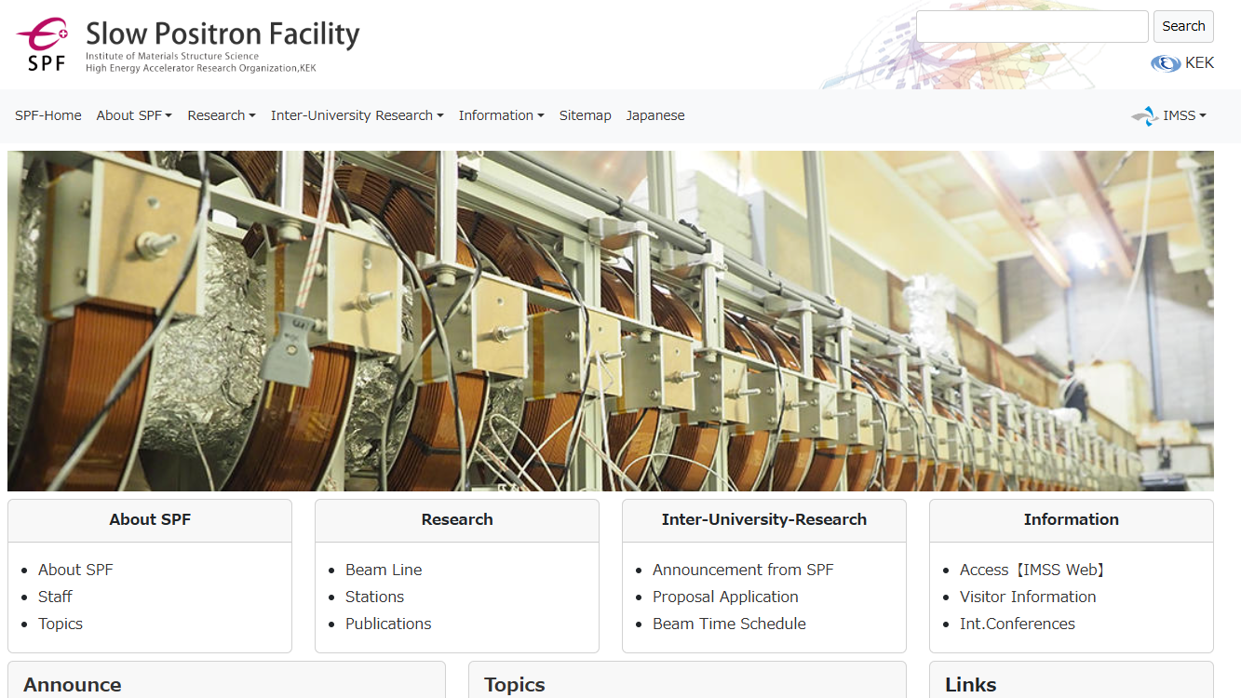
https://www2.kek.jp/imss/spf/eng/

Slide 7
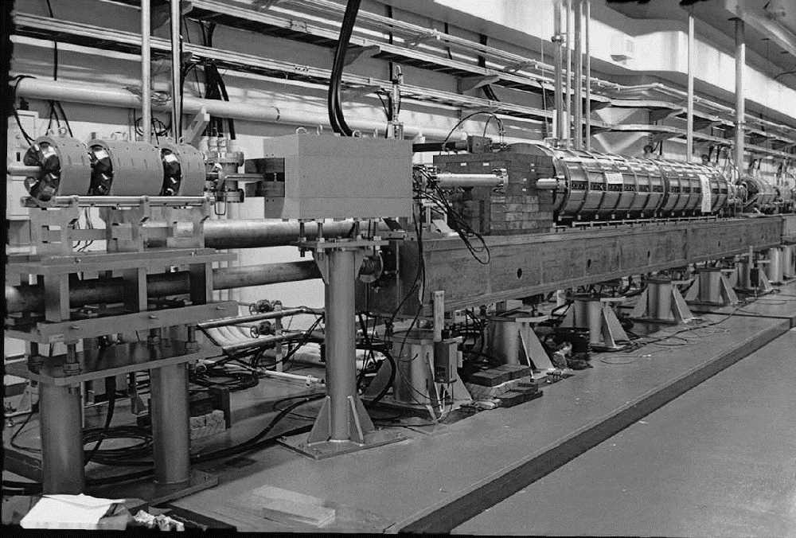
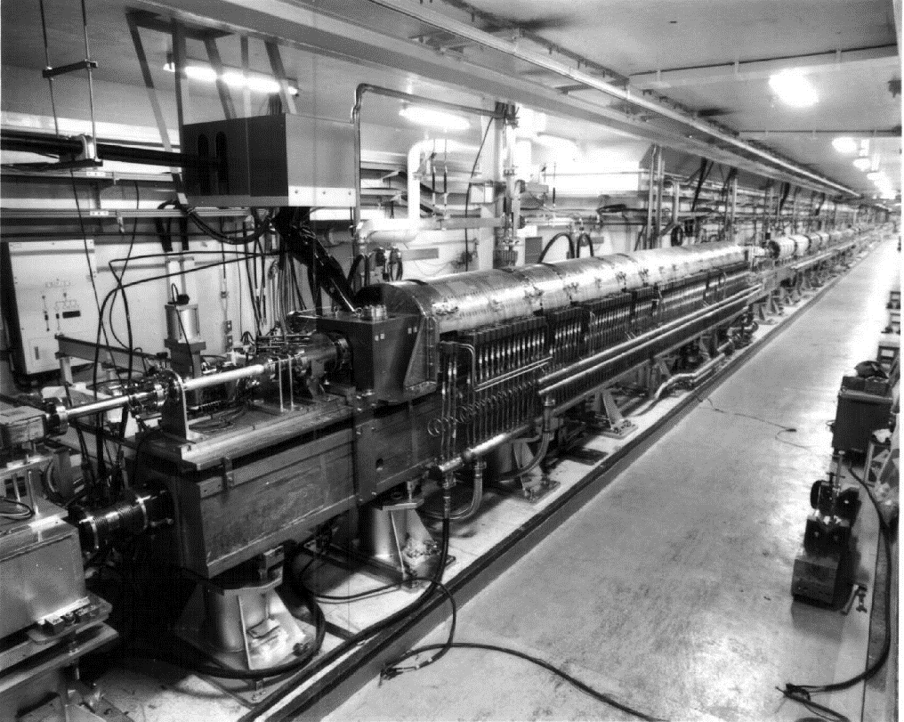

KEK and high energy positron source
From TRISTAN to ILC
  KEK LINAC has keep providing positron beam to e⁺e⁻ collider experiment since 1980s.
  Positron source for SuperKEKB is world’s most intense positron source in operation.
TRISTAN
KEKB
SuperKEKB

Slide 8
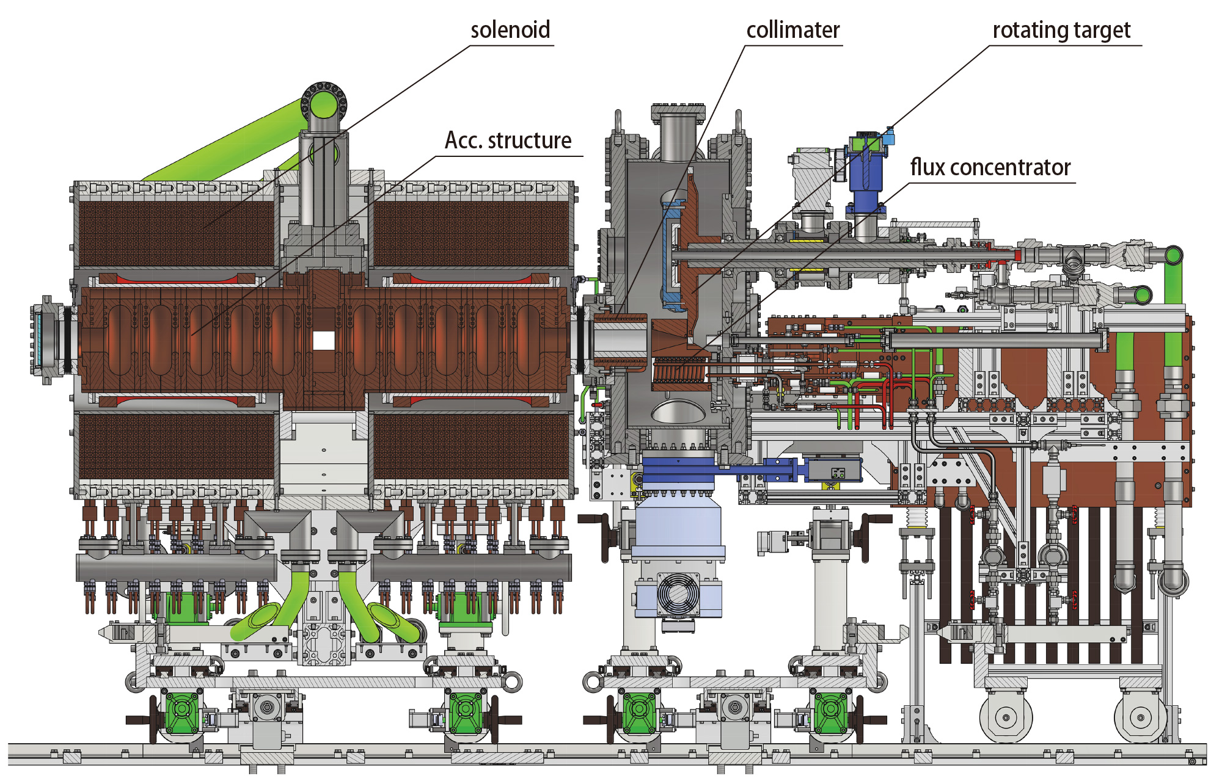
Prototype for ILC

Slide 9
Big Jump from Present to Future
 | SKEKB | ILC
e- energy | 3.2 GeV | 3 GeV
e- charge/bunch | 10 nC | 3.7 nC
Repetition | 50 (25) Hz | 5 Hz
Num. bunches | 2 | 1320 = (33+33) x 20
Total charge / s | 1000 (500) nC | 24667 nC
Beam power on target | 3.2 | 74
yield | 0.4 | 1.1
●past
▲present
◆future
ILC e-driven
CLIC
High efficiency
SuperKEKB
FCCee
(many options)
BEPC
Beam power requirement for Ce⁺BAF is close to ILC
DAFNE
VEPP-5
CEPC
KEKB
SLC
ILC undulator
High power

Slide 10
Schedule and status
FY |  | 2022 |  | 2023 |  |  |  | 2024 |  |  |  | 2025 |  |  |  | 2026 |  |  |  | 2027
year |  |  | 2023 |  |  |  | 2024 |  |  |  | 2025 |  |  |  | 2026 |  |  |  | 2027
Quarter |  | Q4 | Q1 | Q2 | Q3 | Q4 | Q1 | Q2 | Q3 | Q4 | Q1 | Q2 | Q3 | Q4 | Q1 | Q2 | Q3 | Q4 | Q1 | Q2 | Q3 | Q4 | Q1
Test bench
High power test bench
W-Cu connection
Target unit | Rotation mechanism
 | Disk
FC base | 1st unit
magnet | Solenoid
 | Power supply
Chamber, vacuum, support
Acc. structure | 1st unit
FC power supply
Now!
Design
Manufacturing
test
This work was supported by 【MEXT Development of key element technologies to improve the performance of future accelerators Program】 Japan Grant Number JPMXP1423812204.

Slide 11
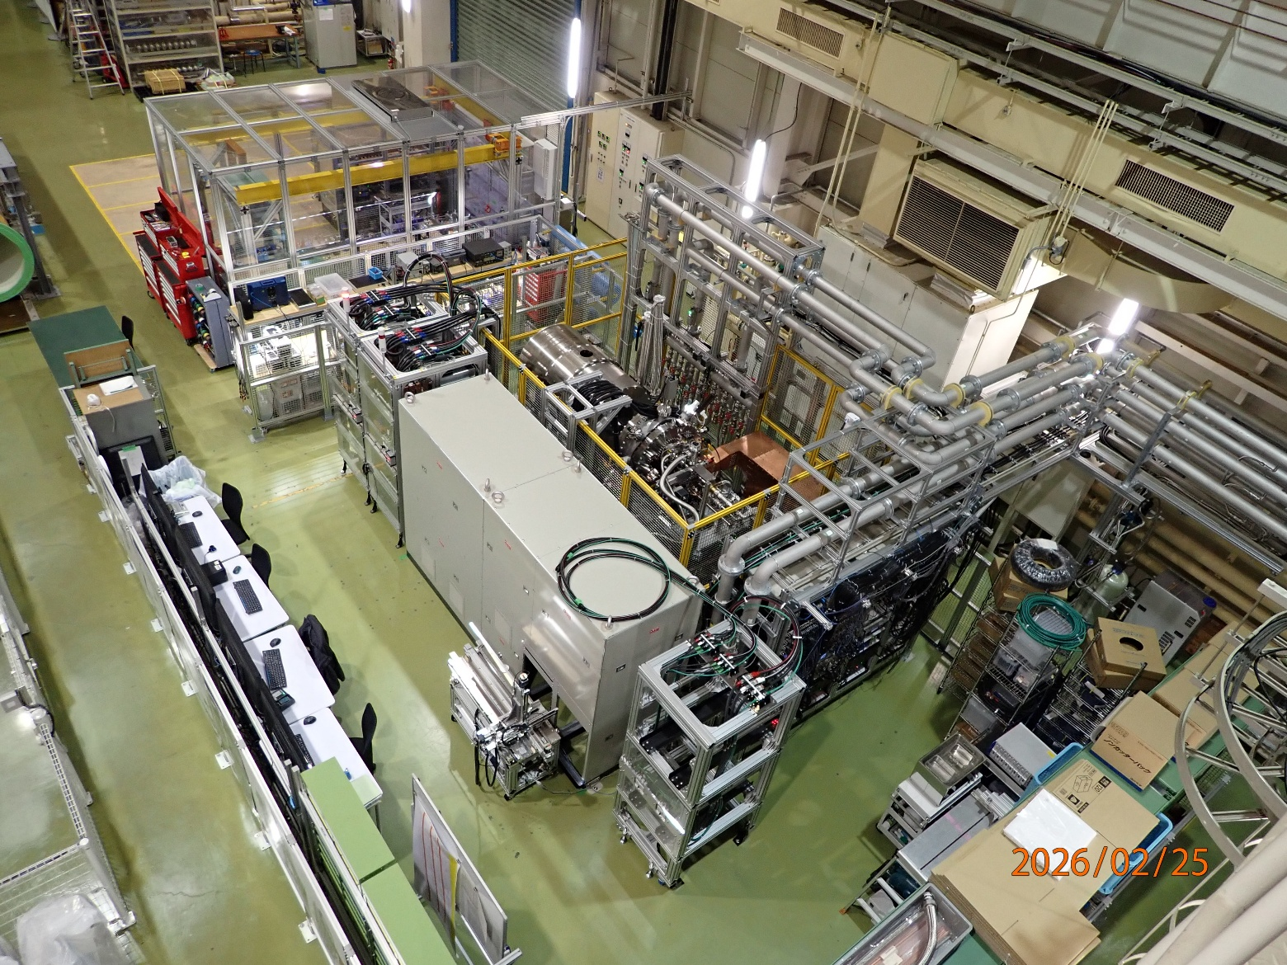

Slide 12
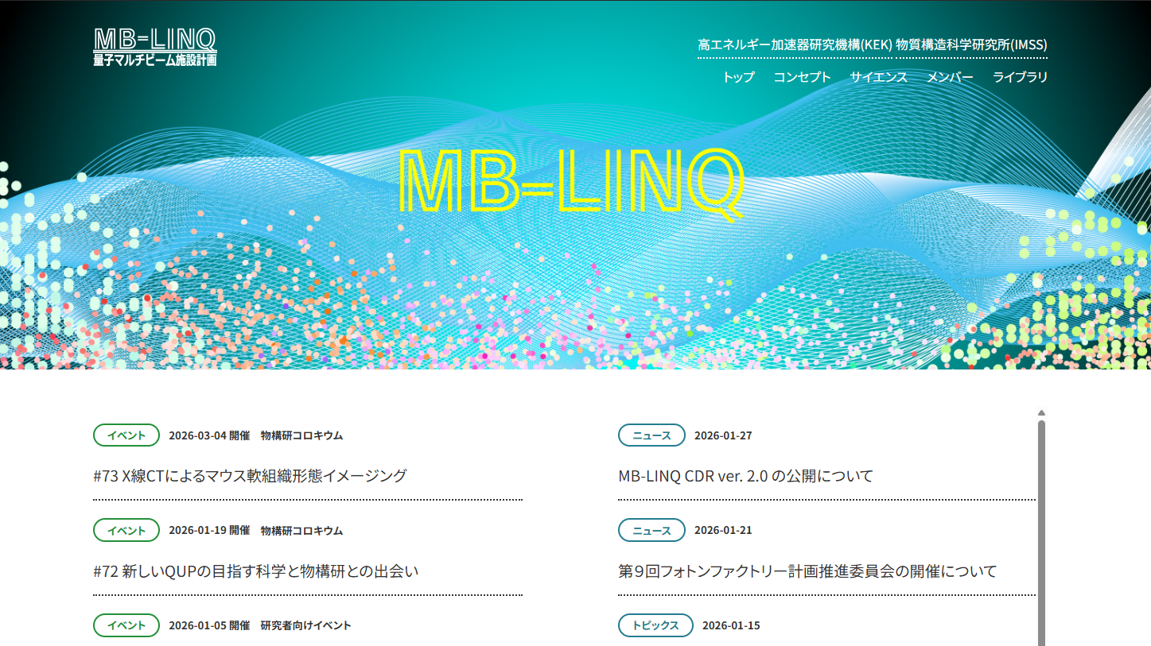
MB-LINQ: Multi quantum-Beam facility with superconducting LINac for material-Quantum-life sciences
https://www2.kek.jp/imss/mb-linq/

Slide 13

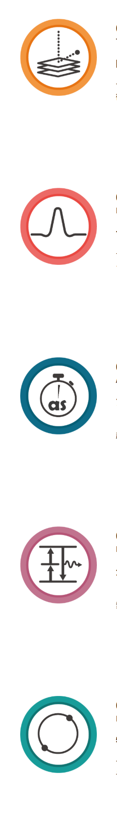
MB-LINQ
CDR published
  Details of facility are not yet fixed
In the context of PF (photon factory, a 40 years old SR light source in KEK) upgrade
  Number of users for light source is much larger than that for slow positron beam
Multi beam
  XFEL, SR, Laser
  Slow Positron
Topmost-Layer Surface structure Science
Petahertz Quantum Materials Science
Attosecond Materials and Life Science
Extreme Nonlinear Optics
Increase slow positron x100
10⁸ →10¹⁰ slow e⁺/s
1 kW → 100 kW e⁻ on target
Leptonic-Atom Extreme-Precision Spectroscopy
https://www2.kek.jp/imss/mb-linq/library/mblinq_cdr_ver2.0.pdf

Slide 14
Positron source in KEK
Long history and operation experience of positron source
Both high energy physics and material science users
Both present and future projects
Everything goes well…..?

Slide 15
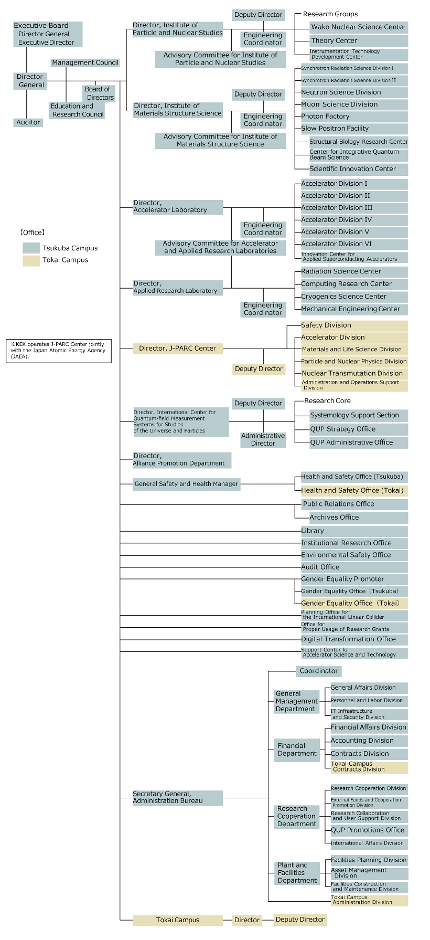

Organization of KEK

Slide 16
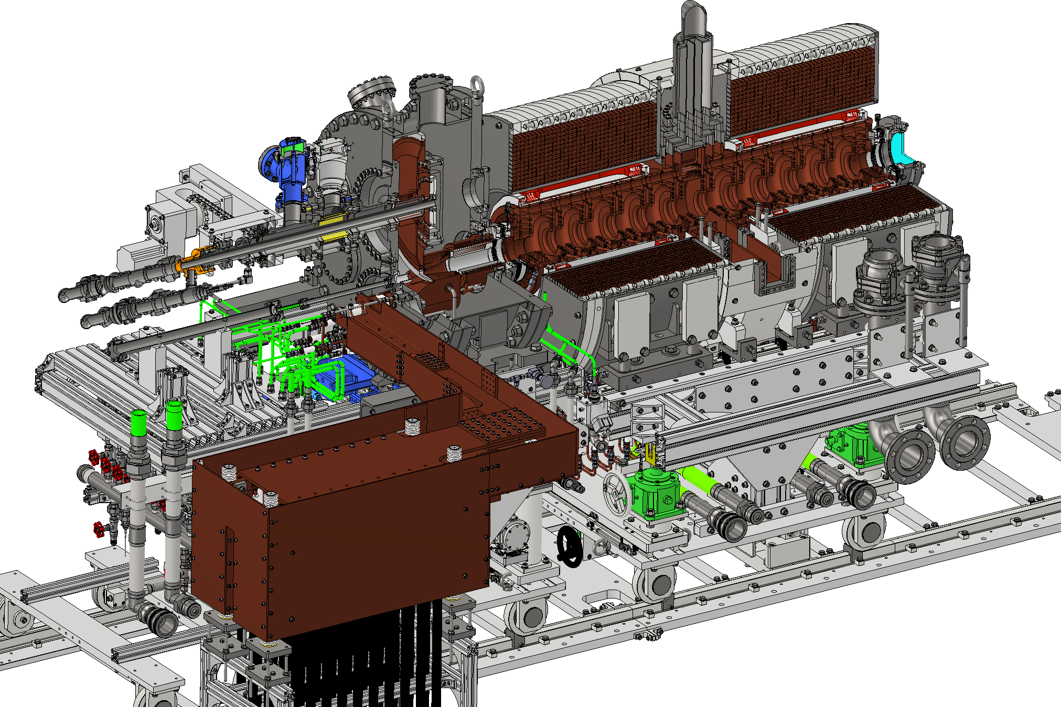
Importance of integrated system design and prototyping
Positron source is one of a most complex component in the accelerator
Slight change of layout affect the result
Integrated design including replacement mechanism etc.. is important
Initial cost is relatively high
For Slow positron
  High efficiency moderator
  Beamline for very low energy positron beam

Slide 17
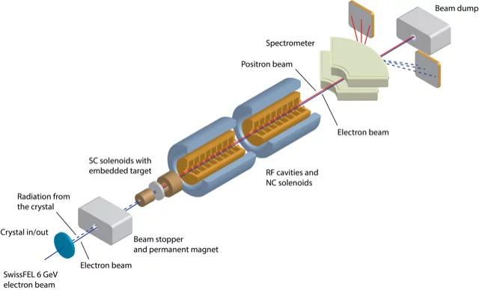
Importance and difficulties of beam test
Beam experiment is highly desirable to validate performance and reliability under high radiation environment
There are limited high power facilities
  SuperKEKB@KEK (3.5 kW)
  BEPC@IHEP
  VEPP@BINP
  --------------------------
  P3@PSI (Swiss FEL, < 10 W)
LERF@Jlab will be a valuable facility in this field.

Slide 18
Comparison of high-power targets in Japan
 | e⁺ | e⁺ | μ | n | Neutrinos | Hadrons | RIBF
Institute | KEK (SuperKEKB) | ILC (e-driven) | J-PARC | J-PARC | J-PARC | J-PARC | RIKEN
Primary particle | e⁻ | e⁻ | p | p | p | p | C~U
Target material | W | W | C | Hg | C | Au | Be, W
Energy [GeV] | 3 | 3 | 3.5 | 3 | 30 | 30 | 0.345/u
Charge/pulse [nC] | 10 ✕ 2 | 3.7 ✕ 66 | 13300 | 13300 | 52900 | 16470 | CW
Repetition [Hz] | 50 | 100 / 300 | 25 | 25 | 0.47 | 0.19 | CW (1puA)
Beam Power [kW] | 3 | 74 | 1000 | 1000 | 750 | 95 | 82
Beam size σ_{x} ✕ σ_{y} [mm] | 0.5 ✕ 0.5 | 2 ✕ 2 | 3.5 ✕ 3.5 | 37 ✕ 17 | 4.2 ✕ 4.2 | 2.5 ✕ 1.0 | 0.42 ✕ 0.42
Thickness [mm] | 14 | 16 | 20 | 2000 | 909 | 66 (6 ✕ 11) | ~mm
Deposited power [kW] | 0.5 | 18.8 | 3.1 | 480 | 20 | 7.4 | 18
PEDD [J/g] | 27.5 | 33.6 | 20 | 1.1 | 190 | Slow extraction | CW
Cooling | Water | Water | Radiation | Water | He | Water | Water
structure | Fixed | Rotating | Rotating | Liquid | Fixed | Fixed | Rotating
■■ beam power
■ deposited power
Power (kW)
SKEKB
ILC
μ
n
H
ν
RIBF
SKEKB
ILC
μ
n
H
ν
RIBF

Slide 19
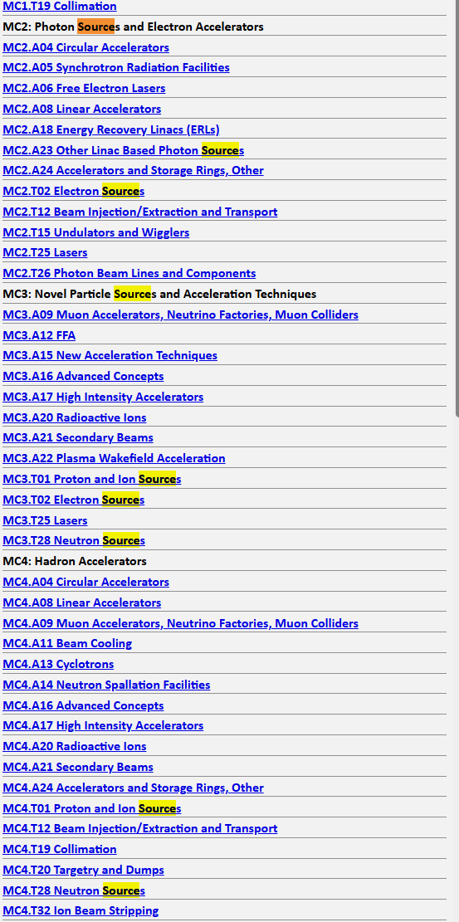
Positron source in accelerator science
Number of people working on the positron source is very limited
  < 100 all the people in the world
Very limited investment for R&D
The left list is Table of classification of IPAC’24 PROCEEDINGS
  There are electron source, ion source, proton source, neutron source but there isn’t positron source
Most of the technologies were developed at SLAC in 1980s for the SLC.
We still rely on these data and experiences
https://proceedings.jacow.org/ipac2024/classification/index.html

Slide 20
Difficulties and challenges for R&D of positron sources
High initial cost
Limited resource
Limited number of users
Wide and integrated knowledge

Slide 21
Difficulties and challenges for R&D of positron sources
High initial cost
Limited resource
Limited number of users
Wide and integrated knowledge
Blue ocean!

Slide 22
Situation in slow positron facility
p.459
10¹⁰ slow e⁺ /s by 100 kW e⁻ beam is next goal

Slide 23
Jlab’s accelerator technology and positron source
CW SC linac
  Bunch structure is suitable for some of slow positron experiment
    w/o buncher or stretcher
    Complementary to 50 Hz, NC linac in KEK
High-energy, high-power e⁻ beam fixed target experience
  High power target and beam dump
  Radiation protection and safety
    Difficult for light source facilities

Slide 24
Summary
KEK/Japan have several positron facilities and project
  Both high energy (GeV) and low energy (< a few tens keV)
  Both present and future
  Coherent R&D plan is necessary beyond projects and institute
Beam test is important
  Such facility is limited
Many difficulties and challenges exist
  Blue ocean
Jefferson lab’s positron project will bring valuable experiences and knowledge for intense positron source development in the world
Accelerator parameters are complementary to linac in KEK

Slide 26
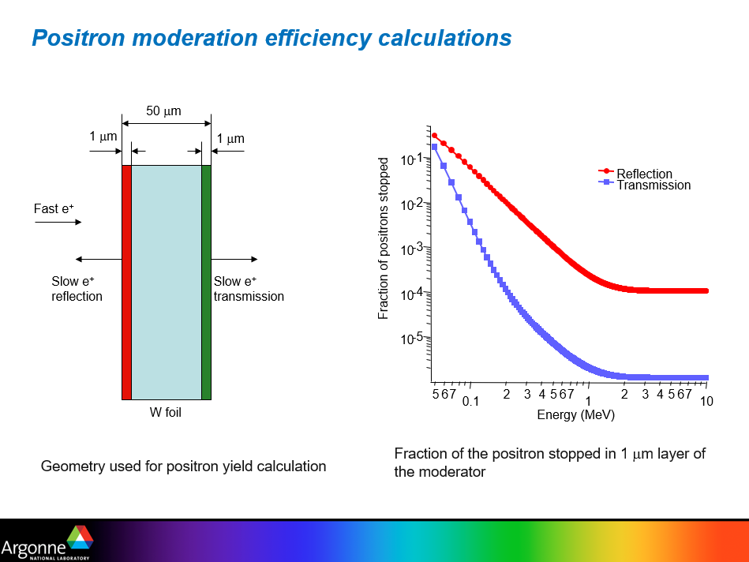

Slide 27
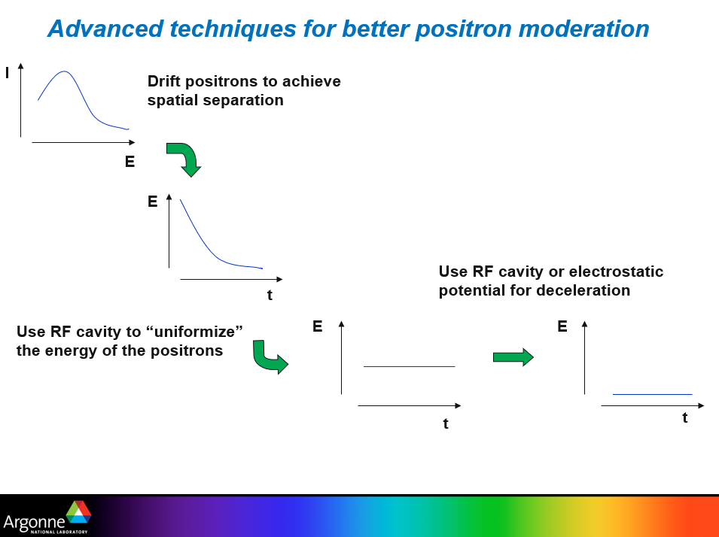

Slide 28
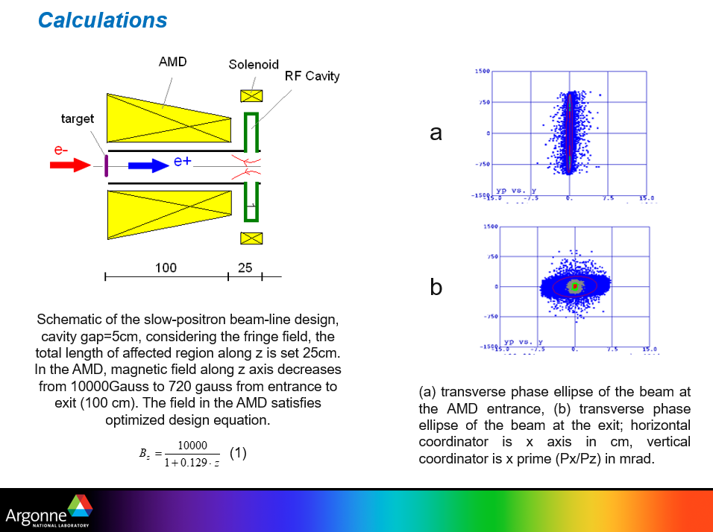

Slide 29
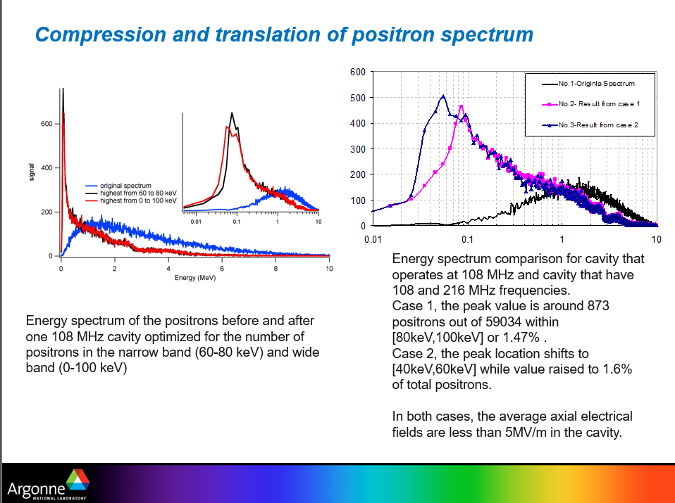

Slide 30
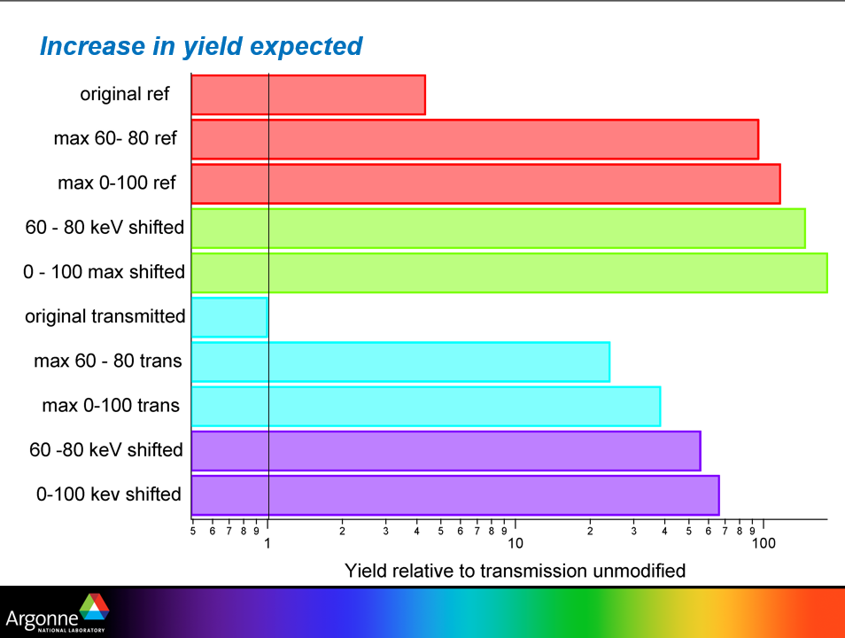

Slide 31
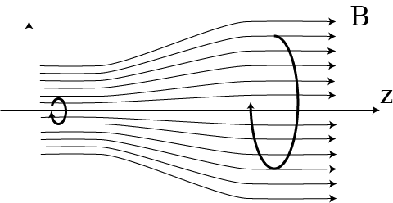



AMD (adiabatic matching device)
Velocity : v₁
Position : r₁
Angle :φ₁
e⁻
target
e⁺
Electron hit small point of the target.
Positron comes from small spot.
Angle distribution is large.
Velocity : v₂
Position : r₂
Angle :φ₂
B₁
B_{２}
target
$$r_{2}=r_{1}\sqrt{\frac{B_{1}}{B_{2}}}$$
$$φ_{2}=φ_{1}\sqrt{\frac{B_{2}}{B_{1}}}$$
e⁺
$$v_{1}=v_{2}$$
Adiabatically expand position distribution.
Angle distribution decrease.
Matched to the aperture of the following section.

Slide 32
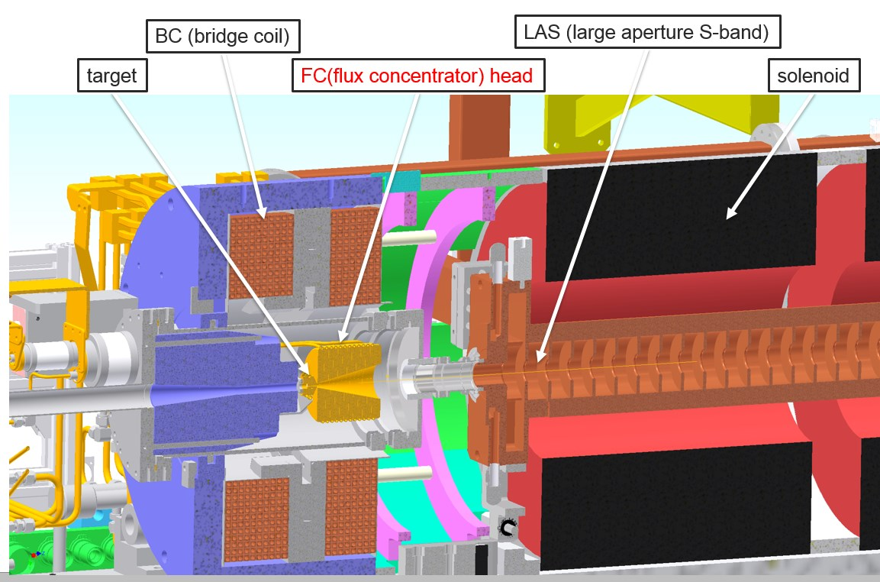
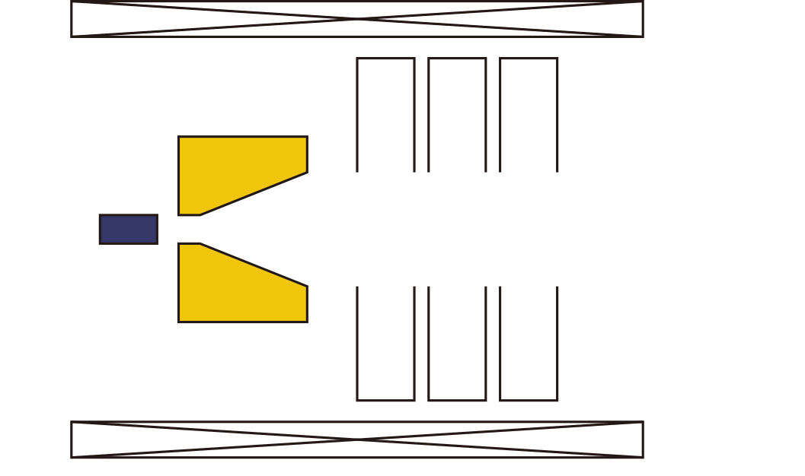
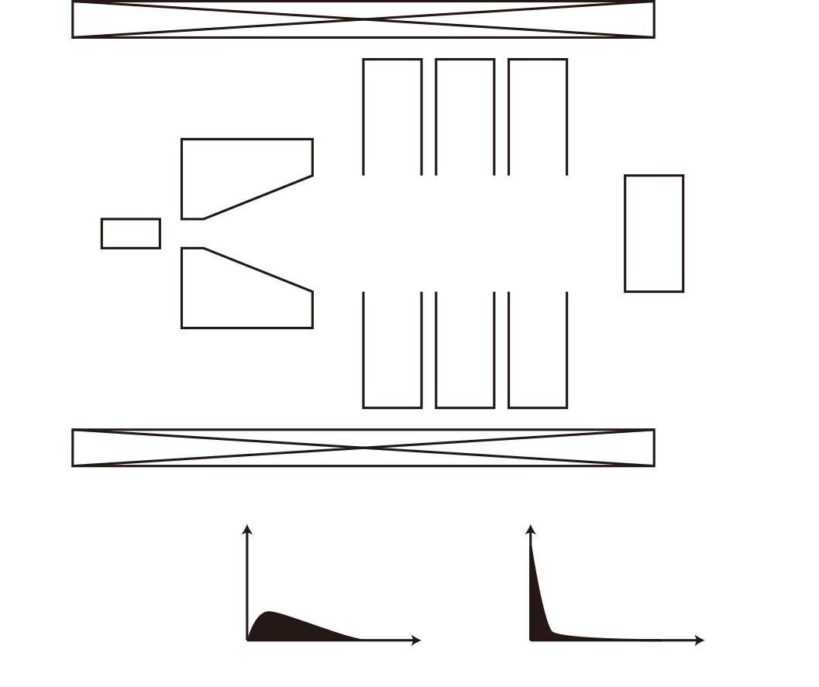





Deceleration injection to moderator
AMD
cavity
$$Fast {\text{e}}^{−}$$
Fast ${\text{e}}^{+}$
Slow-${\text{e}}^{+}$
deceleration
0.1－35 keV
Cross sectional view of positron source for SuperKEKB
Converter
Moderator
Realized for high energy positron source.
For slow positron production, replace downstream acc. cavities with moderator.
Solenoid
Count
Count
Technically difficult
10¹¹ slow e⁺/s will be possible
$$E$$
$$E$$

Slide 33
Back up

Slide 34
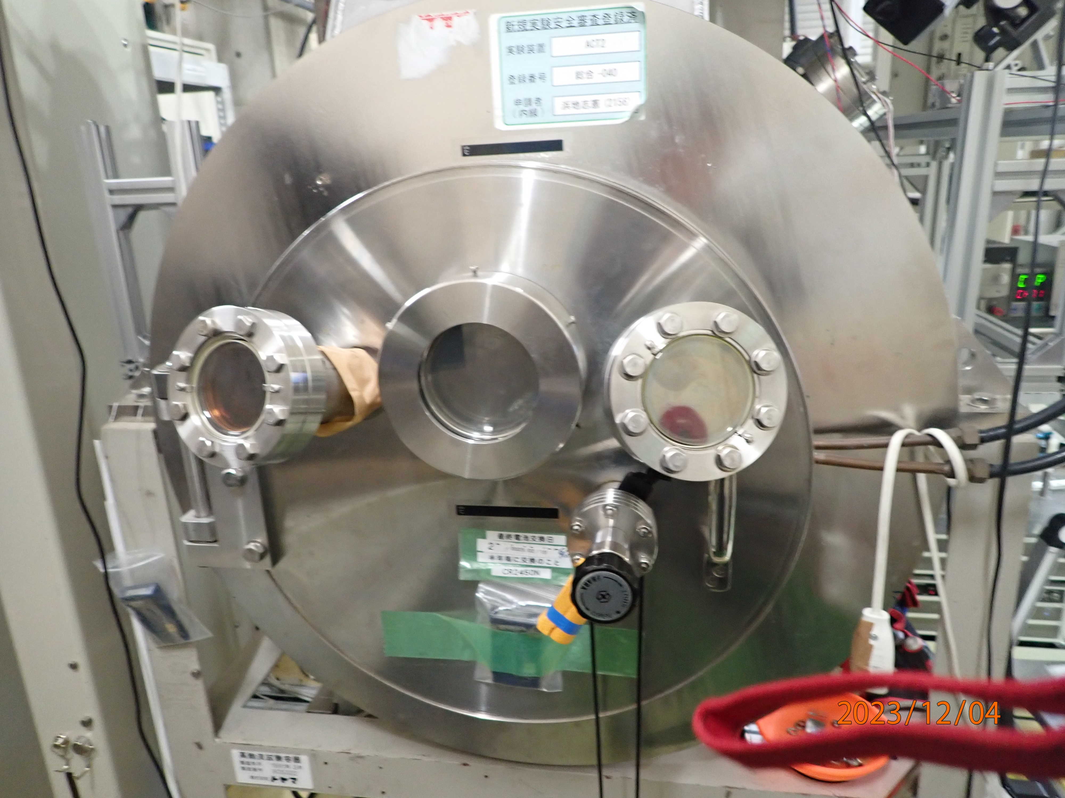
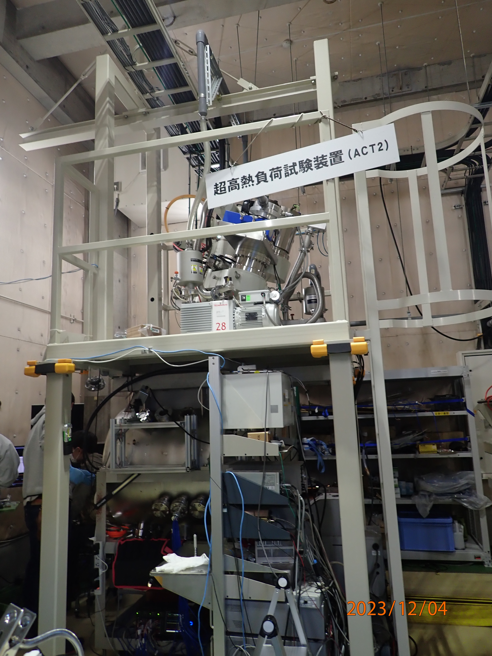
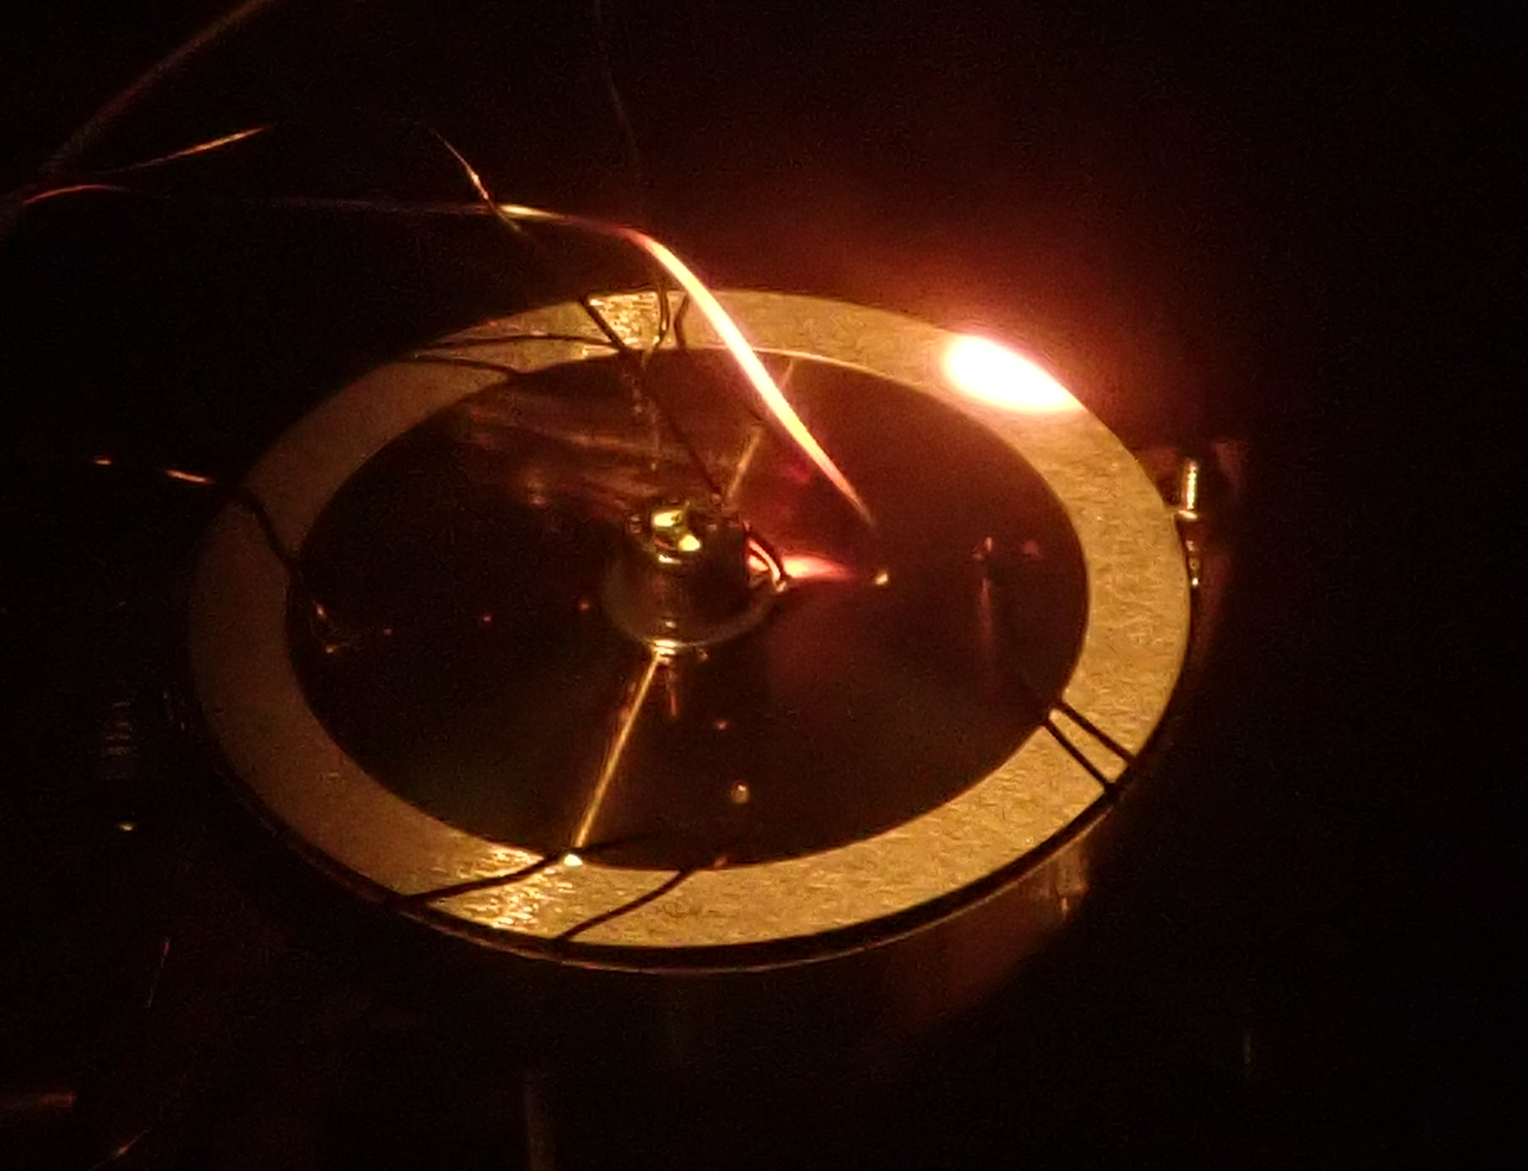
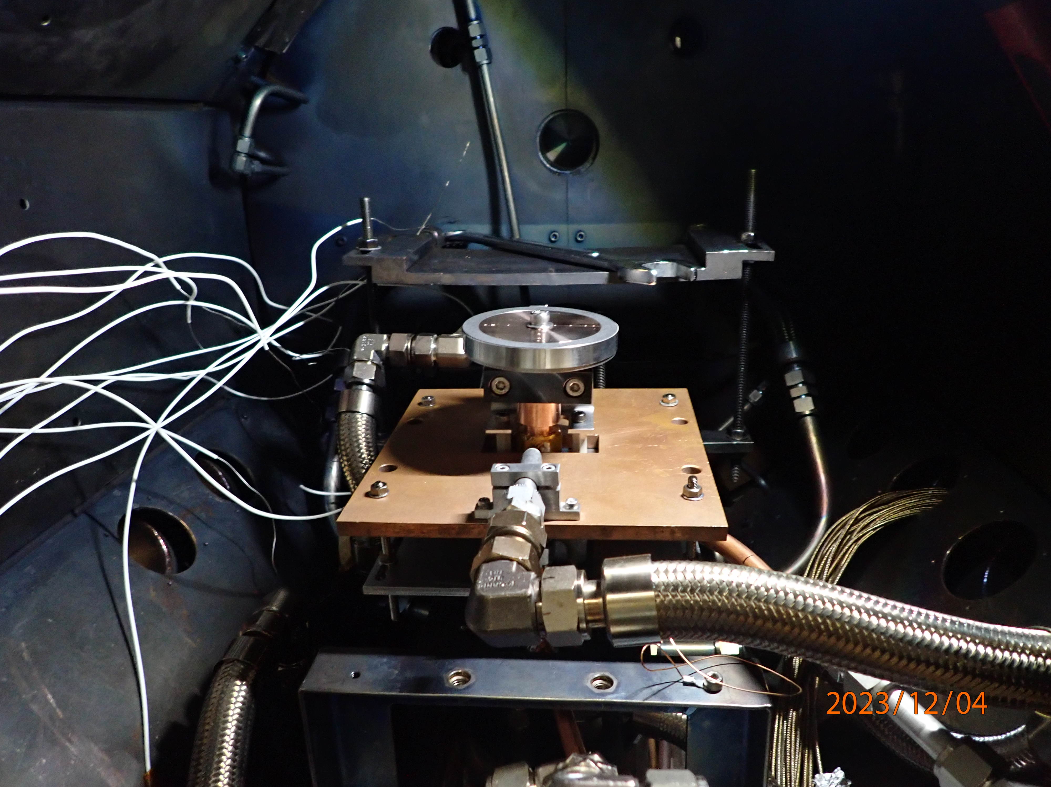
High power electron beam
ACT2@NIFS (National Institute for Fusion Science)
  300 kW, 40 kV, electron beam test facility
Low energy (w/o RF acc.) high power DC electron beam is available
→ elector energy of > MeV is desirable for test facility

Slide 35
Particle sources and positron source
secondary particle source
Primary particle source
Neutron source
Muon source
Neutrino source
Accelerator
Electron source
Ion source
High quality beam for acceleration
Stand alone test is possible
No radiational, thermal requirement
Positron source source
Low beam quality is acceptable
Need high power primary beam
Severe radiational, thermal requirement
Positron source is installed in the middle of accelerator
Collection and acceleration of secondary particles
need high power primary beam for full test
  Usually impossible before construction

