Slide 1
Ideas of Spin Rotator for Polarized e⁻ and e⁺ Beams at CEBAF
Fanglei Lin
Oak Ridge National Laboratory
LEEPP@JLAB, March 26, 2026, Newport News, VA

Slide 2
Outline
A brief review of earlier work on the exploration of spin rotator designs for polarized positron beams
Two spin rotator concepts for low-energy beams
Summary

Slide 3
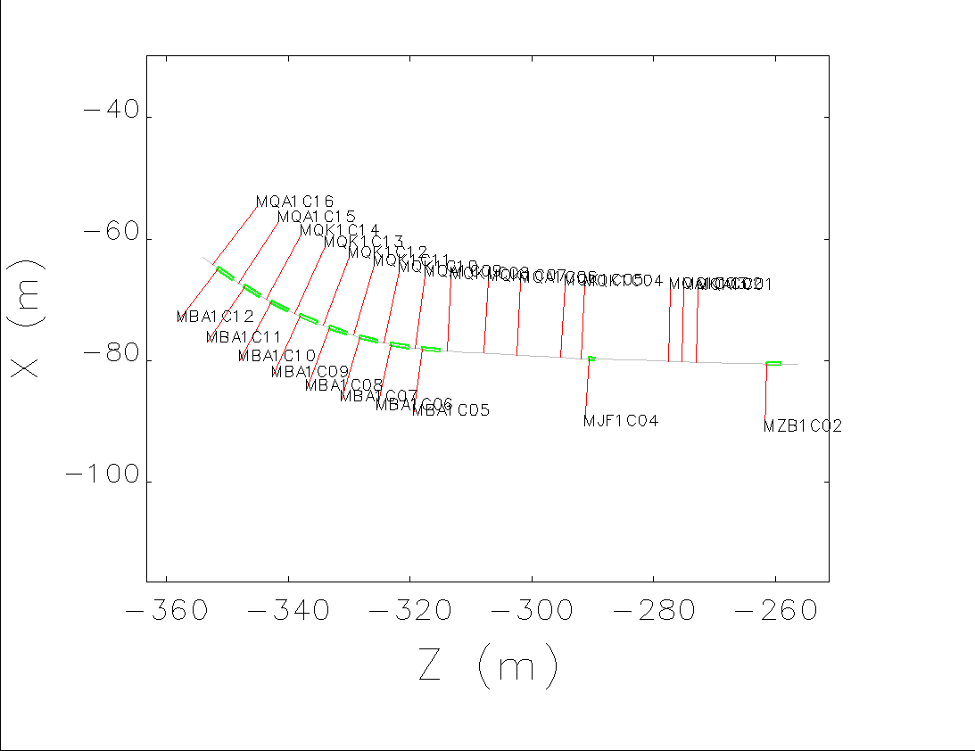
Two spin rotator designs may be applicable for polarized e⁺ at CEBAF, with certain limitations and challenges.
In 2021, we investigated two spin rotator designs, eRHIC-like and JLEIC-like, based on earlier experience.
  The eRHIC-like design provides a full 90° spin rotation at a specific energy, whereas the JLEIC-like design can achieve a 90° rotation over a range of energies.
  Both designs use dipole and solenoid magnetic fields and are better suited for spin rotation at relatively high beam energies (GeV) rather than MeV levels.
  Both designs require additional machine components and modifications to the existing accelerator layout, making them costly.
eRHIC-like
JLEIC-like
End of Hall A lattice
Courtesy of Amy Sy

Slide 4
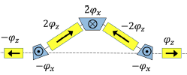
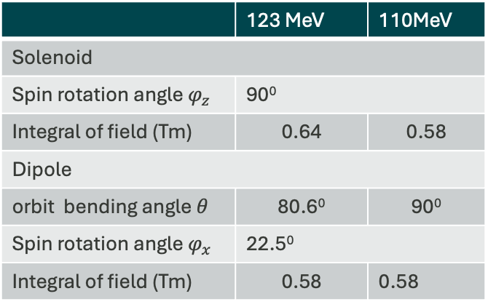
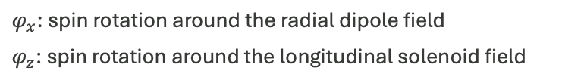
We investigated a spin rotator scheme capable of providing a 90° spin rotation at beam energies of hundreds of MeV range.
In 2022, we concluded that:
  High energy rotators are complicated additions to the end stations
  Prefer low energy spin rotator with "Wien-like" functionality
  Space should be constrained by LERF
  Cost should be minimized
Yu.N. Filatov et al., Eur. Phys. J.C, 81:986 (2021)
vertical
dipole
  We explored one spin rotator scheme (right plot)
    Applicable over an energy range of 110–123 MeV
    The spin dance could potentially be implemented within a compact dancing region
    This design module can be added or removed without altering the accelerator layout.
solenoid
$φ_{x}$: spin rotation around the radial dipole field
$φ_{z}$: spin rotation around the longitudinal solenoid field
longitudinal
 | 123 MeV | 110MeV
Solenoid
Spin rotation angle $φ_{z}$ | 90⁰
Integral of field (Tm) | 0.64 | 0.58
Dipole
orbit bending angle $θ$ | 80.6⁰ | 90⁰
Spin rotation angle $φ_{x}$ | 22.5⁰
Integral of field (Tm) | 0.58 | 0.58

Slide 5
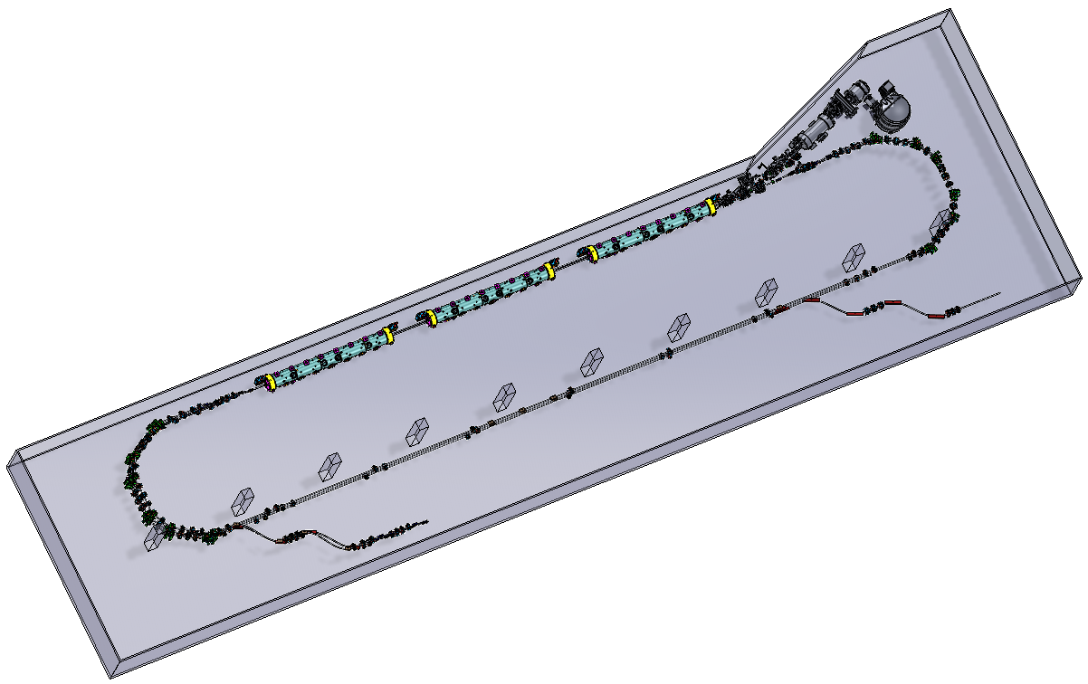
Recent Development of Universal Injector at LERF – 3-passes Extraction to CEBAF
MeV beam inj.
650 MeV
Higher
Energy
positrons
Lower
Energy
positrons
1,2,3
Pass
electrons
223/437 MeV

Slide 6
Recent Development of Universal Injector at LERF – 3-passes Extraction to CEBAF
Wien-Filter for keV e⁻
MeV beam inj.
Potential area of spin rotator and physics program for e⁻ and e⁺ at low energy 4 -12 MeV
Higher
Energy
positrons
650 MeV
Lower
Energy
positrons
1,2,3
Pass
electrons
Potential area of spin rotator for e⁻ and/or e⁺ at energy 123 - 650 MeV
223/437 MeV

Slide 7
Design of Spin Ratation/Rotator for Polarized Ce⁻/e⁺BAF
Specify physics requirements (learn more from this workshop)
  Longitudinal polarization and/or Transverse polarization
  Energy or energy range
Require accelerator design effort
  Design of spin rotator module
  Incorporate the spin design into the accelerator system
  Diagnose any potential issues and optimize the performance
Exploratory ideas for a spin rotation for polarized Ce⁻/e⁺BAF
  The Wien filter can still be used to rotate the spin of polarized electrons at keV beam energies.
  A spin rotator formed by solenoid and dipole magnetic fields for polarized e⁻ and e⁺ at MeV beam energy
  Control the final polarization by adjusting the spin precession angle in the horizontal plane at the experimental halls if the polarization stays in-plane during the acceleration in the CEBAF

Slide 8
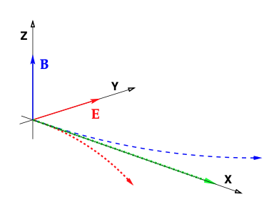
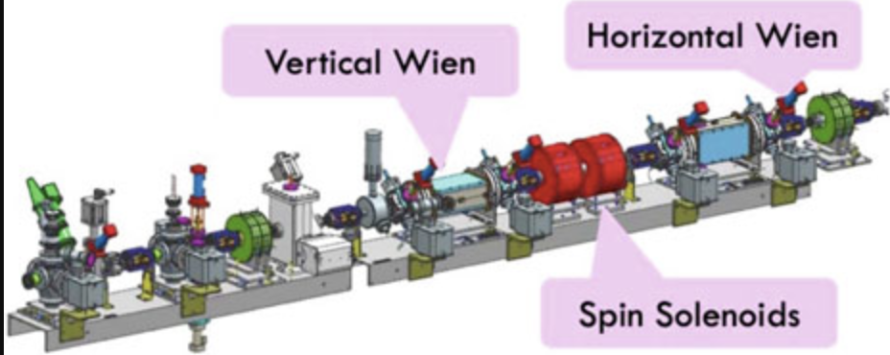
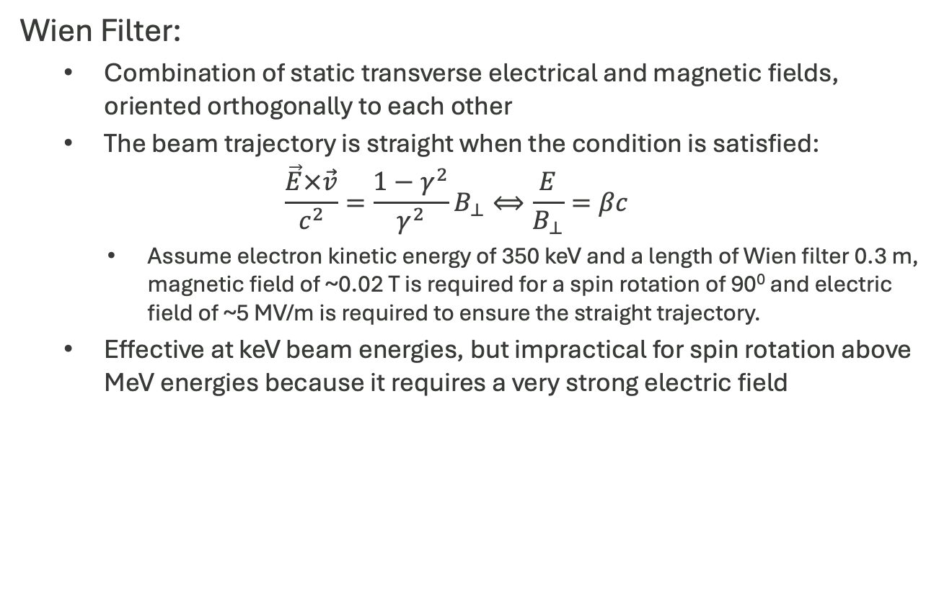
Wien Filter for Polarized Electrons at keV Beam Energy
Wien Filter:
  Combination of static transverse electrical and magnetic fields, oriented orthogonally to each other
  The beam trajectory is straight when the condition is satisfied:
  $$\frac{\vec{E}×\vec{v}}{c^{2}}=\frac{1−γ^{2}}{γ^{2}}B_{⊥}⟺\frac{E}{B_{⊥}}=βc$$
    Assume electron kinetic energy of 350 keV and a length of Wien filter 0.3 m, magnetic field of ~0.02 T is required for a spin rotation of 90⁰ and electric field of ~5 MV/m is required to ensure the straight trajectory.
  Effective at keV beam energies, but impractical for spin rotation above MeV energies because it requires a very strong electric field
USPAS Summer 2021 Spin Class Lecturs, F. Meot, et al., Springer Nature
When E = 0
When B = 0
e⁻
“CEBAF double Wien filter setup at around 130keV. The first Wien filter (vertical) rotates the polarization from longitudinal to vertical. The second Wien filter (horizontal) rotates the polarization in-plane to compensate precession of CEBAF transport magnets. Solenoids in-between ensure additional polarization rotation requirements.” (Y. Roblin)
e⁻

Slide 9
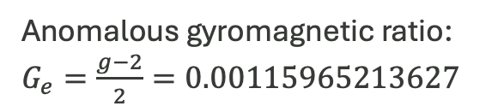
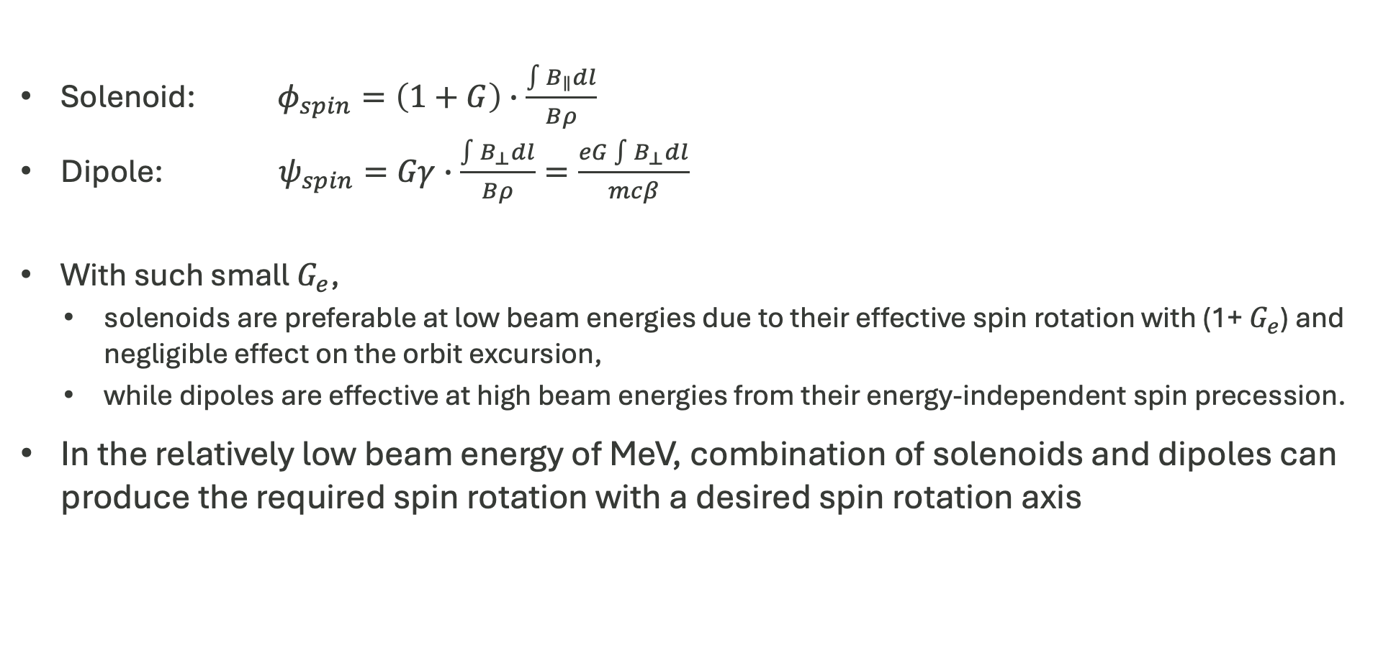
A combination of solenoid and dipoles can achieve the desired spin rotation for polarized e⁻ and e⁺ at MeV energies
Solenoid: $φ_{spin}=\left(1+G\right)∙\frac{\int{B_{∥}dl}}{Bρ}$
Dipole: $ψ_{spin}=Gγ∙\frac{\int{B_{⊥}dl}}{Bρ}=\frac{eG\int{B_{⊥}dl}}{mcβ}$
With such small $G_{e}$,
  solenoids are preferable at low beam energies due to their effective spin rotation with (1+ $G_{e}$) and negligible effect on the orbit excursion,
  while dipoles are effective at high beam energies from their energy-independent spin precession.
In the relatively low beam energy of MeV, combination of solenoids and dipoles can produce the required spin rotation with a desired spin rotation axis
Anomalous gyromagnetic ratio: $G_{e}=\frac{g−2}{2}=0.00115965213627$

Slide 10
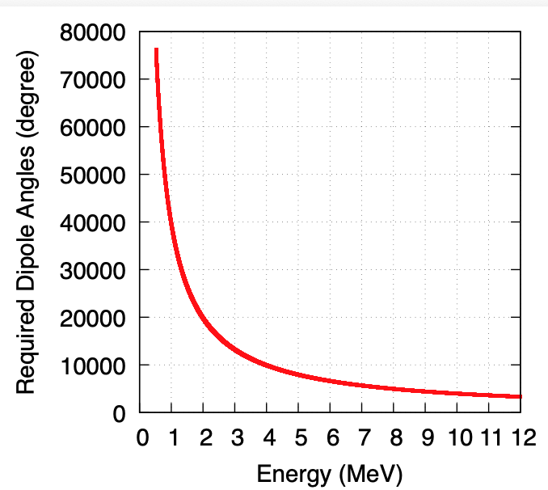
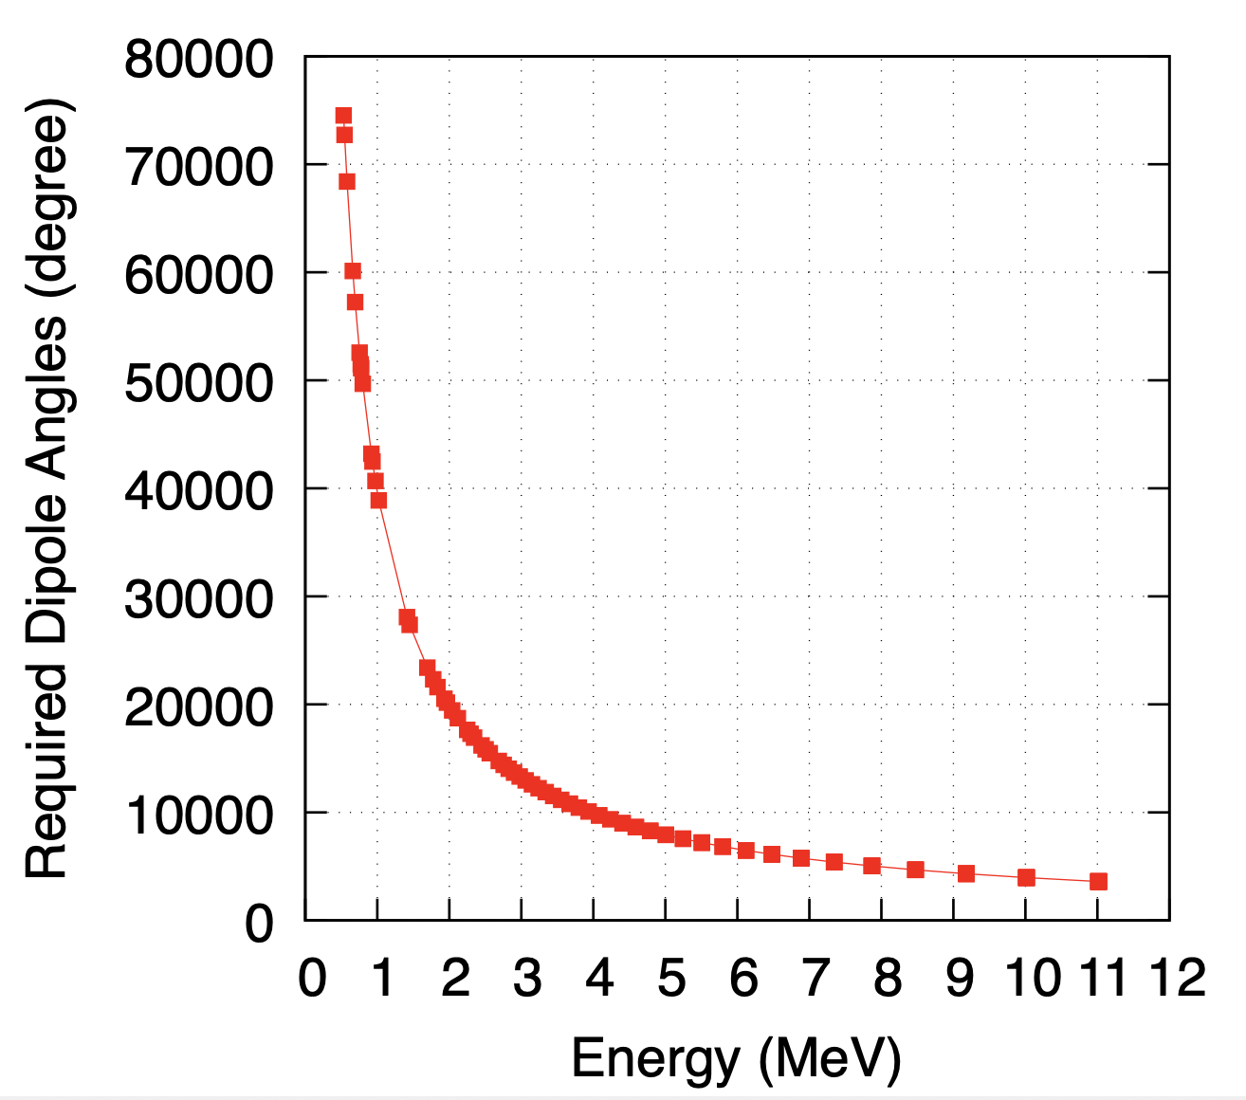


The simplest spin rotator for e⁻/e⁺ beam energy of 520 keV - 12 MeV consists of a dipole set combined with one solenoid
Top view
spin
dipole
spin
solenoid
spin
$$ψ_{spin}={90}^{0}$$
$$φ_{spin}={90}^{0}$$
Continuous beam energy
Discrete beam energy
Rotation angle = integer * 360⁰ (per revolution)

Slide 11
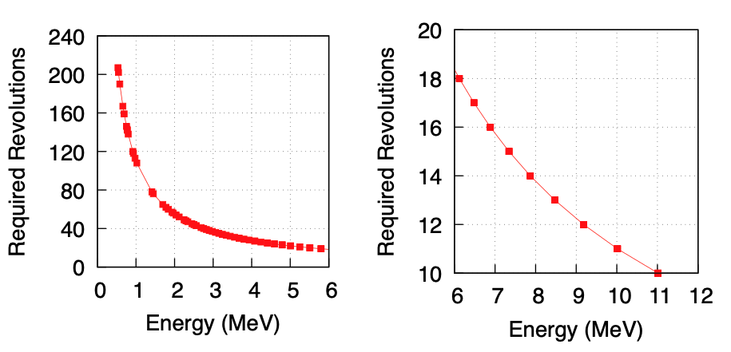
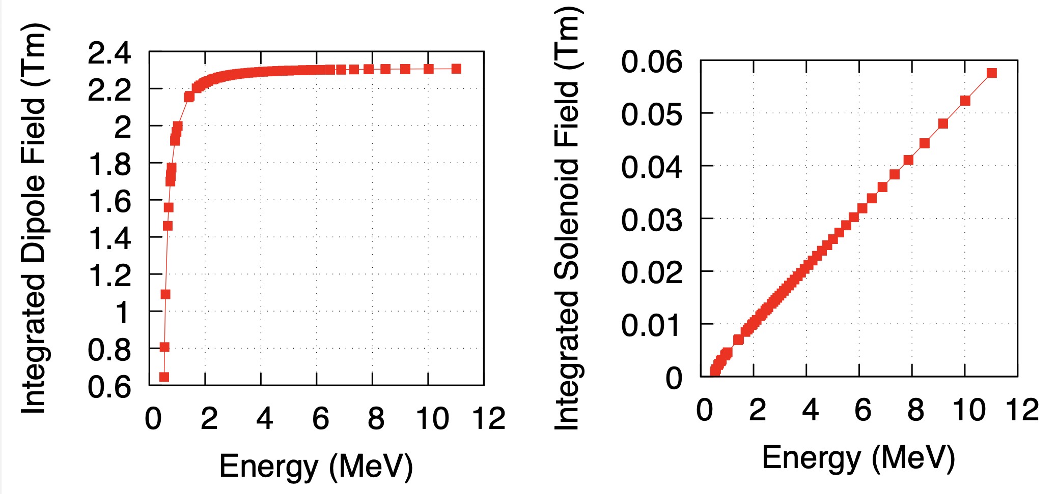
The simplest spin rotator design has both pros and cons
To provide a spin rotation of 90⁰ in such spin rotator:
the integrated dipole field tends to level off toward a constant value.
The integrated solenoid field is proportional to the beam energy
Both the required dipole and solenoid fields are relatively low at this energy range of 520keV – 12 MeV
Note that (!) :
Spin diffusion arises from the beam energy spread when longitudinally polarized spins are injected into the ring and rotates in the horizontal plane during subsequent revolutions.
This leads to beam depolarization, which can be particularly significant for polarized positrons produced from polarized electrons.
The depolarization increases with the number of turns that the beam completes in the ring.

Slide 12

A ring spin rotator, along with a low-energy physics program, can be placed upstream of the beam acceleration
Cons of this type of ring spin rotator :
Spin diffusion => beam depolarization
Pulse or low rep rate CW beams
Potential challenges on injection and extraction kickers
MeV beam inj.
$$\vec{S}$$
Low-energy physics program
650 MeV
Higher
Energy
positrons
Lower
Energy
positrons
1,2,3
Pass
electrons
223/437 MeV

Slide 13
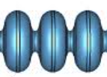
A chicane spin rotator at approximately 110–123 MeV in an ERL concept for a low-energy (a few MeV) physics program
MeV beam inj.
In such arrangement:
It requires a decelerating cavity
It requires an extra arc for transporting polarized positrons to the ERL for energy recovery
It needs path length adjusted (by half integer RF wavelength for e⁻, ~1/6 off integer RF wavelength for e⁺ for example) in the ERL
Spin rotation is implemented in a relatively high beam energy of ~100 MeV
No injection and extraction are needed, CW beams
Simultaneous polarized e⁻ and e⁺ physics programs
Decelerating cavity
ERL
Low-energy (MeV) physics program
Higher
Energy
positrons
650 MeV
Lower
Energy
positrons
1,2,3
Pass
electrons
223/437 MeV
vertical
Thanks to Jiquan Guo for reminding me about the ERL application !
dipole
solenoid
longitudinal

Slide 14
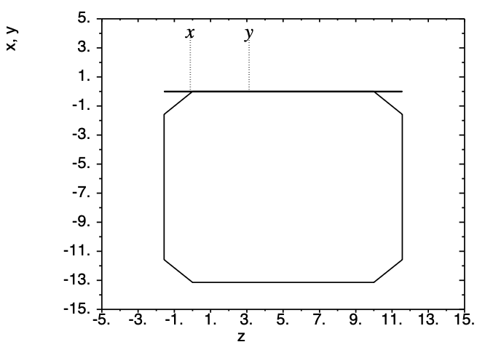
Possible geometry of ring spin rotator for beam energy at 6 MeV
~ 13 m
Beam energy ~6 MeV (18 revolutions)
Dipole: physical length 2 m (path length ~2.22m), B~0.014 T, bending angle 90⁰
Solenoid: L=1m, B ~ 0.03 T
10 m space between dipoles is reserved for necessary accelerator elements
~ 13 m

Slide 15
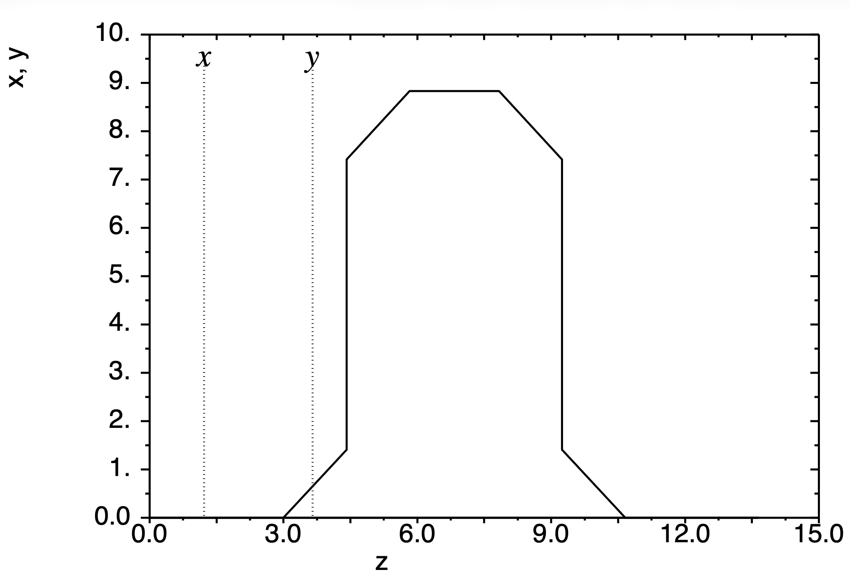
Possible geometry of a chicane spin rotator for beam energy at 110 MeV
vertical
dipole
solenoid
~ 9 m
longitudinal
Beam energy 110 MeV
Dipole: physical length 2 m (path length ~2.22m), B~0.17 T, bending angle 90⁰
Solenoids: L=1m, B ~ 0.58 T
~ 14 m

Slide 16
Summary
Two preliminary concepts for spin rotation of polarized e⁻ and e⁺ beams in the LERF, aimed at CEBAF low-energy physics programs, have been explored, with promising overall results.
  Ring spin rotator option
    Suitable for the beam energy around 10 MeV
    Produce pulse or low rep rate CW polarized beams
    Injection and extraction kickers are required
  Chicane spin rotator option
    Suitable for the beam energy above 110 MeV
    Produce high rep rate CW polarized beams
    An ERL is essential for low-energy physics program
To further develop the spin rotation/rotator designs, we need to define the physics requirements and commit dedicated accelerator design effort. Multiple integrations will be required to meet the goals and align with the capabilities of the accelerator system.

Slide 17
Thank you for your attention !

