Slide 1



Moderator Informed Compact Positron Optimization
Sophie Crisp, Spencer Gessner
March 23, 2026

Slide 2
Acknowledgements
PI: Spencer Gessner (SLAC, Stanford)
Undergraduates: Ryland Goldman (UCLA), Arif Ismail (Stanford University)
This work was supported by the Department of Energy, Laboratory Directed Research and Development program at SLAC National Accelerator Laboratory, under contract DE-AC02-76SF00515.

Slide 3
Outline
Motivation: Where are we now?
Makeup of a slow positron beamline
Simulations and modeling of a linac based positron source
Testing at the XTA beamline in the NLCTA bunker at SLAC

Slide 4
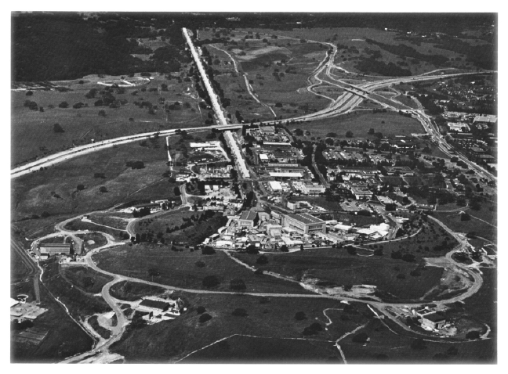
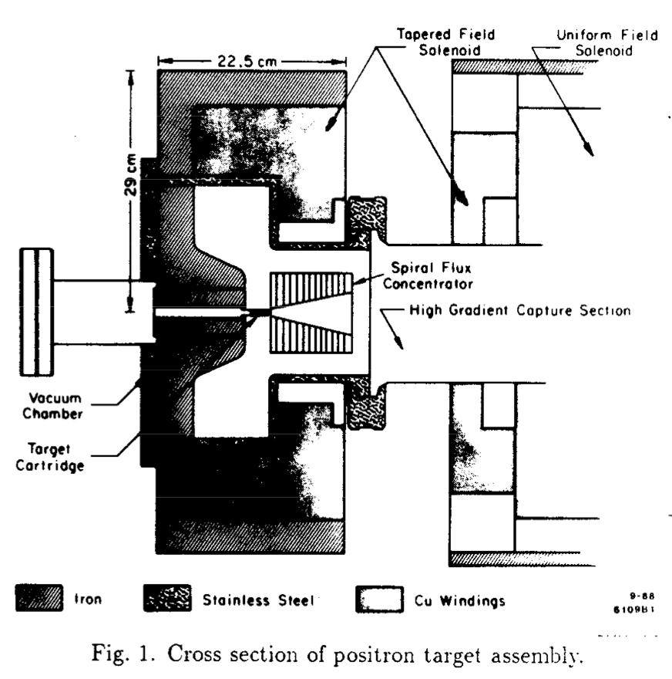
SLAC Once Hosted the World’s Highest Intensity Positron Source
SLC Positron Target
How can we leverage this expertise and apply it to new scientific challenges?

Slide 5
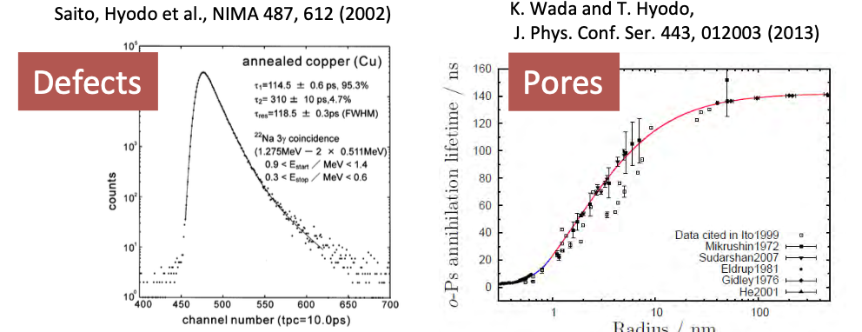
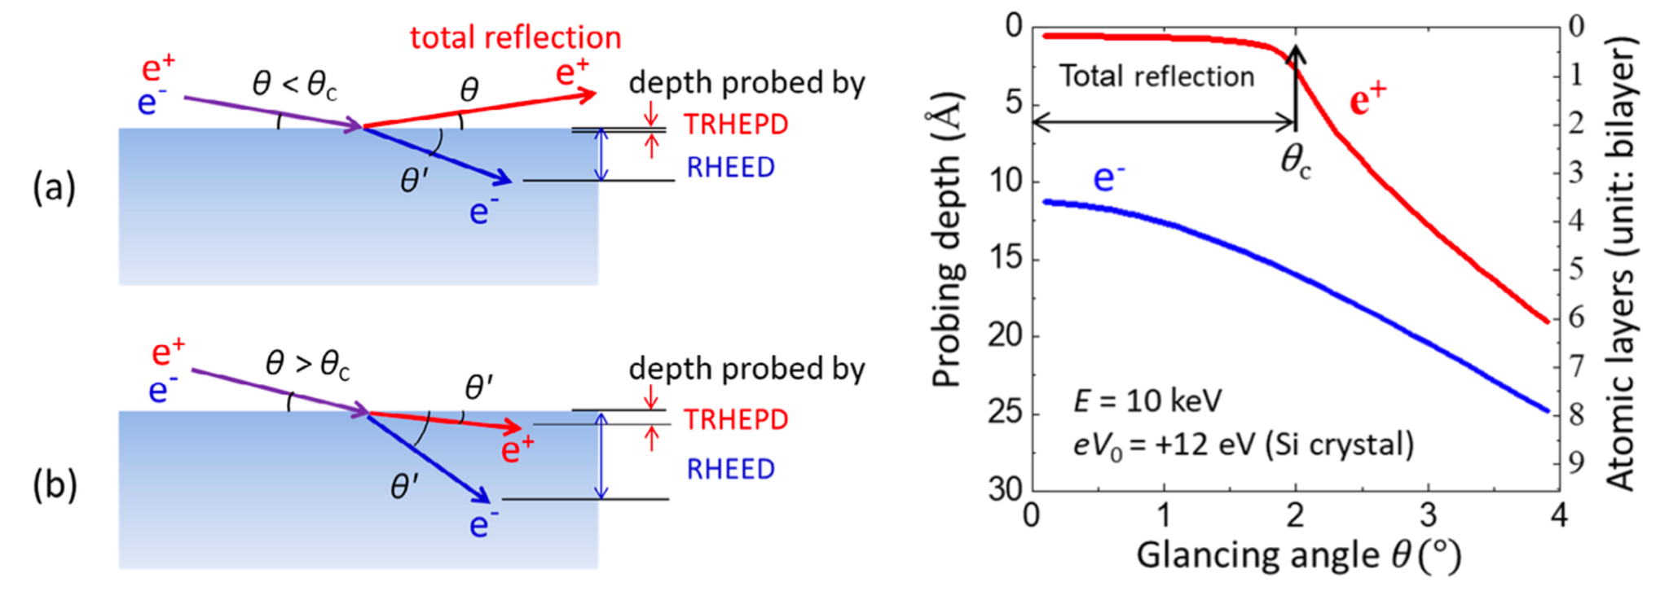
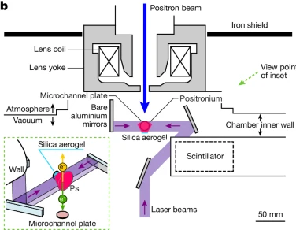
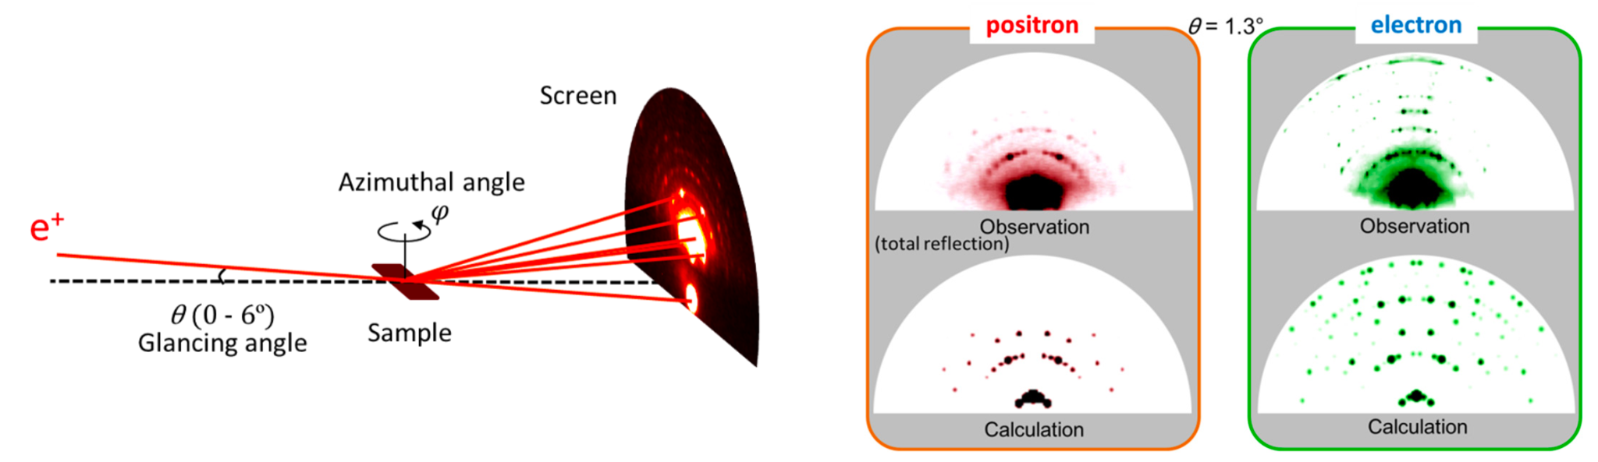
Positrons for Basic Research
Positron Annihilation Lifetime Spectroscopy
Total Reflection High Energy Positron Diffraction
Y. Fukuya, J. Phys. D: Appl. Phys. 52, 013002
Laser Cooled Positronium
K. Shu et al., Nature 633, 793–797 (2024)
Positrons enable exciting scientific opportunities, but positron sources have limitations.

Slide 6
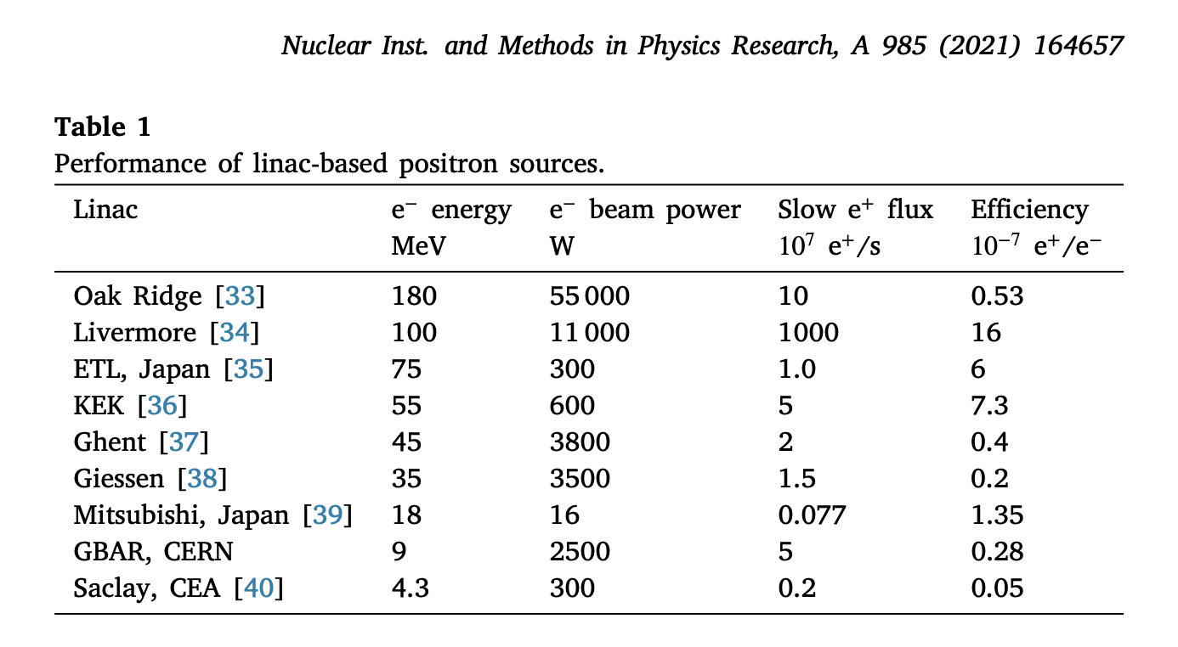
Current Positron Sources are Limited by Efficiency
x 10
* This is just linac sources, but you get the idea
Why is the yield so low?

Slide 7
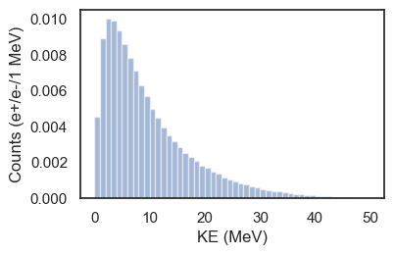
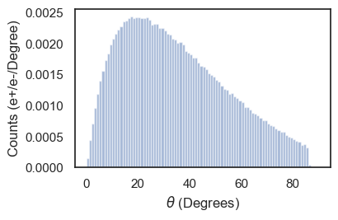
Schematic of a Linac Based Slow Positron Beamline
‘Monochromatic’ e+
Electron Linac
e+, e- Particle Shower
65 MeV e-
Lens
High Z Target
Moderator
Remoderator
Positron Energy Distribution After Target
Positron Angular Distribution After Target

Slide 8
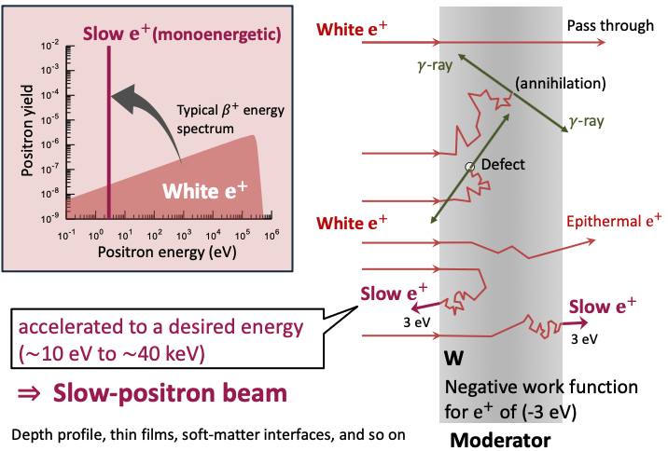
Positron Moderation
Typically on the order of 10⁻⁴ slow positrons per fast positron*
Credit: K. Wada

Slide 9
Lots of ideas to increase e+/e- efficiency
Moderator Geometry/ Material
Target Geometry
Decelerating Linac
Trapping

Slide 10
Lots of ideas to increase e+/e- efficiency
Moderator Geometry/ Material:
Tungsten is robust, and you can have complicated geometries
but solid neon gives order of magnitude higher efficiency
Target Geometry:
Potential Conical or Inverse Conical Designs increase fast positron yield- critically, at the desired energy
Decelerating Linac:
Certainly effective, but how much for the increased complexity?
Trapping:
Buffer gas traps are often use to build up positrons to a high number and release all at once, but it’s hard (never been designed or done) to get picosecond timescale beam
Goldman 2025: https://doi.org/10.48550/arXiv.2508.15975
Crisp 2025: https://doi.org/10.48550/arXiv.2508.07549
Hessami, Gessner, 2023 https://doi.org/10.1103/PhysRevAccelBeams.26.123402
Notes:
trade-offs - complexity, reliability, size
put trapping to the side for the time being

Slide 11
Efficiency Through the Beamline
‘Monochromatic’ e+
Electron Linac
e+, e- Particle Shower
65 MeV e-
Lens
High Z Target
Moderator
Remoderator
Max eff: 0.01
Typ: 1e-5
Max eff: 0.65
Typ: 0.1
Eff: 0.01
Increasing moderator efficiency is critical to increasing positron flux.

Slide 12
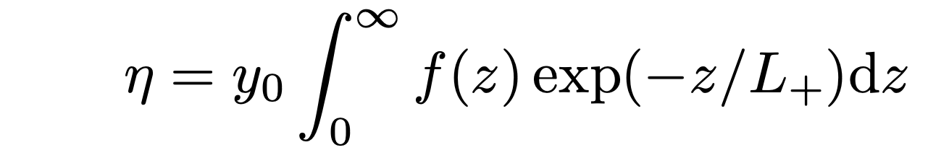
Positron Moderation is Inefficient
In order to be re-emitted as a moderated positron:
The fast positron must first be ‘stopped’ in the moderator material
without annihilating
at which point it has some probability of getting back to the surface
without annihilating
and being reemitted as a ~3 eV positron
Reemission Probability
<10⁻³
Branching
Ratio
~0.3
Stopping
Profile
~microns
Diffusion
Length
~55 nm
Notes:
In order to be re-emitted as a moderated positron, the positron must first be ‘stopped’ in the moderator material, at which point it has some probability of getting back to the surface and being reemitted

Slide 13
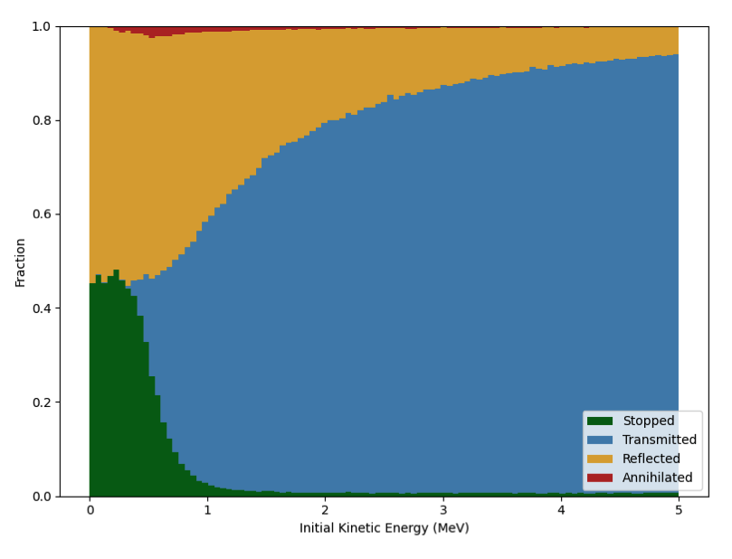
Positron Fate as a Function of Energy
Whether the positrons get stopped within a moderator foil is energy dependent, and so is where
Left: results from g4beamline simulations of positrons incident on a moderator foil. Stopped positrons contribute to f(z) and thus have a probability of remission as ‘slow’ positrons

Slide 14
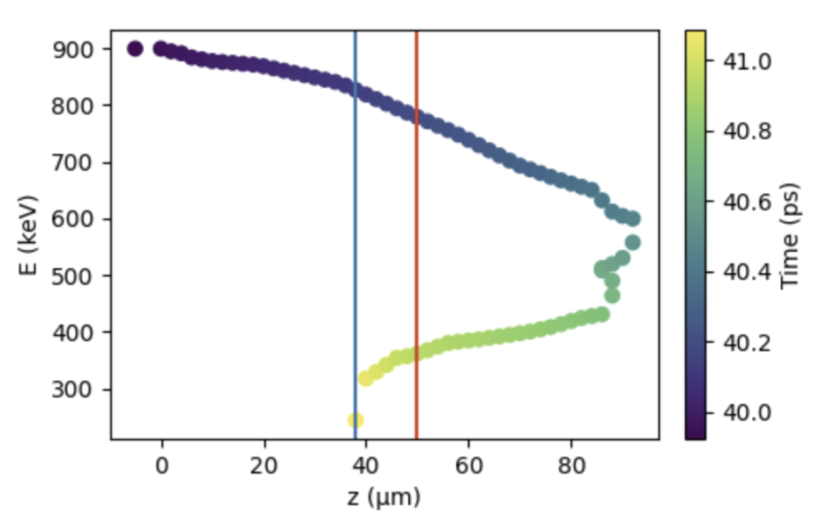
Modeling the Moderation Process
O’Rourke (Rev. Sci. Instrum. 82, 063302 (2011))
Using Geant4, model interaction inside converter/moderator
Since Geant4 cannot model diffusion:
Allow particles to scatter until they reach KE<50 eV
Assign probability according to exp(-z/L+) for them to diffuse back to surface, where L+ is the diffusion length (L+ = 55 nm for polycrystalline tungsten, 135 nm for single crystal)
Assign probability y_0 (0.3) for branching ratio, the proportion of thermalized, surface positrons which are reemitted
Extract final efficiency
e+ track inside moderator foil

Slide 15
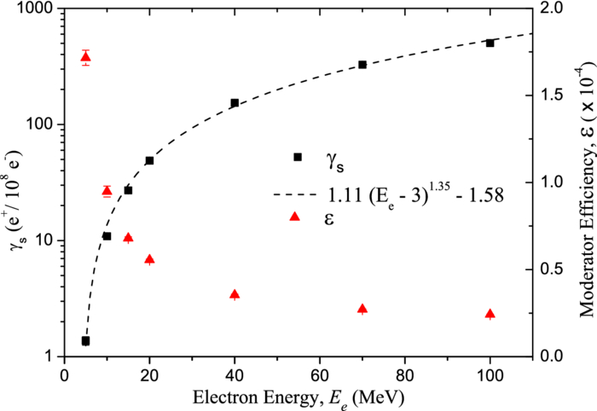
Modeling the Moderation Process
O’Rourke (Rev. Sci. Instrum. 82, 063302 (2011))
JLAB?

Slide 16
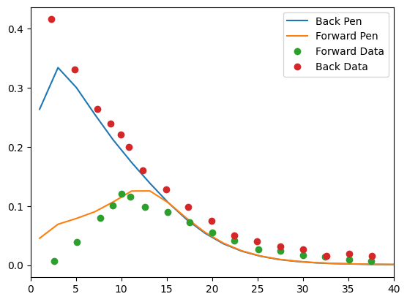
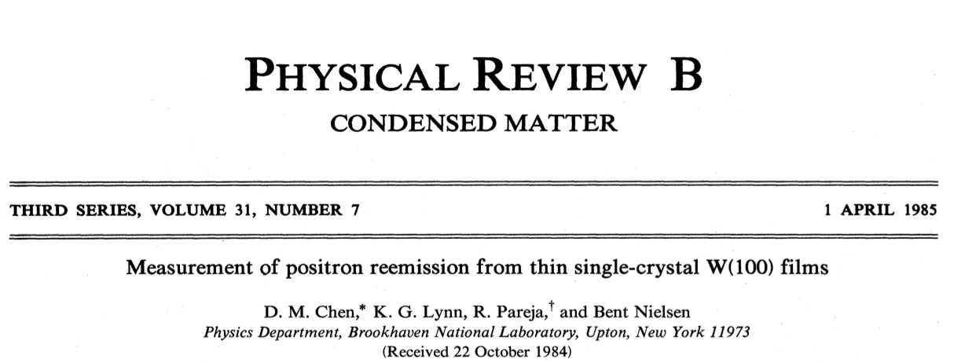
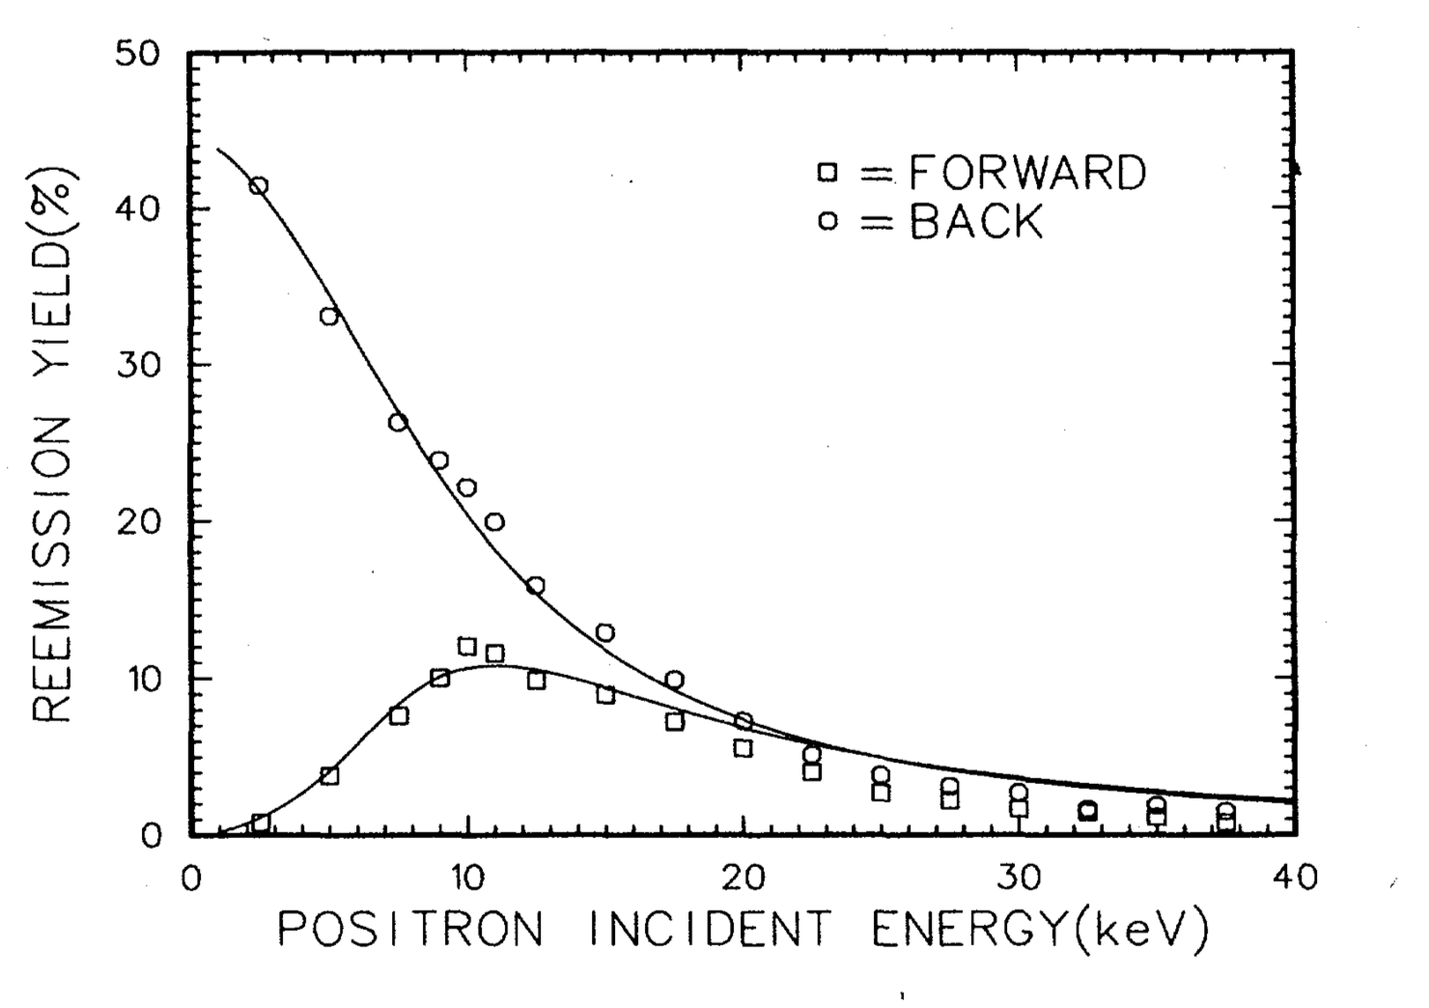
Benchmarking Moderation Numbers
2500 Angstrom foil
Points are extracted from Chen et al
Lines are from simulation
Reemission Fraction
Positron Energy (keV)

Slide 17
Benchmarking Moderation Numbers
Moderation is inefficient at the energies of the fast positrons out of the target
Reemission Fraction
Positron Energy (keV)

Slide 18
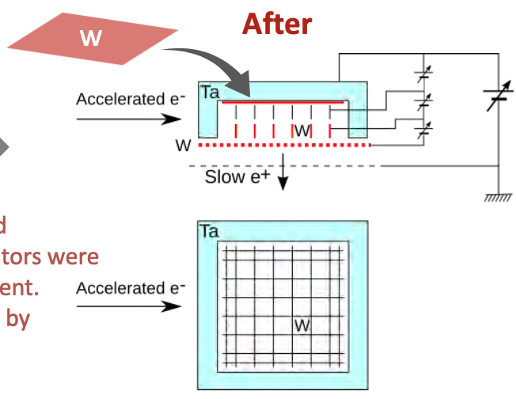
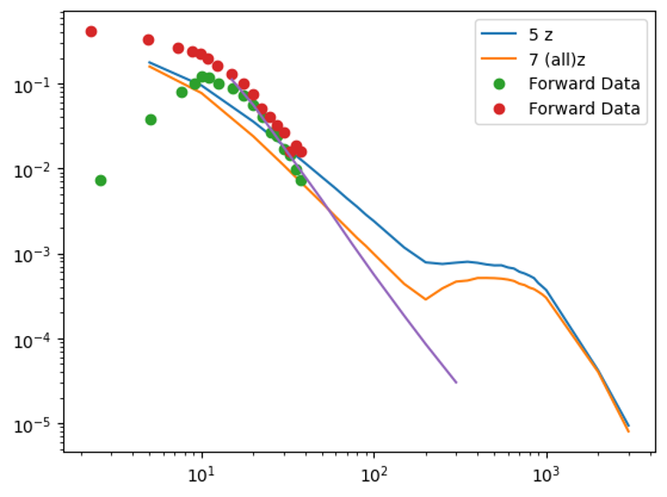
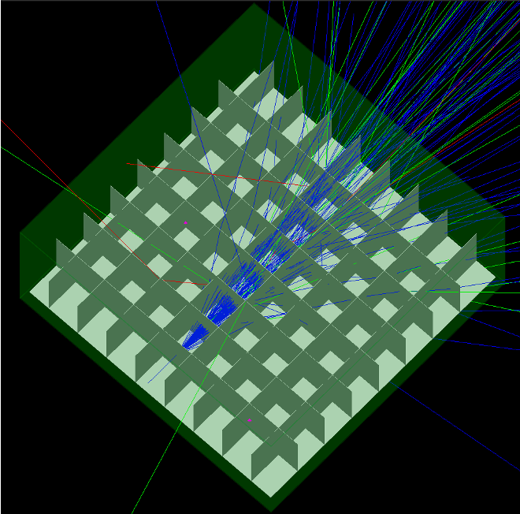
KEK Moderator Efficiency Study
Simulations of a KEK style moderator indicate significant improvements in capture of higher energy positrons
We want more, though!
Left: remission probability as a function of incoming positron energy (keV)
Data refers to 1985 single crystal exp.
5z and 7z are two different grid based (like KEK) geometries I simulated - clear that the grid allows for more scattering which captures more of the high energy positrons - but this is at the expense of beam size/length
Tailoring positron energy distribution is one way you could increase flux.

Slide 19
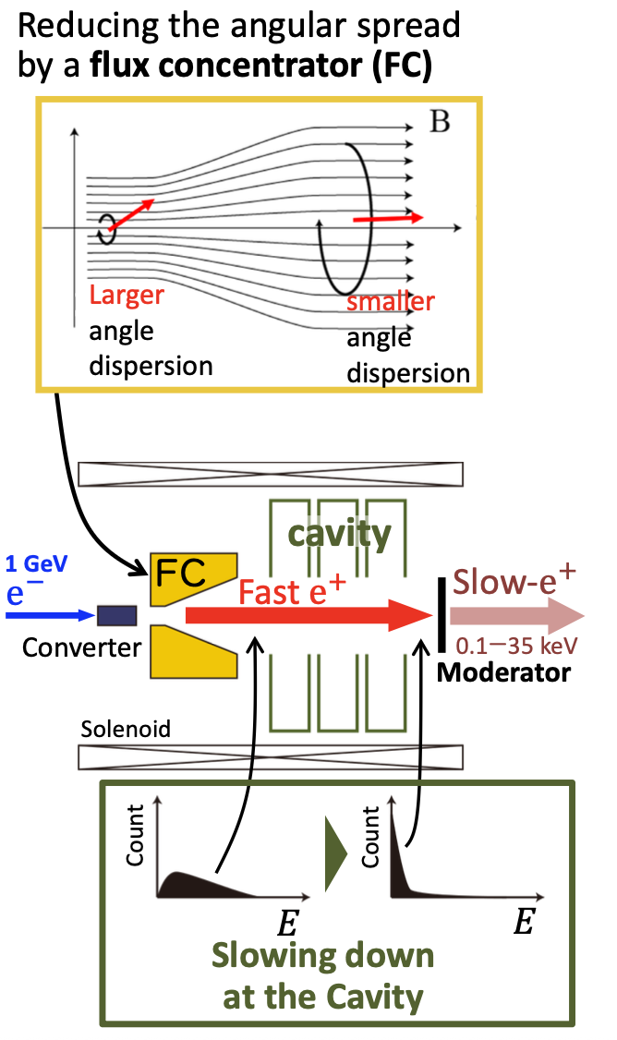
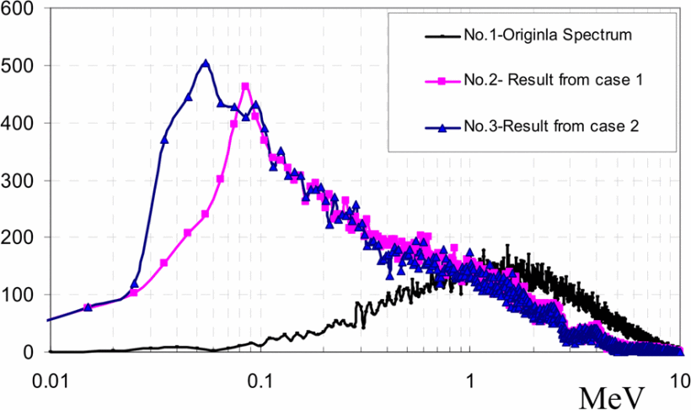
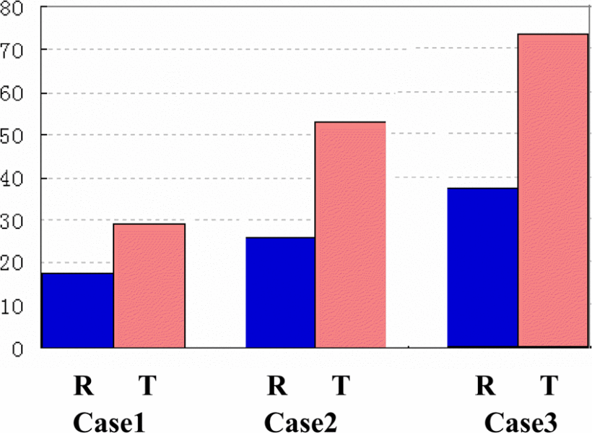
Since Moderation is Energy Dependent, Tailoring the Fast Positrons Could Help
Previous work suggests near 2 orders of magnitude improvement in moderation via first decelerating the fast positrons
Reemitted Positron Count
Long et al, Study on high flux accelerator based positrons source (2007)
Notes:
Explanation of the seed paper: Flux concentrator first captures a large transverse momentum spread, then linac deceleration to better enable moderation
Pros:
clear increase in potential positrons
obvious connection to existing SLAC expertise - if anyone is going to put a decelerating linac after a positron source, we are
Problem: the corresponding theory paper on how they calculated these numbers is missing

Slide 20
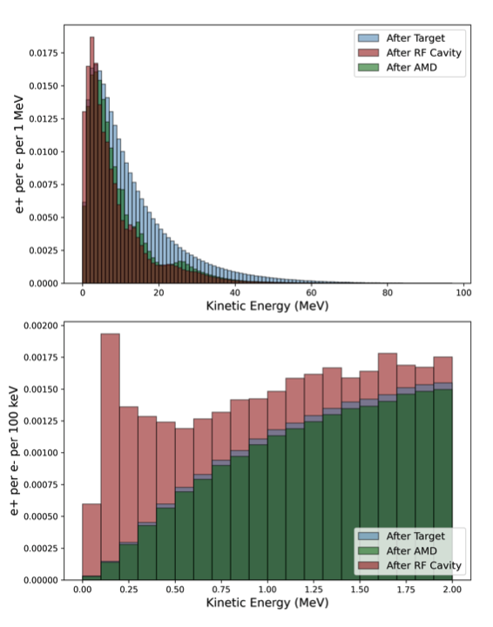
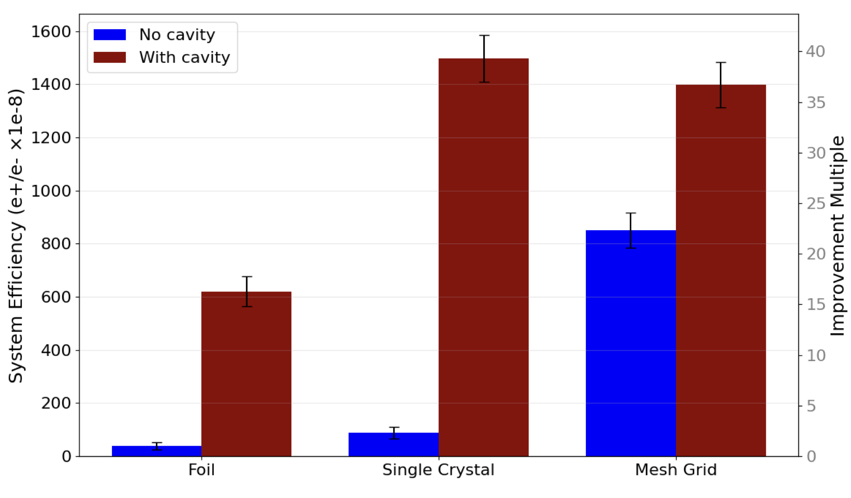
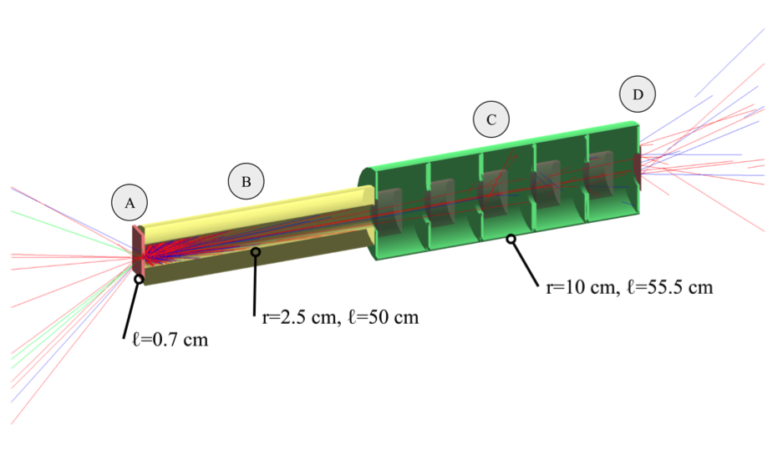
Linac Deceleration Scheme
Using an L-band cavity to decrease the energy of the positrons before the moderated, we obtained a 40x improvement in output positron count
A: Target
B: AMD
C: L-Band
D: Moderator

Slide 21
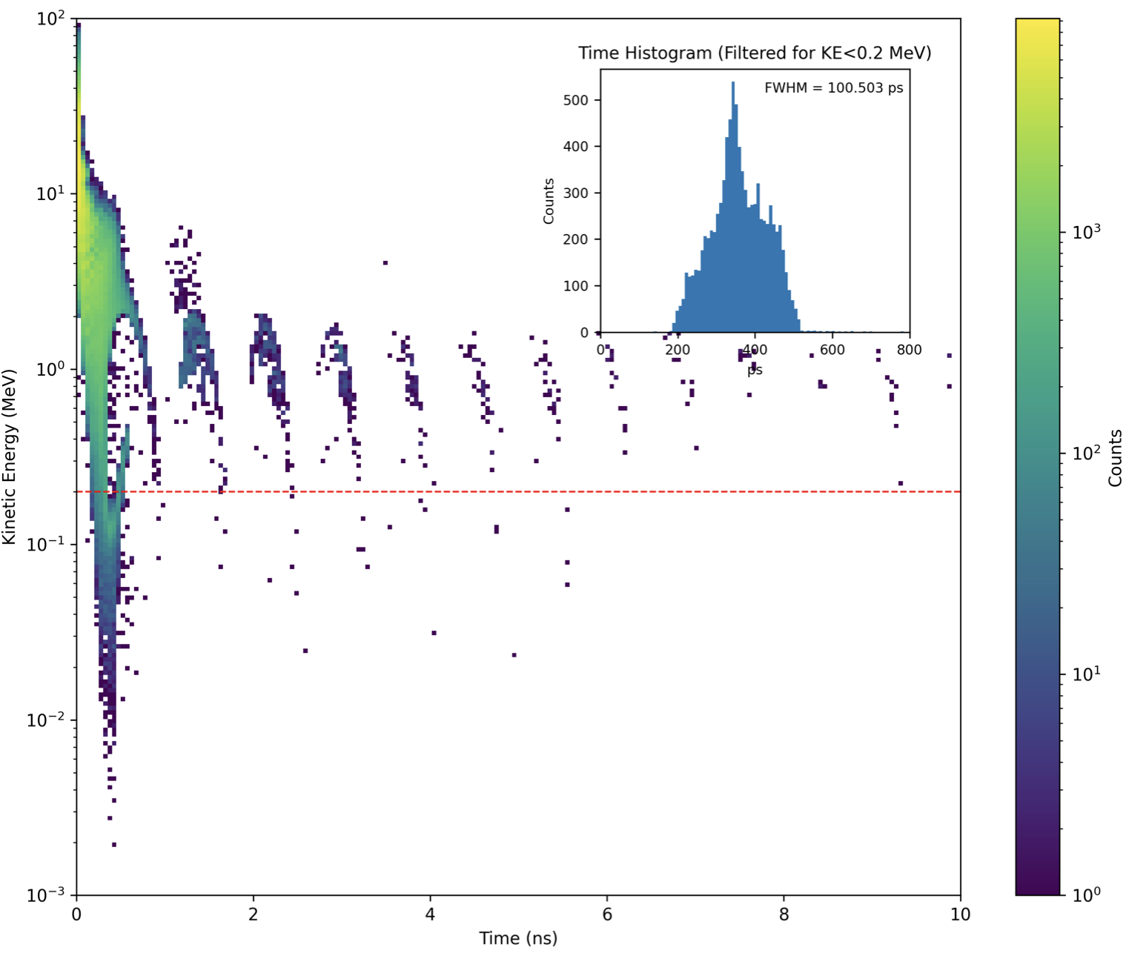
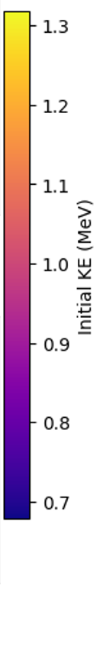
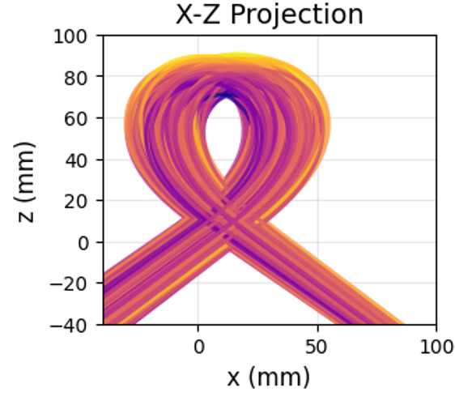
Short Pulse Positrons
With a linac decelerator, we can optimize positron bunches for longitudinal brightness
ie: number of positrons in a ‘short’ pulse <100 ps
Other Possibility: take from the ultrafast electron diffraction community and utilize alpha magnet for compression:
https://arxiv.org/pdf/2508.15975
Ryland Goldman, SULI Intern 2025

Slide 22
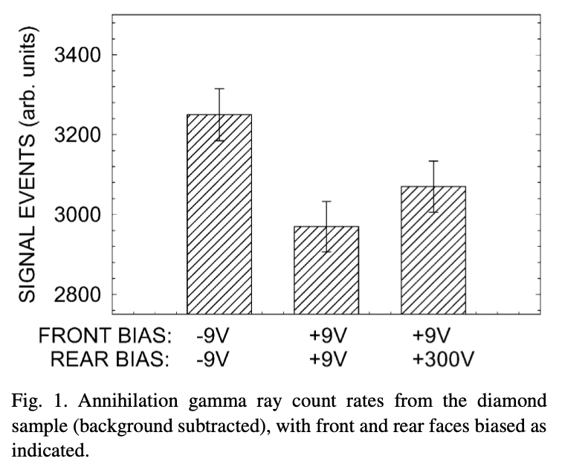
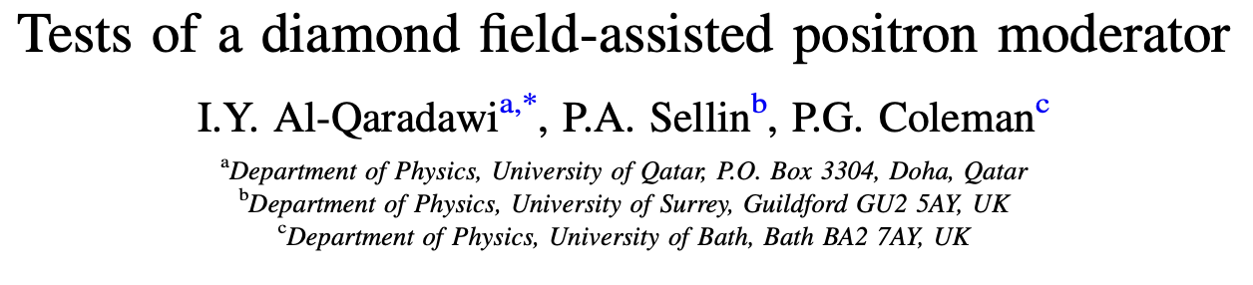
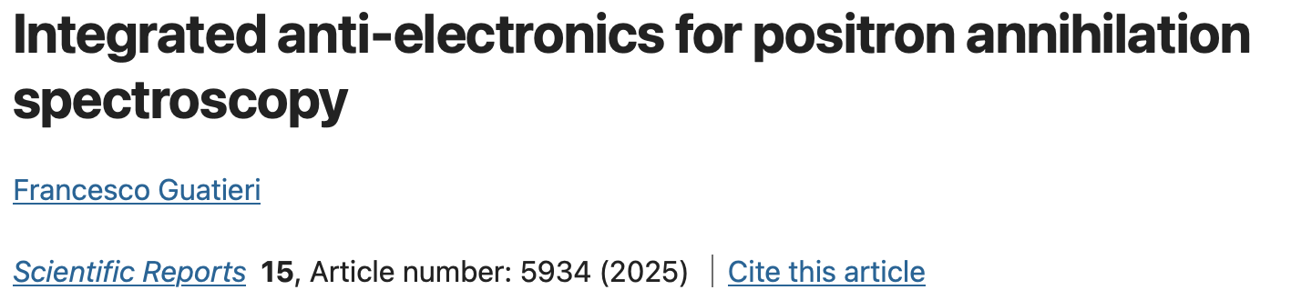
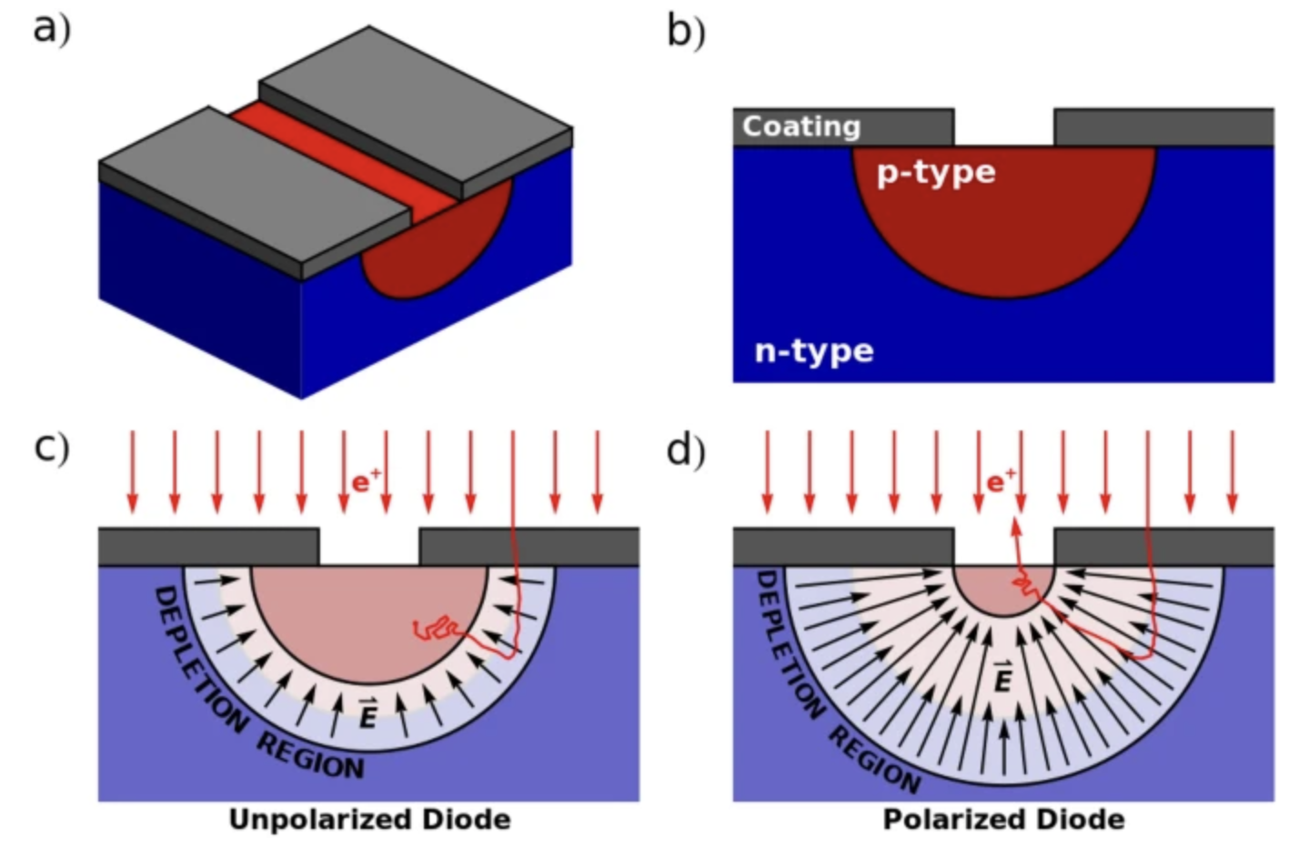
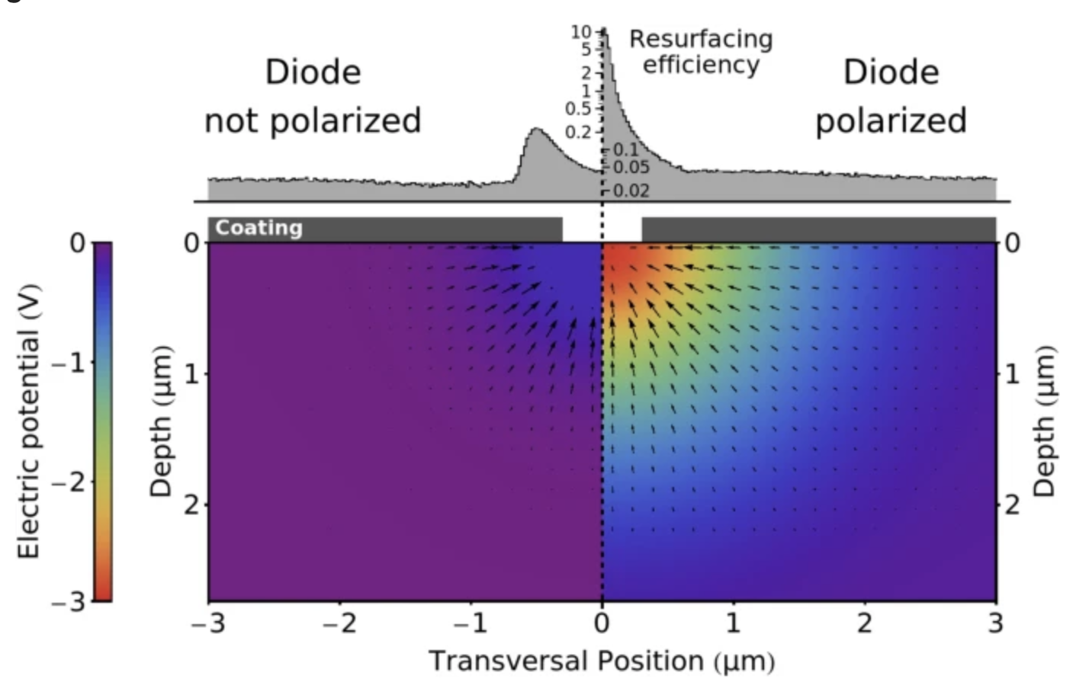
Further Moderator Possibilities
Unsuccessful, but maybe just a methodology problem?
Applied Surface Science 194 (2002) 29–31
Not for maximization of beam, but maximization of PALS resolution

Slide 23
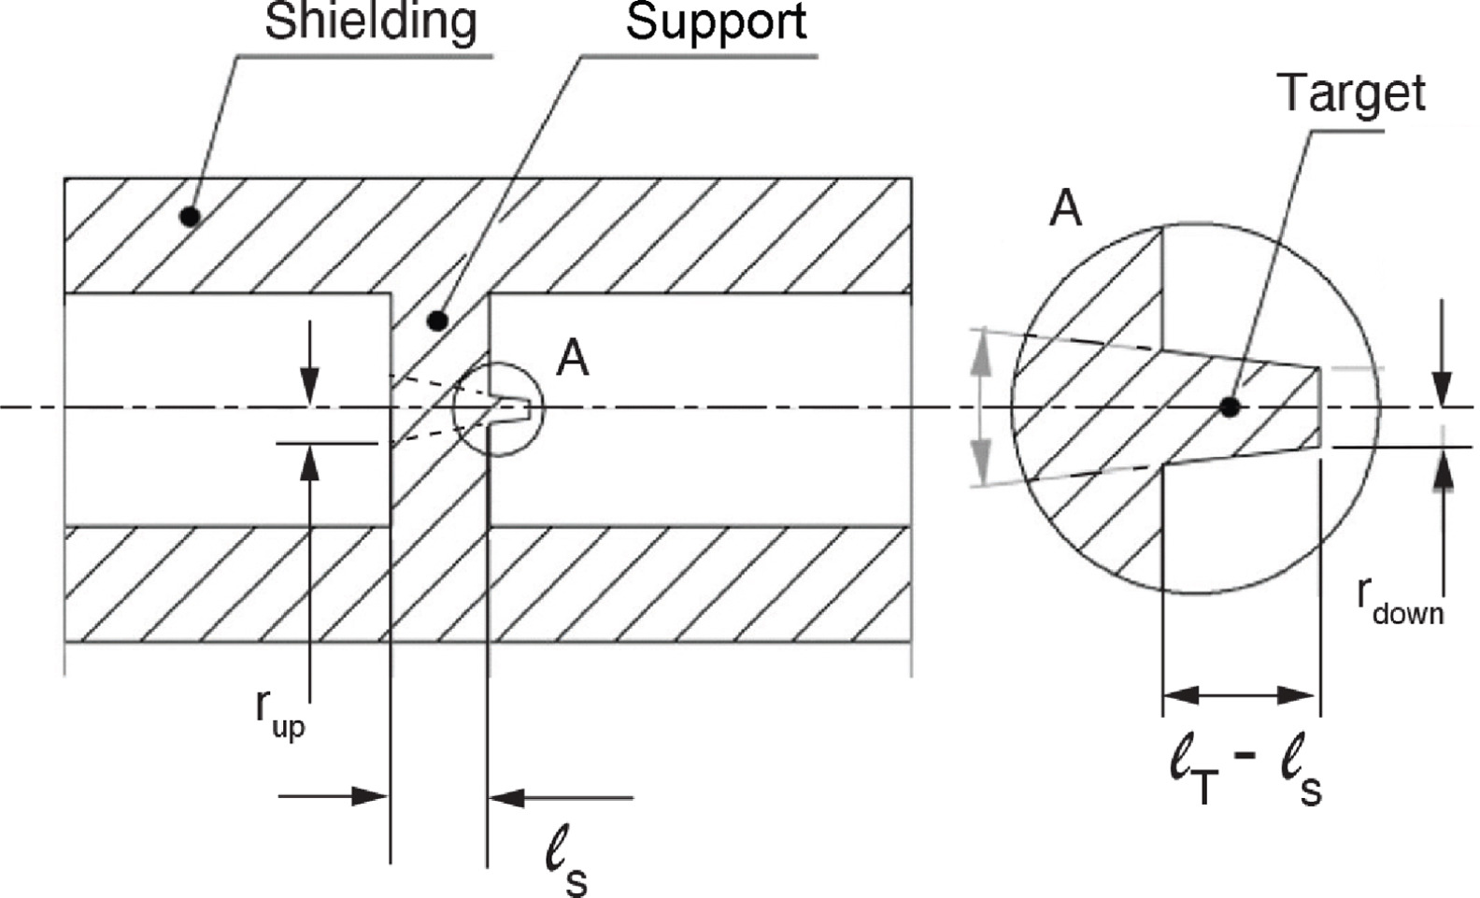
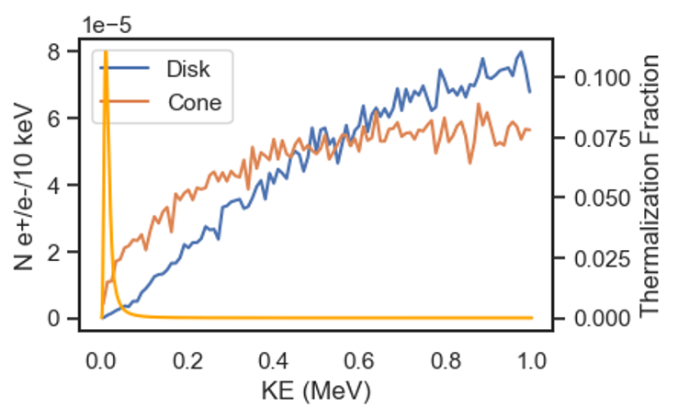
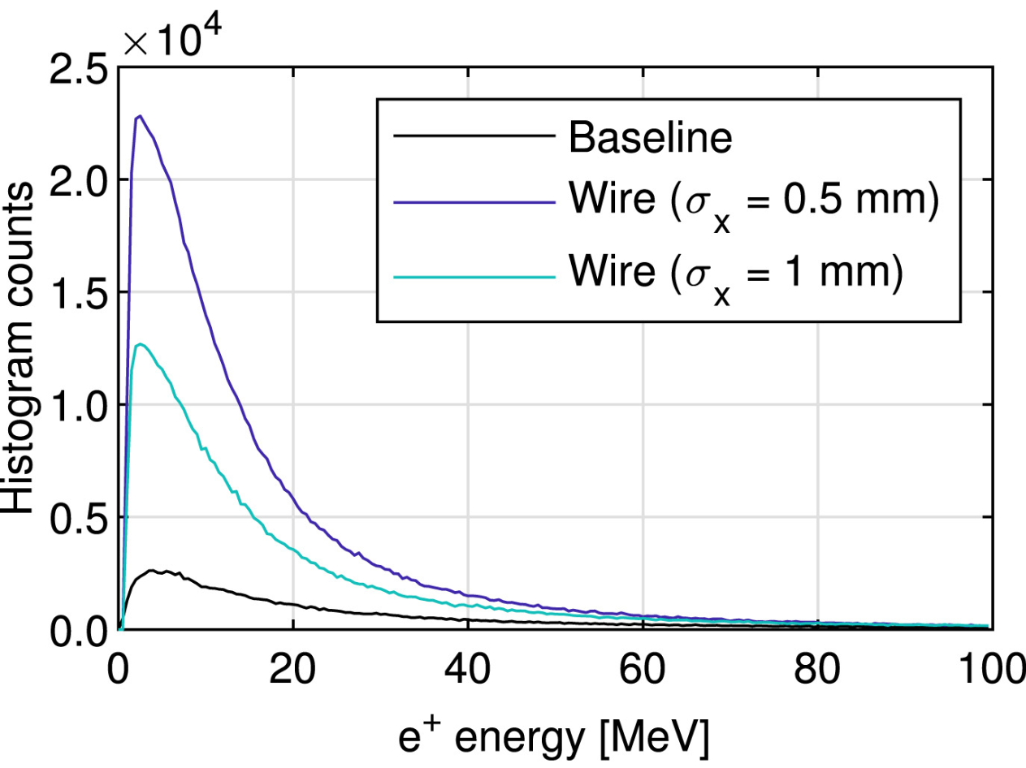
Further Target Possibilities
Conical targets for enhanced high-current positron sources
Vallis et al., Nuclear Instruments and Methods in Physics Research B 568 (2025) 165854
Alternatively, for low(er) energy drive: Inverse conical target
e-
e-, e+, gamma spray
Reemitted Fraction
Part of this improvement is due to being in a high magnetic field

Slide 24
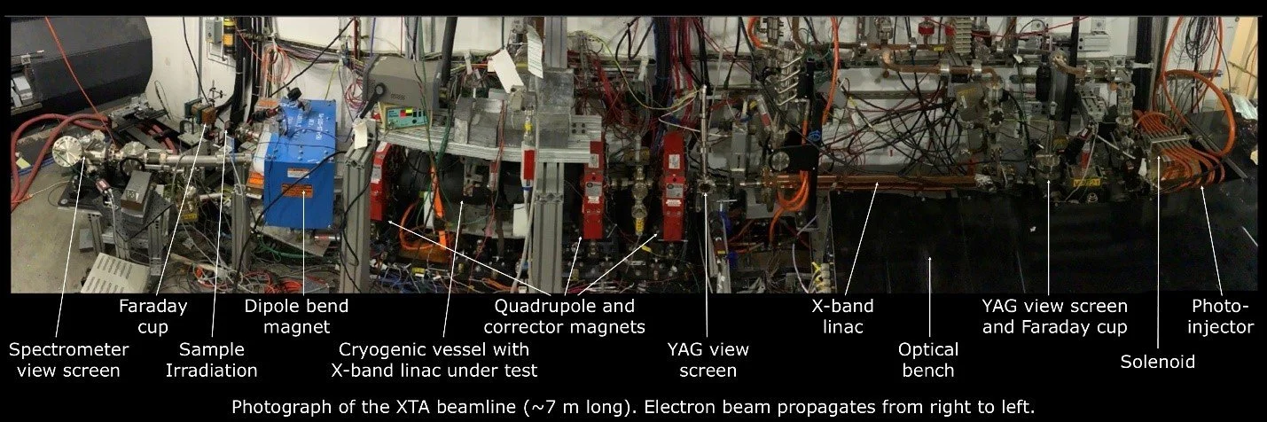
The XTA Accelerator at SLAC is our Testbed for Positron Experiments
e- beam direction
XTA can provide a 65 MeV, 100 pC, 30 Hz e- beam with <10ps pulse length

Slide 25
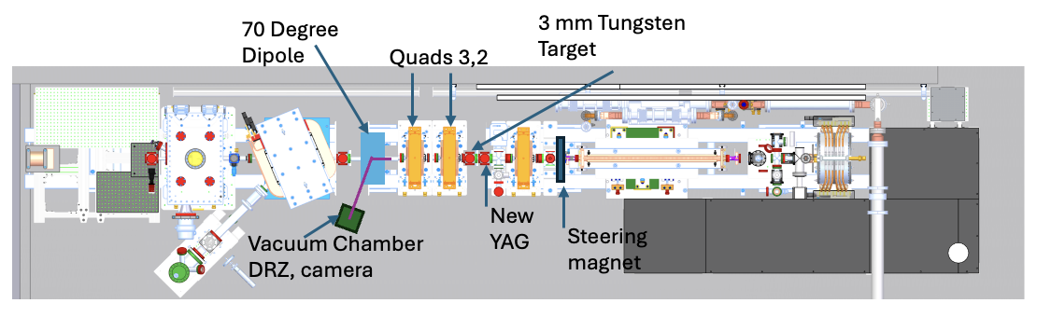
Initial XTA Facility Positron Upgrade
Positron Energy: 1-5 MeV Spot Size: 10 mm x 50 mm
Pulse length: <100 ps Charge: 1 fC/s - 30 fC/s (1e5 e+/s)
XTA can provide a 65 MeV, 100 pC, 30 Hz e- beam with <10ps pulse length (<0.5 W)

Slide 26
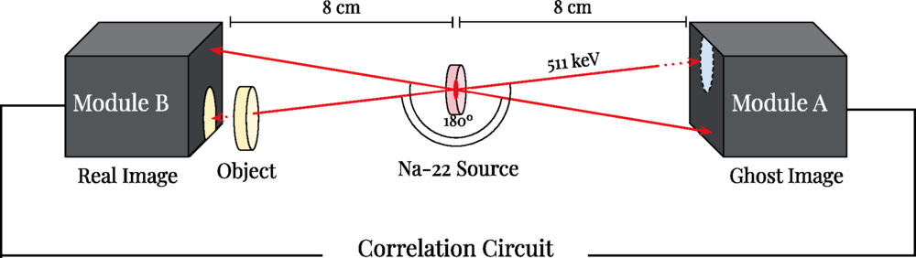
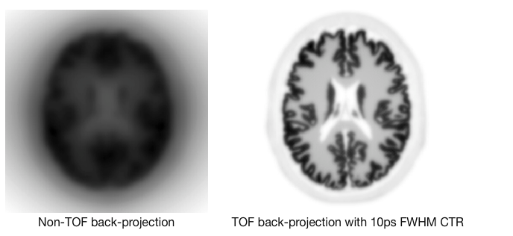
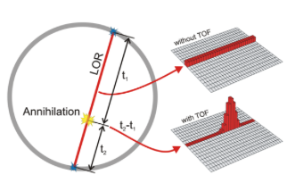
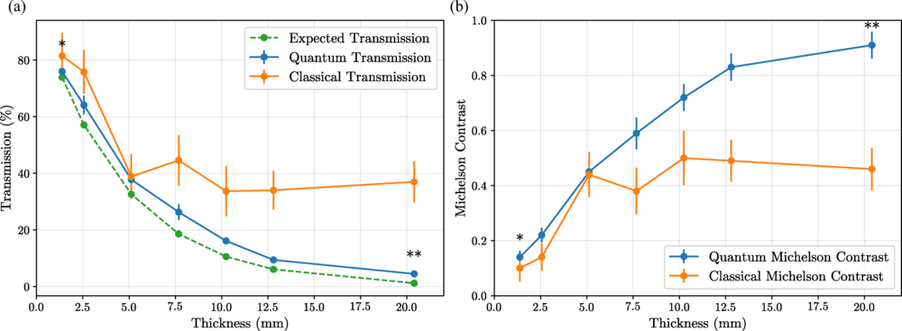
First Science with the SLAC Compact Positron Source
Time of Flight PET Detectors
Ghost Imaging with Gamma Rays
10 ps Time of Flight resolution for PET detectors would enhance the SNR, enabling lower dose and quicker measurements
Utilizing the entangled nature of the emitted gamma rays enables imaging of dense materials
Utilize well-timed positrons.
Schneider et al., Phys. Rev. A 113, 013715 (2026)
Notes:
One big issue with detector testing: radioisotope sources are not timed
which either reduces measurement time or radiation dose requirements - next generation PET

Slide 27
Roadmap for a SLAC Positron Facility
Phase 1: MeV Positron Source
Phase 2: Ultrashort Positron Bunches
Phase 3: Ultrashort, High Brightness Positron Facility
Utilize existing infrastructure to generate 100 ps positron bunches.
Enable PET detector, ghost imaging, and basic positron studies.
Utilize magnetic and RF bunching to create sub-picosecond positron pulses.
Enable pump-probe positron science.
Utilize historic SLAC infrastructure to enable average power, high peak power positron source.
Enable pump-probe positron diffraction, laser-cooled positronium electron positron pair plasma studies.
Notes:
Imminently: 1-5 MeV positron production, low current, high emmitance
Nearterm upgrade: Ultrashort bunches
Far Far upgrade: Bright positron source for pump-probe e+ diffraction

Slide 28
Takeaways:
At the XTA beamline at SLAC, this could provide a positron source of up to 1e6 e+/s, comparable to radioactive source capabilities, in a <100 ps pulse
Tailoring the e+ energy spectrum is a promising way to increase slow positron source conversion efficiency, but requires experimental validation of our moderator models
In the near term, positron production at SLAC will enable testing of
novel PET detectors, high SNR ghost imaging
positron targets and moderators

