Slide 1


Low-energy Monochromatic High-intensity High-brightness Positron Source in the LERF and its Possible Applications
Branislav Vlahovic (North Carolina Central University) Bogdan Wojtsekhowski (Jefferson Lab) Guy Ron (Hebrew University of Jerusalem) Joe Grames (Jefferson Lab) Maxim Eingorn (North Carolina Central University) Patrick Flanigan (North Carolina Central University) Shizhong Yang (Southern University and A&M College)
Yongqiang Wang (Los Alamos National Laboratory)
Serkan Golge, NCCU.
Steve Benson JLab
mA
Center for Advanced Studies of Accelerators and Radiation Control Group at JLab, Dr. M. Tiefenback, Dr. B. Barbiellini, and Professor A. Mills
S. Golge, B. Vlahovic, and B. Wojtsekhowski, J. Appl. Phys. 115, 234907 2014). https://doi.org/10.1063/1.4884781

Slide 3

Budget and support from other institutions
Needed is $4M for positron beam (stage 1 of the project) and about $3M for laboratory infrastructure (if only existing space will be used, no new building)
After NSF approval, additional funding from the NCCU existing grants up to $300K could be used
Probable support from NCCU NASA-URC program up to 1M for this project
All participating universities will contribute toward building laboratory experimental infrastructure
Funding up to $4M through MRI is possible
DOE Material Science Division (likely support, according to Prof. Bansil, who is a former program manager of Theoretical Condensed Matter Physics division at DOE)
Industry support, listed are just a few that submitted letters of support: IBM, Boeing, Northrop Grumman, Lockheed Martin Corporation, Intel

Slide 4
Outlook
Motivation – Create the unique center for positron science
The most intense and the highest brightness positron beam
Comparison LERF vs. other facilities
How it would be achieved
What is already done and pathway to the completion
Why it is needed
Possibilities that it opens, impact on science and industry
Conclusion

Slide 5
Existing slow positron facilities (T₊ < 30 keV)
Radioisotope-based slow positron facilities:
Positron emitting isotopes ²²Na (t_{1/2}=2.6 yr), ⁵⁸Co (t_{1/2}=71 d), ¹⁸F (t_{1/2}=109 min)
Disadvantages: Low-intensity (<10⁶ slow e⁺/s)
Reactor-based slow positron facilities:
Positrons are produced via pair-production from the emission of high energy prompt γ-rays after thermal neutron capture i.e. ¹¹³Cd (n, γ) ¹¹⁴Cd
Operational: PULSTAR at NCSU (~ 6x10⁸ slow e⁺/s, projected 1-3 x 10⁹ slow e⁺/s)
NEPOMUC Munich Reactor Positron Source (>10⁹ moderated e⁺/s at 1 keV, and for the remoderated beam 5×10⁷ e⁺/s with about 1.85 mm FWHM)
Electron linac-based slow positron facilities:
Positrons are produced via pair production from bremsstrahlung photons
Operational: KEK’s Slow Positron Facility ~ 10⁸ e⁺/s, Elbe Positron Source (EPOS) in Germany. Projected ~10⁸ slow e⁺/s
Advanced Industrial Science and Technology (AIST) in Japan. Achieved ~10⁷ slow e⁺/s

Slide 6
The most intense positron sources

Slide 7

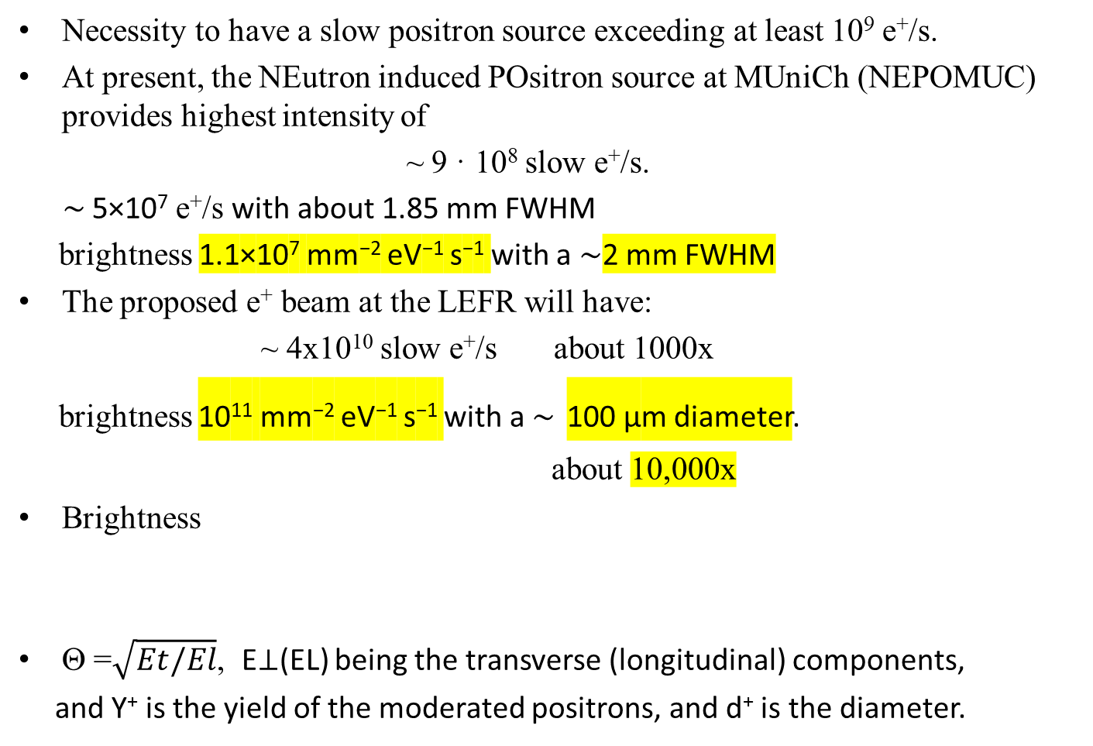
Comparison of e⁺ beams
Necessity to have a slow positron source exceeding at least 10⁹ e⁺/s.
At present, the NEutron induced POsitron source at MUniCh (NEPOMUC) provides highest intensity of
~ 9 · 10⁸ slow e⁺/s.
∼ 5×10⁷ e⁺/s with about 1.85 mm FWHM
brightness 1.1×10⁷ mm⁻² eV⁻¹ s⁻¹ with a ∼2 mm FWHM
The proposed e⁺ beam at the LEFR will have:
~ 4x10¹⁰ slow e⁺/s about 1000x
brightness 10¹¹ mm⁻² eV⁻¹ s⁻¹ with a ∼ 100 μm diameter.
about 10,000x
Brightness
Θ =$\sqrt{Et/El}$, E⊥(EL) being the transverse (longitudinal) components,
and Y⁺ is the yield of the moderated positrons, and d⁺ is the diameter.

Slide 8
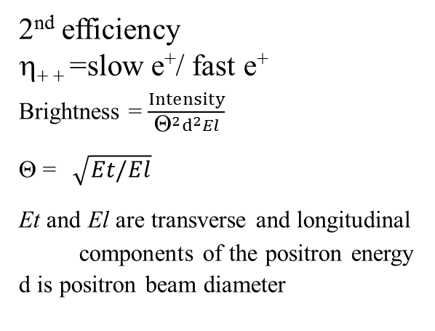
Production stages of slow positrons at accelerators
Linac
High energy e⁻ beam
1st efficiency
η₊ =e⁺/ incident e⁻
Converter
Metallic W, Ta
η₊ ₊ =slow e⁺/ fast e⁺
= 10⁻⁴ − 10⁻³
Rare Gas (RGM)
solid Ne moderator
η₊ ₊ = 7×10⁻³−1.4×10⁻²
e⁺ ~ < 5 MeV
2nd efficiency
η₊ ₊ =slow e⁺/ fast e⁺
Brightness = $\frac{Intensity}{Θ^{2}d^{2}El}$
Θ =$\sqrt{Et/El}$
Et and El are transverse and longitudinal
components of the positron energy
d is positron beam diameter
Moderator
e⁺ ~ 1-2 eV
Electrostatic extraction,
remoderation,
and focusing
e⁺ ~ 1-30 keV
Sample
Monoenergetic beam with a spot size Ø < 0.1 mm.

Slide 9
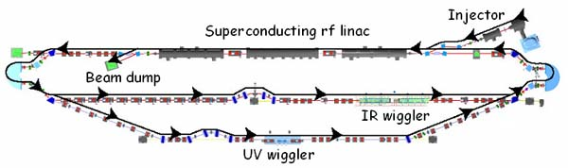
Why Free Electron Laser (LERF) at Jefferson Lab (JLab) ?
Existing facility
Variable time structure from the photo-gun
The intensity of electron beam on e⁻ - e⁺ pair conversion target up to 1 mA at 120 MeV or 10 mA at 10 MeV
High quality of electron beam

Slide 10
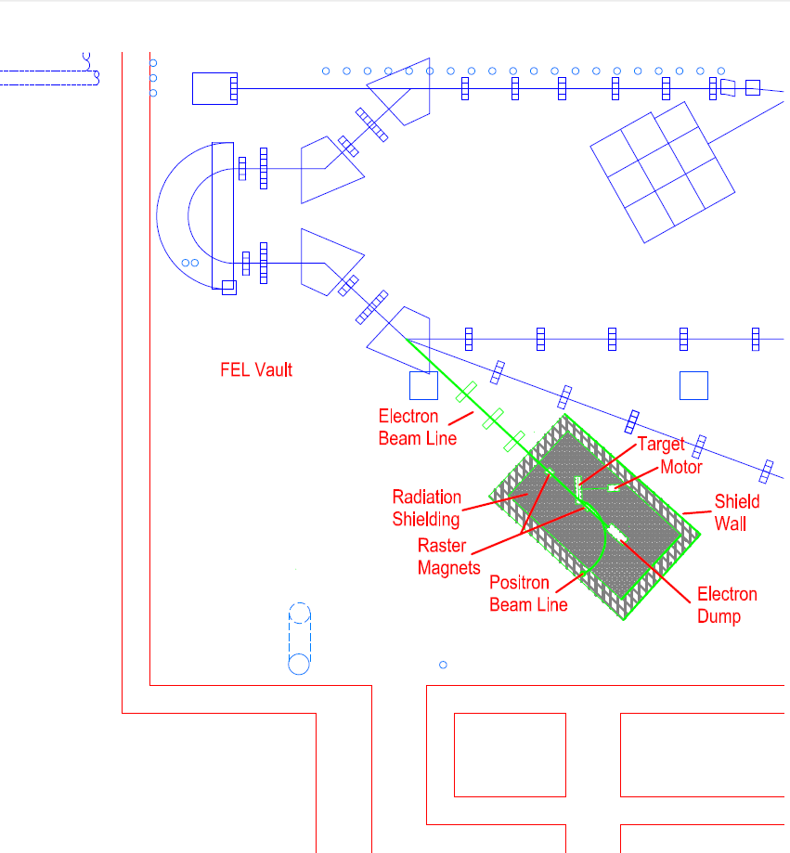
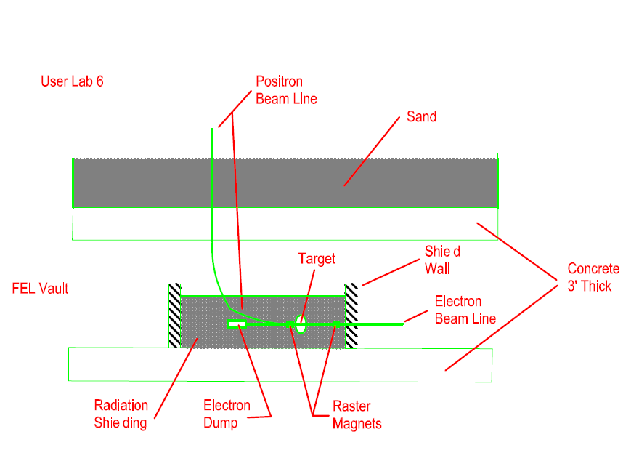
Proposed location in the LERF vault
(Left) A new (3rd) port next to the IR-UV beamline that will enable e⁻ beam to be sent to the positron converter target.
(Right) Collected e⁺ will be transported vertically to the User Lab-6 (~ 20 x 30 ft²) for moderation and physics experiments.

Slide 11
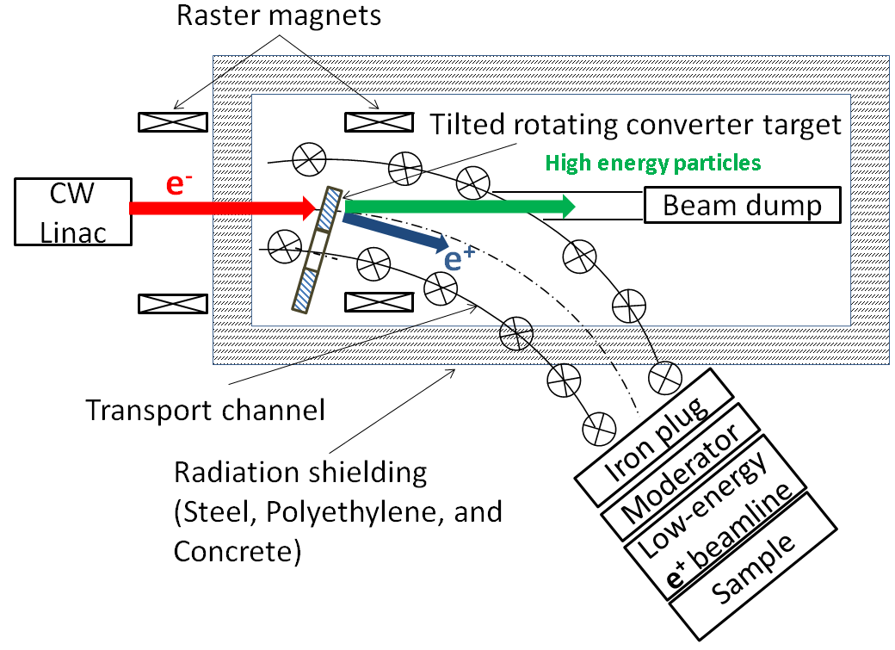
Conceptual design of the positron source at the FEL
Concept: The concept in our design relies on transport of positrons (T₊ below 600 keV) from the converter to a low-radiation area for moderation in a high-efficiency cryogenic rare gas moderator.
Key features:
Incident e⁻ beam: 120 MeV – 0.25 mA (30 kW)
Rotating electron-positron converter
Synchronized raster magnets
Solenoid transport channel
Beam-dump (~ 8 kW)
Radiation shielding of the converter area
Extraction to a magnetic field-free area
High-efficiency solid-Ne moderator
Micro-beam formation via remoderation
*The illustration is not to scale.

Slide 12
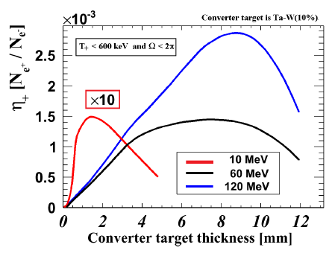

Optimized energies of the emitted positron and driving electron beams
GEANT4-based software, G4beamline
90% tungsten
10% tantalum
8 mm thick converter + ∽ η₊=3 × 10⁻³ e⁺/ e⁻
p_{x}/p_{z} up to ±1.5 rad (±86 degrees)
≈2 kG=0.2 T
for 6 cm inner
diameter solenoid channel

Slide 13
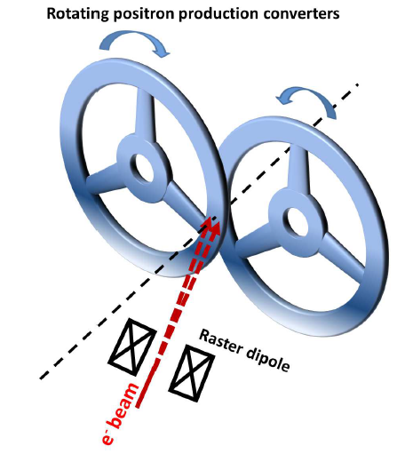
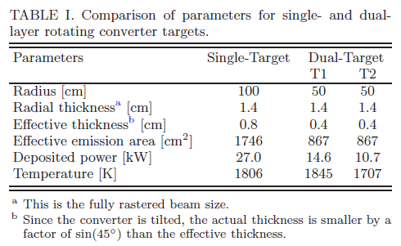
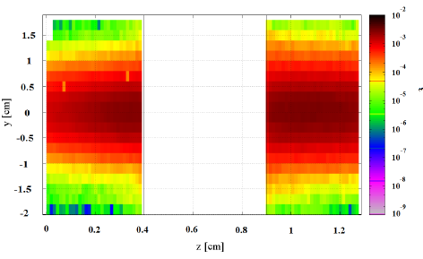
Converter
Tilted 45º
Raster size 1.4 cm
Raster reduces b e⁺ bem intensiti for
about 12%
Energy deposition density in a dual target with abotal 8 mm converter thickness from a FLUKA simulation is shown. There is a 5 mm gap between converters. The incident e− beam momentum is 120 MeV/c.

Slide 14
Transportation of e⁺ to the moderator
Bending radius of 4 m
Total arc length ~ 4.2 m
Arc angle 60º
B_{z}=2 kG

Slide 15
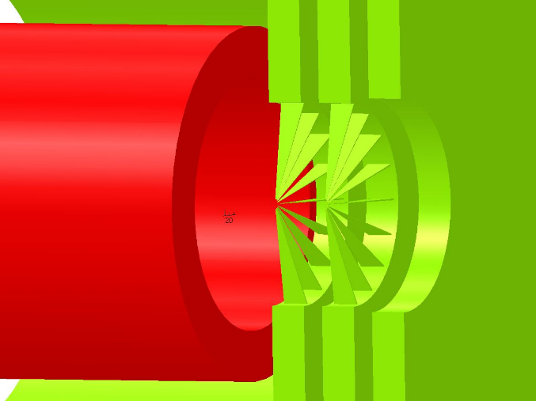
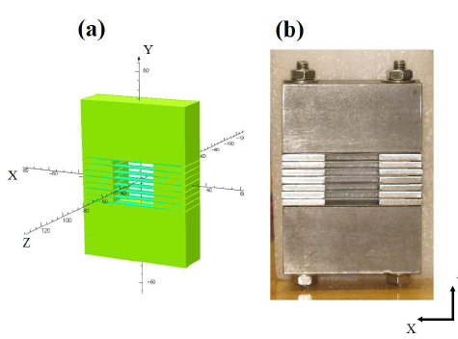
Prototype magnetic field terminator plug
(a) OPERA-3D (TOSCA) simulation model and
(b) manufactured prototype magnetic
plug are shown. The scale in (a) is in units of mm.
two nested wedge structures, 18 wedges in the in-
ner structure and 10 in the outer,
with the outer jacketa cylindrical extension
wedge thickness varies from 150 μm to 15 μm at the center. 2 mm wide diameter hole

Slide 16
Monte Carlo simulation of the positron beamline
η₊ ₊ ∼ 5×10⁻⁴ e⁺/e⁻
For 1 mA beam
3.1 × 10¹² e⁺/s
spot size of 8 mm
Moderator
η₊ ~ (0.7-1.4)%
(2.2 − 4.3) × 10¹⁰ e⁺/s with T₊ = 1-2 eV.

Slide 17
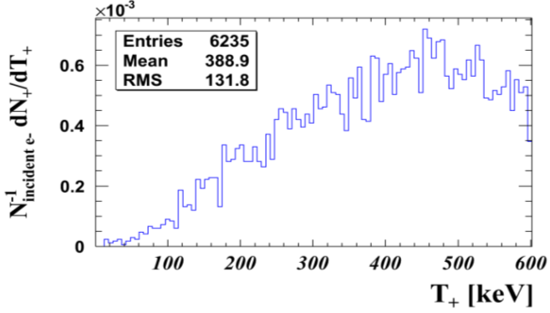



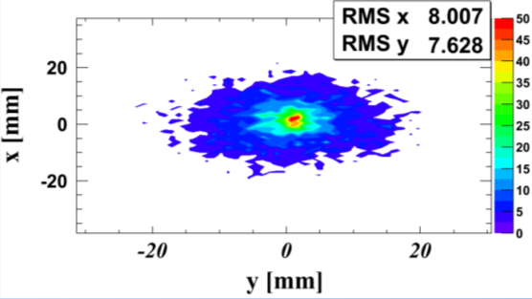
Moderation of positrons
The positron implantation profile in solids - Makhovian distribution,
The probability of a thermalized positron diffusing back to the surface
z is the distance from the surface, n=1.6, m=2.0, and A=4.0 μg/cm2.
The diffusion length L₊ = (D₊τ)^{1/2} 0.5 − 1 μm, where τ)is the mean lifetime of positrons
Kinetic energy of the positrons after the iron plug.
We used GEANT4 low-energy physics data to perform
Monte Carlo simulations and estimated the reemission probability.
The reemission probability for positron energies
with z_{av} = 1 μm, ~35%, and z_{av} = 5 μm, ~25%.
The transverse spot profile of the positron beam on the moderator. T₊<600 keV.

Slide 18
Estimated moderator thickness
We applied reemission probability - Any positron that reaches ≤30 keV energy and is within 5 μm of the surface has a 30% chance of being reemitted as a slow positron.
This number comes from the measured efficiency of solid‑neon moderators in the 1986 experiment Mills and Gullikson.
Extending the same setup and method for our electron-linac driven positron source in our Monte Carlo simulations, we have estimated the required thickness of the moderator to slow down fast positrons and obtain the same moderator efficiency.

Slide 19
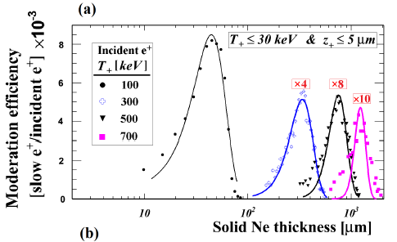
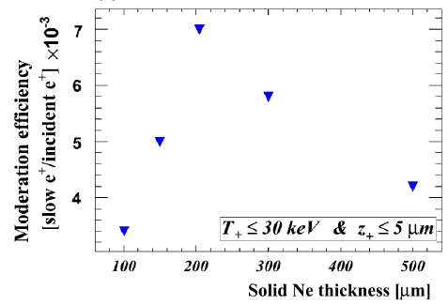
When compared against the efficiency obtained with the 100 keV positron beam, the 300 keV provided about a factor of 8, the 500 keV a factor of 16, and 700 keV provided a factor of 20 less moderation efficiency.
The 100 keV beam has an optimum moderation thickness of 30 μm whereas, the 700 keV has 1050 μm.
0.7%, is obtained with 210 μm
Solid Ne thickness for our beamline should be in the range of 100-400 μm.

Slide 20
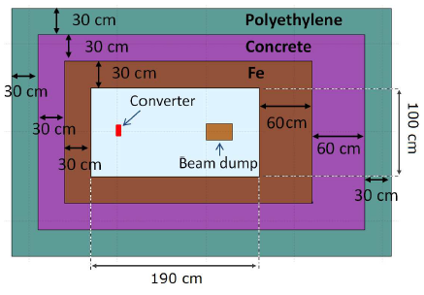
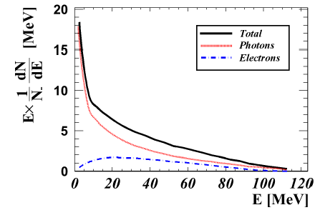

Slide 21
Why positrons ?
e⁺ diffraction limit is shorter than that of relevant energy photons --> atomic resolution
e⁺ interaction cross-section is greater than that for X-rays --> stay near the surface
e⁺ attracts into while e– repels from the material -> big advantage over TEM/AFM, for early stage material degradation monitoring, for single molecule detection, etc.
e⁺ can be traced inside the material while e– is getting lost inside the “electron sea”
e⁺ directly probes the electronic structure of metals and metallic compounds, positron annihilation (PA) with outer-shell electrons provides a direct image of the Fermi surface
e⁺ interacts with collective excitations --> molecular resonances in gases, vibrations in liquids and solids, delocalized and/or localized electronic states, defects in materials
e⁺ can probe surfaces and interfaces --> depth-profiling studies, 3D imaging of defects
e⁺ can form Ps in insulator materials, or in (e⁺-e–) scattering reactions:
Ps in vacuum --> a unique tool for advanced QED models testing
Ps in material --> unaffected by Coulomb interaction (neutral !!), very sensitive to internal vibrations, has negative work function and tends to enter micro-cavities, probes free volume type defects and porosity (mechanical stability !!) of dielectric materials, including biological materials (e.g., living tissue), biopolymers, etc.

Slide 22
Slow positron beams in solid state physics and materials science
positron lifetime and (coincident) Doppler broadening spectroscopy
the depth dependent analysis of vacancy-like defects and their chemical
surrounding
annihilation induced Auger-electron spectroscopy
surface studies, the analysis of the elemental composition in the topmost
atomic layer
positron diffraction and reflection - the atomic positions at the surface with outstanding accuracy
low-energy positronium beams with narrow band width– for surface science and fundamental experiments, e.g. production of cold positronium or positronium negative ions, Ps Bose-Einstein condensate, anti hydrogen atoms, QED fundamental tests

Slide 23
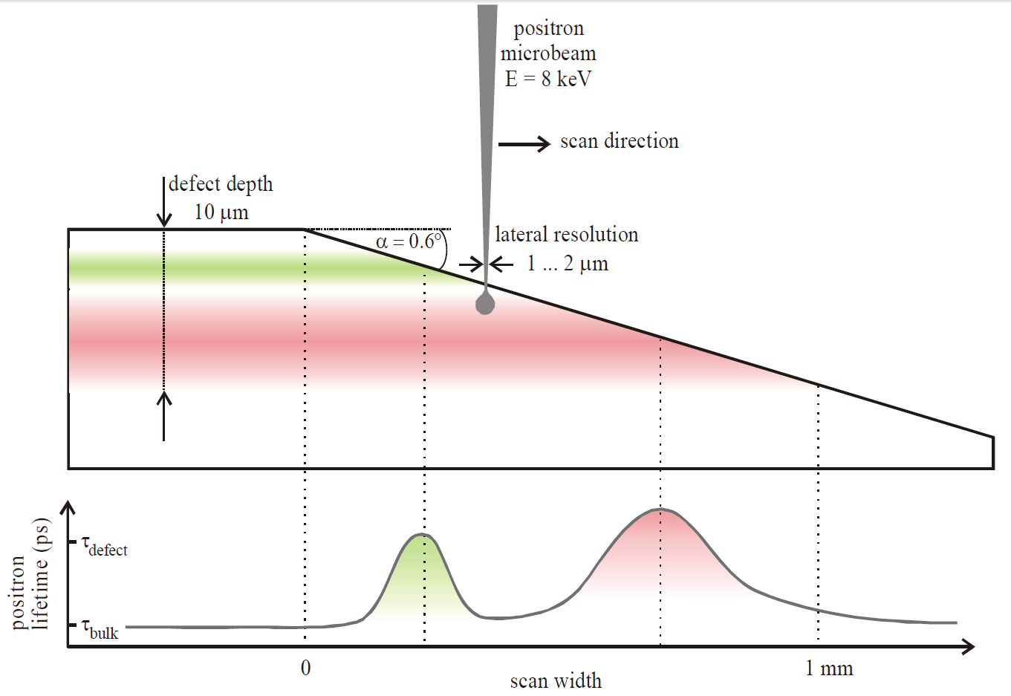
Surface Defects Depth Profiling
With 1-2 μm diameter positron beam directed on the sample, slow positrons are getting trapped by surface defects as they are moving and losing their energy inside the sample. They stop completely in about 10 μm thick surface layer and then annihilate on defects. Their lifetime reflects the defect electron density and the surface defect depth profile:
Metals, alloys, semiconductors >> characterization of surfaces, early stage material degradation, voids, vacancies, substitution defects, etc.
Insulators (Ps forms !!) >> characterization of free volume type defects, porosity, momentum relaxation, phonons, magnetic quenching, ortho-para-conversion, etc.
*Picture courtesy of R. Krause-Rehberg, EPOS, Dresden Germany

Slide 24
Difference between electron and positron refraction and reflection

Slide 25
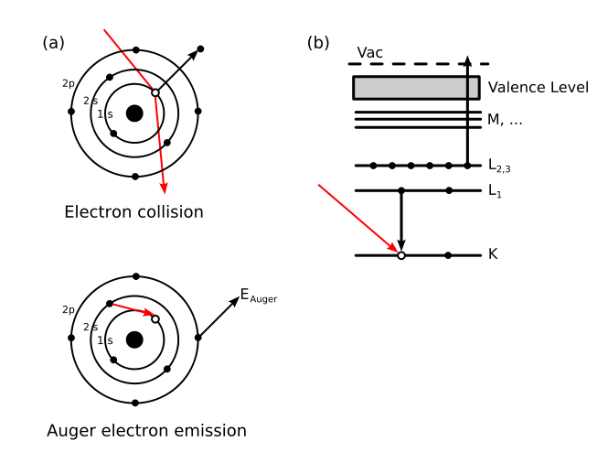
Difference Between Electron and Positron Auger Spectroscopy

Slide 26
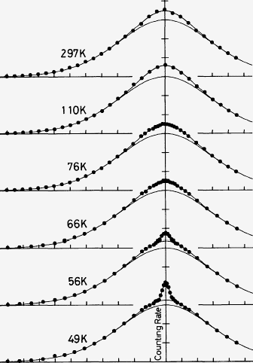
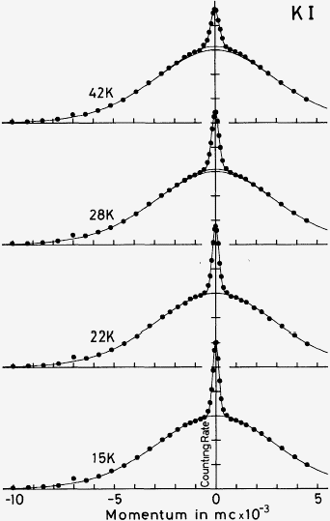
Detection of Ps in dielectric crystals
Schematic of 1D-ACAR experiment
z
D1
D2
Ps
y
x
Typical 1D-ACAR spectra
of Ps in ionic crystals
Kasai, Hyodo & Fujiwara, J. Phys. Soc. Jpn. 57 (1988) 329

Slide 27
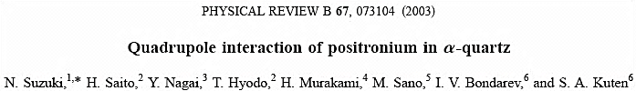
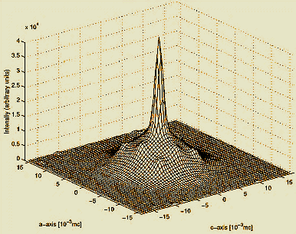
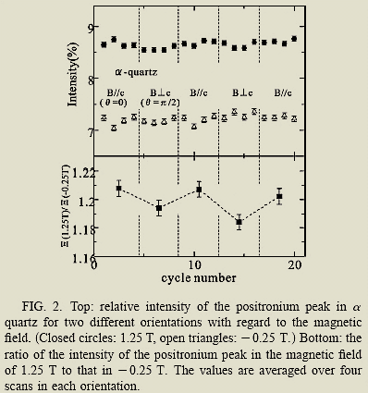
Ps interactions in non-cubic crystals
Schematic of 2D-ACAR experiment
D2
D3
Ps
D1
1.25 T
-0.25 T
d = Q_{Ps}V_{zz} = (3 ± 0.9) ×10⁻⁵ eV

Slide 28




TPE, proton radius, and where positronium 1³S₁ → 2³S₁ fits
Recommended framing: positronium does not measure rₚ directly; it supplies a proton-free Rydberg constant that constrains the allowed proton-radius solutions
1) Scattering tension: Gₑ/Gₘ and two-photon exchange
2) Atomic puzzle: hydrogen mixes R∞ and rₚ
3) Our proposal: Ps 1³S₁ → 2³S₁ gives R∞(Ps)
A long-standing disagreement appears in proton form-factor extractions from unpolarized and polarization measurements.
Hard two-photon exchange (TPE) is a leading explanation because it modifies the scattering cross section in a way that can bias extracted form factors.
At low Q², the slope of Gₑ sets the proton charge radius, so scattering-systematic issues propagate into rₚ.
Hydrogen spectroscopy depends on both the Rydberg constant and the proton finite-size term.
That coupling is why the proton-radius puzzle is also a spectroscopy problem, not only a scattering problem.
An independent measurement of R∞ helps disentangle the two.
Positronium contains no proton, so it does not measure the proton radius directly.
Instead it gives a proton-free Rydberg constant in a purely leptonic QED system.
Combining R∞(Ps) with H or μH indicates which proton-radius solution is more consistent with a clean leptonic anchor.
ordinary hydrogen:
0.8406(15) fm
muonic hydrogen: 0.84087(39) fm
r_{p}​≈0.887±0.012 fm Mainz
r_{p​}=0.831±0.007_{stat}​±0.012_{syst​} fm
Ps spectroscopy provides an independent constant, not a direct radius.
Hydrogen alone ties R∞ and rₚ together.
Supplementary slide for JLab Ps proposal
Notes:
[Sources] - Review of the proton form-factor discrepancy and its relation to two-photon exchange: https://arxiv.org/pdf/1105.0951 - Review of the proton charge radius and spectroscopy/scattering extractions: https://link.aps.org/doi/10.1103/RevModPhys.94.015002 - Positronium review for the role of a Ps-derived Rydberg constant in the proton-radius discussion: https://www.sciencedirect.com/science/article/pii/S0370157322001508

Slide 29
Positron lifetime and (coincident) Doppler broadening spectroscopy
Near surface or depth and/or laterally resolved lattice defect analysis, vacancy-like defects and their chemical surrounding - single vacancy concentrations as low as 10⁻⁷ vacancies per atom
Positron Annihilation Lifetime Spectroscopy (PALS) – determines electron density at the annihilation site - depth dependent
characterization of free volume in thin polymers or to identify the species of vacancies in thin films
Doppler-Broadening Spectroscopy (DBS) - of the positron electron annihilation line - imaging defect distributions, spatial
distribution open-volume defects
Coincidence DBS (CDBS) – measuring energy of both gamma quanta - determines longitudinal momentum of the electron
- chemical surrounding of open volume defects or the presence of precipitates in thin layers or near the surface
- element selective analysis of metallic cluster, structure and defects in the near surface region, thin films, multi-
layers, and interfaces few nm to mm
Angular Correlation of Annihilation Radiation (ACAR), the angular deviation of the 180° collinearity of the two annihilation
gamma quanta – to derive the transversal momenta of the electrons to study the electronic structure of matter, valence
electrons
Depth-Dependent ACAR and 2D-ACAR - to analyze the electronic structure in thin layers and to observe the evolution of
the Fermi surface from the bulk to the surface
Age-Momentum Correlation (AMOC, 2D-AMOC, 4D-AMOC), positron lifetime and the Doppler-shift are detected
simultaneously for each annihilation event, determines longitudinal electron momenta and the defect types with its
respective concentrations, detects the defect type and the chemical vicinity of the annihilation site

Slide 30
Low-energy positron and positronium (Ps) beams with narrow band width
For surface science and fundamental experiments, e.g. production of cold positronium or positronium negative ions, a neutral positron electron pair plasma, positronium negative ion Ps⁻, Ps₂ molecule
Positron Annihilation Induced Auger-Electron Spectroscopy (PAES) is applied for element selective surface studies of the topmost atomic layer, elemental composition of 3-10 atomic layers, element distribution at surface defects such as vacancies which play a major role in heterogeneous catalysis, examination of organic molecules weakly bound to surfaces, non destructive
Time dependent PAES enables the investigation of dynamic processes at surfaces such as segregation and surface alloying, surface segregation in situ, stability of small (magnetic) structures on surfaces, in thin membranes, e.g. applied in fuel cells, or for thin film applications such as heterogeneous catalysis, ultrathin surface coatings, and surface corrosion
Low-Energy Positron Diffraction (LEPD) and (Total) Reflection High-Energy Positron Diffraction ((T)RHEPD) - for surface structure determination studies of the topmost atomic layer, determination of the atom positions of (reconstructed) surfaces with outstanding accuracy, all kinds of surfaces, 1D and 2D structural, buckling of 2D systems such as graphene and silicene, phase transitions of overlayers and self-assembled organic molecules at surfaces to understand extraordinary electronic structure

Slide 31
Low-energy positron and positronium (Ps) beams with narrow band width
For surface science and fundamental experiments, e.g. production of cold positronium or positronium negative ions, a neutral positron electron pair plasma, positronium negative ion Ps⁻, Ps₂ molecule
Positron Annihilation Induced Auger-Electron Spectroscopy (PAES) is applied for element selective surface studies of the topmost atomic layer, elemental composition of 3-10 atomic layers, element distribution at surface defects such as vacancies which play a major role in heterogeneous catalysis, examination of organic molecules weakly bound to surfaces, non destructive
Time dependent PAES enables the investigation of dynamic processes at surfaces such as segregation and surface alloying, surface segregation in situ, stability of small (magnetic) structures on surfaces, in thin membranes, e.g. applied in fuel cells, or for thin film applications such as heterogeneous catalysis, ultrathin surface coatings, and surface corrosion
Low-Energy Positron Diffraction (LEPD) and (Total) Reflection High-Energy Positron Diffraction ((T)RHEPD) - for surface structure determination studies of the topmost atomic layer, determination of the atom positions of (reconstructed) surfaces with outstanding accuracy, all kinds of surfaces, 1D and 2D structural, buckling of 2D systems such as graphene and silicene, phase transitions of overlayers and self-assembled organic molecules at surfaces to understand extraordinary electronic structure

Slide 32
Proposed Physics Projects
Metals, Alloys, Surfaces & Interfaces
The PA technique provides a direct image of the Fermi Surfaces
of metals, alloys and semiconductors
the Fermi surface, the most important fundamental property of the electronic structure of metals, alloys and semiconductors can be measured directly
surface defects created by mechanical friction, their surface depth distribution, defects created thermally, or by applying external pressure, can be characterized
electron hyperfine coupling to local magnetic clusters, electron spin conversion, magnetic phase transitions can be detected
near-surface structural changes, early stage corrosion of iron, radiation damage and recovery in reactor steels and UO₂ can be monitored
many more prospective applications…………………..
for NAVY and INDUSTRY related applications
UT-Arlington will lead this project in collaboration with NEU & NCSU

Slide 33
Proposed Physics Projects
Semiconductors, Polymers, Biological Systems
PA studies of surfaces and interfaces of semiconductor heterostructures, formation of defects and their time evolution, controlled defect engineering
PA detection of sizes, surface composition and structure of semiconductor nanocrystals down to below 10 nm, confinement on valence electron states
PA studies into low/high dielectric constant insulators (key components in high-speed nanoelectronics and chip manufacture)
Positronium atom is a unique probe of pore size, voids, geometry and connectivity of pore channels in polymeric and other insulator materials
for understanding device operational functionality & fabrication techniques
NCCU and NEU will lead the project; possible collaboration with Washington State
and UM-Ann Arbor
Positron and Positronium microscopy of biological systems, 3D-imaging of single biomolecules on organic membranes, human skin and tissue samples testing for the presence of cancerous cells or other surface tissue modifications caused, e.g., by oxidation
for understanding biological mechanisms of human cells modifications
UM-Kansas City will lead the project;
possible collaboration with UM-Ann Arbor

Slide 34
Proposed Physics Projects
Electron-positron plasmas, Bose condensation
Electron-Positron Plasmas
Relativistic e⁺-e– plasmas are important special class of plasmas that are relevant to astrophysical settings such as the magnetospheres of pulsars. The opportunity to create and study e⁺-e– plasmas using the high-flux positron facility would be of enormous benefit to this area of fundamental research
Related Many-Particle Quantum Systems
Positrons can probe strong multi-electron correlations in complex many-particle quantum systems such as transition metal oxides, Kondo systems, heavy fermion superconductors, elemental actinide metals
Positronium BEC is a striking fundamental phenomenon (Platzman&Mills, Jr., 90s) with very promising applications (e.g., γ-laser). Experiments will study Ps BEC response to external conditions, its coherent optical properties, other aspects of the dense Ps gas behavior, such as Ps₂ formation, etc., --- for better understanding of fundamentals and development of novel applications
Prospective Partners:
UC-San Diego, W&M, UC-Riverside, Columbia U, NCCU,
Washington State, UT-Arlington, UM-Ann Arbor

Slide 35
Proposed Physics Projects
Atomic Physics of Ps
Positronium Atom is a Unique Totally Neutral Particle-Antiparticle
Atomic System (all multipole moments are identical zeros!!)
Low-energy atomic physics of positronium is of fundamental interest
Experimentation with positronium is difficult due to relatively short Ps lifetime, corresponding atomic data are scarce, or unknown
Ps atom is known to scatter from a wide variety of atomic and molecular targets in the manner similar to that a bare electron does at a given collision velocity; physical reason for this similarity is not clear (looks like e⁺ in Ps is heavily screened from the target electrons by its own e–, but WHY ??..)
Knowledge of how Ps interacts with matter is crucial for better understanding of a variety of phenomena, ranging from interstellar clouds (environment in which positrons annihilate in outer space) to radiation dosimetry of the human body
University of College, London, U.K. (G. Laricchia) is the only place in the world
where the Ps beam currently exists…….

Slide 36
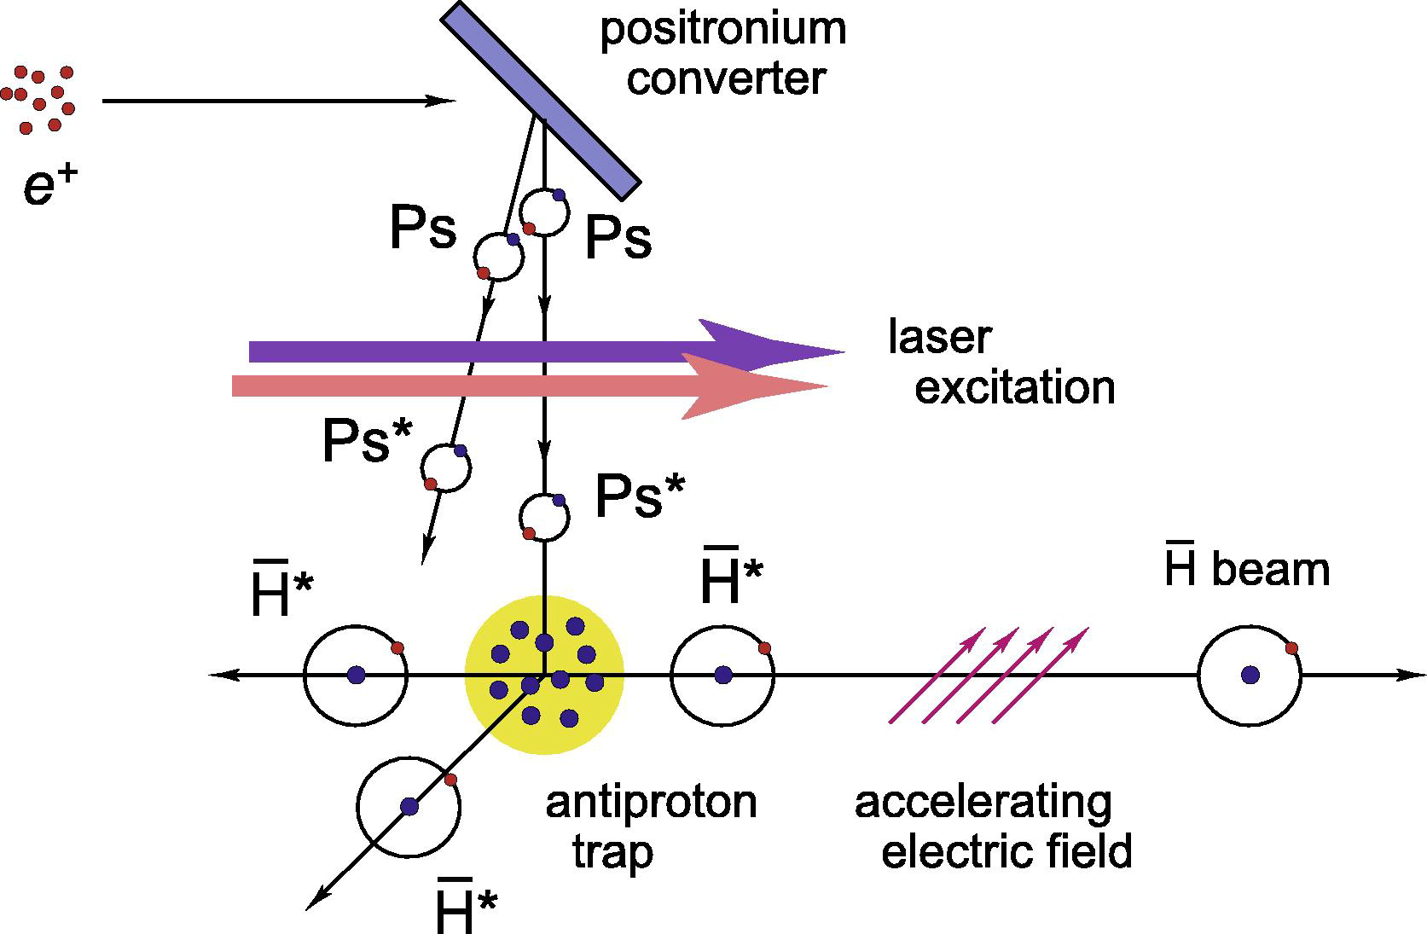
Proposed Physics Projects
Understanding Fundamentals of Nature
New Physics Beyond the Standard Model
Measurements of the ortho-Ps decay rate in vacuum with the highest possible precision are needed to test the 3γ-decay cross-section QED predictions
Currently running experiments have errors of at least two orders of magnitude
greater than the error of the theoretical value predicted by the QED
Discrepancy between the QED and the experiment may be explained by
i) extra-dimensions, ii) fractionally charged particles, iii) new particles
iv) dark matter of the mirror matter type
Anti-hydrogen atoms, spectroscopy of bound
leptonic systems
Test of gravity using anti-matter
Test of equivalence principle
Formation of Ps₂ molecule
create exotic molecules such as positronic water
creation of Ps Bose-Einstein condensates
Prospective Partners:
JLAB, UC-San Diego, W&M, UC-Riverside, Columbia U

Slide 37
Confluence of high demand LERF infrastructure and existing research programs
Nano technology with low dimensional systems (OD QD, 1D nanowires, nanotubes, 2D thin films) will be the most important technology in future
All industries will be affected photovoltaics, semiconductors, catalysts, superconductors, polymers, biological systems, batteries, etc.
The positron beams technique are the most powerful for such objects characterization, electron structure, energy levels, topography, dopants concentrations, etc…
The JLab LERF high quality electron beam after modest modification could be used to produce the most intense and highest brightness pulsed positron beam
Existing JLAB materials and physics programs will benefit: pulsed laser deposition,
polymer surface processing, polymer or fiber production, new friction, filtration, wetting,
or appearance characteristics, better adhesion for forming multicomponent film products
or composite structures, more effective fibers for use in filters, and improved feel of
synthetic fiber fabrics; carbon nanotubes, metal surface processing hardening, smoothing,
texturing, and improving the corrosion resistance of metals, electronic materials,
micromachining

Slide 38
Roadmap of consortium
Form a consortium board
monthly meetings
Conference at JLab
potential users
physics program
Colloquium/Seminars by prominent experts
Committee for experiments and beam time integrated with LERF PAC operation
Involve industry/NASA/NAVY and local government
Provision of expansion, e.g. a larger lab building

Slide 39
Conclusion
Utilize JLAB LERF to produce the most intense 4x10¹⁰ e⁺/s and the highest brightness 10,000 times more than elsewhere.
Create unique center for positron fundamental and applied research
There is strong interest in academia and industry, both willing to support program
The project is in alignment with existing CEBAF and LERF research
Significant work is already completed and there is no any technical difficulty to realize the program
The cost is modest and could be easily achieved

