Slide 1
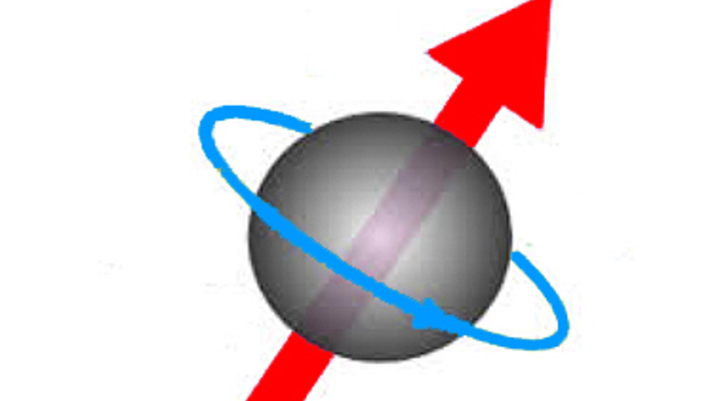
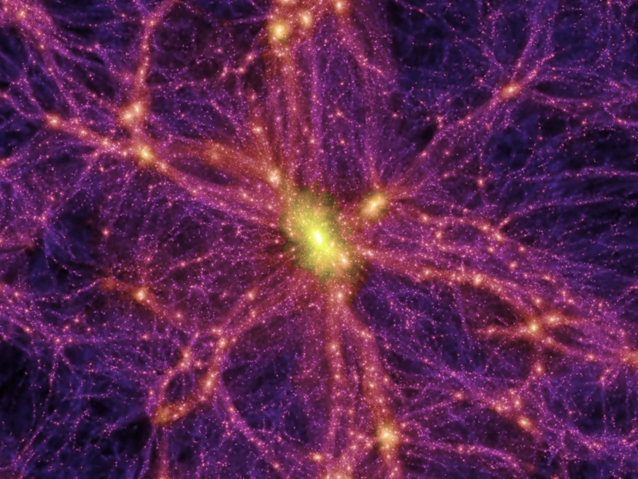
High Precision Fundamental Physics Experiments with
Particle Accelerator Compact Spin-transparent Storage Rings
of Low-energy Polarized Electron / Positron Beams
Vladimir Khachatryan Riad Suleiman
Mississippi State University Jefferson Lab
Low Energy Electron Positron Physics Workshop
Jefferson Lab, Newport News, VA
March 23-27, 2026

Slide 2
Outline
1. Introduction and Motivation
2. Spin-transparent (ST) Storage Ring Concept and Design
3. Polarized Electron Source and Mott Polarimetry
4. Electron EDM Expected Statistical Limit / Systematic Uncertainties
5. Ultra-light (Axion) Dark Matter Search
6. ST Concept Development in Progress: Positron Beams
7. Summary and Outlook

Slide 3
1. Introduction and Motivation
Presentation slides mostly based on three papers of Riad and collaborators
High precision fundamental physics experiments using compact spin-transparent storage rings of low energy polarized electron beams; Phys Lett B 843, 138058 (2023)
On Possibilities of High Precision Fundamental Physics Experiments in Spin-Transparent Storage Rings of Low Energy Polarized Electron Beams; [arXiv:2105.11575v3 [physics.acc-ph]]
Particle Accelerator Spin-Transparent Storage Rings for Beyond State-Of-The-Art Science; Proceedings of the 15th International Particle Accelerator Conference (pp. 1897-1900)
EDM very sensitive to physics beyond Standard Model and new sources of Charge-conjugation and Parity (CP) violation
Such CP violation to indicate presence of new physics and potentially explain matter-antimatter asymmetry puzzle in Universe
Many current experiments searching for nonzero atomic or neutron EDMs
But no direct measurements of electron and proton EDMs available up to date

Slide 4

1. Introduction and Motivation
Measure EDM by measuring spin precession rate
in electric field in particle rest frame
particle mass
MDM
EDM
speed of light
magnetic anomaly
particle charge
electric dipole factor
Thomas-BMT equation of spin precession
$\vec{v}=\vec{β}c$ particle velocity
with
Lorentz energy factor
Flat reference orbit generally employed with vertical magnetic & horizontal transverse electric fields
All-electric ring in
“magic energy” approach
Combined electric
and magnetic ring
B_{y} = 0 and

Slide 5
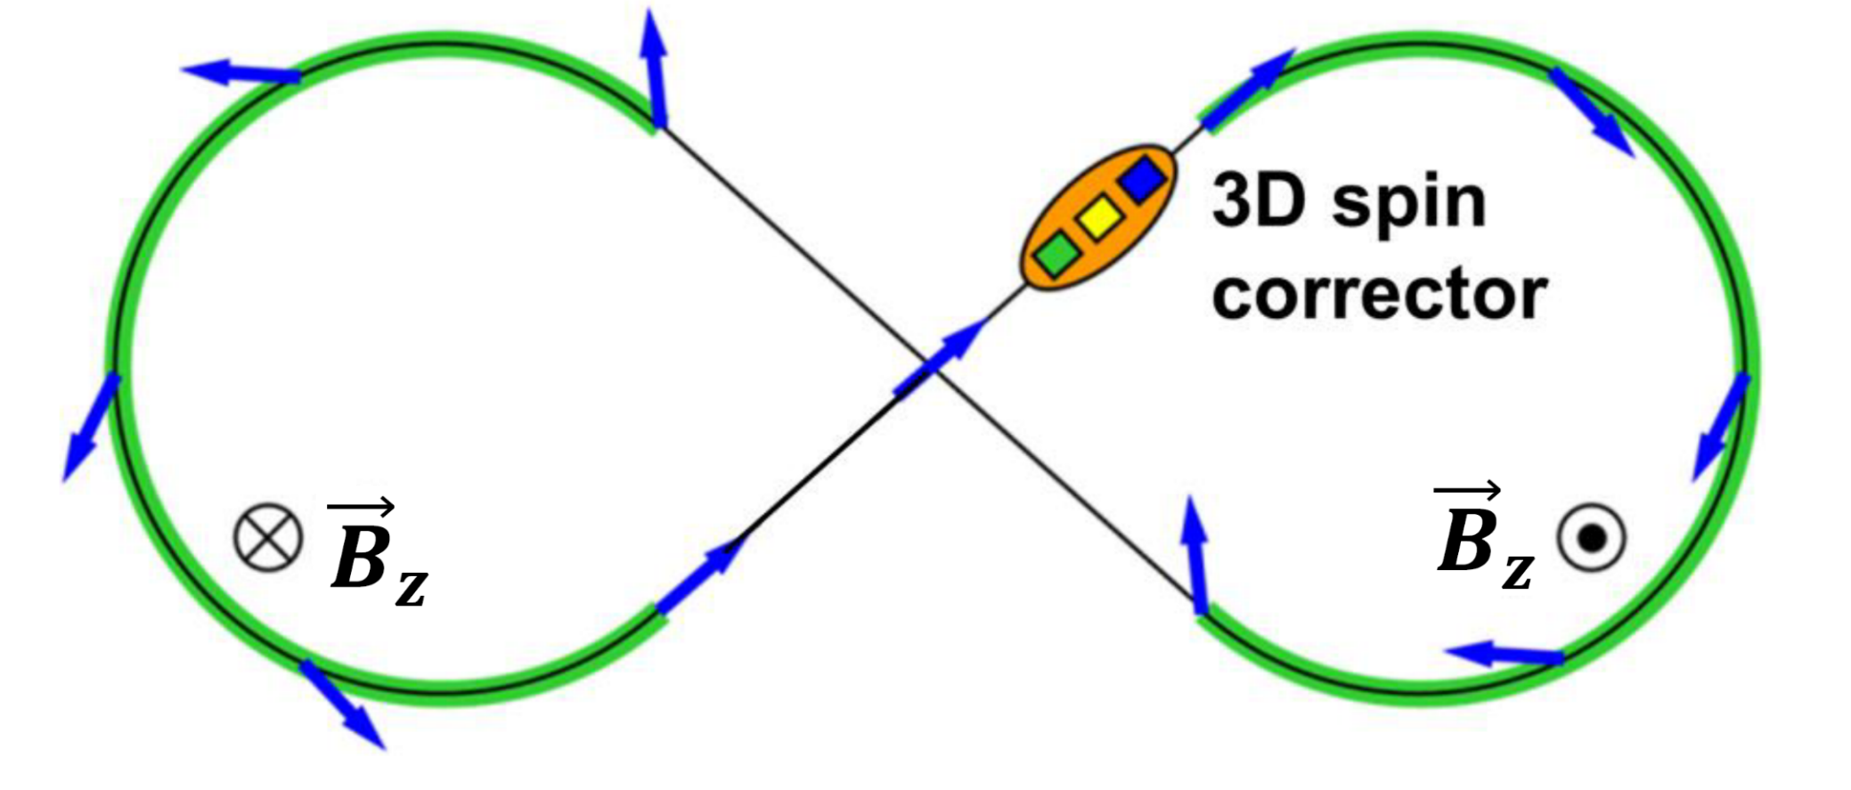
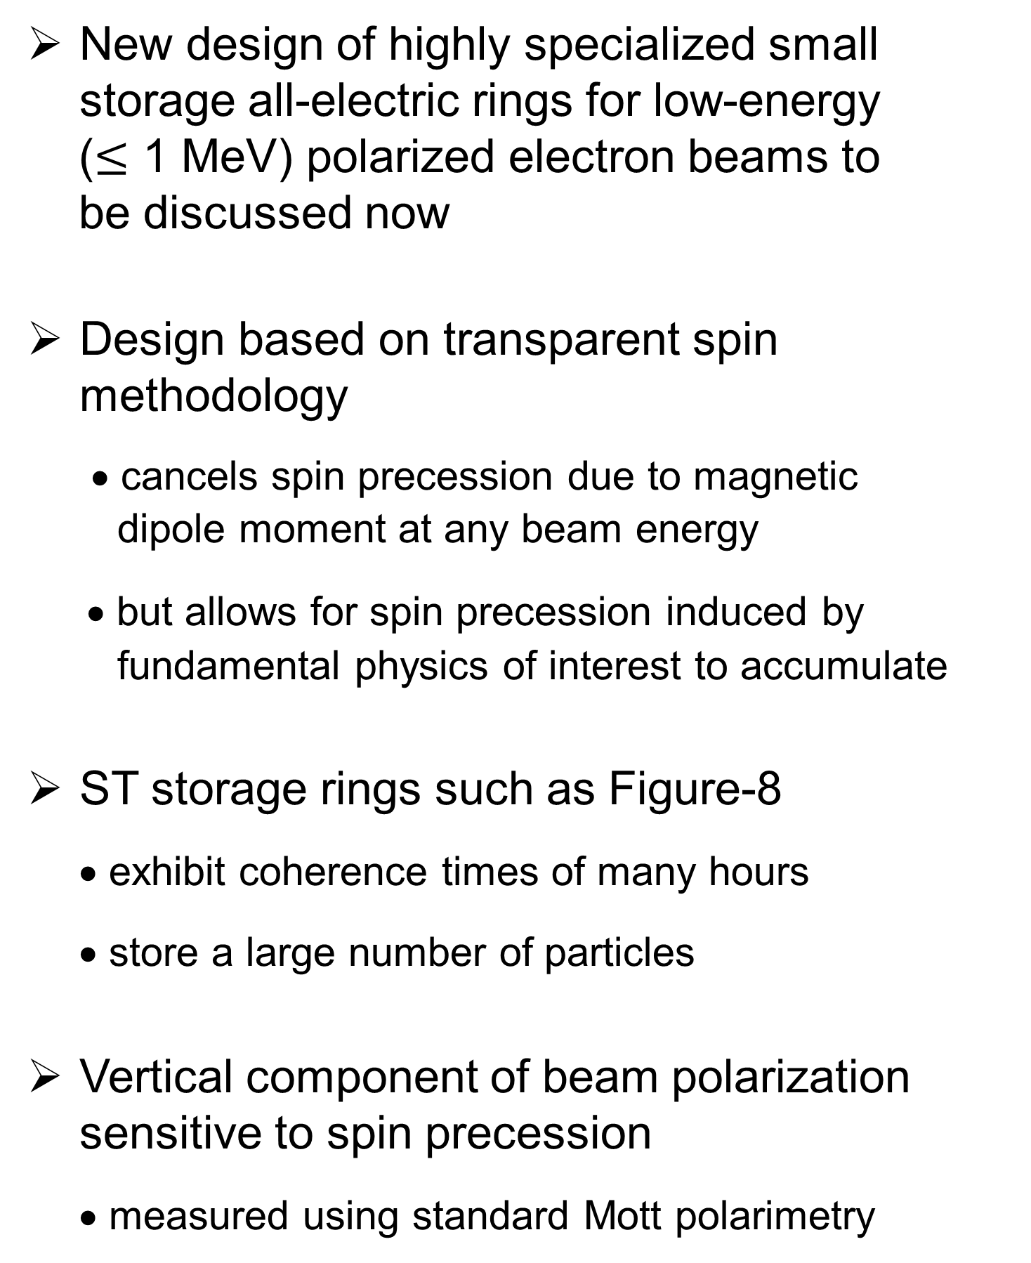
1. Introduction and Motivation
New design of highly specialized small storage all-electric rings for low-energy
($≤$ 1 MeV) polarized electron beams to
be discussed now
Design based on transparent spin methodology
• cancels spin precession due to magnetic
dipole moment at any beam energy
• but allows for spin precession induced by
fundamental physics of interest to accumulate
ST storage rings such as Figure-8
• exhibit coherence times of many hours
• store a large number of particles
Vertical component of beam polarization sensitive to spin precession
• measured using standard Mott polarimetry
Spin Transparency
Example of a spin-transparent storage ring
Most natural ST topology as the
Figure-8 ring configuration
Any spin direction repeats after a particle turn along periodic orbit in ST storage ring
Global spin precession is zero independent of particle energy: spin-echo effect

Slide 6
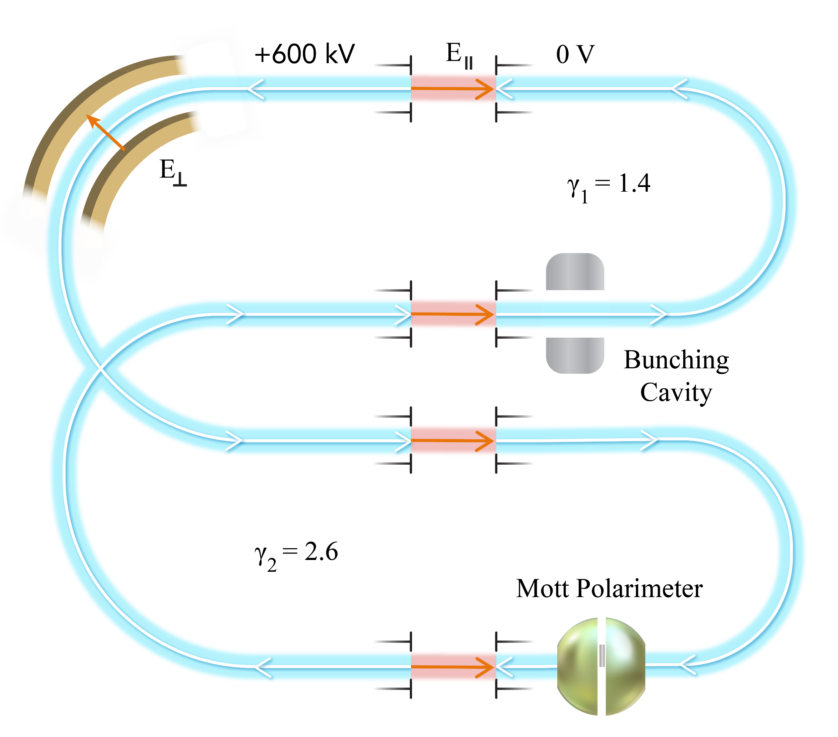
2. ST Storage Ring Concept and Design
EDM effect as tiny signal on top of relatively large MDM spin precession
Suppress MDM signal to leave EDM one
MDM suppression as natural consequence
of ST ring topology
Systematic effects associated with
• beam emittances, field errors
• background magnetic fields
Figure-8 configuration with two-rings
Systematic effects mostly suppressed by introducing two CR beams
Employ static longitudinal electric field sections for acceleration and deceleration
Stochastic cooling necessary to maintain beam bunch intensities
Layout of a two-energy ST storage ring
for measuring the electron EDM
Both vertical and horizontal polarization components can be simultaneously measured using a Mott polarimeter

Slide 7

2. ST Storage Ring Concept and Design
Treat EDM signal as perturbation to MDM spin motion
EDM effect considered as perturbation in natural spin reference frame
$$\left({\hat{e}}_{1},{\hat{e}}_{2},{\hat{e}}_{3}\right)$$
Spin reference frame aligned
with accelerator reference frame
Spin rotation components per particle turn due to EDM given by integral over ring circumference
with
Magnitude of spin rotation due to EDM in one turn

Slide 8
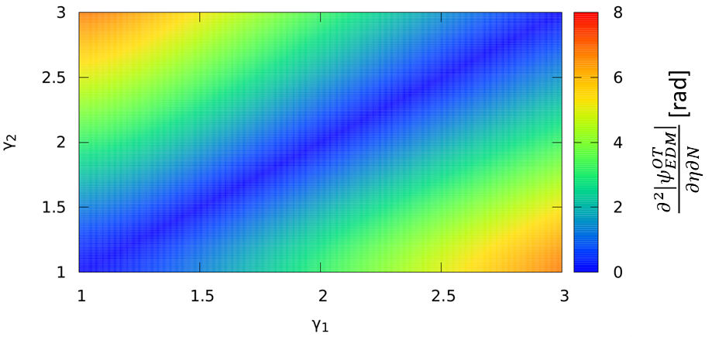
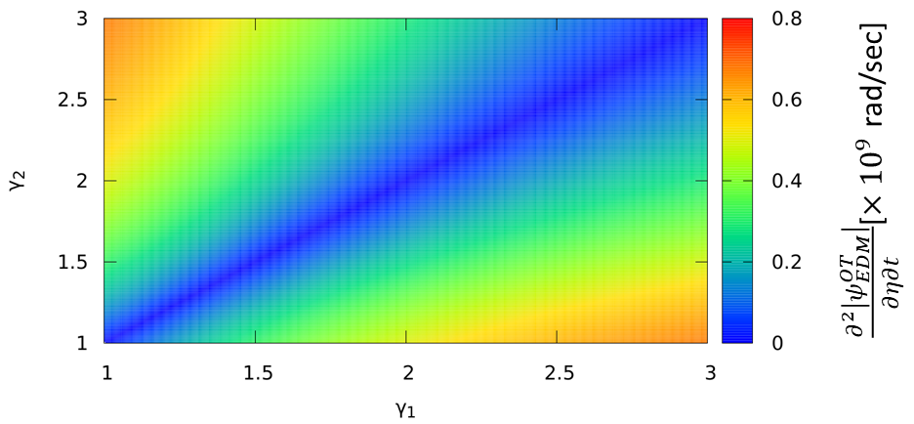
2. ST Storage Ring Concept and Design
Need to evaluate EDM spin rotation rate per unit time
Electron revolution time
in two-energy ST ring
EDM spin rotation per unit time
Determine EDM precession rate
for γ₁ = 1.4 and γ₂ = 2.6 to be
EDM spin rotation magnitude in the two-energy ST ring per unit η per turn N as a function of γ₁ and γ₂
EDM spin rotation magnitude in the two-energy ST ring per unit η per time t as a function of γ₁ and γ₂

Slide 9
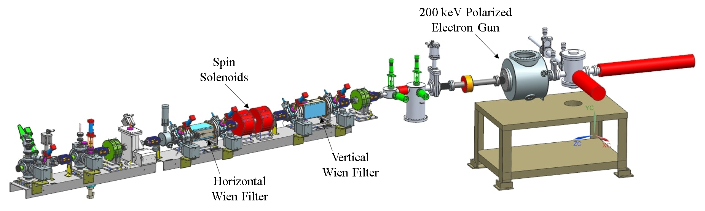
3. Polarized Electron Source and Mott Polarimetry
Figure below showing main parts of polarized electron source
Polarized electron beam to be generated with 780 nm laser light incident on photocathode
Polarized electron sources deliver beam polarization of 90%
Beamline equipped with 3D spin manipulator to rotate electron spin in any direction
Spin manipulator used at JLab over last 15 years
JLab polarized electron gun and 3D spin manipulator

Slide 10
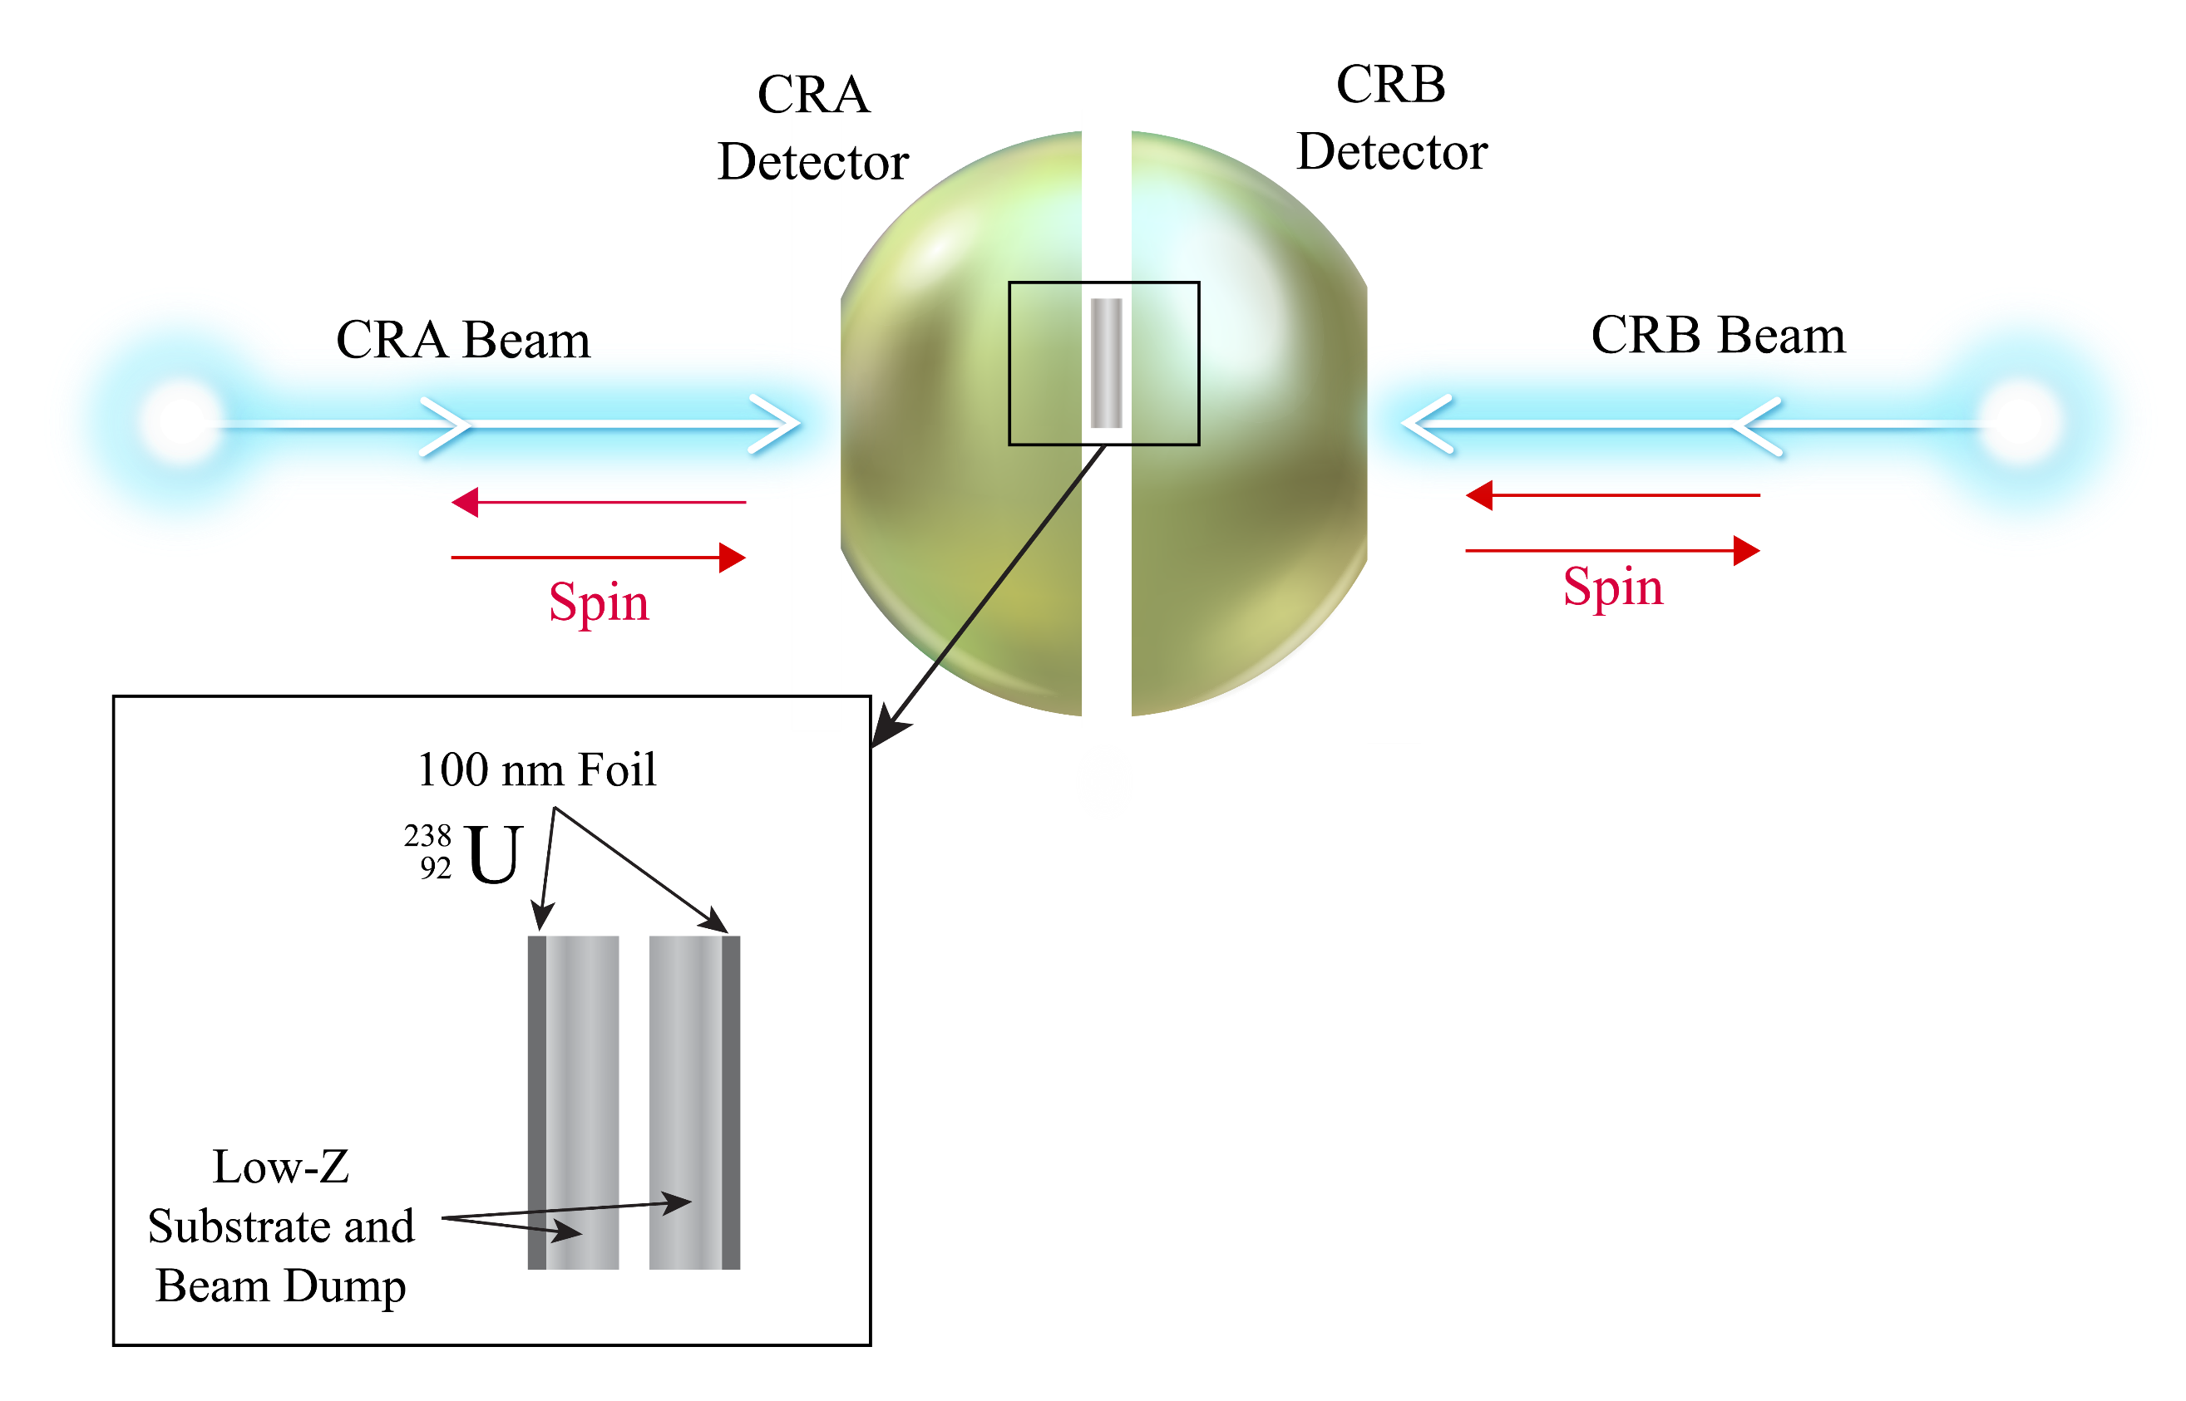
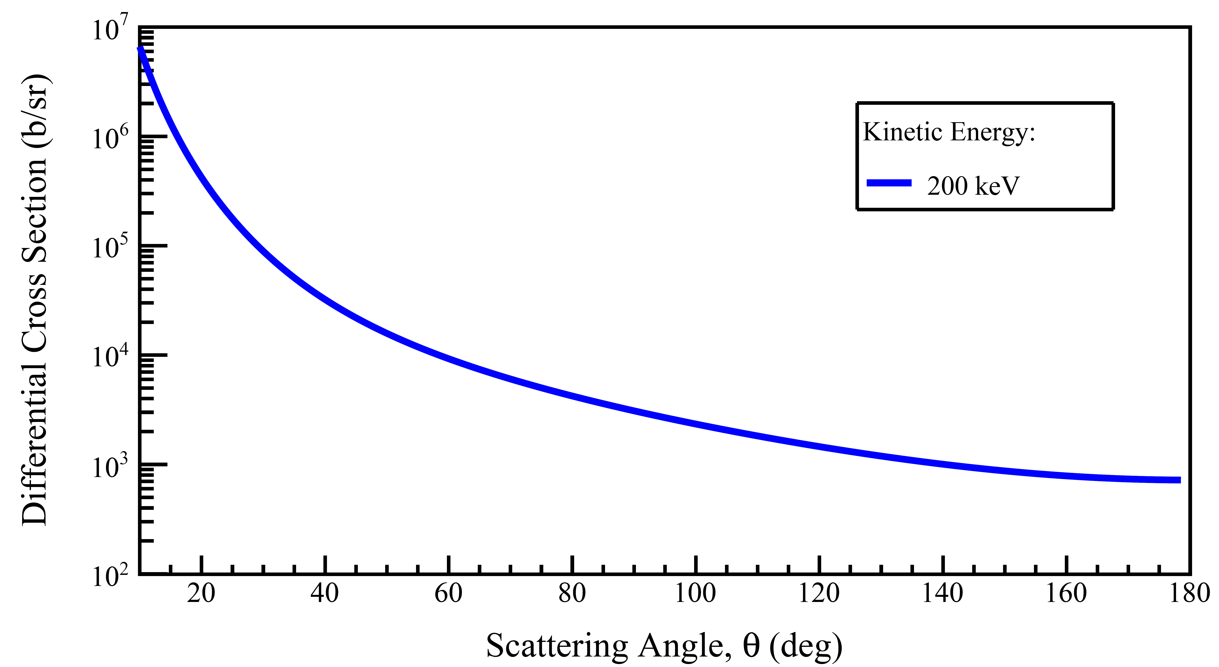
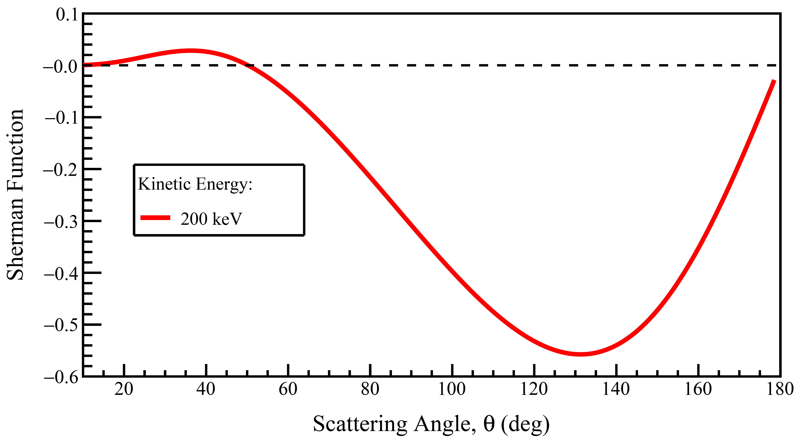
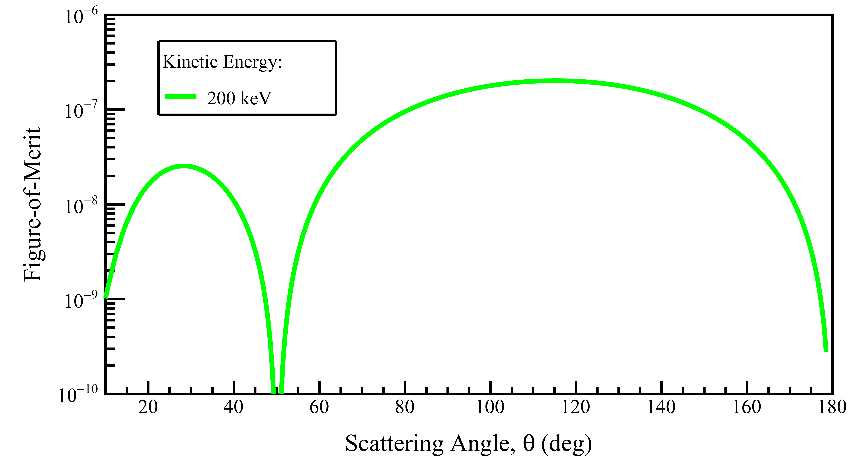
3. Polarized Electron Source and Mott Polarimetry
Differential cross section
of Mott scattering from
²³⁸U nucleus
Mott Polarimeter schematic
Coverage of the scattering angles from 90° to 160° with full azimuthal span
Analyzing Power (Sherman Function) of Mott scattering
Polarimeter
Figure-of-Merit of
Mott scattering

Slide 11
3. Polarized Electron Source and Mott Polarimetry
List relevant quantities to Mott polarimetry
Detector solid angle acceptance
Integrated total cross section
Polarimeter efficiency
Polarimeter average
analyzing power
Polarimeter FOM
Stat. uncertainty of vertical polarization due to EDM spin precession δ P = 0.029%

Slide 12
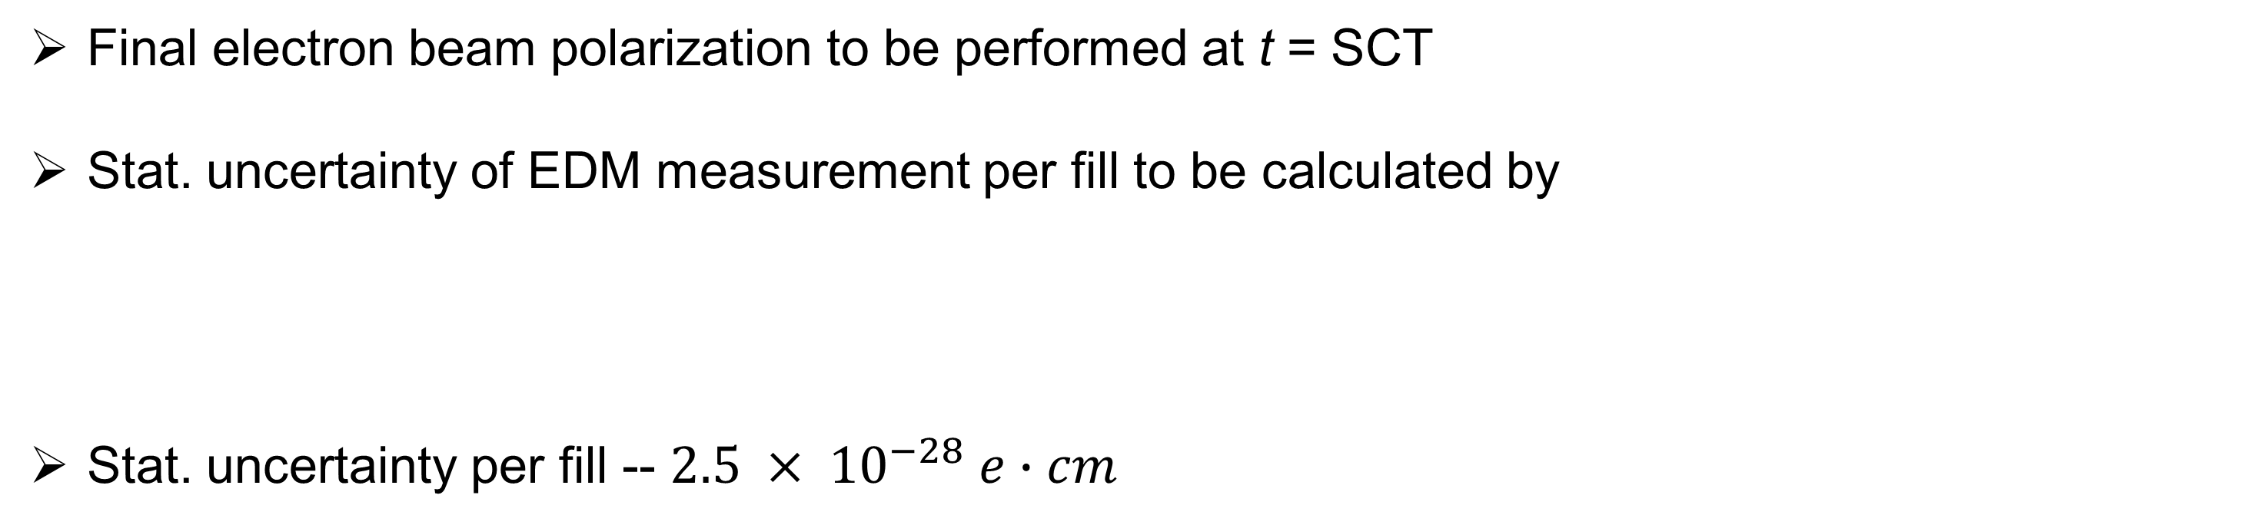
4. Electron EDM Expected Statistical Limit / Systematic Uncertainties
Final electron beam polarization to be performed at t = SCT
Stat. uncertainty of EDM measurement per fill to be calculated by
Stat. uncertainty per fill -- $2.5 × {10}^{−28} e∙cm$
Parameters for evaluating the statistical uncertainty of the EDM measurement

Slide 13
4. Electron EDM Expected Statistical Limit / Systematic Uncertainties
Possible way to operate EDM storage ring
Fill the ring with four polarized electron bunches in two opposite directions
Use four possible filling schemes for each beam, dependent on different helicity and polarization arrangements
Longitudinally polarized bunches to be used to measure EDM
Radial and vertical polarized bunches to be used to measure systematic uncertainties
related to background electromagnetic fields
Accumulate for EDM
• positive vertical polarization component for (CRA,+h) and (CRB,-h) beams
• negative vertical polarization component for (CRA,-h) and (CRB,+h) beams

Slide 14
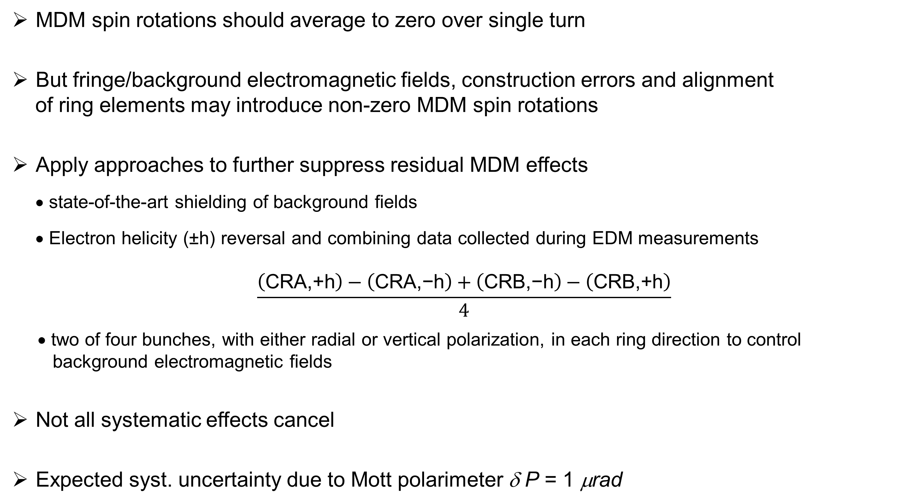
4. Electron EDM Expected Statistical Limit / Systematic Uncertainties
MDM spin rotations should average to zero over single turn
But fringe/background electromagnetic fields, construction errors and alignment
of ring elements may introduce non-zero MDM spin rotations
Apply approaches to further suppress residual MDM effects
• state-of-the-art shielding of background fields
• Electron helicity (±h) reversal and combining data collected during EDM measurements
$$\frac{\left(\text{CRA}\text{,+}\text{h}\right)−\left(\text{CRA}\text{,−}\text{h}\right)+\left(\text{CRB}\text{,−}\text{h}\right)−\left(\text{CRB}\text{,+}\text{h}\right)}{4}$$
• two of four bunches, with either radial or vertical polarization, in each ring direction to control
background electromagnetic fields
Not all systematic effects cancel
Expected syst. uncertainty due to Mott polarimeter δ P = 1 μrad

Slide 15
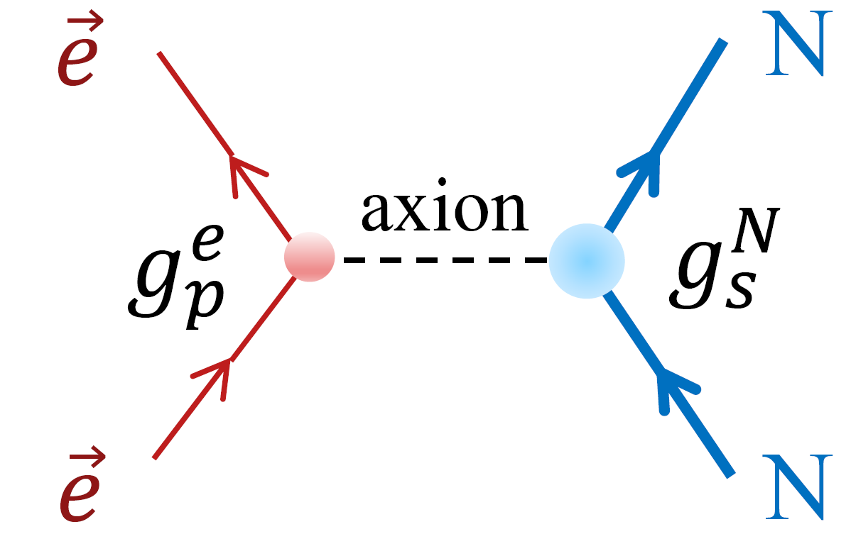
5. Ultra-light Axion Dark Matter Search
Ultra-light axion particles as candidates for new physics beyond Standard Model
Motivated by dark matter puzzle and strong CP problem
Axions representing very light spinless fields to couple
to matter and mediate long-range macroscopic forces
Low-energy ST storage rings usable to measure spin precession induced by axion fields
Axion field gradient to couple to transversely polarized electron spin with sensitivity proportional to relativistic
beam velocity, β, and SCT
Longitudinally polarized electrons to measure EDM while transversely polarized electrons to search for axions
Axion-mediated
electron-nucleon interaction
Axions also as viable candidates for dark matter that dominates mass
of Universe
Earth produces vertical
axion field
Axion ring analogous to EDM ring; Figure-8 electric ring without longitudinal electric fields

Slide 16
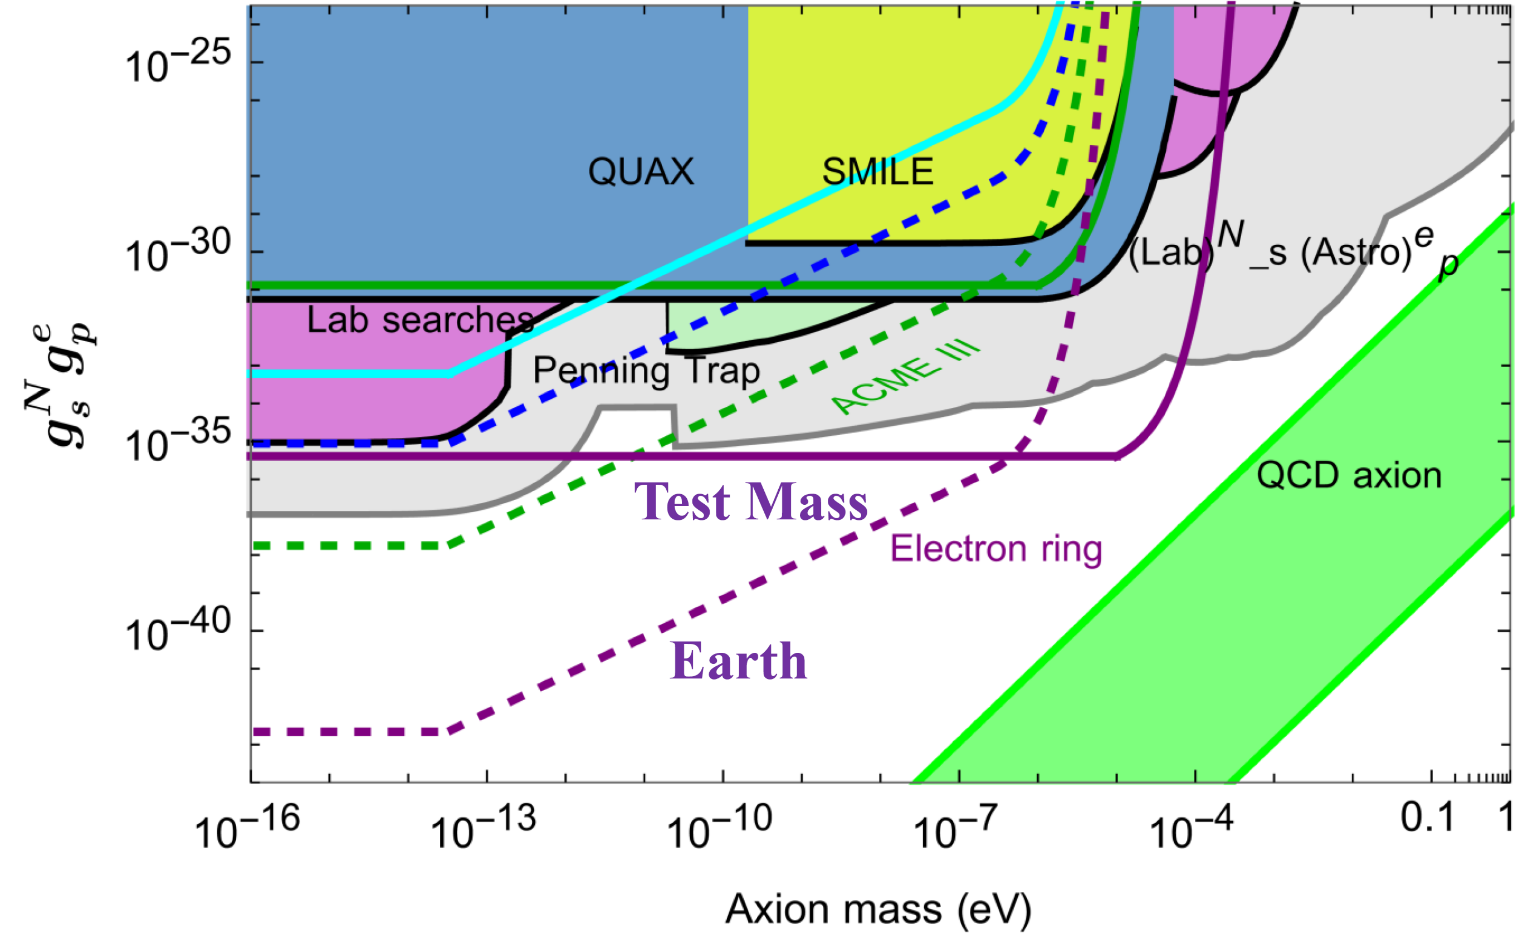
5. Ultra-light Axion Dark Matter Search
In axion search experiment
• spin rotates around electron’s
velocity
• longitudinal background magnetic
field as main source of systematic
uncertainty
• rotates spin of CRA and CRB
beams in same direction
• axion interaction rotates spin in
opposite directions, resulting in
cancellation of background effect
when combining CRA & CRB data
ST axion ring to measure ∼nHz
(10⁻⁹ Rad/s) spin precession
frequency
Different spin precession experiments with their bounds projected on the parameter space of scalar-pseudoscalar nucleon-electron couplings versus axion mass
Expected sensitivity to axion-mediated forces in the electron ring sourced from the earth nucleons
ST axion ring to give strongest bound to surpass any existing search by several orders of magnitude

Slide 17
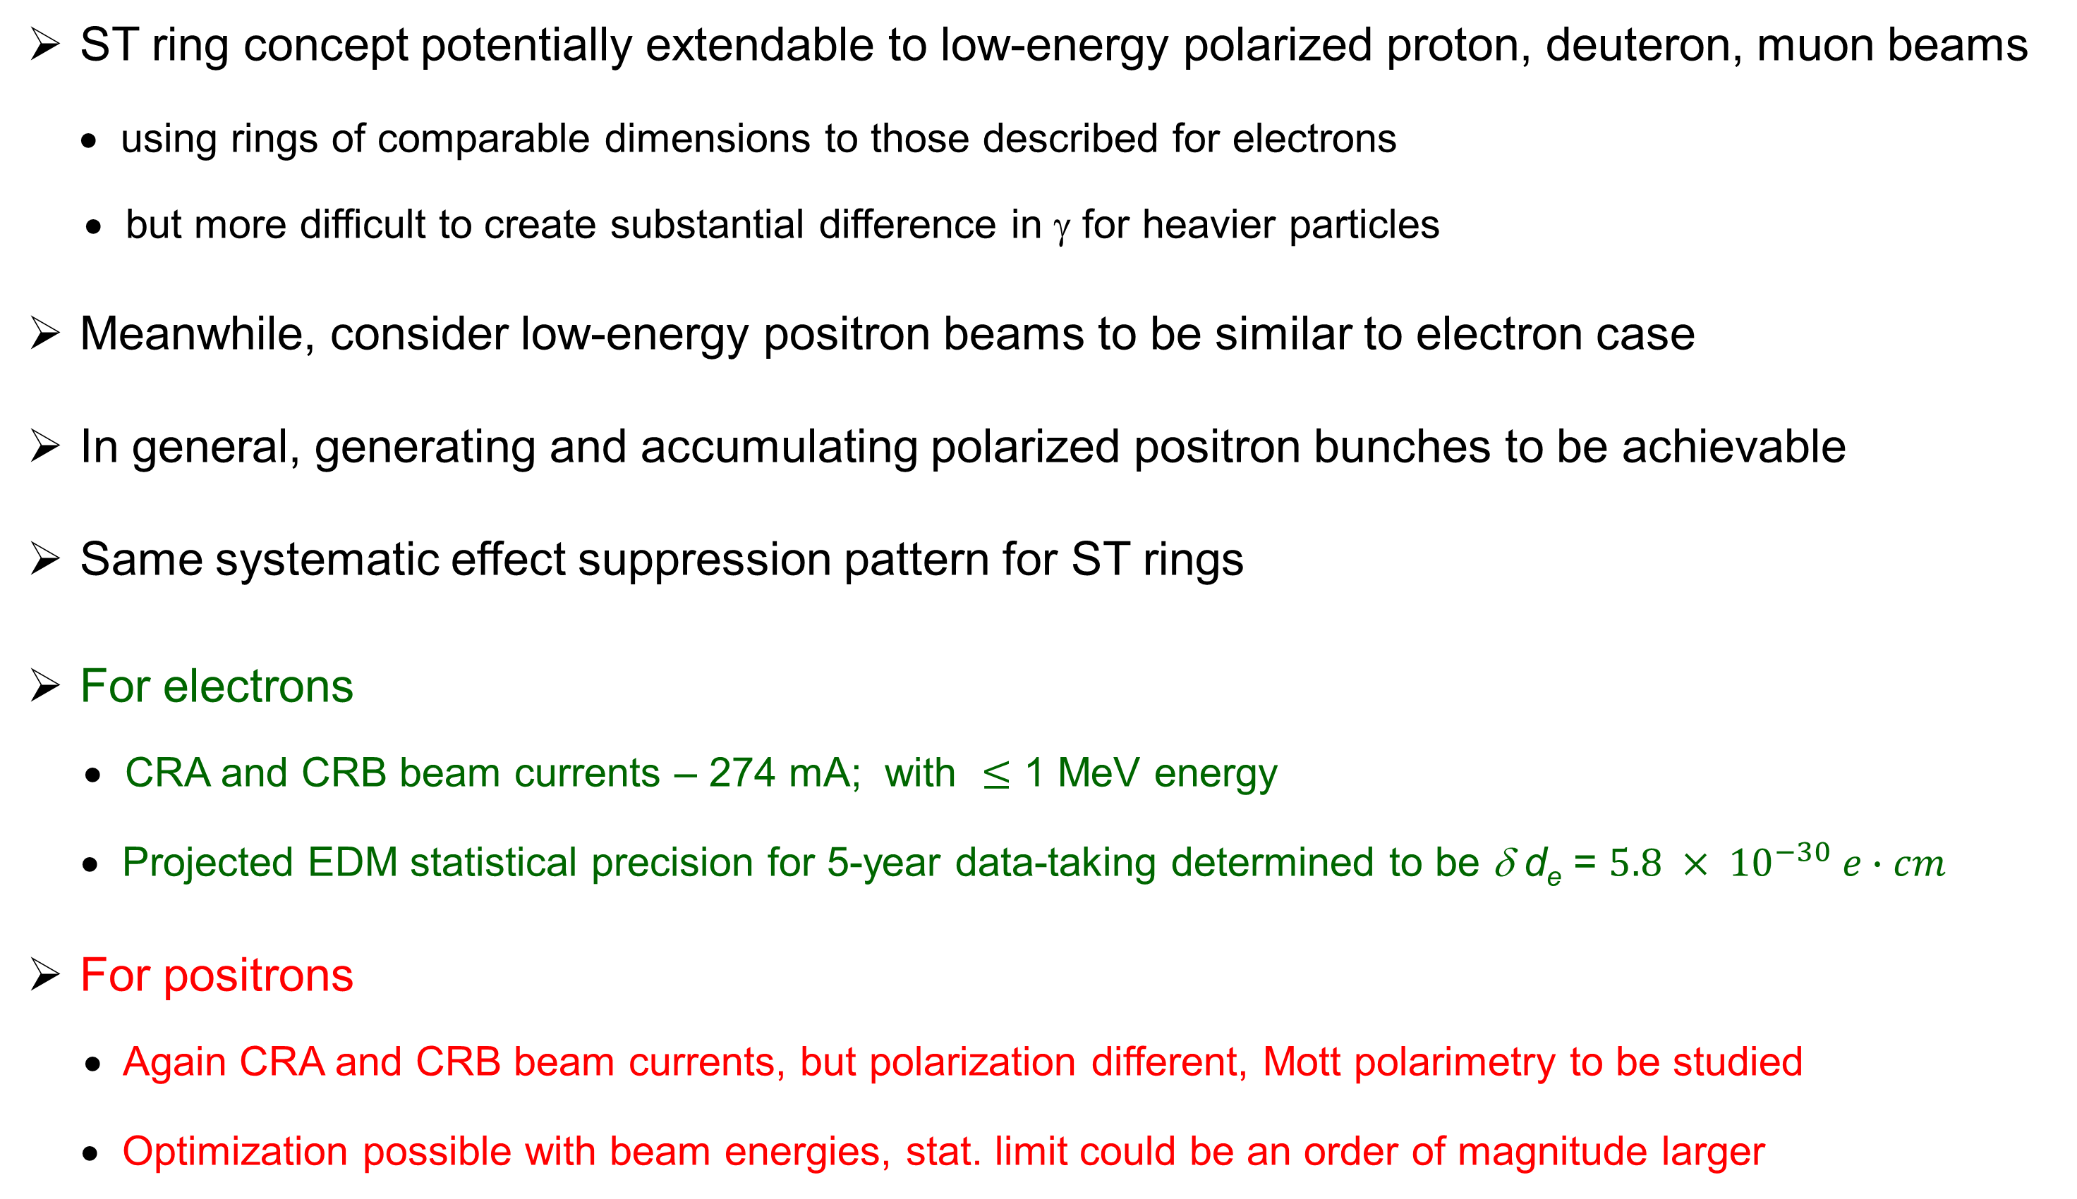
6. ST Concept Development in Progress: Positron Beams
ST ring concept potentially extendable to low-energy polarized proton, deuteron, muon beams
• using rings of comparable dimensions to those described for electrons
• but more difficult to create substantial difference in γ for heavier particles
Meanwhile, consider low-energy positron beams to be similar to electron case
In general, generating and accumulating polarized positron bunches to be achievable
Same systematic effect suppression pattern for ST rings
For electrons
• CRA and CRB beam currents – 274 mA; with $≤$ 1 MeV energy
• Projected EDM statistical precision for 5-year data-taking determined to be δ d_{e} = $5.8 × {10}^{−30} e∙cm$
For positrons
• Again CRA and CRB beam currents, but polarization different, Mott polarimetry to be studied
• Optimization possible with beam energies, stat. limit could be an order of magnitude larger

Slide 18
7. Summary and Outlook
Spin-transparent storage rings showing important and exciting applications
To measure electron/positron permanent electric dipole moment and search for axions
Presented approach gives following advantages
• Counter-rotating A and B electron beams to circulate concurrently
• Long spin coherence time ∼1 day
• Bunched beam and no synchrotron radiation
• Straightforward polarimetry
• Good control of systematic effects and ring imperfections with background magnetic fields
• Minimum safety issues and manageable cost
• Testbed for larger-scale experiments
LOI being prepared for this PAC
Thanks for attention !

Slide 19
Backups

Slide 20
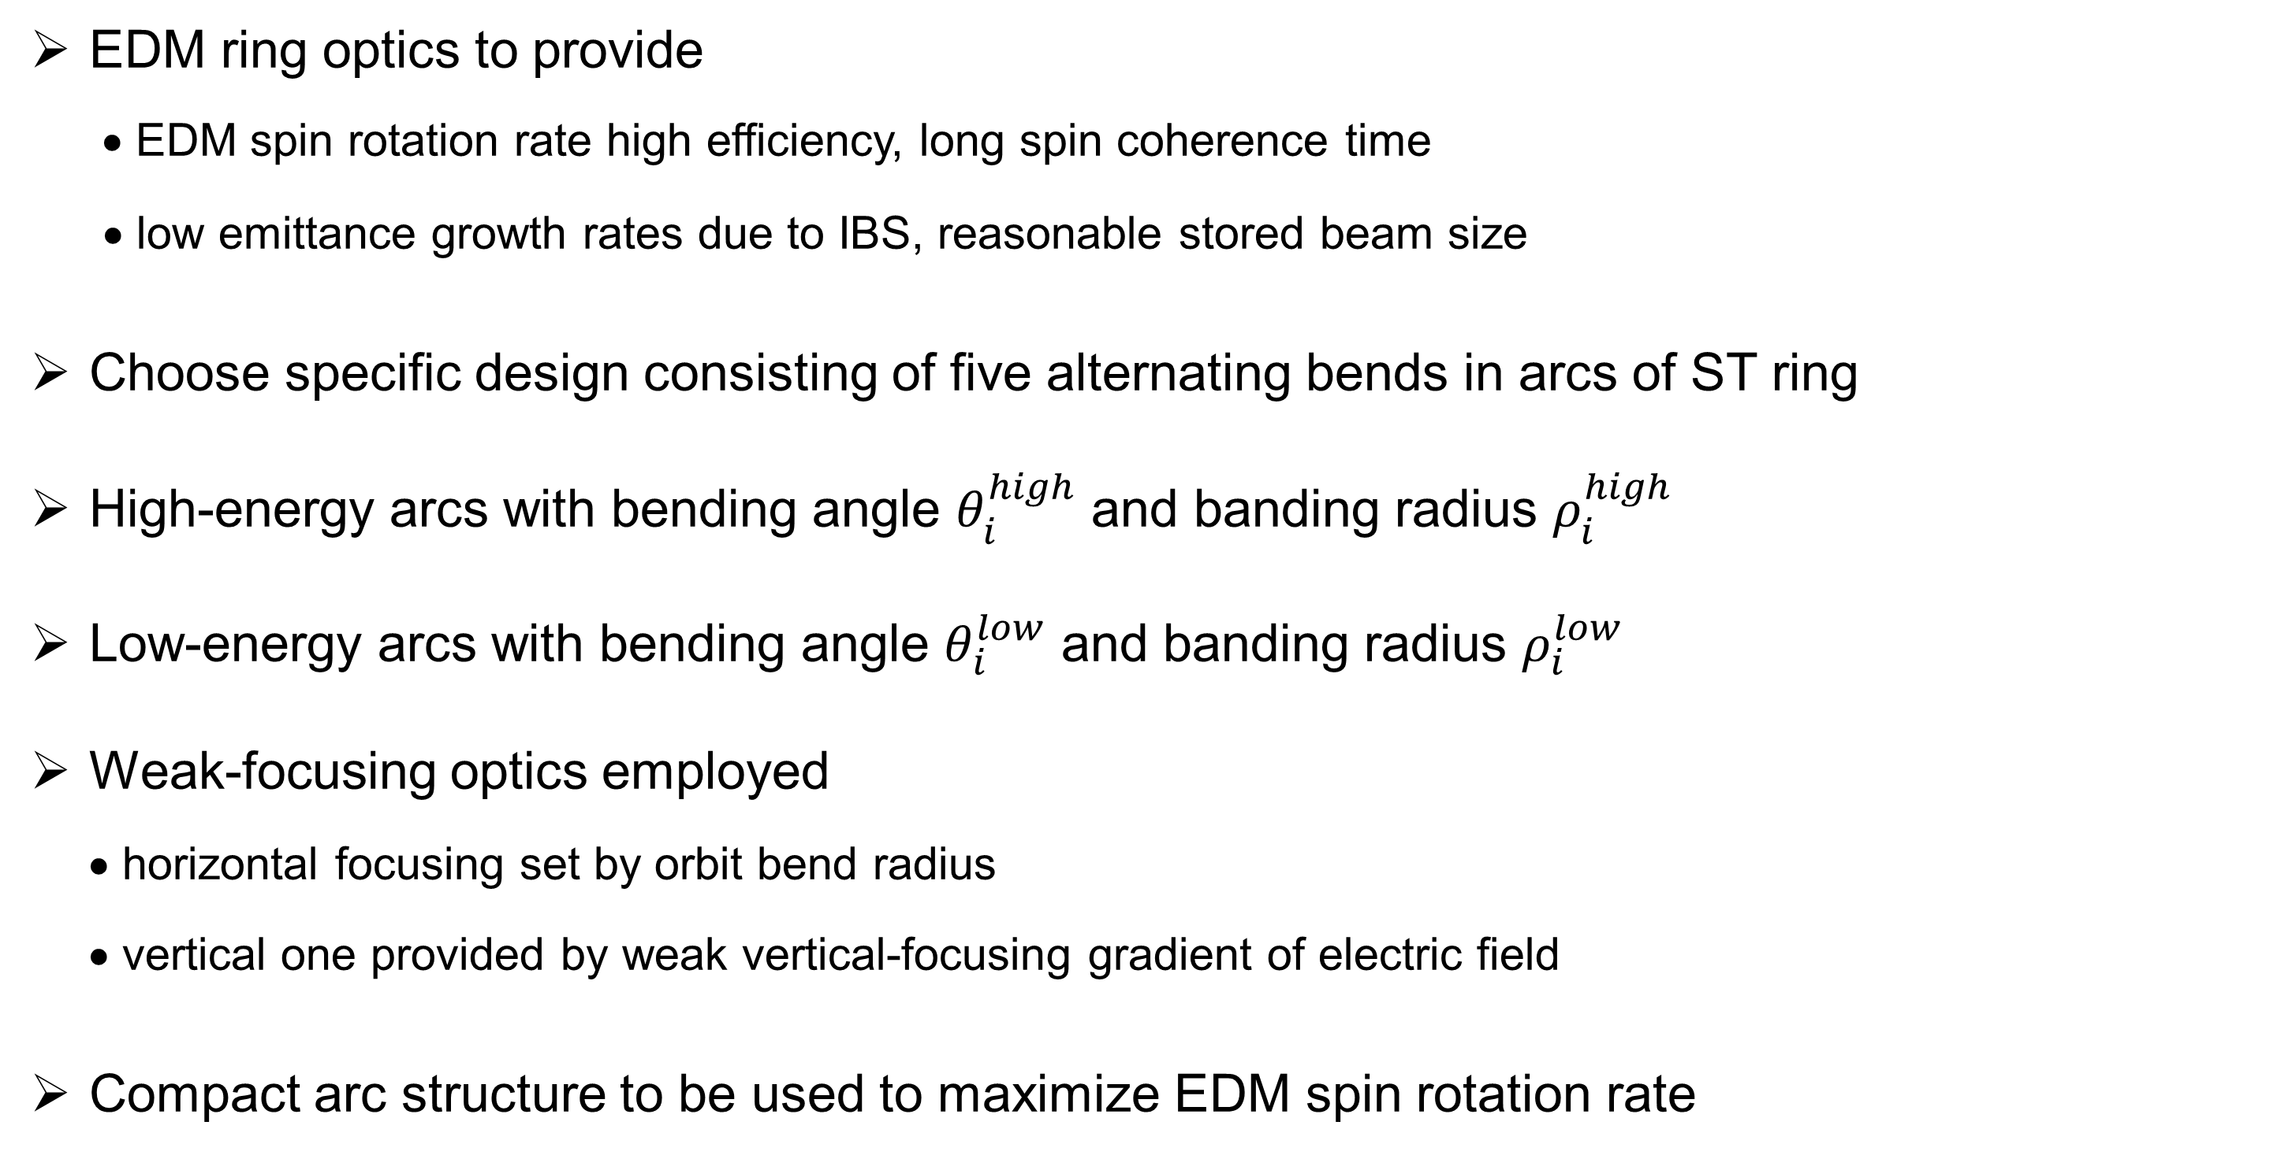
Two-energy ST Electron EDM Ring: Optics design
Specific ring design to be discussed gives rate
EDM ring optics to provide
• EDM spin rotation rate high efficiency, long spin coherence time
• low emittance growth rates due to IBS, reasonable stored beam size
Choose specific design consisting of five alternating bends in arcs of ST ring
High-energy arcs with bending angle $θ_{i}^{high}$ and banding radius $ρ_{i}^{high}$
Low-energy arcs with bending angle $θ_{i}^{low}$ and banding radius $ρ_{i}^{low}$
Weak-focusing optics employed
• horizontal focusing set by orbit bend radius
• vertical one provided by weak vertical-focusing gradient of electric field
Compact arc structure to be used to maximize EDM spin rotation rate

Slide 21
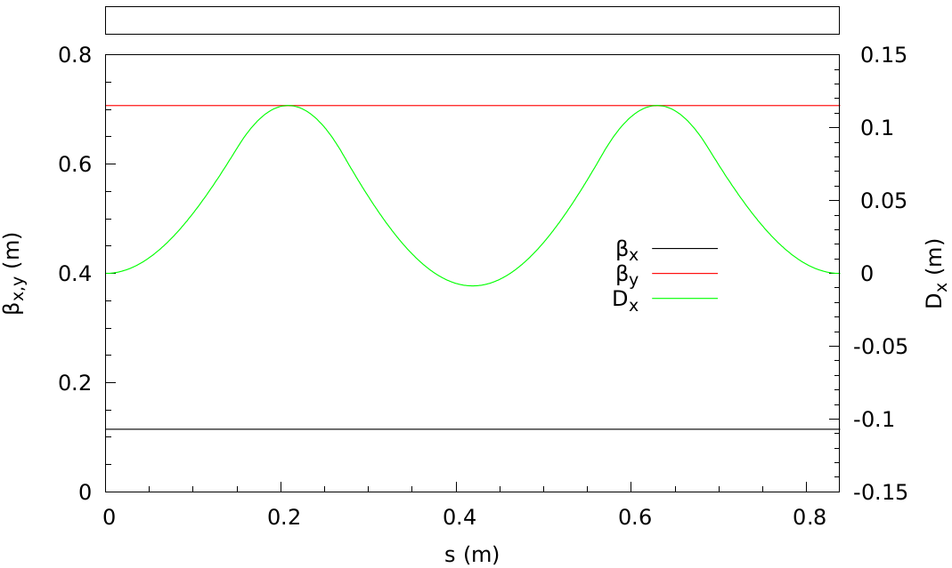
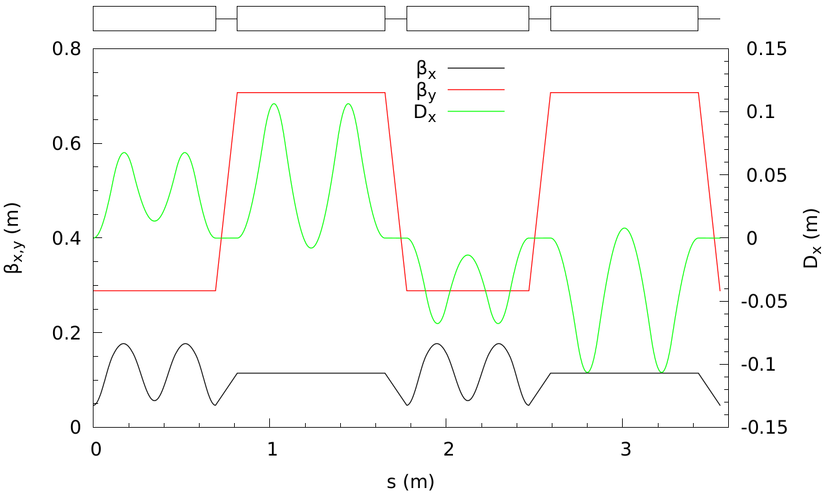
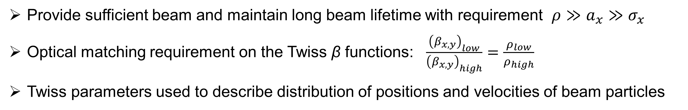
Two-energy ST Electron EDM Ring: Transverse Dynamics
Provide sufficient beam and maintain long beam lifetime with requirement $ρ≫a_{x}≫σ_{x}$
Optical matching requirement on the Twiss β functions: $\frac{{\left(β_{x,y}\right)}_{low}}{{\left(β_{x,y}\right)}_{high}}=\frac{ρ_{low}}{ρ_{high}}$
Twiss parameters used to describe distribution of positions and velocities of beam particles
High-energy arc optics
Twiss β functions in both planes (β_{x,y}) and
horizontal dispersion (D_{x}) along the arc
Complete optics of the EDM two-energy ST ring
Twiss β functions in both planes (β_{x,y}) and
horizontal dispersion (D_{x}) along the ring

Slide 22
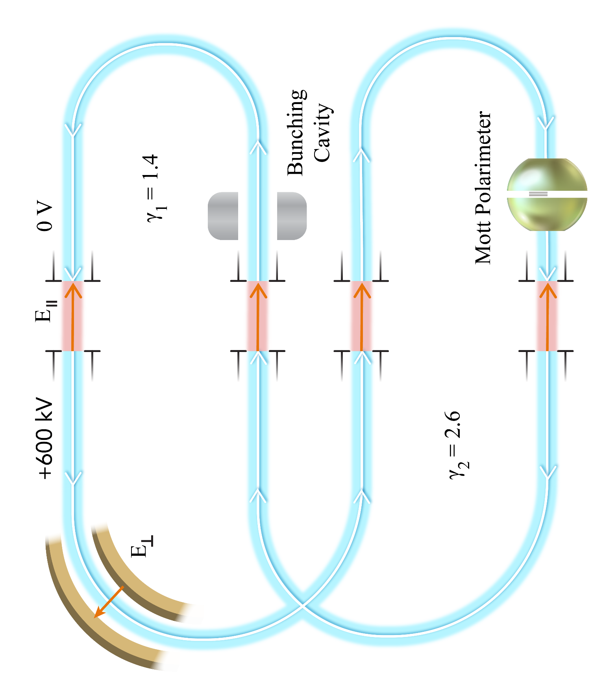
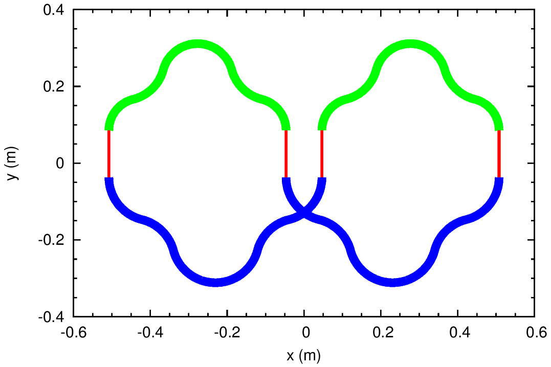
Two-energy ST Electron EDM Ring: Longitudinal Dynamics
For beam bunches: four buckets to be filed, one bucket to be kept empty for injection,
and ion cloud clearing
Figure on slide 6 rotated 90° to
the left to compare to the right figure
Footprint of the EDM ST ring drawn to scale
High-energy arcs in blue, low-energy arcs in green,
and longitudinal static electric field sections in red

Slide 23
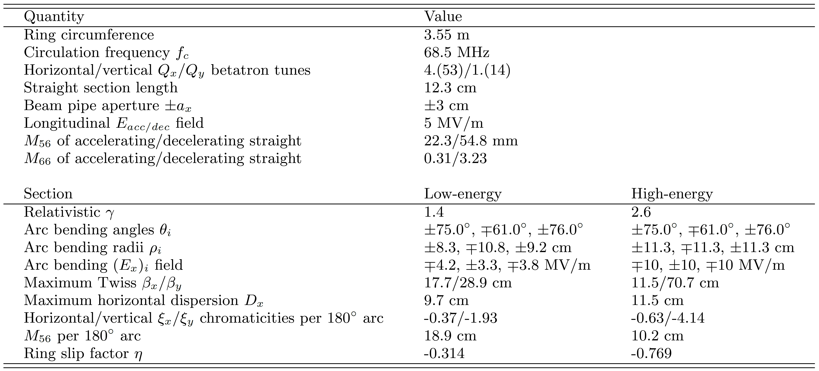
Two-energy ST Electron EDM Ring: Longitudinal Dynamics
Geometrical and optical ring parameters
Use stochastically cooled bunched beams for having
low emittances
and
comparatively high beam intensities
Longitudinal dynamics parameters for
a stochastically cooled beam
Bunching cavity is placed in the
low energy section

Slide 24
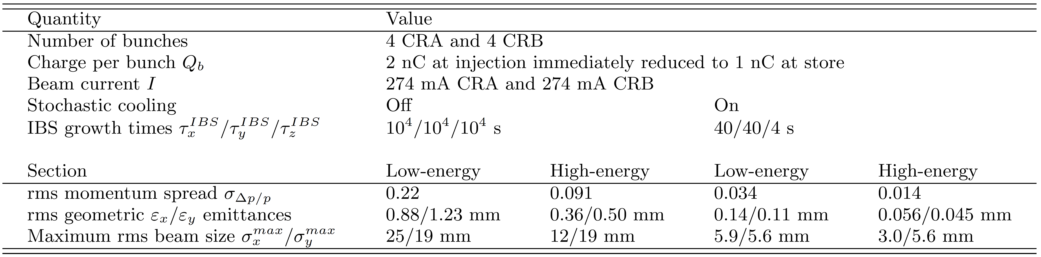
Beam Physics Limitations: IBS and Stochastic Cooling
EDM measurement precision to be determined by statistical error
Sufficiently large number of particles to be stored in ring
• 2 nC electron charge initially injected into each RF bucket
• reduce bunch charge down to 1 nC after polarization measurement
With such bunch charge, IBS causing concern for beam lifetime
In equilibrium, IBS balanced by stochastic cooling
Beam parameters without and with stochastic cooling

Slide 25
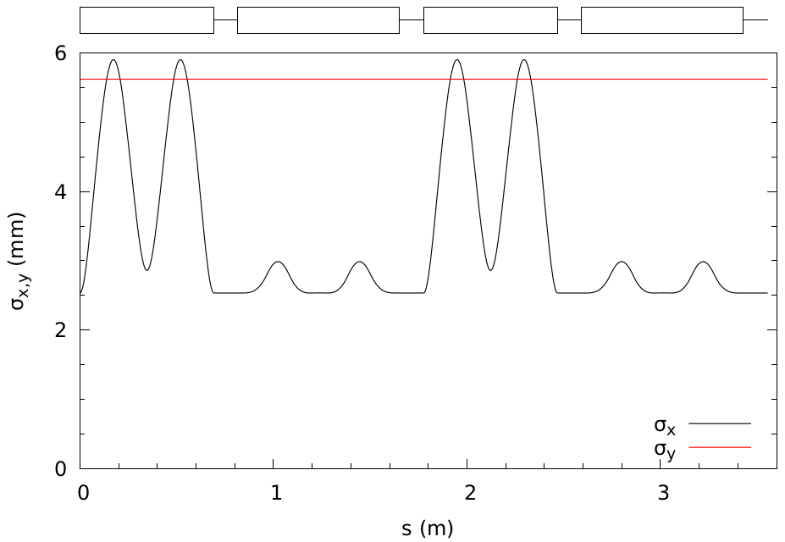
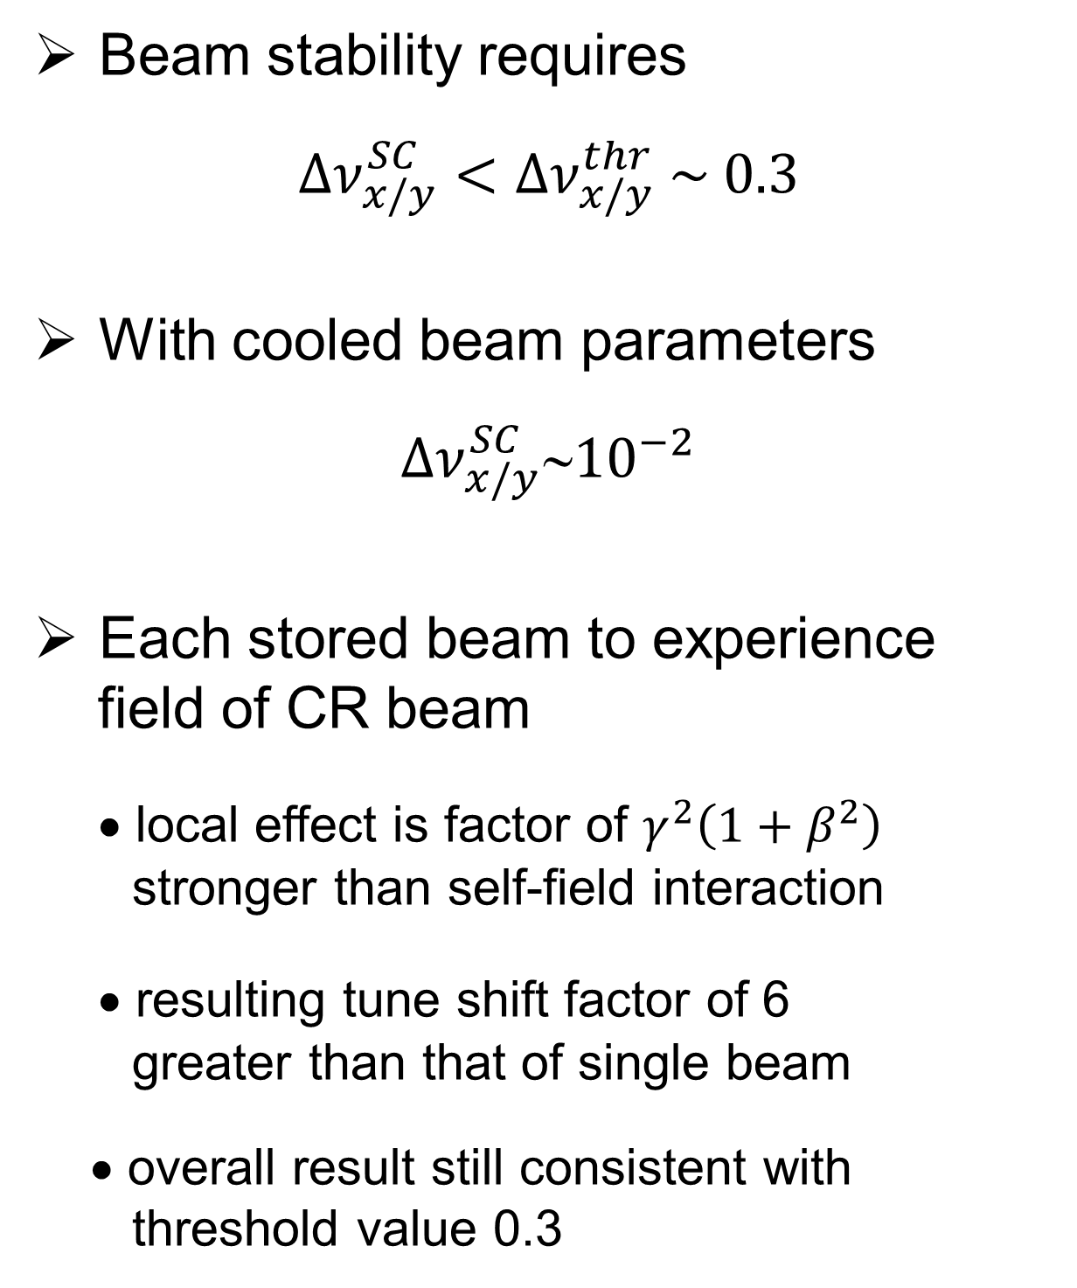
Beam Physics Limitations: Space Charge and Other Effects
Potential limitation on stored charge amount from betatron tune shift $∆ν_{x/y}^{SC}$
Beam stability requires
$$∆ν_{x/y}^{SC}<∆ν_{x/y}^{thr} \sim 0.3$$
With cooled beam parameters
$$∆ν_{x/y}^{SC}{10}^{−2}$$
Each stored beam to experience
field of CR beam
• local effect is factor of $γ^{2}\left(1+β^{2}\right)$
stronger than self-field interaction
• resulting tune shift factor of 6
greater than that of single beam
• overall result still consistent with
threshold value 0.3
Beam sizes along the EDM ring when stochastic cooling is applied

Slide 26
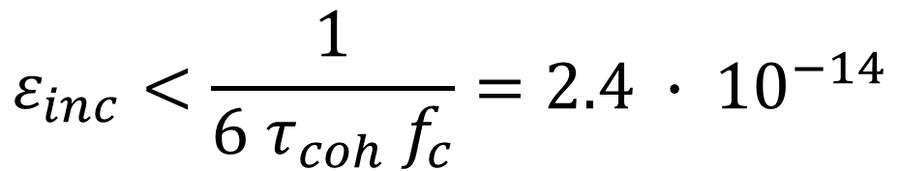
Spin Stability and Precision Control
Need to have long SCT to accumulate and observe EDM signal
• time for beam staying polarized in ST
Spin tune energy independent in ST ring
• beam emittance → spin tune spread → depolarization
Spin motion governed by spin resonance in ST ring
• spin resonance strength defined as number of spin precessions per unit turn
Spin resonance strength consisting of coherent and incoherent parts
• coherent part determined by ring imperfections, same for all particles
• limit on SCT primarily determined by incoherent part, causes spins of particles to precess
at slightly different rates
For, now give upper limit
$$ε_{inc}<\frac{1}{6 τ_{coh} f_{c}}=2.4 ∙ {10}^{−14}$$

Slide 27
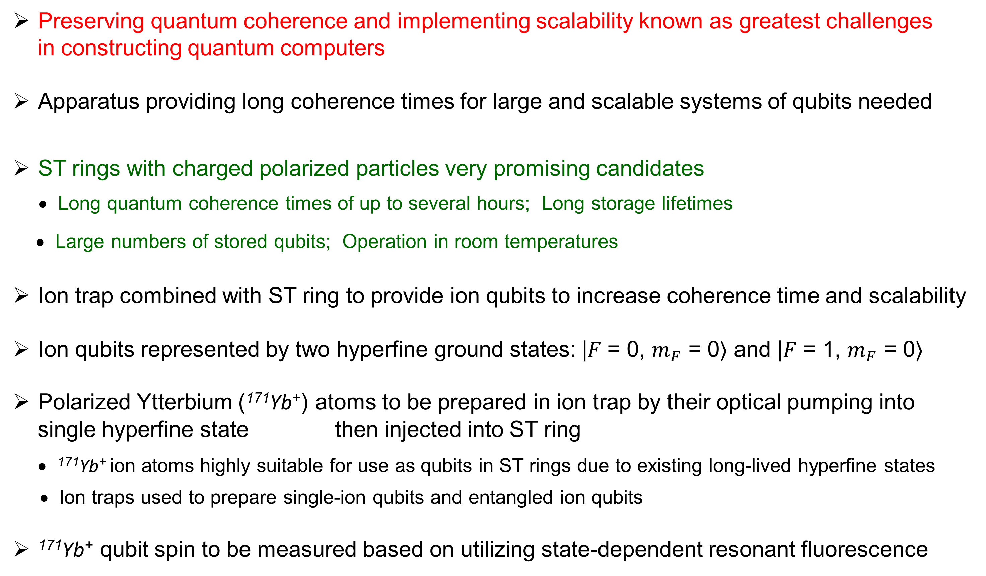
Quantum Computing with ST Rings
Preserving quantum coherence and implementing scalability known as greatest challenges
in constructing quantum computers
Apparatus providing long coherence times for large and scalable systems of qubits needed
ST rings with charged polarized particles very promising candidates
• Long quantum coherence times of up to several hours; Long storage lifetimes
• Large numbers of stored qubits; Operation in room temperatures
Ion trap combined with ST ring to provide ion qubits to increase coherence time and scalability
Ion qubits represented by two hyperfine ground states: |𝐹 = 0, $m_{F}$ = 0⟩ and |𝐹 = 1, $m_{F}$ = 0⟩
Polarized Ytterbium (¹⁷¹Yb⁺) atoms to be prepared in ion trap by their optical pumping into
single hyperfine state then injected into ST ring
• ¹⁷¹Yb⁺ ion atoms highly suitable for use as qubits in ST rings due to existing long-lived hyperfine states
• Ion traps used to prepare single-ion qubits and entangled ion qubits
¹⁷¹Yb⁺ qubit spin to be measured based on utilizing state-dependent resonant fluorescence

Slide 28
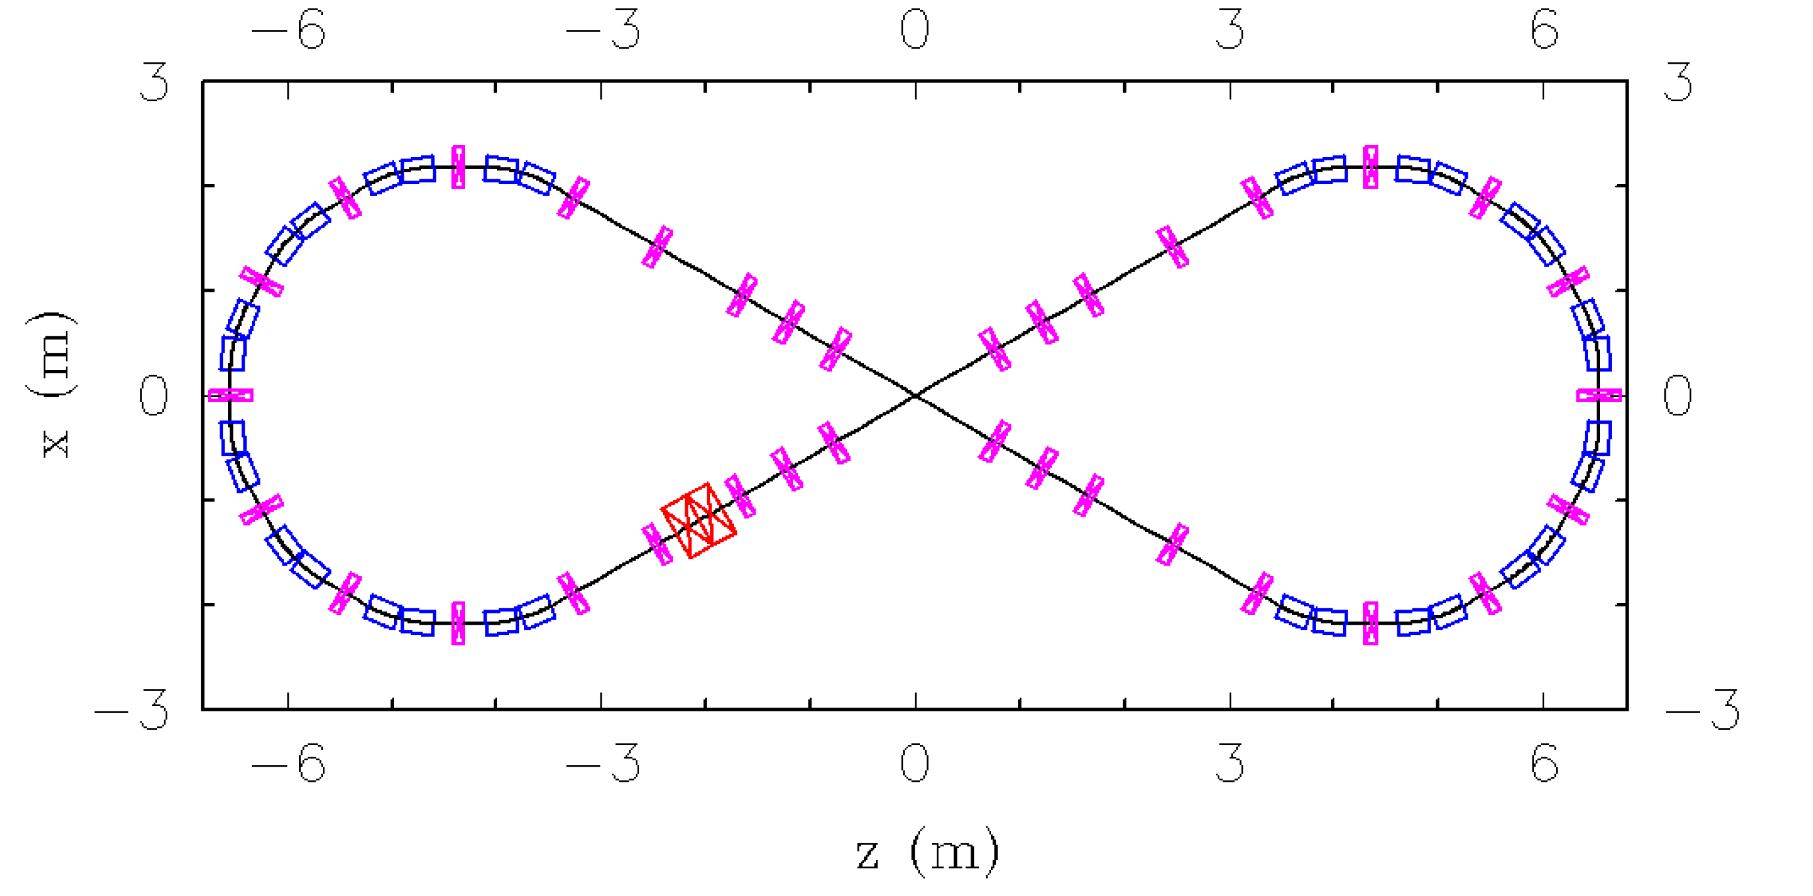
Quantum Computing with ST Rings
Spin-based qubit states stable, unlike techniques relying on orbital motion quantization
Spin states being decoupled from orbital motion and being robust to external factors
Largest limitation from Doppler shift of state transition frequencies still manageable
Layout of all-electric ST ring with
injected ¹⁷¹Yb⁺ ions
Bending electrodes in blue
Focusing elements in magenta
RF bunching cavity in red
¹⁷¹Yb⁺ ion ST ring parameters
Example of 12 m long and 6 m wide setup

