Slide 1

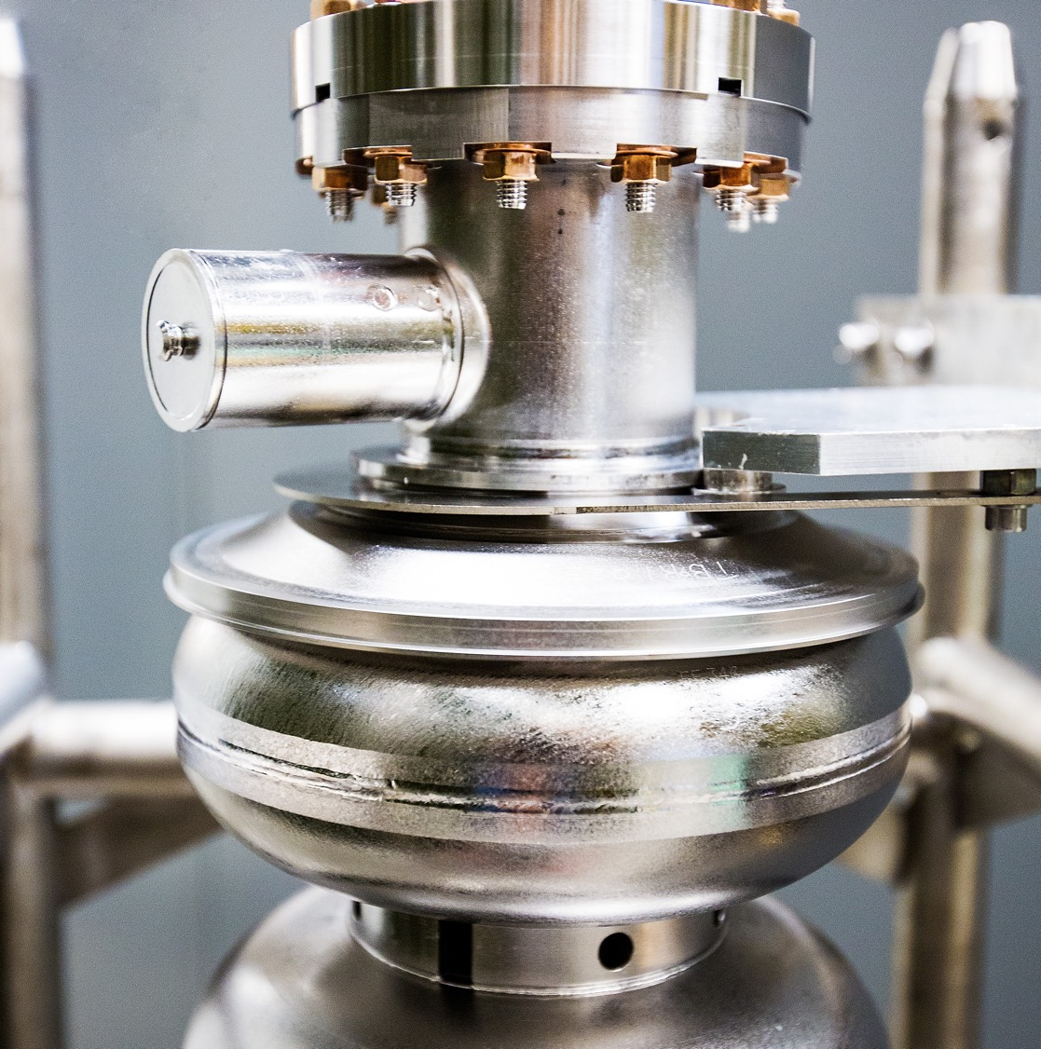
An Accelerator-Based Source of High-Intensity Quantum-Entangled Annihilation Gamma Photons
Low Energy Electron and Positron Physics at Jefferson Lab (LEEPP)
March 23-27, 2026
Riad Suleiman
Notes:
Tip: Keep titles under 60 characters for readability
To change the photo: Right-click on photo and select change photo

Slide 2
Outline
Positron Sources
Positron Annihilation and Gammas Entanglement
Compton Polarimetry
Entanglement Witness
Applications
Summary and Outlook

Slide 3
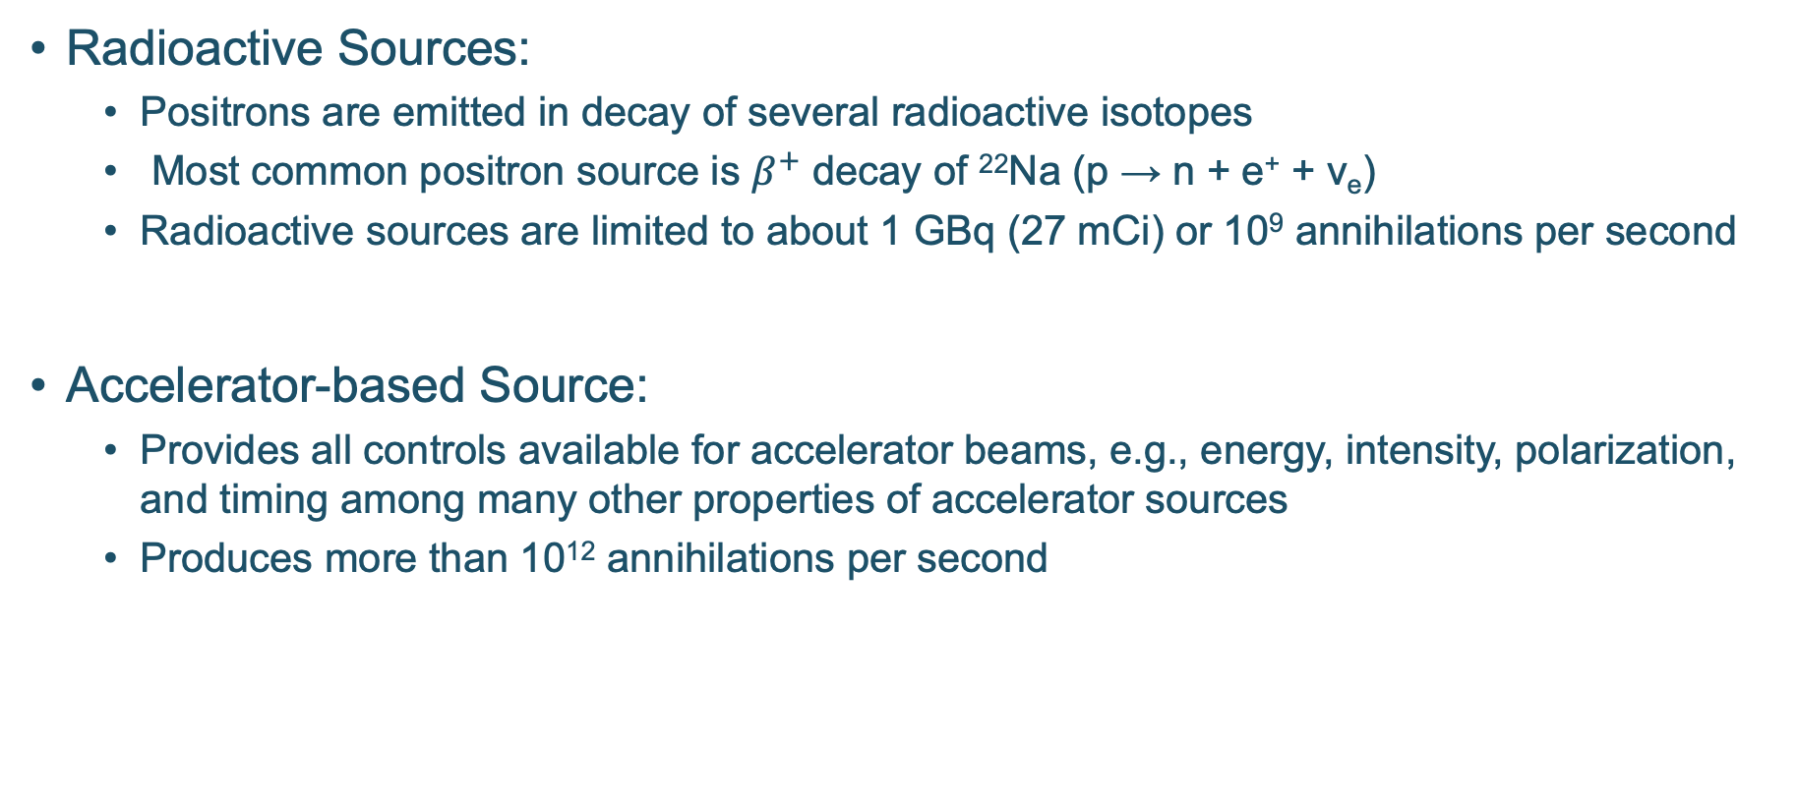
Positron Sources
Radioactive Sources:
Positrons are emitted in decay of several radioactive isotopes
Most common positron source is $β^{+}$ decay of ²²Na (p → n + e⁺ + ν_{e})
Radioactive sources are limited to about 1 GBq (27 mCi) or 10⁹ annihilations per second
Accelerator-based Source:
Provides all controls available for accelerator beams, e.g., energy, intensity, polarization, and timing among many other properties of accelerator sources
Produces more than 10¹² annihilations per second
Notes:
Sodium-22 (22Na) is a radioactive isotope primarily produced artificially in a cyclotron by bombarding magnesium (𝑛𝑎𝑡 Mg) or neon-22 (22Ne) targets with high-energy proton beams (approx. 15-70 MeV).

Slide 4
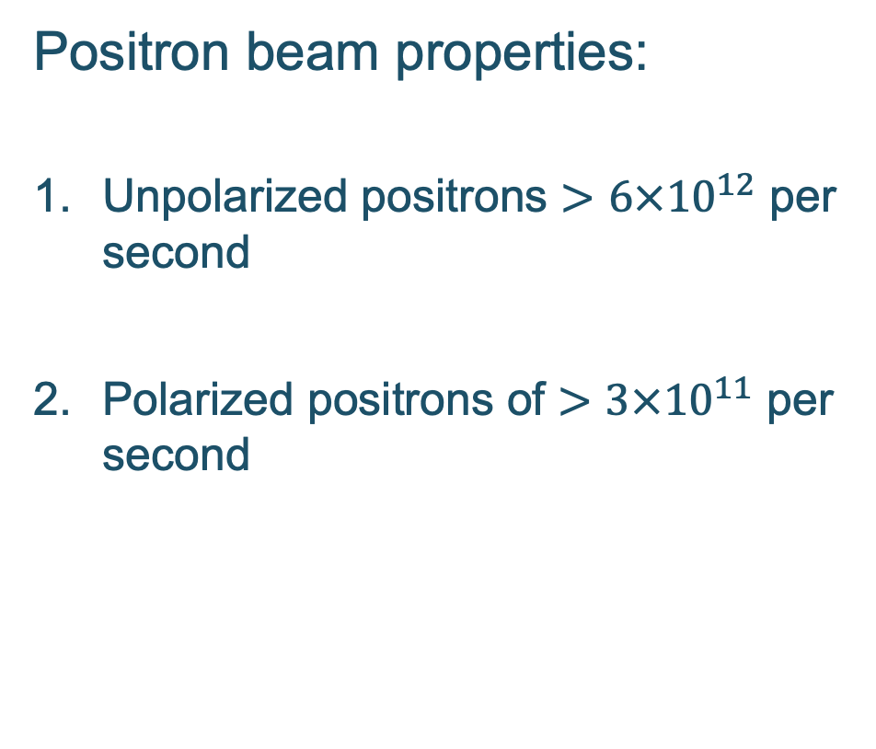
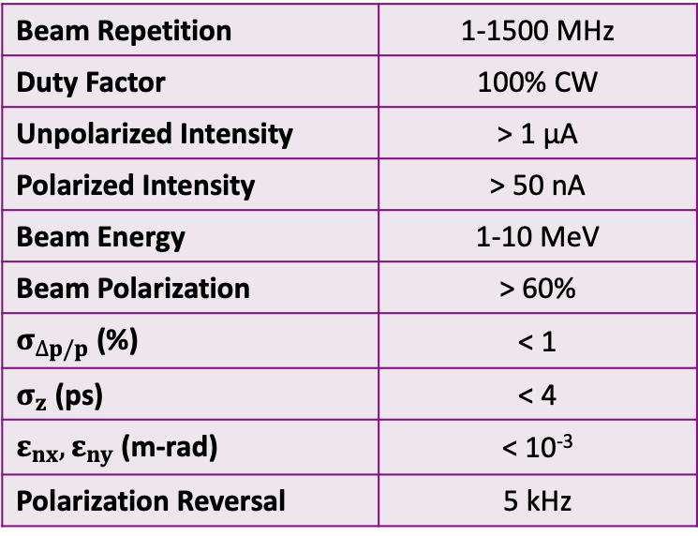
Jefferson Lab Positron Beam
Positron beam properties:
Unpolarized positrons $>6×{10}^{12}$ per second
Polarized positrons of $>3×{10}^{11}$ per second
Beam Repetition​ | 1-1500 MHz​
Duty Factor​ | 100% CW
Unpolarized Intensity​ | > 1 µA​
Polarized Intensity​ | > 50 nA​
Beam Energy | 1-10 MeV
Beam Polarization​ | > 60%​
$σ_{∆p/p}$ (%) | < 1
$σ_{z}$ (ps) | < 4
$ε_{nx},ε_{ny}$ (m-rad) | < 10⁻³
Polarization Reversal​ | 5 kHz
Notes:
Guidelines: 6-8 bullets per slide; Use sentence fragments for bullets

Slide 5
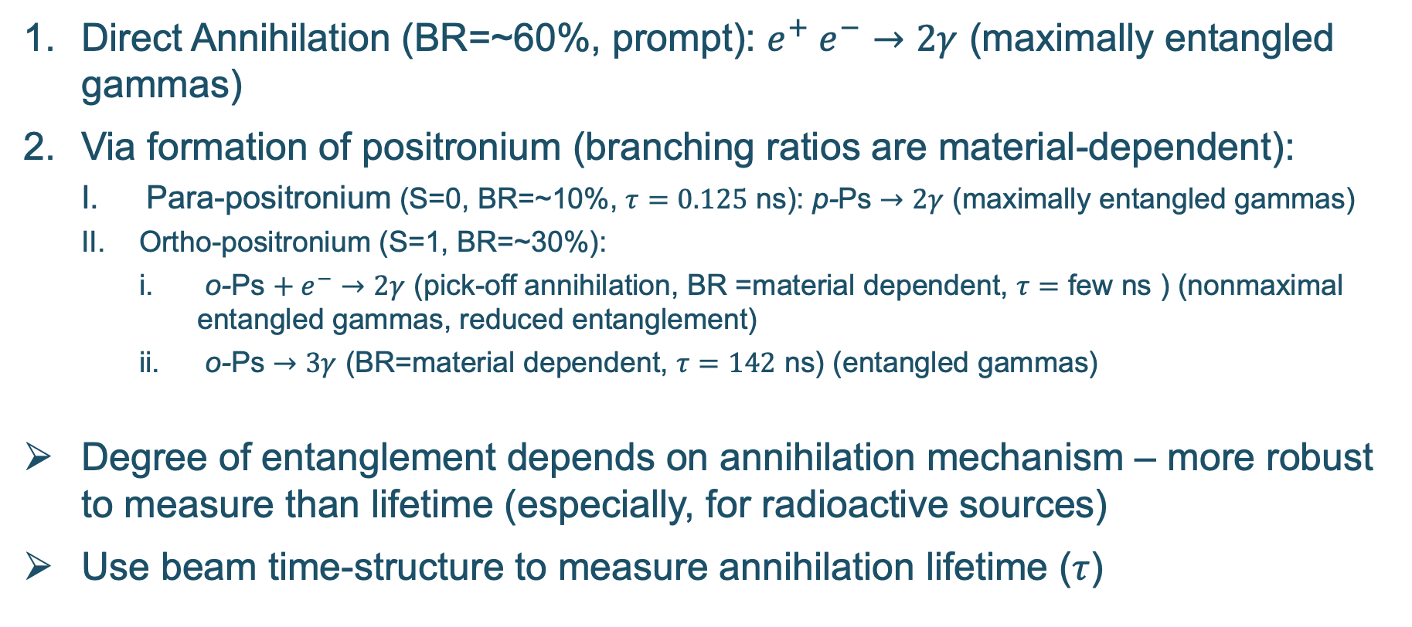
Positron Annihilation and Gammas Entanglement
Direct Annihilation (BR=~60%, prompt): $e^{+} e^{−}→2γ$ (maximally entangled gammas)
Via formation of positronium (branching ratios are material-dependent):
Para-positronium (S=0, BR=~10%, $τ=0.125$ ns): p-Ps $→2γ$ (maximally entangled gammas)
Ortho-positronium (S=1, BR=~30%):
o-Ps $+ e^{−}→2γ$ (pick-off annihilation, BR =material dependent, $τ=$ few ns ) (nonmaximal entangled gammas, reduced entanglement)
o-Ps $→3γ$ (BR=material dependent, $τ=142$ ns) (entangled gammas)
Degree of entanglement depends on annihilation mechanism – more robust to measure than lifetime (especially, for radioactive sources)
Use beam time-structure to measure annihilation lifetime ($τ$)

Slide 6
Quantum-Entangled Gamma Source
Quantum-entangled gamma source consists of:
Positron beam
Annihilation target made of thin metal foil or a tissue sample under study
Quantum-entangled gamma photons
Two or more Compton Polarimeters, each consist of:
Analyzer: can be a metal block, an object to be imaged, or an active gamma detector where 511 keV gammas scatter from
Gamma detectors to detect scattered gammas with high timing and energy resolutions
Coincidence electronics and data acquisition system

Slide 7

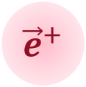
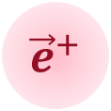
Source Schematics
Compton Polarimeter 1
Linearly Polarized
Gamma Photon Pair
~ ns → ~ µs
$${\vec{e}}^{+}$$
$${\vec{e}}^{+}$$
Annihilation Target
(Tissue Sample)
Positron Beam
Compton Polarimeter 2
Notes:
Guidelines: 6-8 bullets per slide; Use sentence fragments for bullets

Slide 8

Beam Time-Structure
Entangled gamma pairs can be identified with triple coincidence
Use beam time-structure to measure annihilation lifetime ($τ$)
Compton Polarimeter 1
Coincidence
Logic
Compton Polarimeter 1
Beam Timing
Window

Slide 9

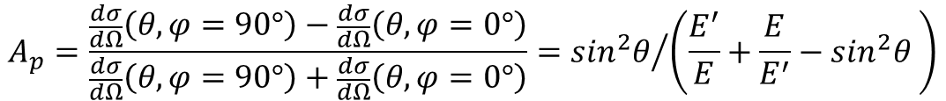

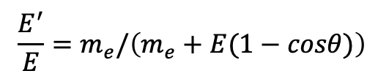
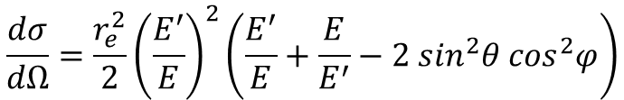


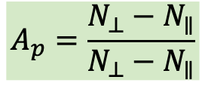

Compton Polarimetry of Longitudinally Polarized Gammas
Differential cross section:
Analyzing power:
Compton Polarimeter 1
$$\frac{dσ}{dΩ}=\frac{r_{e}^{2}}{2}{\left(\frac{E^{′}}{E}\right)}^{2}\left(\frac{E^{′}}{E}+\frac{E}{E^{′}}−2 \sin^{2}θ \cos^{2}φ\right)$$
Detectors
$$N_{⊥}$$
$$θ$$
$$\frac{E^{′}}{E}=m_{e}/\left(m_{e}+E(1−cosθ)\right)$$
Analyzer
$$φ$$
$$N_{∥}$$
$$\vec{E}$$
$$A_{p}=\frac{\frac{dσ}{dΩ}\left(θ,φ=90°\right)−\frac{dσ}{dΩ}\left(θ,φ=0°\right)}{\frac{dσ}{dΩ}\left(θ,φ=90°\right)+\frac{dσ}{dΩ}\left(θ,φ=0°\right)}={\sin^{2}θ}/{\left(\frac{E^{′}}{E}+\frac{E}{E^{′}}−\sin^{2}θ \right)}$$
$$A_{p}=\frac{N_{⊥}−N_{∥}}{N_{⊥}−N_{∥}}$$
For $E=511$ keV, $A_{p}$ reaches maximum of 0.69 at $θ=81.7°$

Slide 10
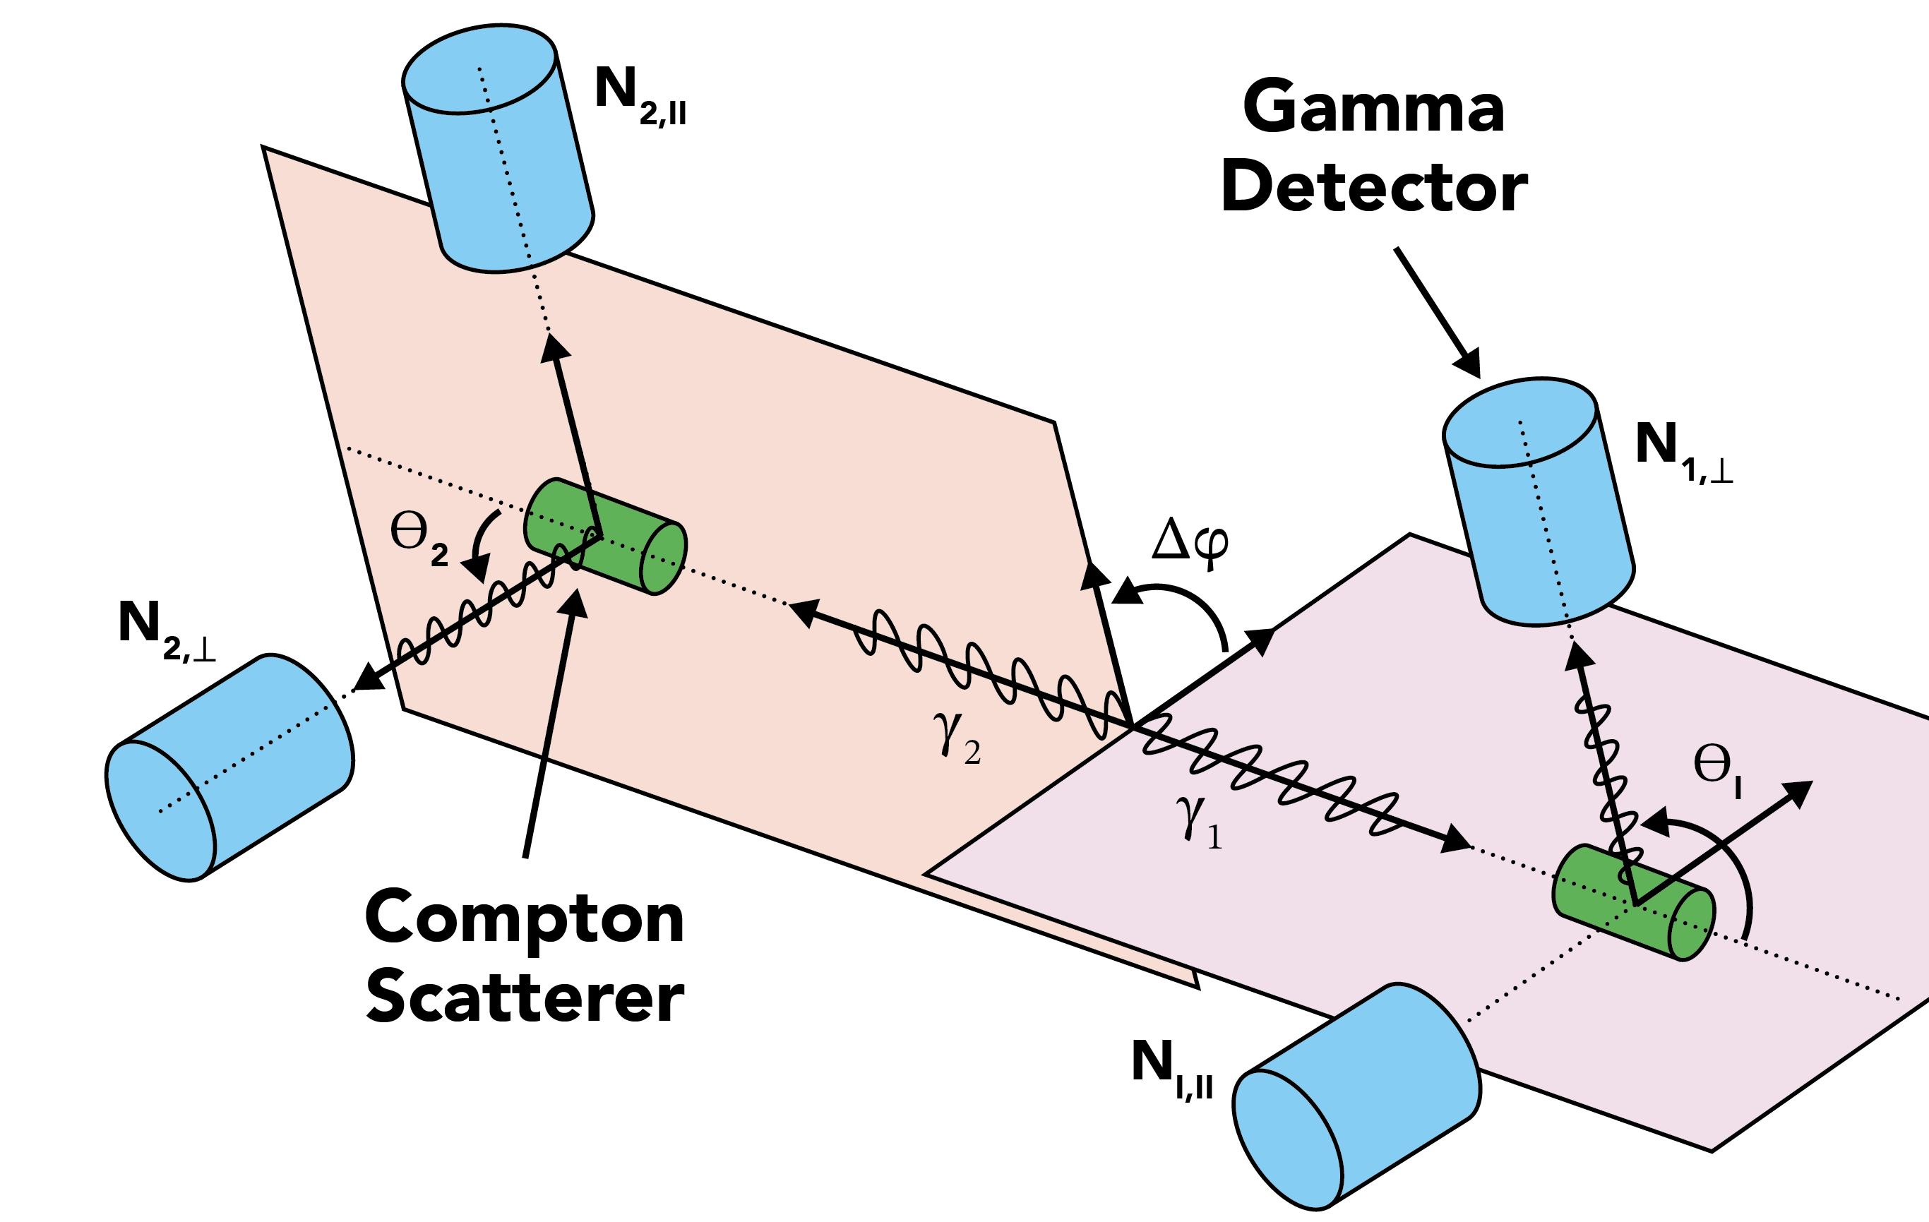





Double Compton Polarimetry
Differential cross section of double Compton scattering:
$$\frac{d^{2}σ_{double}}{dΩ_{1}dΩ_{2}}≠\left(\frac{dσ_{1}}{dΩ_{1}}\right)\left(\frac{dσ_{2}}{dΩ_{2}}\right)$$
$$\frac{d^{2}σ(θ_{1},θ_{2},Δφ)}{dΩ_{1}dΩ_{2}}=\frac{r_{e}^{4}}{16}\left[A\left(θ_{1},θ_{2}\right)−B\left(θ_{1},θ_{2}\right) cos⁡(2Δφ)\right]$$
$$A=\frac{\left[{(1−cosθ_{1})}^{3}+2\right] ∙ \left[{(1−cosθ_{2})}^{3}+2\right]}{{(2−cosθ_{1})}^{3} ∙ {(2−cosθ_{2})}^{3}}$$
$$B=\frac{\sin^{2}θ_{1} ∙ \sin^{2}θ_{2}}{{(2−cosθ_{1})}^{2} ∙ {(2−cosθ_{2})}^{2}}$$
Analyzer
$$N\left(φ\right)=A−B cos⁡(2Δφ)$$

Slide 11
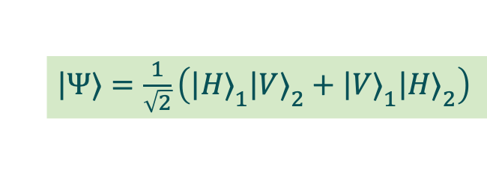
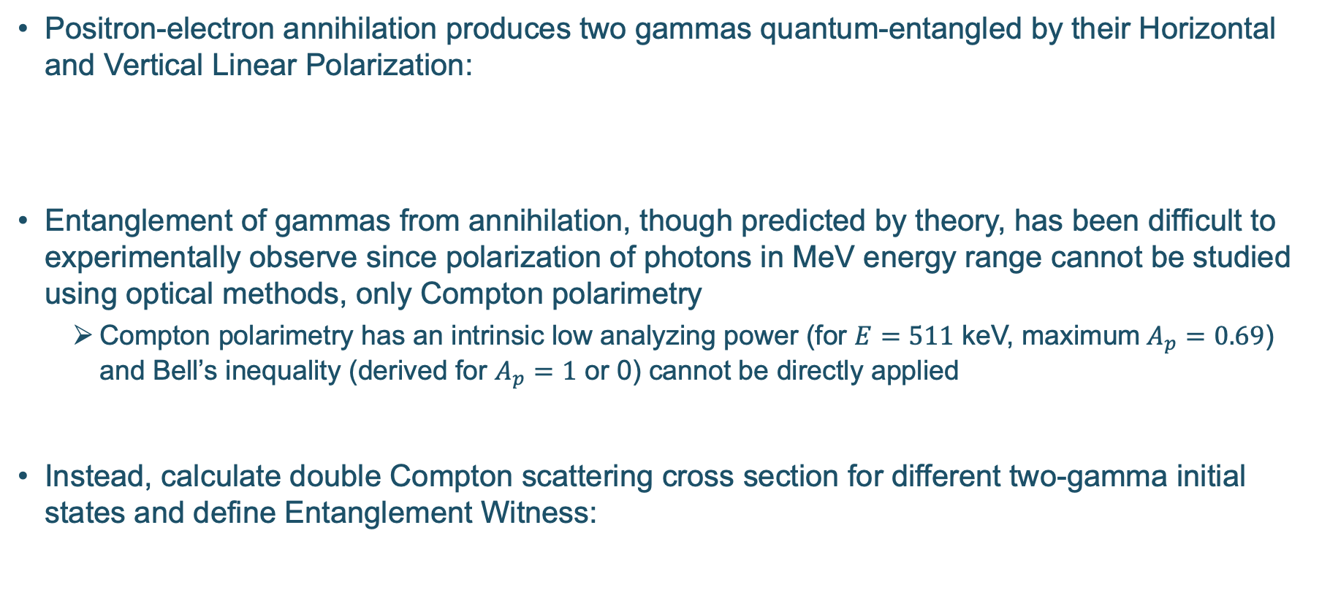
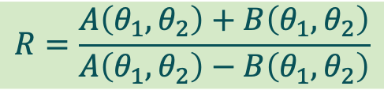
Quantum Entanglement
Positron-electron annihilation produces two gammas quantum-entangled by their Horizontal and Vertical Linear Polarization:
Entanglement of gammas from annihilation, though predicted by theory, has been difficult to experimentally observe since polarization of photons in MeV energy range cannot be studied using optical methods, only Compton polarimetry
Compton polarimetry has an intrinsic low analyzing power (for $E=511$ keV, maximum$A_{p}=0.69$) and Bell’s inequality (derived for $A_{p}=1$ or 0) cannot be directly applied
Instead, calculate double Compton scattering cross section for different two-gamma initial states and define Entanglement Witness:
$\left|Ψ⟩\right.=\frac{1}{\sqrt{2}}\left({\left|H⟩\right.}_{1}{\left|V⟩\right.}_{2}+{\left|V⟩\right.}_{1}{\left|H⟩\right.}_{2}\right)$
$$R=\frac{A\left(θ_{1},θ_{2}\right)+B\left(θ_{1},θ_{2}\right)}{A\left(θ_{1},θ_{2}\right)−B\left(θ_{1},θ_{2}\right)}$$

Slide 12
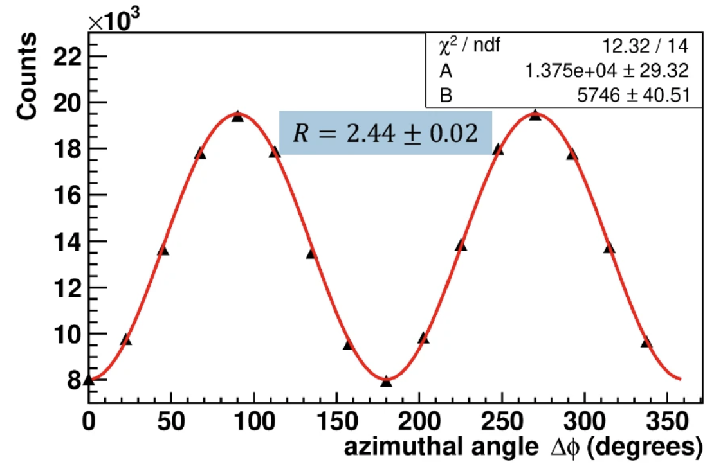
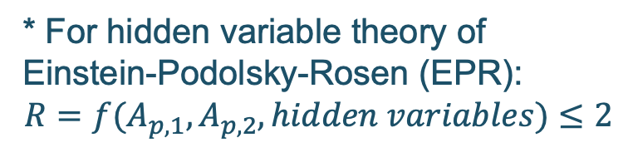
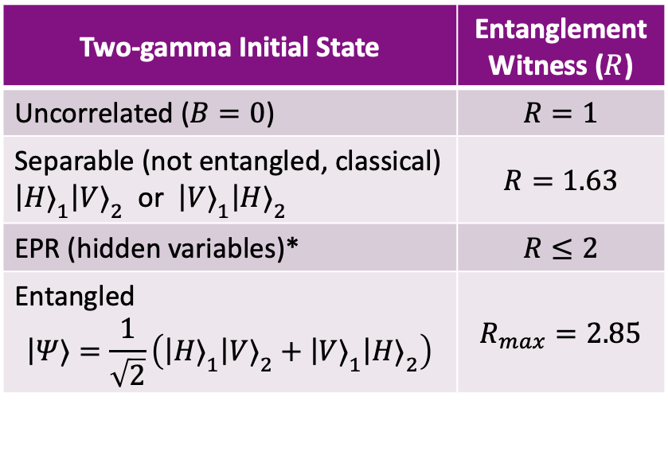

Entanglement Witness
$$θ_{1}=θ_{2}=90°$$
Two-gamma Initial State | Entanglement Witness​ ($R$)
Uncorrelated ($B=0$) | $$R=1$$
Separable (not entangled, classical) ${\left|H⟩\right.}_{1}{\left|V⟩\right.}_{2}$ or ${\left|V⟩\right.}_{1}{\left|H⟩\right.}_{2}$ | $$R=1.63$$
EPR (hidden variables)* | $$R≤2$$
Entangled $$\left|Ψ⟩\right.=\frac{1}{\sqrt{2}}\left({\left|H⟩\right.}_{1}{\left|V⟩\right.}_{2}+{\left|V⟩\right.}_{1}{\left|H⟩\right.}_{2}\right)$$ | $$R_{max}=2.85$$
* For hidden variable theory of Einstein-Podolsky-Rosen (EPR):
$$R=f(A_{p,1},A_{p,2}, hidden variables)≤2$$
Ivashkin, A., Abdurashitov, D., Baranov, A. et al. Testing entanglement of annihilation photons. Sci Rep 13, 7559 (2023).
https://doi.org/10.1038/s41598-023-34767-8

Slide 13
Quantum-Entangled Gamma Source – Advantages
511 keV gammas are penetrating radiation that can go through material which are not transparent for low energy photons
Entanglement can be used to identify positronium systems
Entangled gammas are generated using a positron beam from an accelerator:
Positrons arrive at annihilation target with a well-defined time-structure
Ability to control degree of polarization of positrons
Note: positrons from radioactive decays are polarized due to parity violation
Ability to set positron initial energy
Control of entangled gamma source can be achieved by controlling either the electron or the positron beam
Notes:
Quantum entangled photons are primarily produced using nonlinear optical processes, most commonly Spontaneous Parametric Down-Conversion (SPDC), where a high-energy pump photon splits into two lower-energy entangled photons within a nonlinear crystal (e.g., BBO, Lithium Niobate).

Slide 14
Applications
Entangled gamma photons have many relevant applications that include:
Improving image quality of Positron Emission Tomography (PET) systems
Material Ghost Imaging with Entanglement: one gamma interacts with an object and subsequently with a bulk detector, while its entangled pair contributes to generating the image with a second position-sensitive detector
Studying Quantum Entanglement: study the basic science of entanglement and local hidden-variable theories

Slide 15
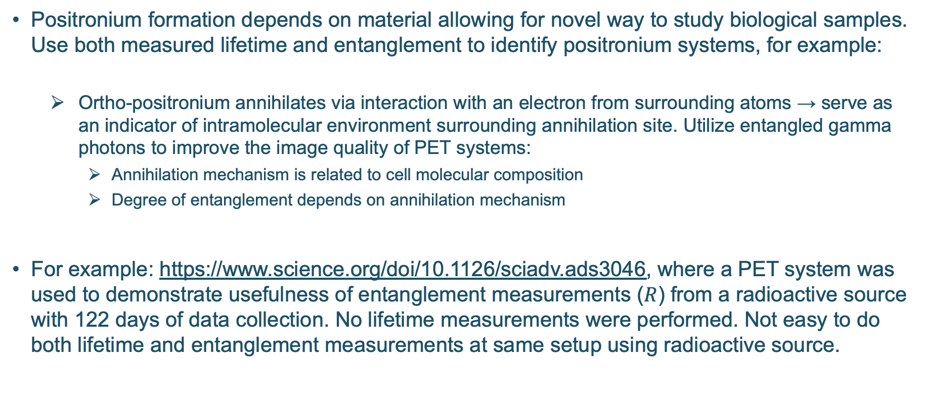
Application I – Medical Application
Positronium formation depends on material allowing for novel way to study biological samples. Use both measured lifetime and entanglement to identify positronium systems, for example:
Ortho-positronium annihilates via interaction with an electron from surrounding atoms → serve as an indicator of intramolecular environment surrounding annihilation site. Utilize entangled gamma photons to improve the image quality of PET systems:
Annihilation mechanism is related to cell molecular composition
Degree of entanglement depends on annihilation mechanism
For example: https://www.science.org/doi/10.1126/sciadv.ads3046, where a PET system was used to demonstrate usefulness of entanglement measurements ($R$) from a radioactive source with 122 days of data collection. No lifetime measurements were performed. Not easy to do both lifetime and entanglement measurements at same setup using radioactive source.

Slide 16
Ortho-positronium Application
Use positron beam time structure to study positronium system: positron beam with time structure of 5 MHz (200 ns bunch separation) allows for coincidence techniques to isolate such state
Very high intensity source enables precise second-scale measurements of environmental evolution during physical and chemical processes
With a beam-based source, measuring both lifetime and entanglement are straightforward and provides simple setup to study biological sample via positronium formation

Slide 17
Application II – Spintronics Application
Positronium formation depends on positron spin allowing for novel way to study spintronics. When positron and electron spins are parallel, only o-Ps are formed and when spins are antiparallel, both o-Ps and p-Ps are formed. Use both measured lifetime and entanglement to identify positronium systems.
Observing change in fraction of o-Ps or p-Ps upon spin reversal of polarized positrons, information about spin surface electron density of states can be measured.
Spin-polarized positronium spectroscopy can be used to study nature of spin of top surface electronic states and can be instrumental in field of spintronics: https://doi.org/10.1103/PhysRevLett.126.186401
With a beam-based source:
Spin reversal of positron beam up to 5 kHz is easily achieved by reversal of electron beam spin
Measuring positronium lifetime can be achieved using beam time structure
Measuring entanglement in double Compton polarimeters provides additional information to identify positronium formation

Slide 18
Summary and Outlook
A New Accelerator-Driven Source of Quantum-Entangled Gamma Photons:
Orders-of-magnitude intensity increase
Unique beam control capabilities
Applications:
Improving image quality of PET systems
Quantum imaging
Studying quantum entanglement
Future Plans:
Source optimization
Compton Polarimeter design
Applications development

Slide 19
Thank you
Notes:
Before sharing your presentation, confirm:
Fonts are consistent
Images meet quality standards
Charts use template colors
Footer information is current
Spell check completed
Links are working
File size is optimized

