Slide 1

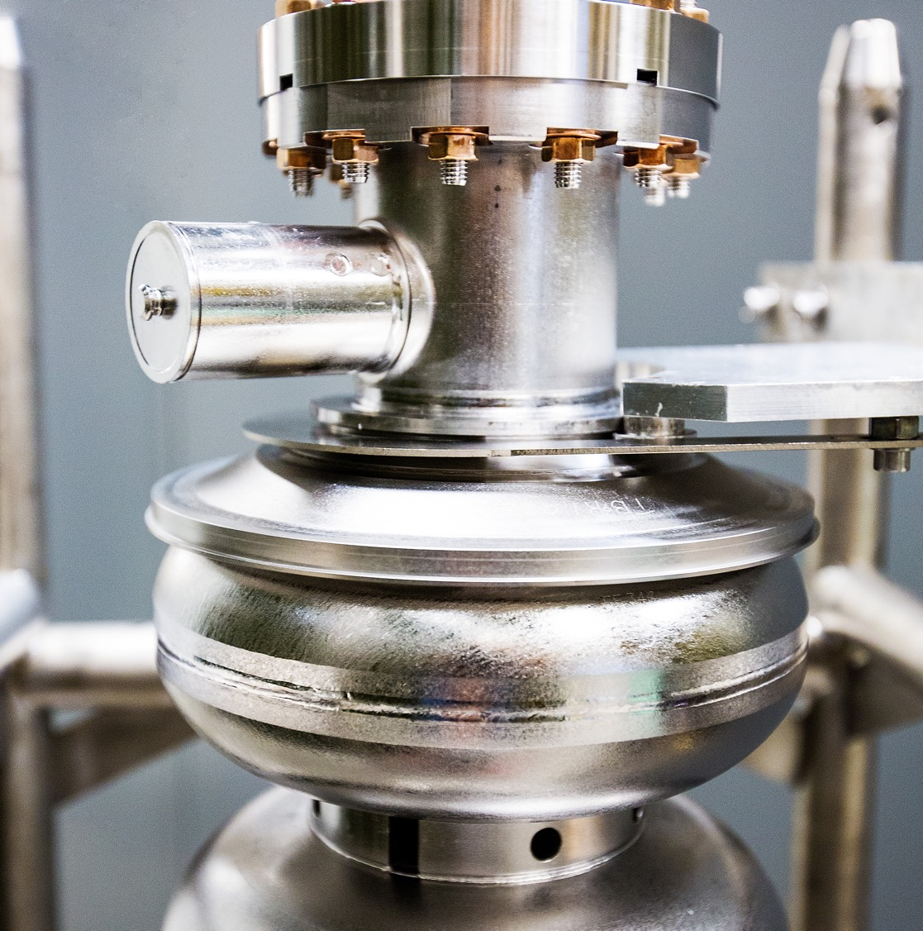
Ce⁺BAF: Positron Program at Jefferson Lab
03/23/2026
Yves R. Roblin and the Ce⁺BAF team
Notes:
Tip: Keep titles under 60 characters for readability
To change the photo: Right-click on photo and select change photo

Slide 2
Talk Outline
Motivation: Why polarized positrons at JLab?
Approved physics experiments
Two-Photon Exchange, Nuclear Structure, BSM
The Ce⁺BAF Concept
PEPPo technique — polarized positron production
LERF as a positron injector for CEBAF
Optics design connecting LERF to CEBAF 12 GeV
R&D Progress in Five Critical Areas
Solid rotating target & liquid metal jet target
High-intensity polarized electron gun (R30-5)
CW injector design — Generation 2
SRF capture cavity concept
Large-emittance beam transport & degrader experiment
LERF Test Facility
Path Forward

Slide 3
Science Case: Why Positrons at Jefferson Lab?
Jefferson Lab is uniquely positioned to provide CW, polarized (and unpolarized) positron beams
Two-Photon Exchange (TPE)
Resolve the proton form-factor discrepancy between Rosenbluth and polarization methods
Requires simultaneous e+ and e− beams — only possible at JLab
Nuclear Structure
Time-like form factors, deeply virtual Compton scattering with e+
Unique access to sea quark distributions
Beyond the Standard Model
Lepton universality tests, dark photon searches
~250 physicists from 70 institutions (PWG) supporting the science case
PAC has approved multiple experiments requiring polarized positron beams

Slide 4
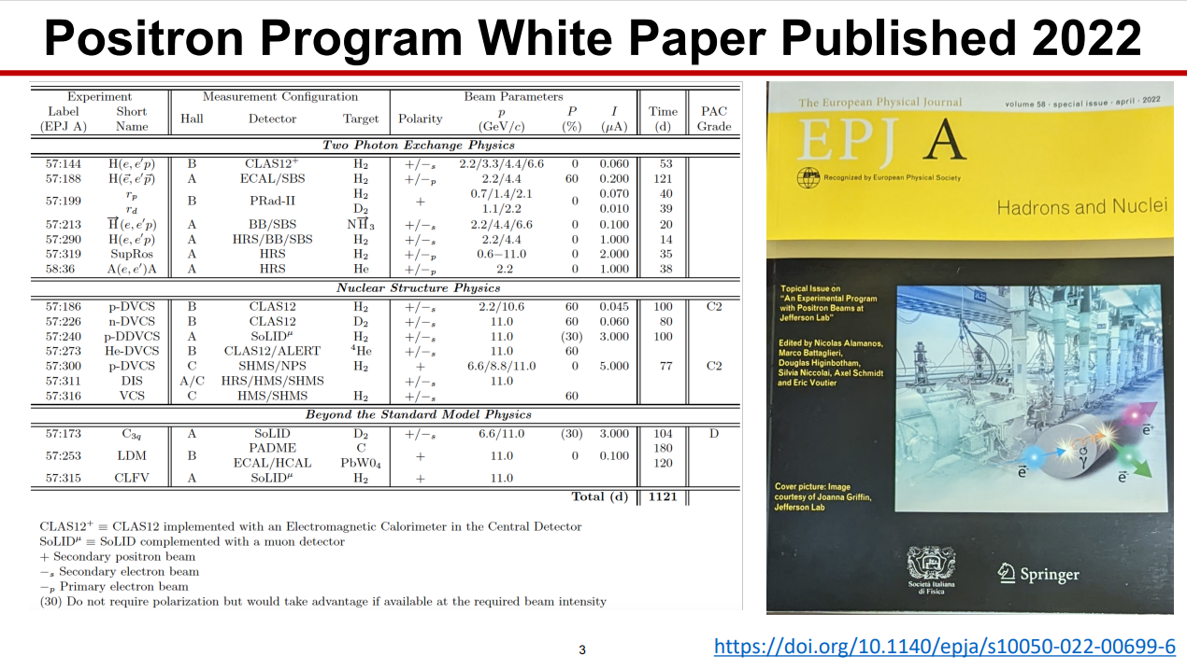
The Ce⁺BAF program

Slide 5

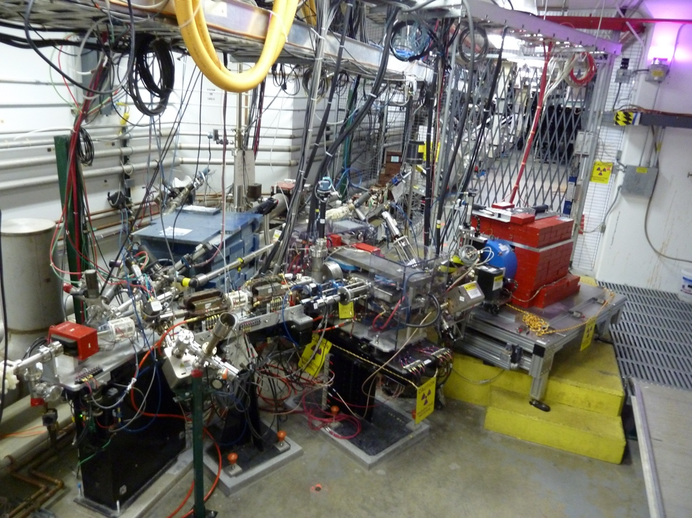
Polarized Electrons for Polarized Positrons (PEPPo)
Photo of the PEPPo setup in the injector area of CEBAF.
Notes:
positron source based on a high-energy electron driver beam works by sending the electron beam into a high-Z target, such as tungsten or tantalum, where the electrons first produce intense bremsstrahlung gamma rays as they are rapidly decelerated in the strong electric fields of the nuclei. Those gamma rays then interact with the same target material and, if their energy is above 1.022 MeV, can create electron-positron pairs. The result is a shower of secondary particles containing many positrons, along with electrons and photons

Slide 6
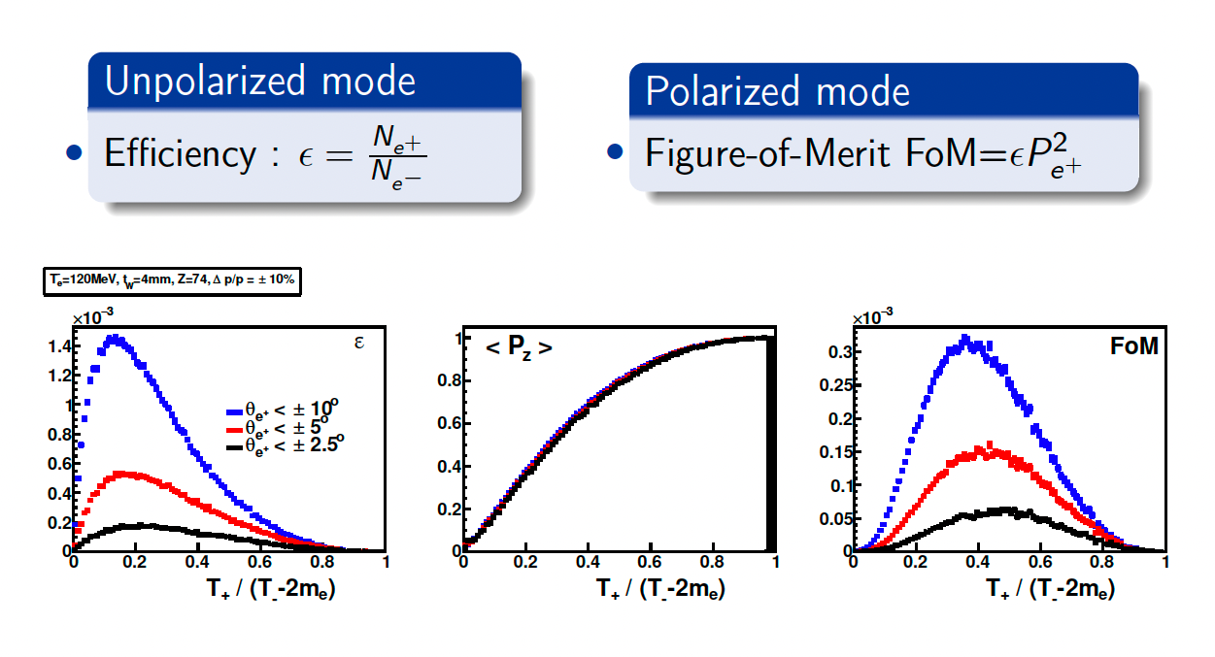
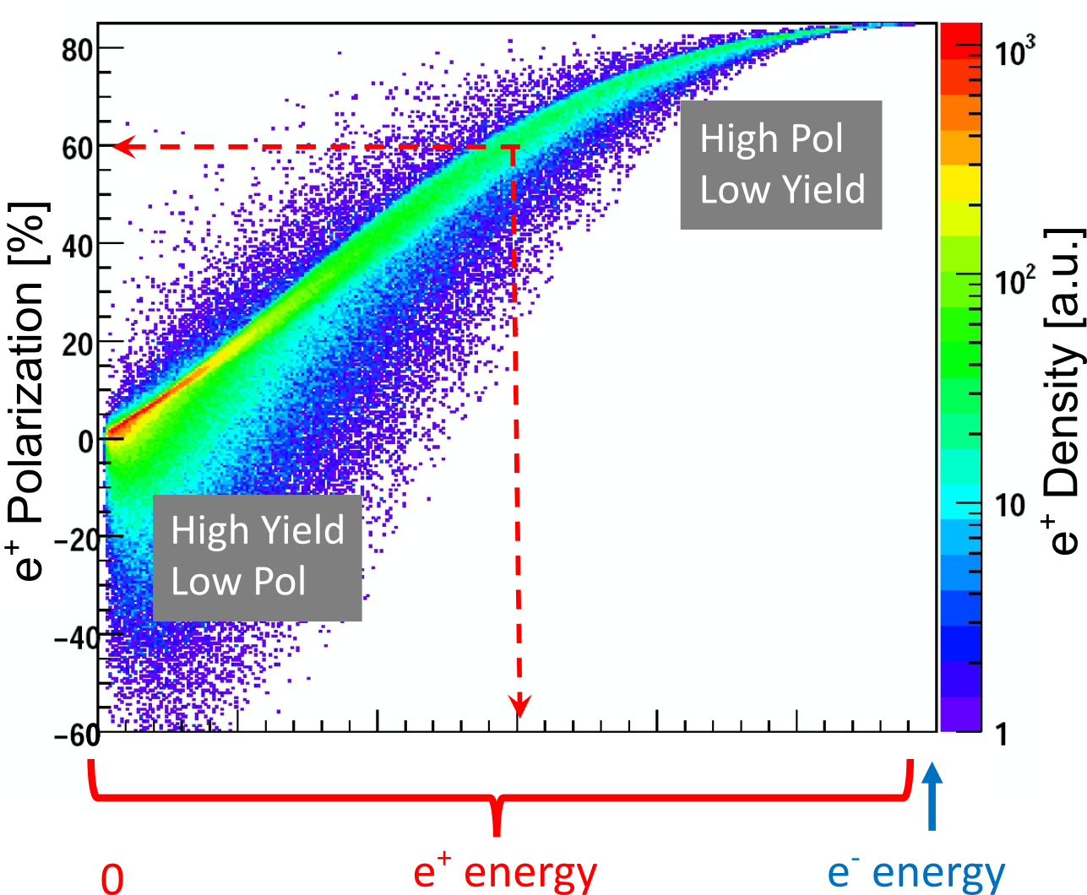
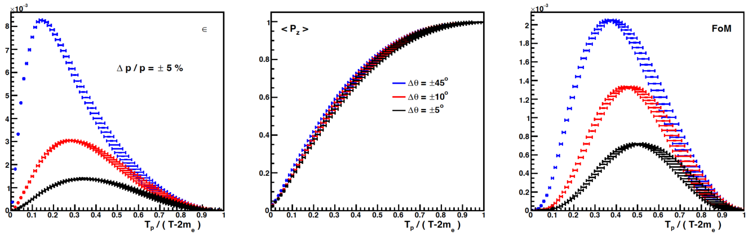
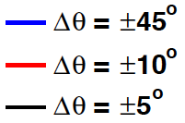
Positron generation for polarized vs unpolarized
e⁺ Polarization vs Energy
4 mm Tungsten Target
Efficiency
120 MeV e‒
FoM
e⁺
e‒
e⁺
e‒
Positron beamline has to be designed for efficient capture and transport of e⁺ with different energies

Slide 7
Ce⁺BAF: The Concept
Goal: deliver 123 MeV polarized positrons to the CEBAF 12 GeV accelerator
Exploit the Low Energy Research Facility (LERF) as a positron injector
LERF can house a SRF linac (See Next talk by A. Bogacz)
Can be used as a R&D area for developing various things (target, capture, gun )
1)1 mA CW electron gun to produce polarized positron beams
2)build positron source and LERF-to-CEBAF beamline
Plan designed to ramp up as EIC project cost ramps down

Slide 8
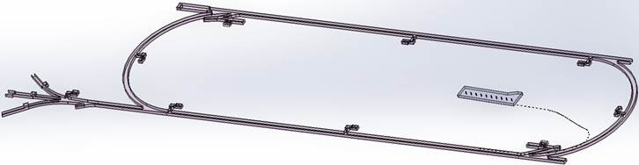
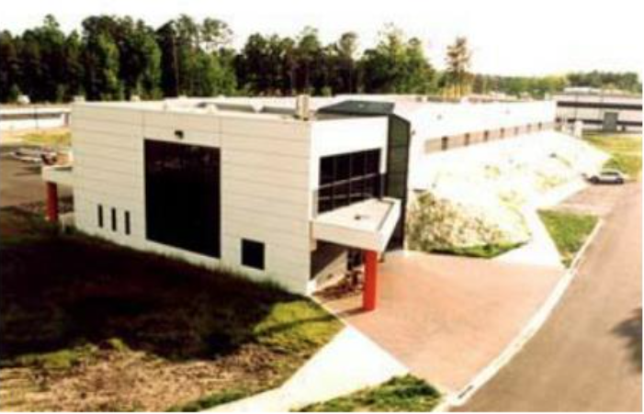
Turning the LERF into a Positron Injector Facility
123 MeV
Inject e⁺ into North Linac to usual 12 GeV (w/ magnets reversed)
Build e⁺ injector at the LERF
Build new LERF to CEBAF tunnel
123 MeV
Build new transport line along South Linac and West Arc

Slide 9
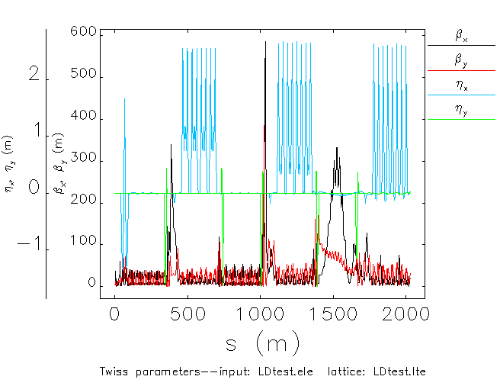
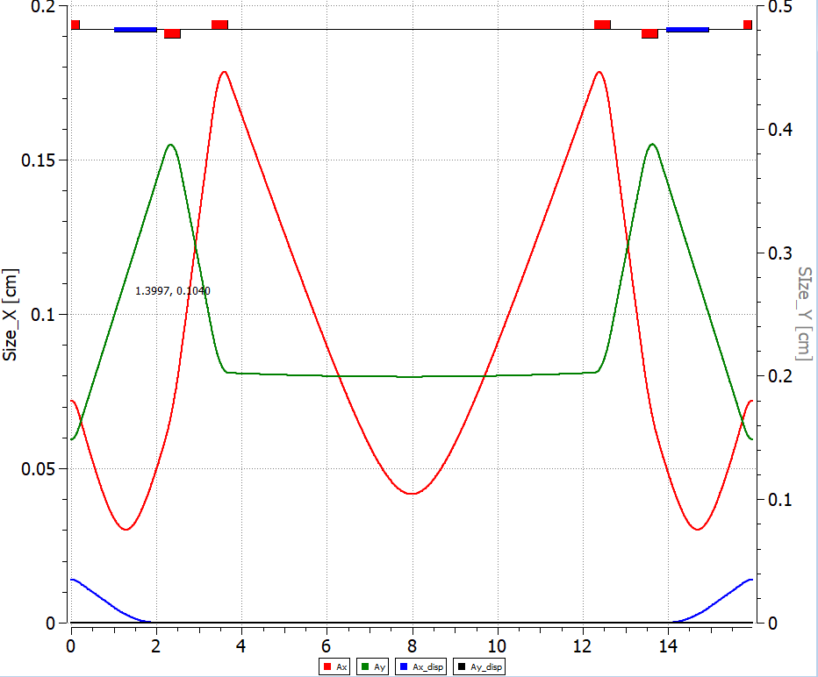
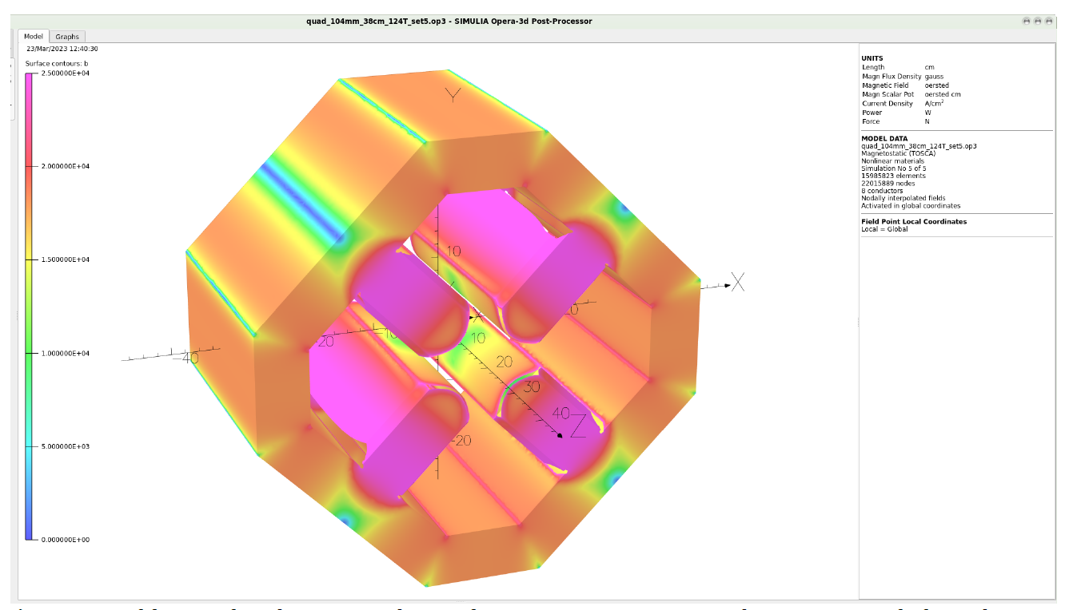
Transporting Large emittance beam
Area | dp/p [x10⁻³] | emit_{x} [nm] | emit_{y} [nm]
Chicane | 10 | 500 | 500
Arc 1 | 1 | 50 | 50
Arc 2 | 0.53 | 26.8 | 26.6
Arc 3 | 0.36 | 19 | 18.6
Arc 4 | 0.27 | 14.5 | 13.8
Arc 5 | 0.22 | 12 | 11.2
Arc 6 | 0.19 | 10 | 9.5
Arc 7 | 0.17 | 8.9 | 8.35
Arc 8 | 0.16 | 8.36 | 7.38
Arc 9 | 0.16 | 8.4 | 6.8
MYAAT01 | 0.18 | 9.13 | 6.19
damping
Sync rad.
Low dispersion optics in ARC1/ARC2
Design optics similar to low emittance rings (n-bend achromats) from LERF to CEBAF
Use larger bore quadrupoles

Slide 10
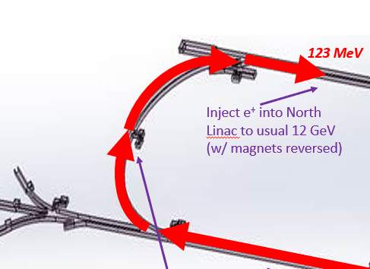
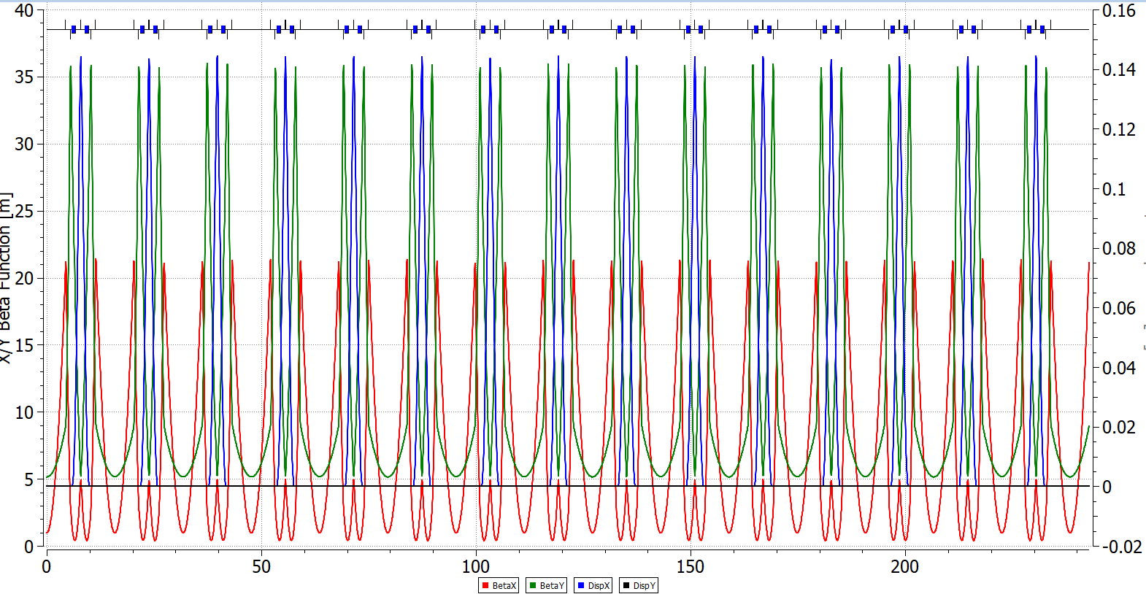
Using a Double Bend Achromat

Slide 11
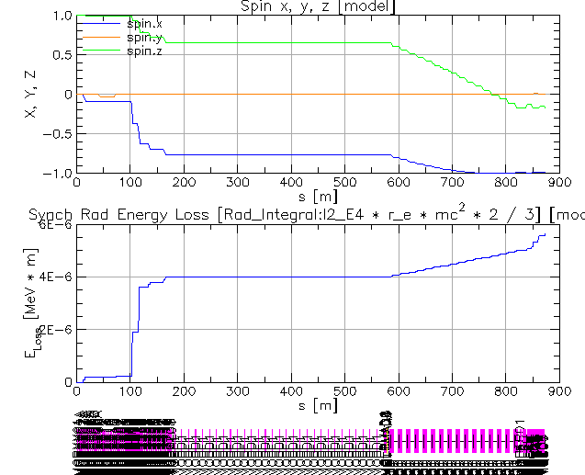
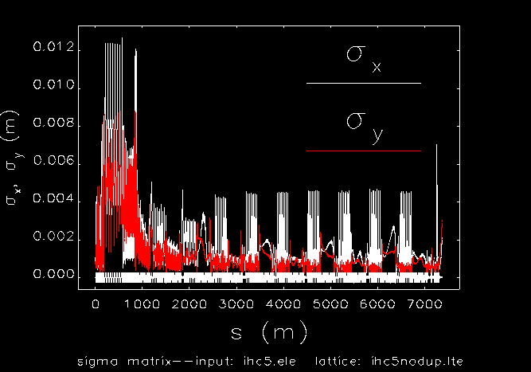
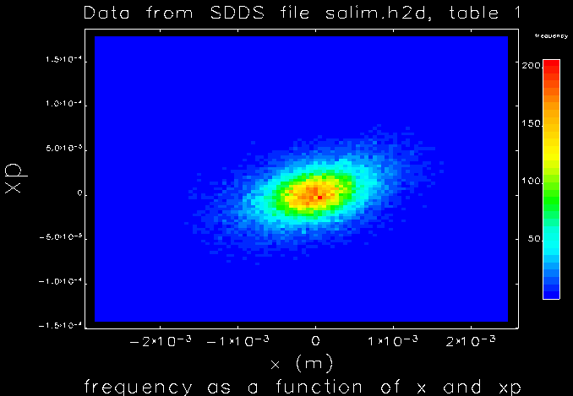
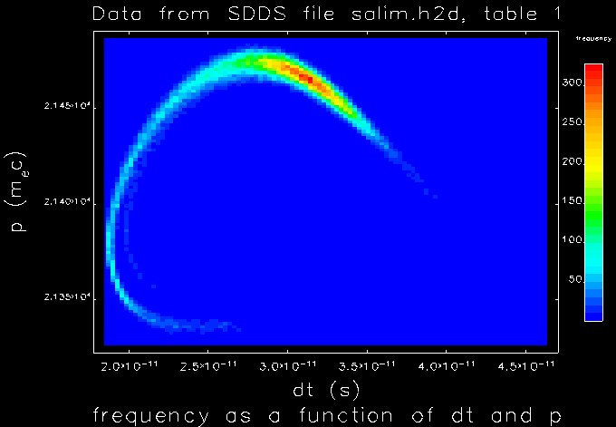
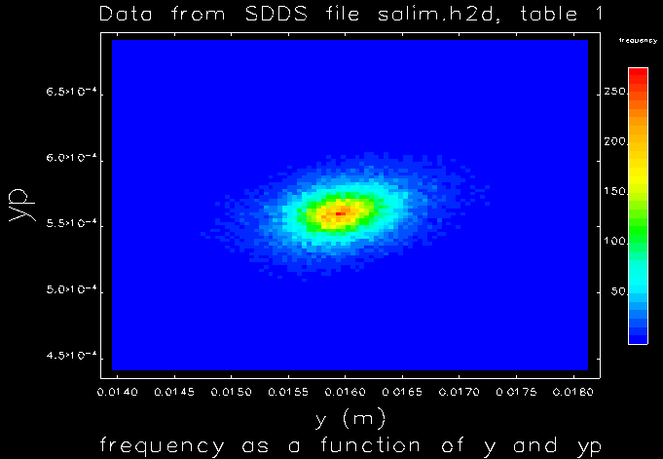
Multiparticle Tracking with 123 MeV e+ Beam to Hall C
​ | Simul.​ | Goal​
Energy [MeV]​ | 123​
Current [nA]​ | 170​ | > 50​
Polarization [%]​ | 65​ | > 60​
[%]​ | 0.6​ | < 1​
[ps]​ | 2​ | < 4​
[m·rad]​ | 1.5e-3​ | < 4e-5​
S.Ogur
Particle bunch tracking as well as spin tracking validate current design
Notes:
Optics design connecting LERF to CEBAF 12 GeV completed in 2025
Led by Salim Ogur (Grunder Fellow) with CASA colleagues
Documented in a JLab Technical Note and presented at FCC-ee peer workshops
Design transports 123 MeV e+ or 650 MeV e− using bipolar supplies
Large-emittance acceptance: εn,x , εn,y < 100 mm·mrad, dp/p < 5%, σz < 1 mm
Dedicated transport lines with large-bore quads and low-dispersion optics
104 mm-ID quads (JLAB TN-06-029) accommodate 60 mm·mrad normalized emittance
Spin tracking performed end-to-end — no issues found
Very positive step forward; forms the basis of the conceptual design report

Slide 12
R&D in Five Critical Areas
Notes:
We discussed the physics motivation and the concept. Now let’s look at how this translates in terms of R&D.

Slide 13
Target R&D: Solid Rotating Tungsten Target
DOE NP 'Futures' funded a solid rotating target prototype
Designer: Silviu Covrig + team
Technical parameters under study
~40 cm target diameter, 2 Hz rotation frequency
8 mm water channel radius, 0.3 kg/s water mass flow rate (1.5 m/s)
Motion mechanism: stable rotation in vacuum up to 10 Hz via ferrofluid feedthrough
Target disk sandwiched between copper frames, bolted together
Key challenges: deposited power, radiation damage, thermal fatigue
Project progress: CFD 75%, engineering 30%, fabrication 5%
Vacuum + thermal testing using high-power laser at LERF planned for later this year
See Talk By S. Covrig

Slide 14
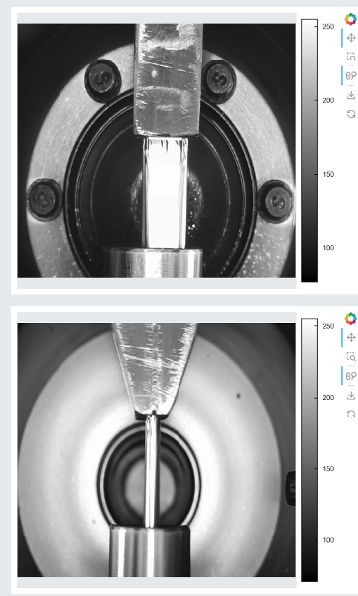
Target R&D: Liquid Metal Jet Target
DOE SBIR Phase II (Xelera Research) — working prototype demonstrated
Windowless liquid jet of GaInSn (gallium-indium-tin eutectic, liquid at room T)
3 mm thick × 10 mm wide jet at high velocity
Heat extracted via water-cooled heat exchanger — capable of absorbing 10s of kW
Recent progress (FY25–FY26)
No-cost extension approved by DOE for extended testing phase
Constructing final transportable system for delivery to JLab this spring
Vacuum consistently below 1×10⁻⁸ Torr in lab testing
Negligible impact from magnetic fields confirmed
Long-duration runs (24–36 hours) in progress; EPICS controls in development
Next step: irradiation with >50 kW / 10 MeV beam at LERF
See Talk By K. Smolenski

Slide 15
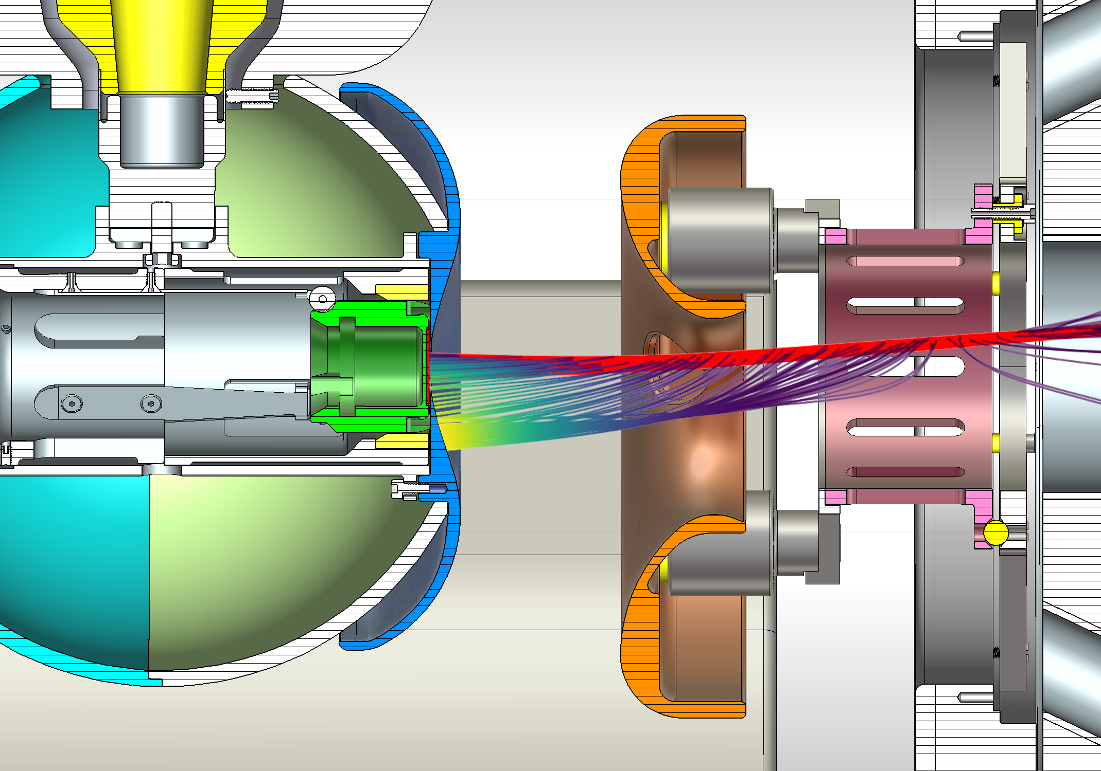
R30-5: a 200 keV photogun optimized for high charge lifetime
See Talk By M. Bruker

Slide 16
CW positron Injector: Generation 2 Design
Realistic Generation 2 model developed (based on SLC, ILC, FCC-ee concepts)
Led by Andriy Ushakov Documented in JLab Technical Note; presented at LDRD reviews and workshops
Components: polarized e− source → high-Z target → normal-conducting capture cavity
→ quarter-wave transformer → transport to CEBAF
Key challenge identified: emittance–yield tradeoff unfavorable by ~50×
At 130 MeV, 1 mA, 4 mm W target: normalized emittance ~50× too large
Extensive CFD simulations (Covrig) underway to probe limits on beam size
FY26 pivot: evaluate improvements via higher beam energy, smaller spot, thinner target
Synergy with 22 GeV upgrade motivates Universal Electron Injector at LERF (3-pass SRF), See next Talk By Alex Bogacz

Slide 17
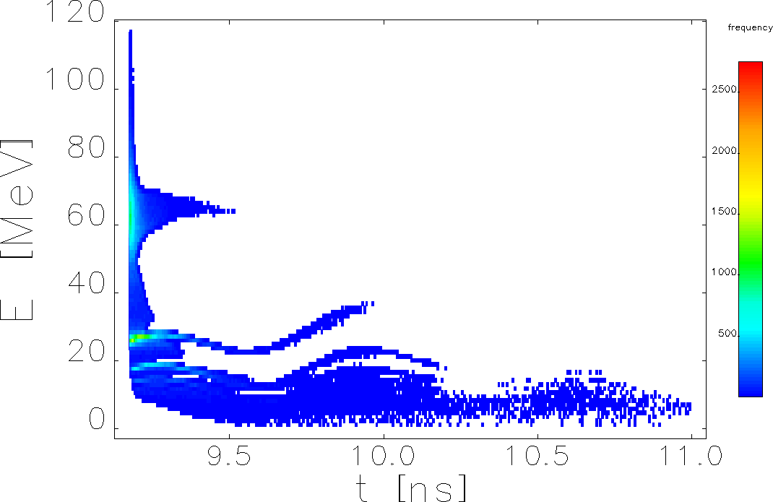
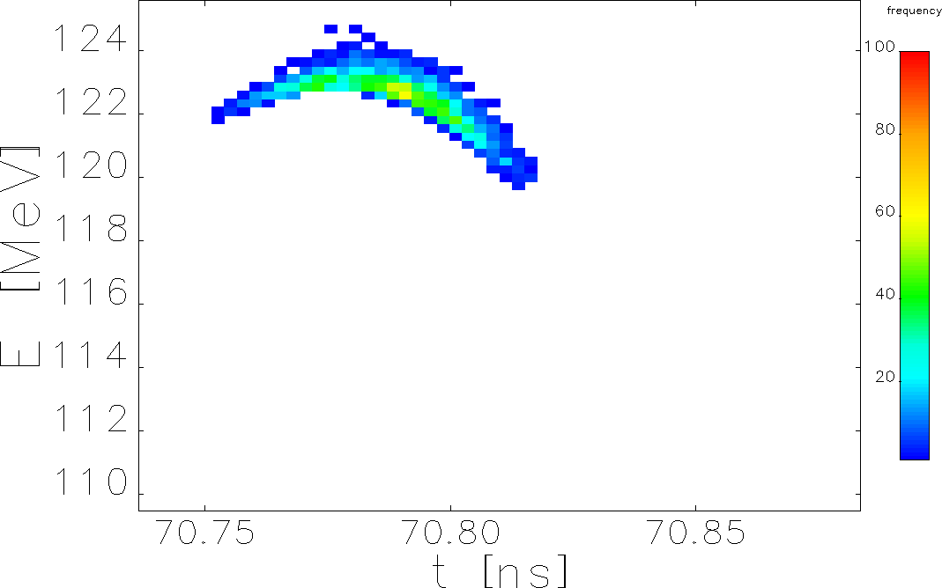
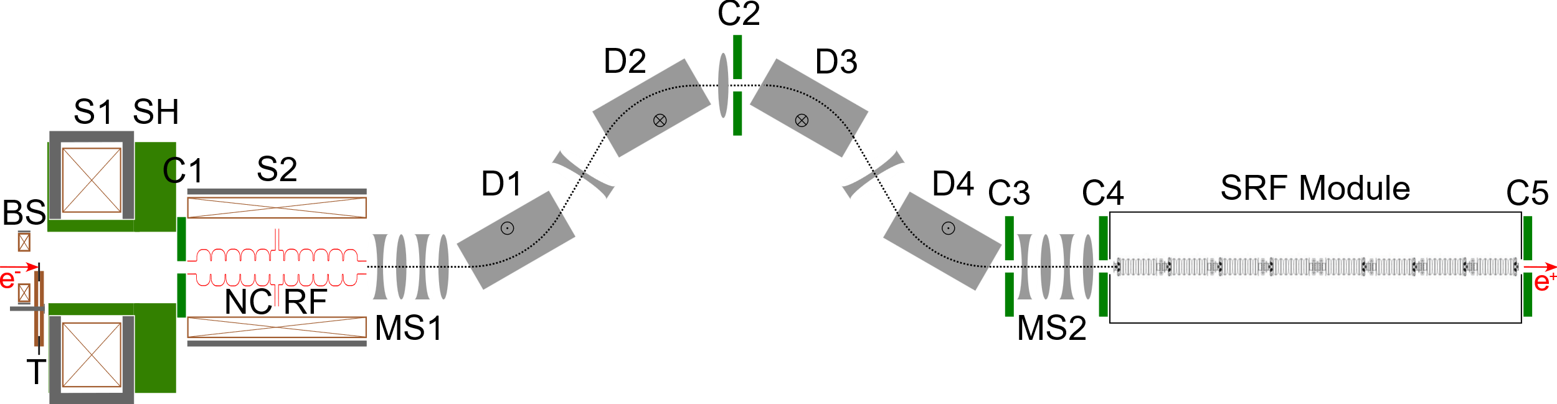
Schematic Layout of Positron Injector for Ce⁺BAF
Select Energy Range
E = 123 MeV
σ_{ΔE/E} < 1%
BS: bucking solenoid
T: conversion target
S1,S2: solenoids of capture system
SH: shielding
NC RF: normal conducting capture cavity
MS1,MS2: matching sections
D1-D4: dipoles
C1-C5: beam collimators
SRF Module: CEBAF C75 module
A. Ushakov
Notes:
For CW or high-duty-factor positron sources, SRF is essential
Normal-conducting RF: prohibitive wall losses at high duty factor
High RF field gradient needed to capture and damp the large-emittance e+ beam quickly
Solenoids between SRF cavities confine the beam transversely during capture
Adiabatic damping reduces transverse emittance during acceleration
px stays constant while vx decreases with increasing γ → x' decreases → emittance damped
This is a key mechanism for making the positron beam acceptable to CEBAF

Slide 18
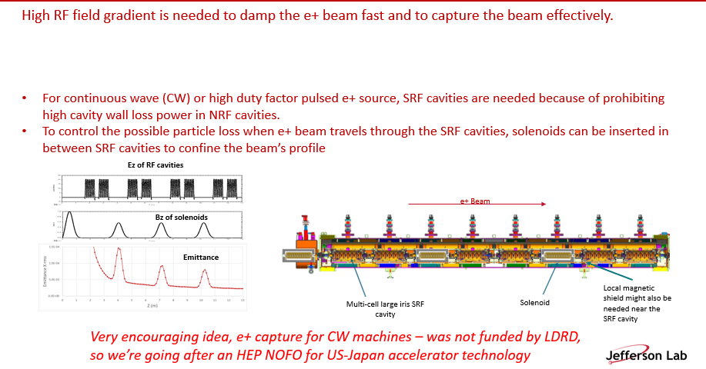
Conceptual Development SRF CW capture

Slide 19
Large-Emittance Beam Transport
Core challenge: e+ beam emittance is 10s–100s× larger than typical CEBAF e− beam
Transverse normalized emittance: up to 40 mm·mrad vs. <1 mm·mrad for normal e−
Energy spread: up to ±1% vs. <0.1% for typical CEBAF operation
Up to 40 mm·mrad must be injected and survive to NL arc
Design solutions
Dedicated transport lines with large-bore quadrupoles (104 mm ID, JLAB TN-06-029)
Low-dispersion DBA optics in the LERF-to-CEBAF transport line
Degrader experiment: probing CEBAF acceptance directly with degraded e− beams

Slide 20
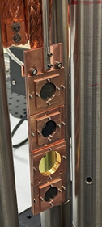
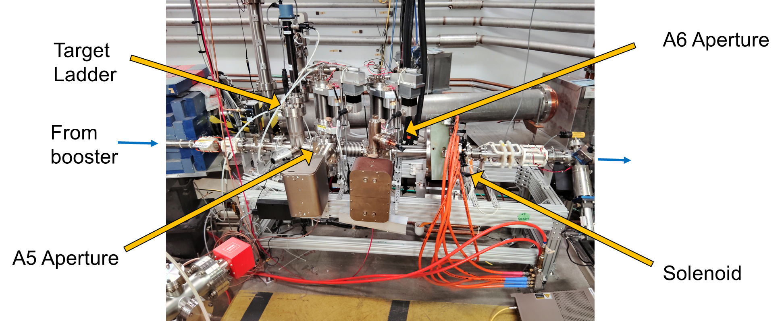
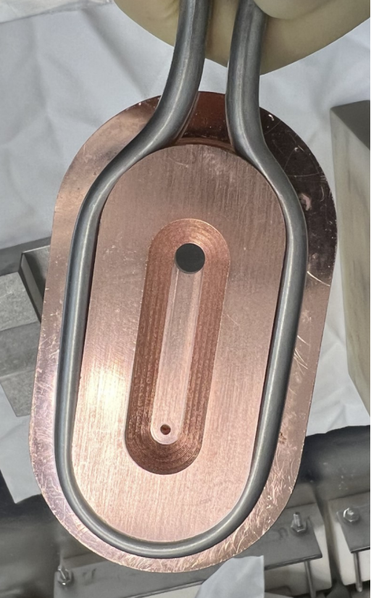
Degraded beams
The intensity of the positron beam depends on the extent of the beam size (emittance), bunch length, and energy spread at the target
It is especially important to quantify the acceptance of CEBAF at injection and through the first pass, as beam properties improve with acceleration
An LDRD project (FY22-FY24) funded the design, construction and installation of an e- beam degrader in the CEBAF injector to test these limits in conjunction with nominal e- beams
The degrader device consists of targets to degrade e- beam phase space; two collimating apertures to limit transverse emittance; and solenoid to match to the rest of the CEBAF injector
Target ladder
Aperture
Degrader device installed in CEBAF injector
Amy Sy

Slide 21
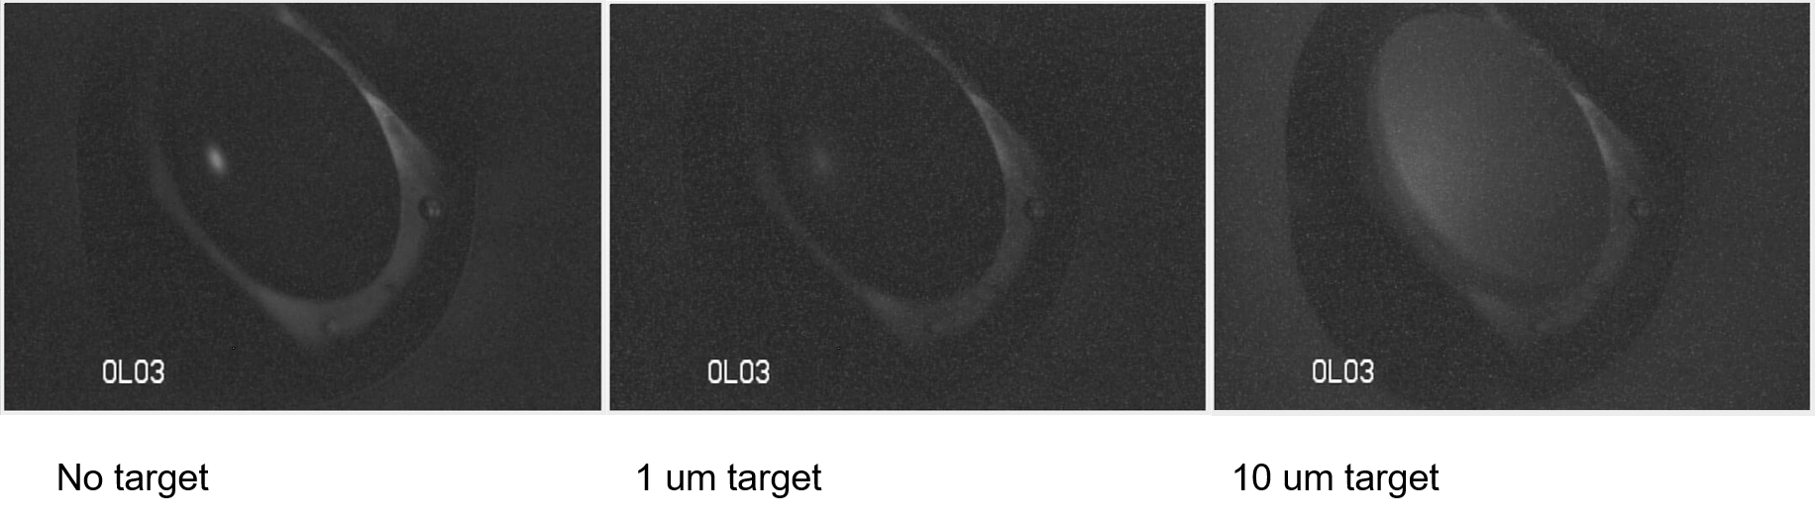
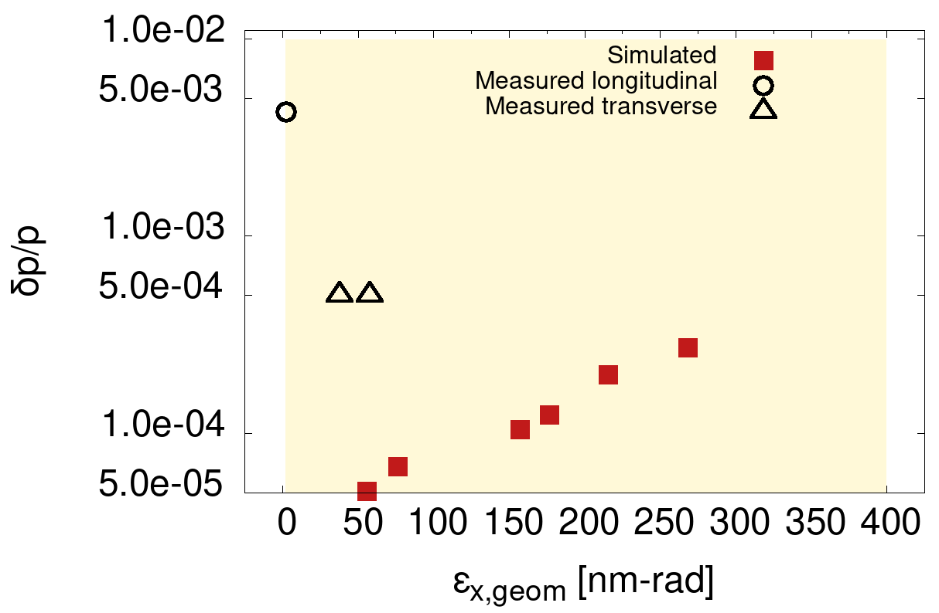
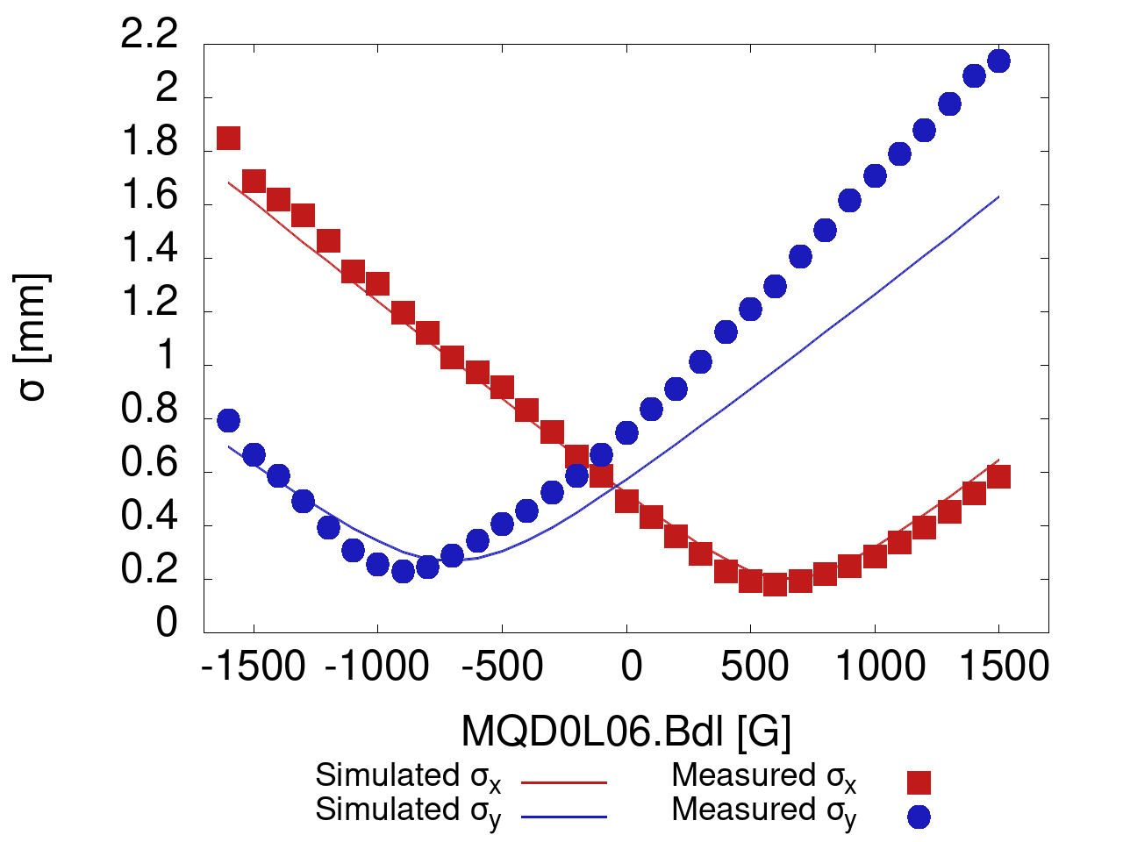
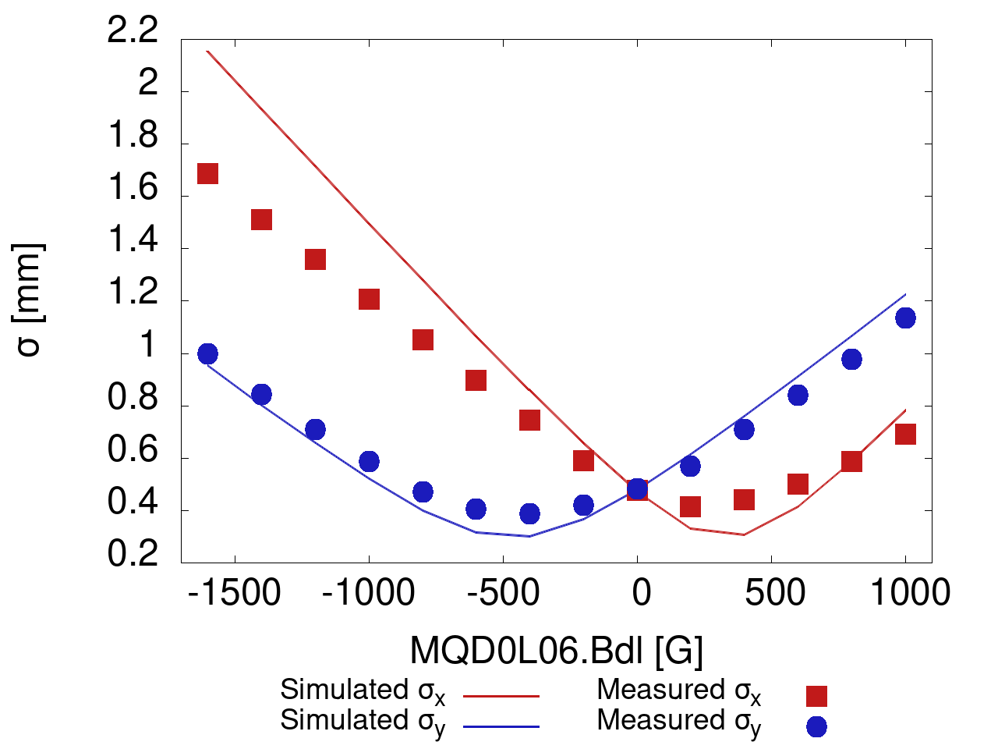
Degraded beams – Commissioning and Experiment
Degrader device commissioning and first degraded beams during FY25 physics run
Initial emittance measurements of degraded beams show reasonable agreement with simulation
Measurements during upcoming FY26 physics run will focus on characterization of degraded beams and transport beyond injector
Degraded beams on view screen in CEBAF injector
Degraded beam phase space for injection to NL
Goal
Quadrupole scans vs simulation using 1 μm carbon target
IHA0L08
IHA0L09
Amy Sy
Notes:
Open markers in bottom right plot mean quantity is unknown in other plane, e.g. measured transverse data point has unknown dp/p

Slide 22
Degrader Results: FY25 Measurements & FY26 Plans
FY25 — First commissioning and degraded beam runs
Degraded beams visible on view screens in CEBAF injector
Quadrupole scans match simulation predictions (1 μm carbon target)
~13 mm·mrad degraded beam transported to NL demonstrated
Critical harp repaired during SAM shutdown — enables quantitative emittance measurement
FY26 plans — quantitative characterization beyond injector
Objective: transport degraded beam through NL and into ARC1 (to 1R)
Use repaired wire scanner for quantitative phase-space study
Map CEBAF acceptance as function of emittance and momentum spread
Results will directly inform Ce+BAF injector design parameters
Significance: first direct experimental confirmation of CEBAF large-emittance acceptance
Amy Sy

Slide 23
LERF: The R&D Testbed
LERF (Low Energy Research Facility) — the old FEL injector
Plan: restore to 100 kW / 10 MeV e− capability for target and e+ R&D
Year 1: install CEBAF-style load-lock gun and drive laser (FY25)
Year 2: install repaired QCM and commission 10 MeV beam
Year 3: target testing and e+ production demonstration
Current status: CEBAF-style gun installed (FY25)
Ongoing: SRF quarter + RF refurbishment understood but unfunded
FEL gun/PS restoration delayed due to reduced staffing

Slide 24
Summary & Path Forward
• The Ce⁺BAF concept is sound — a CW, polarized e+ injector to CEBAF can be built
• Generation 2 model identified a 50× emittance challenge → FY26 focus on CFD + SRF capture
• Three prototype projects (mA gun, solid target, liquid jet) all progressing, results in 6–12 months
• Degrader experiment provides first direct data on CEBAF large-emittance acceptance
• LEEPP workshop (this week!) aims to build broad community support for e± physics at Jlab
• Next milestones: FY26 degrader run to 1R, liquid jet delivery, solid target thermal test at LERF

