Slide 1

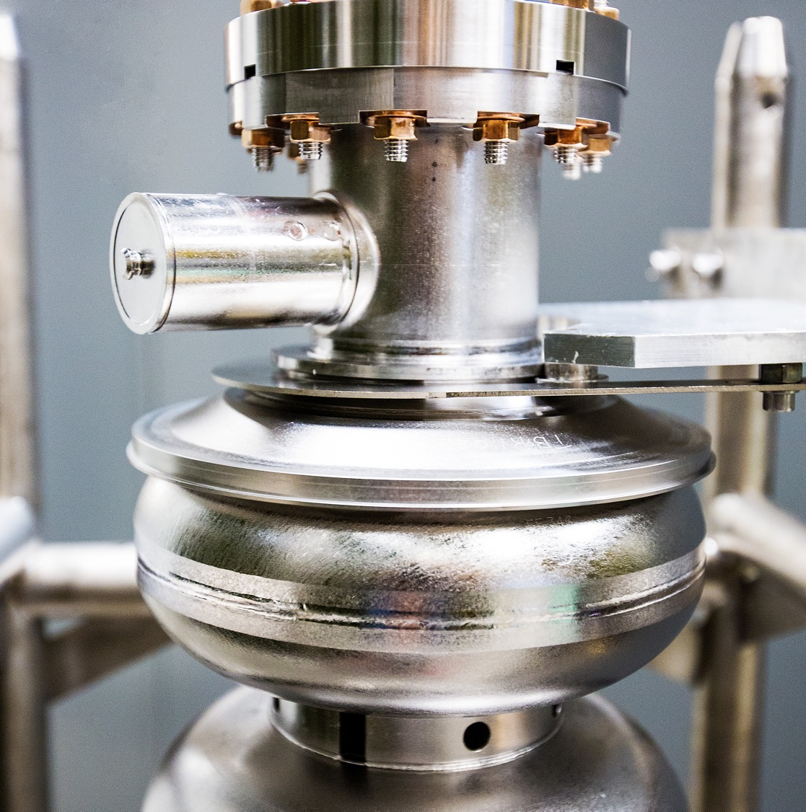
Low Energy Electron Positron Physics at the LERF
Low Energy Recirculation Facility (LERF) Capabilities
March 23, 2026
Kevin Jordan
Notes:
Tip: Keep titles under 60 characters for readability
To change the photo: Right-click on photo and select change photo

Slide 2
Outline
FEL/LERF History
Capabilities
Infrastructure
Summary
Notes:
Guidelines: 6-8 bullets per slide; Use sentence fragments for bullets
To change the photo: Right-click on photo and select change photo

Slide 3
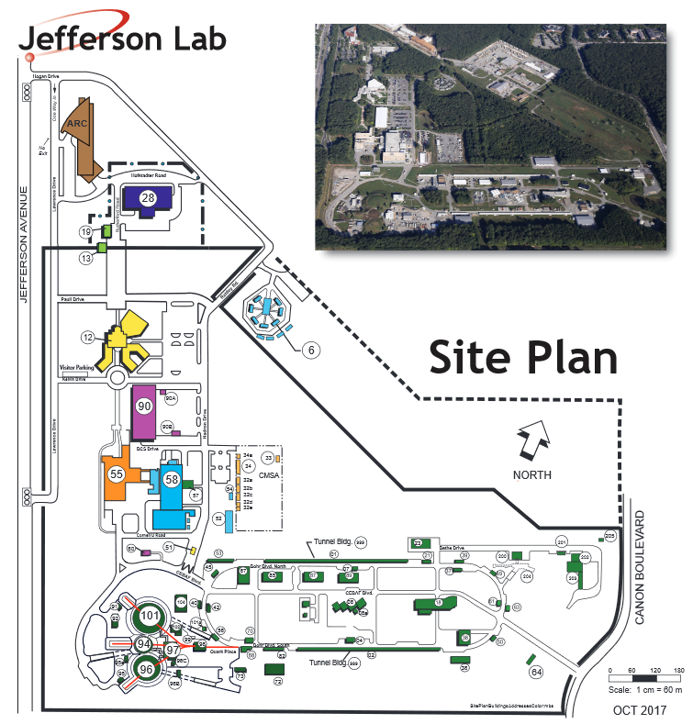
Low Energy Recirculation Facility (LERF)
Building design/shielding parameters
Up to 200 MeV electron energy
10 mAmp recirculating beam
100 kwatt beam dump
73m x 12.2 m
Achieved 1.2 Mwatt recirculating beam 2006
More than CEBAF machine!
Dark Light Experiment 2014
Removed 2 RF zones for LCLS – II CM testing 2018
Isotope Experiment
5 kwatt run for Copper 67 from Gallium in 2020
LCLS – II & HE Cryomodule Testing – Ongoing
Future efforts
Restore machine
Positron development
NNSA NCRF machine testing
EIC 591 MHz Cryomodule Testing
Notes:
Guidelines: 6-8 bullets per slide; Use sentence fragments for bullets
To change the photo: Right-click on photo and select change photo

Slide 4
Early History of the FEL Project
Realization: the CEBAF CW SRF linac was a game-changer, not only for particle physics but for all high power applications
1990: “Applied Research and Technology “ grant from VA’s Center for Innovative Technology (CIT)
1991: First Design for standalone kilowatt class IR-UV FEL
1994: Reference Design completed for expanded collaboration:
“The Laser Processing Consortium”
1994: Submitted to DOE/DOC for $25m with $10m of partner $s
(didn’t make the cut ~ 0.1% of proposals funded)
1995: Project reviewed by NASA for DOE; Energy Sec. O’Leary: “great project, a model for the nation”
“…good luck in finding the money”…
1995: With help from Navy Postgraduate School (NPS) and VA Congressional delegation,
$10M in FY 96 appropriation for Office of Naval Research (ONR)
Notes:
Guidelines: 6-8 bullets per slide; Use sentence fragments for bullets
To change the photo: Right-click on photo and select change photo

Slide 5
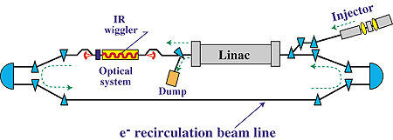
First Accomplishments
Concept from early 1990’s with key hires: Fred Dylla, George Neil, Michelle Shinn, Steve Benson
IRFEL demo project launched in 1996
1 kW IR FEL using spare cryomodule parts donated by DOE-NP
Multipurpose FEL Facility and User Labs built with VA funds - $3.2 M
Construction project compressed to 18 months (including 14 reviews)
First lasing June 15, 1998; 42 MeV @ 5 micron
June 17, 1998 - 155 watts CW
1999 – 2,100 watts!
IR Demo FEL
One Cryomodule – Strait Ahead Lasing
With Energy Recovery
Notes:
Guidelines: 6-8 bullets per slide; Use sentence fragments for bullets
To change the photo: Right-click on photo and select change photo

Slide 6
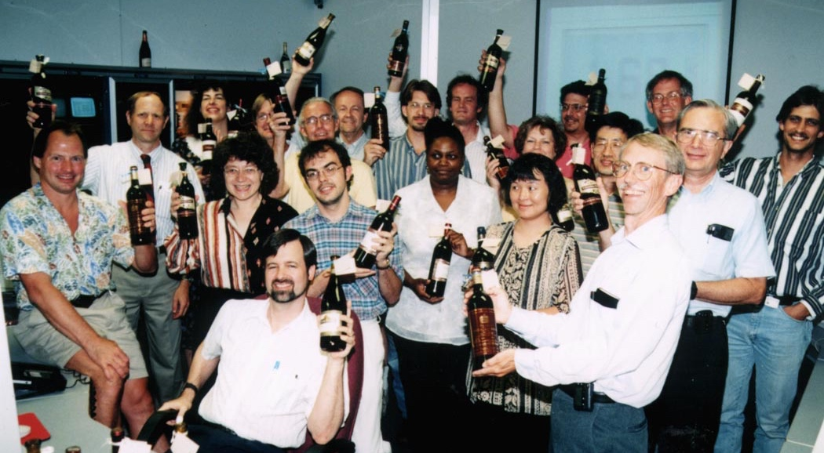
FEL Team celebrating the “kilowatt prize” First to >1 kilowatt
Notes:
Guidelines: 6-8 bullets per slide; Use sentence fragments for bullets
To change the photo: Right-click on photo and select change photo

Slide 7
On to the Upgrade
Navy provides significant funding for upgrade of FEL to 10kW; $9.3 M 2001
VA and collaborators continue to support FEL user operations
Army Research Office (ARO) provides support for THz beamline
Air Force Office of Scientific Research (AFOSR) provides support for UV Demo
Commissioned in 2003
October 30, 2006; 14.2 kwatts @ 1.6 µ
FEL Power Record
Still the highest CW FEL Power!
Notes:
Guidelines: 6-8 bullets per slide; Use sentence fragments for bullets
To change the photo: Right-click on photo and select change photo

Slide 8
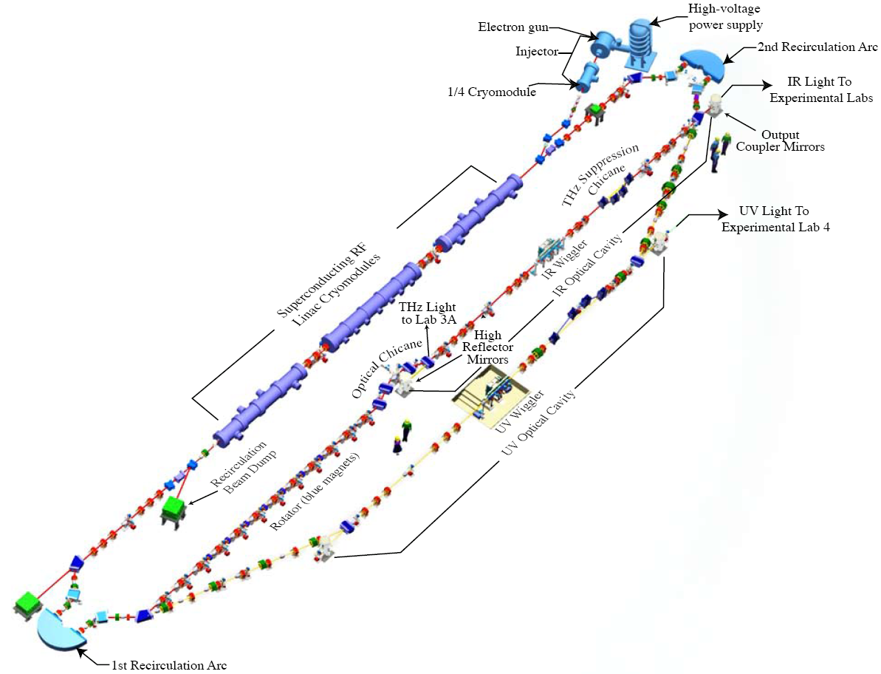
JLab IR / UV ERL FEL
Energy 120 MeV – Magnets designed for up to 200 MeV
Pulse structure – 135 pC up 75MHz CW (20th sub harmonic)
120 µ Joules/ pulse in IR
20 µ Joules/ pulse in UV
Lasing at 250 nm to 14 microns
Emission in THz from 0.1 to 5 THz
Photocathode source, drive laser on second floor
Electron source power supply up to 600 kV @ 10 milliamps
K. Jordan
Notes:
Guidelines: 6-8 bullets per slide; Use sentence fragments for bullets
To change the photo: Right-click on photo and select change photo

Slide 9
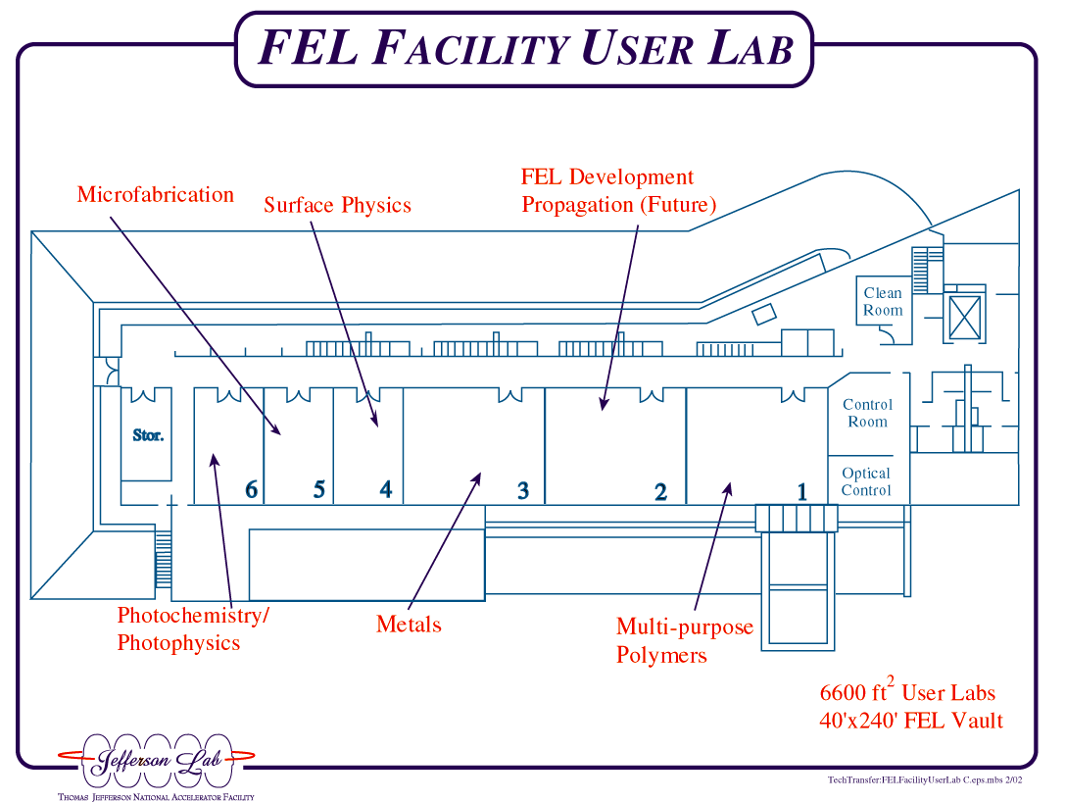
Drive Laser
Laser
Lab
3-D
Print
Kimball Gun
&
Vacuum Lab
CEBAF
Diagnostics Lab
915 MHz
Magnetron
12 Gev Magnets
W Target
Notes:
Guidelines: 6-8 bullets per slide; Use sentence fragments for bullets
To change the photo: Right-click on photo and select change photo

Slide 10
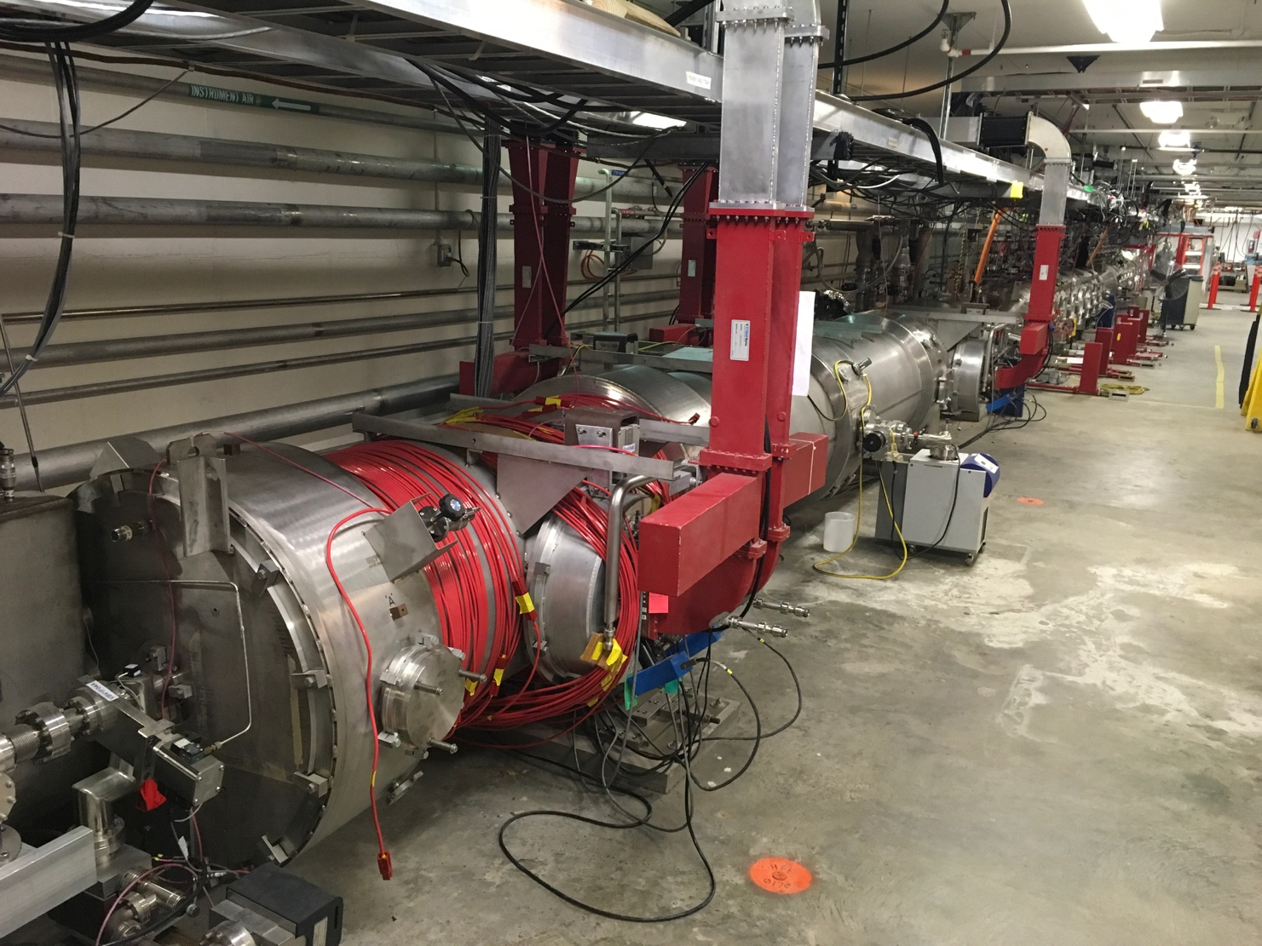
Cryomodules in LERF
Facility is configured for 3 + ¼ CM
4 x Supply & Return 2k & 40K
Cryogenics are fed directly from Central Helium Liquefier (CHL)
LERF is connected to CEBAF South Linac Helium Plant
If south linac trips or goes to 4K, so does the LERF
Cryomodules in LERF Vault 2 CMs removed for LCLS-II Testing
Notes:
Guidelines: 6-8 bullets per slide; Use sentence fragments for bullets
To change the photo: Right-click on photo and select change photo

Slide 11
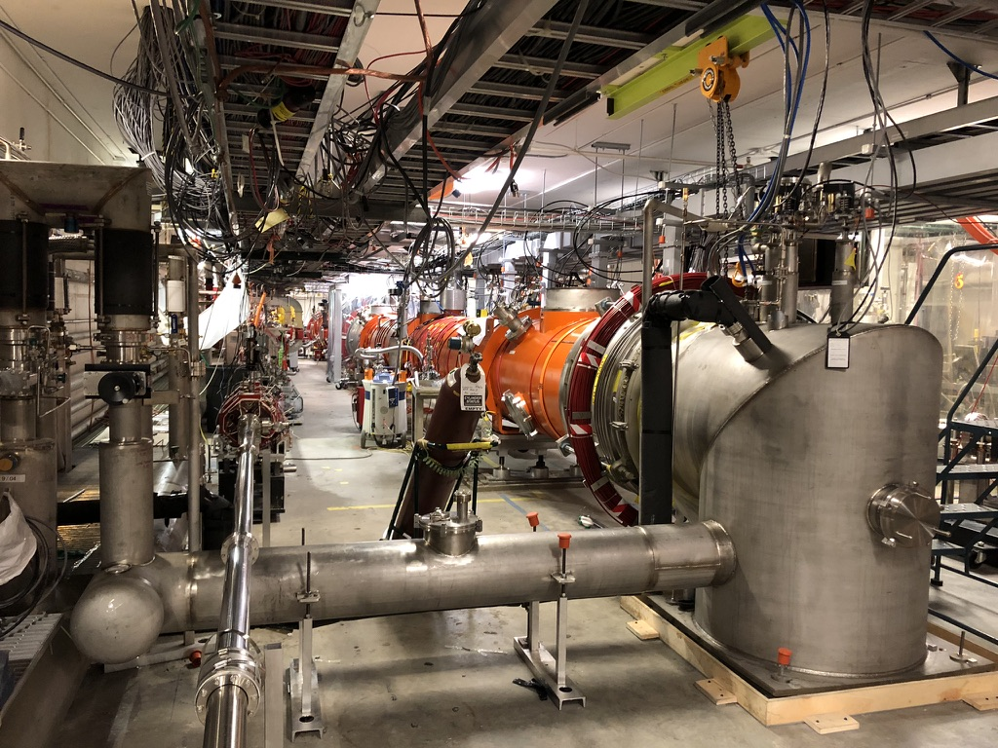
LCLS-II Testing Reconfiguration
Intention was both test & duplicate LCLS-II Linac 1 which has 2 cryomodules
This enabled early operational experience with the same equipment used in L1
Installed 16 Solid State Amplifiers (SSAs)
Added 1,000 Feet WR650 waveguide
Custom CryoCan to interface with existing helium transfer line
Complete Cryogenic Controls
For LCLS-II HE All 16 SSAs were shipped back to SLAC & 8 new 8 kWatt SSAs were installed
Testing of 2 reworked cryomodules will be completed by September 2026 & equipment shipped back to SLAC
LCLS-II CMs in LERF Vault Originally 2 CMs tested & 1 for HE
Notes:
Guidelines: 6-8 bullets per slide; Use sentence fragments for bullets
To change the photo: Right-click on photo and select change photo

Slide 12
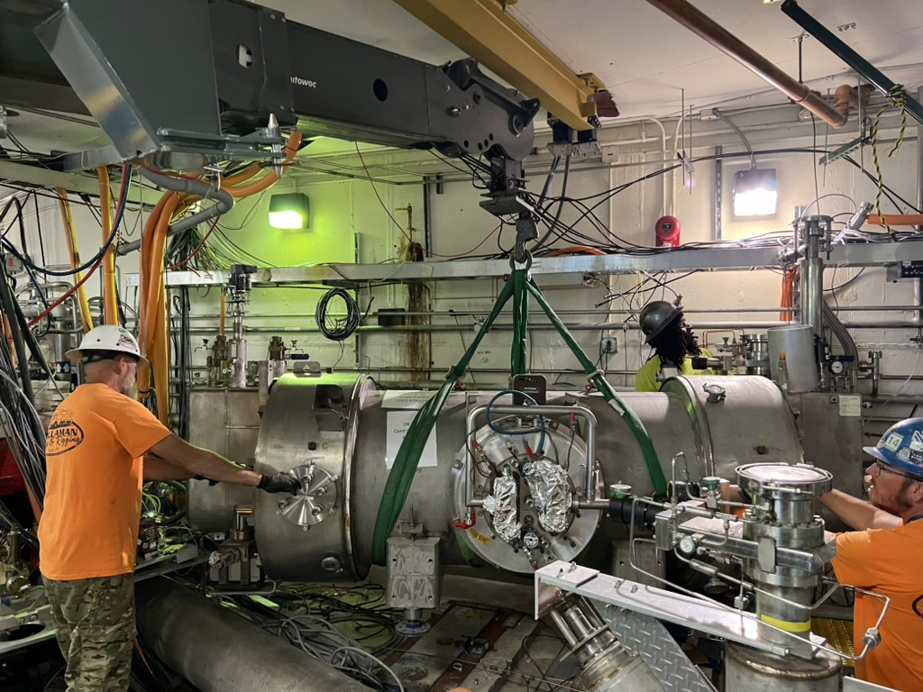
¼ Cryomodule Removal
Removal was due to small superfluid leak of Helium to beamline
Reworking of this ¼ CM has not yet begun
This ¼ CM was designed for high power – 100 kWatt of electron beam power
10 MeV @ 10 milliamps
Two 120 kWatt Klystrons power injector
Both RF input couplers and the Higher Order Mode (HOM) dampers are unique
HOM dampers are heat strapped to 40 K heat shield
Ongoing debate if this should be full power or a 2 cell 6 cell copy of CEBAF booster
Injector ¼ Cryomodule being removed for rework
Notes:
Guidelines: 6-8 bullets per slide; Use sentence fragments for bullets
To change the photo: Right-click on photo and select change photo

Slide 13
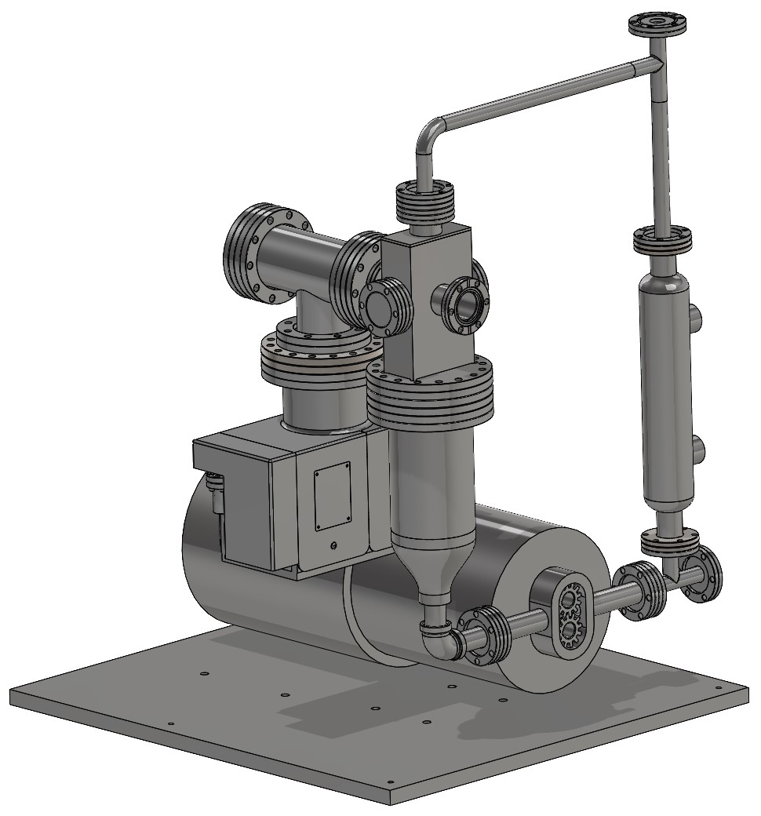
Liquid Metal Target GaInSn
Considering options for irradiation
¼ Cryomodule Rework will not be ready
Could use LERF gun + old CEBAF capture
Looking at option to use Rimmer’s NNSA CW copper injector
This would be powered by 915 MHz magnetron
Talk this afternoon by Karl Smolenski
Liquid Metal Target Assembly
Gallium Indium Tin
Notes:
Guidelines: 6-8 bullets per slide; Use sentence fragments for bullets
To change the photo: Right-click on photo and select change photo

Slide 14
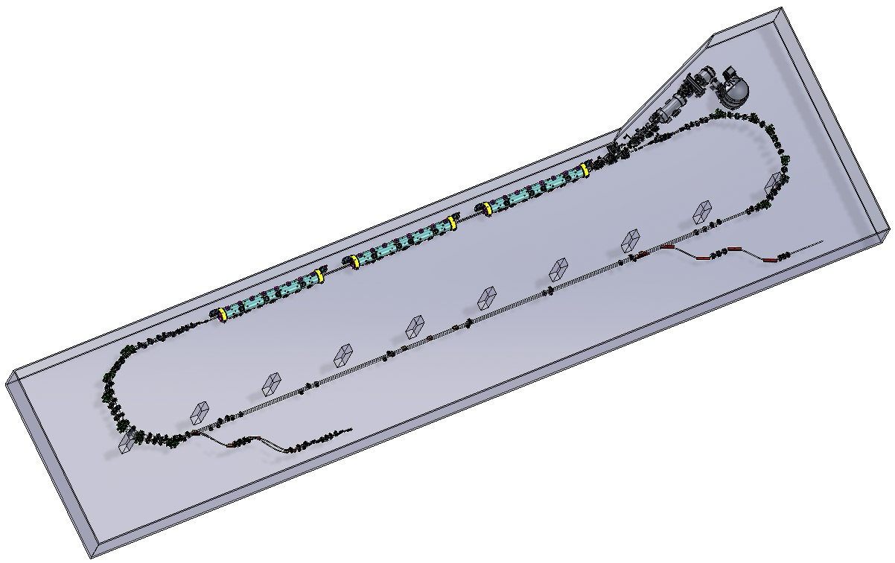
Universal Injector 2.0
One option for positron injection to the CEBAF machine
Upcoming talk by Alex Bogaz
Injector 2.0
Inject Positrons to CEBAF
Notes:
Guidelines: 6-8 bullets per slide; Use sentence fragments for bullets
To change the photo: Right-click on photo and select change photo

Slide 15
Summary
LERF is well suited for a variety of experiments to realize a dependable CW positron source
Ample utilities available
2,000 Amps 480 VAC
1.2 Mwatt LCW cooling water
750 kwatt industrial chilled water
Direct connection to Central Helium Liquifier
Large shielded vault; 73 meters x 12.2 meters (240’ x 20’)
Notes:
Guidelines: 6-8 bullets per slide; Use sentence fragments for bullets
To change the photo: Right-click on photo and select change photo

Slide 16
Questions?
Thank you for your attention!
Notes:
Guidelines: 6-8 bullets per slide; Use sentence fragments for bullets
To change the photo: Right-click on photo and select change photo

