Slide 1


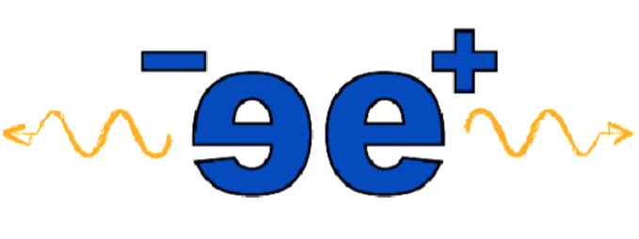
Antimatter to Materials The power of low energy positrons
Farida Selim
Arizona State University
E-mail: Farida.Selim@asu.edu

Slide 2
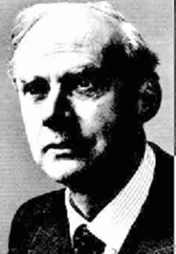
A little bit of history
Dirac: His theory predicted negative energy holes with properties similar to electron
Nobel prize 1933
Andreson: positron detection
Nobel Prize 1936
1933, PRL V. 43, The positive electron
Deutsch: proved the existence of positronium

Slide 3
1928 Predicted by Dirac
1932 Found in cosmic
Radiations by Anderson
1940’s First studies of
Electronic structures
1950’s Establishment of Positron
Annihilation Spectroscopy
1950’s First demonstration of annihilation radiation
for medical imaging and development of PET
1952 Positronium discovery, other positron interactions.
1960’s Positron trapping at defects
1982 Slow positron beams
2005 Gamma induced positron spectroscopy

Slide 4
Outlines
Positron interactions with matter
Positron annihilation Spectroscopy
Positronium formation
PAS as a unique probe in condensed matter physics and materials science
existing intense slow positron beam facilities
Science to be enabled by intense positron beams

Slide 5
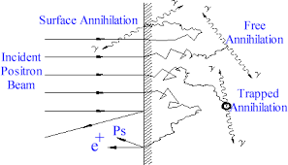
Positron interacts with matter
Scattering
Annihilation
Forming bound states with electron
These three interaction pathways are not separate phenomena, they form the foundation of how positrons probe matter

Slide 6
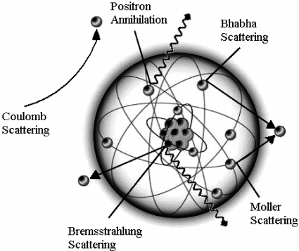
Scattering
Positrons interact with electrons and nuclei via Coulomb forces
Elastic scattering → change in direction
Inelastic scattering → energy loss
Bhabha scattering
(excitation, ionization)Dominates during thermalization

Slide 7
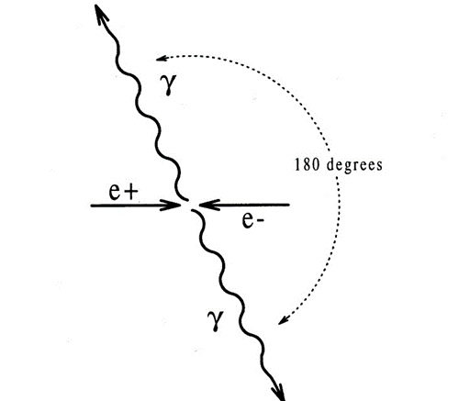
Annihilation
at rest ⇒TQA(two quantum annihilation )
is the most probable
Positron annihilates
in flight ⇒TQA (two quantum annihilation)
SQA(single quantum annihilation)
Positron annihilation at rest has been developed as a powerful tool for materials science and study defects

Slide 8
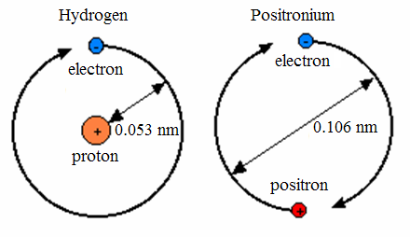
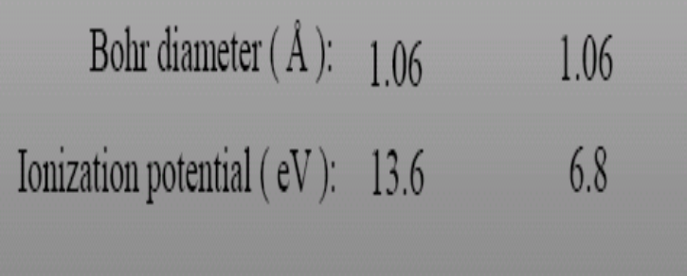
Positronium e⁺+ e⁻ =Ps
Positronium formation
Hydrogen-like bound state of an electron and a positron.

Slide 9
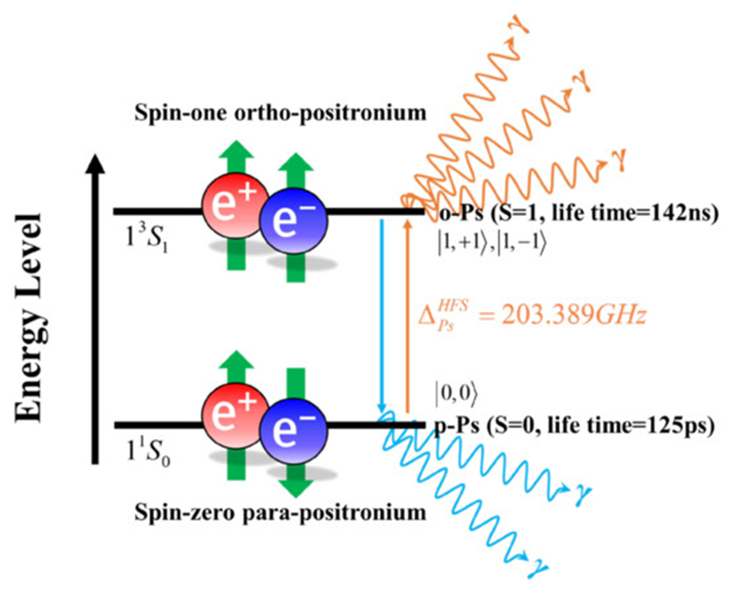
Positronium
doi.org/10.3390/electronics11193178
Exists in two states:
p-Ps(↑↓) and o-Ps(↑↑)
In vacuum: p-Ps lives 0.125 ns, o-Ps – 142 ns.
In porous materials, o-Ps lifetime is quenched to some ns because of the pick-off annihilation.
It provides a unique platformm to test QED

Slide 10
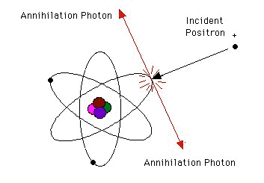
Basics of positron annihilation spectroscopy
In condensed matter, positron thermalizes in few pico-seconds, diffuses and then annihilates with an electron emitting two 511 keV annihilation photons within few hundred pico-seconds.
Three independent spectroscopies are:
Positron lifetime spectroscopy
Doppler broadening spectroscopy
Angular correlation of annihilation radiation (ACAR)
Coincidence Doppler Spectroscopy
Age Momentum Correlation
Study of these annihilation photons provides information about the electron densities and their momentum distributions.

Slide 11
*The annihilation rate is proportional to the electron density (lifetime measurements )
*The angular and energy distributions of the annihilation radiation reflect the electron momentum distributions (ACAR measurements & Doppler spectroscopy)
Conservation of momentum : ΔE=c P _{z}/2 (Doppler Broadening)
θ_{x,y}=P_{x,y}/m_{o} c (ACAR)
γ₁
e⁺
e⁻
E₁
θ
E₂
γ₂

Slide 12
Doppler spectroscopy
The 511 keV photon is Doppler shifted by the longitudinal component of the electron momentum.
From this measurement we can extract one-dimensional electron momentum distributions

Slide 13
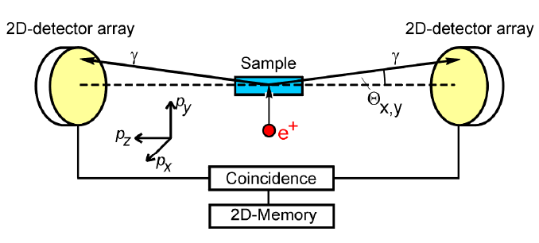
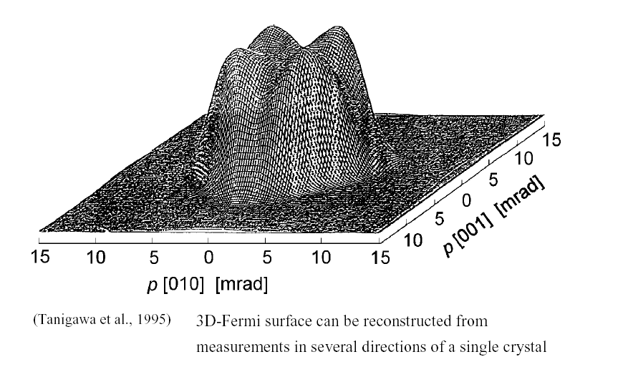
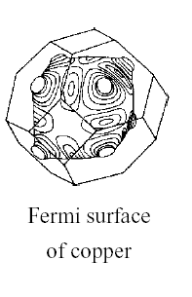
ACAR measurements
The perpendicular components of the electron momentum cause small angular deviation in the emission of the two photons
Two dimensional electron
momentum distributions
From Doppler broadening and ACAR measurements

Slide 14
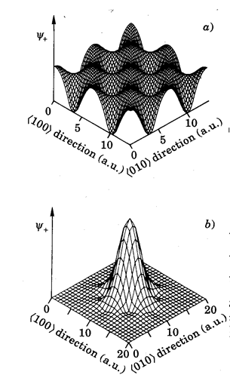

Positron trapping at defects
Atomic size defects
High sensitivity
Defect quantification
Chemical environment around defects
Defect charge state
Free positron in the Bloch state
e+ diffusion length:100 nm
sensitivity to defects (10⁻⁷)
Ref: F. A. Selim, Materials Characterization
Volume 174, 2021, 110952

Slide 15
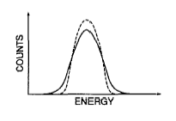
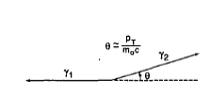
e⁺ trapping at defects leads to characteristic changes in the measured parameters of PAS
In Doppler spectroscopy:
In ACAR measurements :
defects
increase in the annihilation fraction with low momentum electrons (S-parameter) and reduction in the Doppler broadening of the 511 peak
reduction in the angular deviation of the annihilation
radiation
P. J. Schutz and K. G. Lynn, J. Appl. Phys. 76, 4935 (1994)

Slide 16
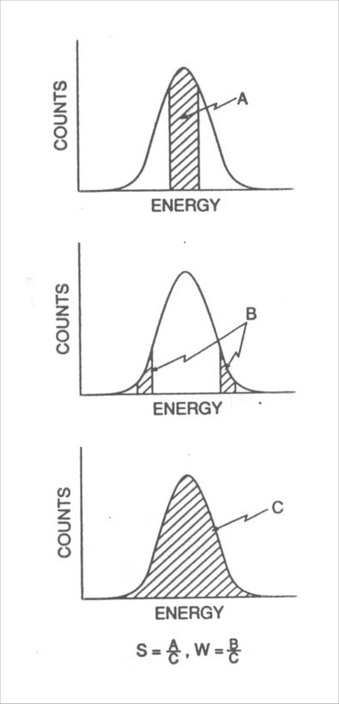
Doppler broadening can be characterized by S &W parameters
S reflects the annihilation with valence electrons S= A / C
W reflects the annihilation with core
electrons W= B / C
S is known as open volume defect parameter
J. Appl. Phys. 76 (1994), p. 4935

Slide 17
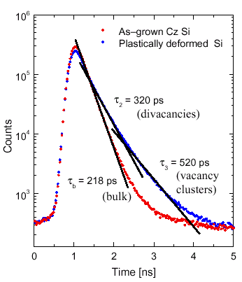

lifetime spectroscopy :
In a free defect metal or semiconductor only one lifetime component is
existed
Open volume defects lead to long
lived lifetime components
From spectrum analysis, we can
obtain the lifetime τ_{i} and
its intensity I_{i}
Positron decay curve
Ref.: Positron Annihilation in Semiconductors,
Krause-Rehberg, Berlin, 1999

Slide 18
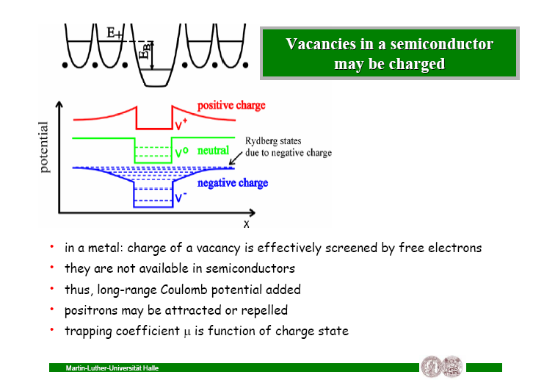
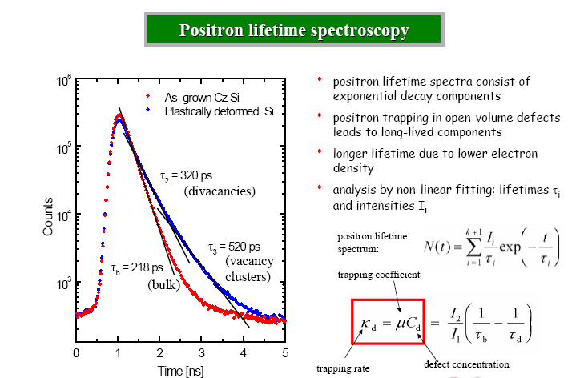
positron trapping depends on the defect charge state
makes positron very effective tool in semiconductors

Slide 19
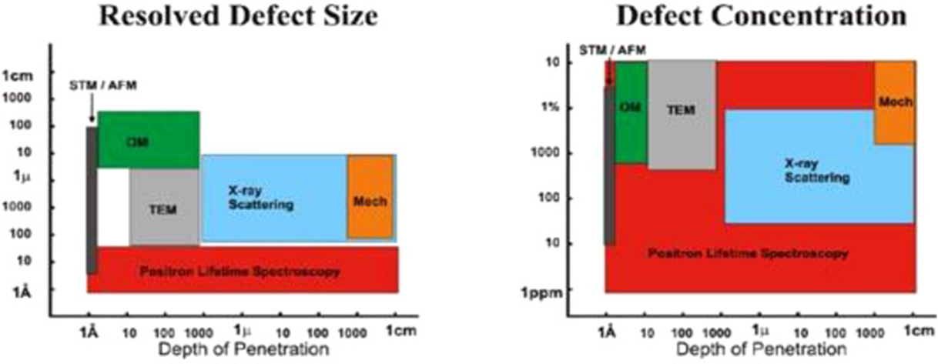
e + is a unique powerful probe in material science

Slide 20
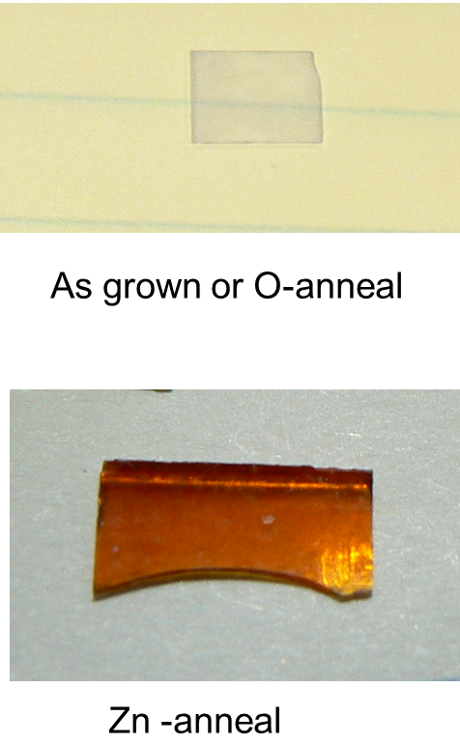
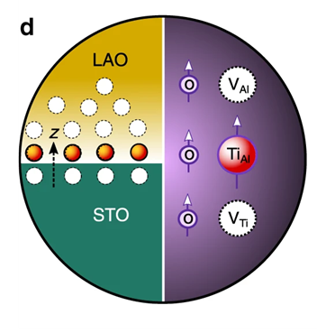
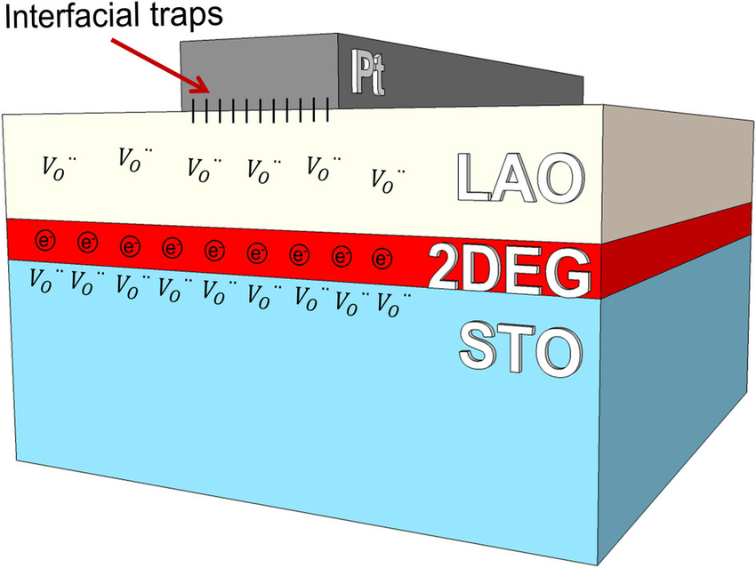
Point Defects in functional materials
ZnO
R. Krause Rehberg
http://www.saha.ac.in/cs/icpa.15/
Nature Communications 11,
3650 (2020)
F. A. Selim et al, PRL 99,
085502, 2007
Tracing the formation of oxygen vacancies at the conductive LaAlO3/SrTiO3 interface .
Opto-Electronic Science (2022).
Scientific Reports 5(1):8023, 2015

Slide 21
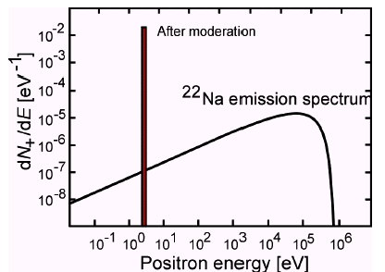
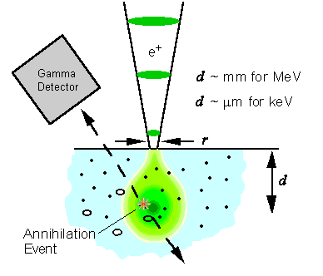
Conventional positron techniques
Bulk measurements
100μm bulk property
Depth resolved measurements
Slow or variable energy positron beams
.

Slide 22
Slow Positron beams for Fundamental and Applied Science
Fundamental research in atomic Physics
Depth resolved probe for material science
Unique tool for surface science
Semiconductor and microelectronics
Polarized beam for spin and magnetism studies
Positronium beams
Jlab: Opportunity for high-brightness, high-intensity beams

Slide 23
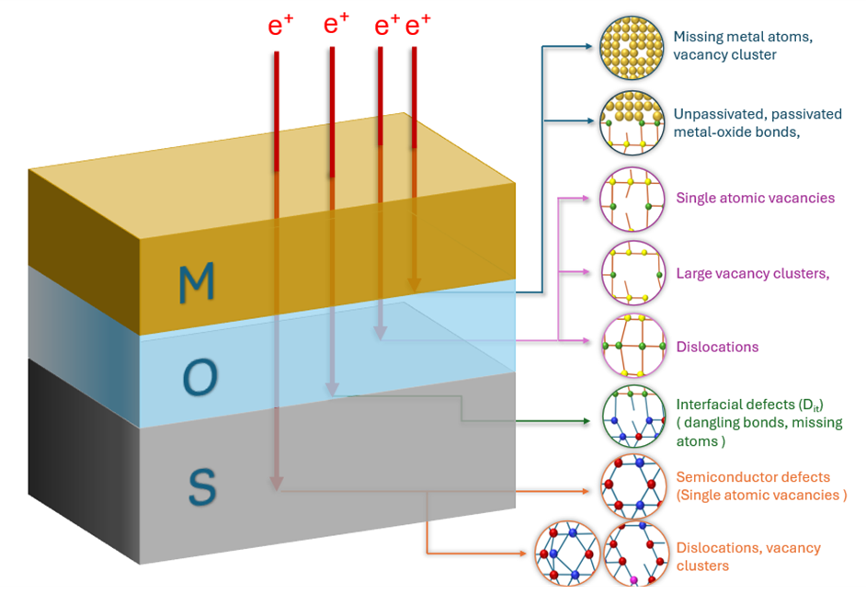
R&D tool for microelectronics

Slide 24
Existing intense positron beam facilities and their success
NEPOMUC, Munich (Germany)
MePS Dresden (Germany)
KEK Japan
AIST Japan
Experiments realized at KEK:
TRHEPD (total-reflection high-energy positron diffraction), LEPD (low-energy positron diffraction), Ps− (positronium negative ion), and Ps-TOF (positronium time-of-flight) experiments
JLab is uniquely positioned to lead the next generation of low-energy positron science

Slide 25
Science enabled by high intensity positron beam
High brightness beams
Positron microprobe and positron microscope for a broad range of applications in materials and defect studies
Advancing positron induced Auger Spectroscopy

Slide 26
Science enabled by high intensity positron beam
Positron diffraction (LEPD, TRHEPD)
- LEPD provide 2D image of the surface with
crystal order
- TRHEPD is affected only by the top
monolayer because e+ are repelled by the
inner potential
Angle resolved positronium emission spectroscopy (ARPsES) similar to ARPES

Slide 27
Science enabled by high density positronium
Testing QED
PsBEC
Gamma laser
Search /test for PS antigravity

Slide 28
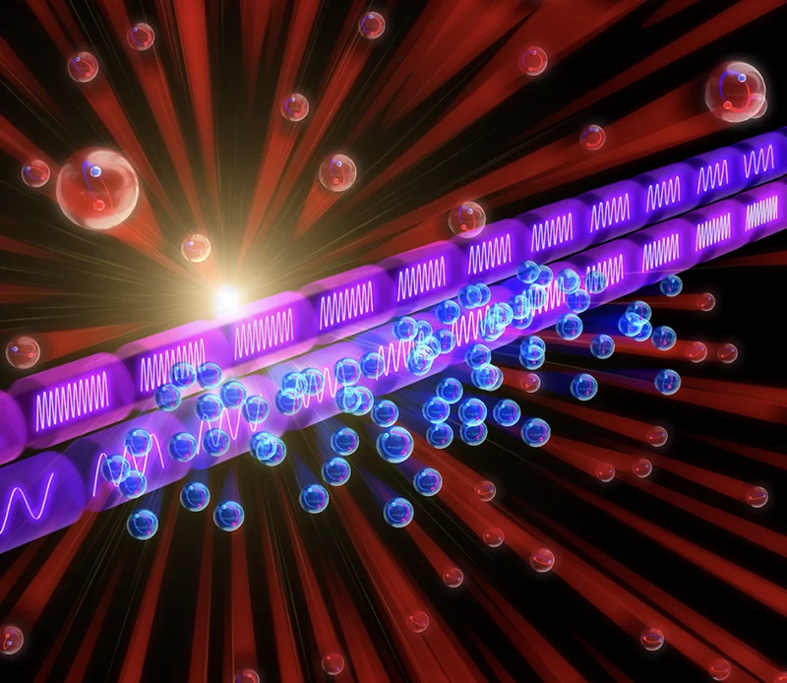
BEC and γ laser
https://physics.aps.org/articles/v17/145
If a dense Ps gas (> 10¹⁸
atoms per cm³) can be cooled to (< 10 K)
It is expected to form a Bose-Einstein condensate (BEC).
As PS self-annihilates, it would generate a coherent pulse of gamma rays (Gamma-Ray Lasers).
Kosuke Yoshioka, University of Tokyo

Slide 29
Summary
Positrons interact via:
Scattering, Annihilation, Positronium formation
a fundamental probe of electron structure from QED bound states to condensed matter systems
Low-energy positrons offer a powerful and underutilized capability—JLab can lead the next generation.”

