Slide 1
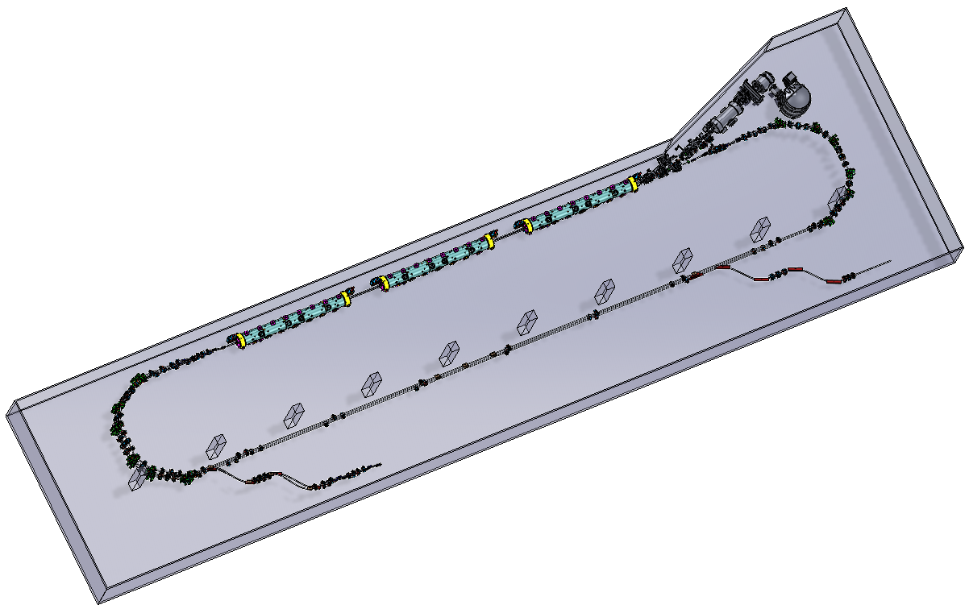
‘Universal Injector’ at LERF − Layout and Optics Architecture*
Developing a compact 3-pass injector design within the LERF vault, which would serve both the 22 GeV CEBAF and the positron program; being synergistic with electron source required to produce positrons for Ce⁺BAF.
8 MeV inj.
650 MeV
Alex Bogacz
Accelerator Physics Group Leader
Joe Gubeli
222/437 MeV
 | S.A. Bogacz, M. Bruker, J. Grames, J. Gubeli, C. Hernandez-Garcia, K. Jordan, V. Lizarraga-Rubio, I. Neththikumara, S. Ogur, N. Sereno (JLAB) and A. Fomin (IJCLAB, Orsay)
*

Slide 2
Layout – Racetrack (3-pass, including Merger)
8 MeV + 3 × 3 × 71.3 MeV = 650 MeV
8 MeV inj.
Spr
C-75
C-75
C-75
Rec
W_Arc 1
Straight 1
E_Arc 1
W_Arc 2
Straight 2
E_Arc 2
W_Arc 3
Straight 3
650 MeV

Slide 3
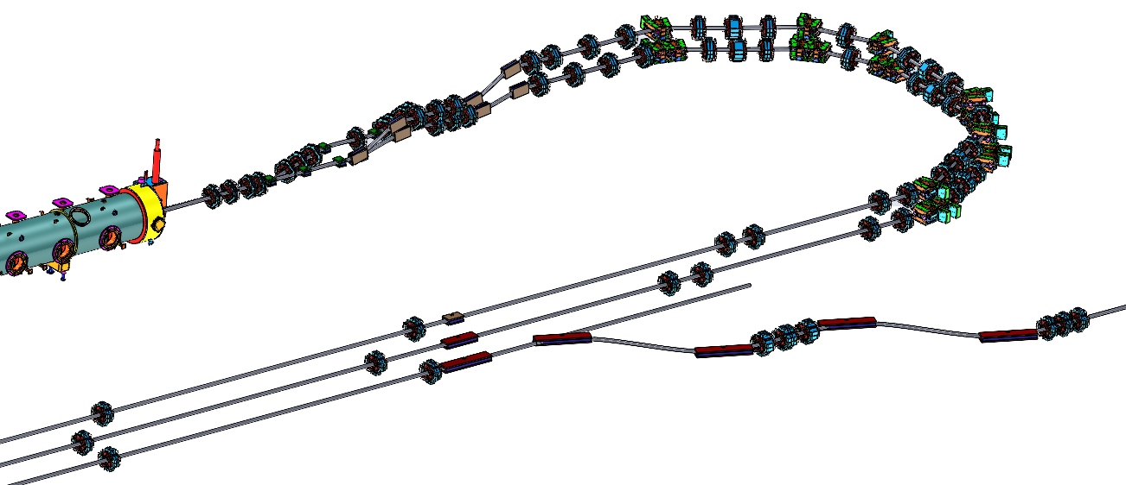
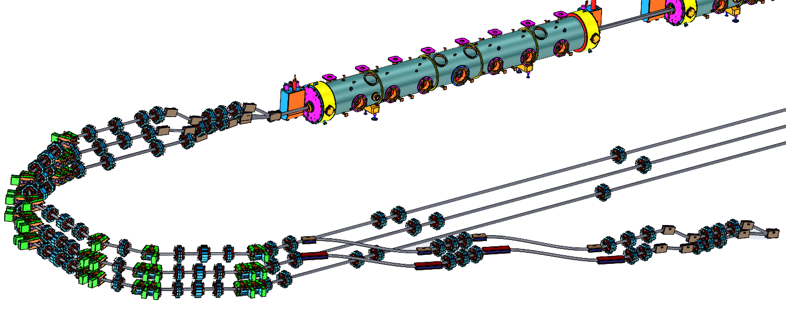
Layout – Racetrack (3-pass)
Joe Gubeli

Slide 4
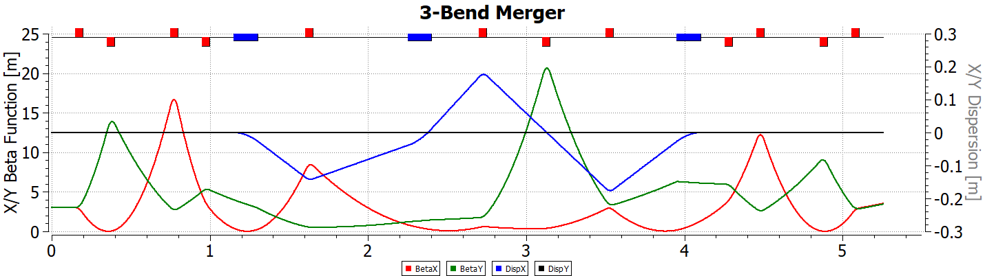




Merger – Optics Architecture, Separate quad functionality
Top view
120
8 MeV inj.
M₅₆
100
D_{x}
D2
Q1
D1
80
β_{x,y}
Q2
D’_{x}
Q3
60
Q4
40
[cm]
D3
20
0
222/437 MeV
-600
-500
-400
-300
-200
-100
-20
0
[cm]
D1
Q1
D2
Q2
Q3
Q4
D3
ρ
−ρ
ρ
= 0
β_{x,y} = 3 m
α_{x,y} = 0

Slide 5
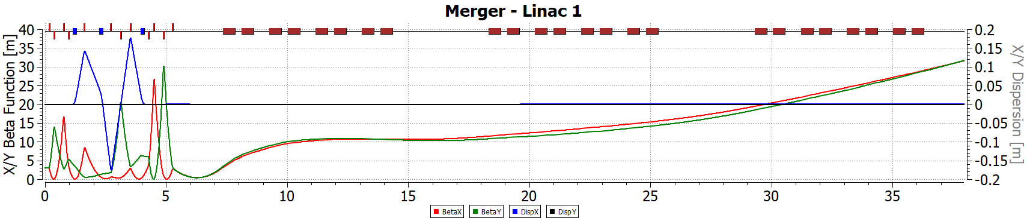
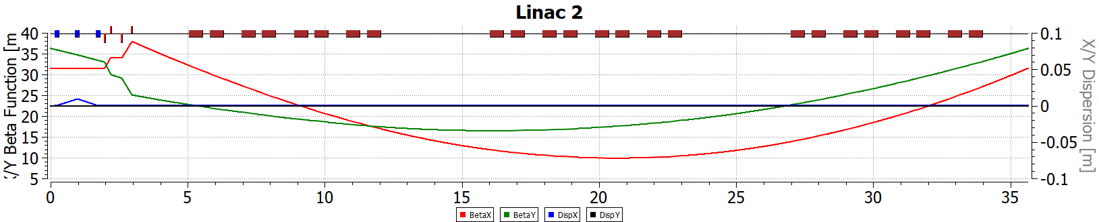
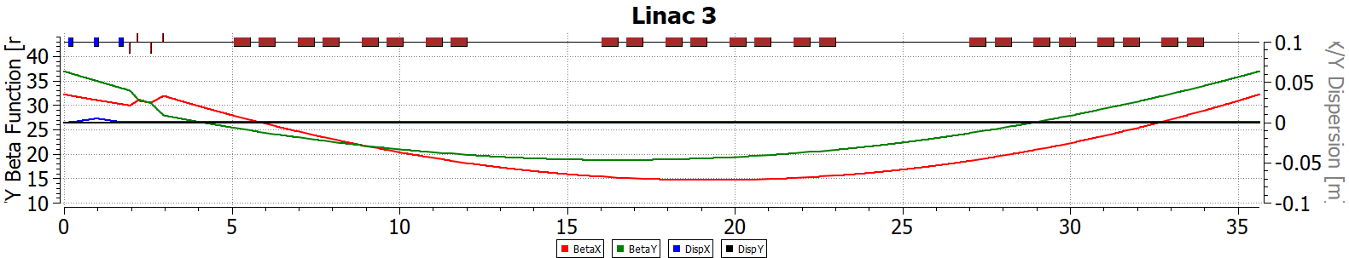
Multi-pass linac
169 λ
8 MeV
222 MeV
178 λ
222 MeV
437 MeV
178 λ
437 MeV
650 MeV

Slide 6
Isochronous Arcs
7.57 m
Joe Gubeli

Slide 7
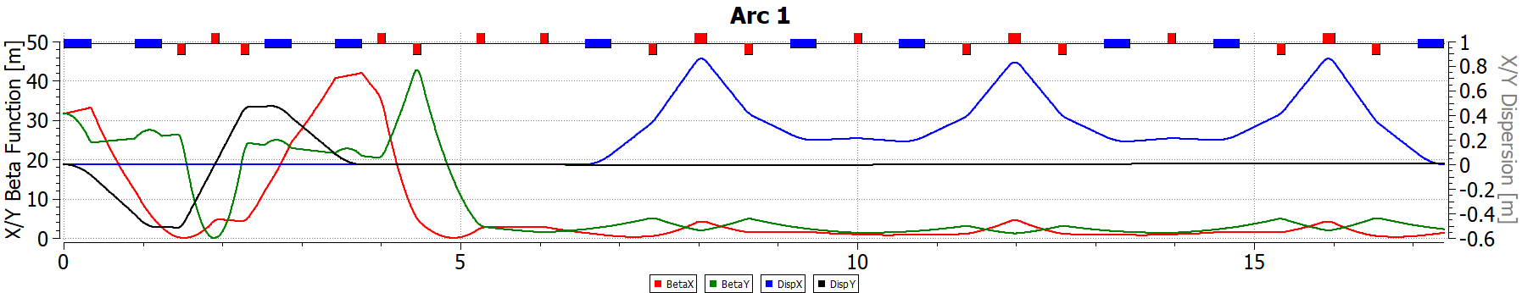
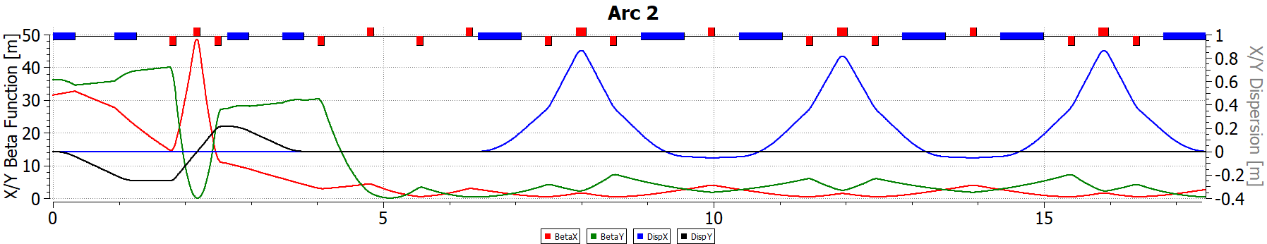
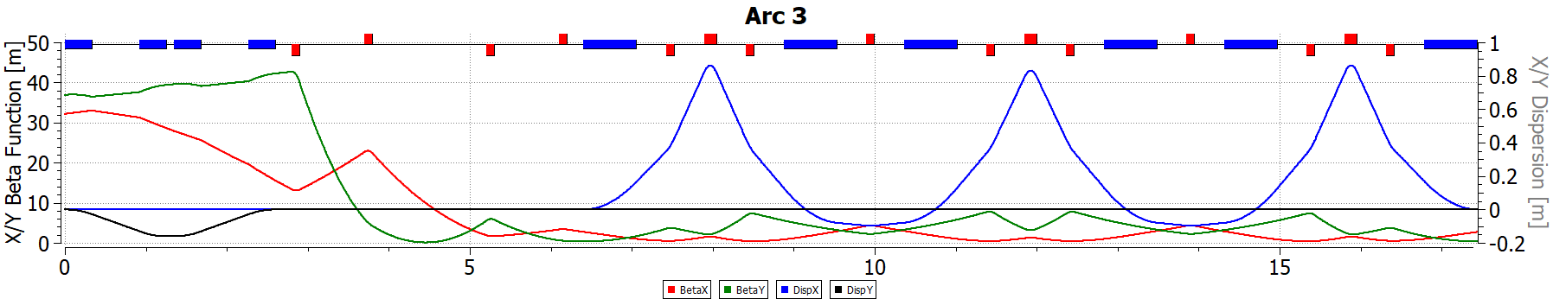
Isochronous Arcs (West)
B-com 1
Six sector bends: 33 cm, 1.1 Tesla
222 MeV
B-com 1
B-com 2
Six sector bends: 66 cm, 1.1 Tesla
437 MeV
B-com 1
B-com 2
Six sector bends: 66 cm, 1.65 Tesla
650 MeV

Slide 8
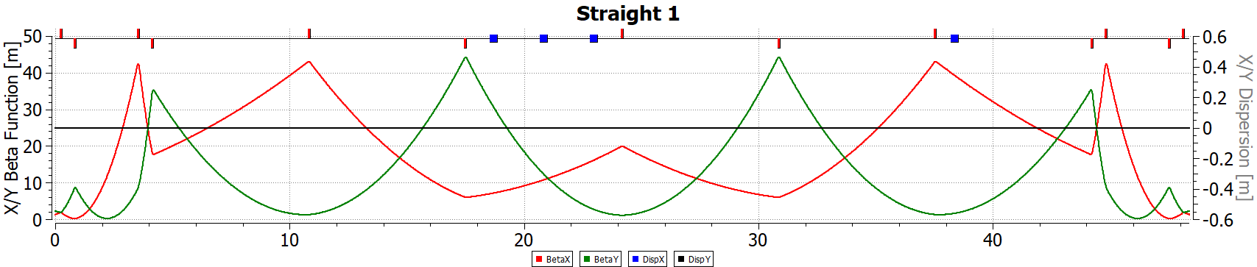
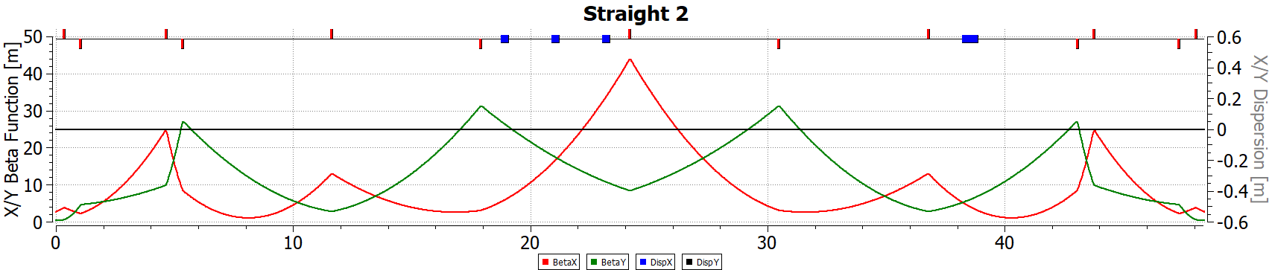
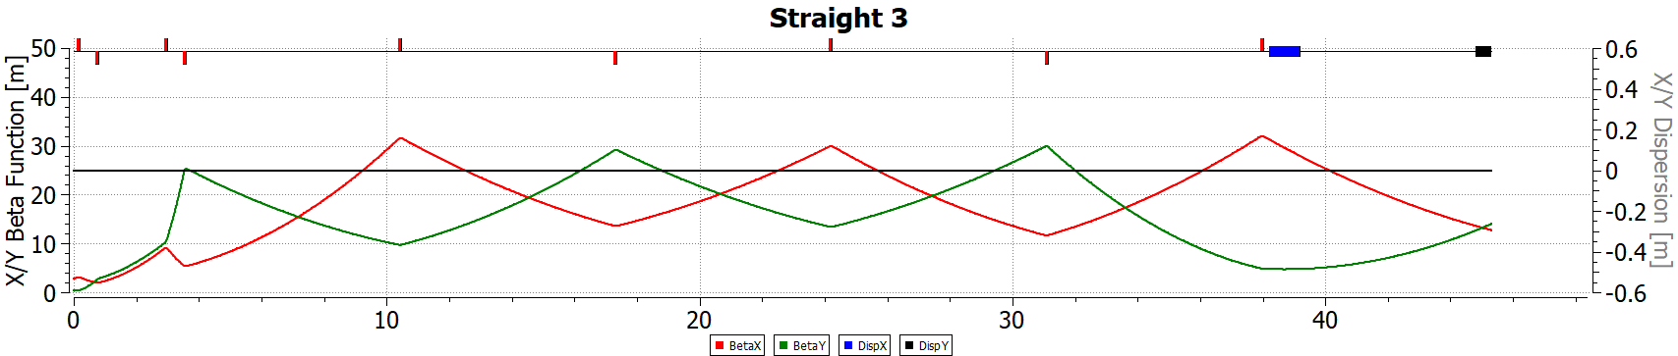
Straights
extraction bends
dogleg 1
222 MeV
dogleg 2
437 MeV
dump
650 MeV

Slide 9
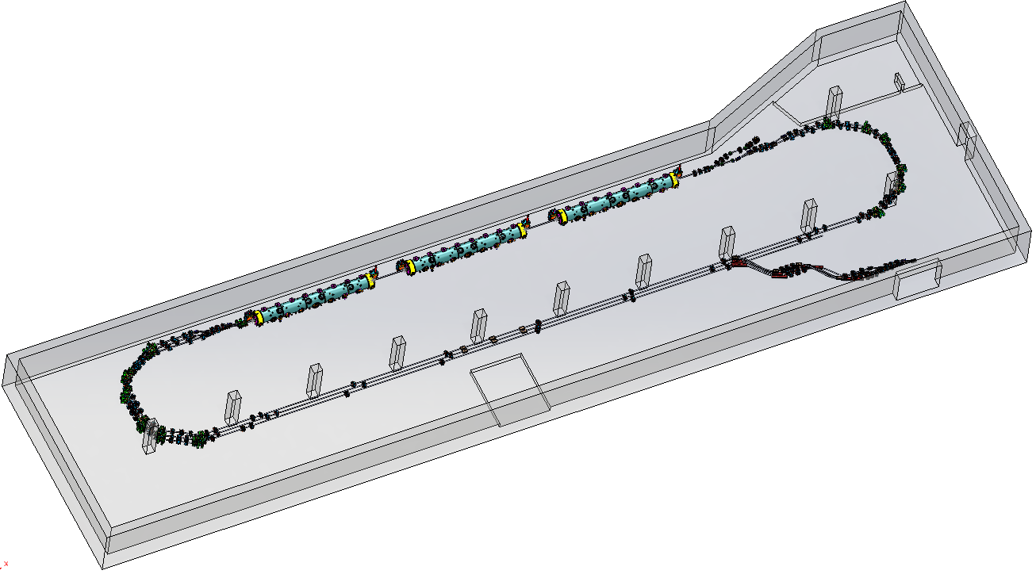
Extraction Lines
N name S[cm] X[cm] Y[cm] Z[cm] TetaX[deg] TetaY[deg] Energy[MeV]
0 0.000 0.000 160.000 0.000 0.0000 0.0000 221.4890
1 g1E01 0.000 0.000 160.000 0.000 0.0000 0.0000 221.4890
3 G1E01 36.654 -13.669 160.000 33.000 -45.0000 0.0000 221.4890
5 g1E02 280.835 -186.331 160.000 205.662 -45.0000 0.0000 221.4890
7 G1E02 317.489 -200.000 160.000 238.662 0.0000 0.0000 221.4890
15 g1E03 447.489 -200.000 160.000 368.662 0.0000 0.0000 221.4890
17 G1E03 484.142 -213.669 160.000 401.662 -45.0000 0.0000 221.4890
19 g1E04 728.323 -386.331 160.000 574.324 -45.0000 0.0000 221.4890
21 G1E04 764.977 -400.000 160.000 607.324 0.0000 0.0000 221.4890
30 g1S04 953.599 -400.000 160.000 795.946 0.0000 0.0000 221.4890
32 g1S04 986.979 -400.000 151.459 827.822 0.0000 -30.0000 221.4890
34 g1S03 1042.514 -400.000 123.691 875.916 0.0000 -30.0000 221.4890
36 g1S03 1075.894 -400.000 115.150 907.792 0.0000 0.0000 221.4890
44 g1S02 1205.894 -400.000 115.150 1037.792 0.0000 0.0000 221.4890
46 g1S02 1239.274 -400.000 106.609 1069.667 0.0000 -30.0000 221.4890
48 G1S01 1294.809 -400.000 78.842 1117.762 0.0000 -30.0000 221.4890
50 g1S01 1329.367 -400.000 70.000 1150.762 0.0000 0.0000 221.4890
8 MeV inj.
222/437/650 MeV
4 m
Joe Gubeli

Slide 10
Layout – Racetrack (3-pass) including Extraction Lines
Spr
C-75
C-75
C-75
Rec
Rec
W_Arc 1
Straight 1
E_Arc 1
W_Arc 2
Straight 2
E_Arc 2
W_Arc 3
Straight 3
222/437/650 MeV

Slide 11
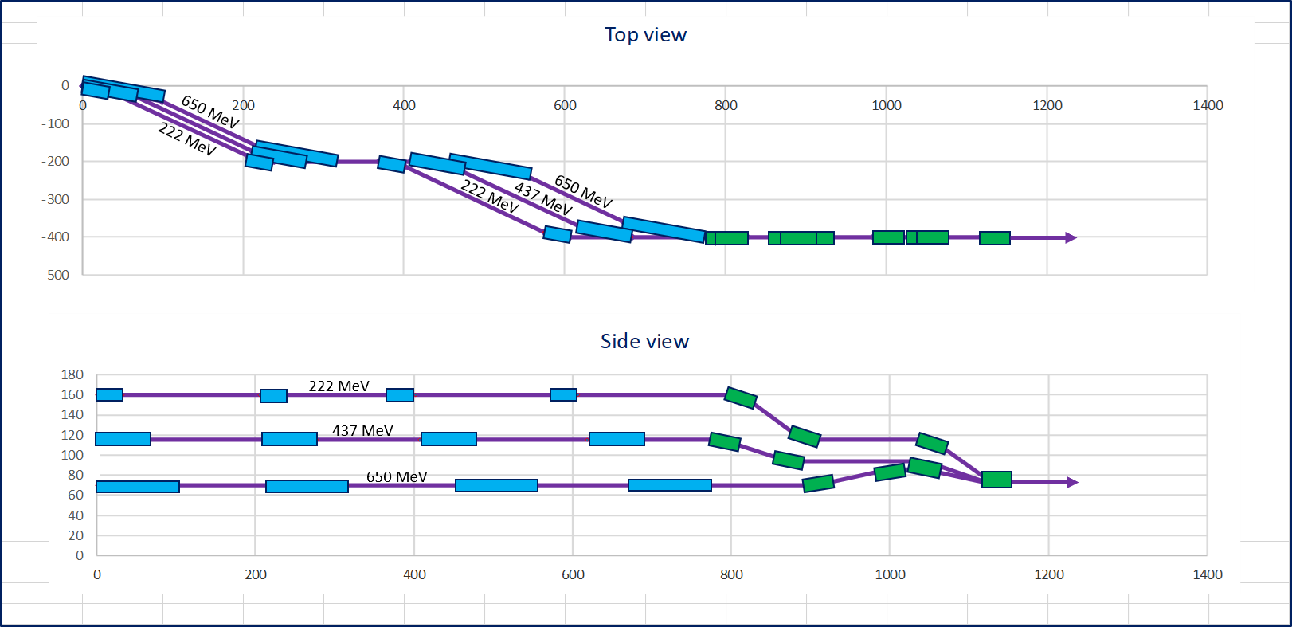
Extraction Lines

Slide 12
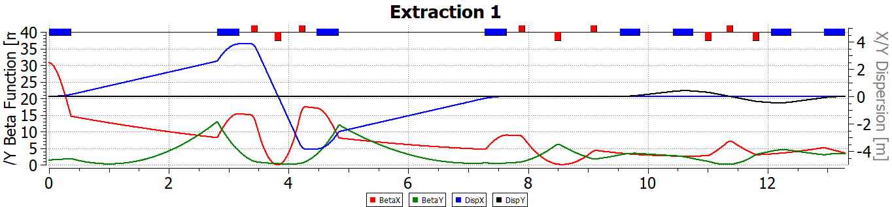
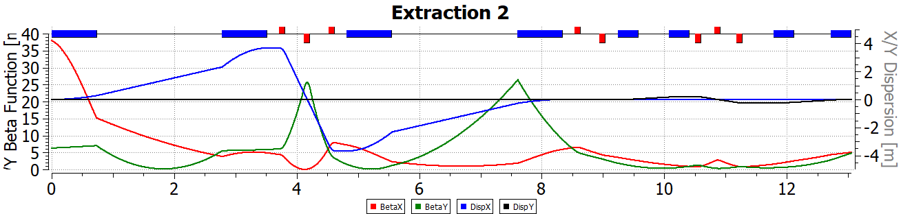
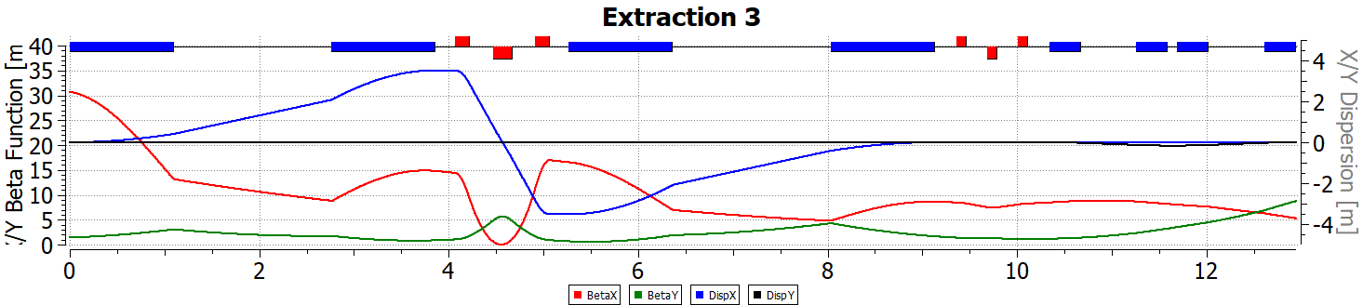
Extraction Lines
Four rectangular bends: 33 cm, 1.6 Tesla
222 MeV
Four rectangular bends: 66 cm, 1.6 Tesla
437 MeV
Four rectangular bends: 99 cm, 1.6 Tesla
650 MeV

Slide 13
Layout – Racetrack with combined Extraction Lines
C-75
C-75
C-75
W_Arc 1
Straight 1
E_Arc 1
W_Arc 2
Straight 2
E_Arc 2
W_Arc 3
Straight 3
222/437/650 MeV

Slide 14
Layout – Racetrack with separated Extraction Lines
C-75
C-75
C-75
222/437 MeV
650 MeV
W_Arc 1
Straight 1
E_Arc 1
W_Arc 2
Straight 2
E_Arc 2
W_Arc 3
Straight 3
222/437 MeV
650 MeV

Slide 15
Layout – Racetrack with separated Extraction Lines
7.57 m
4 m
Joe Gubeli

Slide 16
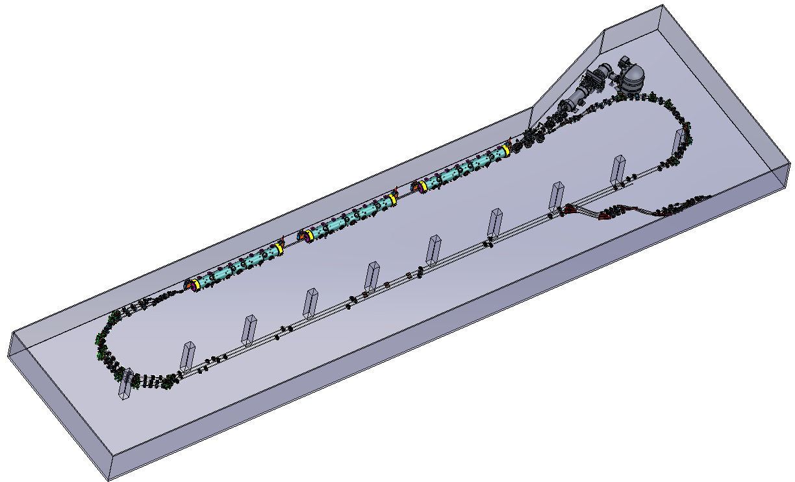
Universal Injector – ‘Combined vs Separated' Extraction Lines
8 MeV inj.
8 MeV inj.
222/437/650 MeV
650 MeV
222/437 MeV
Joe Gubeli

Slide 17
Summary
‘Universal Injector’ - Recirculating (3-pass) injector to 650 MeV
‘Three-bend’ Merger Optics
Isochronous, horizontal achromat
Independent tunability – ‘orthogonal knobs’
Quadruplets added before and after the merger – tuning initial/final Twiss
Multi-pass Linacs
Configured with there C-75 cryomodules
Optics based on weakly focusing ‘drift linac’ (no quads between the cryomodules)
Switchyard Configuration
Compact ’two step’ Spr/Rec with 30 deg. 33 cm bends (vertical elevation by 45 + 45 cm)
Arc Optics Architecture
‘Six bend’ isochronous arcs – balanced M₅₆
Flexible Momentum Compaction Optics with orthogonal tunability
Lower/Higher energy (222/437/650 MeV) arcs configured with 33/66 cm sector bends ( 1.1 − 1.6 Tesla)

Slide 18
Summary − cont.
Recirculating 3-pass injector to 650 MeV – cont.
Straights
Mirror-symmetric lines (at 222, 437 and 650 MeV) matched to the corresponding arcs
Include initial bends of a horizonal extraction lines for 1-, 2- and 3-pass beams respectively
Accommodate pathlength correction ‘doglegs’ (in straights 1 and 2)
Extraction lines – combined or separated
Allowing independent extraction of 222, 437 and 650 MeV beams
Horizonal 2-step ‘jogs’ configured with (33/66/99 cm bends) followed by a vertical recombiner replica
Lattice follow-ups (completed)
Compiled a DIMAD survey deck (centers of elements) to create a 3D rendering
Propagated complete lattice decks to MADX and ELEGANT platforms
Design validation studies (ongoing)
Orbit correction with ELEGANT
Start-to-End tracking with errors (ELEGANT)

