Slide 1


A high-power positron converter based on a recirculated liquid metal in-vacuum target
V.O. Kostroun, Joe Conway, Colwyn Gulliford, Will Hutter, Karl Smolenski, Nick Taylor
Xelera Research LLC
March 23, 2026
LEEPP Workshop

Slide 2
Liquid metal (LM) targets: Introduction
The very large power in electron beams needed to generate positrons require that solid tantalum, tungsten, or tungsten-rhenium targets have some means of heat removal, e.g. by cooling high speed rotating discs of such materials.
The mechanical complexity of such rotating discs in the ultra high vacuum of an accelerator beam line suggests that other target possibilities be considered.
A free surface liquid metal jet target possesses some advantages. It is conceptually simple compared to a solid metal target, it can operate directly in an ultra high vacuum environment due to the very low vapor pressure of LMs used, it can handle very high heat loads and act directly as target coolant.
Two possible eutectics are GaInSn and PbBi. GaInSn is a liquid at 20°C while PbBi requires operation at 150°C. PbBi is preferable for positron production because of its higher Z and density. But since GaInSn is a liquid at room temperature, it was selected for this prototype.

Slide 3
Targets
    Fixed targets (such as CESR) – tungsten windows / paddles, typically water cooled. Power density (melting, thermal stress) and cooling capacity (boiling of coolant) quickly limit maximum power capability
    Rotating targets – spread power deposition over a larger surface. Failure mode analysis, large / bulky, brute force, but still complex, thermal fatigue, radiation damage
    Liquid targets (Xelera)– power deposited in liquid itself, higher ultimate powers possible. Coolant and converter are one. Sufficiently novel to be considered for an SBIR grant / research funding.

Slide 4
Options for Positron Converter Targets
Fixed
Moving / Rotating
Liquid Jet
Typical Objections
  Vacuum contamination
  Complexity
  Activation
  Stability of Jet
  Droplet formation

Slide 5
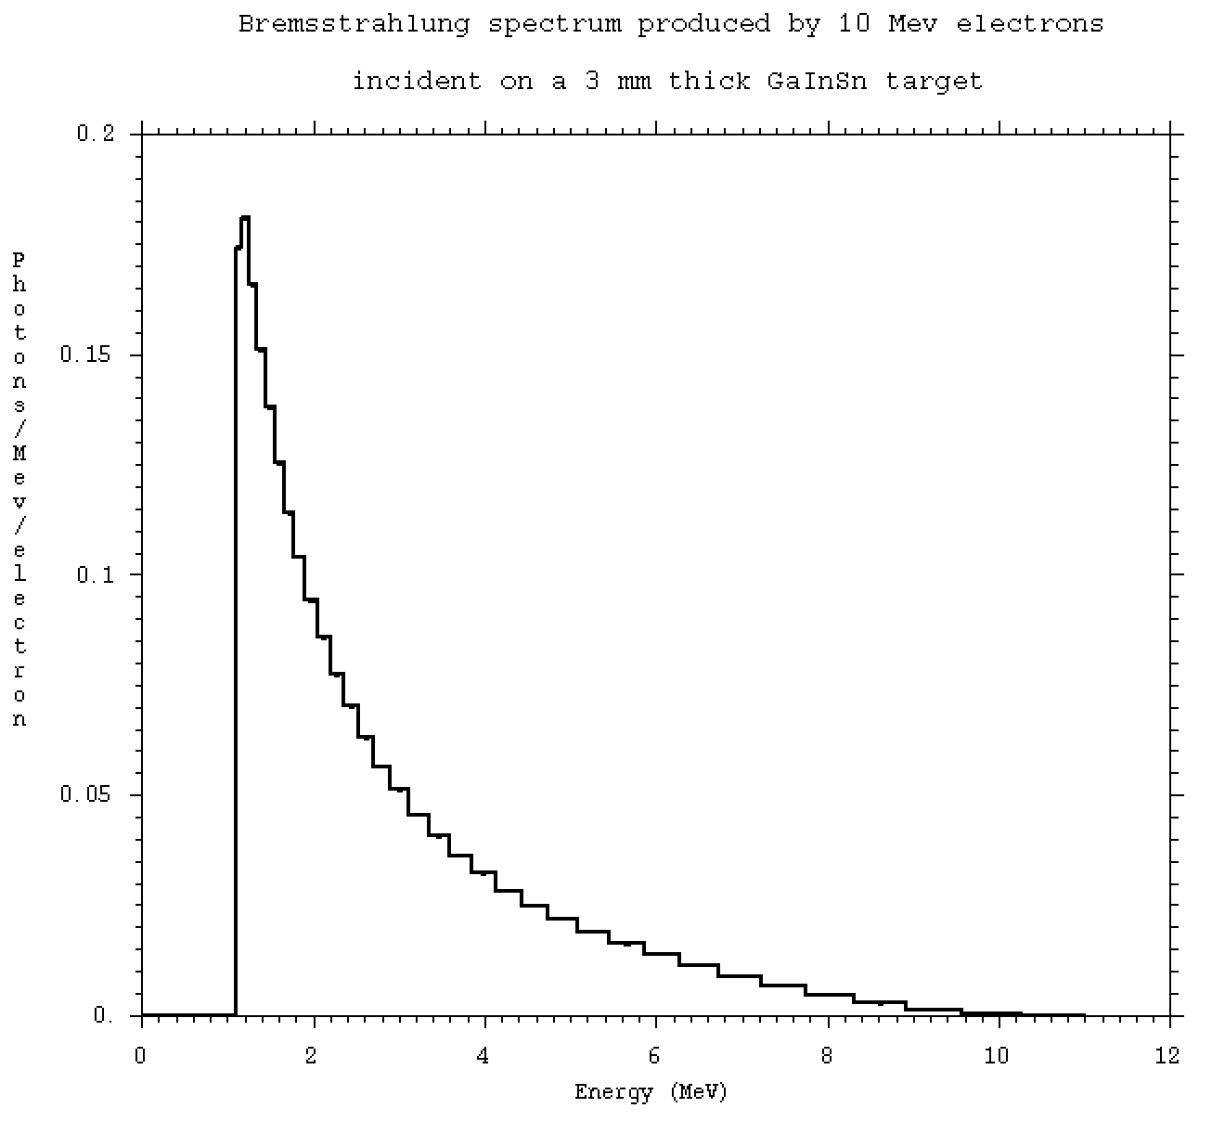
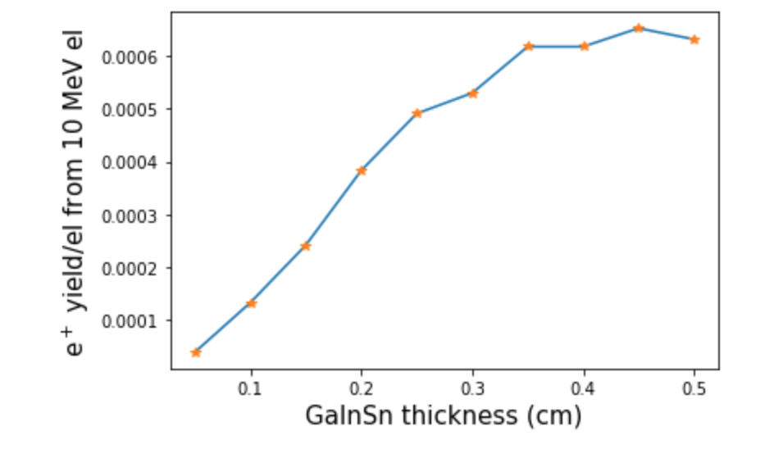
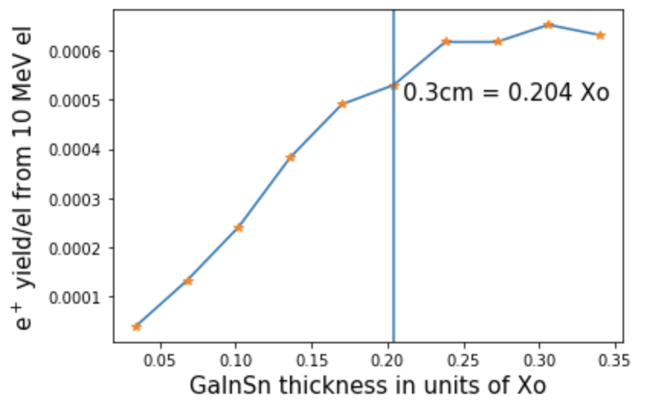
GaInSn Positron Yield (proposed 10 MeV)
Positron Yield vs. thickness (cm and Xo)
All GaInSn properties presented were calculated with the MCNP6.2 code

Slide 6
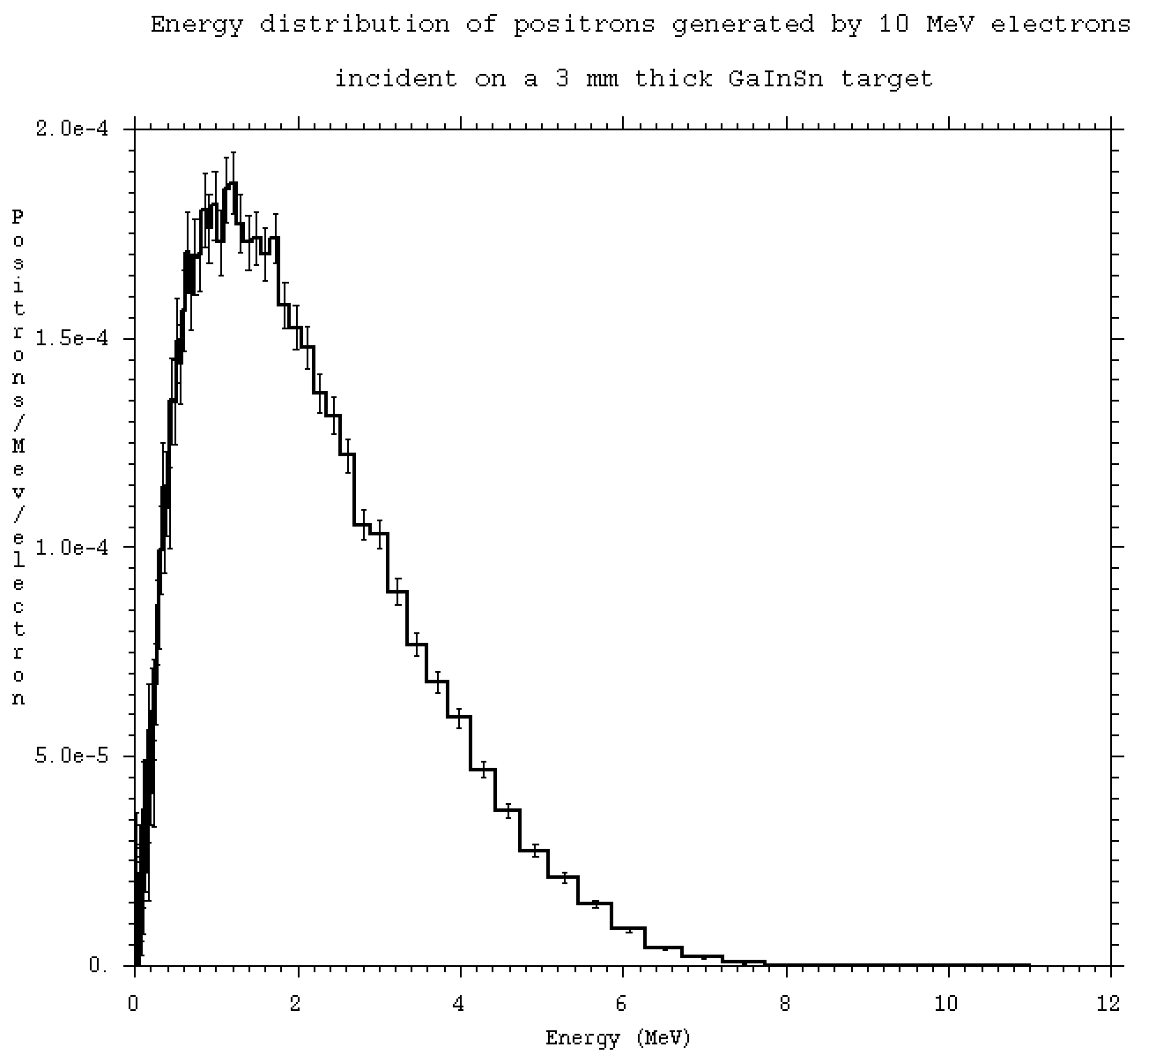
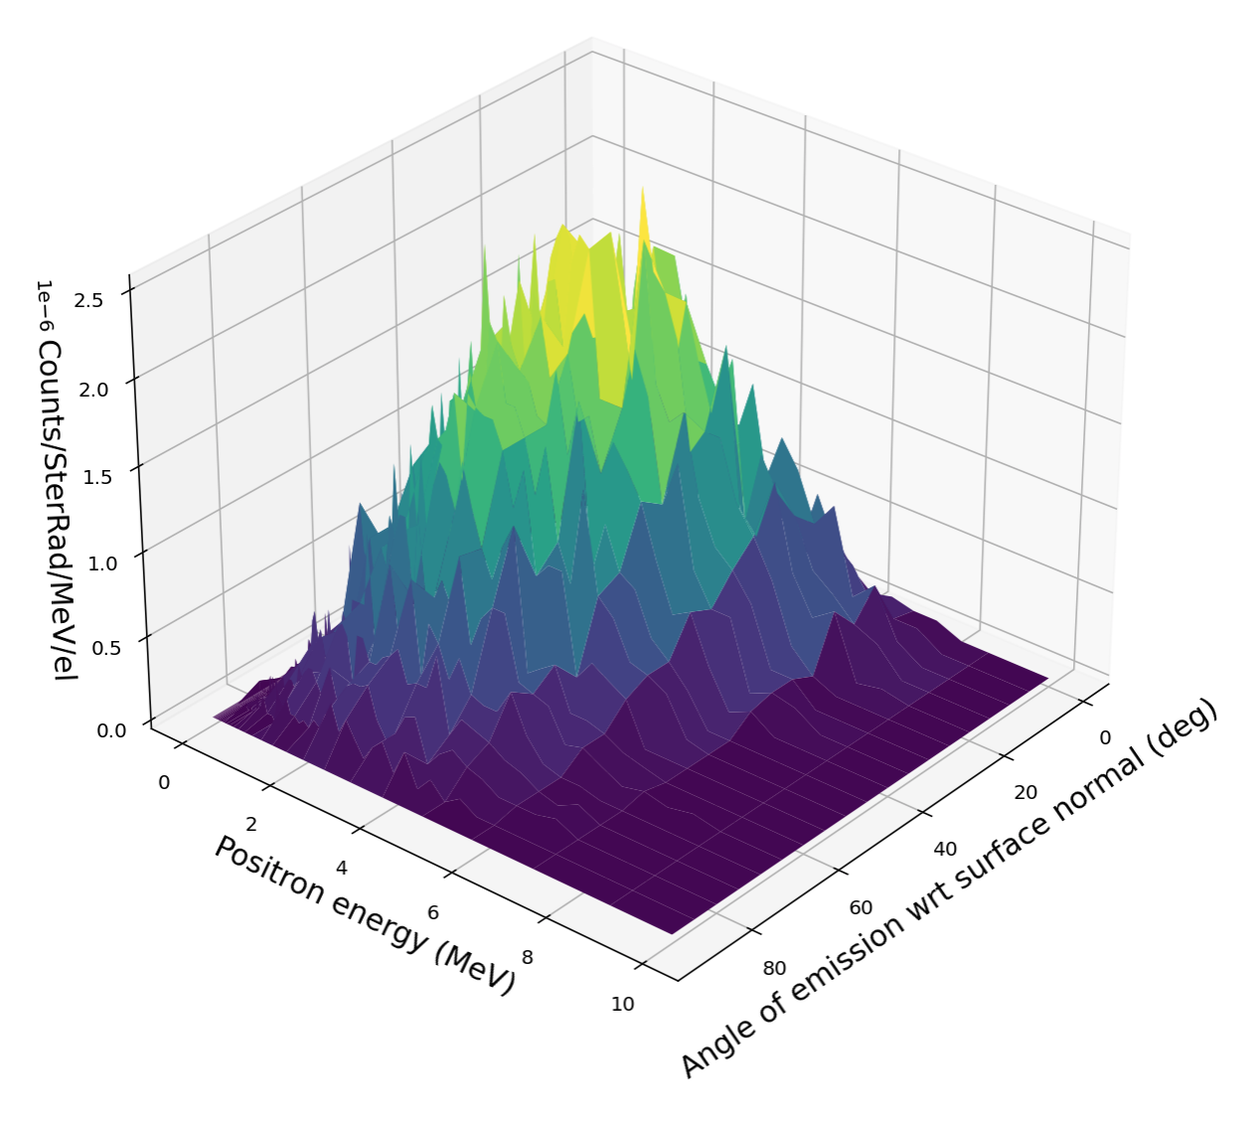
Energy and angular distribution of positrons from 3 mm thick GaInSn target
Angular and energy spread of positrons

Slide 7
Positron production by 10 MeV electrons in various targets of roughly the same radiation length thickness
The PEPPo experiment at Jlab was designed to evaluate and demonstrate the PEPPo concept. A few mA, 85% polarized 8.25 Mev/c continuous electron beam generated positrons in a 0.1-1.0 mm tungsten target. (E. Voutier, Nucl. Theory 33, (2014))
From Yu. S. Tsai, “Pair Production and Bremmstrahlung of Charged Leptons”, Rev. Mod. Phys., 46:4, 815 (1974), one gets the radiation lengths for various elements. Xo for tungsten, (divided by the density of 19.25 g/cm³) is 0.3513 cm. Thus in the Jlab experiment the W thicknesses were 0.02847 – 0.2847 Xo.

Slide 8
The properties of a GaInSn liquid metal nozzle were calculated using OpenFOAM, a free, open source CFD software.(https://openfoam.org) The basic nozzle design was taken from the paper by Gordeev et al. The nozzle contraction ratio given is four. Since the GaInSn positron target thickness at 10 MeV is 3mm, the rest of the nozzle dimensions were scaled accordingly, except for the nozzle width, which was set at 10mm.
The shape of the nozzle is given by a fifth order polynomial as discussed in the paper by Bell and Mehta (JIAA TR-84. April 1988) y(x’)/H_{i} = 1-(1-H_{e}/H_{i})(6 x’⁵ -15 x’⁴ + 10 x’³)
Where 0 < x’< 1. x’ = x/L, L is the length of the contraction region and H_{i} and H_{e} are half the heights of the nozzle at input and exit respectively. (If the widths of the input, W_{i} and output, W_{e}, are the same, H_{i}/H_{e} is the contraction ratio, otherwise it is H_{i}W_{i}/H_{e}W_{e}.)
The calculation was carried out using the OpenFOAM standard solver simpleFoam a steady-state solver for incompressible, turbulent flow, using the SIMPLE algorithm. As per Gordeev et al, the V2F model results exhibited a reasonably good agreement with measured results and therefore the v2f version in OpenFOAM was used in the present calculations.
Nozzle Design and CFD Simulation

Slide 9
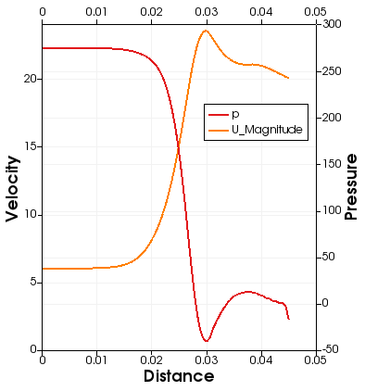
Nozzle Geometry
The GaInSn flow is shown in red and the nozzle walls in blue. So far, the best flow occurred for an input velocity U = 6 m/s.
Since the input area is 1.2 cm², the flow of GaInSn has to be 1.2 cm² times 600 cm/s or 0.72 l/s (11.41 gpm).

Slide 10
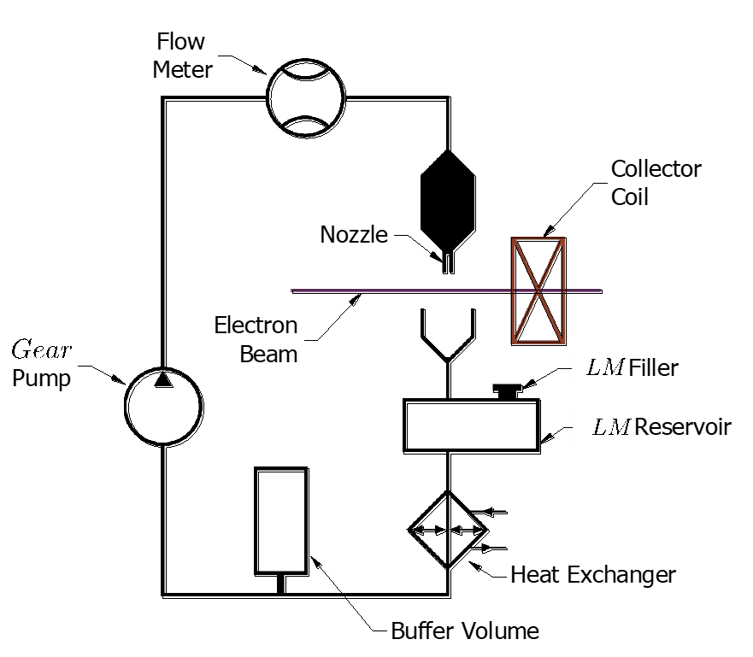
View of the prototype positron converter

Slide 11
View of the prototype positron converter

Slide 12
Accomplishments along the way
Jet Laser doppler velocity measurements (through vacuum window)
EPICS control system for remote control
Impact of magnetic field on Jet
Liquid metal flow meters (Keyence vs. home made) (Calibration)
Jet thickness / stability image processing
Radioisotope production (in Backup)
Operational Gamma Field (neutrons too) (in Backup)

Slide 13
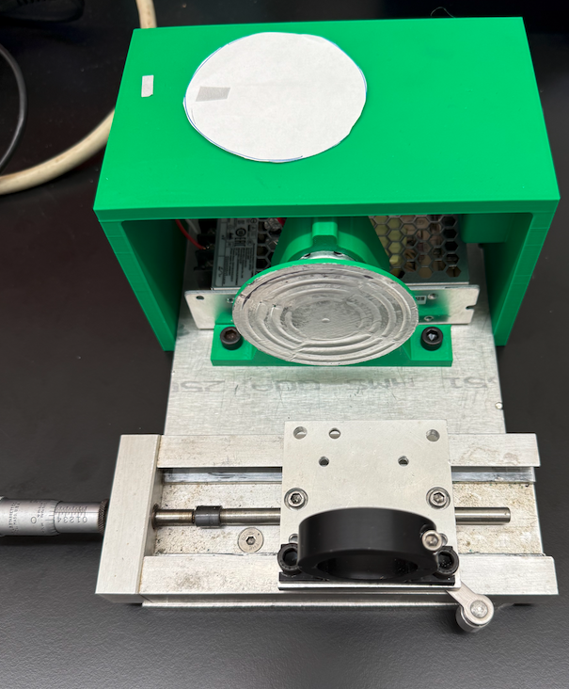
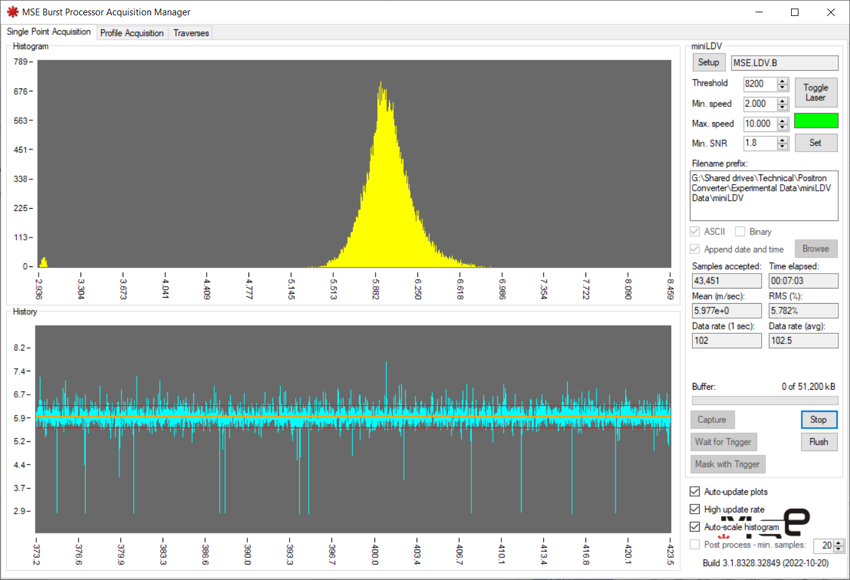
Calibration of Laser Doppler Velocimeter (miniLDV)
Calibration method is based on a spinning wheel.
At a wheel rpm=3201, measured with a
CyberTech Digital Tachometer, ω = 335.21
rad/s. The following data was obtained:
r(mm) v = rω (m/s) v (miniLDV)
18.13 6.077 6.075
21.78 7.300 7.296
24.56 8.233 8.226
28.35 9.503 9.497
32.15 10.777 10.770

Slide 14
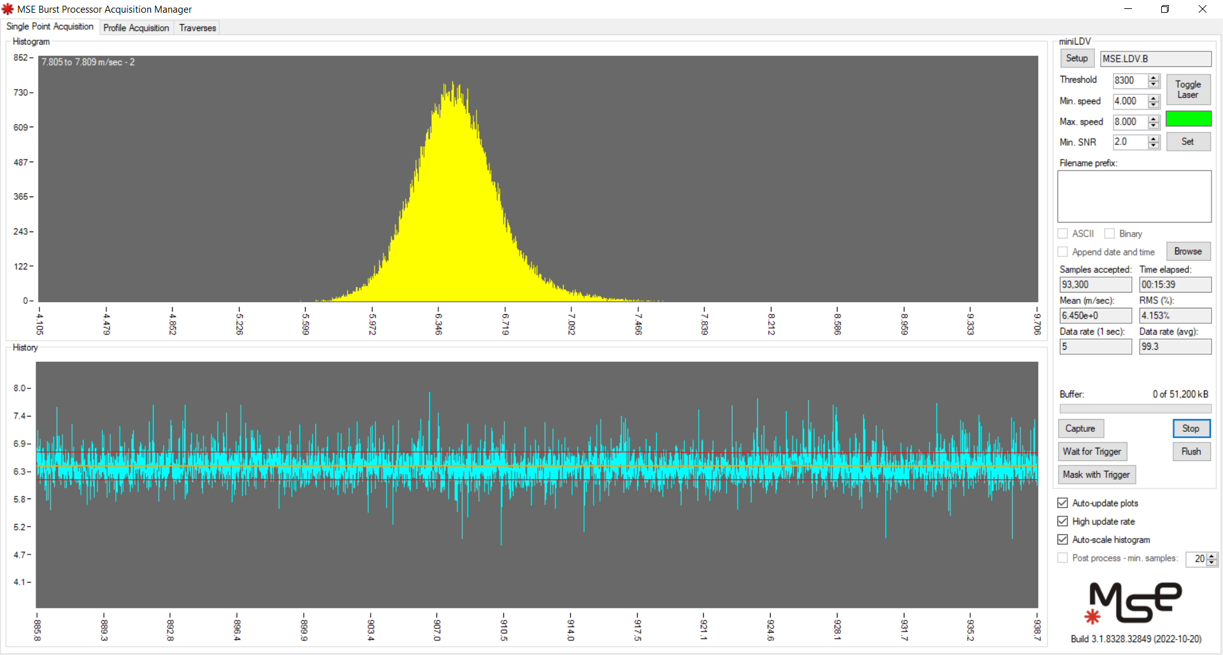
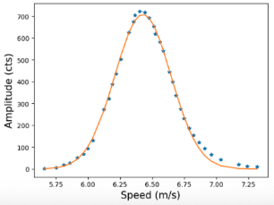
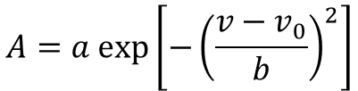
Example of Liquid Metal Jet Velocity Measurement
Digitized profile, fitted to
$$A=a exp\left[−{\left(\frac{v−v_{0}}{b}\right)}^{2}\right]$$
With a = 708, v_{o} = 6.427 m/s
b = 0.308
Fitted v_{o} = 6.427 (m/s), σ = 0.218
miniLDV = 6.450 (m/s), σ =0.268

Slide 15
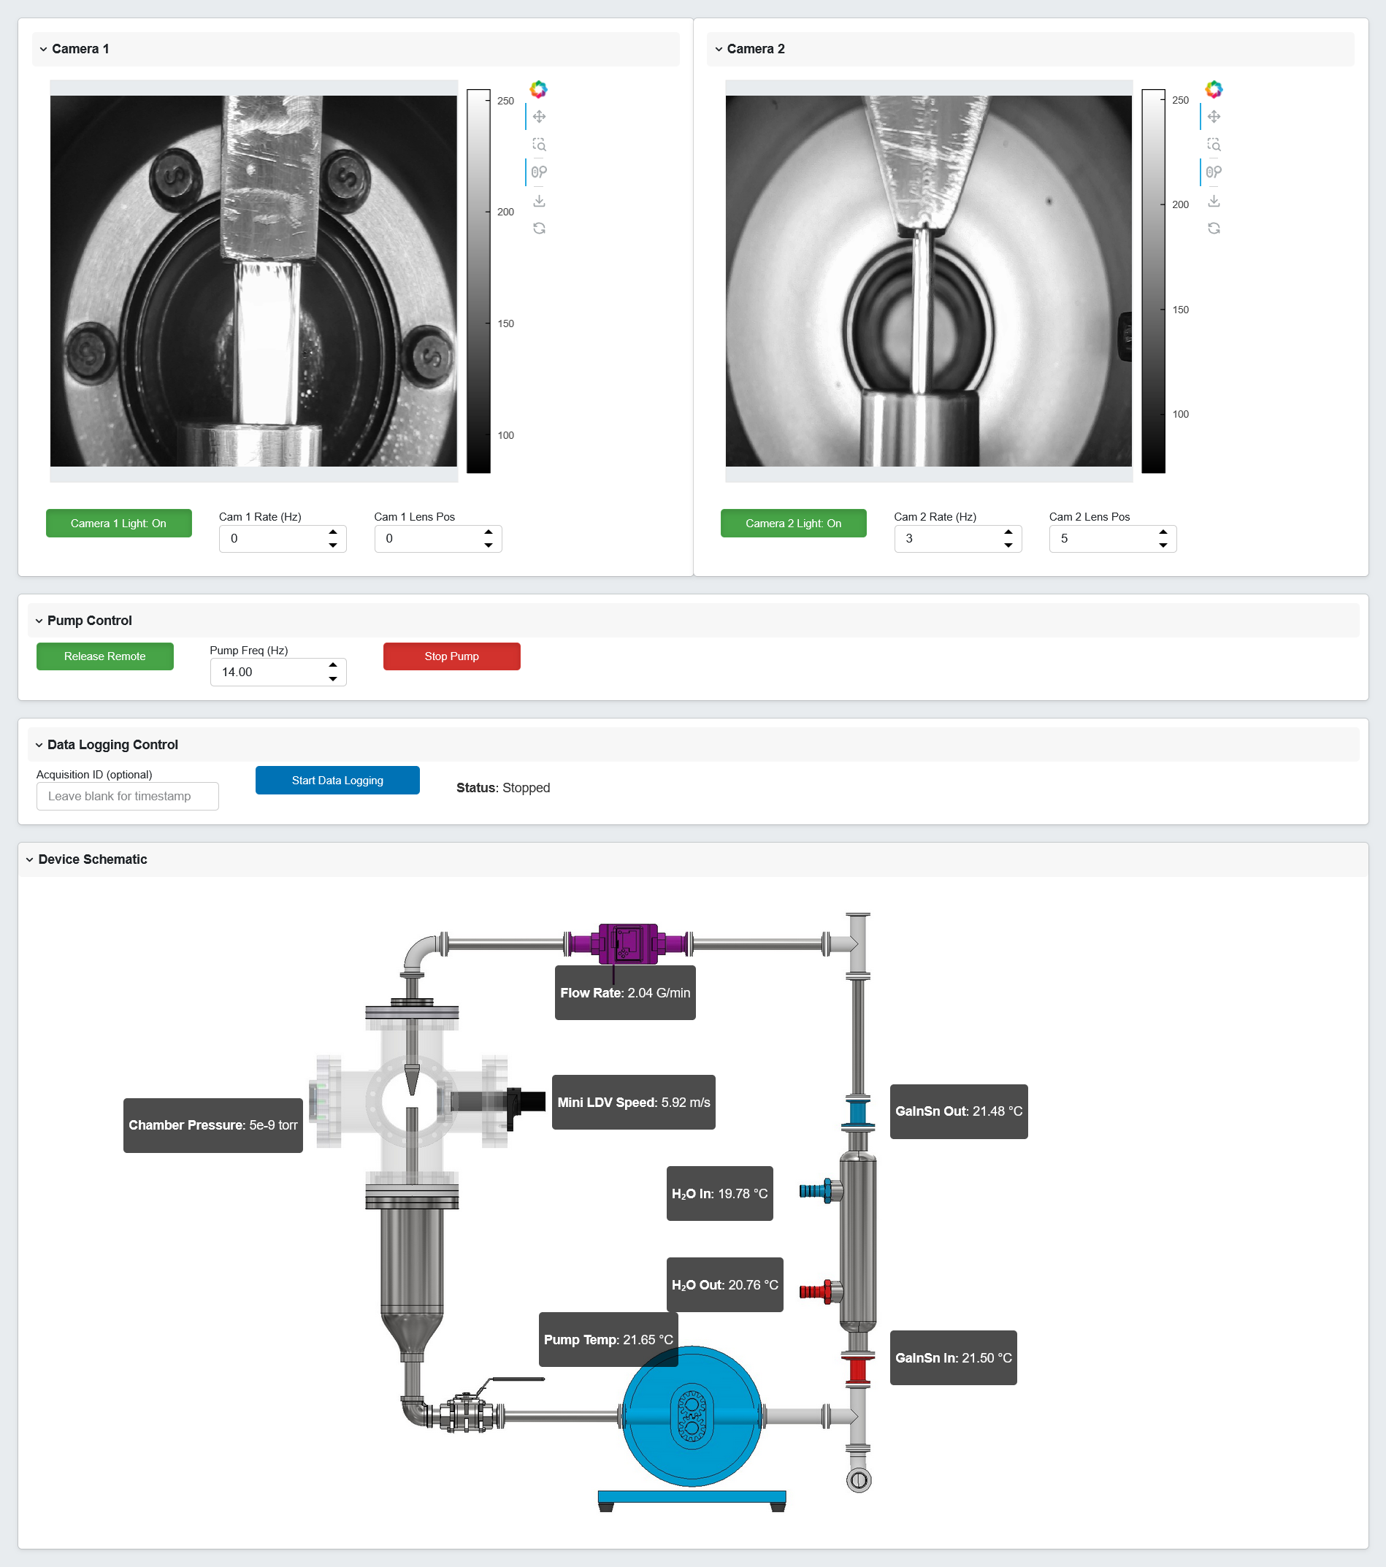
EPICS based control system
Jet Characterization:
Temperature Monitors:
Remote control of 2 RPI cameras, viewing the thickness and width of the GaInSn jet
Online analysis of jet thickness (discussed later)
Readout of thermocouples (K-type) by serving DataQ instruments Di808 data logger to EPICS
Water inlet/outlet
GaInSn coming inlet/outlet
LiquiFlo Gear Pump
Flow Monitors:
Gear pump and Vacuum:
Readout of the Keyence MD-MZ50AYK flow meter.
Readout of the Leybold Turbolab 300 l/s turbomolecular pump vacuum and Gamma Vacuum ion pump
Readout of Measurement Science Enterprise miniLDV laser Doppler velocimeter
Remote control of the Dura Impulse GS 20 sensor-less drive (VFD) controlling the Liquiflo gear pump motor.

Slide 16
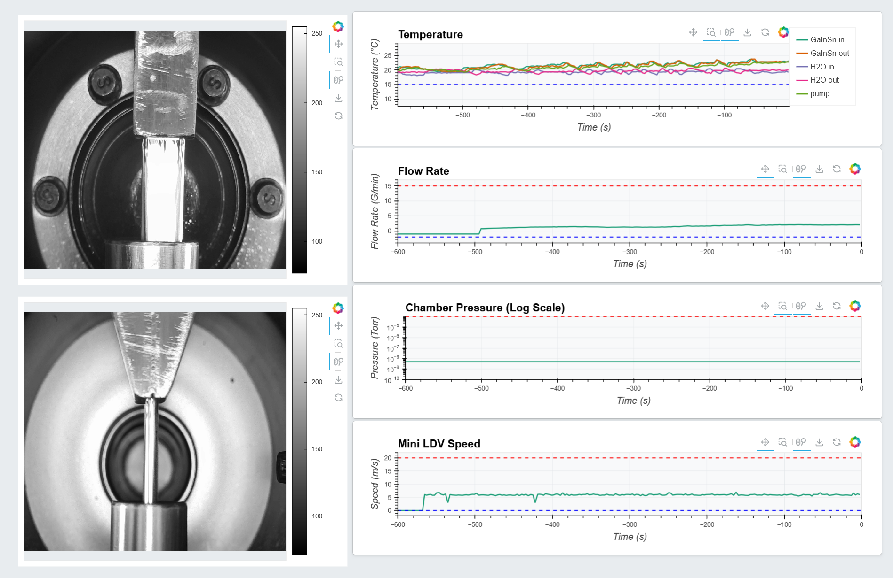
Example of Data Logged and Stored (6.5 m/s)
Dashboards via Holoviews Python package
Basic dashboard served securely over web
EPICS PVs updated on 1 - 10 Hz range
Data logging script for saving comprehensive data set for a single experimental run (tested over hours)
Scripts for combing logged camera images into movies
Scripts for plotting logged data traces over the course of a full experiment

Slide 17
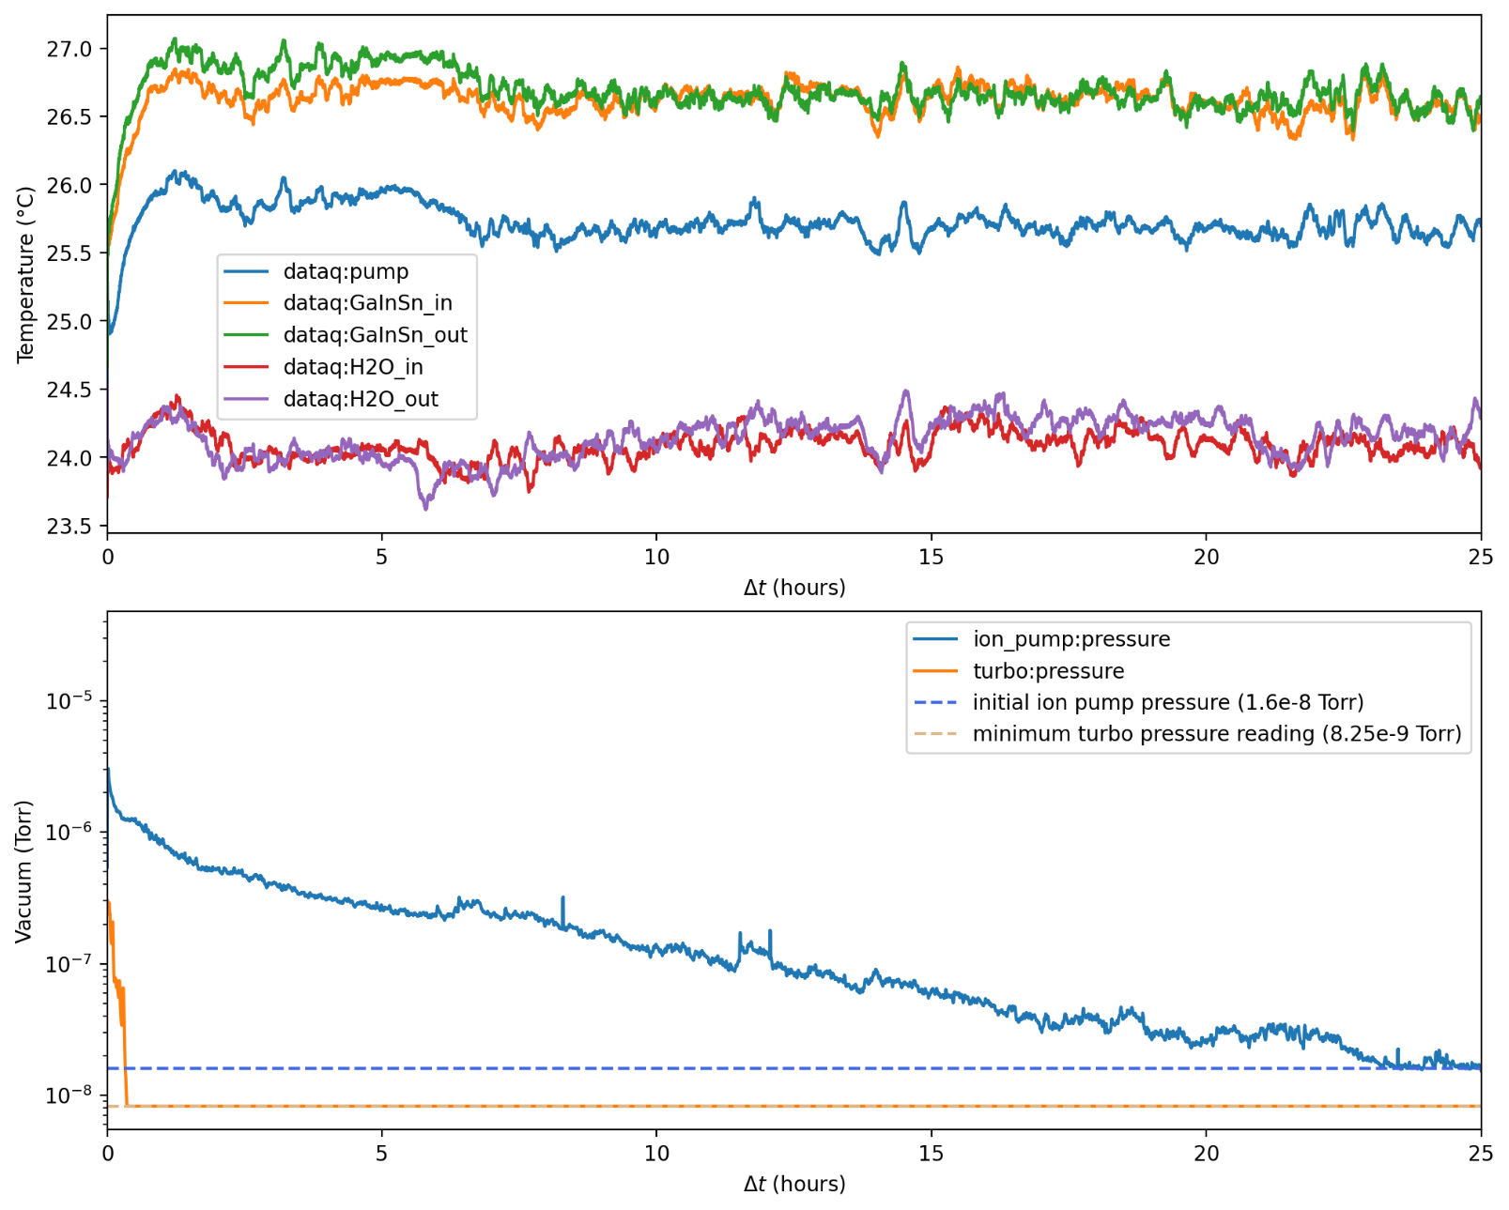
25 Hour Duration Run (Thermal / Vacuum)
1st Run
Note: with solenoid magnet

Slide 18
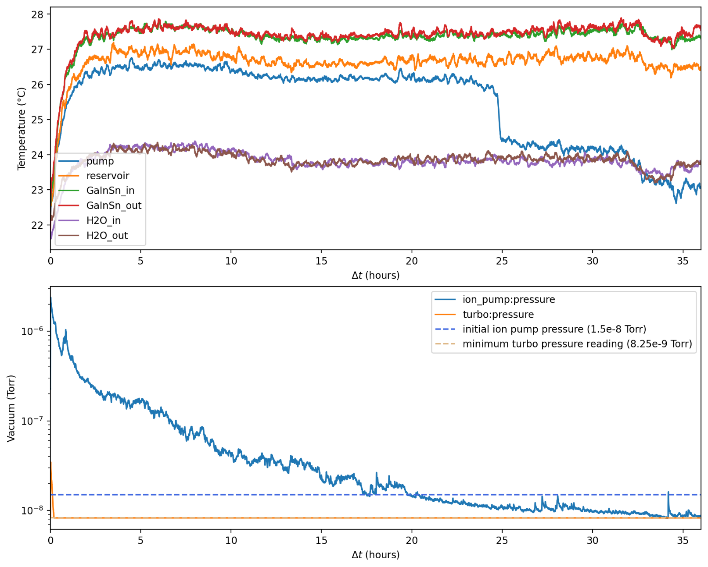
36 Hour Duration Run (Thermal / Vacuum)
2nd Run
Thermocouple fell off
Note: with solenoid magnet

Slide 19
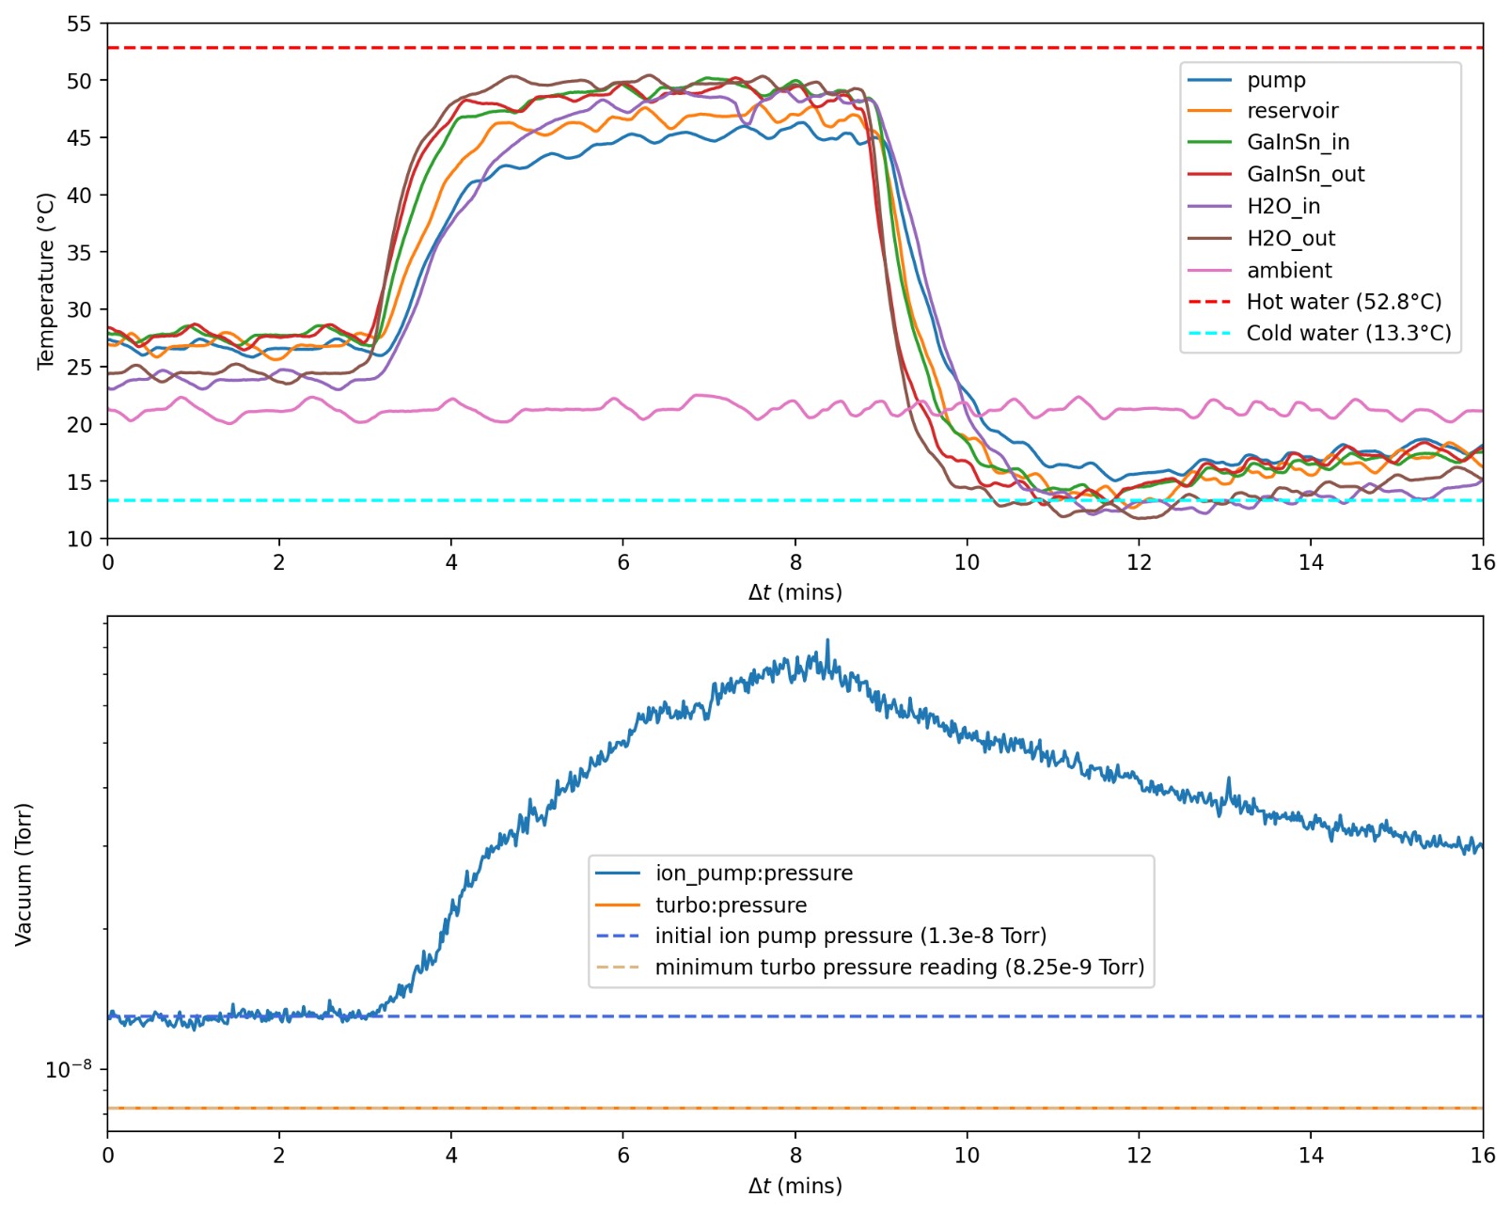
Heat Exchanger tests (Thermal / Vacuum)
Short Run
minutes
Note: with solenoid magnet removed

Slide 20
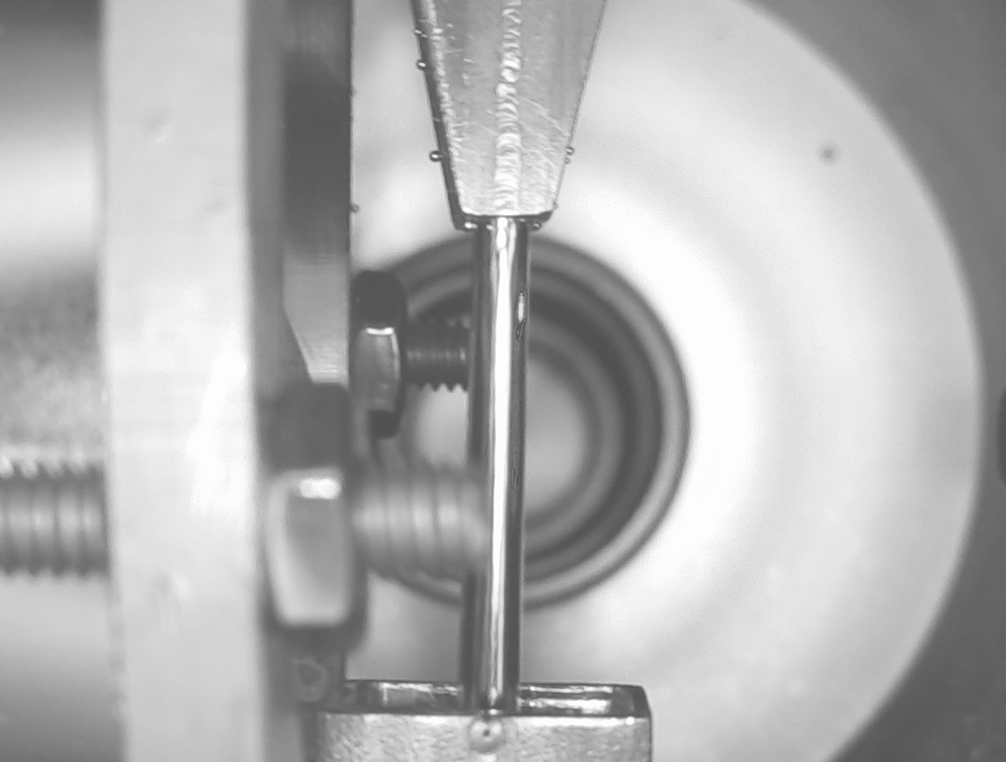
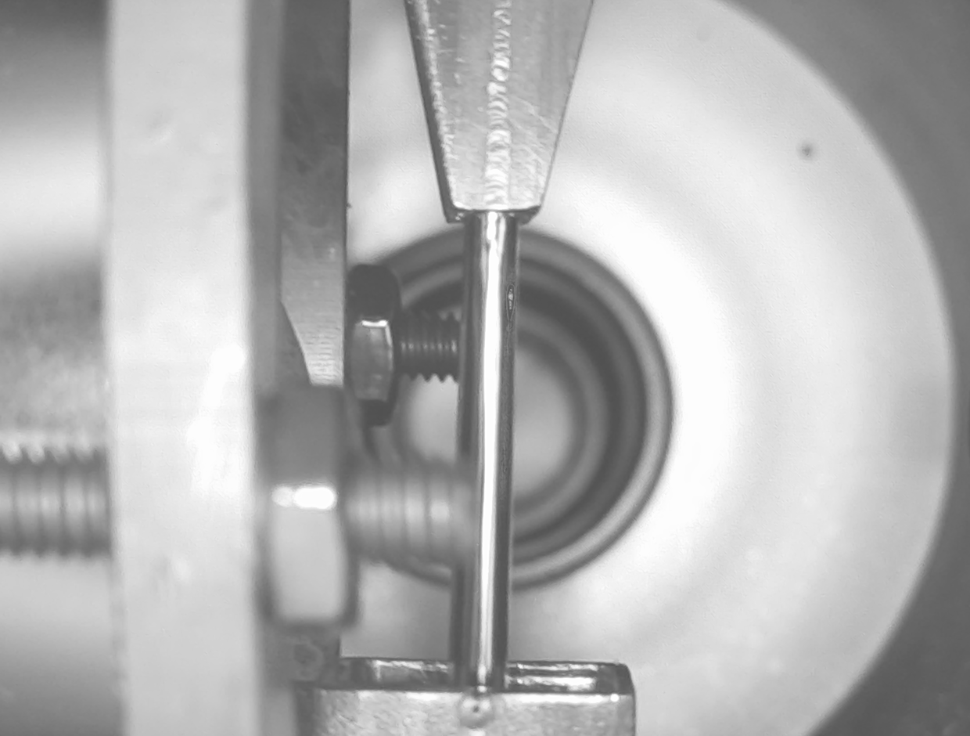
36 Hour Duration Gun (Start / End)

Slide 21
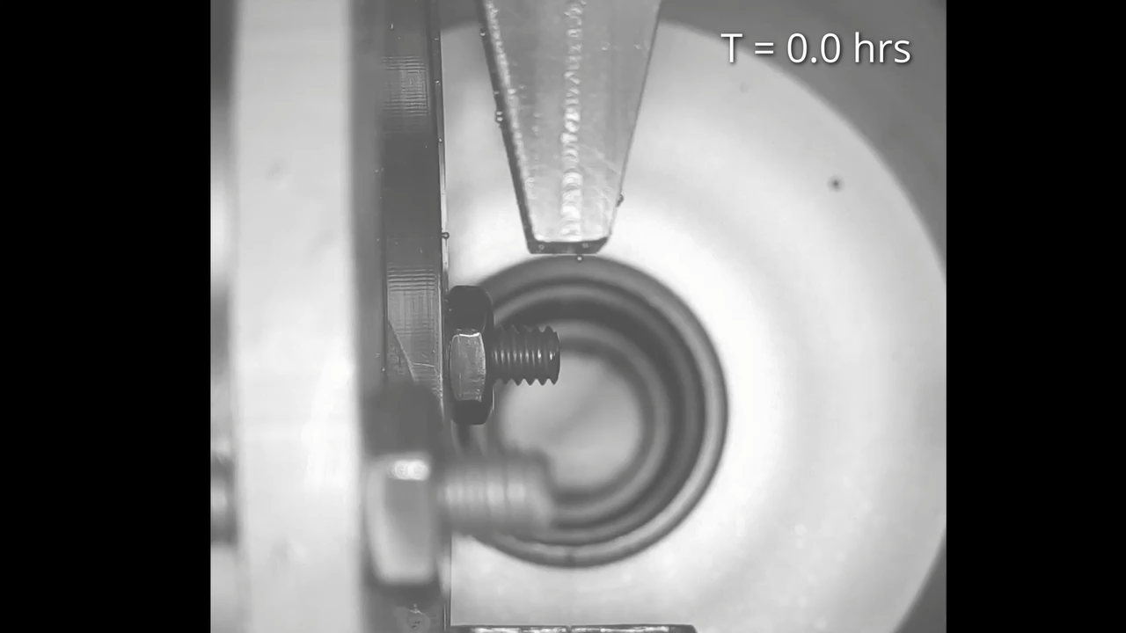
Time Lapse video

Slide 22
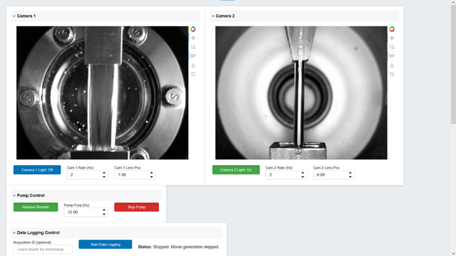
Jet Images (beam direction / side view)

Slide 23
Effect of magnetic field on jet flow (6.5 m/s)
A 3 x 1 ½” NdFeB N52 magnet was used to investigate the effect of a magnetic field on the jet behavior.
At the jet center, 19.5 mm from the magnet, the B field is 2400 Gauss – no measurable impact on jet

Slide 24
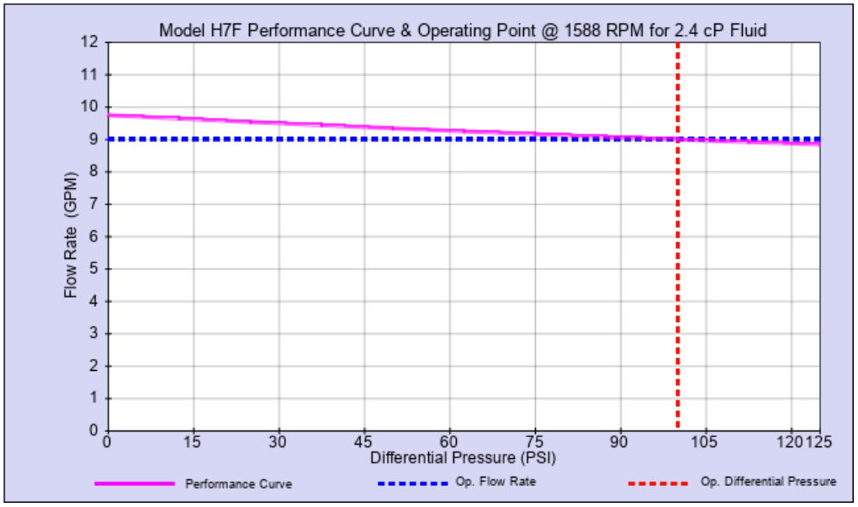
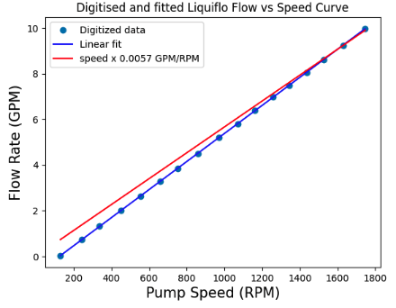
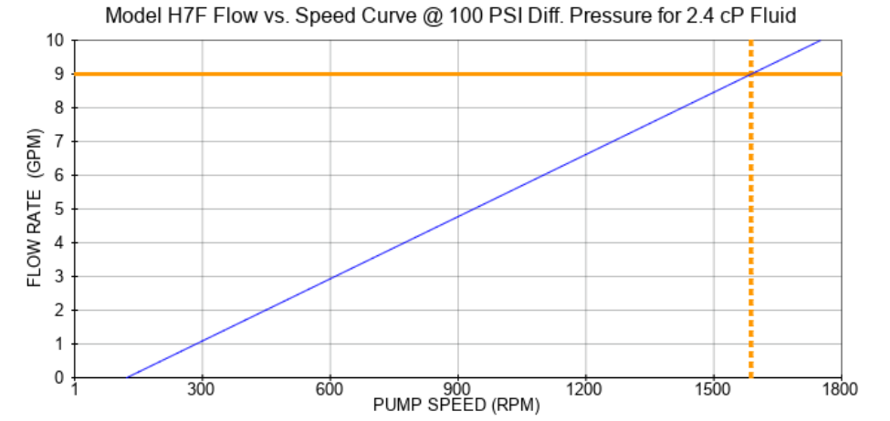
Liquiflo Gear Pump: Flow vs Speed Curve
The Flow (GPM) vs Speed Curve (RPM) and the Performance Curve provided by the manufacturer for a 2.45 cP fluid (viscosity of GaInSn at room temperature) are needed
The performance curve shows that the flow rate is essentially independent of the differential pressure.
Pump manufacture data gives Flow = 6.14 x 10⁻³ * Pump RPM - 0.76
At 1588 RPM, the fitted flow rate is 8.99 GPM, while the Liquiflo curve gives 9 GPM
Also plotted in red is the curve Flow = 9/1588 speed, based on the amount pumped per revolution.

Slide 25
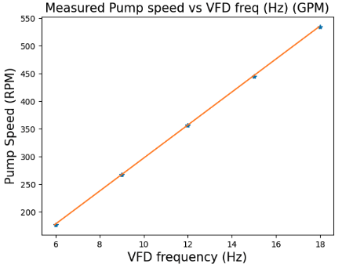
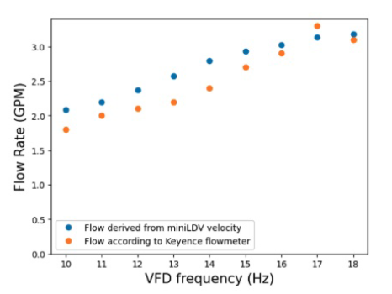
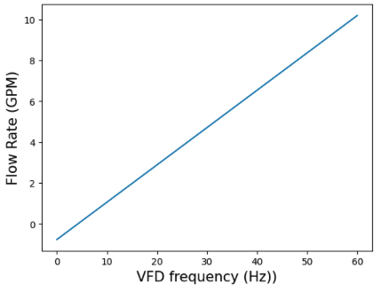
Calibration of the Variable Frequency Drive
At 60 Hz, the motor rated speed is 1750 RPM. Giving 29.167 RPM/Hz.
Speed was measured with the CyberTech digital tachometer at different VFD frequencies
A linear fit to the data gives
speed = 29.73 x freq-1.0
At 6 Hz, the flow rate is 0.326 GPM
at 6 Hz, pump speed is 177 RPM
177 RPM corresponds to 0.323 GPM
At 60 Hz, the flow rate is 10.192 GPM
at 60 Hz, pump speed is 1760 RPM
1760 RPM corresponds to 10.051 GPM
To convert frequency to pump flow, replace speed in
flow = 6.14522 x 10⁻³ speed - 0.76451923 with speed = 29.73333 x freq-1.0
So that
flow = 0.1827179 x freq-0.7706645
The resulting plot of flow vs frequency is

Slide 26
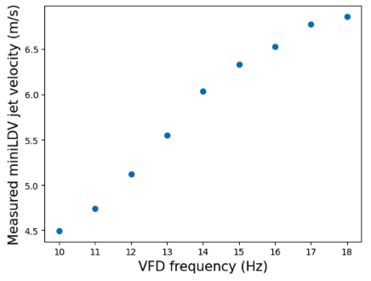
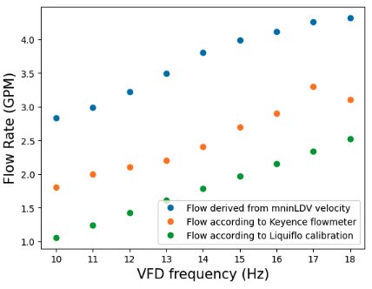
GaInSn Jet
The jet flow in GPM is obtained from the measured jet velocity as follows:
From the properties of the nozzle, v_{in}A_{in}= v_{out}A_{out} , so that v_{in}= v_{out}A_{out}/A_{in}
since A_{out} / A_{in}=0.150, v_{in}= 0.15v_{out}
Inflow(GPM) = v_{in}A_{in} = 0.15v_{out}A_{in}
= 0.15 v_{out} (m/s) 100 (cm/m) A_{in} (cm²) 60 (s/min)
/1000 (cm³/l)/2.7853 (l/gal)
Outflow = Inflow
Problem:
Plot of flow vs frequency obtained from jet velocity measurements
does not agree with the Keyence flowmeter data or with the flow vs frequency data derived from plot provided by Liquiflo. While
the overall trends are similar, the values do not agree with one another.

Slide 27
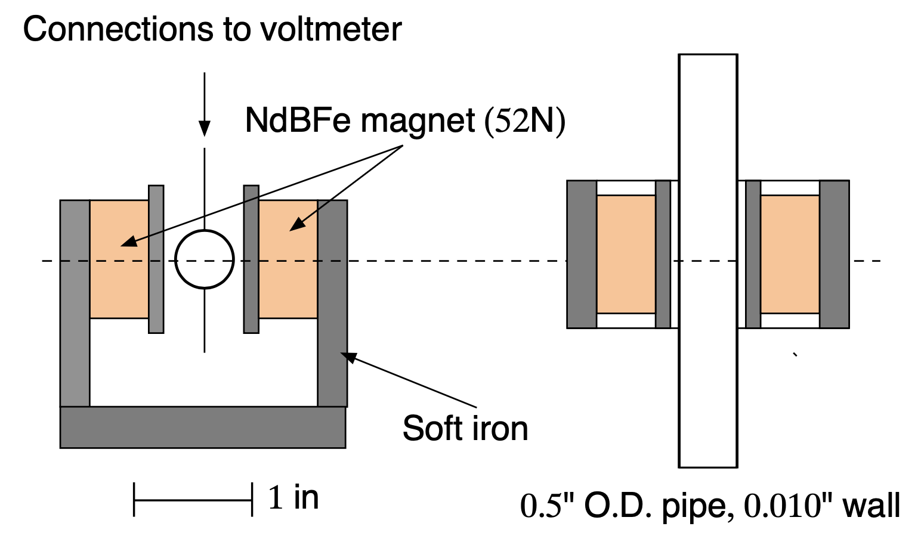
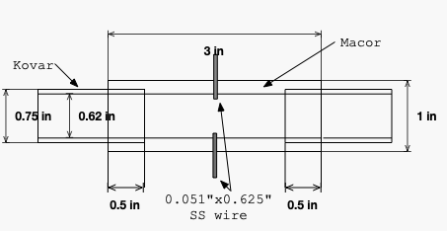
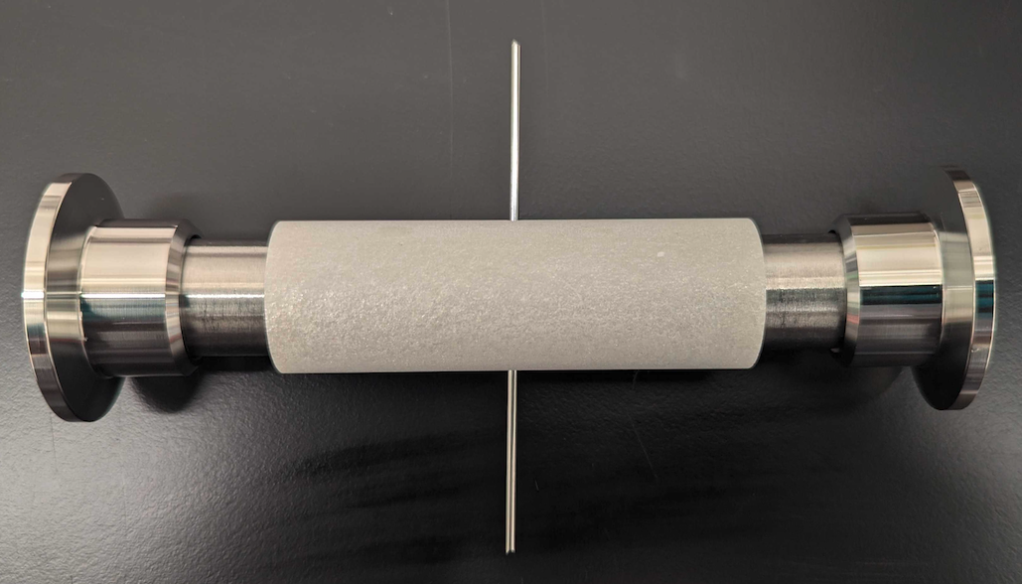
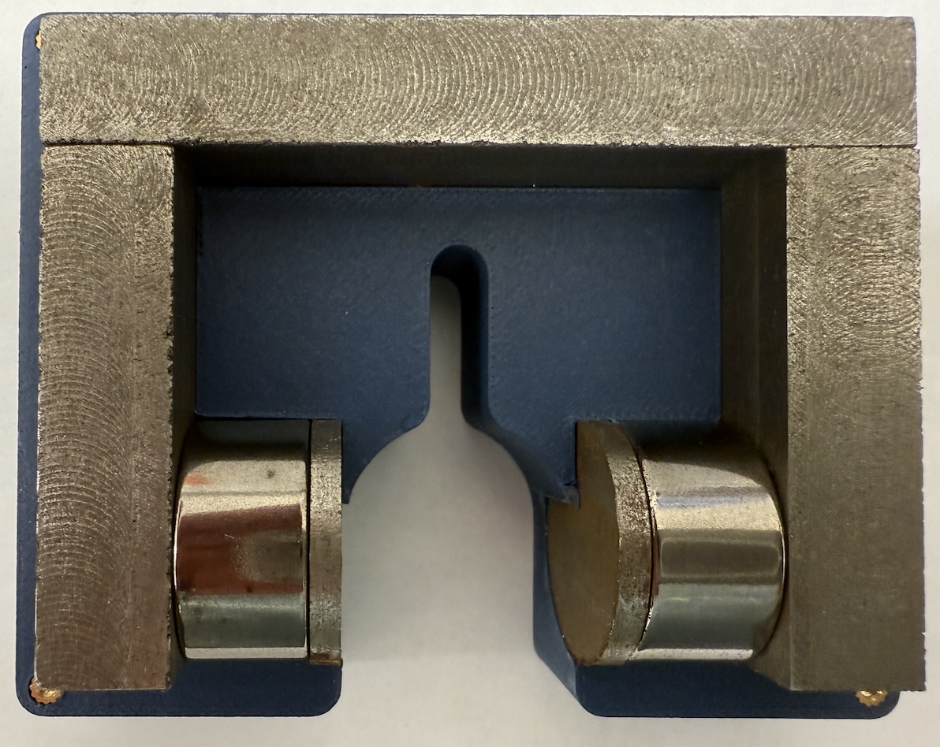
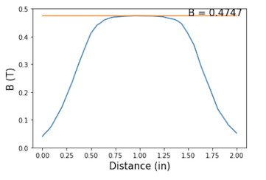
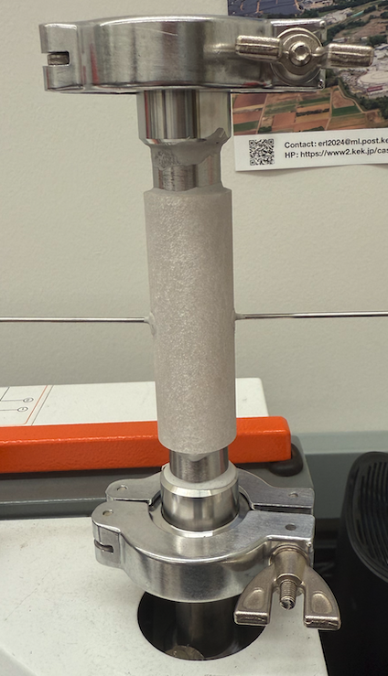
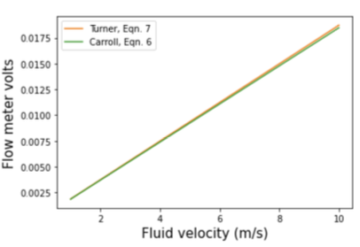
Flow meter cont’d
Flow meter dimensions and materials
Flow meter as constructed with KF flanges
Assembled flow meter being leak checked
Magnet holder
B field as calculated with FEMM
Comparison of voltages generated using equations
given in the above mentioned references for GaInSn
flowing in a 4747 gauss field.

Slide 28
Jet Thickness Measurement – image processing
It is critical that the target thickness remains constant
Summer undergraduate intern developed a image processing technique to measure the variation of the jet thickness in time was implemented using Python + Open CV:
ROI and noise reduction applied to image from the RPi camera
Canny edge detection is then applied to each processed subarea. This is a binary pixel map that highlights high contrast pixels.
The Hough lines algorithm is then applied to probabilistically find straight lines in the Canny Edge map.
The lines that are farthest apart are selected. The change in distance between the line pairs is then determined.
Assuming that the change in width is constant, the known starting width (3mm) and distance between the nozzle and the flow capturing tube (20mm) are then used to find the width halfway between the nozzle and the receptacle.

Slide 29
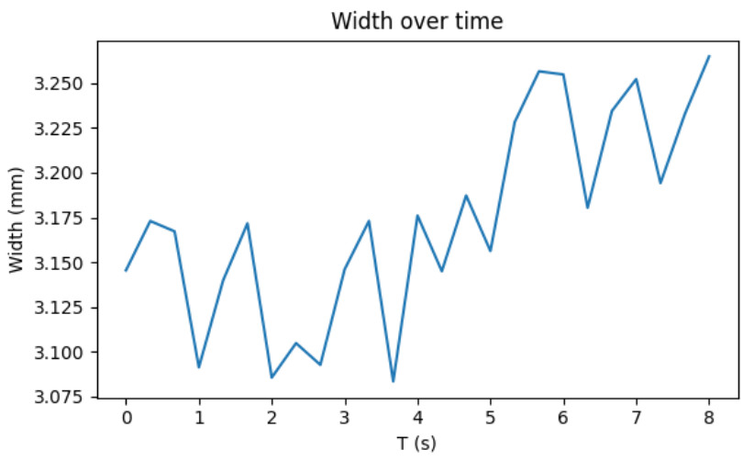
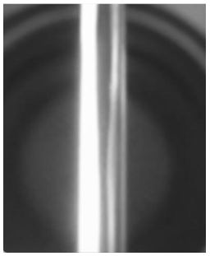
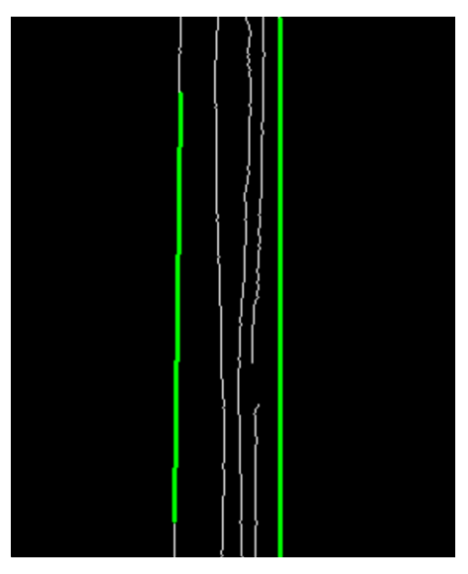
Flow width measurement – image processing
Preliminary test taken at a frequency of 3 Hz provided an average width measurement of 3.17 mm with a standard deviation of 0.057 mm (1.78%).
Typical camera image used
Example of Hough Lines used.
Algorithm is a convenient and reliable method to visually measure changes in the width of the liquid metal jet
Sensitive to lighting conditions and camera mounting (Sealed Camera volume)

Slide 30
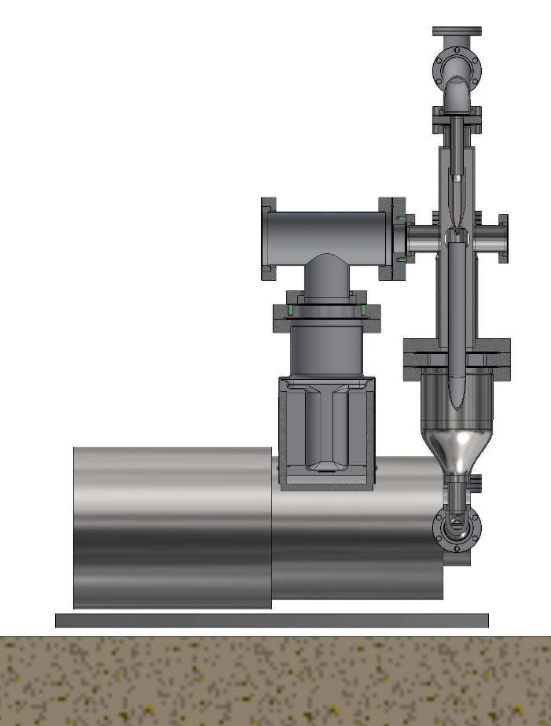
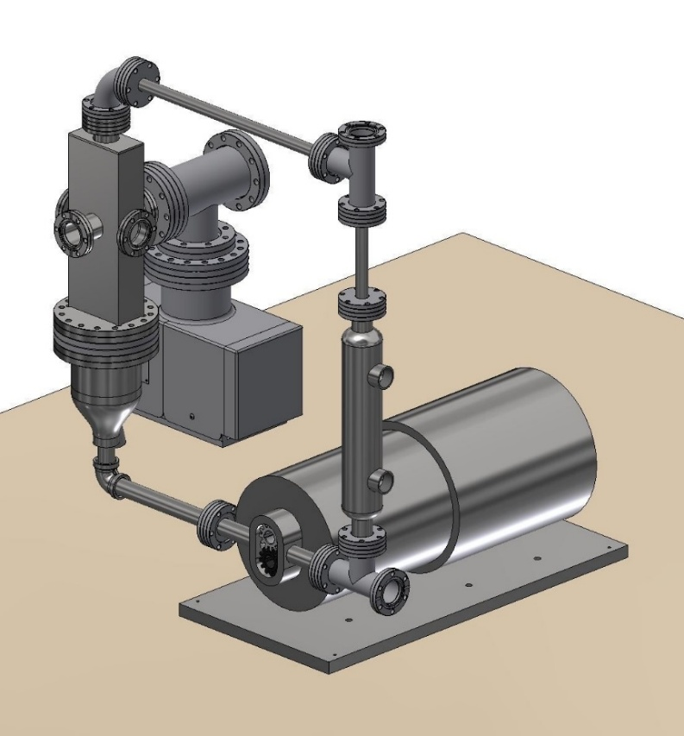
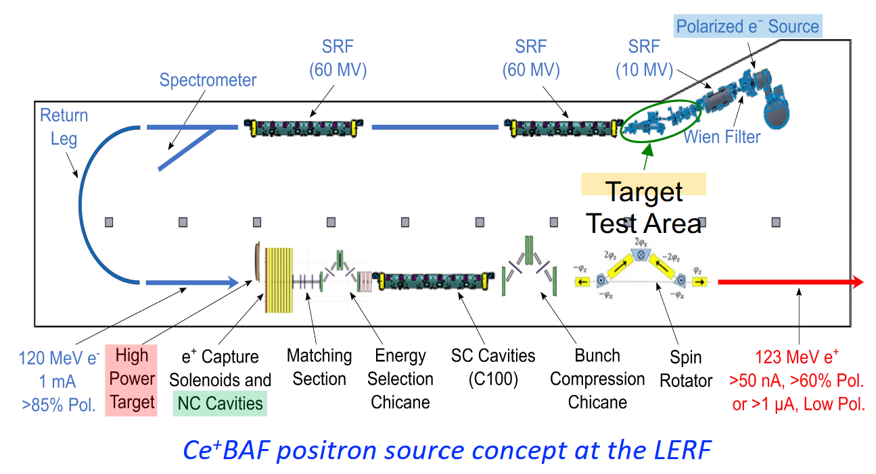
Readiness for JLab LERF beam test
A second system is being built incorporating all the improvements we’ve developed over the past two years, to be delivered later this spring to Jlab for testing.

Slide 31
Next steps
Continue experiments that investigate jet properties, new 3D printed nozzles
Investigate new designs for jet collector (almost complete) – can we reduce droplets formation to zero – unsteady start up flow (?)
Construct final version of positron converter and incorporate lessons learned from the prototype for delivery to Jlab for upcoming LERF tests
This work is based upon work supported by the U.S. Department of Energy under Award Number DE-SC0023574

Slide 32
Backup Slides
Backup Slides

Slide 33
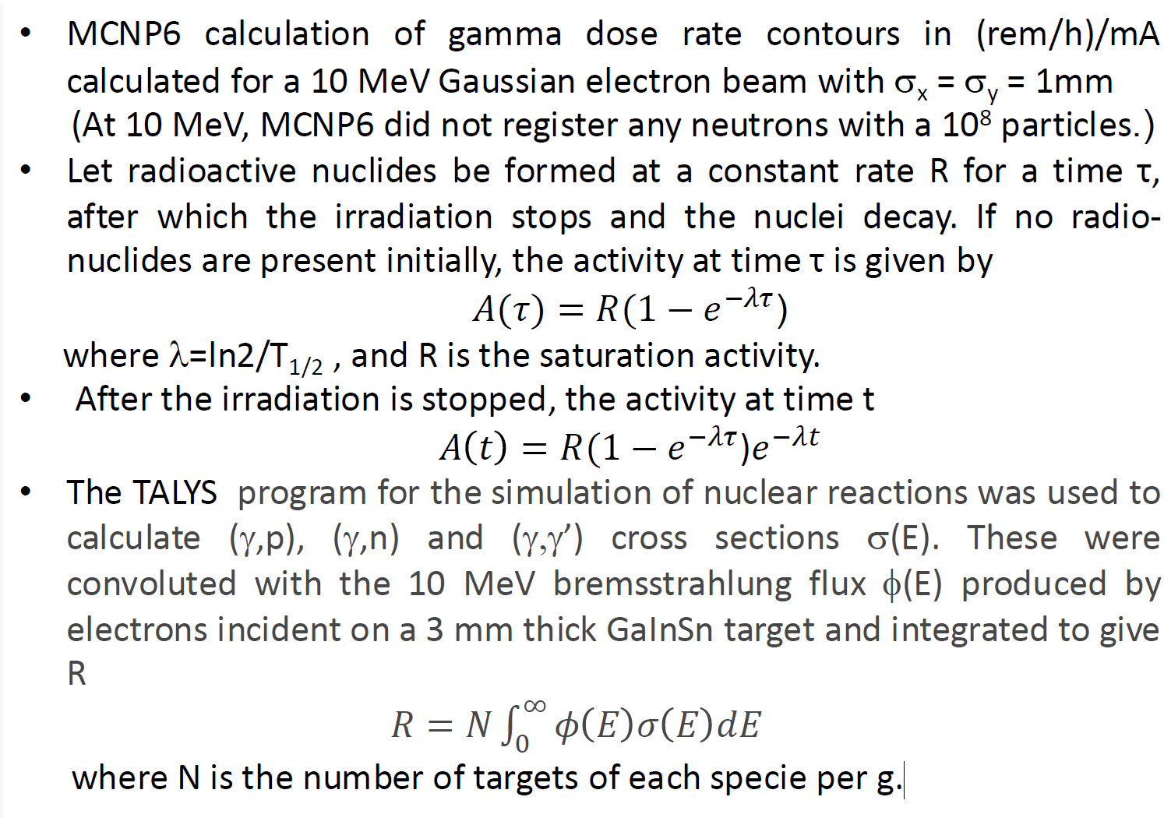
Radioisotope production in the GaInSn target

Slide 34
Radio isotope production

Slide 35
Gamma dose rates in (rem/h)/(el/s) in GaInSn and W targets by 10 MeV electrons

Slide 36
Gamma dose near target (LM and W)
In both cases, 3 cm from target, the dose rate is ~4.0E-07 (rem/h)/(el/s). 1 mA corresponds to 6.242E+15
(el/s), so dose rate is 2.5E+09 rem/h. For gammas, rem=rad, so dose rate is 2.5E+09 rad/h.
The GigaRad/h dose rates is a problem for the magnetic field needed to collect the positrons. No known magnet wire insulation can withstand such high dose rates. Need bare conductor coils with many turns and several kA currents.

Slide 37
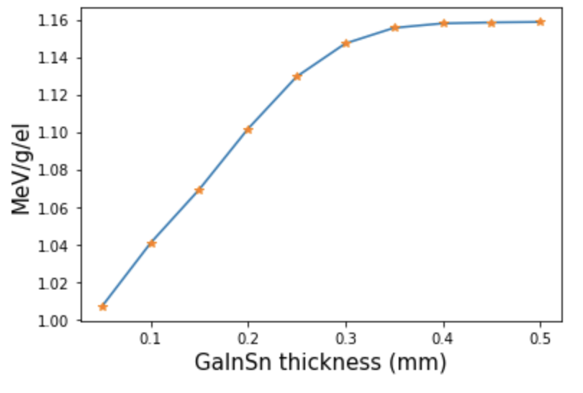
Energy per gram deposited in the GaInSn target by 10 MeV electrons
Energy deposited into a 1.2 cm² area of GaInSn vs. target thickness. At 0.3 cm, the energy deposited is 1.15 MeV/g/el, or 2.67 MeV/el. For a 1 mA beam, this corresponds to 2.67 kW.

Slide 38
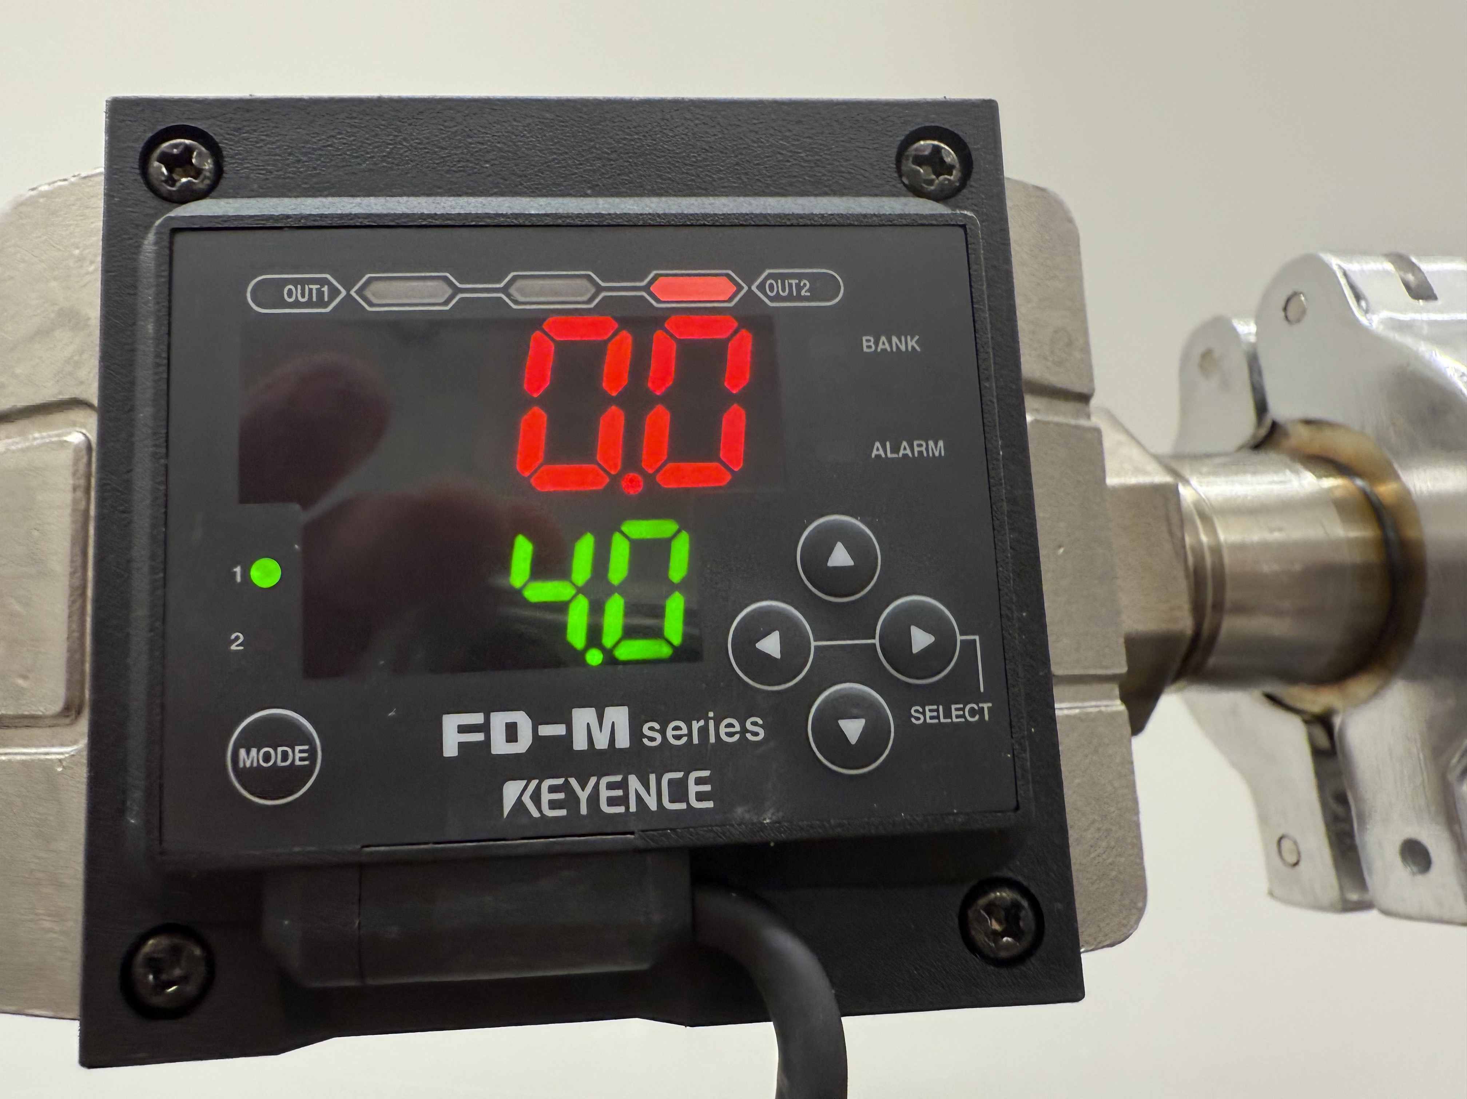
Flow meter
Purchased a model MD-MZ50AYK flow meter from Keyence and incorporated it into the system. Initially behavior of the device was very erratic, but it settled with time. Not much information about the device was available. This, combined with the fact that the device electronics probably would not survive in a high radiation field led to a design and construction of a device, based two papers available on the web.
G.E. Turner, "Liquid Metal Flow Measurement (Sodium) State-of-the-Art Study", LMEC-Memo-68-9
R. M. Carroll, "A Simple Electromagnetic Flowmeter for Liquid Metals", ORNL-1461
Magnetic flowmeter operation is based on the physical phenomenon discovered by Faraday, namely, that a potential is developed across a moving conductor in a magnetic field. This potential is proportional to the object’s velocity and magnetic field strength, and is developed at right angles to both the magnetic field and the direction of movement of the object.

Slide 39
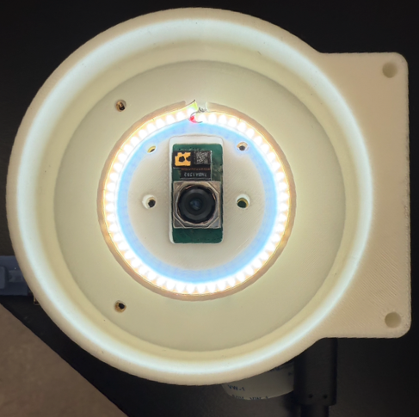
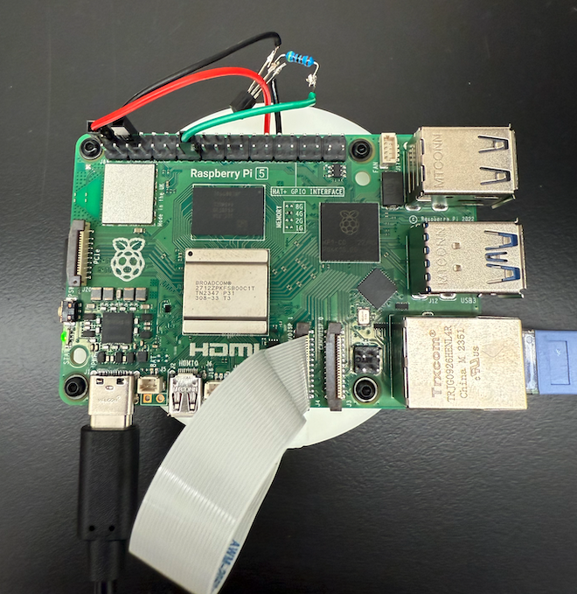
Front and Back View of Cameras Used
Each camera used is a Raspberry Pi Camera Module 3, 12MP IMX708 75°(D) Autofocus Pi Camera V3.

Slide 40
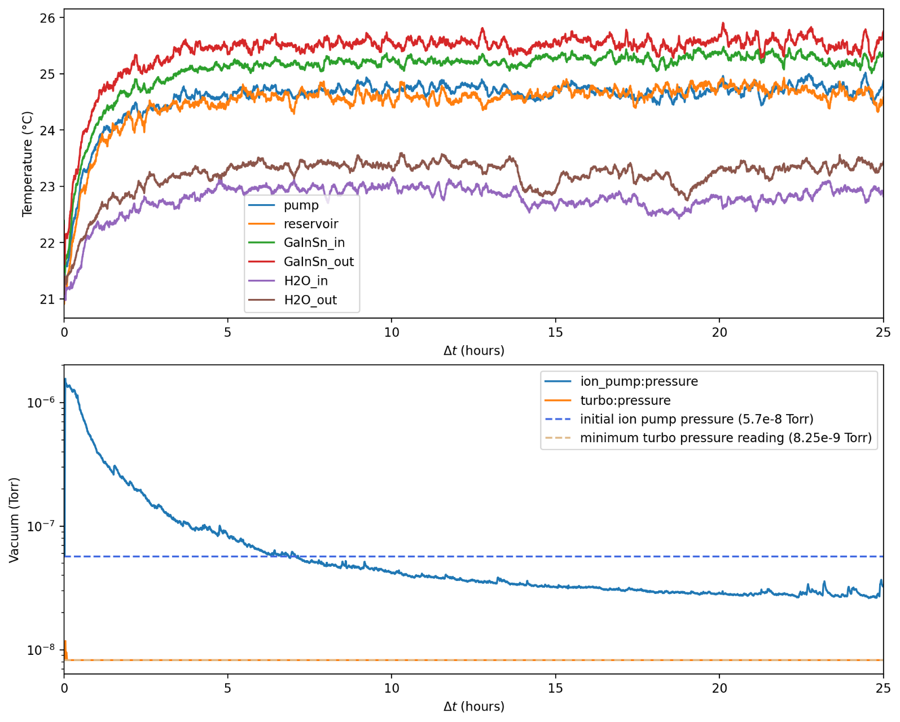
25 Hour Duration Gun (Thermal / Vacuum)
3rd Run
Note: with solenoid magnet removed

Slide 41
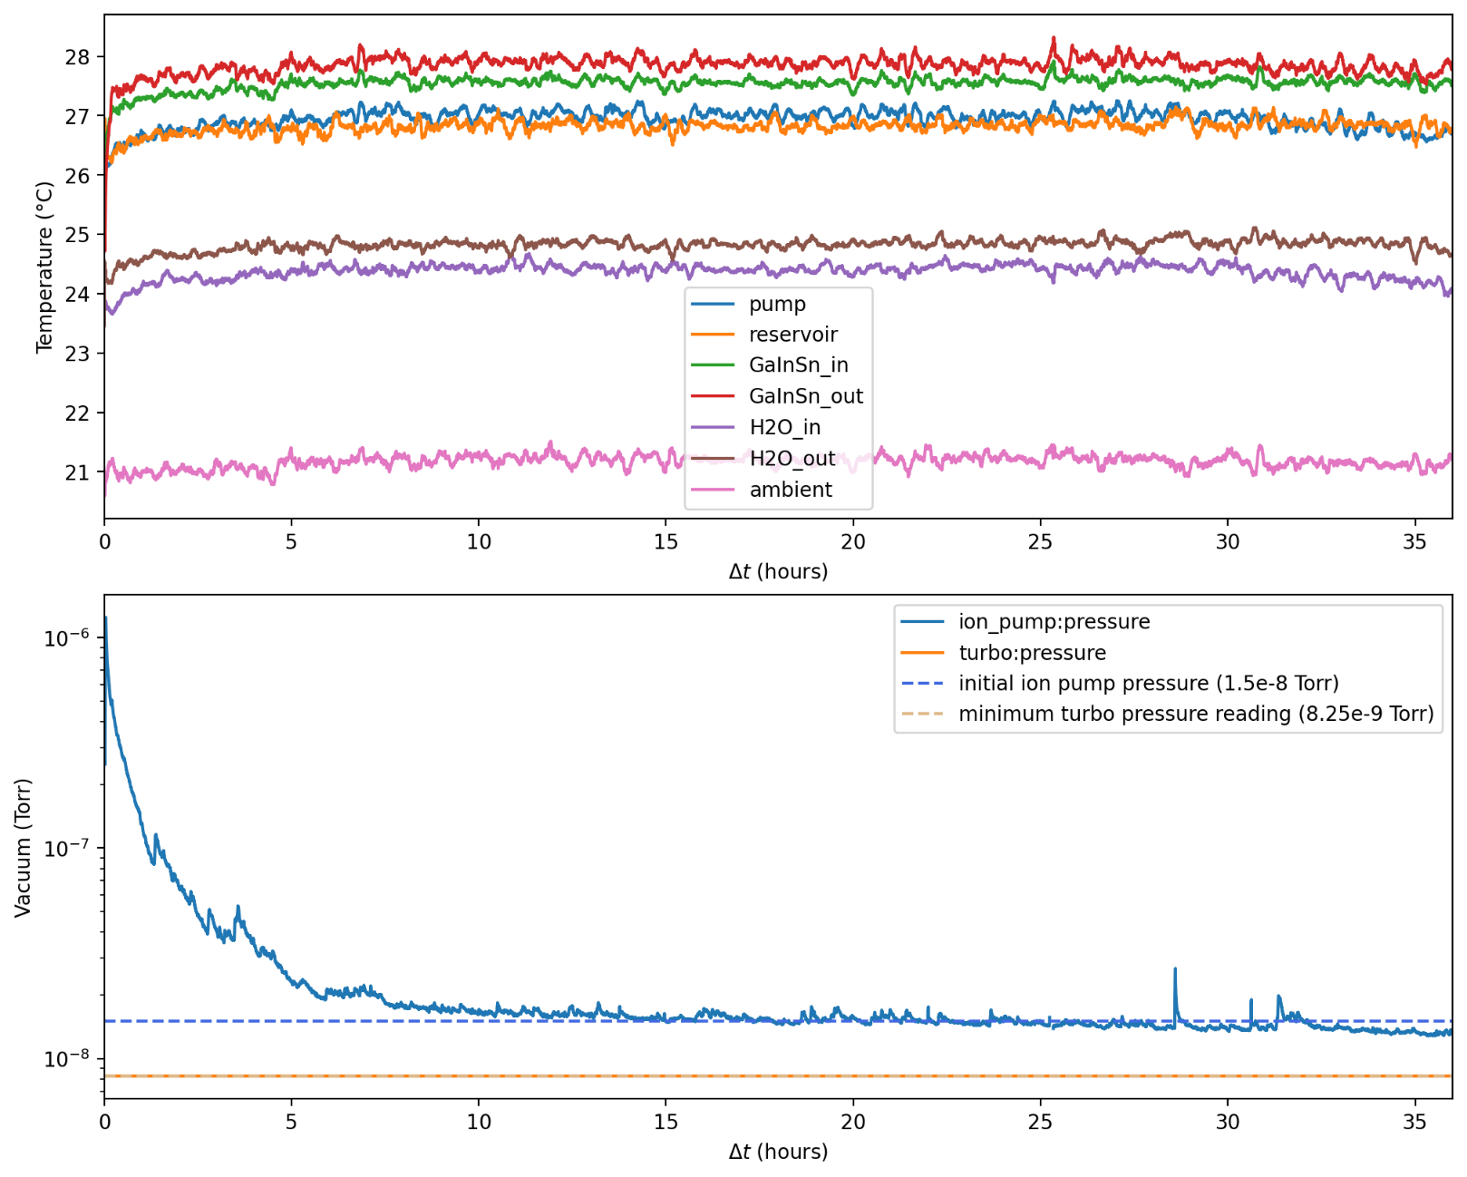
36 Hour Duration Gun (Thermal / Vacuum)
4th Run
Note: with solenoid magnet removed

