Slide 1
Electron Plasmas and Positron Bunches in Levitating and Supported Magnetic Dipole Traps
Matthew R. Stoneking
for the APEX Collaboration
Presented at: Low Energy Electron and Positron Physics Workshop,
Newport News, VA – 25 March 2026

Slide 2
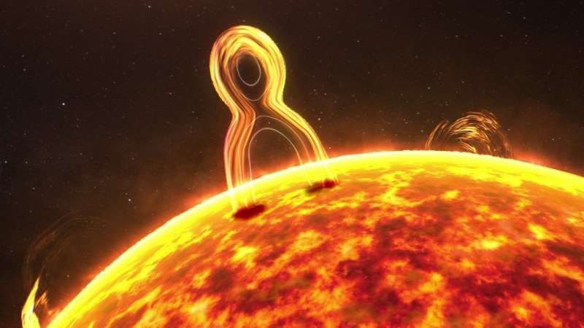
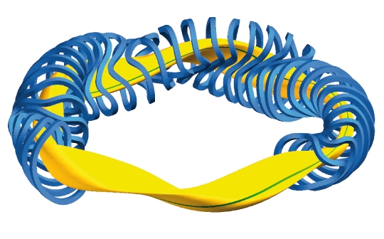
What do plasma physicists care about?
PLASMA = charged particles with sufficiently high density and low
temperature to exhibit collective behavior.
Trapping, equilibria and transport (of particles, momentum, and energy).
Wave propagation, resonances, cutoffs, and mode conversion.
Instabilities and nonlinear cascade to broadband turbulence.
Wave-particle interactions, particle acceleration, beam instabilities, …
Understanding astrophysical phenomena: solar flares, accretion disks, dynamos, magnetic reconnection, …
Enabling other physics studies: neutral antimatter production, wakefield acceleration, gaseous electronics, …
Applications for society/industry: fusion energy, plasma chemistry, semi-conductor manufacturing, lighting, medicine, …
phys.org
Max-Planck Institut
für Plasmaphysik

Slide 3
Mass-asymmetry is the source of instability in magnetized plasmas
Example: coupling of density and electric potential fluctuations.
Light electrons leave a density perturbation faster, creating an electric field.
In magnetized plasmas with density gradient → drift wave (or “universal”) instability.
In ion-electron plasmas, the spatial and temporal scales for ion and electron dynamics differ by ~ two orders of magnitude due to mass asymmetry.
Mass asymmetry is source of instabilities that lead to turbulence and transport.
Hypothesis (supported by much theory): A mass-symmetric magnetized plasma will be much more stable and therefore better confined than a mass-asymmetric plasma.
M.R. Stoneking, et al., J. Plasma Phys. 86, 155860601 (2020).

Slide 4
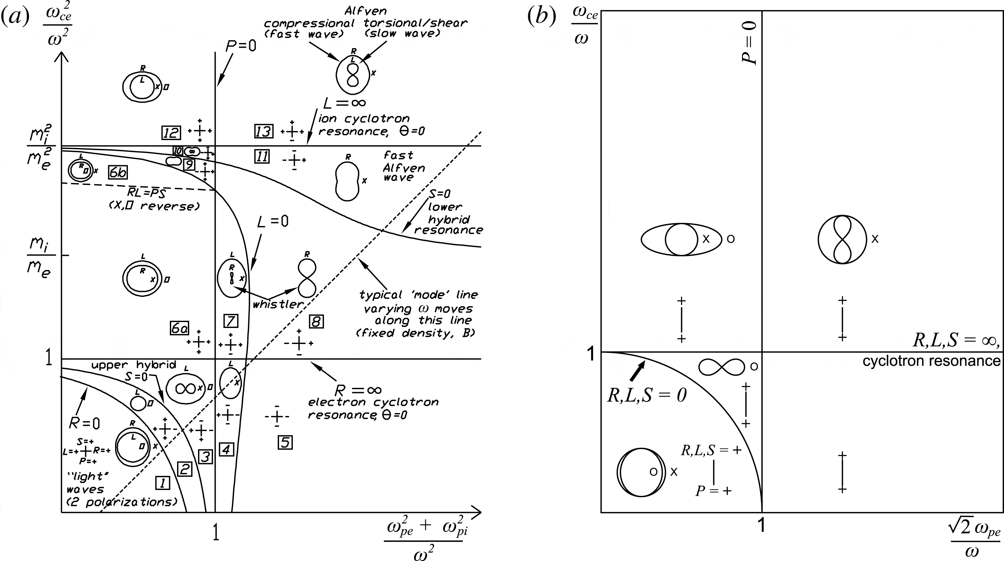


Wave physics of mass-symmetric plasmas is predicted to be simple.
CMA diagram
Pair plasma
$$m_{ion}≫m_{e}$$
$$m_{+}=m_{−}$$
Mass asymmetry is a source of complexity and instability in ion-electron plasma.
Mass symmetry reduces complexity and eliminates sources of instability.
magnetic field
density
E.V. Stenson, et al., J. Plasma Phys. 83, 595830106 (2017)

Slide 5
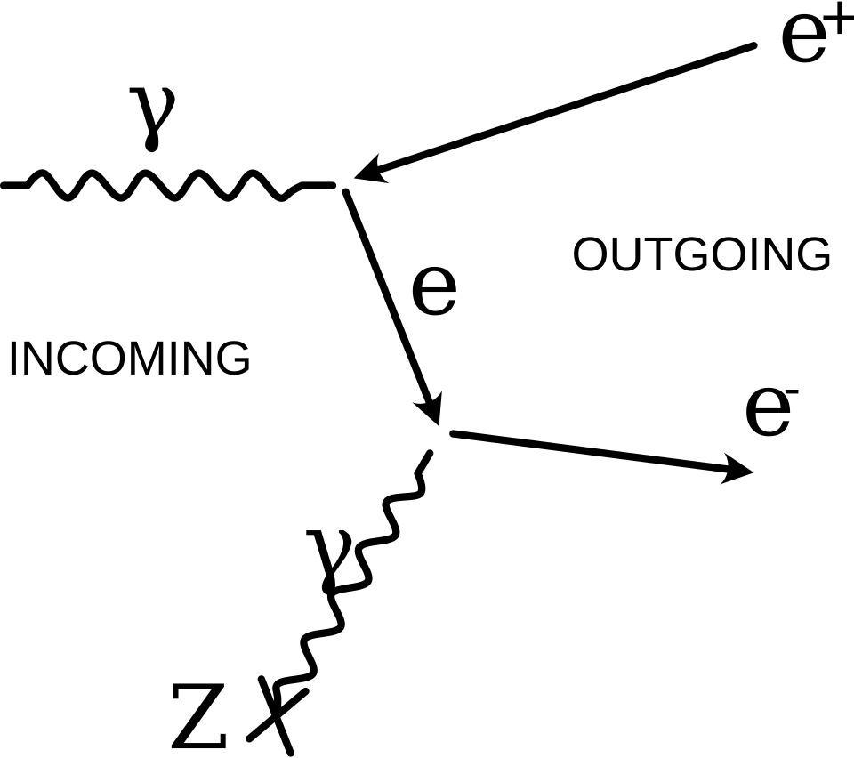
Choosing electron-positron plasma
Dirac equation:
Exact mass symmetry
Light particles are easily magnetized.
Positrons are available
→ sometimes in some places.
“We should not expect to find [anti-electrons] in nature, on account of their rapid rate of recombination with electrons, but if they could be produced experimentally in high-vacuum they would be quite stable and amenable to observation.” P.A.M. Dirac (1931)
Small numbers of positrons can be confined / are stable for > 3 days.
- Haarsman, Abdullah, and Gabrielse, PRL 75, 806 (1995).
wikipedia.org

Slide 6
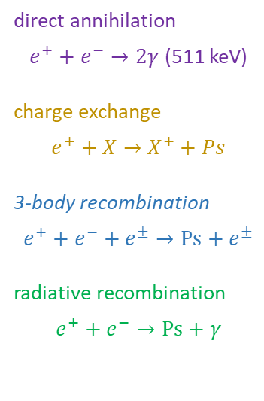
Annihilation is not an impediment to doing plasma physics with electrons and positrons
direct annihilation
$e^{+}+e^{−}→2γ$ (511 keV)
charge exchange
$$e^{+}+X→X^{+}+Ps$$
3-body recombination
$$e^{+}+e^{−}+e^{±}→Ps+e^{±}$$
radiative recombination
$$e^{+}+e^{−}→Ps+γ$$
Radiative recombination / Ps formation → annihilation limits timescales to hours at low temperatures.
Charge exchange Ps formation → annihilation could limit timescales to seconds at higher temperatures (and bad vacuum conditions).
M.R. Stoneking, et al., J. Plasma Phys. 86, 155860601 (2020).

Slide 7
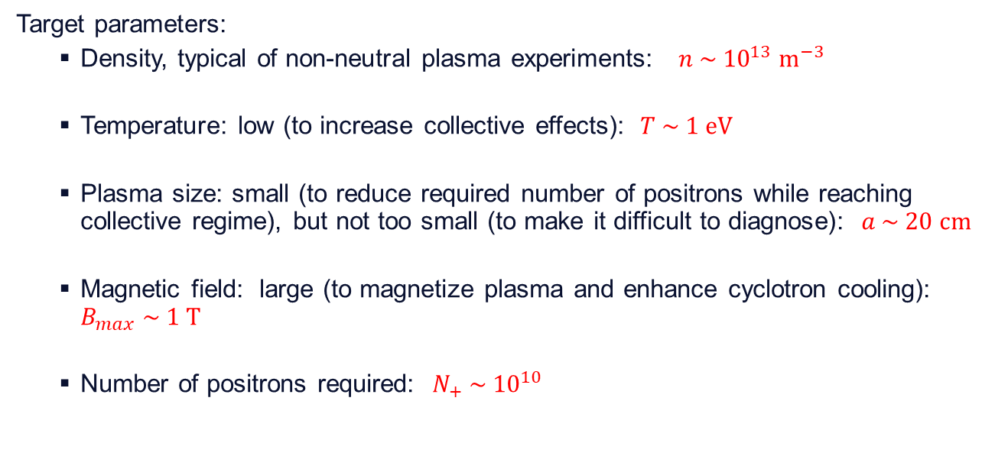
Need ~10¹⁰ low energy (<10 eV) positrons with low energy spread (< 1 eV).
Target parameters:
Density, typical of non-neutral plasma experiments: $n \sim {10}^{13} {\text{m}}^{−3}$
Temperature: low (to increase collective effects): $T \sim 1 \text{eV}$
Plasma size: small (to reduce required number of positrons while reaching collective regime), but not too small (to make it difficult to diagnose): $a \sim 20 \text{cm}$
Magnetic field: large (to magnetize plasma and enhance cyclotron cooling): $B_{max} \sim 1 \text{T}$
Number of positrons required: $N_{+} \sim {10}^{10}$

Slide 8
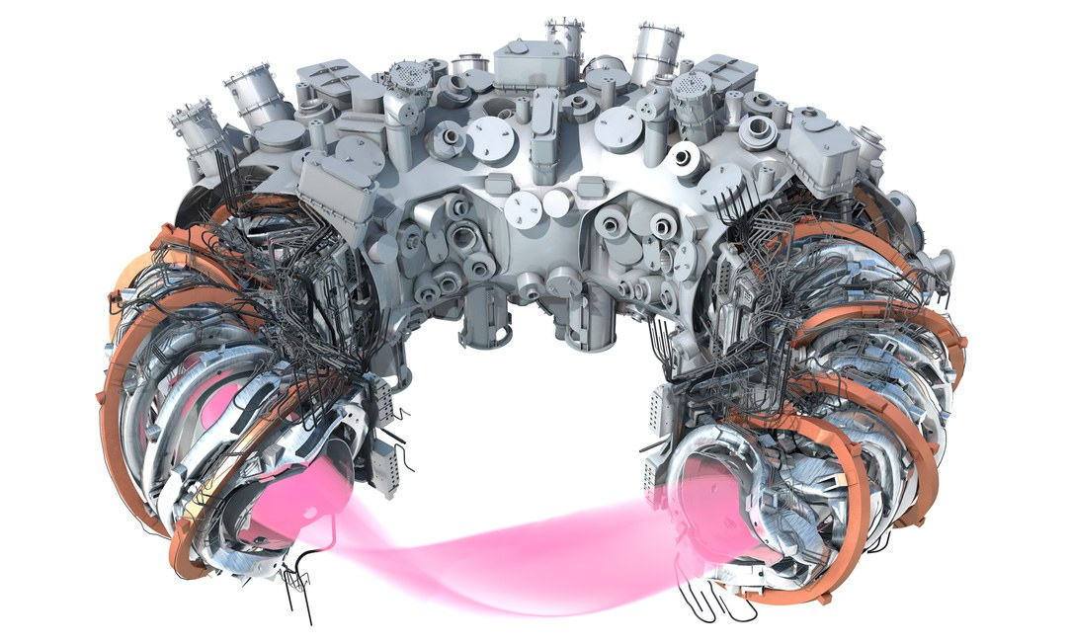
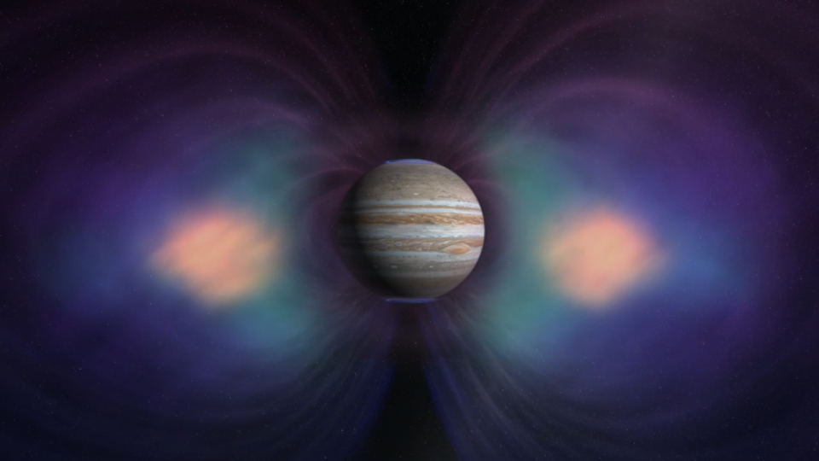
Two options for magnetic traps
From nature:
magnetic dipole/magnetosphere
From fusion:
stellarator
https://www.missionjuno.swri.edu/jupiter/magnetosphere/
Max Planck Institute for Plasma Physics
These configurations:
Do NOT require plasma currents
Can confine un-neutralized combinations of charged particles

Slide 9
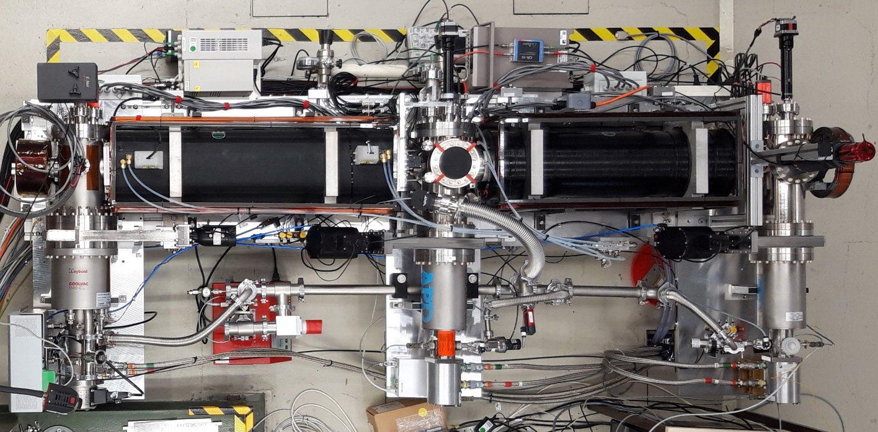
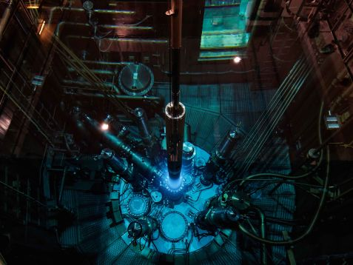
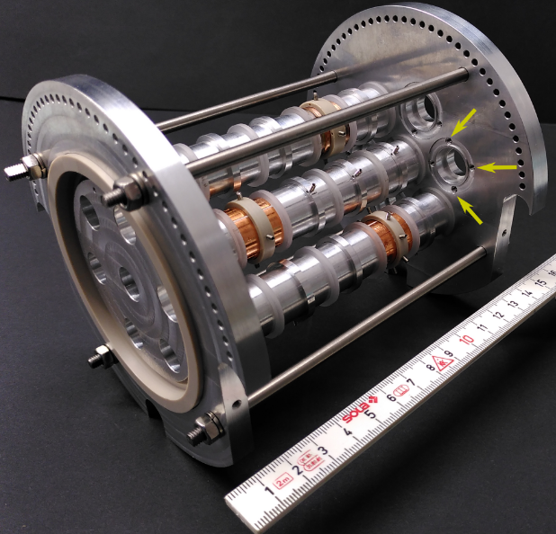
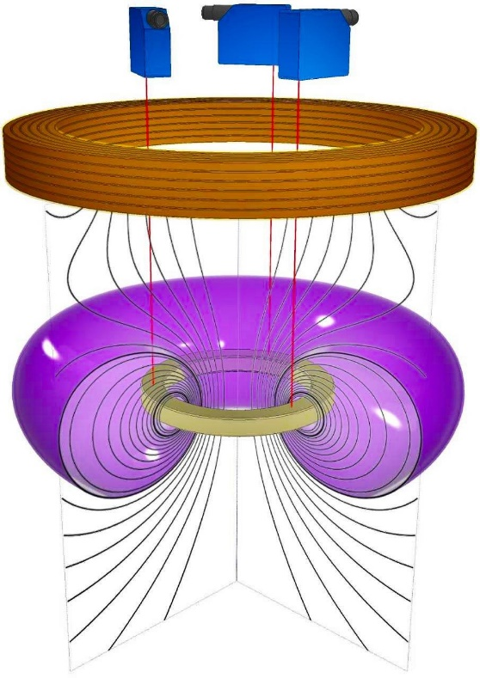
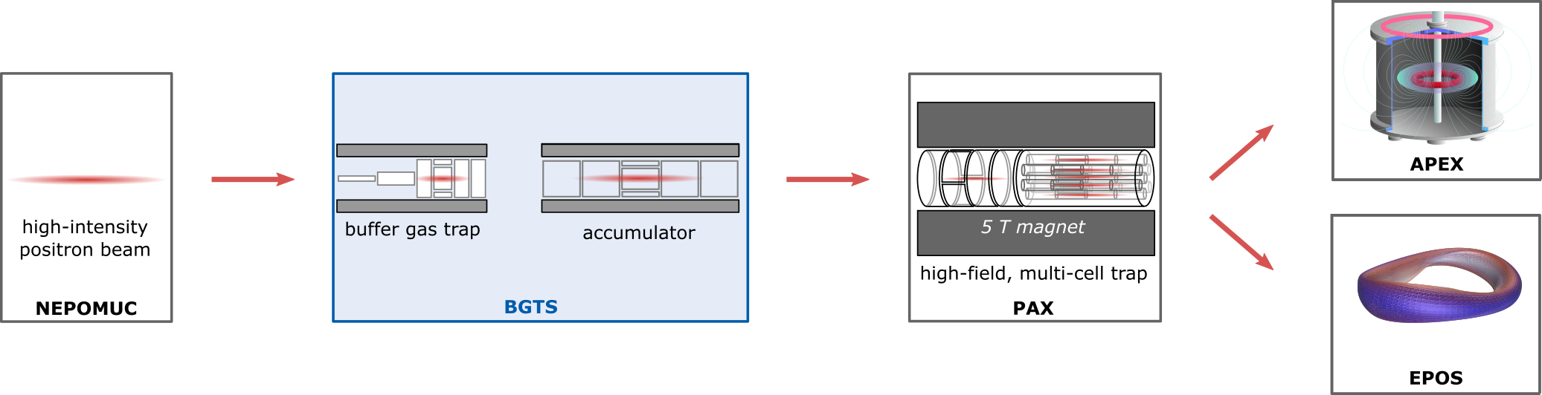
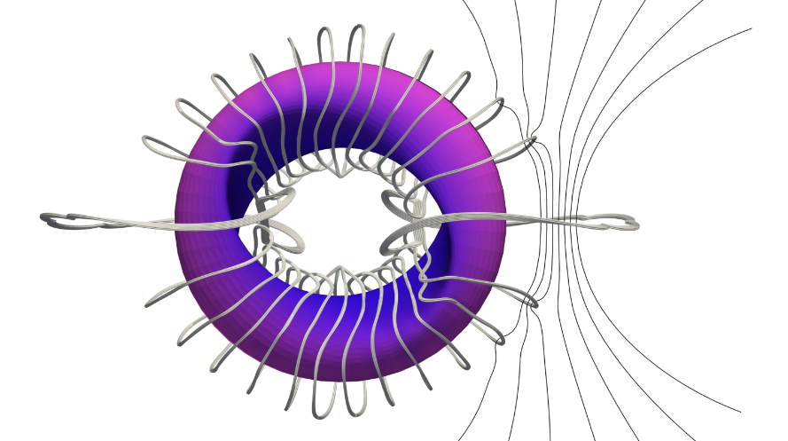

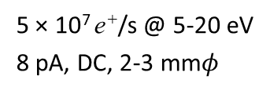
A Positron Electron eXperiment (APEX): Grand Scheme
FRM II reactor at TUM
Surko trap & accumulator
Prototype
APEX-LD
5 × 10⁷ e⁺/s @ 5-20 eV
8 pA, DC, 2-3 mm$φ$
10⁶ e⁺ per pulse (1 Hz)
10⁸ e⁺ per pulse (1/min)
10¹⁰ e⁺ delivered at 1/hour
$$e^{−}$$
EPOS
MCT
Accumulation in traps with increasing confinement time & space-charge capacity
FRM II

Slide 10
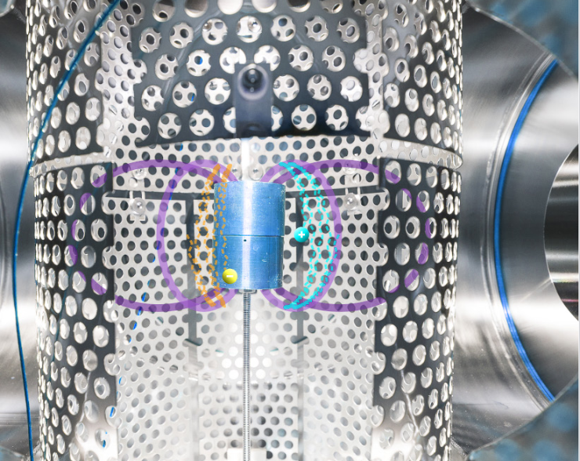
Experiments in a Permanent (Supported) Magnetic Dipole Trap
Efficient injection of a DC positron beam.
Good confinement of a gated DC positron beam.
Injection of DC positron beam into a pre-formed electron plasma.
Efficient injection and confinement of positron pulses.
Resolving positron transport and positronium formation rates in dipole trap.
Proto APEX. Photo: Markus Singer

Slide 11
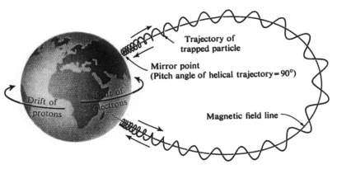
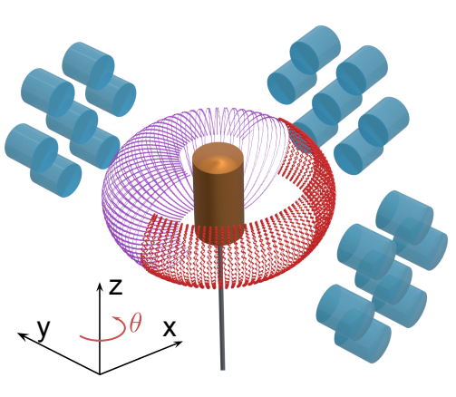

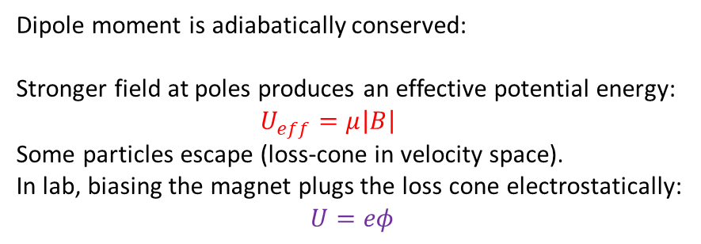
Charged Particle Motion in a Dipole Field
Frequency scales:
Magnetosphere Laboratory
kHz GHz
Hz MHz
mHz kHz
Single-particle motion:
Gyration about the magnetic field
Poloidal bounce/mirror
Toroidal drift
Slow ←→ Fast
$$μ=\frac{m{v_{⊥}}^{2}}{2B}$$
Dipole moment is adiabatically conserved:
Stronger field at poles produces an effective potential energy:
$U_{eff}=μ\left|B\right|$
Some particles escape (loss-cone in velocity space).
In lab, biasing the magnet plugs the loss cone electrostatically:
$$U=eφ$$

Slide 12
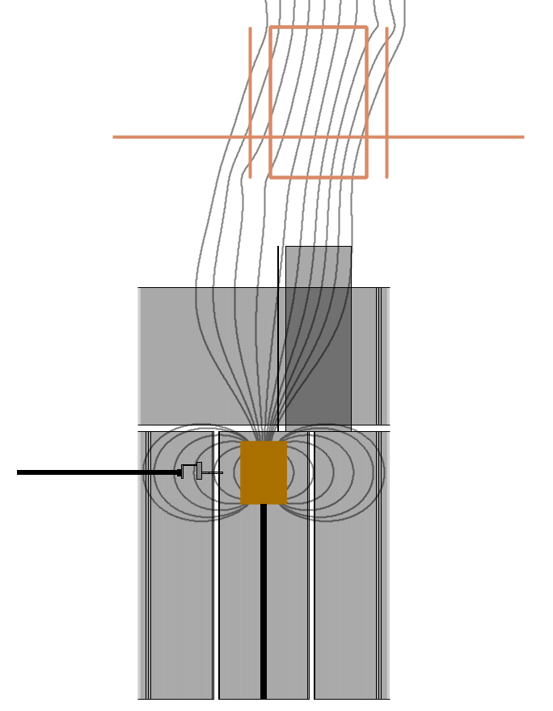
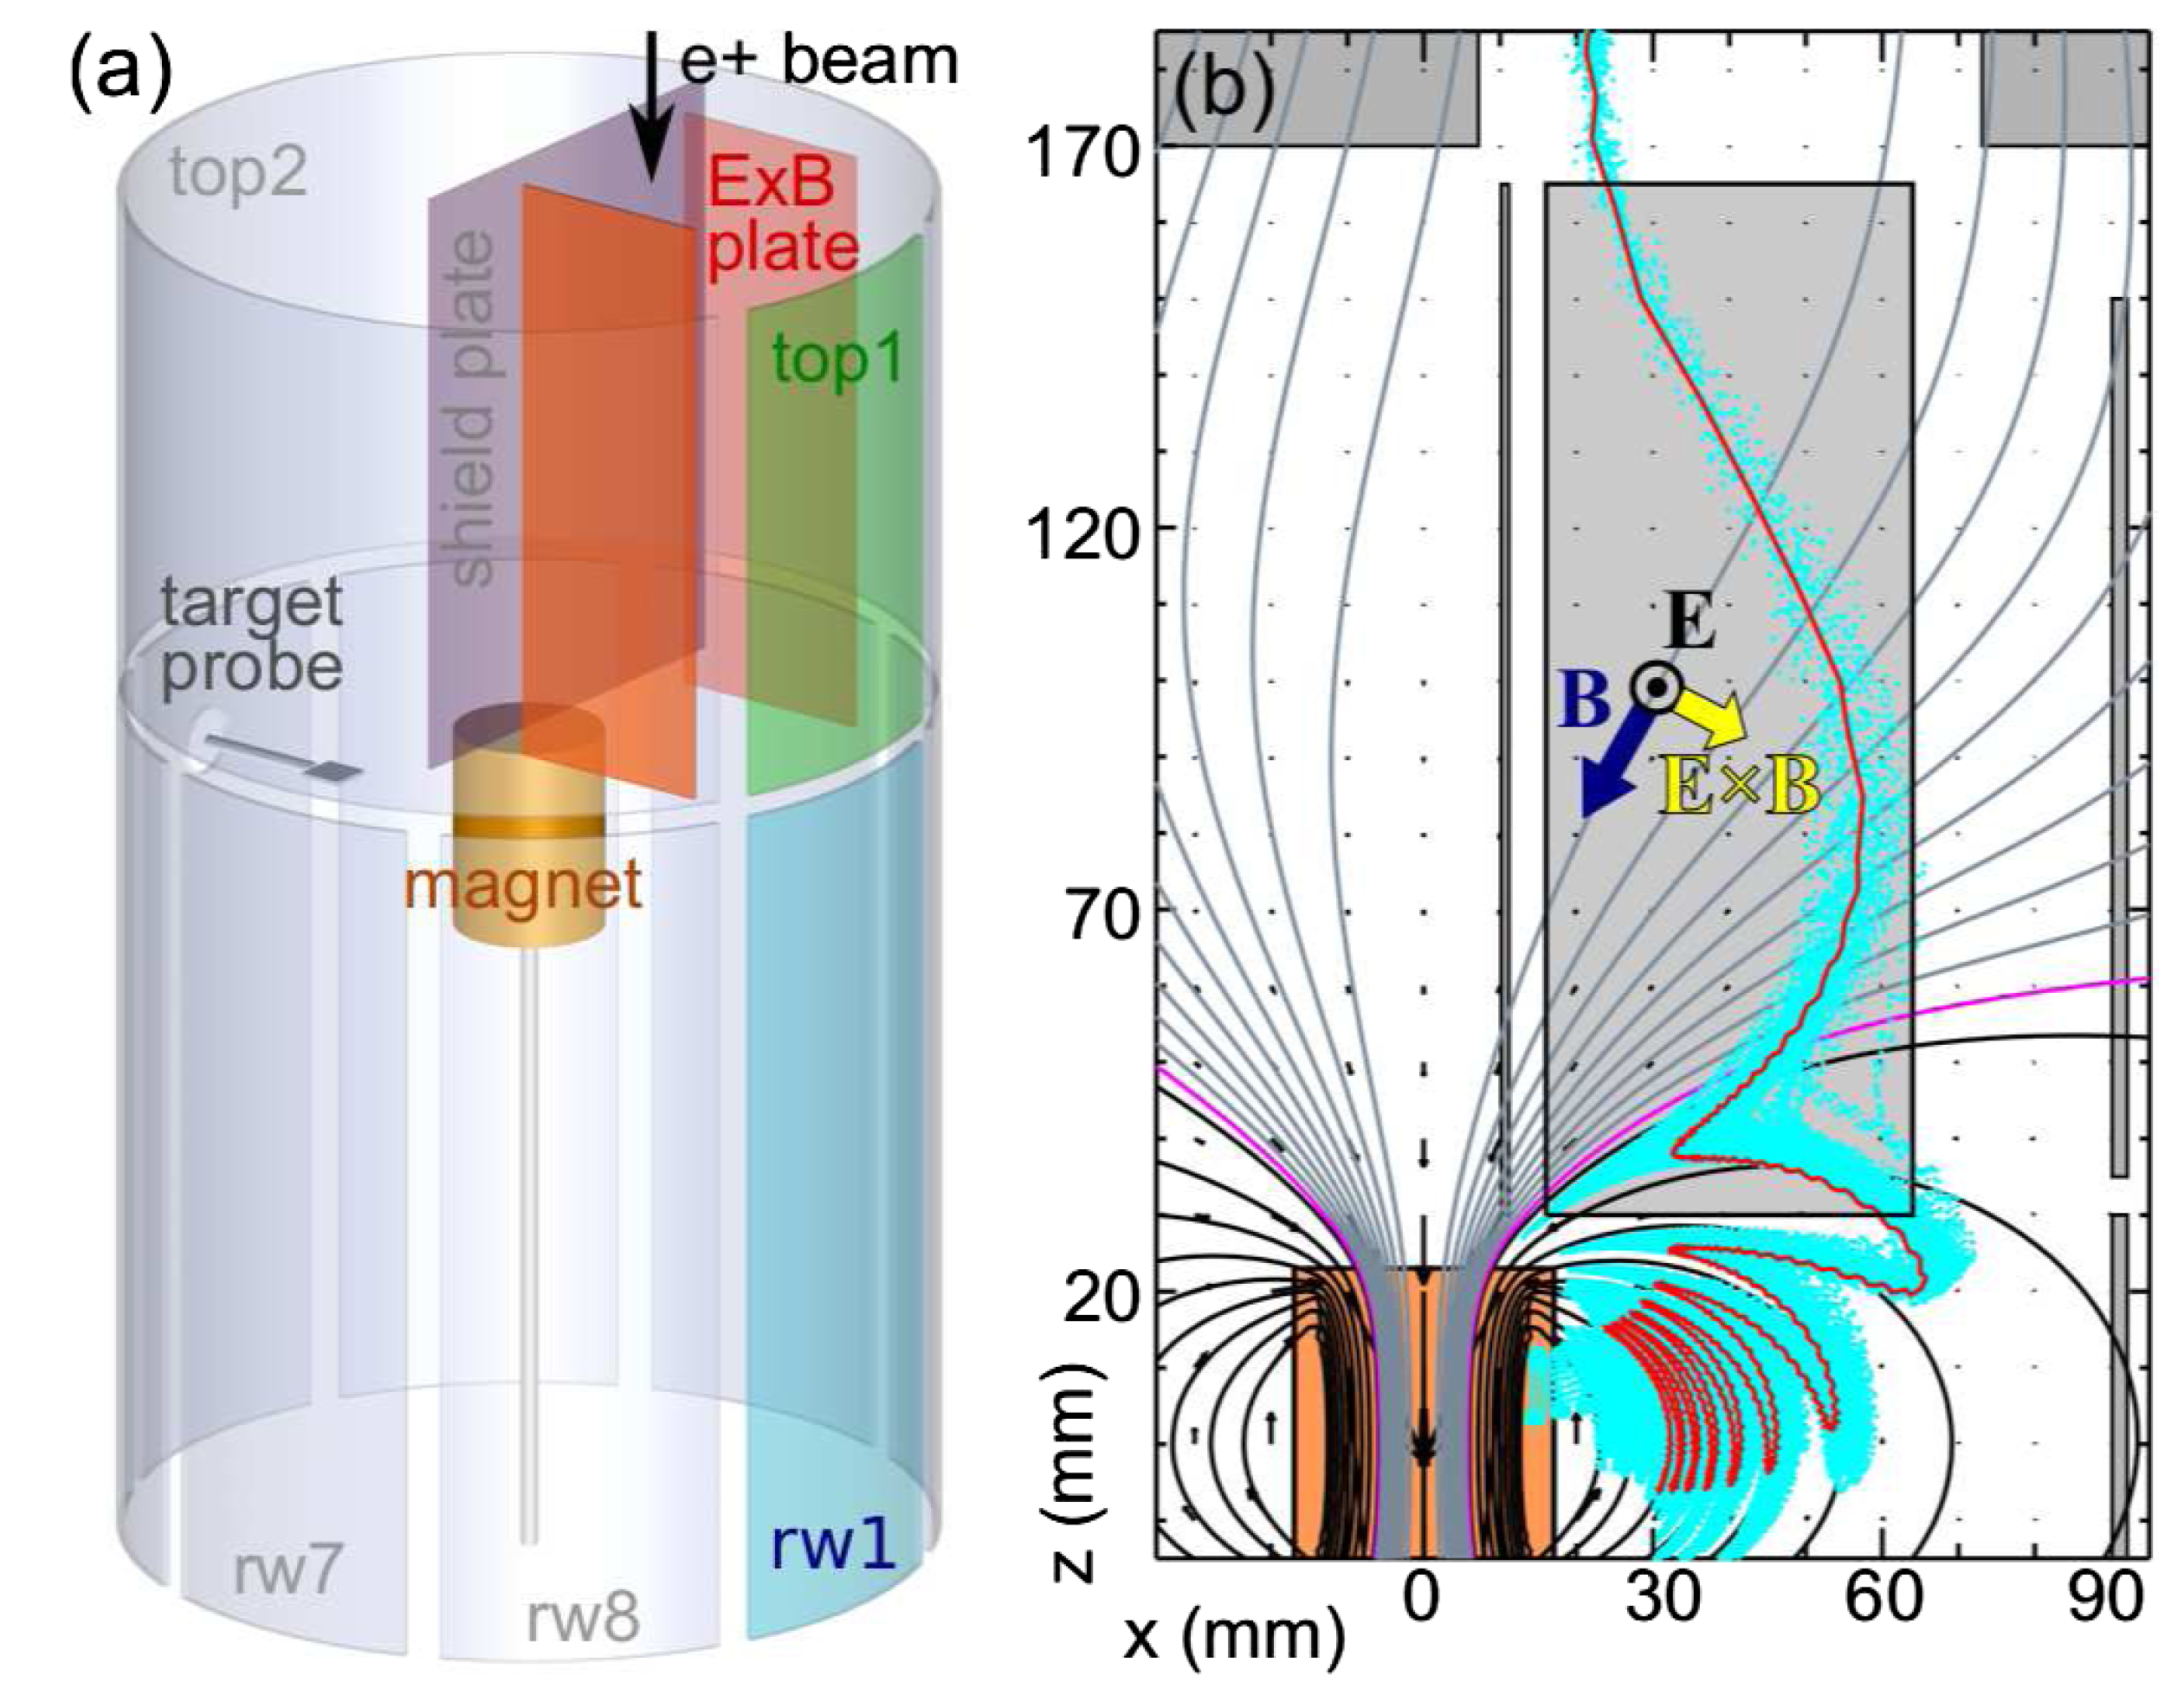
ExB drift technique for injection
Nearly 100% of positrons can be injected onto orbits that drift 180° toroidally.
DC positron beam from NEPOMUC
Highest efficiency requires (positive) bias on the magnet AND on electrodes localized to injection azimuth.
Gamma diagnostic and direct charge flux measurements agree on location of orbits.
Simulations reproduce measured signals.
Annihilation gammas detected with collimated BGO detectors viewing target probe.
E. V. Stenson, et.al., Phys. Rev. Lett. 121, 235005 (2018).

Slide 13
The presence of an electron space charge does NOT impede positron injection
Annihilation signal for different e+
beam steering positions.
Electron cloud generated with tungsten filament.
Substantial space charge measured on other side of device.
no electrons
with electrons
Positrons are still efficiently injected!
M. Singer, et. al., Phys. Plasmas 28, 062506 (2021).
with electrons

Slide 14
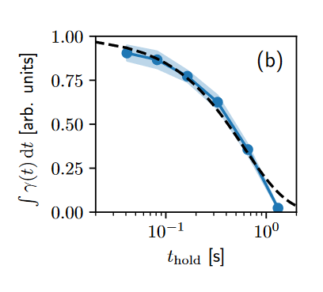
Confinement of positrons in a supported dipole trap → switch off the ExB potentials
AIST Slow-Positron Facility Tsukuba, Japan
Pulsed (AIST) e+ beam
Gated DC (NEPOMUC) e⁺ beam
Electron source
67 kV, 100 mA, 40 Hz
LINAC
40 MeV, 80 mA, 40 Hz
Slow positrons
Ta converter & W moderator
30 eV, ~6 ×10⁶ e⁺/s (1 pA), 2 us, 40 Hz
Buffer-gas trap
N=10⁵ e⁺/ pulse, ~7 eV, ~100ns, 0.3 Hz
A = magnet biased to +8 V, plugging loss cone
B = magnet grounded
J. Von der Linden, A. Deller, et al., in preparation for publication (2026).
J. Horn-Stanja, et al., PRL 121, 235003 (2018)
H. Higaki et al. (2020) Appl. Phys. Express 13 066003

Slide 15
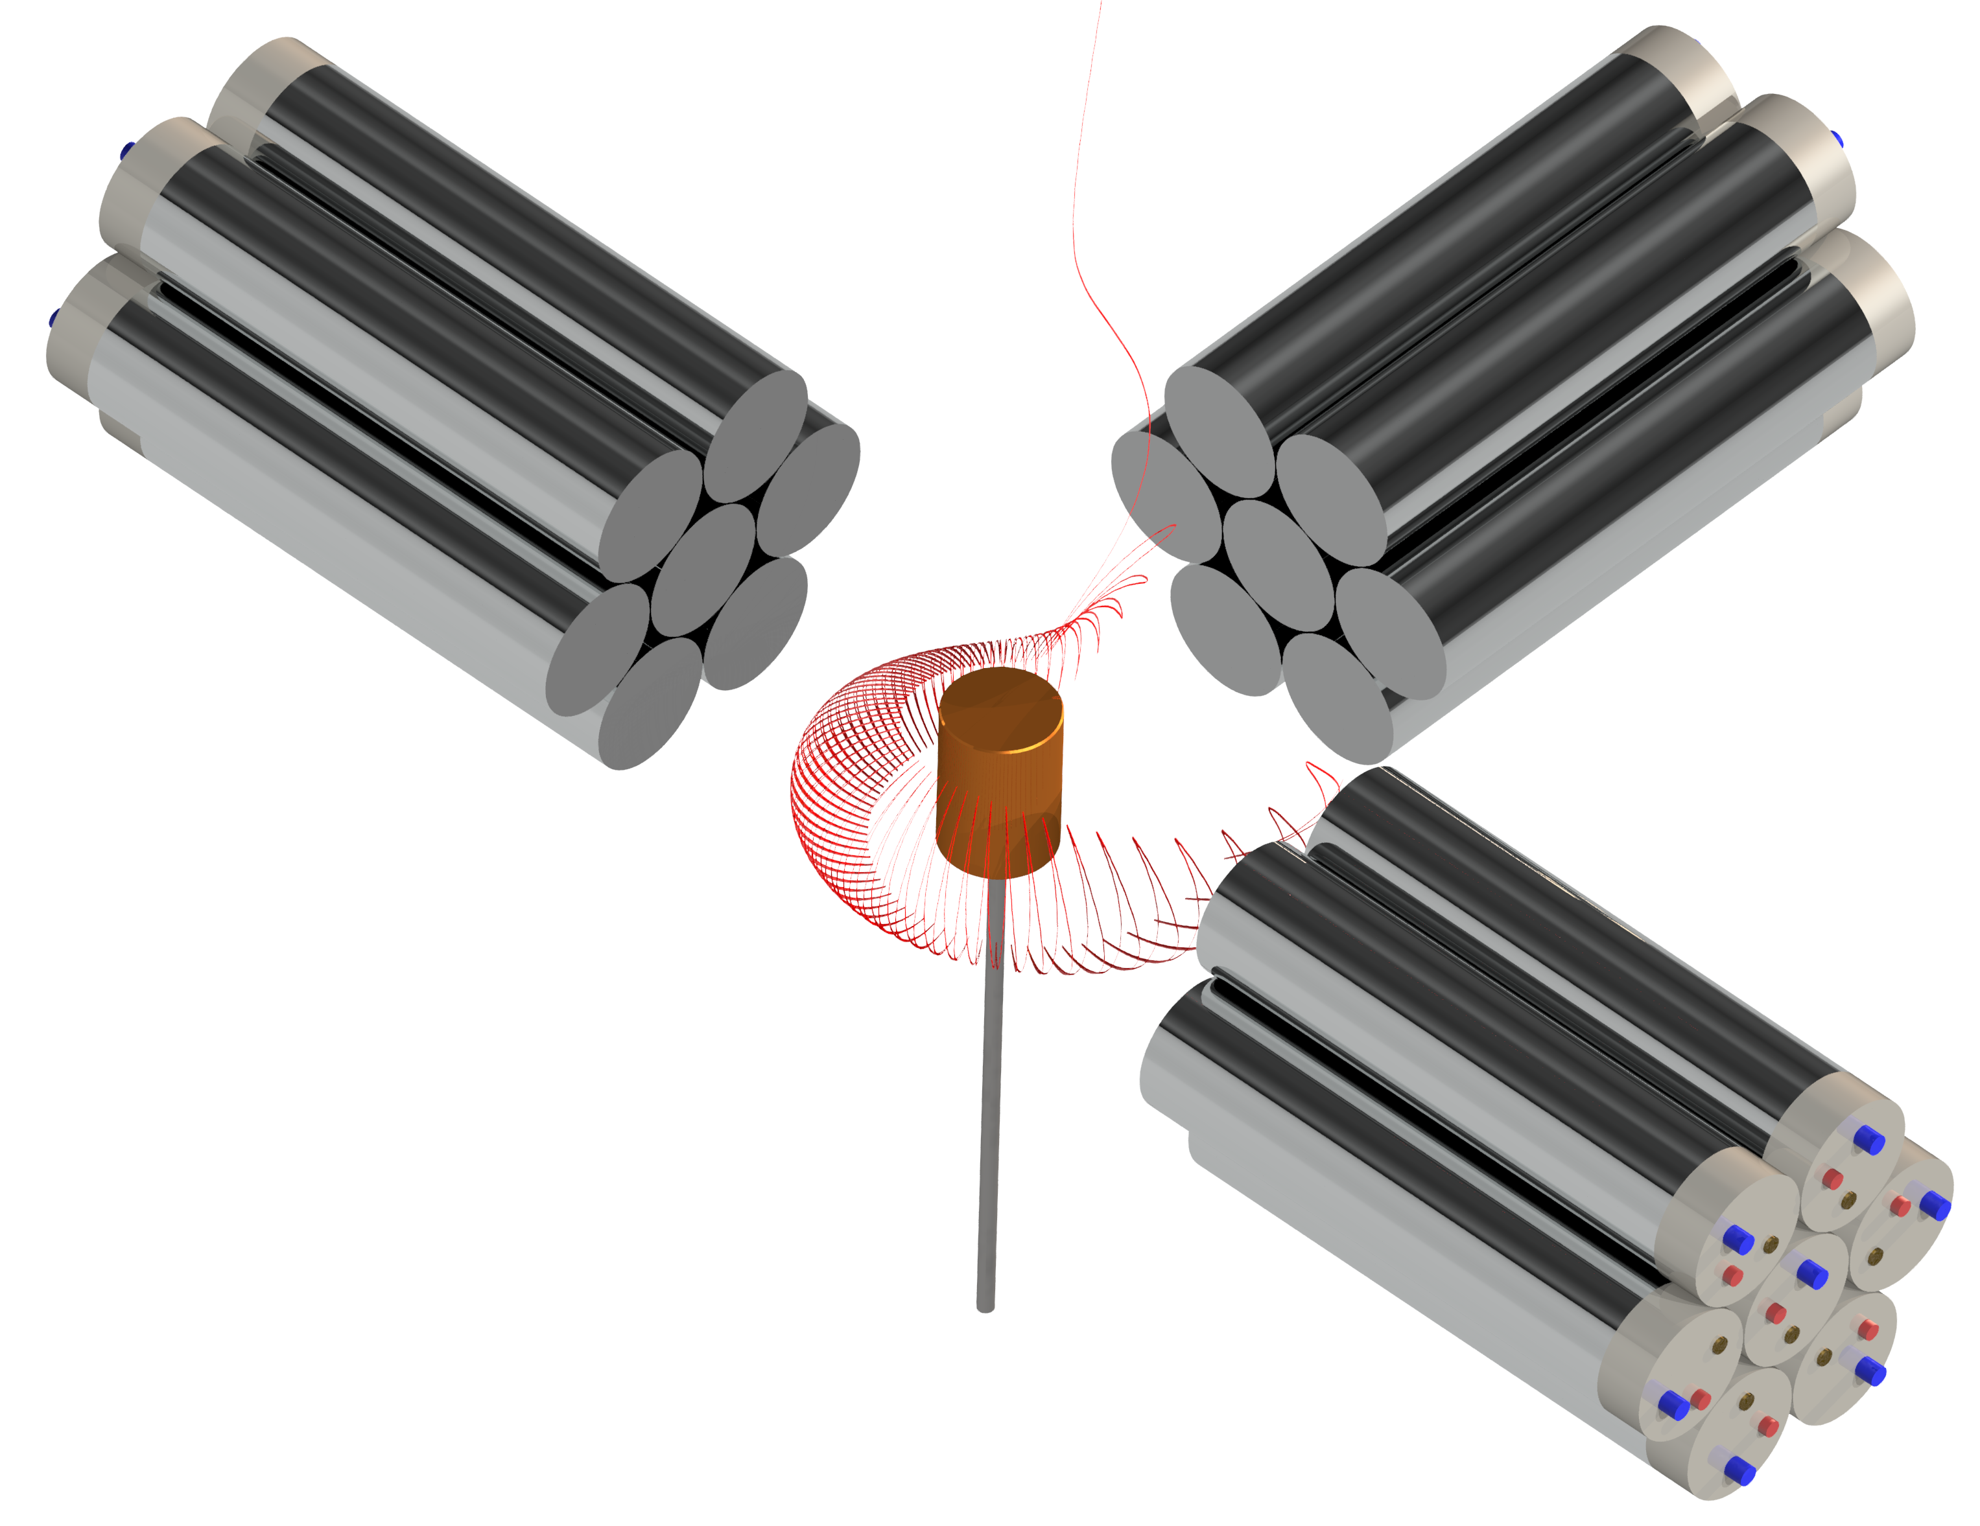
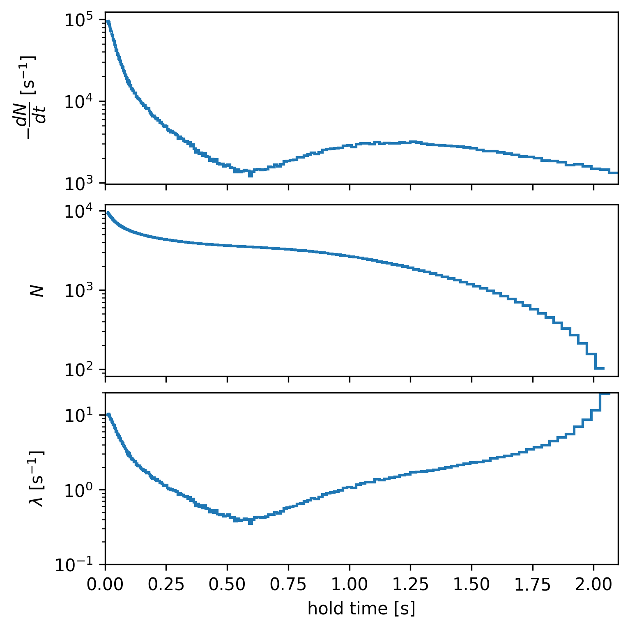
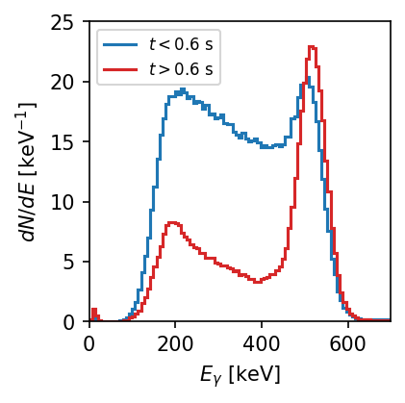
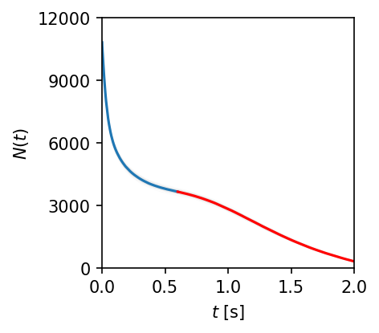

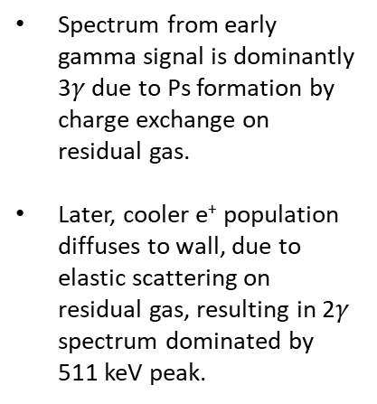


Positron pulses → using annihilation signal to observe positronium formation
Pulsed (AIST) e+ beam
energy spectrum
gamma-ray count rate
Spectrum from early gamma signal is dominantly 3$γ$ due to Ps formation by charge exchange on residual gas.
Later, cooler e⁺ population diffuses to wall, due to elastic scattering on residual gas, resulting in 2$γ$ spectrum dominated by 511 keV peak.
$$3γ$$
future counts
$$2γ$$
Positron cooling rate (and diffusion due to elastic scattering) can be enhanced by introduction of CF4.
decay rate
positron population
$$λ=−\frac{1}{N}\frac{dN}{dt}$$
Ps
wall
J. Von der Linden, A. Deller, et al., in preparation for publication (2026).

Slide 16
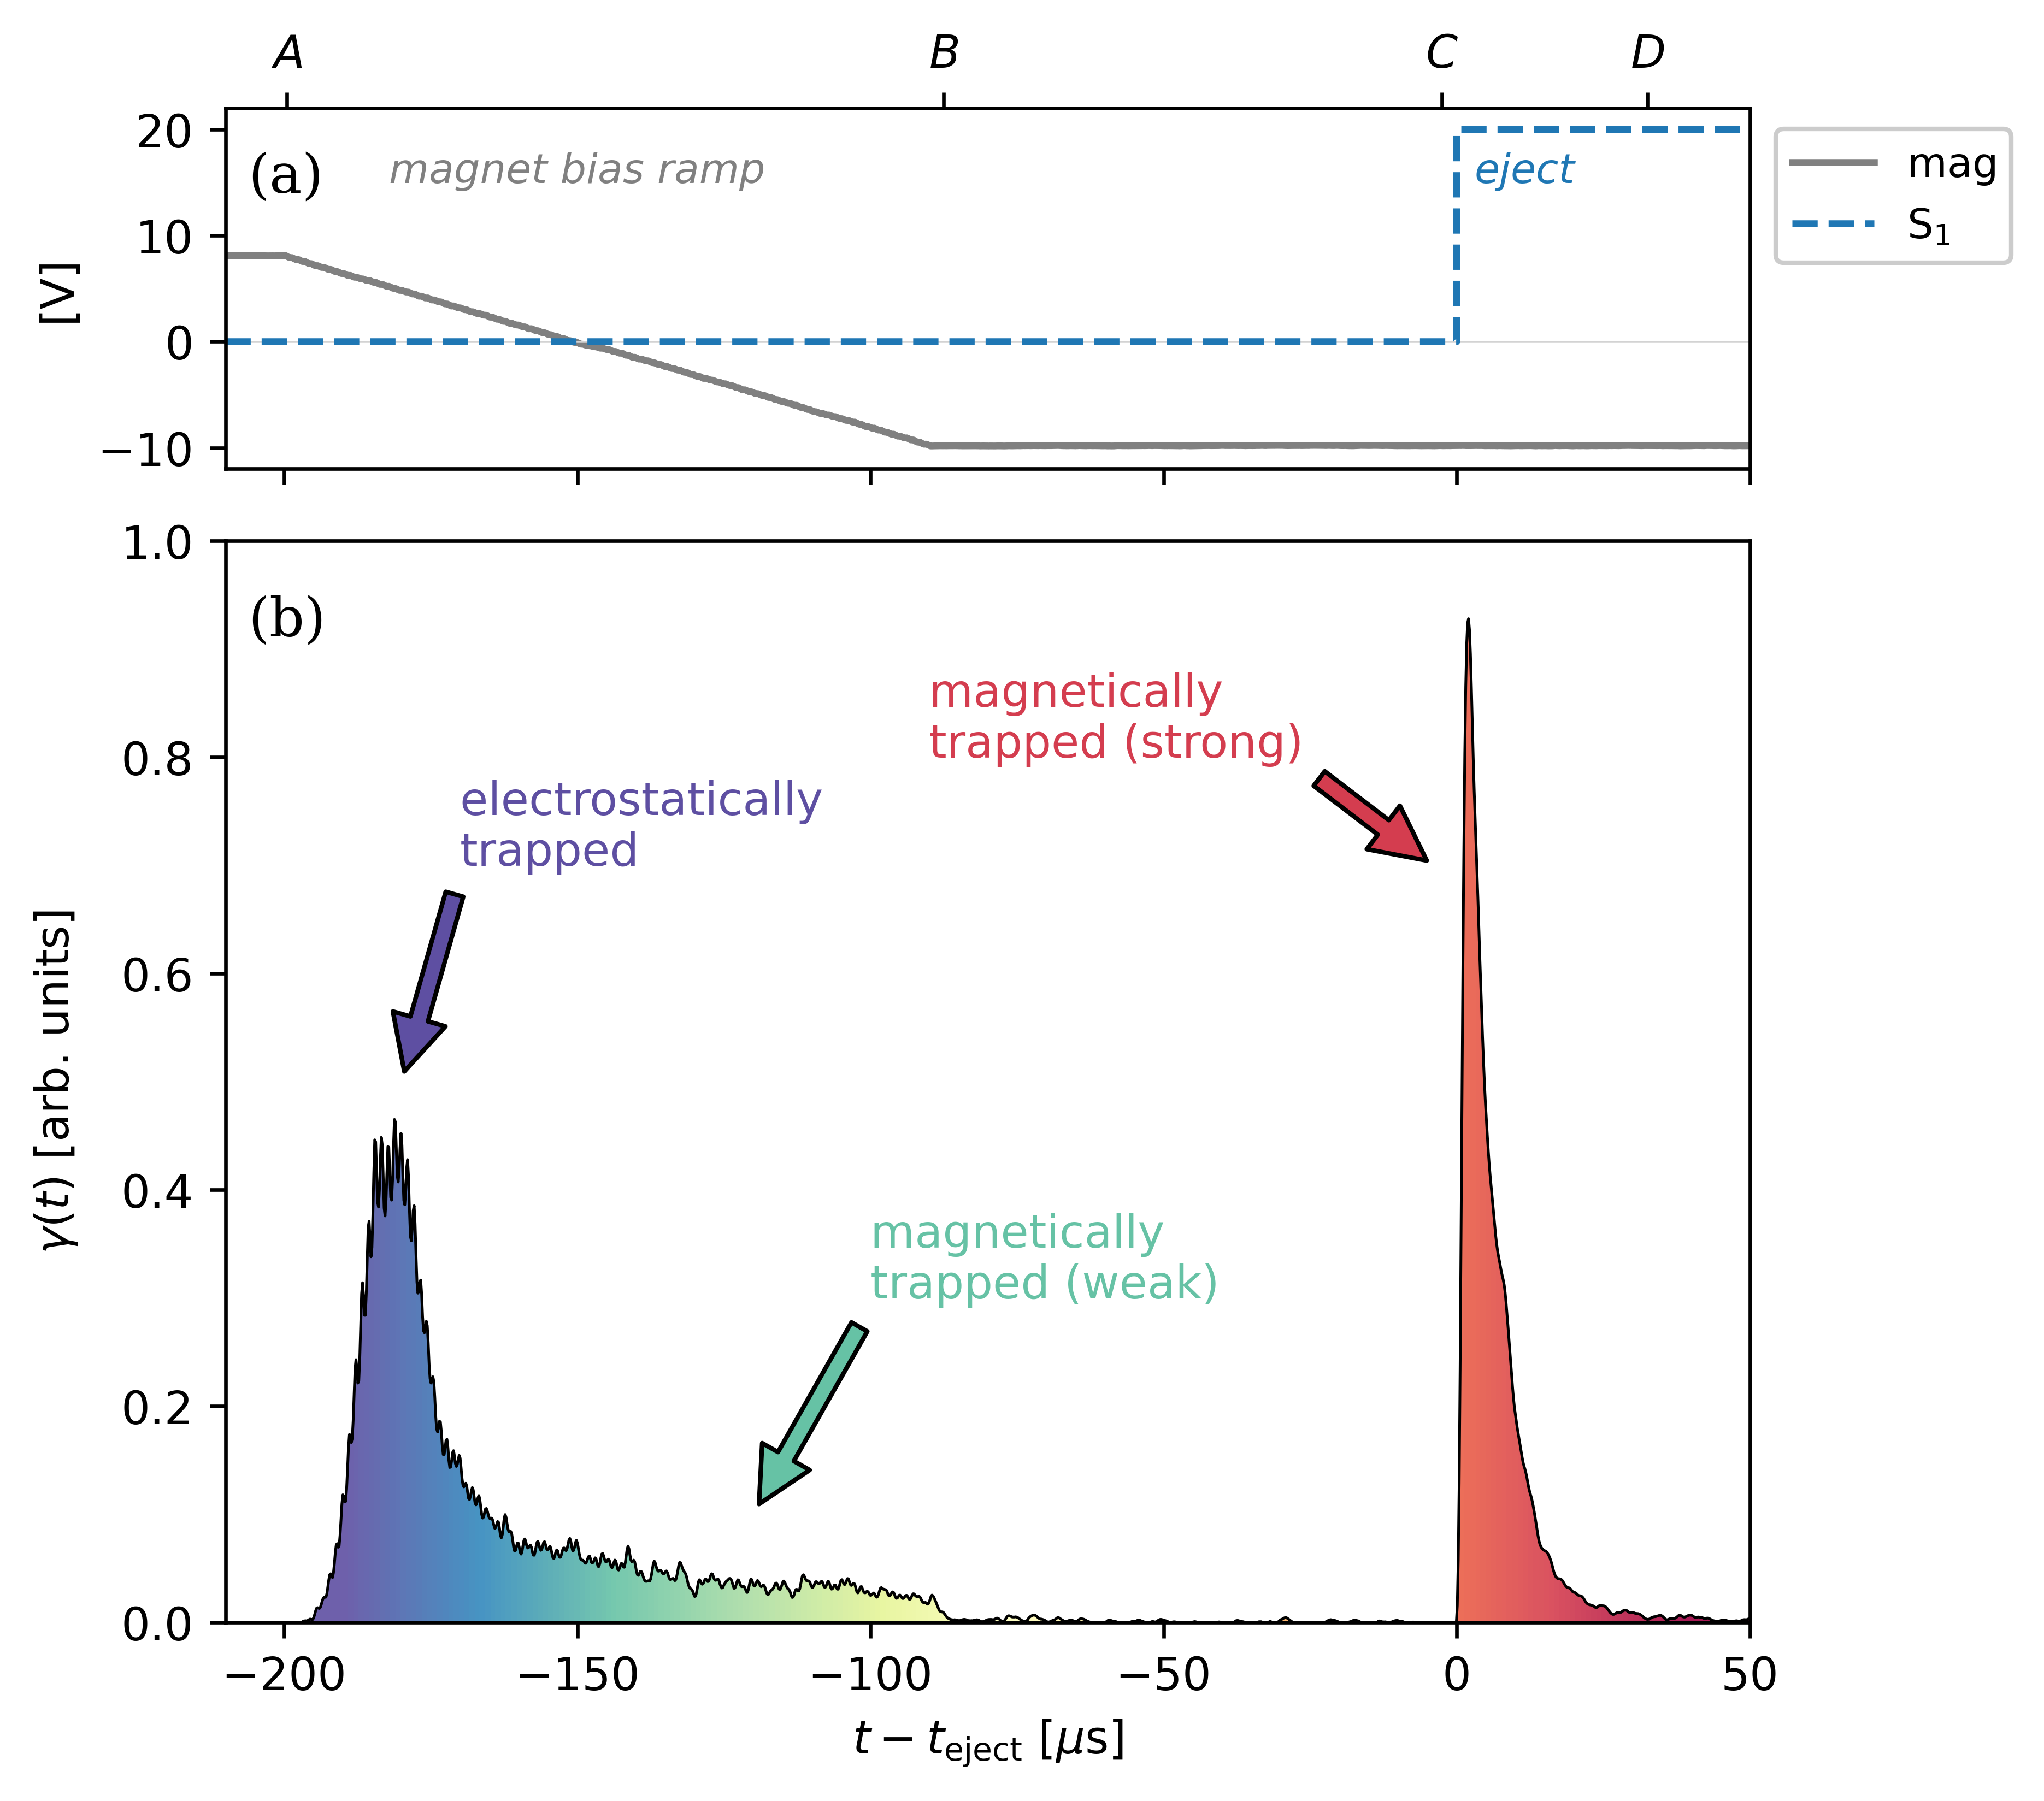




Positron pulses → using annihilation signal to diagnose distinct trapped populations
ExB plates ON
$$\vec{v}$$
Small pitch-angle [electrostatically trapped]
slowly ramp magnet bias
Ramping the magnet bias allows electrostatically trapped particles to escape/annihilate.
Turning on ExB plate bias ejects remaining, magnetically trapped particles.
$$\vec{B}$$
Large pitch-angle [magnetically trapped]
$$\vec{v}$$
$$\vec{B}$$
J. Von der Linden, A. Deller, et al., in preparation for publication (2026).

Slide 17
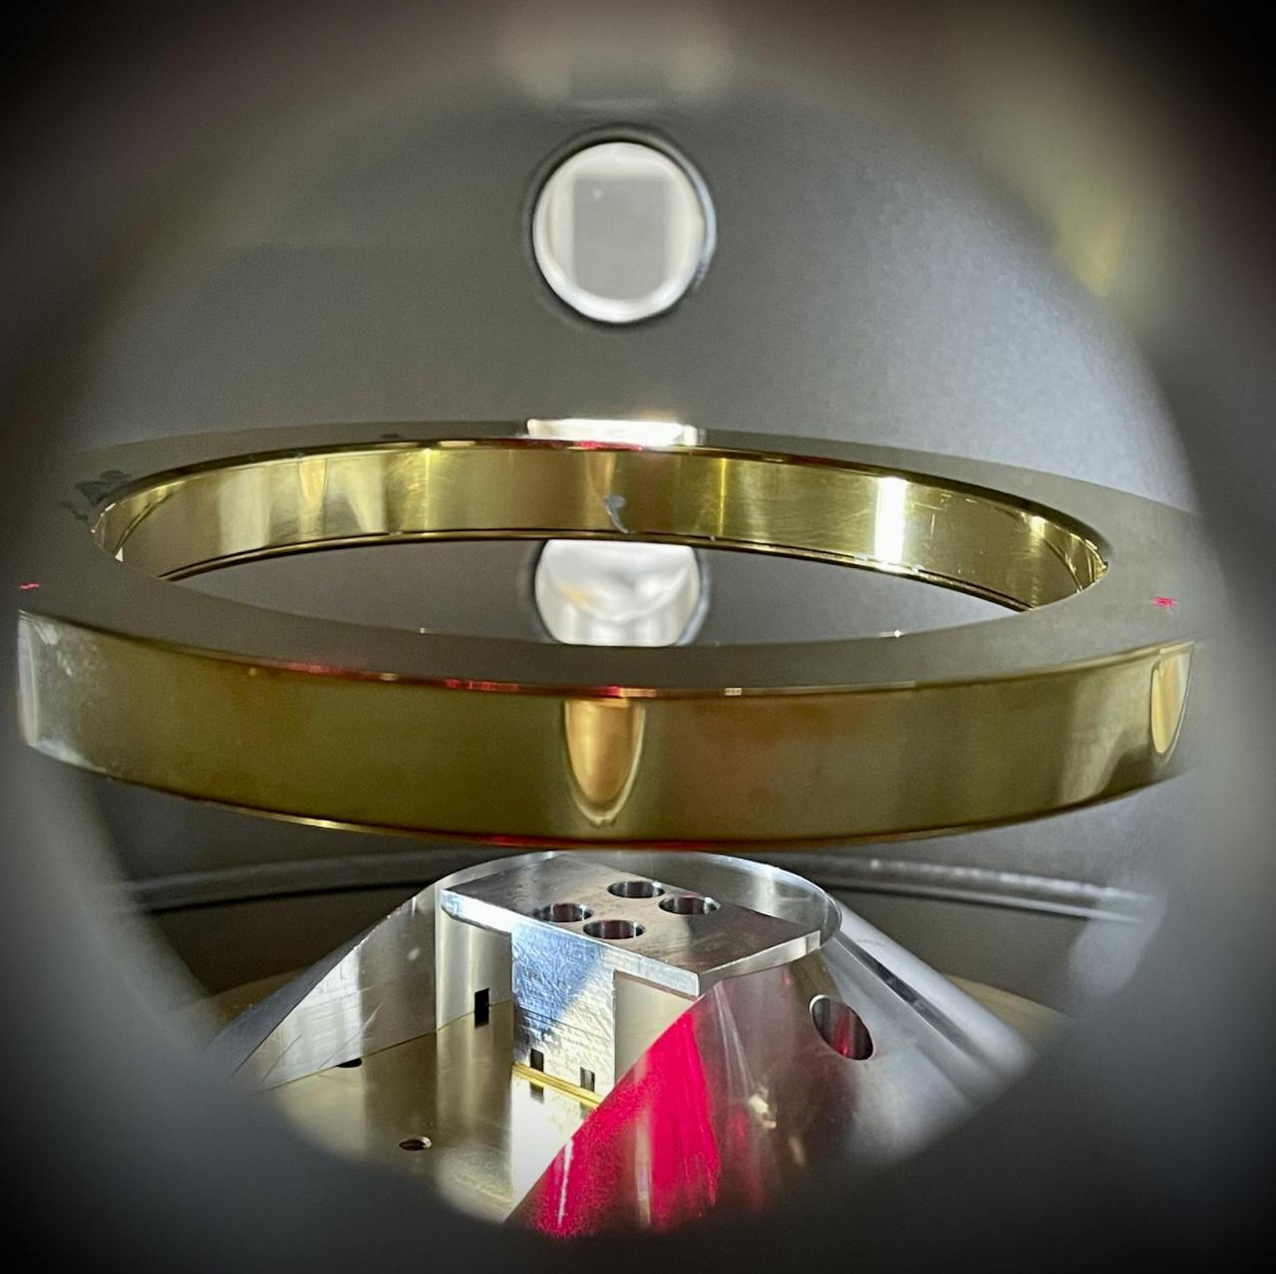
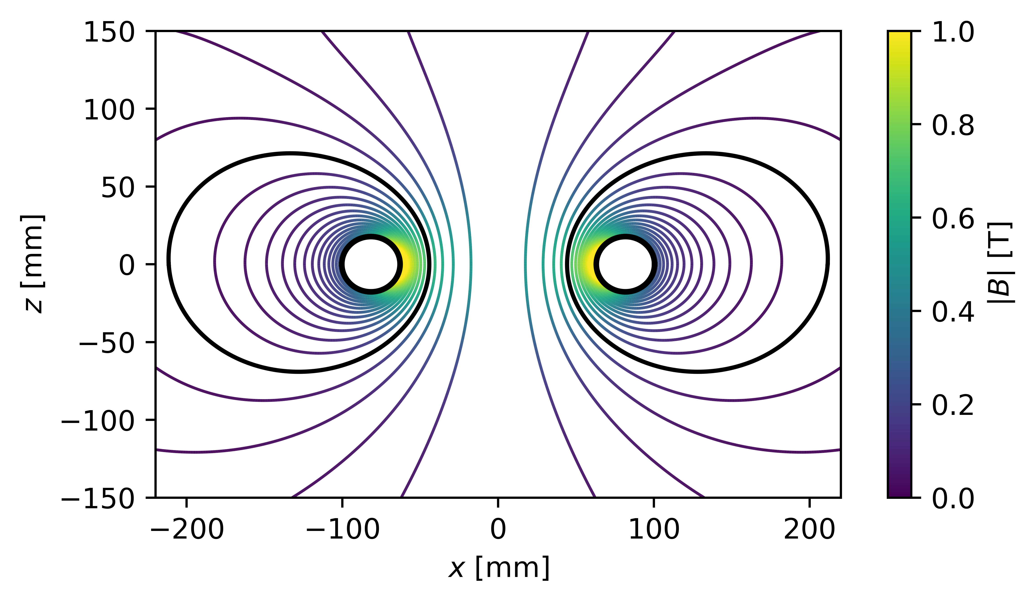
Levitating dipole → allow passing orbits
Levitated Dipole Trap
Poloidal field lines wrap around current ring.
Levitation eliminates supports that would interrupt the confinement volume.
Good confinement for neutral and non-neutral collections of charge.

Slide 18
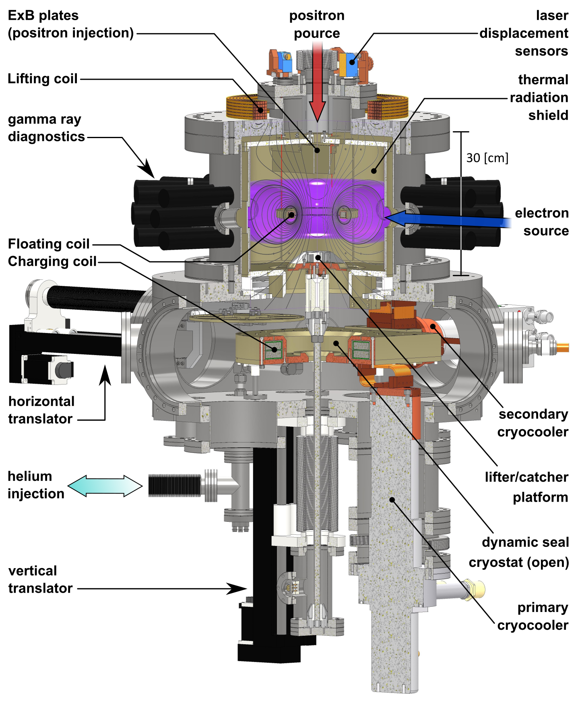
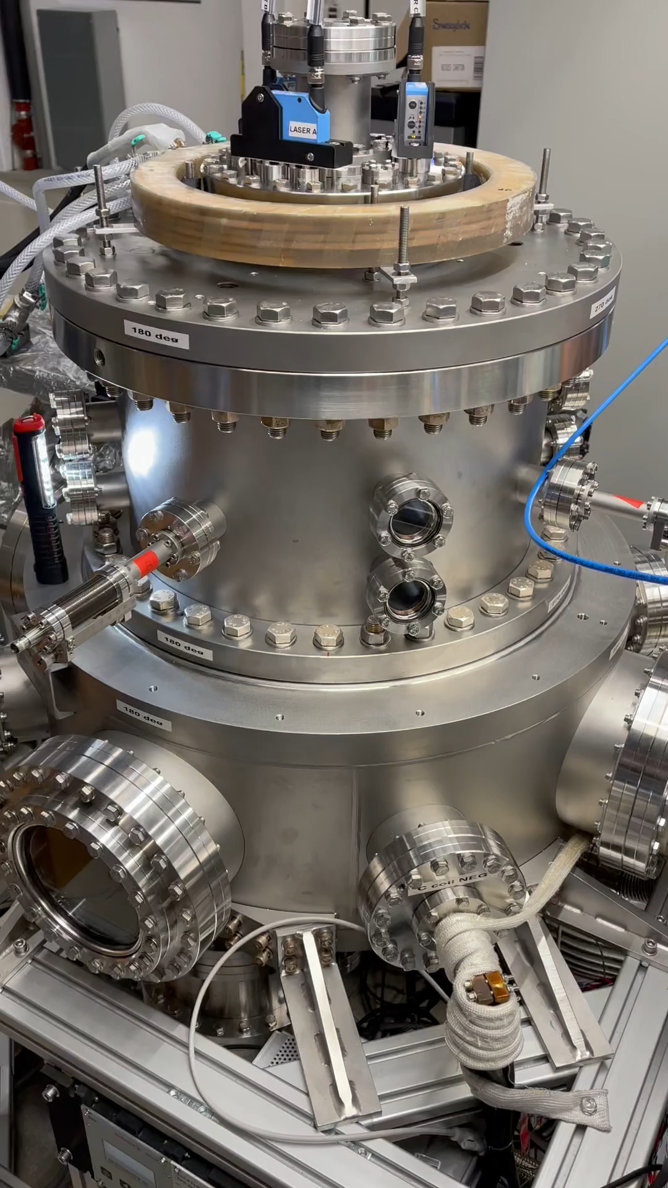
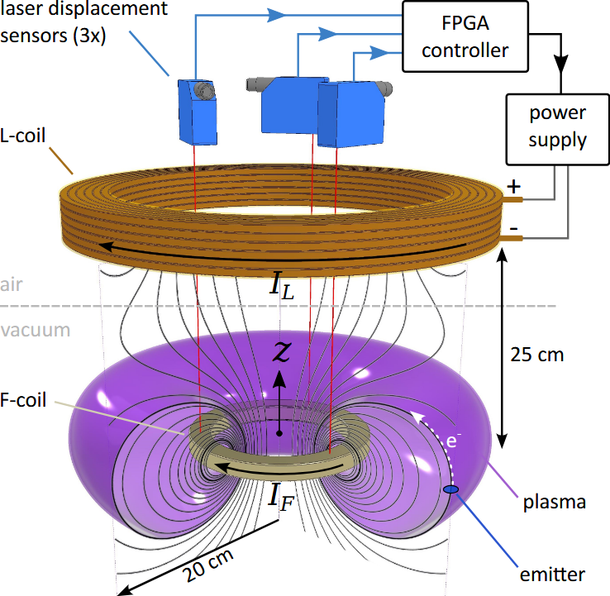
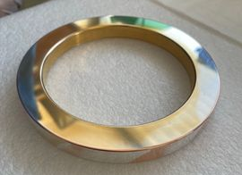
Design and operation of a levitating dipole trap
HTS Floating coil
A. Card, et al., Rev. Sci. Instrum. 97, 023501 (2026).

Slide 19
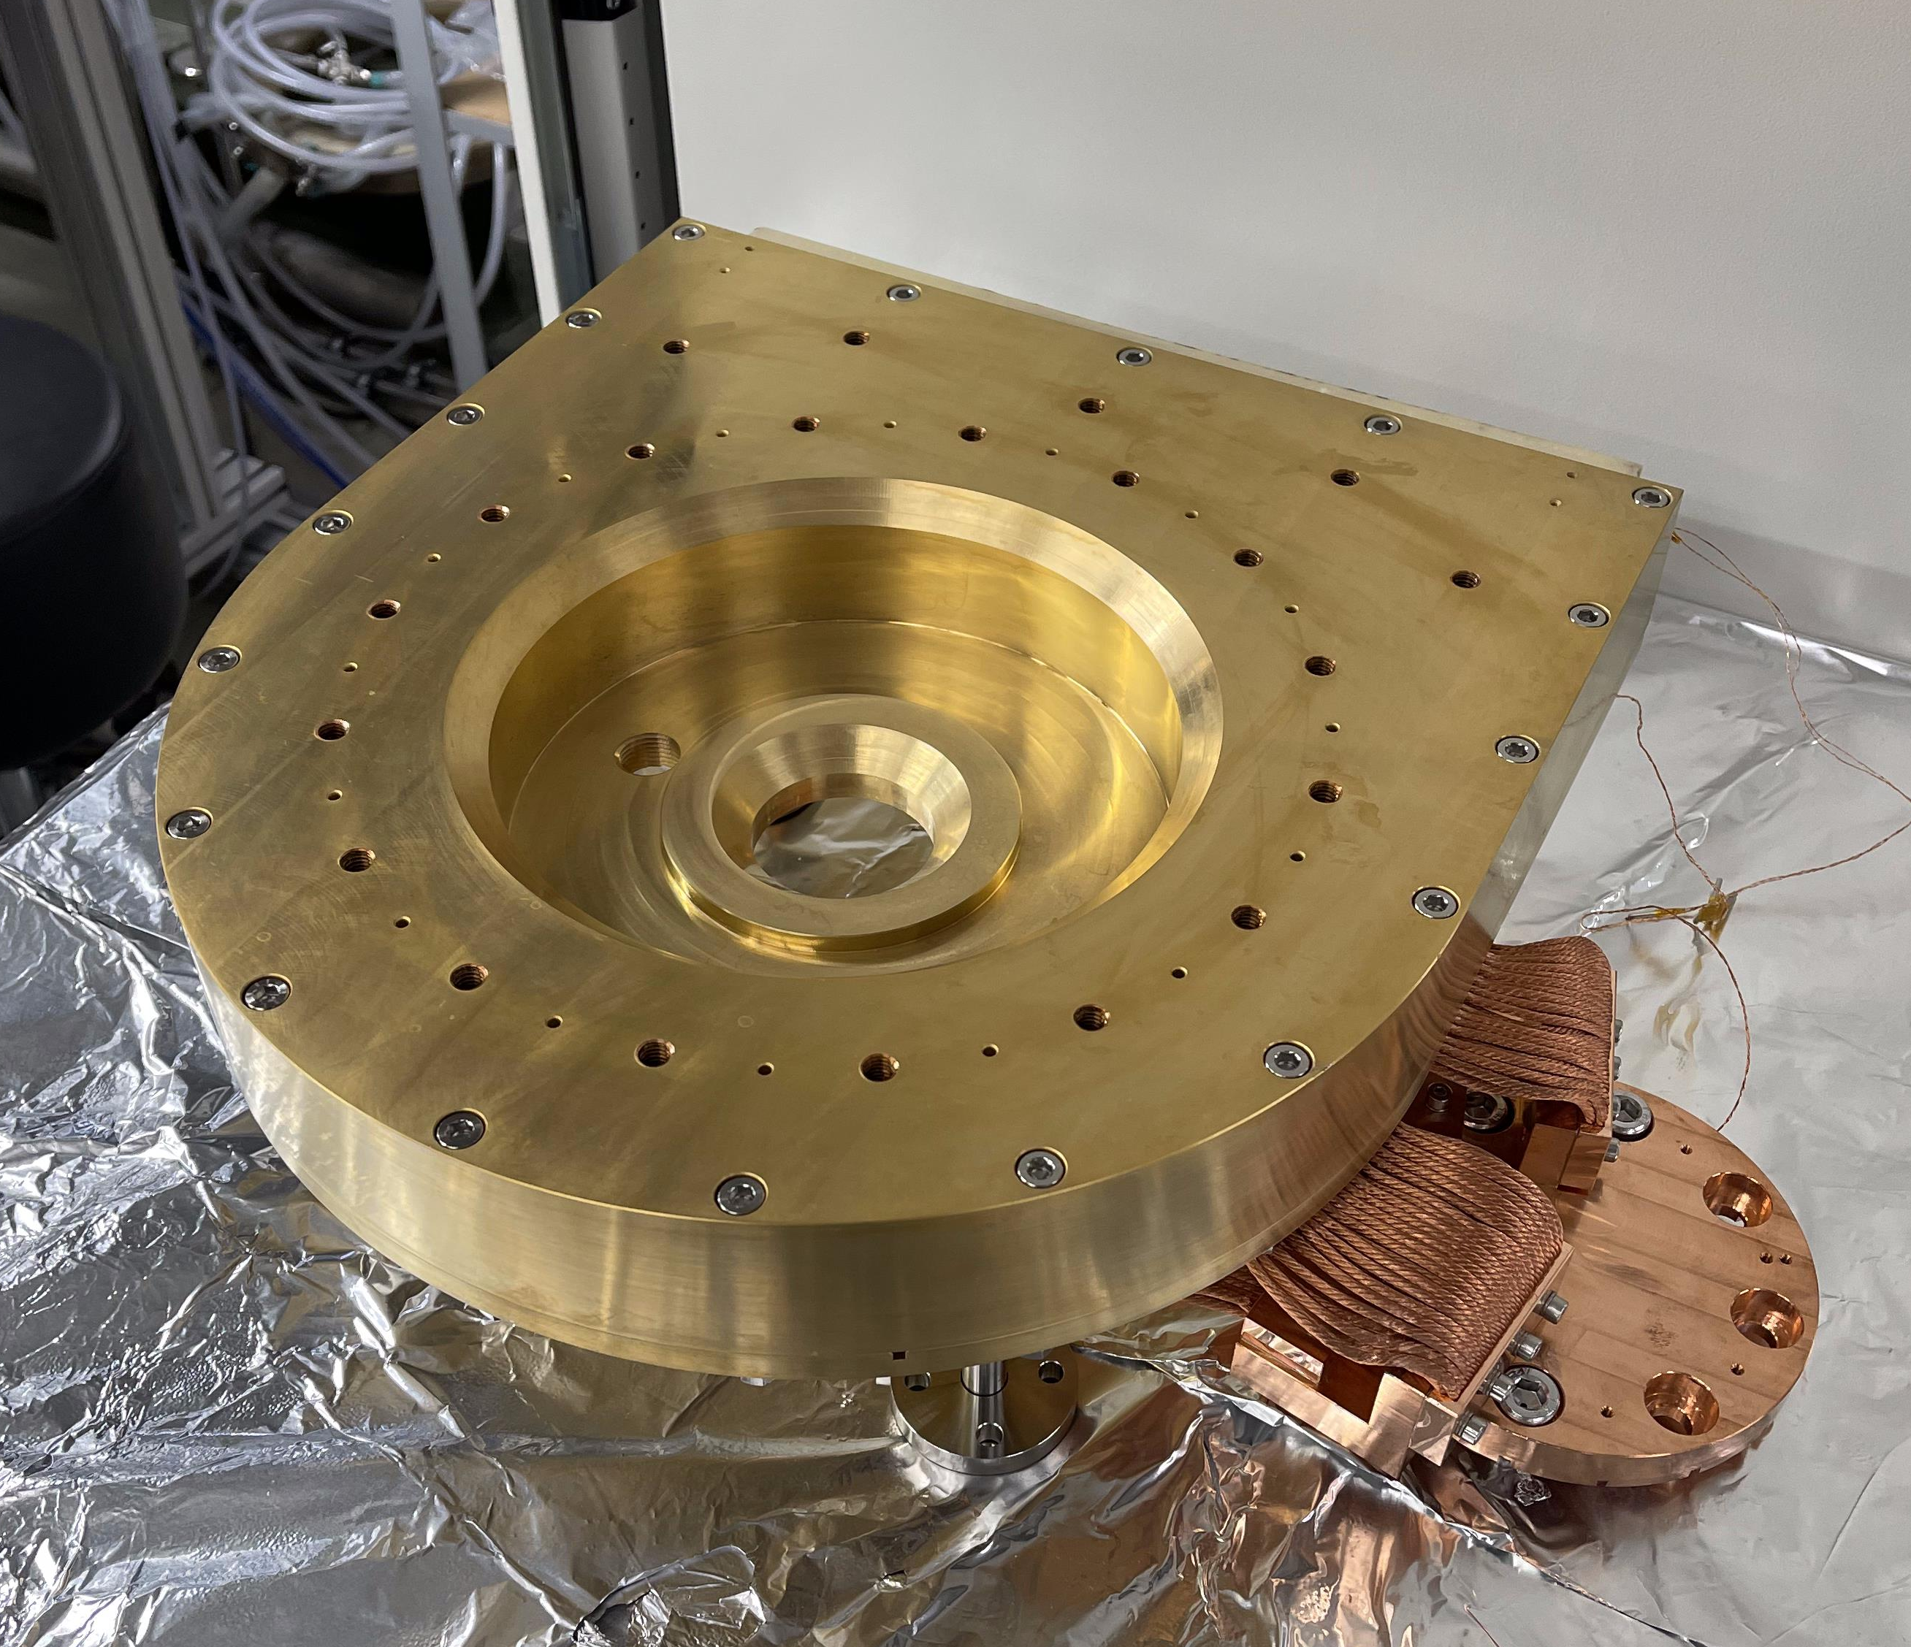
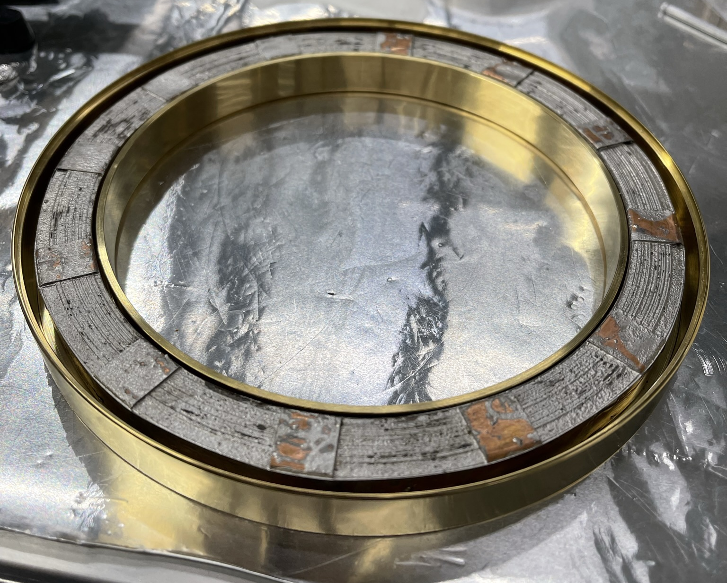
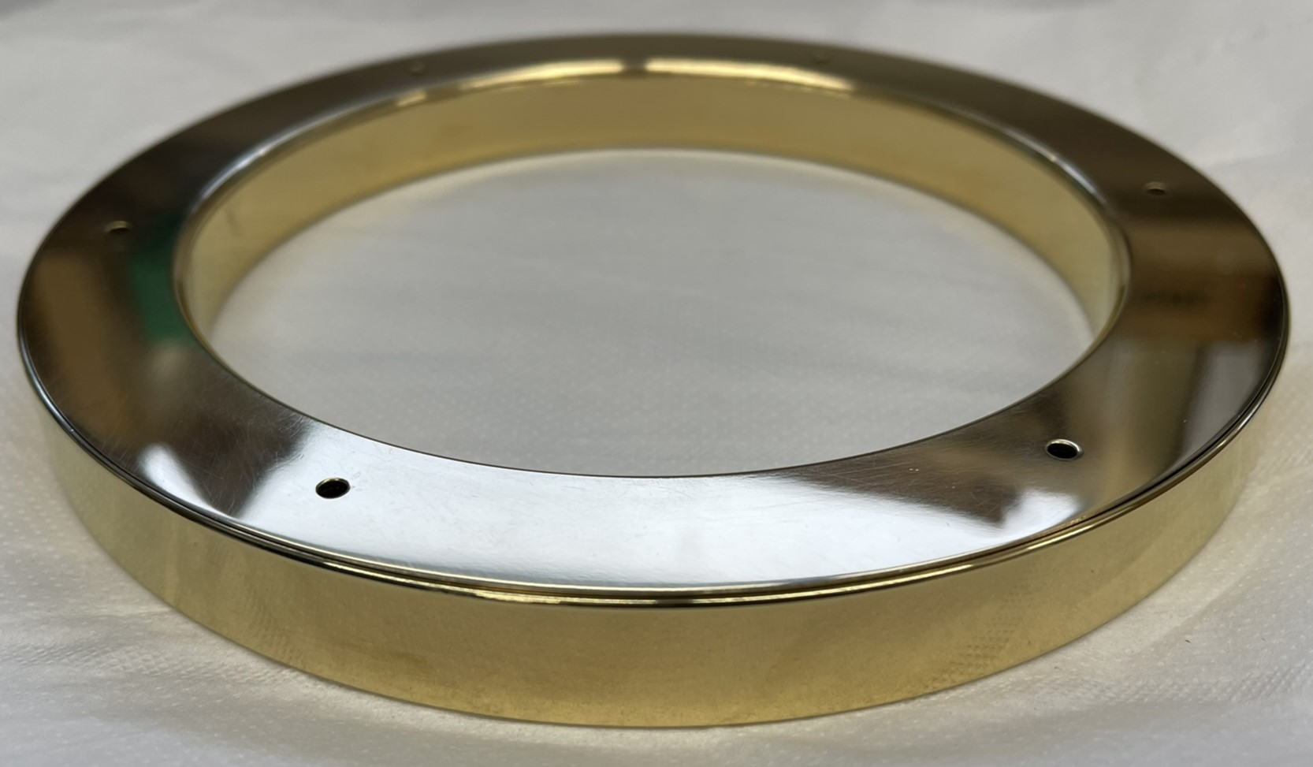
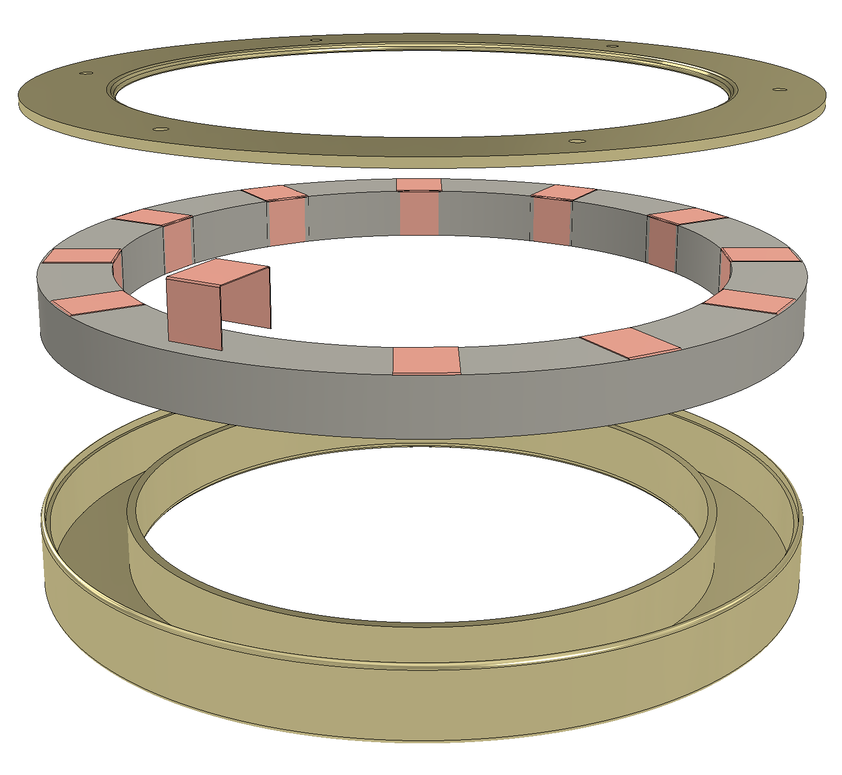
High-temperature Superconducting Coils
Floating coil
No-insulation ReBCO tape (12 mm).
150 turns.
Single pancake coil with 12 return bands.
Inductively charged.
Charging coil
Insulated, copper-laminated HTS ReBCO tape (12 mm).
450 turns.
Double-pancake coil.
Epoxy encased.
DC powered.
F-coil tub
260 mm
150 mm

Slide 20
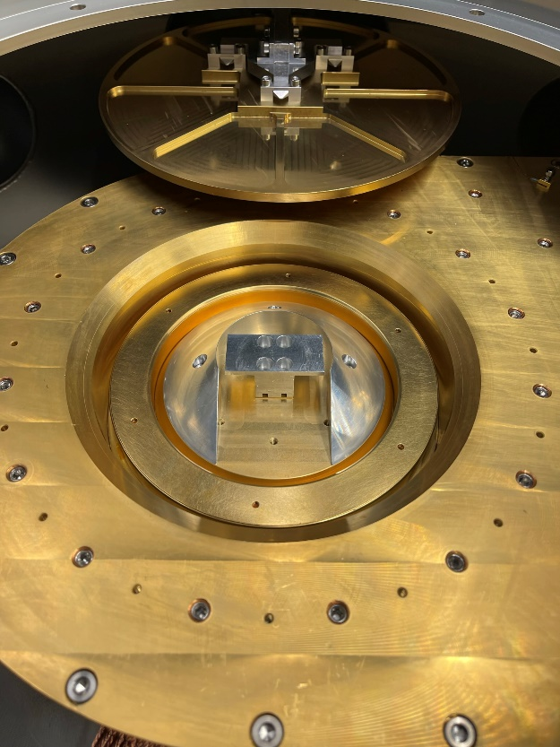
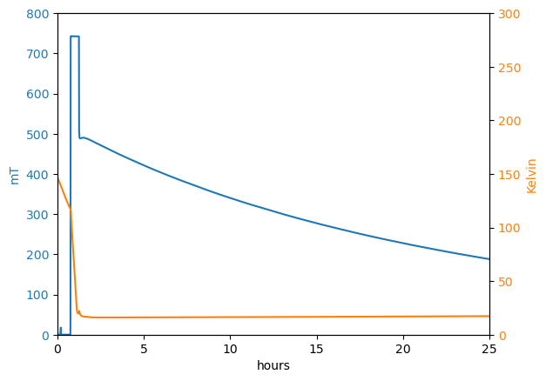
Cooling and Charging the F-coil
Cooling and charging enclosure
C-coil is maintained below 45 K and is energized while F-coil is above SC transition (110 K).
He gas is introduced into sealed enclosure, cooling F-coil below SC transition.
C-coil current is ramped down to induce F-coil current (60 kA-t) which persists for 24 hours (if maintained at 20 K).
Horizontal and vertical translators move enclosure lid into position and remove it after charging.
Vertical translator then raises the charged F-coil into levitation position.
24-hour decay time
L = 6 mH
R = 70 nΩ
Maximum on-axis field is 0.5 T
Exceed 1 T near the coil
A. Card, et al., Rev. Sci. Instrum. 97, 023501 (2026).

Slide 21
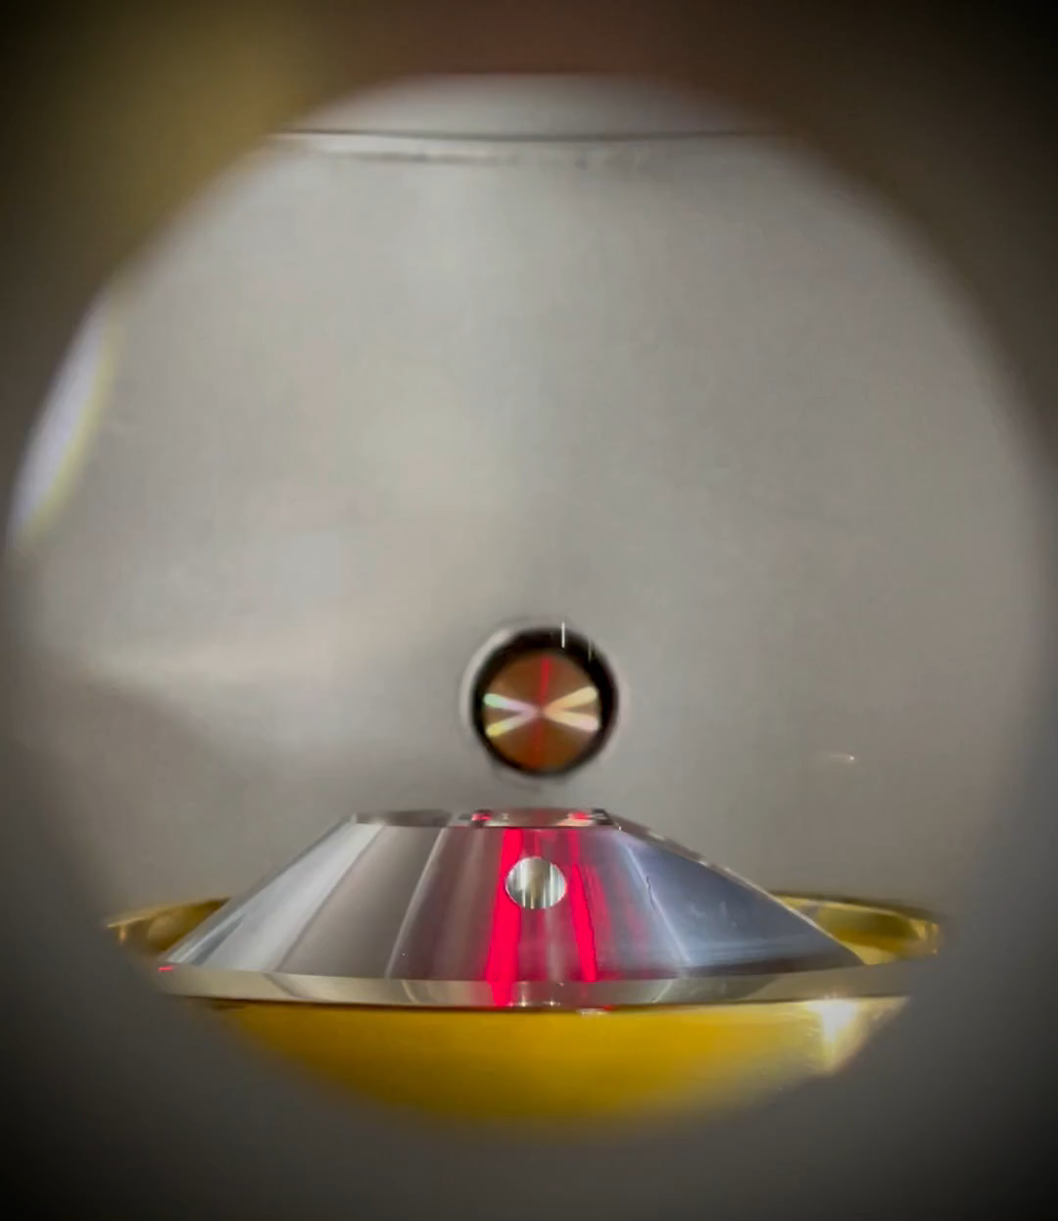
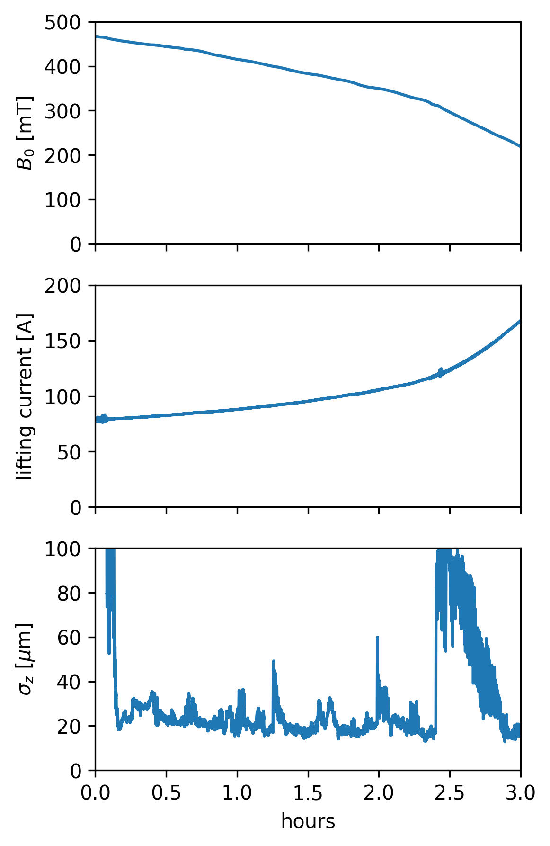
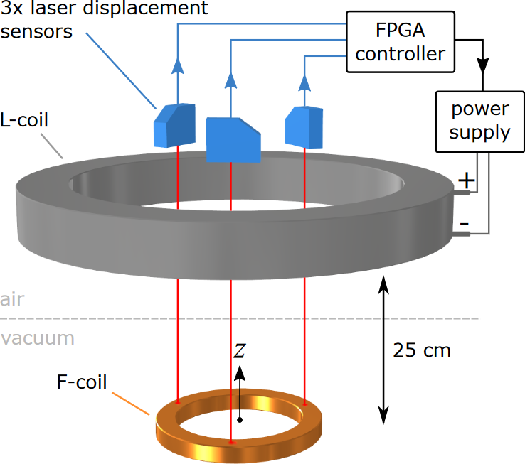
Stabilizing the Levitation
3 hours of stable levitation
~20 μm vertical stability
APEX-LD: LAUNCH
A PID feedback, implemented on an FPGA controller, manipulates lifting coil current, based on 3 laser range finder signals to stabilize the vertical position.
Tilt and slide displacements are inherently stable in this configuration.
A. Card et al., (2024), IEEE Trans. Appl. Supercond., 1–9

Slide 22
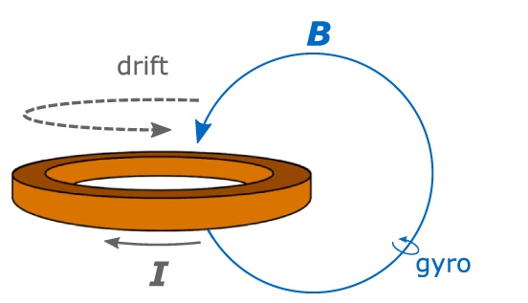
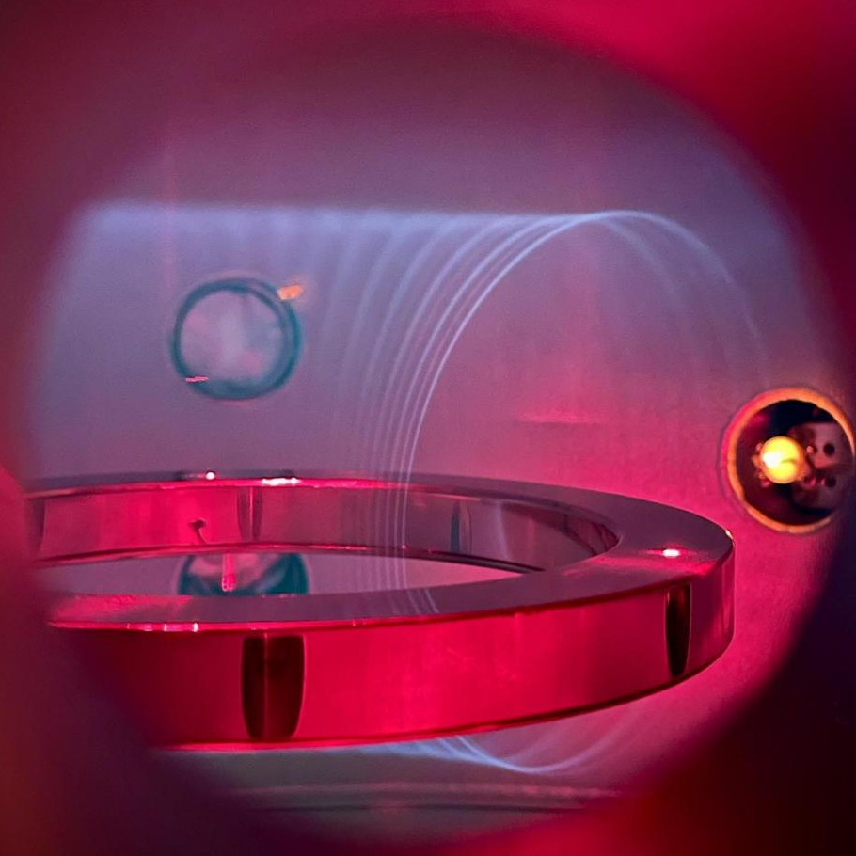
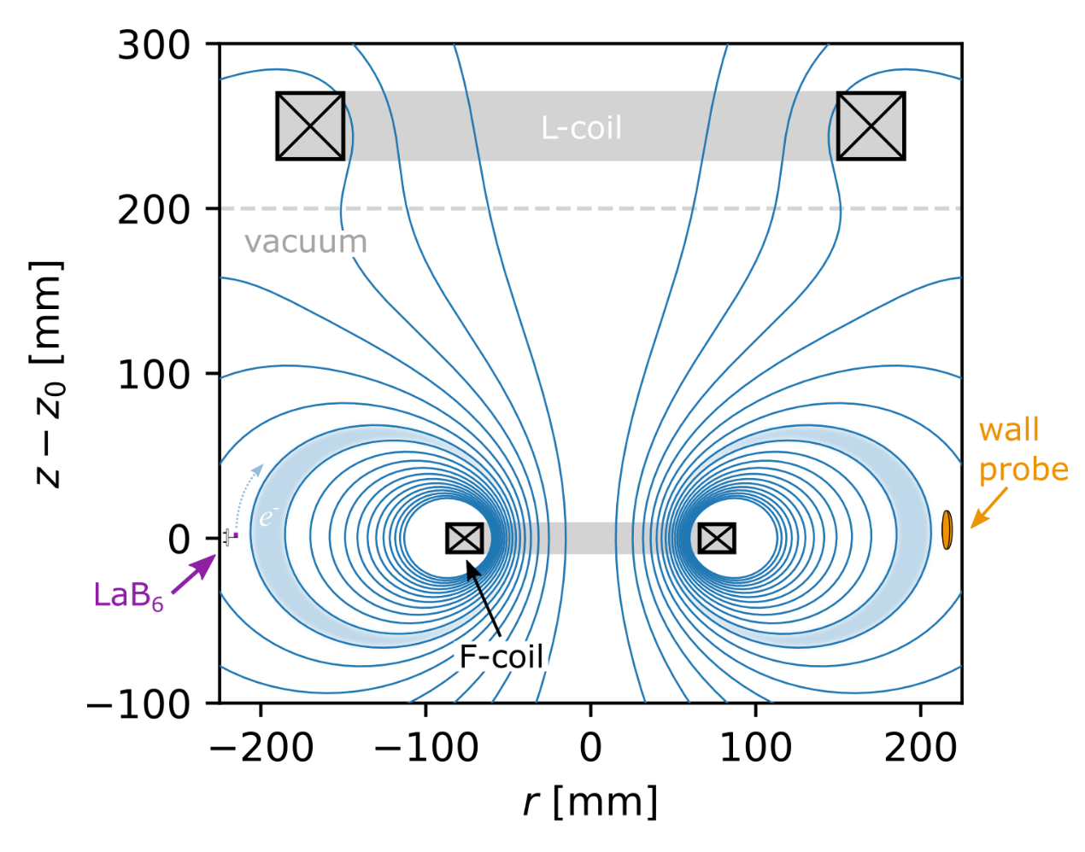
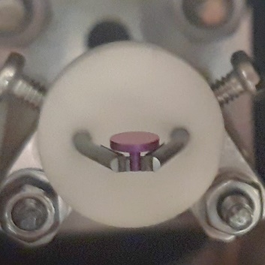
Visualizing Field Lines and Particle Motion using Helium
Electrons emitted from a thermionic emitter excite He gas.
Single particle trajectories are visualized.
Electron orbits in Helium
LaB₆
A. Deller et al. Plasma Phys. Control. Fusion 67 015030 (2025).
YouTube video https://www.ipp.mpg.de/5379974/Levitated_Dipole_apex

Slide 23
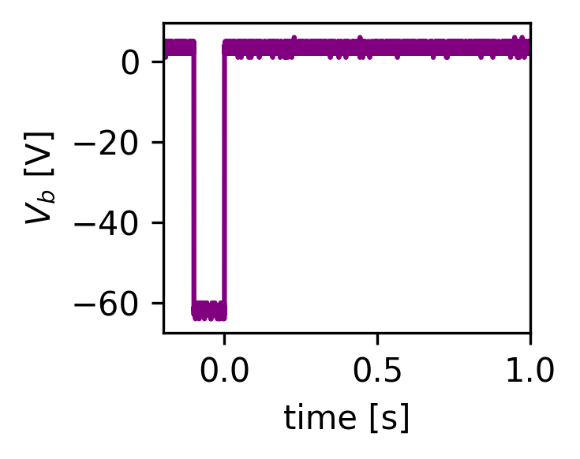
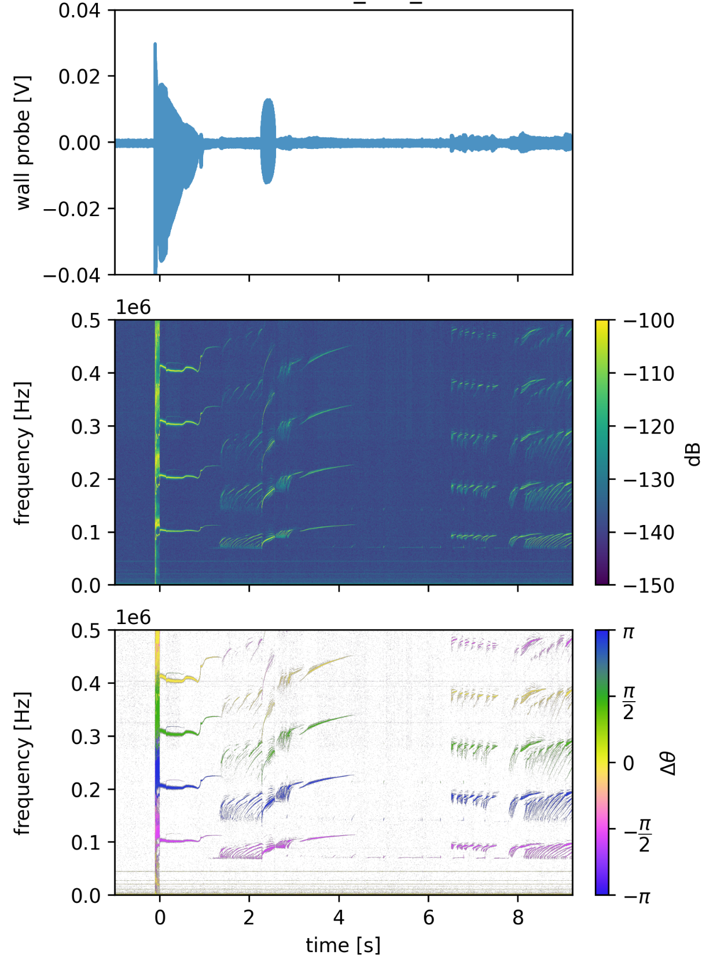
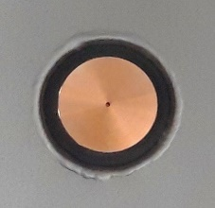








Electron plasma experiments in the levitating trap
Electrons are injected from edge-localized thermionic emitter.
After early turbulent phase (during injection), a coherent mode emerges, diagnosed with capacitive wall-probes.
Mode has one toroidal wavelength (m=1), but exhibits complicated frequency chirping.
This is evidence of collective behavior of a confined electron plasma.
Wall probes
0.1 s fill
LaB₆
$$270$$
$$drift$$
$$0$$
$$180$$
$$90$$
A. Deller, et al, submitted to Phys. Plasmas (2026).

Slide 24
Diagnosing the electron plasma equilibrium with an electron beam probe
Diagnostic e-beam is sent down the axis.
Beam energy is ramped and transmitted current is collected on lifter.
Clear indication that F-coil becomes charged.
Sample transmitted current vs. beam energy.
Beam stopping potential is measured during confinement, and as reciprocating probe is inserted.
T = 1 eV
The trapped charge distribution can be backed out from the measured stopping potential as the probe is inserted (assuming a temperature).
A. Deller, et al, submitted to Phys. Plasmas (2026).

Slide 25

Electrons and Positrons in an Optimized Stellarator (EPOS)
Motivation:
Exploit technologies developed for APEX-LD (e.g., HTS coils, positron traps, drift injection) to investigate pair plasma confinement in a compact stellarator.
Goals:
Confine a low-energy electron-positron plasma for transport and stability studies.
Experimentally validate state-of-the-art stellarator coil optimization and advance non-planar HTS coil technologies.
Requirements:
Small volume (limited number of positrons).
Good confinement (low neoclassical transport).
Drift injection access (weave lane).
High B-field for cyclotron cooling (HTS).
Buildable tolerances (HTS strain).

Slide 26


EPOS stellarator
Target Specifications
Quasi-axisymmetric
2 field period
20 cm major radius
a/λ > 10
B ~ 2 T on axis
Stray fields for positron injection
Results
22-coil design
Field error < 0.04%
HTS strain < 0.1%
QS error < 0.1%
Iota = 0.06
Feasible tolerances: ~ 1 mm
Engineering considerations:
Cryogenic cooling (20K)
Ultra-high vacuum
Diagnostic access (gamma-rays)
Thermal expansion
Magnetic forces
Feasible tolerances and windable coils
Machinability and material cost
1st test coil in the CNC

Slide 27


Acknowledgements APEX collaboration
E.V. Stenson¹, A. Deller^{1,2}, J.R. Danielson², S. Nißl^{1,3}, A. Card¹, V.C. Bayer¹, P. Gil¹, P. Huslage¹, J. von der Linden⁸, P. Steinbrunner¹, M.R. Stoneking⁴, and C. Hugenschmidt^{3.}
H. Higaki⁵, K. Michishio⁶, H. Saitoh⁷ , and N. Oshima⁶
¹Max-Planck-Institut für Plasmaphysik,
²University of California San Diego,
³Technische Universität München,
⁴Lawrence University,
⁵Hiroshima University, ⁶AIST, Tsukuba, ⁷University of Tokyo,
⁸THEA Energy
Cliff Surko, 1941 - 2024
APEX Alumni: U. Hergenhahn, X. Sarasola, J. Horn-Stanja, C.W. Rogge, N. Belmore, S. Ghosh, M. Singer, M. Singer, S. Kӧnig, T. Schuler, L. Schweikhard, J. Smoniewski, T. Sunn Pedersen, & C.M. Surko.
This work has been carried out with support from the National Science Foundation (PHY-2206620), U. S. DOE (DE-SC0019271) and the UCSD Foundation; The work has also received funding from the European Research Council (ERC) under the European Union's Horizon 2020 research and innovation program (grant agreement No. 741322); and the Deutsche Forschungsgemeinschaft, (Hu 978/15-1 and Sa 2788/2-1). The views and opinions expressed herein do not necessarily reflect those of the European Commission. The NEPOMUC positron beam facility is operated by FRM II at the Heinz Maier-Leibnitz Zentrum (MLZ), Garching, Germany.

