Slide 1
¿e⁺?

Slide 2

Some New Ideas: Low-Energy Positron Physics at the ANU and a Proposal for a New Positron Polarimeter
T.J.Gay
University of Nebraska
J.R.Machacek, S.Hodgman, L.Wymer, S.Kumar and S.J.Buckman
Australian National University

Slide 3
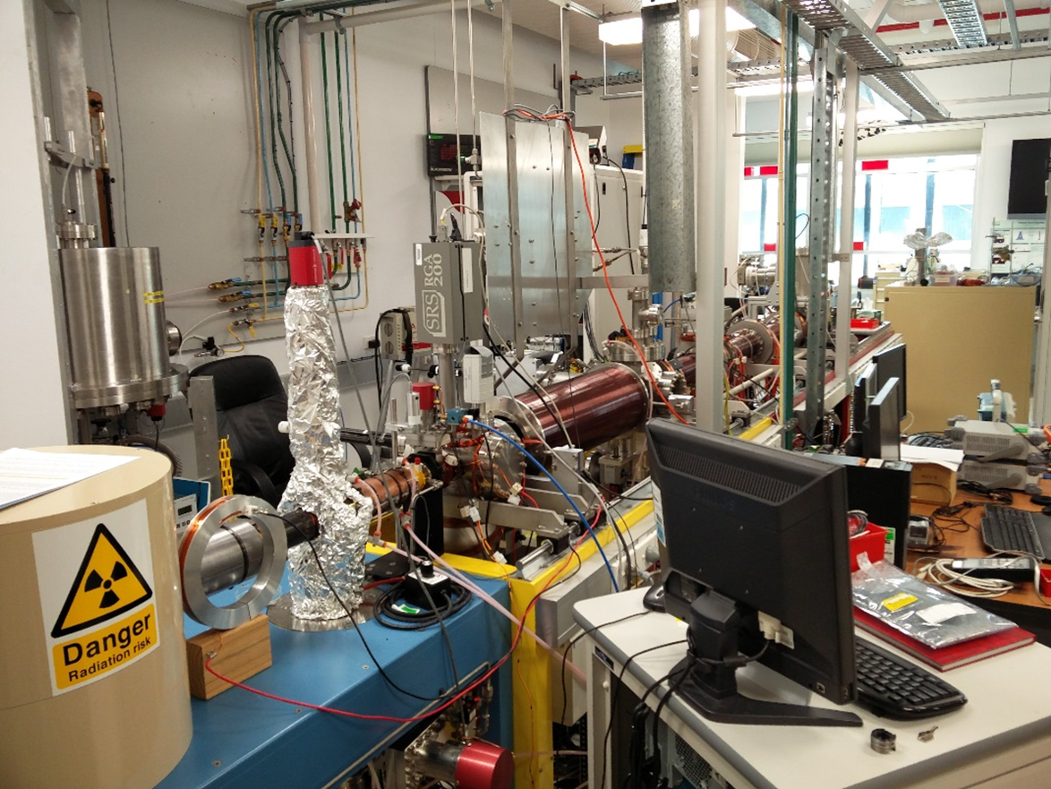
ANU Positron Beamline # 2

Slide 4
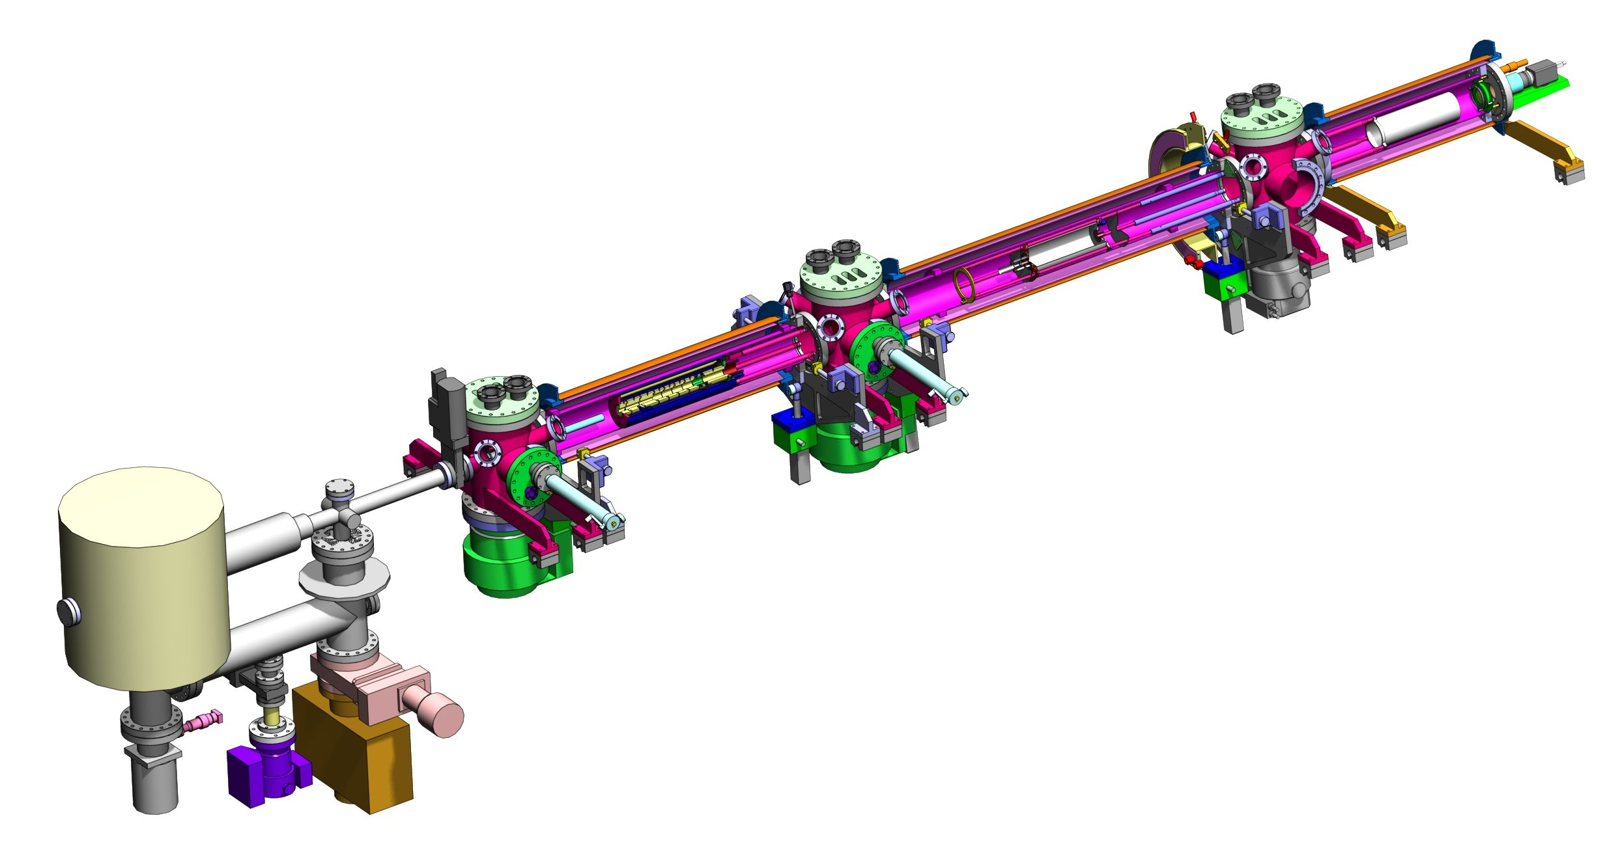
ANU Positron Beamline
MCP
Pumping Stages
²²Na e⁺ Source
and Moderator
RPA 2
RPA 1
Trap
New He Beam
Collision Region

Slide 5
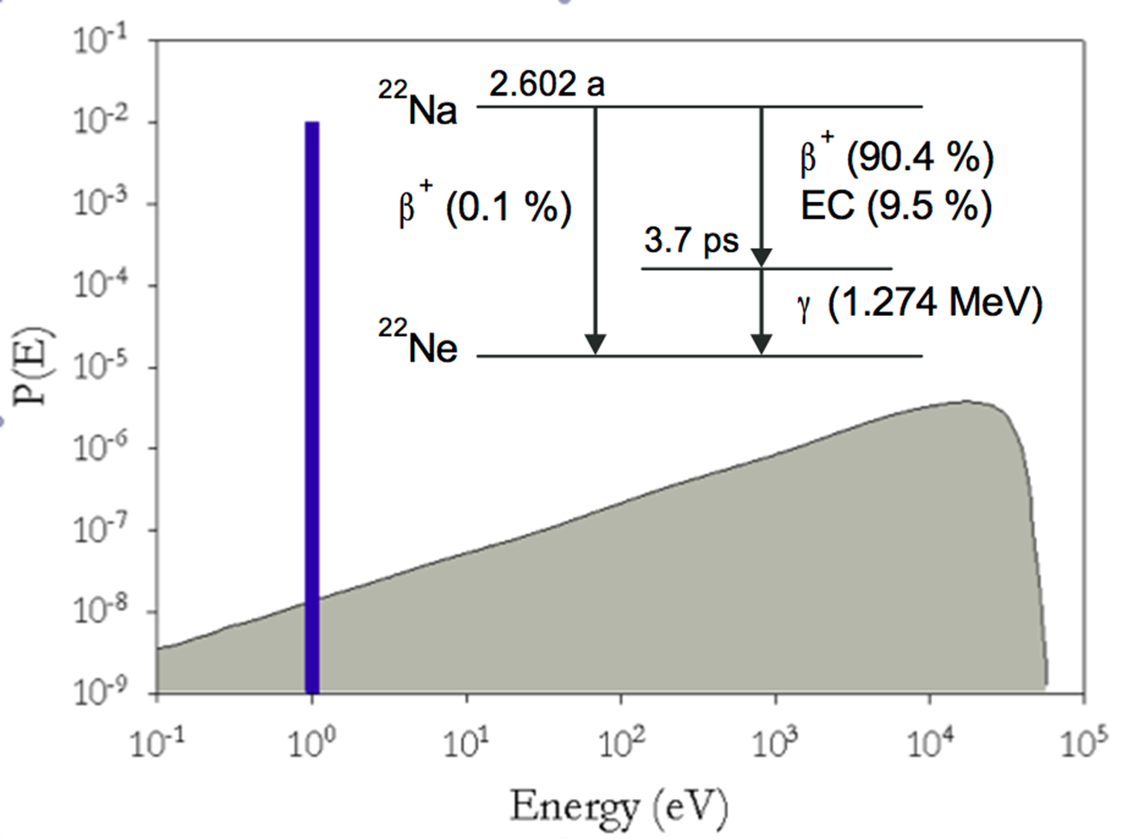
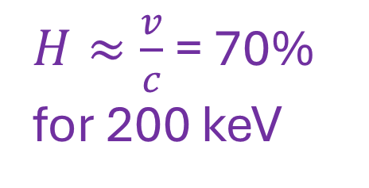
Nuclear β Decay – Weak Interaction
$${}_{11}^{22}{Na}→{{}_{10}^{22}{Ne}}^{∗}+e^{+}+ν→{}_{10}^{22}{Ne}+γ\left(1.28 MeV\right)+e^{+}+ν$$
Helicity:
$H≈\frac{v}{c}$ = 70% for 200 keV

Slide 6
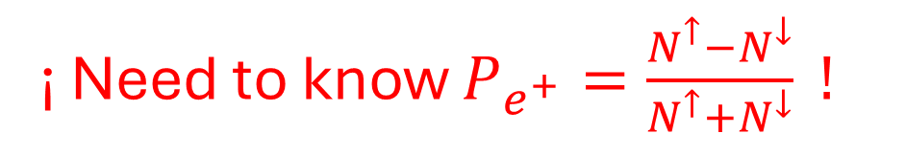
Moderators
D.W.Gidley , A.Rich, J. Van House, and P.W. Zitzewitz, Nature 297, 639 (1982)
¡ Need to know $P_{e^{+}}=\frac{N^{↑}−N^{↓}}{N^{↑}+N^{↓}} !$

Slide 7
Possible Schemes for Low-Energy Positron Polarimetry
Mott Scattering (wrong charge sign)
Bhabba scattering (OK – above several MeV)
The standard: methods involving high magnetic fields to quench positronium with subsequent decay gamma rays being detected with either time, energy, or angle cuts
    non-fatal drawbacks: magnetic field flipping is not ideal
    high magnetic field can pose spatial and stray field constraints

Slide 8

Example:
$$A=\frac{R^{+}−R^{−}}{R^{+}+R^{−}}∝\vec{P}∙\vec{B}$$
G. Gerber et al., Phys. Rev. D 15 1189 (1977)

Slide 9
A Relevant Technology – the Rb Spin Filter
SOURCE
DIFFERENTIAL PUMPING & TRANSPORT OPTICS
TARGET & POLARIMETER

Slide 10
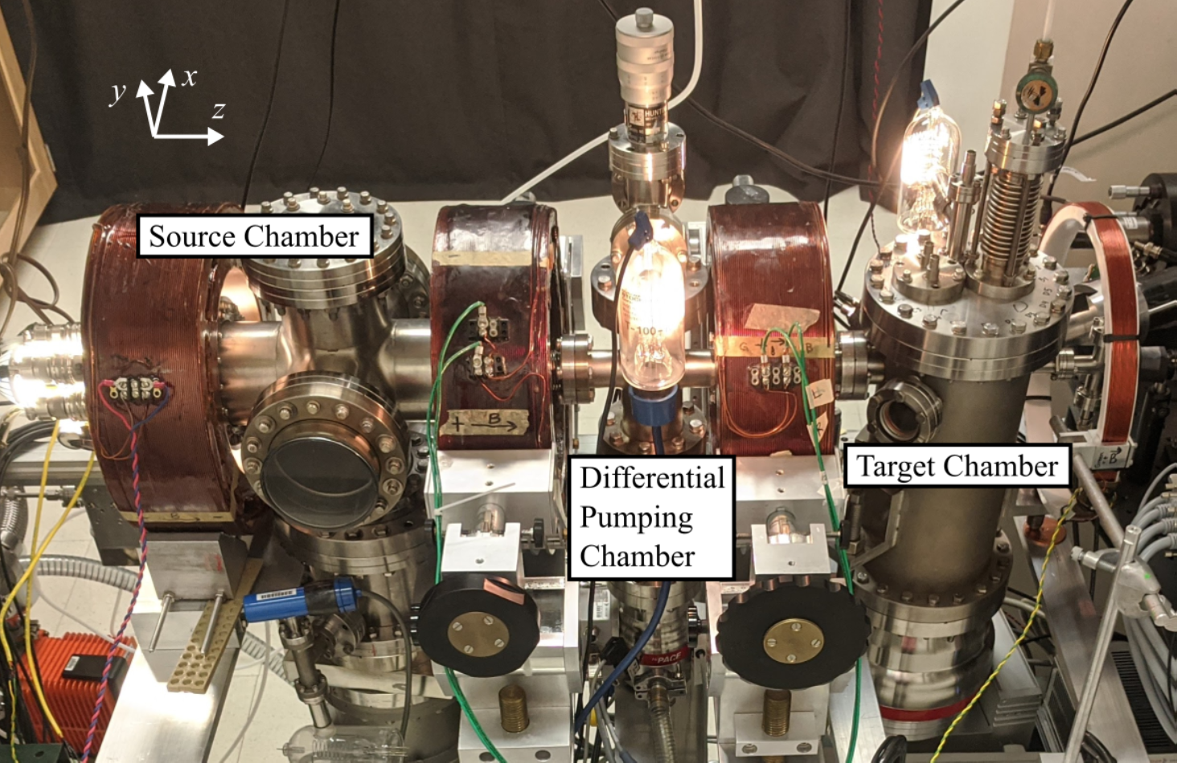

Slide 11
Optically-Pumped Rb Spin-Transfer Cell

Slide 12
Rb Optical Pumping and Radiation Trapping
collisional quenching
rogue photons
One way to solve both the collisional and radiation trapping problem is to use low densities of Rb vapor.

Slide 13
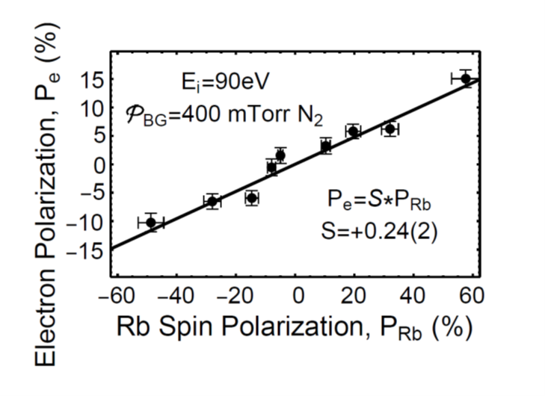
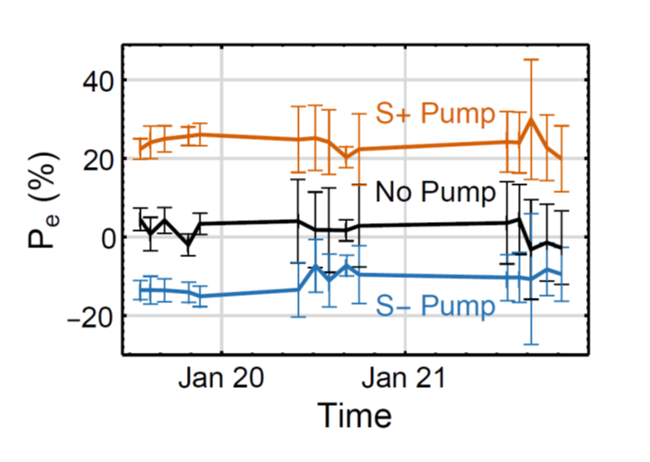
Performance Parameters of the Rb Spin Filter
Spin transfer efficiency
Spin stability over time
P_{e} = 23%
I_{out} > 4 μA
Polarization Figure of Merit – 200 nA
∆E ≈ 1.5 eV
Quasi-turn-key operation
K.J.Ahrendsen, K.W.Trantham, D.Tupa, and T.J Gay, Rev Sci Instrum 94, 083308 (2023)

Slide 14
Optically-Pumped Rb Positron Polarimeter
Surko trap terminus and incident positron beam
Guiding solenoidal magnets
Differential pumping
Rb target
Trochoidal beam deflector
Beam dump
Optical pumping and probe lasers
Reflected probe beam to measure P_{Rb}
NaI scintillators (light blue)
Photomultiplier Tube
Pb blocks
11
2
10
3
7
9
1
5
4
6
8
J.R.Machacek, S.Hodgman, S.J.Buckman, and T.J.Gay, Atoms 11, 65 (2023)

Slide 15
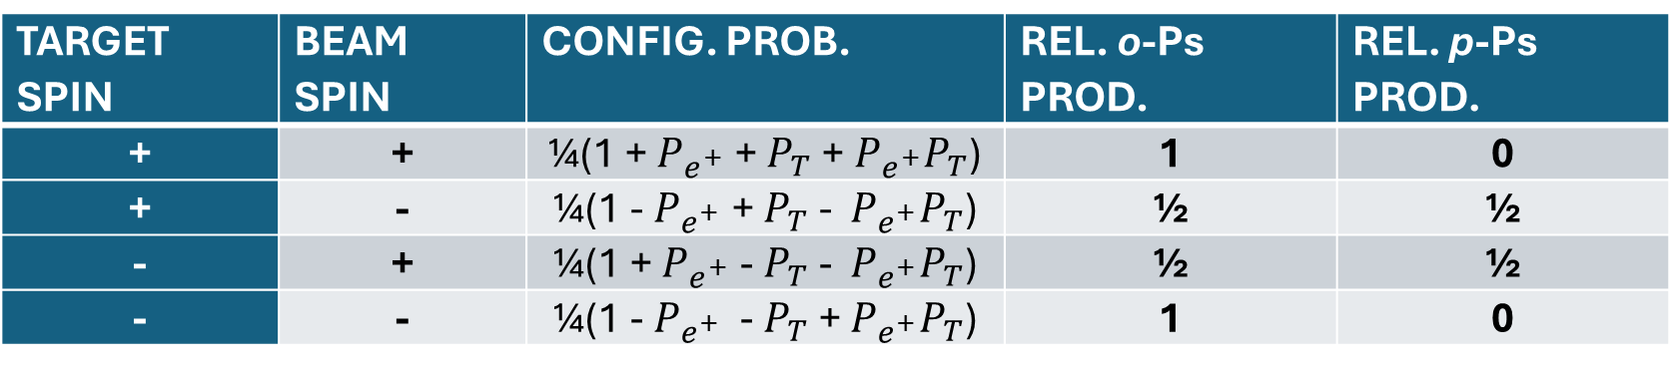
Polarimetry I
e⁺
Rb
TARGET SPIN | BEAM SPIN | CONFIG. PROB. | REL. o-Ps PROD. | REL. p-Ps PROD.
+ | + | ¼(1 + $P_{e^{+}}$ + $P_{T}$ + $P_{e^{+}}P_{T}$) | 1 | 0
+ | - | ¼(1 - $P_{e^{+}}$ + $P_{T}$ - $P_{e^{+}}P_{T}$) | ½ | ½
- | + | ¼(1 + $P_{e^{+}}$ - $P_{T}$ - $P_{e^{+}}P_{T}$) | ½ | ½
- | - | ¼(1 - $P_{e^{+}}$ - $P_{T}$ + $P_{e^{+}}P_{T}$) | 1 | 0

Slide 16
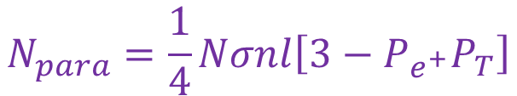
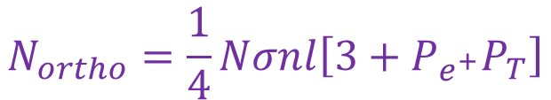
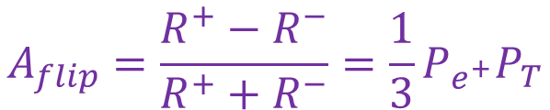
Polarimetry II
$$N_{para}=\frac{1}{4}Nσnl\left[3−P_{e^{+}}P_{T}\right]$$
N = number of incident positrons
σ = Ps formation cross section
n = target density
l = target length
wait 100ns
$$N_{ortho}=\frac{1}{4}Nσnl\left[3+P_{e^{+}}P_{T}\right]$$
$$A_{flip}=\frac{R^{+}−R^{−}}{R^{+}+R^{−}}=\frac{1}{3}P_{e^{+}}P_{T}$$

Slide 17
Optically-Pumped Rb Positron Polarimeter - Details
Narrow heat pipe target to suppress optical trapping of depolarization
<1W circularly-polarized pump laser at the Rb D1 line (795 nm)
μW probe laser at Rb D2 line (780 nm) to measure P_{Rb} using optical rotation
Target spin is flipped not by the weak (10⁻² T) constant magnetic field but by the pump laser helicity
P_{Rb} ≈ 100%
n_{Rb} ~ 10¹¹ cm⁻³
l = 3cm
Positron energy = 2.4 eV; precludes capture to excited states of Ps
σ(positronium formation) = 25 x 10⁻¹⁶ cm²;
σ(Rb 5s – 5p excitation) = 20 x 10⁻¹⁶ cm²;
Σ(quasi-elastic scattering) = 100 x 10⁻¹⁶ cm²
Scattered e⁺ won’t annihilate at target walls because of their cyclotron motion in the magnetic field

Slide 18
Polarimetric Efficiency
e⁺ pulses from our Surko trap: 2 x 10⁶ positrons at 1 Hz
o-Ps production rates of 1.1 x 10³ per second (¡need more flux!)
After a delay of 100 ns, half of these are gone; the rest are counted as signal
Solid angle: 10% of gammas will hit the scintillators
~100% detection rate (NaI - 38 visible photons/keV and a 10% PMT quantum efficiency)
→ 55 Hz useable count rate
For a 𝑃(𝑒+ ) = 22%, a measurement precision of 2% can be achieved in < 6 minutes

Slide 19
Science with Positrons (both polarized and unpolarized)
He Capillary Jet
Copper Mesh
Pulsed, compressed, e⁺ beam from trap
RPA
MCP
B
Deflected excited atoms
Inverting
AMP
CEM
To pump
start
γ detector
(e+ flux monitor)
TAC
AMP
stop
MCA
Pre-AMP

Slide 20
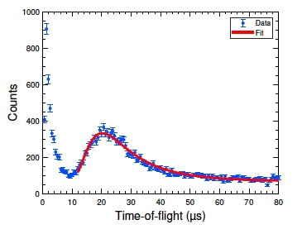
Positron Excitation of Metastable Helium
$$e^{+}+He(1s2) →e^{+}+He^{∗}(1s2s2^{1}S)$$
Positron ToF Spectrum
Prompt γ, Ps, ??
Metastable 2¹S atoms
  Time between beam pulse and CEM detection is recorded
  Fast particles are separated from slow particles
  Gas beam is at room temperature and thus has a Maxwellian distribution
Comparison to previous ANU measurement with a gas-cell and a CCC calculation by Utamuratov et al.
L.Wymer, S.Kumar, T.J.Gay, S.S.Hodgman, S.J.Buckman, and J.R.Machacek, Eur. Phys. J. D 80;12 (2026)

Slide 21
Open Questions
Can Positrons Excite He 2³S states ?
  Only possible via Spin-Orbit interaction which is weak/negligible for positrons
  2³S state has a threshold of 19.82 eV; the 2¹S threshold is 20.62 eV
  Our positron beam has an energy width < 50 eV
  Can we put an upper limit on it ?
Extend to heavier rare gase triplet states where there is little or no work on positron excitation measurements.
  The S-O interaction also scales as Z²
  A test for theory for larger atomic systems

Slide 22
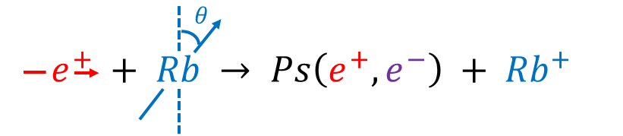
Spin-Dependent Positronium Production with Rb
Spin-polarized
rubidium atom
Rubidium ion
Spin-polarized
positron
Ortho-positronium or
Para-positronium

Slide 23
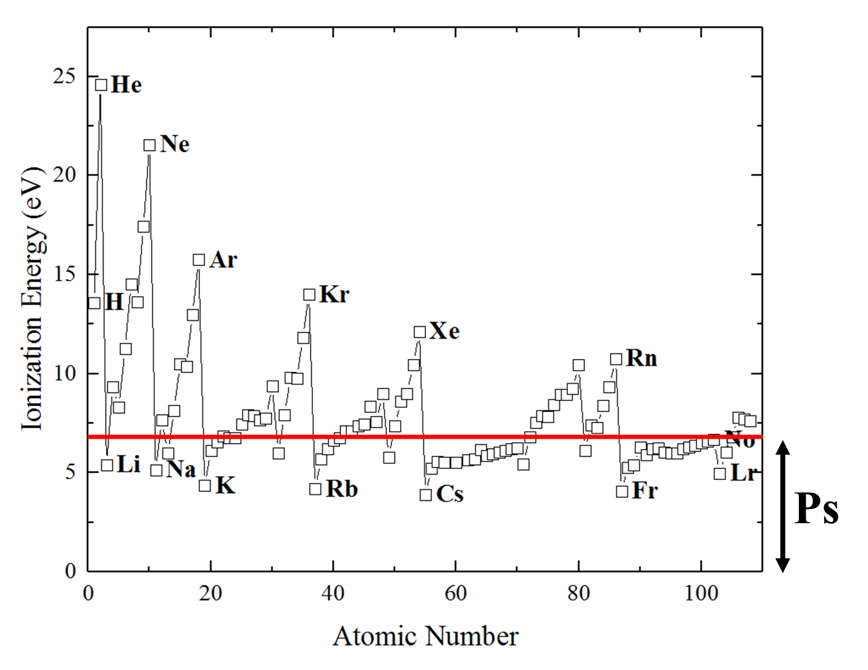
Atomic Targets

Slide 24
The Dynamics of Positronium Formation
Endothermic (Xe)
Exothermic (Rb)
strongest interaction at threshold is between the Ps and the residual target
strongest interaction at low energy is between the e⁺ and the target (there is no threshold)

Slide 25
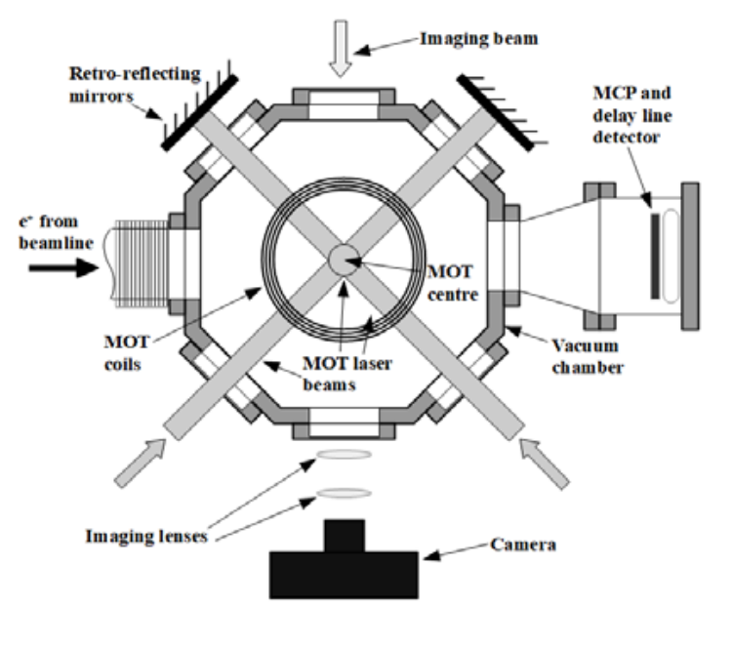
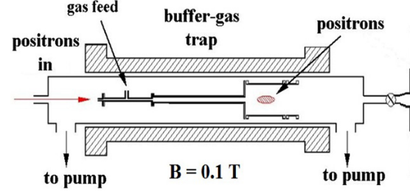
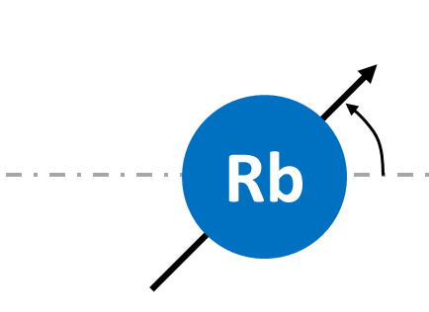
Experimental Apparatus
Differential Pumping
Scintillator

Slide 26
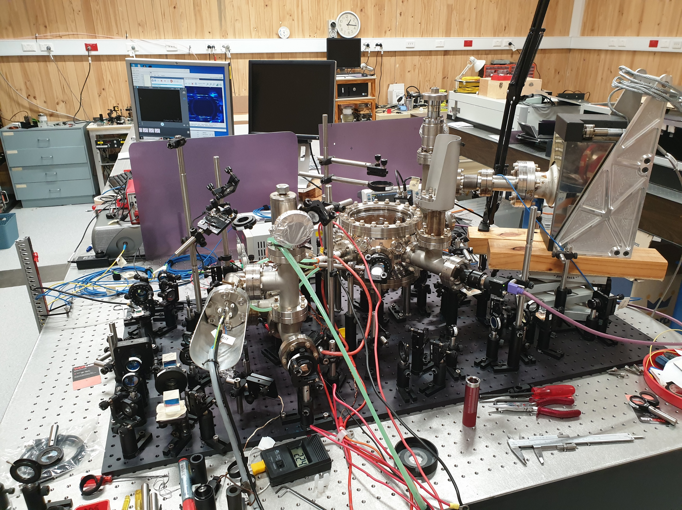

Slide 27
Chiral Collision Dynamics – and we’re not talking vector boson here…
Plane of Mirror Symmetry

Slide 28
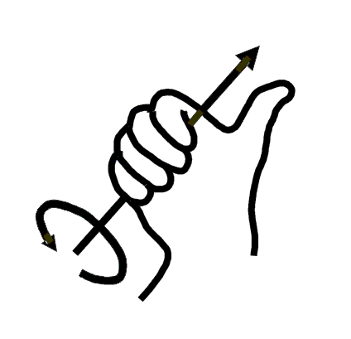
¡ positrons are chiral!

Slide 29
Molecule | Annihilation Asymmetry (pp 10,000)
Cysteine | <7
Tryptophan | <7
Leucine | 31(7)
D.W.Gidley , A.Rich, J. Van House, and P.W. Zitzewitz, Nature 297, 639 (1982)

Slide 30
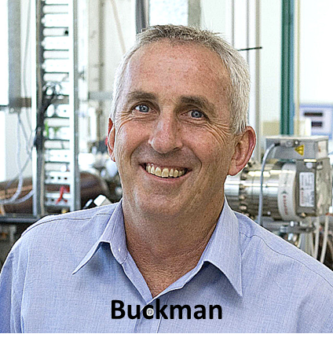
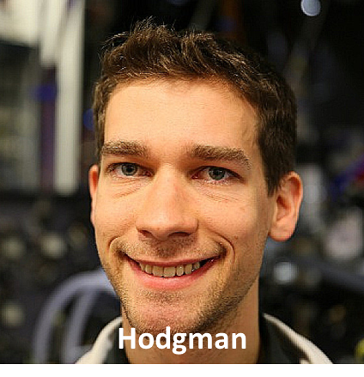
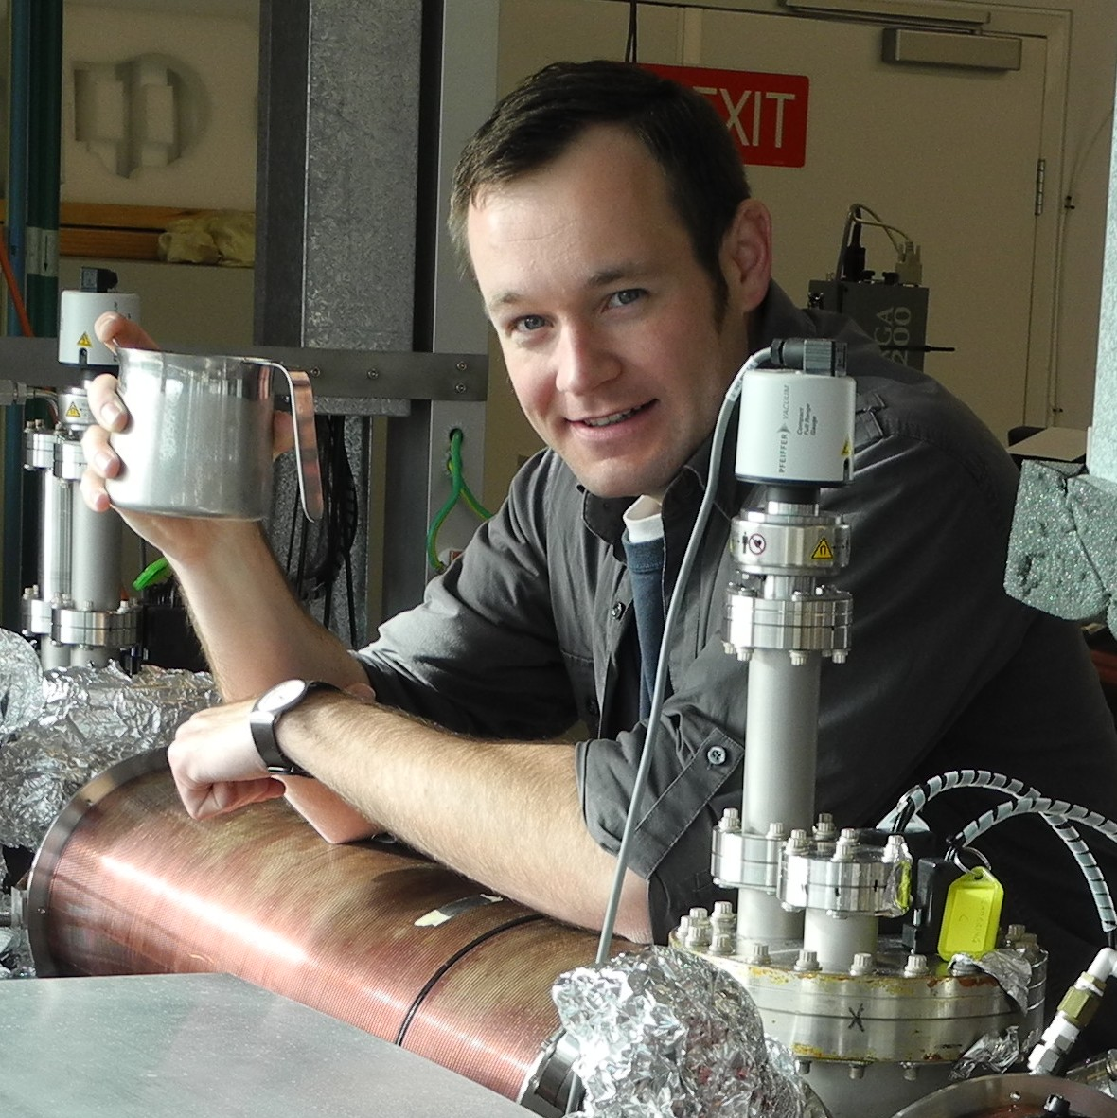

Co-Perpetrators
Machacek
(no photos available for Liam Wymer, Sharan Kumar)

Slide 31
Exothermic
Endothermic

