Slide 1






Status of the Scanning Positron Microscope at the NEPOMUC positron source:
“A Scanning Positron Microscope for
3D defect mapping”
J. Mitteneder, M. Dickmann, R. Helm, W. Egger, G. Kögel and G. Dollinger
Universität der Bundeswehr München
Low Energy Electron Positron Physics Workshop at Jefferson Lab,
Newport News, 2026

Slide 2
Outline
1 000 000 000 eV positron beams
0. 000 000 001 km beam diameter
1 mi ≈ 0.62 km
(2016)
2

Slide 3
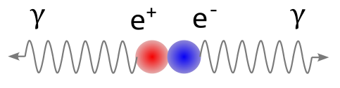
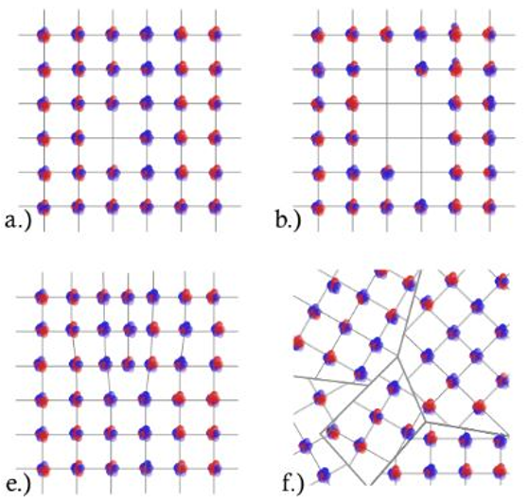
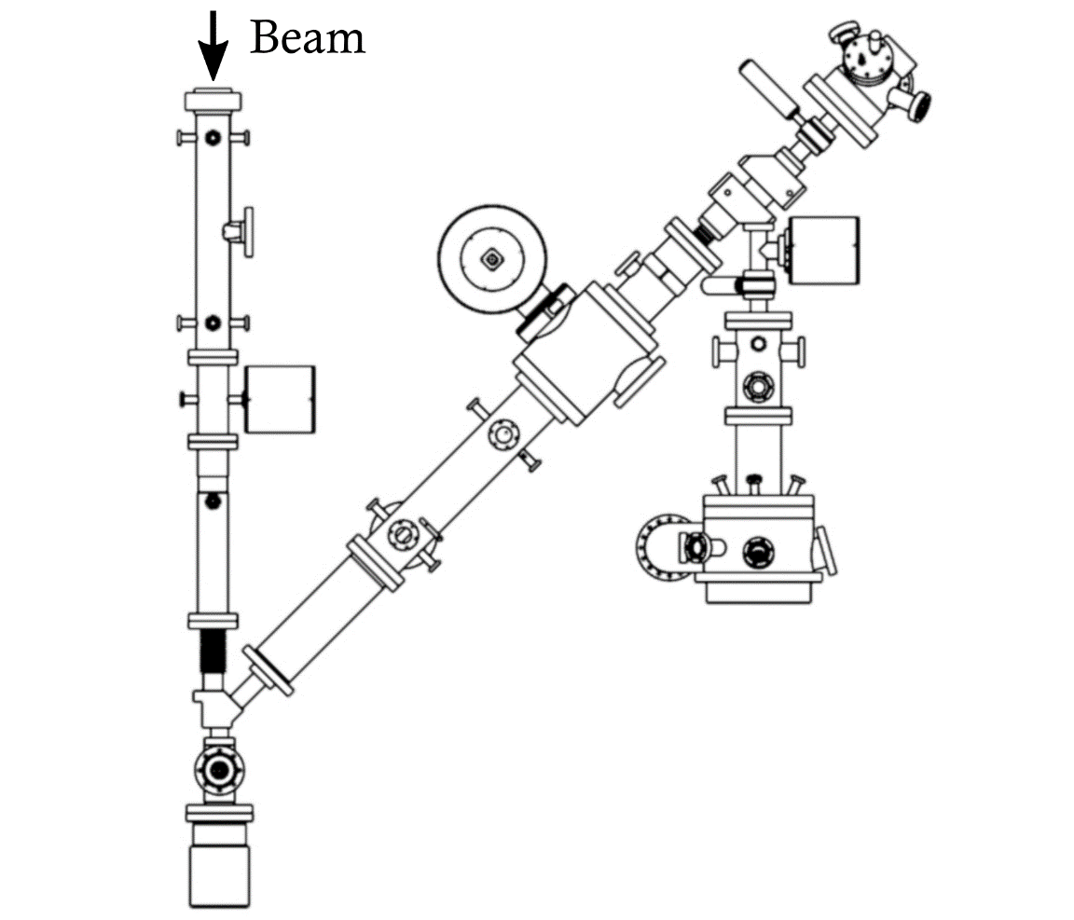
Outline
Position resolved Positron Annihilation Lifetime Spectroscopy (P-PALS)
Defects “seen” by positrons
Positron source NEPOMUC
The Scanning Positron Microscope (SPM)
The positron elevator of the SPM,
(Accelerator with a shunt impedance of 0 Ω)
Research with micrometre positron beams
PALS
Atomic defects
SPM at NEPOMUC
(2016)
3

Slide 4
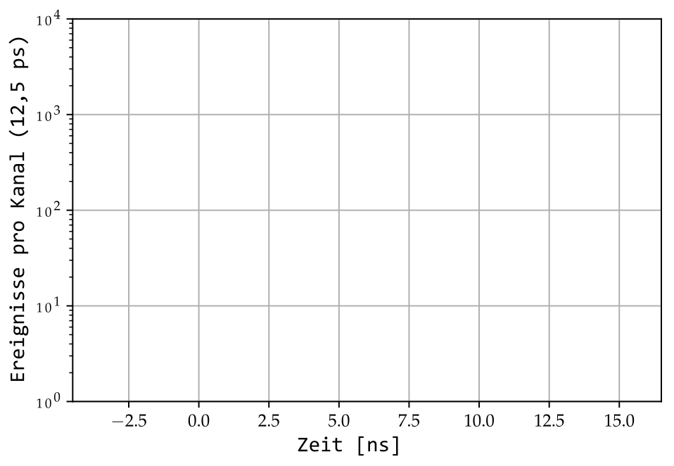
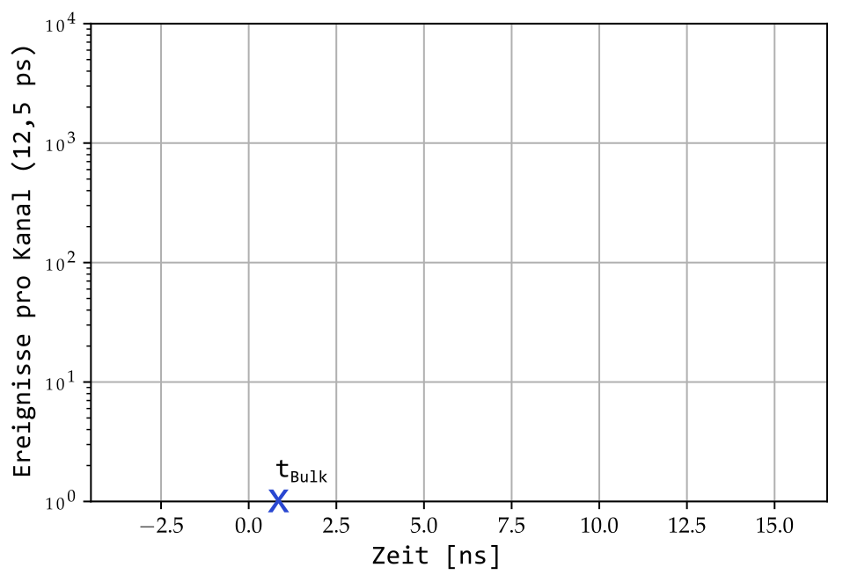
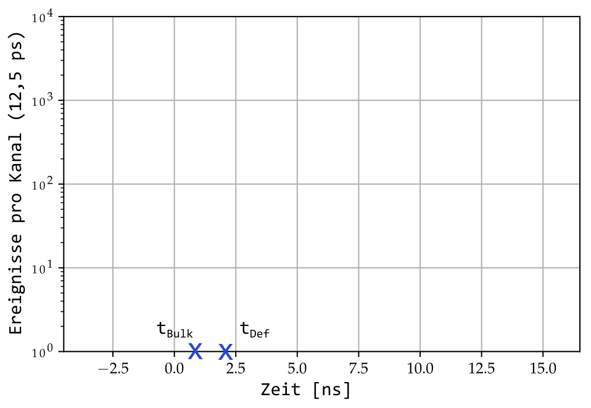
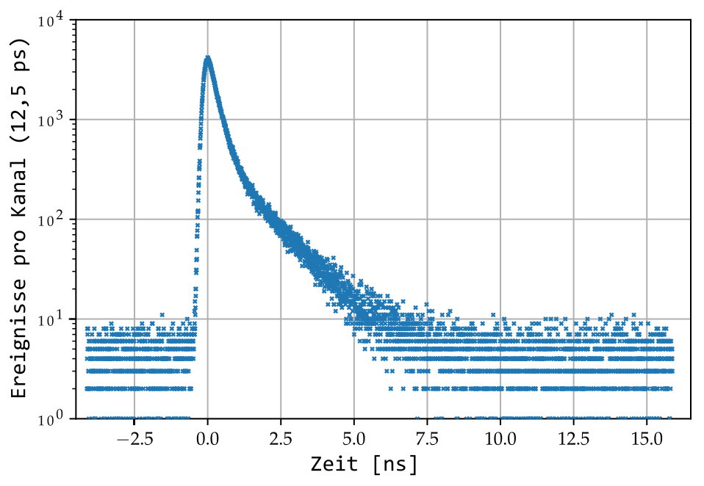
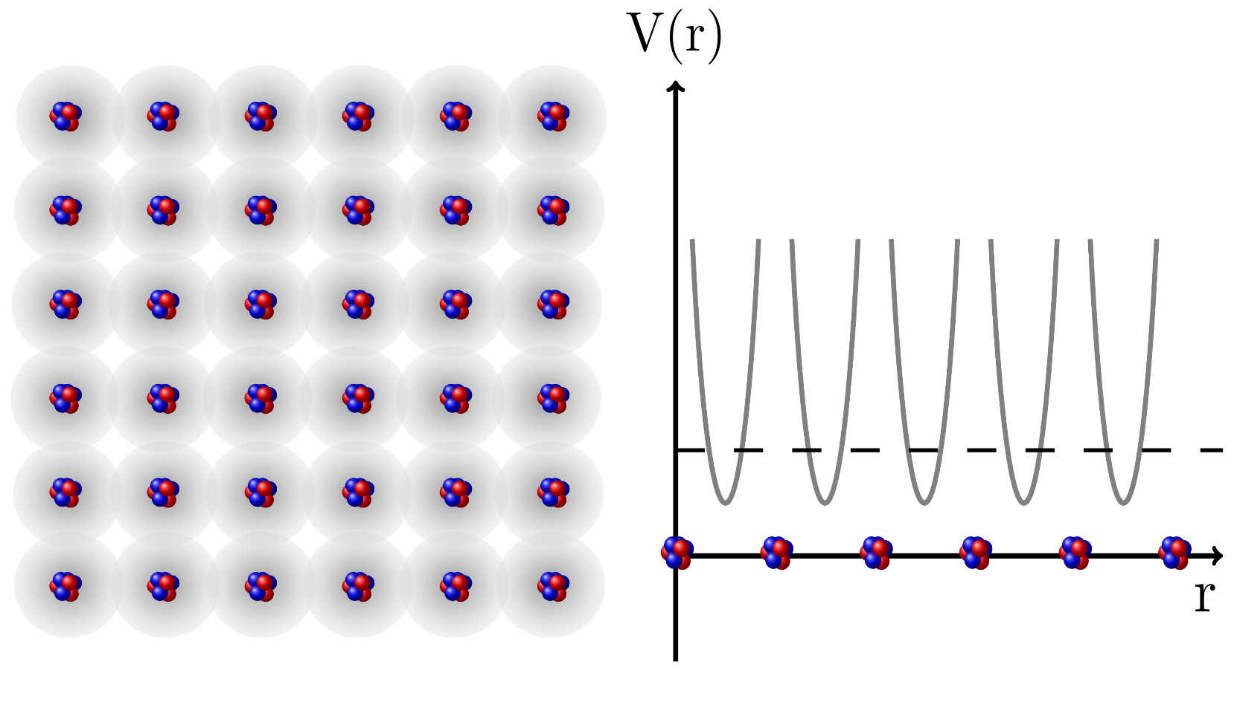
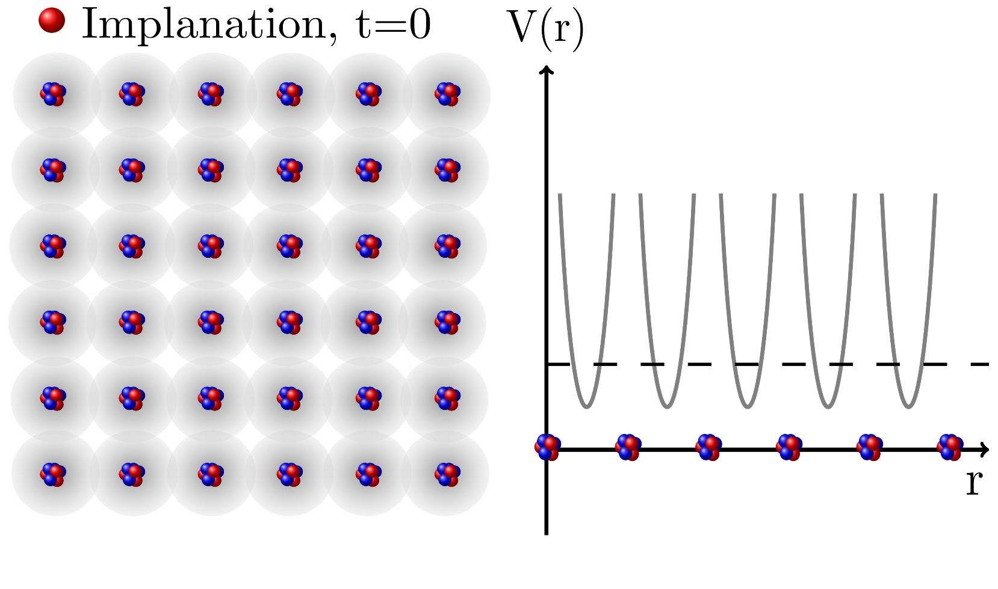
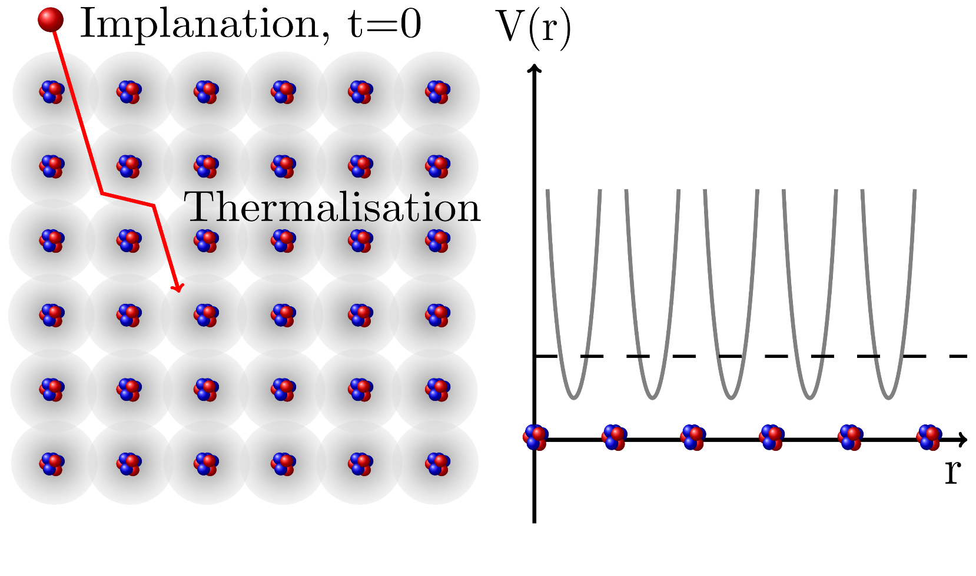
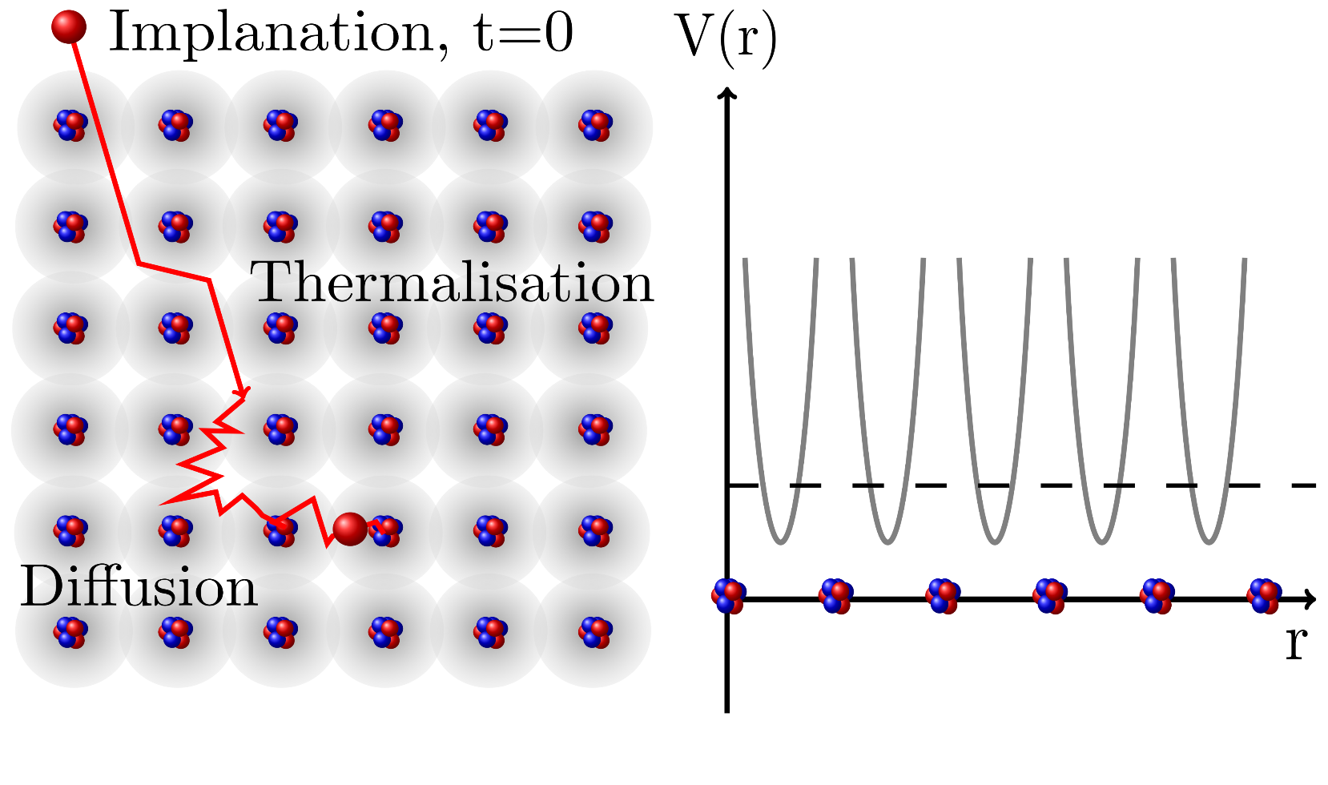
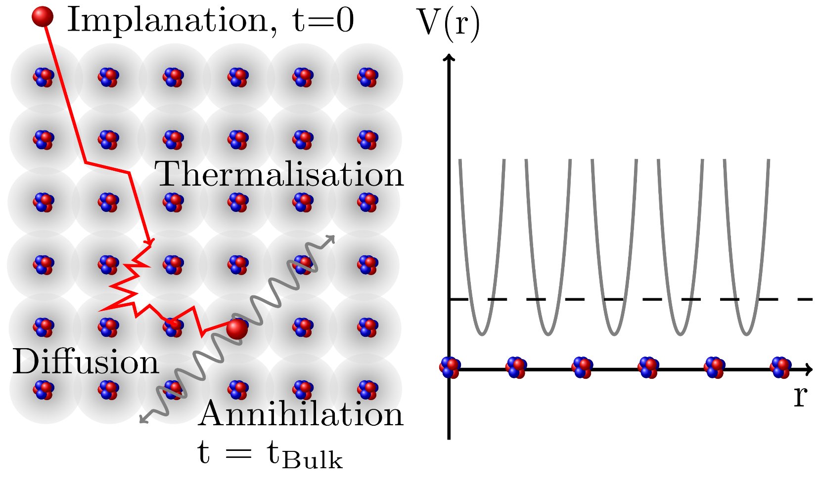
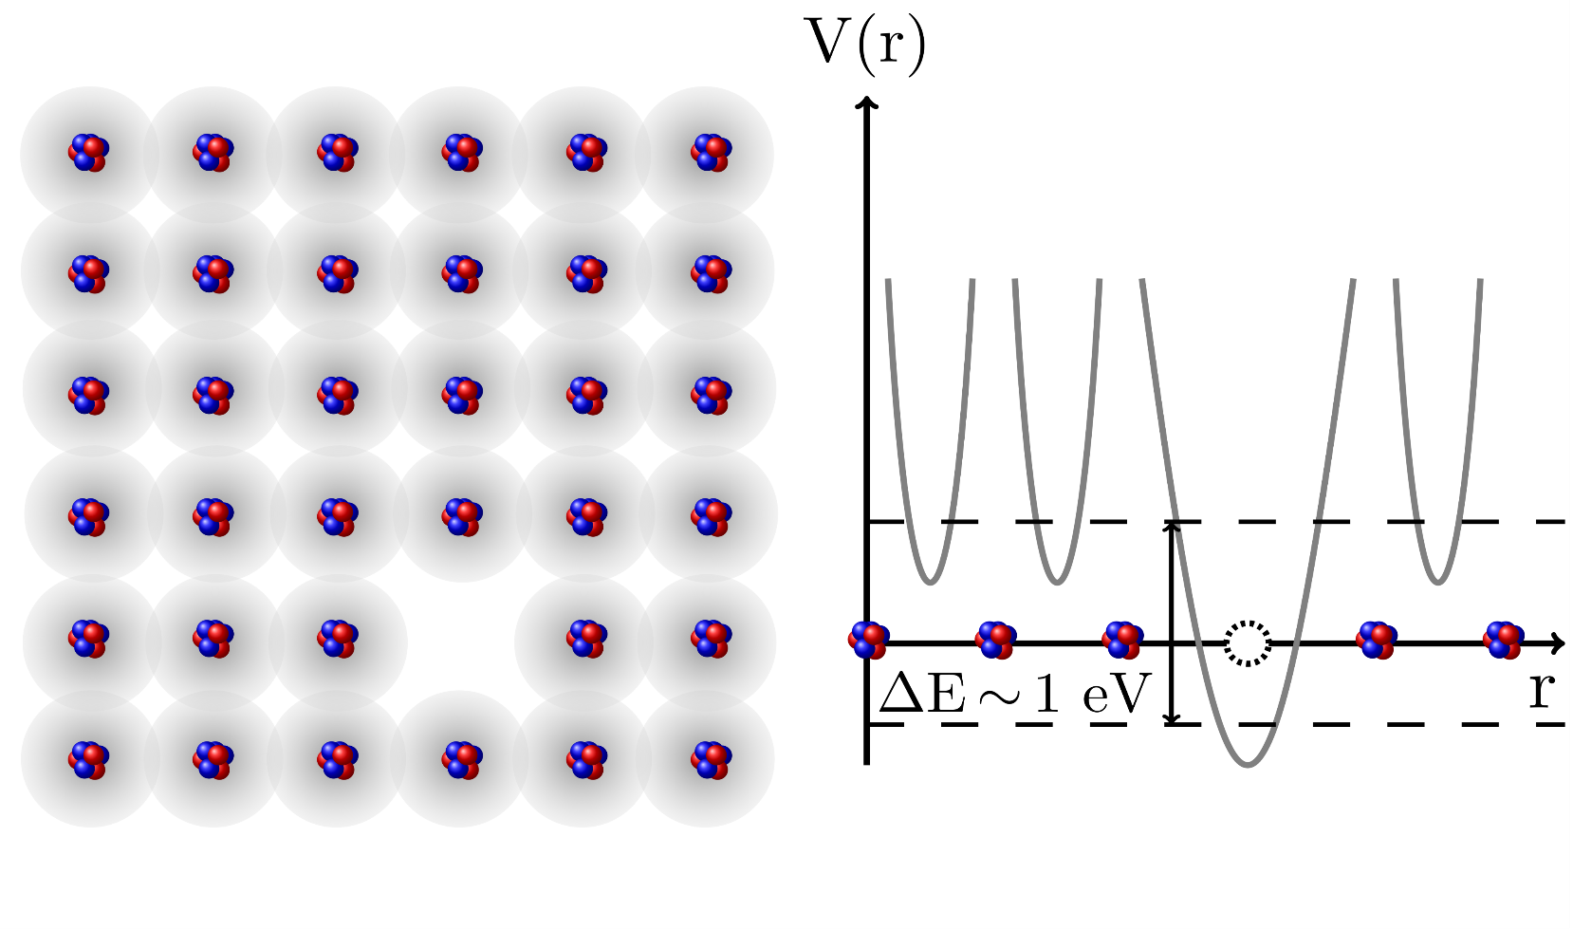
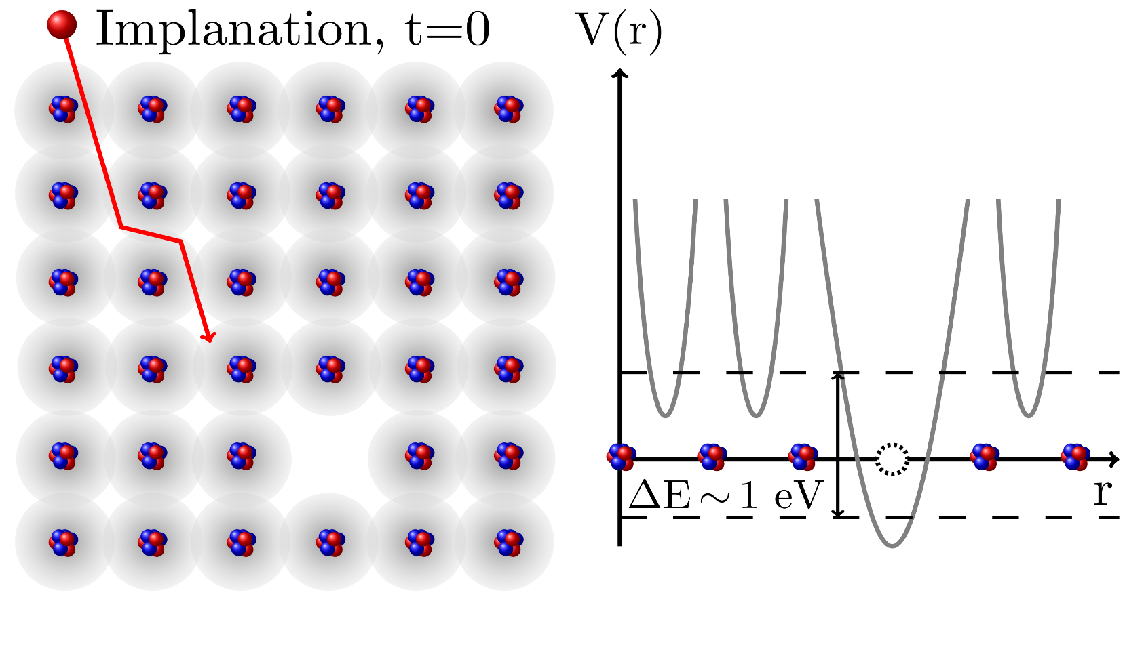
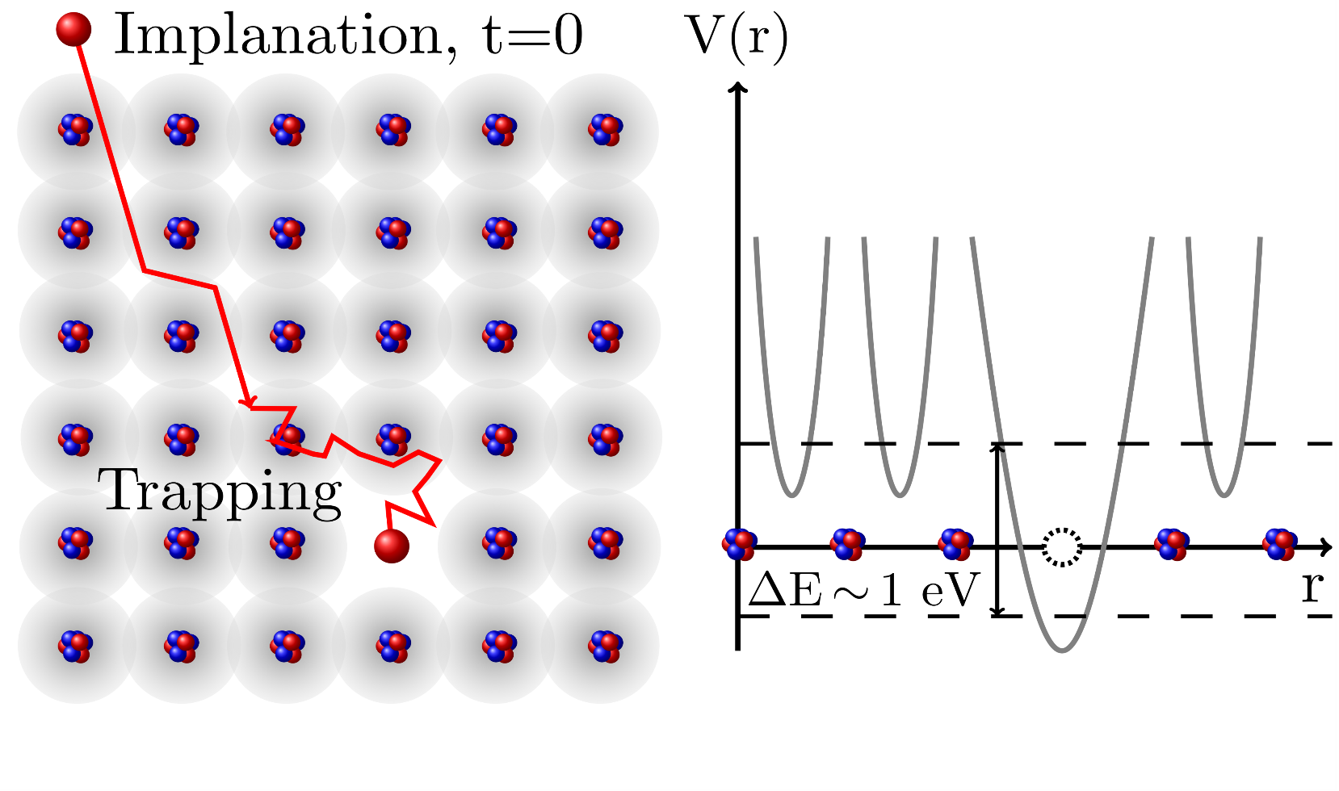
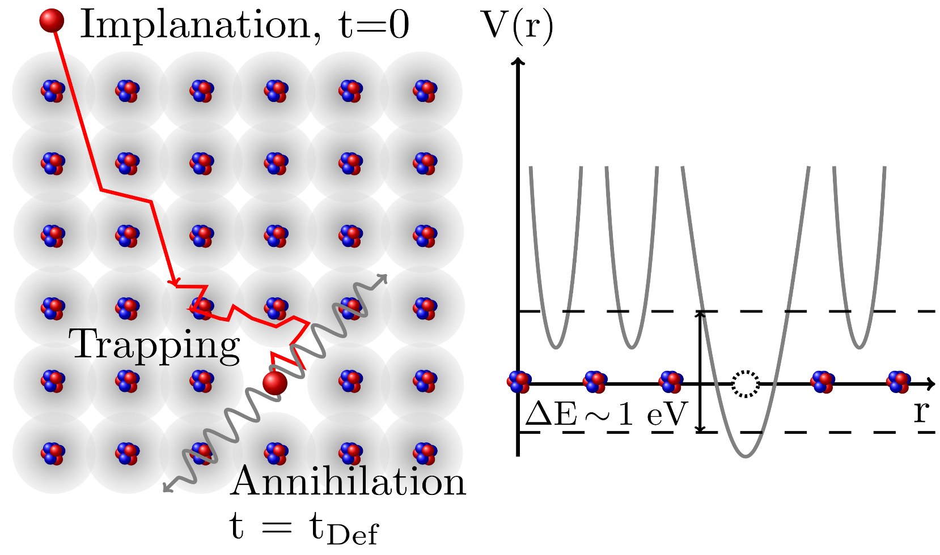

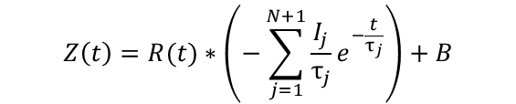
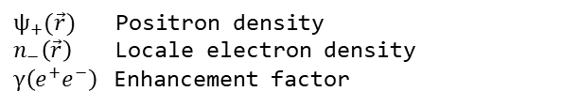


Positron Annihilation Lifetime Spectroscopy (PALS)
Events per channel
Time [ns]
The standard trapping model :
Positron-Electron annihilation:
Thermalisation >5 ps (Metal)
Mean bulk lifetime τ ~100 ps (Metal)
Mean defect lifetime, elongated due to lower electron density.
I
τ
N
R(t)
B
*
Intensity
Mean positron lifetime
Number of defects
Resolution function
Background
Convolution
$$e^{−}e^{+}→2γ$$
$$Z\left(t\right)=R(t)∗\left(−\sum_{j=1}^{N+1}{\frac{I_{j}}{τ_{j}}}e^{−\frac{t}{τ_{j}}}\right)+B$$
Calculation of mean positron lifetimes with Density Functional Theory (DFT)
$$\frac{1}{\text{τ}}= πr_{0}^{2}c \int{{|ψ}_{+}\left(\vec{r}\right)|2n_{−}(\vec{r})γ(e^{+}e^{−})ⅆ^{3}r}$$
$ψ_{+}(\vec{r})$ Positron density
$n_{−}\left(\vec{r}\right)$ Locale electron density
$γ\left(e^{+}e^{−}\right)$ Enhancement factor
(2016)
- Positron lifetimes are typical for the material and defect type -
4
Notes:
Convolution faltung

Slide 5
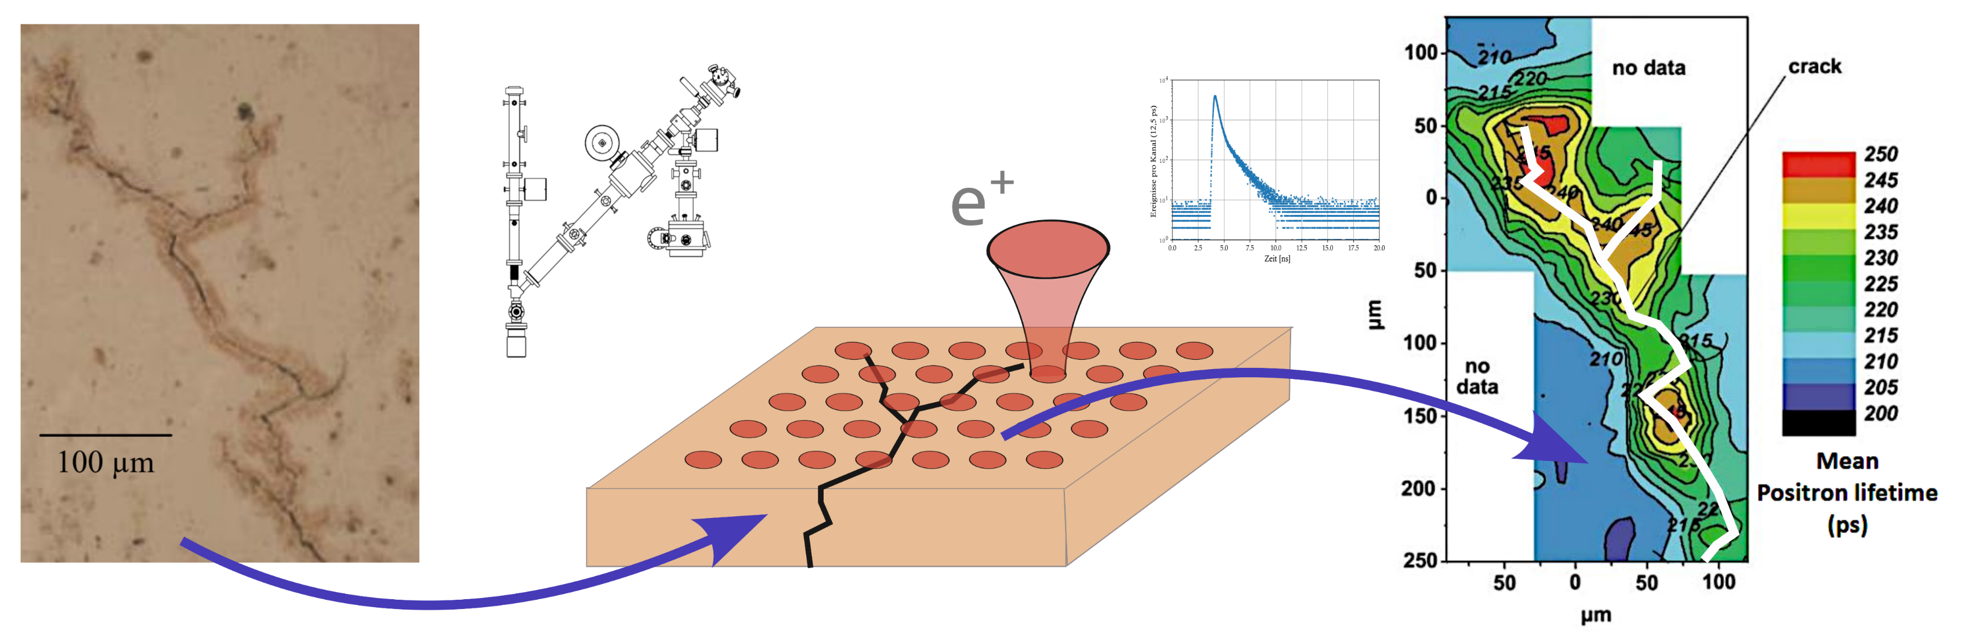
Position Resolved Positron Lifetime Measurements
Inhomogeneous distribution of defects
Pulsed and focused positron beam with variable energy
3D defect spectroscopy of
inhomogeneous samples
[Egger et al., Applied Surface Science 2002]
Fatigue crack in cooper sample
Bulk lifetime 100..120 ps
Typical defect lifetimes of 200...500 ps
Scanning area 1x1 mm²
10 000 individual spectra with ~10 million events each
High count rate > 1 000 cps
Spatial resolution < 1 µm
Time resolution < 250 ps
5
Notes:
ÜBERGANG: kann ich damit ortsaufgelöste PALS Messungen machen.
Aus Lebensdauerspektren Häufigkeit und mittlere Lebensdauer, damit Defekttyp
ÜBERGANG: Ein Gerät mit diesen Eigenschaften gab es schon mal… das SPM

Slide 6
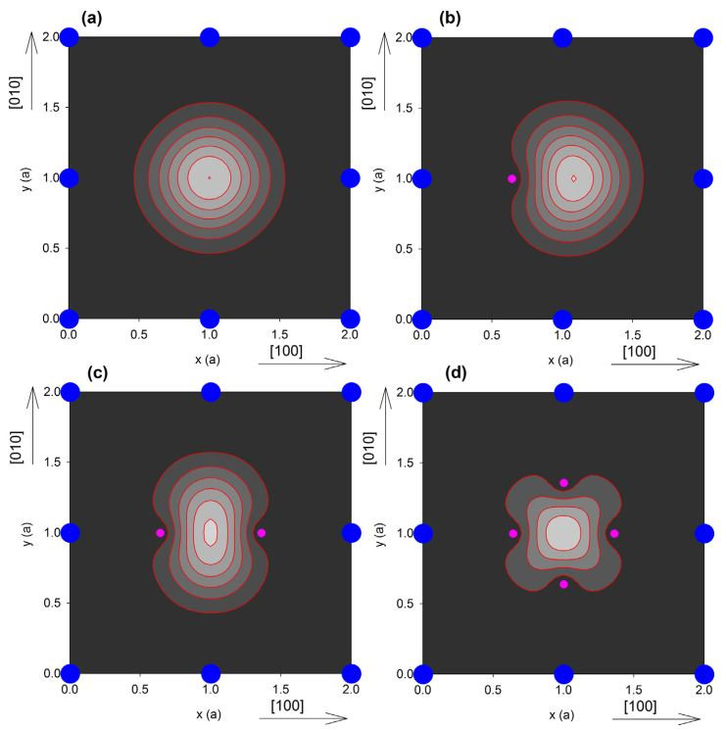
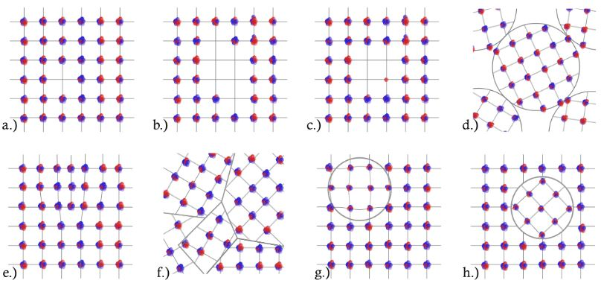
Defect Types (detectable) with PALS
a.) Mono-vacancy
b.) Vacancy-cluster (size)
c.) Vacency-solute complex
d.) Open volume
e.) (Edge)-dislocation
f.) Grain boundaries
g.) Coherent precipitate
h.) Incoherent precipitate
Nb (001), bcc, Mono-vacancy decorated with H
Nb: τ_{n} = 220-(n*20) ps
[J. Čížek, https://doi.org/10.1016/j.jmst.2017.11.050]
Slow - pulsed - monochromatic - micrometer - positron beam with variable energy!

Slide 7
Outline
Position resolved Positron Annihilation Lifetime Spectroscopy (P-PALS)
Defects “seen” by positrons
Positron source NEPOMUC
The Scanning Positron Microscope (SPM)
The positron elevator of the SPM,
(Accelerator with a shunt impedance of 0 Ω)
Research with micrometre positron beams
PALS
Atomic defects
SPM at NEPOMUC
(2016)
7

Slide 8
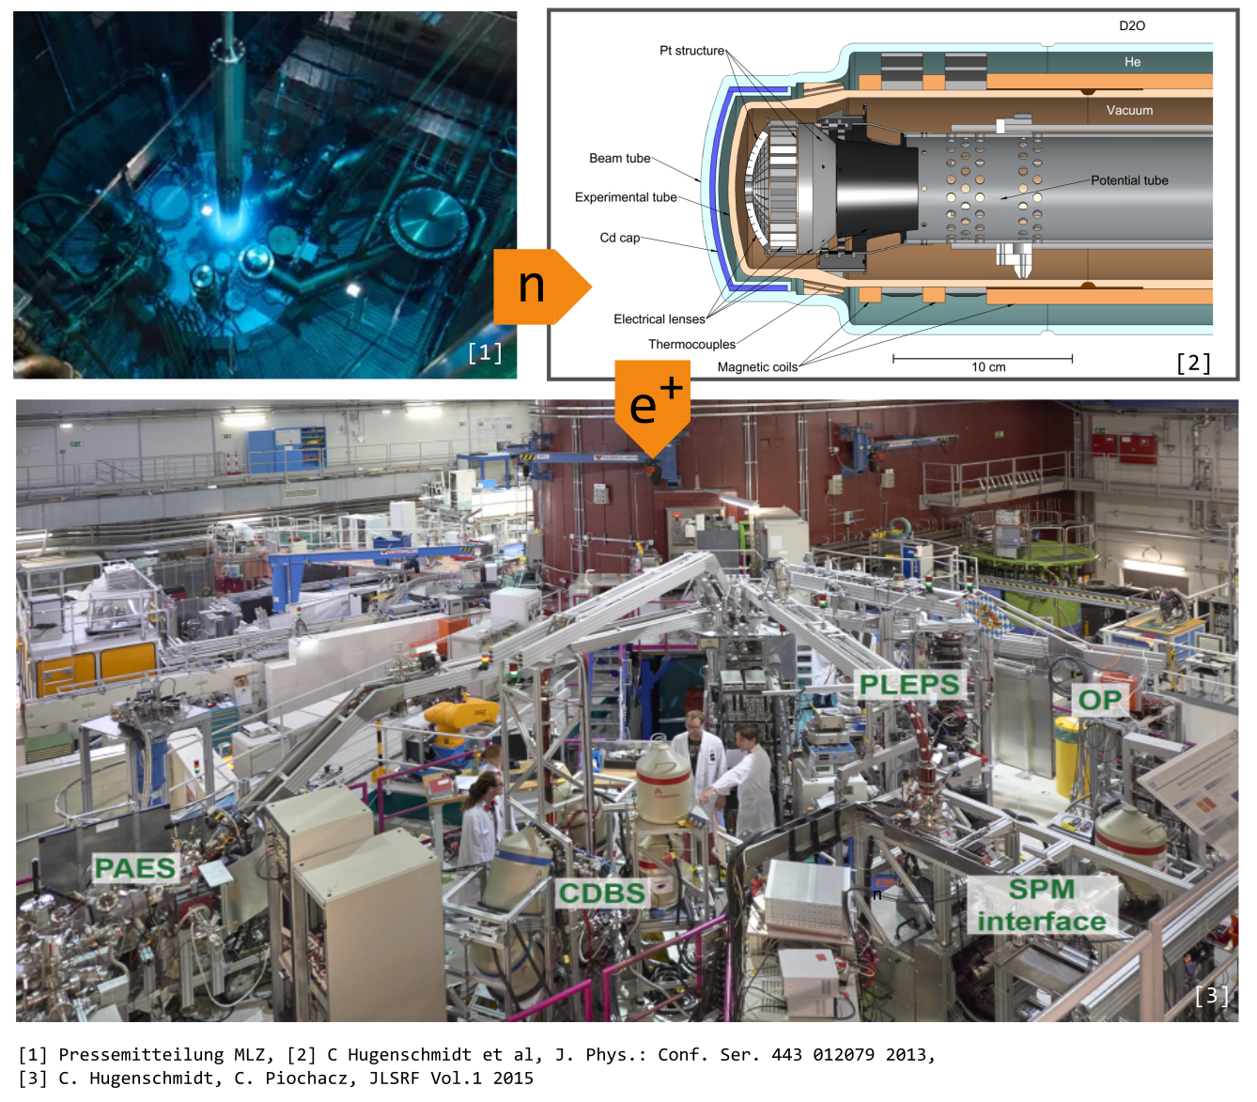
Neutron induced Positron Source Munich (NEPOMUC)
Thermalized neutrons n from fission
¹¹³Cd as (n,γ) converter, up to 9 MeV
Pair production in Pt structure
Magnetic guided positron beam
NEPOMUC (Remoderated)
Modulation | DC
I [e⁺/s] | 5.0 10⁷
d [mm] | 1.85
B [e⁺/(mm² eV s)] | 1.8 10⁷
[M. Dickmann et al, DOI: 10.12693/APhysPolA.137.149]
8

Slide 9
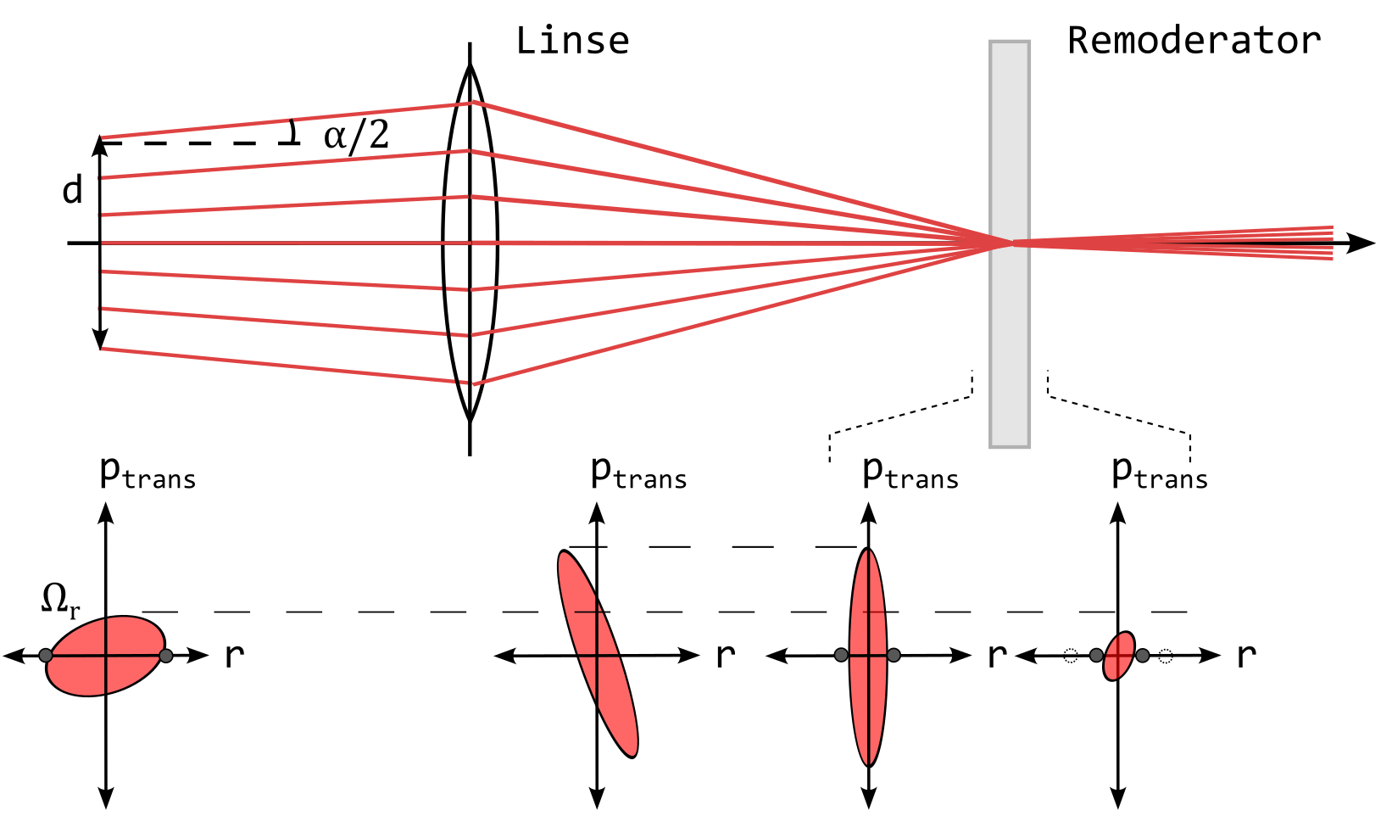
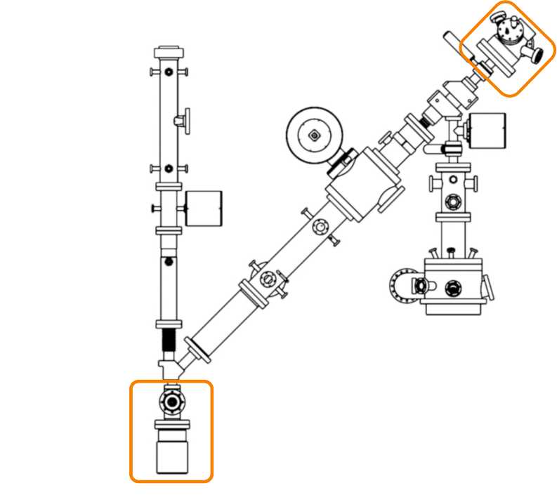


Remoderation to Increase the Beam Quality of NEPOMUC
Beam Brightness B, according to A.P. Mills, is a measure of beam quality:
I Number of positrons
α Opening angle
d Beam diameter
Ω_{r} Transverse phase space
Remoderator: Tungsten (W), -2.7 eV work function
Positron emission:
  Perpendicular to the surface
  Thermal energy distribution 25 meV at 300 K
Reduction of beam diameter and transverse momentum ⇒ increase of phase space density
Loss of 5 keV E_{kin} at each remoderation step
Efficiency maximum 40%
$$B= \frac{I}{α^{2}d^{2}E_{Kin}}= \frac{π^{2}Im_{e}}{4{\text{Ω}}_{r}}$$
$$\frac{B_{2}}{B_{1}}=\frac{I_{2}}{I_{1}} {\left(\frac{d_{1}}{d_{2}}\right)}^{2}≤1000$$
Remoderators
9

Slide 10
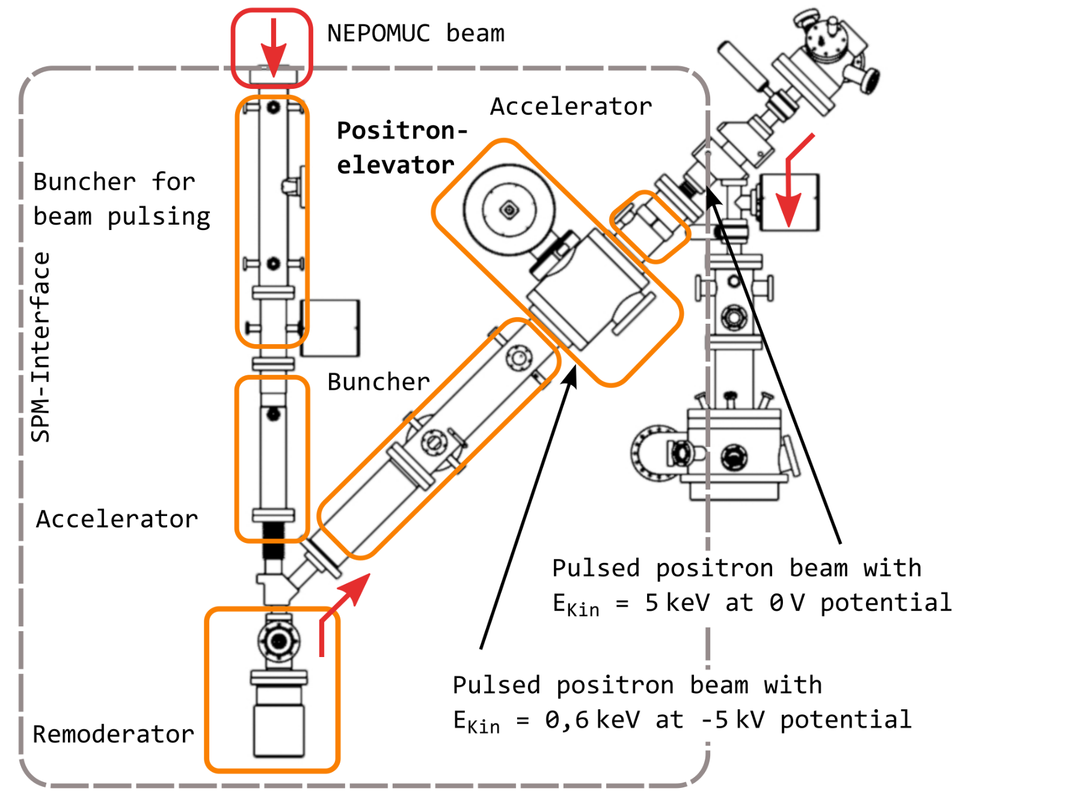
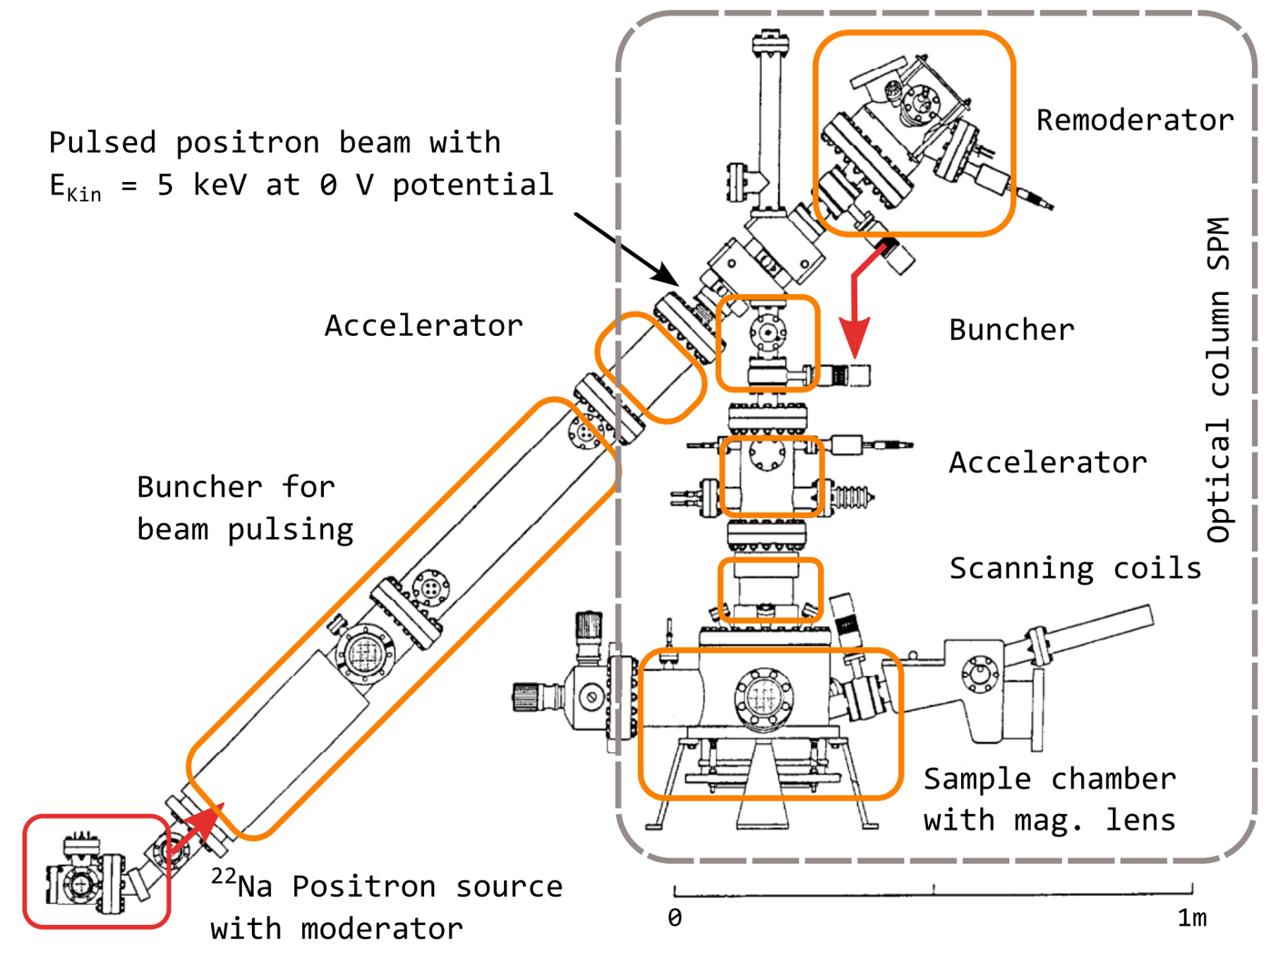
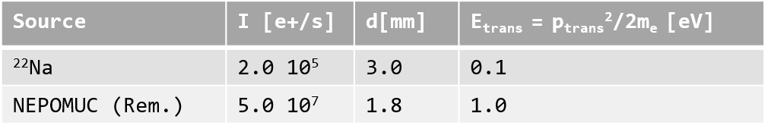
Scanning Positron Microscope (SPM) from Laboratory to NEPOMUC
SPM laboratory setup with ²²Na source
SPM interface and SPM at NEPOMUC, FRM II
Moving the
SPM to
NEPOMUC
SPM-Interface enhances brightness by remoderation, pulses the DC NEPOMUC beam and raises the potential energy to the needs of the SPM.
10
Source | I [e+/s] | d[mm] | E_{trans} = p_{trans}²/2m_{e} [eV]
²²Na | 2.0 10⁵ | 3.0 | 0.1
NEPOMUC (Rem.) | 5.0 10⁷ | 1.8 | 1.0
Notes:
Aufbau SPM Erklären (Wichtig Strahleigenschaft an Übergabe Punkt)
Messungen dauern mehrere Wochen -> ab an NEPOMUC
Intensität 2 Größenordnungen besser, aber Öffnungswinkel größer -> Zusätzlicher Remoderator
Aufzug+ Beschleuniger für gleiche Strahleigenschaften an Übergabe Punkt
SPM ein Instrument an der Positronenquelle NEPOMUC

Slide 11
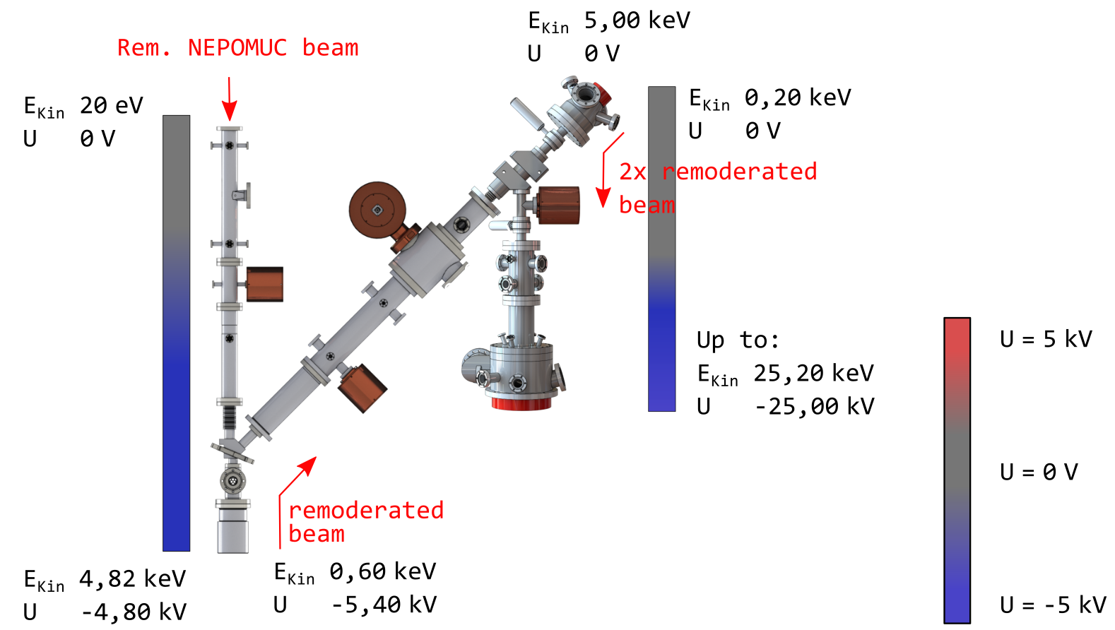
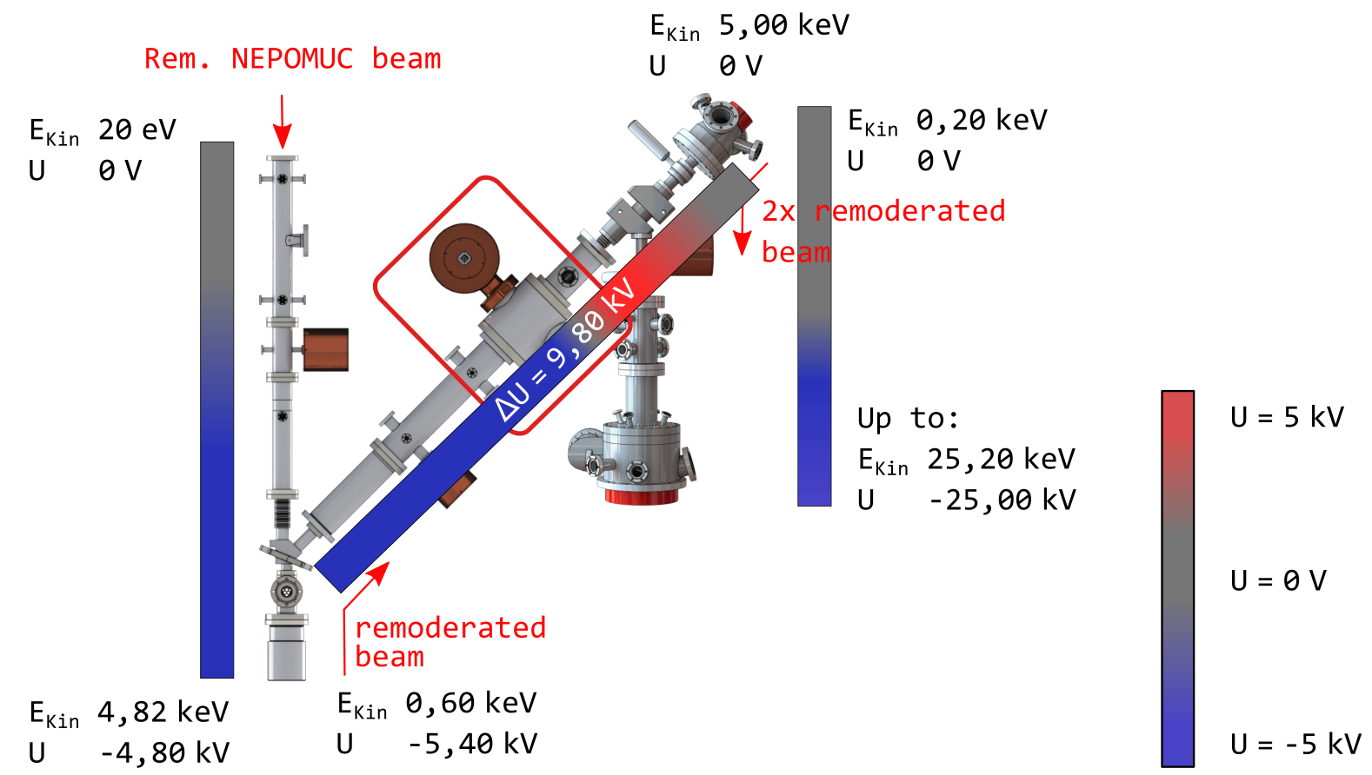
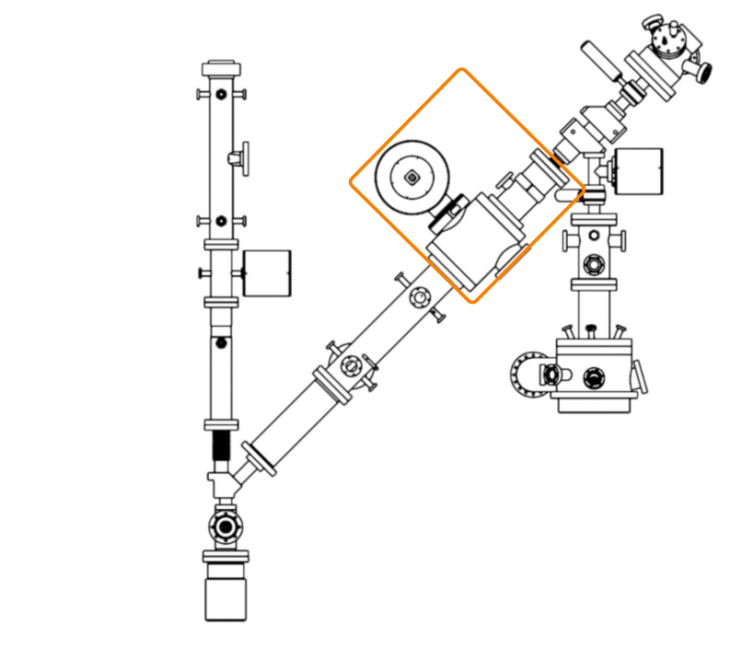
Electric potential at the SPM/SPM-Interface
SPM-Interface SPM
Increase in beam energy by raising the potential, ΔU ~ 10 kV
Positron injection using a static accelerator preserves the beam characteristics, brilliance, and time structure
Requires a stable sinusoidal signal with an amplitude of 10 kV_{pp} at 50 MHz
Positronelevator &
static accelerator
11
Notes:
Bild unten, Wir haben jetzt einen gepulsten Strahl hoher Brillanz, aber noch nicht die benötige potenzielle und kinetische Energie
Optimale Effizienz mit Wolfram Remoderator in Reflexion bei 5 keV kinetischer Energie.
Energieerhöhung durch Erhöhung des umgebenden Potenzials
ÜBERGANG: Erhalt der Strahleigenschaften nur mit absolut stabilem 50 MHz 10 kV Sinussignal

Slide 12
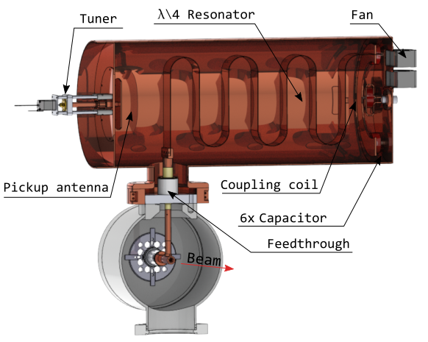
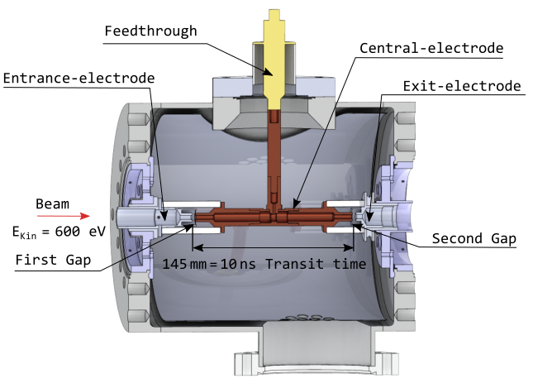
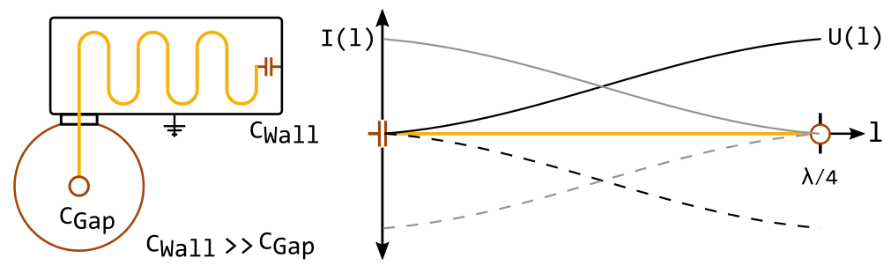
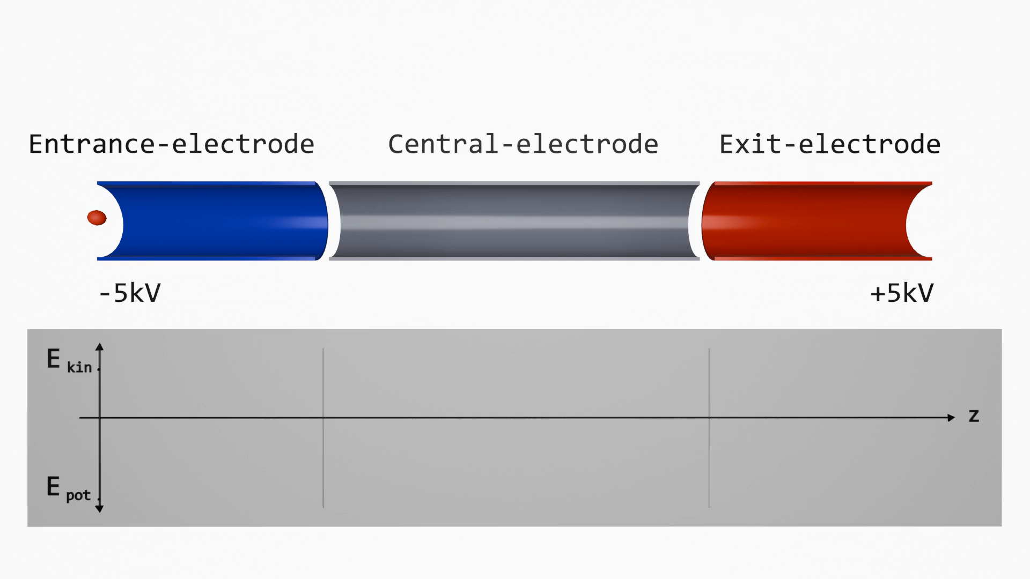
The Positron Elevator: Compact design resonator with high Q
Step in impedance reflects power
At f_{res} = 50 MHz λ/4 is 1.5 m
Resonator amplitude:
U(t)= 10 kV_{PP} sin(2π 50 MHz t)
Q₀ = 1470, Power 56 W, U_{PP} = 10 170 V
Control system:
f_{res} = 50.007 ±0.03%, U = 10 170 V ±0.4%
12
Notes:
Aufbau innen, Elektroden, kleine Durchmesser
Erzeugt wird das Signal durch einen externen Resonator hoher Güte benötigt, schwierig bei 50 MHz.
Resonatorband mit lamda viertel, Einkopplung, Pickup (Wichtig für Messungen), Motor mit Platte zum abstimmen der Resonanzfrequenz
Funktion wie Leiter mit sprung in der Impedanz, die Leistung reflektiert. Glas zeigen
U(l) immer ein Spannungsbauch am Ende
Kenngrößen
Funktion Video. Wie Buncher aber Ein/Ausgang auf unterschiedlichem Potenzial
ÜBERGANG: Problem beim erreichend er Benötigten Amplitude

Slide 13
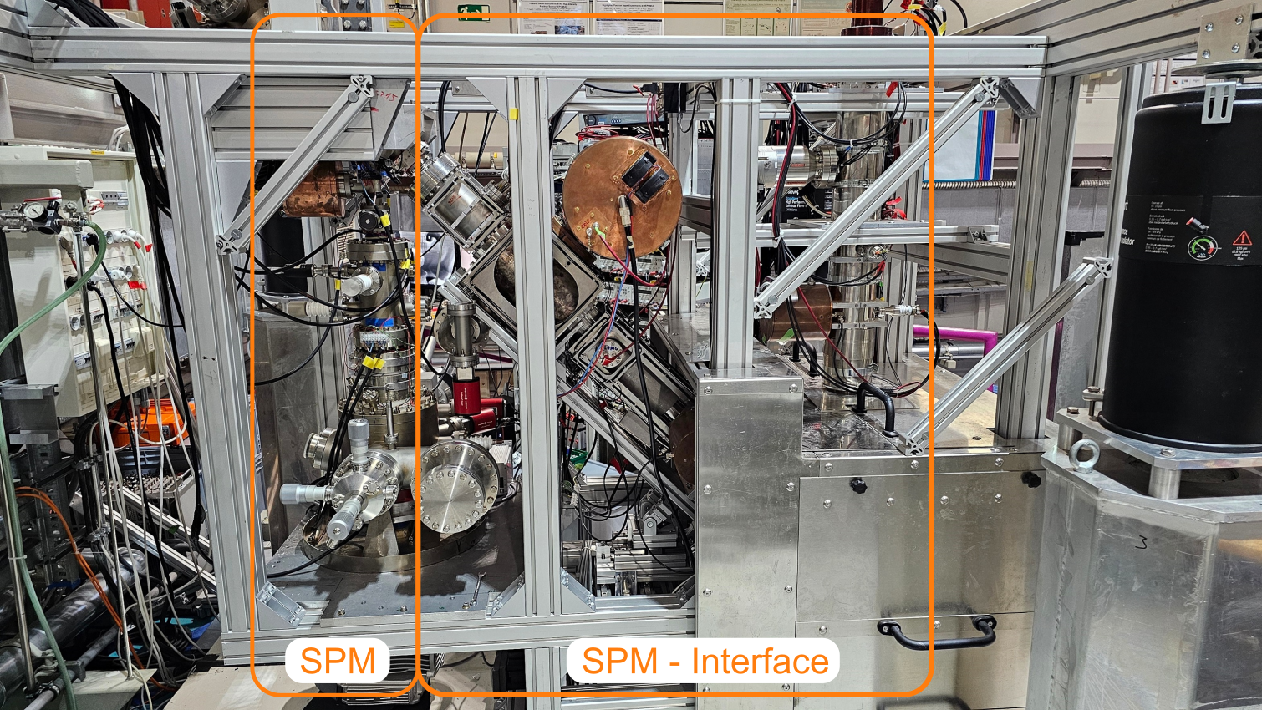
The SPM-Interface and the SPM at NEPOMUC
Multiple steps of pulsing, copping and remoderation are needed to prepare a monochromatic pulsed positron micro beam for P-PALS at the SPM.
13

Slide 14
Outline
Position resolved Positron Annihilation Lifetime Spectroscopy (P-PALS)
Defects “seen” by positrons
Positron source NEPOMUC
The Scanning Positron Microscope (SPM)
The positron elevator of the SPM,
(Accelerator with a shunt impedance of 0 Ω)
Research with micrometre positron beams
PALS
Atomic defects
SPM at NEPOMUC
(2016)
14

Slide 15
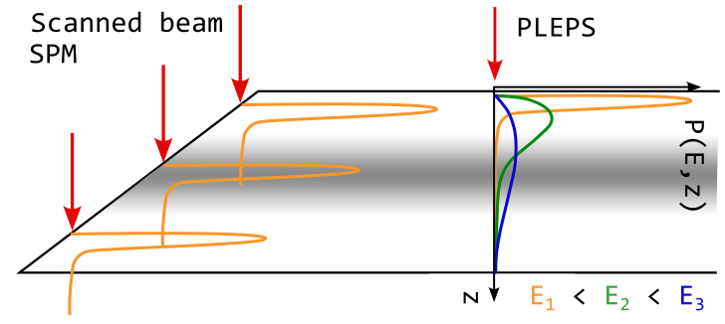
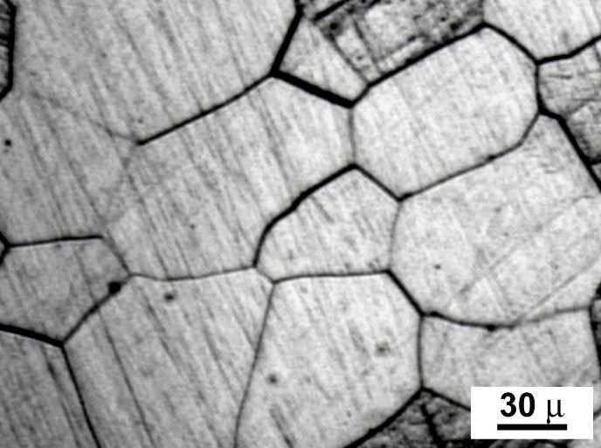
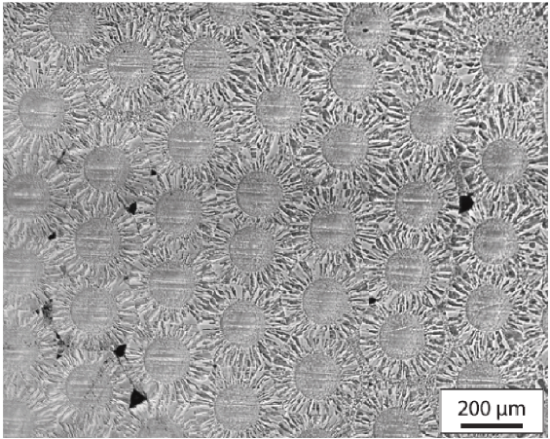
Future Applications for Fusion Materials
  Extended depth profiles
  With constant beam energy
  Constant information dept
  Measurements in the ambience of grain boundaries
  Single-grain studies
  Small sample sizes
Grain sizes of W influence radiation defect effects
Position resolved PALS offers a understanding of defect migration and supports defect engineering
Tungsten composite materials (W_{f}/W)
Multi-material 3D printing (W/Cu)
  Test of inhomogeneous samples
[1] A. Kärcher et al. Deuterium retention in tungsten fiber-reinforced tungsten composites, Nuclear Materials and Energy, 2021
(2016)
[1]
15

Slide 16
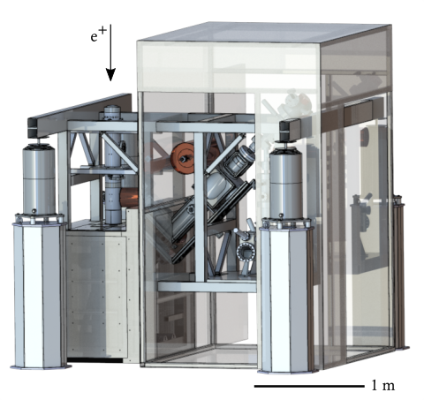
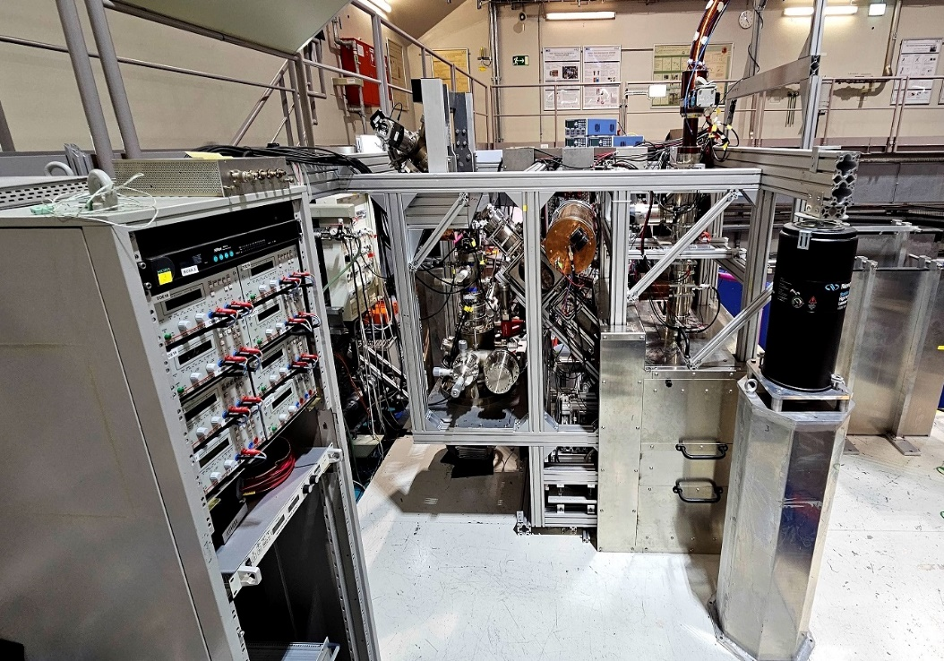
Takeaway Messages
PALS is sensitive to atomic defects, like vacancies, clusters and dislocations
PALS can detect vacancy-H complexes
Position resolved PALS:
  Can help to understand defect migration
  Separation of grain boundary and intergranular defects
  Supports the development of new materials in extreme conditions by defect engineering
The SPM is fully assembled and ready for commissioning measurements
Proposals are welcome!
(2016)
SPM at NEPOMUC, installation completed
16

Slide 17
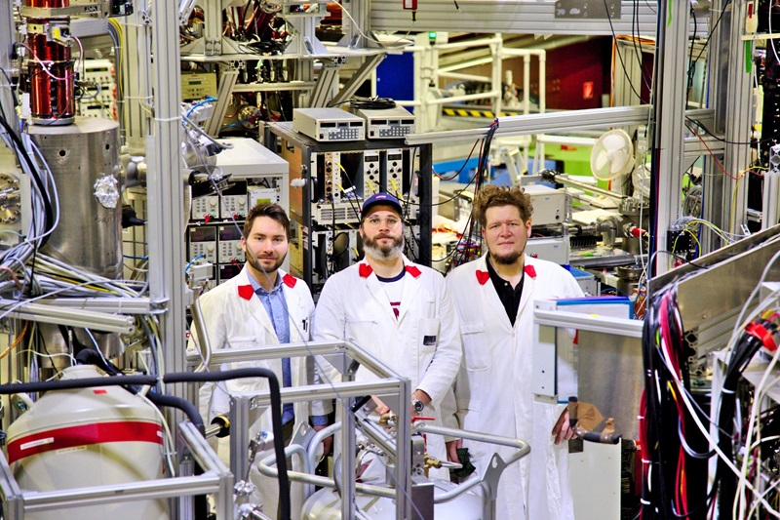


- End -
Universität der Bundeswehr München LRT2:
Prof. Dr. G. Dollinger
Positron group LRT2:
M. Dickmann
W. Egger
R. Helm
G. Kögel
J. Mitteneder
P. Sperr
Do not miss the SLOPOS 17
in Germany, September 2026
https://www.unibw.de/slopos17
Founded by the German BNFTR project
(2016)
17

Slide 18
Some more slides…

Slide 19
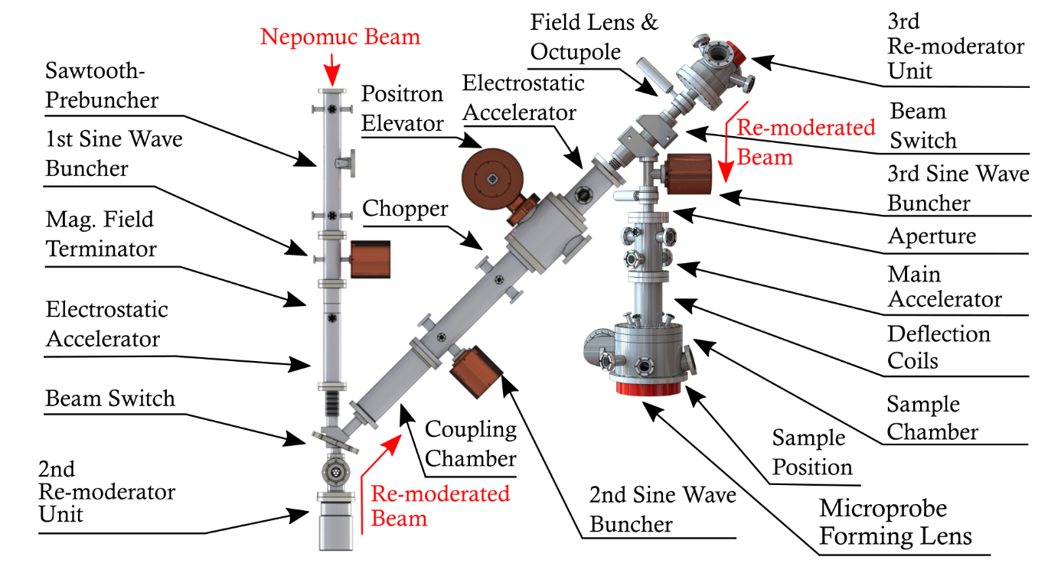
The SPM-Interface and the SPM at NEPOMUC
SPM-Interface SPM
Multiple steps of pulsing, copping and beam cooling (remoderation) are needed to prepare a monochromatic pulsed positron micro beam.
19

Slide 20
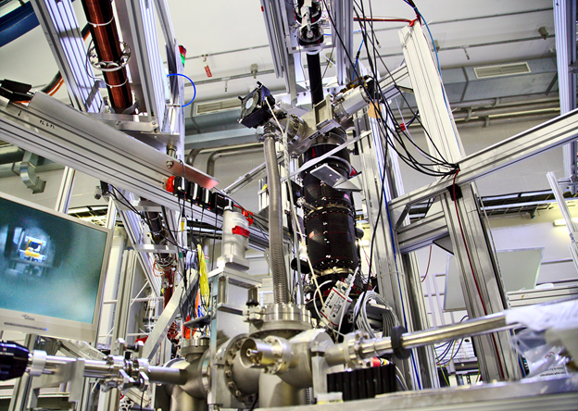

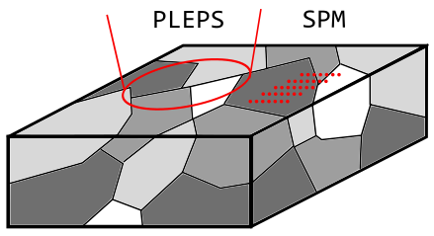
PLEPS and SPM at NEPOMC
PLEPS:
Pulsed Low Energy Positron System
SPM:
Scanning Positron Microscope
Countrate : 6⋅10^3 e⁺/s
Time resolution : 180 ps
Beam spot size : ~1 mm
Beam energy : 0.5-20 keV
Peak to Background : 1/100 000
Countrate : 3⋅10^3 e⁺/s
Time resolution : 250 ps
Beam spot size : > 1 µm
Beam energy : 0.5-25 keV
Peak to Background : 1/10 000
Two unique instruments operated
by the UniBwM
in cooperation with the MLZ
High sample throughput
Stable operation
Very good time resolution
Artefact-free spectra
Depth profiles of layered systems
Worldwide unique instrument
Characterization of the 3D-defect structure
Resolving defect structure at the boundaries and interfaces of mixed-matrix materials
20
Notes:
Aufbau SPM Erklären (Wichtig Strahleigenschaft an Übergabe Punkt)
Messungen dauern mehrere Wochen -> ab an NEPOMUC
Intensität 2 Größenordnungen besser, aber Öffnungswinkel größer -> Zusätzlicher Remoderator
Aufzug+ Beschleuniger für gleiche Strahleigenschaften an Übergabe Punkt
SPM ein Instrument an der Positronenquelle NEPOMUC

Slide 21
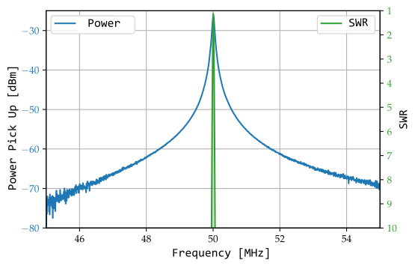
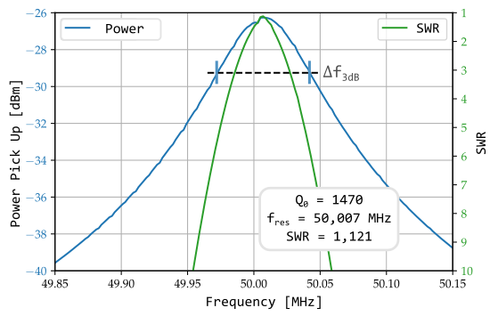
Resonator Test Measurement in the Laboratory
f_{res} = 50,007 MHz, Δf_{3dB} = 70 kHz
Q₀ = 1470±25
With 56 W electric power, U_{PP} = 10 170 V
SWR = 1,121 (P_{R} = 0,3% P_{V})
Changing the amplitude worsens the time and spatial resolution
⇒ Control required for thermal stability
21

Slide 22
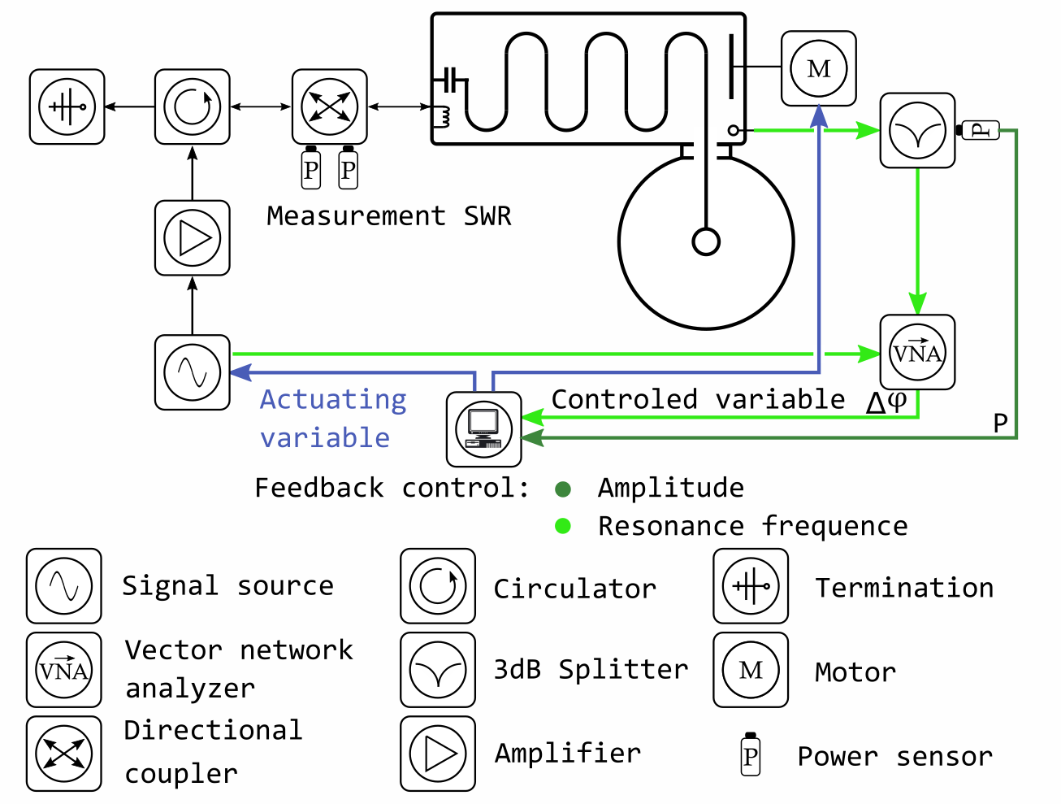
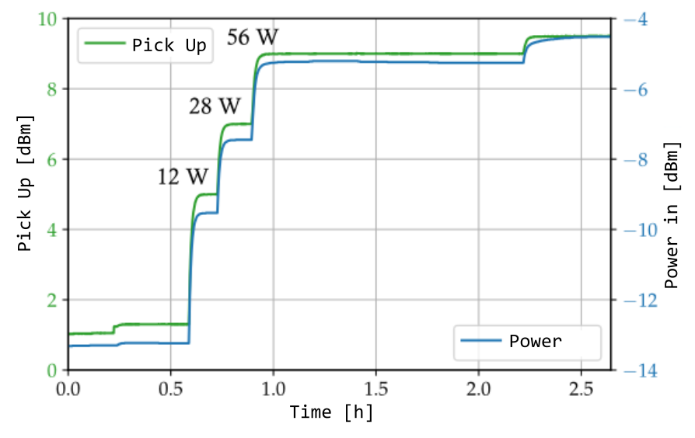
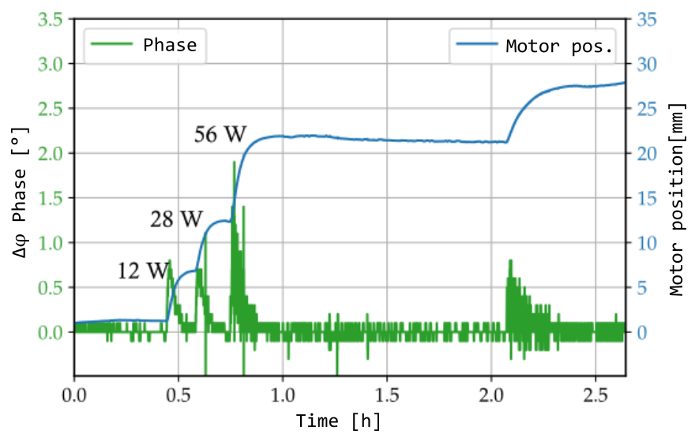
Resonator test Measurement in the Laboratory
Motor position 1,7 kHz/mm
Phase sensitivity 1,5°/kHz
Resonance frequency:
50,007 MHz, ±0,03 % (±130 Hz)
Total amplitude stability:
10 170 V, ±0,4 % (±40 V)
Phase sensitivity 1,5°/kHz
22
Notes:
Resonazkurve, Pickupsignal und SWR, keine Nebenresonanzen o.ä.
Genauer hinschauen, bestimmen von Q
Erfolg mit Q und 56 Watt Amplitude von 10 kV erreicht -> Erwärmung Regelung nötig für stabiles Signal
Zwei Regelkreisläufe für Amplitude und Resonanzfrequenz, Erklärung Aufbau
Amplitude: Regelung über Signalquelle
Frequenz: Vergleich Phasenlage Siganlquelle und Pickupsignal
Hoch Stabiles Signal ausreichend für Positronenaufzug
Überleitung:

Slide 23
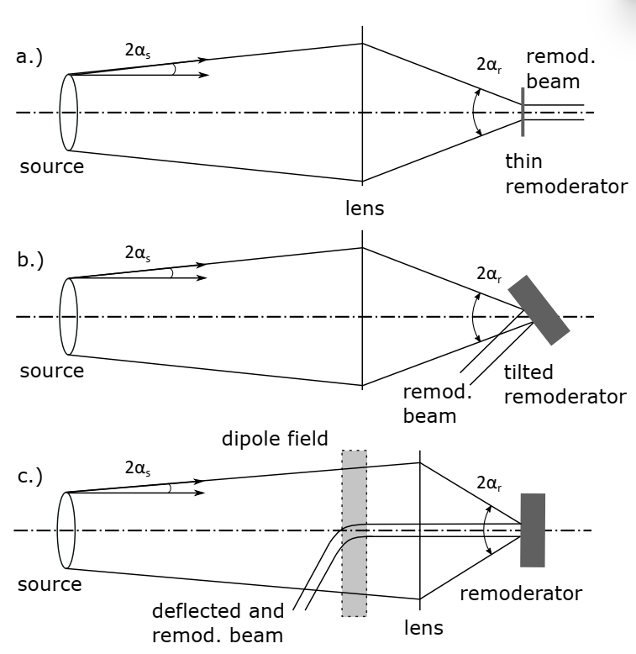

Monochromatic beam by re-moderation
a.) Remoderation in transmission
    (foil thickness some nm)
b.) Reflection with tilted remoderator
c.) Reflection through the lens. Separation by weak magnetic dipole
    (short focal length, small diameter)
In : 1keV, 10^9 e+/s
Out: 20 eV, 5 10^7 e+/s, ~5%
[A positron remoderator for the high intensity positron source NEPOMUC,
doi.org/10.1016/j.apsusc.2008.05.286.]

Slide 24




NEPOMUC as Source for the SPM
Beam brilliance B as a measure
of beam quality
I Number of positrons
α Opening angle
d Beam diameter
Ω_{r} Transverse phase space
$$B= \frac{I}{α^{2}d^{2}E_{Kin}}= \frac{π^{2}Im_{e}}{4{\text{Ω}}_{r}}$$
NEPOMUC
SPM-Interface
SPM
 | NEPOMUC (rem)
Modulation | DC
I [e⁺/s] | 5.0 10⁷
d [mm] | 1.85
E┴ [eV] | 1.0
B [e⁺/(mm² eV s)] | 1.8 10⁷
${\text{Ω}}_{r}$ [mm² eV m_{e}] | 8.4
 | ²²Na source
Modulation | DC
I [e⁺/s] | 2.0 10⁵
d [mm] | 3
E┴ [eV] | 0.1
B [e⁺/(mm² eV s)] | 4.4 10⁵
${\text{Ω}}_{r}$ [mm² eV m_{e}] | 2.2
M. Dickmann et al, SLOPOS 15,
DOI: 10.12693/APhysPolA.137.149
24

Slide 25


Not so easy trapping model
STM extended by diffusion, Diffusion trapping model (DTM)
Dislocations or grain boundary as closed domain, diffusion
  a.) Defect-rich boundary & defect-free grains
  b.) Defect-rich boundary & one intergranular defect
  c.) Precipitate in matrix
  d.) Defect-rich boundary & two intergranular defect
b.) Positron trapping model for point defects and grain boundaries in polycrystalline materials, [2009, doi.org/10.1103/PhysRevB.79.184103]
C.) Diffusion-reaction model for positron trapping and annihilation at spherical extended defects and in precipitate-matrix composites,
[2018, doi.org/10.1103/PhysRevB.97.224108]
d.) Diffusion-reaction model of positron annihilation for complex defect pattern, [2023, DOI 10.1088/1361-648X/ad1279]

Slide 26















Lifetime/Intensity vs. Grain size
$$\overline{τ}$$
ϒ_{d}
$$I_{2}$$
$$I_{1}$$
$$\overline{τ}(C_{1}{=C}_{2}=0)$$
$$I_{GB}$$
$\overline{τ}$ = Mean positron lifetime
C = Def. concentration
$μ$ = spez. trapping rate
L₊ ~100 nm (defect free)
Diffusion-reaction model of positron annihilation for complex defect pattern, [2023, DOI 10.1088/1361-648X/ad1279]
$$τ_{B}=120 ps$$
$$τ_{GB}=τ_{1}=180 ps$$
$$τ_{2}=300 ps$$
$$C_{1}=C_{2}={10}^{−5}$$
$τ_{GB}$: Grain boundary
$τ_{1}$ : Mono-vacancy
$C_{1}$ is ~ 30% over estimated at $r_{0}=1 μm$

