Slide 1





Slow Mono-energetic Positron Beams for Defect Characterization in Material Science
Marcel Dickmann

Slide 2
Content
Principles of Positron (Lifetime) Spectroscopy
Positrons in Matter
Depth-resolved PALS
Pulsed Positron Beam Facilities in Germany
Selection of Investigated Materials using PALS
NV Centers in Diamond
Fusion Materials
Polymers

Slide 3
Content
Principles of Positron (Lifetime) Spectroscopy
Positrons in Matter
Depth-resolved PALS
Pulsed Positron Beam Facilities in Germany
Selection of Investigated Materials using PALS
NV Centers in Diamond
Fusion Materials
Polymers

Slide 4

Implantation, Thermalization, Diffusion, Annihilation
Implantation
Annihilation
Thermalization
Diffusion
$$γ$$

Slide 5
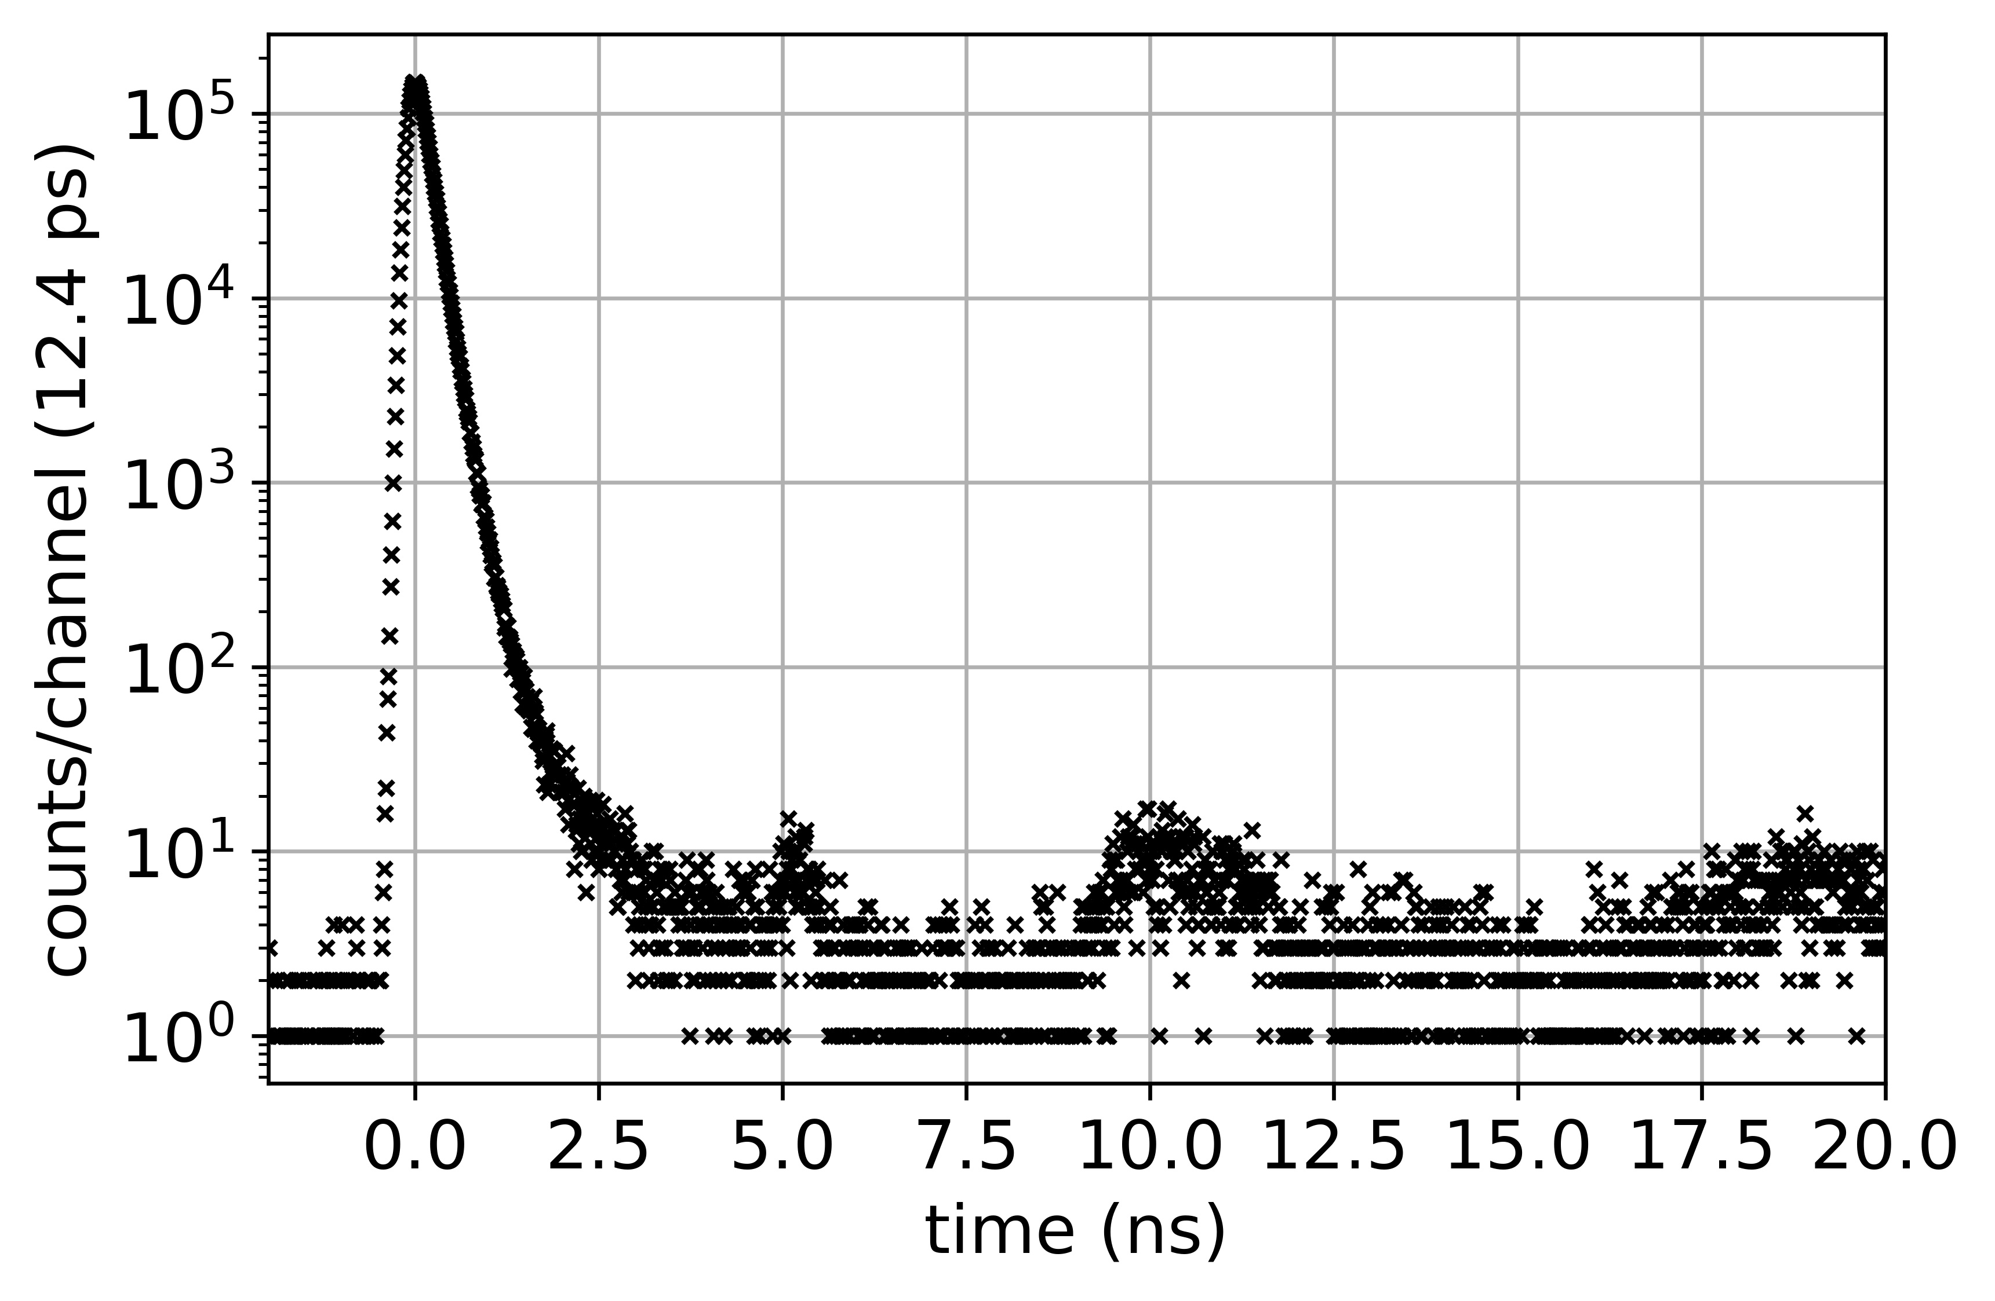
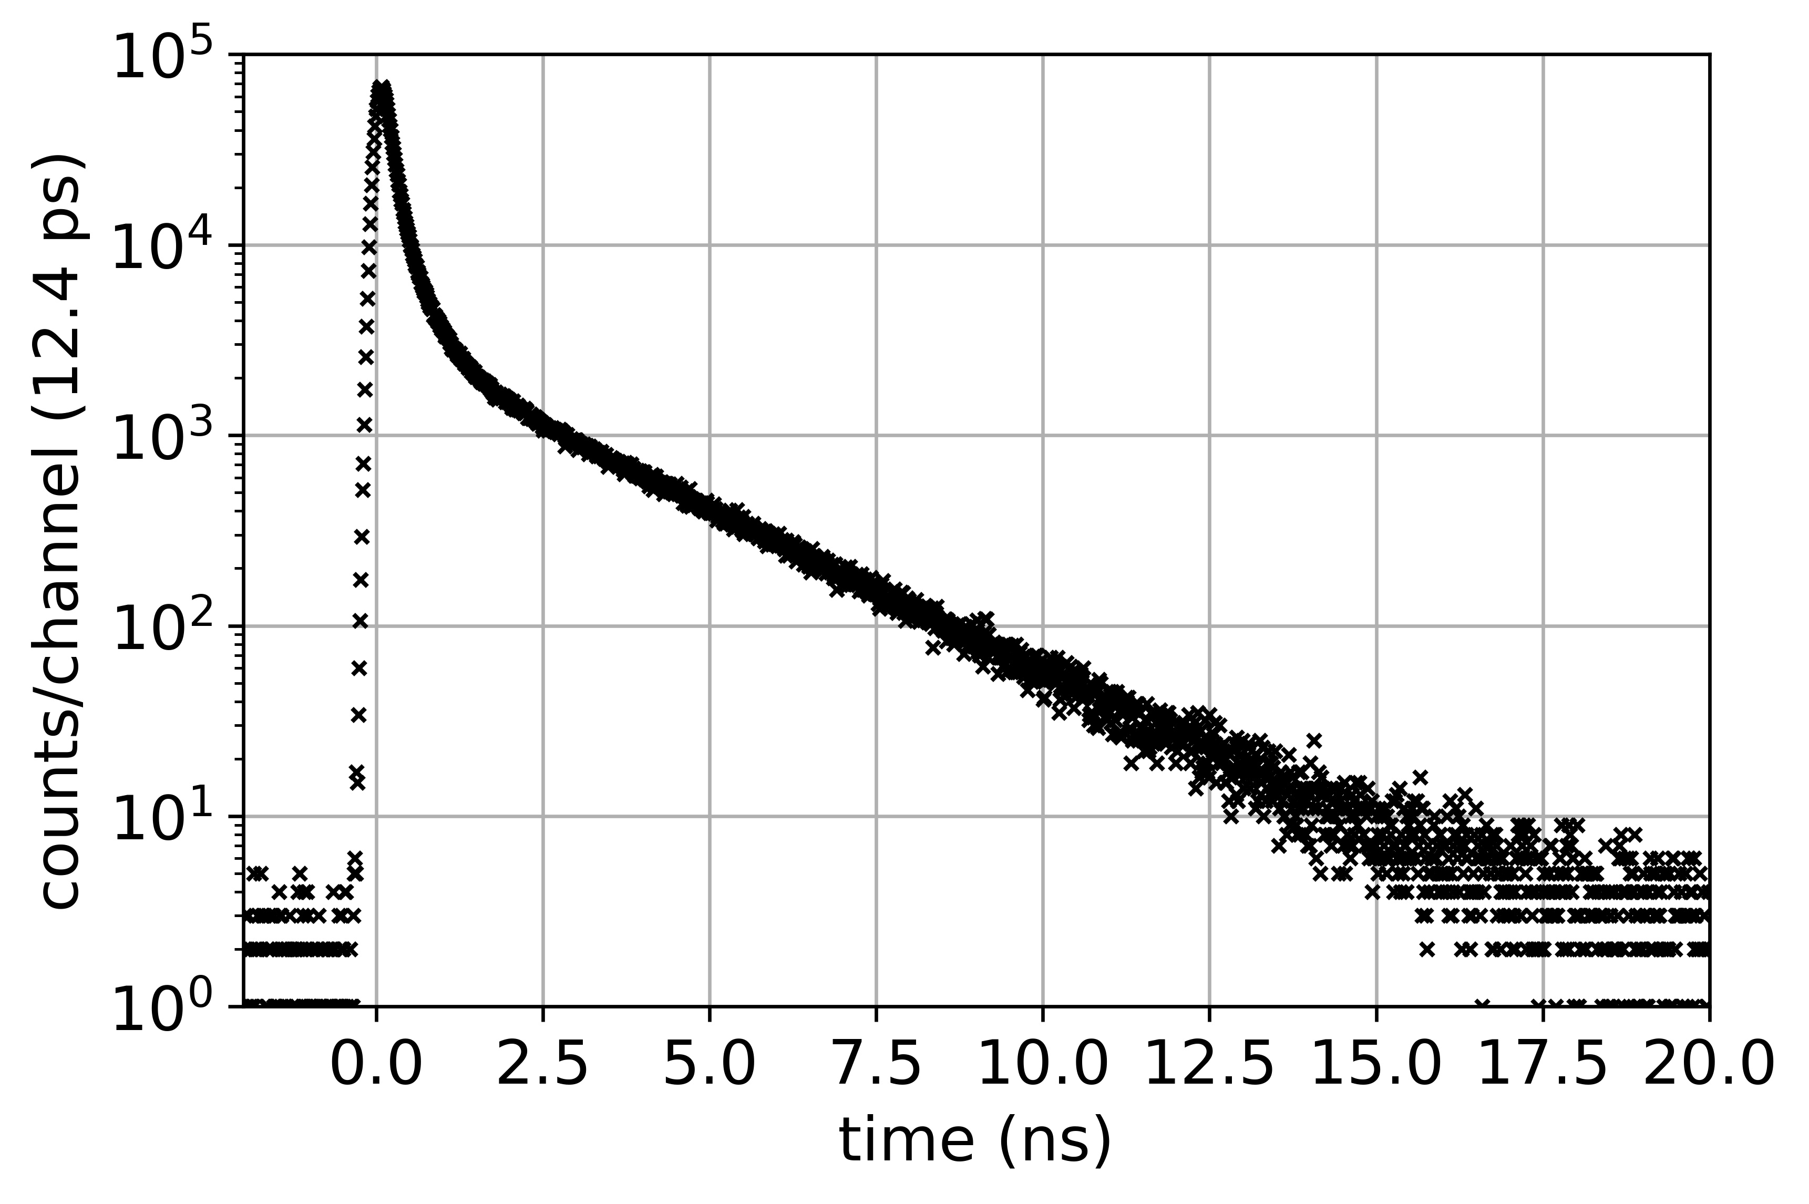

Positron Annihilation Lifetime Spectroscopy (PALS)
Semiconductor (SiC)
START
Polymer (PVA)
STOP
$$γ$$

Slide 6
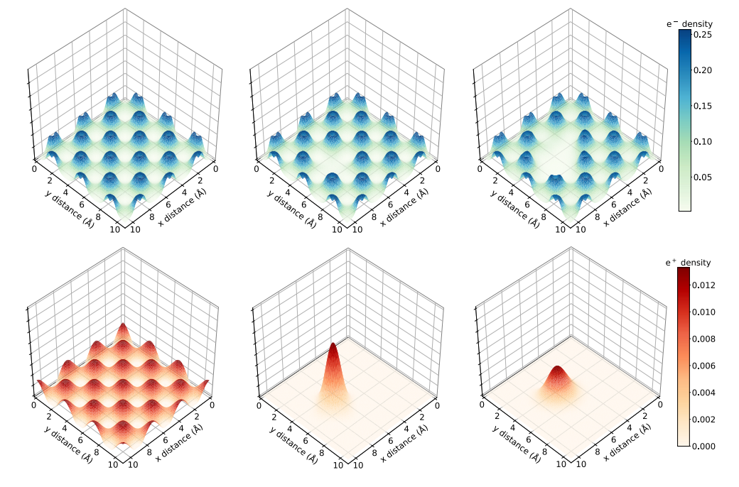
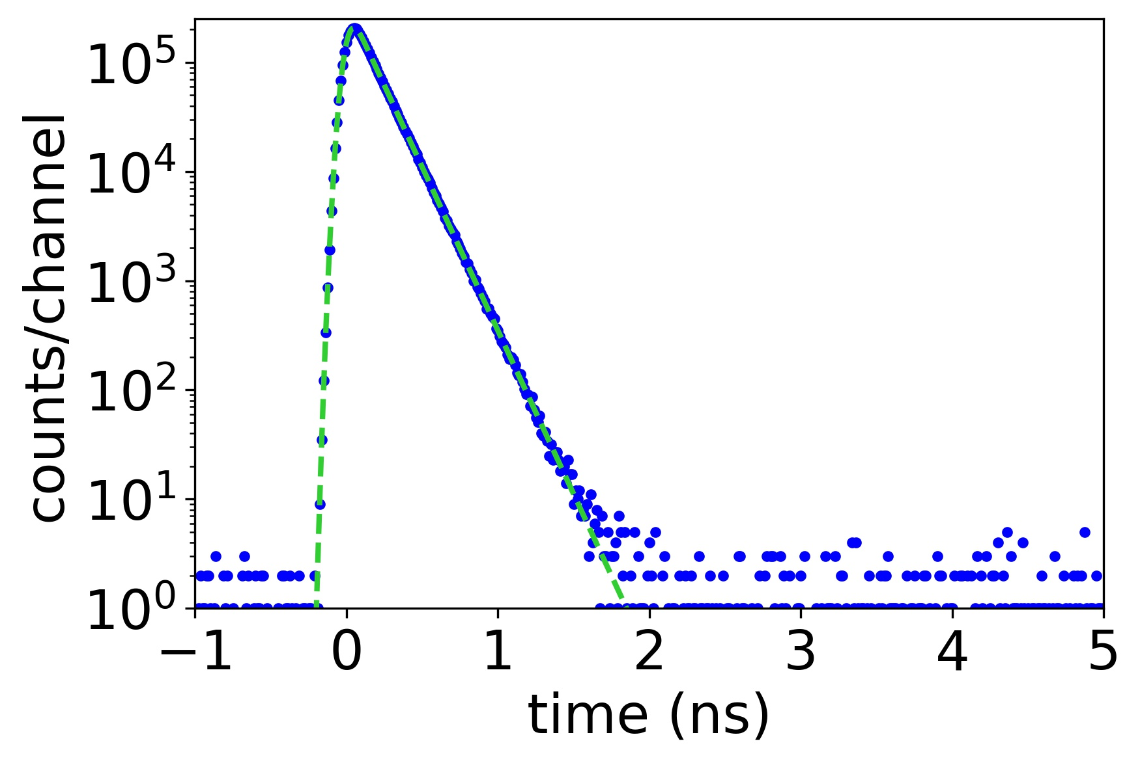
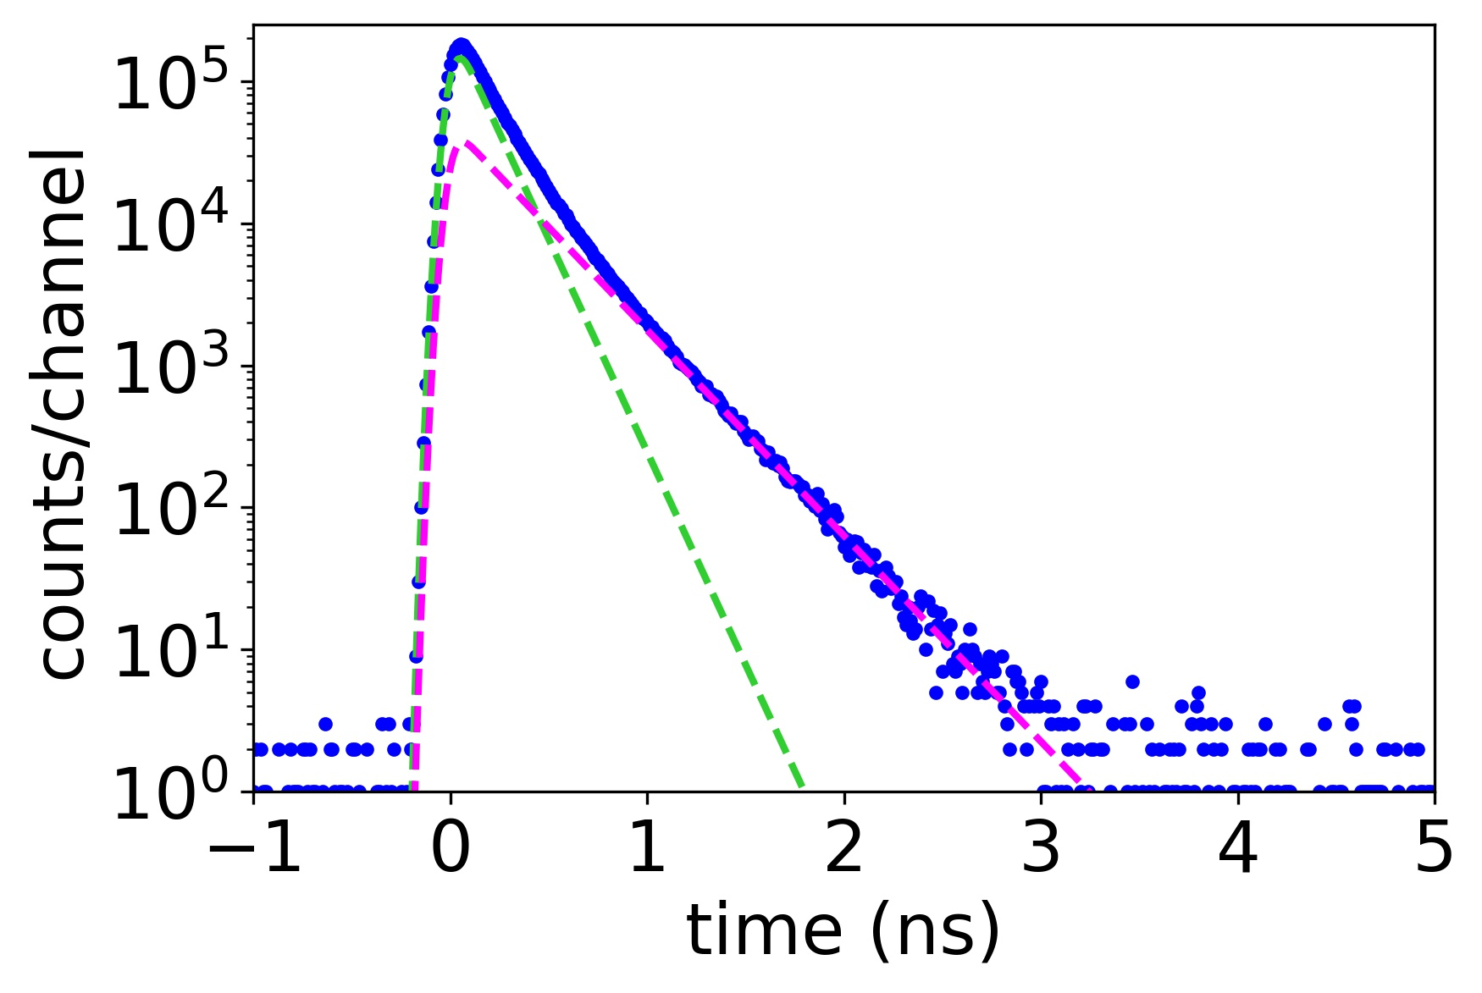
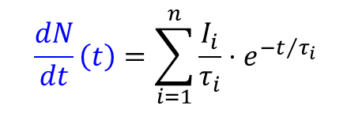
Positrons in Matter
$$\frac{dN}{dt}\left(t\right)=\sum_{i=1}^{n}{\frac{I_{i}}{τ_{i}}⋅e^{{−t}/{τ_{i}}}}$$

Slide 7
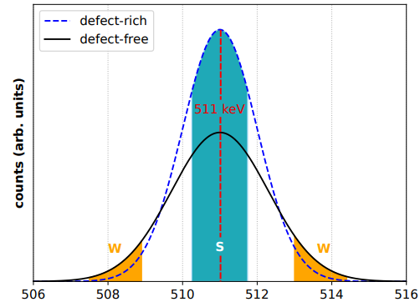


Doppler-Broadening Spectroscopy
center of mass system
-
+
Intensity (counts)
511 keV
511 keV
laboratory system
Photon energy (keV)
-
+
511 keV - ∆E
511 keV + ∆E
$$S=\frac{}{whole area}$$
$$W=\frac{}{whole area}$$

Slide 8
Content
Principles of Positron (Lifetime) Spectroscopy
Positrons in Matter
Depth-resolved PALS
Pulsed Positron Beam Facilities in Germany
Selection of Investigated Materials using PALS
NV Centers in Diamond
Fusion Materials
Polymers

Slide 9
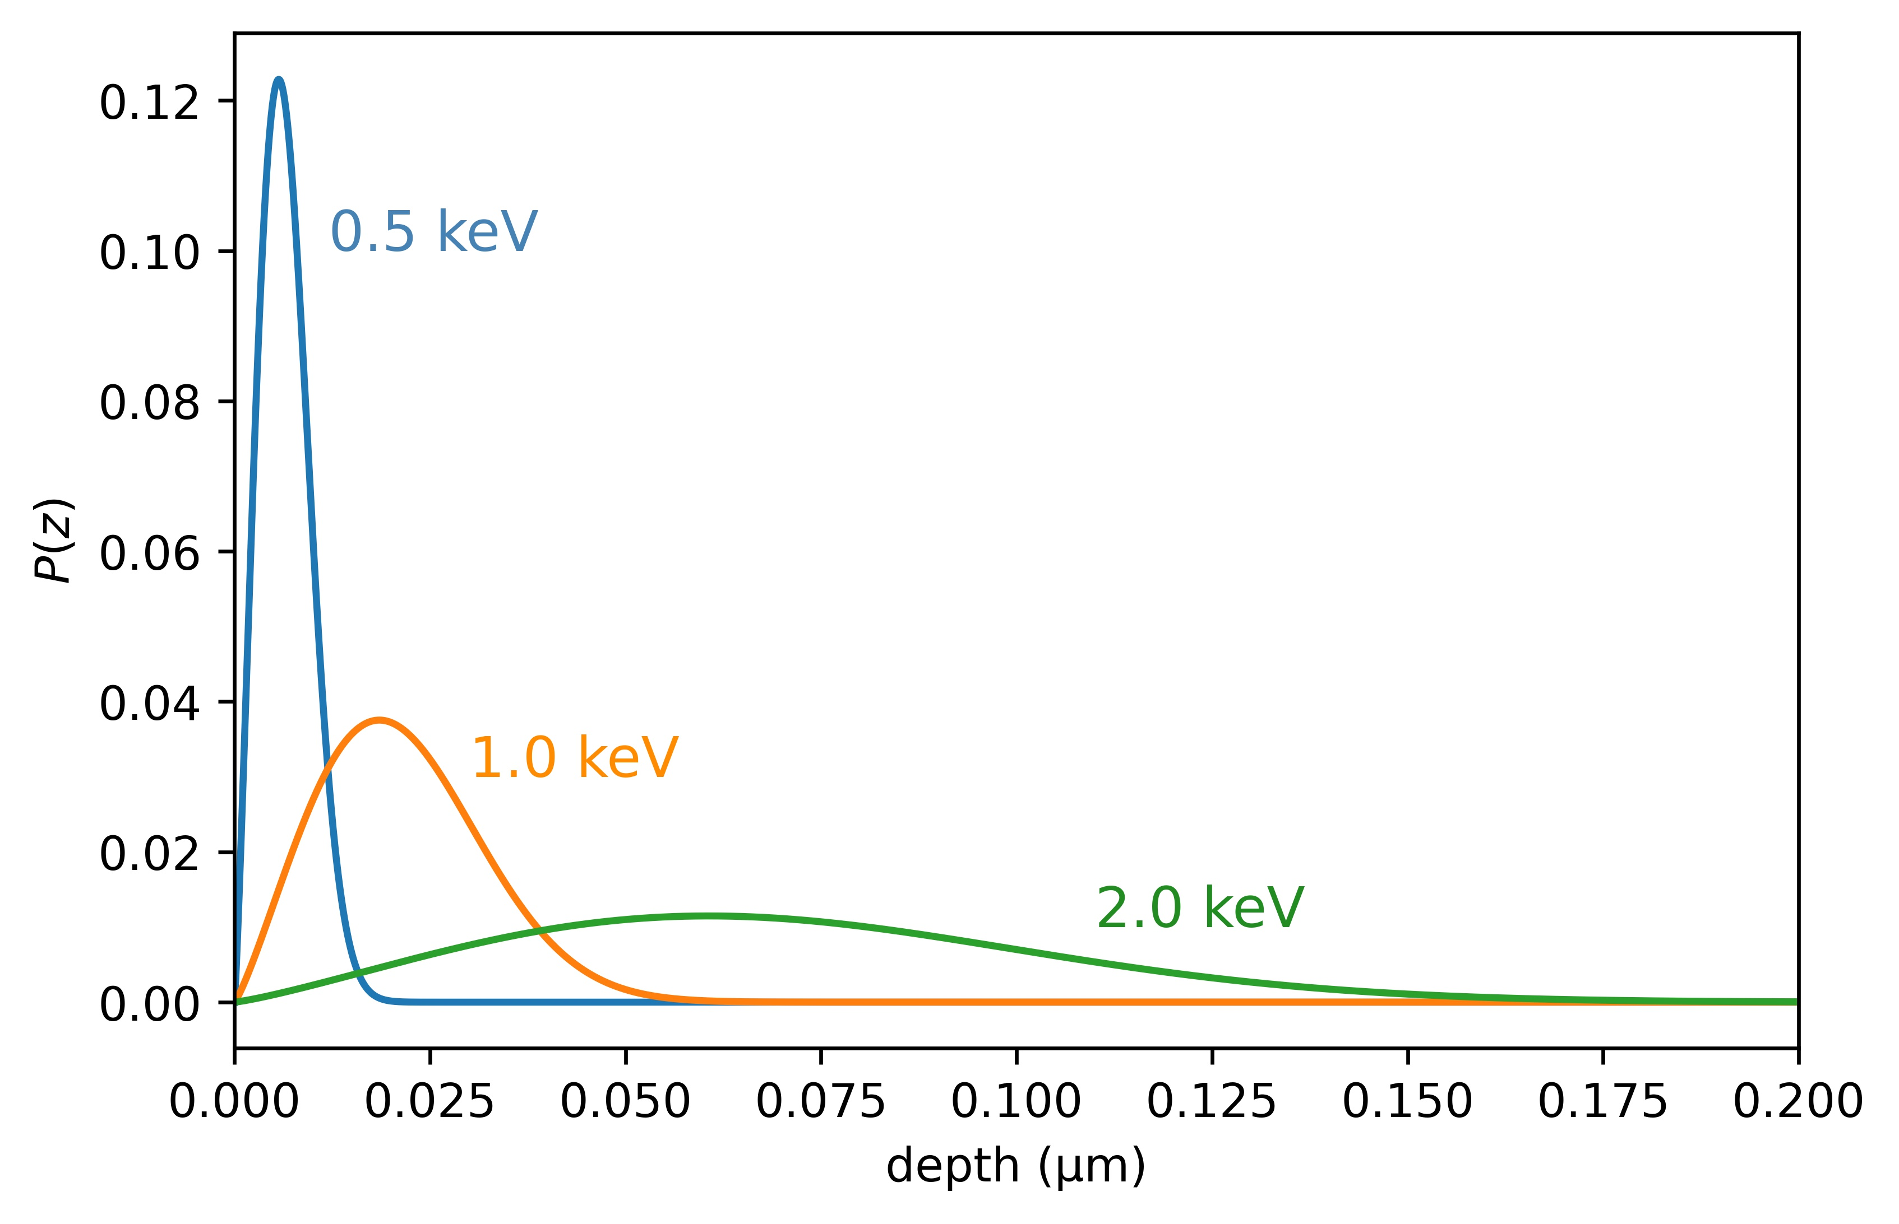
Positron Implantation
Positron implantation profiles using a mono-energetic beam (calculated for PMMA)
Material | density (g/cm³) | mean implantation depth (µm) @4keV @20keV
PMMA | 1.09 | 0.250 | 3.94
Quartz | 2.65 | 0.102 | 1.78
Aluminum | 2.70 | 0.106 | 1.76
Copper | 8.96 | 0.032 | 0.468
Lead | 11.3 | 0.045 | 0.407
Tungsten | 19.3 | 0.021 | 0.230

Slide 10
Content
Principles of Positron (Lifetime) Spectroscopy
Positrons in Matter
Depth-resolved PALS
Pulsed Positron Beam Facilities in Germany
Selection of Investigated Materials using PALS
NV Centers in Diamond
Fusion Materials
Polymers

Slide 11
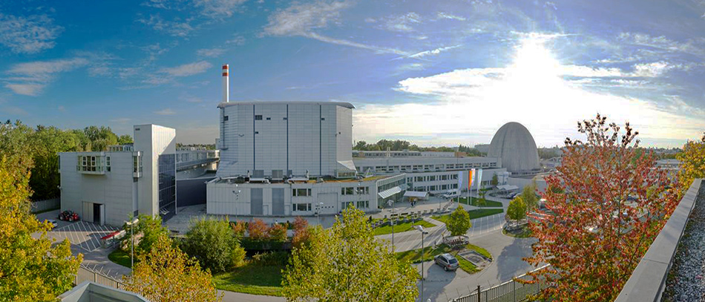
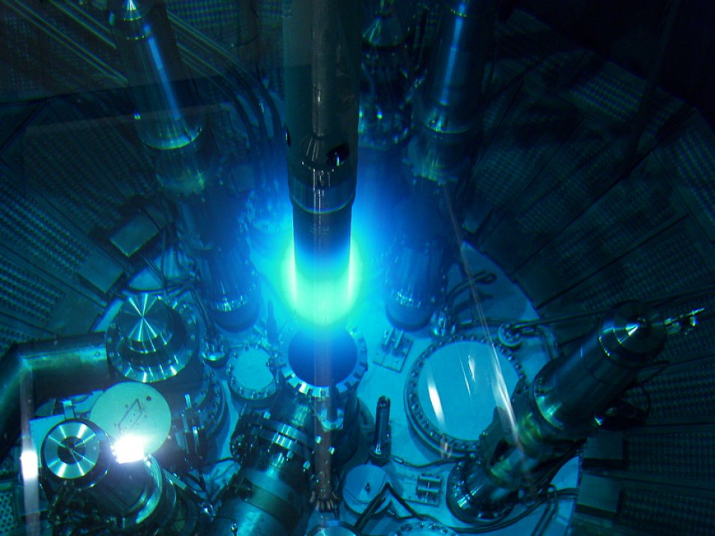
The Research Reactor FRM II
Cold neutron source (E_{kin} < 5 meV): 15 instruments
Thermal neutrons (E_{kin} ≈ 25 meV): 5 instruments
Hot neutron source (E_{kin} 0.1 - 1 eV): 1 instrument
Fission neutrons (E_{kin} 0.1 - 1 MeV): 2 instruments
Positron source NEPOMUC: 5 Experiments

Slide 12
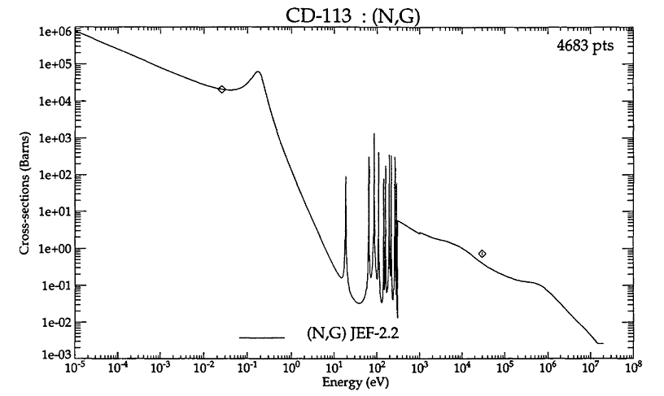
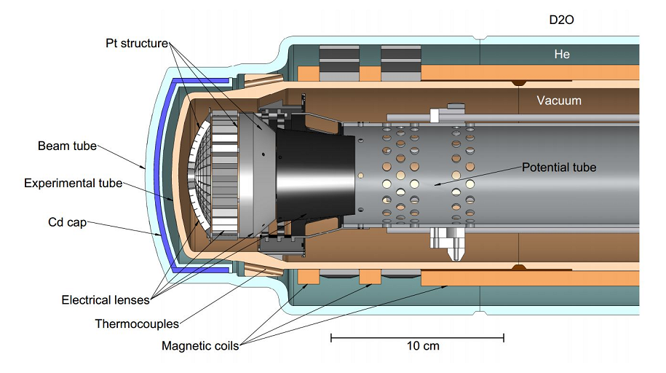
The Neutron Induced Positron Source (NEPOMUC)
Fission
n/γ Conversion
Pair Production
Neutrons
γ-Radiation
Positrons
≈ 10⁹ e⁺/s
²³⁵U
¹¹³Cd(n,γ)¹¹⁴Cd
Platinum
[1] C. Hugenschmidt et al., Journal of Physics: Conference Series, (2013) volume 443, IOP Publishing.

Slide 13
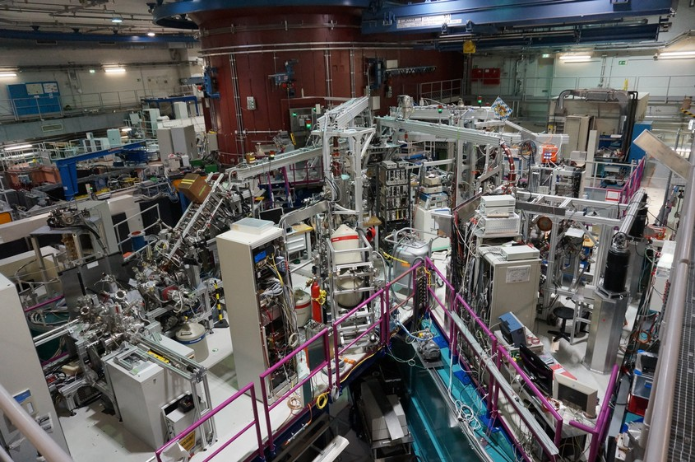
Experimental Hall of the FRM II
NEPOMUC
NEutron-induced Positronsource MUniC
SUSPECT
SurfaceSPECTrometer
CDBS
Coincidence Doppler Broadening Spectrometer
PLEPS
Pulsed Low-energy Positron System
SPM
Scanning Positron Microscope
REMODERATOR
NEPOMUC
REMODERATOR
PLEPS
SUSPECT
SPM
CDBS

Slide 14


The FRM II – A User Facility
University of Tsukuba
KU Leuven
Christian-Albrechts-Universität zu Kiel
TUM Physik
FZ Jülich
Universita di Trento
University of Dundee
TU Delft
Ecole Polytechnique Paris
CEMHTI Orléans
MPI for Plasma Physics
HZDR Dresden Rossendorf
TU Bratislava
Helsinki University
Karls University Prague
Umeå University
Politecnico di Milano
Cornell University (Ithaca/NY/USA)
Idaho National Laboratory (Idaho Falls)
Tsukuba
Japan
USA

Slide 15
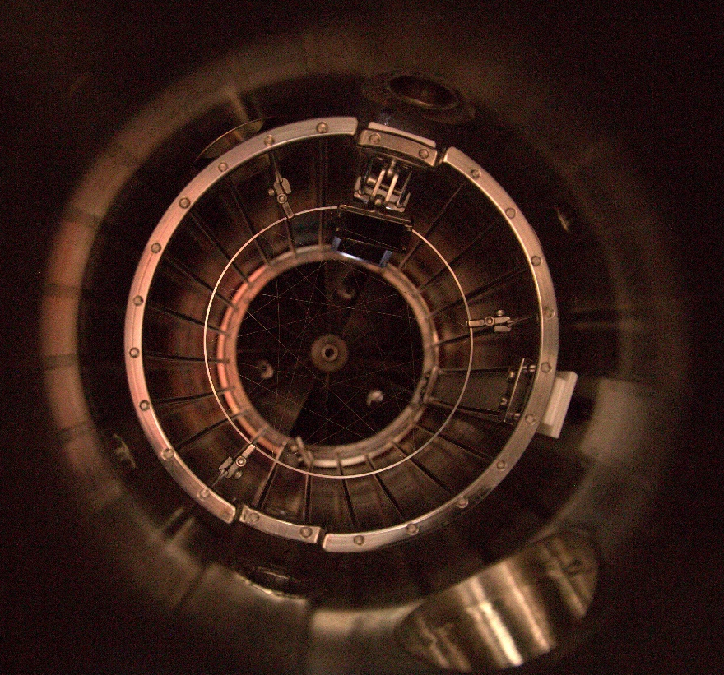
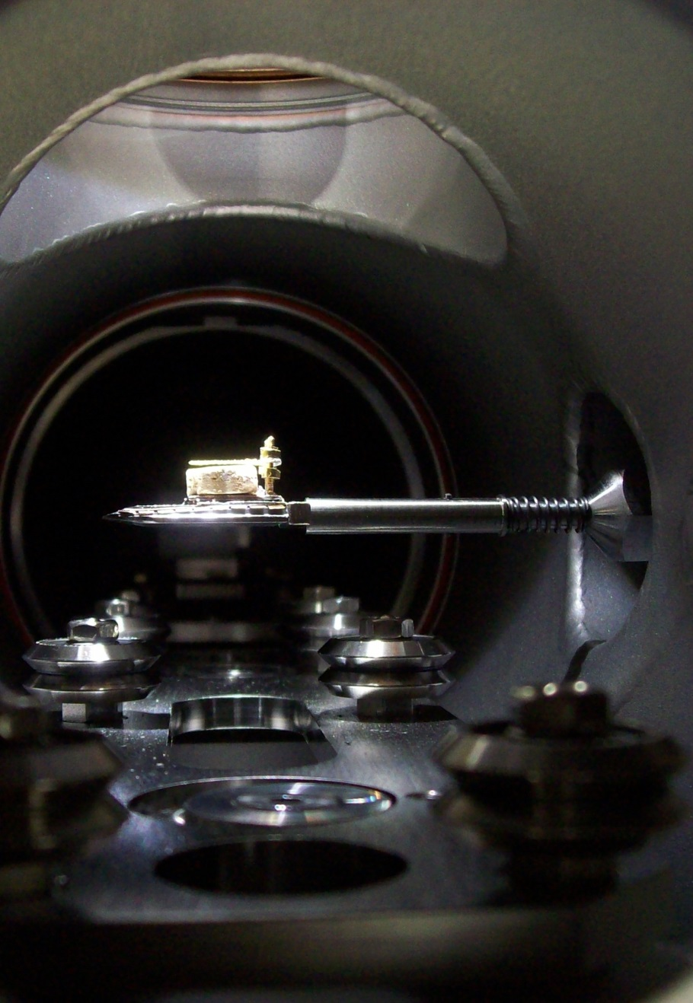
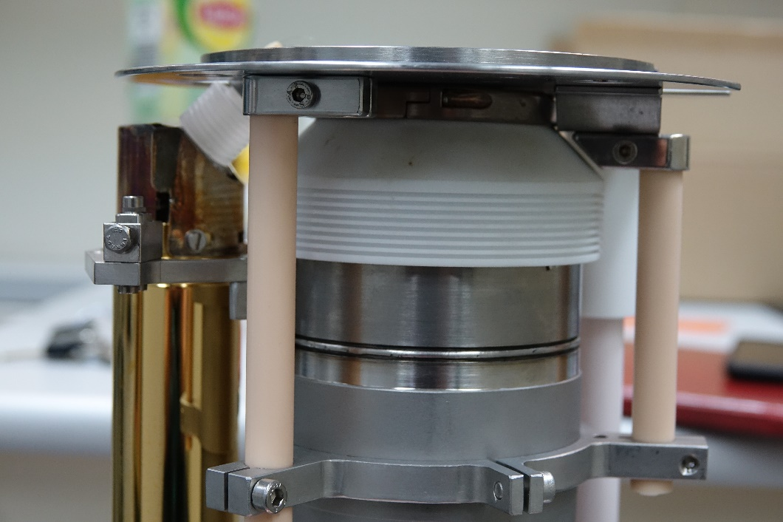
The Pulsed Beam System PLEPS
Implantation Energy
0.25 – 20 keV
Beam Diameter
< 1mm
Total Time Resolution
180 ps (FWHM)
Measurement Time per Spectrum
10 min (4 Mio. Events)
Sample Temperature
80 – 600 K
In Situ Light illumination
200 – 2000 nm

Slide 16
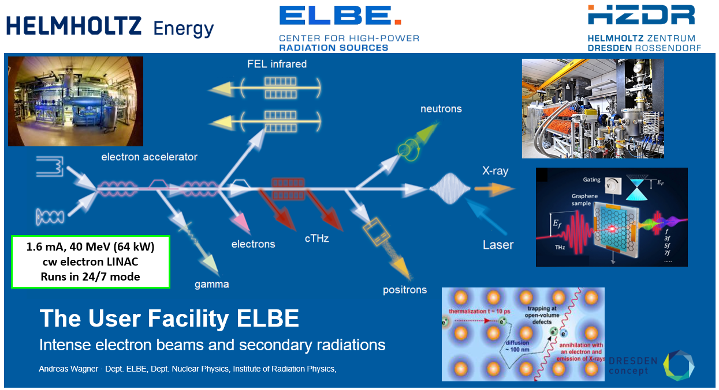

Slide 17
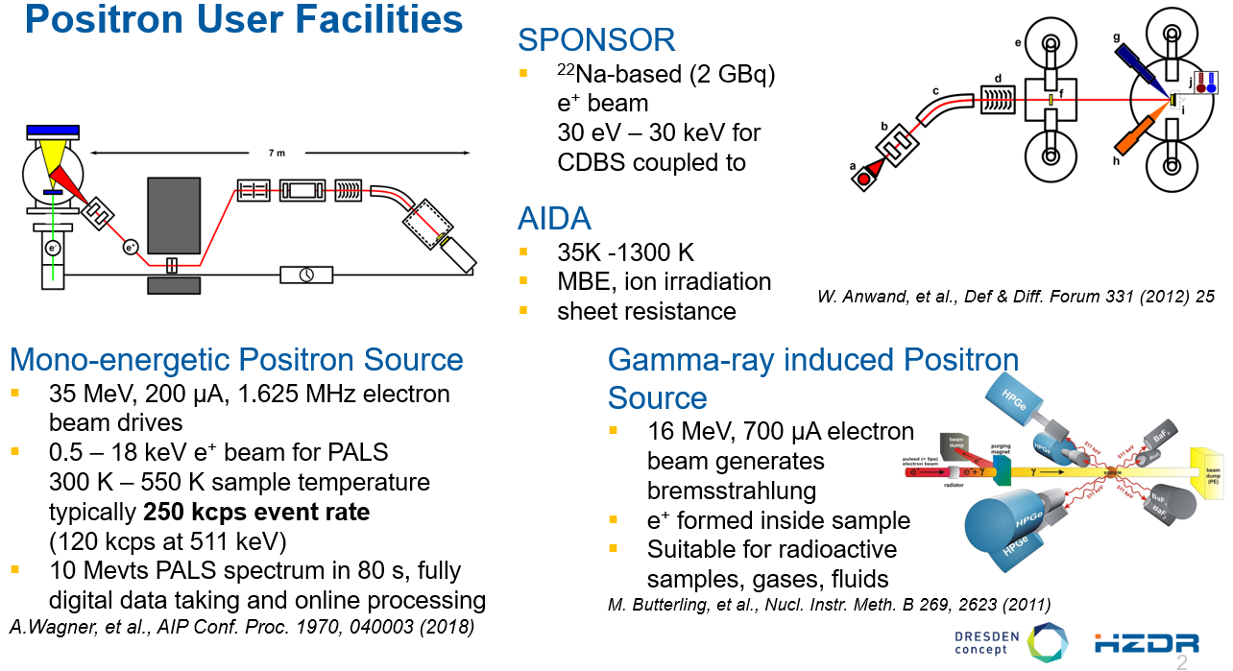

Slide 18
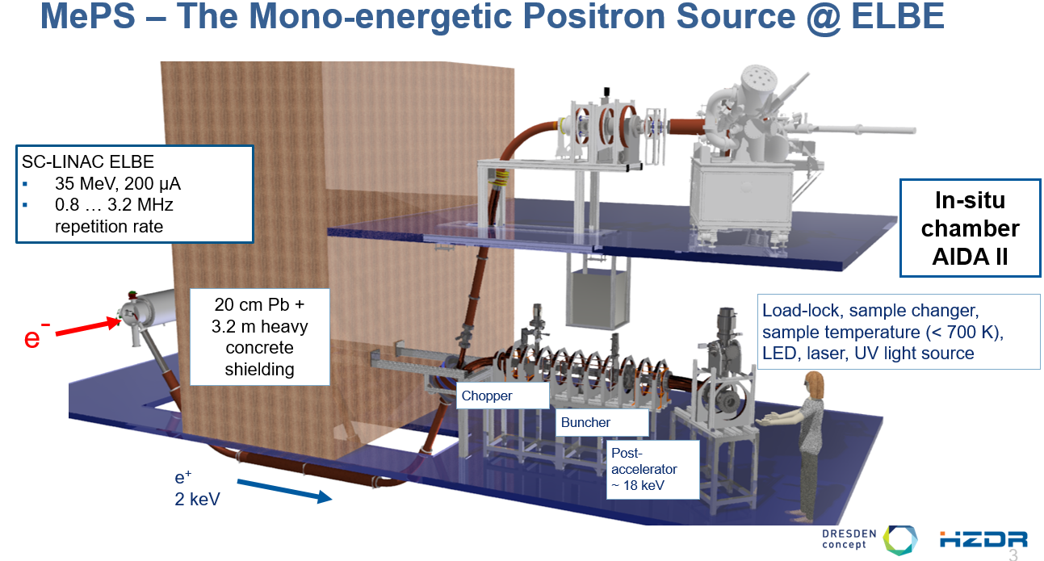

Slide 19
Content
Principles of Positron (Lifetime) Spectroscopy
Positrons in Matter
Depth-resolved PALS
Pulsed Positron Beam Facilities in Germany
Selection of Investigated Materials using PALS
NV Centers in Diamond
Fusion Materials
Polymers

Slide 20
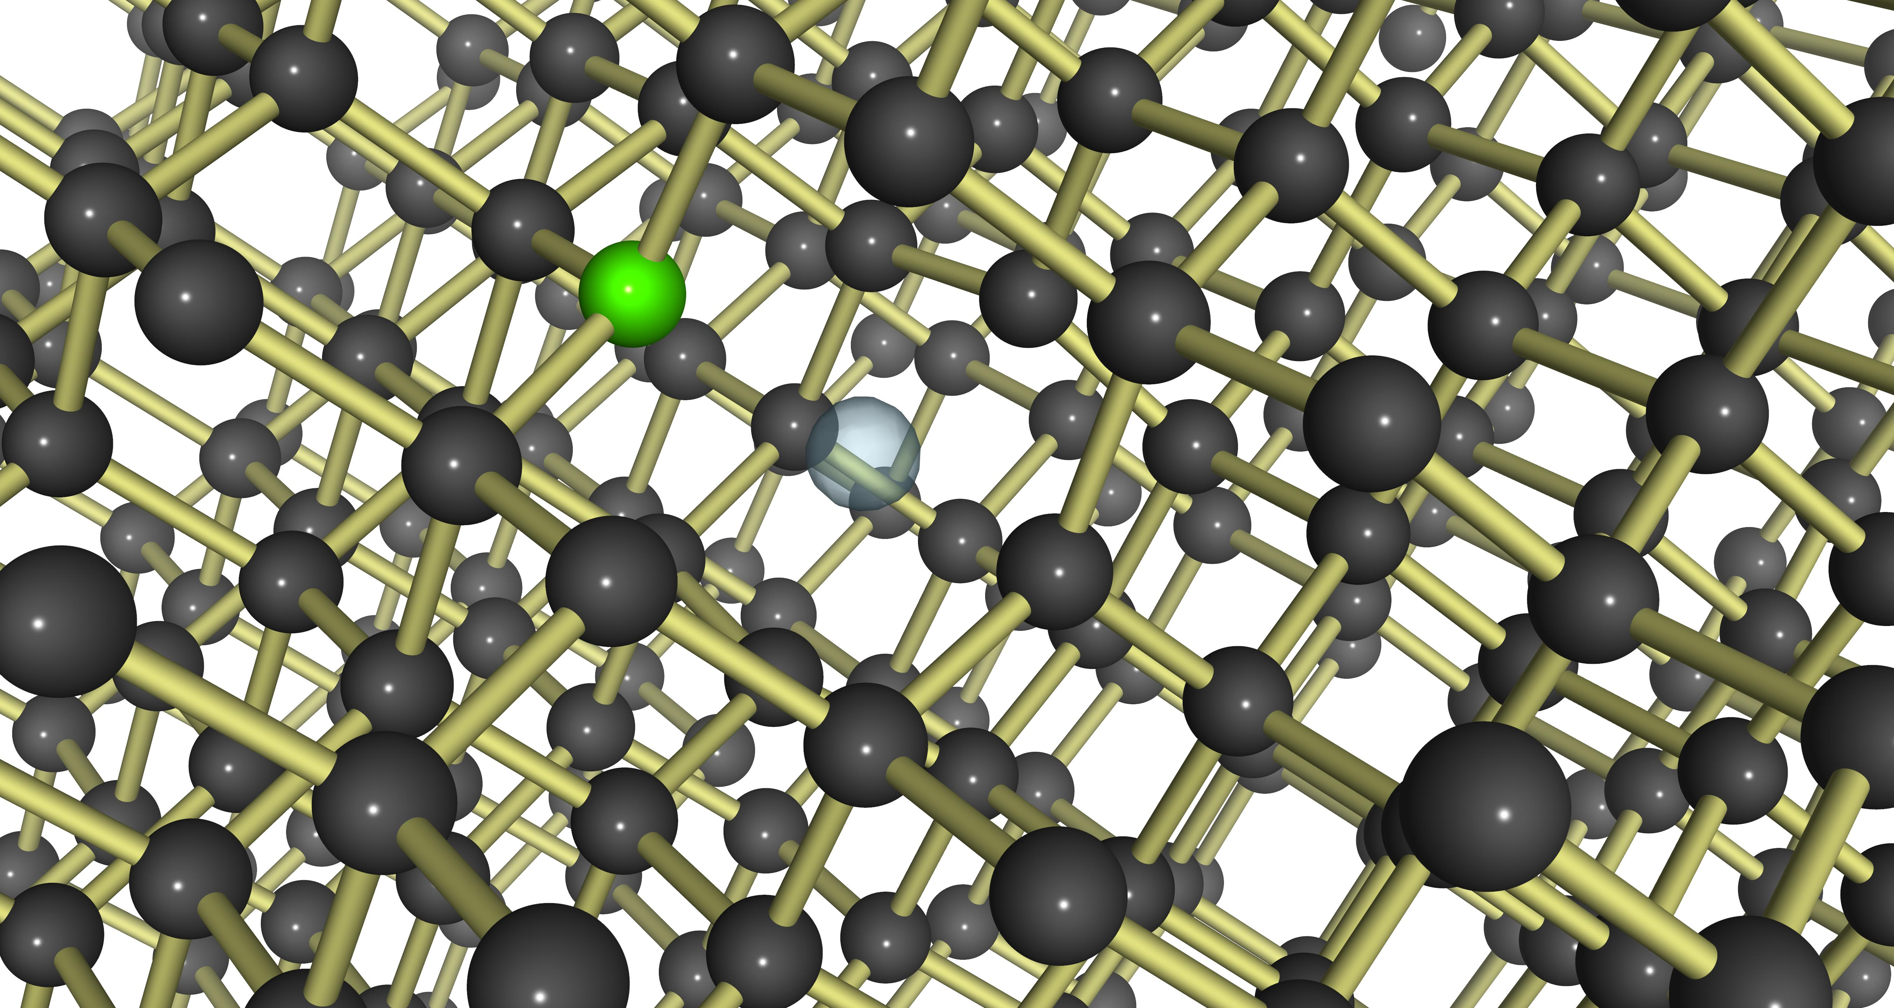
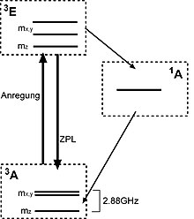
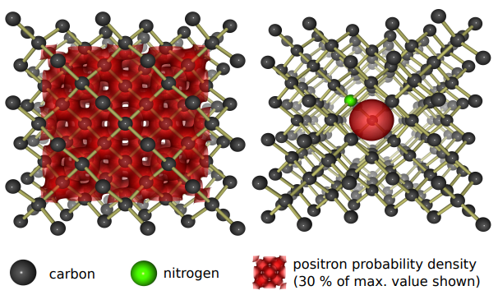
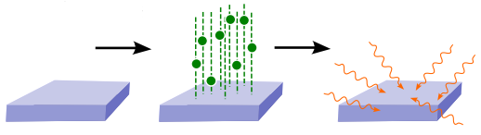
NV Centers in Diamond
Possible charge states: NV⁰, NV⁻ and NV⁺

Slide 21
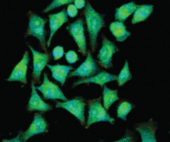
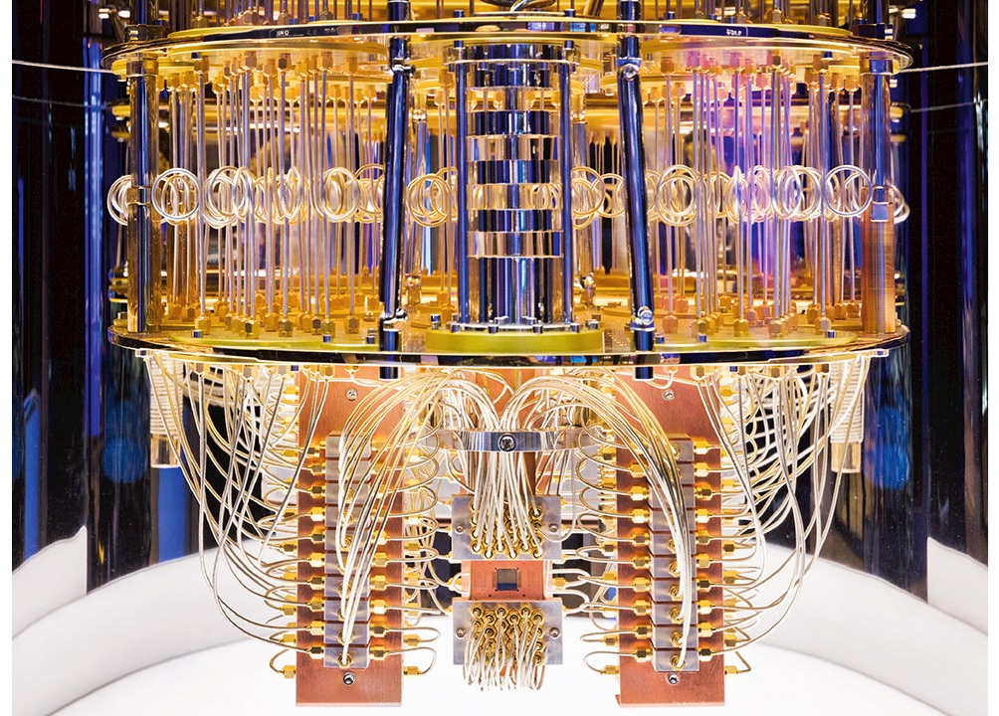
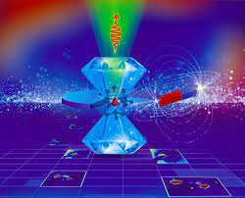
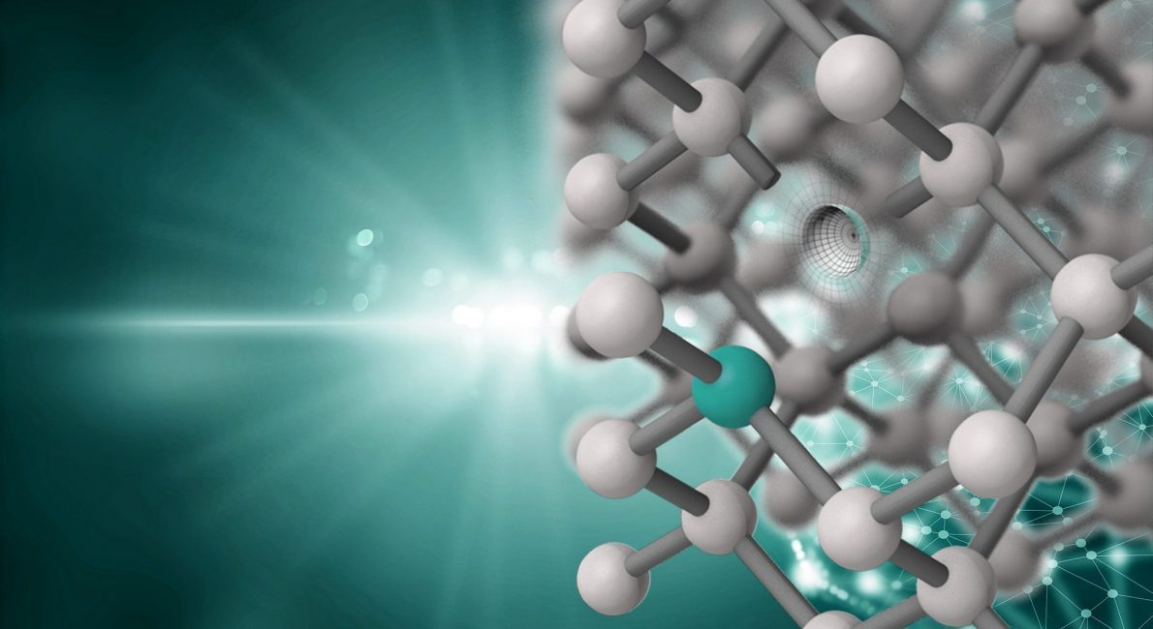
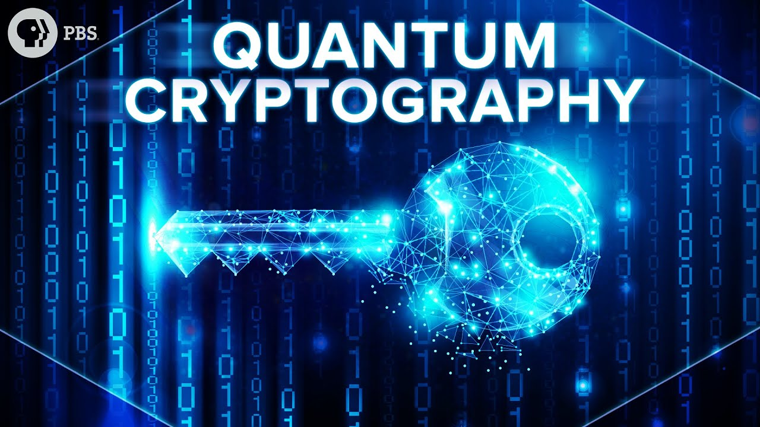
Nitrogen Vacancy Centers in Diamond
NV⁰
NV⁻
NV⁺
Diamond-based light sources
Quantum Technologies
Possible use as spin coherence storage for long-lived nuclear spin states due to the absence of an electronic spin
„Quantum Memory“

Slide 22
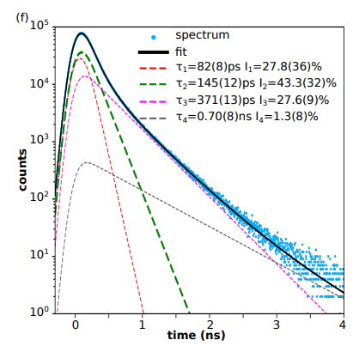
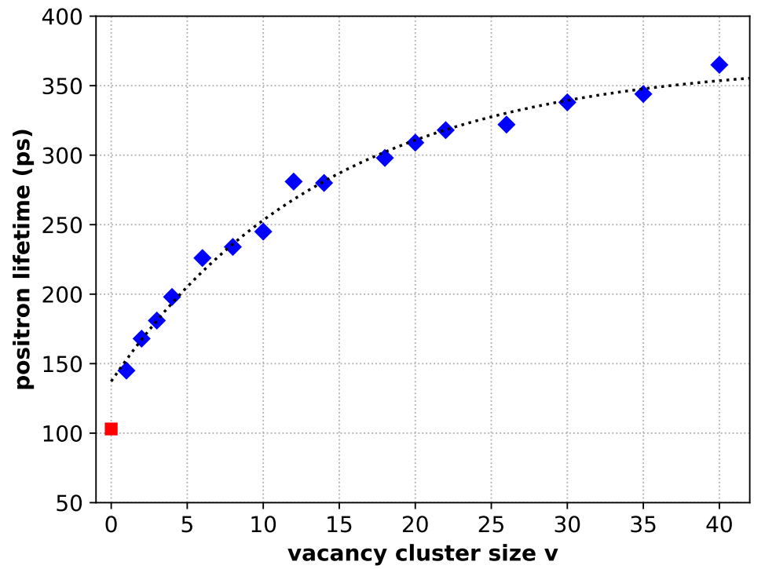
Defects in Diamond Revealed by PALS
[2] M. Dickmann, et al. "Ab Initio Calculations of Positron Lifetimes in Diamond: The Bulk, Vacancies and Grain Boundary." Solid State Phenomena 374 (2025): 145-153.

Slide 23
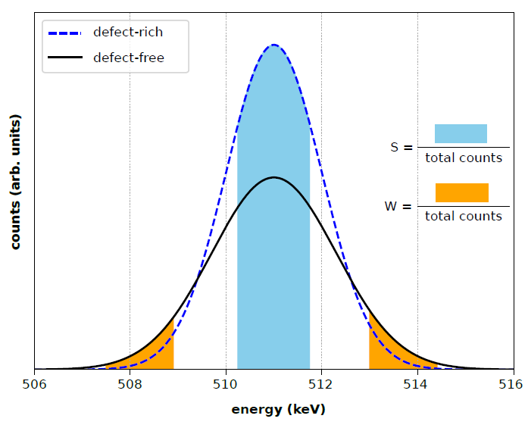
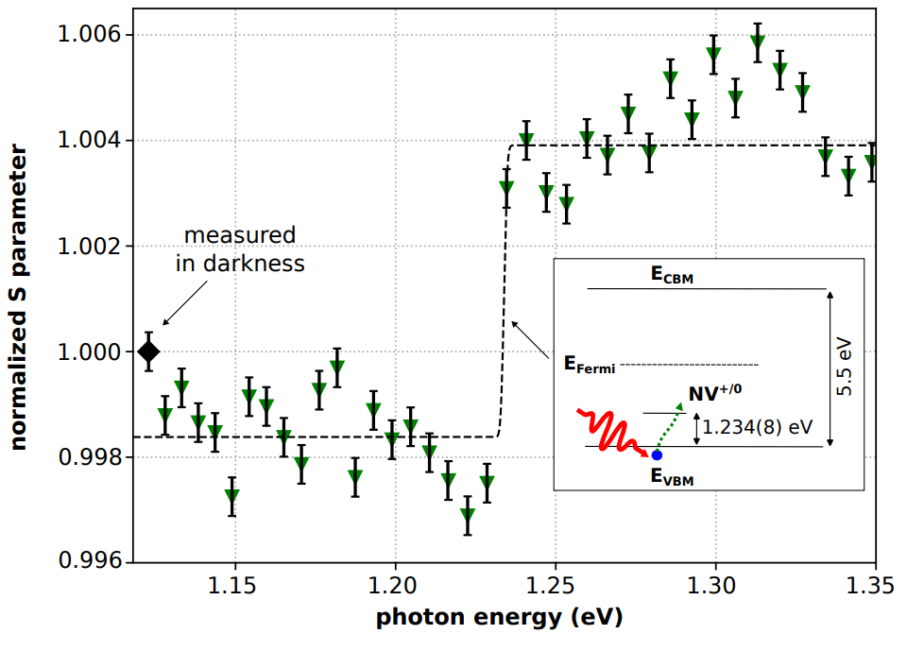
Doppler-Broadening Spectroscopy with in situ light illumination
[3] M. Dickmann, et al. "Identification and Reversible Optical Switching of NV⁺ Centers in Diamond." Advanced Functional Materials (2025): 2500817.

Slide 24
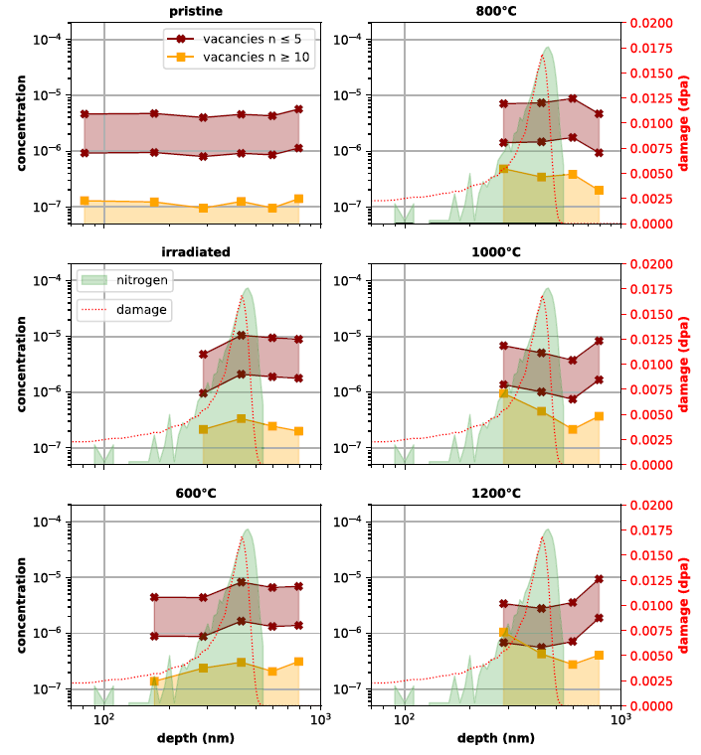
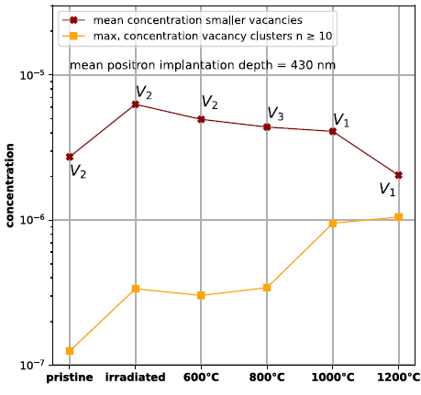
Concentration of Defects
[4] M. Dickmann, et al. “Defect evolution in nitrogen-implanted CVD diamond during thermal annealing” Materials & Design 262 (2026) 115422.

Slide 25
Content
Principles of Positron (Lifetime) Spectroscopy
Positrons in Matter
Depth-resolved PALS
Pulsed Positron Beam Facilities in Germany
Selection of Investigated Materials using PALS
NV Centers in Diamond
Fusion Materials
Polymers

Slide 26
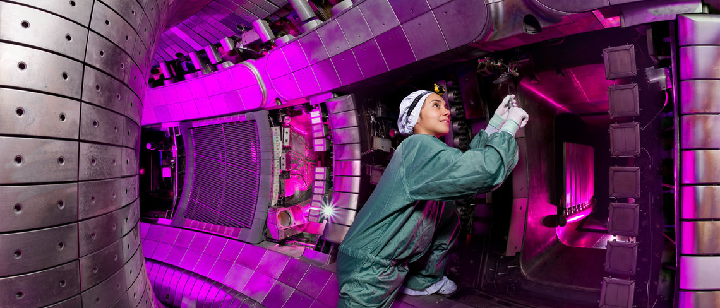

Materials for Fusion Reactors
Tungsten as “first wall” material in fusion technology
High melting temperature (3442 °C)
Low sputtering yield
High thermal conductivity
Low tritium retention
High radiation resistance
Low neutron activation
Future applications in ITER and Wendelstein7-X

Slide 27
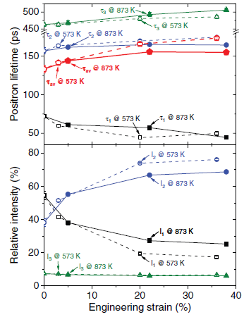
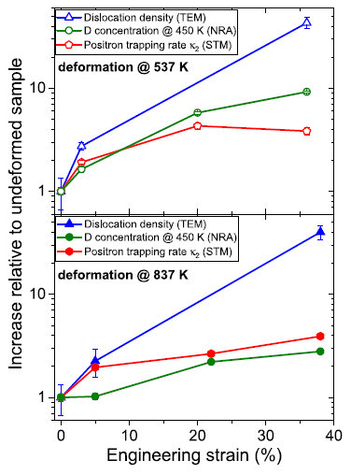
Deuterium Trapping by Deformation-induced Defects in Tungsten
“Where does the deuterium go?”
Recrystallized W samples were subjected to tensile deformations at temperatures of 573 K and 873 K to strains in the range of 3%–38%.
The introduced defects were decorated with deuterium by exposure to a low-flux deuterium plasma
The dislocation density measured by transmission electron microscopy
The vacancy landscape was investigated by positron lifetime spectroscopy
Deuterium retention in the samples was studied using nuclear reaction analysis and thermal desorption spectroscopy
[5] M. Zibrov, et al. "Deuterium trapping by deformation-induced defects in tungsten." Nuclear Fusion 59.10 (2019): 106056.

Slide 28
Content
Principles of Positron (Lifetime) Spectroscopy
Positrons in Matter
Depth-resolved PALS
Pulsed Positron Beam Facilities in Germany
Selection of Investigated Materials using PALS
NV Centers in Diamond
Fusion Materials
Polymers

Slide 29
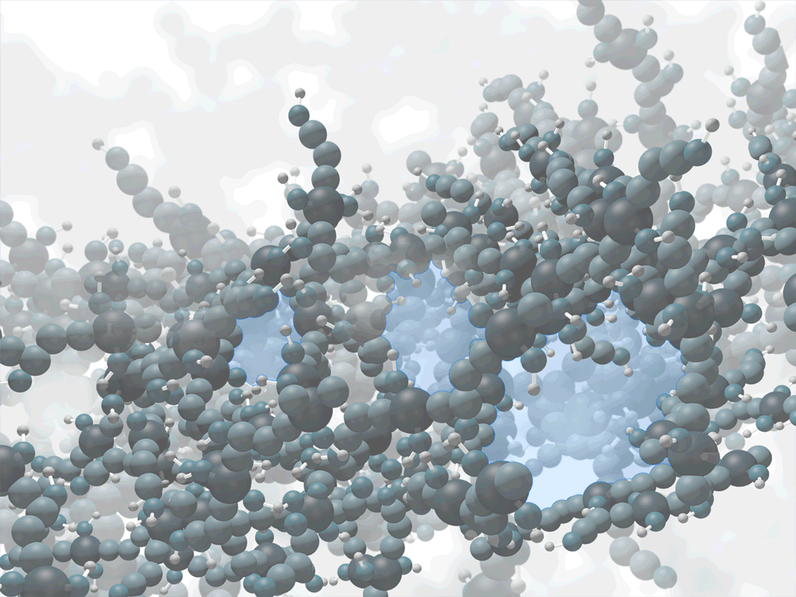
Porosimetry of Polymers

Slide 30
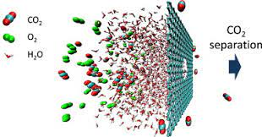
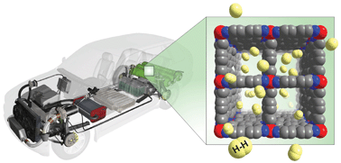
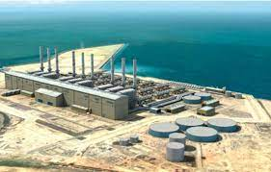

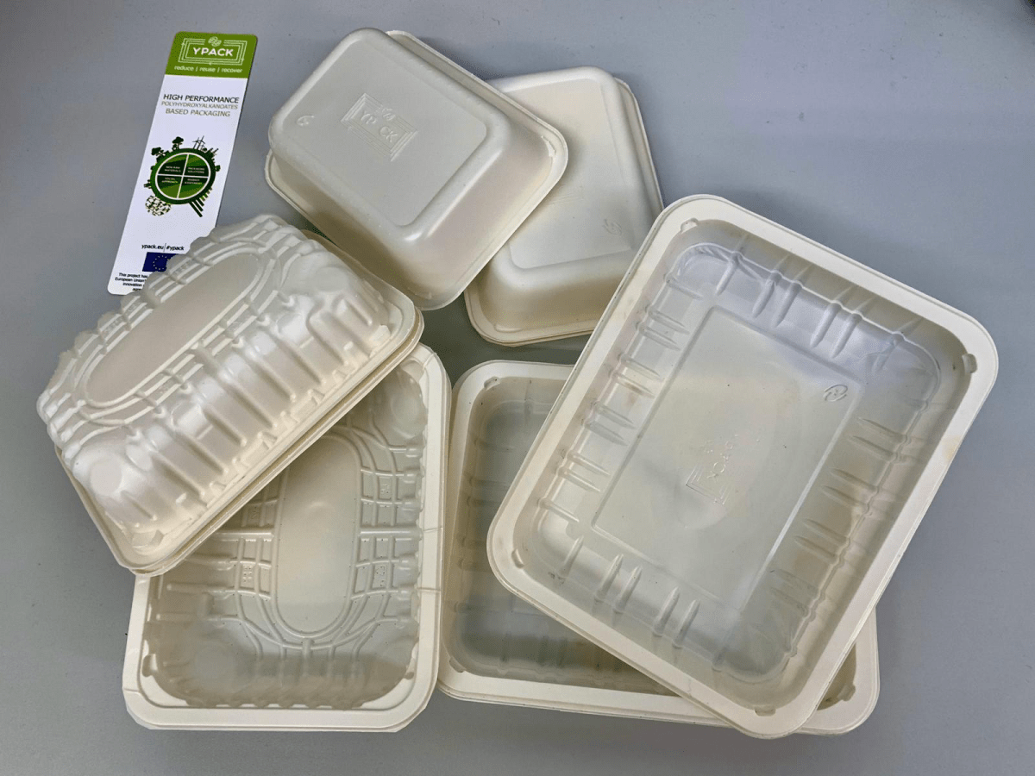
Applications of Nano-porous Polymers
Filter Materials
Gas Storage
Degradable Packaging
Desalination
Purification

Slide 31
Formation of Positronium
Para-Positronium
Ortho-Positronium
+
+
S = 0
S = 1
-
-
Vaccuum Lifetime:
τ_{para} = 0.125 ns
τ_{ortho} = 142 ns

Slide 32

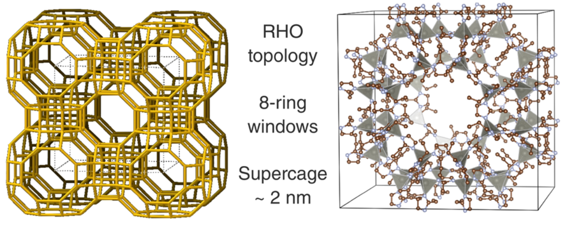
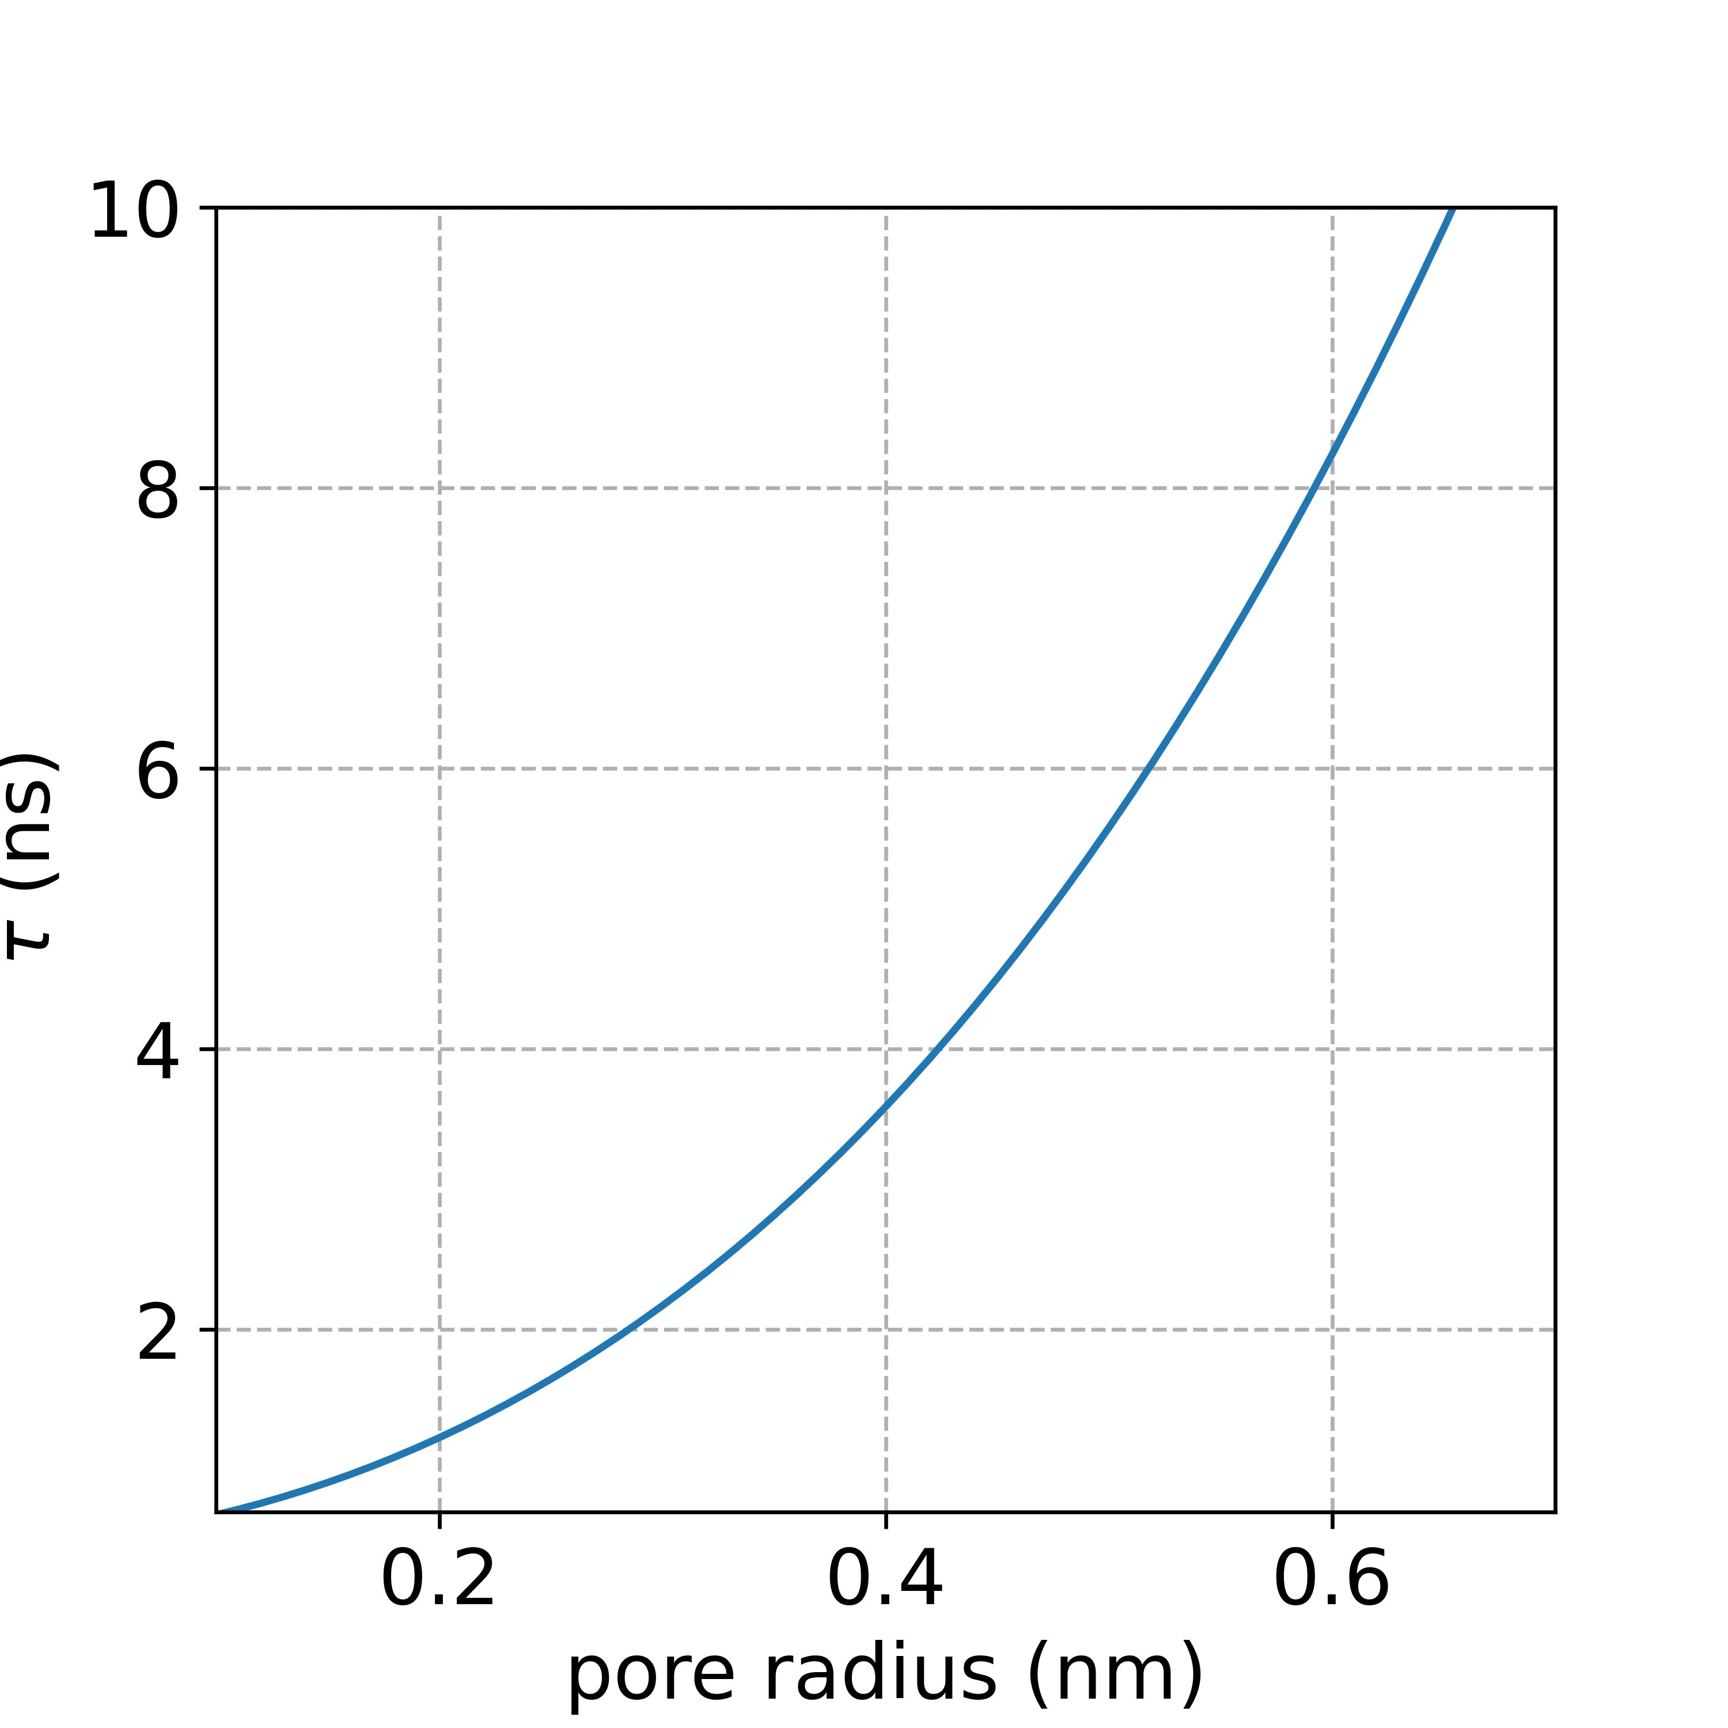
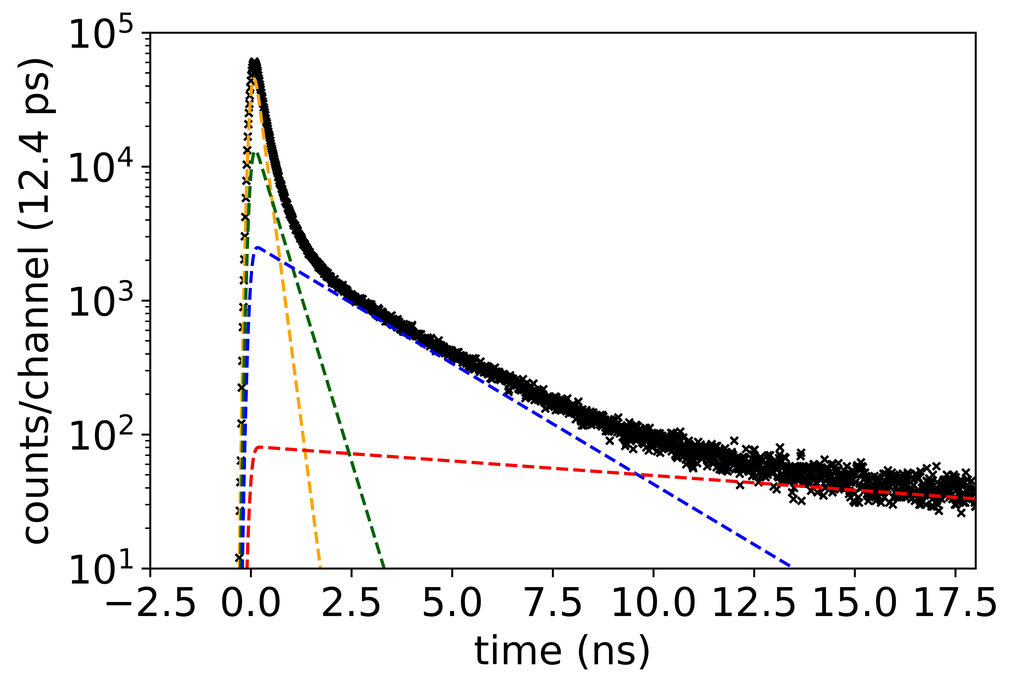


Metal-Organic Frameworks
[6] T. Stassin et al., “Porosimetry for Thin Films of Metal-Organic-Frameworks Advanced Materials 2009662: (2021)
Tao-Eldrup Model:
0.58 nm
0.28 nm
$$τ_{\text{o}\text{1}} = \text{2}\text{.}\text{0 }\text{ns}$$
$$τ_{\text{o}\text{2}} = \text{7}\text{.}\text{5 }\text{ns}$$

Slide 33
SUMMARY
Positrons are ideal probes for open-volume defects
Positron annihilation spectroscopy gives information on defect types and their concentration
Wide range of applications in material sciences (e.g. semiconductors, metals, polymers, quantum materials, …)

Slide 34


Thank you for the attention

