Slide 1


A new pulsed low energy positron system at the UniBwM-Lab:
Design and current status
R. Helm, W. Egger, P. Sperr, J. Mitteneder,
M. Dickmann, P. Oberlaender, G. Dollinger
LEEPP@JLab
24.03.2026

Slide 2
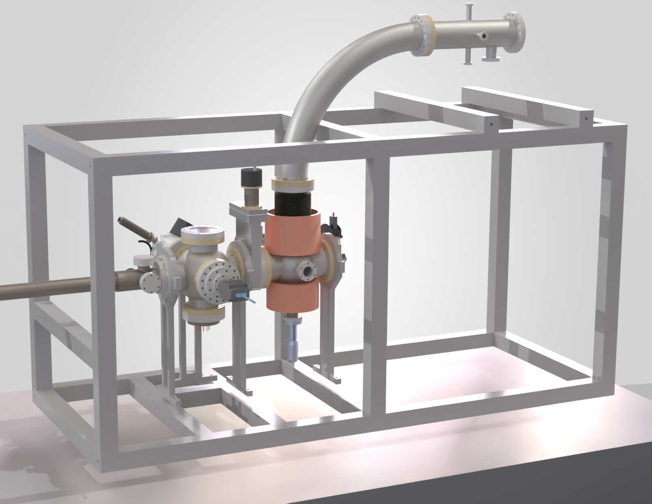
Outline
Positron Group at UniBwM
Concepts of pulsed beams
Source section
Bend & E-filter
Pulsing section
Next steps

Slide 3
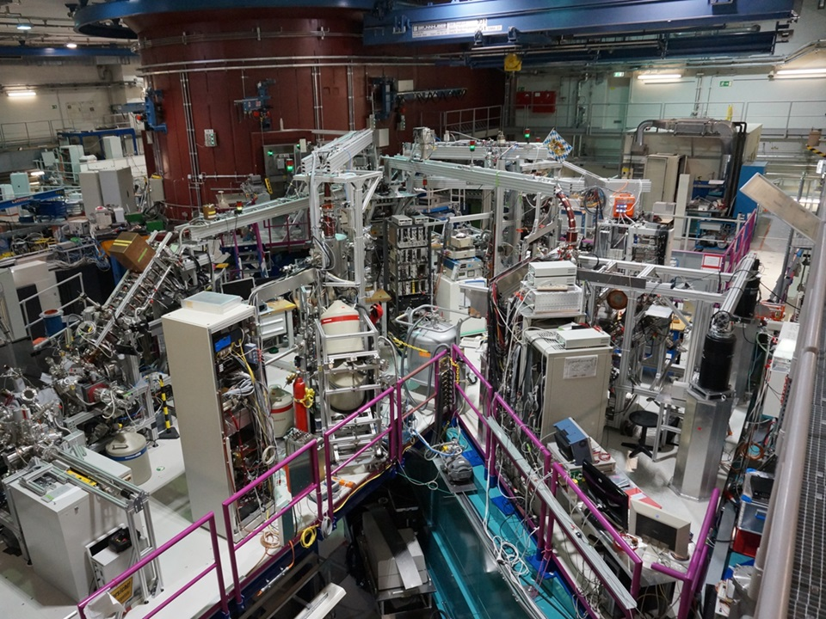


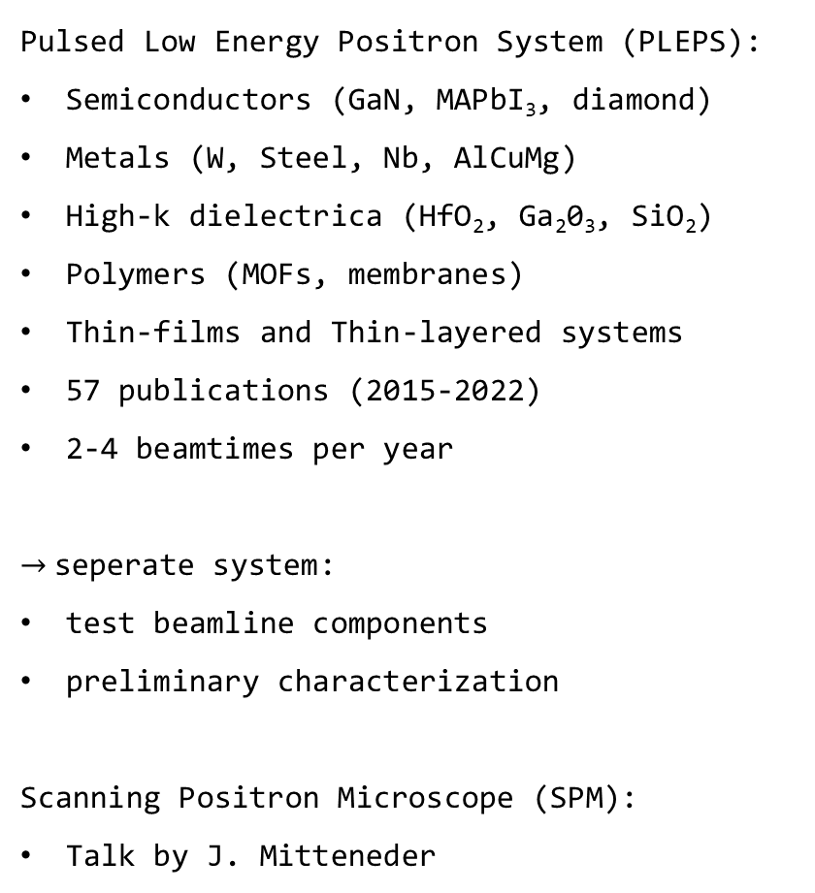
Pulsed Positron beam for materials science
Pulsed Low Energy Positron System (PLEPS):
Semiconductors (GaN, MAPbI₃, diamond)
Metals (W, Steel, Nb, AlCuMg)
High-k dielectrica (HfO₂, Ga₂0₃, SiO₂)
Polymers (MOFs, membranes)
Thin-films and Thin-layered systems
57 publications (2015-2022)
2-4 beamtimes per year
$→$seperate system:
test beamline components
preliminary characterization
Scanning Positron Microscope (SPM):
Talk by J. Mitteneder
NEPOMUC
PLEPS
OP
SPM
PAES
CDBS
MLZ
UniBwM

Slide 4
Positron Group at UniBwM
Concepts of pulsed beams
Source section
Bend & E-filter
Pusling section
Next steps

Slide 5
Basic setup of a pulsed low energy positron system
Why pulse the beam?
Needed for positron lifetimes measurements
Pulsing frequency determines time window of measurement
Efficiency of pulsing is essential for time resolution
Source section:
²²Na-based
Reactor-based
LINAC-based
Moderator
Target station:
Control sample environment
Detect annihilation radiation
Handles backscattered e⁺
e⁺ source
prebuncher
chopper
buncher
drift tube
accelerator
Target station
pulsing section:
Applies time structure
Accumulates e⁺
Reduces background
Most important for data quality
accelerator section:
Adjusts e⁺ transit time
Sets implantation energy

Slide 6
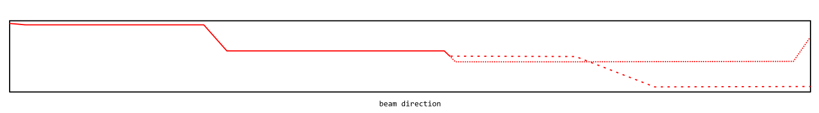
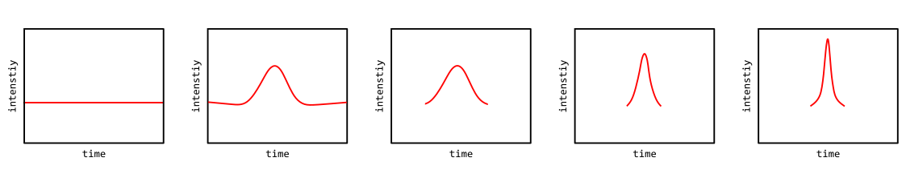











Working principle of the new setup
Guiding solenoid ($B=7 mT$)
Pulsing frequency $25 MHz →40 ns$
e⁺ source
prebuncher
chopper
buncher
drift tube
accelerator
Target station
$$∆E_{kin}\sim 2 eV$$
$$∆E_{kin}\sim 100 eV$$
Potential (in $V$):
$$0 V$$
-17.3V
-1kV
-1kV
-1.5 to -3kV
-1.5 to -25kV
-0.5 to -25kV
Pulse generation:
cw
$$\sim 2ns$$
intenstiy
intenstiy
$$2ns$$
$$≤2ns$$
$$<2ns$$
$$\sim 100 ps$$
time
time
time
time
time
time

Slide 7
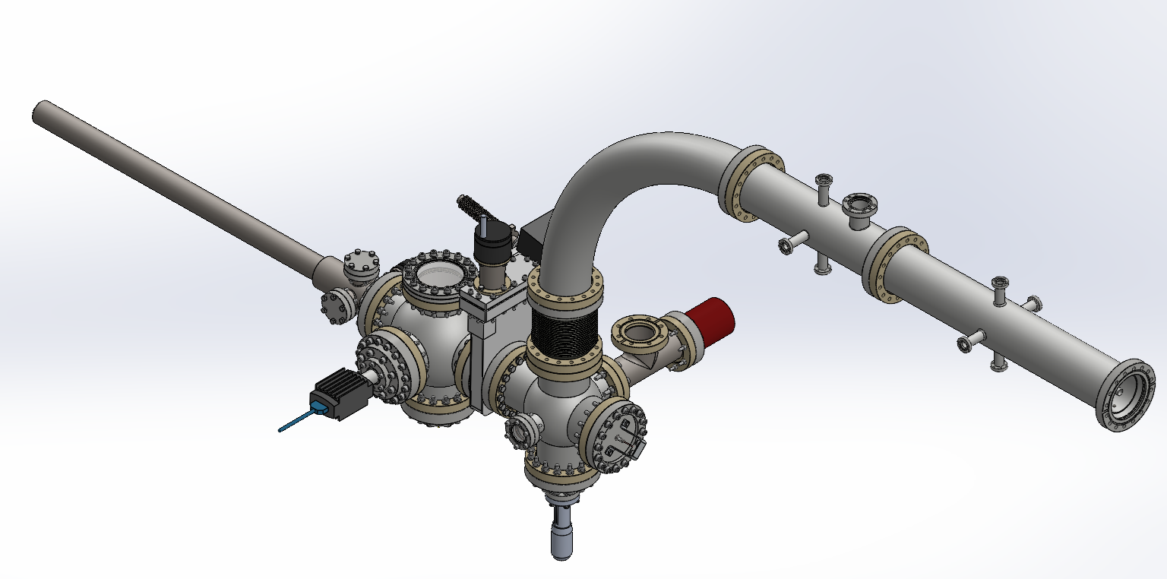
Current state of the pulsed system

Slide 8
Positron Group at UniBwM
Concepts of pulsed beams
Source section
Pusling section
Next steps

Slide 9
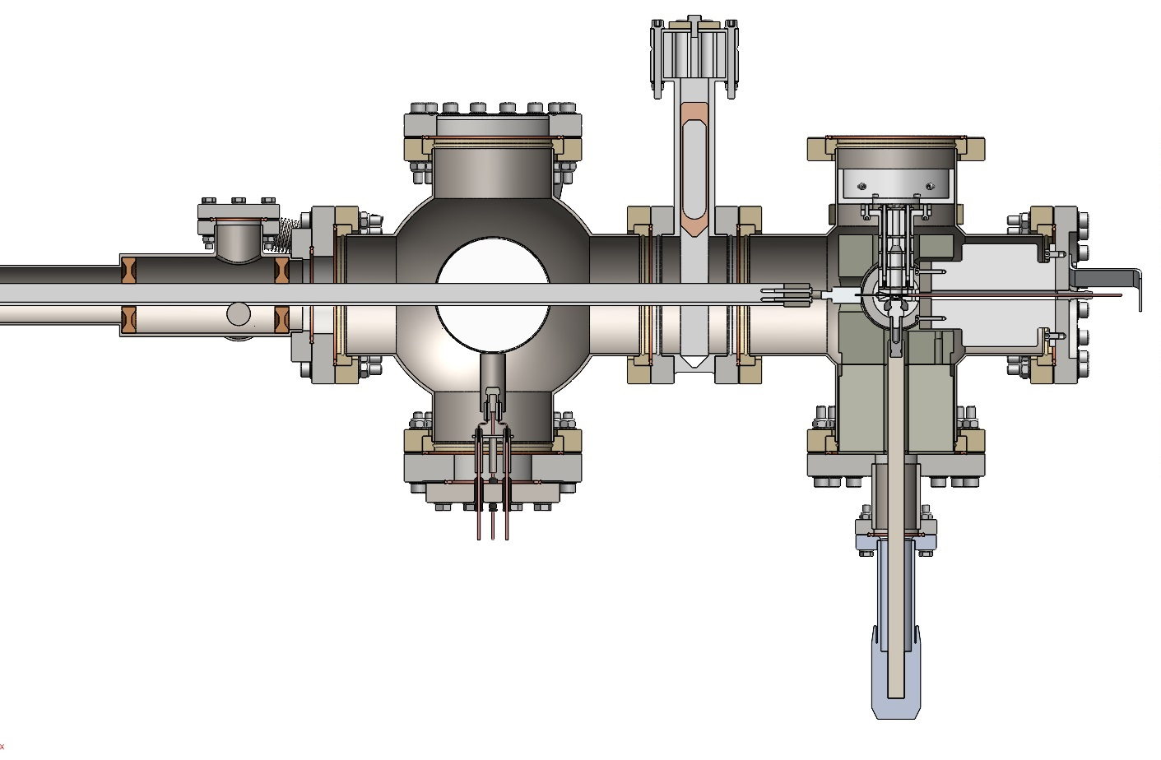
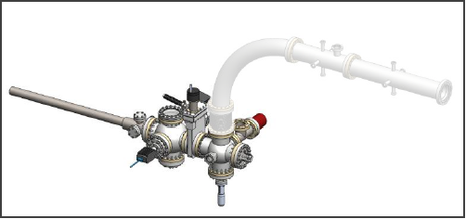
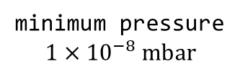
Cross section of the source section
Annealing chamber
bend
Source chamber
e⁺
solenoids
Turbo pump port
Extraction lenses
Transfer rod (W-moderator)
Electron gun
(defocused)
²²Na source
(1.9 GBq)
Transmission W-moderator
(300 µm)
Tungsten shielding
(50 mm)
minimum pressure
$$1×{10}^{−8} mbar$$
Transfer rod
(source)

Slide 10
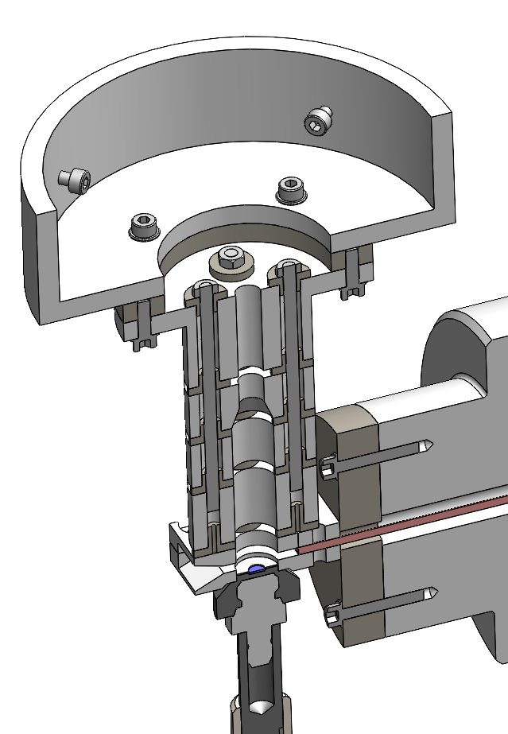
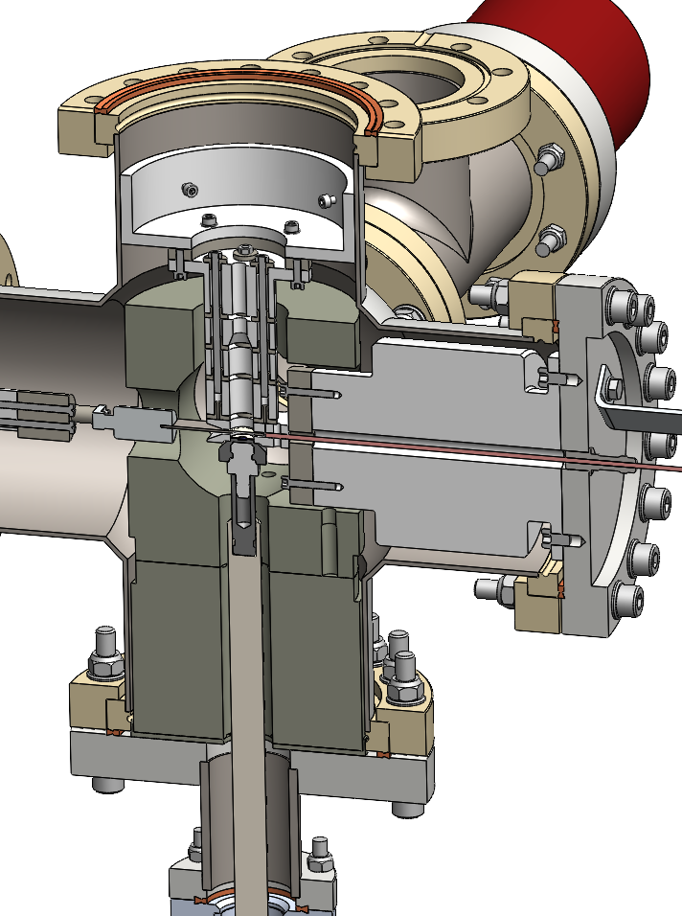
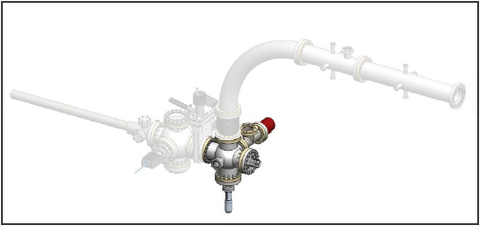
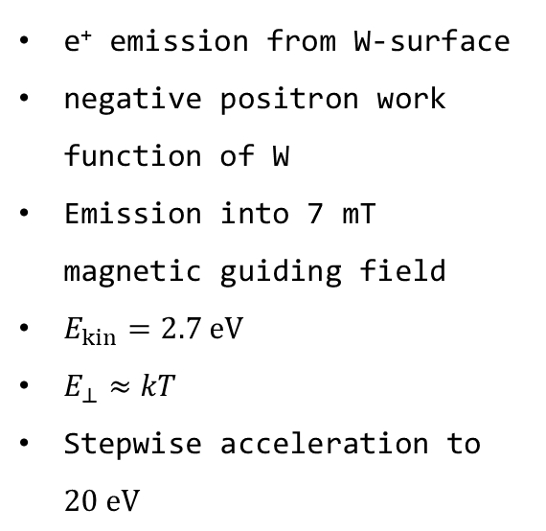
Positron extraction from the moderator
e⁺ emission from W-surface
negative positron work function of W
Emission into 7 mT magnetic guiding field
$E_{kin}=2.7 eV$
$E_{⊥}≈kT$
Stepwise acceleration to $20 eV$
-17.3V
PEEK
-17.3V
-15V
-10V
-5V
GND
moderator
fixture
Source
capsule

Slide 11
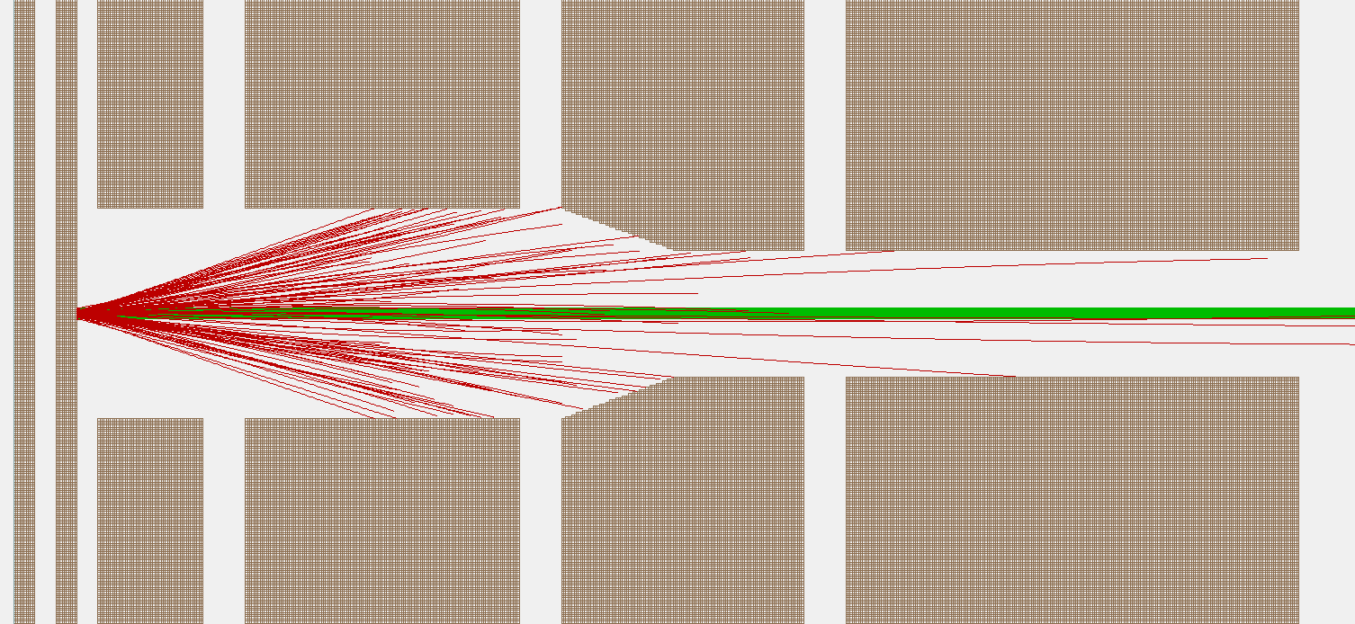

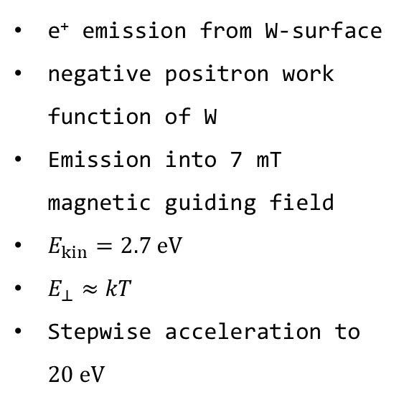




Positron extraction from the moderator
e⁺ emission from W-surface
negative positron work function of W
Emission into 7 mT magnetic guiding field
$E_{kin}=2.7 eV$
$E_{⊥}≈kT$
Stepwise acceleration to $20 eV$
GND
SIMION simulation
$$−5 V$$
$$−10 V$$
$$−15 V$$
$$−17.3 V$$
$$7 mT$$
Fast positrons
Moderated (slow) positrons
efficiency 0.02 %

Slide 12
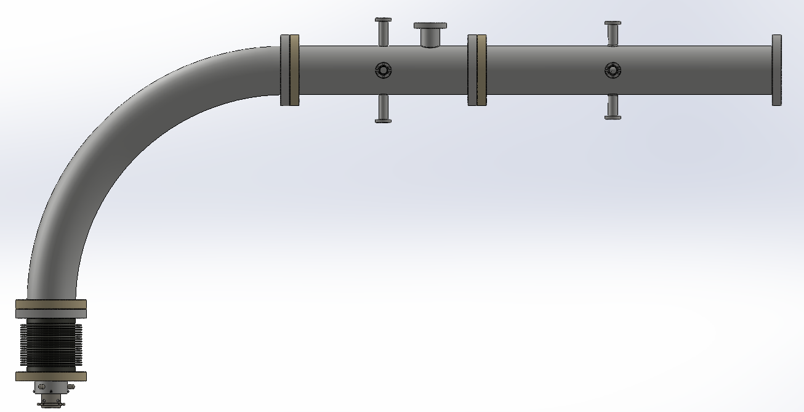
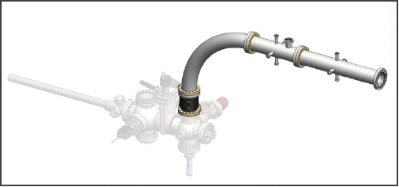





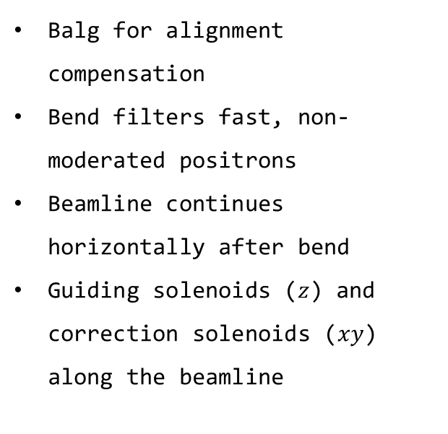


Connection from the source section to the pulsing section
Energy filter
Prebuncher
Balg for alignment compensation
Bend filters fast, non-moderated positrons
Beamline continues horizontally after bend
Guiding solenoids ($z$) and correction solenoids ($xy$) along the beamline
$$x$$
$$z$$
Solenoids (guiding)
$$y$$
Bend ($r=500 mm$)
Balg
$$z$$
e⁺
$$y$$
$$x$$

Slide 13
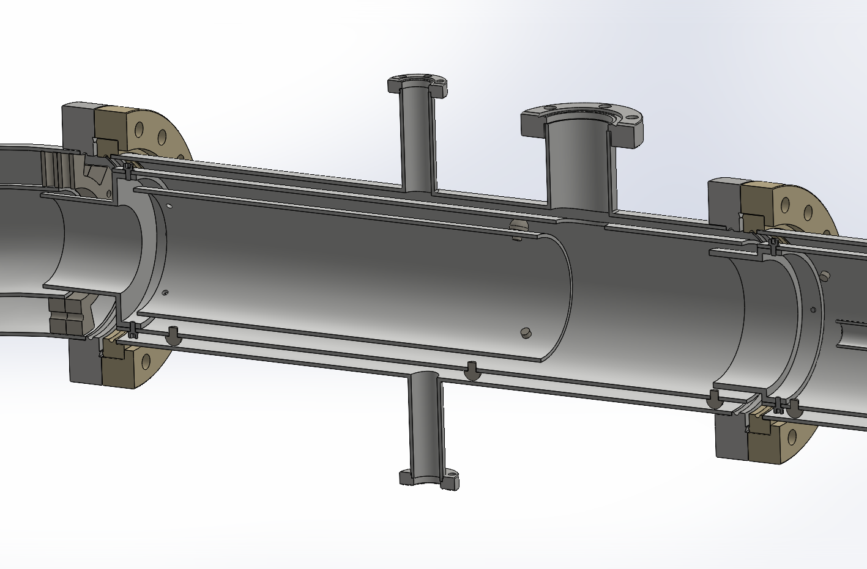
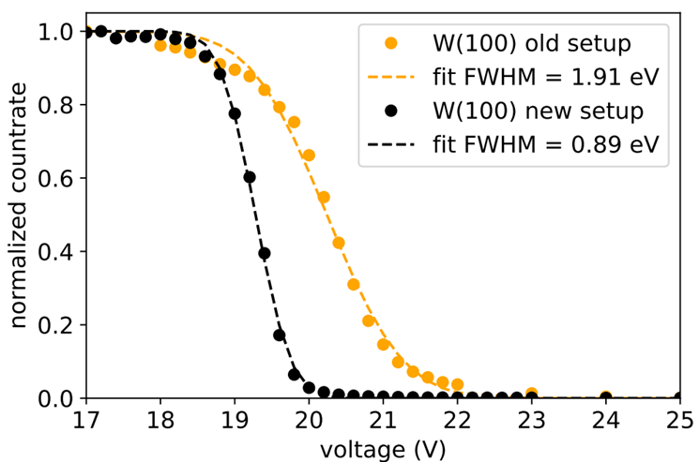
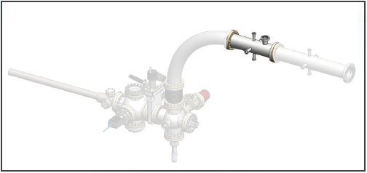
First diagnostic unit: energy filter after bend
Connection port electrode
Potential tube
PLEPS Energy Filter measurement (M. Dickmann 2019)
Exit bend
Electrode

Slide 14
Positron Group at UniBwM
Concepts of pulsed beams
Source section
Bend & E-Filter
Pusling section
Next steps

Slide 15
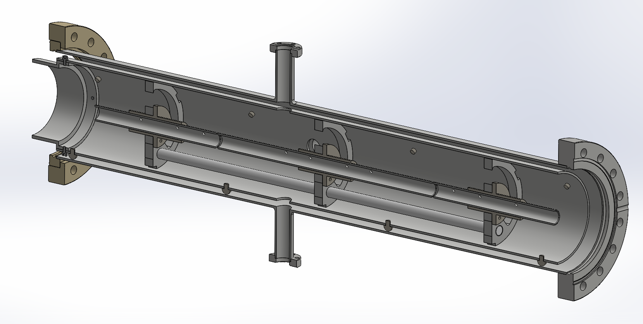
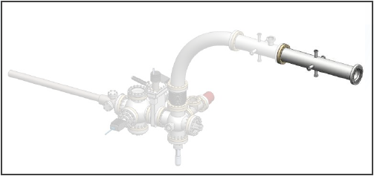
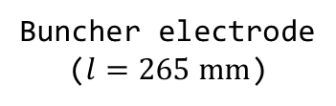
First pulsing unit: prebuncher
Buncher gap
Exit gap
Exit electrode
Entry electrode
Buncher electrode
($l=265 mm$)

Slide 16
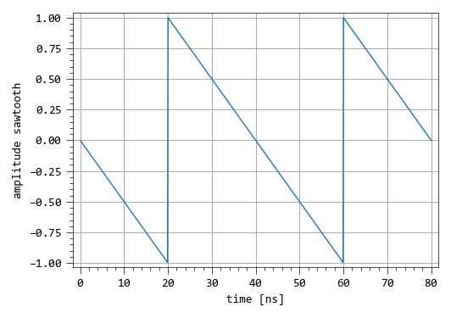
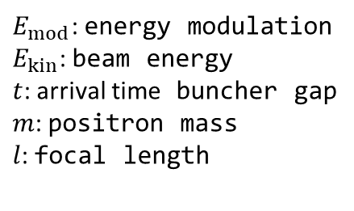


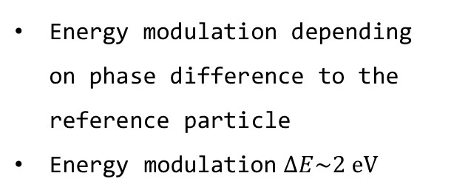

Working principle of the prebuncher
e⁺
Buncher gap
Exit gap
$$-17.3 V$$
$$-17.3 V$$
Energy modulation depending on phase difference to the reference particle
Energy modulation $∆E\sim 2 eV$
cw beam enters the prebuncher from the left
Sawtooth signal at the buncher electrode
$$E_{mod}\left(t\right)≈\frac{\sqrt{8} t \sqrt[3]{E_{kin}}}{\sqrt{m} l}$$
Early
Late
Reference
$E_{mod}$: energy modulation
$E_{kin}$: beam energy
$t$: arrival time buncher gap
$m$: positron mass
$l$: focal length
-40
-30
-20
-10
0
10
20
30
40
time [ns]

Slide 17
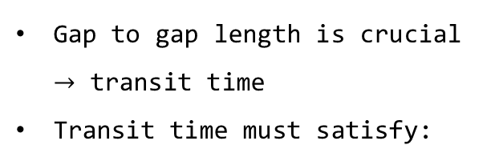
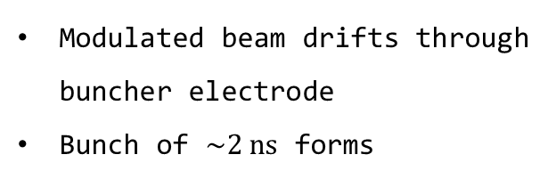




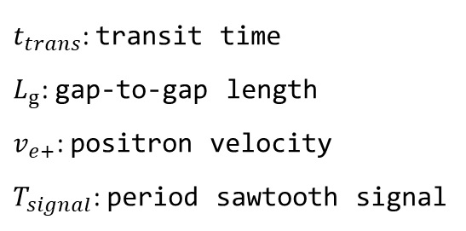
Working principle of the prechopper
$$L_{g}$$
e⁺
Buncher gap
Exit gap
$$0 V$$
$$0 V$$
Gap to gap length is crucial $→$ transit time
Transit time must satisfy:
Modulated beam drifts through buncher electrode
Bunch of $\sim 2 ns$ forms
$$t_{trans}=\frac{L_{g}}{v_{e+}}=(n+1/2)T_{signal}$$
Early
Late
Reference
$t_{trans}$: transit time
$L_{g}$: gap-to-gap length
$v_{e+}$: positron velocity
$T_{signal}$: period sawtooth signal
-40
-30
-20
-10
0
10
20
30
40
time [ns]

Slide 18
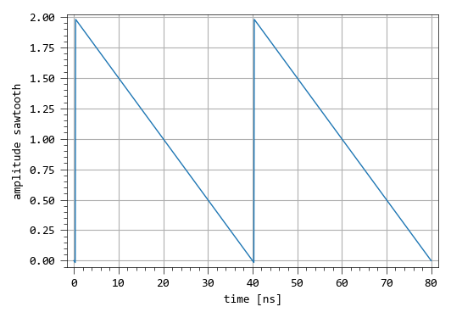


Working principle of the prechopper
e⁺
Buncher gap
Exit gap
$$0 V$$
$$0 V$$
Bunch exits on the steep flank of sawtooth signal
Additional bunching at exit electrode
Early
Late
Reference
-40
-30
-20
-10
0
10
20
30
40
time [ns]

Slide 19
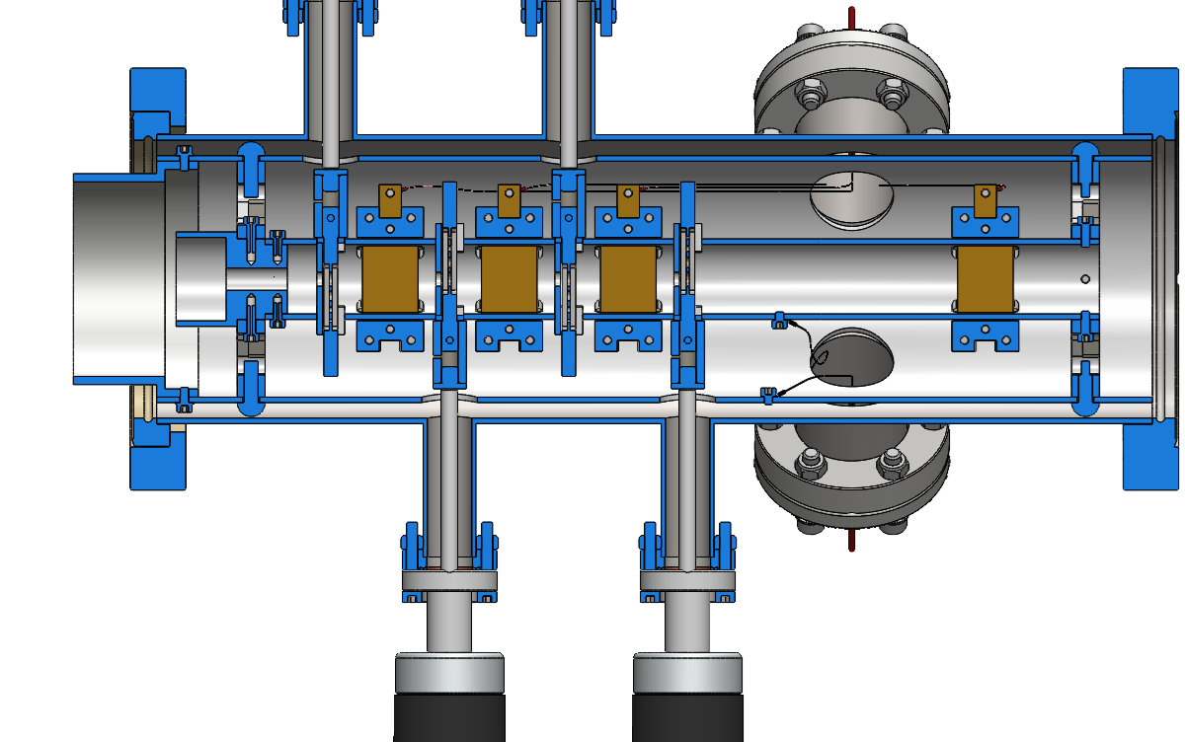

Further down the beamline - chopper
Circular aperture (variable $1−5 mm$)
Two chopper plates are needed
Chopper plate pair
Corrector plate pair
Two different operation modes
Single signal operation (SSO)
Dual signal operation (DSO)
Additional prechopper plate for extention of the time window
e⁺
Chopper plate
Prechopper plate
corrector plates
Left: DSO
Right: SSO

Slide 20
Positron Group at UniBwM
Concepts of pulsed beams
Source section
Bend & E-Filter
Pusling section
Next steps

Slide 21
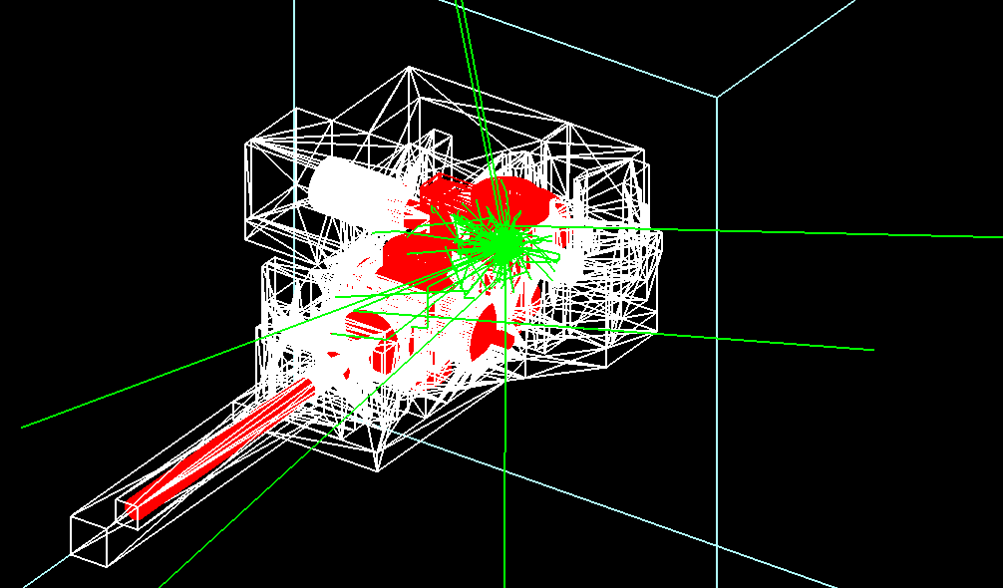
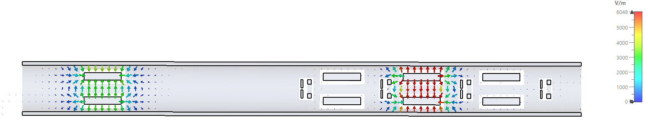
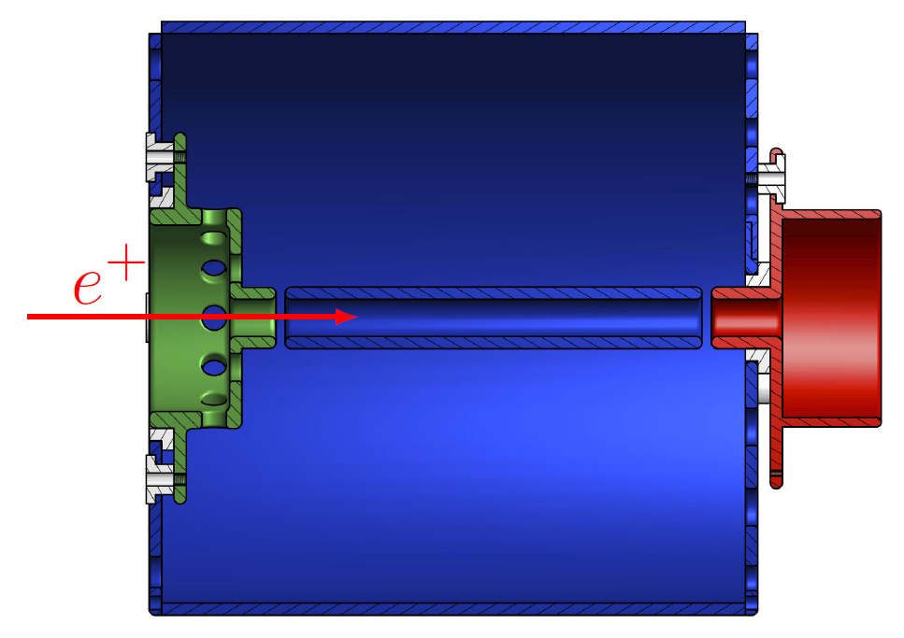

Next steps
Source section:
Shielding ($\sim 4$ tons, complex geometry)
Transfer source from containment to instrument
Simulation and fabrication of the chopper
Design of a 25 MHz buncher
TOPAS (GEANT4), P. Oberlaender
CST Microwave Studio, PIC Solver
(Dissertation L. Ravelli, 2014)

Slide 22


Thank you for your attention!
Interested in slow positron beam physics?
Join us at the SLOPOS-17 in Garmisch-Partenkirchen from the 6th to the 11th September 2026.

Slide 23
Special thanks to our colleagues and collaborators!
University of the Bundeswehr Munich:
Johannes Lehtonen
Lukas Hackel
Peter Sperr
Gottfried Kögel
Micheal Mayerhofer
Johannes Mitteneder
Werner Egger
Günther Dollinger
Marcel Dickmann
Kangho Lee
Georg Duesberg
Cooperation partners:
Roberto Brusa (Trento)
Riccardo Checchetto (Trento)
Rhea Verbeke (KU Leuven)
Daan Van Havere (KU Leuven)
Frank Lotter (CAE Wuerzburg)
Henk Schut (TU Delft)
Catherine Corbel (Paris)
David Keeble (Dundee)
TUM/MLZ:
Christoph Hugenschmidt
Francesco Guatieri
Lucian Mathes
Sebastian Vohburger
TU Delft:
Maik Butterling
Stephan Eijt
HZDR:
Andreas Wagner
Maciej Oskar Liedke
Eric Hirschmann
The 20th International Conference on Positron Annihilation 2025, Takamatsu, Japan

Slide 24
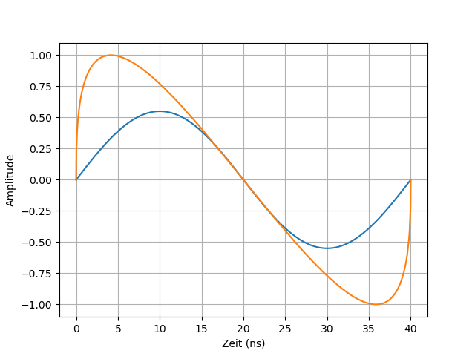
Working principle of the prechopper
e⁺
Buncher gap
Exit gap
$$0 V$$
$$0 V$$
Realistic
sawtooth
Early
Late
Reference
sine

